Slide 1



TOLNet NOAA CSL FY23 YTD Accomplishments
C. Senff, R. Alvarez II, S. Baidar, A. Langford, B. McCarty, S. Sandberg, M. Zucker
Notable Publications
Langford A.O. et al.: Were wildfires responsible for the unusually high ozone in Colorado during 2021?, under review.
Langford A. O. et al.: Anatomy of a high winter ozone episode in Colorado, in prep.
Senff, C. J. et al.: Correlations between lower-tropospheric column and surface ozone: implications for TEMPO observations, in prep.
Field or Other Activities and Data Archived
Completed final analysis and QC of 2018 - 2022 Boulder TOPAZ data. All data (382 days, 2683 hours) were uploaded to the TOLNet archive in December 2022.
Work w/Thierry on evaluation of TOPAZ O₃ retrieval using GLASS is in progress.
Incorporating elevation scans at two azimuth angles into the scan sequence requires a significant change in the TOPAZ analysis procedure. Implementation and testing of these modifications is ongoing.
Hardware and Personnel Updates
The new capability to automatically perform elevation scans at two, fixed azimuth angles has been largely implemented and tested. Hard- and software refinements and additional testing are underway to ensure high accuracy and repeatability when the scanner is moved between the target azimuth angles.
Some progress towards more autonomous TOPAZ operation has been made and testing is in progress. When overnight observations during CUPIDS/AEROMMA are desired, we plan on operating TOPAZ unattended.
Outlook for remainder of this FY
Final preparations are underway for the TOPAZ & Doppler lidar deployment this summer in conjunction with the AEROMMA, STAQS, and CUPIDS field campaigns. TOPAZ will be deployed at the Yale Coastal Field Station near New Haven, CT.
Continued instrument tests and regular observations will be made in Boulder thru June. Quasi-routine TOPAZ operation will be resumed after the summer deployment.
Continue analyzing and interpreting TOPAZ data from past field studies and from the 2018-2022 Boulder observations. Publish results in peer-reviewed literature.

Slide 2
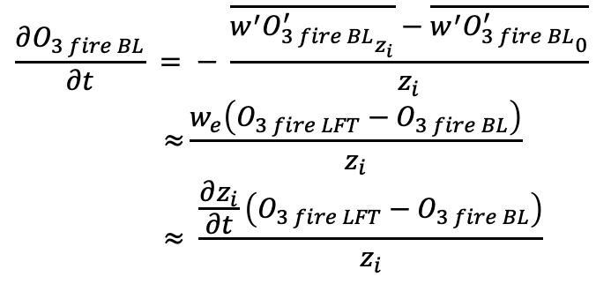
Entrainment of transported pyrogenic O₃ into the boundary layer
12 July 2021 wildfire smoke plume
Estimation of ß and O₃ enhancement in smoke plume
BL entrainment estimate of O_{3 fire}
$$\frac{∂O_{3 fire BL}}{∂t} = − \frac{\overline{{w^{′}O_{3 fire BL}^{′}}_{z_{i}}}−\overline{{w^{′}O_{3 fire BL}^{′}}_{0}}}{z_{i}}$$
$$\text{≈}\frac{w_{e}\left(O_{3 fire LFT}−O_{3 fire BL}\right)}{z_{i}}$$
$$≈ \frac{\frac{∂z_{i}}{∂t}\left(O_{3 fire LFT}−O_{3 fire BL}\right)}{z_{i}}$$
ß
Δß
Subtract lower trop ß back-ground
12 July 2021
O₃ fire z_{i}+
O₃ fire BL 10 min
O₃ fire BL 8 h
∂zi / ∂t
ΔO₃ = 21.5 (1 - exp^{- 0.245 Δß} )
O₃
ΔO₃

