Slide 1

TOLNet UAH FY23 Accomplishments
Shi Kuang, Mike Newchurch, Todd McKinney, Paula Tucker, Darby Stevenson, Mason Mills
Notable Publications
Chen, P., Pour-Biazar, A., Wu, Y., Kuang, S., McNider, R. T., Koshak, W., Utilization of Geostationary Lightning Mapper Derived Lightning NOx Emission Estimates in Air Quality Modeling Studies, submitted to ACP.
Kuang, S., Newchurch, M. J., Tucker, P., McKinney, T., Lee, B., Alexander, S., Calamaio, C., Huntsville Mobile RO₃QET Launch, Proc. 30th International Laser Radar Conference (ILRC), in press.
Kuang, S., Newchurch, M. J., McKinney, T., Perlaky, N., Tucker, P., Stevenson, D., Alexander, S., Pour-Biazar, A., Knupp, K., Johnson, M. S., Sullivan, J. T., Mobile Observations of Ozone and Aerosols in Alabama: Insights into Southeastern US Summer Pollution and Coastal Variability, in prep.
Mettig, N., Weber, M., Rozanov, A., Burrows, J. P., Veefkind, P., Thompson, A. M., ... & Skrivankova, P. (2022). Combined UV and IR ozone profile retrieval from TROPOMI and CrIS measurements. Atmospheric Measurement Techniques, 15(9), 2955-2978.
McKinney, T., Newchurch, M. J., Kuang, S., Tucker, P., Stevenson, D., Freedman, M., Rocket-City Ozone-Quality Evaluation in the Troposphere (RO₃QET): TOLNet/UAH Mobile Ozone LiDAR Laboratory, in prep.
Field or Other Activities and Data Archived
Lidar and airborne observations at Dauphin Island, AL on July 7-11, 2022.
Mobile lidar observations on Oct. 22, 2022 and coordinated lidar-airborne observations on Apr. 18, 2023.
Days* | hours | Files | Size [MB]
24 | 101 | 37 | 32
*On-road data has not been uploaded.
Hardware and Personnel Updates
Roof plates of RO₃QET are under construction.
Scanning lidar receiver has been designed.
Mason Mills, a UAH undergraduate student, joined our team recently and will help the field campaign in summer 2023.
Collaboration with UAH Rotorcraft Center for drone services.
Collaboration with NOAA/CSL for airborne NO₂ instrument.
Outlook for Next FY
Upgrade two 532nm lasers to 266nm lasers to pump Raman cells.
Field campaign in Kenosha, WI, from July 10 – Aug. 18 for TEMPO validation and to support STAQS and AEROMMA missions.
Fabricate the scanning lidar receiver and conduct scanning measurements and drone observations.
Promote wider use of TOLNET O₃/aerosol data and greater cooperation with other ground-based networks.

Slide 2


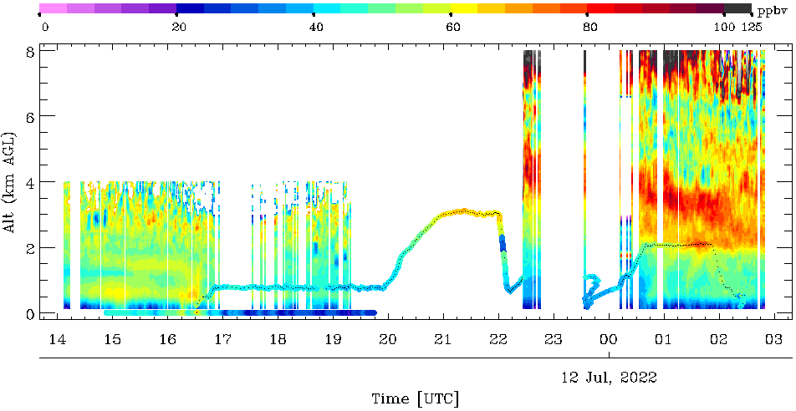
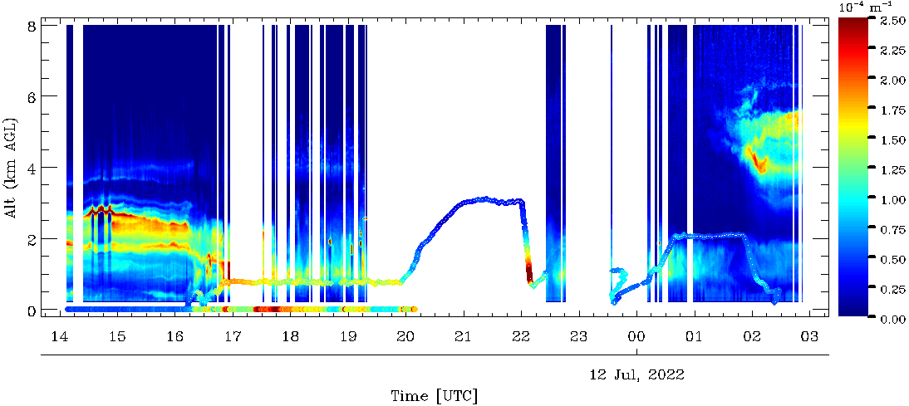
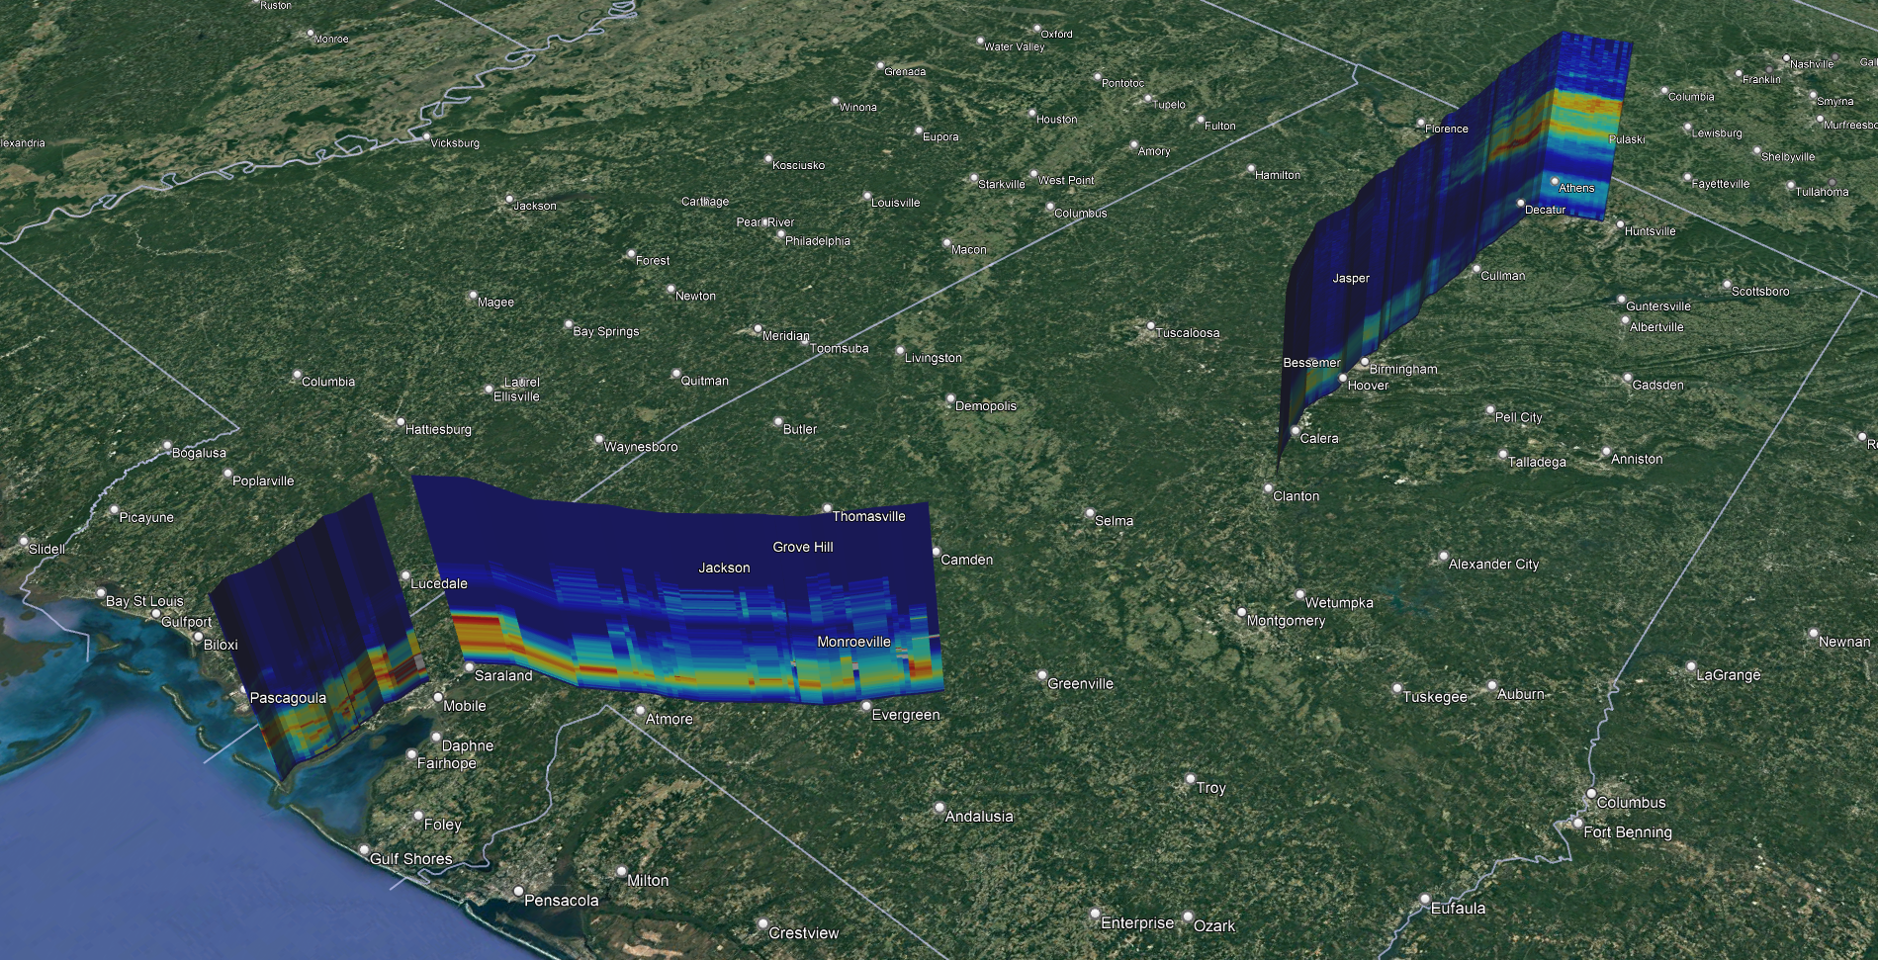
Mobile Observations of Ozone and Aerosols in Alabama: Insights into SEUS Summer Pollution and Coastal Variability
Shi Kuang¹, Michael J. Newchurch¹, Todd McKinney¹, Nicolas Perlaky¹, Paula Tucker¹, Darby Stevenson¹, Susan Alexander¹, Arastoo Pour-Biazar¹, Kevin Knupp¹, Matthew S. Johnson², John T. Sullivan3 1UAH, ²NASA/ARC, ³NASA/GSFC
Background:
We carried out a 5-day mini-campaign from Huntsville to Dauphin Island, AL, a coastal site along the Gulf of Mexico, to measure O₃ and aerosols using the newly developed mobile laboratory, RO₃QET.
Findings:
The on-road lidar observations captures the O₃ and aerosol structures associated with synoptic weather conditions, stratospheric intrusions, wildfire smoke transport, and enhancements in urban areas.
The O₃ and PM variability at Dauphin Island was found to be related to both the synoptic flow and land-sea breeze cycle. The onshore sea breeze, which typically begins in the afternoon, rapidly diffuses air pollutants near the surface, resulting in significant horizontal gradients.
Lidar O₃
rain
Airborne O₃
Strato intrusion
Truck O₃
x10 µg m⁻³ for PM2.5
Lidar Aerosol
Fire smoke
Significance:
NASA-funded RO₃QET lidar will provide valuable 3-D O₃ and aerosol data for various scientific studies and satellite validation.
Lidar Aerosol
Airborne PM2.5
Huntsville
Birmingham
Dauphin Island
Departure from DI
Huntsville
Height x 10
Truck PM2.5
Birmingham
Notes:
25 ppb for STT and 19 ppb for smoke

