Slide 1

TOLNet Hampton University FY23 Accomplishments
Ruben Delgado and John Anderson
Notable Publications
Maurice Roots, John T. Sullivan, Ruben Delgado, Laurence Twigg, and Belay Demoz (2023), An Integrated Monitoring System (IMS) for Air Quality: Observations of a Unique Ozone Exceedance Event in Maryland, Atmos. Environ. (under revision).
Field or Other Activities and Data Archived
Finalizing logistics for deployment of Ceilometer, NASA AERONET, PANDORA, Precipitation Network and low-cost Air Quality sensors (Purple Air and Cairsens) at Chesapeake Bay Bridge Tunnel (OWLETS I site) as part NASA Increasing Participation of Minority Serving Institutions (IPMSI)
US EPA Sponsored Tidewater Air Monitoring Evaluation (TAME): Lidar Measurements to aid in environmental justice project.
NSF REU in Atmospheric Science (HU PI W. Moore), SARP-EAST (NASA PI B. Swap) and SOWLETS (NASA PI T. Berkoff)
Joint Efforts with Unified Ceilometer Network
Invited Presentations
Delgado et al. Integrated Atmospheric Pollution Observing System @ Hampton University: NASA AERONET, PANDORA, and TOLNET, NOAA CESSRST and UCN, NASA AMES Research Center, May 25, 2023.
Outlook for FY23
Integration of Lidar (Aerosol and Ozone) Remote Sensing to Atmospheric Measurements (APS 750) and Air Pollution and Health (APS 411)
Deployment of Ceilometer, AERONET, PANDORA and Precipitation Network sensors at Hart Miller Island (OWLETS II site)
Tropospheric O₃ and NO₂, and aerosol lidar measurements for TEMPO validation in coastal urban environment (Pixel-Sub pixel evaluation).
Create opportunities among NASA IPMSI and TOLNET as part of SMD Bridge Program.
Hardware and Personnel Updates
Patrick McCormick retired October 2022. New PI Ruben Delgado.
HU and NASA LARC Space Act agreement (April 2023).
Development of Integrated Observing System: Lidar (Ozone, Aerosol, Doppler Wind), K-band Doppler Radar, Low-Cost AQ sensors, AERONET, PANDORA, solar radiation and met sensors.
Acquisition of Atmospheric Sounder Spectrometer by Infrared Spectral Technology (ASSIST II): 0-4 km profiles of Temperature, H₂O, O₃, CO, CH₄, NO_{X}, CO₂ and Aerosols.

Slide 2
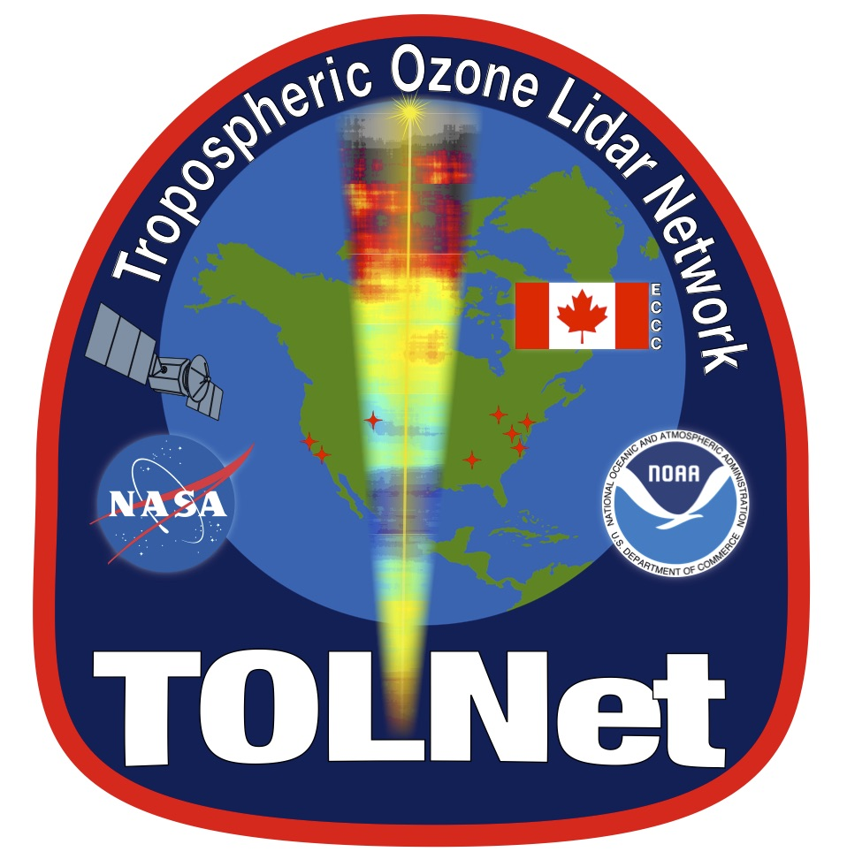
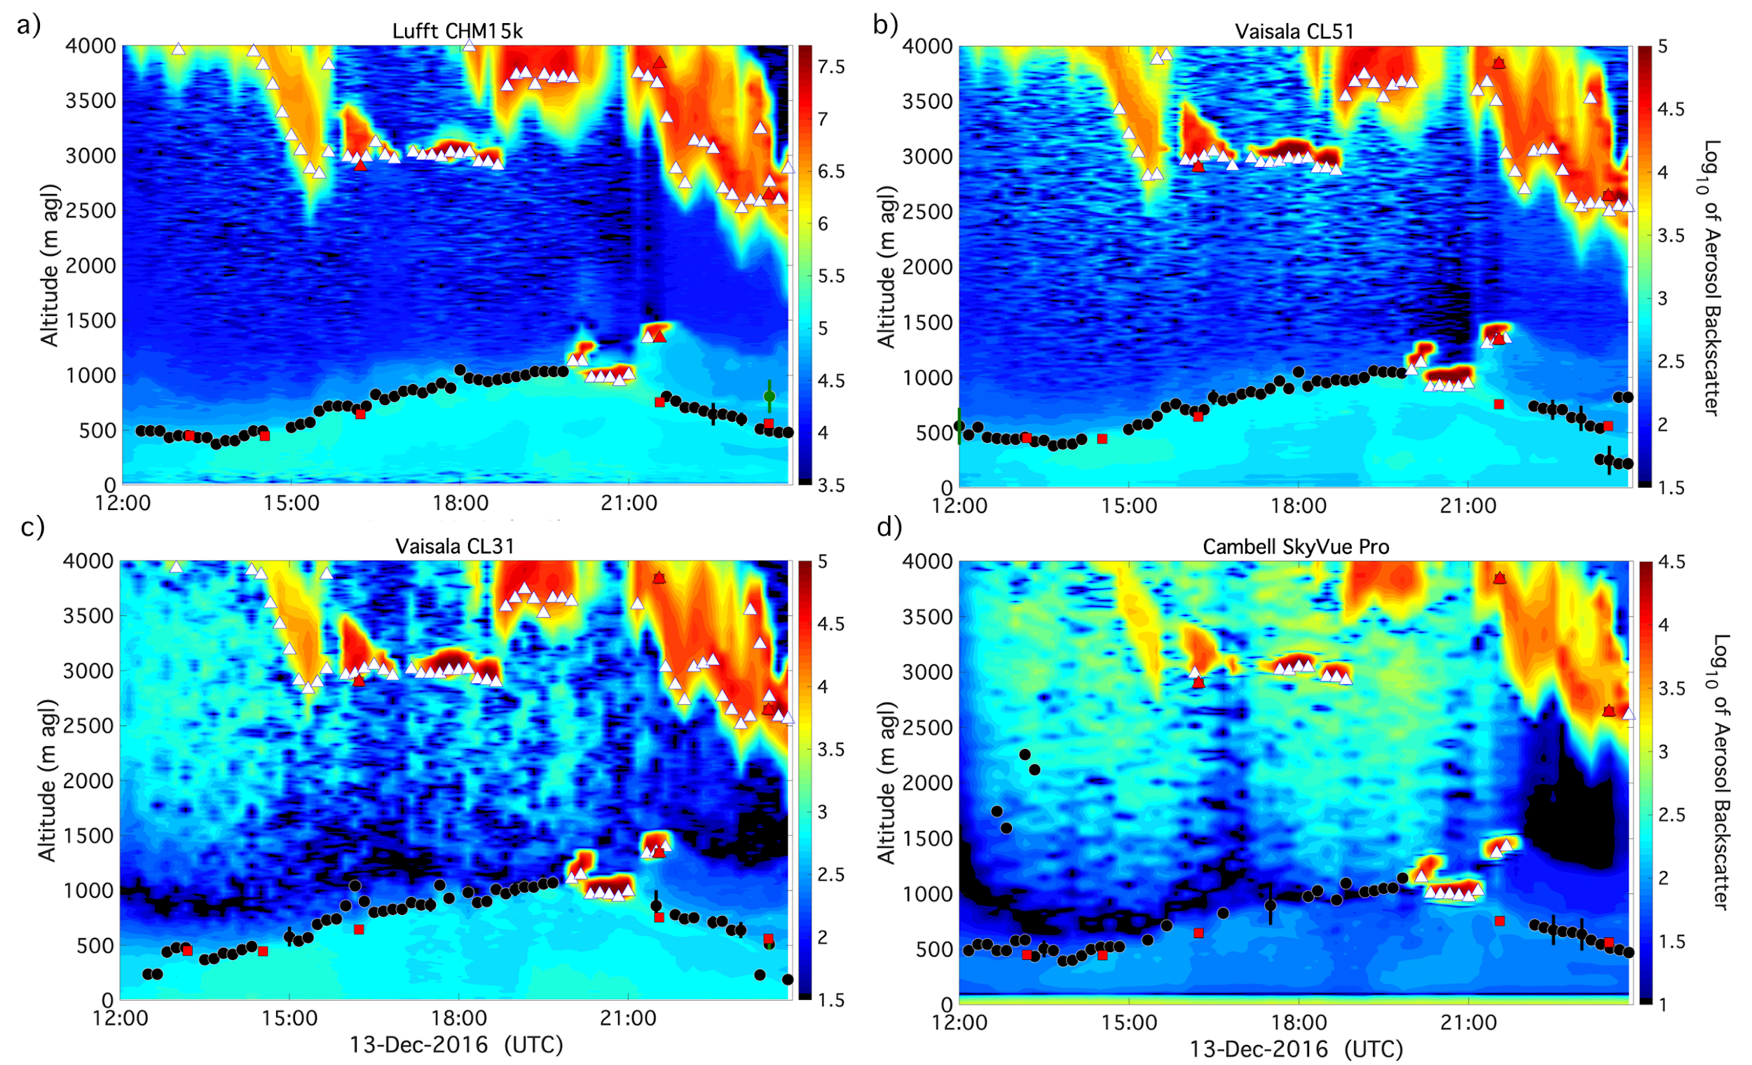
Integrated Atmospheric Pollution Observing System @ Hampton University
Significance:
Observations and analysis of atmospheric chemistry and dynamics events, satellite and lidar retrievals for validation of weather and air quality forecasts and their impacts on public health and infrastructure.
Assessment of long-range transport of natural and anthropogenic sources and impact to air quality.
Aid source allocation of particle pollution and gases during Air Quality Action Days. Evidence for Exclusion of Air Quality Exceedance due to Exceptional Events.
Continuous monitoring of PBL –verification and validation of satellite, forecasts and models.
Results:
Satellite column vs. surface concentrations: Lidar/ASSIST II and soundings allow PBLH determination and quantify contribution of free troposphere vs PBL.
Observations of trace gases/aerosols/meteorological in complex coastal regions are critical for TEMPO validation and improvement in its data product retrievals.
Lidar + real time ground monitoring of pollutants: Characterization of temporal and spatial changes of particle pollution, oxidants, and precursors.
https://alg.umbc.edu/ceilometer-testbed/
Unified Ceilometer Network
PBL Automated Outputs:
Cloud-base heights
Precipitation flags
Filtered PBL heights (NSL, RL, MLH)
Uncertainties for PBLH

