Slide 1

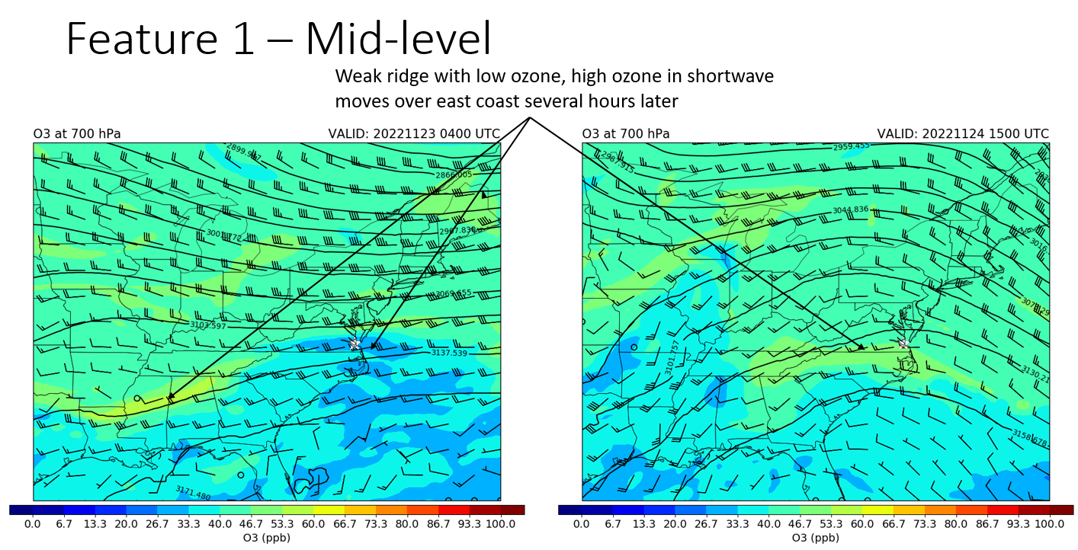
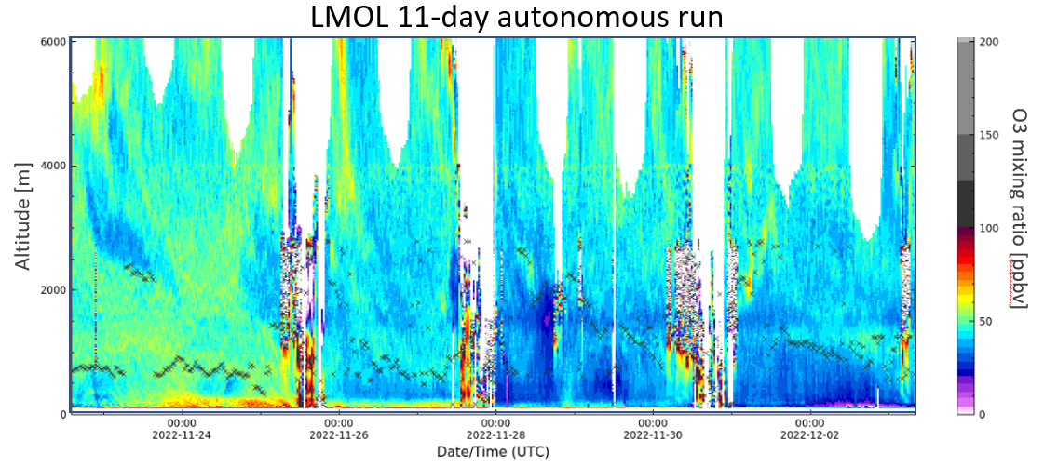
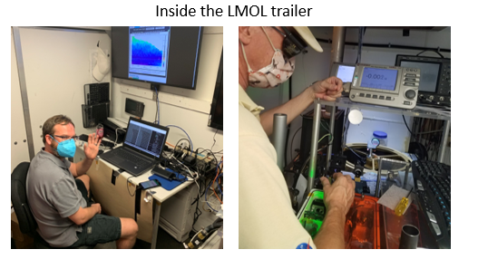
Langley Mobile Ozone Lidar Team Accomplishments
Tim Berkoff (PI), Guillaume Gronoff (Co-PI), Daniel Phoenix, Randa Elhertani, Claudia Bernier (NASA Fellow at U of H)
Publications
Lei et al., Retrieval of UVB aerosol extinction profiles from the ground-based Langley Mobile Ozone Lidar (LMOL) system, Atmospheric Measurement Techniques, 2022
Bernier et al.: Cluster-based characterization of multi-dimensional tropospheric ozone variability in coastal regions: an analysis of lidar measurements and model results, Atmos. Chem. Phys., 22, 15313–15331, https://doi.org/10.5194/acp-22-15313-2022, 2022. .
Torres-Vazquez, A., et al. Performance evaluation of the meteorology and air quality conditions from multiscale WRF-CMAQ simulations for the Long Island Sound Tropospheric Ozone Study (LISTOS). Journal of Geophysical Research: Atmospheres, 127, e2021JD035890, 2022
Gronoff et al., SO2 plumes observation with LMOL: Theory, Modeling, and Validation In 30th International Laser Radar Conference, Vol I. Springer International Publishing, Springer Atmospheric Sciences Series, 2023.
Zhao et al., Identification of the roles of urban plume and local chemical production in ozone episodes observed in Long Island Sound during LISTOS 2018: implications for ozone control strategies Environment International,2023, 107887, ISSN 0160-4120
Dreessen et al., (2023)VOC and trace gas measurements and ozone chemistry over the Chesapeake Bay during OWLETS-2, 2018,Journal of the Air & Waste Management Association,73:3,178-199
Berkoff et al., Langley Mobile Ozone Lidar: Instrument Updates and Results, Applied Optics (in progress)
Phoenix et al., Analysis of Atmospheric Conditions Responsible for an Ozone Exceedance Event in Southeast Virginia on June 15, 2022, Journal of Geophysical Research (in progress)
Gronoff et al., Observation of pollution events at low altitude during TRACER-AQ: the advantage of adaptive resolution lidar, AMT (in progress)
Field or Other Activities and Data Archived
1,676 hours of lidar operation in 2022 (approaching 1.0 FTE in data!)
four
7 posters on display at this meeting!
(quick-look curtain)
Posters!
Strat O₃
Frontal
passages
Mid-level ridge
shortwave
(also related
to strat)
O₃
streamers
Poster!
High surface O₃
CF aloft,
low O₃
Outlook
SOWLETS, SARP-E, & STAQS campaigns, new lab space, building-up sonde capability
Fully automated O₃, aerosol system with SO₂ capability (LaRC IRAD funded)
Experimental extreme near field testing underway (25-100 m altitude)
Poster!
Personnel Updates
Tim Berkoff is still backfilling laser/trailer work until replacement can be identified
Randa Elhertani, Engineering Division, is providing temporary support
Posters!
Poster!

Slide 2
Cluster-based characterization of multi-dimensional tropospheric ozone variability in coastal regions: an analysis of lidar measurements and model results
Claudia Bernier¹, Yuxuan Wang¹, Guillaume Gronoff^{2,3}, Timothy Berkoff², K. Emma Knowland^{4,5}, John T. Sullivan⁴, Ruben Delgado^{6,7}, Vanessa Caicedo^{6,7}, & Brian Carroll^{2,6}
¹Department of Earth and Atmospheric Science, University of Houston, ²NASA Langley Research Center, ³Science Systems and Application Inc., ⁴Global Modeling and Assimilation Office, NASA Goddard Space Flight Center, ⁵Goddard Earth Science Technology & Research, ⁶Joint Center for Earth Systems Technology, ⁷University of Maryland
Background:
Coastal regions are subject to harmful ozone (O₃) accumulation that are difficult to forecast due to a lack of measurements in these areas. Recent and planned NASA air quality campaigns have focused on this issue.
Method:
Developed a clustering method (left figure) based on a suite of multi-dimensional lidar O₃ measurements from 3 recent air quality campaigns: OWLETS 1 & 2, LISTOS
By filtering/grouping the lidar measurements into associated clusters, we characterize coastal O₃ behavior during high pollution months
Findings:
Derived lidar clusters used to evaluate the ability of two chemical transport models to simulate the distinct O₃ cases (right figure b, c)
The clusters allowed us to easily highlight current model limitations e.g., both models fairly capture low-level/near surface O₃ pattern and magnitude but fail to capture mid-level O₃
This method can be used to understand air quality patterns for a specific region, more readily evaluate model performance, and for future work, investigate TEMPO retrievals vs. lidar and models to assess the ability of satellite retrievals (e.g., TEMPO) to monitor O₃ over such complex environments
Significance:
NASA TOLNet lidar measurements provide crucial observations to better understand air quality behavior, comprehensively evaluate models, and improve satellite retrievals, resulting in forecast improvements of hazardous pollution conditions that impact human health, vegetation/agriculture, and related ecosystems.
Work recently published: Bernier, C., Wang, Y., Gronoff, G., Berkoff, T., Knowland, K. E., Sullivan, J. T., Delgado, R., Caicedo, V., and Carroll, B.:, Atmos. Chem. Phys., 22, 15313–15331, https://doi.org/10.5194/acp-22-15313-2022, 2022.

Slide 3

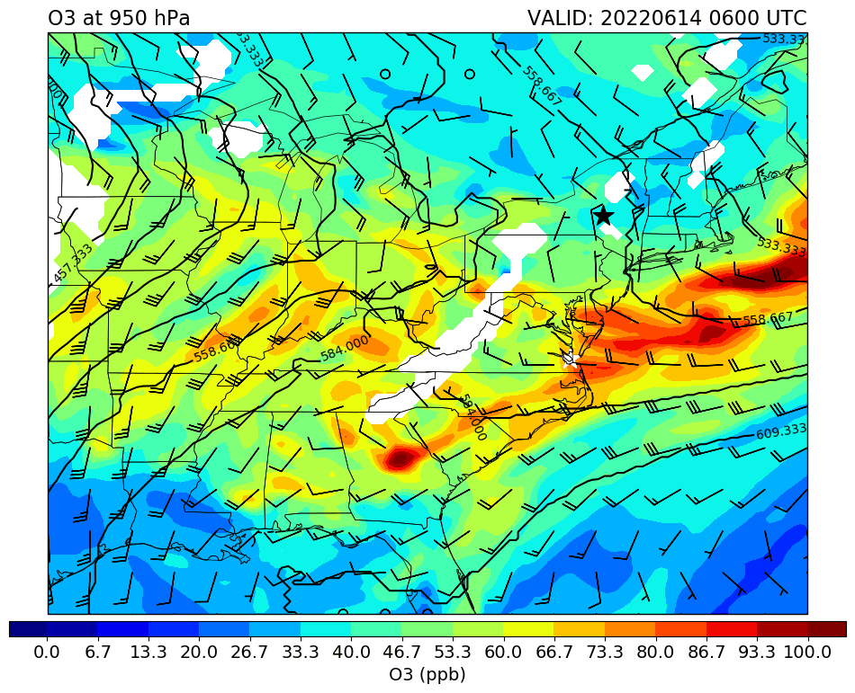
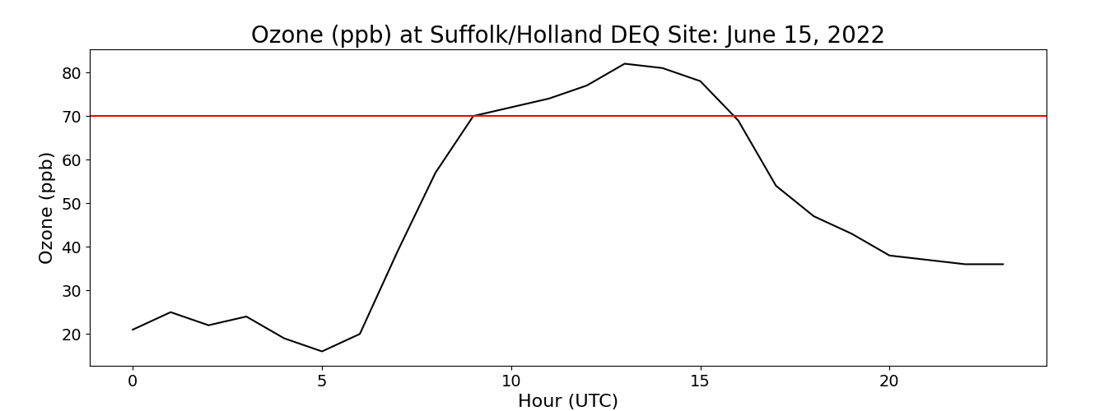
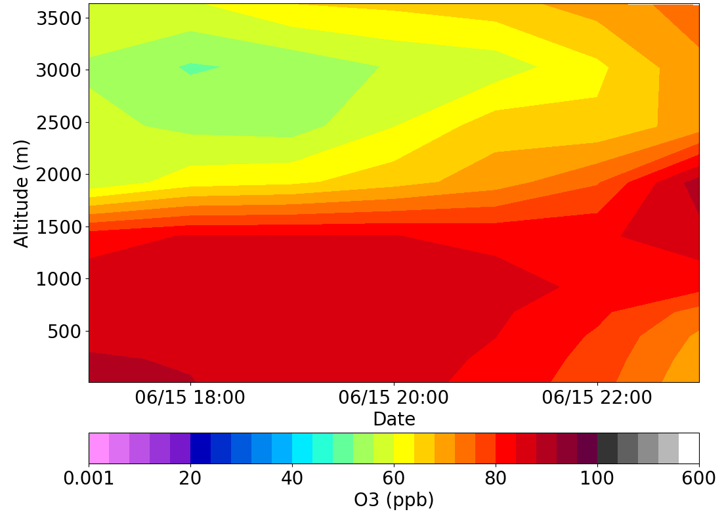
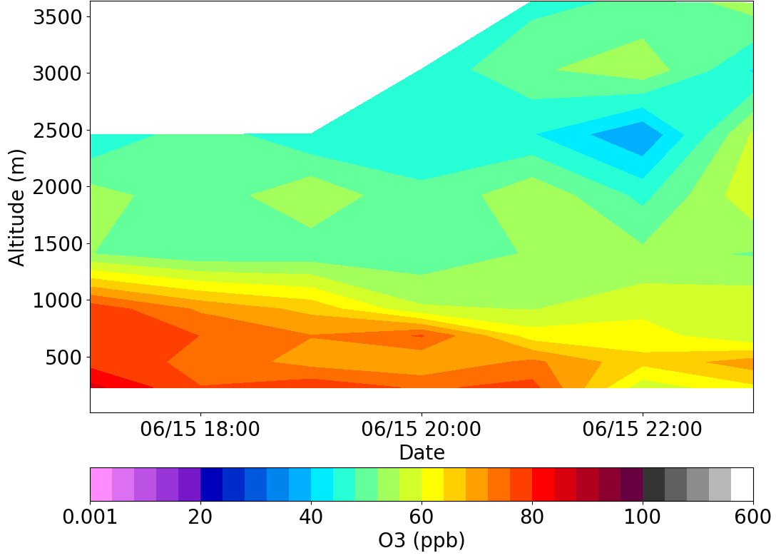
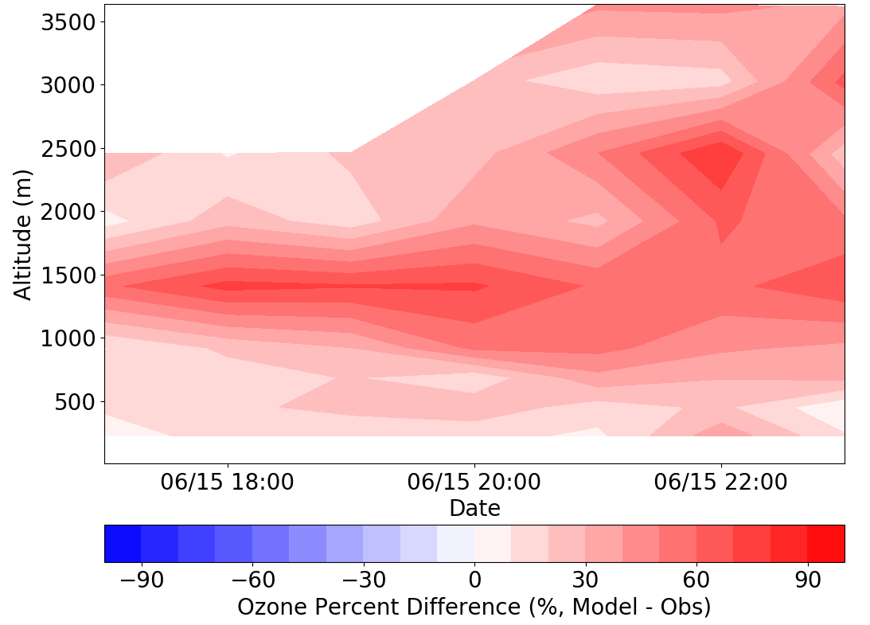
Analysis of Atmospheric Conditions Responsible for an Ozone Exceedance Event in Southeast Virginia on June 15, 2022
Daniel B. Phoenix¹, Guillaume P. Gronoff^{1,2}, Timothy A. Berkoff², Daniel Salkovitz³, K. Emma Knowland^{4,5}, John T. Sullivan⁴, Laurence W. Twigg^{4,6}, Maurice Roots⁷, and Claudia Bernier⁸ ¹Science Systems and Applications, Inc., Hampton, VA 23666, ²NASA Langley Research Center, Hampton, VA 23666, ³Virginia Department of Environmental Quality, Richmond, VA, USA,
⁴NASA Goddard Space Flight Center, Greenbelt, MD, USA, ⁵Morgan State University, Baltimore, MD, USA, ⁶Science Systems and Applications, Inc., Greenbelt, MD, USA
⁷University of Maryland, Baltimore County, Baltimore, MD, USA, ⁸Department of Earth and Atmospheric Science, University of Houston, Houston, TX 77004
Background:
On June 15, 2022, the Virginia Department of Environmental Quality monitoring site at Suffolk/Holland, a rural site in southeast Virginia, recorded its first ozone exceedance since 2016. The Richmond DEQ site also recorded an ozone exceedance.
This is an unusual event because the Suffolk/Holland DEQ site is not located in an area with high vehicular traffic or local sources of primary pollutants.
NAAQS exceedance is rare for Virginia and must be addressed or risk being classified as a nonattainment area, which requires compliance to meet federal air quality standards.
TOLNet was able to assist the VA DEQ in understanding what happened and why this event occurred.
Findings:
Model calculations reveal that much of the high O₃ air in SE Virginia was transported from the I-95 traffic corridor (e.g., NYC, NJ, Philadelphia).
GEOS-CF model analysis shows air rich in O₃, CO, and NO_{X} traveling from NYC/NJ to SE Virginia. An upper-level ridge and large-scale anticyclonic circulation at the surface drives the transport.
This air mass arrives at sunrise on June 15 and quickly mixes into the PBL, contributing to the elevated O₃ mixing ratios near the surface.
Analysis:
TOLNet lidars at Greenbelt, MD (TROPOZ, not shown) and Hampton, VA (LMOL, shown below) collected data during this period.
The lidars enable us to understand the temporal evolution of O₃ that afternoon as well as evaluate the O₃ representation in air quality models such as GEOS-CF.
We can use GEOS-CF and the HYSPLIT back-trajectory model to identify the source of the high O₃ air.
GEOS-CF (model)
LaRC (obs)
Percent Difference
Significance:
NASA TOLNet lidar measurements provide crucial observations that allow us to better understand air quality behavior and comprehensively evaluate models with the goal of improving the forecasting of dangerous pollution events which can be harmful to humans, vegetation, and ecosystems.
TOLNet lidars also assist in evaluating air quality model forecast and satellite retrievals (e.g., TEMPO), and can assist state regulators for the benefit of society.

Slide 4



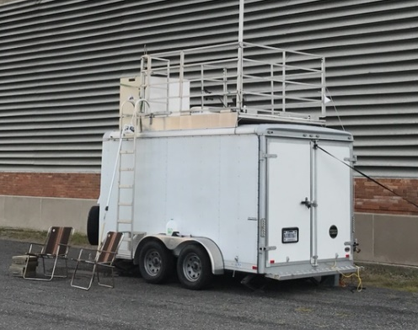
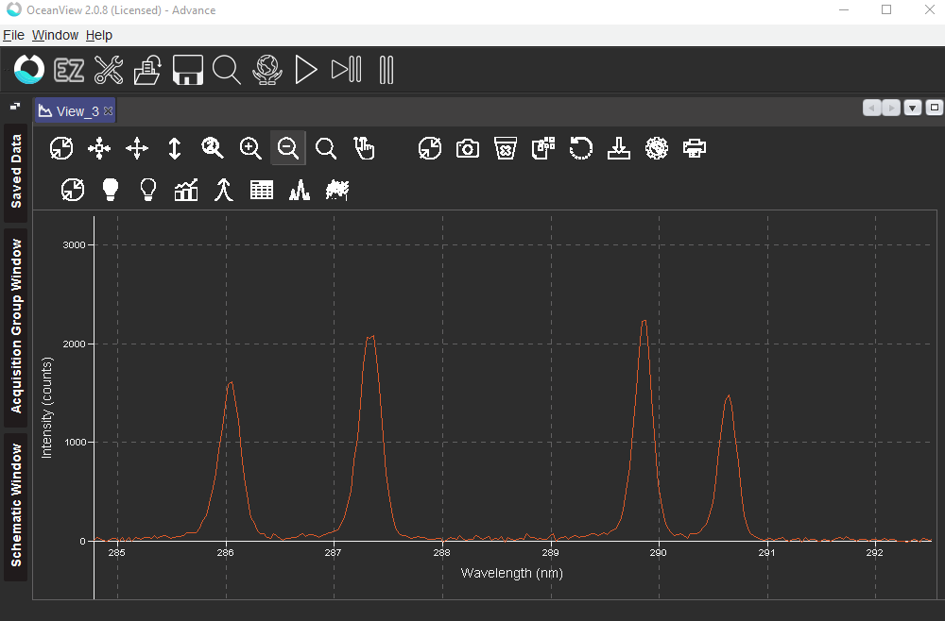
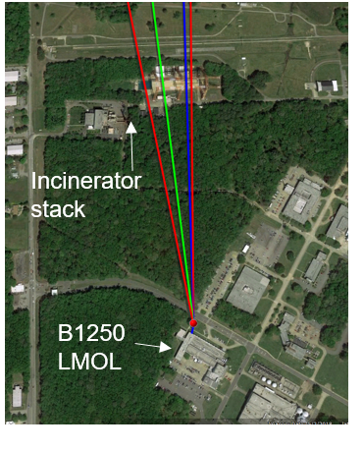
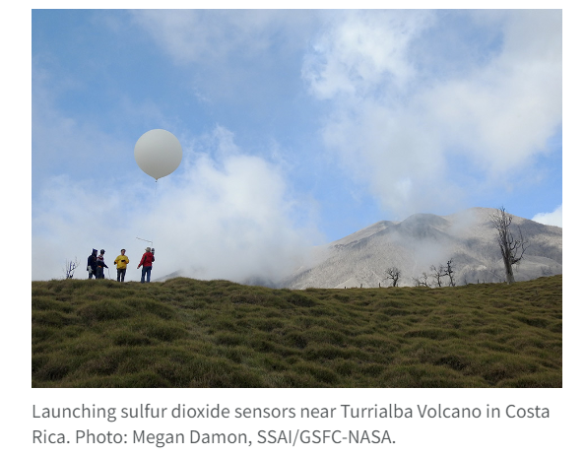
SOWLETS 2023 Technology Demonstration Campaign
2017, 2018: OWLETS, Ozone Water Land Environmental Transition Study
2023: SOWLETS, SO₂ & Ozone Water Land Environmental Transition Study
OWLETS
SOWLETS
Background:
SOWLETS is a NASA Langley IRAD 2023 project to demonstrate a new lidar technology:
Pulsed 4-wavelength laser for simultaneous O3, SO₂, & aerosol profiles
(Gronoff et al. poster)
Key Goal:
Intercompare lidar with O₃/SO₂ sonde launches operated by University of Houston & St. Edwards for validation of new SO₂ lidar retrievals
Site:
NASA Langley campus (Building 1250 and/or CRAVE/CAPABLE site)
Adjacent Hampton Steam Incinerator emissions will serve as a source of SO₂ and aerosol
Key Measurements:
Langley Mobile Ozone Lidar (May Test/June 2023)
Ten SO₂ sonde launches (June 2023)
Pandora, Ceilometer, Wind lidar, Plume thermal imagery
Hampton University
Synergistic SARP-E SO₂, aerosol, and wind measurements
LMOL lidar
4-wav. laser spectrum
Langley site
SO₂ sonde launch

