Slide 1
TOLNet CCNY FY23 Accomplishments
Fred Moshary, Yonghua Wu, Dingdong Li, and Thomas Ely
Notable Publications
Zhao, K., Wu, Y., Huang, J., Gronoff, G., Berkoff, T., Arend, M., Moshary, F., 2023. Identification of the roles of urban plume and local chemical production in ozone episodes observed in Long Island Sound during LISTOS 2018: implications for ozone control strategies, Environment International, 174, 107887, https://doi.org/10.1016/j.envint.2023.107887.
Wu, Y., Ren, X., Dickson, R., Zhao, K., Huang, J., et al., Diurnal variation of PBL height and ground-level ozone in the NYC urban and downwind coastal areas during LISTOS 2019, in prep.
Dingdong Li, Yonghua Wu, Thomas Legbandt, Mark Arend, Fred Moshary, Tropospheric Ozone Differential Absorption Lidar (DIAL) observation during heat wave events at New York City Area, AMS Annual Meeting, Jan. 8-12, 2023, Denver, Colorado.
Dingdong Li, Yonghua Wu, Thomas Legbandt, Mark Arend, Maggie Liang, Fred Moshary, Tropospheric Ozone DIAL Development at NYC area, the 30th International Laser Radar Conference (ILRCl), June 26th – July 1st, 2022.
Field or Other Activities and Data Archived
Made regular observations with CCNY Ozone lidar during April-August 2022. Additional observations include a Lufft-Ceilometer, aerosol-lidar and wind lidar profiles, and the observations from CCNY AERONET and PANDORA radiometers, and CCNY ceilometer at Flax Pond, as well as a drone flight obs..
# of measurement days from CCNY Ozone-DIAL (April-August 2022): 37
Hardware and Personnel Updates
Worked on a mobile ozone DIAL in a trailer (CLEGG Industries); Build a platform for mounting the DIAL system. Consisting of a Raman cell, a Quantel Q-smart 450 Nd:YAG laser, Hamamatsu PMTs, a Newtonian telescope (20-inch diameter)
The Ozone dial shares the receive telescope with an aerosol lidar
Mr. Thomas Ely -graduate student; September 2022;
Ms. Dingdong Li will graduate with her Ph. D this June 2023.
Outlook for Next FY
Integration of mobile DIAL
Experimental tests and field observations;
participation in the intensive observations for the 2023 summer campaigns in greater NY metropolitan area (AGES)
Routine observations for the validation of TEMPO and TROPOMI product in NYC area
Validation of GFS-CMAQ in collaboration with NAQFC and uWRF-CHEM in collaboration with NOAA ESRL Chemical Sciences Lab

Slide 2
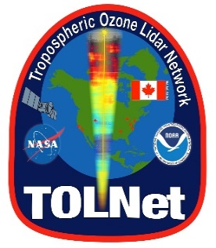
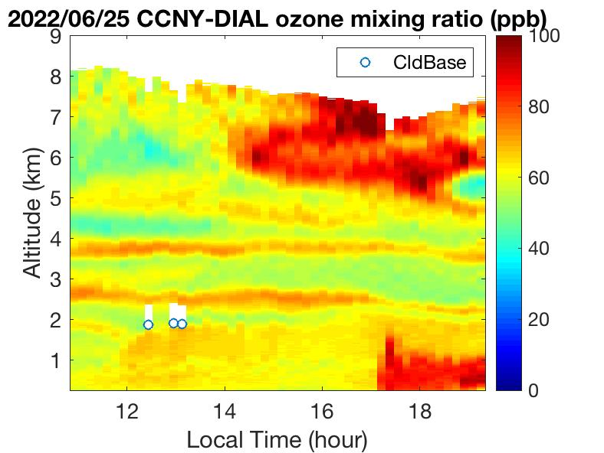
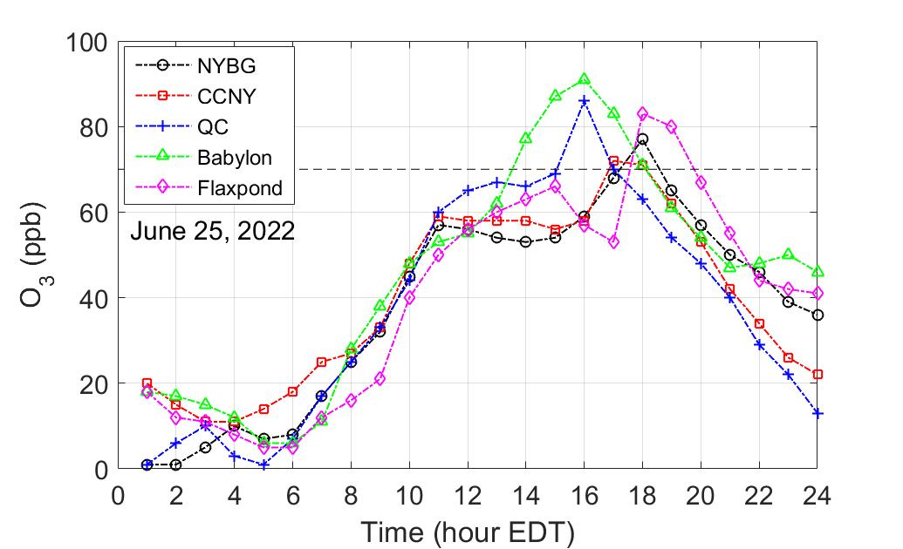
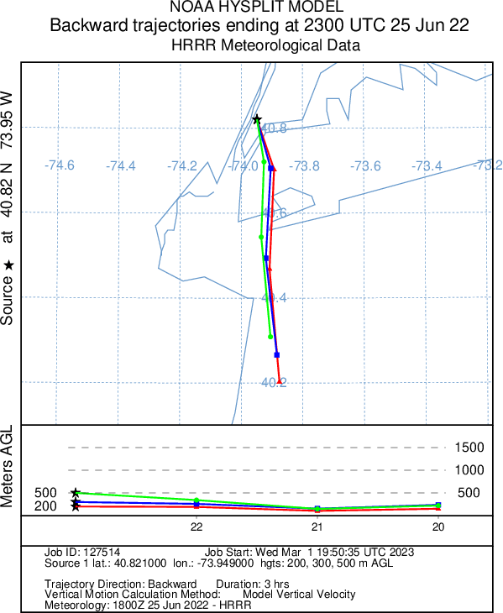
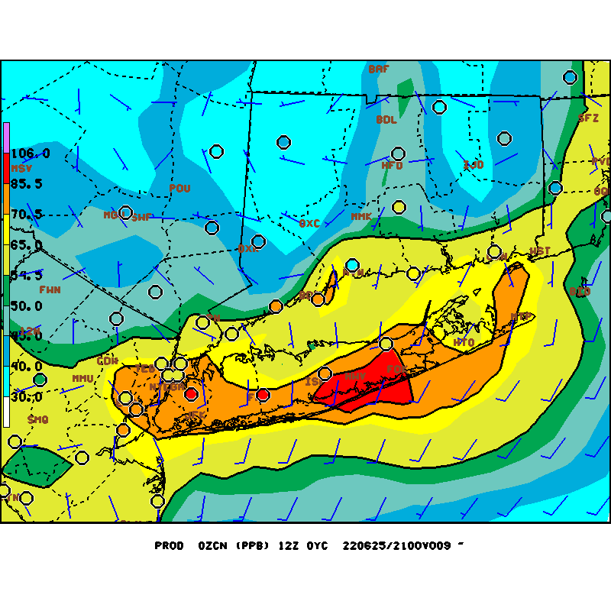
Ozone variation and transport associated with sea-breeze from an integrated observation in summer 2022 in New York City Area
Dingdong Li ¹, Yonghua Wu ¹, Thomas Ely ^{1, 2}, Mark Arend ^{1, 2}, Fred Moshary ^{1, 2}
¹ CCNY, ² NOAA CESSRST
Background:
High ozone (O₃) episodes occur in New York City and downwind coastal area in Long Island Sound due to urban emissions and pollutants transport, land-sea breeze recirculation, chemistry and PBL dynamics, etc.
Analysis:
Characterize the time-height distribution, variation and transport of O₃ in the NYC urban area with CCNY lidar remote sensing of O₃, aerosol and winds profiles, near-surface data and the model product.
Findings:
The CCNY O₃-DIAL observations show a dramatic variation of O₃ concentration below 1-km altitude in the late afternoon, associated with the sea-breeze recirculation from the Southern Long Island (SLI) and NY/NJ Bight. A timing shift of ground O₃ peak at the different AQ-sites and the HYSPLIT air backward trajectories indicate consistent transport driven by the sea-breezes from NY/NJ Bight.
Significance:
NASA remote-sensing (TOLNet) is critical to understand ozone formation and transport in the NYC urban and downwind coastal area.
A timing shift of ground-level O₃ peaks
Air transport from the NY/NJ Bight
NOAA NAM-CMQ forecast O₃ at 21UTC
High O₃ in the southern coastal LI
CCNY wind direction

Slide 3
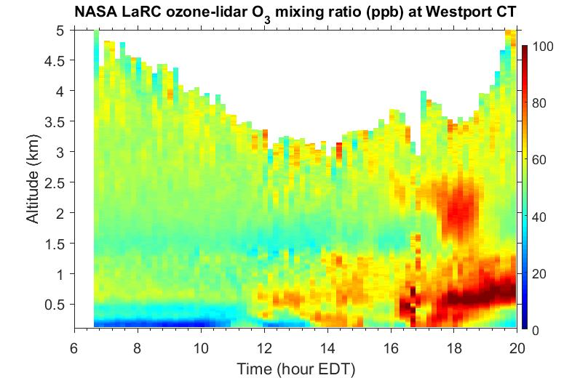
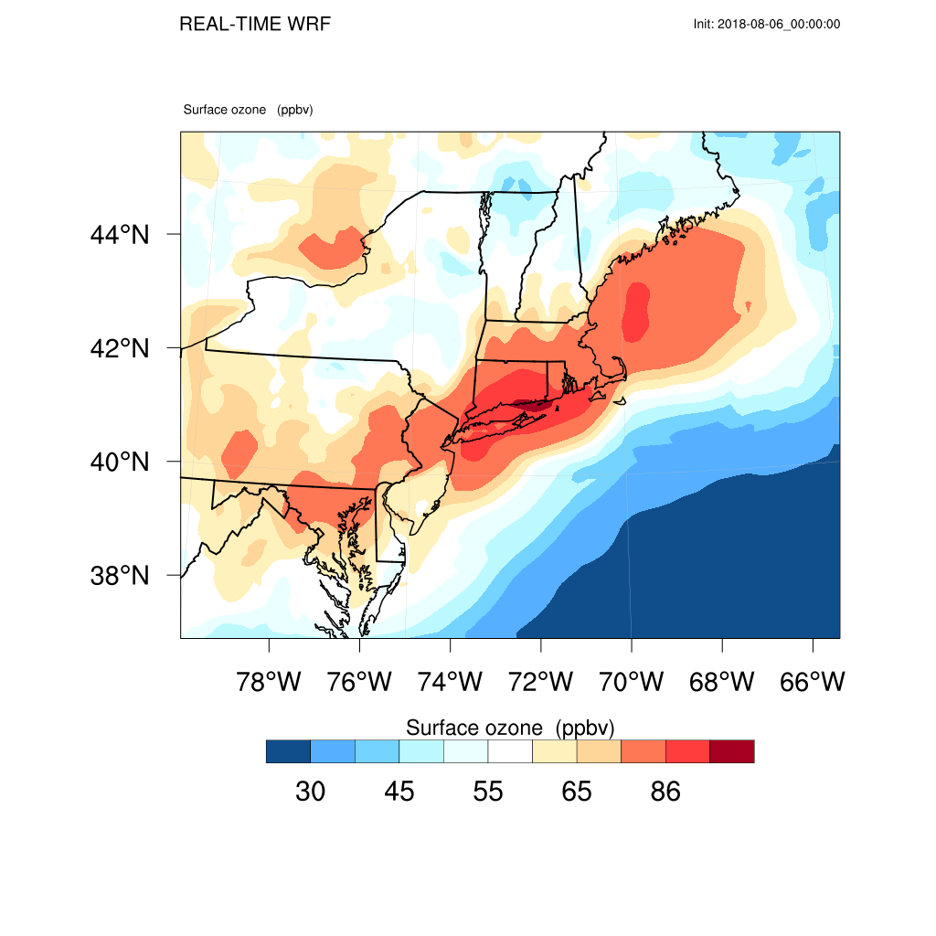
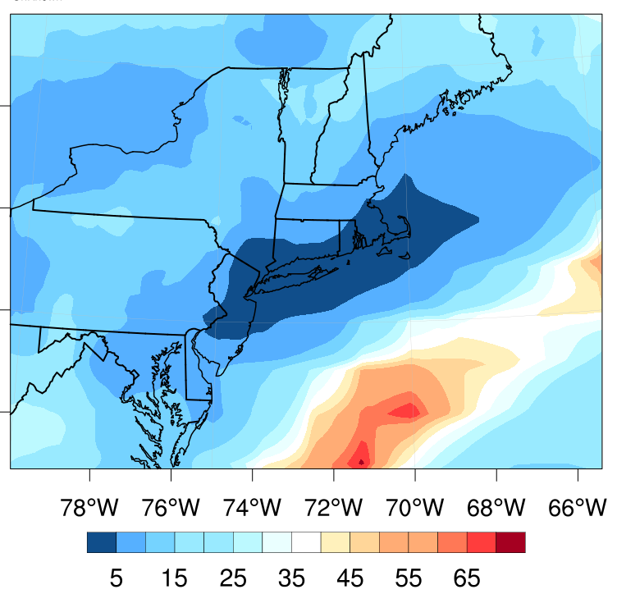
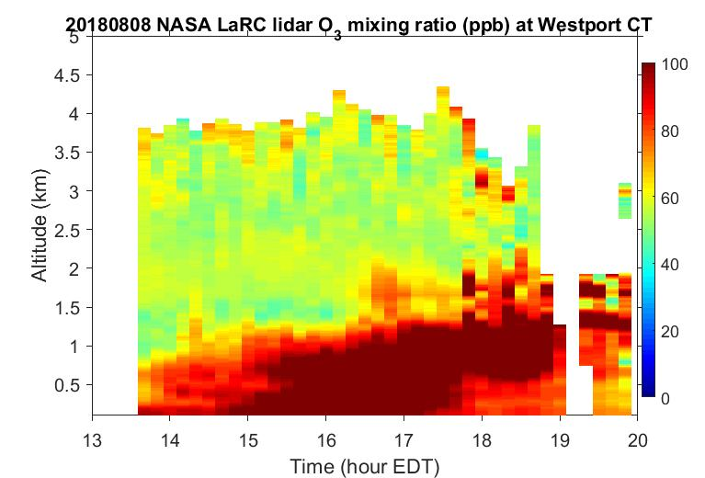
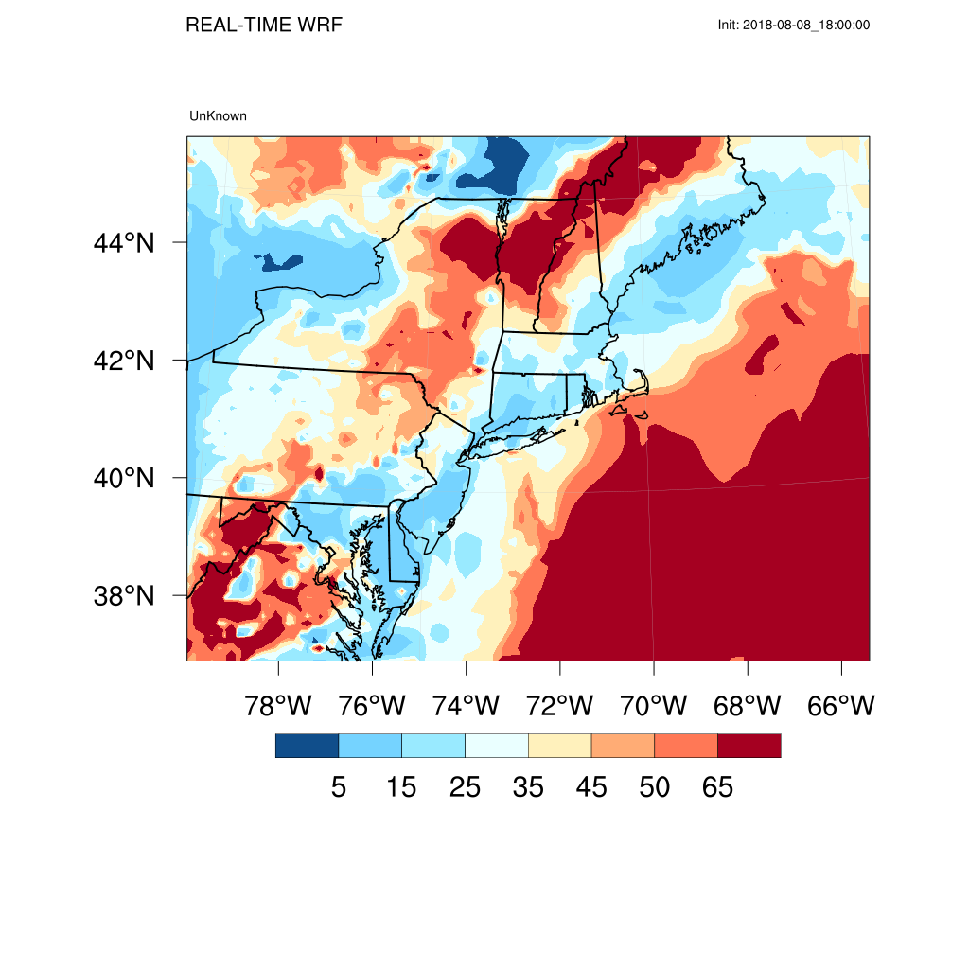
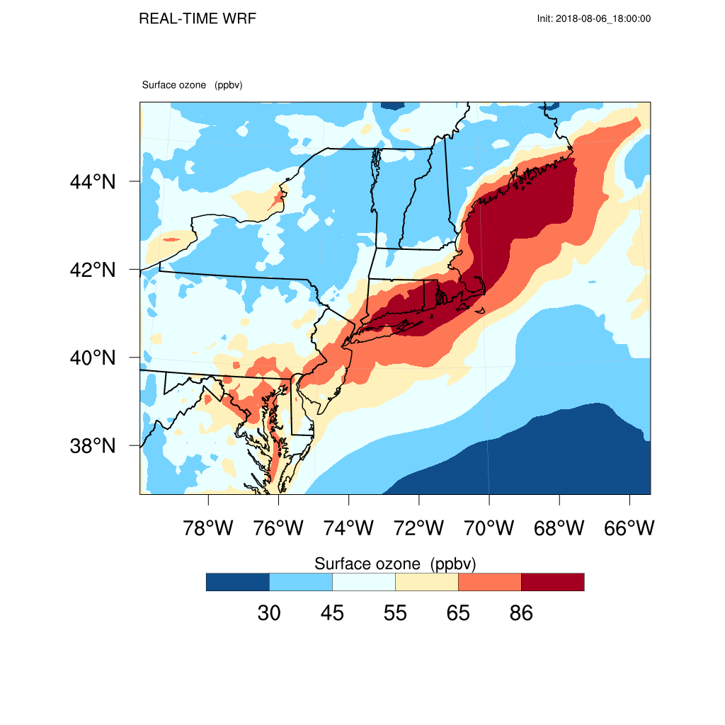
Identification of the roles of urban plume and local chemical production in ozone episodes observed in Long Island Sound during LISTOS 2018: Implications for ozone control strategies
Kaihui Zhao ¹, Yonghua Wu ², Jianping Huang ³, Guillaume Gronoff ^{4,5}, Timothy A. Berkoff ⁴, Mark Arend ², Fred Moshary ²
¹ Yunnan University, ² CCNY, ³ NOAA-NCEP EMC, ⁴ NASA Langley Research Center, ⁵ SSAI
Background:
High ozone (O₃) concentrations in Long Island Sound (LIS) area are related to the NYC urban plume (emissions and pollutants) transport, chemical production and urban-coastal meteorology, etc.
Analysis:
Analyze the NYC urban plume transport and local chemical production for the O₃ episodes in the LIS with the integrated observations from LISTOS 2018 and the WRF-Chem model; Investigate the ozone-precursor sensitivity (OPS) in the LIS area.
Findings:
Urban plume transport and local chemical reactions were identified as two key factors responsible for O₃ enhancement from the multi-source observations at LIS. The results revealed significant variations in ozone-precursor sensitivity during two O₃ events in the LIS area.
Significance:
TOLNet data are critical to validate the chemical transport model predict (WRF-Chem) and understand O₃ transport in the LIS.
WRF-Chem 20180806 14 EST O₃
20180806 14 EST O₃/NO_{v} <5
(VOC-limited)
Case-1 2018-08-06
WRF-Chem 20180808 14 EST O₃
20180808 14EST O₃/NO_{y} ~15
(NOx-limited)
Case-2 2018-08-08

