Slide 1
TOLNet ECCC AMOLITE FY23 Accomplishments
Kevin Strawbridge and Michael Travis
Presentations
Paul Makar, Colin Lee, Ayodeji Akingunola, Wanmin Gong, Craig Stroud, Junhua Zhang, Mahtab Majdzadeh, Roya Ghahreman, Stefan Miller, Sepehr Fathi, Alex Lupu, Ali Katal, John Liggio, Katherine Hayden, Ralf Staebler, Kevin Strawbridge, Eric Edgerton, Matthew Landis, Emily White, Samar Moussa, Jeremy Wentzell, Sumi Wren, Balbir Pabla, Philip Cheung, Greg Wentworth: Key Processes in Canadian Oil Sands Gas and Aerosol Chemistry Identified through Model Evaluation Against Monitoring Network and Aircraft-Based Data. EGU 2023. Vienna, Austria, April 23-28, 2023.
Matthew S Johnson, Nora Mettig, Mark Weber, Alexei Rozanov, John Sullivan, Mike Newchurch, Shi Kuang, Thierry Leblanc, Fernando Chouza, Timothy Berkoff, Guillaume Gronoff, Kevin B Strawbridge, Raul J Alvarez II II, Guillaume Kirgis, Andrew O'Neil Langford, Christoph J Senff, Brandi McCarty and Scott Sandberg: Validation of the TROPOMI ozone profile product in the troposphere with TOLNet ground-based lidar observations. Fall AGU 2022. Chicago, Decembewr 12-16
Field or Other Activities and Data Archived
TEMPO validation at our home facility (Centre For Atmospheric Research Experiments in Egbert, ON, Canada)
We are also participating in SWAPIT (Study of Winter Air Pollution in Toronto)
Large field study with several university partners and all levels of government
We are all up to date on TOLNet data archival.
Files | Size [MB]
Hardware and Personnel Updates
ECCC lidar group consists of 1.8 PY
Main issue going forward
Purchased a diode solid state laser for the ozone system
40 mJ @ 100 Hz – improve our temporal resolution
Problem with the separation optics – still awaiting a fix!!
Shipping issues back to the UK have been very problematic
Moving our 355 nm diode solid state system from our Arctic lidar to AMOLITE
Improve reliability
Increased signal to noise – 3 aerosol wavelengths, night time water vapor
Outlook for Next FY
Engaged the modelling community in our Stratospheric/Tropospheric transport of ozone cases
Continue in TEMPO validation activities
Retirement??

Slide 2

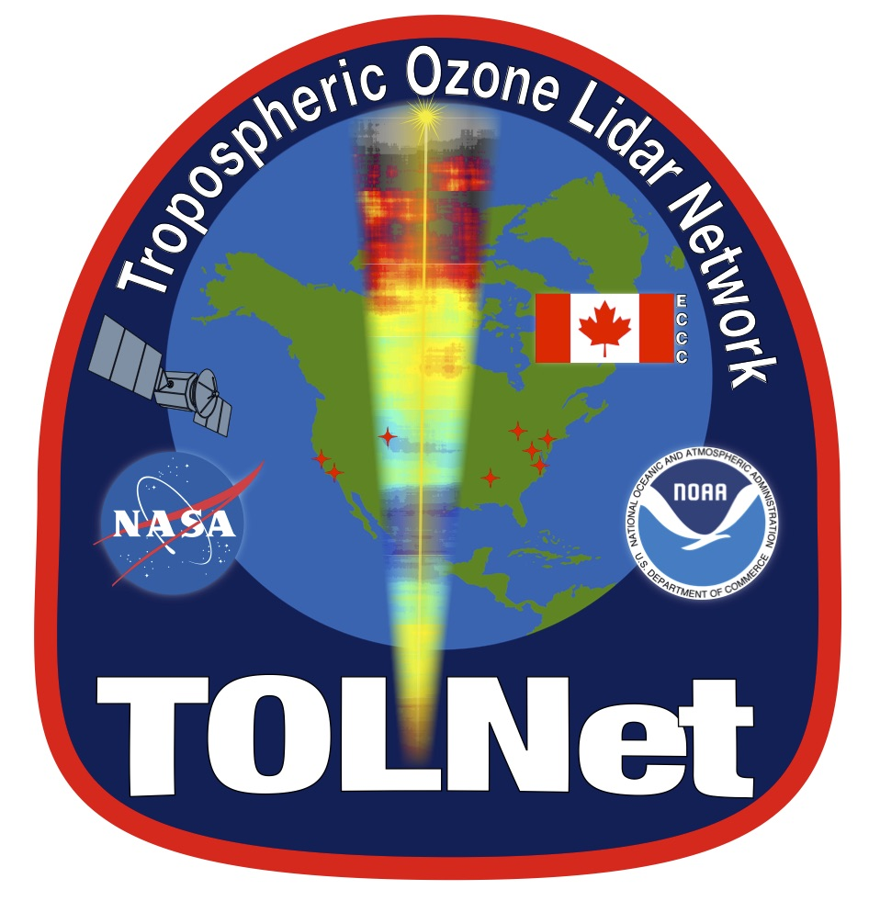
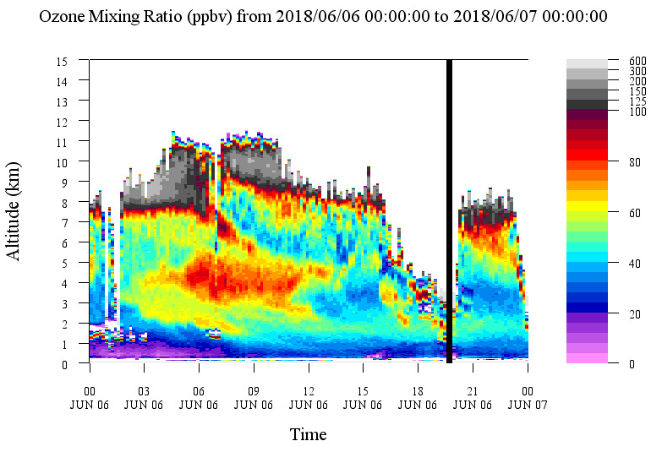
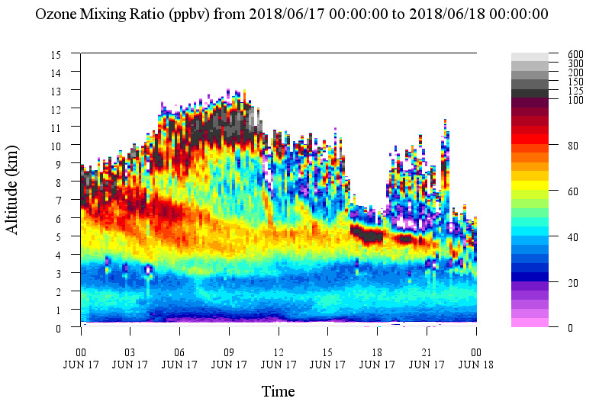
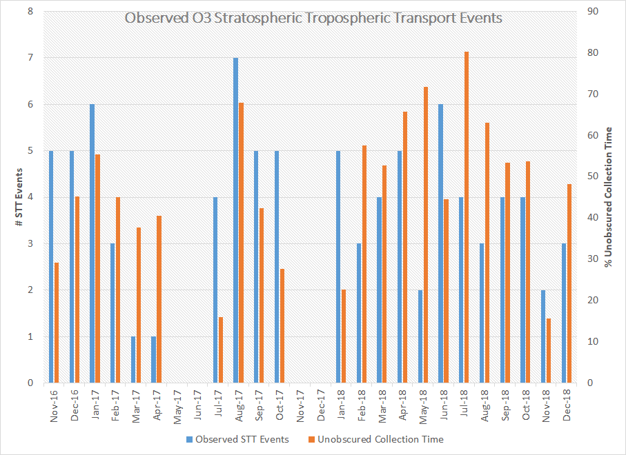
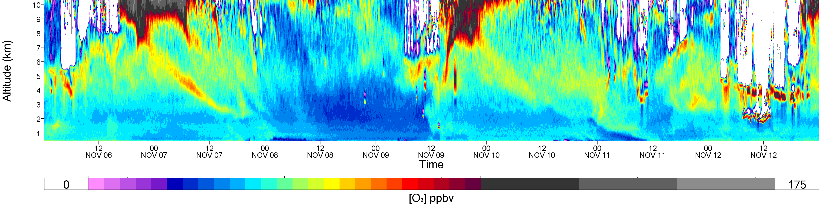
AMOLITE Stratospheric/Tropospheric Transport
Background:
While AMOLITE was located at Fort McKay in Northern Alberta for an approximate 3 year period we observed several Stratospheric/Tropospheric transport (STTT) events. Assessing the magnitude and frequency of occurence.
Analysis:
Put together a spread sheet on all the events
Screen captures of all the events
Produced the ozone data profiles for all the events
do the STT of ozone penetrate the PBL (how often)
Findings:
We want to do some model comparisons.

