Slide 1


Python Interface to RSIG
(pyrsig)
Presented: Barron H. Henderson
Date: 2023-03-23
RSIG Team: Jim J. Szykman, Luke Valin, Todd Plessel, Matt Freeman
Disclaimer: The views expressed in this presentation are those of the authors and do not necessarily reflect the views or policies of the U.S. Environmental Protection Agency.

Slide 2
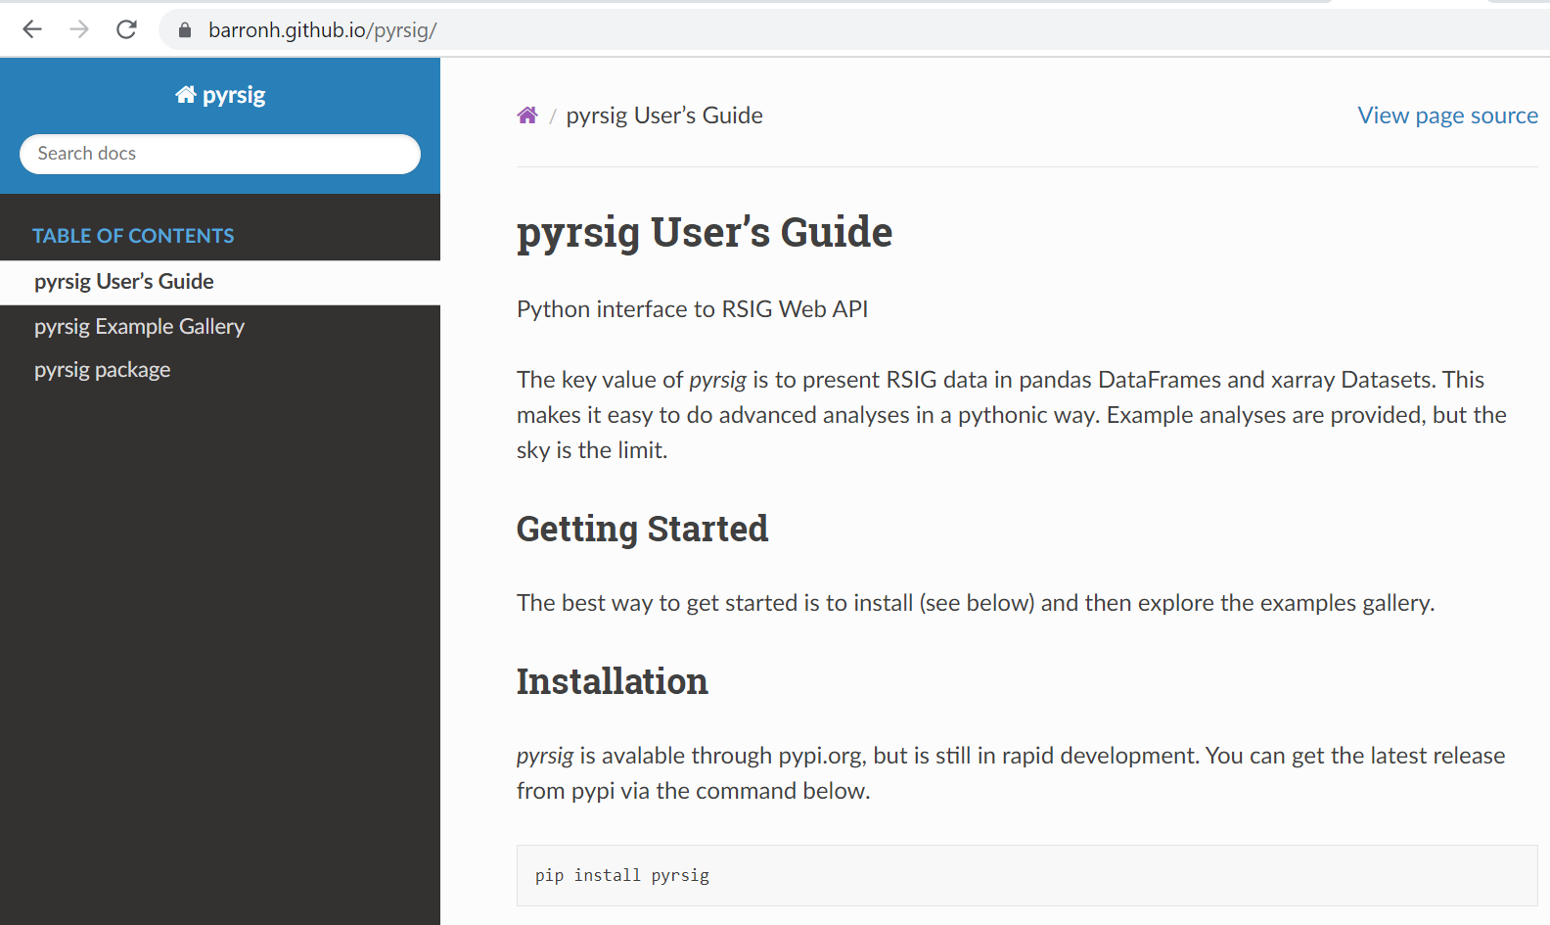
https://barronh.github.io/pyrsig/
RSIG server prepares the data!

Slide 3
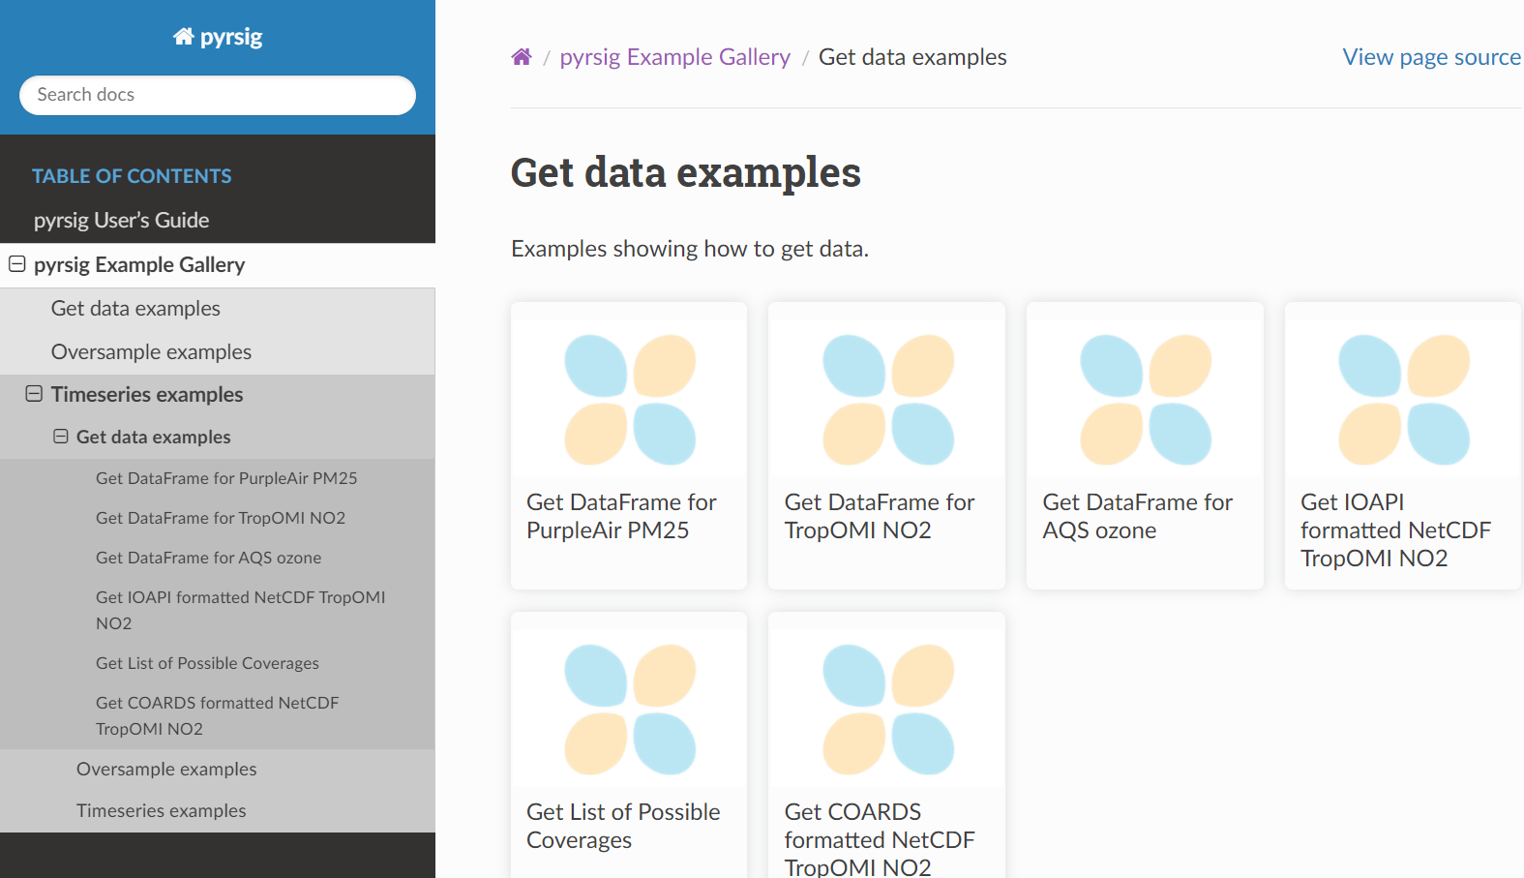

Slide 4
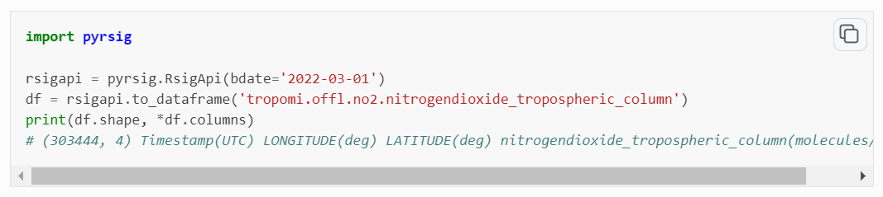

Slide 5
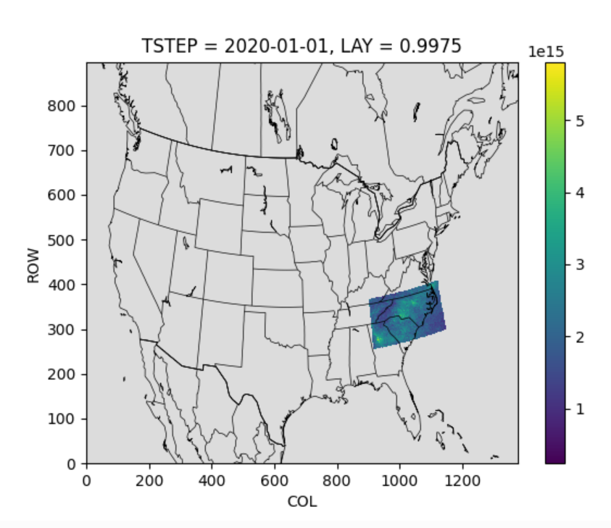
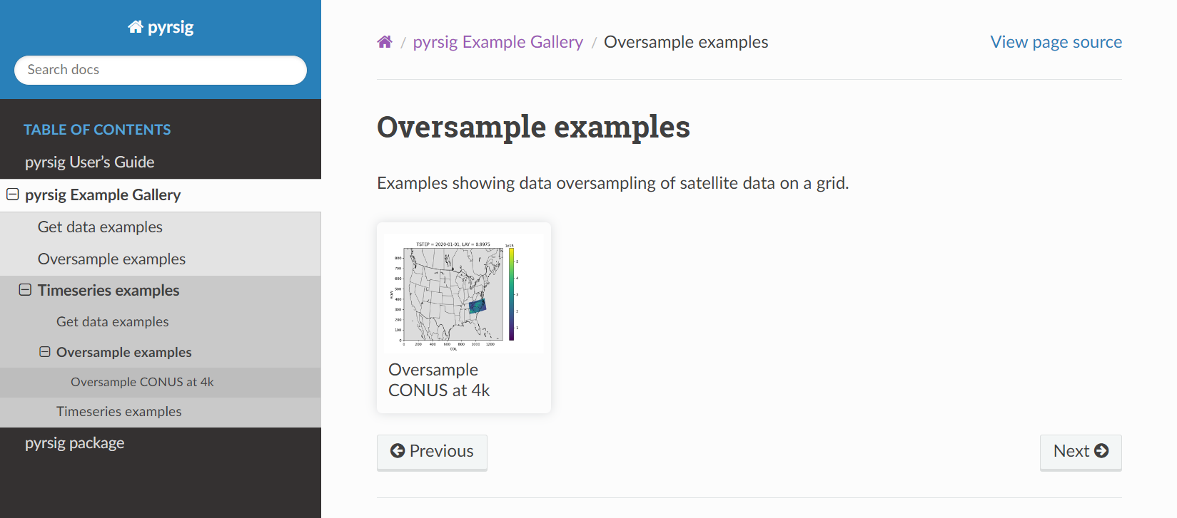
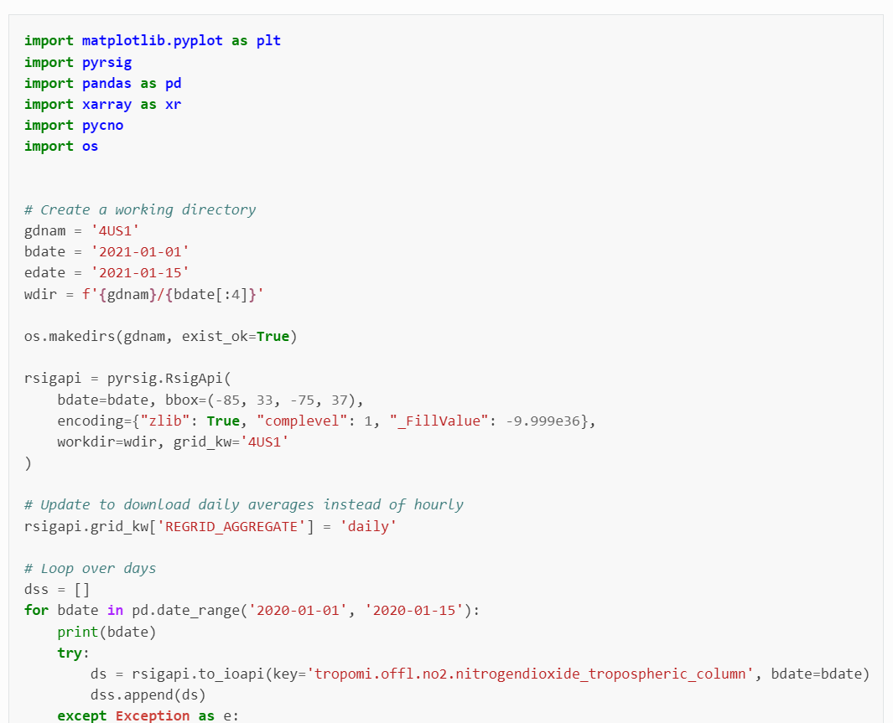

Slide 6
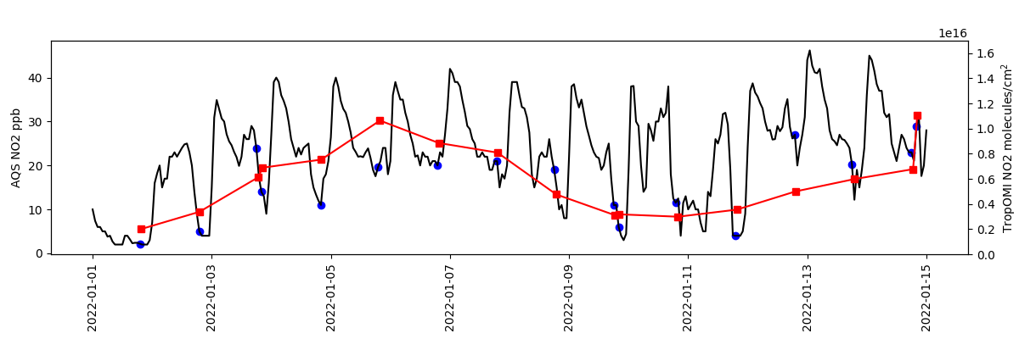
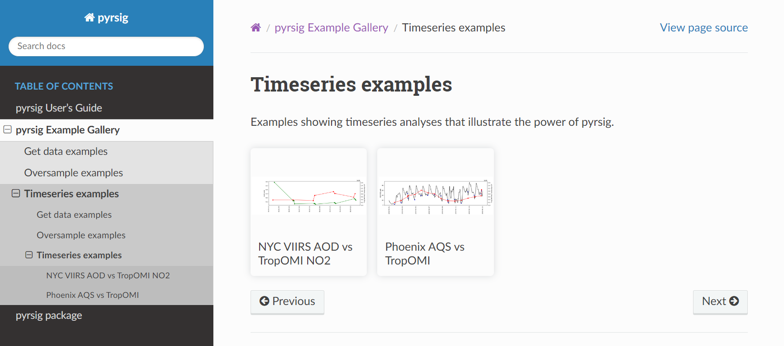
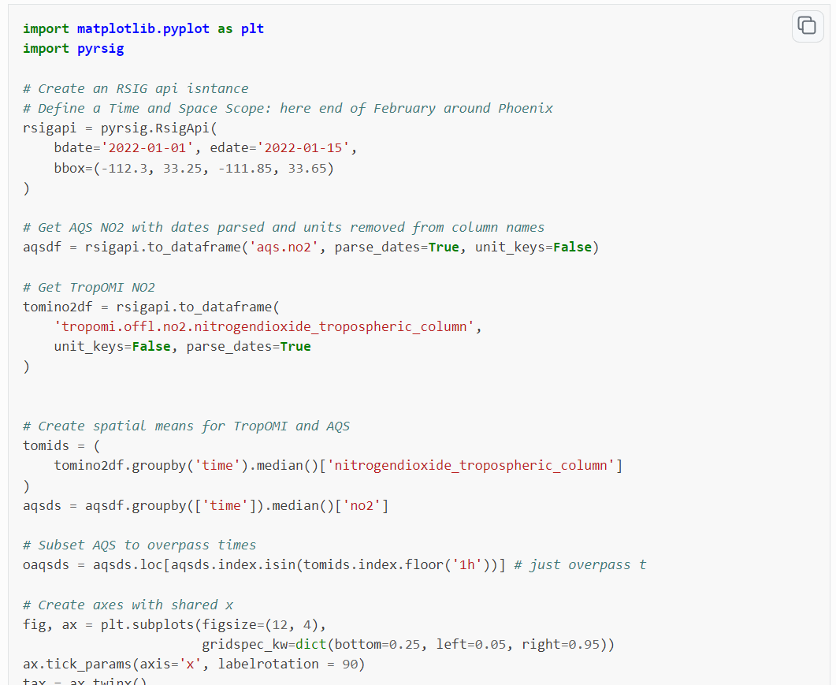

Slide 7
Run Example On Colab
General
colab.research.google.com
  Open a new notebook
  Add “%pip install --user netcdf4 pyproj pycno pyrsig”
  And run it
barronh.github.io/pyrsig
  Navigate to example
  Copy code from example
  Paste it in your colab notebook
  Run it
Today prepackaged examples:
gist.github.com/barronh/6faf2008a0cf0ac9e49543f31c300601
gist.github.com/barronh/497e3418fb66ddce2d04a4c8d68e31a3
https://gaftp.epa.gov/Air/aqmg/bhenders/

Slide 8
Questions?
pyrsig: henderson.barron@epa.gov
RSIG: rsig@epa.gov

