Slide 1
TEMPO TRAINING
Notes:
STILL

Slide 2
Agenda
NASA Earthdata Search
NASA Earthdata Harmony
Global Imagery Browse Service (GIBS)
NASA Worldview
OPeNDAP
ASDC Subsetters
NASA Earthdata GIS

Slide 3
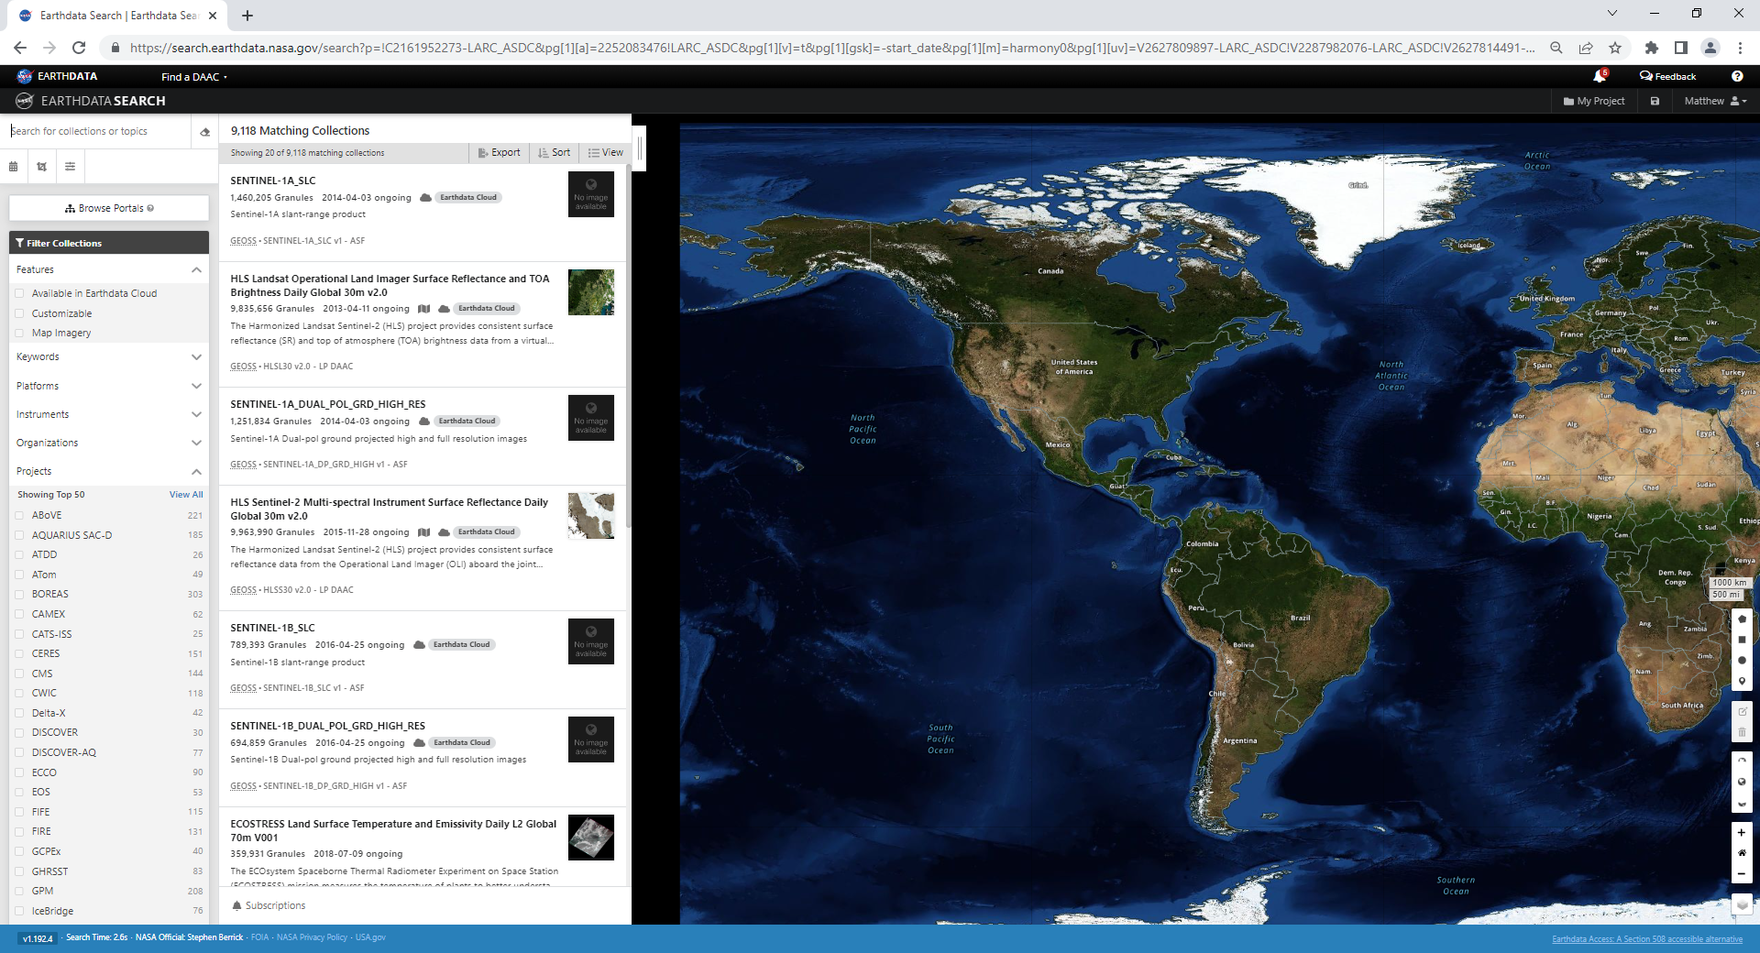

Slide 4
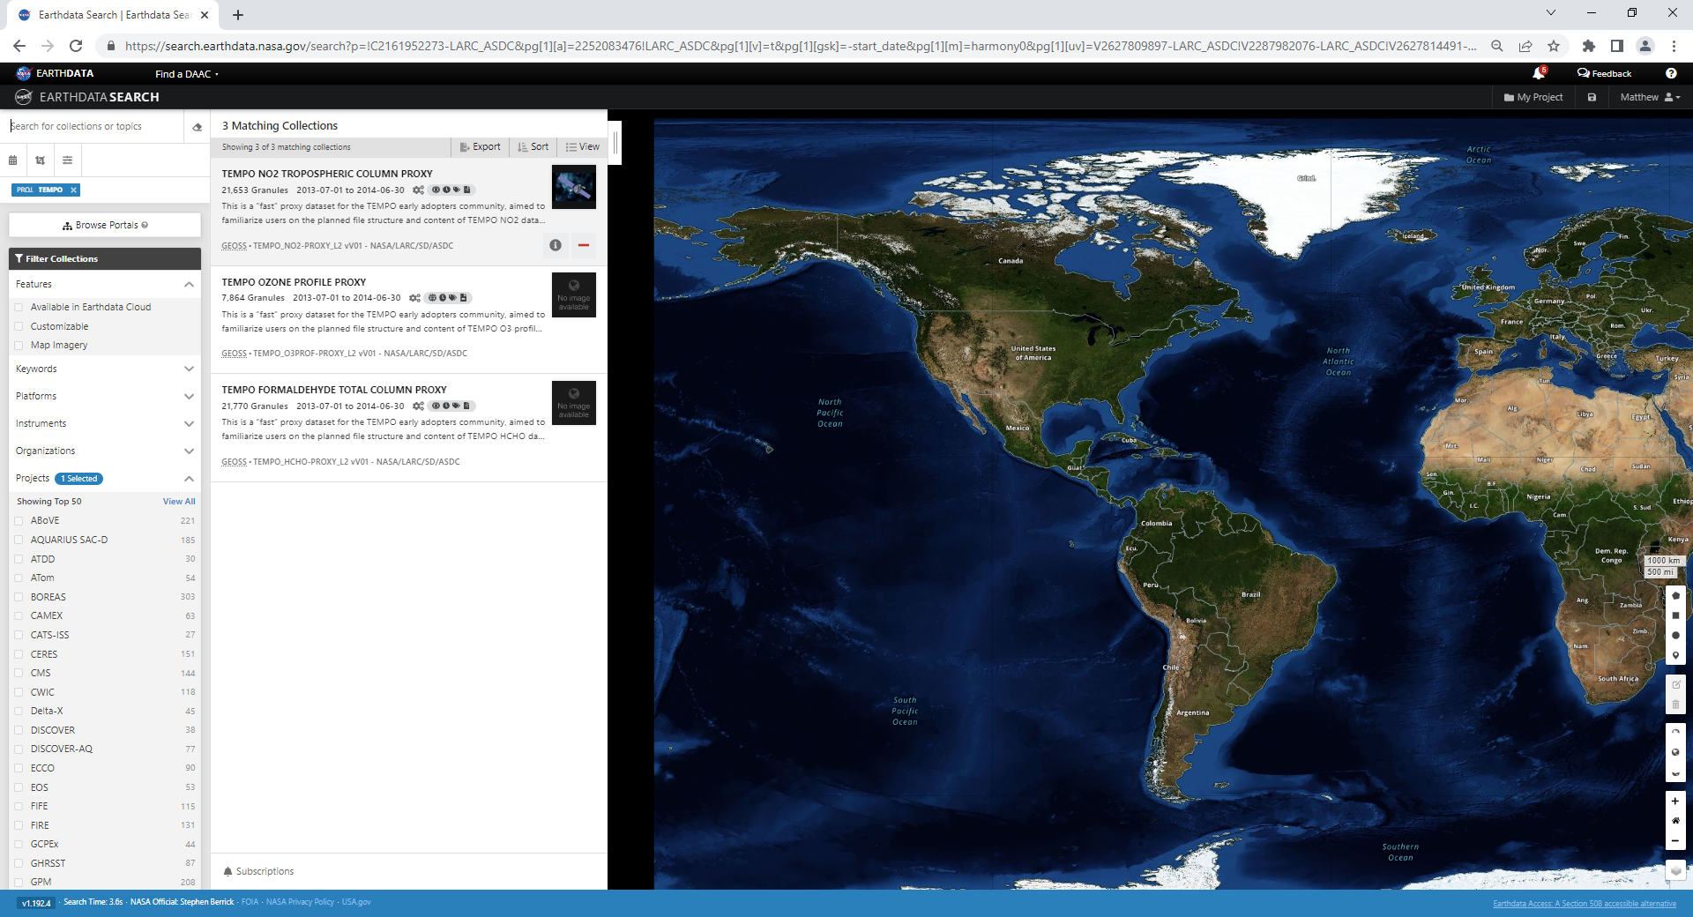

Slide 5
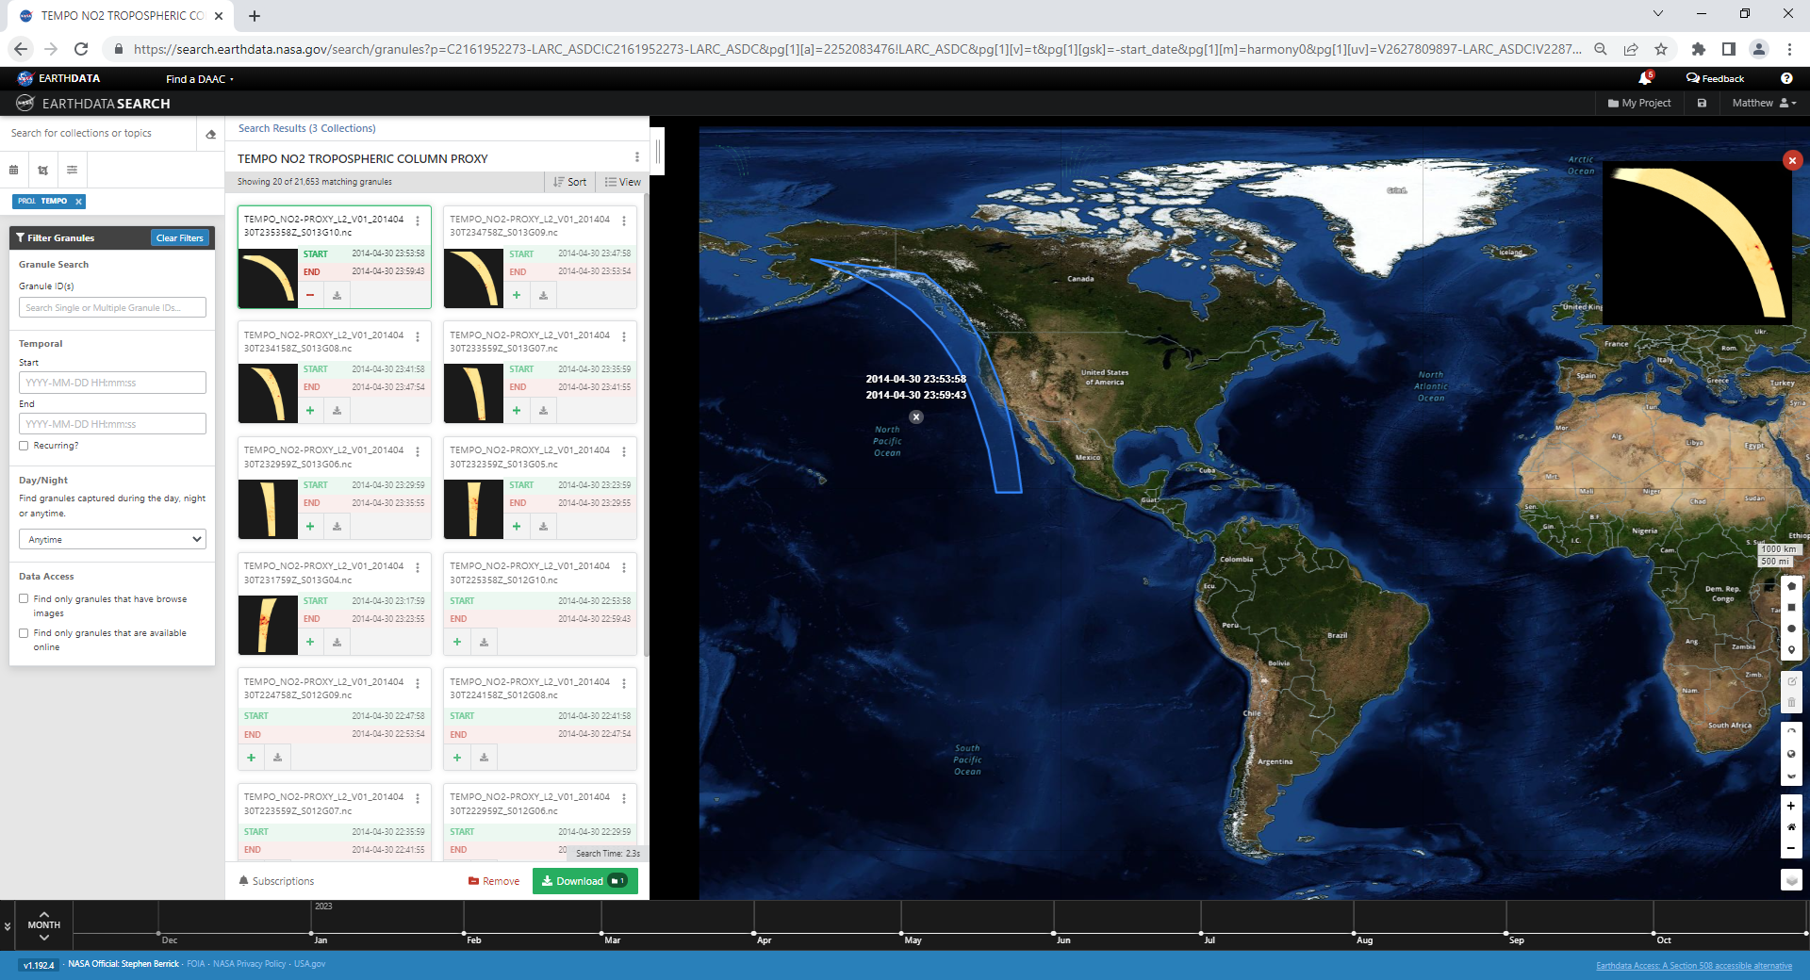

Slide 6
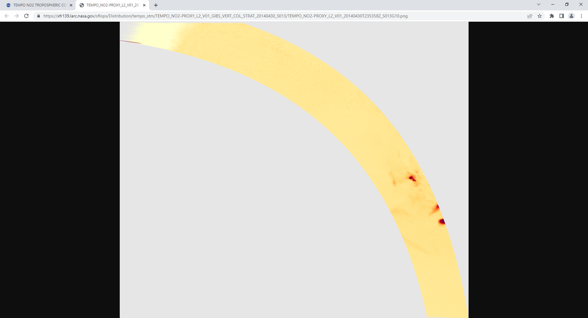

Slide 7
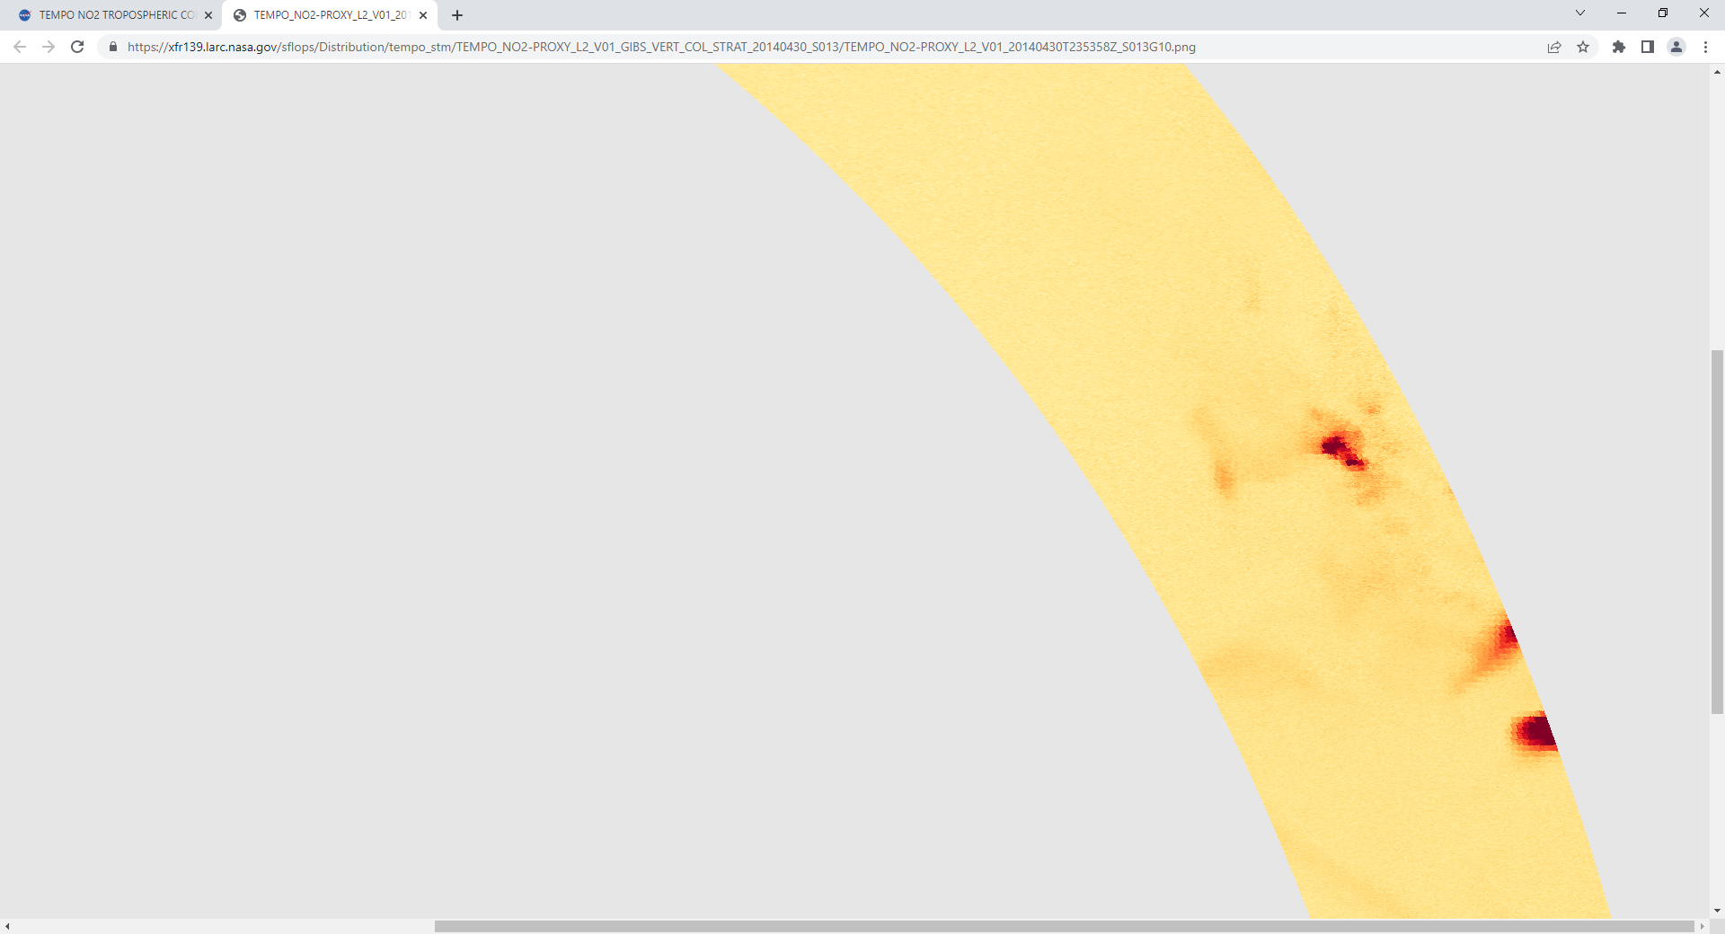

Slide 8
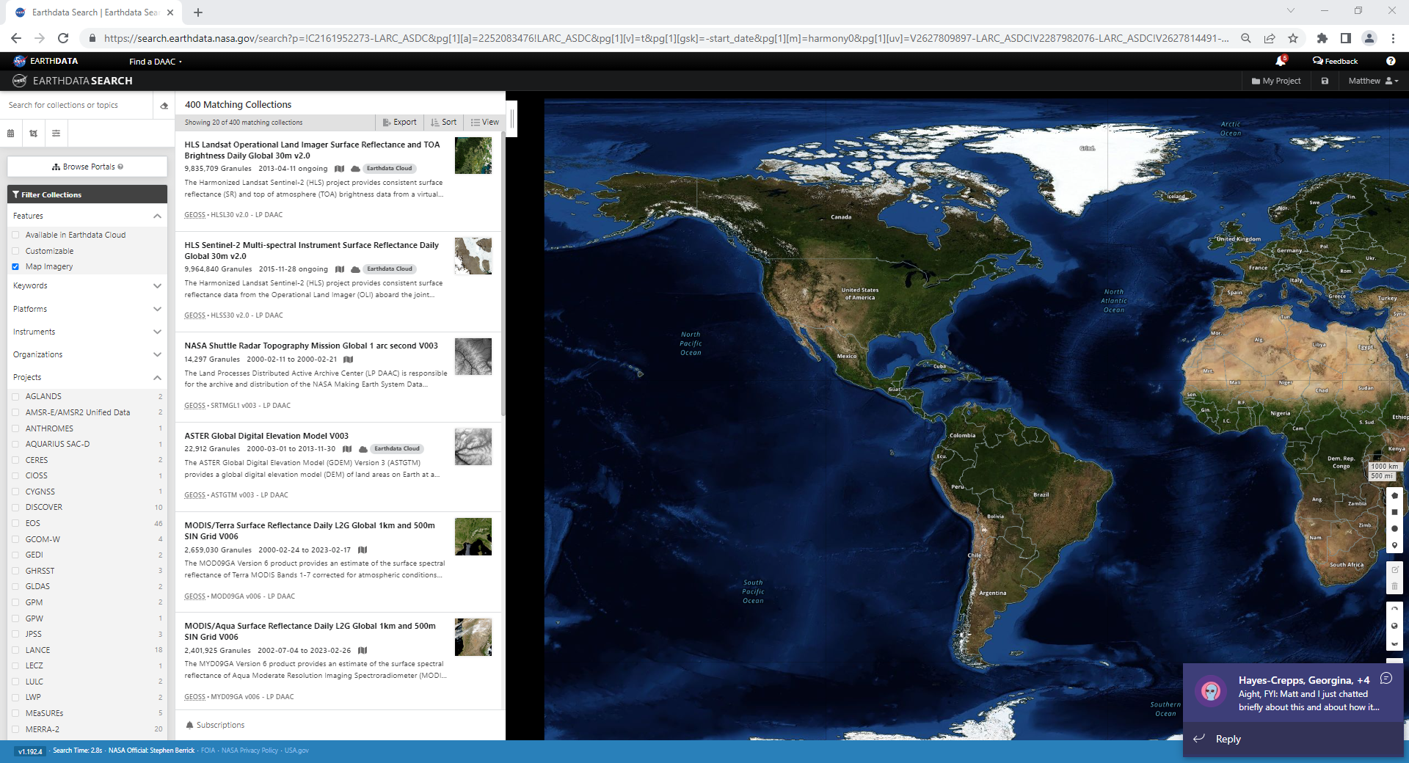
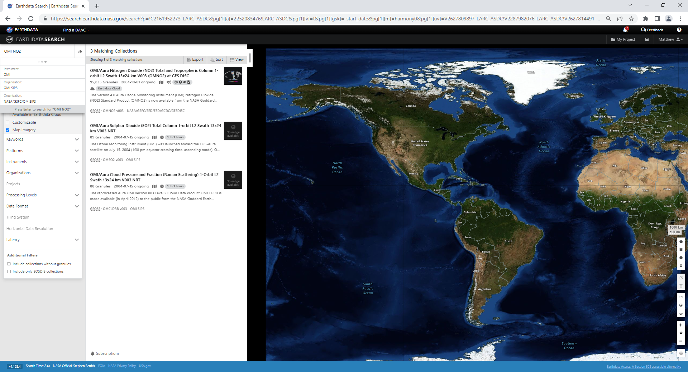

Slide 10
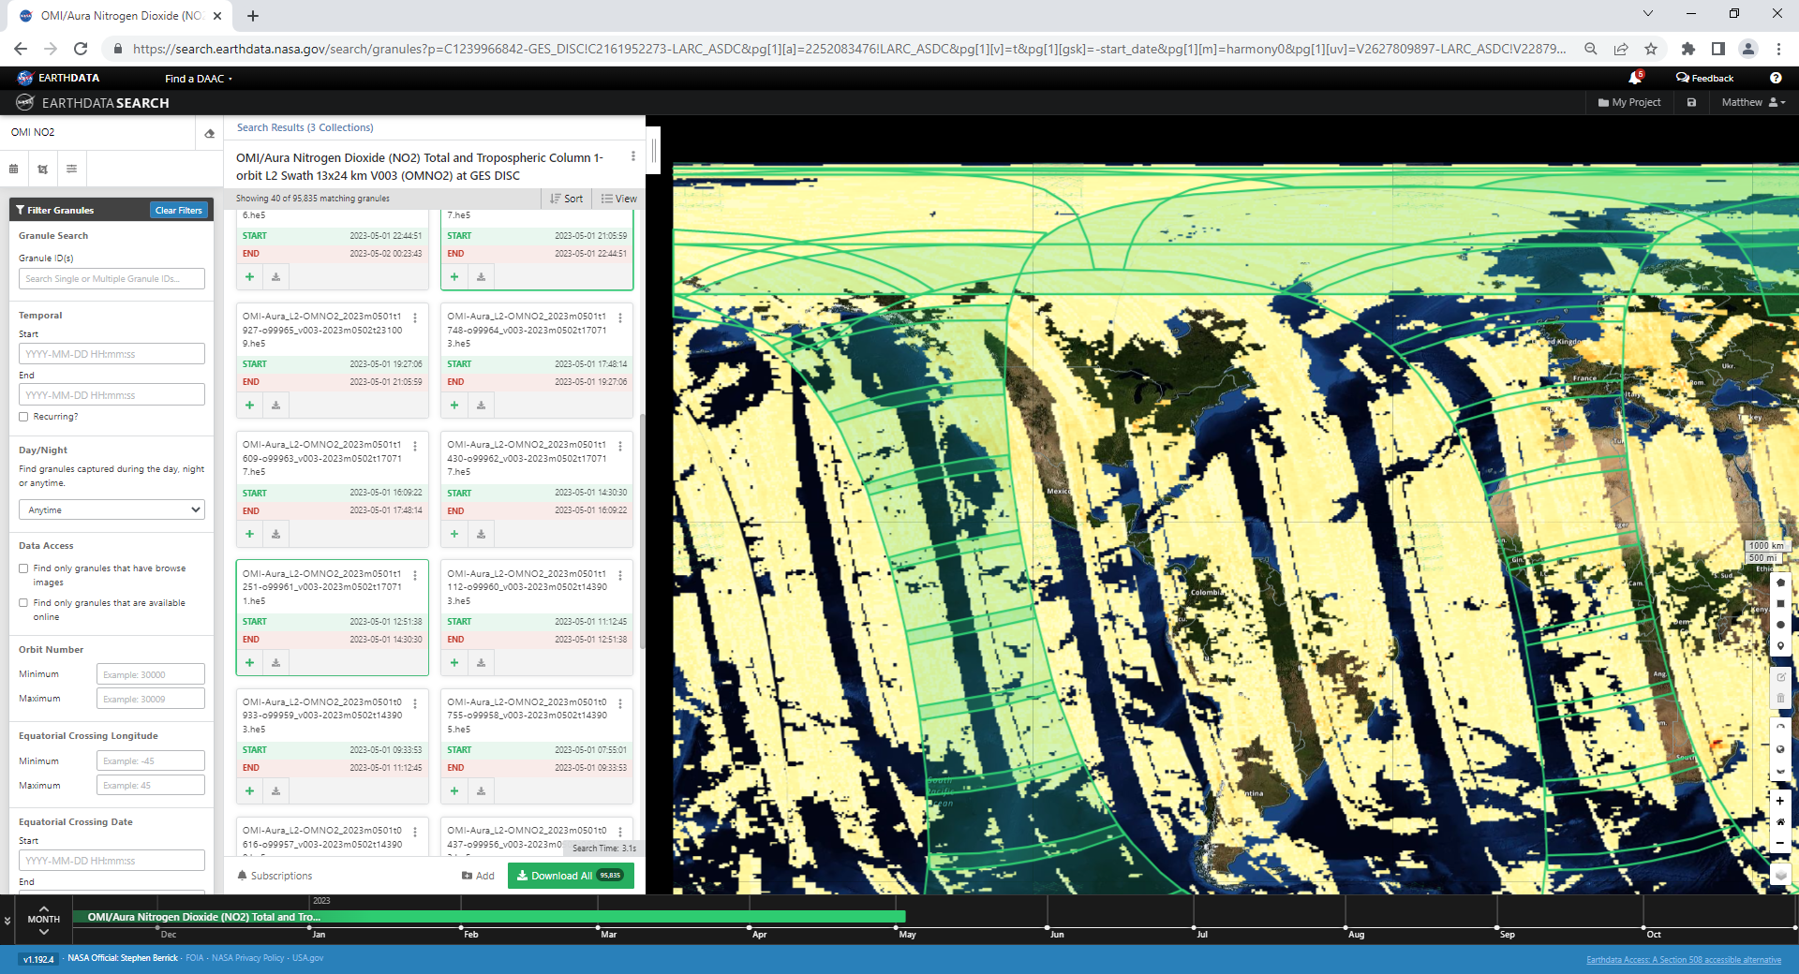

Slide 11
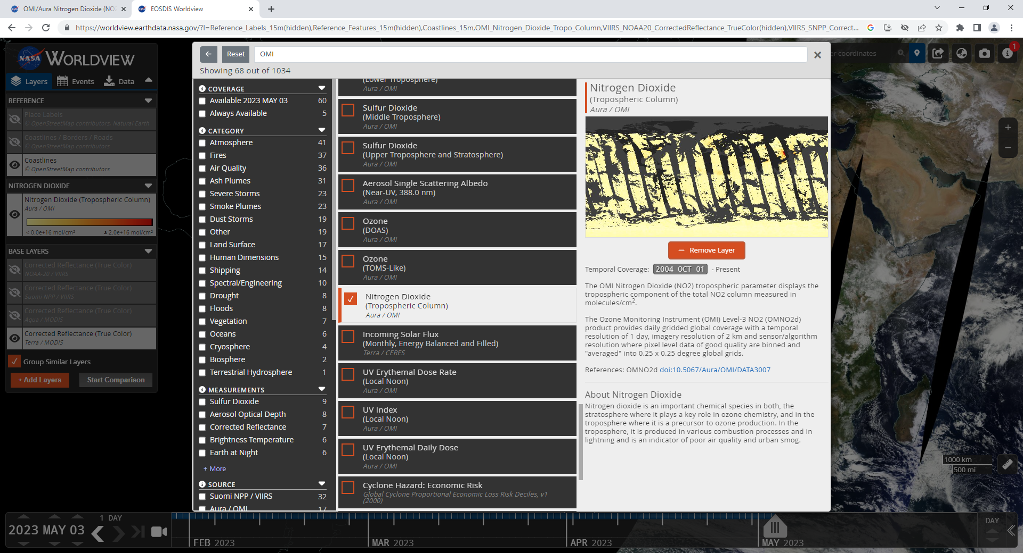

Slide 12
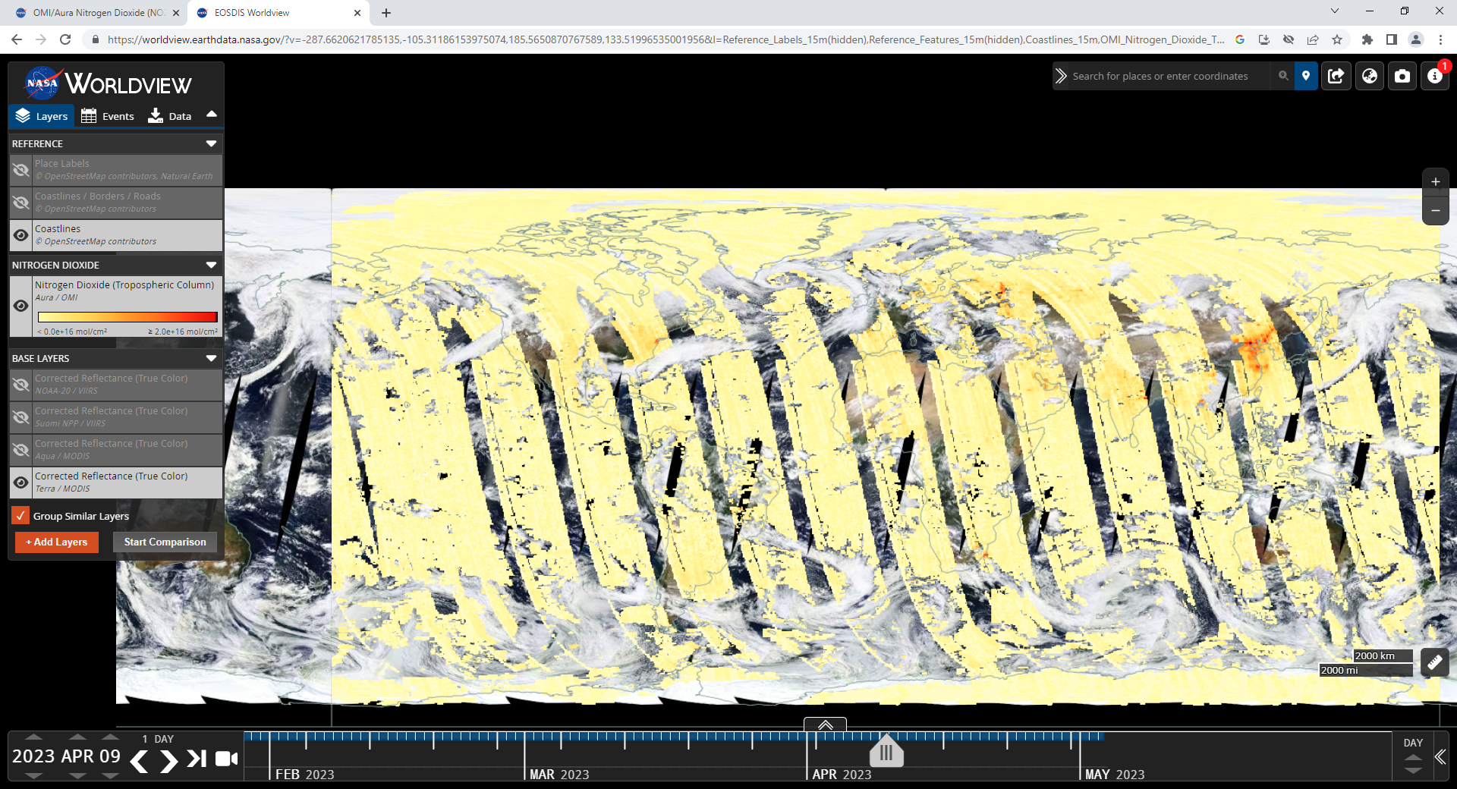

Slide 13
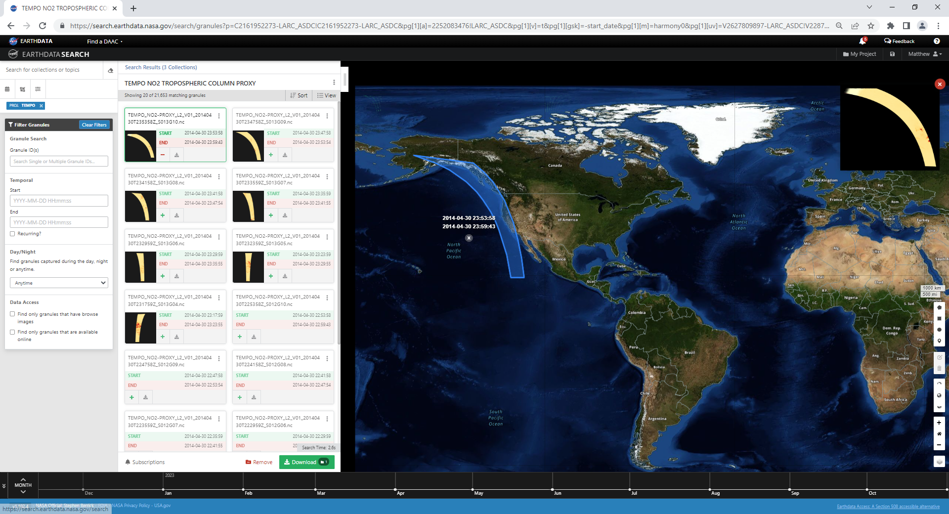

Slide 14
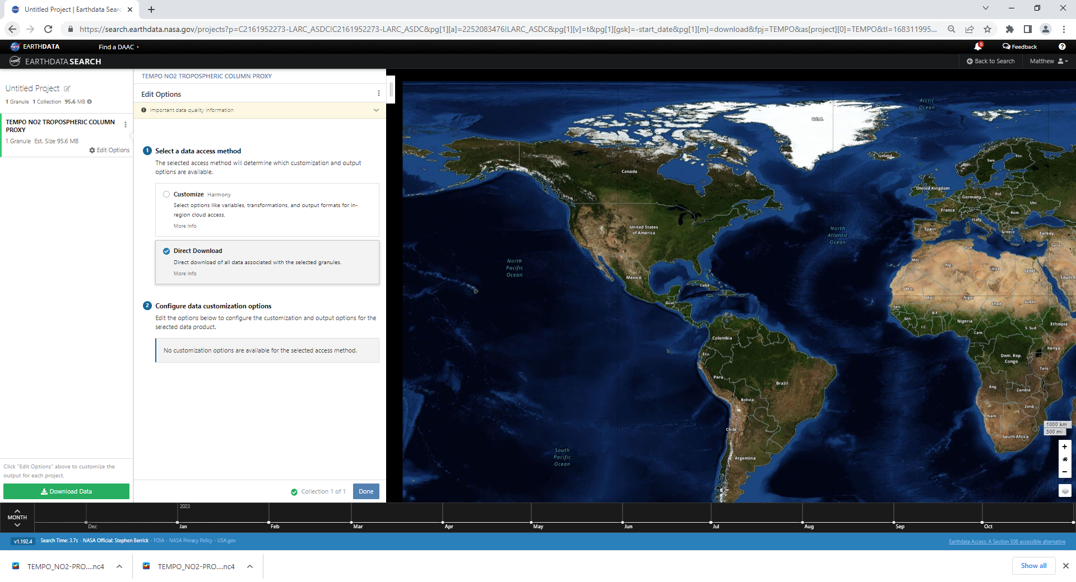

Slide 15
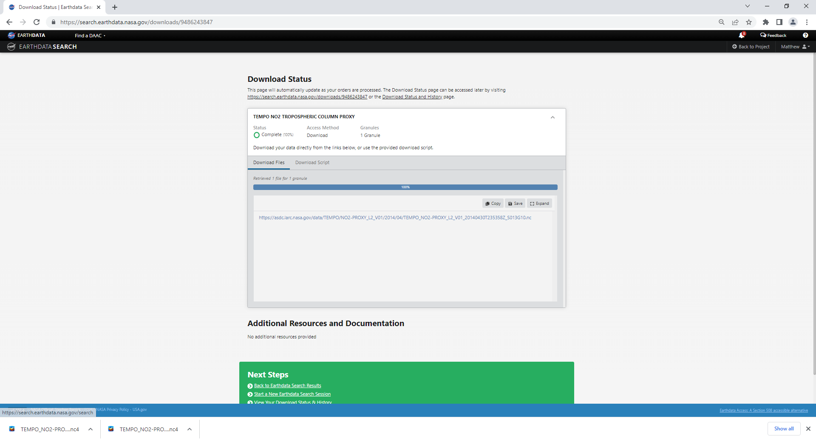

Slide 16
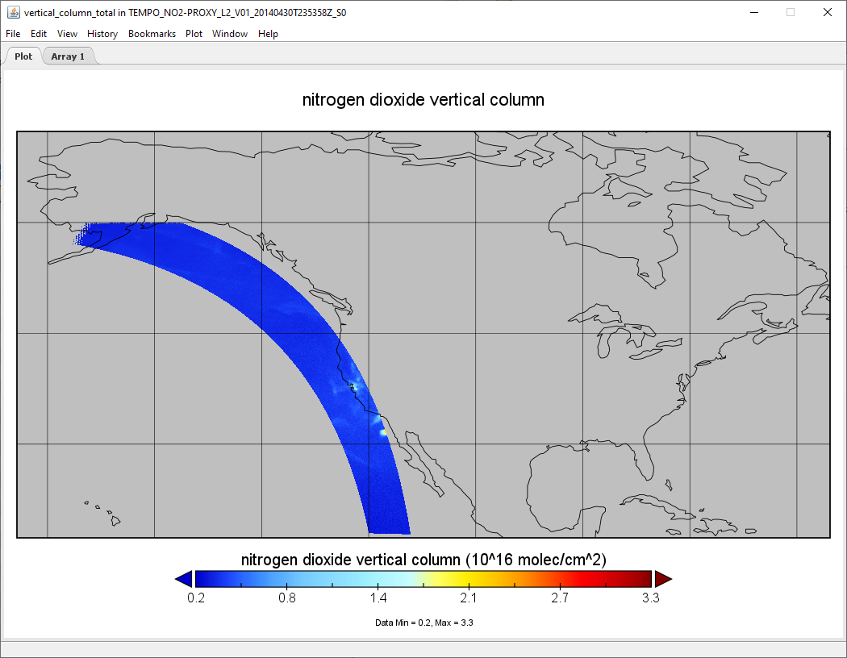
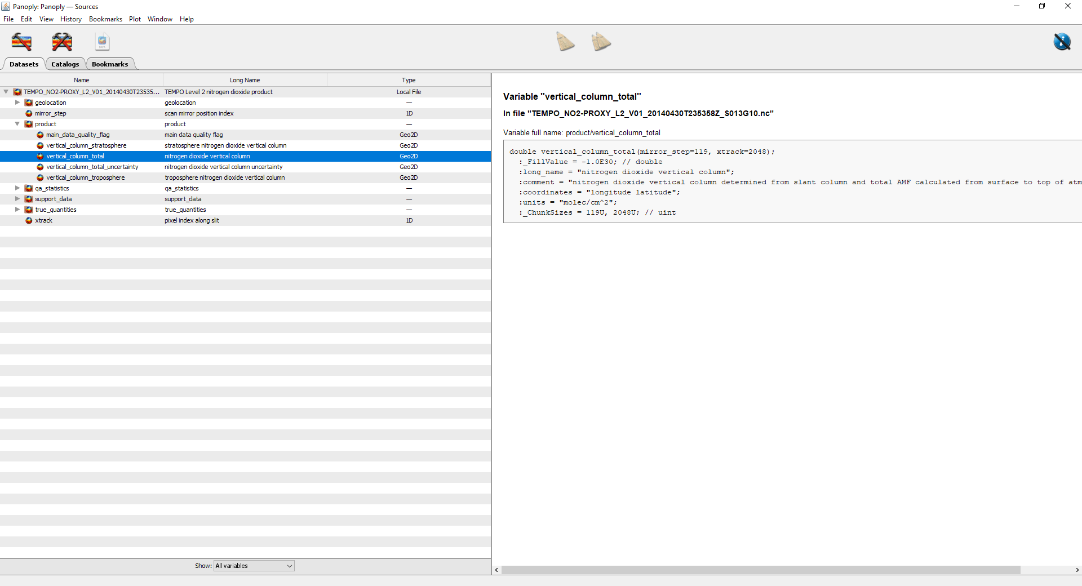

Slide 17
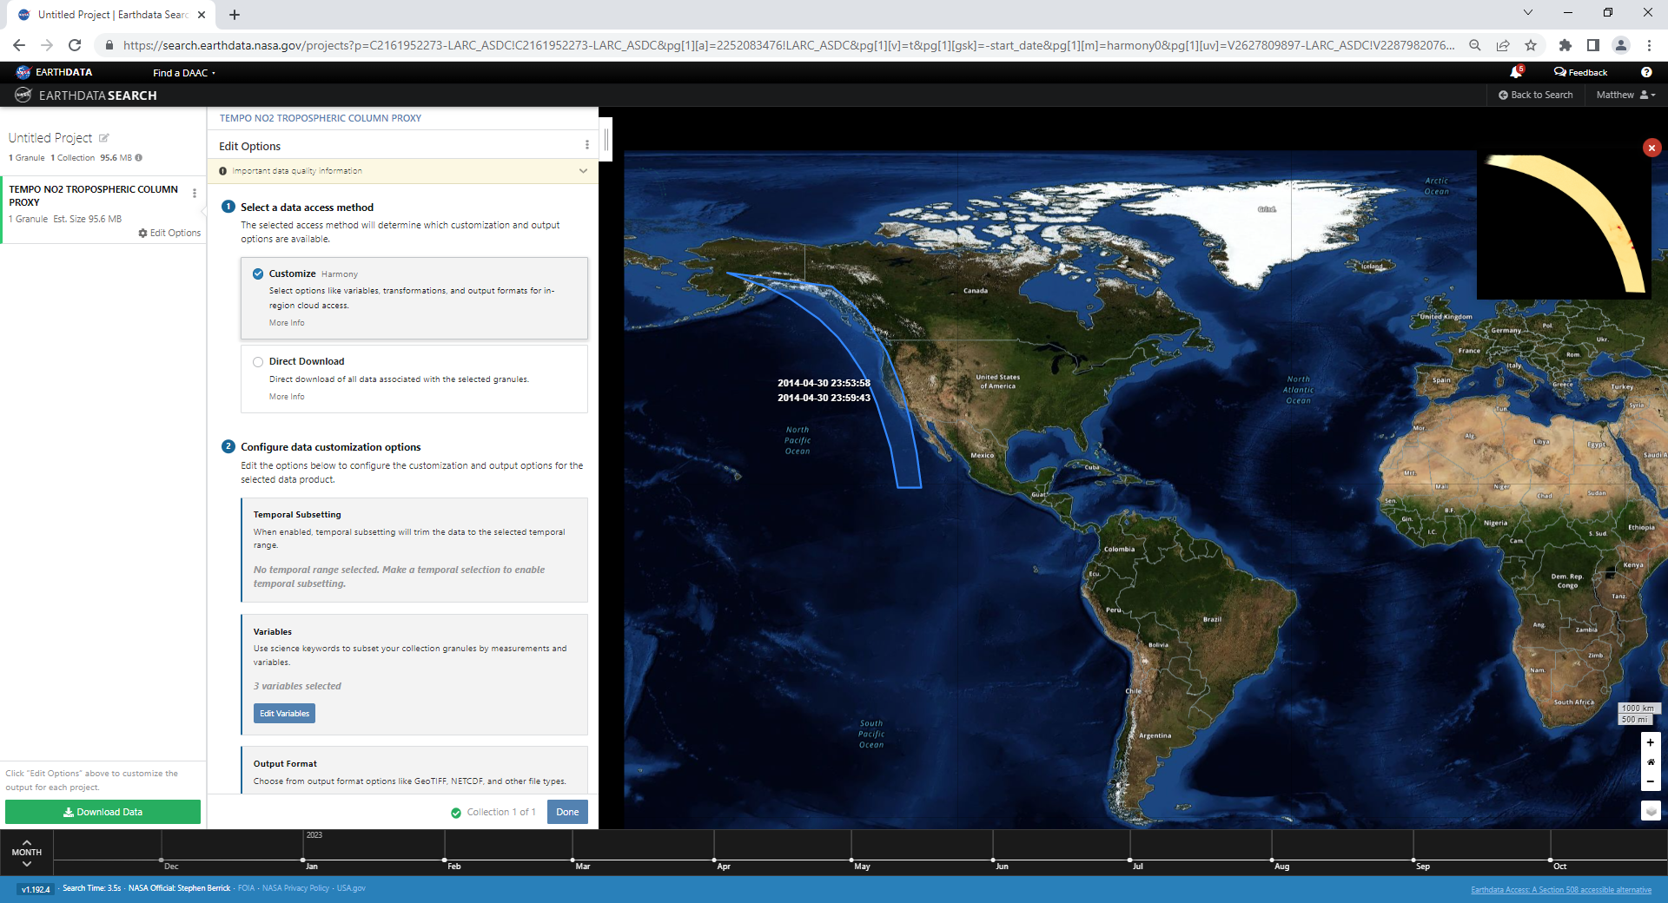

Slide 18


Slide 19
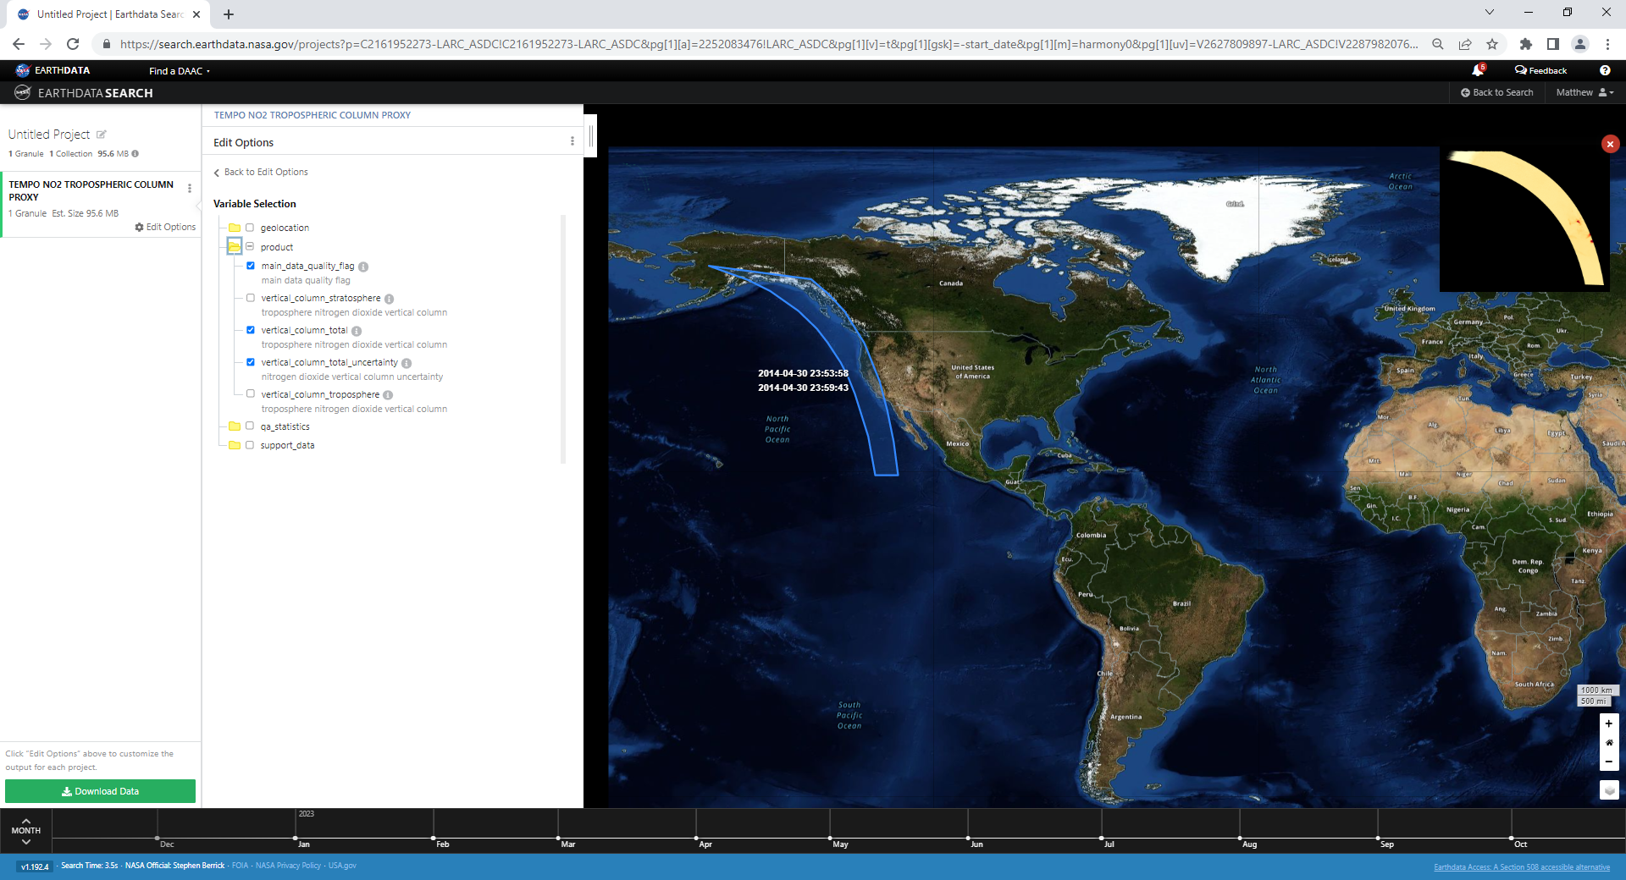

Slide 20
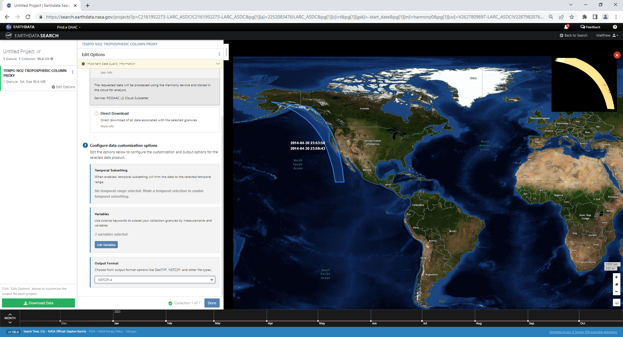

Slide 21
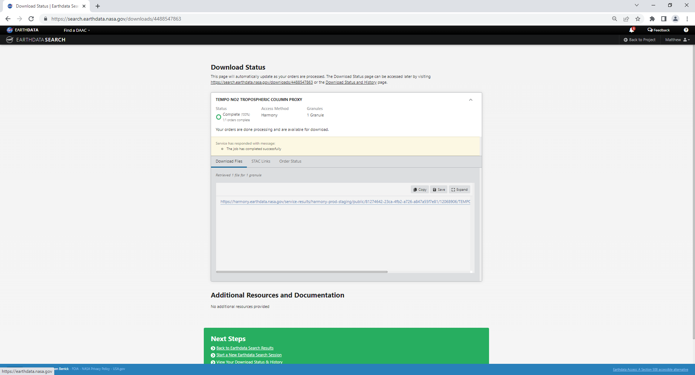

Slide 22
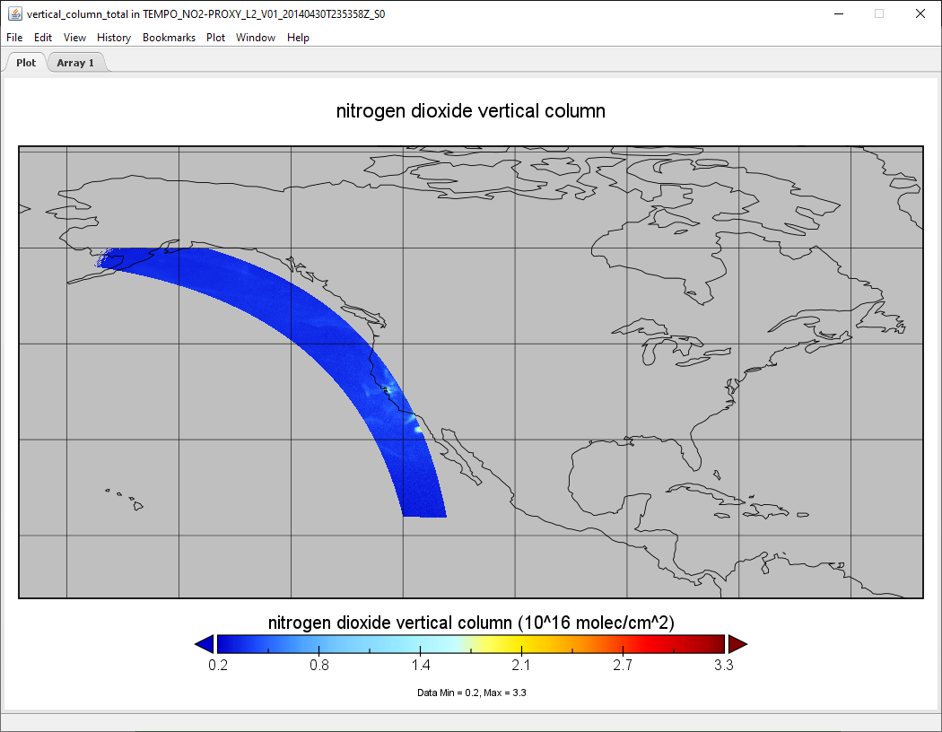
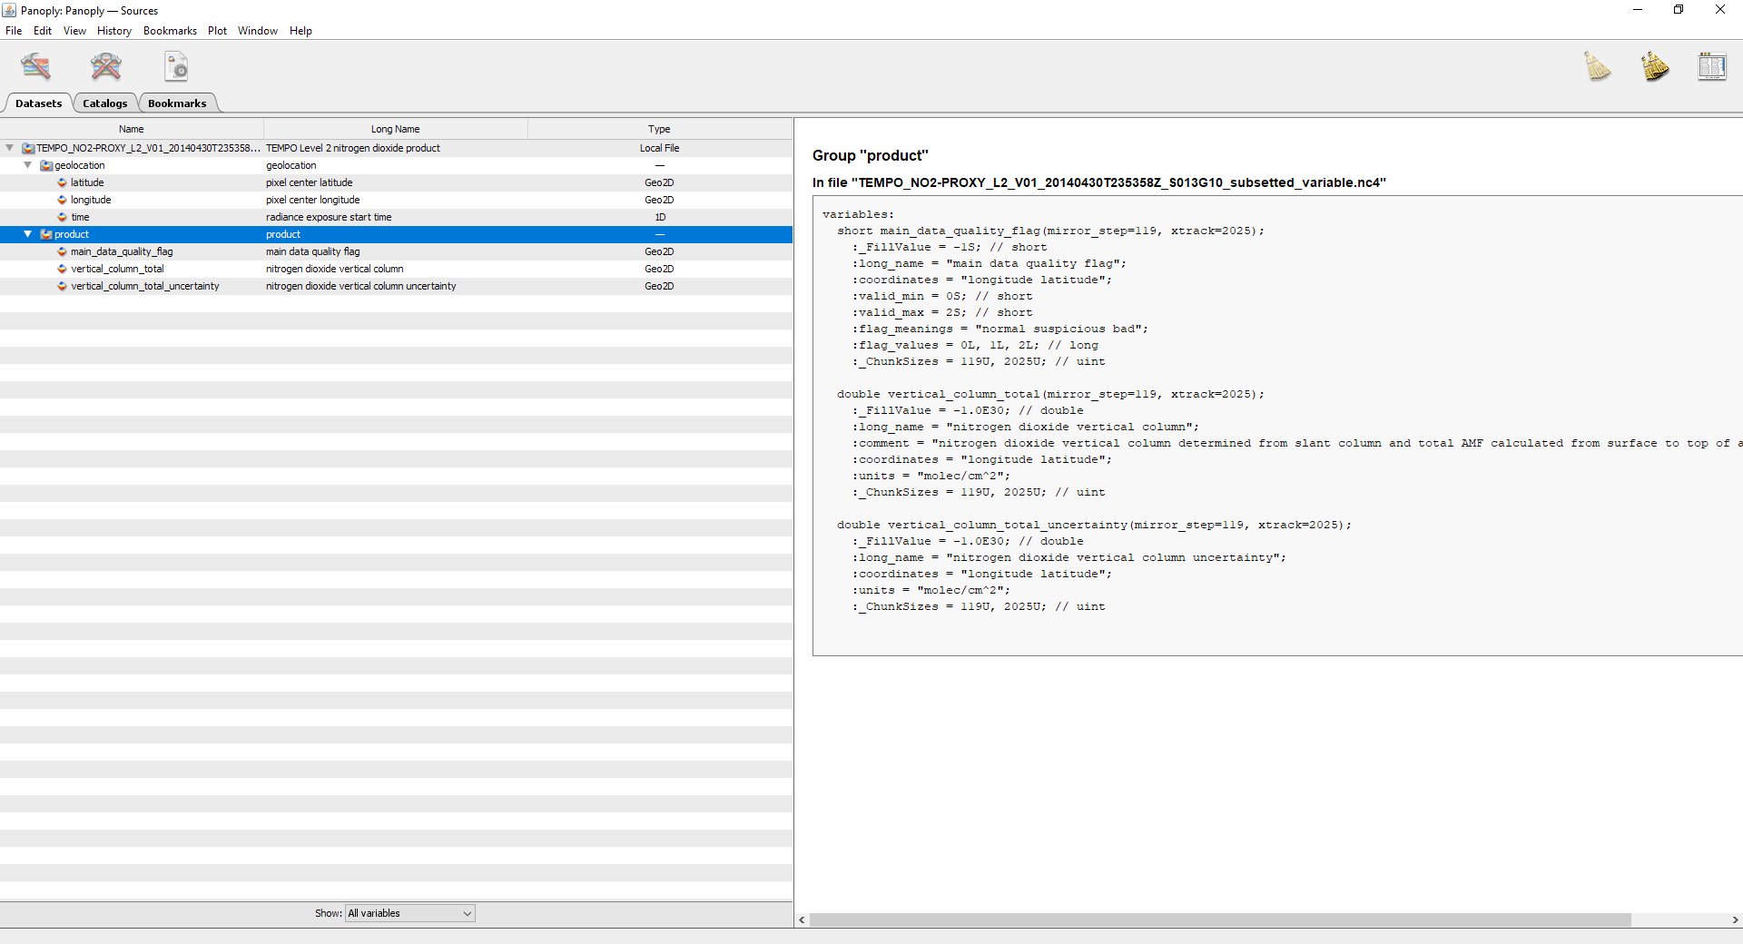

Slide 23
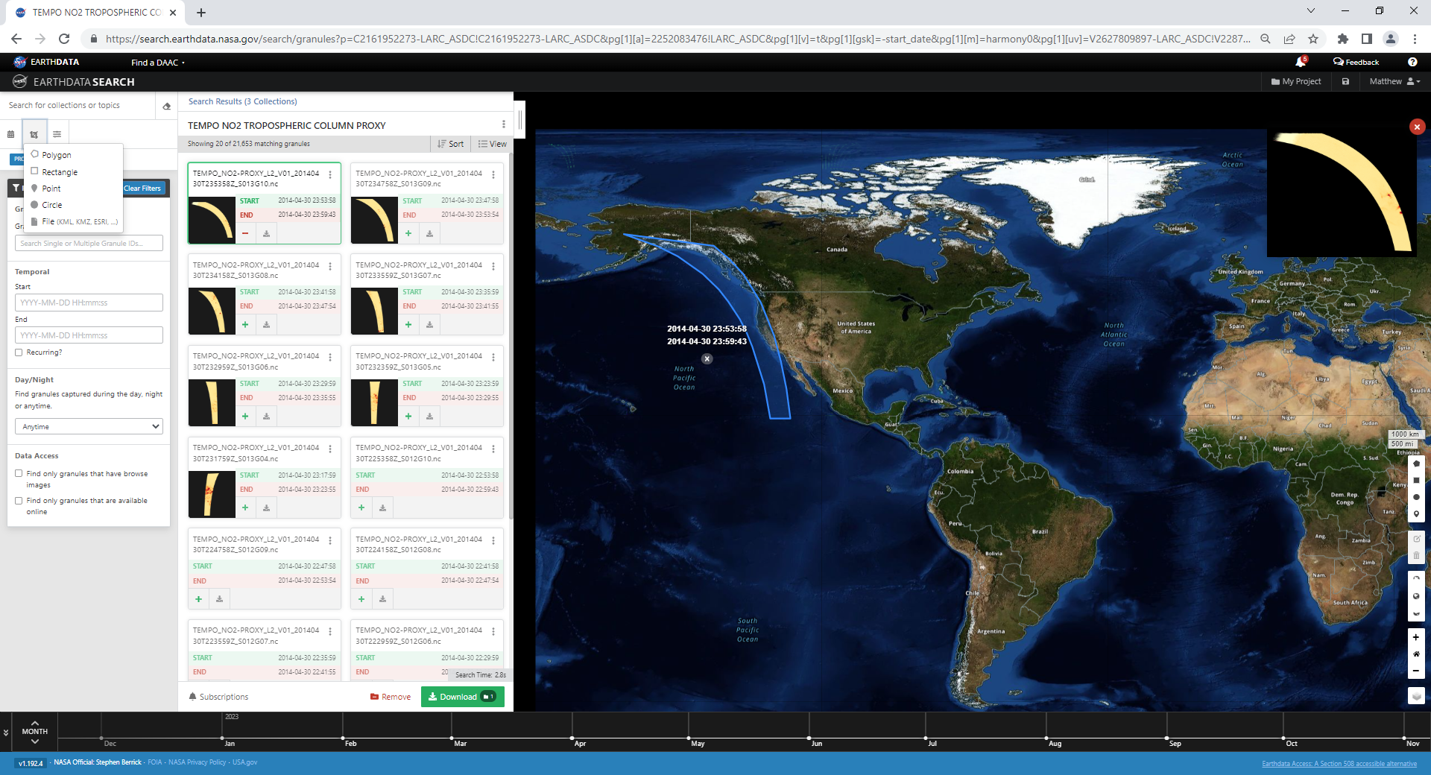

Slide 24
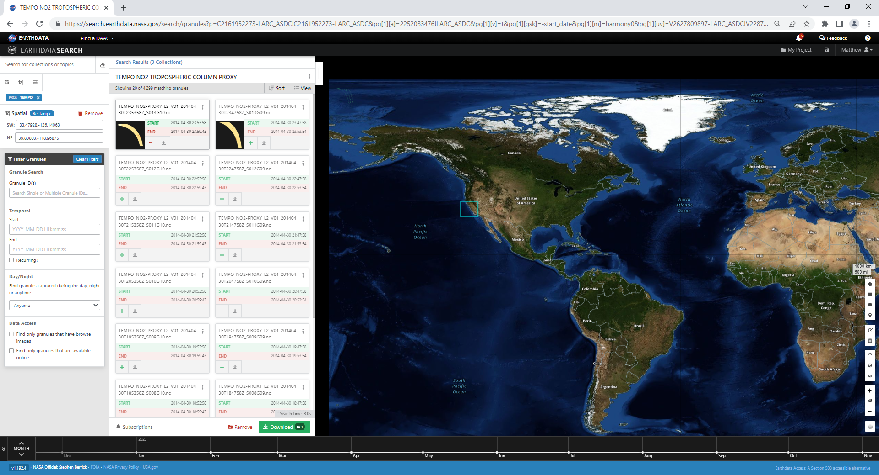

Slide 26
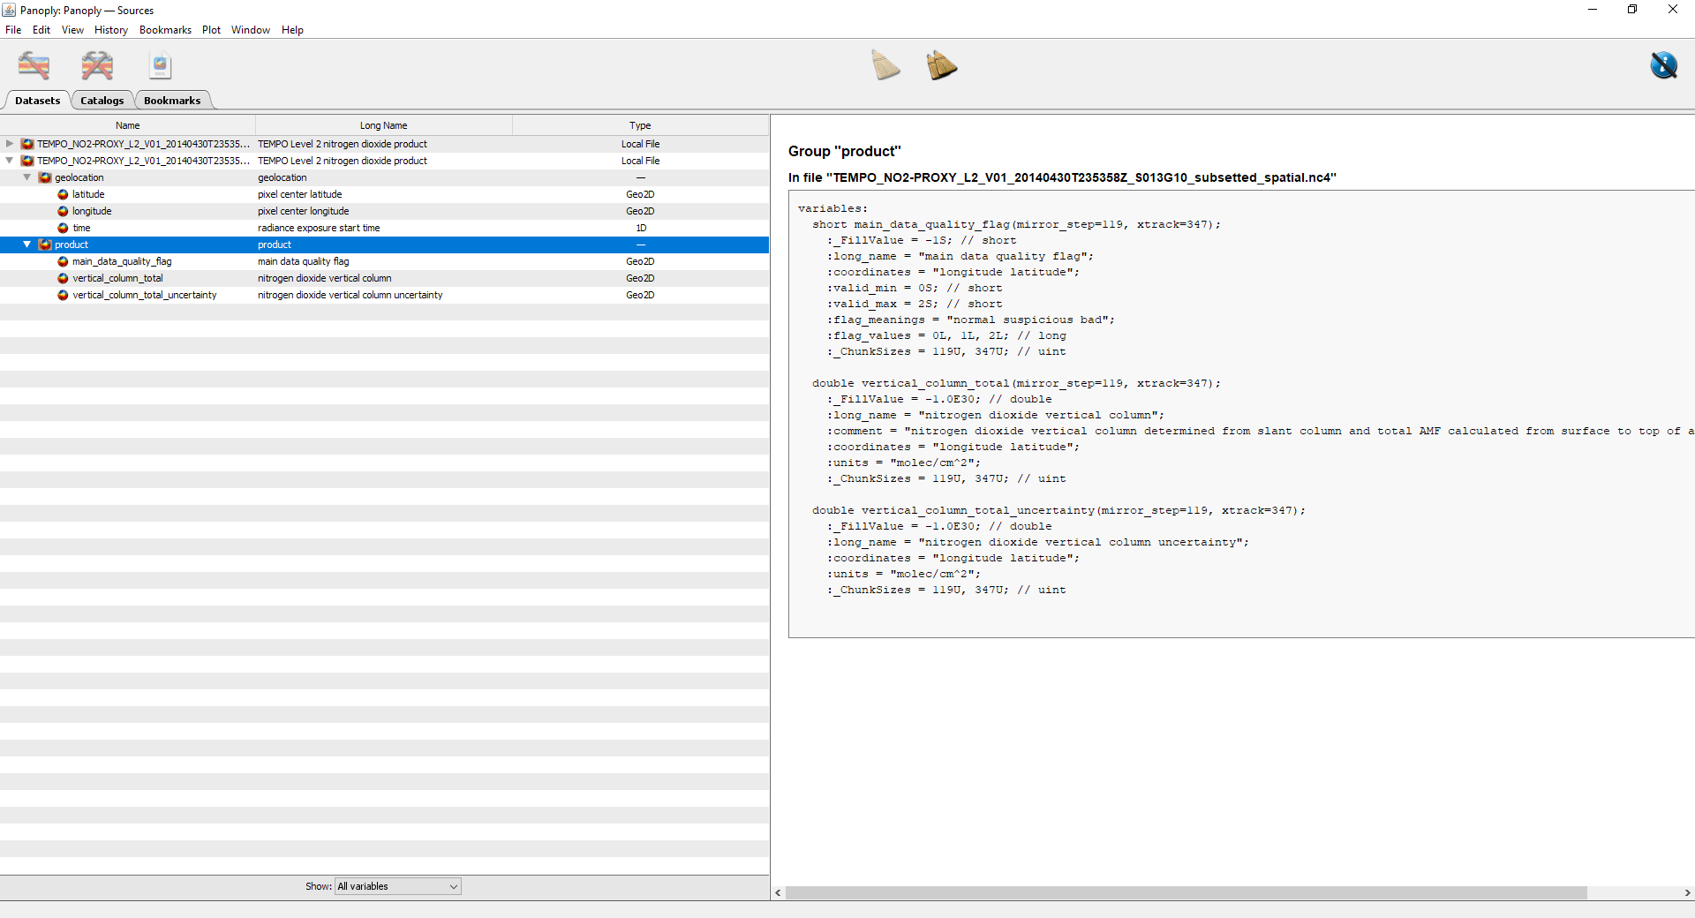

Slide 27
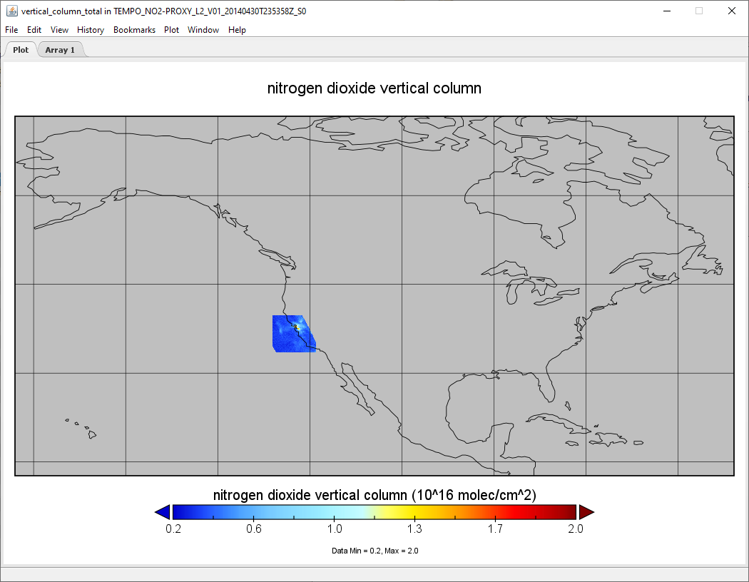

Slide 28
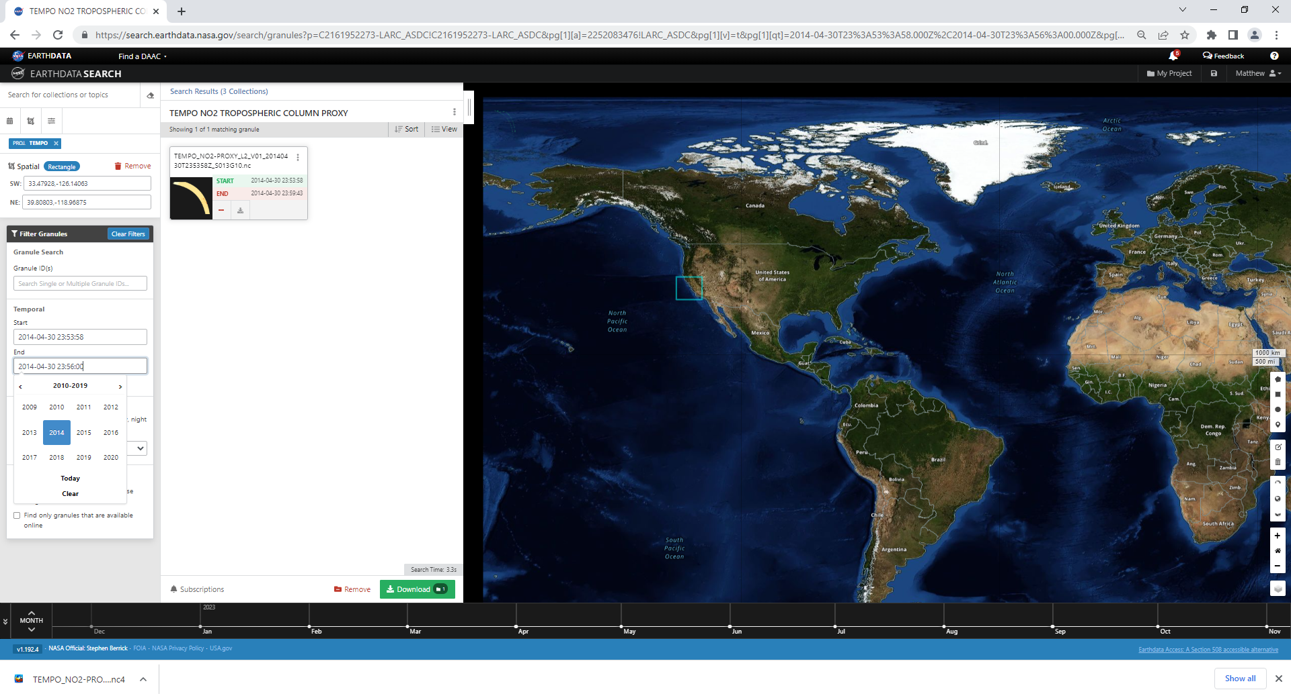

Slide 29
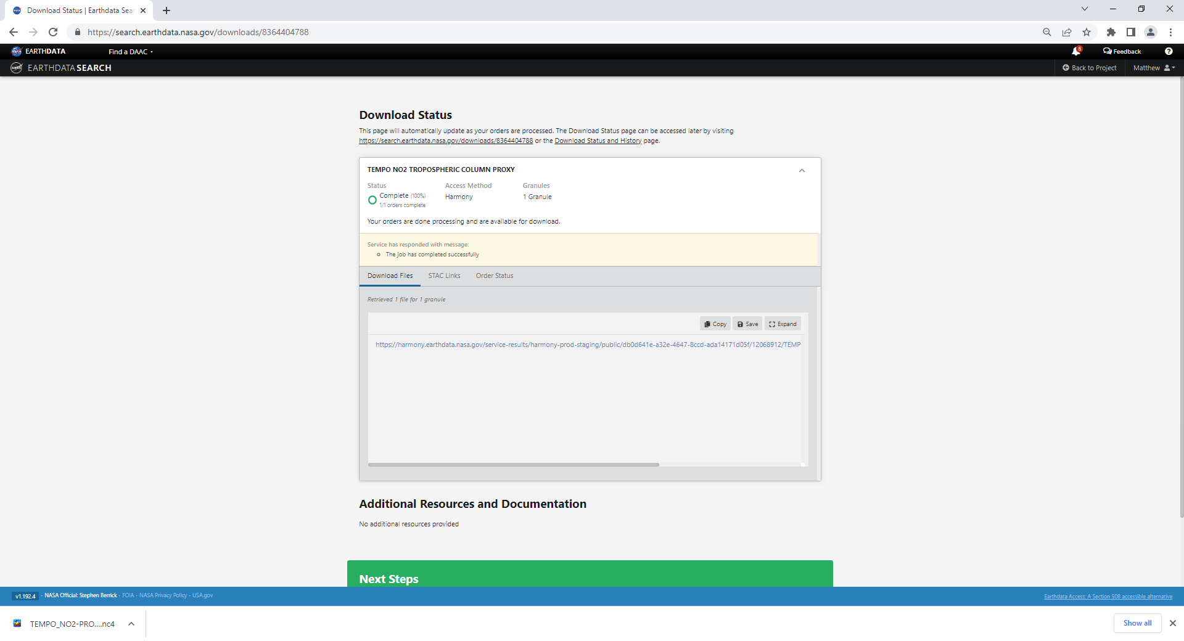

Slide 30
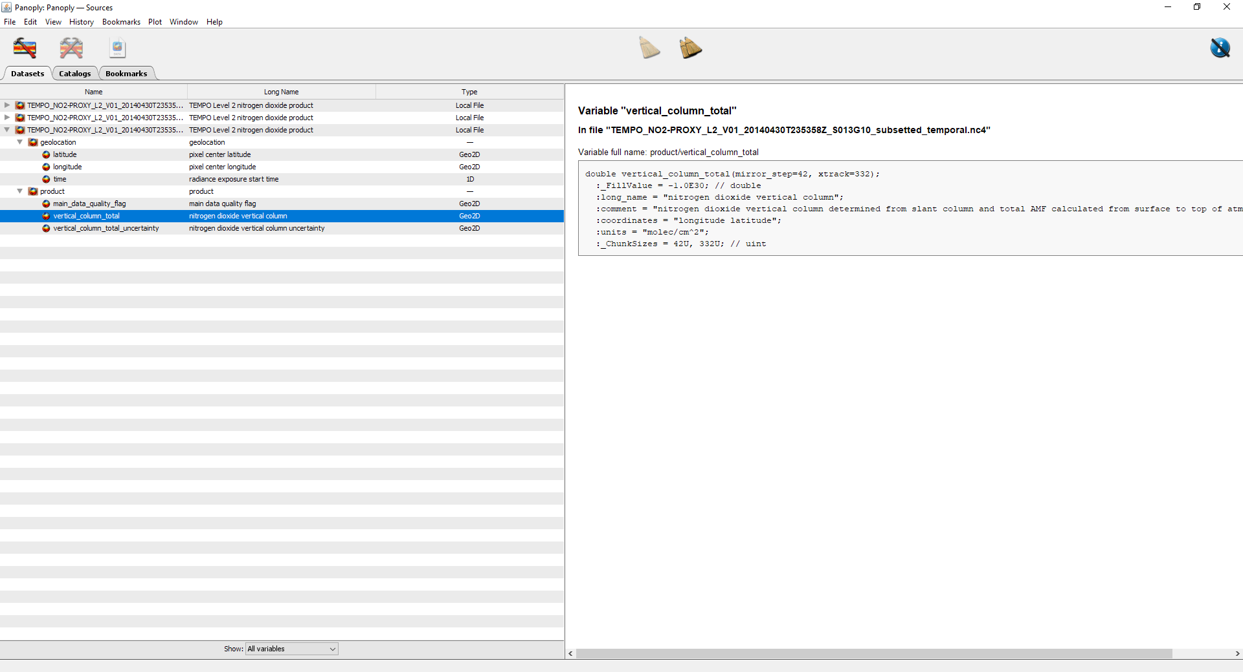

Slide 31
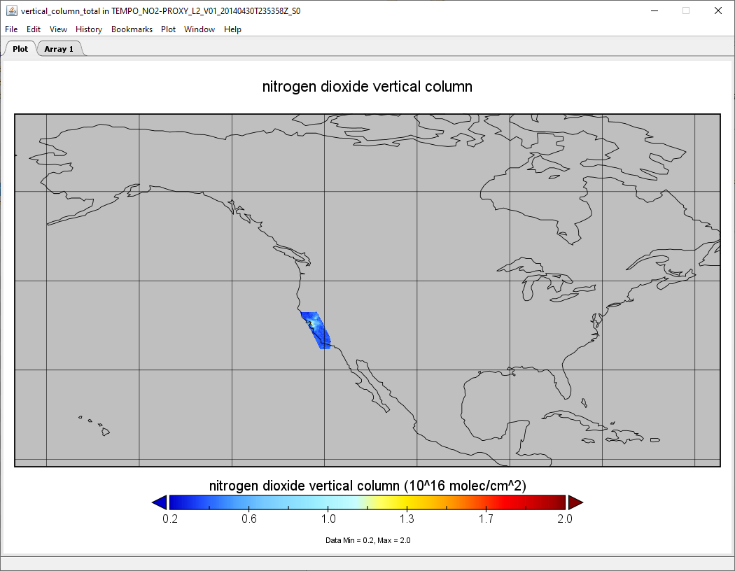

Slide 32
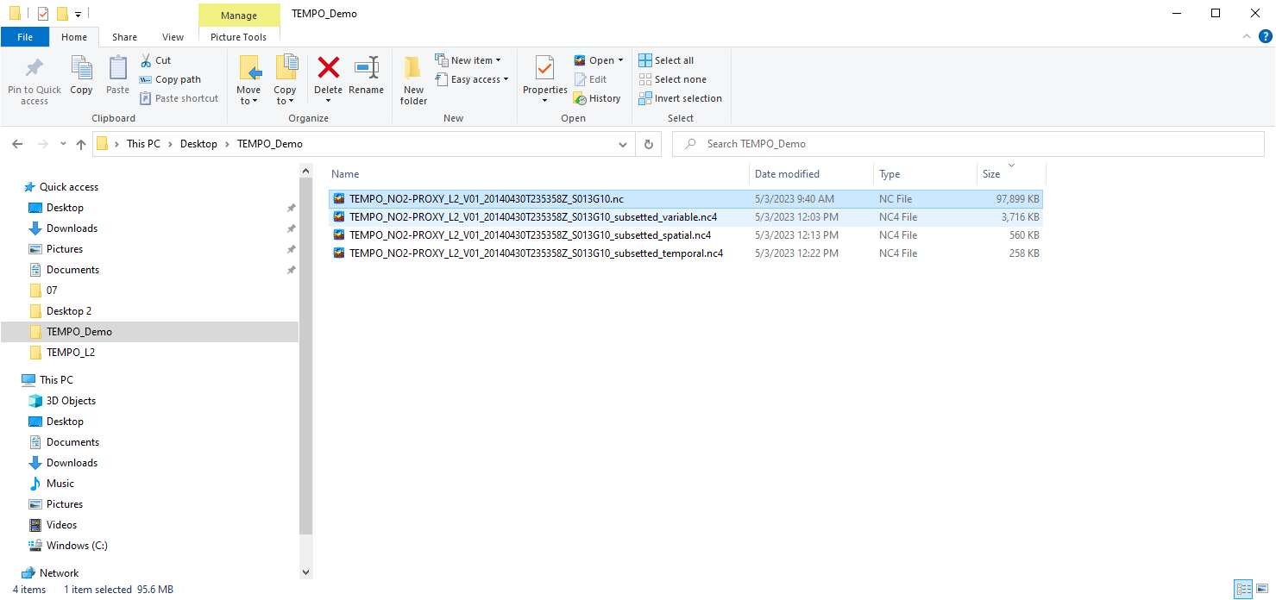

Slide 33
TEMPO in Amazon Web Services (AWS)
Coming soon

Slide 34
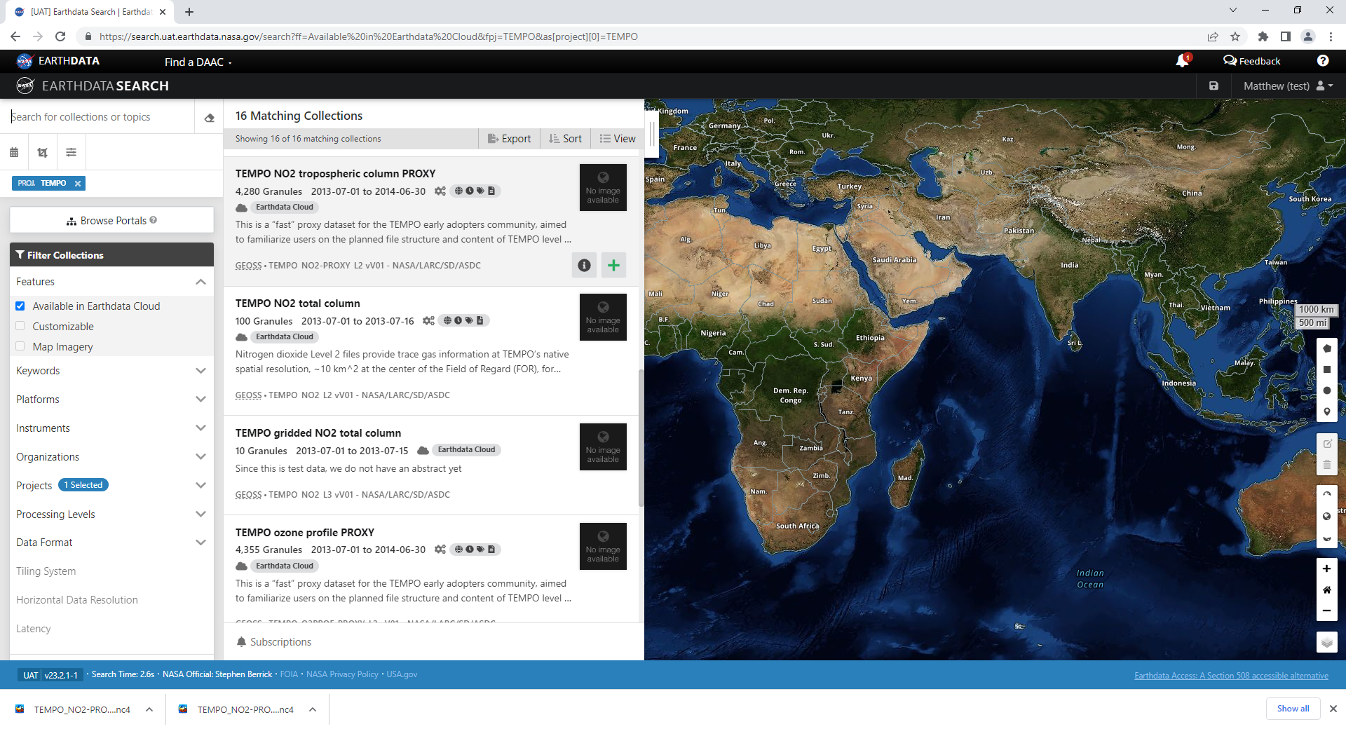

Slide 35
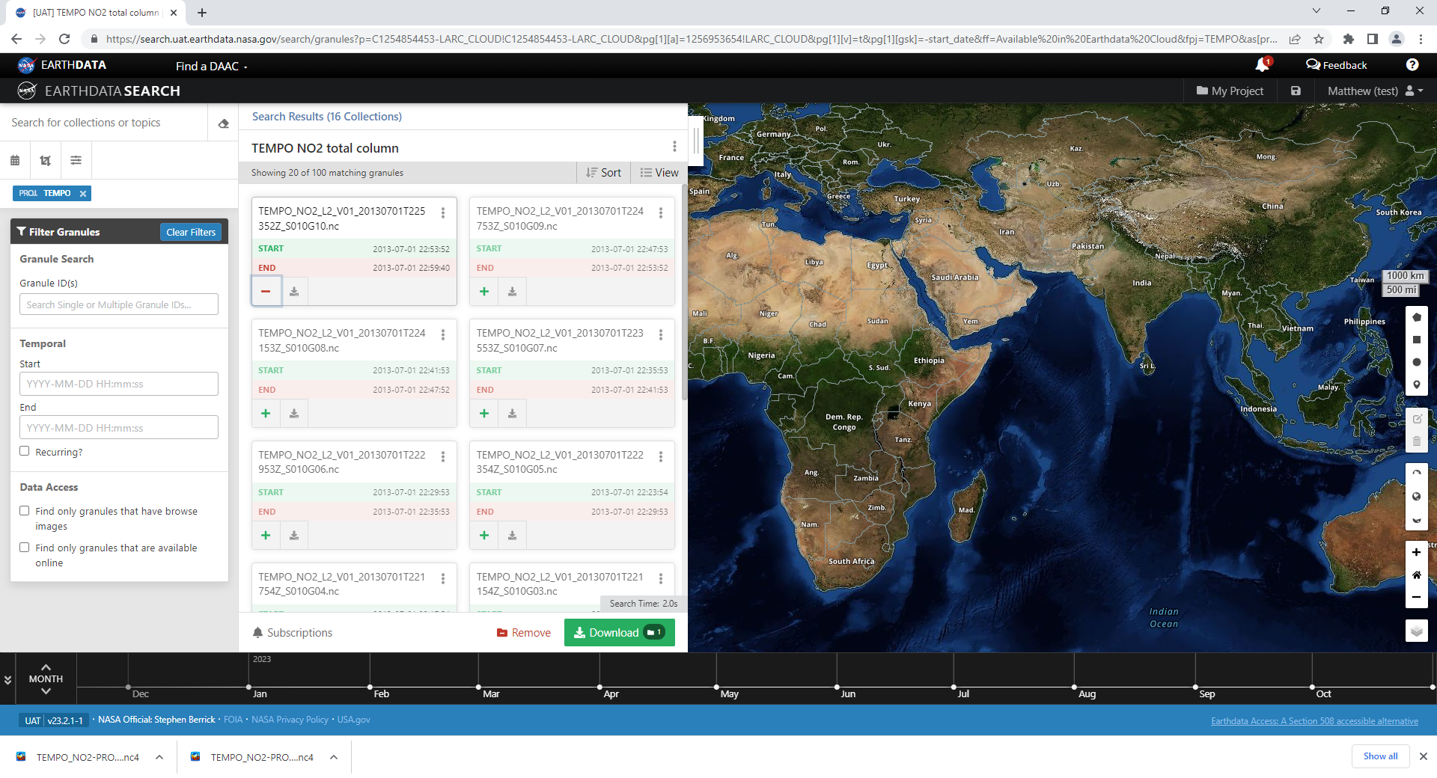

Slide 36
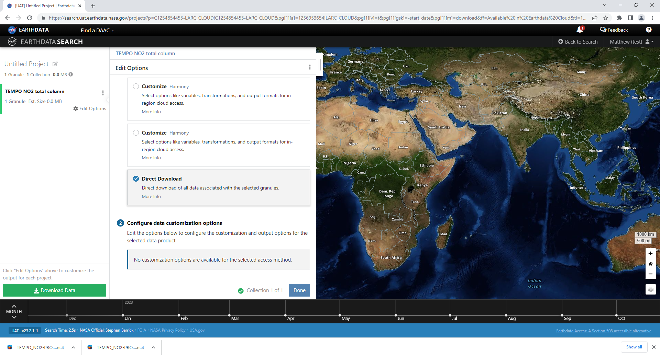

Slide 37
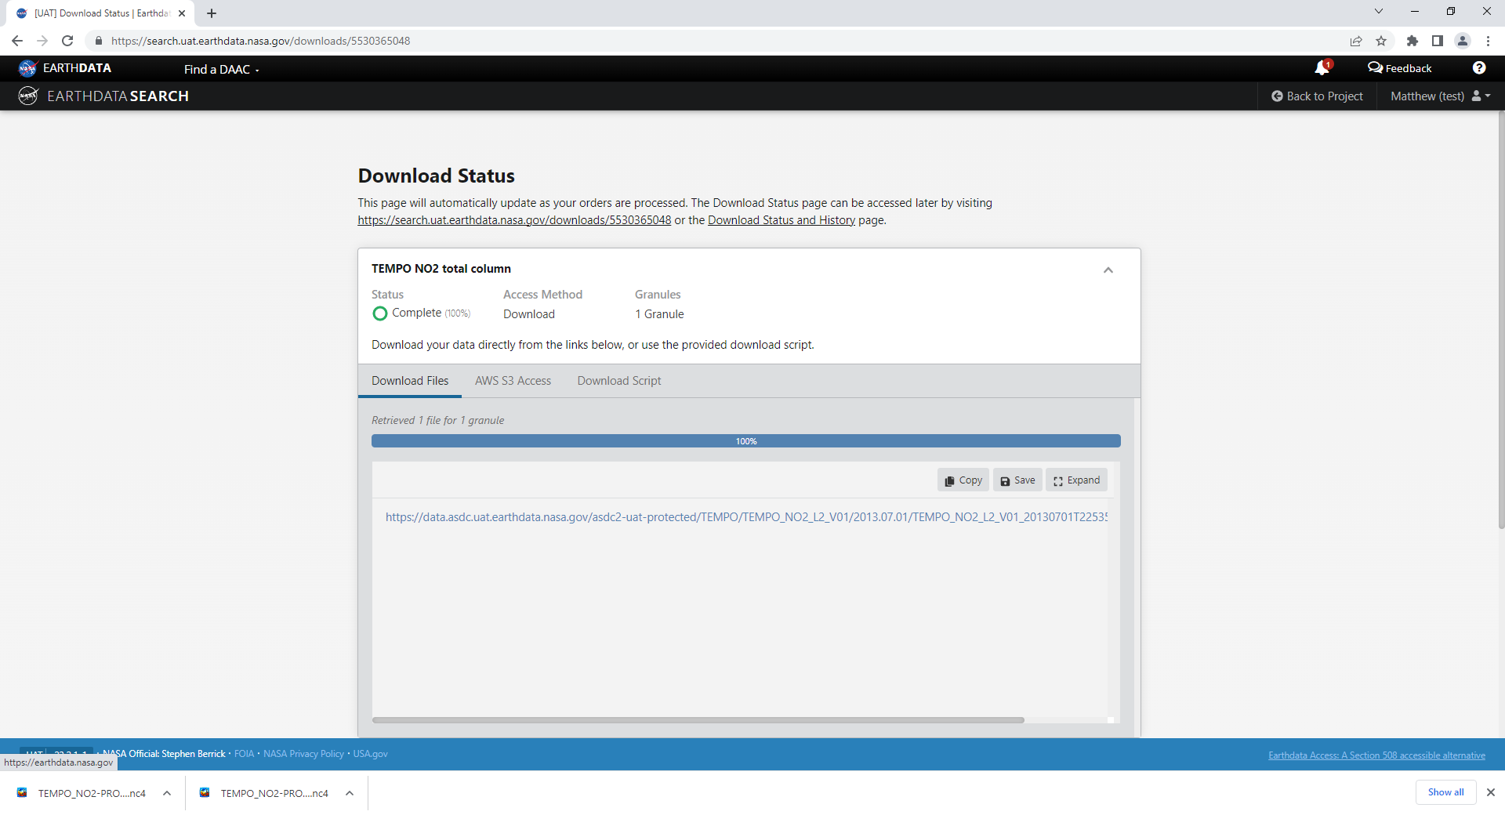

Slide 38
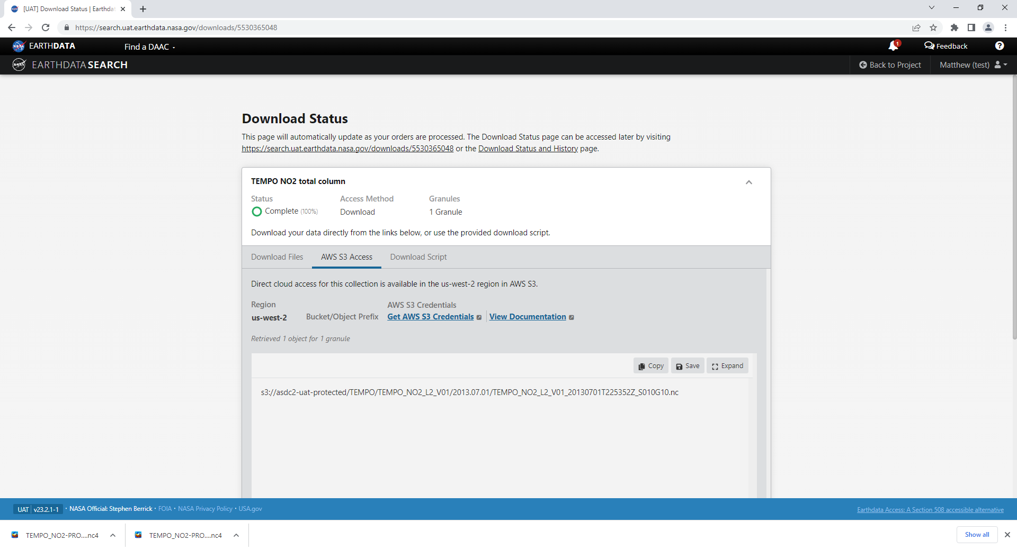

Slide 39
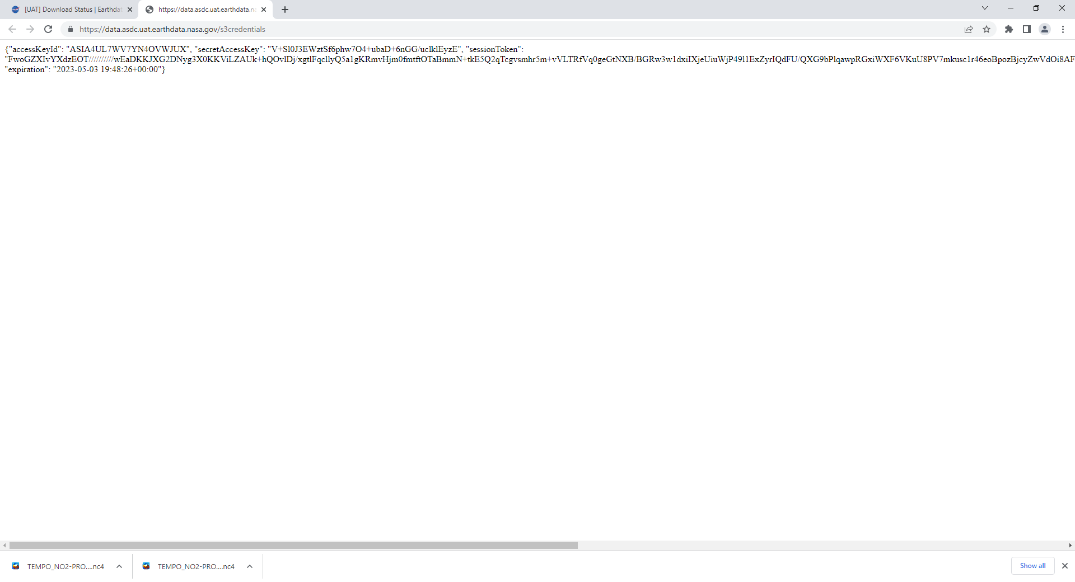

Slide 41
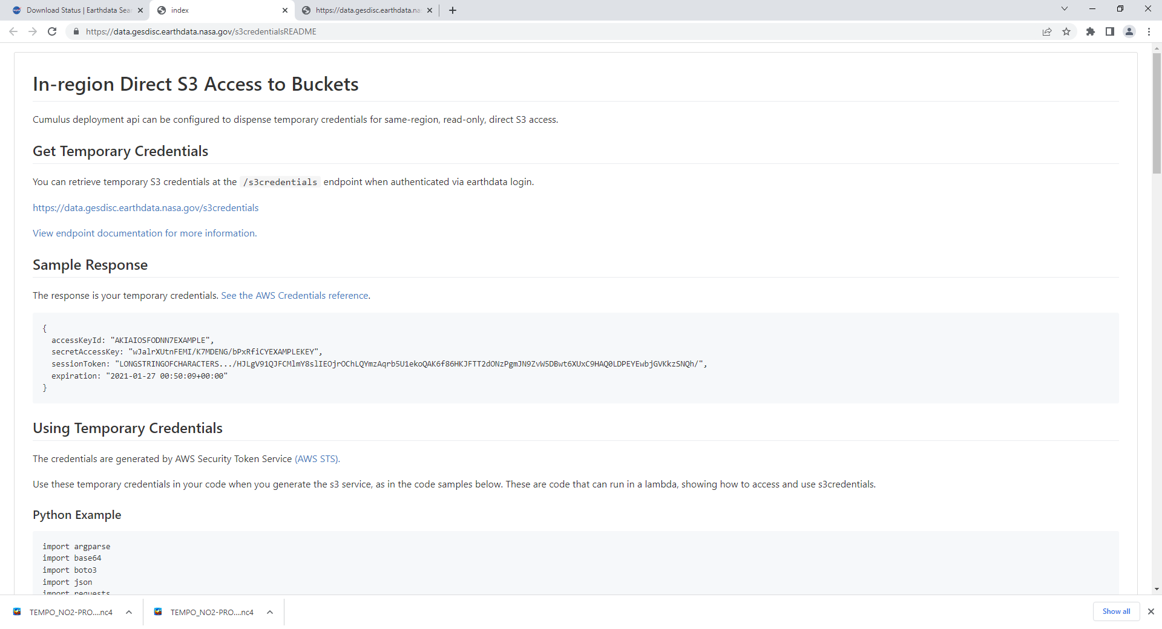

Slide 42
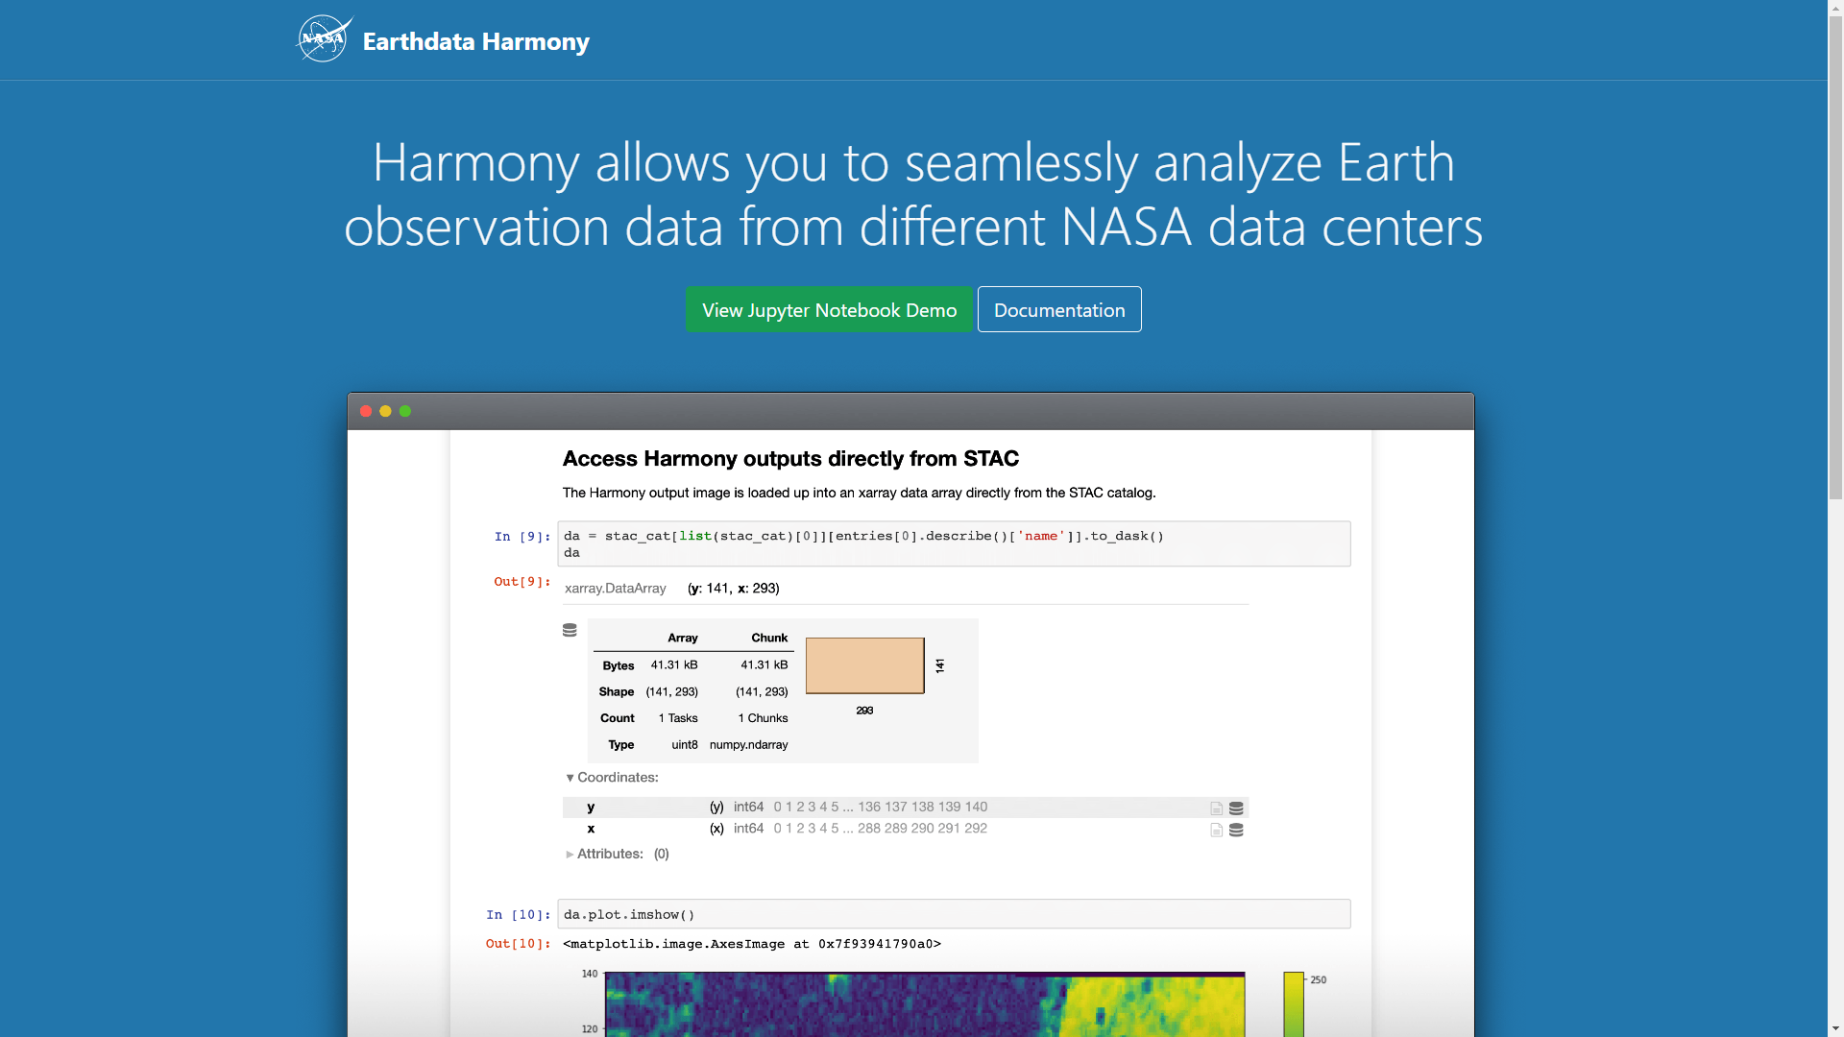

Slide 43
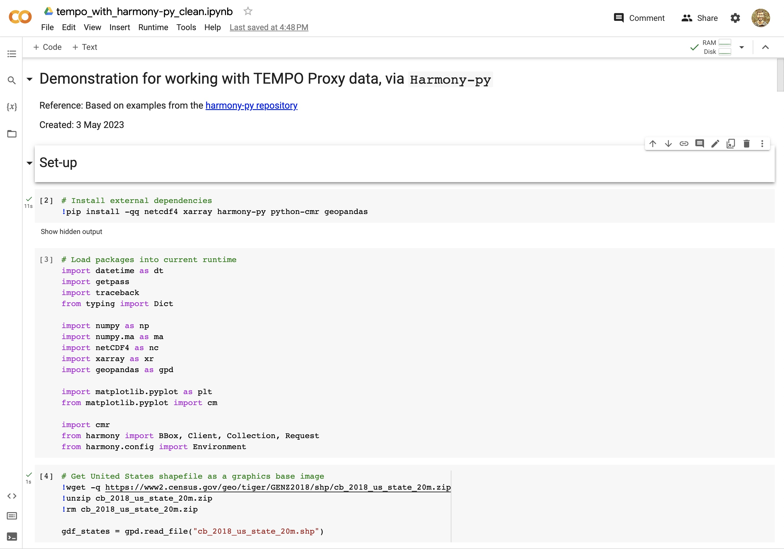

Slide 44
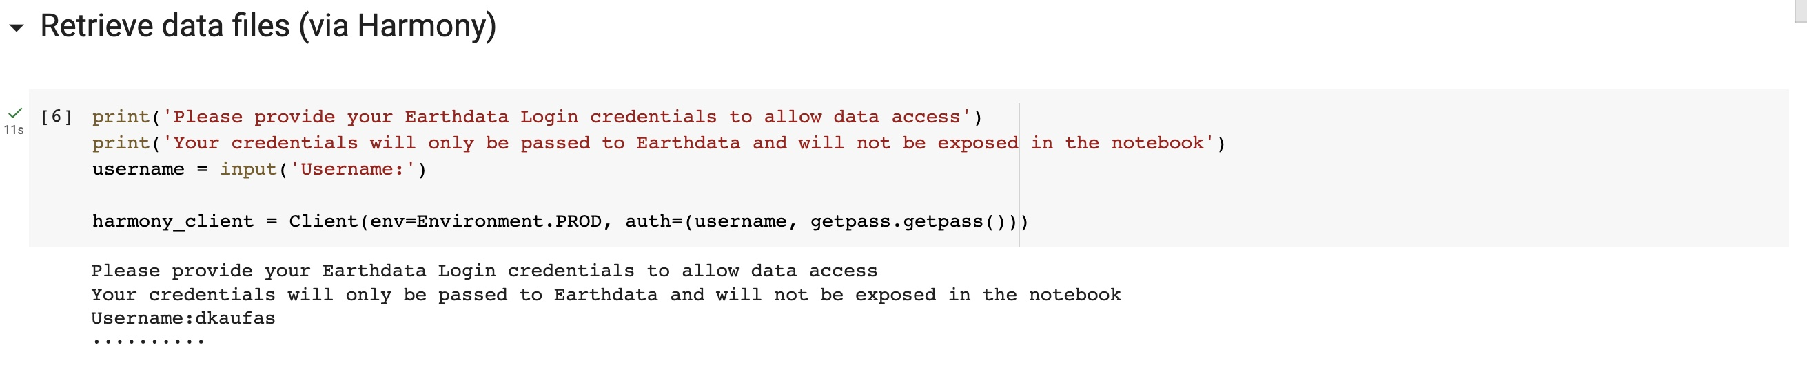
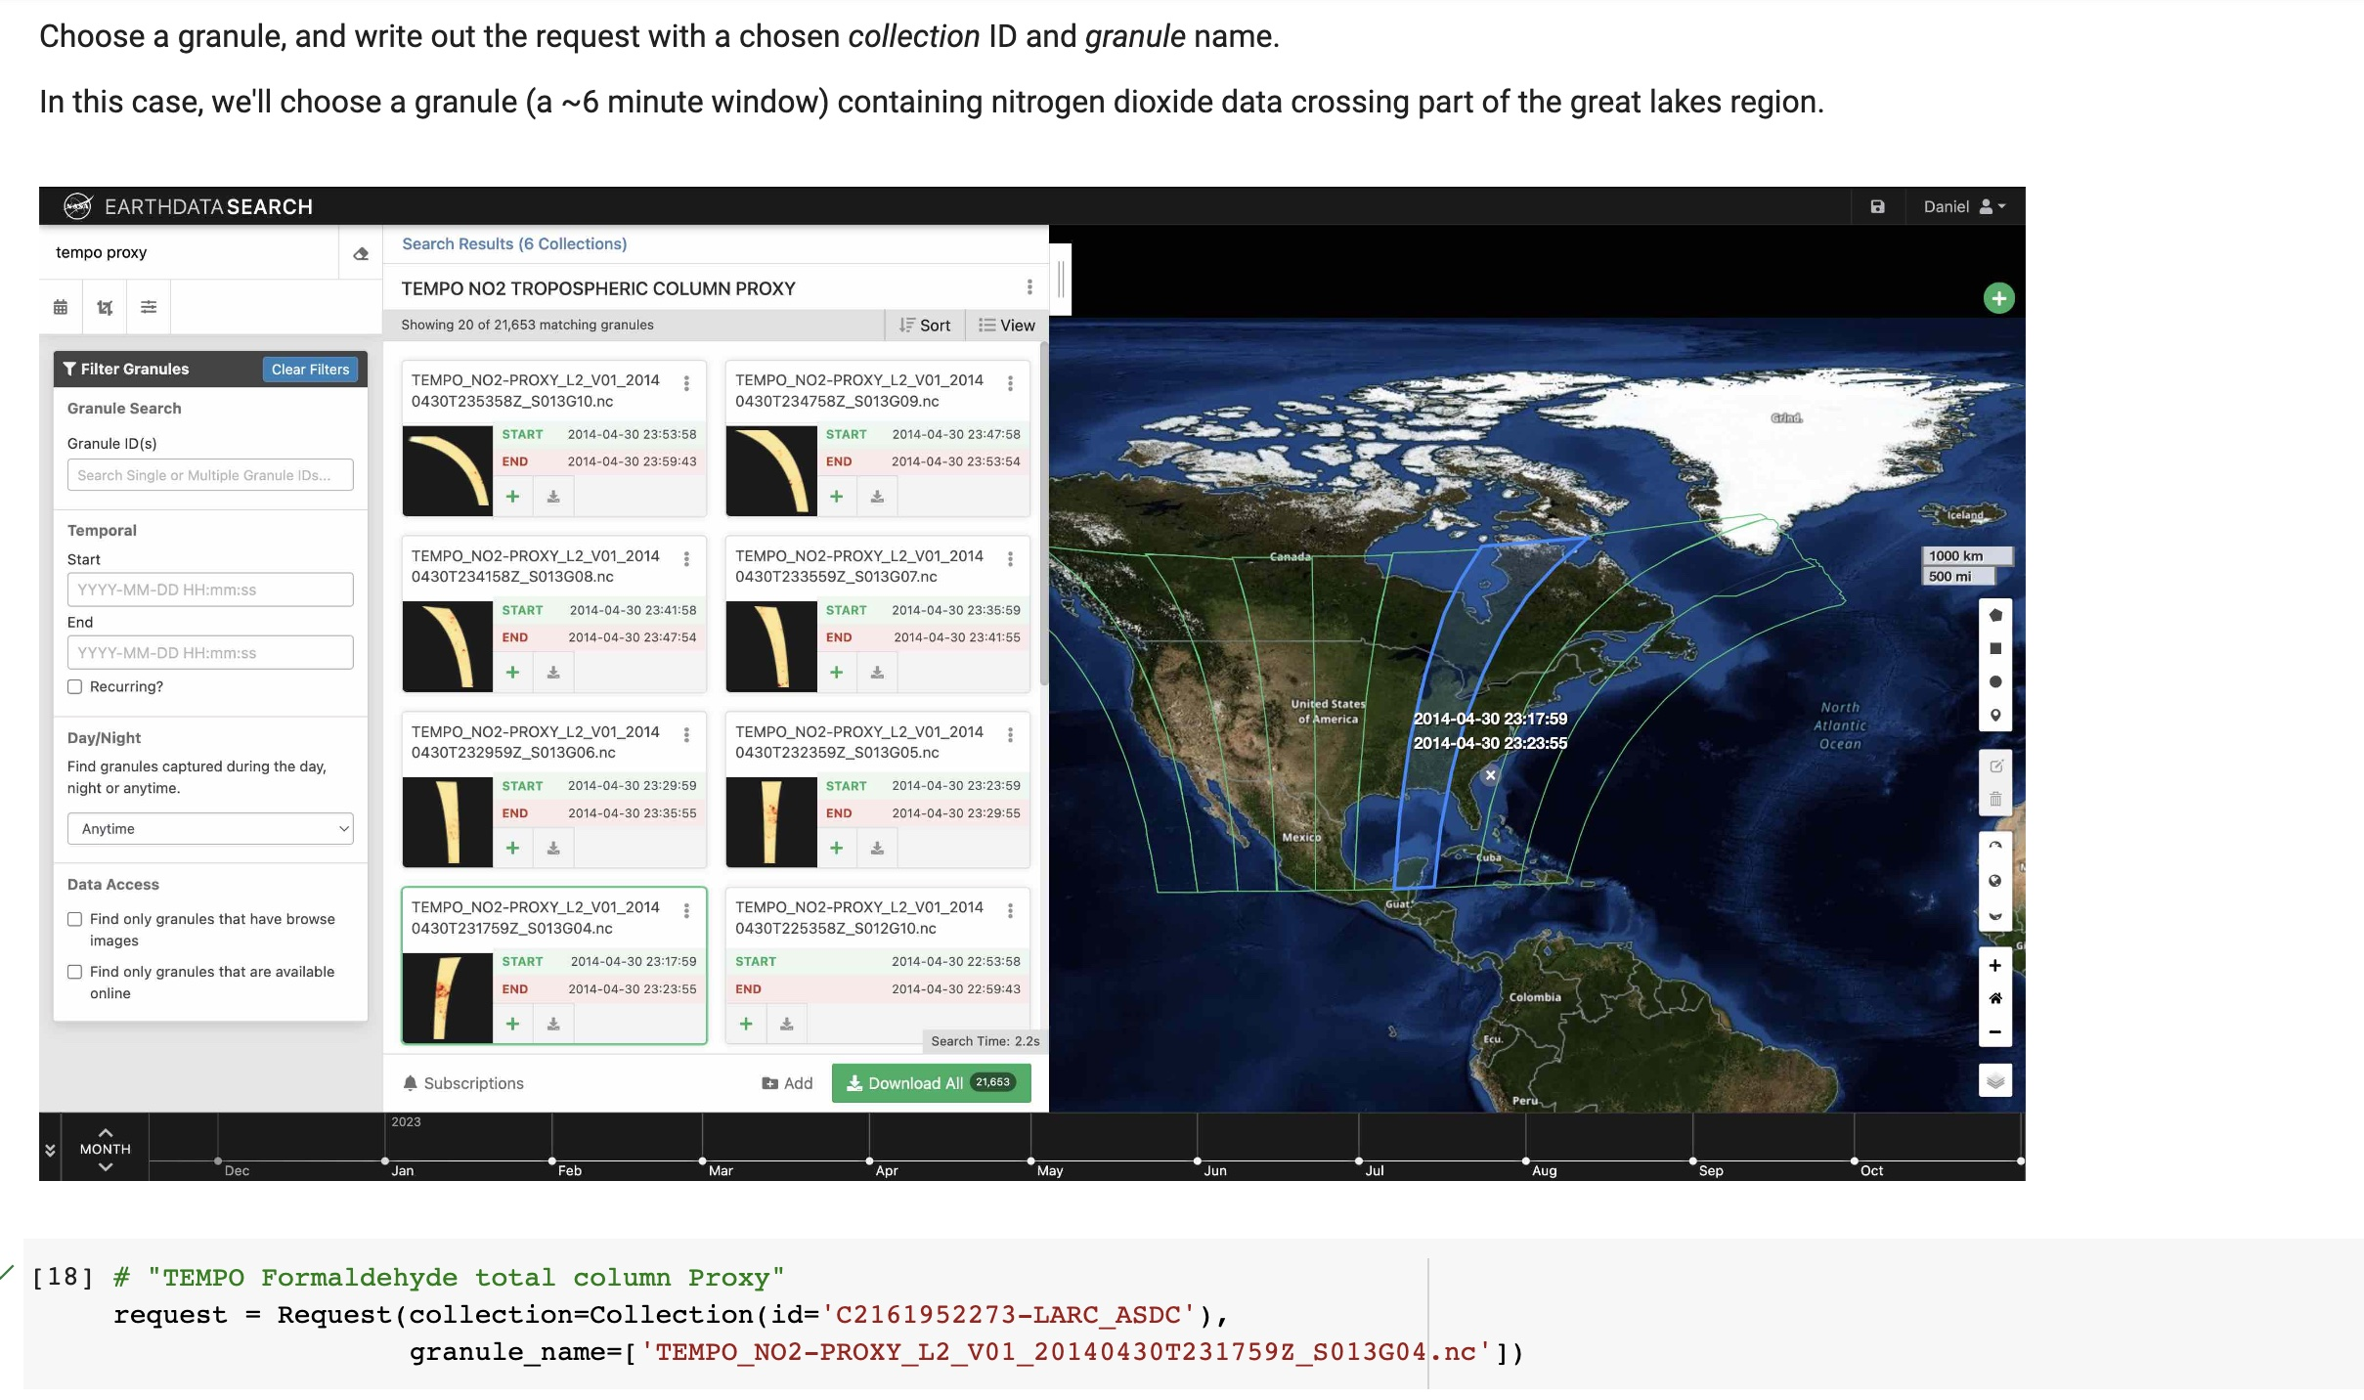

Slide 45
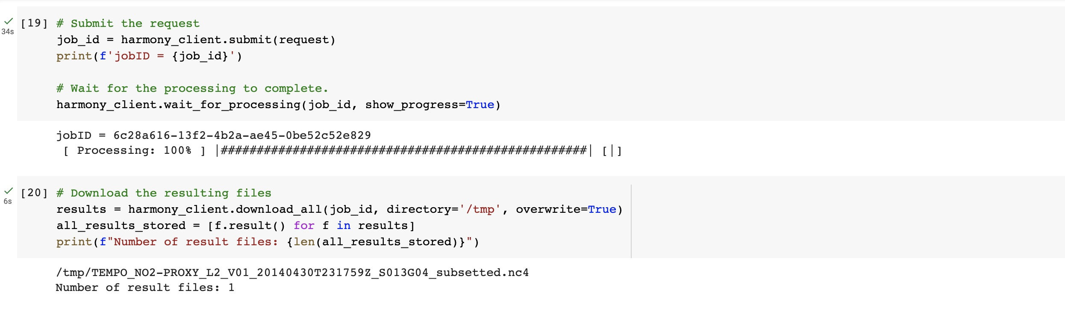
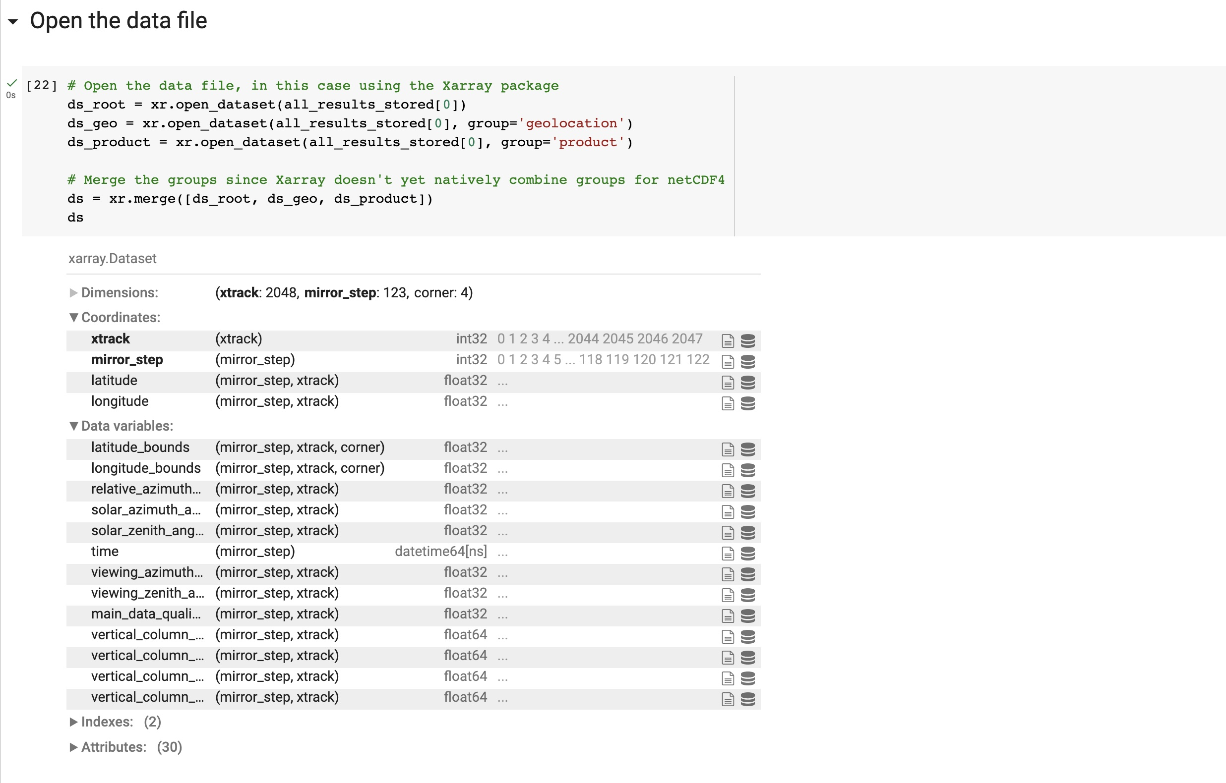

Slide 46
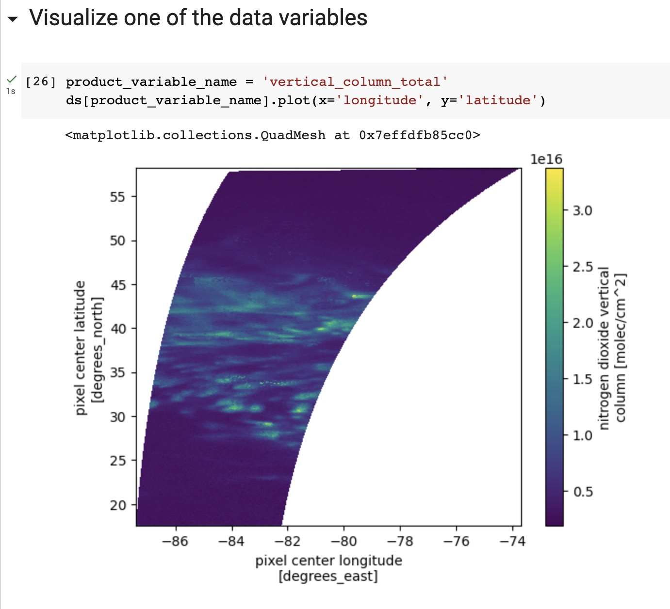
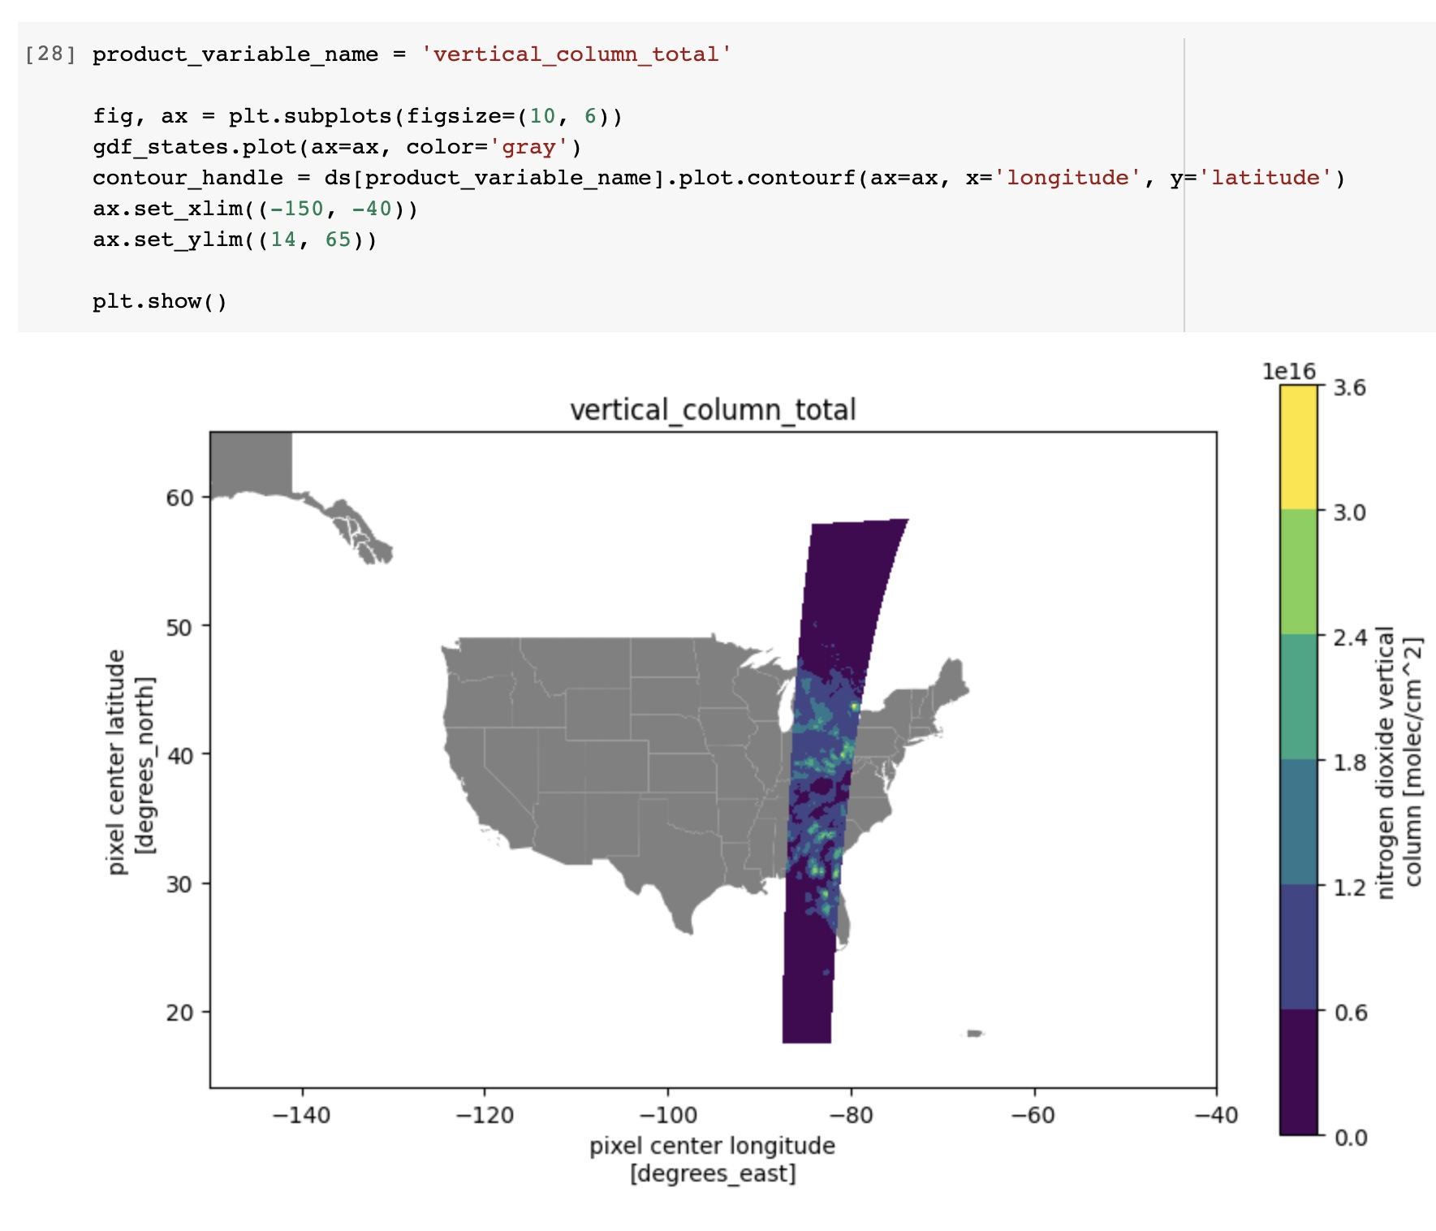
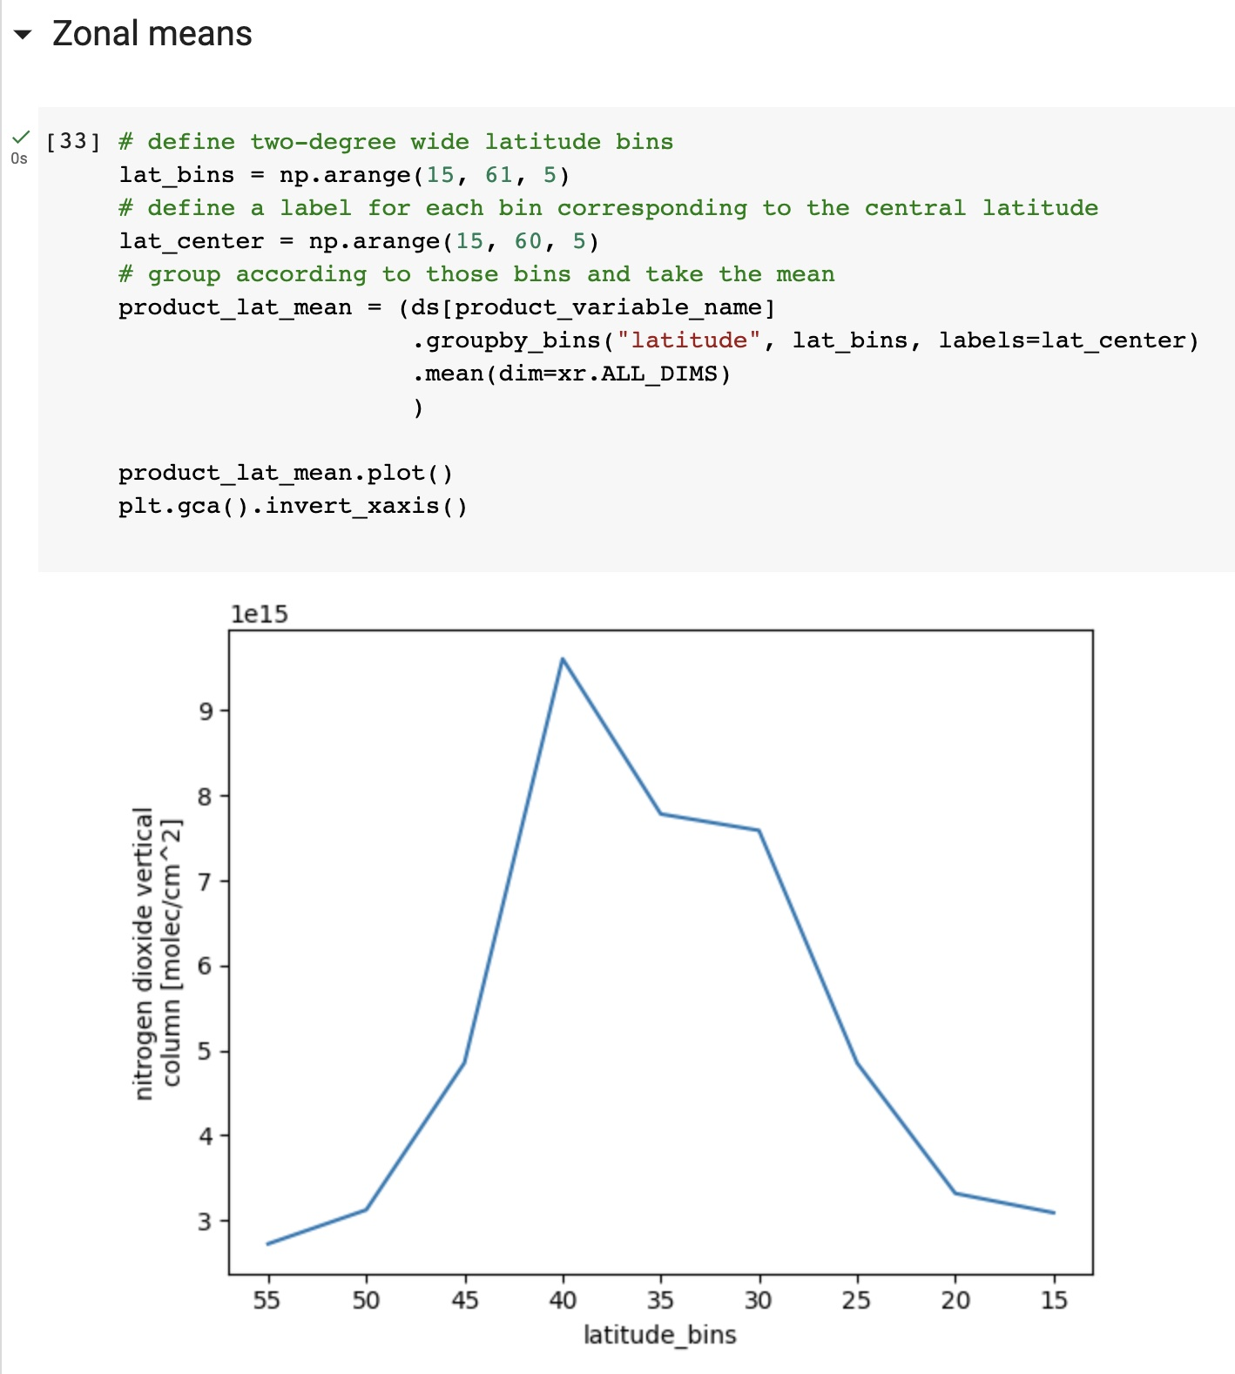
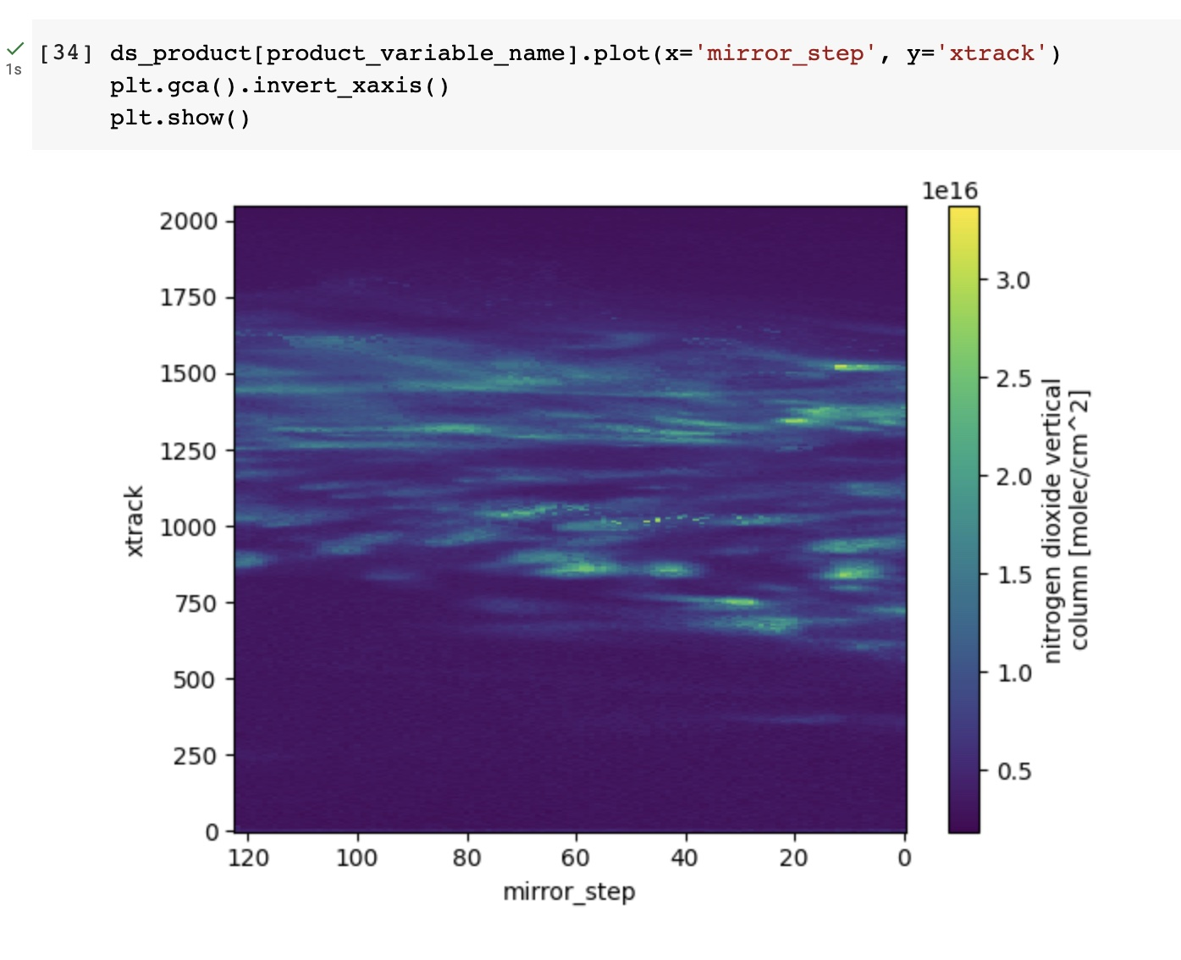

Slide 47
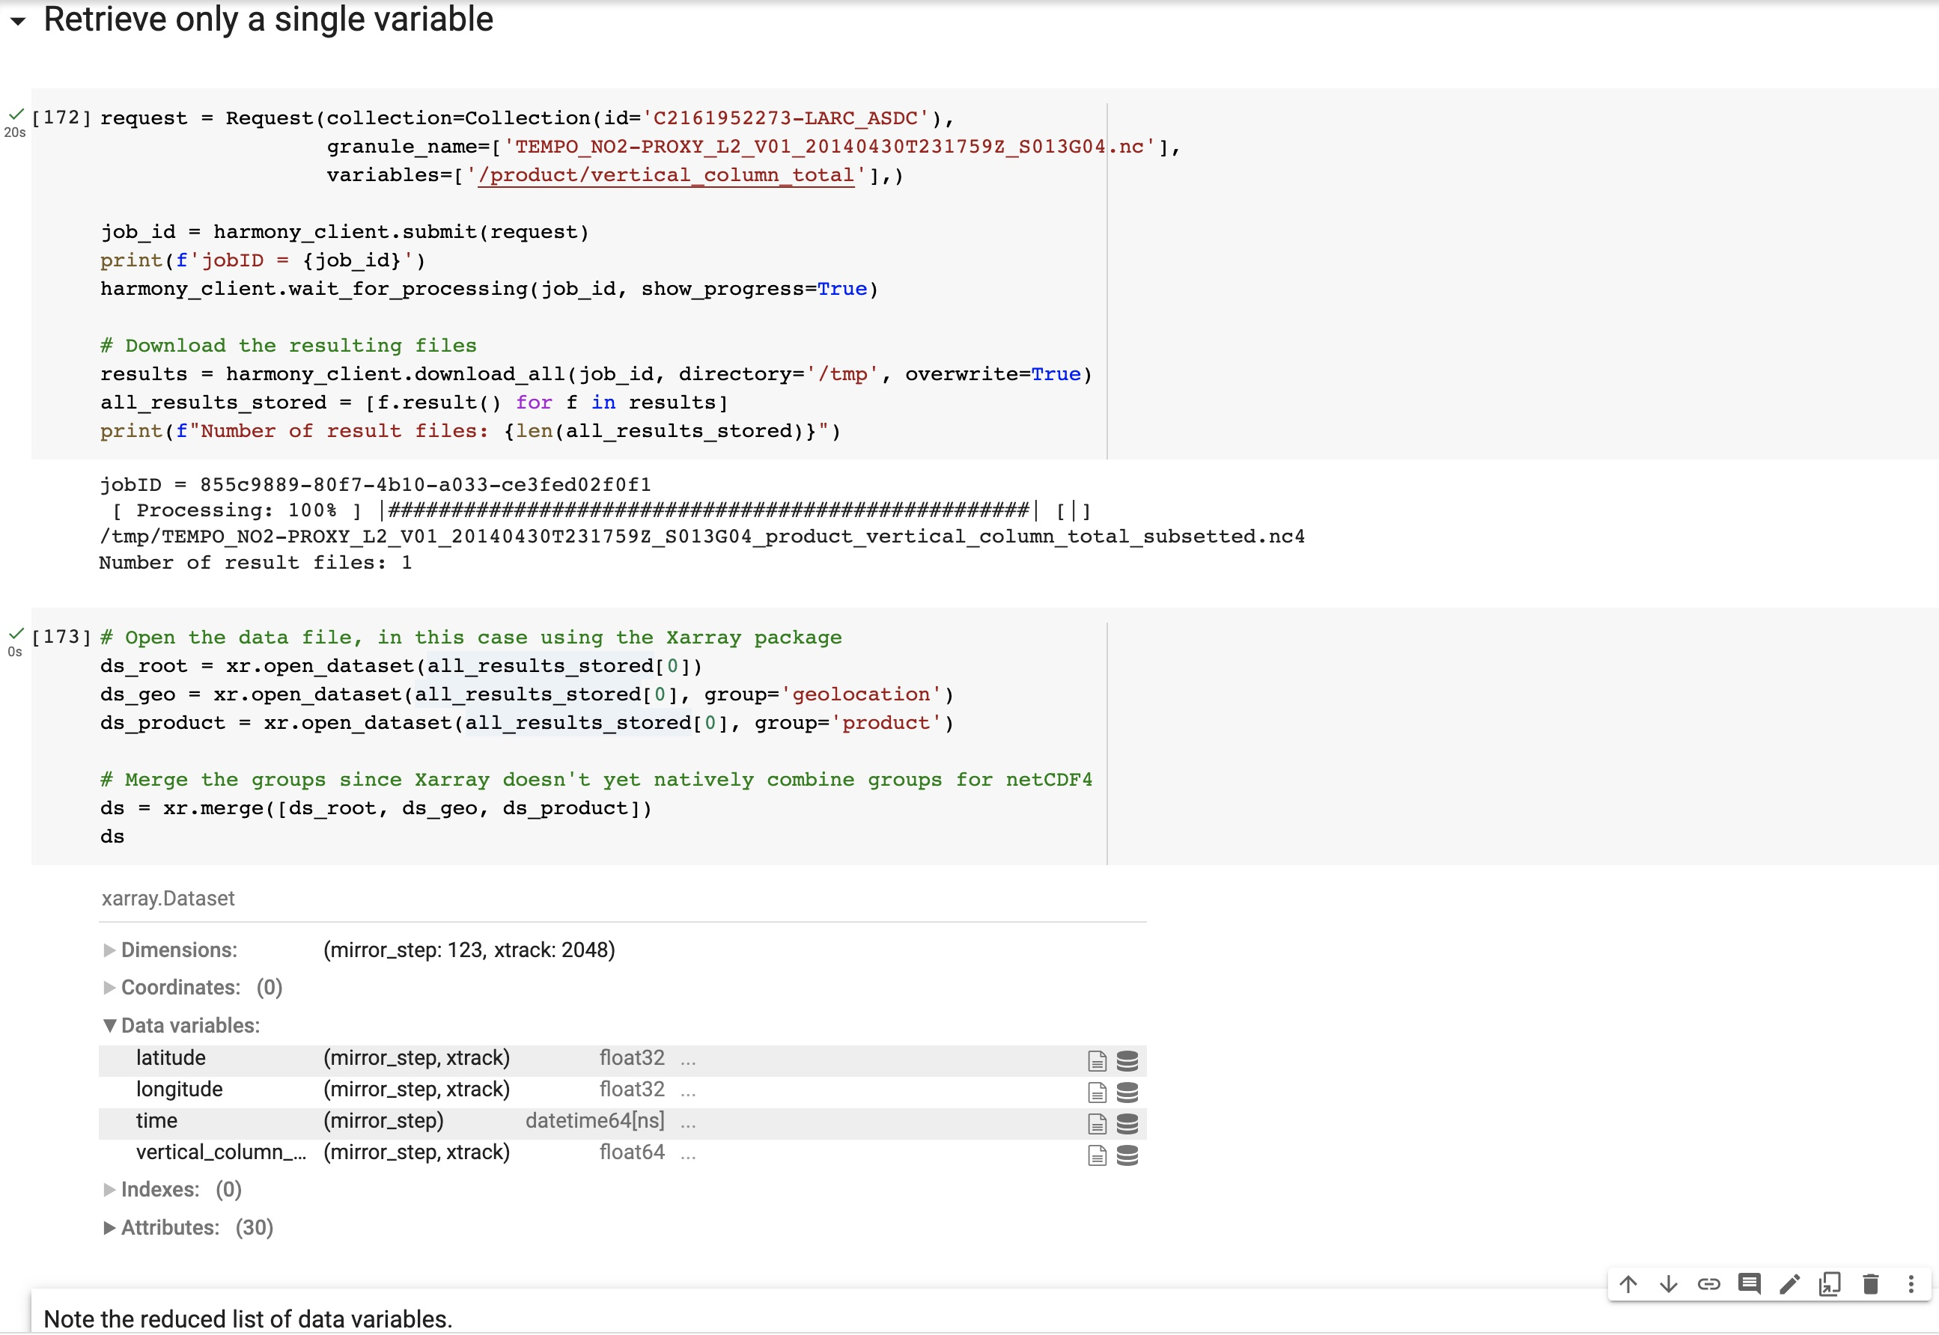

Slide 48
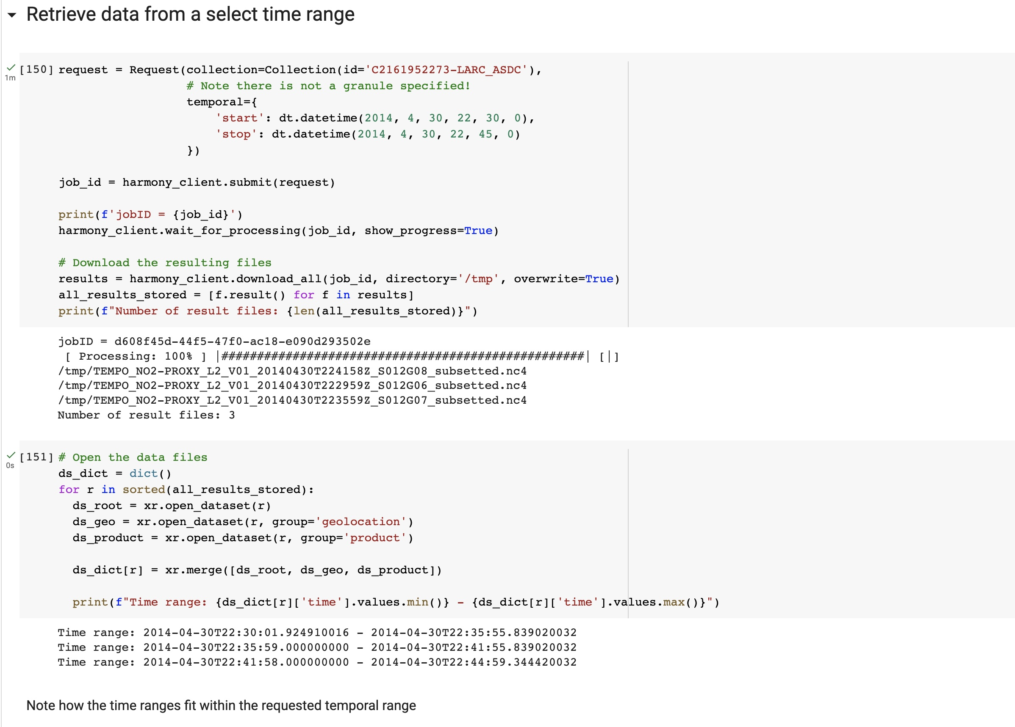
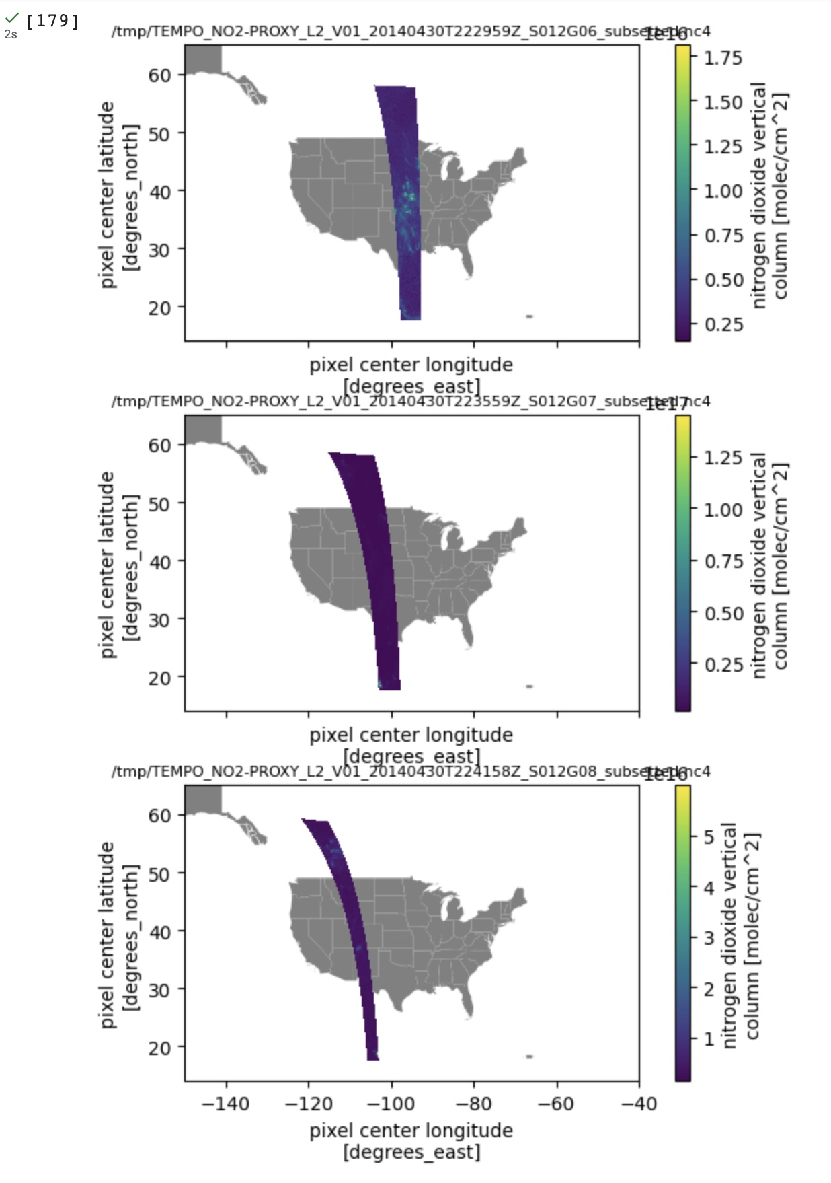


Slide 49




Slide 50

ASDC Subsetter
Additional services via on-prem subsetter planned to be available during Early Adopter period, in advance of incorporation into Earthdata Search subsetter
Point Selection – choose lat/lon, and retrieve time series
Polygon Selection – draw or chose vertices and retrieve spatial subset
Pre-loaded shapes – shapefiles of interest may be able to be made available
Aggregation across scans – retrieval of multiple granules throughout a day can be returned as single netCDF4 with additional `scan_count` dimension
Will be available at https://subset.larc.nasa.gov
Notes:
The Earthdata Forum is our new online resource for staff members and subject matter experts from several NASA Distributed Active Archive Centers (DAACs) assist inquirers with questions about their NASA Earth science data. General questions, research needs, and data applications can all be subjects here. Members of the NASA scientific user community are encouraged also provide insights and collaborative assistance.​

Slide 51


Slide 52


Slide 53


Slide 54


Slide 55


Slide 56


Slide 57


Slide 58


Slide 59


Slide 60
TEMPO Data Access for Early Adopters
Tool | URL | Primary Function | Data | Notes
Earthdata Search | https://search.earthdata.nasa.gov | Search, Browse, Preview, Spatial Extent, Download, Subset | TEMPO L1 TEMPO L2 TEMPO L3 | TEMPO L2 Proxy available now for testing and feedback!
AWS S3 Direct Access | https://data.asdc.earthdata.nasa.gov |  | TEMPO L2 TEMPO L3 | TEMPO L2 Proxy available soon for testing and feedback!
Worldview / Global Imagery Browse Service (GIBS) | https://worldview.earthdata.nasa.gov | Browse, Preview, Animate | TEMPO L2 TEMPO L3
Harmony API | https://harmony.earthdata.nasa.gov | Subset, Transform | TEMPO L2 TEMPO L3 | TEMPO L2 Proxy available now for testing and feedback!
Earthdata GIS (EGIS) | https://gis.earthdata.nasa.gov | ArcGIS Image Service, OGC WMS & WCS | TEMPO L2 TEMPO L3
OPeNDAP | https://opendap.larc.nasa.gov https://opendap.earthdata.nasa.gov | Subset, Transform | TEMPO L2 TEMPO L3
ASDC Subsetters | https://subset.larc.nasa.gov | Subset | TEMPO L2 | TEMPO L2 Proxy to be available in July for testing and feedback!

Slide 61

Image of dust devil vortices, laden with dust, passing the Spirit lander on sol 568. Image credit: NASA/JPL.

