Slide 1

@NaegerAaron
TEMPO Training
May 1-5, 2023
Huntsville, AL
Aaron Naeger & TEMPO Team
TEMPO Deputy Program Applications Lead
NASA / University of Alabama in Huntsville
U.S. Government sponsorship acknowledged.

Slide 2

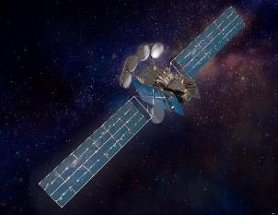
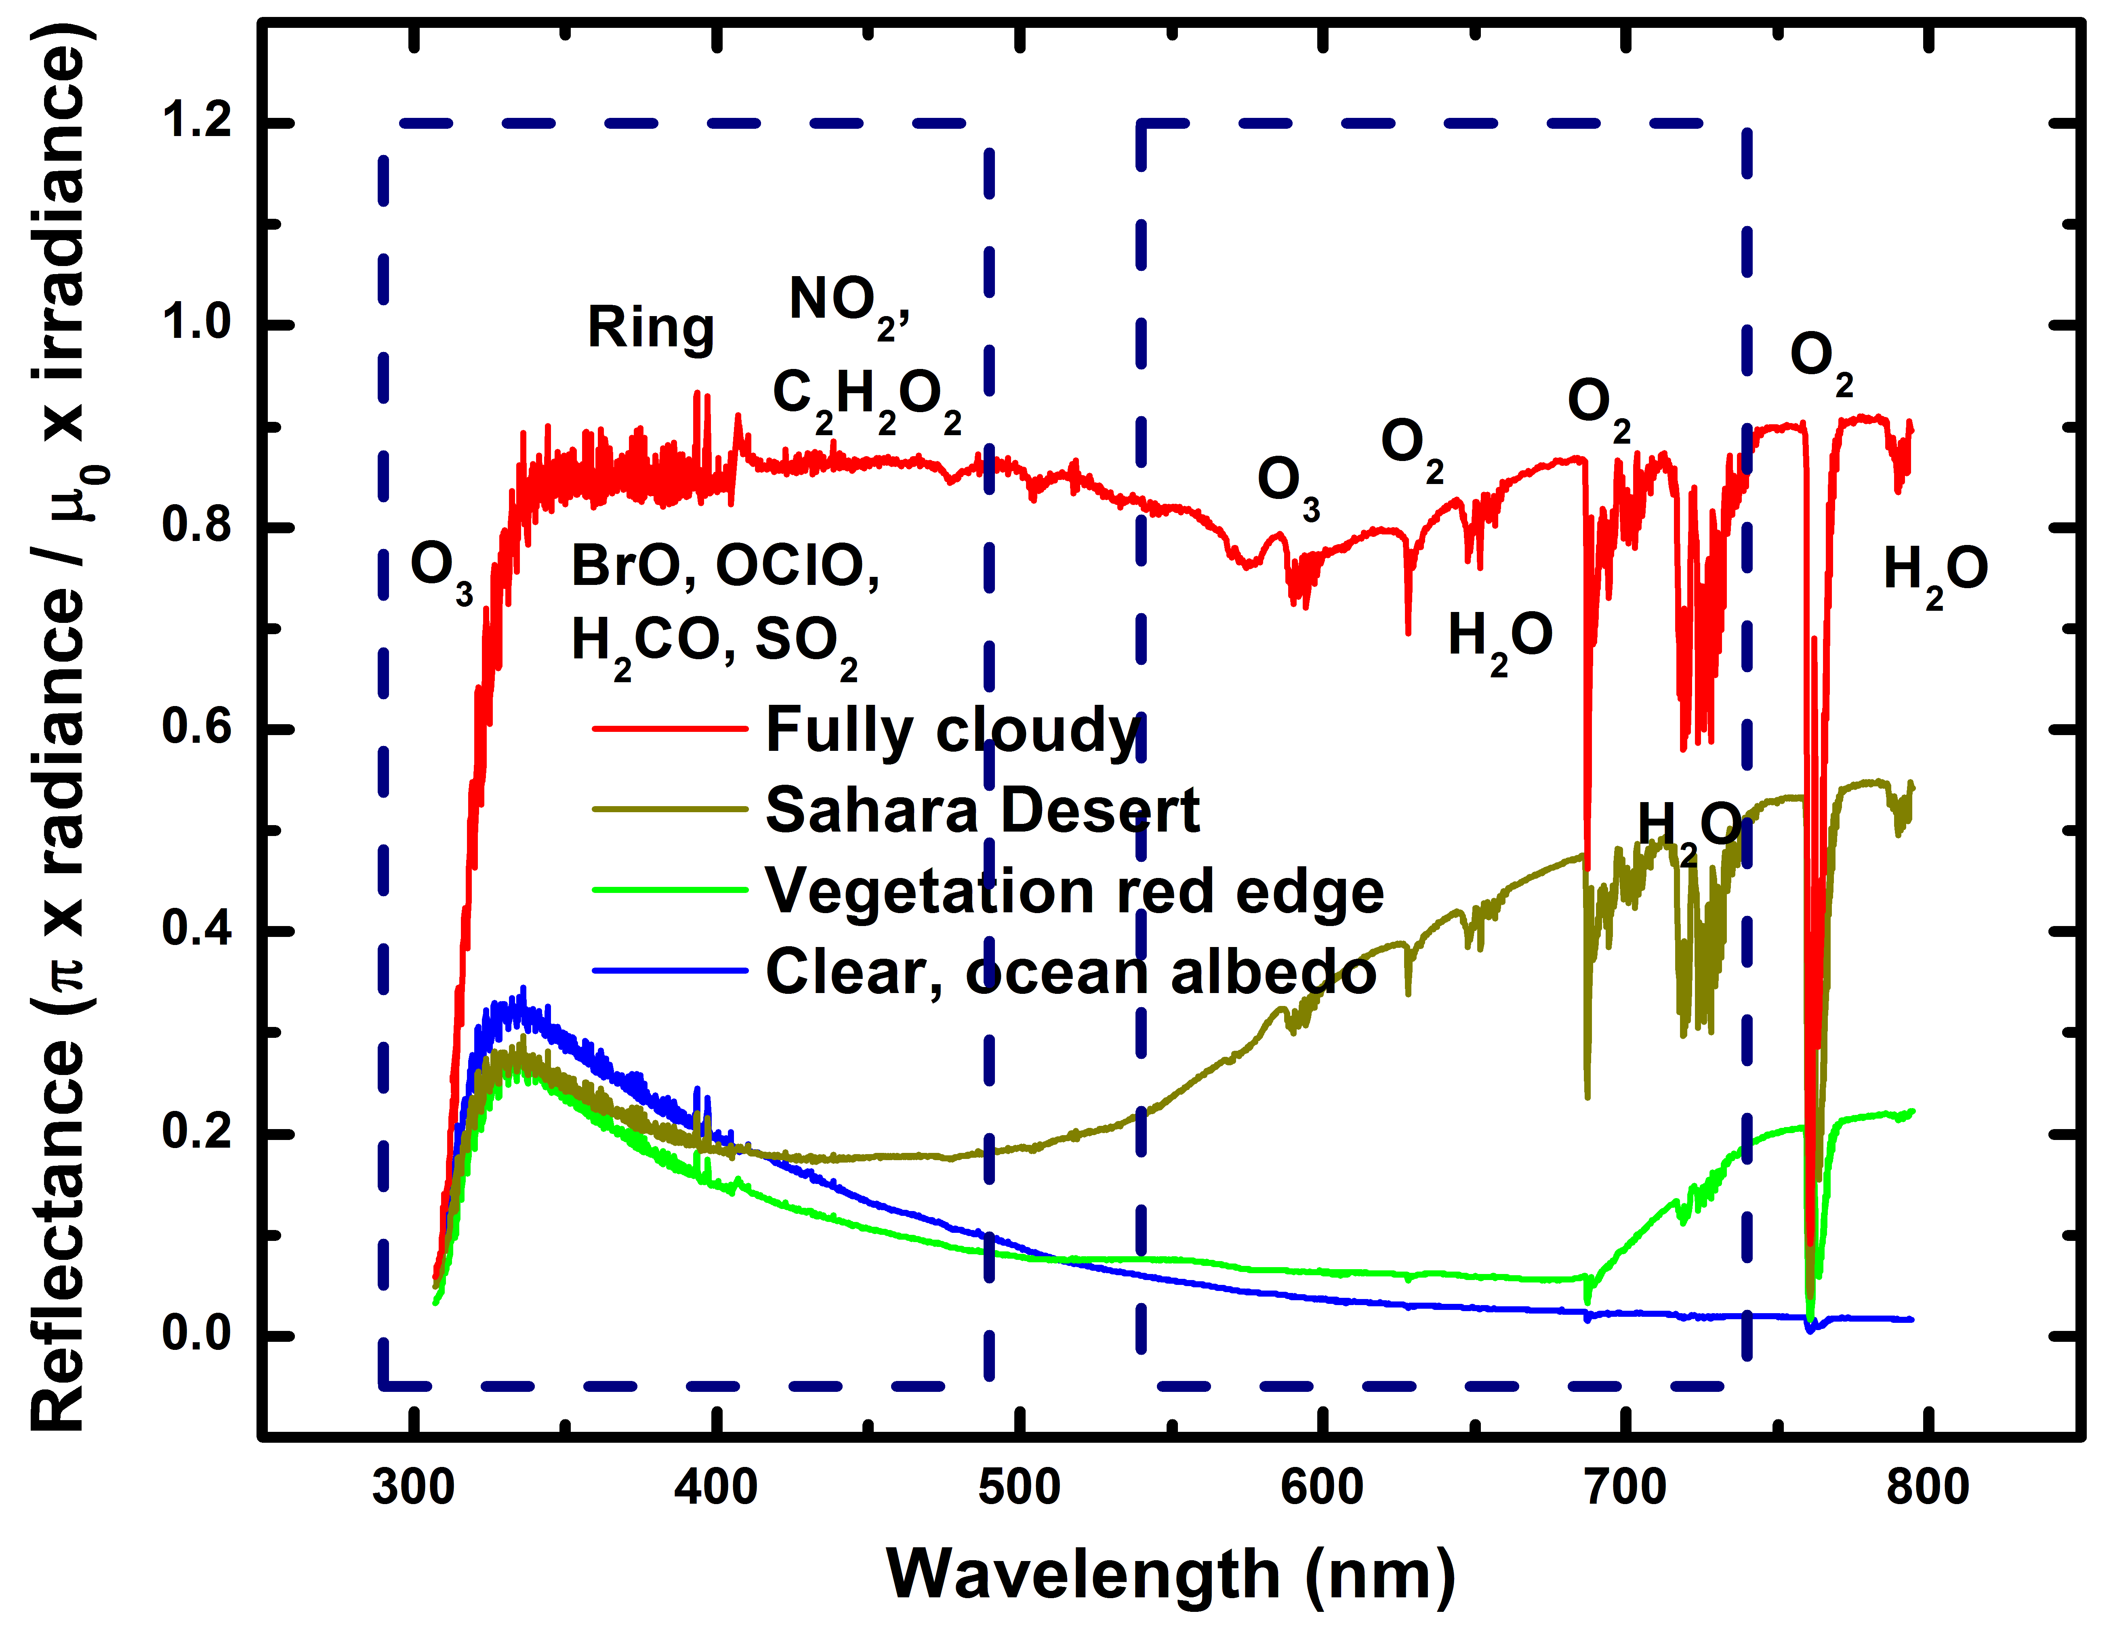
What will TEMPO measure?
Spectral range of TEMPO
Vertical Column Density (VCD)
Slant Column Density (SCD)
Atmosphere
Clouds
Raw
Level 3
Land
TEMPO will measure the backscattered UV and visible (VIS) radiation
TEMPO retrieval algorithms use information on the absorption spectra of different trace gases in the UV & VIS bands to infer column density amounts of trace gases

Slide 3
Slant Column to Vertical Column Density
Slant Column Density (SCD)
Vertical Column Density (VCD)
Air Mass Factor (AMF)
AMF converts slant columns into a vertical column (dimensionless quantity)
AMF - the relative length of mean light path at a certain wavelength for photons interacting with a certain absorber in the atmosphere relative to the vertical path
Dependence on the vertical distribution of the trace gas, surface albedo, viewing geometry, clouds, aerosols, and the O₃ column
An increase in the light path through the atmosphere leads to an increase in AMF

Slide 4
How Can We Make Pre-Launch Products?
TEMPO Coming Soon!
Spectral range of TEMPO
Vertical Column Density (VCD)
Vertical Column Density (VCD)
Slant Column Density (SCD)
Model Atmosphere
Clouds
Land
Level 1
Level 3
Use a Chemical Transport Model (CTM) to represent the atmosphere
Use radiative transfer calculations and known information on TEMPO instrument, sensitivities, trace gas absorption spectra, and auxiliary data to derive SCDs and VCDs

Slide 5
How Can We Make “Fast” Pre-Launch Products?
TEMPO Coming Soon!
Spectral range of TEMPO
Vertical Column Density (VCD)
Vertical Column Density (VCD)
Slant Column Density (SCD)
Model Atmosphere
Clouds
Land
Level 2
Level 3
Use lookup tables to generate “Fast” Proxy products, rather than very “slow” computationally expensive radiative transfer calculations of the TEMPO radiance spectra
Bypass Level 1 radiance calculations!

Slide 6
TEMPO “Fast” Proxy L2 Products
Proxy L2 products are being developed for the early adopter community to expand and enhance engagement activities with a diversity of stakeholders / end-users
Files have similar format and structure as the planned operational files
Key uses of the proxy products include:
Prepare decision support systems for immediate ingestion and application of operational TEMPO data once available after launch (e.g., prepare data assimilation systems)
Understand best practices / methods of incorporating TEMPO products into applied (and fundamental) science studies
Conduct qualitative assessments of how TEMPO data will enhance the application focus areas of the mission
Goal
Promote immediate and effective use of operational TEMPO data and enhance the applications value and societal benefit of the data products

Slide 7
TEMPO Proxy Products
Level | Product | Major Outputs | Res km² ** | Freq/Size
L2 | NO₂ | SCD, strat./trop. VCD, error, AMFs, scattering weights | 2.0 x 4.75 | Hourly, granule
 | HCHO | SCD, VCD, error, AMFs, scattering weights | 2.0 x 4.75 | Hourly, granule
 | O₃ profile | O3 profile, total/strat/trop/0-2 km O3 column, a priori, averaging kernels | 8.0 x 4.75 | Hourly, granule
 | Aerosol | AAI, UVAOD, UVSSA, AOCH, VISAOD | 8.0 x 4.75 | Hourly, granule
L3 | Gridded L2 | Same as L2 | ~5 x 5 (TBD) | Hourly, scan
Green text: Available to Early Adopters and Science Team via Earthdata Search
Level 3 products will be available very soon!
** Center of Field of Regard
AAI: Aerosol Absorption Index
UVAOD: UV Aerosol Optical Depth
VISAOD: VIS Aerosol Optical Depth
UVSSA: UV Single Scatter Albedo
AOCH: Aerosol Optical Centroid Height
SCD: Slant Column Density
VCD: Vertical Column Density
AMF: Air Mass Factors

Slide 8
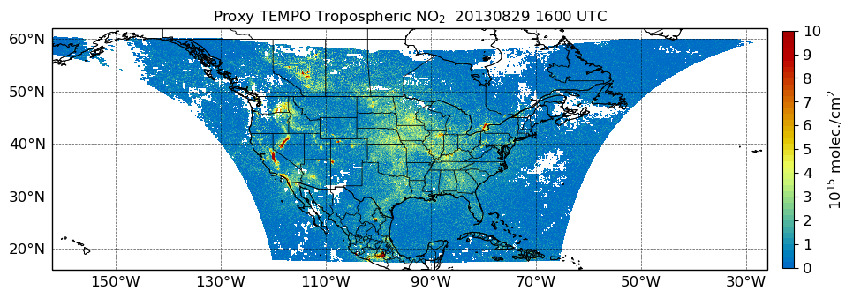
“Fast” Proxy Method for NO₂ & HCHO
Calculate scattering weights (ω) from LUT (function of view geometry, **surface reflectance, clouds)
Interpolate GEOS-NR-Chem (G5NR) model data onto TEMPO grid
Derive true SCDs from model concentration profiles and ω
G5NR simulation from July 2013 – June 2014
Calculate VCD and errors from AMFs and true SCDs
Apply TEMPO SNR module to add noise to true SCDs & derive SCD error
Rederive SCDs and AMFs from model climatology profiles
**Surface reflectance from MODIS climatology
Output
AMF: Air Mass Factor
LUT: Lookup Table
SNR: Signal-to-Noise Ratio

Slide 9
Proxy Methods for Deriving Column Density
∫
Trace Gas Profile
(Model)
SCD (model)
Scattering Weights (Lookup Table)
dz
Rederive SCD from climatology-based trace gas profile and scattering weights
AMF (Climatology)
SCD (Climatology)
VCD (Climatology)
VCD
(Product)
SCD (Model)
AMF (Climatology)
Fast proxy method starts from modeled trace gas concentration profile and scattering weights from lookup table to derive SCD
Scattering weights characterize the vertical measurement sensitivity to a trace gas

Slide 10
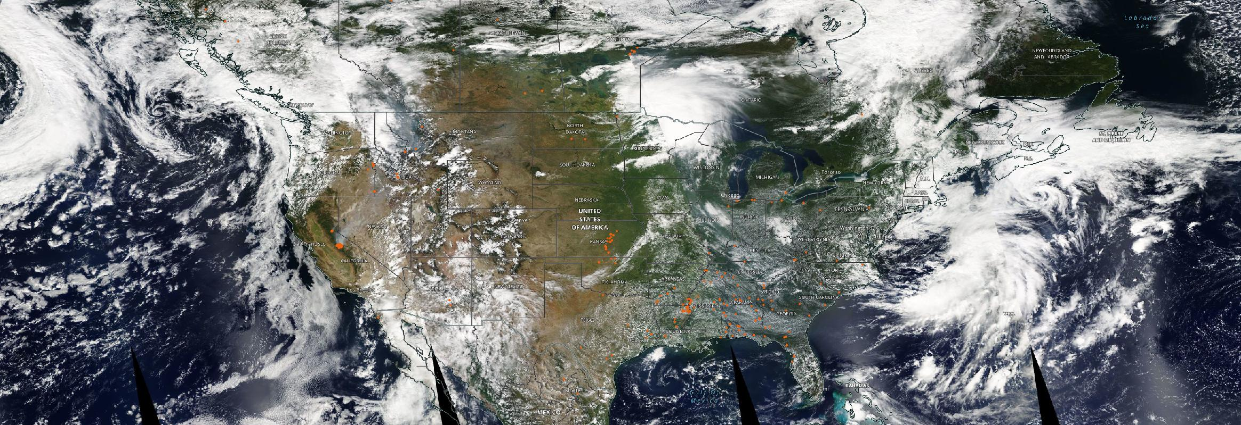
Wildfire Smoke - August 29, 2013
NASA Worldview
Aqua MODIS True Color imagery shows distinct smoke plumes from wildfires across western U.S.

Slide 11
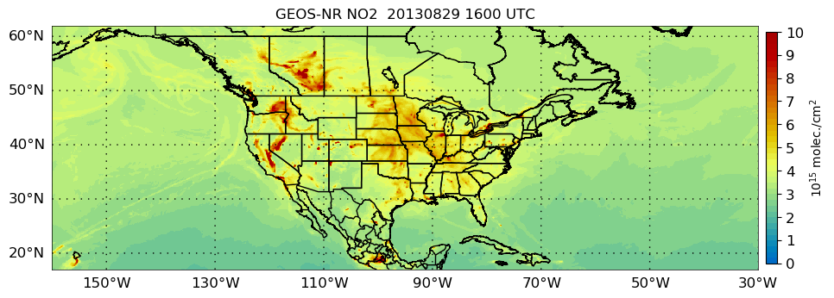
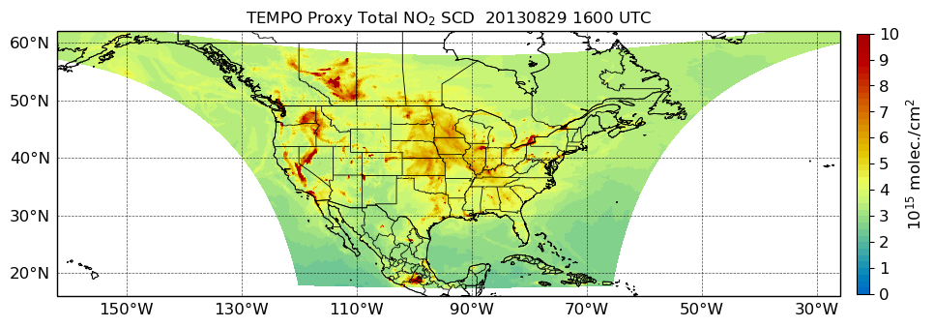
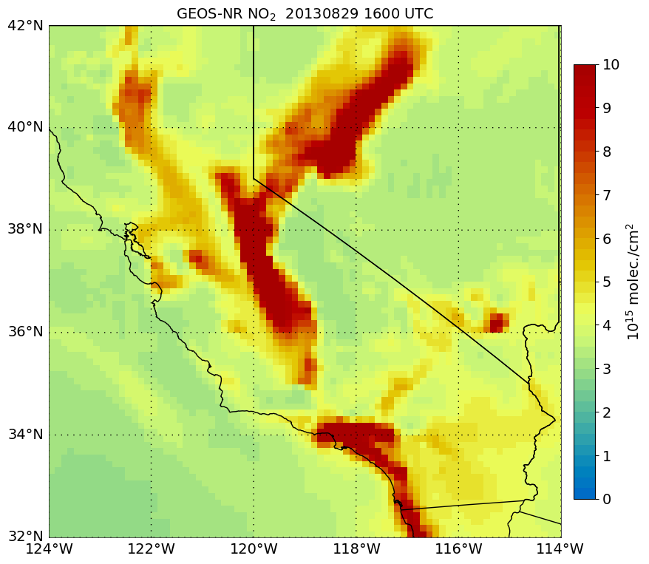
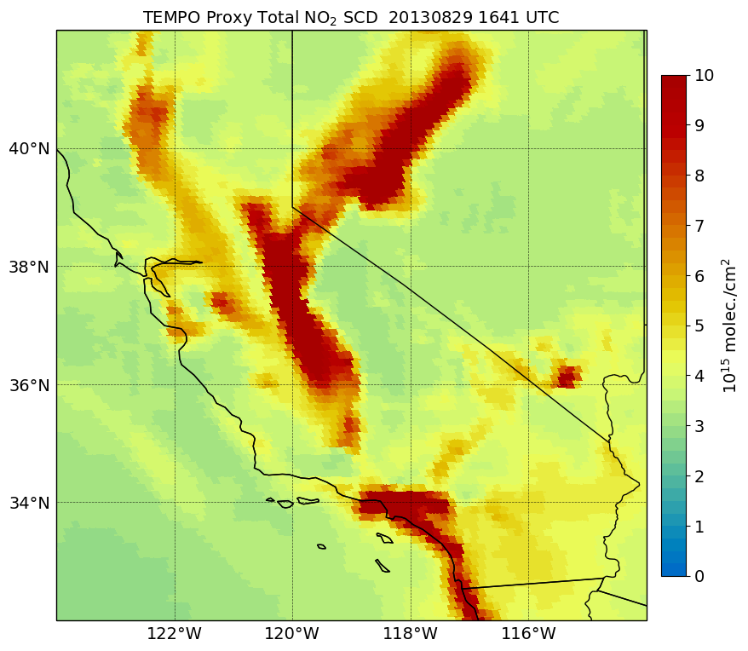
G5NR to TEMPO Grid
Interpolate G5NR fields (~12.5 x 12.5 km²) to native TEMPO pixel resolution (2 x 4.75 km²)
G5NR Grid
TEMPO Grid
G5NR Grid
TEMPO Grid

Slide 12
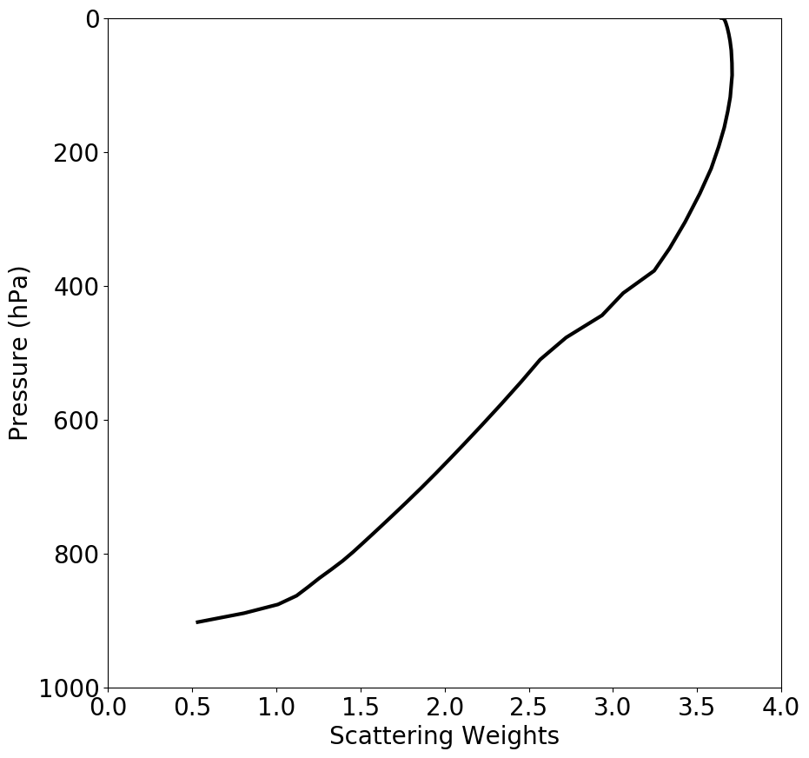
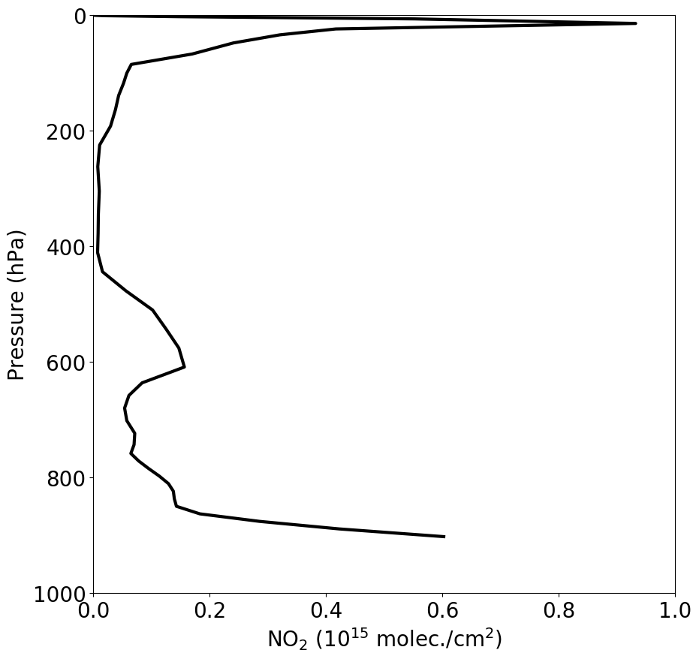
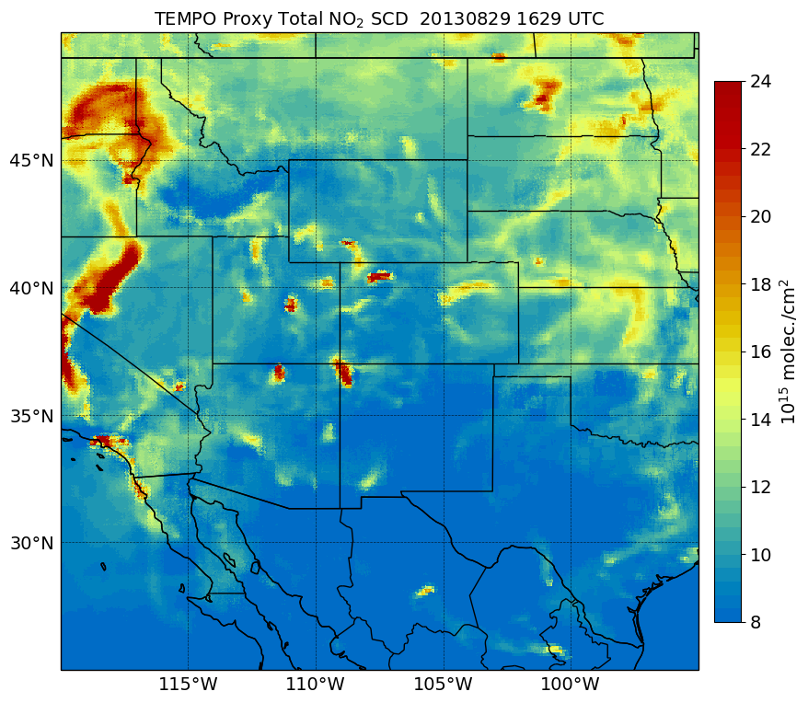
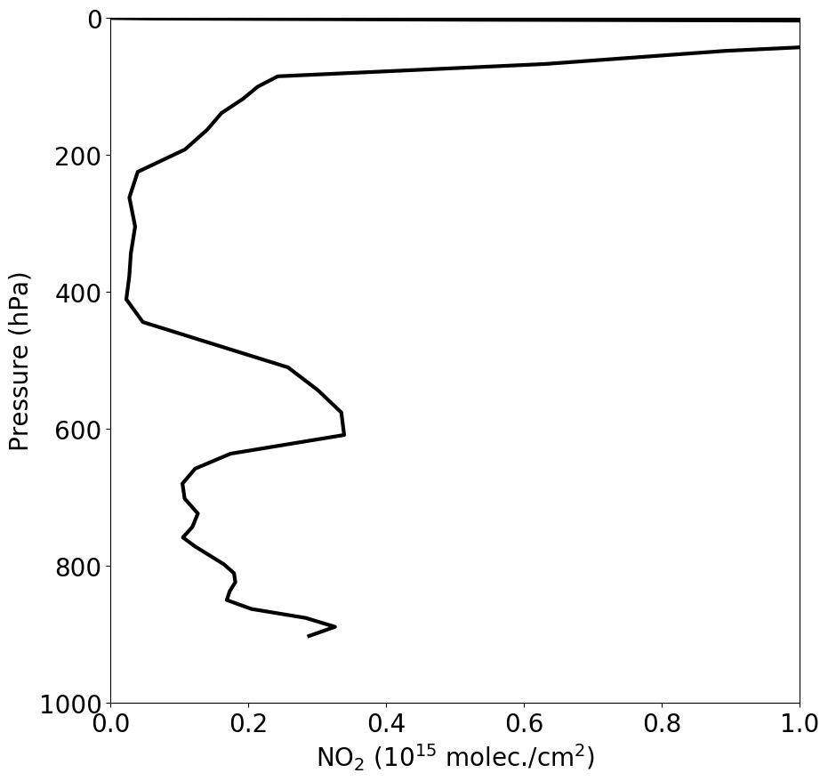
Calculating SCDs
∫
NO₂ Scattering Weights
NO₂ Model Profile
dz
NO₂ SCD

Slide 13
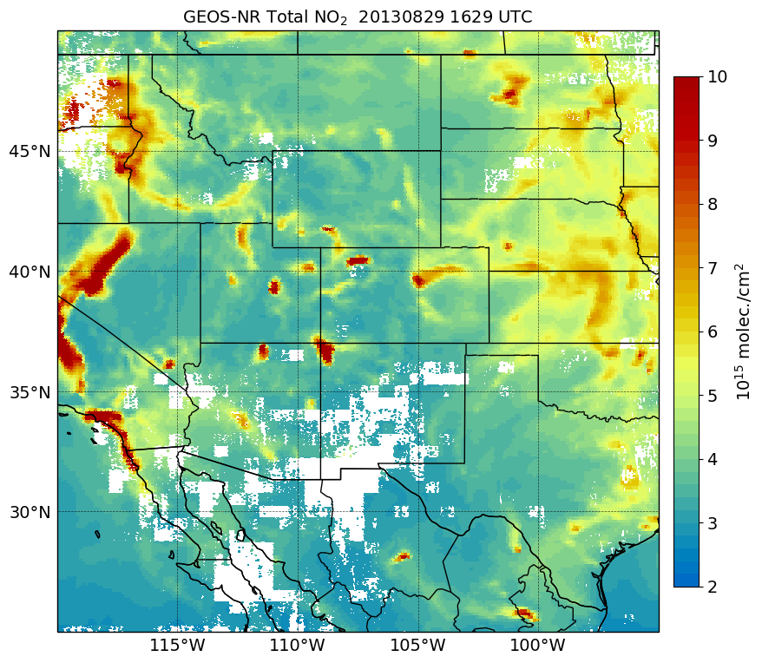
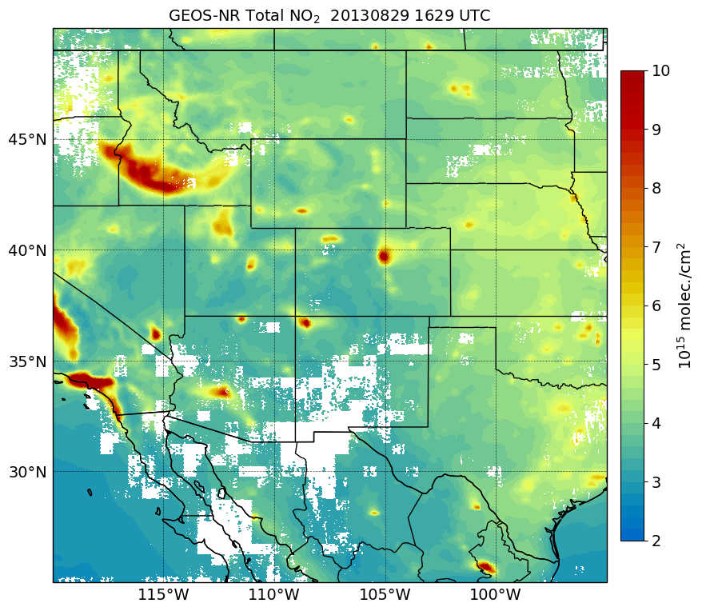
Model “Truth” vs Climatology
NO₂ Truth
NO₂ Climatology
G5NR
G5NR
G5NR simulation
G5NR monthly hourly average
Notable differences between model truth and climatology associated with wildfire smoke in the western U.S.

Slide 14
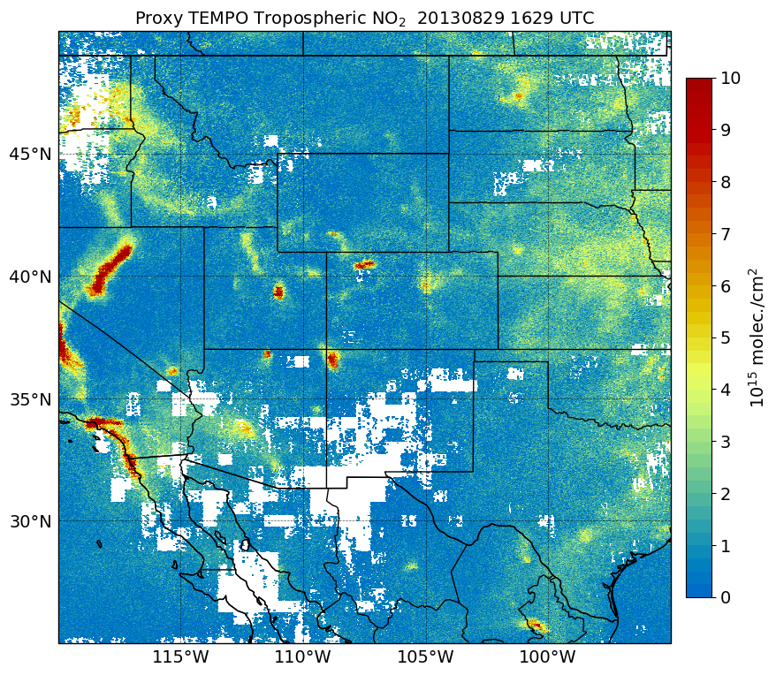
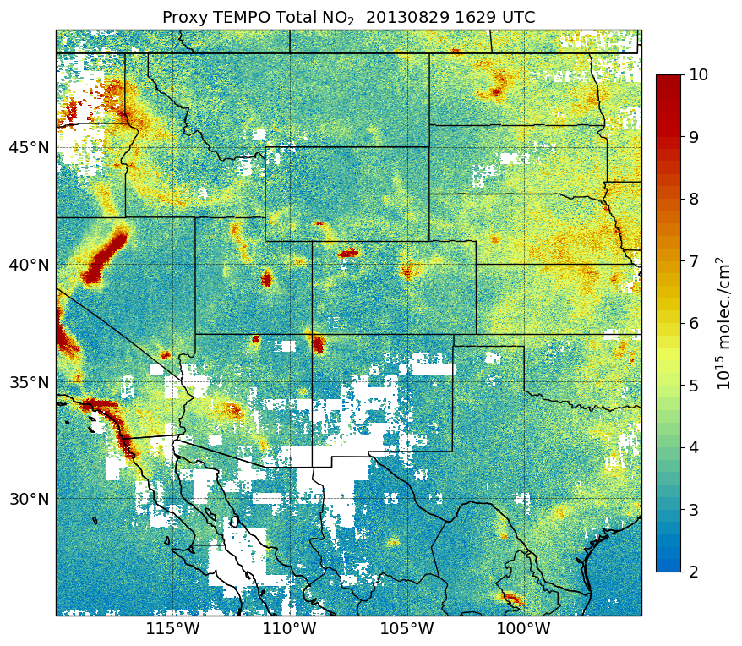
Model “Truth” vs Retrieval
NO₂ Truth
NO₂ VCD Product
G5NR
NO₂ VCD product is different than model truth due to applying LUTs, noise, etc. in fast proxy method

Slide 15
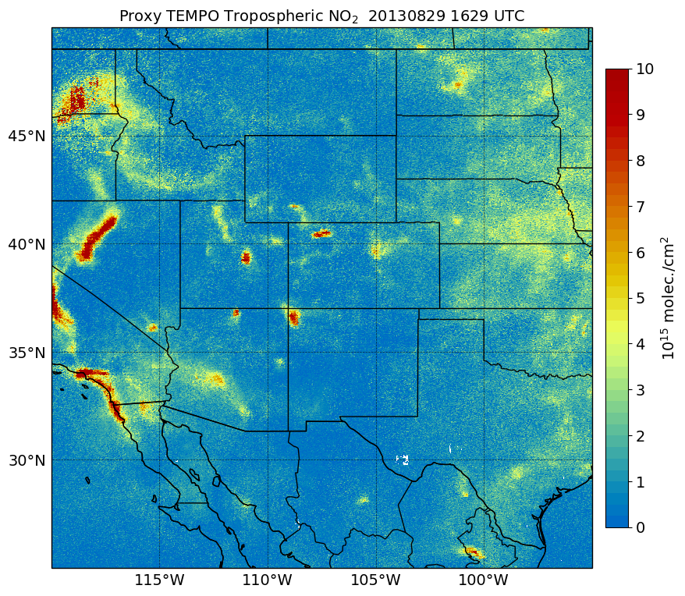
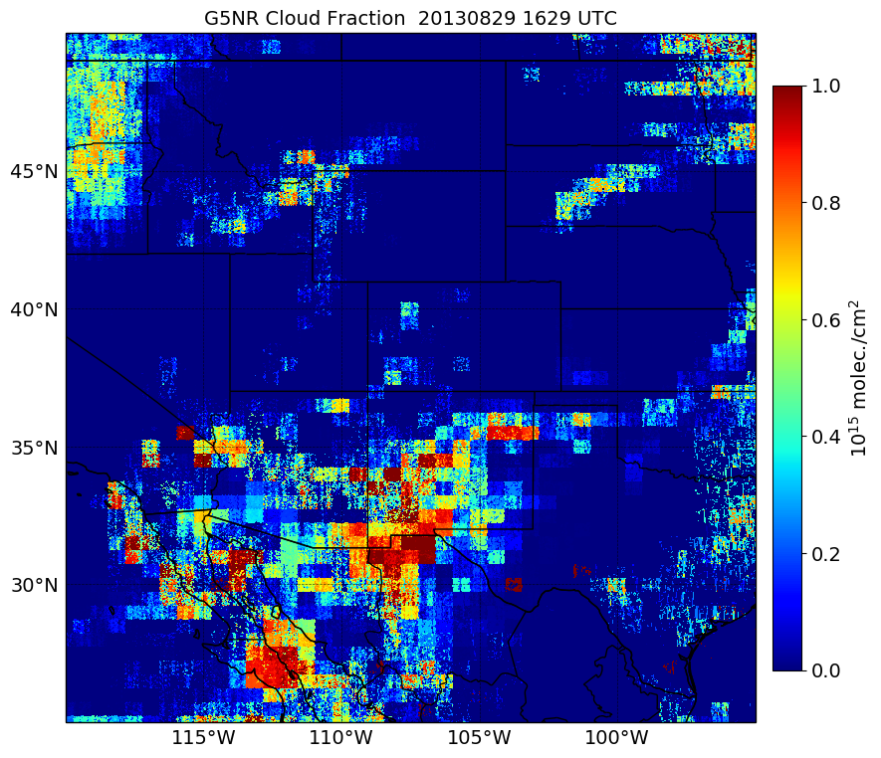
Cloud Filtering
Cloud Fraction
NO₂ VCD
Pre-cloud filtering
NO₂ VCD
Filter NO₂ pixels with cloud fraction > 0.3

Slide 16
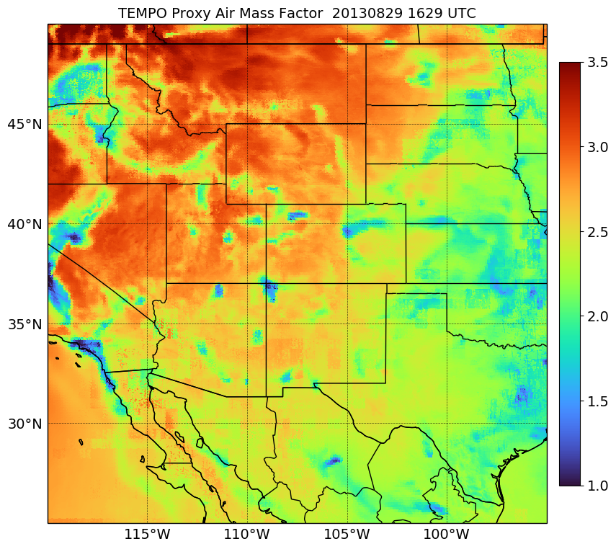
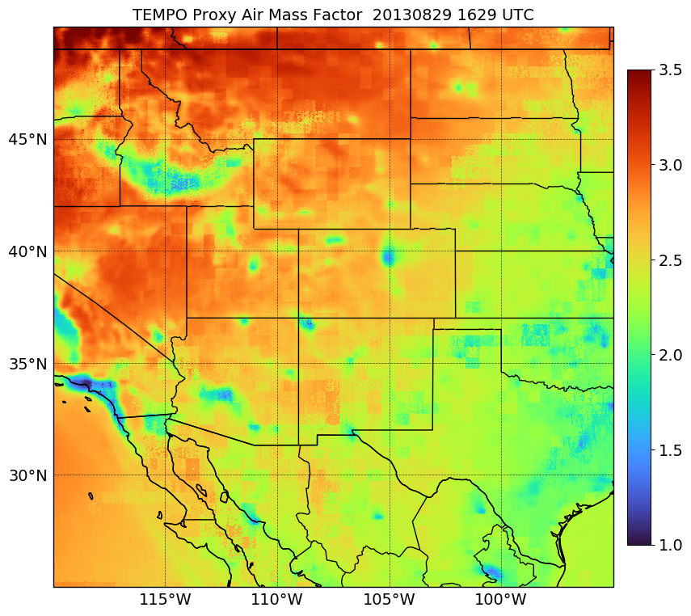
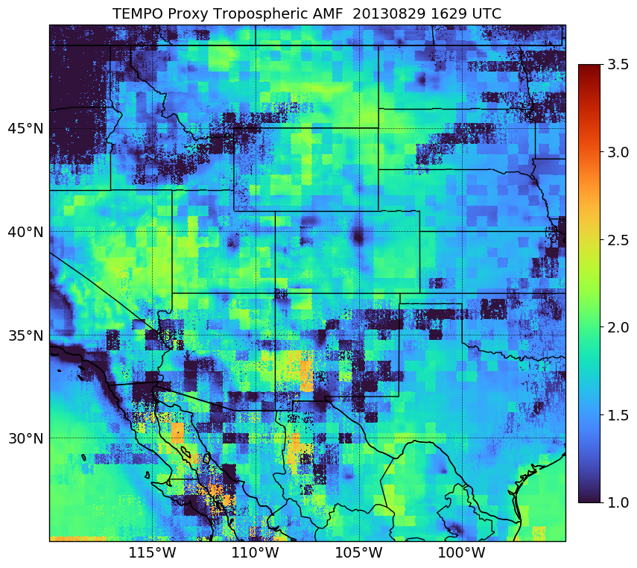
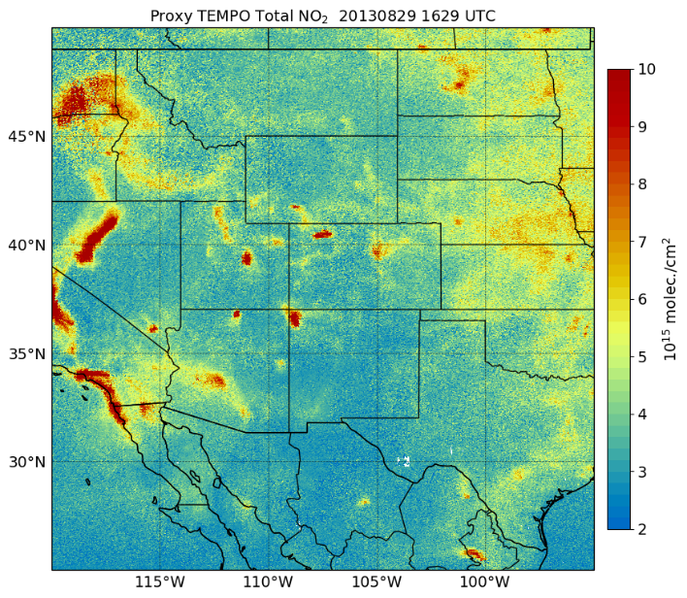
Air Mass Factors
NO₂ Truth
NO₂ Climatology
NO₂ VCD
NO₂ SCD
Smaller AMFs in areas of high NO₂ VCDs (e.g., cities, smoke plumes)
Proxy method does not account for influence of aerosols on AMFs!
SCD can be backed out from proxy product variables
AMF x VCD = SCD

Slide 17
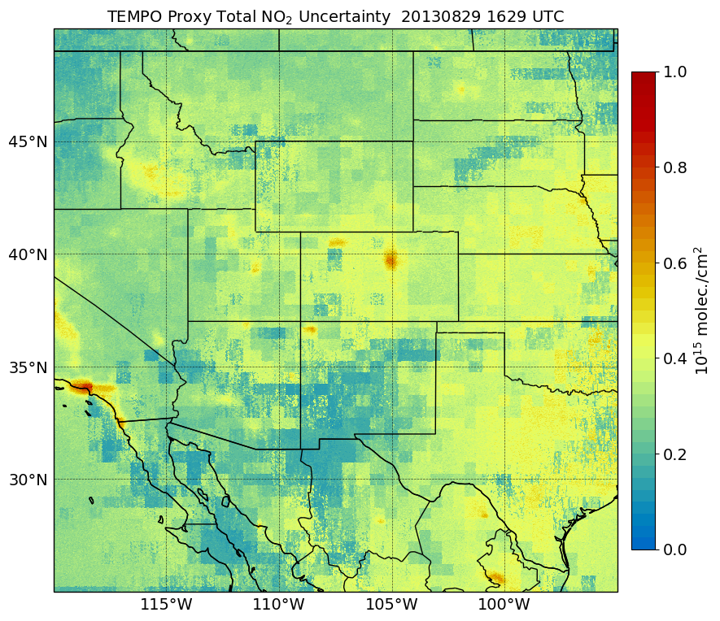
Instrument Errors
NO₂ VCD Uncertainties
NO₂ VCD Product
Instrument errors from TEMPO noise module reflected in VCD uncertainty

Slide 18
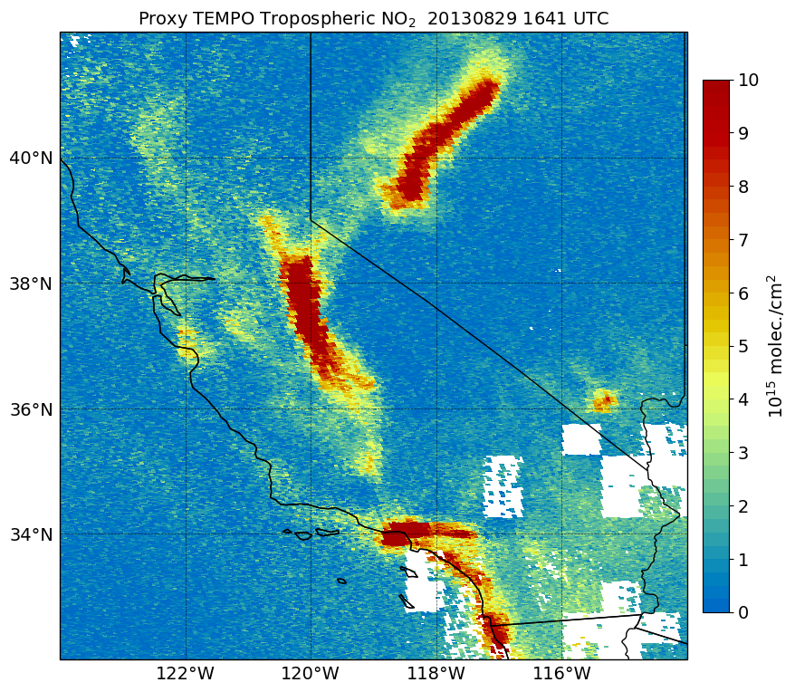
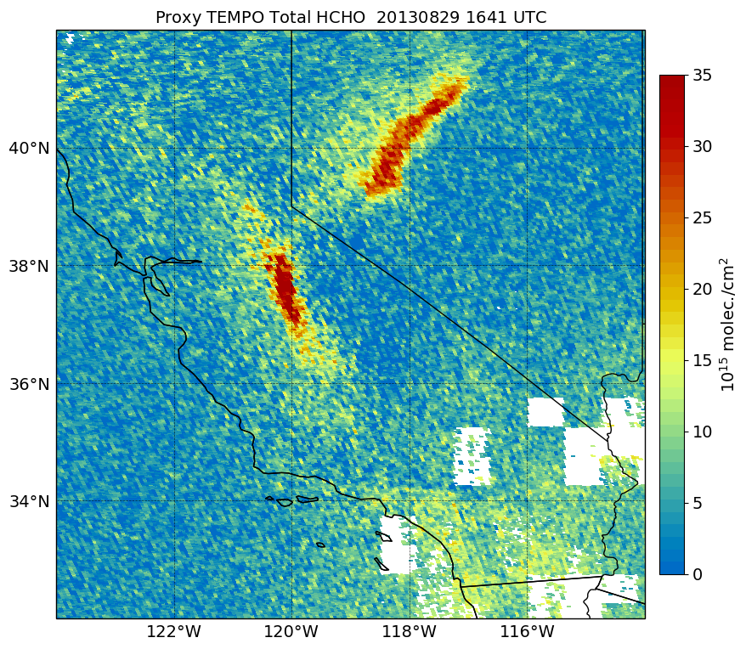
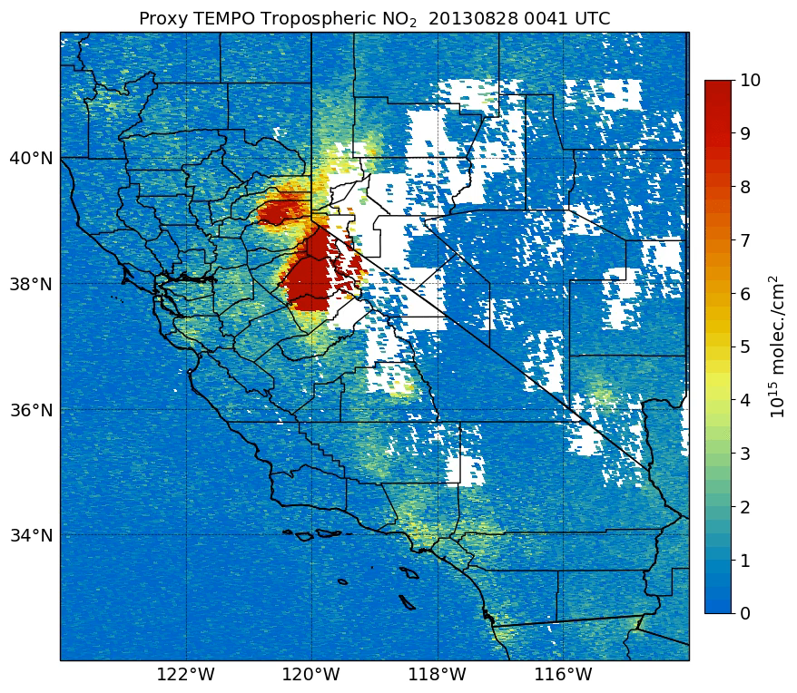
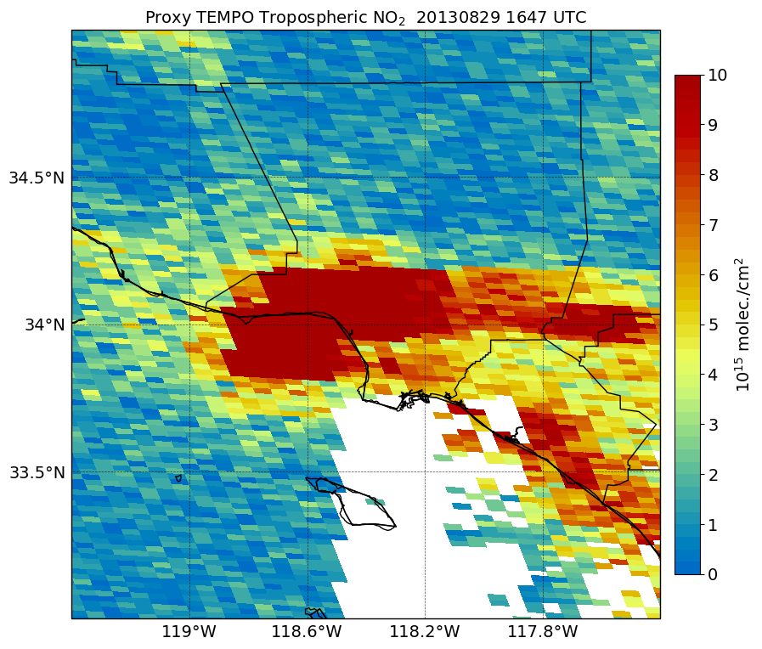
NO₂ and HCHO Proxy Products
Tropospheric NO₂ VCD
Total HCHO VCD
Tropospheric NO₂ VCD
Aug. 28 – Aug. 31
Proxy products show high NO₂ and HCHO VCDs in wildfire smoke plumes
Enhanced NO₂ VCDs from urban emission sources also shown

Slide 19
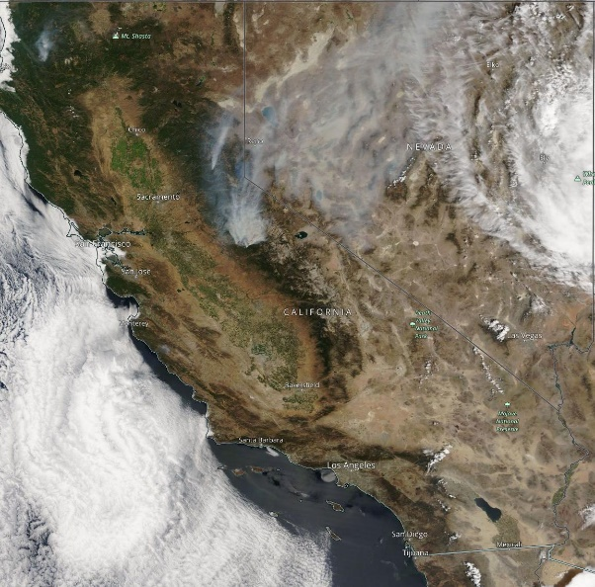
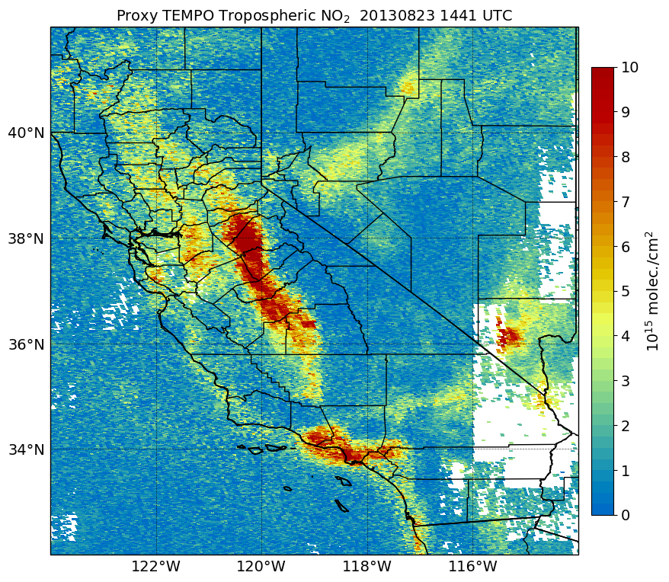
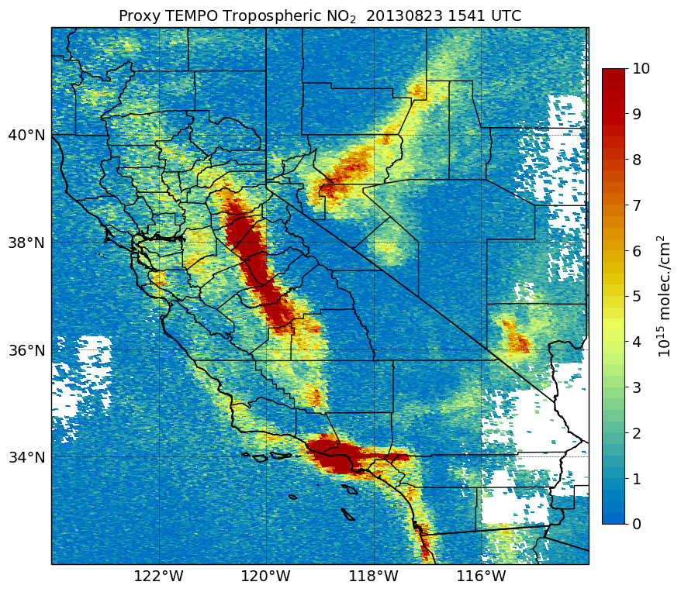
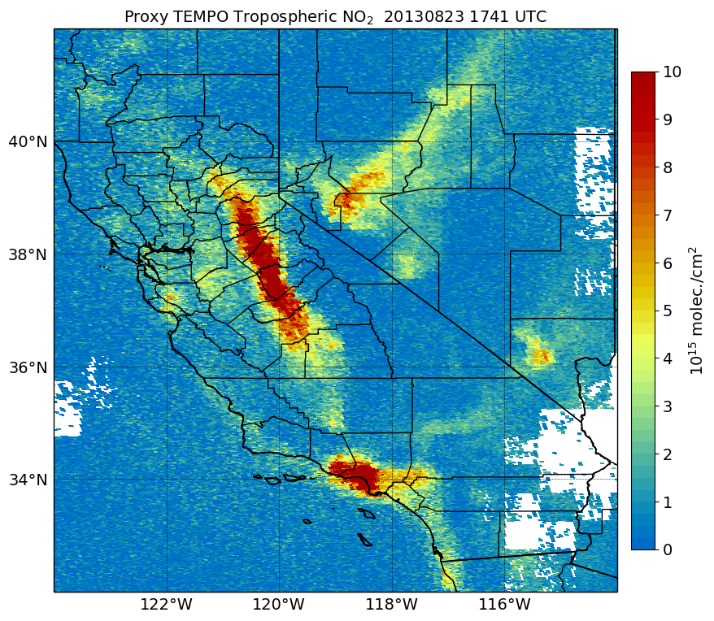
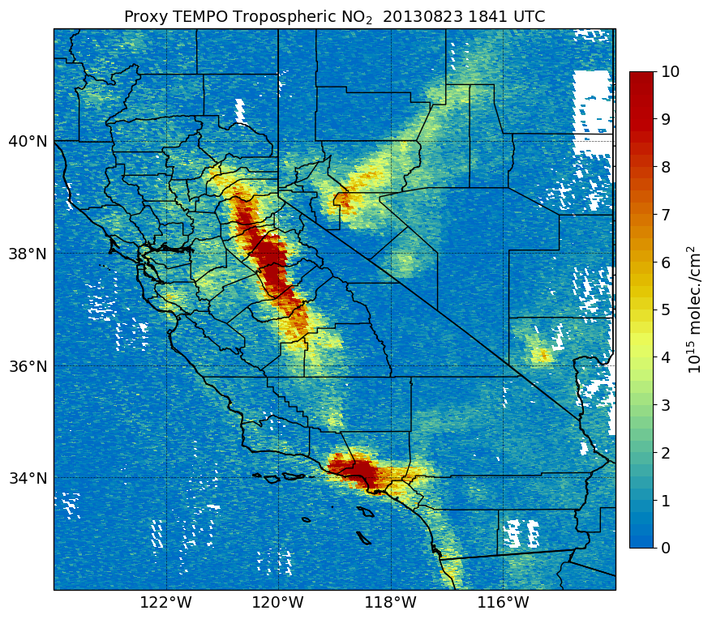
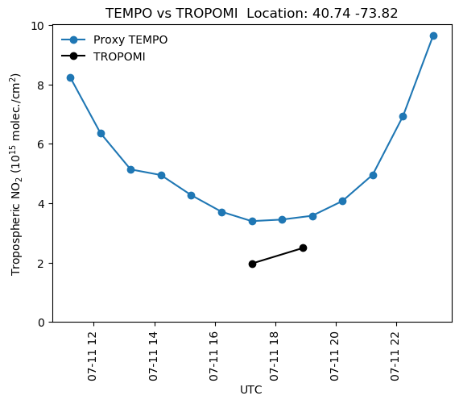
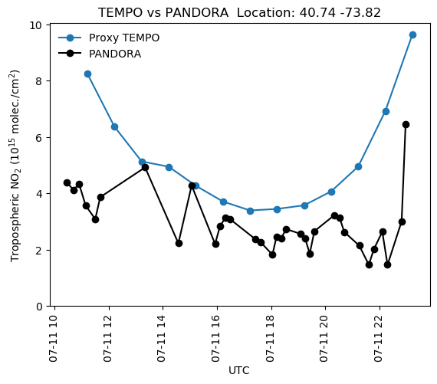
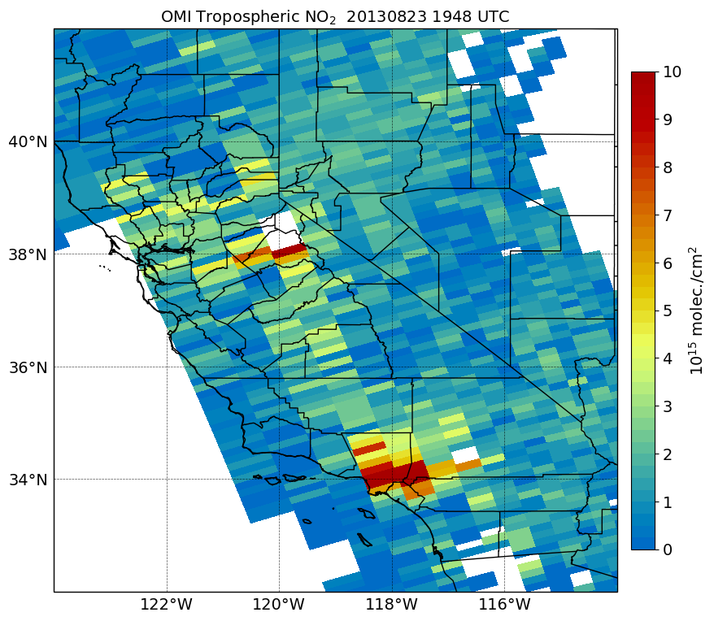
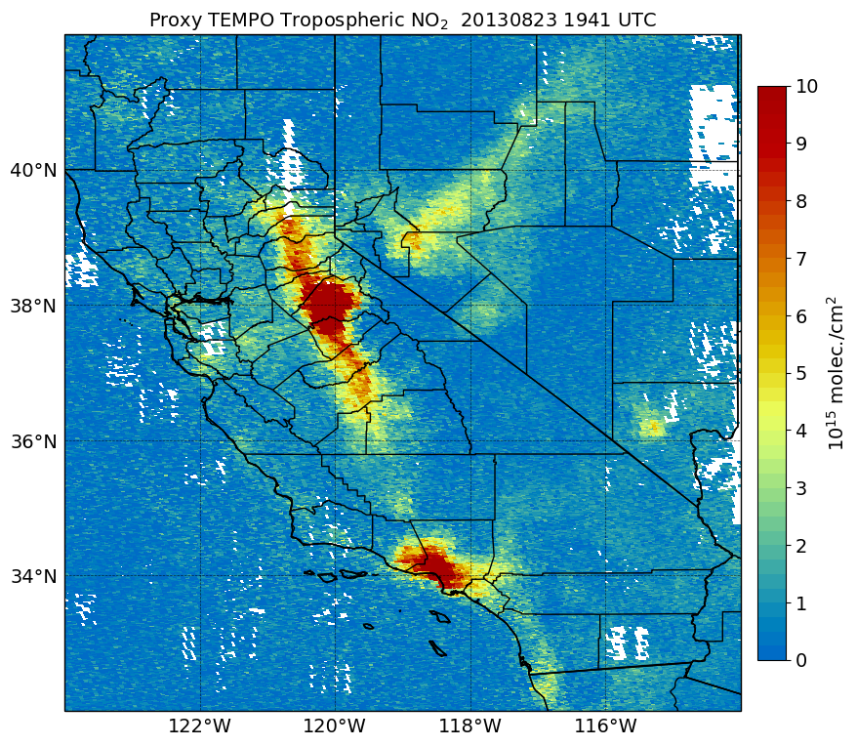
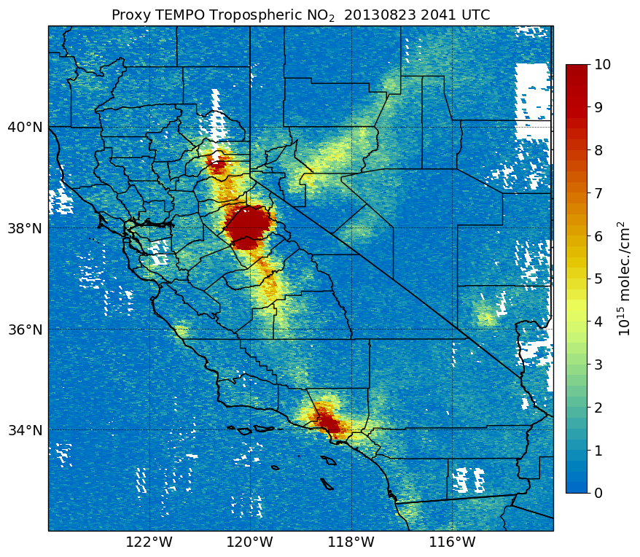
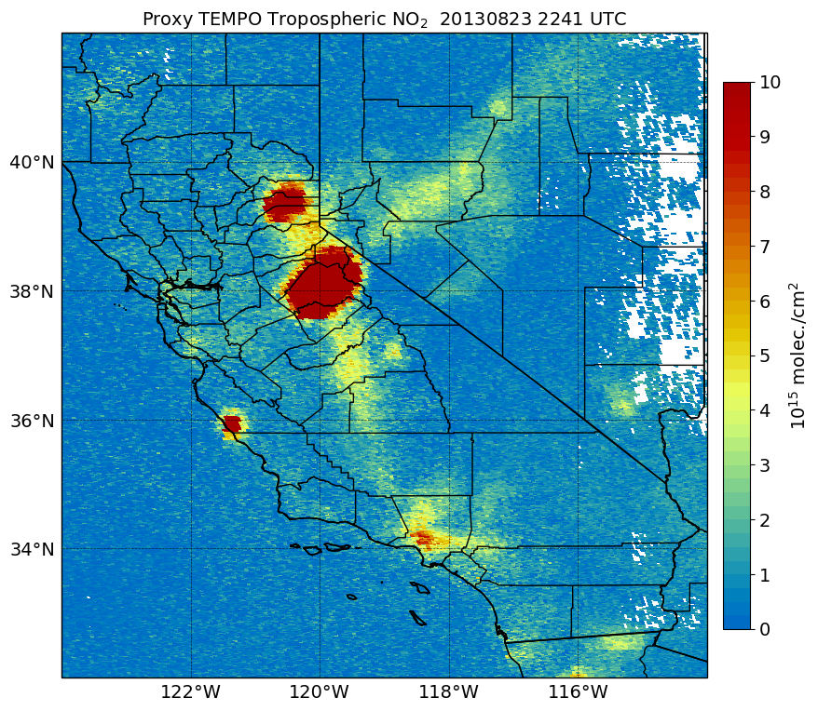
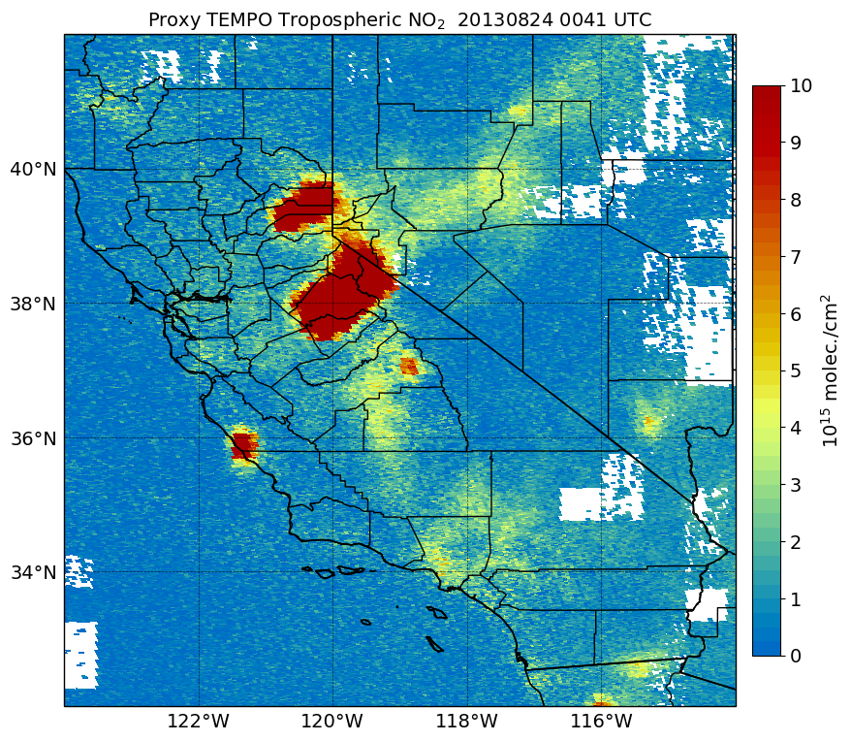
Monitoring NO₂ with TEMPO
Aug. 23, 2013
TEMPO Proxy Level 2 NO₂ data
Terra MODIS
~7:40 AM
~8:40 AM
~10:40 AM
~11:40 AM
OMI
NASA Worldview
~12:40 PM
~1:40 PM
~3:40 PM
~5:40 PM
OMI NO₂
~12:50 PM
TEMPO will observe rapidly varying NO₂ columns within wildfire smoke plumes and across urban areas and traffic corridors.
*Proxy data not intended to support operational decisions or scientific research studies
19

Slide 20
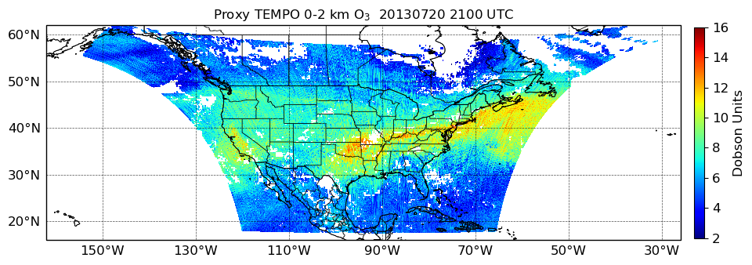
“Fast” Proxy Method for O₃ profile
Calculate radiances & weighting functions from multiwavelength LUT (function of view geometry, **surface reflectance, clouds)
Interpolate G5NR model data onto TEMPO grid
Apply TEMPO SNR model to estimate instrument SNR
Input a priori covariance matrix & TEMPO SNR into optimal estimation retrieval
Derive the retrieved O₃ profile product and add random noise
Derive covariance matrix & averaging kernels from optimal estimation
**Surface reflectance from OMI climatology
Output
LUT: Lookup Table
SNR: Signal-to-Noise Ratio

Slide 21
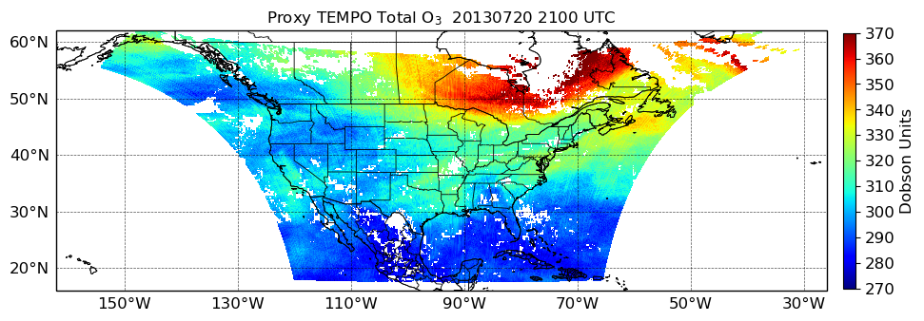
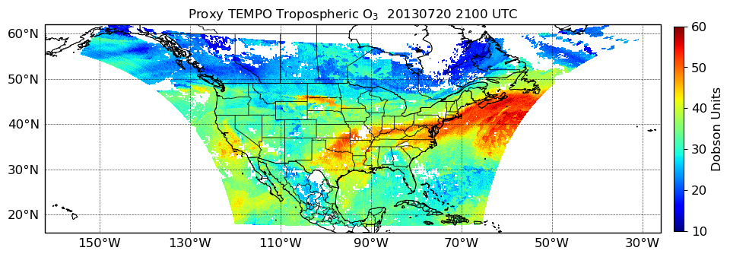
TEMPO Proxy O₃ Profile Product
Total O₃
Tropospheric O₃
0-2 km O₃
O₃ profile product reveals higher O₃ columns in the tropospheric and 0-2 km layer, which are difficult to distinguish using the total O₃ column alone
Tropospheric and 0-2 km O₃ columns are particularly high over the eastern U.S.

Slide 22
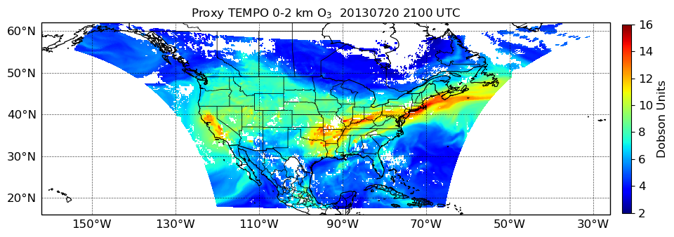
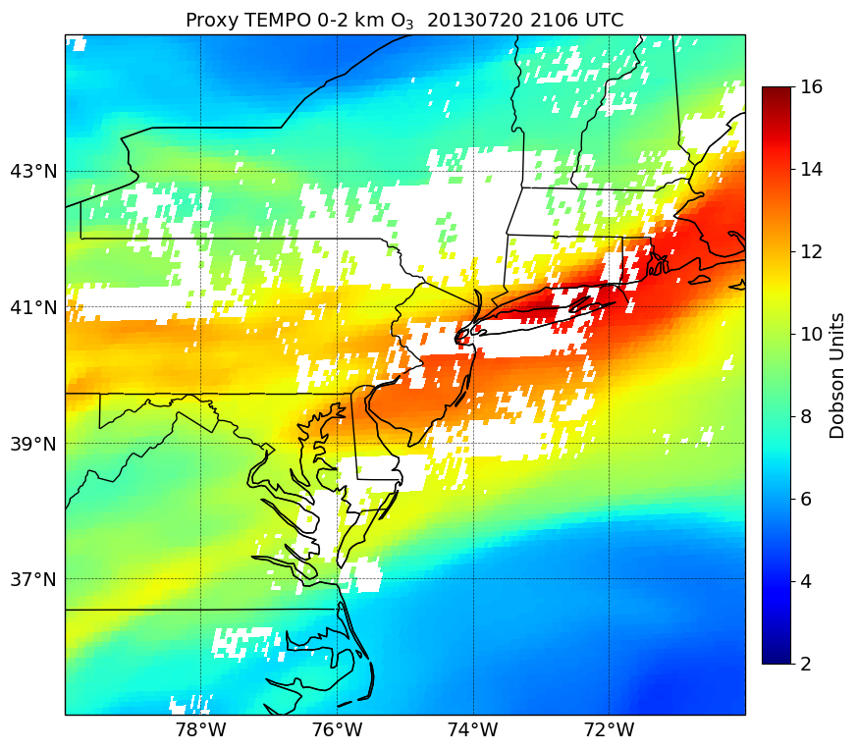
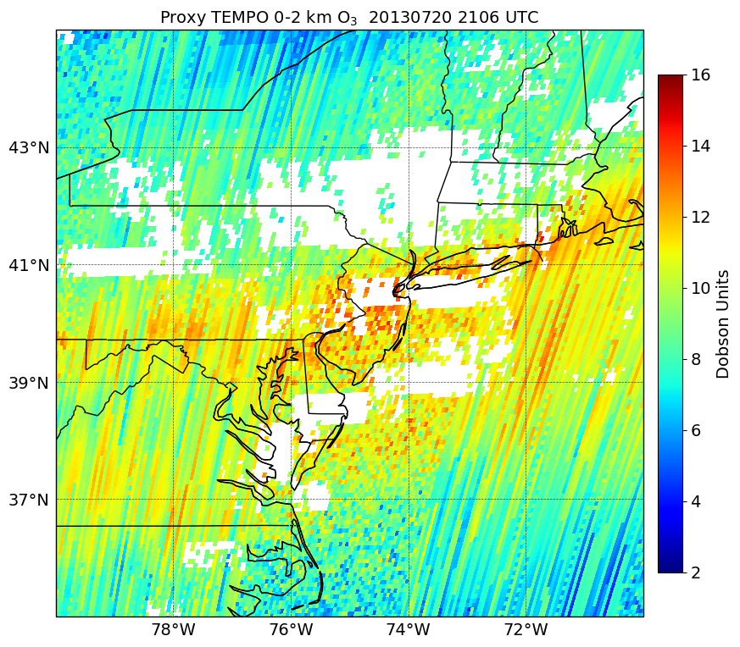
Model “Truth” vs Retrieval
Truth O₃
O₃ profile product
Filtered O₃ pixels with cloud fraction > 0.3
Fast O₃ proxy method introduces significant noise in the 0-2 km O₃ product compared to the model truth
High O₃ columns are still apparent across the east coast

Slide 23
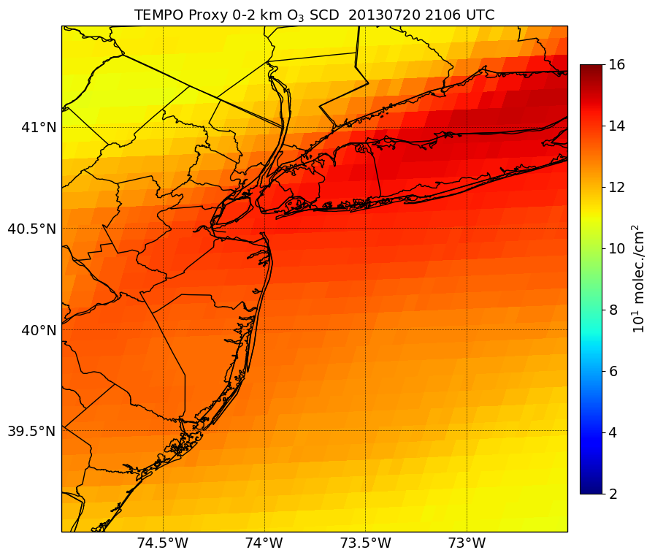
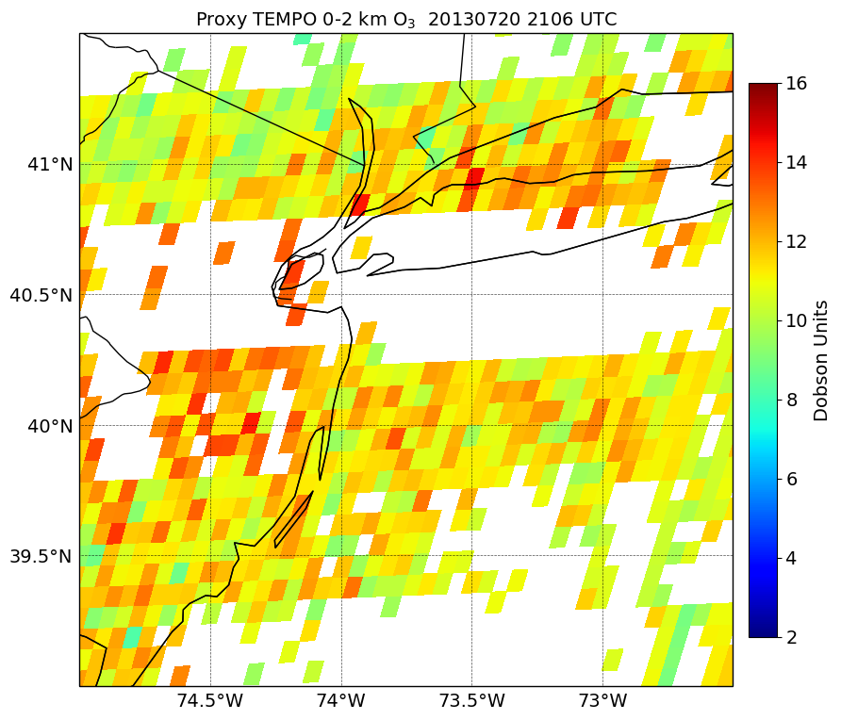
0-2 km O₃ product
Truth 0-2 km O₃
Retrieved 0-2 km O₃
O₃ profile product resolves the majority of the O₃ column in the lower troposphere
Demonstrates the sensitivity of the TEMPO instrument to the O₃ pollution
TEMPO will provide new information on O₃ pollution within the layer of air where people live
Proxy product can provide early adopters an understanding of the expected information content from the operational product

Slide 24
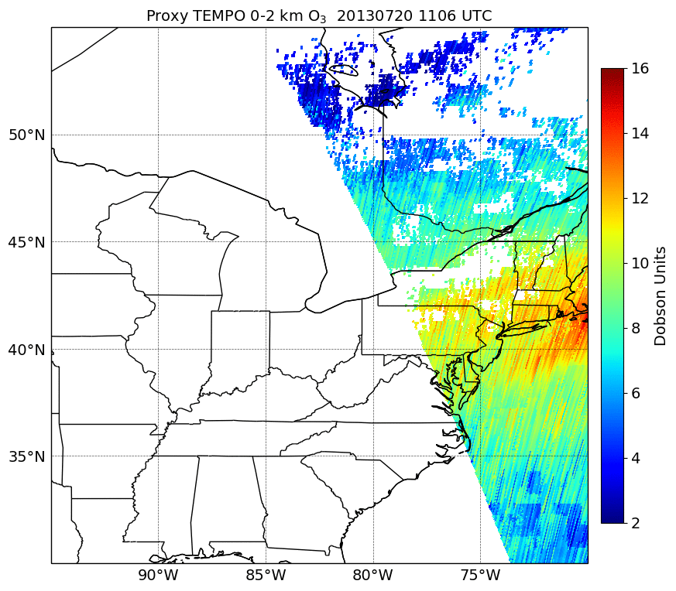
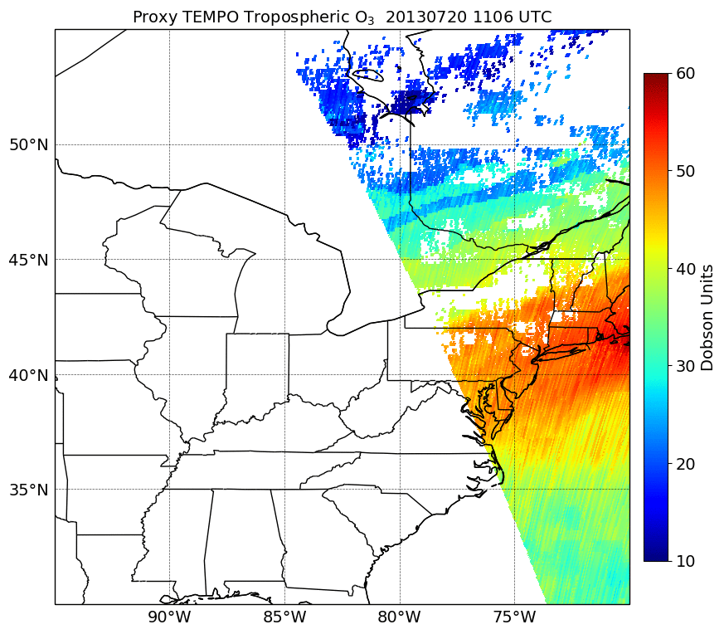
Hourly TEMPO Proxy O₃ Profile
0-2 km O₃
Tropospheric O₃
Hourly O₃ profile product tracks O₃ pollution in the tropospheric layer throughout the daytime
A large area of higher O₃ columns moves eastward
Further enhancements in O₃ pollution are shown over the U.S. east coast during the afternoon

Slide 25
“Fast” Proxy Method Overview
Advantages
Avoids need of radiative transfer model for calculating TEMPO spectra / radiances (very computationally expense!)
Capable of generating a longer term archive of proxy TEMPO data for early adopters
Accounts for information (scattering weights, AMF, a priori profiles, averaging kernels) that characterizes the vertical sensitivity of the retrieval algorithms
Accounts for uncertainties from realistic instrument noise information
Disadvantage
Operational retrieval algorithms not applied due to bypassing radiance calculations
Not useful for validating and optimizing TEMPO retrieval algorithms
Use of model truth data in the proxy product with coarser resolution than TEMPO can underrepresent the expected spatial information from operational TEMPO data
Realism of proxy data is ultimately dependent on model performance!

Slide 26
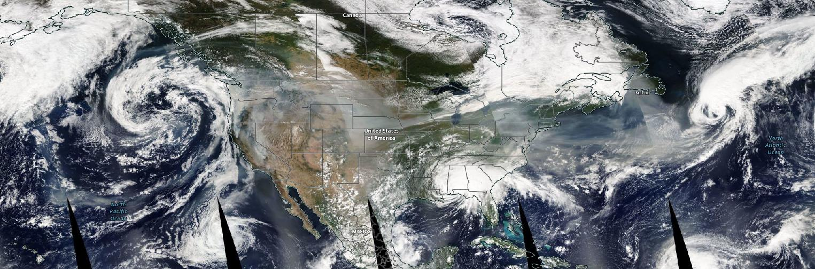



Proxy Aerosol Product from EPIC data
UVAOD
Worldview
AAI
Sept. 16, 2020
Proxy aerosol products are developed from EPIC UV aerosol data
Spatiotemporal interpolation to the TEMPO grid and repackaging to expected operational TEMPO aerosol file
EPIC is a good source for TEMPO proxy aerosol:
Operational TEMPO aerosol retrievals will be similar to EPIC
EPIC has high temporal resolution (1-2 hours)
UVSSA

