Slide 1

@NaegerAaron
TEMPO Proxy & Operational Data Updates
May 1-5, 2023
Huntsville, AL
Aaron Naeger & TEMPO Team
TEMPO Deputy Program Applications Lead
NASA / University of Alabama in Huntsville
U.S. Government sponsorship acknowledged.

Slide 2
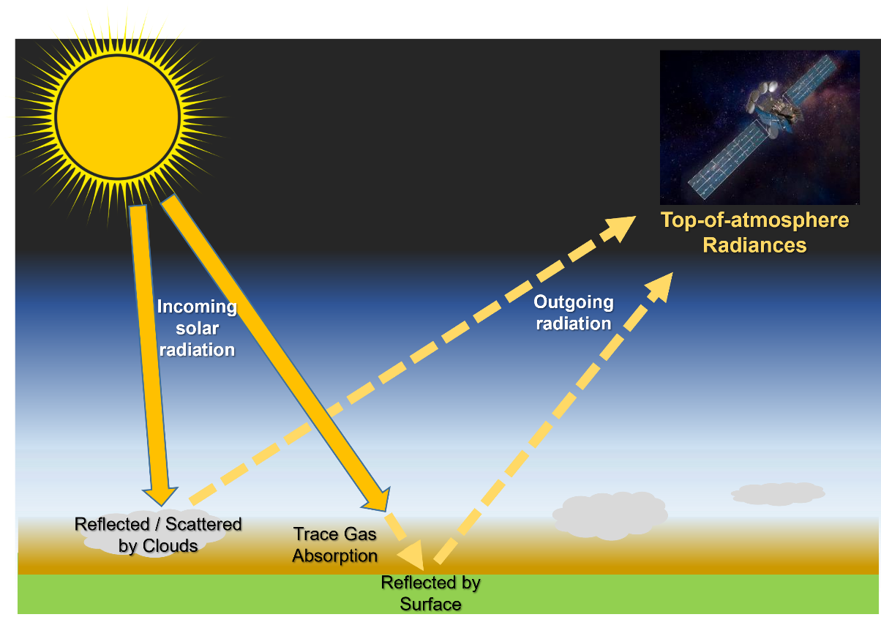
TEMPO Measurements & Baseline Products
Vertical Column Density (VCD)
Slant Column Density (SCD)
TEMPO operational trace gas retrievals based on 2-step approach
  Derive slant column densities (SCD) – integrated number density of gas molecules in mean photon path from sun to instrument – by spectral fitting to measured radiances in known trace gas absorption windows
  Calculation of vertical column densities (VCD) using Air Mass Factors calculated offline with a radiative transfer model accounting for surface, atmospheric, and viewing geometry conditions
AQ relevant precision (ppb) assumes all gas molecules are contained over an area from the surface to 1 km
TEMPO products will be of high accuracy and precision, particularly NO₂
VCDs provide information on the trace gas in the vertical above the TEMPO footprint
2

Slide 3
TEMPO L2+ Products: Baseline + SNWG TEMPO NRT
Level | Product | Key Variables | Resolution (km²) | Frequency/ SIze
L2 | Cloud | Cloud Fraction, Cloud Pressure | 2.0 x 4.75 | Hourly, granule
 | O₃ (Ozone) profile | O₃ profile, Tropospheric O₃ column, Total O₃ column, Stratosphere O₃ column, Cloud Fraction, O₃ a priori, O₃ Averaging Kernel | >= 8.0 x 4.75 | Hourly, granule
 | Total O₃ | Total column O₃, Cloud Fraction, Aerosol Index | 2.0 x 4.75 | Hourly, granule
 | NO₂ (Nitrogen Dioxide) | Slant Column Density (SCD), Tropospheric Vertical Column Density (VCD), Total VCD, Cloud Fraction, Air Mass Factor (AMF), Data Quality Flag | 2.0 x 4.75 | Hourly, granule
 | HCHO (Formaldehyde) | SCD, Total VCD, Cloud Fraction, AMF, Data Quality Flag | 2.0 x 4.75 | Hourly, granule
 | Aerosol | Ultraviolet & Visible Aerosol Optical Depth (AOD), Aerosol Optical Centroid Height (AOCH), Aerosol Absorption Index (AAI) | 8.0 x 4.75 (TBD) | Hourly, granule
L3 | Same as L2 (Gridded) | Same as L2 | ~2 x 2 (TBD) | Hourly, scan
**
** Center of Field of Regard
Near real-time (NRT) products: Latency 2 - 3 hours
Baseline (Offline) products: Latency 3 - 6 hours (except O₃ profile ~24 hours)
SNWG: Satellite Needs Working Group
Level 3 product stitches together TEMPO Level 2 product granules for each scan
3
3
3

Slide 4
TEMPO L2+ Products: Additional
Level | Product | Key Variables | Resolution (km²) | Frequency/ SIze
L2 | C₂H₂O₂ (Glyoxal) | SCD, Total VCD, Cloud Fraction, AMF, Data Quality Flag | 2.0 x 4.75 | Hourly, granule
 | H₂O (Water Vapor) |  | 2.0 x 4.75 | 2.0 x 4.75
 | BrO (Bromine) |  | 2.0 x 4.75
 | SO₂ (Sulfur Dioxide) | SCD, VCD (Total, Planetary Boundary Layer, & Lower / Middle / Upper Tropospheric, Lower Stratospheric) | 2.0 x 4.75 | Hourly, granule
 | TEMPO/GOES-R Synergistic | Aerosol, Fire / Hotspot, Cloud & Mask, Lightning, Snow / Ice, Precipitable Water, etc. | 2.0 x 4.75 | Hourly, granule
L3 | Same as L2 (Gridded) | Same as L2 | ~2 x 2 (TBD) | Hourly, scan
L4 | UVB | UV irradiance, erythemal irradiance, UVI | TBD | Hourly, scan
**
** Center of Field of Regard

Slide 5
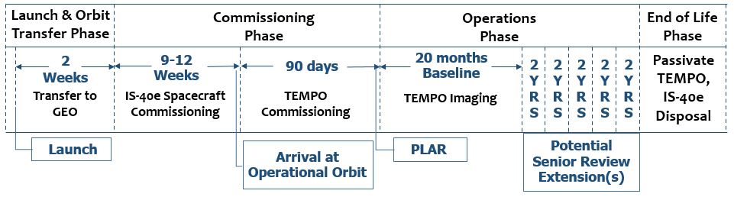
Mission Phases & Operational Timeline
Launched: April 7, 2023
Power On: June 6
Commissioning: July – Sept 2023
ASDC: Atmospheric Science Data Center
First light: Targeting June 26
TEMPO commissioning phase from July – Sept 2023
Nominal operation: ~6 months after launch (Oct 2023)
Baseline mission length: 20 months (Oct 2023 – May 2025) w/ possible 10+ year lifetime depending on senior reviews
Public release of Baseline Products at ASDC: Level 1b data ~Feb 2024, Level 2 & 3 data ~April 2024
Initial public release of NRT products at ASDC ~Oct 2024
5
5

Slide 6
TEMPO Proxy Products
Pre-launch proxy products have been developed for the TEMPO early adopters to familiarize the community with the file format, data variables, download methods, and developing codes and tools
Level | Product | Major Outputs | Res km² ** | Freq/Size
L2 | NO₂ | SCD, strat./trop. VCD, error, AMFs, scattering weights | 2.0 x 4.75 | Hourly, granule
 | HCHO | SCD, VCD, error, AMFs, scattering weights | 2.0 x 4.75 | Hourly, granule
 | O₃ profile | O3 profile, total/strat/trop/0-2 km O3 column, a priori, averaging kernels | 8.0 x 4.75 | Hourly, granule
 | Aerosol | AAI, UVAOD, UVSSA, AOCH, VISAOD | 8.0 x 4.75 | Hourly, granule
L3 | Gridded L2 | Same as L2 | ~5 x 5 (TBD) | Hourly, scan
Green text: Available to Early Adopters and Science Team via Earthdata Search
Level 3 products will be available very soon!
** Center of Field of Regard
AAI: Aerosol Absorption Index
UVAOD: UV Aerosol Optical Depth
VISAOD: VIS Aerosol Optical Depth
UVSSA: UV Single Scatter Albedo
AOCH: Aerosol Optical Centroid Height
SCD: Slant Column Density
VCD: Vertical Column Density
AMF: Air Mass Factors

Slide 7
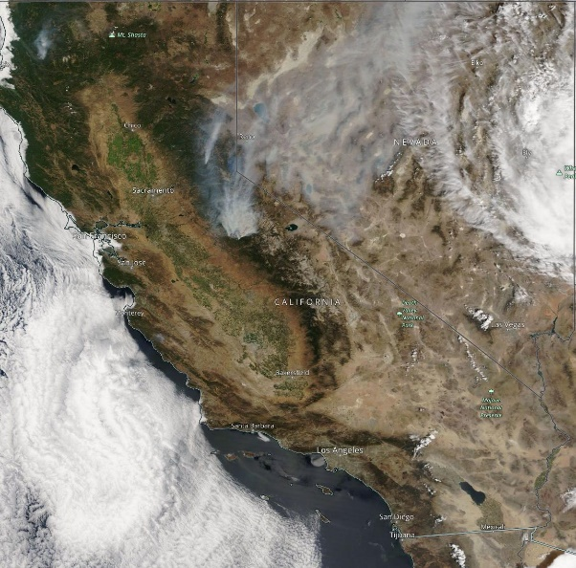
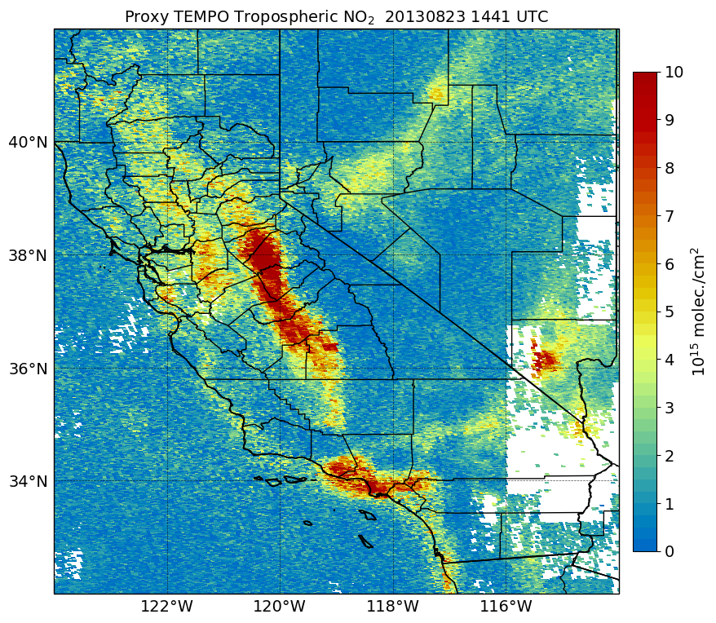
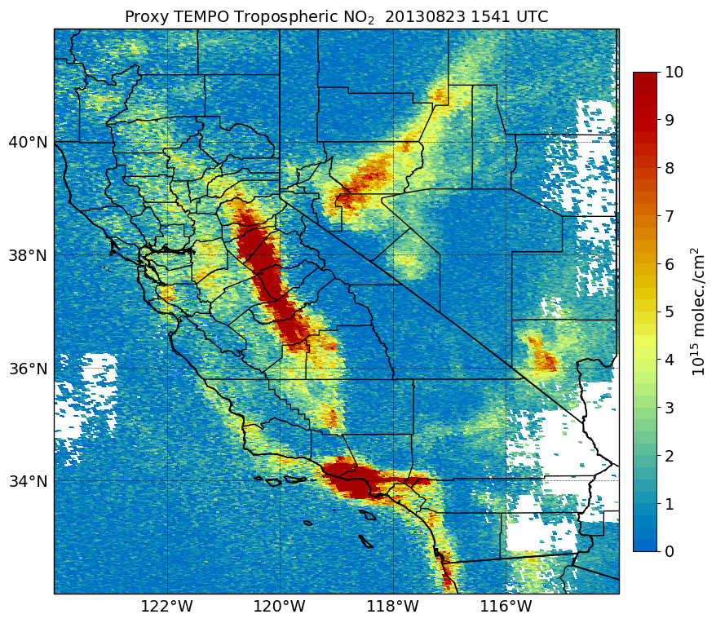
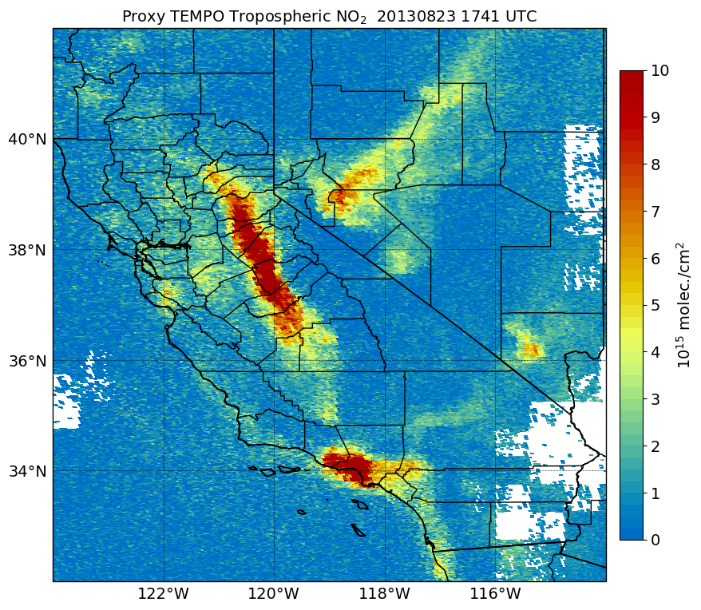
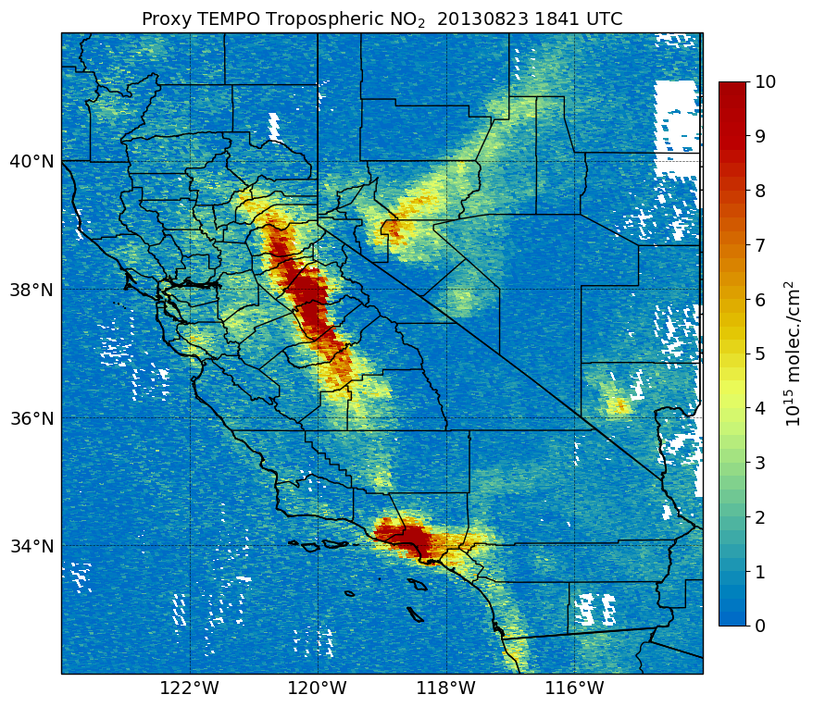
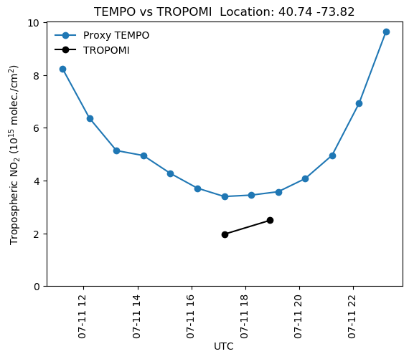
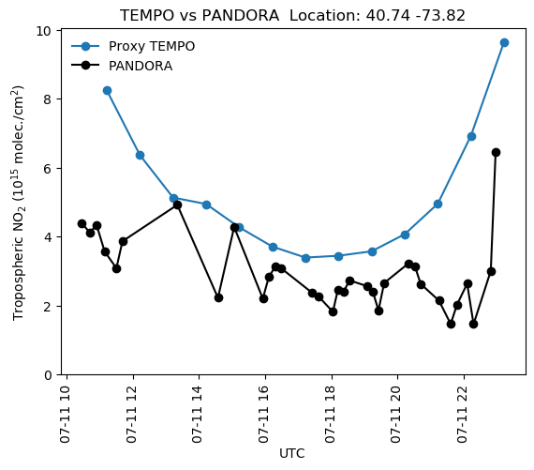
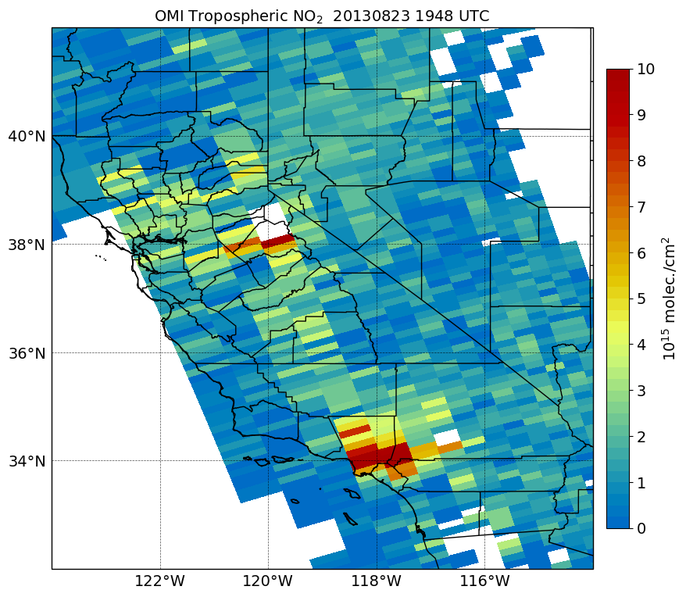
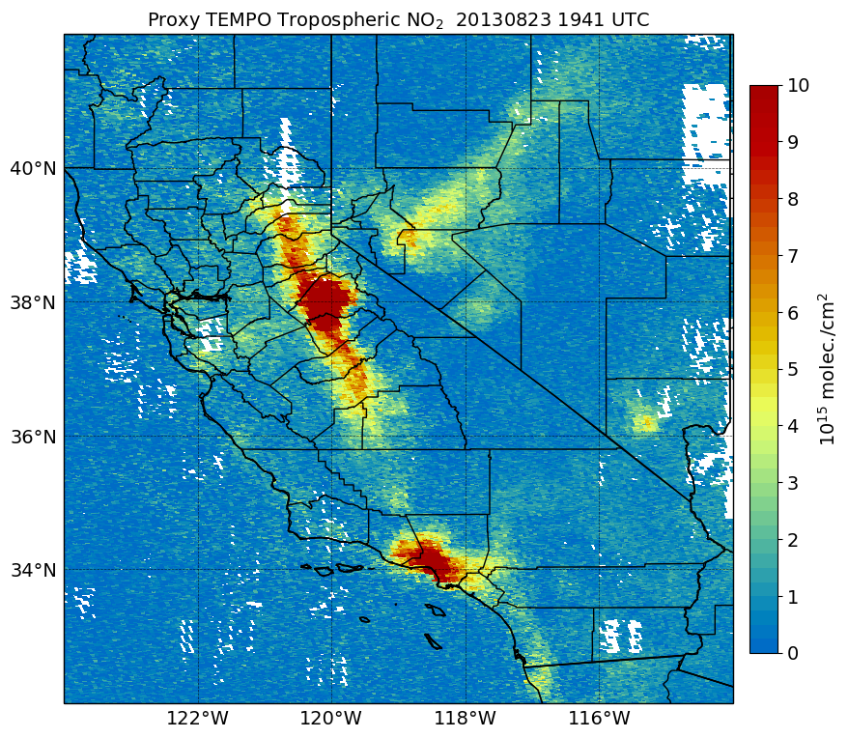
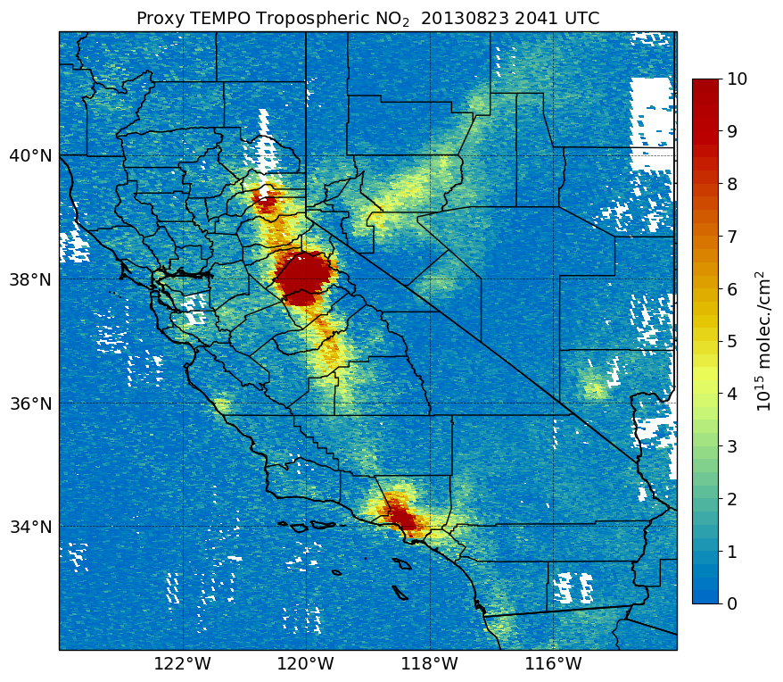
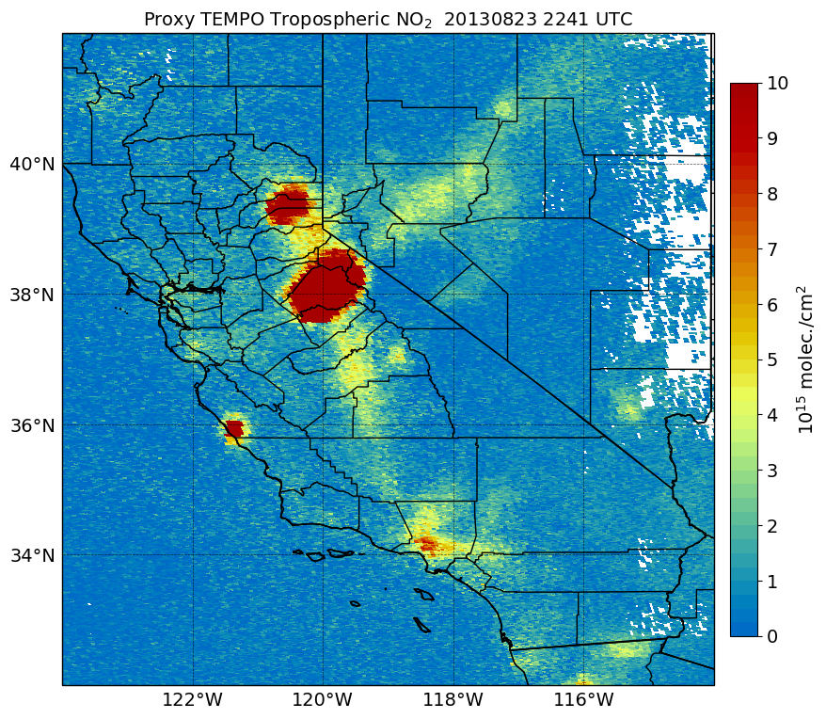
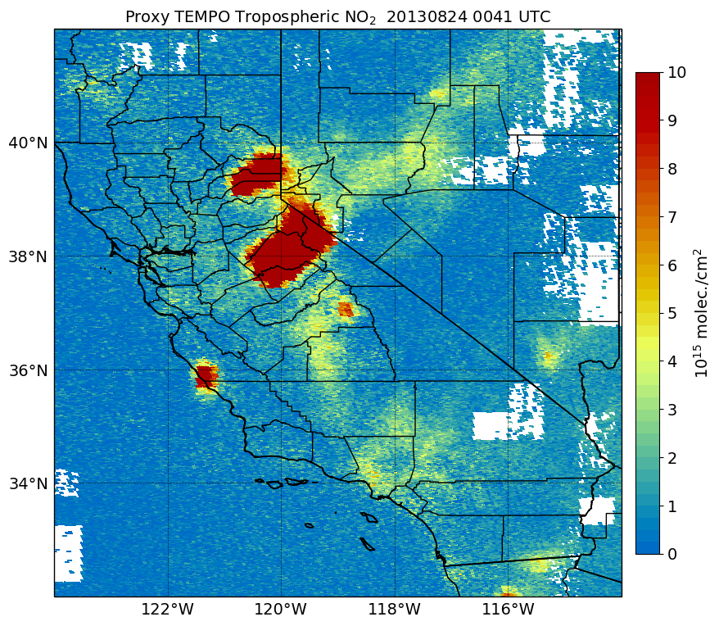
Monitoring NO₂ with TEMPO
Aug. 23, 2013
TEMPO Proxy Level 2 NO₂ data
Terra MODIS
~7:40 AM
~8:40 AM
~10:40 AM
~11:40 AM
OMI
NASA Worldview
~12:40 PM
~1:40 PM
~3:40 PM
~5:40 PM
OMI NO₂
~12:50 PM
TEMPO will observe rapidly varying NO₂ columns within wildfire smoke plumes and across urban areas and traffic corridors.
*Proxy data not intended to support operational decisions or scientific research studies
7

Slide 8
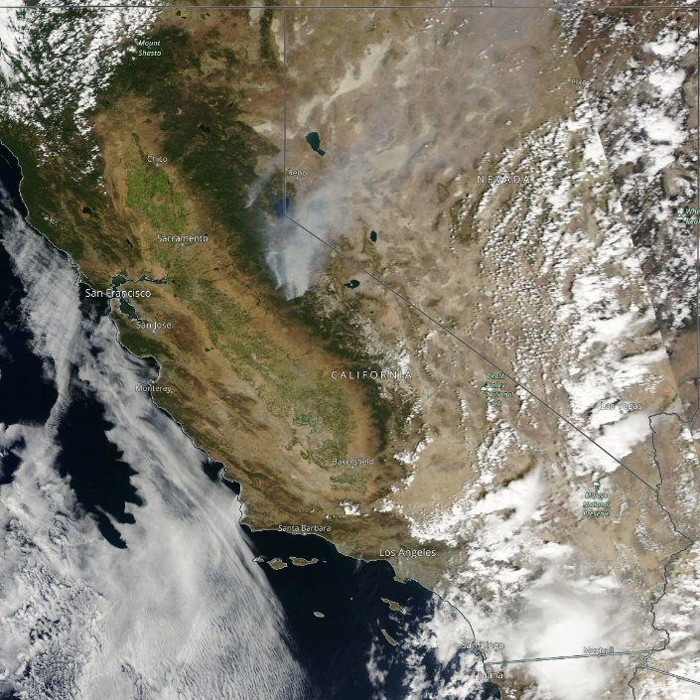
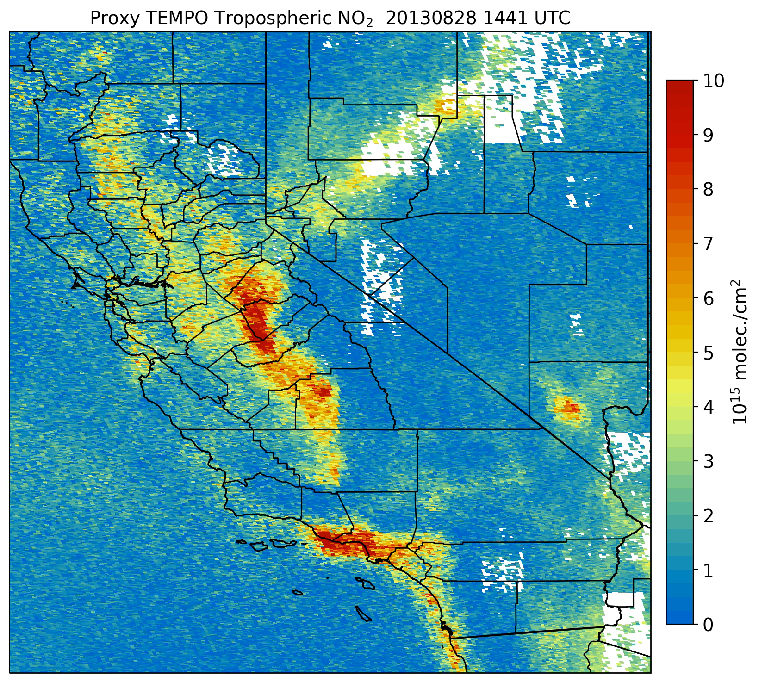
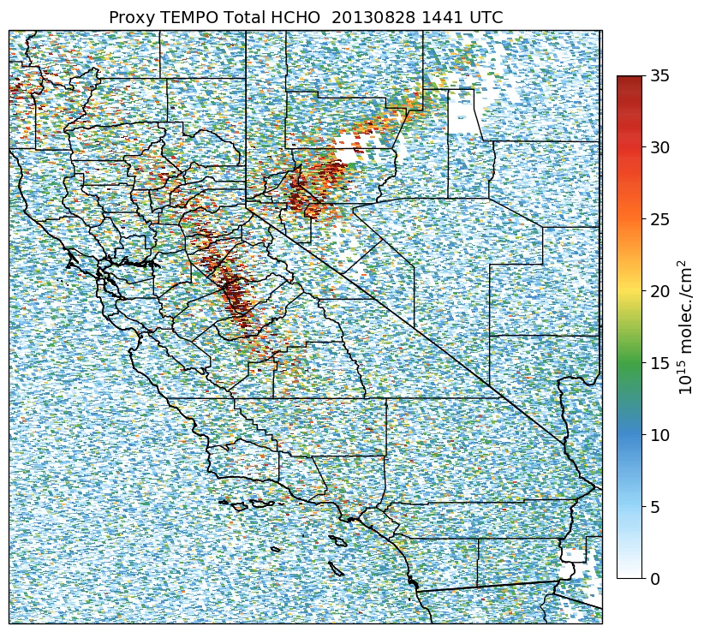
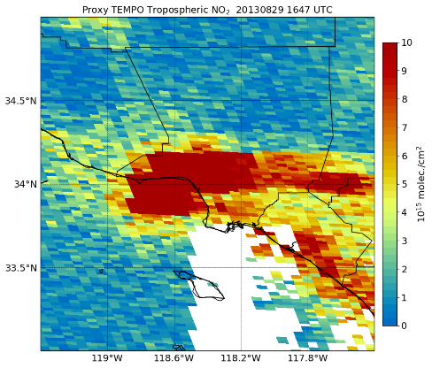
Multi-Pollutant Assessments with TEMPO
Tropospheric NO₂ VCD
Total HCHO VCD
Aqua MODIS
Worldview
29 Aug. 2013
28 – 31 Aug. 2013
Multi-pollutant information from TEMPO will help better diagnose emission sources, pollutant transport, and health impacts
HCHO/NO2 ratios can help infer ozone sensitivity to precursors
*Proxy data not intended to support operational decisions or scientific research studies

Slide 9
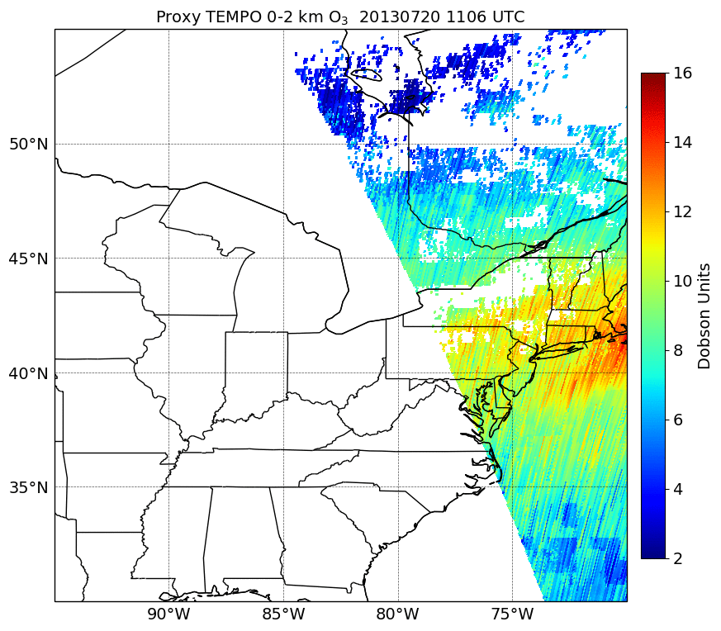
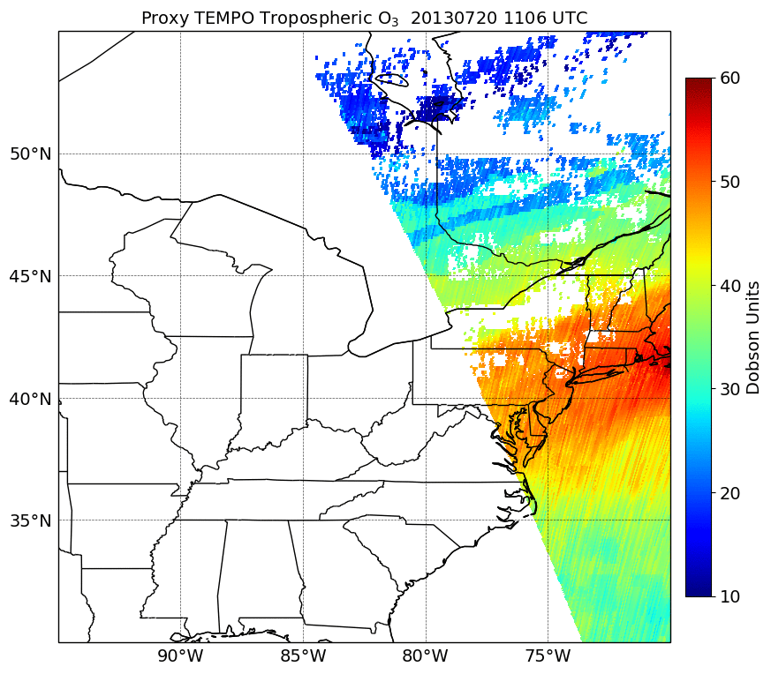
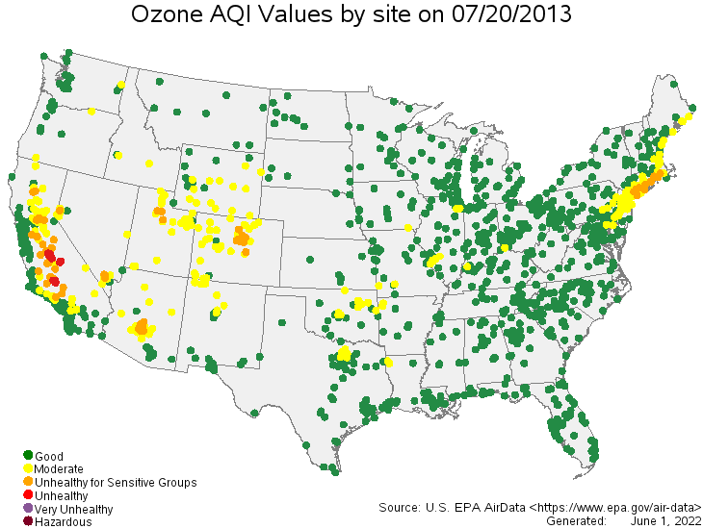
Monitoring Ozone Pollution with TEMPO
0-2 km (PBL) O₃
Tropospheric O₃
20 July 2013 Use Case
TEMPO instrument will be sensitive to O₃ in the lower troposphere as shown by the proxy data
O₃ profile will offer new capabilities to track and predict (assimilation) O₃ concentrations and transport from the stratosphere to the planetary boundary layer (PBL)
Unprecedented monitoring of O₃ pollution within the layer of air where people live and breathe
TEMPO O₃ data will help fill the gaps in surface monitor coverage, especially the large gaps in the western region

Slide 10
Summary of TEMPO Strengths (Non-Exhaustive)
O₃ profile will offer new capabilities to monitor and distinguish ozone concentrations from the stratosphere to the planetary boundary layer (PBL)
High-resolution tracking of air pollutants during interstate and international transport, which will provide valuable information and support for exceptional event analyses
TEMPO will observe small-scale emission sources that have not been adequately resolved by current satellite missions, capability to quantify sub-urban emissions and pollutant gradients
TEMPO will monitor rapidly evolving pollutants from episodic events such as wildland fires
Diurnal information on HCHO / NO₂ ratios for new understanding of sensitivity of local O₃ production and assessments of O₃ production regimes
Data will be valuable for surface monitor site analysis (selecting new site locations)
Robust monitoring of industrial operations, regulatory monitors may miss peak emissions!
Hourly scans for observing gaps in cloud cover, mitigate impact of clouds on satellite monitoring
Aerosol optical depth and aerosol layer height for aerosol plume monitoring and PM2.5 estimates
Low latent NO₂, HCHO, and aerosol products for real-time monitoring & forecasting!

Slide 11
Challenges Remain!
Space-borne spectrometers like TEMPO provide vertical column measurements, not nose-level concentration measurements
  Periods of persistent cloud cover will still cause gaps in TEMPO
Challenges associated with accessing, processing, and properly interpreting satellite data, especially noisy products such as HCHO and SO₂
  Large increase in data volume with TEMPO
Adapting previous retrieval methods for low-earth orbiting instruments (TROPOMI) to account for new challenges associated with geostationary satellites
  Changing solar geometry throughout the day, surface reflectivity, and a priori input for retrievals
First-ever O₃ PBL retrieval from space will be challenging, sensitivity to changes in O₃ in the PBL will require detailed assessments
@NaegerAaron
aaron.naeger@nasa.gov

