Slide 1

Short-Term Prediction Research and Transition Center (SPoRT)
“Rapidly translating user-driven science needs into applications”
Christopher Hain, Project Lead
Emily Berndt
Christopher Schultz*
Patrick Duran

Slide 2






Stakeholder Needs & Involvement
“Operations-to-Research” feedback and sustained stakeholder use
User-driven solutions derived from NASA observations and capabilities
Timely delivery of data products & applications training
Stakeholder assessment, analysis, and feedback
Accelerating the conversion of science to societal benefits through applications amplifies the societal impact and value of NASA’s investments

Slide 3


Connecting Science to Society
Science to Applications / Applications to Science requires a range of Technical and Educational roles to facilitate Innovation and Meet User Needs
Algorithm developer
Technical Integrators
Stakeholders
Innovators
Applications Team
Translators
Applications & Society
Science
Intermediaries
Ambassadors
Decisions & Policy
Process Studies
Science Team
Educators/Trainers
Beneficiaries
Mission Requirements
R2O/O2R:
User-Driven Innovation & Education
User Needs

Slide 4
Rapidly Translating Science into Applications
Traditional ROSES Proposal Process:
Proposal Preparation
Review
Jan
Jul
Jan
SPoRT Process:
Develop
Training
Product
Assessment
Customer Engagement
Science Co-Development
Prototype Delivery
Science Co-Development
Version 2 Delivery
Integrated into Operations
Jan
Jul
Jan
Opportunity: In this case, we were able to develop, train, and transition a tool into operations in the same amount of time it took to write a proposal, have it go through peer review and get a response.

Slide 5
















NASA SPoRT Team Structure
Current Partners
Current SPoRT “research-to-operations” Thematic Areas:
SPoRT remains focused on applying and utilizing its “research-to-operations” paradigm to support the current suite of NASA satellites and those upcoming in future missions, with a focus on future missions related to the Earth System Observatory.
Research Areas:
Tropical Meteorology
Atmospheric Remote Sensing
Lightning/ Convection
Air Quality / Human Health
Land Surface Remote Sensing
Machine Learning
Transition Activities:
End-User Training
Product Assessments
Data Production
Data Production

Slide 6

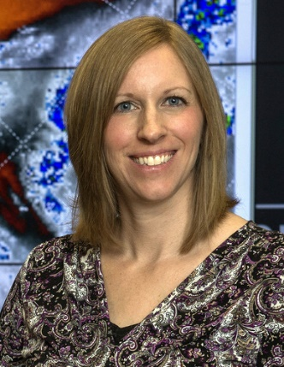







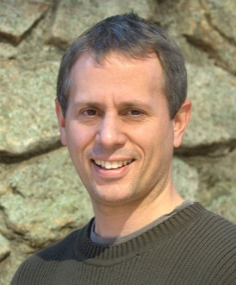
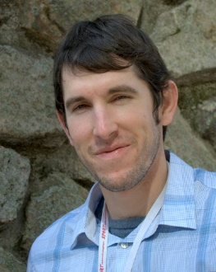








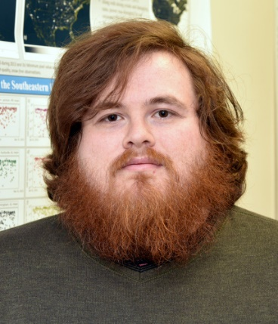
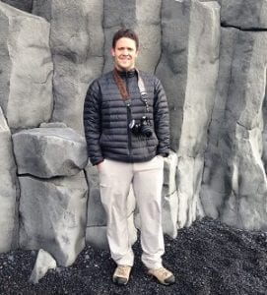






NASA SPoRT Team and Expertise
NASA Civil Servant Team
USRA Support Staff
NWS Staff
Christopher Hain
Emily Berndt
Christopher Schultz
Patrick Duran
Paul Meyer
(Emeritus)
Neelam Maheshwari
Clay Blankenship
Jayanthi Srikishen
Kris White,
NWS Applications Integration Meteorologist
UAH Support Staff
ENSCO Support Staff
Kevin Fuell
Aaron Naeger
Anita LeRoy
Matthew Smith
Kelley Murphy
Andrew White
Rob
Junod
Ryan Wade
Liz
Junod
Jacobs Support Staff
UAH Graduate Research Associates and Undergraduates
Jon Case
Sebastian Harkema
Sydney
Lybrand
Kiahna
Mollette
John Mark Mayhall
Amy McAlister
Roger Allen
Michael Antia
Christopher
Tracy

Slide 7
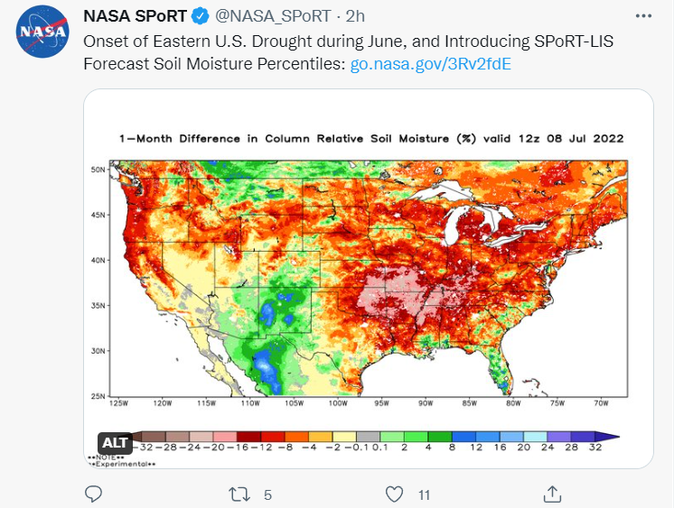
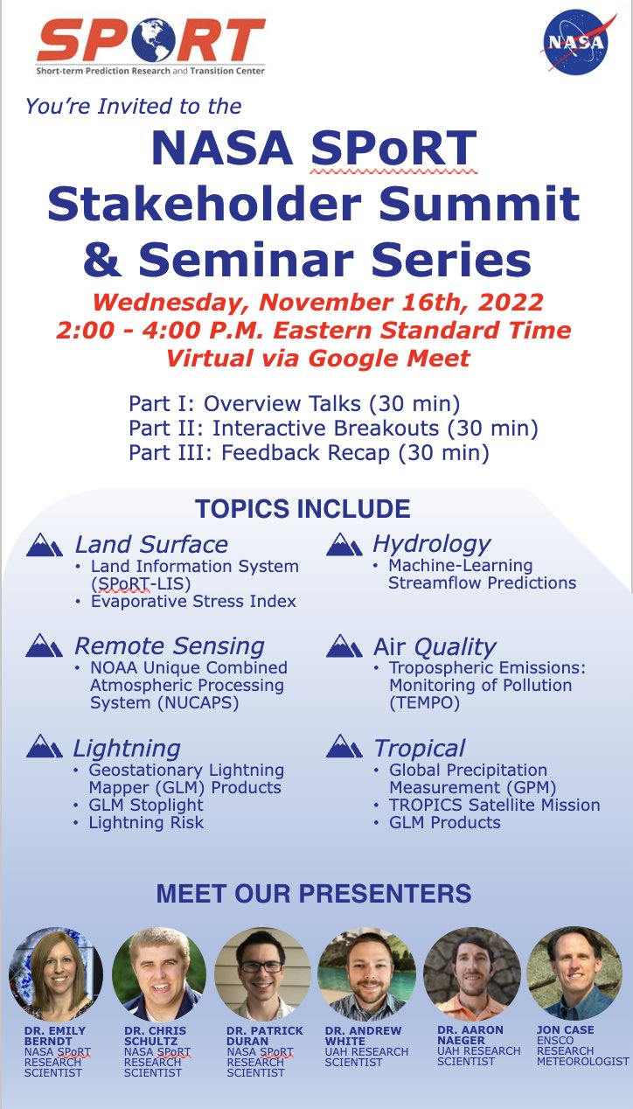
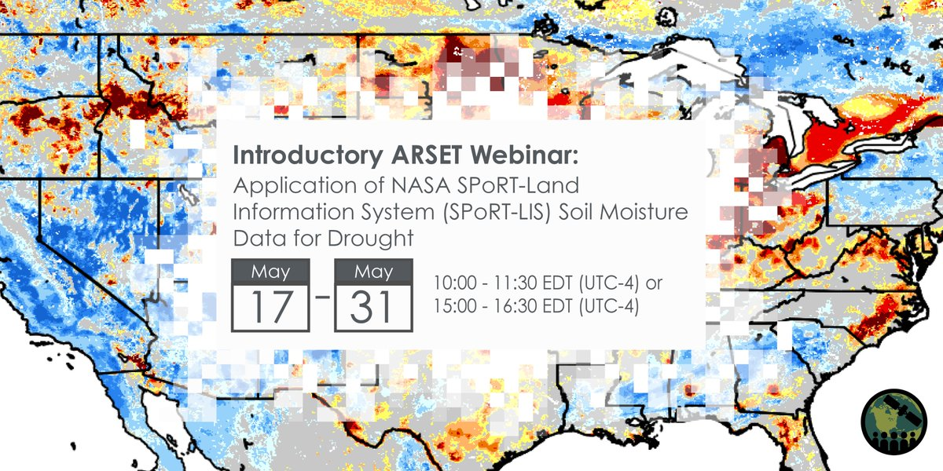
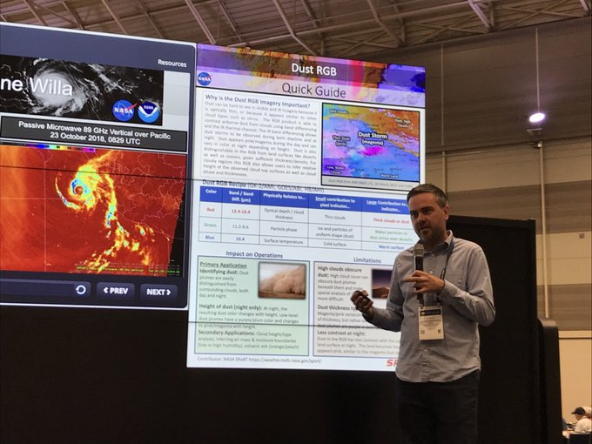
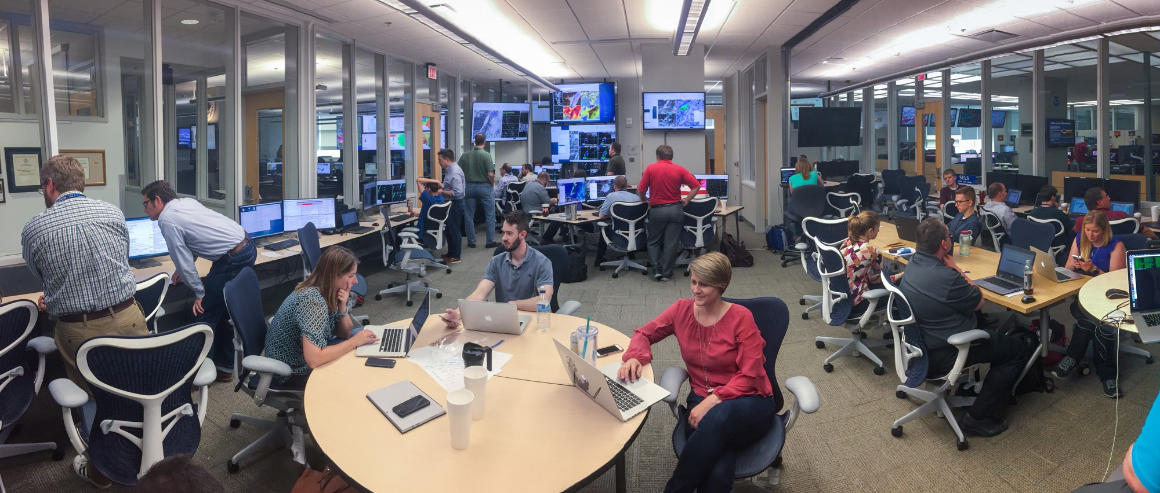
Ways We Engage The Community
Chris Hain presenting SPoRT Project at the Ag Commodity Classic
Hazardous Weather Testbed participation (2011-2023)

Slide 8
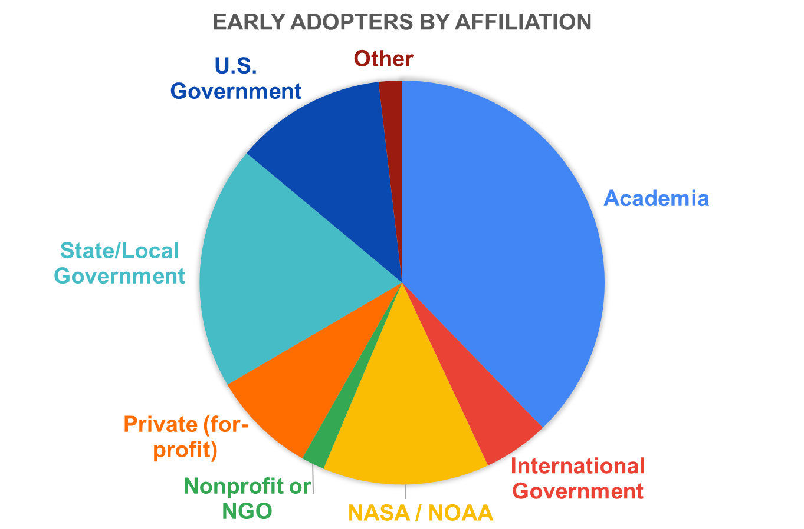
Building a User-Driven TEMPO Early Adopter Program
Success #1
Major growth of TEMPO user community with 300+ early adopters including 50+ AQ and health organizations
Success #2
Educate community on planned products and early development of tools via dissemination of proxy data
Success #3
Expansion of AQ and health application areas and addressed critical needs for NRT TEMPO data
Enhanced knowledge in TEMPO data and applications across user community including Community of Potential (e.g., Health and EJ groups)
Weather Analysis & Forecasting
Air Quality Modeling & Forecasting
TEMPO Launched!
Vegetation & Ocean Monitoring
Air Pollution Emissions & Monitoring
Overarching Goal
Maximize and accelerate the value of TEMPO data for societal benefit
Public Health
Regulatory Science
Extend TEMPO mission lifetime

Slide 9
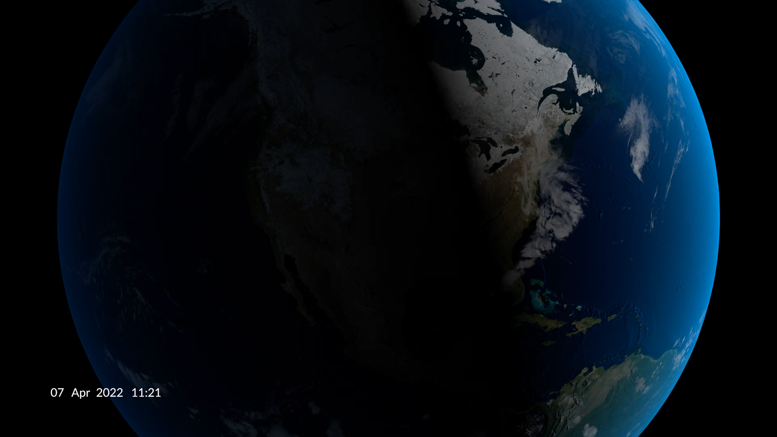
DustTracker-AI
Less Human Analysis, More AI-driven Data Curation
NWS operational
Use cases, feedback,
and impact on decisions
Once the solar angle got low enough and the Dust RGB started to suffer, that's when the ML model output started to shine.
… It certainly added additional confidence and clarity of how the dust was evolving.
… it gave me confidence to keep patchy dust in the forecast this evening
… supplemented our decision making when issuing a Blowing Dust Advisory, as well as supplemented our briefing to Emergency Managers
Notes:
Assessment Results:
In 62% of cases, the Dust ML probabilities added confidence to interpreting the Dust RGB and other satellite products to objectively assess the dust extent and trends
In 75% of cases, the Dust ML probabilities increased the amount of time the plume could be tracked
A physically-based approach dust detection machine learning model:
Can be used to study the processes driving the onset and progression of high impact dust events especially as they extend into the nighttime hours.
Has the potential to improve dust plume identification and analysis, overcoming the limitations of satellite imagery alone.
Can potentially lead to more timely operational dust storm warnings and advisories issued to alert the public.

Slide 10
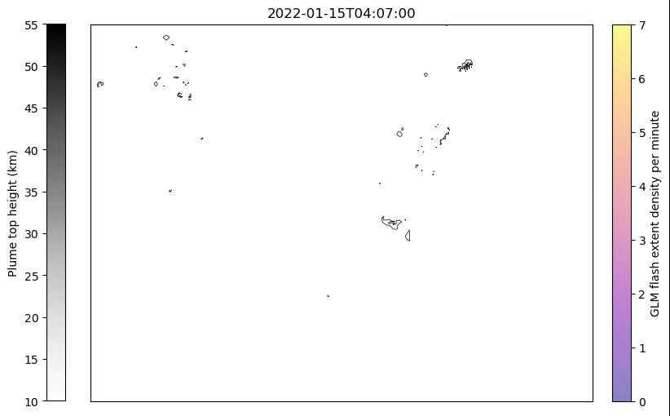
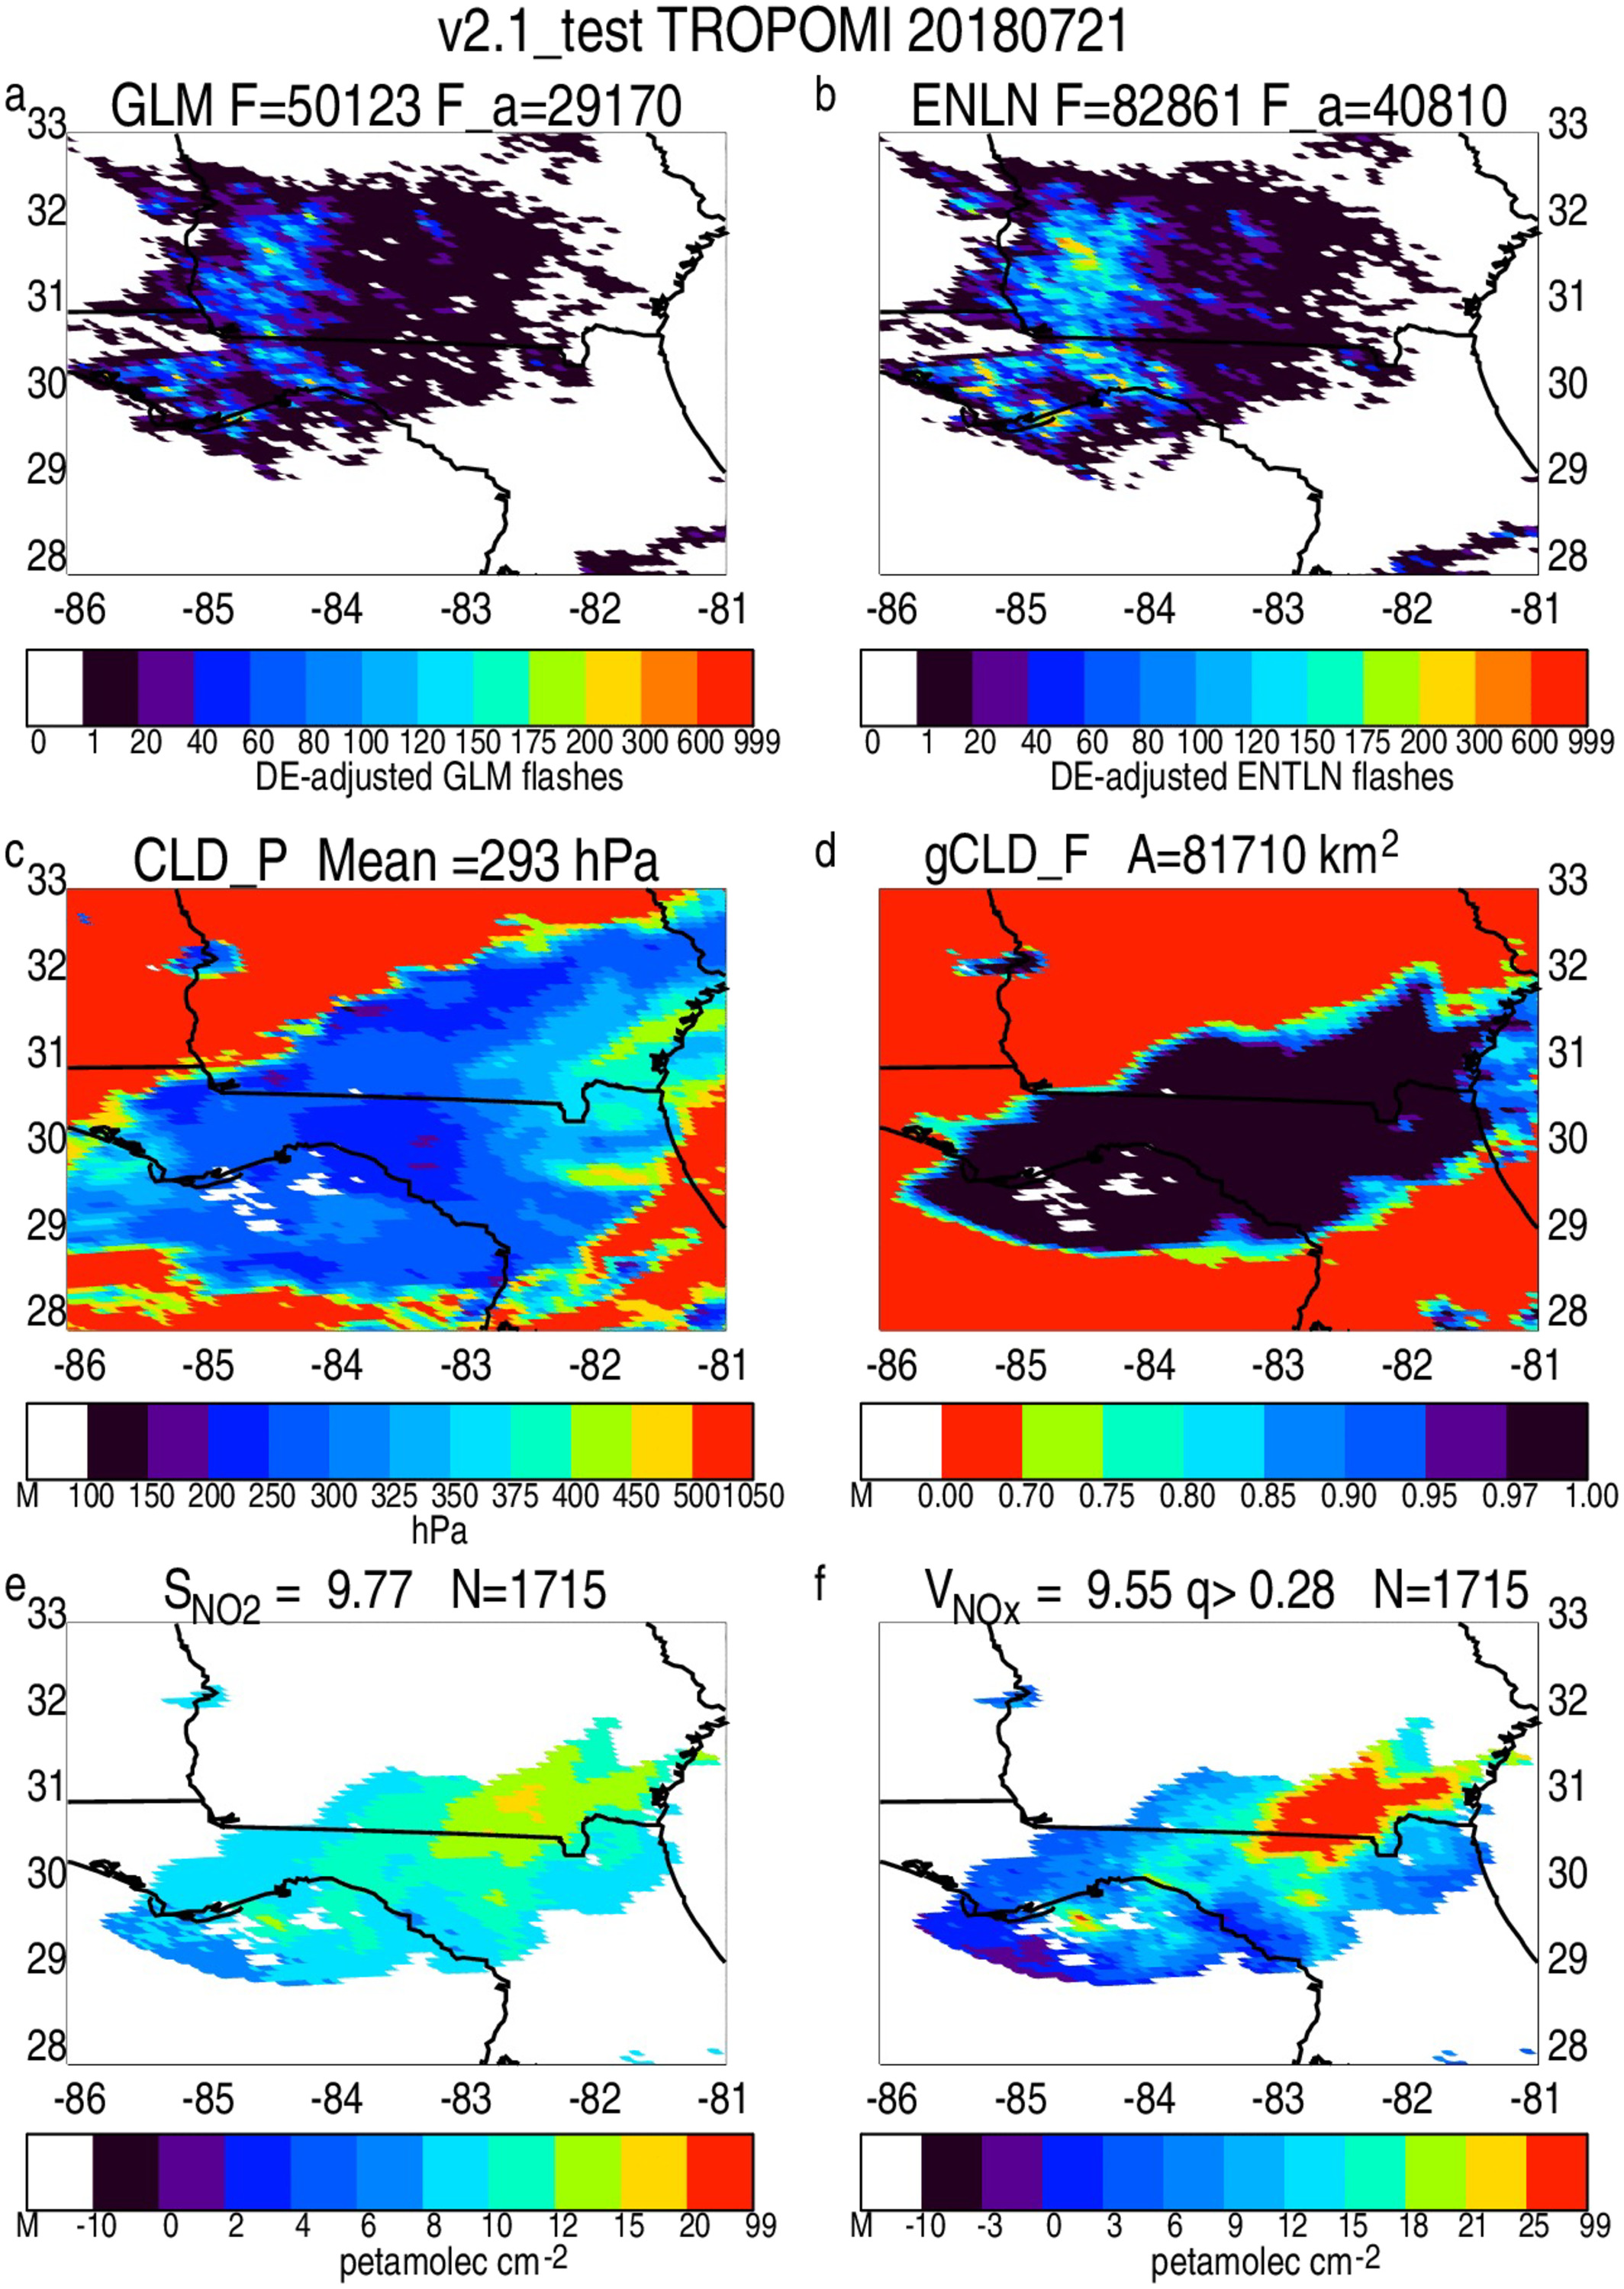
Lightning, aerosols, NOx
Van Eaton et al. 2023, GRL
Thorton et al. 2017, GRL
Allen et al. 2021, JGR

