Slide 1
Air Quality & Health Apps
Moderator: Barron H. Henderson
Panelists:
Joel Dreessen (Maryland DE),
Brian McDonald (NOAA CSL),
Ron Pope (Maricopa County AQD),
Sara Strachan (Idaho DEQ),
Dan Welsh (Colorado DPHE),
Dave Westenbarger (Texas CEQ)

Slide 2
Joel Dreessen
Maryland Department of the Environment

Slide 3
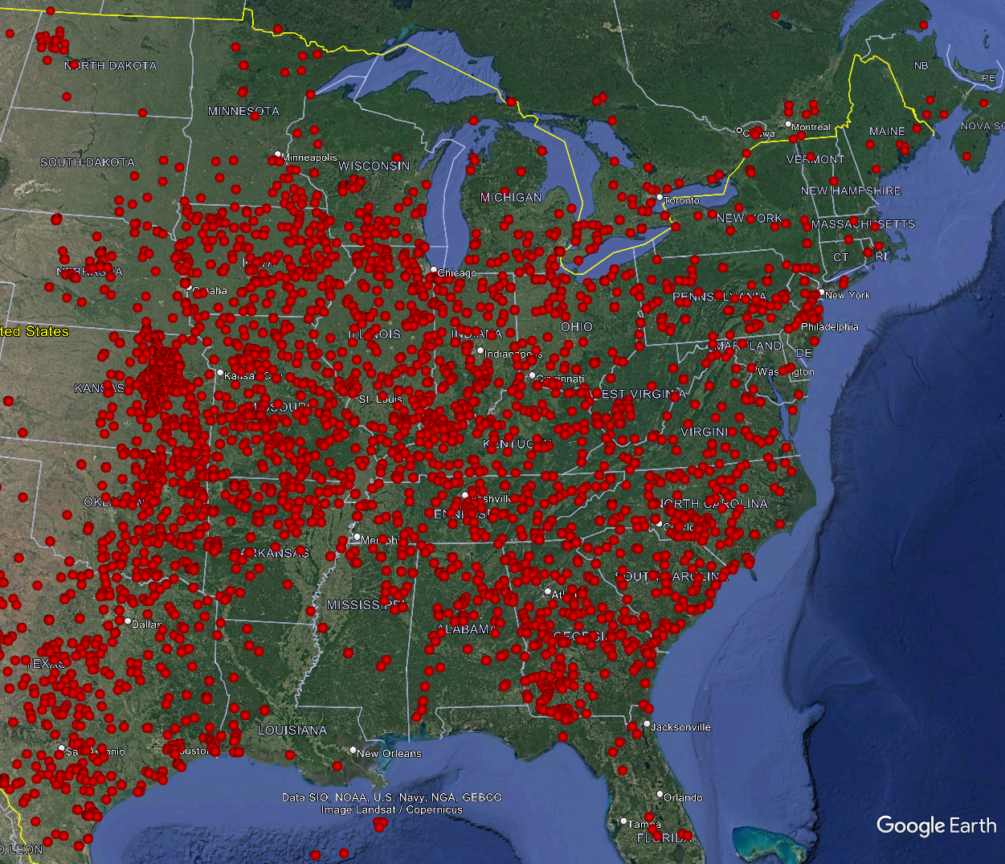
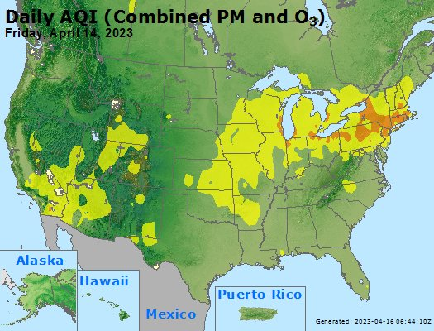
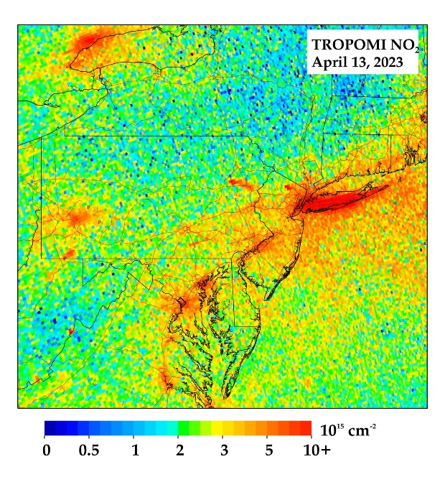
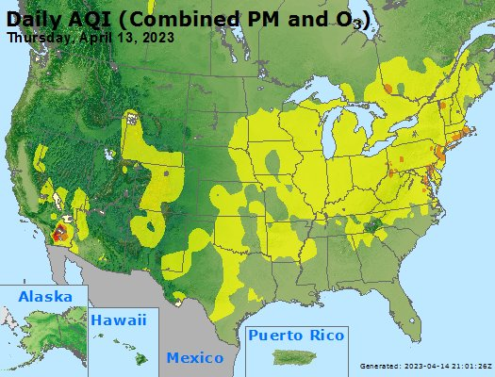
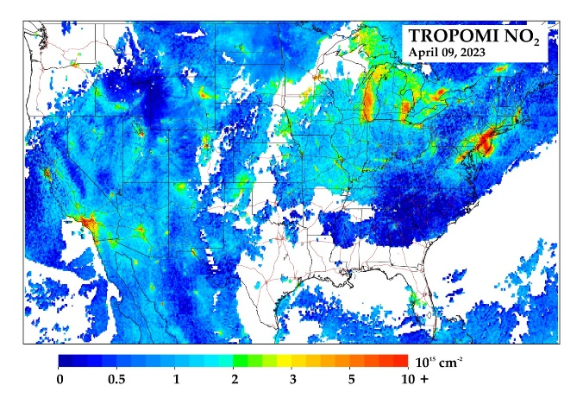
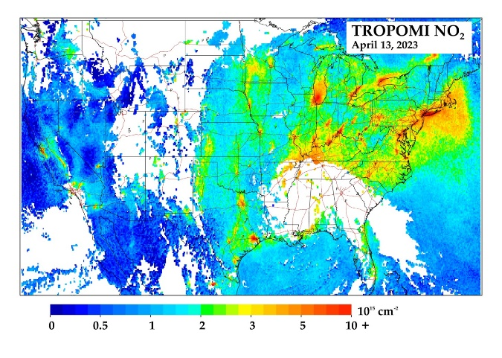
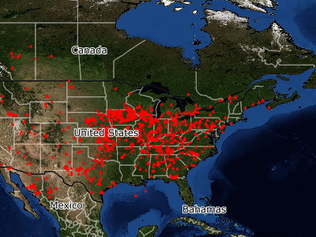
Thursday-Friday, April 13-14, 2023 Ozone Exceedance
9781 fire detections by satellite between April 9, and April 13, 2023
Tropomi Images: James Boyle - MDE
Joel Dreessen - MDE
NASA FIRMS – VIIRS retrievals

Slide 4
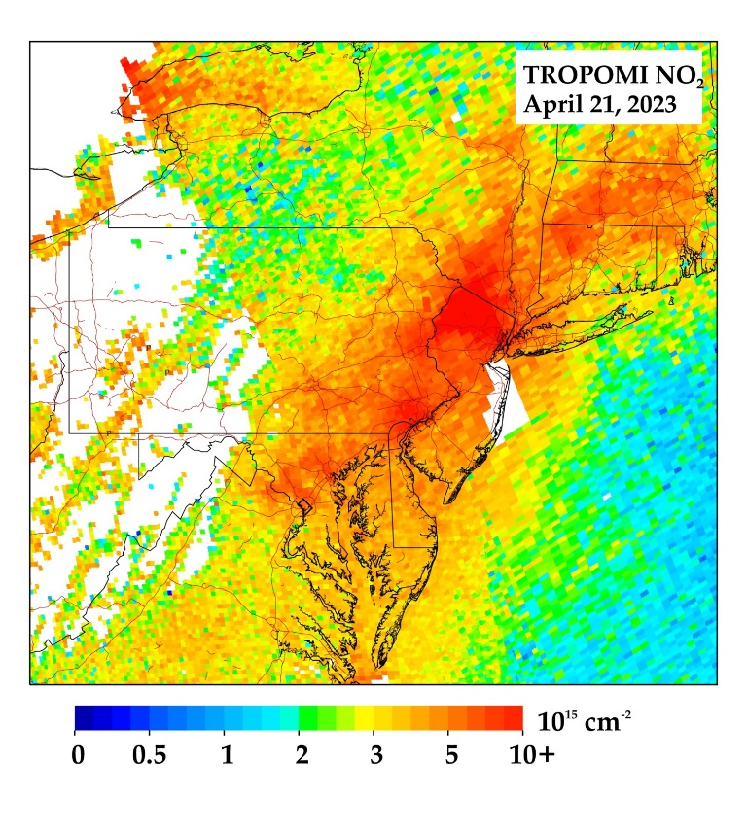
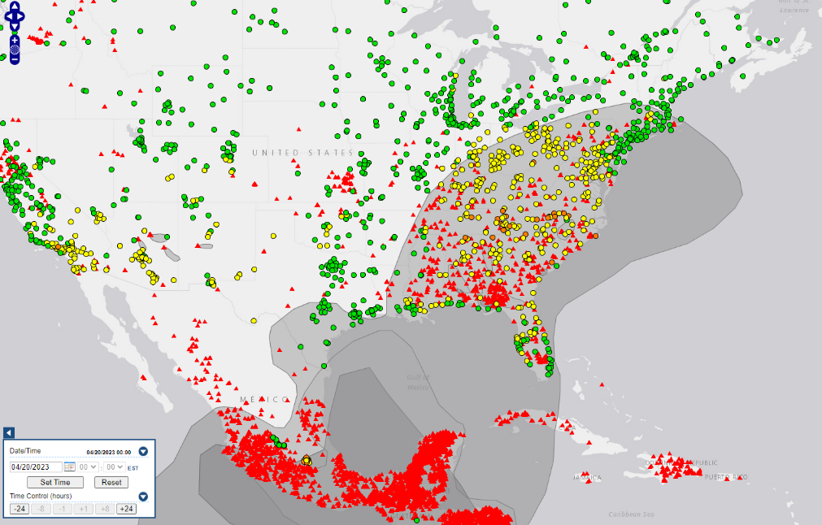
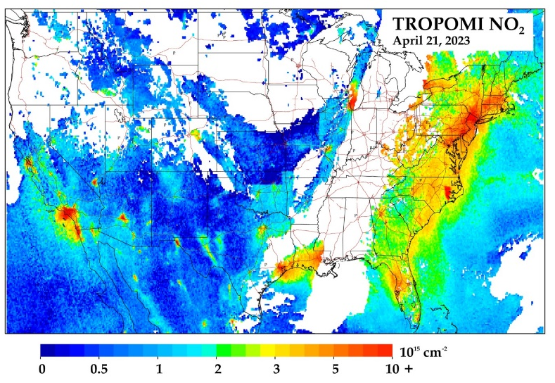
Friday, April 21, 2023 Ozone Exceedance
Smoke episodes and exceedances need both short latency to understand morphology, and quick post-access for Exceptional Event applications
Joel Dreessen - MDE

Slide 5
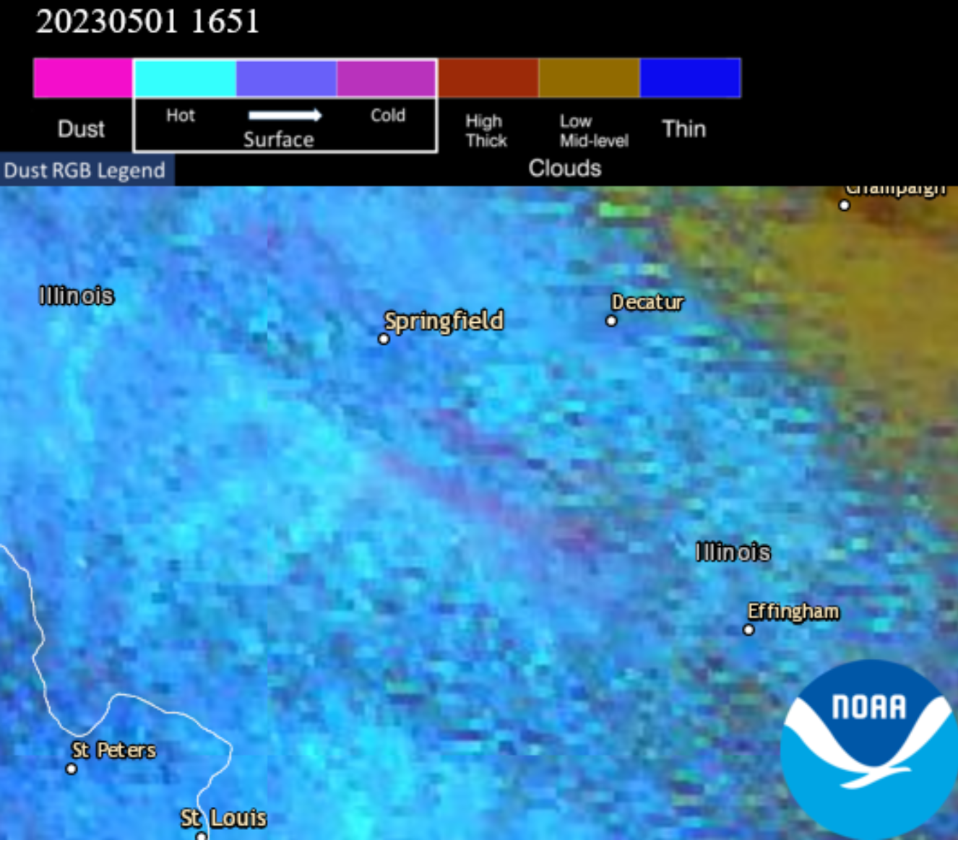
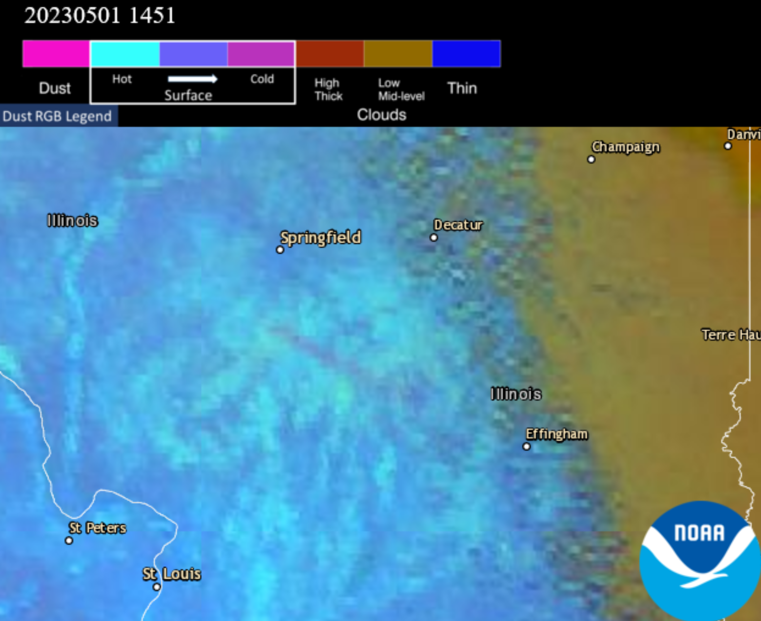
IL Dust Storm – Operational Example
Aerosol Watch
10-15 minute latency
Joel Dreessen - MDE

Slide 6
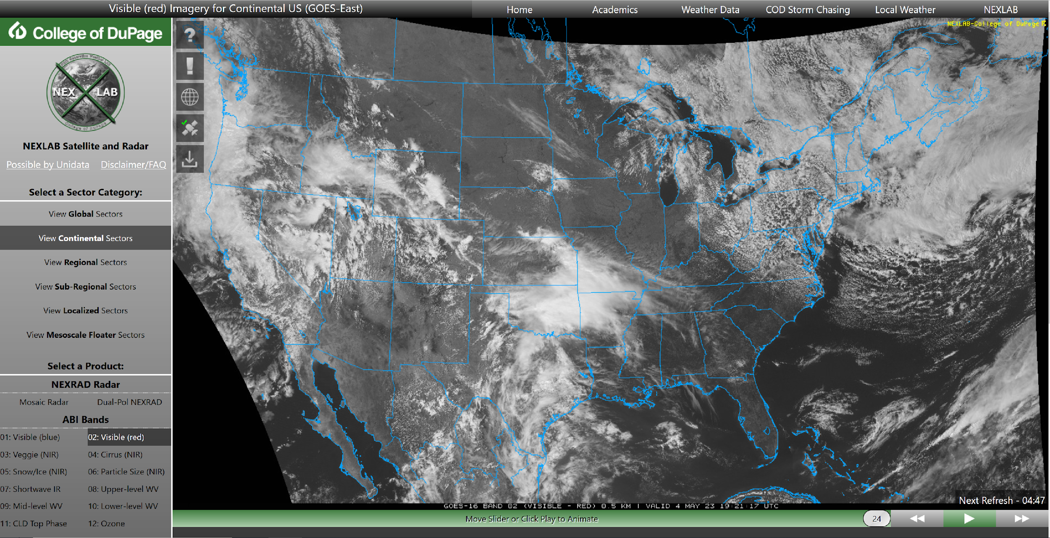
Operational Satellite – Example Site
Joel Dreessen - MDE

Slide 7
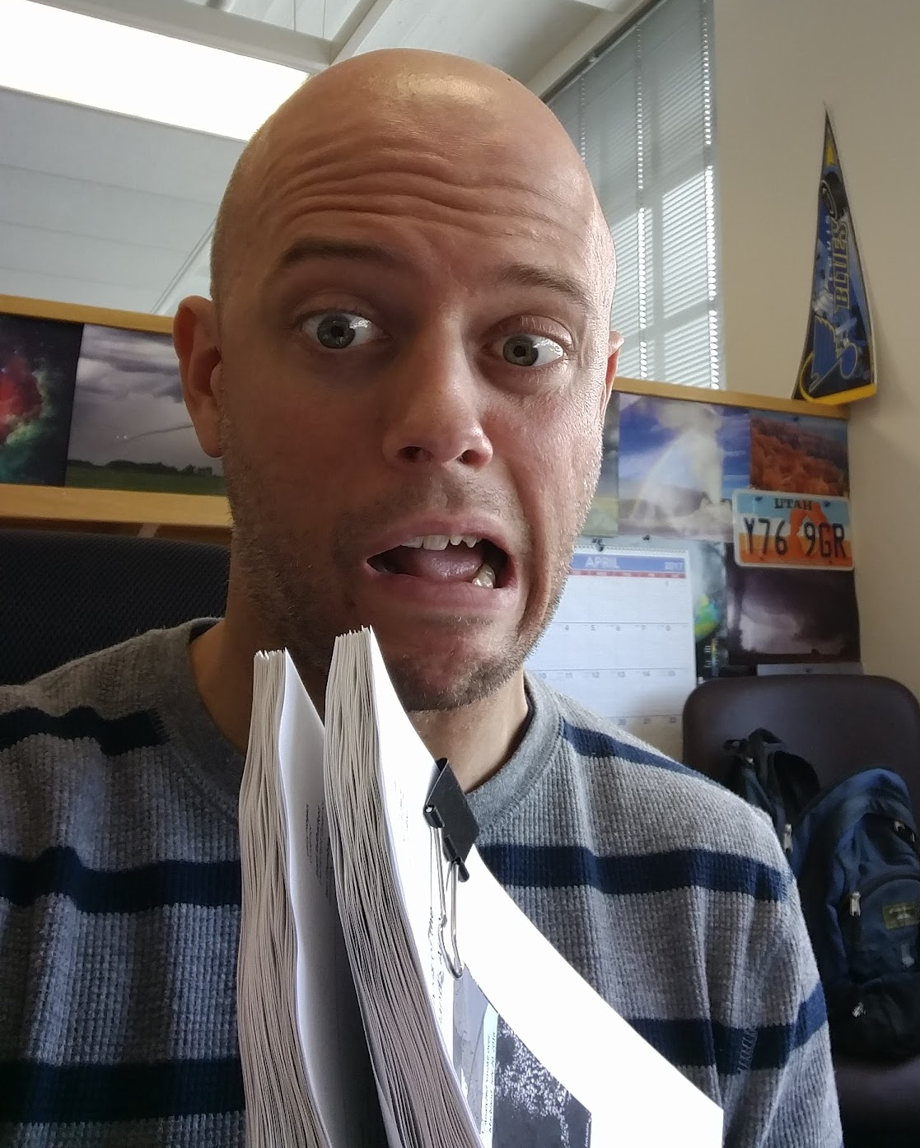
Exceptional Event Demonstrations are…‘fun’
200+ pages kept Maryland in attainment of the 2008 ozone standard in 2018
https://www.epa.gov/air-quality-analysis/exceptional-events-documents-ozone-maryland

Slide 8
Brian McDonald
NOAA Chemical Sciences Laboratory

Slide 9
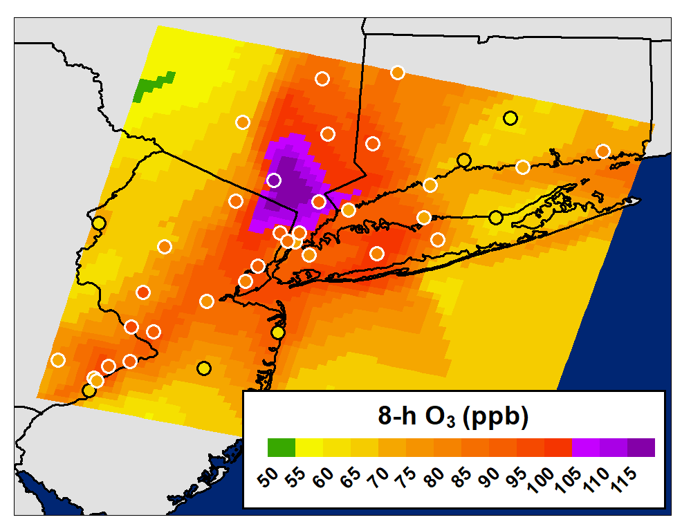
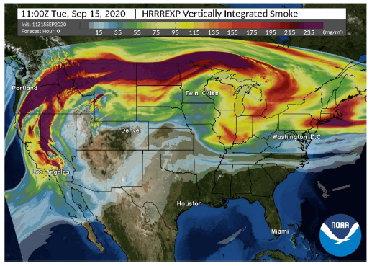
TEMPO L2 Products for AQ Forecasting
NRT Emissions for AQ Forecasting
Wildfire PM & Ozone Forecasting
NO₂, HCHO, O₃ (0-2 km)
AOD, ALH, NO₂, HCHO, glyoxal, HONO

Slide 10
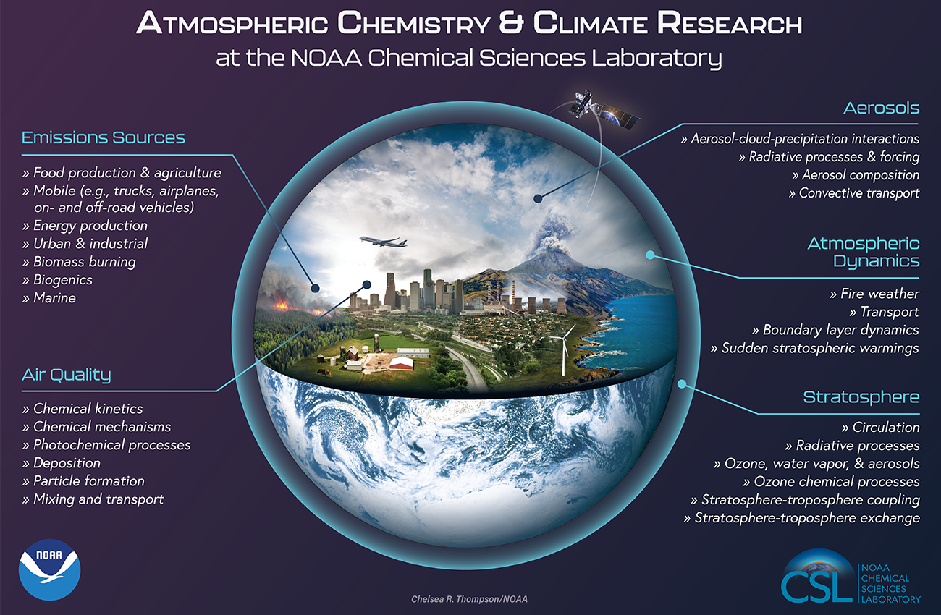
TEMPO Synergistic with NOAA CSL Research
Our Mission: To advance scientific understanding of the chemical and physical processes that affect Earth's atmospheric composition and climate.
Our Vision: A nation with the best scientific understanding and information about atmospheric chemistry and composition necessary to make optimal decisions for current and future generations.

Slide 11
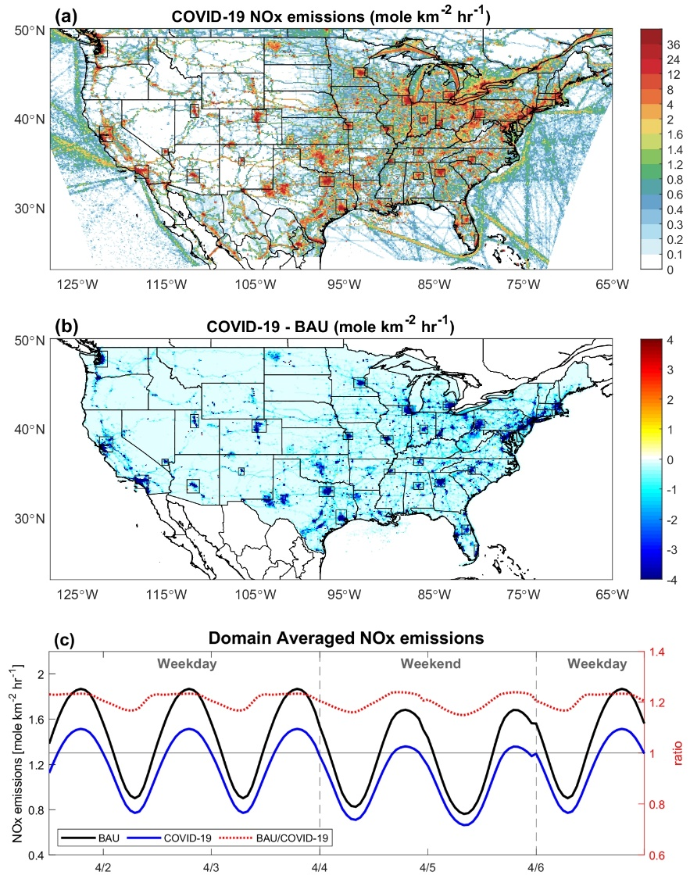
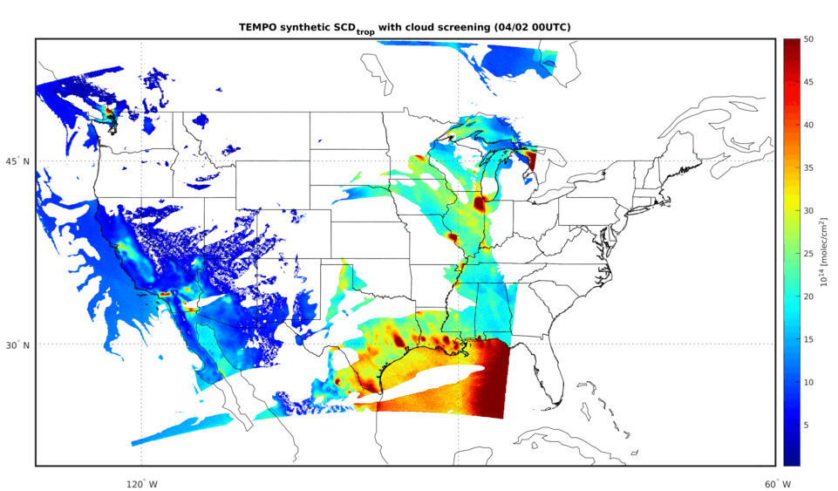

Computing Resources
Typically work with L2 Data
→ L3 Products
Modeling & Data Assimilation
Cloud-to-cloud data transfer
Cloud computing for modeling (e.g., WRF-Chem)

Slide 12
Maricopa County Air Quality Department
Ronald Pope
Atmospheric Scientist,
Planning & Analysis Division

Slide 13
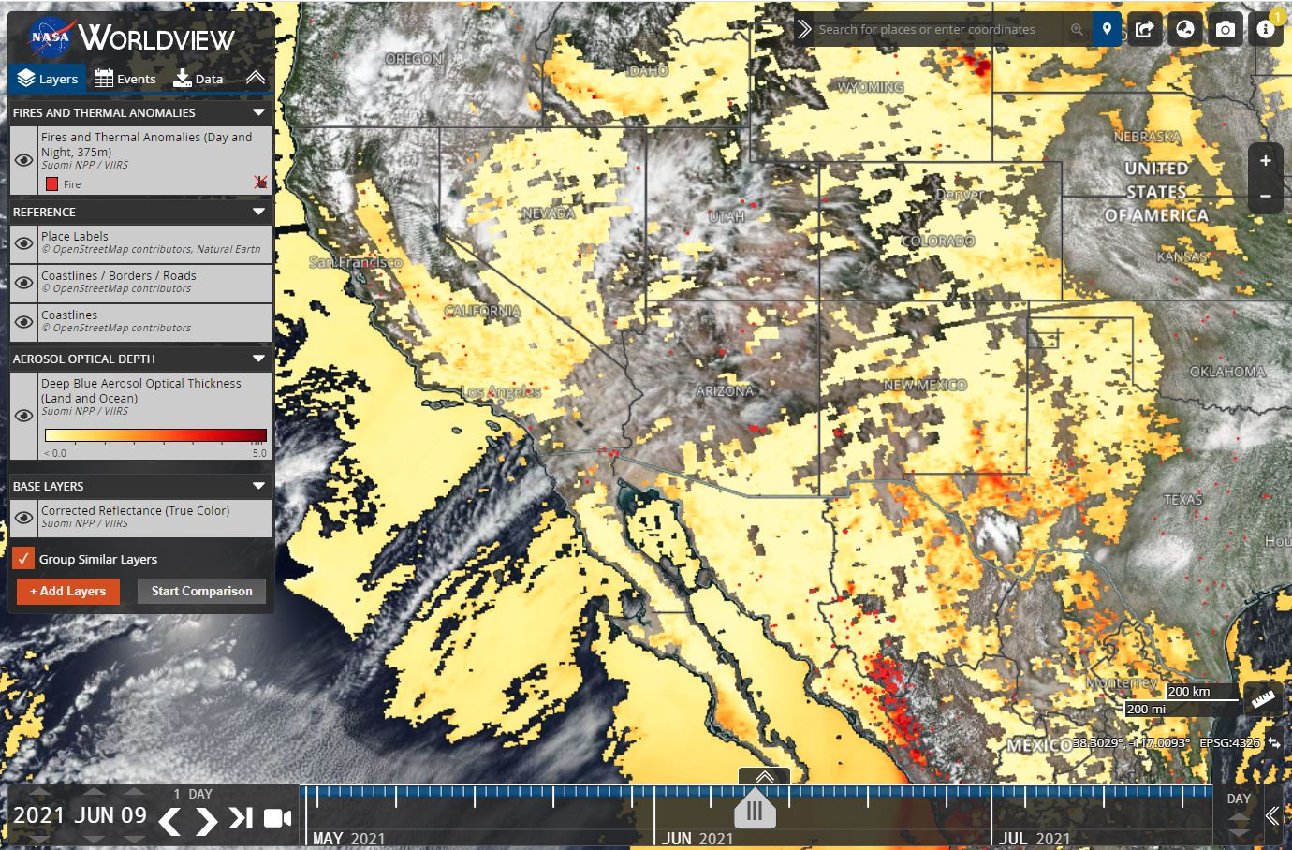
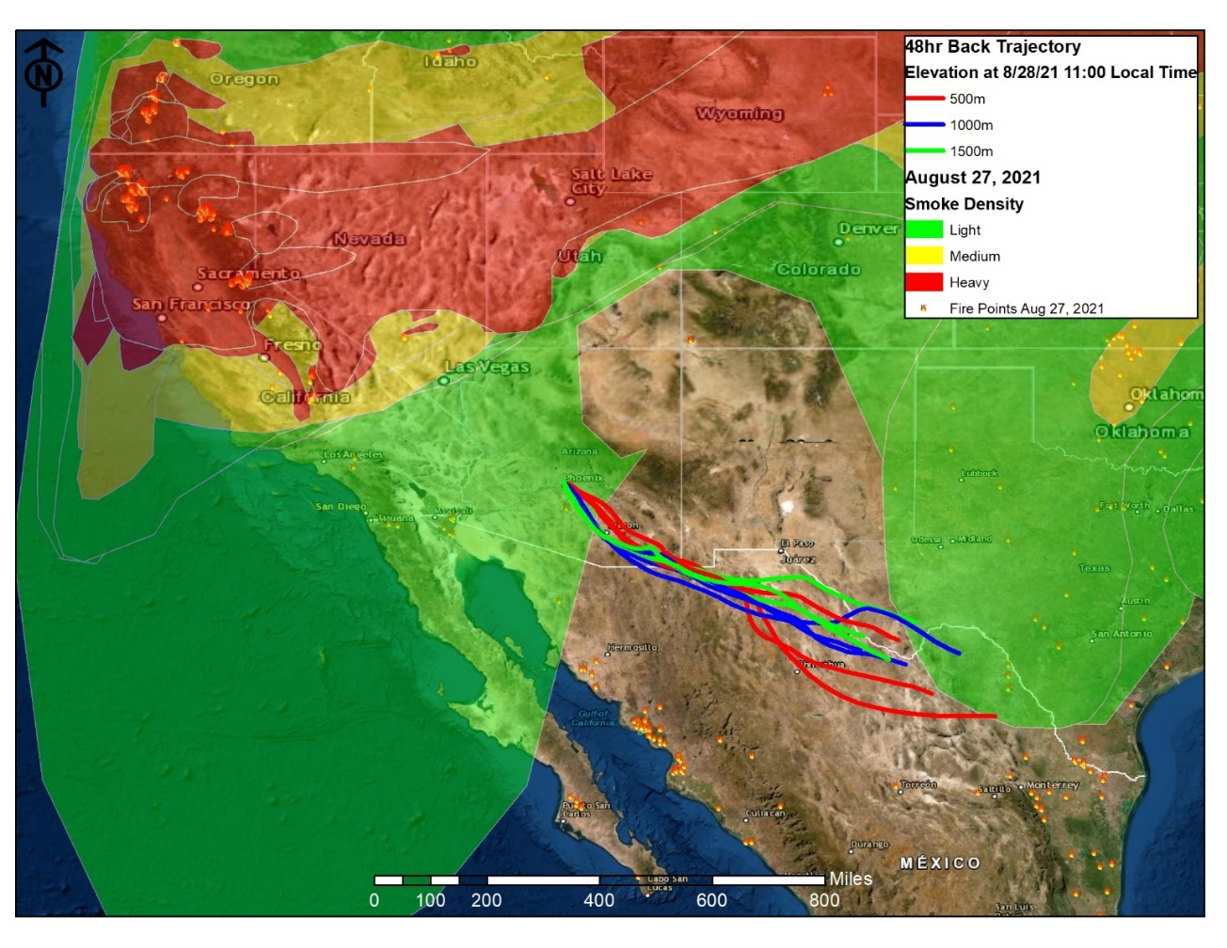
Ozone Exceptional Event Demonstrations
Aerosol optical depth map taken from the Suomi NPP satellite on June 9, 2021.
Source: NASA Worldview
NOAA smoke and fire maps from August 27, 2021, and HYSPLIT 48-hour back trajectories for the North Phoenix, South Phoenix, and Mesa monitoring sites.
Source: NOAA Hazard Mapping System

Slide 14
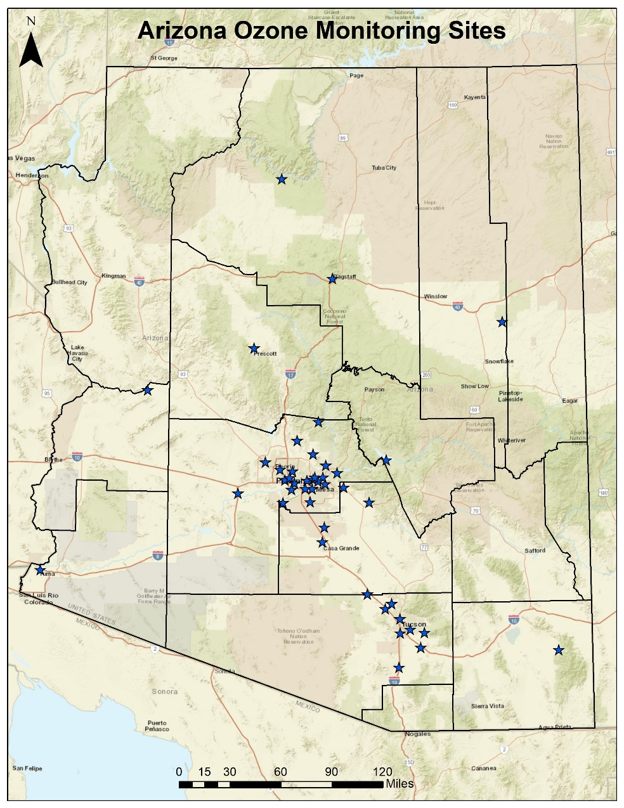
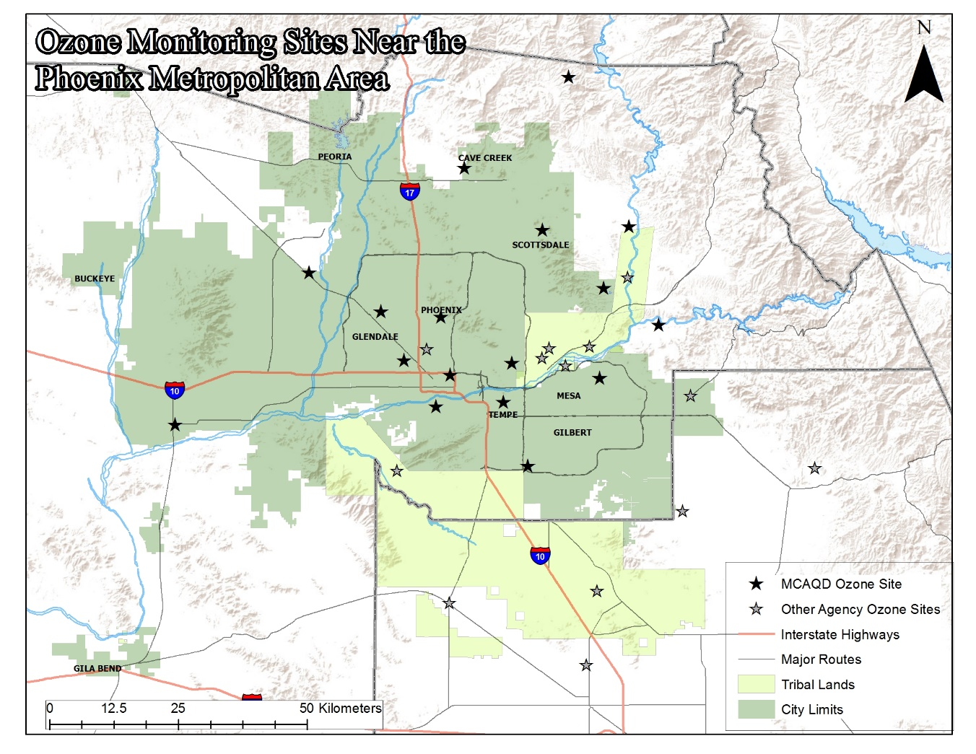
Ozone Monitoring Sites

Slide 15
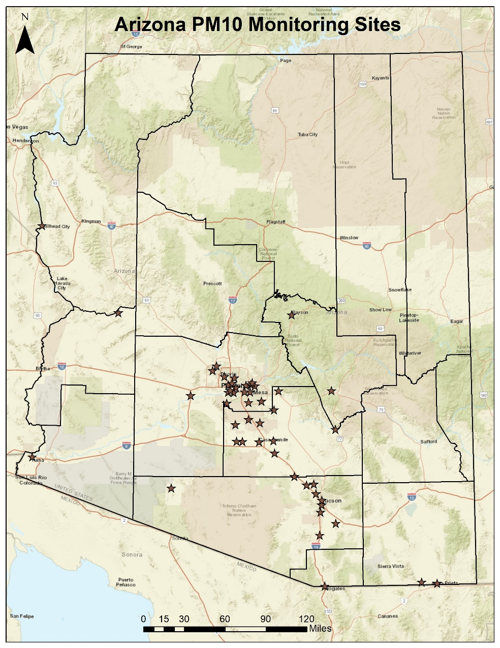
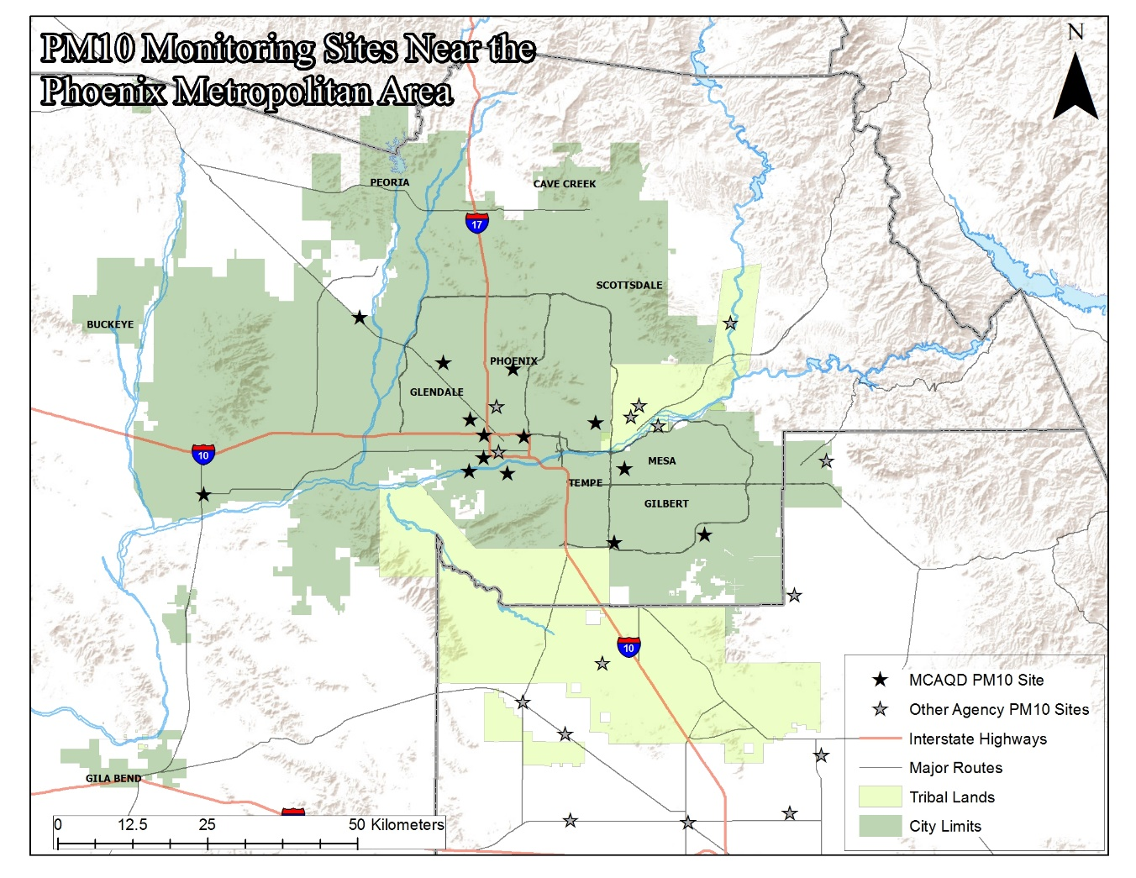
PM₁₀ Monitoring Sites

Slide 16
Sara Strachan
Idaho Dept of Environmental Quality

Slide 17
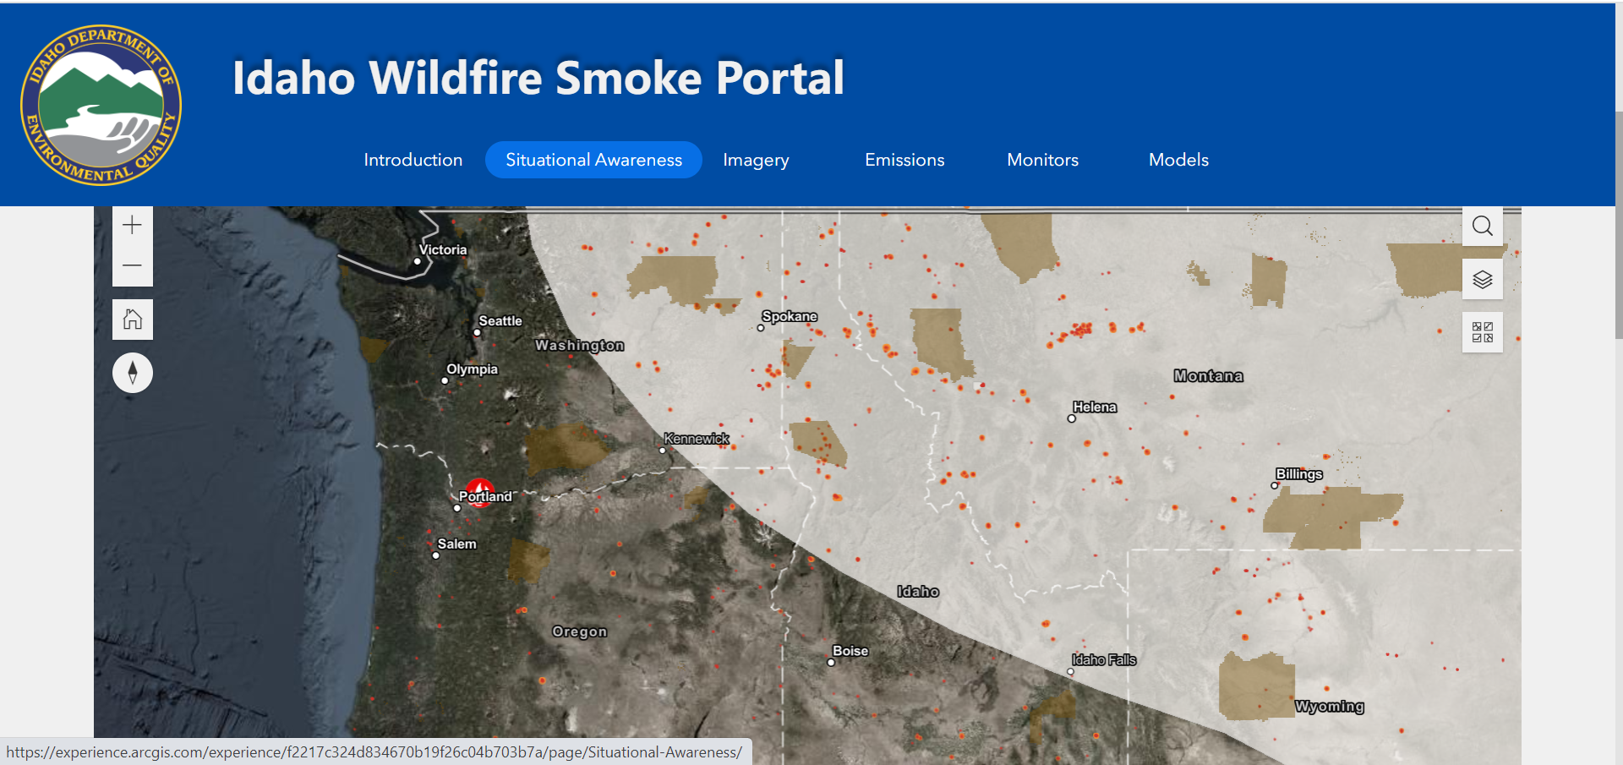
https://experience.arcgis.com/experience/f2217c324d834670b19f26c04b703b7a

Slide 18
Dan Welsh
Colorado Dept of Public Health and Environment

Slide 19

TEMPO Application to Air Quality Monitoring (and Communication) in Colorado
Dan Welsh, Katie Broyles, Scott Landes
Colorado Department of Public Health and Environment
dan.welsh@state.co.us
Notes:
3 min

Slide 20
CDPHE, Air Pollution Control Division
Mission: The APCD protects the health and well-being of [all] Coloradans by enforcing the state's air pollution laws and improving the quality of the air they breathe.

Slide 21
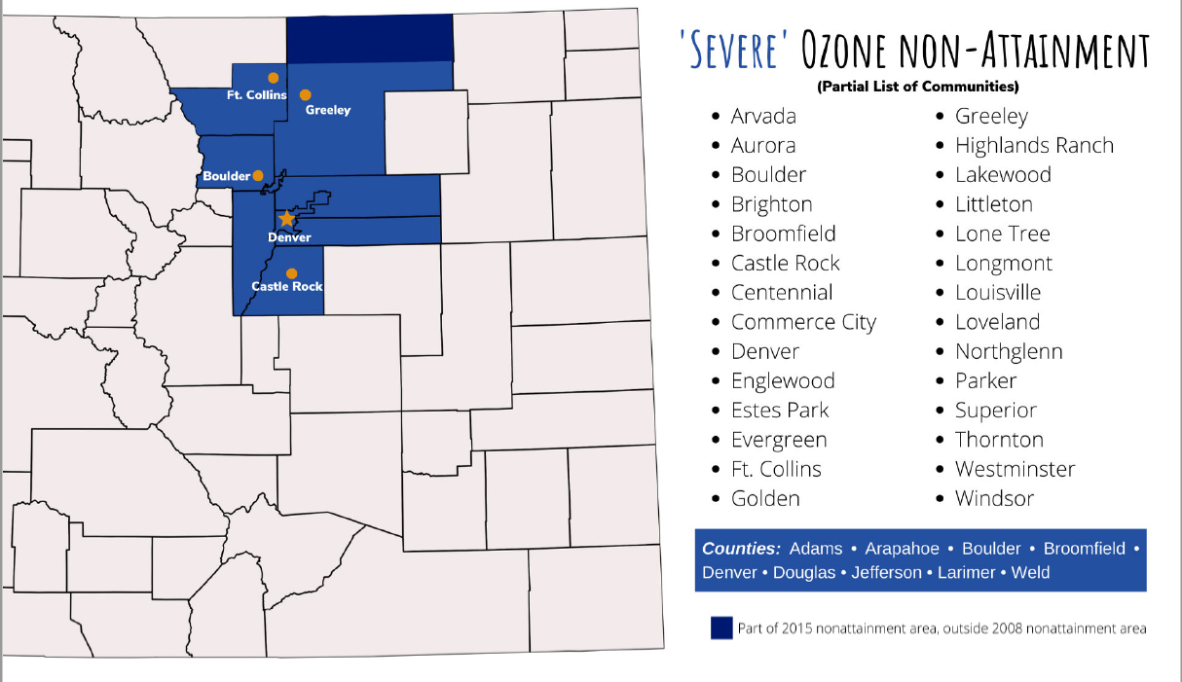
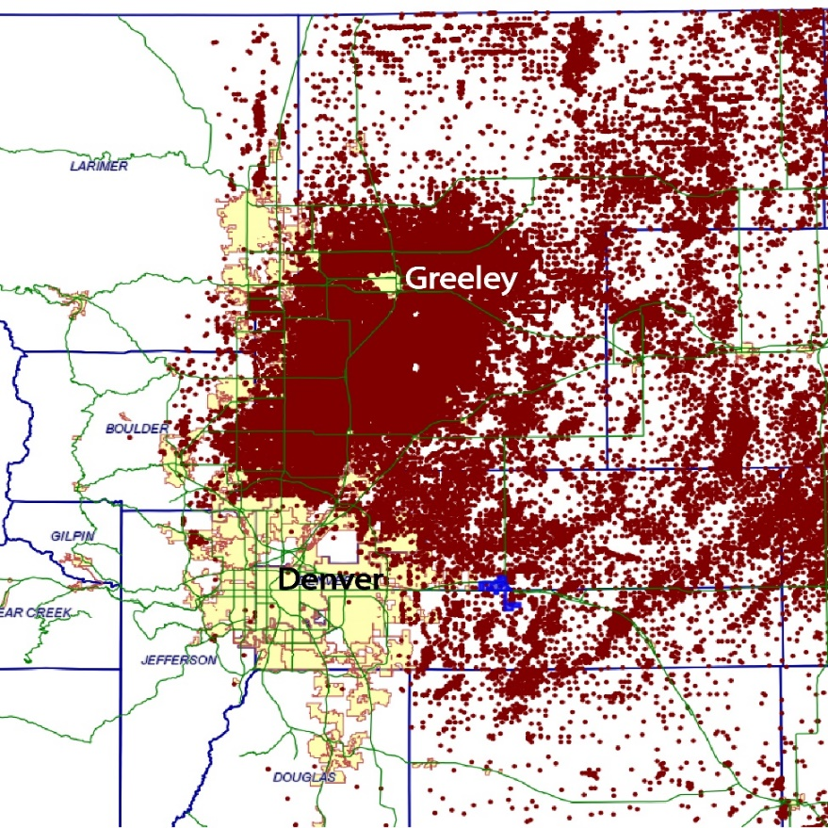

Background
Ozone Nonattainment area
-Repeated downgrade
-> Marginal (2008)
-> Moderate (2016)
-> Serious (2020)
-> Severe (2022)
Contributions:
Urban concentrations, traffic emissions
O&G Operations
Topography
Notes:
Long standing ozone problem, wealth of O&G operations in the region-extraction, storage, transport

Slide 22
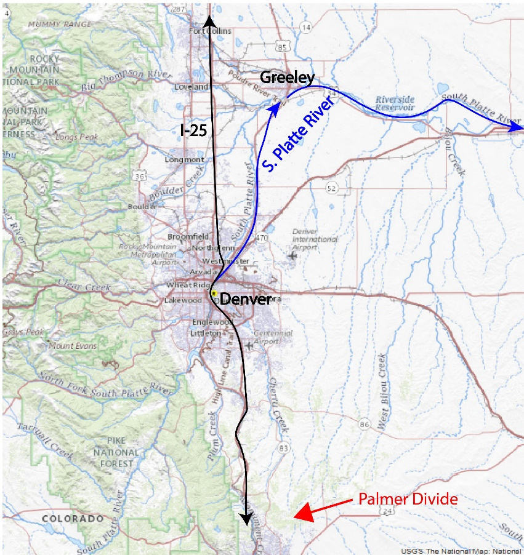
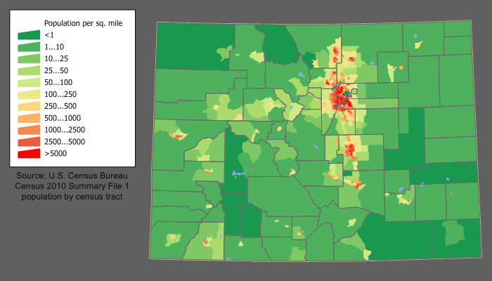
Background
Population Density highest along Colorado Front Range
Topography of region is also a major influence
Source: https://commons.wikimedia.org/wiki/File:Colorado_population_map.png

Slide 23
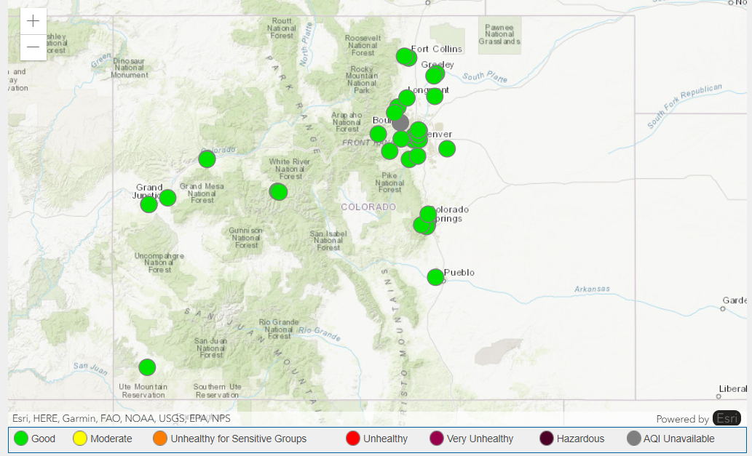
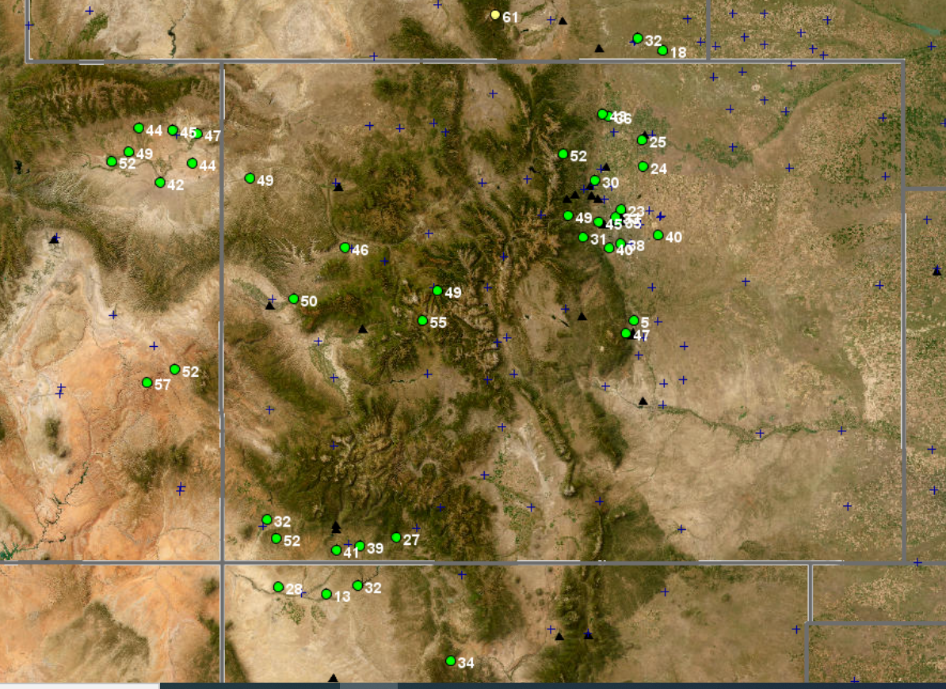
Monitor Locations CDPHE Others (EPA, Tribal, States)
All Have Significant Data Gaps

Slide 24
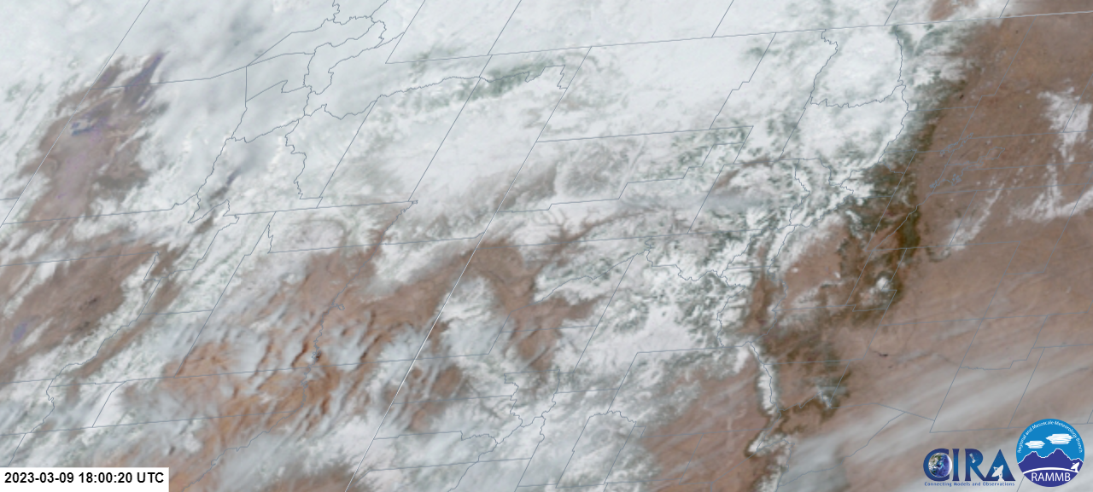
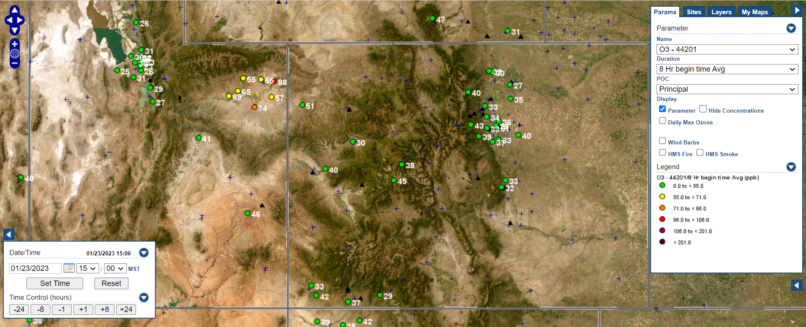
Rural areas lack monitor coverage
To protect all public health, population density cannot be the only consideration

Slide 25

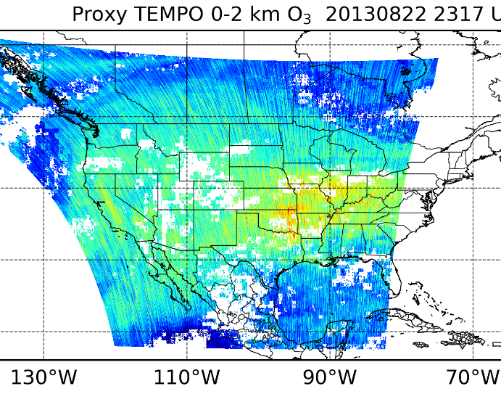
TEMPO Observations Will Help to Fill Data Gaps

Slide 26
Dave Westenbarger
Texas Commission of Environmental Quality

Slide 27
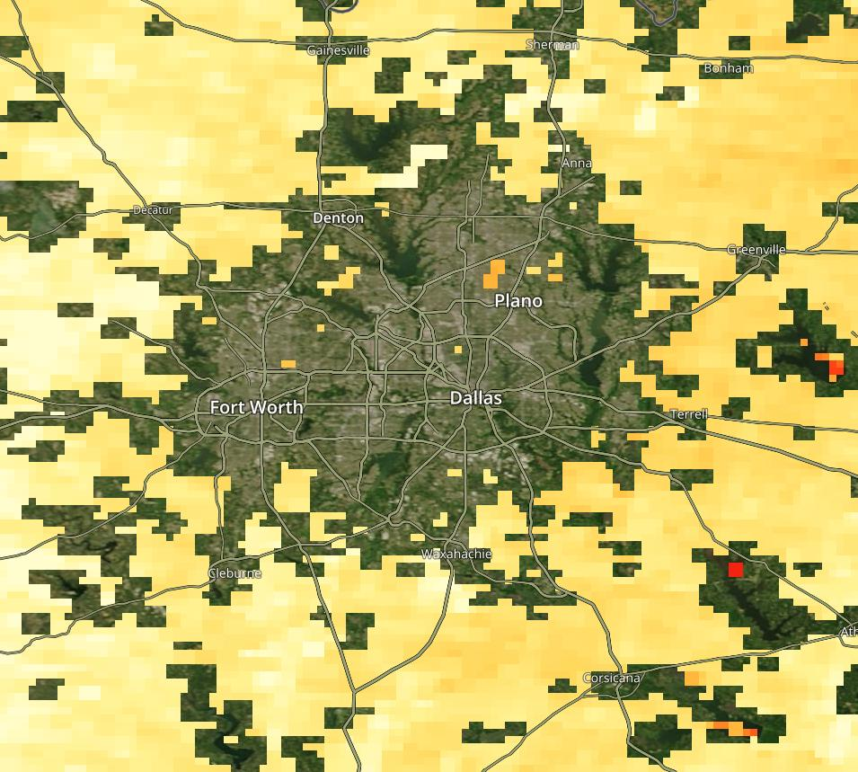
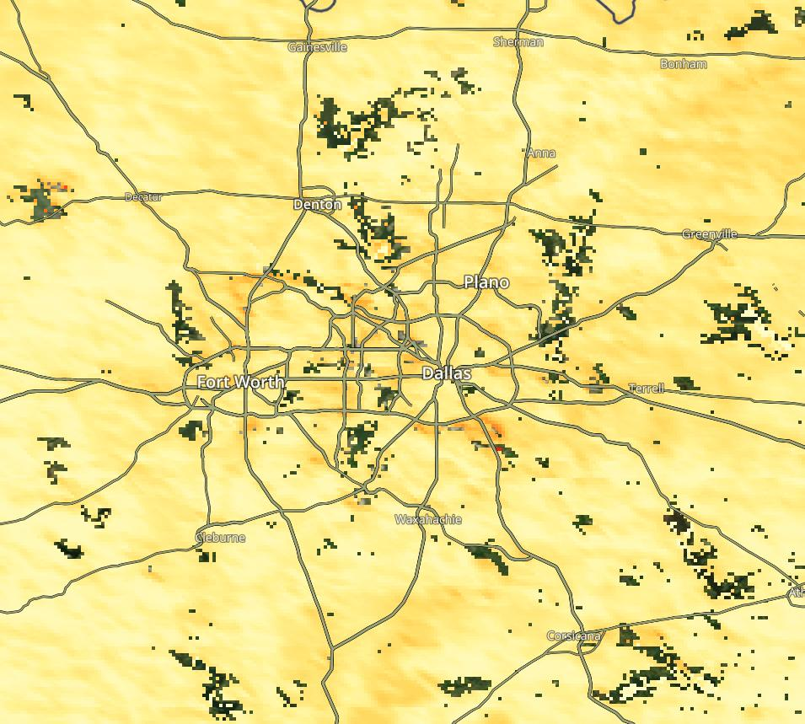
Dark Target (Terra MODIS)
MAIAC (Aqua & Terra)

Slide 28
Discussion Questions
What baseline or proposed TEMPO products are most critical to your organization?
How will TEMPO data improve your current research or operations?
How will TEMPO enhance your application area?
How do you (organization) intend on processing and analyzing TEMPO data?
Do you have the resources needed to implement TEMPO into your research or operations? (https://weather.cod.edu/satrad/)
Are there existing NASA tools/capabilities that you hope will include TEMPO?
What are your needs in terms of data products and levels?
Discuss needs for any level 3 products and resolution?
Data latency needs?
PBL ozone? Aerosols?
What other data formats and tools would facilitate your use of TEMPO data?
Do you have any needs for data from the TEMPO special operations to further improve your research or operations?
What evaluation products will be necessary for your agency to use this data?

