Slide 1
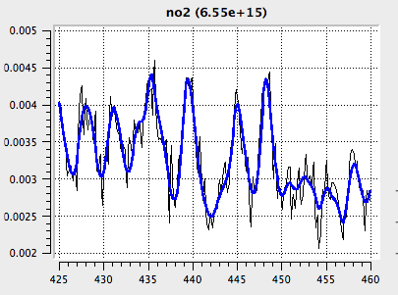
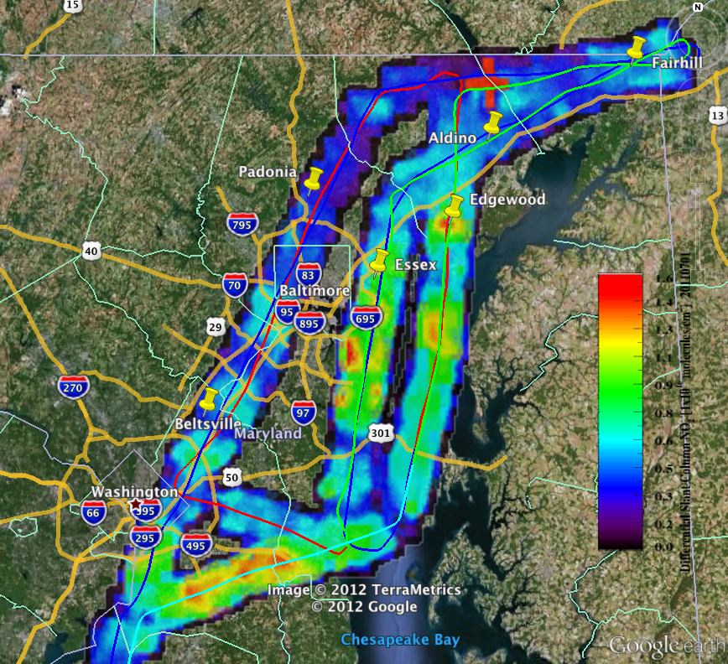
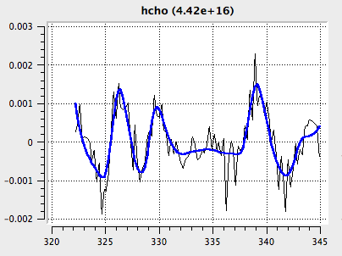
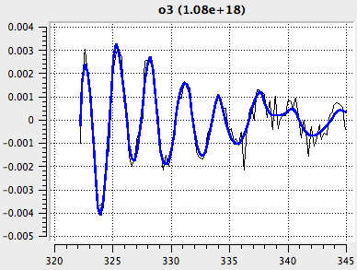
ACAM/GCAS Measurements of NO₂, CH₂O, and O₃ during Discover-AQ
GSFC
Scott Janz
Matt Kowalewski
Sam Xiong
Kent McCullough
Nickolay Krotkov
Lok Lamsal
SAO
Xiong Liu
Cheng Liu
Caroline Nowlan

Slide 2
Original ACAM configuration MD and CA deployments

Slide 3
Original ACAM configuration MD and CA deployments
Nadir Flight
Track
10 steps per scan
1 Hz step rate
IFOV footprint
6-7 km
Minimum Cell size
0.5km x 0.75km
Spectrometers used (similar to PANDORA) sample each spatial location sequentially
Scan Direction

Slide 4
Houston/Denver Configuration [GCAS]
Purge Port
Internal Environment
Dry nitrogen backfill
1 Atm
Wedged Housing Window
VIS/NIR spectrograph not shown
PC/104
Power Connector
Elphel Visible Video camera
ADC
Data Connector
Nadir view
Hybrid-Wedge Depolarizer
Short Pass
Filter
AD590 Support
Ethernet Switch
UV/VIS
Offner
GPS Antenna Feedthru
Telecentric
Foreoptics
GPS Receiver
B/I
CCD
Wireless
(Bluetooth, USB)
Wireless Antenna Feedthru
Custom designed 2-d spectrograph
45° instantaneous FOV. Vis/NIR not shown
Outer Housing
Purge Port

Slide 5
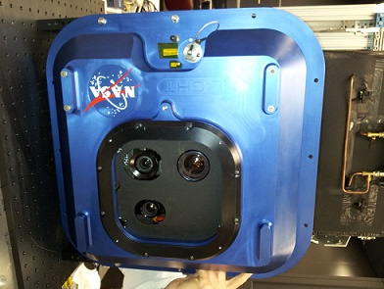
GCAS System Layout
UV/VIS
Telescope
Radiometric Calibration Fixture
Exploded view of entire assembly
VIS/NIR
Telescope
Telescopes map vertical slit extent to a 6-7 km cross-track FOV at typical flight altitudes. Increases dwell time for each pixel by factor of 10 compared to previous configuration.
Camera is run at ~2Hz -> 20 images captured every 1.1 km of along-track movement.
In-field calibration fixture to track radiometric response
HD Video
Spectral coverage and resolution similar to ACAM
300-490 nm @0.2 nm/pixel
480-890 nm @0.4 nm/pixel
System F/# the same, 7 meters/pixel GSD @8km
Nadir viewing only

Slide 6
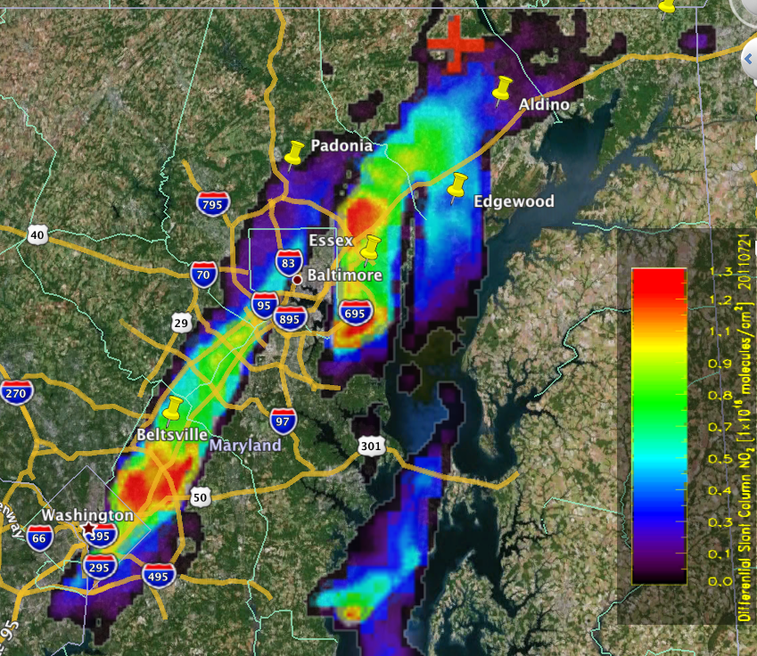
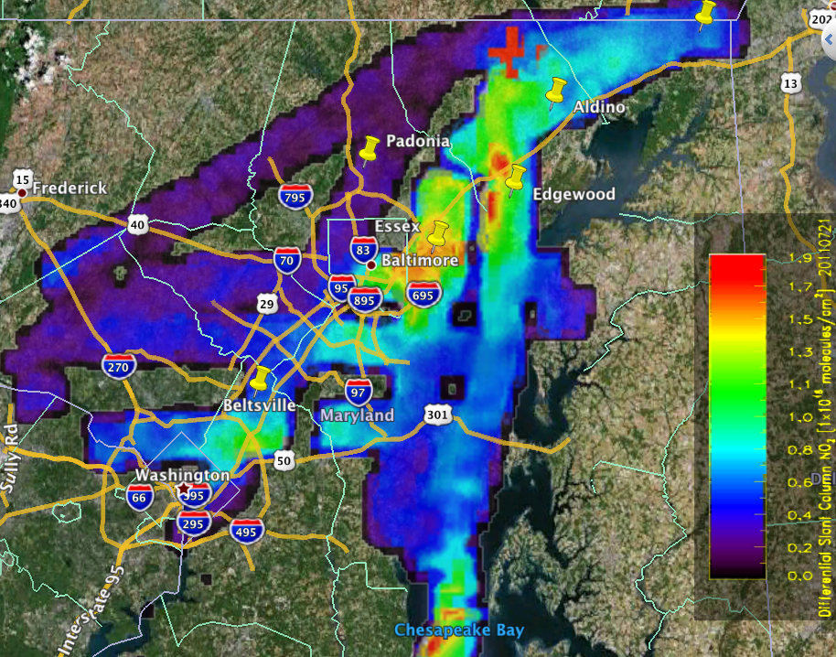
ACAM Spatial/Temporal Variability NO₂ July 21st MD Deployment
Morning
0.005° x 0.005° grid of 3 km² average, differential slant column abundance. “Clean scene” reference at cross.
Afternoon

Slide 7
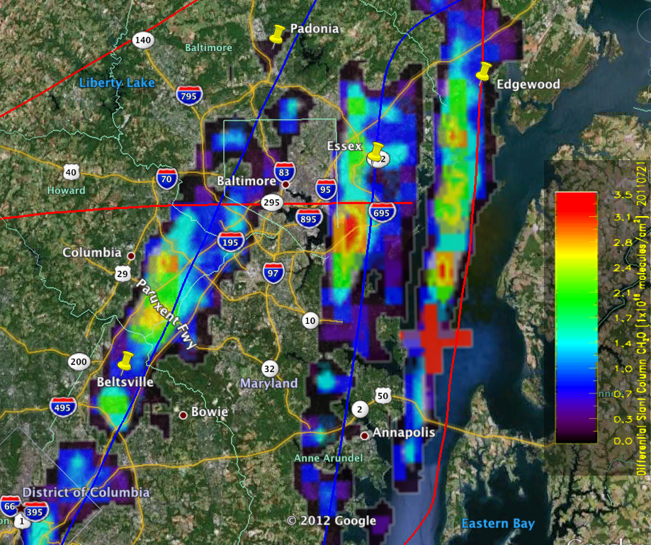
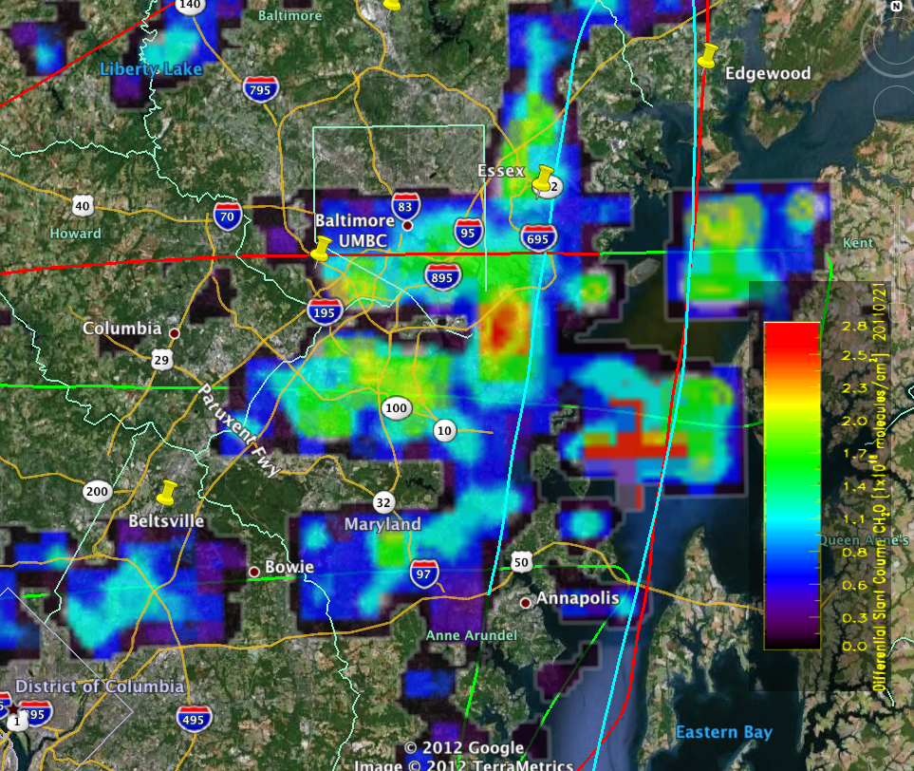
ACAM CH₂O – July 21st
MD Deployment
1500-1630 Local
1630-1800 Local
0.005° x 0.005° grid of 3 km² average, differential slant column abundance. “Clean scene” reference at cross. Hot spots correlate well with DFGAS integrated columns.

Slide 8
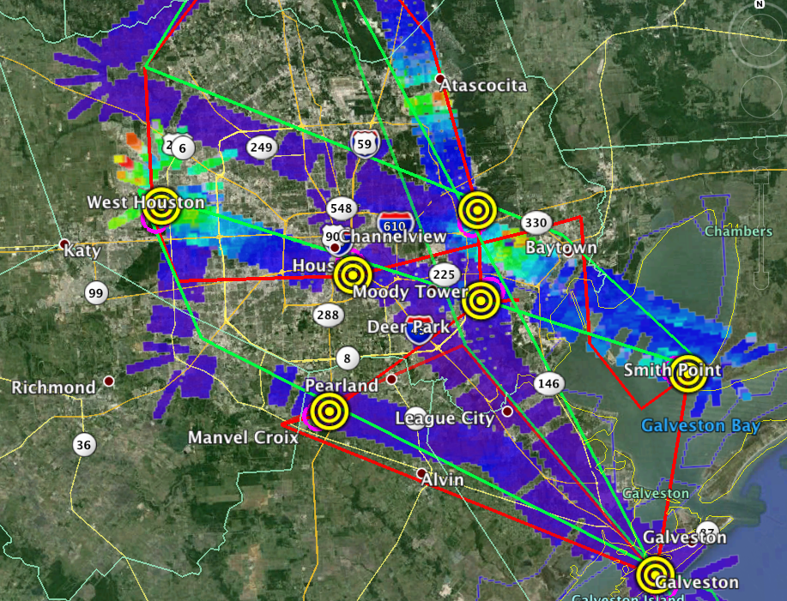
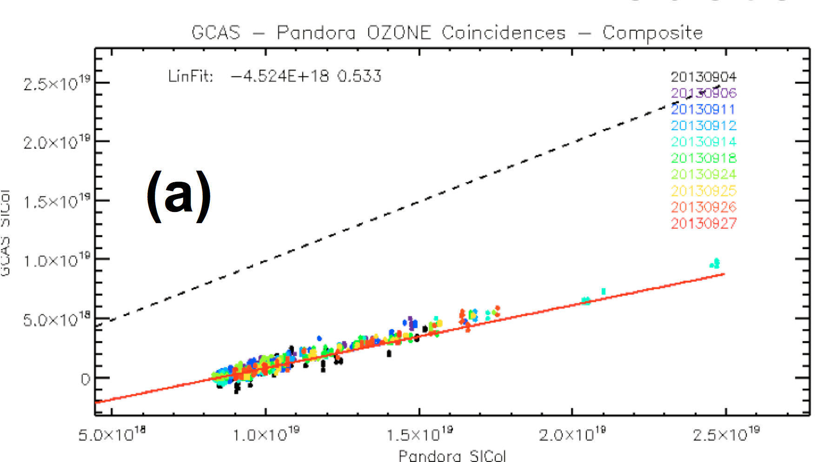
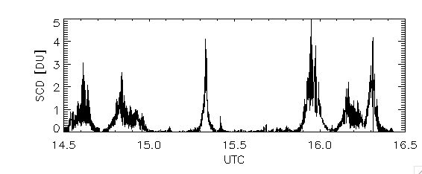
GCAS NO₂ Sept. 25th, O₃ Pandora Comparisons Houston Deployment
Composite comparison with Pandora O3 overflights – all days/stations
Differential slant column abundance shows good correlation with Pandora slant column – absolute offset due to viewing different air mass.
Differential slant column abundance – example of large gradients. GCAS is 3x more sensitive than ACAM for a given spatial binning scheme.

Slide 9
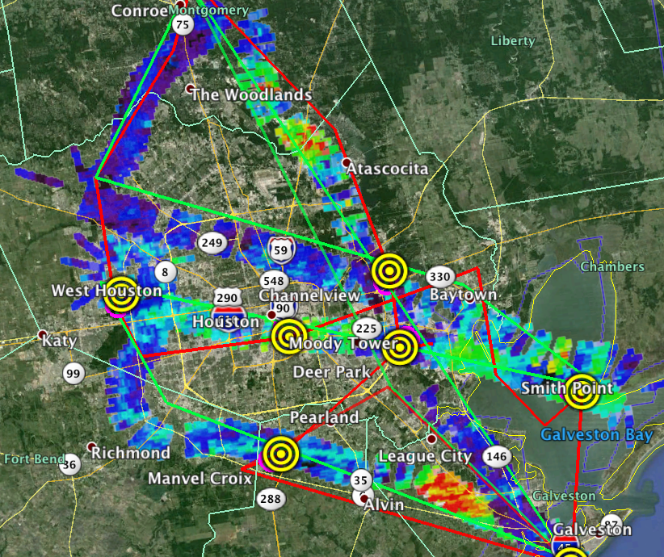
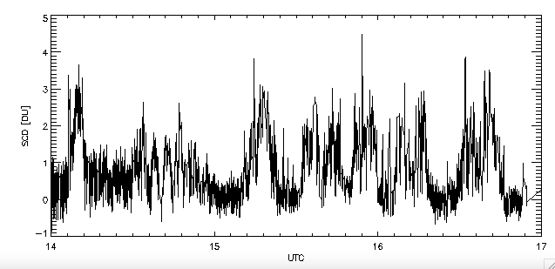
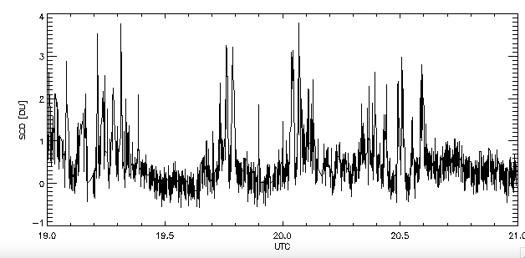
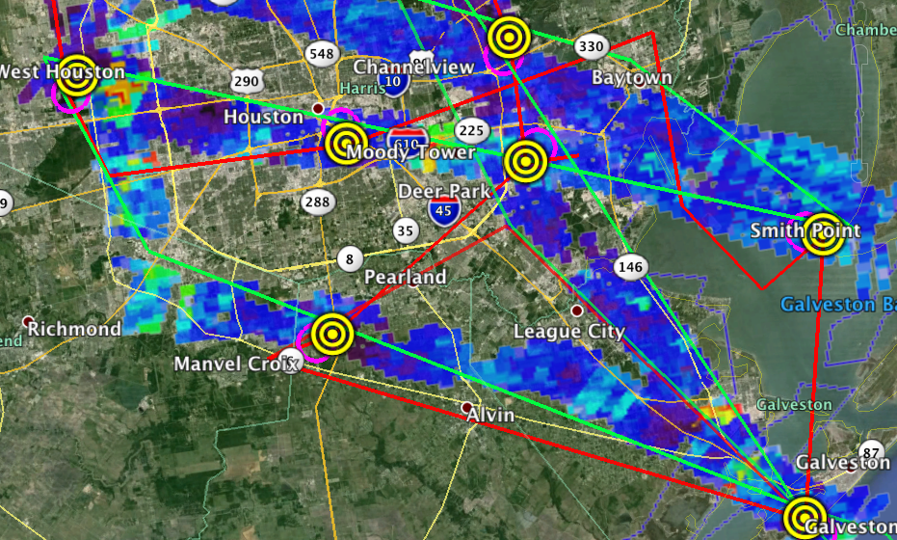
GCAS CH₂O Sept. 24th Houston deployment
Morning
Afternoon
Highest levels of CH2O seen of the four deployments. Comparisons with DFGAS complicated by cloud interference.

Slide 10
GCAS NO₂ SCDs (SAO) – Houston Deployment
Preliminary results of GCAS NO₂ SCDs at spatial resolution of 250 x 500 m² show significant spatiotemporal variability.

Slide 11
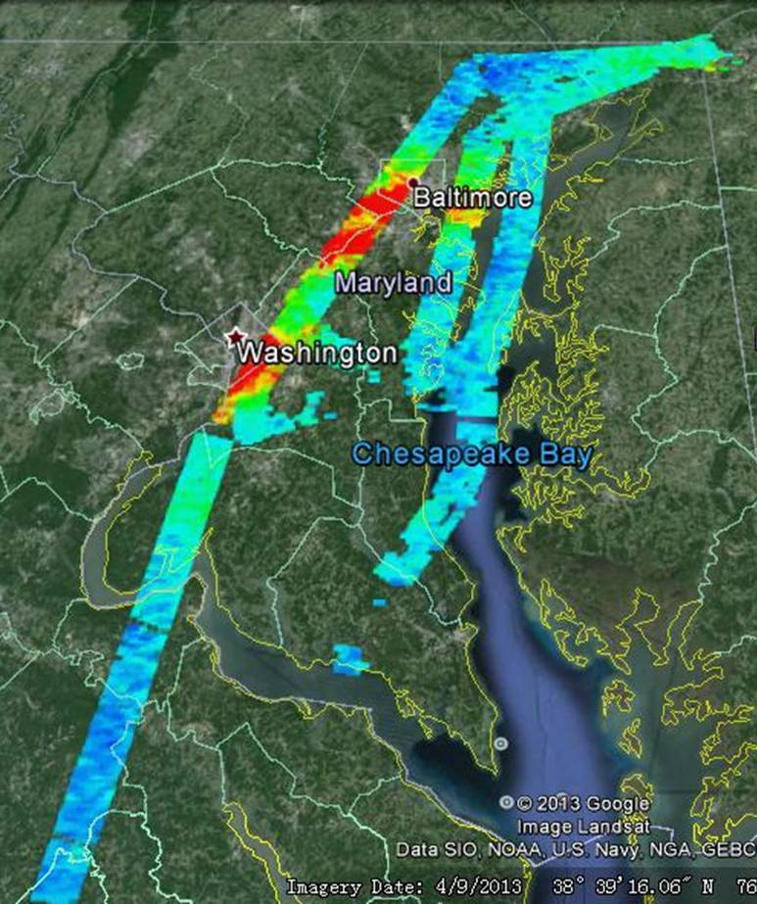
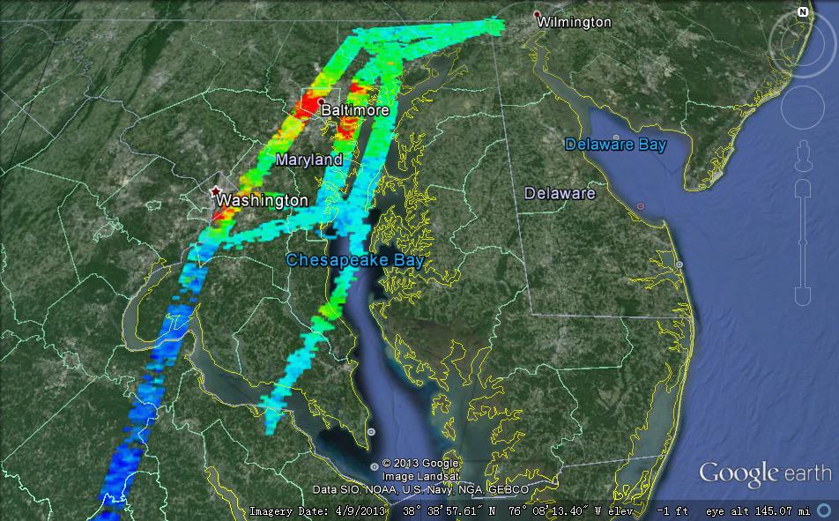
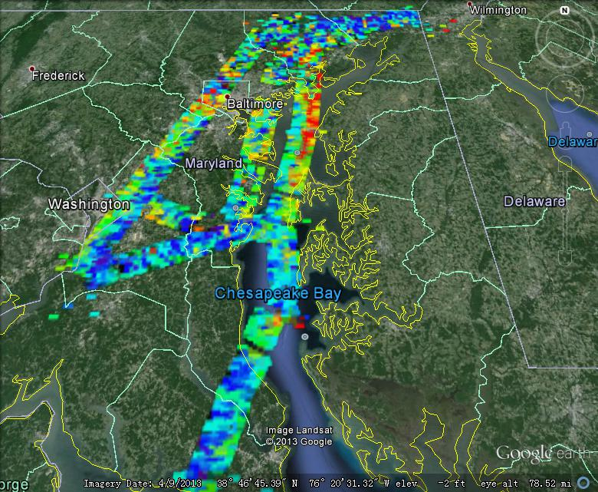
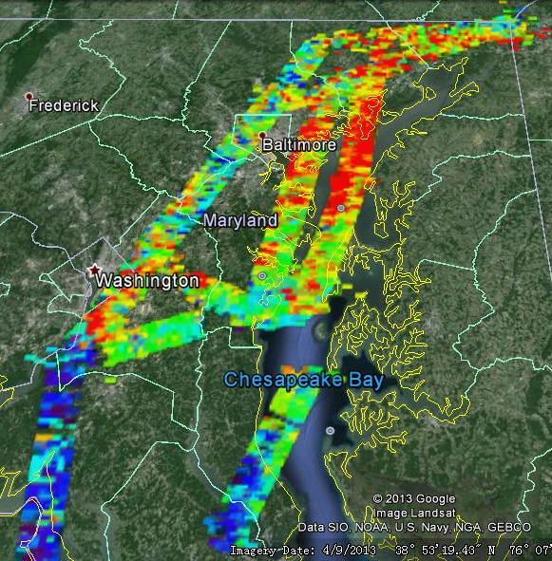
SAO ACAM Trace Gas Retrievals
July 20th Morning July 20th afternoon
July 22th Morning July 22th afternoon
NO₂
July 20th Morning July 20th afternoon
Perform ACAM Trace Gas Retrievals of NO₂, HCHO, and total O₃ columns using a two-step approach: SCDs, SCDs to VCDs.
Retrievals for the first campaign were archived at the DISCOVER-AQ data center.
_{HCHO}
11
Notes:
6/3/15
11

Slide 12
Trace Gas Fitting
OMI/TEMPO trace gas fitting algorithm to derive Slant Colum Densities (SCDs, S) against average“clean” background (NO₂, HCHO) or derived reference at the top of the atmosphere (for total O₃)
Basic Optical Absorption Spectroscopy (BOAS): Direct fitting of radiances using nonlinear least squares fitting (NLLS)
NO₂: 430-485 nm, average “clean” background, average fitting precision of ~6.3x10¹⁴ molecules/cm²
HCHO: 324-357 nm, average “clean” background, average fitting precision of ~8.0x10¹⁵ molecules/cm²
Total O₃: 318-335 nm, derived TOA reference, BDM cross sections at 228 K (using 2 or more cross sections reduces residual, but increase fitting precision), fitting precision of ~3.5 DU.

Slide 13
Air Mass Factor Calculation
Merged ozone profile: CMAQ tropospheric O₃ + OMI stratospheric O₃
Hourly CMAQ trace gas profiles (s_{z}) of NO₂ and HCHO in the troposphere and MACH stratospheric NO2 profiles
MODIS BRDF/albedo climatology at 30 arc sec (~ 1km)→ derive blue sky albedo for NO₂ at ~470 nm from black & white sky albedo weighted using the ratio of direct to total downwelling flux at the surface
High-resolution MODIS albedo @470 nm scaled down to 342 nm based on ratio of coarse-resolution OMI albedo at @471 nm to that @342 nm for both HCHO and O₃
VLIDORT calculation of scattering weights w_{z} at flight altitude weighted by CMAQ profiles to derive wavelength-dependent AMFs (A_{λ})
Weighted by cross sections to derive A for fitting window (for total O₃)

Slide 14
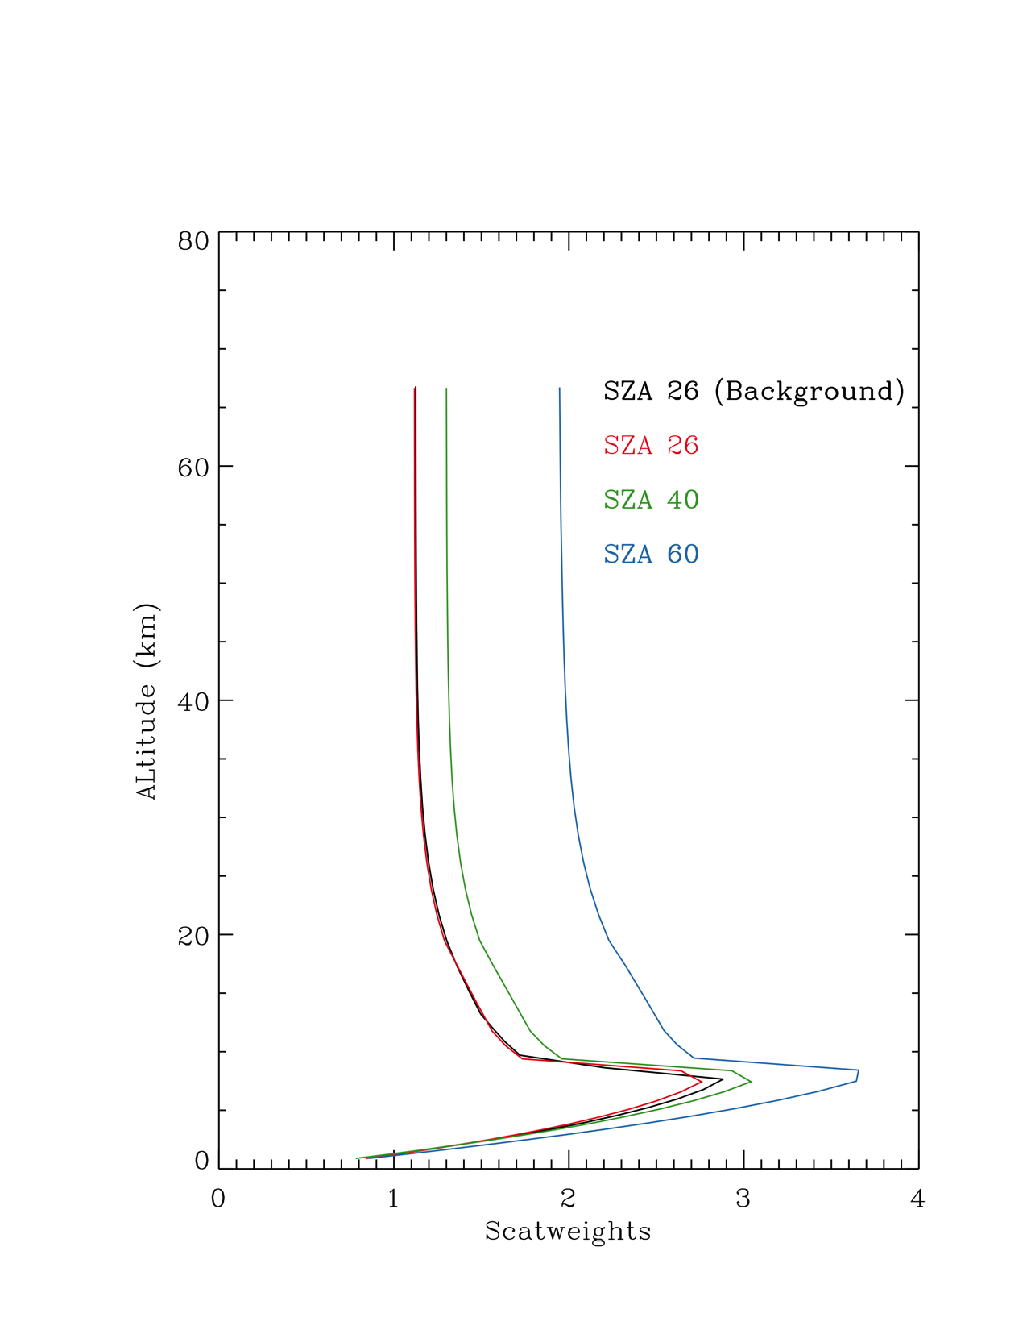
Convert from SCDs to VCDs
NO₂ and HCHO: need to account for background reference as fitting against reference does not remove abundance above the aircraft
Derive total/tropospheric VCDs (e.g., comparison with Pandora/OMI) or VCDs below aircraft (comp. with P3B)
Approximate V_{ref} and V_{abv,ac} based on CMAQ profiles and MACH stratospheric NO₂, which can cause systematic biases.

Slide 15
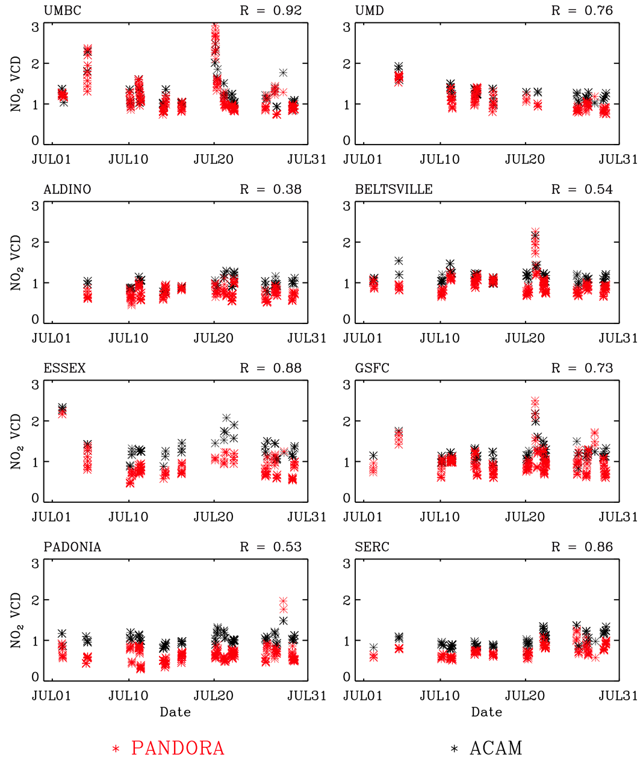
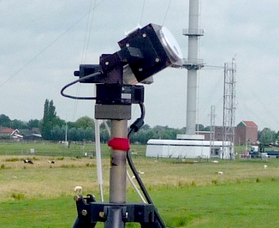
Comparison with PANDORA NO₂
PANDORA total NO₂ from direct-sun: high precision (~2.6E14 molecules cm⁻²), accuracy (~1.0E15 based on PANDORA performance inter-comparison (Tzortziou et al., 2013)
Collocation: within 3 km and 20 mins, average both data
Generally good agreement, higher correlation at stations more variability (with R > 0.86, e.g., UMBC, Essex, SERC), lower correlation at stations with less variability (e.g., Padonia, Aldino), large biases at Essex/Padonia
15
Notes:
6/3/15
15

Slide 16
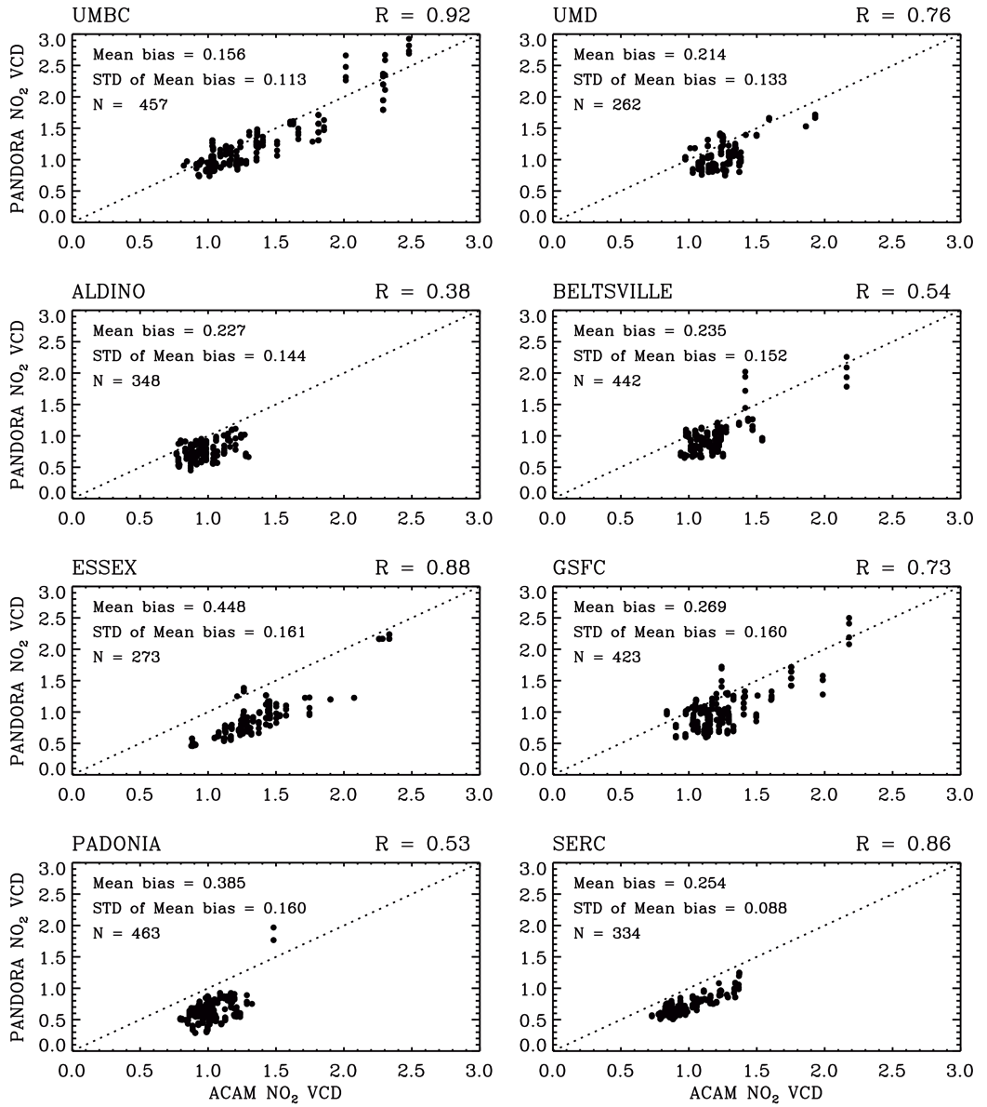
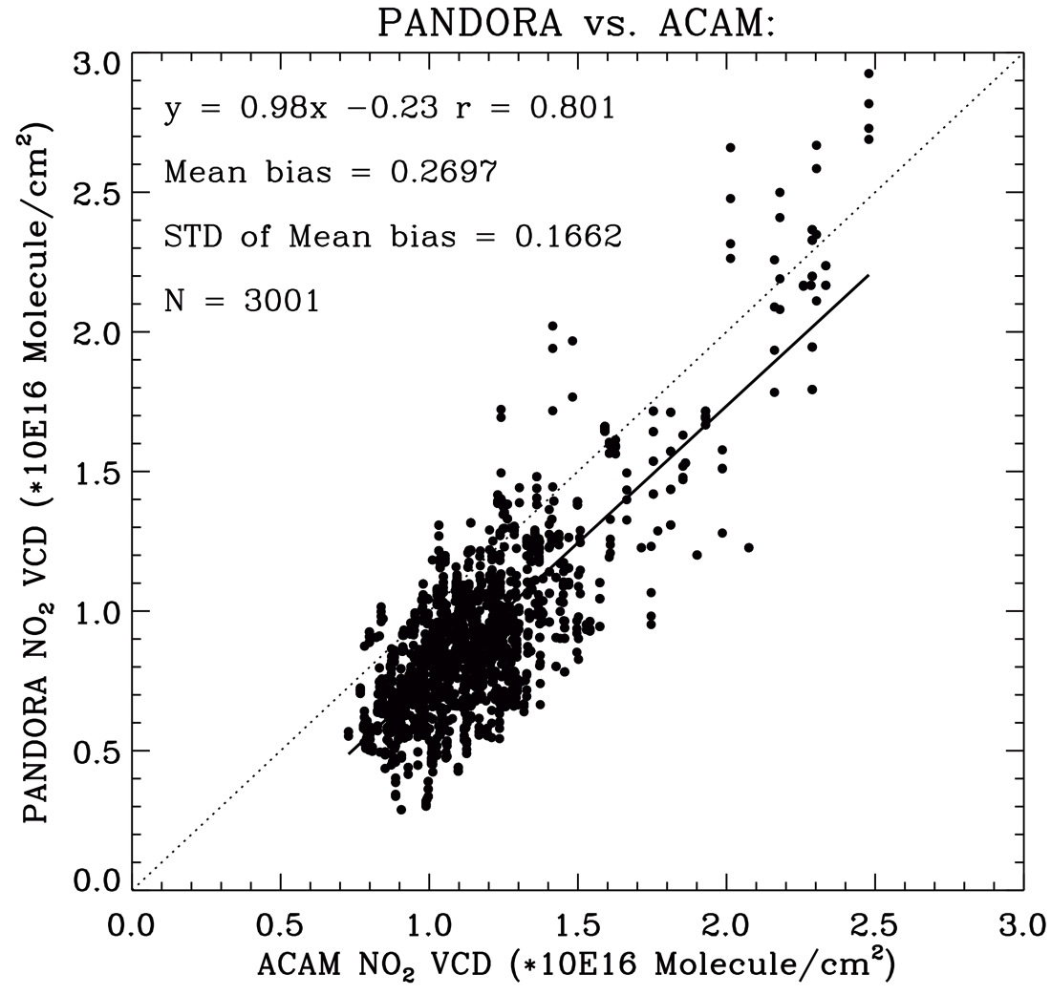
Comparison with PANDORA NO₂
Generally good agreement with correlation of ~0.80 and slope of 0.98: mean biases of ~2.7E15 molecules cm⁻² (1.5-4.5) and 1σ of 1.7E15 (0.9-1.6) with large biases at Essex and Padonia (3.9-4.5E15)
16
Notes:
6/3/15
16

Slide 17
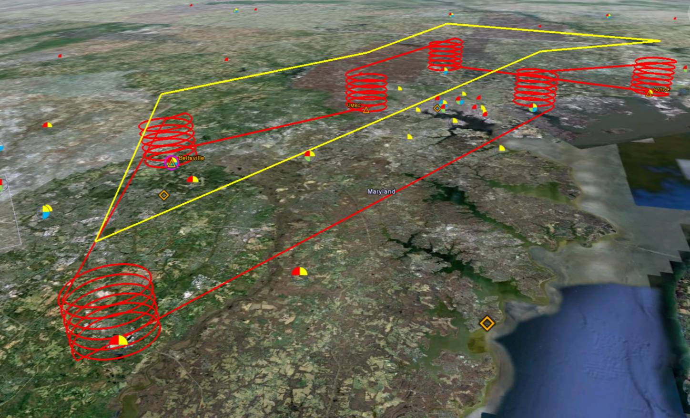
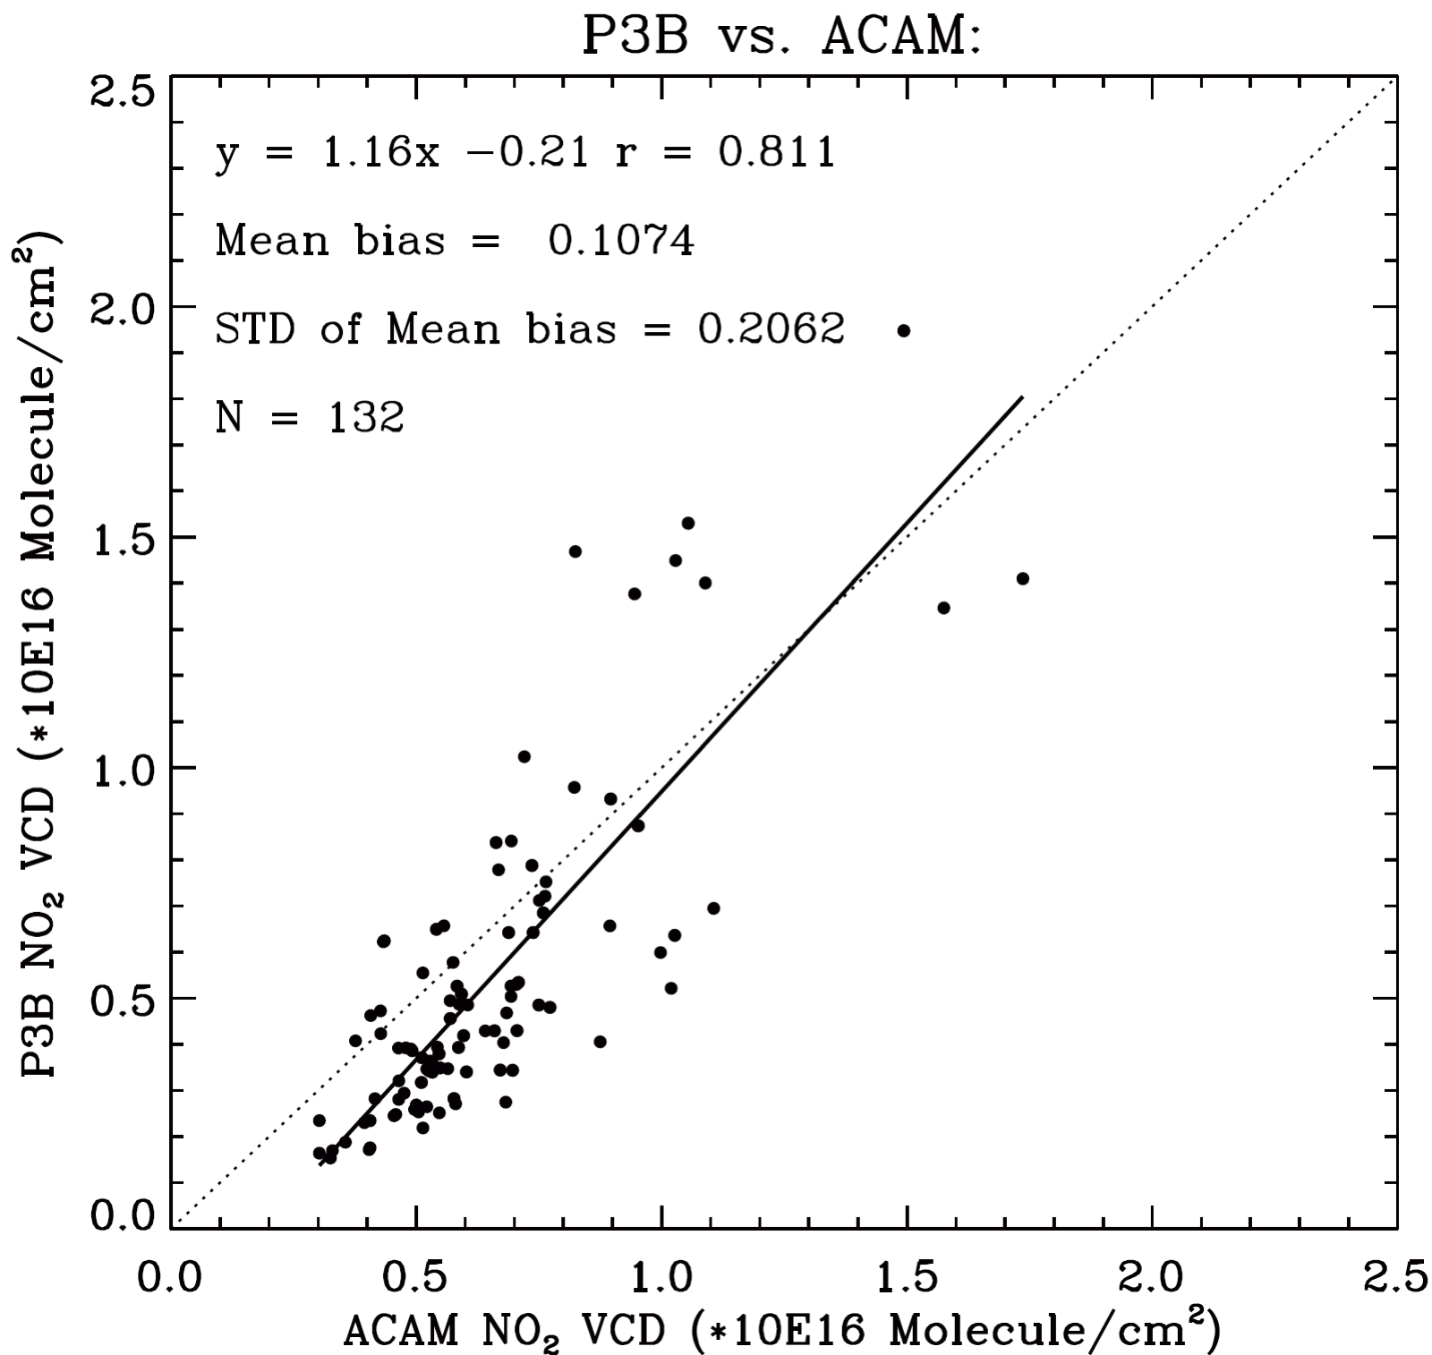
Comparison with P3B NO₂
In situ P3B: column integration from spiral scaled to NO₂ columns below aircraft with CMAQ profiles
Collocation: within 3 km and 30 mins, average ACAM data
Generally good correlation of ~0.81 with slope of 1.2.
Mean biases of 1.0E15 molecules cm⁻² and 1σ of 2.1E15 molecules cm⁻²
17
Notes:
6/3/15
17

Slide 18
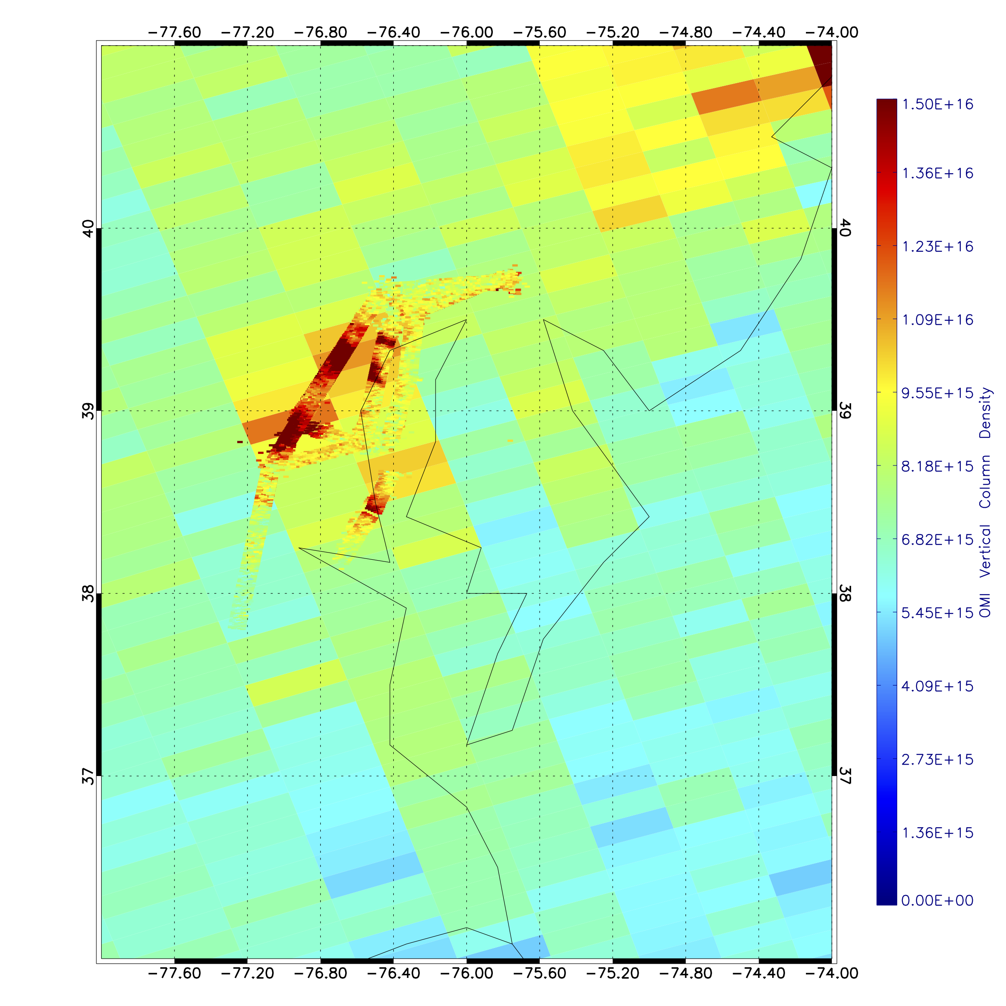
Comparison of ACAM and OMI NO₂
Collocation: ±0.05° lat, ±0.20°lon, ~0.5 hr, average ACAM data
OMI NO₂ distribution agree well with ACAM NO₂ considering the significant difference in spatial resolution.
Reasonably good correlation (R=0.62), with mean biases of 2.0E15 molecules cm⁻² and 1σ of 1.4E15 molecules cm⁻² except that OMI underestimates slope by 2/3 likely due to much larger footprints and differences in profile shapes
18
Notes:
6/3/15
18

Slide 19
Comparison with P3B HCHO
In situ P3B: column integration from spiral data (~0.3 km-3 km) scaled to HCHO column below aircraft with CMAQ profiles
Collocation: within 3 km and 1 hour, average all ACAM data
P3B
ACAM
Overall, general good correlation of ~0.80.
19
Notes:
6/3/15
19

Slide 20
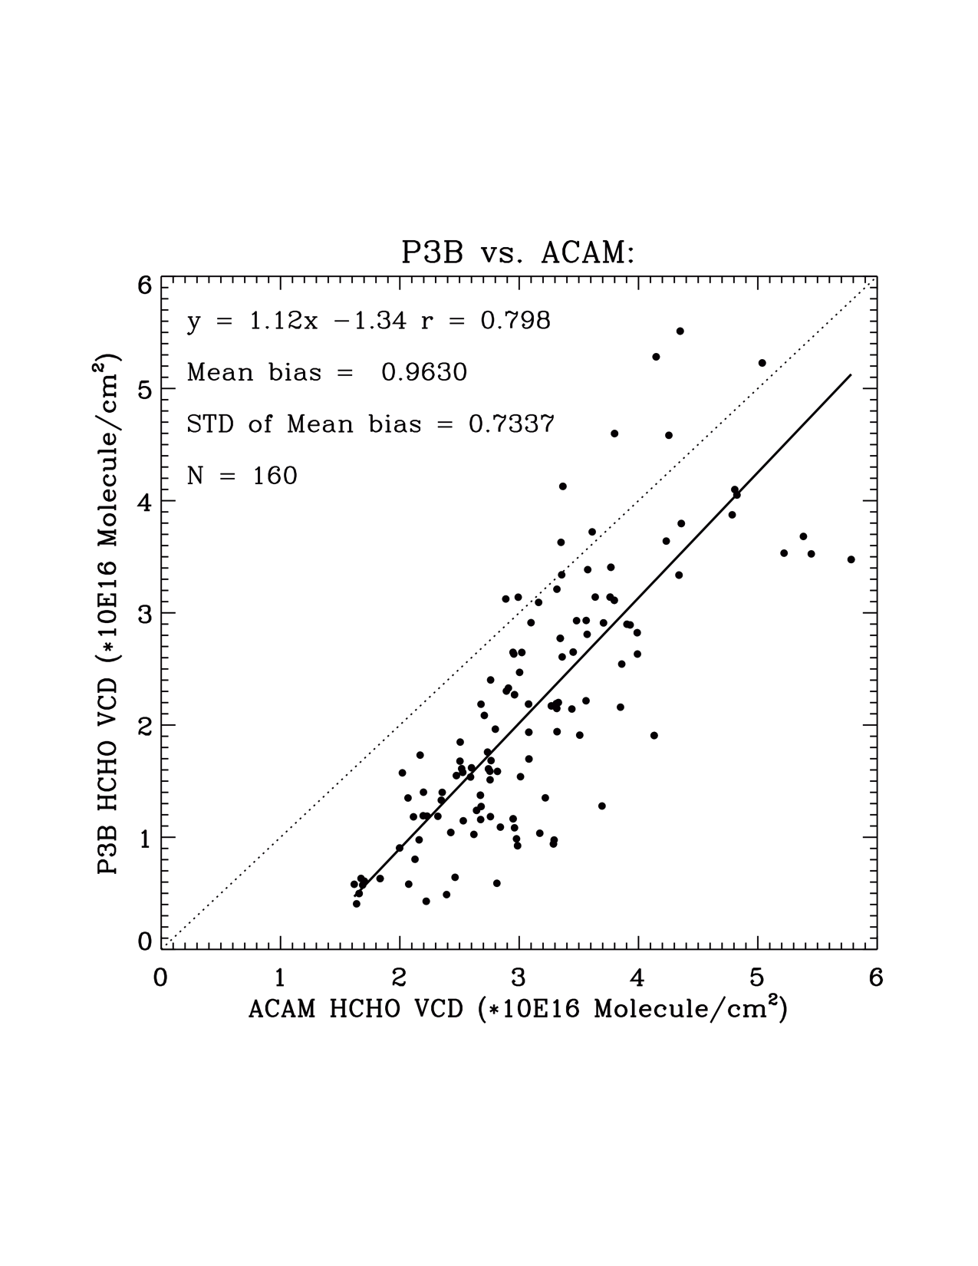
Comparison with P3B HCHO
Generally good correlation of ~0.8 with slope of 1.1.
Large mean biases of ~1.0E16 molecules cm⁻² and 1σ of 7.3E15 (5.2-8.5-E15) molecules cm⁻²
20
Notes:
6/3/15
20

Slide 21
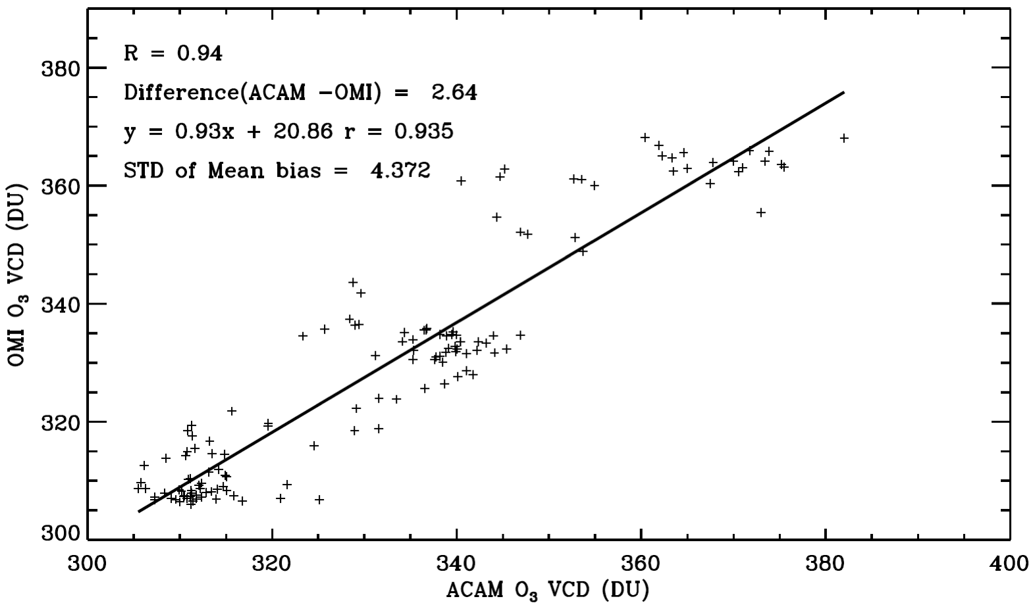
Comparison with OMI Total O₃
OMTO3 V8.5: typically accurate to within 2%, negative biases of ~2% due to the use of Bass-Paur data.
Collocation: within 1° in longitude, 0.1 ° in latitude and 1 hour
Generally good agreement with a mean bias of 2.6 DU and 1σ of 4.4 DU.
21
Notes:
6/3/15
21

Slide 22
Summary and Future Outlook
ACAM trace gases of NO₂, HCHO, and total O₃ for the Washington D.C.-Baltimore campaign were retrieved using a two-step approach and were archived at the DISCOVER-AQ data center.
Generally good agreement with other correlative measurements except for some large biases that need to be further investigated.
Apply the trace gas fitting algorithms to GCAS for Houston and Colorado campaigns
Optimize O₃ profile retrieval algorithm from UV and UV/Visible.
Compare ACAM/GCAS retrievals between GSFC and SAO, and compare GCAS and GeoTASO retrievals, sort out the differences and improve the retrievals
22

