Slide 1
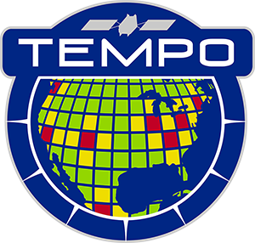



Tropospheric Emissions:
Monitoring of Pollution
A New Era of Air Quality Monitoring from Space over North America with TEMPO: Mission Status from First Two Years in Orbit
Xiong Liu¹, K. Chance¹, C.R. Nowlan¹, G. Gonzalez Abad¹, R. Suleiman¹, J. Houck¹, J. Davis¹, H. Wang¹, H. Chong¹, W. Hou¹, J. Park¹, M. Ghahremanloo¹,
J. Bak¹, C. Chan Miller¹, J. Fitzmaurice¹, L. Yatsuhashi¹, A. Oppenheimer¹, E. O’Sullivan¹, K. Daugherty², D.E. Flittner², C. Fenn², D. Rosenbaum², C. Brown², N. Mishra², R.T. Neece² , E. Roback², J. Strickland², L. Judd², P. Rawat², K. Travis²,
J. Carr³, J. Szykman⁴, B. Henderson⁴, L. Valin⁴, J. Joiner⁵, Z. Fasnacht⁵, S. Frith⁵,
D. Haffner⁵, E. Knowland⁵, N. Kramarova⁵, N. Krotkov⁵, C. Li⁵, W. Qin⁵,
G. Jaross⁵, C. Seftor⁵, A. Vasilkov⁵, E.-S. Yang⁵, J. Ziemke⁵, M. Newchurch⁶,
Naeger⁶, R. Cohen⁷, J. Geddes⁸, J. Herman⁹, B. Pierce¹⁰, R. Spurr¹¹,
S. Kondragunta¹², J. Wang¹³, O. Torres⁵, H. Zhang¹², P. Ciren¹²,
X. Zhao¹⁴, and the TEMPO Team
¹Smithsonian Astrophysical Observatory (SAO), CfA
²NASA LaRc ³Carr Astro. ⁴EPA ⁵NASA GSFC ⁶UAH ⁷UCB
⁸BU ⁹UMBC ¹⁰UWM ¹¹RT Sol. Inc ¹²NOAA ¹³UI ¹⁴ECCC
DC Air Researchers Consortium
February 27, 2026

Slide 2
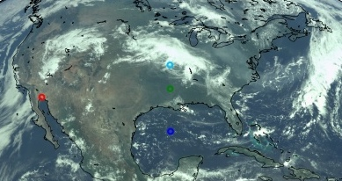
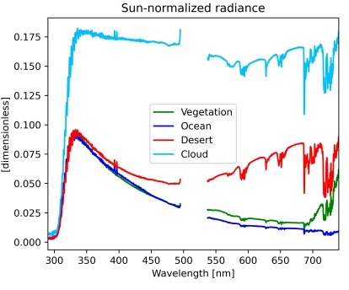
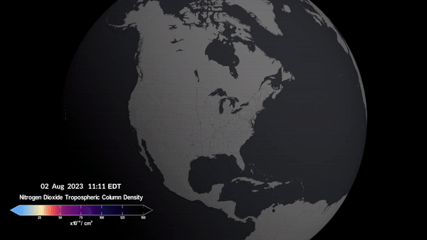
TEMPO (Tropospheric Emissions:
Monitoring of Pollution)
NASA’s first Earth Venture Instrument (EVI-1), selected in 2012
Led by Smithsonian Astrophysical Observatory (SAO) in partnership with NASA LaRC, with instrument built by Ball Aerospace (now part of BAE Systems)
NASA’s first GEO & host payload, launched on board IS-40e in April 2023 on to the GEO at 91 ∘ W
Hourly daytime air pollution over North America at neighborhood scale (2x4.75 km² at the center of the field of regard)
Baseline products (L2):
  NO₂, HCHO, Total Ozone, Ozone Profile, Clouds
Global Geo-Ring for Air Quality along with GEMS (2020) and Sentinel-4 (2025)
538-741 nm
293-494 nm
TEMPO first light RGB and examples of spectra
Credit: Heesung Chong
Credit: NASA’s Scientific Visualization Studio

Slide 3
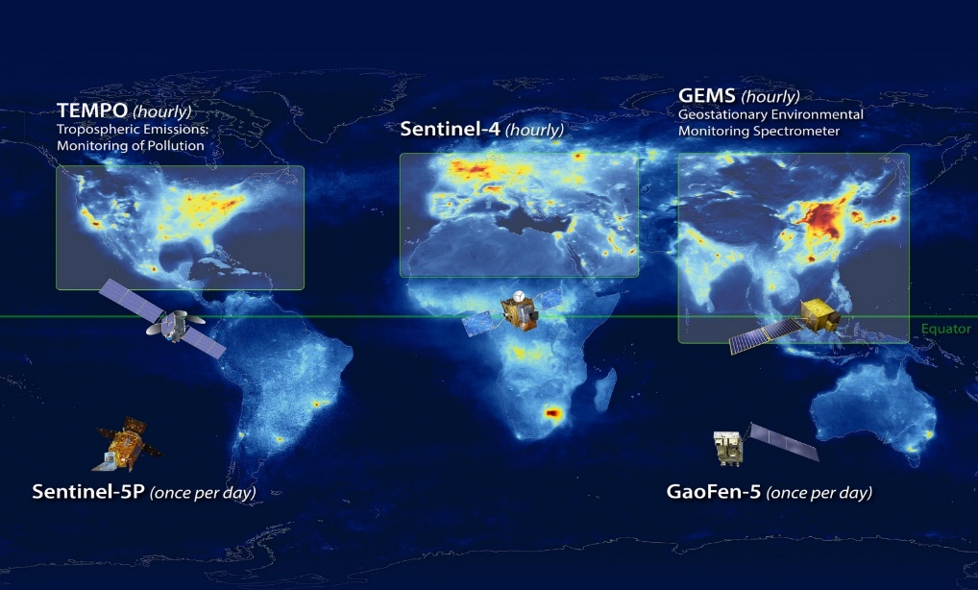
Geostationary Air Quality Constellation
Launch April 2023
Sentinel-4a: Launch 2025
Sentinel-4b: launch ~2035
GEMS: Launch Feb 2020
GEMS-2: Launch ~2032
Image Credit: NASA LaRC

Slide 4
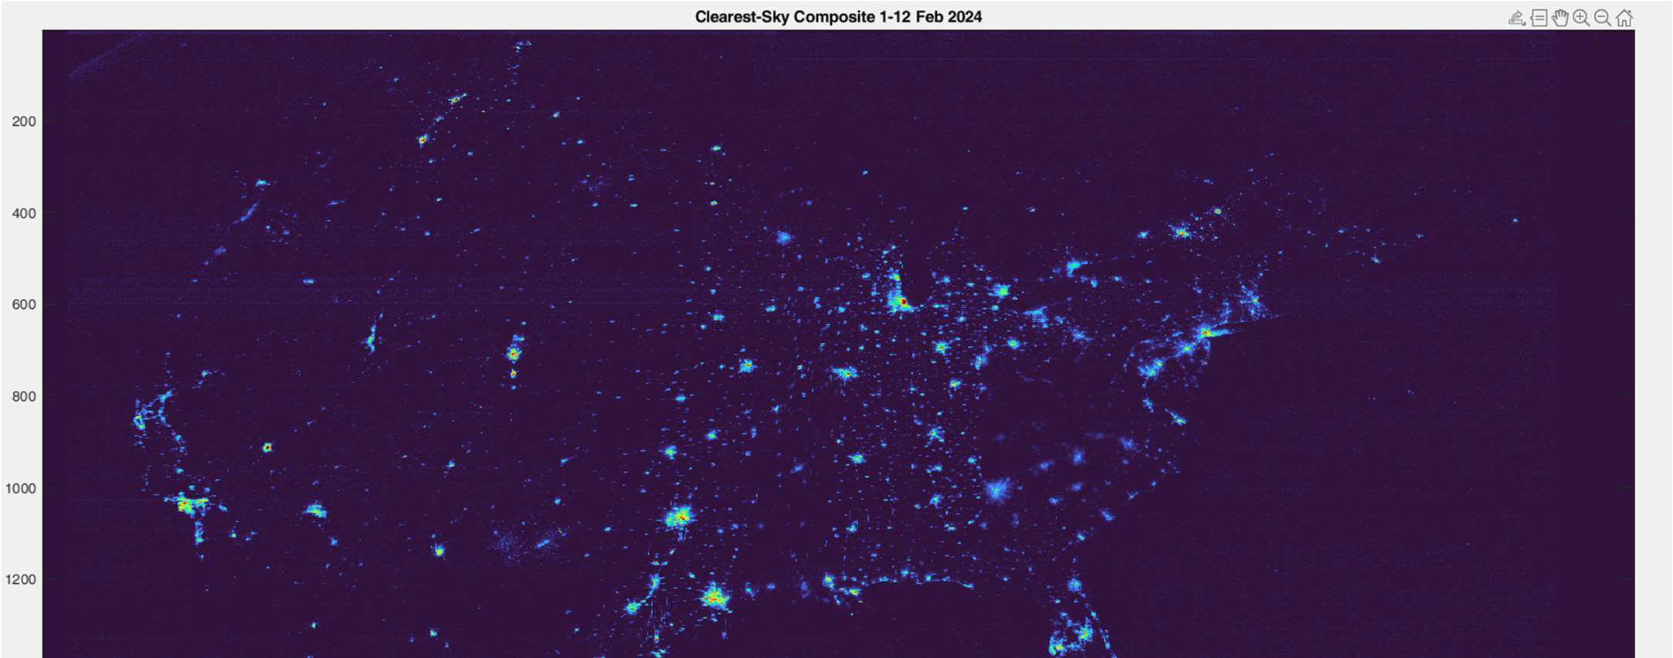
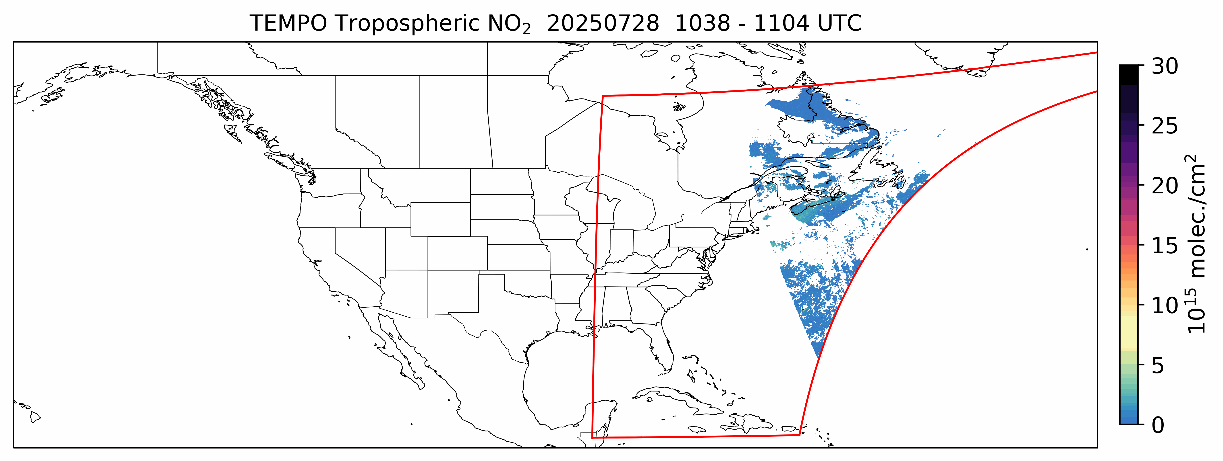
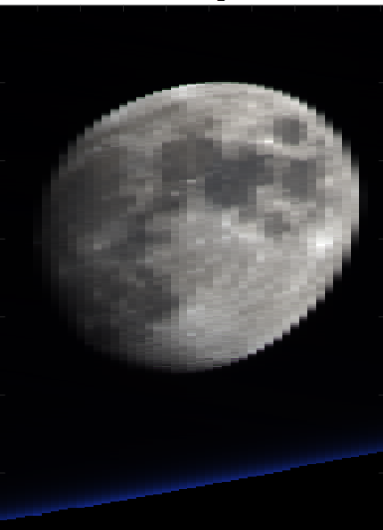
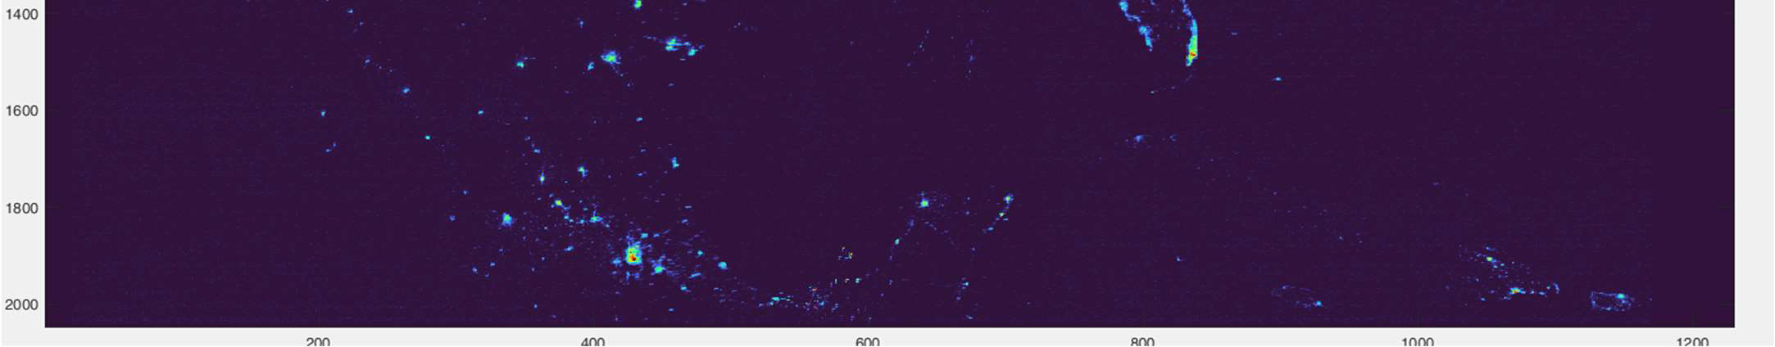

TEMPO Scanning
Nominal scans: hourly, 2.4M pixels
  2035 N/S pixels x 1181 E/W steps per hour
  2 x 4.75 km² at center of field of regard
Optimized scans
  Higher temporal resolution scans in early AM and late PM over coasts (40 mins)
Twilights scans (science bonus & discovery)
  Performed during darkness (~Aug. 15-Apr. 15)
  City lights (lighting types), moonlights, Aurora, airglow, gas flaring, lightning, fires
Special observations to support TEMPO Green Paper & Cal/Val: 21 days in 2025 for wildfires, prescribed burning, lightning NOx, CO Front Range field campaigns, CAL/VAL
  High-frequency scans (~10 mins) over
  selected regions (alternate hourly
  scan / 1 hour high-frequency scans)
  Lunar collect (4/9/2025, 9/9/2025,
  11/3/2025, 12/10/2025, 2/3/2026)
  Railroad Valley (6/2024, 6/2025, 10/2025 (side slither)
Clearest-Sky City lights Composite 1–12 February 2024
Credit: Aaron Naeger
Radiance derivation → Post-processing (de-speckling, de-streaking, etc.) → Composite
Credit: Jim Carr
Request Special Observations at TEMPO Early Adopter Website

Slide 5
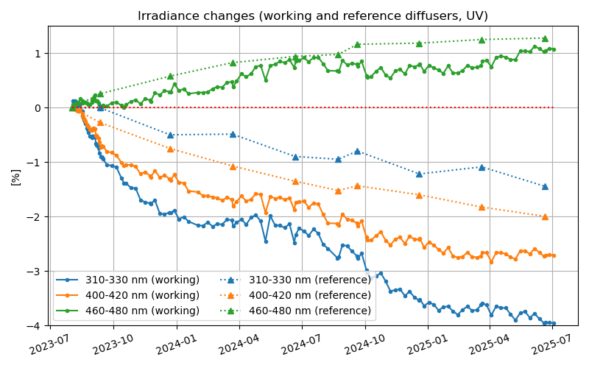
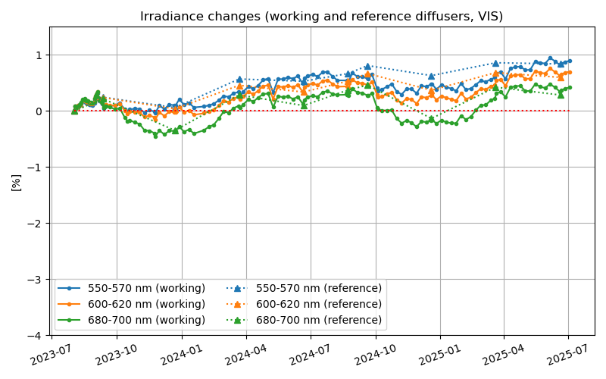
TEMPO Timeline & Status
Date | Details
7 April 2023 | Launch
June-July 2023 | TEMPO power on + dry-out, cool down, etc.
2 August 2023 | First light
19 October 2023 | Nominal operations
18 June 2025 | Baseline mission ended (End-of-Prime Mission Review 12/11/2025)
September 2026 | First extended mission ends, further extension by NASA senior reviews (next in March 2026)
Very small degradation in 2 years even for short UV, correctable in future versions.
Credit: Heesung Chong & Dave Flittner
Successful commissioning & nominal operation. Instrument & spacecraft performing very well!

Slide 6
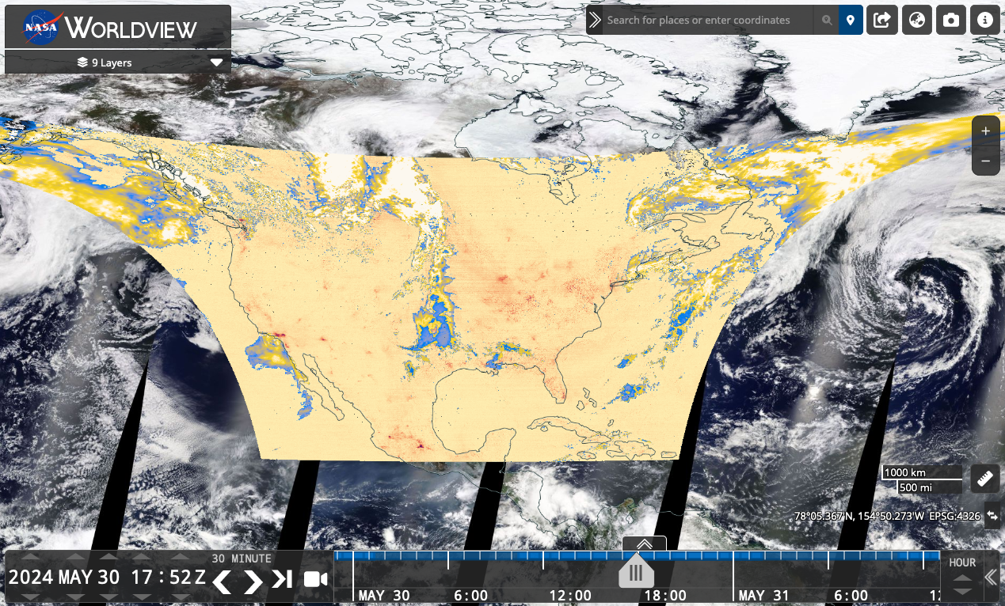

TEMPO Data Products Public Release
NASA’s Atmospheric Science Data Center (ASDC)
Public Release | Date | Details
V01 | 2/5/2024 | Limited 3 weeks released
V02 | 2/26/2024 | Level 1 (spectra) released
V03 | 5/20/2024 | L1, L2/3 cloud, NO₂, H₂CO, total O₃ (provisional) V3 O₃ profile (ASDC 6/9/2025, not for the public)
V04 | 9/17/2025 | Ozone Profile (beta), L1 + other L2/L3 (provisional) RADT (1/6/2026), Reprocessing started on (1/29/2026)
NRT V02 | 9/17/2025 | L1, L2/3 cloud, NO₂, H₂CO (funded by SNWG)
TEMPO data now publicly available at NASA’s ASDC (~6 hours latency, NRT with 2-3 hours latency).
Multiple tools (ASDC/Enabled by ASDC):
  Earthdata Search, OPeNDAP
  NASA Worldview: all data products (L2+L3)
  ArcGIS services (Earthdata & Living Atlas):
  L3 NO₂ + HCHO + total ozone
  RSIG (EPA)
  TEMPO-Lite (CfA CosmicDS): L3 NO₂
  NASA SPoRT Viewer
  Google Earth Engine (L3 NO2 & HCHO)
For more information check out:
  User Guides (known issues)
  Daily operation & commissioning logs
  Validation reports
  ATBD (drafts available upon request for L0-1 & O₃ profile, released for total O₃, cloud, NO₂, & HCHO)
ASDC TEMPO
TEMPO V3/V4 download metrics (May 2024-December 2025)
5 PB, 170M files, >1300 unique user IPs
Worldview: >5300 unique user IPs, 6.2M records
ArcGIS Trop. NO₂ (Living Atlas): >7800 unique user IPs

Slide 7
Baseline TEMPO Data Products (V4)
Level | V4 Product | Validation Status
L1 | Irradiance | Provisional
 | Radiance | Provisional
 | Radiance (twilight – city lights) | Provisional
L2 | Clouds | Provisional
 | NO₂ | Provisional
 | HCHO | Provisional
 | O₃ (total) | Provisional
 | O₃ (profile) | Beta->Provisional in 6/2026
L3 | L2 gridded to 0.02° × 0.02° | Provisional
Reprocessing started on 1/29/2026, 2 days reprocessed in 1 day
Work with the Validation Team and PEGASOS team to validate V4 and advance it to Full level
*Beta: “minimally validated”, publication “not recommended and highly discouraged”
*Provisional: “performance demonstrated”, "suitable for scientific publication”

Slide 8
Expand Beyond TEMPO Baseline Products
SNWG NRT + SNWG Enhanced + Research
Level | Product | Developer
L1 | Irradiance | SAO
 | Radiance ^{NRT} | SAO (Chong, ESS, accepted)
 | Radiance (twilight – city lights) | SAO (Carr, ESS, 2025)
L2 | Cloud ^{NRT} | SAO/GSFC (Wang, ESS, 2025)
 | NO₂ ^{NRT} | SAO (Nowlan, ATBD, 2024)
 | H₂CO ^{NRT} | SAO (Gonzalez Abad, ATBD,2024)
 | O₃ (total) | SAO/GSFC
 | O₃ (profile) | SAO
 | TEMPO/GOES-R aerosol products ^{NRT} | NOAA(released, ASDC, Zhang, JGR,2025)
 | C₂H₂O₂ | SAO
 | H₂O | SAO
 | BrO | SAO
 | SO₂ ^{NRT} | NASA GSFC (Li, 2025, GRL)
 | UVAOD | NASA GSFC (under develop.)
 | Aerosol layer height | U. Iowa (under develop.)
 | UVB | NASA GSFC (under develop.)
Baseline Products
Satellite Needs Working Group (SNWG)
Cycle 3 NRT Products (~2-3 hours)
Public release (Sep. 17, 2025)
SNWG Cycle 4
TEMPO SO₂ NRT & Enhanced Products
Public release in ~9/2028
Research Products
Ocean color (Fasnacht, 2025, ESS, NASA ROSES)
Vegetation (GPP) (Bandel @SSAI/NASA GSFC)
HNO₂ (Theys @BIRA-IASB)
Free tropospheric NO₂ (Dang, 2025, PNAS)
Surface Products (Ghahremanloo, JGR & many studies)
Emissions (Sun, JGR, Hsu, submitted @many studies)
JEDI Data Assimilation (Abdi-Oskouei, submitted)
TEMPO/GOES-R Synergy Radiance (Wang+Carr, ROSES)
Surface albedo/DLER (Zhang, JGR, NOAA)
IO, NO₃, Solar induced fluorescence

Slide 9
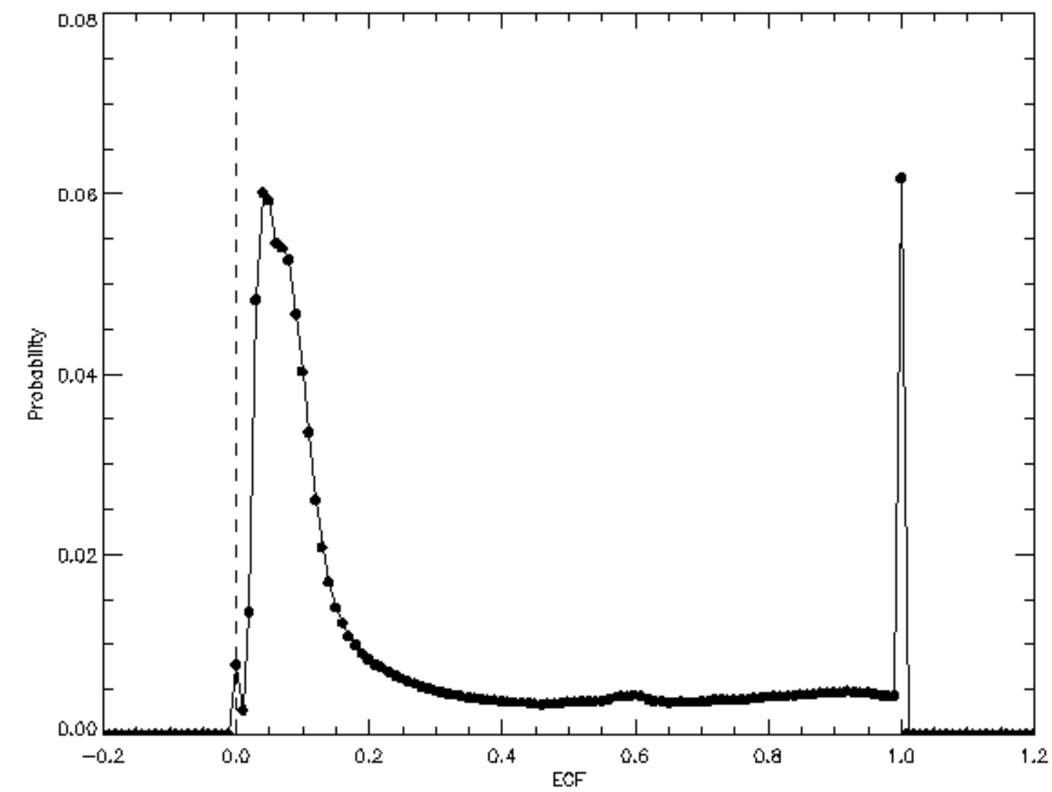
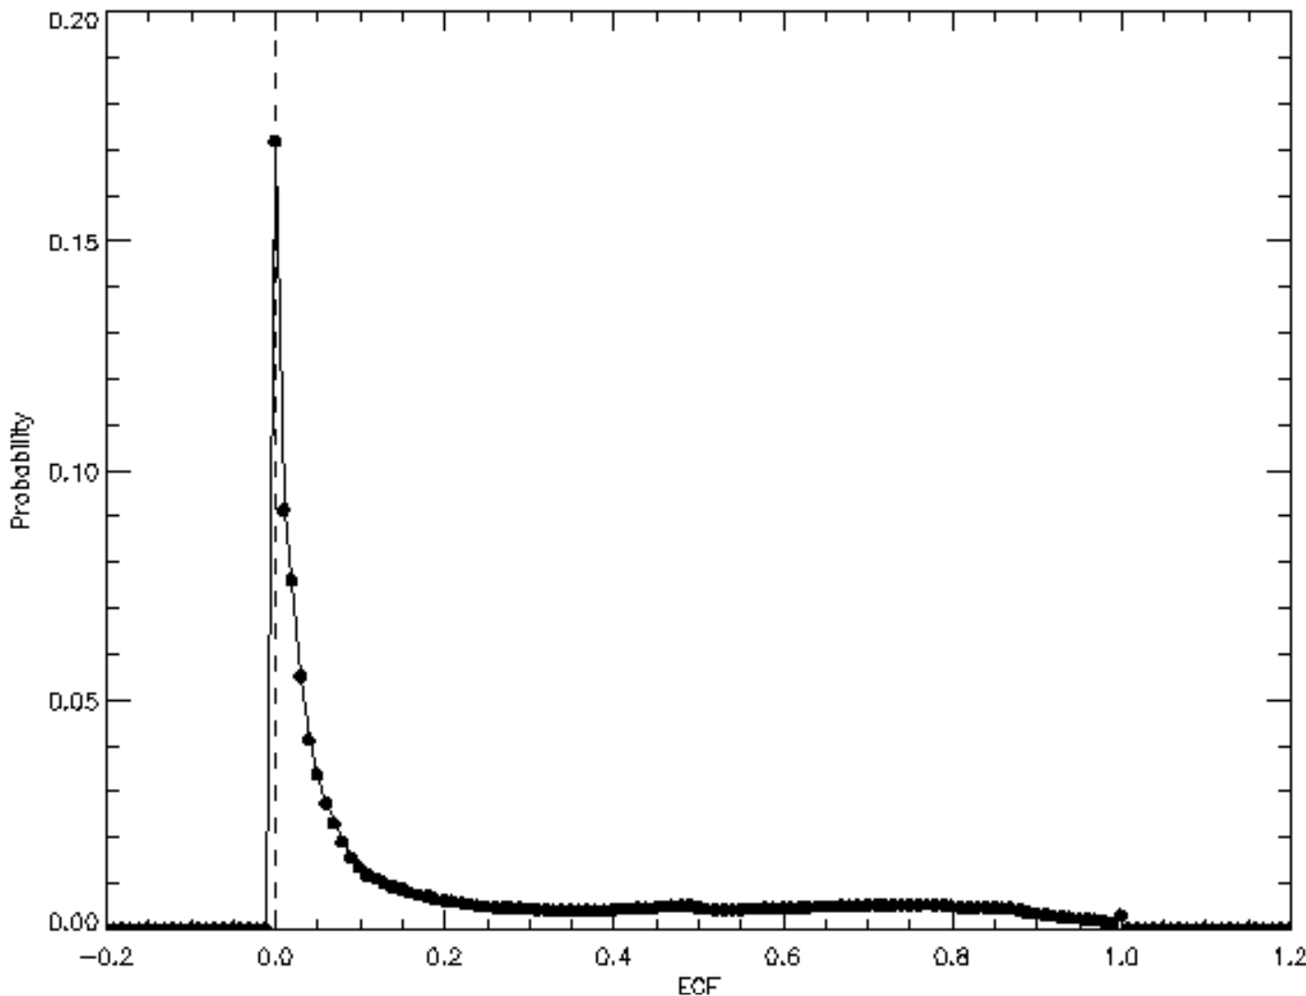
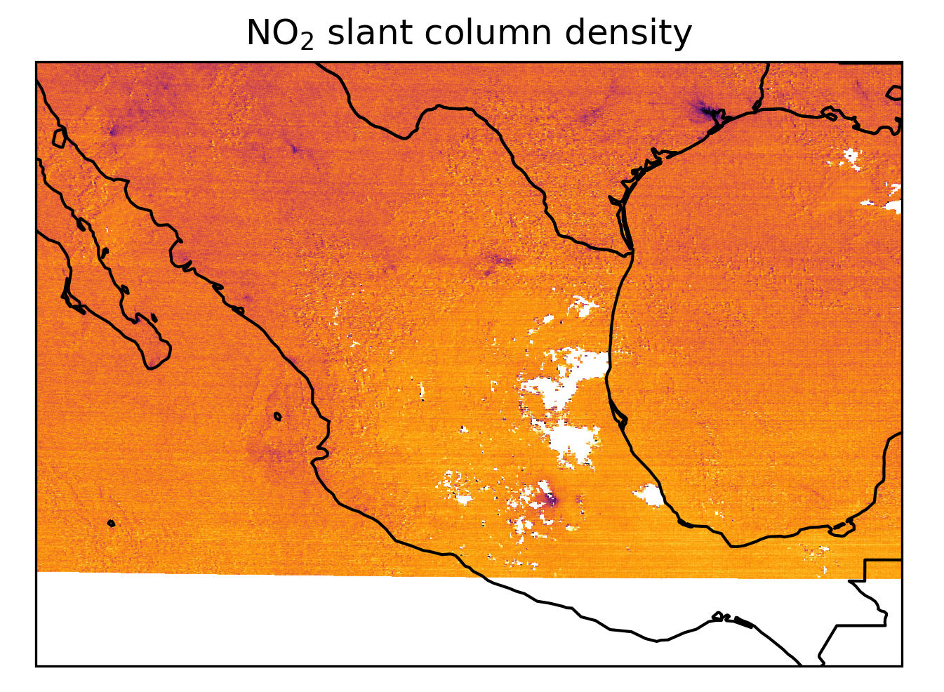
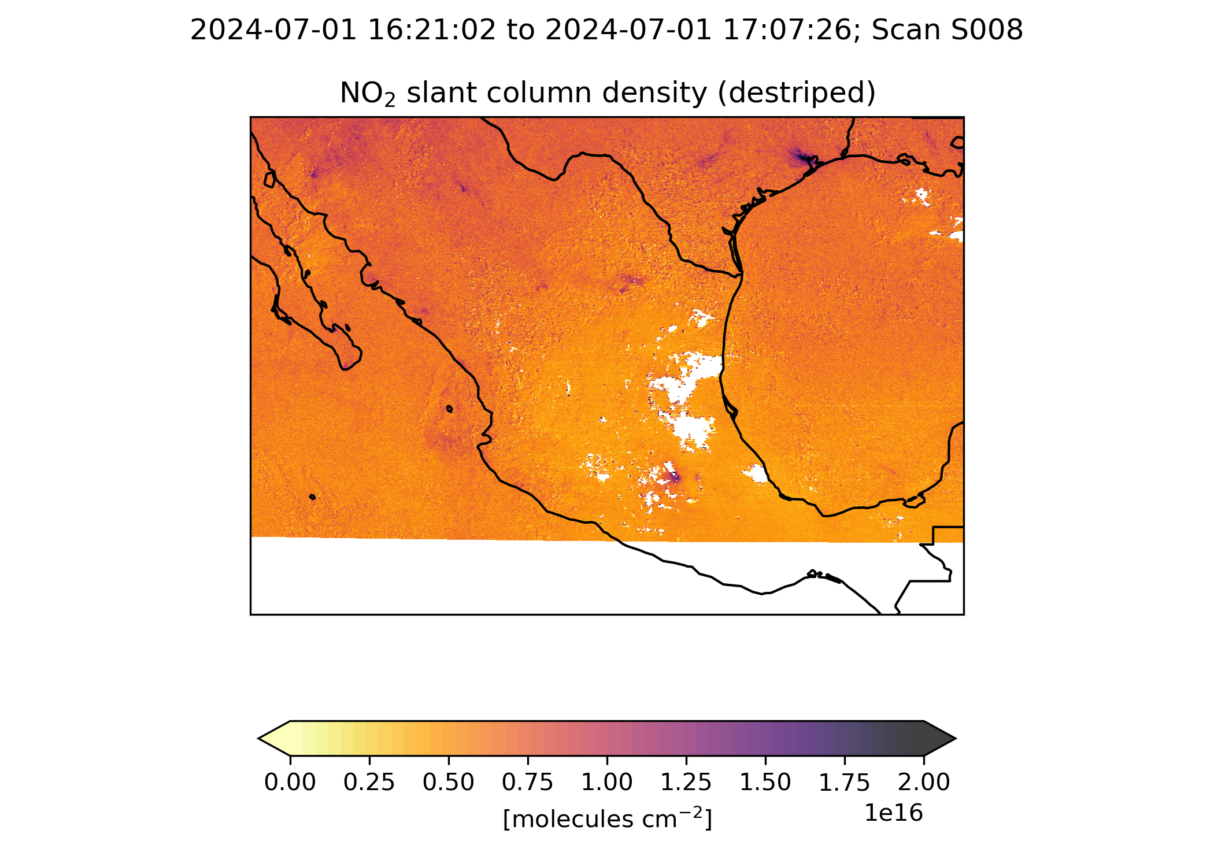
Algorithm Updates for TEMPO V4 (NRT V2)
GEOS-CF (meteorology / a priori): V1 → V2
L1b: Improve absolute calibration (~10% overestimation in normalized radiance)
  Update BTDF by ~cos(30°) and scattering angle dependence, update to radiometric calibration coefficients based on ABI/VIIRS comparison
  Improve straylight correction (over correction in V3): improve PSF + background correction + reconstruct saturated pixels
  Improve wavelength calibration, and wavelength grid for rad. cal. coefficients
  Improve INR (geolocation)
Trace gases and clouds
  Greatly Improved GLER surface albedo climatology over land/snow (fix RAA clipping & BRDF clipping)
  NO₂ / O₂-O₂ cloud de-striping
  Fix surface pressure anomaly (index shift by 1 in GEOS-CF surface pressure)
  Include clear-sky AMF & scattering weights for NO₂/HCHO
Histogram of Effective Cloud Fraction (ECF)
TEMPO V3 in NASA ASDC
TEMPO V4*
20240601 all scans
20240601 all scans
histogram peaks at ECF ~ 0.05,
suggesting an overestimate.
ECF histogram peaks ~0.0, primary
due to L1b update & GLER

Slide 10
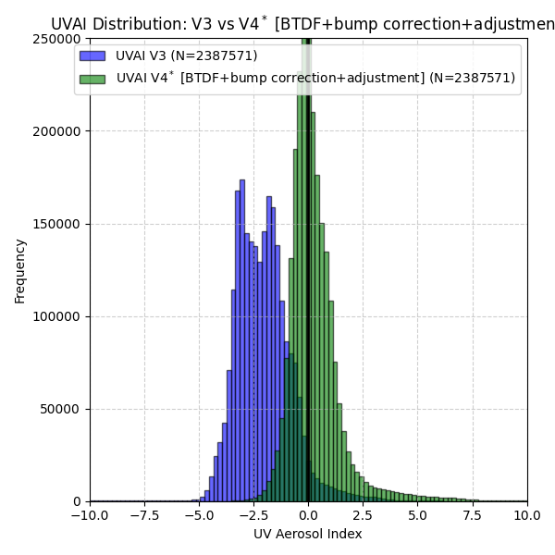
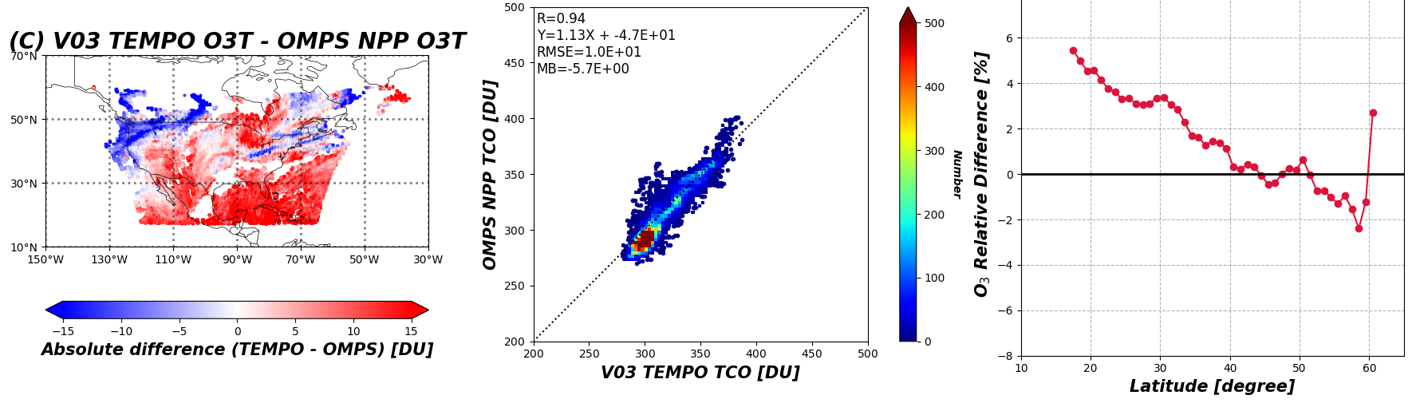
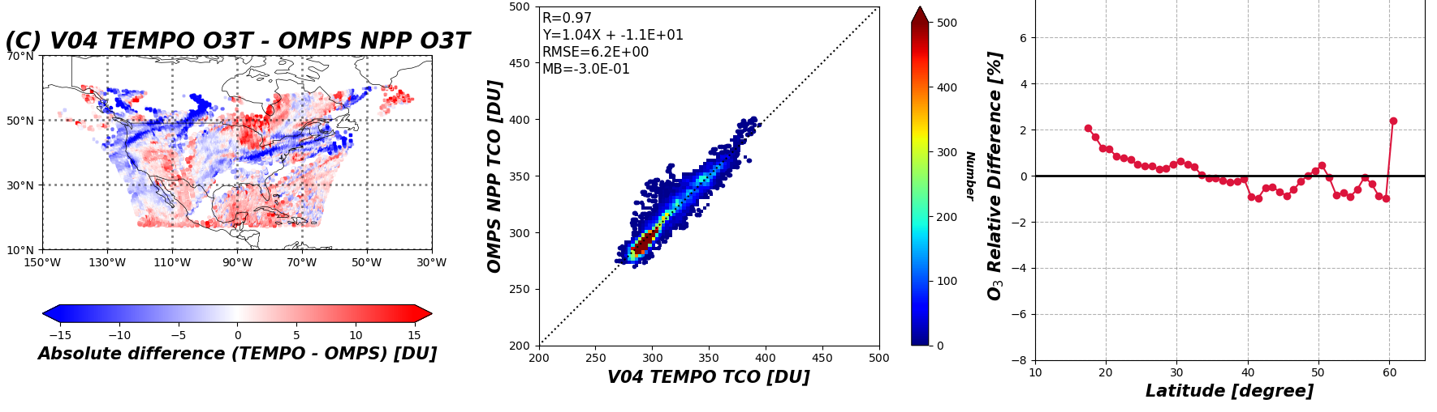
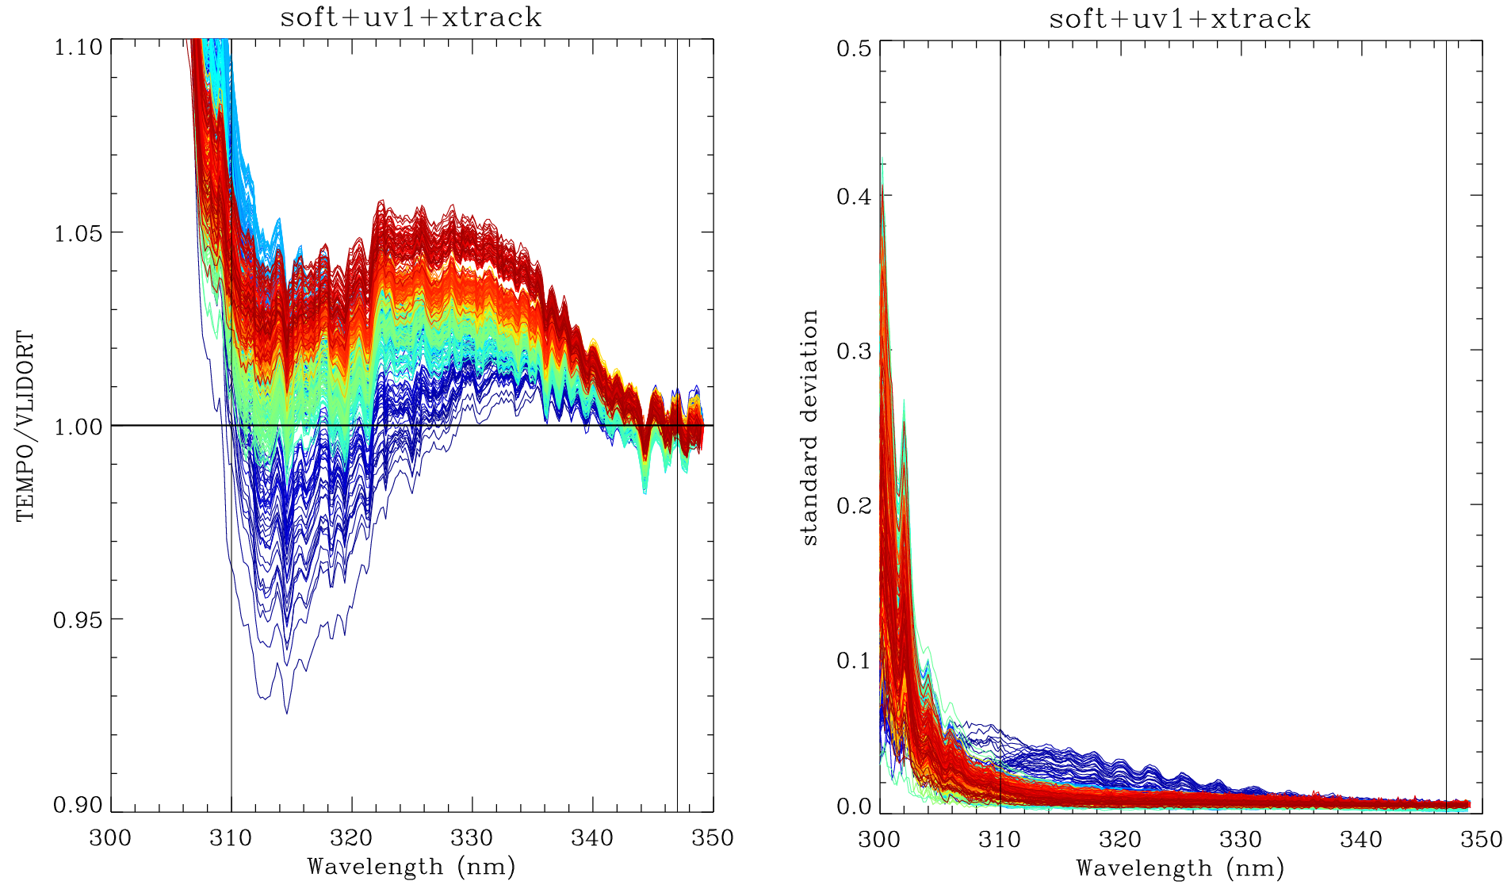
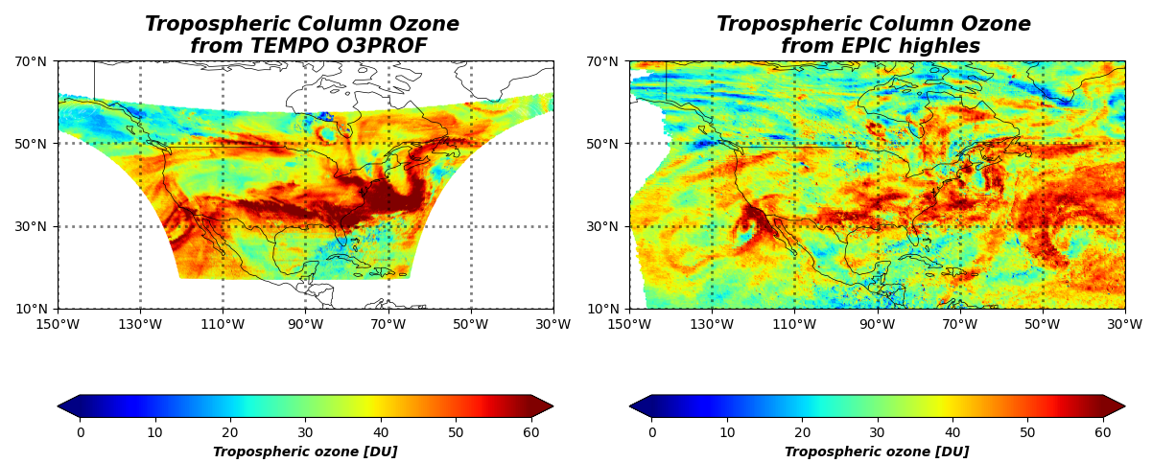
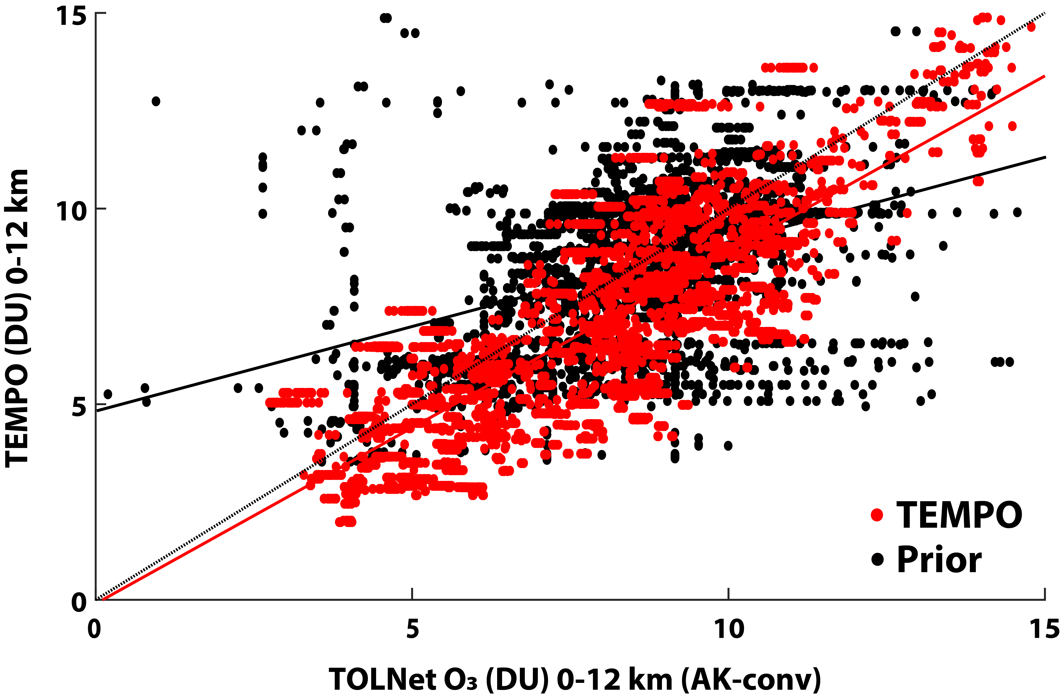
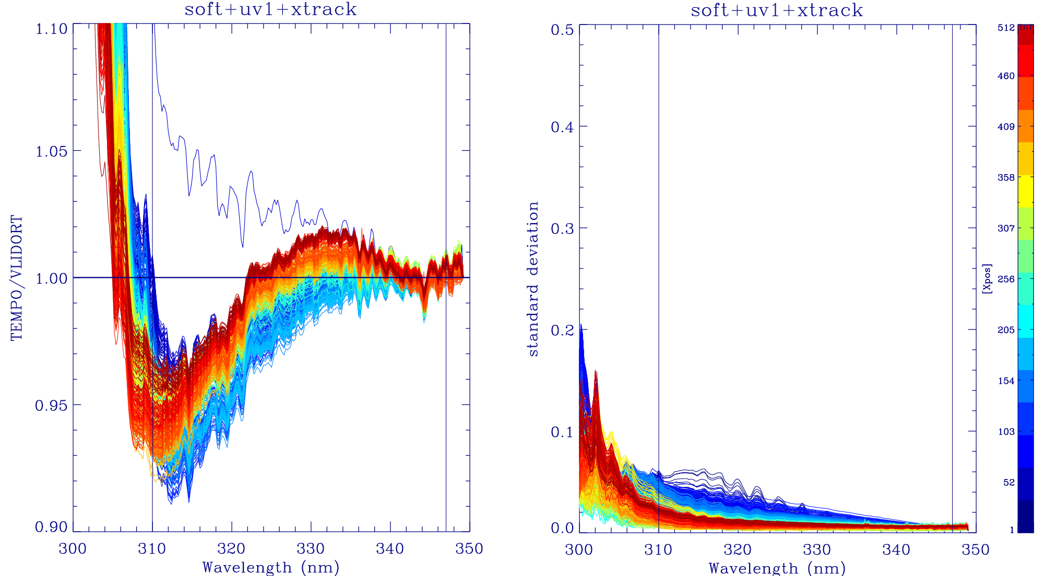
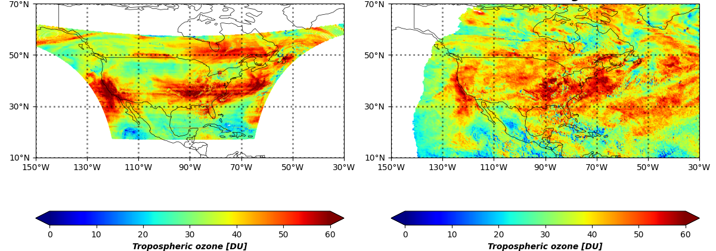
Algorithm Updates for TEMPO V4
Total O_{3:} L1b improvement and
  Update LUTs with average on-orbit slit functions
  Perform additional soft calibrations using NPP OMPS data
  Quality flag updates.
Profile O_{3 :} L1b improvement and
  Additional soft calibration
  Optimization in a priori, surface albedo, and measurement error constraint
7/26/2024
UVAI bias reduced from -2 in V3 to 0 in V4* (mostly from L1b)
V3: TEMPO-NPP
Lat. depen. reduced from soft cal.
V4*: TEMPO-NPP
V3 soft cal.
7/26/2024
6/12/2024 S006
V4* soft cal.
7/26/2024
Credit: Matthew Johnson
8/08/2024 S008
Credit: Matthew Johnson
V4*: This version is subject to change before public release of V4.

Slide 11
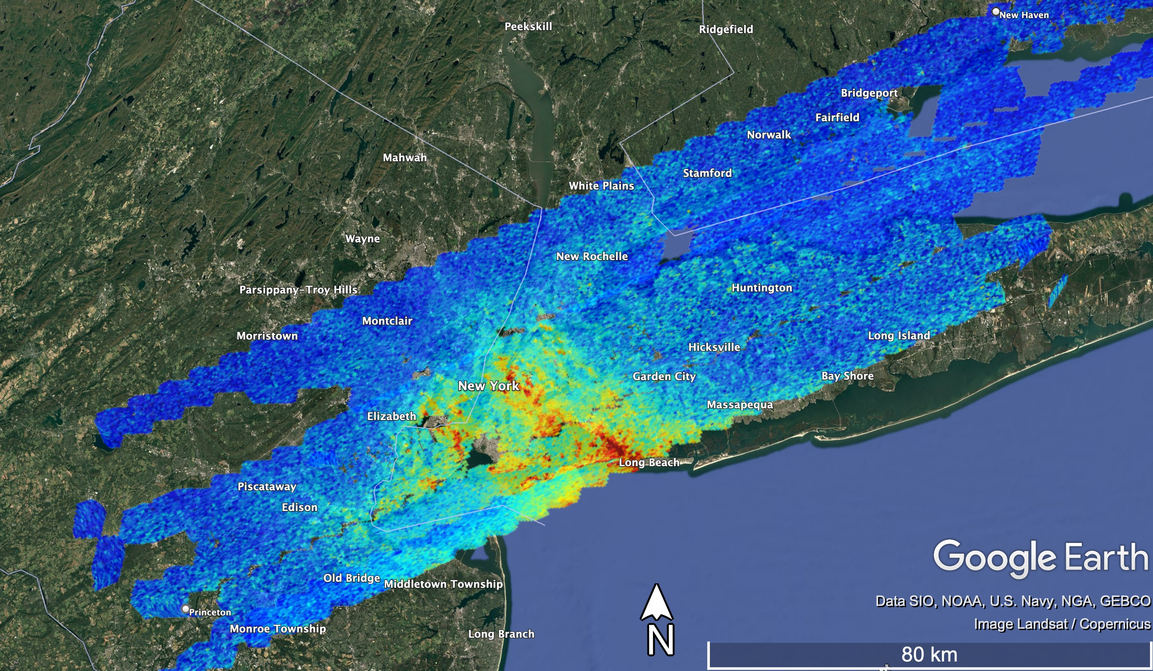
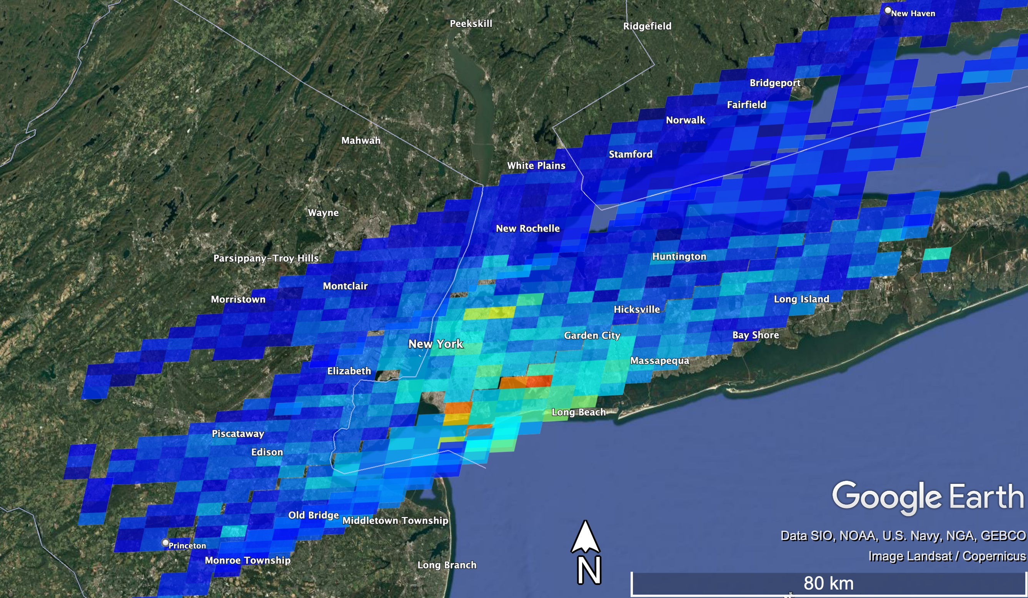
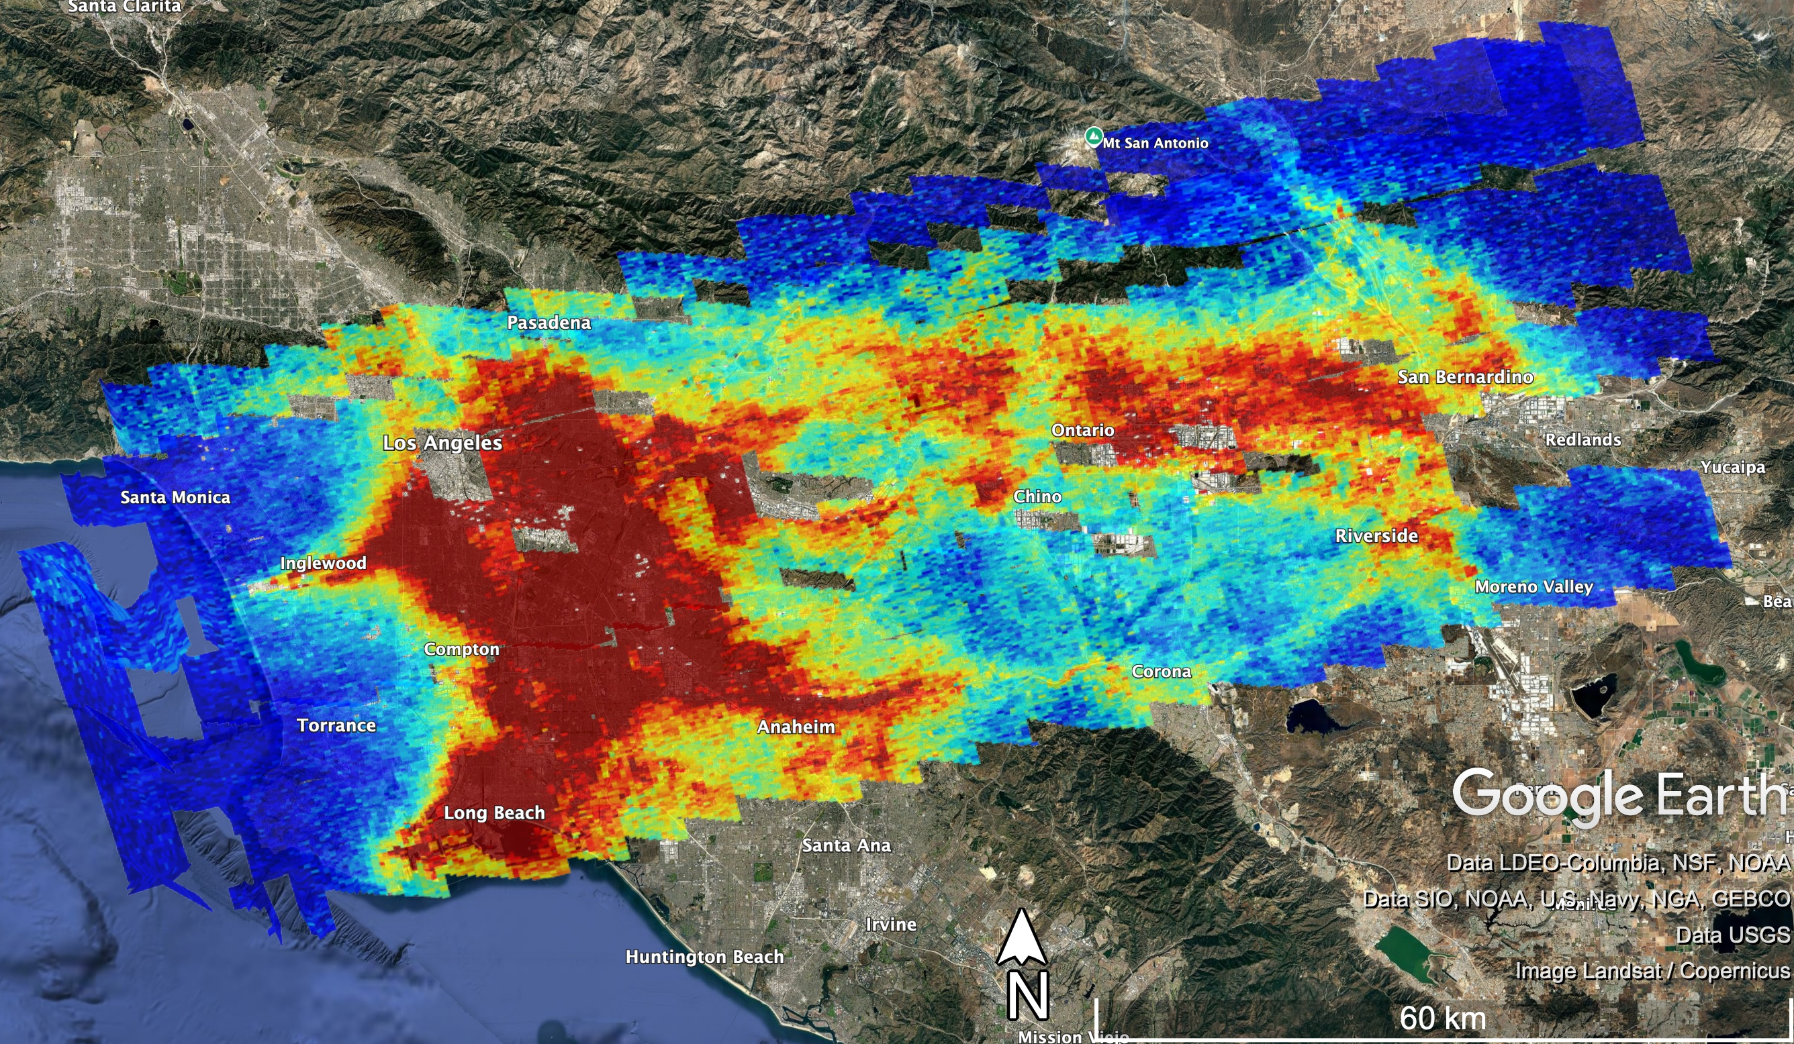
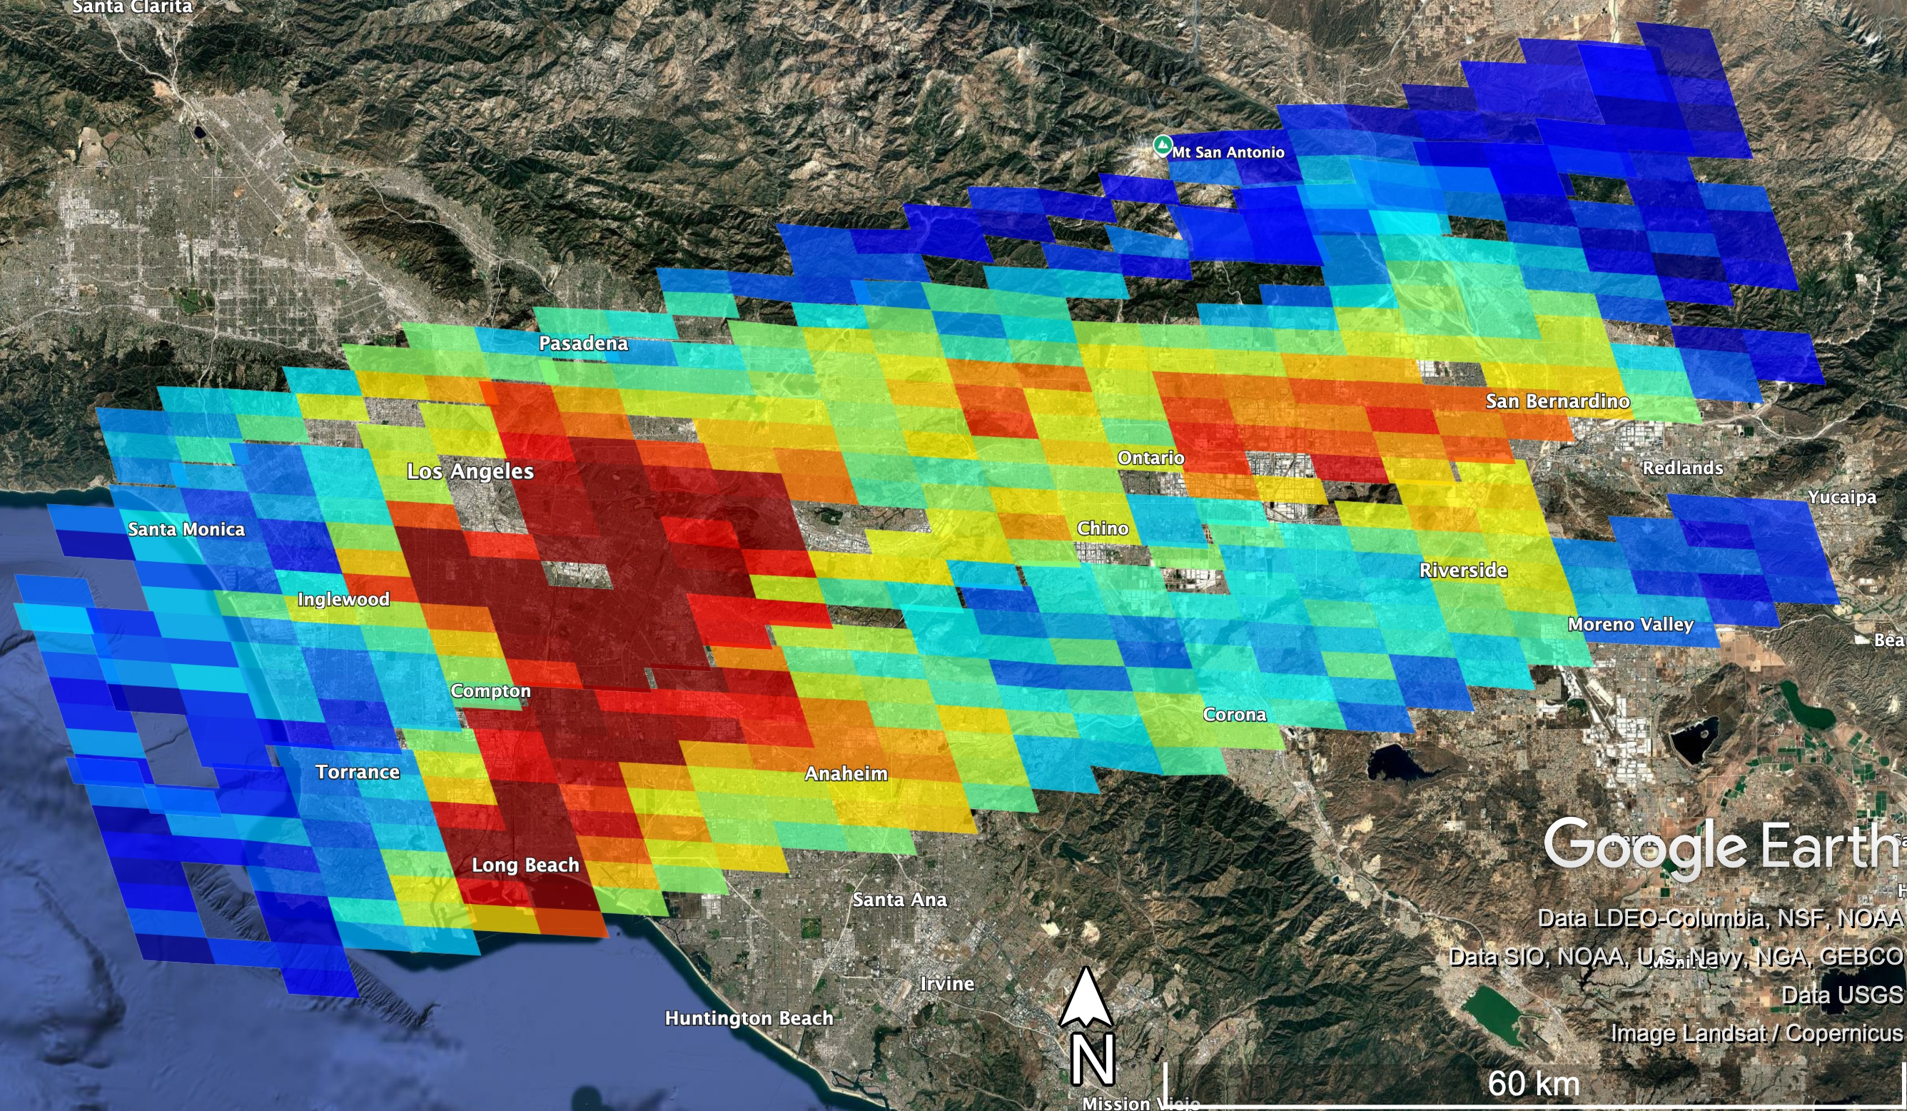
TEMPO V4 L2 Validation
GCAS
TEMPO
y=0.95x+2E14
r²=0.85
Median % difference: -1.7%
Median difference: -6E13
New York City on August 9th, 2023: Scans 2,3,4
Los Angeles on August 22nd, 2023: Scans 9, 10
V4 shows a huge improvement over V3 in all regions measured during STAQS
r² improved from 0.73→ 0.85 for all sites
0.49→0.62 for East Cost
All GCAS data is collected within 30 minutes of the TEMPO scan
Credit: Laura Judd

Slide 12

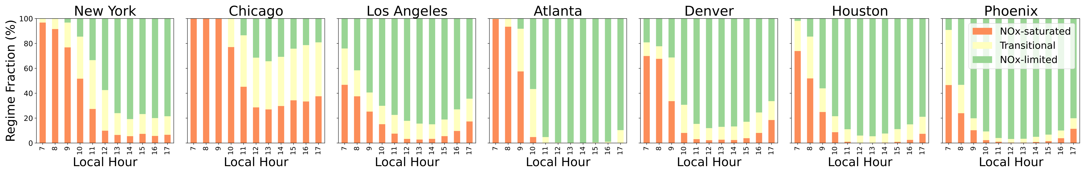
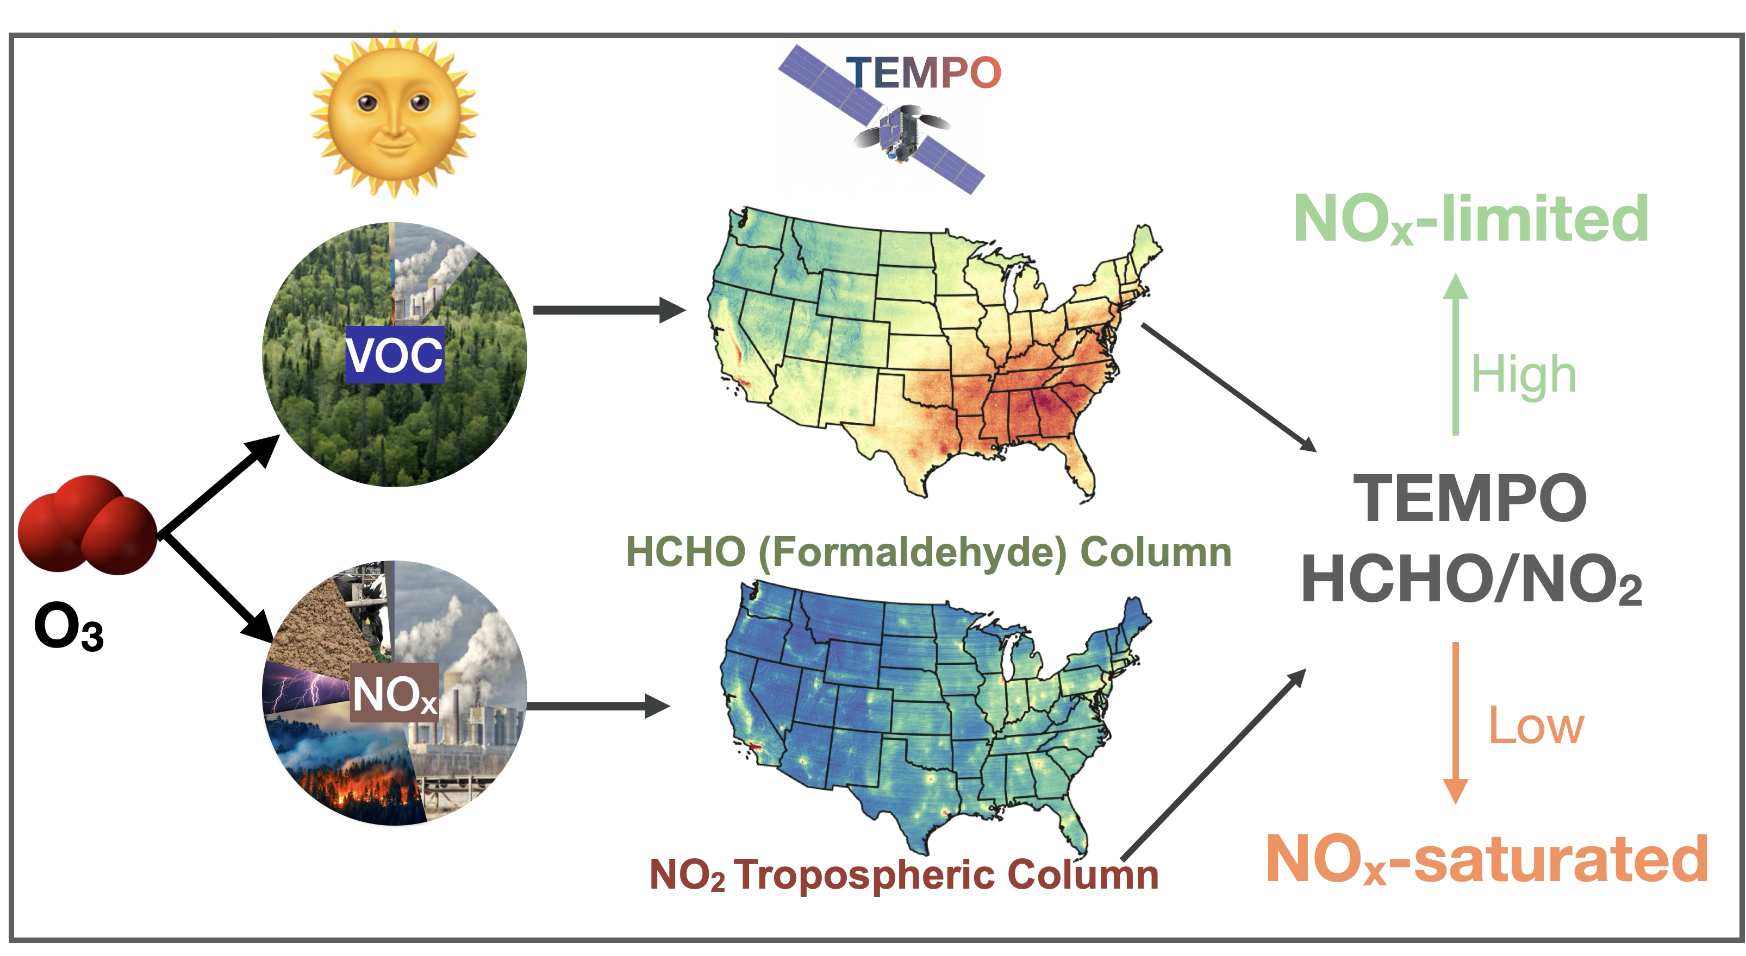
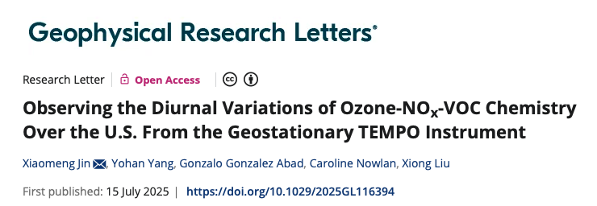

New TEMPO Study Published in GRL (Jin et al., 2025):
Observing the Diurnal Variations of Ozone-NOx-VOC Chemistry Over the U.S. From the Geostationary TEMPO Instrument
Diurnal Variations of O3 Production Regime Derived from TEMPO
Xiaomeng Jin (xiaomeng.jin@rutgers.edu)
12

Slide 13

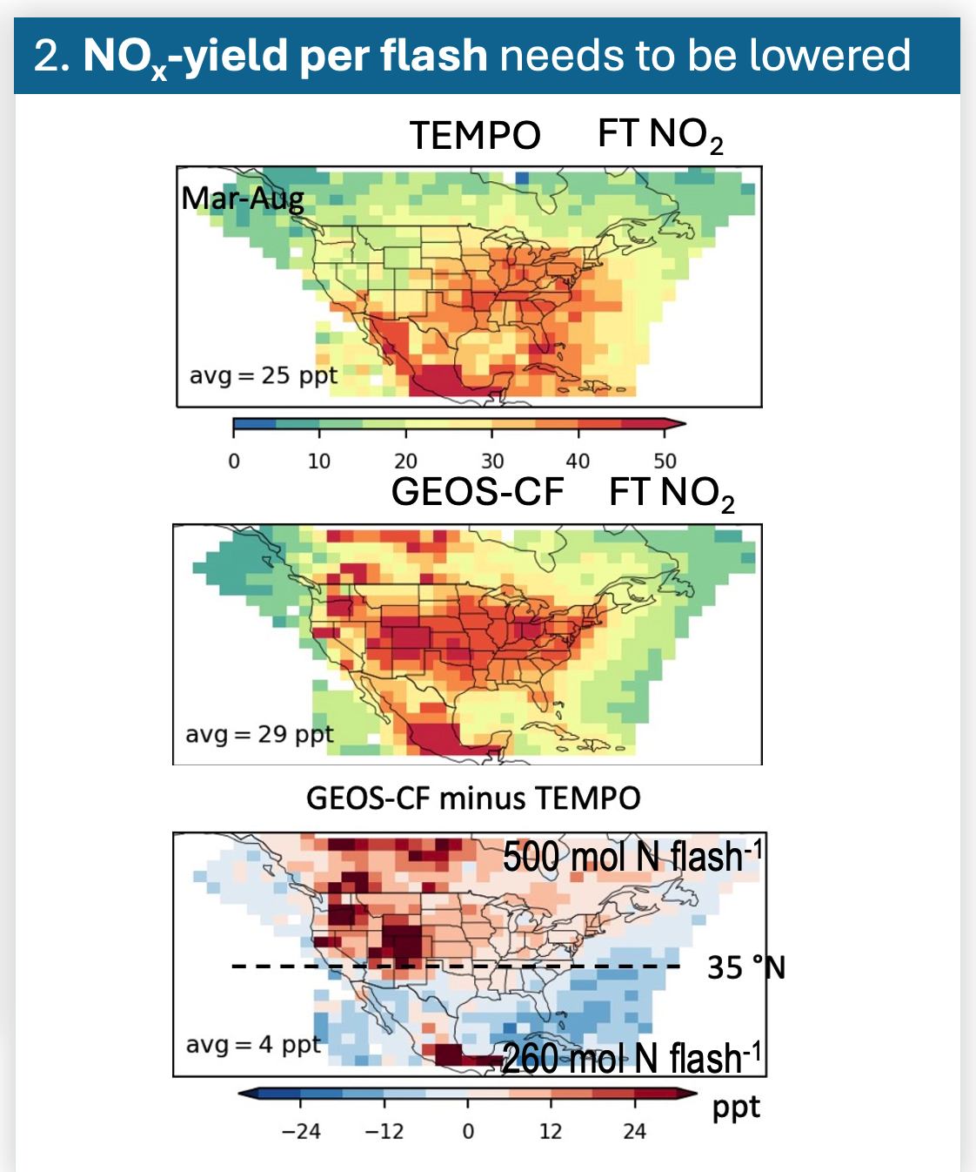
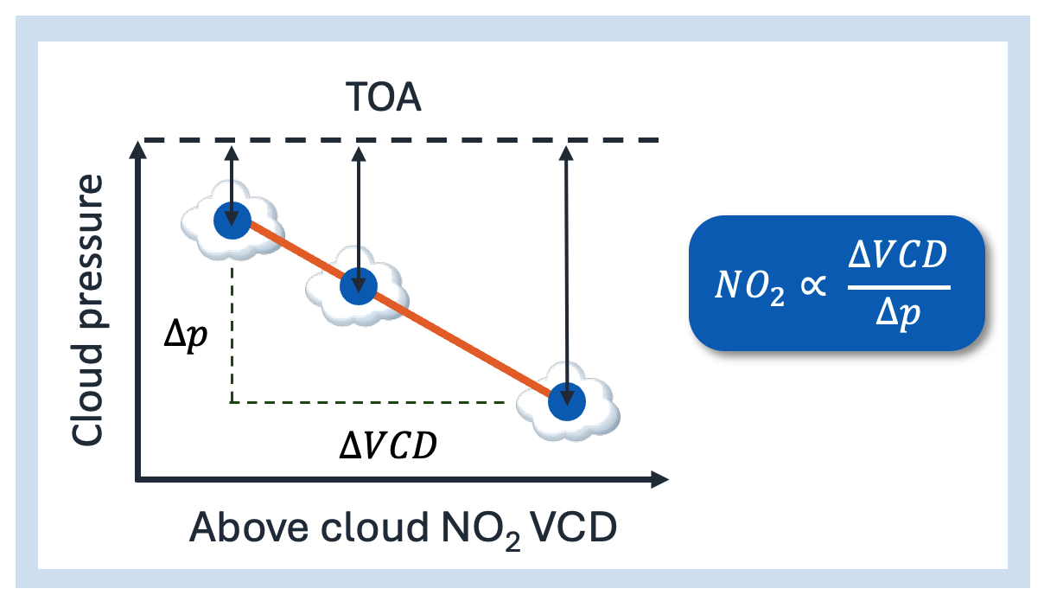
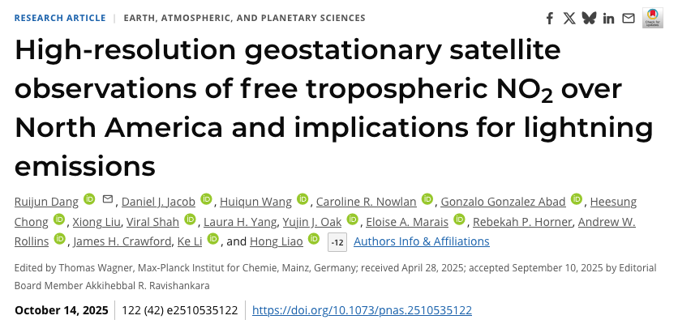
TEMPO Cloud-Sliced Free Tropospheric (FT) NO₂
Observations: Implications for Lightning Emissions
New TEMPO Study published on PNAS
Dang et al., 2025
First Diurnal Observation of FT NO₂
Cloud Slicing to Derive Free Tropospheric (700-300 hPa) NO₂
High observation density from TEMPO enables effective cloud slicing
Large errors in model lightning NOx emissions: A yield of 150 mol N flash⁻¹ appears most reasonable for NA.
Ruijun Dang (rjdang@g.harvard.edu)

Slide 14
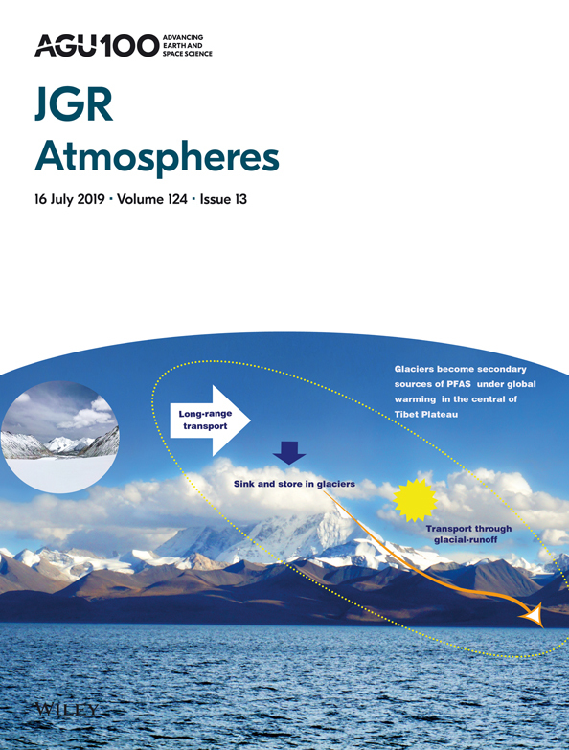
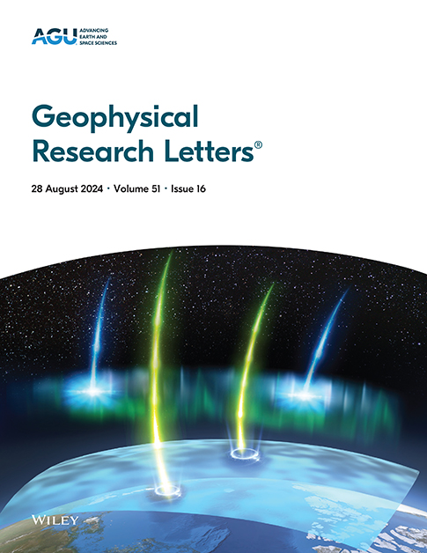
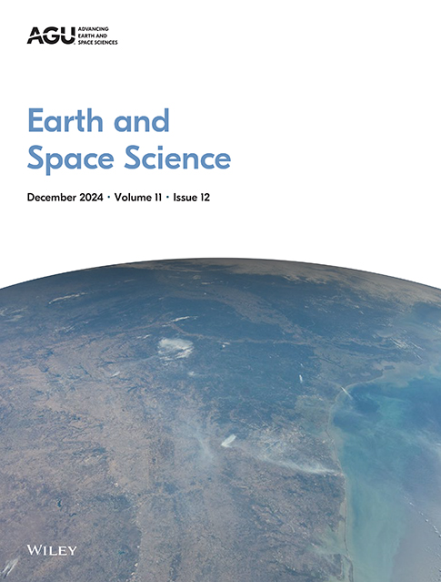

TEMPO AGU Special Collection
Call for Papers
TEMPO Data Products, Science, and Applications
Submission Deadline: December 31, 2026
Currently, 28 papers submitted, 21 papers published so far!

Slide 15
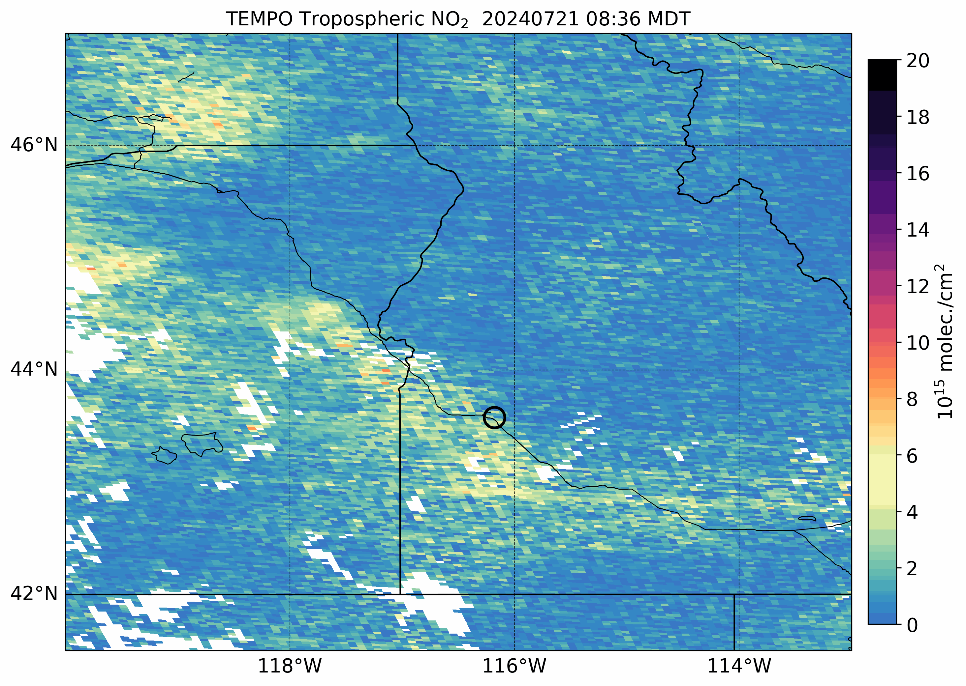
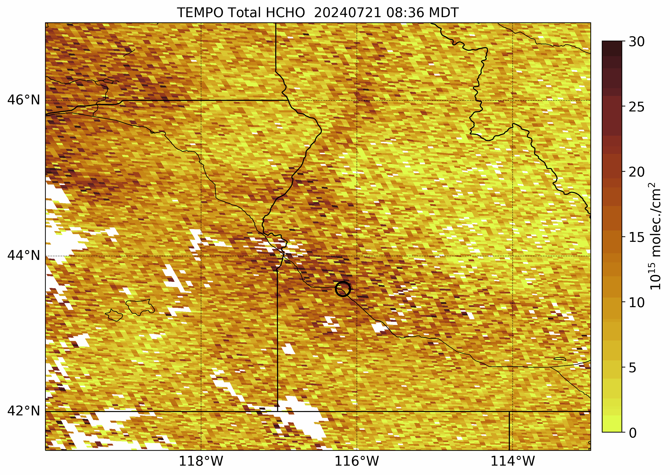
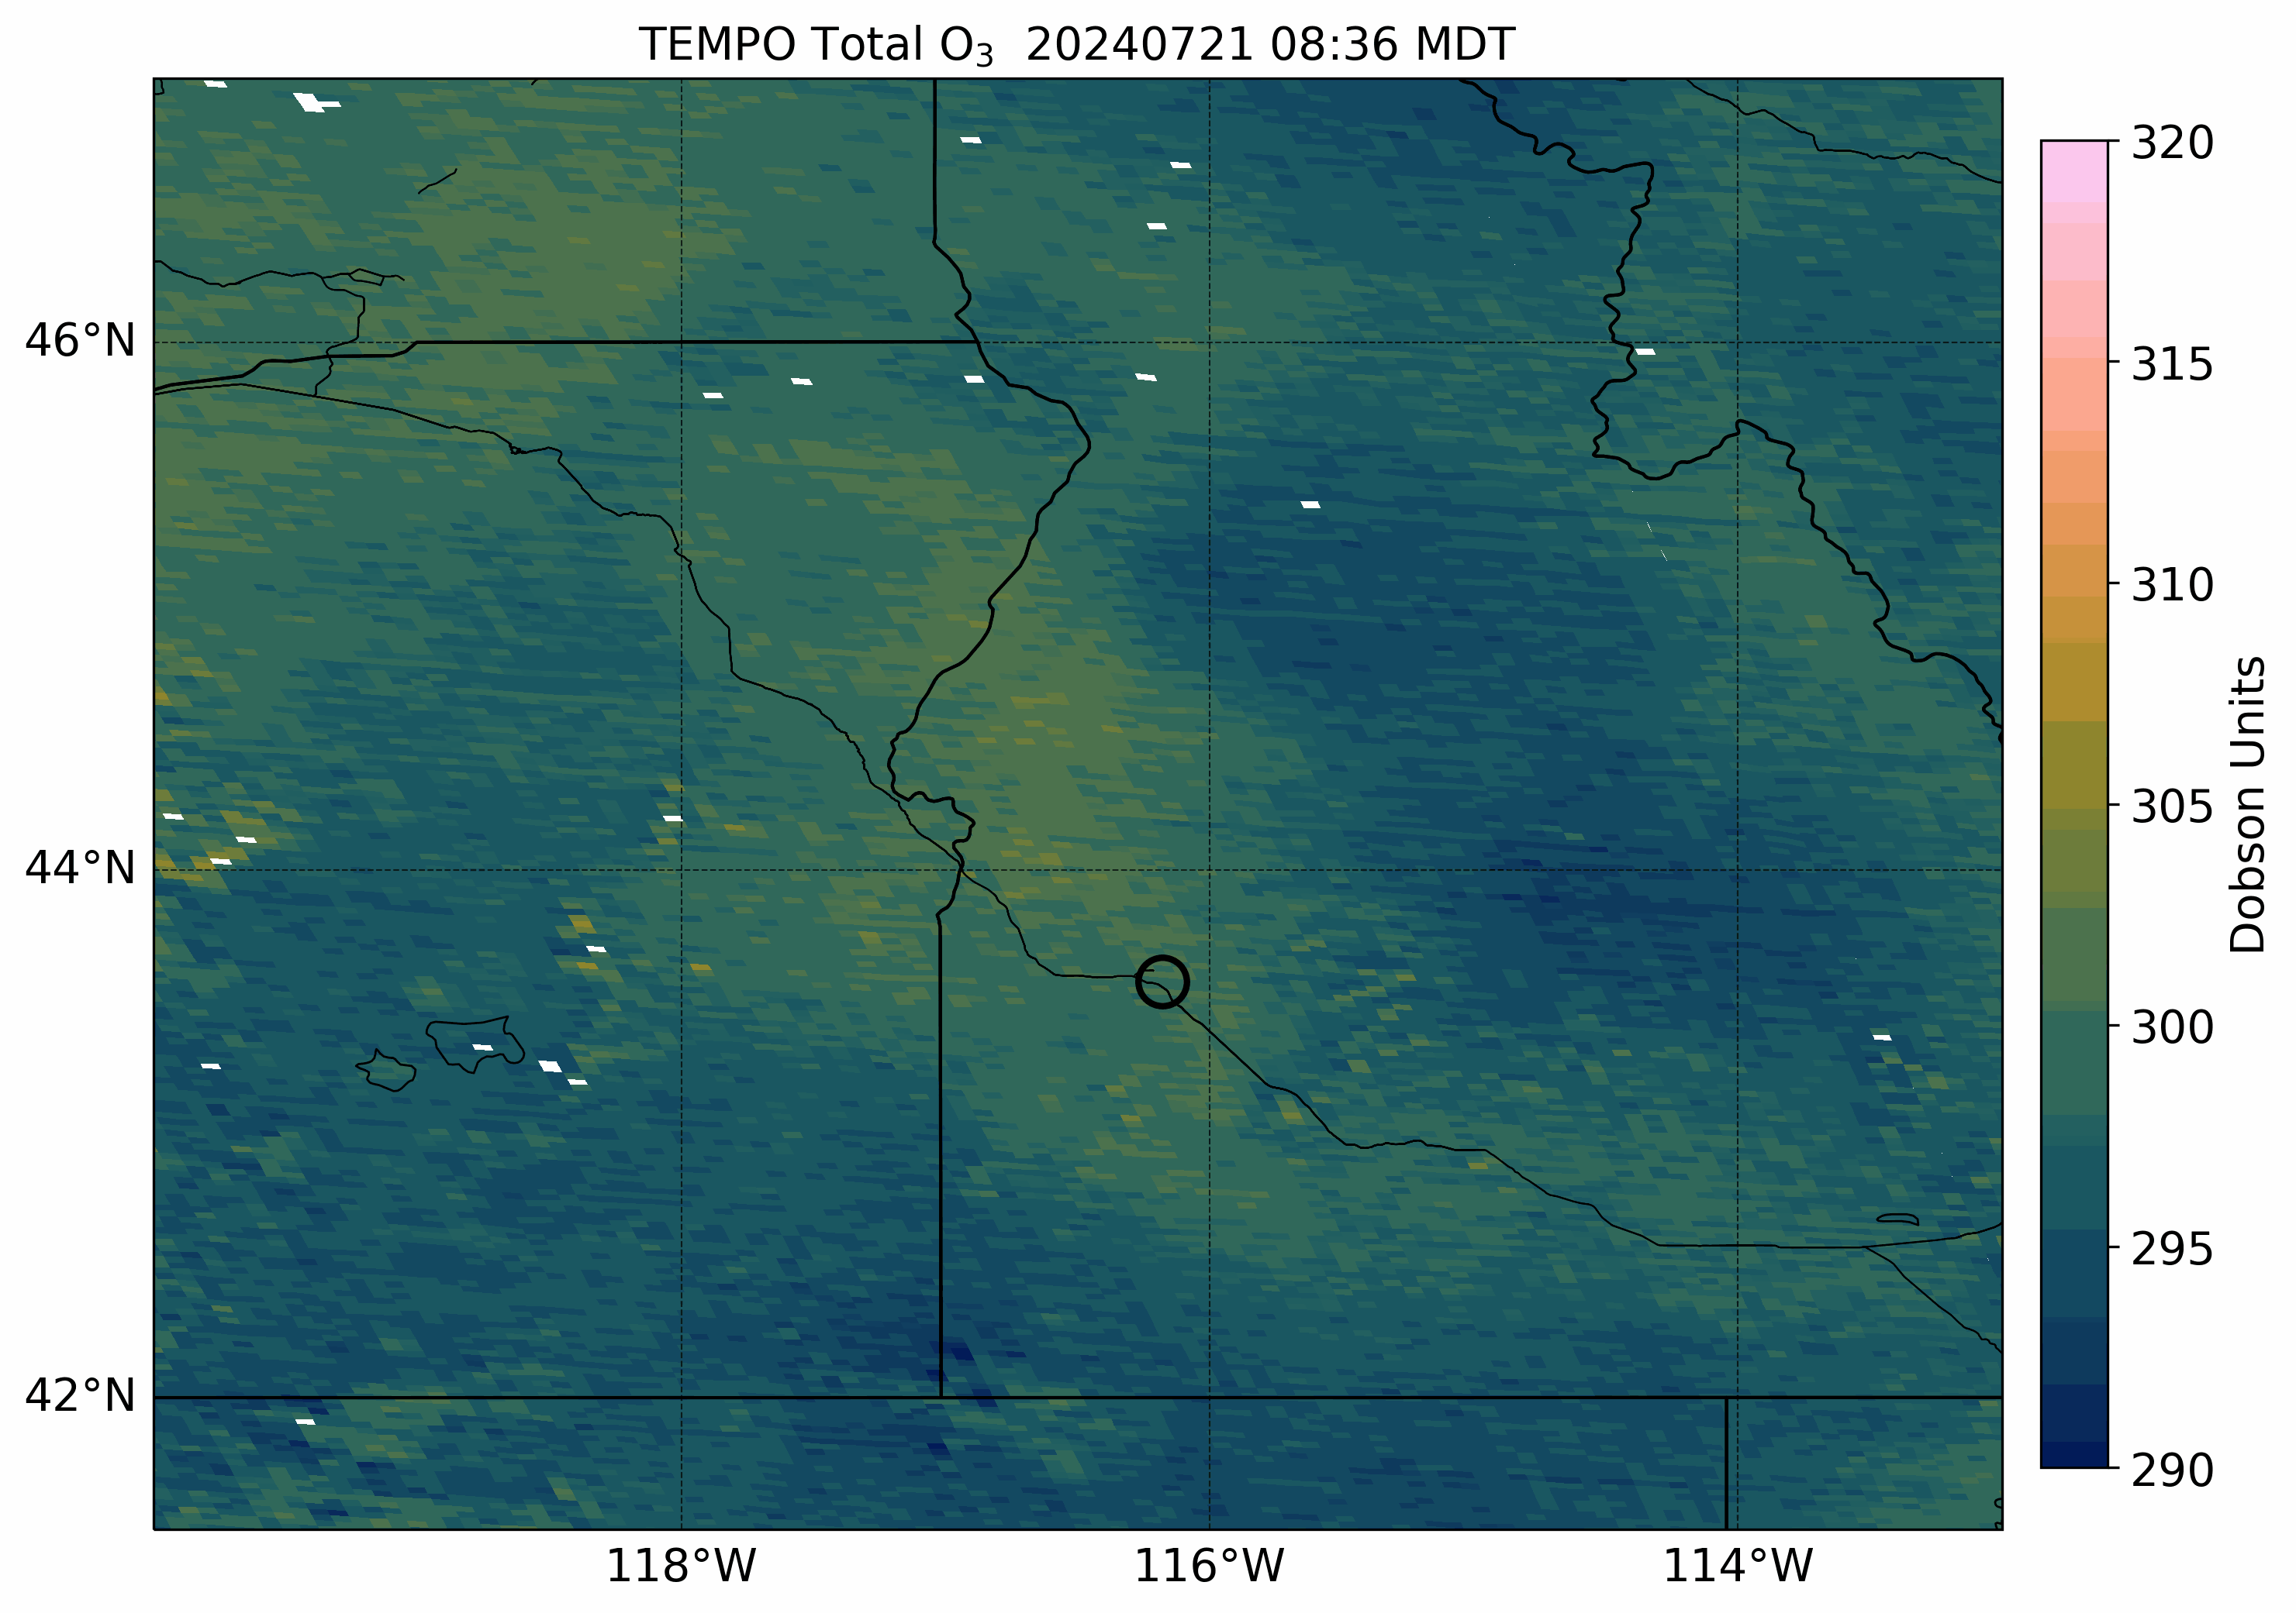
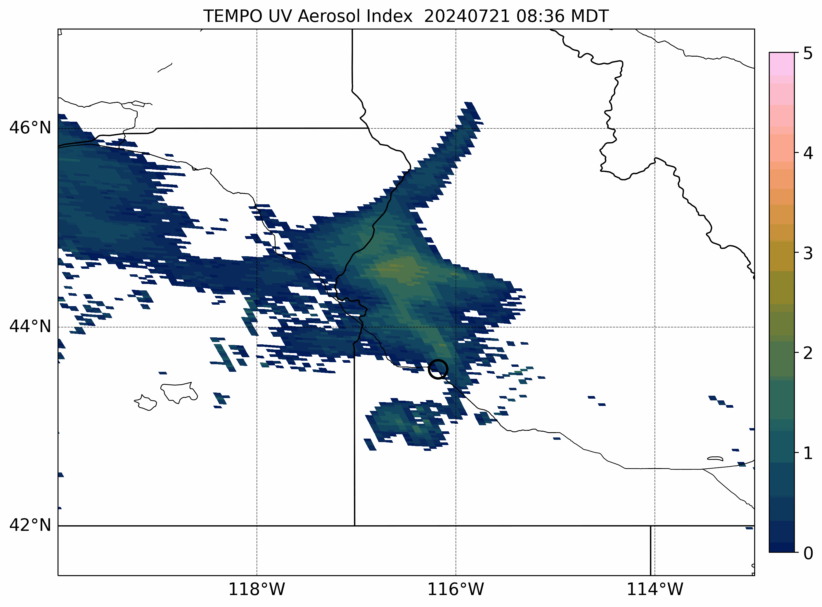
TEMPO Early Adopter Program for
Science and Applications
NO₂
HCHO
TEMPO Early Adopter program: ~650 Early Adopters including ~115 from local, state, and regional AQ agencies
TEMPO wildfire smoke monitoring in Idaho
TEMPO observed large NO₂ and HCHO plumes associated with wildfires, mostly in Oregon
NO₂ VCDs peaked during the afternoon with the wildfire intensity
Large HCHO VCDs were observed farther downstream from the wildfire locations
UVAI tracked the smoke transport shown by the strongly positive values tied to absorbing particles
Distinct increases in total O₃ columns within the wildfire smoke plumes
Boise
Boise
Cloud Fraction < 50%
Cloud Fraction < 50%
O₃
UVAI
Stakeholder quote “The new knowledge gained by TEMPO data will allow Idaho DEQ to document wildfire/ozone events in Exceptional Event demonstrations. We may be able to use the data to maintain situational awareness of enhanced precursors from fire and eventually improve our ozone forecasting. We have also been looking for a way to screen for ozone EE events - this may be a promising way to do it.”
Boise
Boise
Credit: Aaron Naeger

Slide 16
Summary and Outlook
Successful commissioning & nominal operations; instrument performing very well.
Special observations capability to support TEMPO Green Paper & CAL/VAL
TEMPO at night capability provides bonus science and discovery
Successfully completed baseline mission. 1st extension to September 2026 & further extension via NASA Senior Reviews
Released significantly improved V4 data products including ozone profile and V2 NRT products on September 17, 2025.
Continue to improve data products (next version in ~2028)
Develop new data products (funded under SNWG)
Expand the wide usage of TEMPO data for science and applications
Acknowledgements: Funding from NASA (TEMPO, NNL13AA09C; SNWG TEMPO NRT, 80MSFC24CA004)
Thank you!

Slide 17










