Slide 1

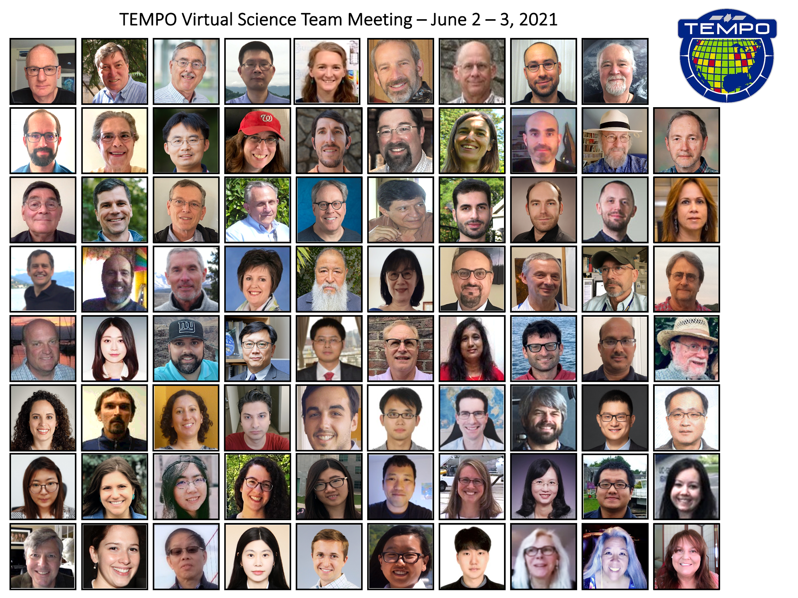




Tropospheric Emissions:
Monitoring of Pollution
TEMPO: A New Era of Air Quality Monitoring from Space
over North America
Xiong Liu¹, Kelly Chance¹, Raid M. Suleiman¹,
Kevin Daugherty², David Flittner², John Houck¹, John Davis¹,
Gonzalo Gonzalez Abad¹, Caroline Nowlan¹, Huiqun Wang¹,
Chistopher Chan Miller^{1,3}, Juseon Bak⁴, Hyeong-Ahn Kwon^{1,5},
Jim Carr⁶, Weizhen Hou¹, Heesung Chong¹, Mike Newchurch⁷,
Jim Szykman⁸, Aaron Naeger⁷, The TEMPO Team
¹CfA | Harvard & Smithsonian ²NASA LaRc
³Harvard University ⁴Pusan National University
⁵U. Suwon, ⁶Carr Astronautics ⁷UAH ⁸EPA
xliu@cfa.harvard.edu, https://tempo.si.edu/
ECCC AQRD Seminar, June 1, 2023

Slide 2
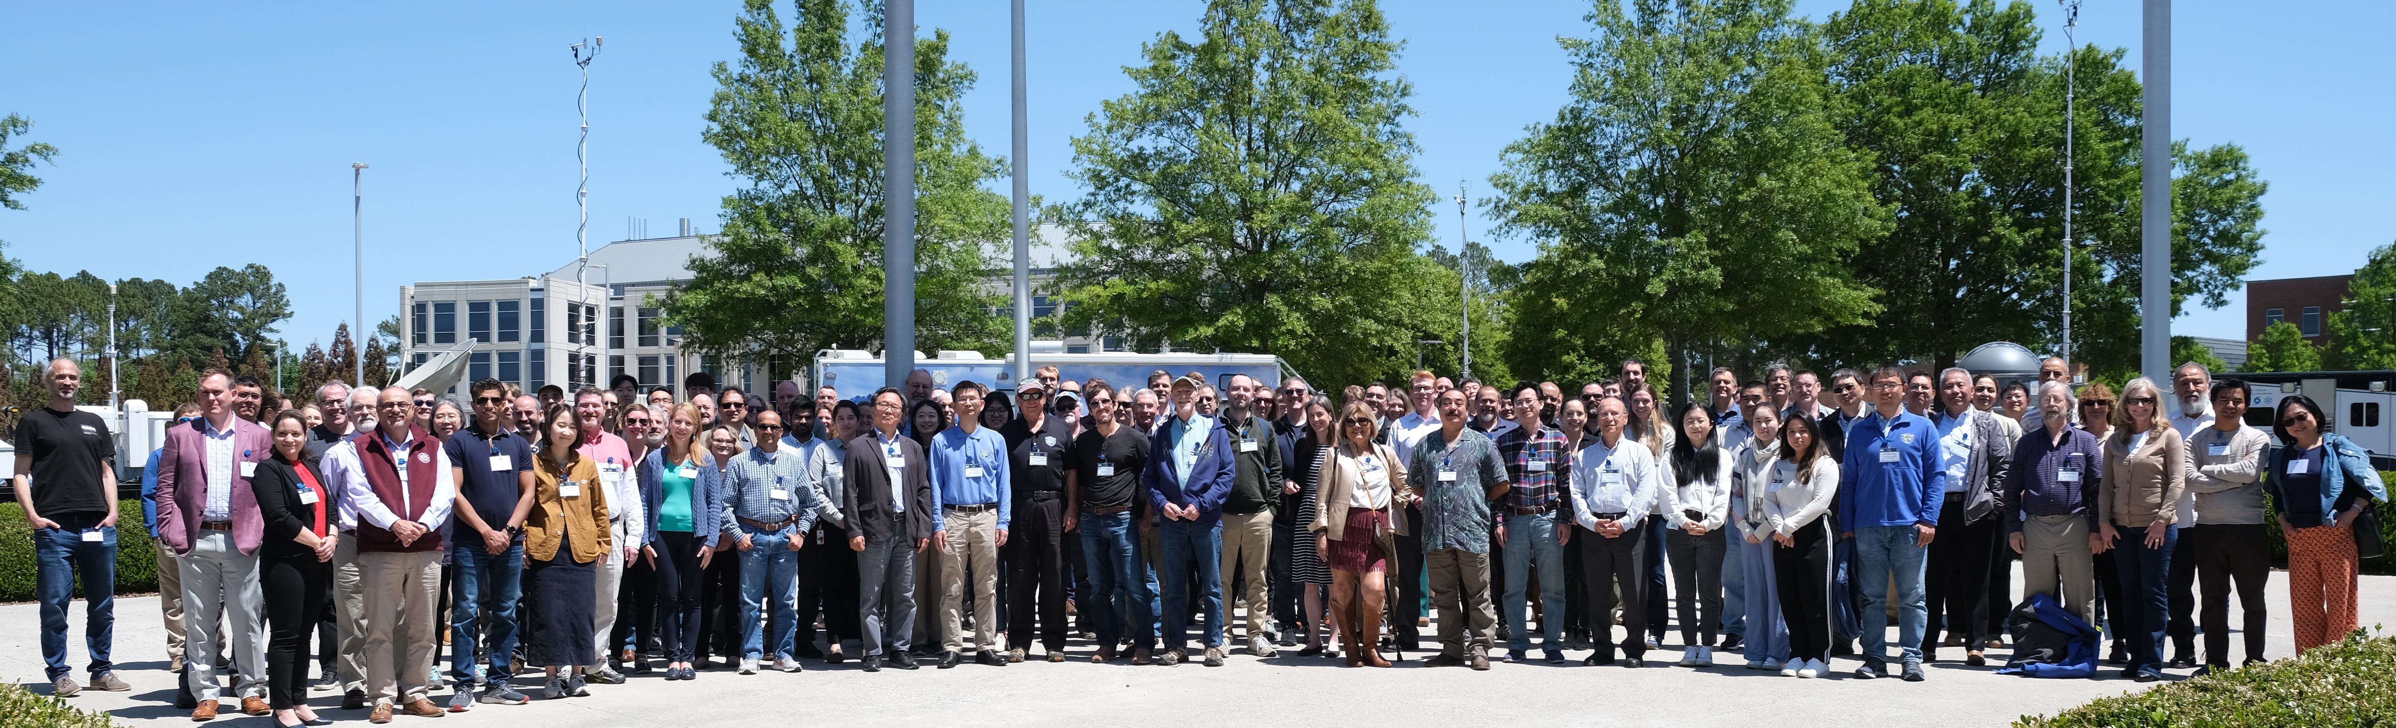
Outline
Introduction
TEMPO Science Overview
TEMPO Instrument and Operation
TEMPO Data Products and Algorithm Development
Commissioning, Nominal Operation, Data Release Plan, Cal/Val Plan
TEMPO Participation, Early Adopters and Green Paper

Slide 3
Impacts of Air Pollution
State of the Air 2023 Report [American Lung Association]
  More than 1 in 3 Americans (36% or 119.6M) lives in places with unhealthy levels of air pollutions
  Climate change is making the job of cleaning up the air more difficult
  People of color were 3.7 times as likely as white people to live in a county with 3 failing grades.
Health
  4.2 million people globally (60,000 in US) of premature death linked to air pollution in 2016 [WHO]
  Particulate matter (PM), ozone (O₃), nitrogen dioxide (NO₂) and sulfur dioxide (SO₂) have strongest links to mortality and morbidity
  Increased risk of COPD, respiratory infections, asthma, lung cancer, preterm birth, heart disease, stroke, diabetes
Ecosystems
  Harmful effects on crops and vegetation from ozone
  Deposition adds excess nitrogen and sulfur to soils, vegetation and water
3

Slide 4
Surface Pollution Monitoring
Surface observations can be sparse
Tend to be biased to urban areas
Non-existent in some countries
Cannot capture spatial patterns of short-lived species
EPA Air Quality System NO₂ Monitors

Slide 5
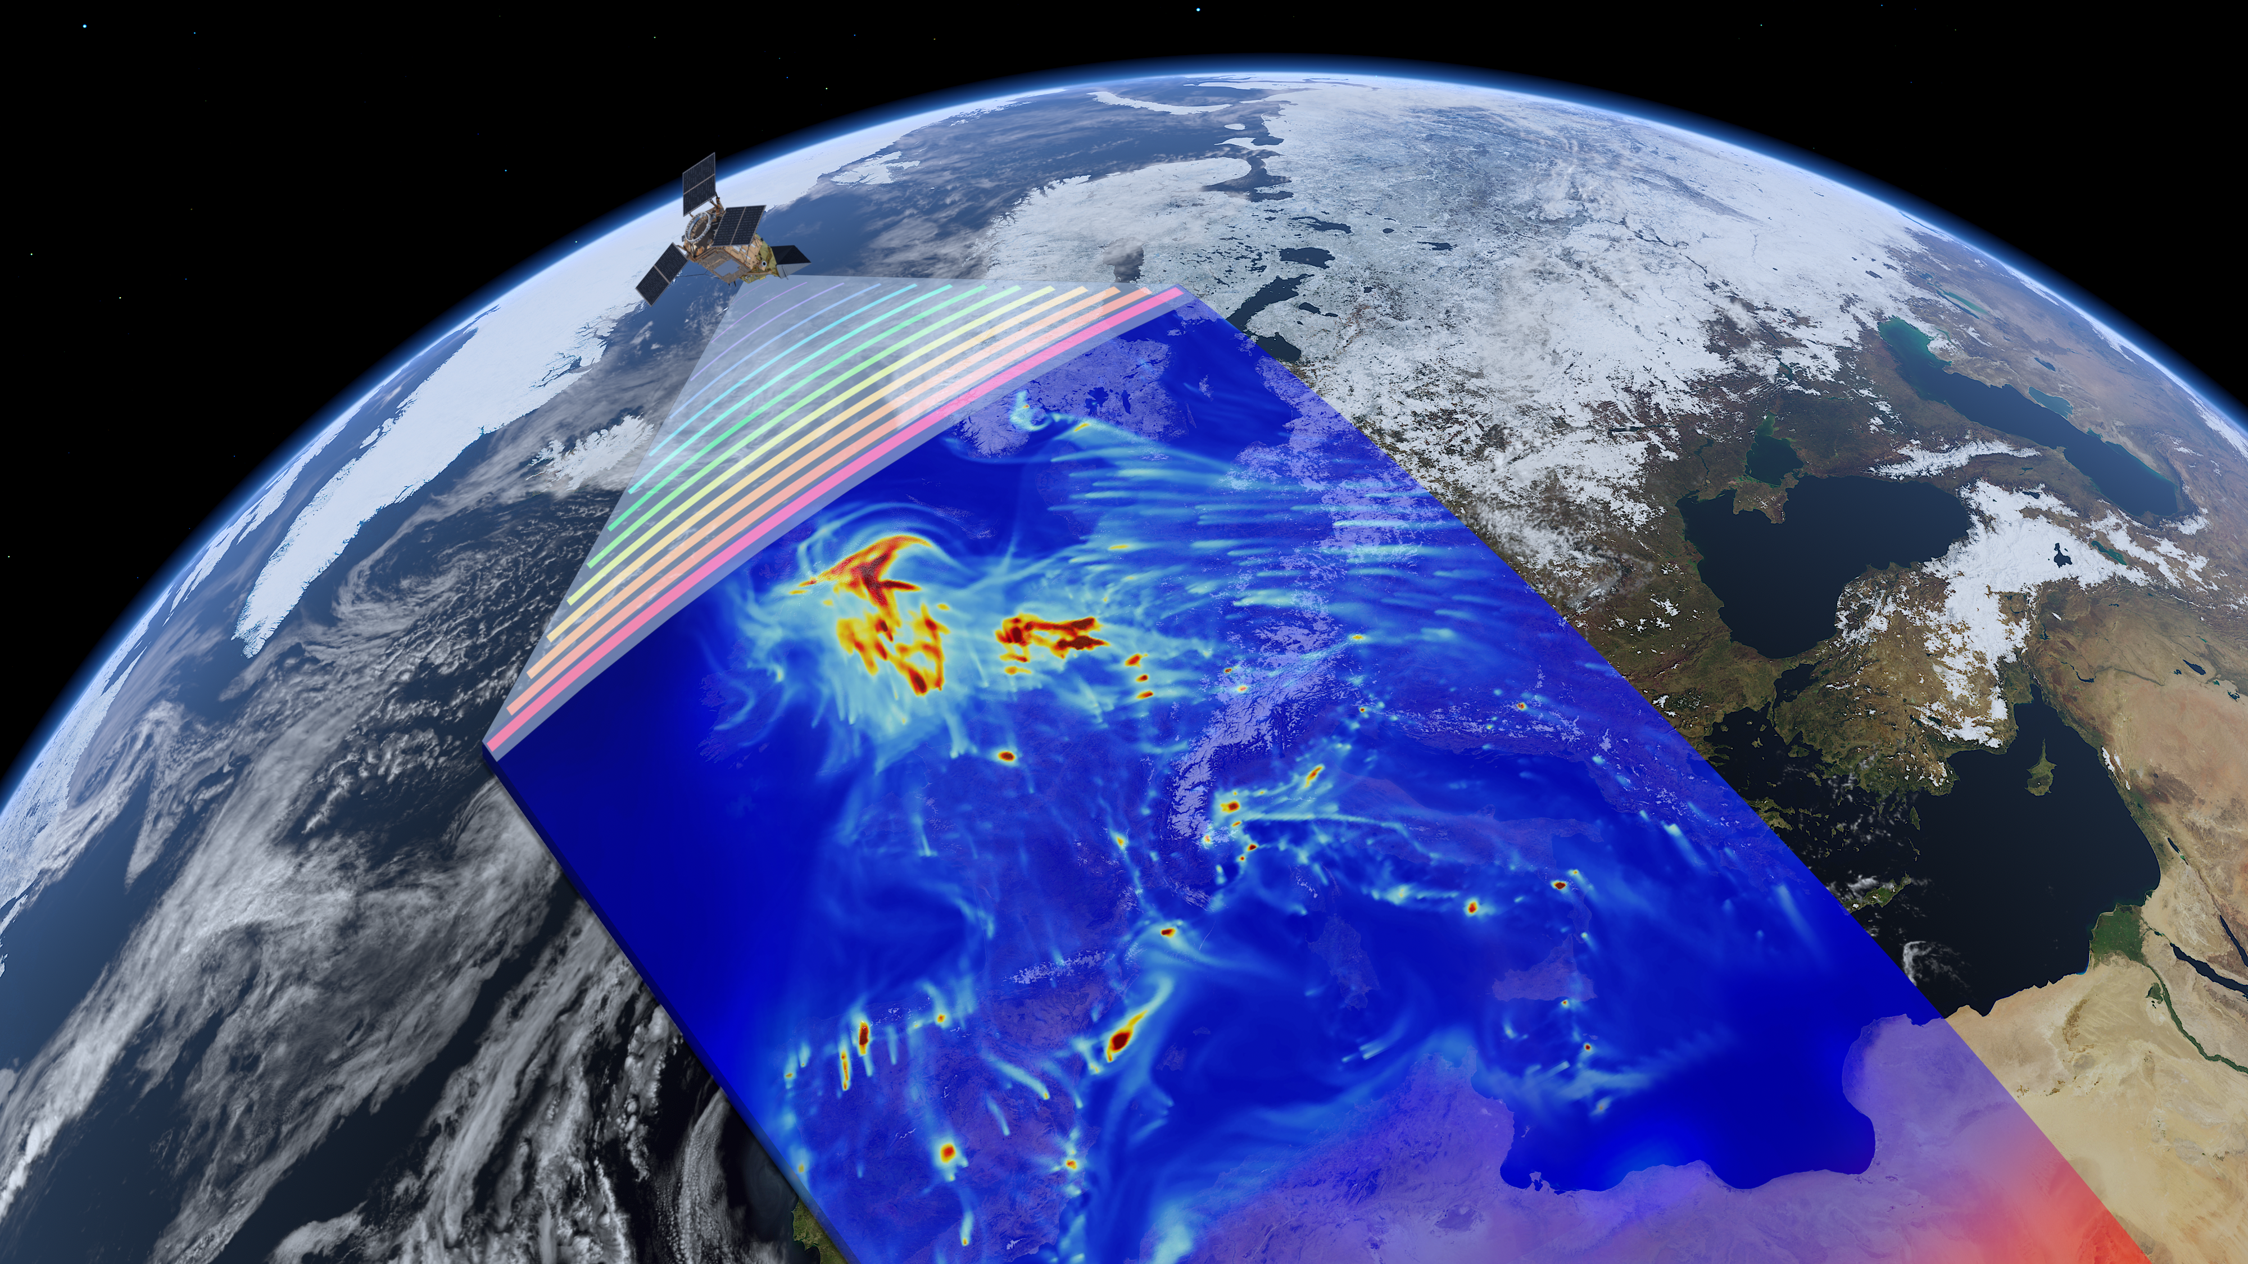
Satellite Remote Sensing
Satellites can provide continuous mapping
  Monitor remote regions
  Measure globally
UV/visible/near-infrared instruments are sensitive to pollutants in the lower atmosphere
Currently:
  Eight UV/Vis instruments in Low Earth Orbit
  Measure a location typically once per day
  Spatial resolutions ~3.5 × 5.5 km² to ~50 × 80 km²
TROPOMI NO₂, ESA
5

Slide 6
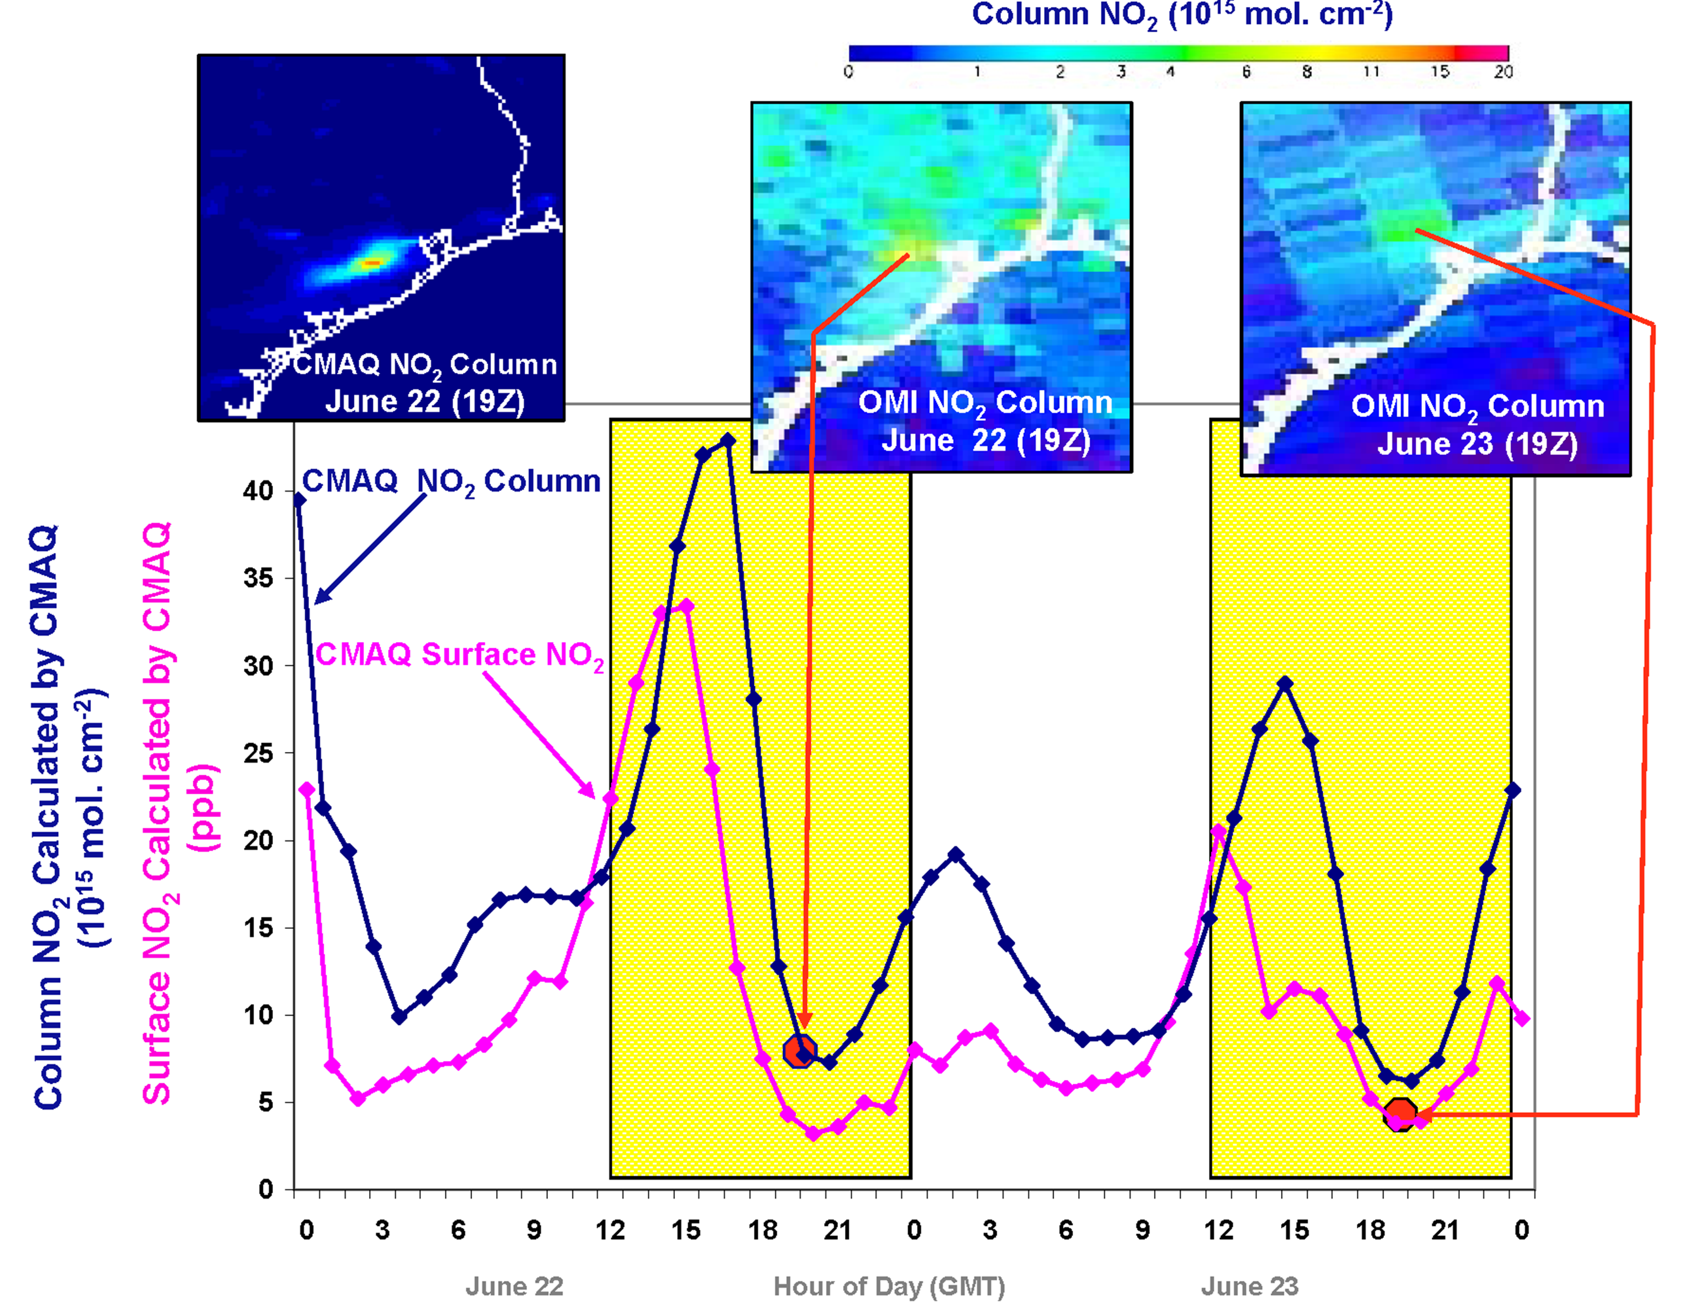
Why geostationary?
High temporal and spatial resolution
Hourly NO₂ surface concentration and integrated column calculated by CMAQ air quality model: Houston, TX, June 22-23, 2005
[Fishman et al., 2008]
June 22
Hour of Day (UTC)
June 23
LEO observations provide limited information on rapidly varying emissions, chemistry, & transport
GEO will provide observations at temporal and spatial scales highly relevant to air quality processes
NRC’s 2007 Earth Science Decadal Survey recommended Geostationary Coastal & Air Pollution Events (GEO-CAPE) mission

Slide 7

Hourly Daytime Atmospheric Pollution over North America from the GEO
NASA’s first Earth Venture Instrument (EVI) selected in 2012 & first hosted payload
PI: Kelly Chance, Smithsonian Astrophysical Observatory (SAO): Science team, ground systems, science data processing center
Instrument Development: Ball Aerospace
Instrument Project Management: Kevin Daugherty, NASA LaRC
Other Institutions: NASA GSFC, NOAA, EPA, NCAR, Harvard, UC Berkeley, St. Louis U, UAH, U Iowa, Sitting Bull College, RT Solutions, Carr Astronautics
International collaboration: Mexico, Canada, Cuba, Korea, U.K., ESA, Spain
Mission Project Management: Kevin Daugherty, NASA LaRC
Host Satellite Provider: Maxar Technologies
Satellite Host: Intelsat (IS-40e)
Launch: SpaceX
Provides hourly daylight observations to capture rapidly varying emissions and chemistry important for air quality
  UV/visible grating spectrometer to measure key elements in tropospheric ozone and aerosol pollution
  Distinguishes boundary layer from free tropospheric & stratospheric ozone
Aligned with NRC Earth Science 2007 Decadal Survey recommendations
  Makes many of the GEO-CAPE atmospheric measurements
  Responds to the phased implementation recommendation of GEO-CAPE mission design team
TEMPO: It’s about Time!

Slide 8
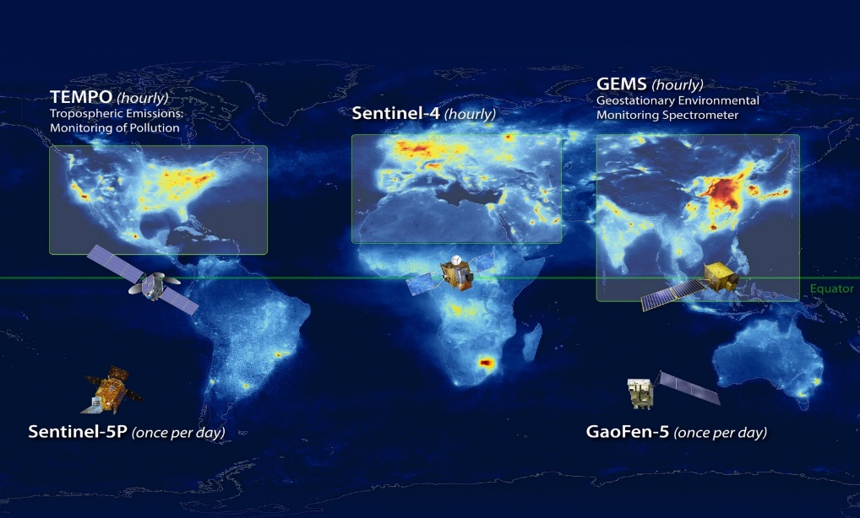
North American Component of an International Geostationary Air Quality Constellation
Launch April 2023
Launch late 2024
Launch Feb 2020
Image Credit: NASA LaRC

Slide 9
TEMPO Science Questions
What are the temporal and spatial variations of emissions of gases and aerosols important for air quality and climate?
How do physical, chemical, and dynamical processes determine tropospheric composition and air quality over scales ranging from urban to continental, diurnally to seasonally?
How does air pollution drive climate forcing and how does climate change affect air quality on a continental scale?
How can observations from space improve air quality forecasts and assessments for societal benefit?
How does intercontinental transport affect air quality?
How do episodic events, such as wildfires, dust outbreaks, and volcanic eruptions, affect atmospheric composition and air quality?

Slide 10
TEMPO Science Traceability Matrix
TEMPO Requirements and Science Questions are leveraged from the GEO-CAPE Science Traceability Matrix

Slide 11
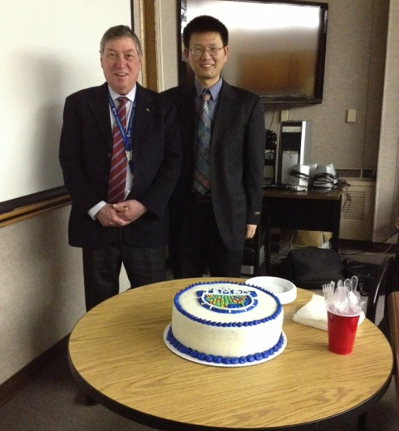
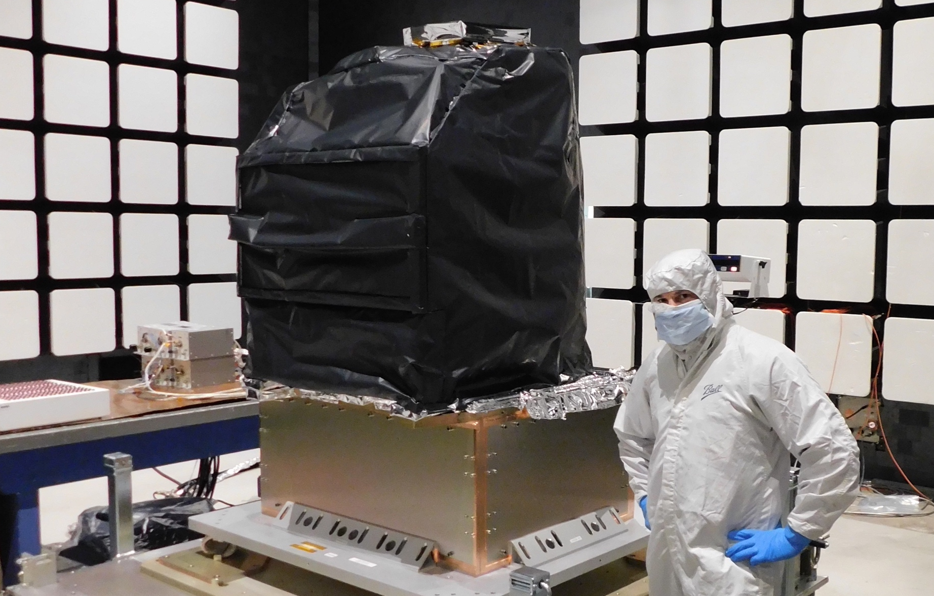
TEMPO Timeline
1/2013 | TEMPO project kick off
11/2018 | Instrument delivered
07/2019 | Host provider Maxar selected
02/2020 | Host Intelsat 40e (IS-40e) selected
6/2022 | TEMPO fully integrated onto IS-40e
02/2023 | Operation/Mission Readiness Review (ORR/MRR) Part 1
02/2023 | TEMPO integration tested with IS-40e
4/07/2023 | Launch
5/17/2023 | ORR/MRR Part 2
6/6/2023 | TEMPO power on
7/26/2023 | TEMPO first light
10/2023 | TEMPO nominal operation
4/2024 | Release data products to the public
Credit: Ball, Instrument Delivery

Slide 12
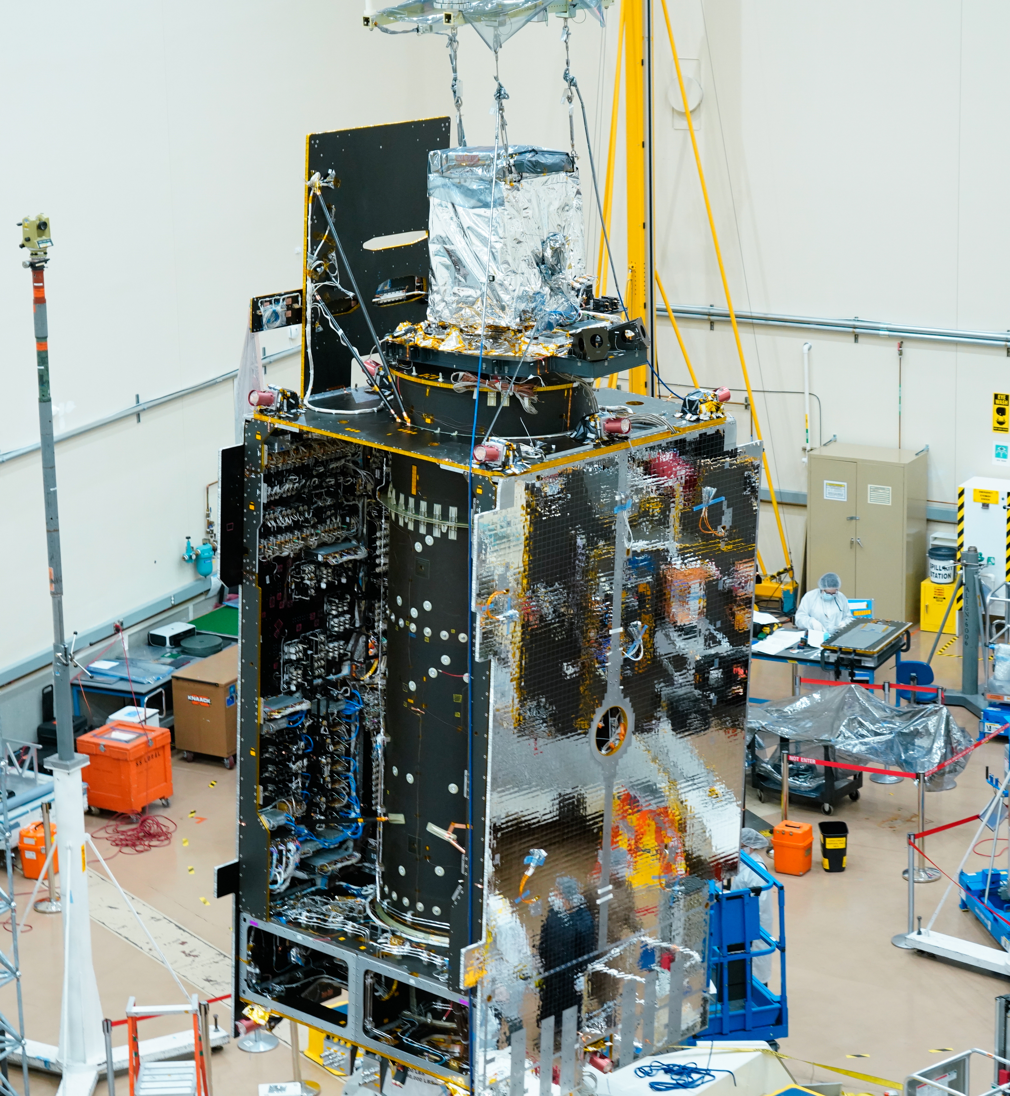
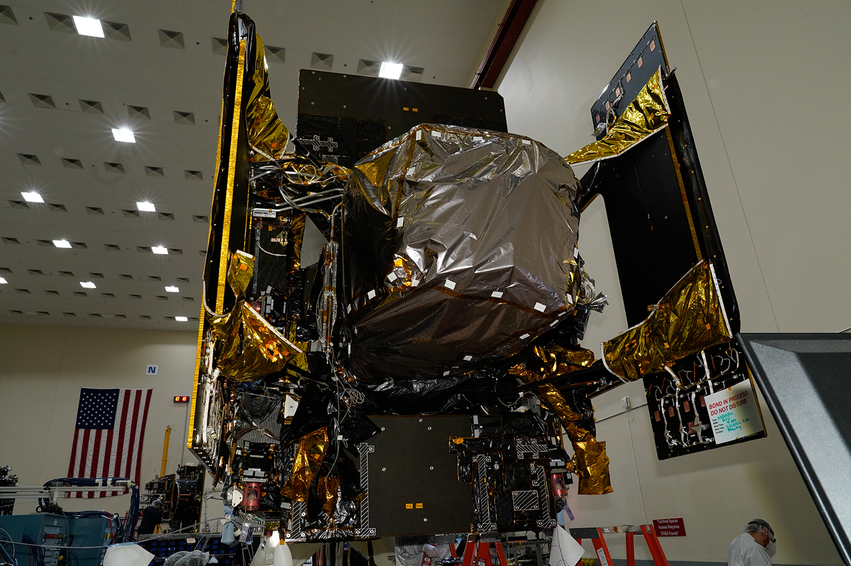
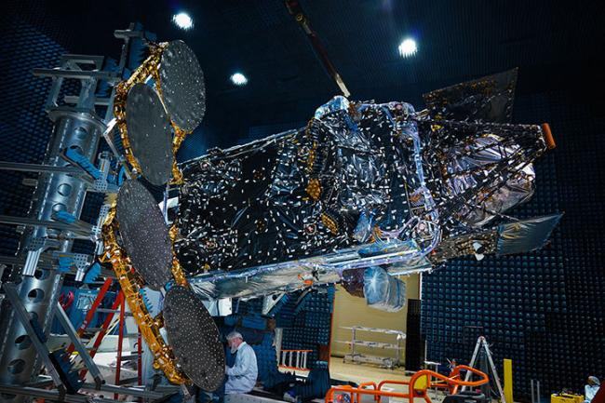
TEMPO Integration and Testing
Credit: Maxar, Sensor installed
Credit: Maxar, Sensor fully integrated
Credit: Maxar, Sensor tested

Slide 13
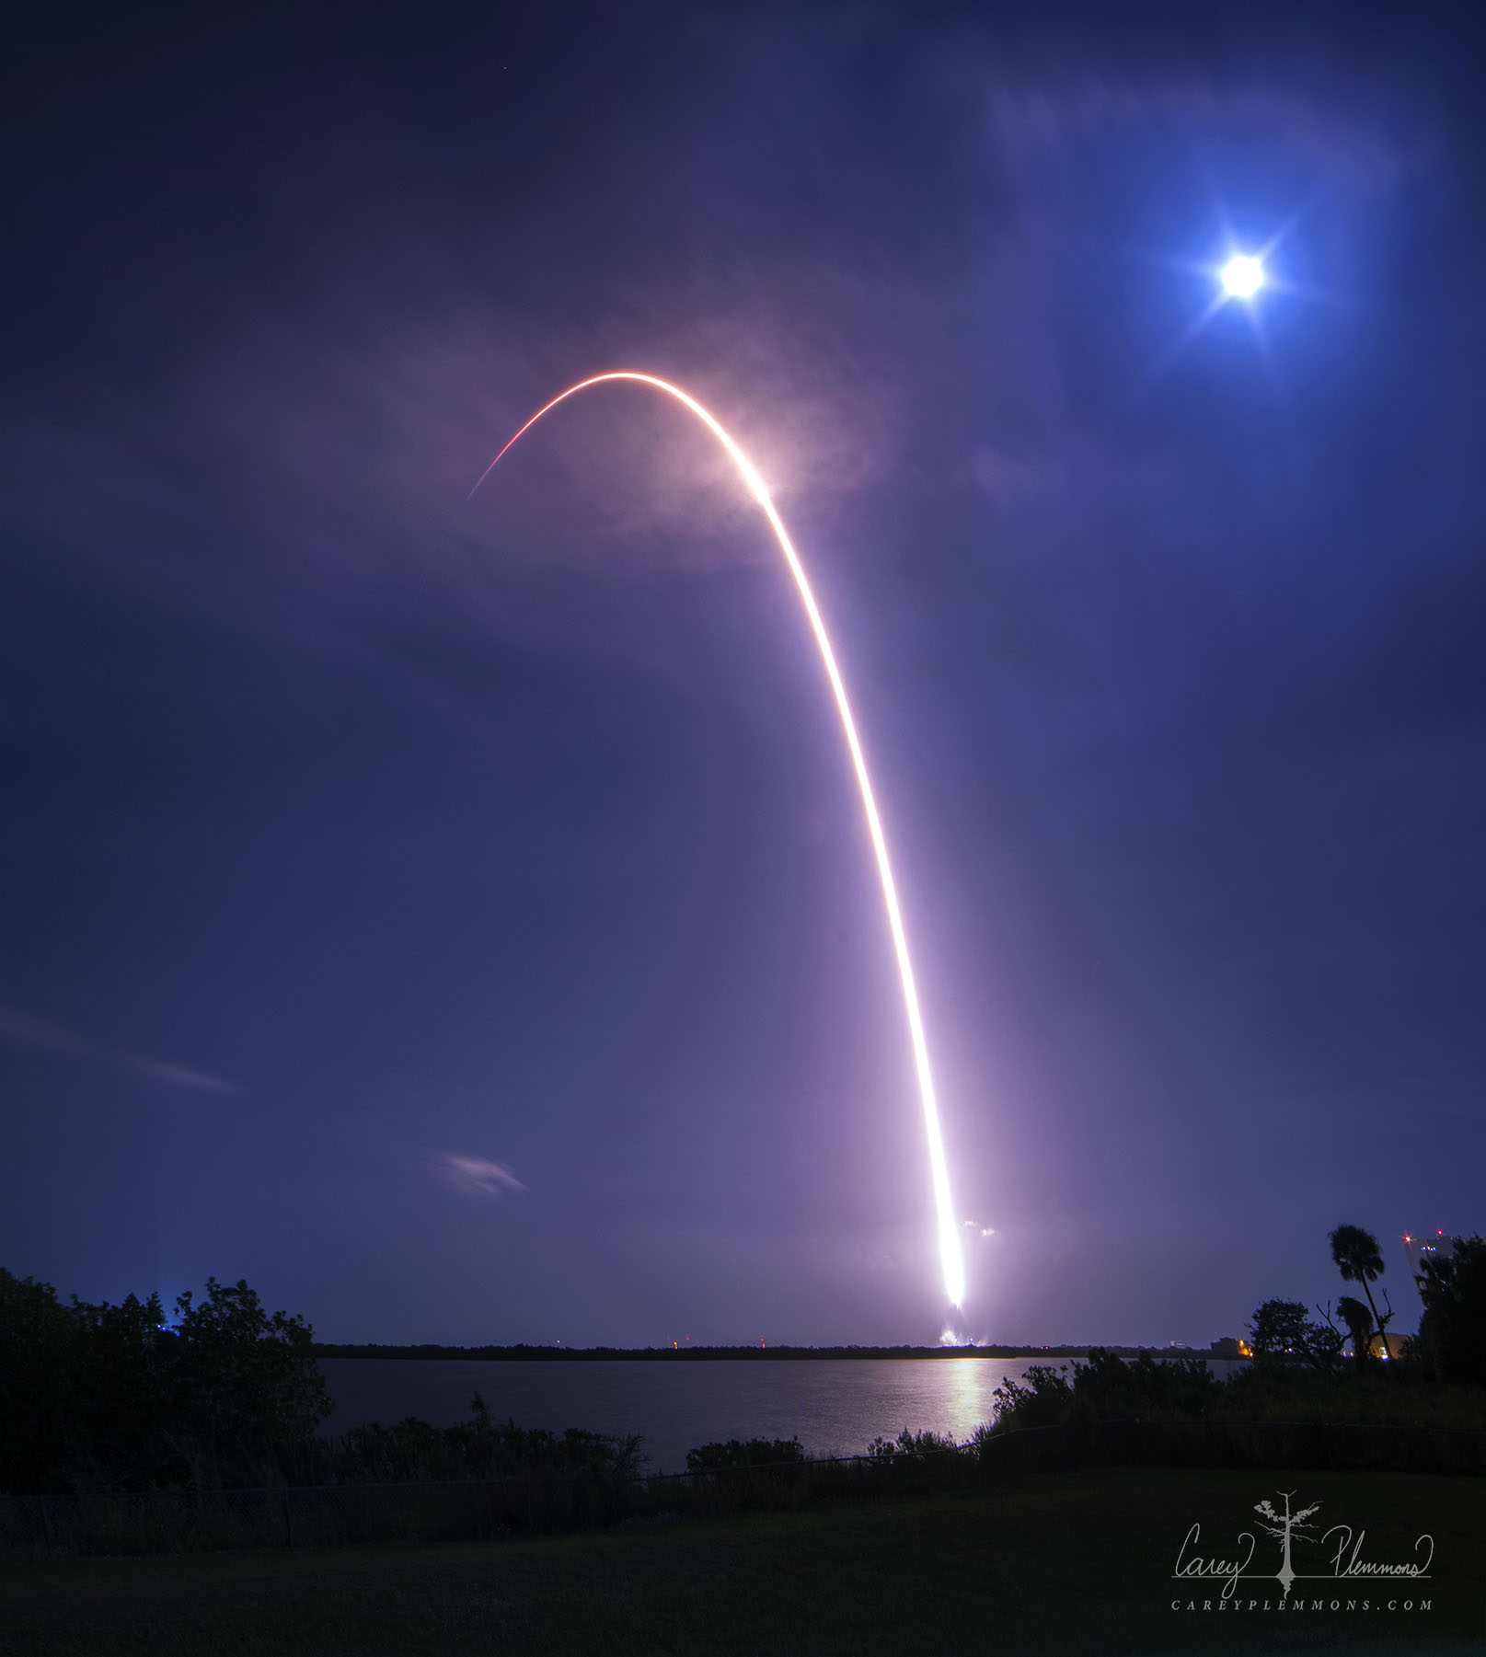
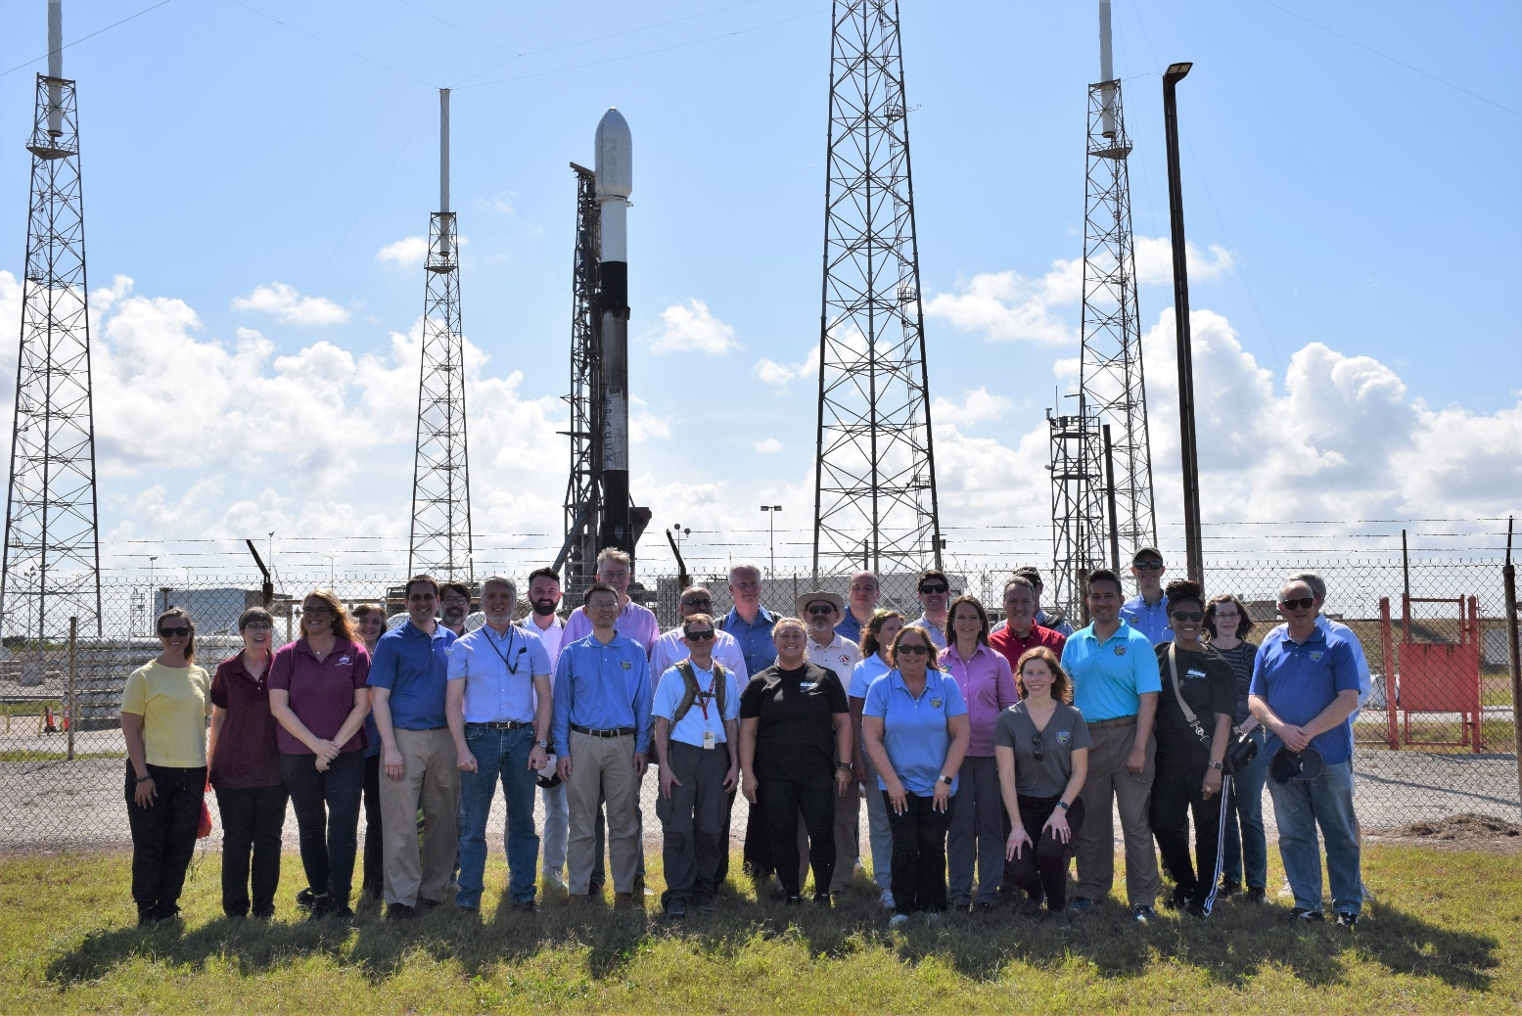
TEMPO Launch
TEMPO was successfully launched on April 7, 2023 at 12:30 am!
Credit: Maxar, Sensor tested
SAO and NASA TEMPO Team Members At Launch Pad
TEMPO Launch (Photo Credit: Carey Plemmons)

Slide 14


TEMPO Instrument
Imaging grating spectrometer measuring solar irradiance and solar backscattered Earth radiance
  2 channels (1 focal plane but with 2 2-D 2 k $×$1k detectors ): ~293-494 + 538-741 nm
  ~0.6 nm FWHM, ~0.2 nm sampling
~293-494 nm
~538-741 nm
Examples of spectra based on GOME

Slide 15
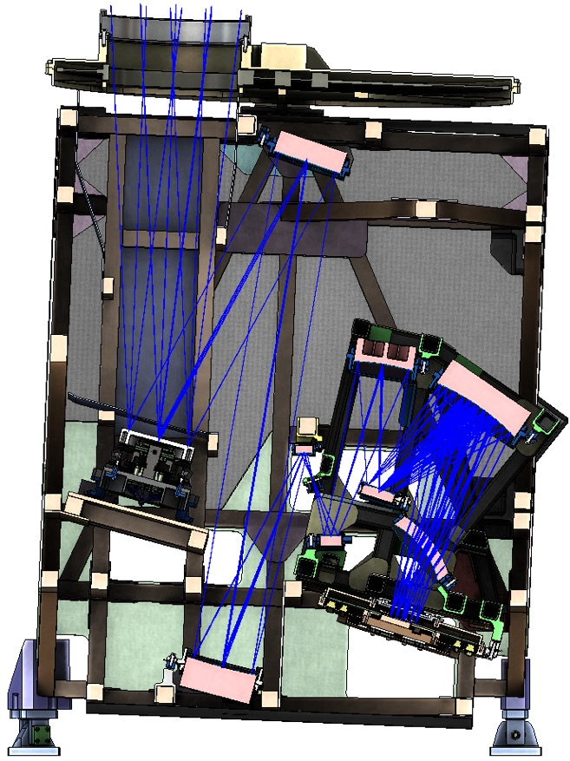
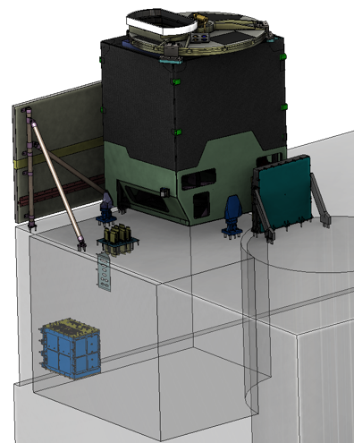
TEMPO Instrument
Calibration Mechanism Assembly
Telescope Assembly
Scan Mechanism Assembly
Spectrometer Assembly
Sensor heat sink
Focal Plane Electronics
Focal Plane
Assembly
Instrument
Control Electronics
Instrument Support
Assembly
Credit: Ball

Slide 16

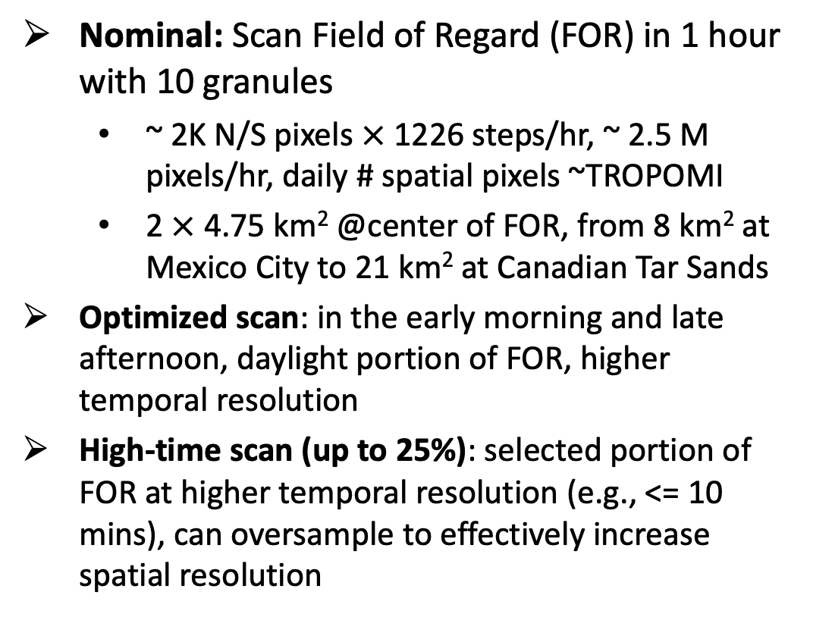
TEMPO Operation
  Operate on geostationary communications satellite Intelsat 40e (IS-40e) at 91 ∘ W
Nominal: Scan Field of Regard (FOR) in 1 hour with 10 granules
  ~ 2K N/S pixels $×$ 1226 steps/hr, ~ 2.5 M pixels/hr, daily # spatial pixels ~TROPOMI
  2 $×$ 4.75 km² @center of FOR, from 8 km² at Mexico City to 21 km² at Canadian Tar Sands
Optimized scan: in the early morning and late afternoon, daylight portion of FOR, higher temporal resolution
High-time scan (up to 25%): selected portion of FOR at higher temporal resolution (e.g., <= 10 mins), can oversample to effectively increase spatial resolution
Field of regard is optimized to cover both Puerto Rico and Canadian tar sands.
S5p-TROPOMI NO₂ product oversampled by Kang Sun.

Slide 17
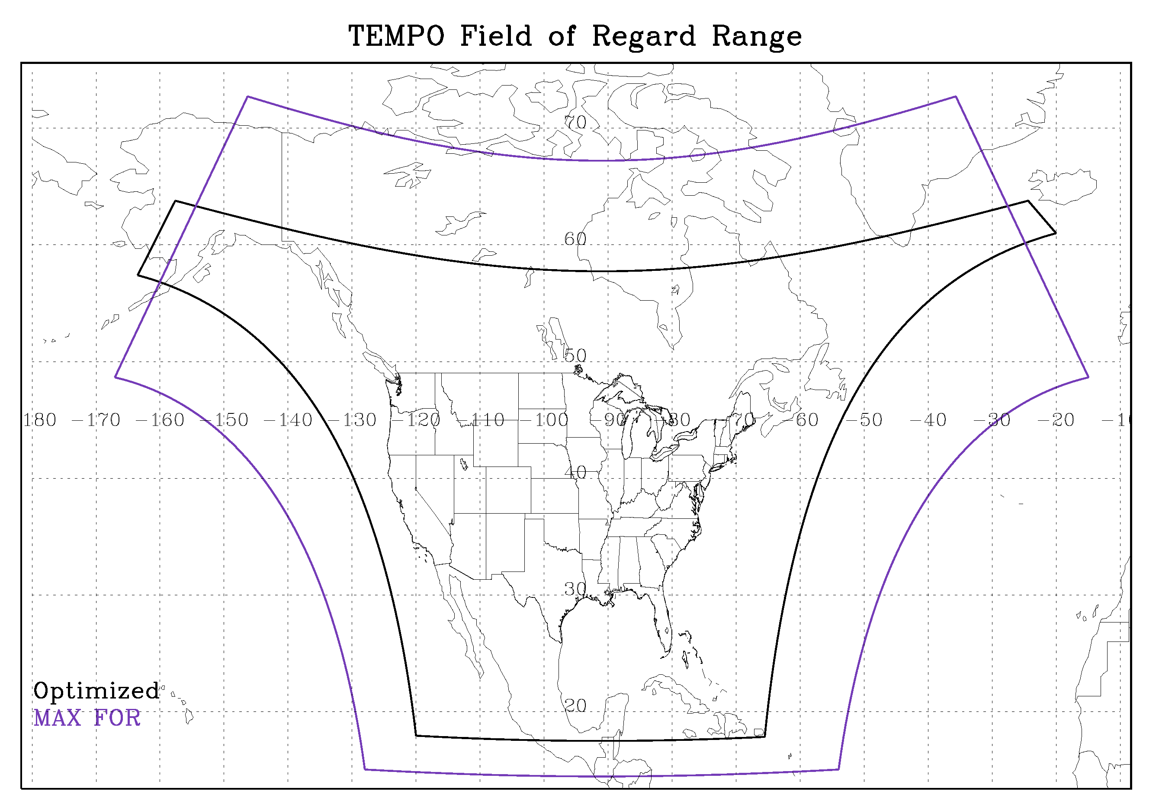
TEMPO Field of Regards
  FOR: N/S +/-210 pixels, E/W +230/160 mirror steps

Slide 18
TEMPO Instrument and
Measurement Characteristics
Volume, Mass, Average Power | 1.4 m x 1.1 m x 1.2 m, 137kg, 138W
Detector size | Two 2048 (spatial) x 1028 (spectral)
Wavelength range | UV band: ~293 - 494 nm, Visible band: 538 - 741 nm
Spectral resolution | ~0.6 nm @FWHM(0.54-0.63 nm)
Spectral sampling | ~0.2 nm or ~3 pixels /FWHM (2.7-3.2)
Spectral co-registration¹ | < 0.1 pixel (for UV, visible, UV/visible)
Orbit | GEO (35786 km), 91.0°W above equator
Instantaneous FOV | 41.49 µrad (N/S) x 129.20 µrad (E/W)
MTF @Nyquist | 0.31-0.41 N/S x 0.38-0.49 E/W
Field of view² | 4.92° N/S x 8.64° E/W
Spatial resolution | 2.0 km (N/S) x 4.75 km (E/W) km @center of FOR
Temporal resolution³ | ~1 hour, ~3s snapshot / mirror step
Spectra per hour^{2,3,4} | 2035 N/S (cross-track) x 1226 E/W (mirror step)
Maximum SNR⁵ | 1350 @ 330 - 340 nm, EOL
¹Smile, keystone, and UV/visible co-alignment are within 0.1 pixel.
²Assume 123µrad E/W mirror step size (6.2µrad overlap) & 1226 steps as in left Fig.
³Nominal mode.
⁴2035 out of 2048 spatial pixels are valid; 1016 out of spectral 1028 pixels are valid.
⁵For the nominal radiance.

Slide 19
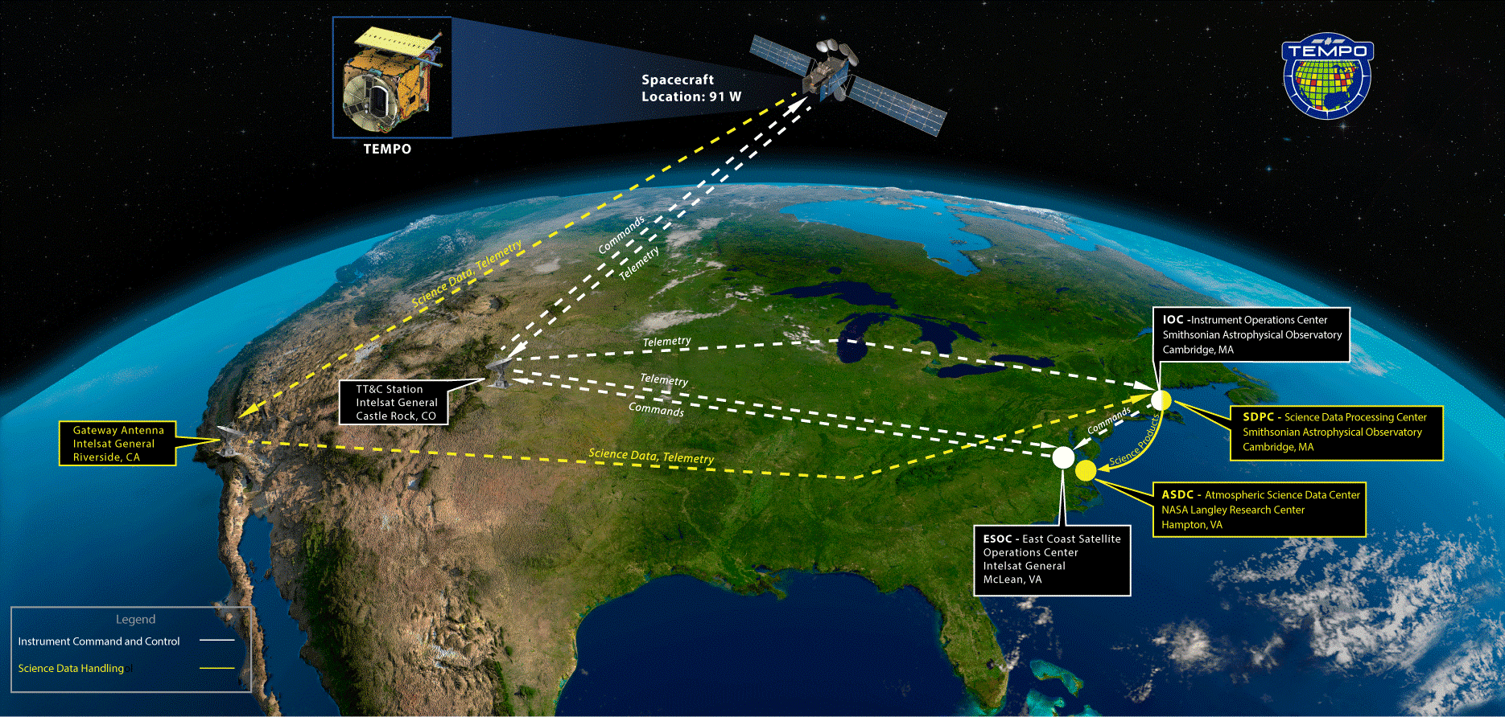
Ground System Architecture Review

Slide 20
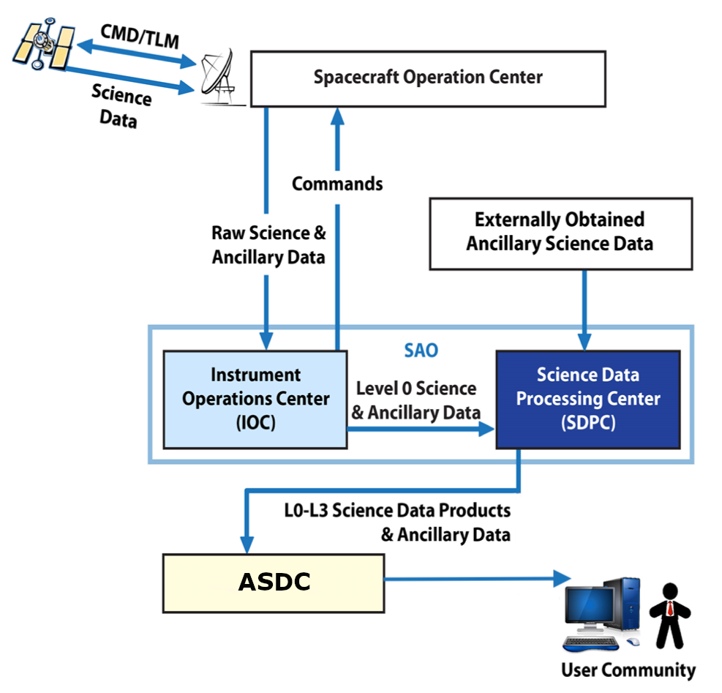
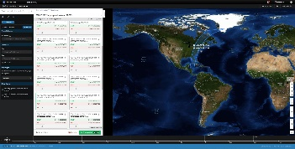
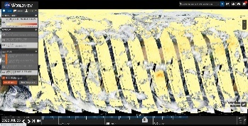
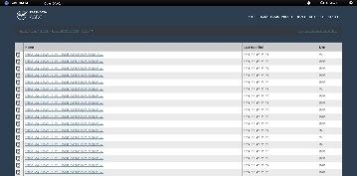
Instrument Operations Center (IOC) and Science Data Processing System (SDPC)
SDPC
Uses Level 0 (L0) data from the IOC and ancillary data from external sources like GOES satellites to produce L1, L2, and L3 data products that are sent to the Atmospheric Science Data Center (ASDC) for storage and distribution to the public
Provides scan plans from which the IOC builds instrument command loads
Delivers data to the ASDC for storage and user access
Working toward compliance with Open Science; working some remaining areas
IOC
Generates command loads using inputs from SOC and SDPC
Receives and processes instrument mission and spacecraft ancillary data
Automatically monitors telemetry and provides anomaly alerts, 24/7
User community access to data in ASDC
Earthdata Search
Worldview
Direct Data Download

Slide 21
Baseline and Threshold Products
(Variables) & Requirements
Species/Products | Required Precision | Temporal Revisit*
0-2 km O₃ (Selected Scenes) Baseline only | 10 ppbv | 2 hour
Tropospheric O₃ | 10 ppbv | 1 hour
Total O₃ | 3% | 1 hour
Tropospheric NO₂ | 1.0 × 10¹⁵ molecules cm⁻² | 1 hour
Tropospheric H₂CO | 1.0 × 10¹⁶ molecules cm⁻² | 3 hour
Tropospheric SO₂ | 1.0 × 10¹⁶ molecules cm⁻² | 3 hour
Tropospheric C₂H₂O₂ | 4.0 × 10¹⁴ molecules cm⁻² | 3 hour
Aerosol Optical Depth | 0.10 | 1 hour
* # of hourly measurements to be averaged to achieve required precision
Mission duration: 20 months for baseline, 12 months for threshold
Spatial resolution: < 60 km² for baseline (4 native pixels coadded), < 300 km² for threshold
Aerosols, SO₂, C₂H₂O₂ were removed from baseline products during KDPC
Cloud product (cloud fraction, cloud pressure): used in trace gas/aerosol retrievals

Slide 22
TEMPO Data Products
Baseline + SNWG TEMPO NRT
Level | Product | Algorithm | Major Outputs | A Priori (L2) | Res km^{2 *} | Freq/Size
L0 | Digital counts | Raw to L0 | Reconstructed/reformatted digital counts |  | 2.0 x 4.75 | Daily/hourly
L1-b | Irradiance ^{NRT} | SAO L0-1 | Calibrated & quality flags |  |  | daily
 | Radiance ^{NRT} | SAO L0-1 | Geolocated, calibrated, viewing, geolocation & quality flags |  | 2.0 x 4.75 | Hourly, granule
L2 | Cloud ^{NRT} | OMI O₂-O₂ | Cloud fraction, cloud pressure | GEOS-CF | 2.0 x 4.75 | Hourly, granule
 | O₃ profile | SAO O₃ profile | O₃ profile, total/strat/trop/0-2 km O₃ column, errors, a priori, AKs | Climatology+GEOS-CF | >= 8.0 x 4.75** | Hourly, granule
 | Total O₃ | TOMS V8.5 | Total O₃, AI, cloud fraction | Climatology | 2.0 x 4.75 | Hourly, granule
 | NO₂ ^{NRT} | SAO trace gas, BU strat./trop. sep. | SCD, strat./trop. VCD, error, shape factor, scattering weights | GEOS-CF | 2.0 x 4.75 | Hourly, granule
 | HCHO ^{NRT} | SAO trace gas | SCD, VCD, error, shape factor, scattering weights | GEOS-CF | 2.0 x 4.75 | Hourly, granule
L3 | Gridded L2 | SAO L2-3 | Same as L2 |  | 2 x 2 (?) | Hourly, scan
* Spatial resolution at center of FOR. ** Might be at 8 x 9.5 km²
Satellite Needs Working Group (SNWG) will fund TEMPO NRT products (L2 products < 3 hours from observation time): 6/1/2023-5/30/2025, NOAA to produce NRT aerosol products

Slide 23
TEMPO Data Products
Baseline + SNWG 2020 NRT + SNWG 2022 NRT/Enhanced
Level | Product | Algorithm | Major Outputs | A Priori (L2) | Res km^{2 *} | Freq/Size
L0 | Digital counts | Raw to L0 | Reconstructed/reformatted digital counts |  | 2.0 x 4.75 | Daily/hourly
L1-b | Irradiance ^{NRT} | SAO L0-1 | Calibrated & quality flags |  |  | daily
 | Radiance ^{NRT} | SAO L0-1 | Geolocated, calibrated, viewing, geolocation & quality flags |  | 2.0 x 4.75 | Hourly, granule
L2 | Cloud ^{NRT} | OMI O₂-O₂ | Cloud fraction, cloud pressure | GEOS-CF | 2.0 x 4.75 | Hourly, granule
 | O₃ profile | SAO O₃ profile | O₃ profile, total/strat/trop/0-2 km O₃ column, errors, a priori, AKs | Climatology + GEOS-CF | >= 8.0 x 4.75** | Hourly, granule
 | Total O₃ | TOMS V8.5 | Total O₃, AI, cloud fraction | Climatology | 2.0 x 4.75 | Hourly, granule
 | NO₂ ^{NRT} | SAO trace gas, BU strat/trop sep. | SCD, strat./trop. VCD, error, shape factor, scattering weights | GEOS-CF | 2.0 x 4.75 | Hourly, granule
 | HCHO ^{NRT} | SAO trace gas | SCD, VCD, error, shape factor, scattering weights | GEOS-CF | 2.0 x 4.75 | Hourly, granule
 | C₂H₂O₂ | SAO trace gas |  | GEOS-CF | 2.0 x 4.75 | Hourly, granule
 | H₂O | SAO trace gas |  | GEOS-CF | 2.0 x 4.75 | Hourly, granule
 | BrO | SAO trace gas |  | GEOS-CF | 2.0 x 4.75 | Hourly, granule
 | Aerosol ^{NOAA NRT} | OMAERUV/UI AOCH | AAI, UVAOD, UVSSA, AOCH, VISAOD |  | 8.0 x 4.75 | Hourly, granule
 | SO₂ ^{NRT} | OMSO2 PCA | SCD, VCD (PBL,TRL,TRM,TRU,STL) |  | 2.0 x 4.75 | Hourly, granule
 | UVB | GEMS/GSFC UVB | UV irradiance, erythemal irradiance, UVI |  | 2.0 x 4.75 | Hourly, scan
L3 | Gridded L2 | SAO L2-3 | Same as L2 |  | 2 x 2 (?) | Hourly, scan
* Spatial resolution at center of FOR. ** Might be at 8 x 9.5 km²
Satellite Needs Working Group (SNWG) will fund TEMPO NRT products (L2 products < 3 hours from observation time): 6/1/2023-5/30/2025
SNWG 2022 Survey has selected to produce TEMPO NRT/Enhanced Productions starting in 2025

Slide 24
Research Products
TEMPO research products will greatly extend science and applications
  OClO, IO, HNO₂, NO₃, volcanic (SO₂ plume height and Vertical Column Density)
  Additional/improved cloud with O₂-O₂ bands / O₂ B band
  Additional aerosol products from hyperspectral spectra, O₂ B and O₂-O₂-bands, and TEMPO + GOES-R synergy at @U Iowa, NOAA, GSFC
  Vegetation/Ocean Color products: vegetation indices, Growth Primary Productivity (GPP), Solar Induced Fluorescence (SIF), ocean color
  Surface albedo/Bidirectional Reflectance Distribution Function (BRDF) products
  Diurnal out-going shortwave radiation and cloud forcing
  Night lights: allows discrimination between lighting types
  Higher-level products: Near-real-time pollution/Air Quality indices

Slide 25
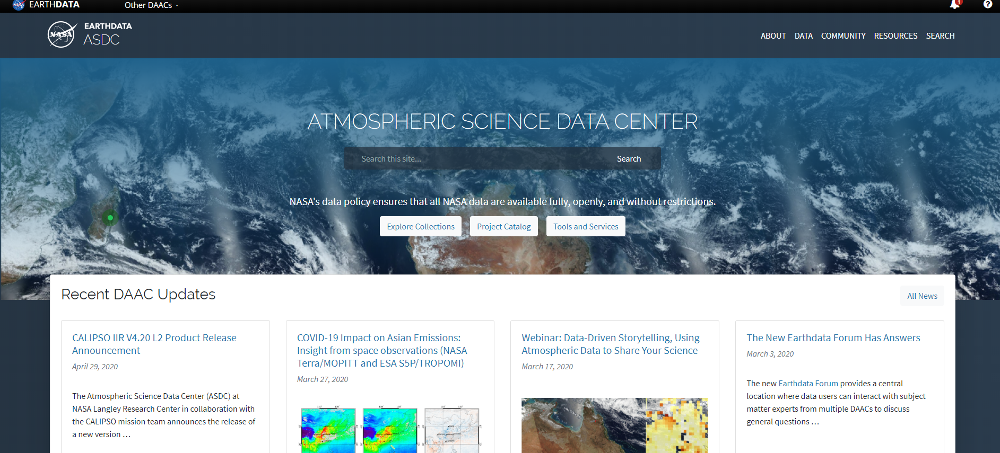



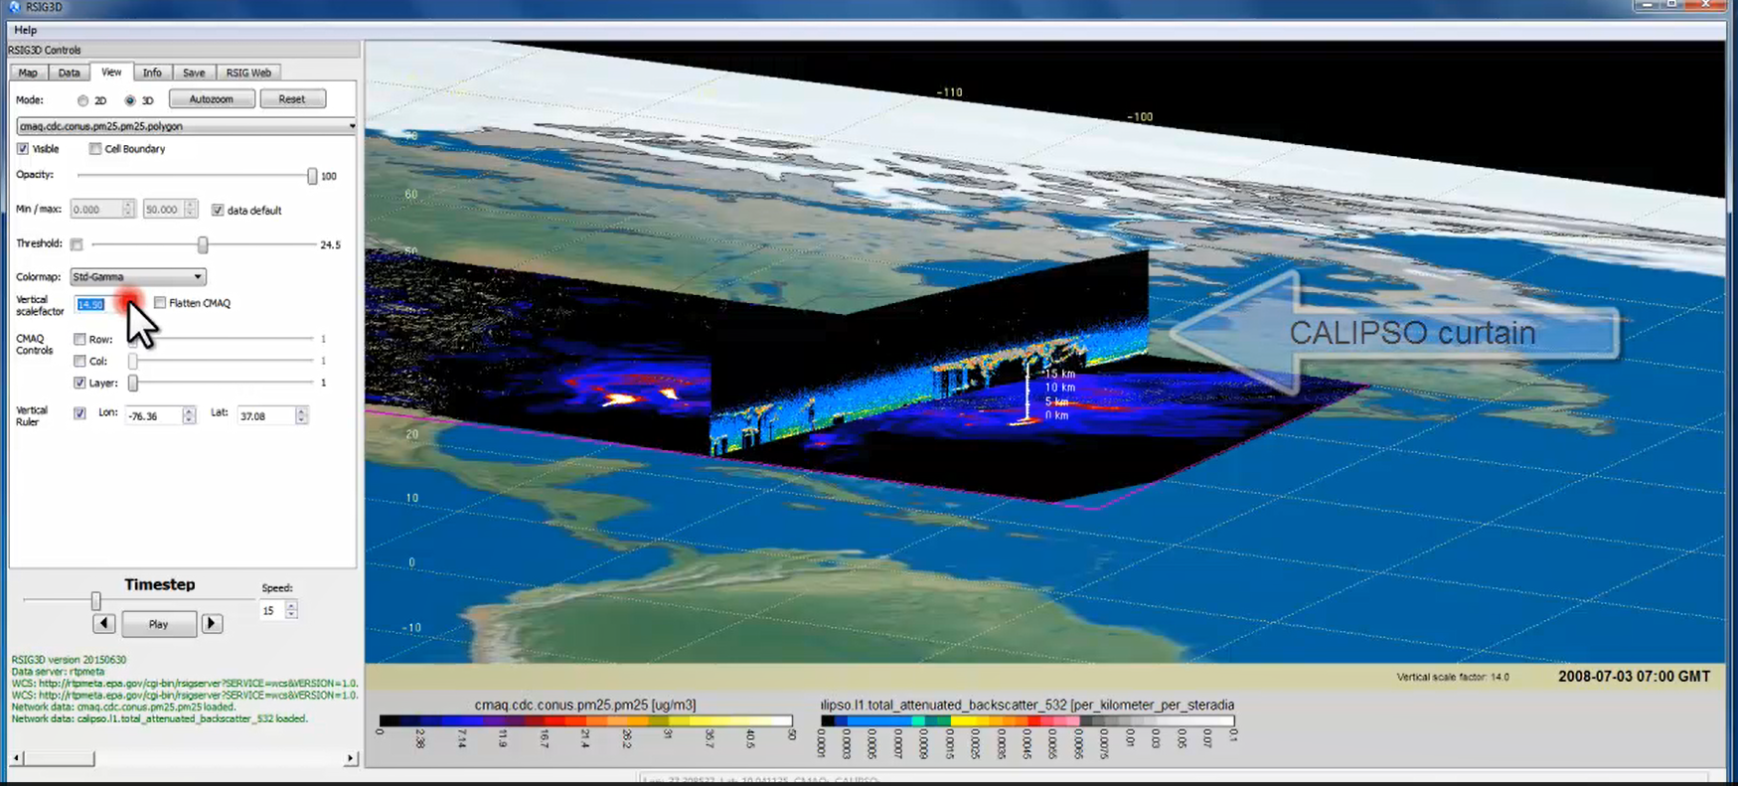

TEMPO Data Products Distribution
Slides from Jeff Walters, Tim Larson at TEMPO STM 2020 & EAWNov2021
ASDC Data Archival & Distribution: Tools and Services
NASA Earthdata Search
  CMR Search ⚬ Metadata
NASA WorldView
  GIBS API ⚬ visualization
Harmony and OPeNDAP
  ⚬ transform ⚬ subsetting
  ⚬ reformatting ⚬ distribution
HTTPS data access
  ⚬ datapool
  ⚬ permanent URL/direct access
  ⚬ enables scripts/workflow
Geospatial Web Services
  ⚬ WCS ⚬ WMS ⚬ ArcGIS Image Service
Example scripts
  ⚬ Python/Jupyter Notebook
  ⚬ R scripts
  ⚬ contributed tutorials/scripts
EPA RSIG3D Gateway
TEMPO data can be served directly through the EPA RSIG. https://www.epa.gov/hesc/remote-sensing-information-gateway
User Support and Other Resources
Earthdata Login https://urs.earthdata.nasa.gov
Earthdata Forum https://forum.earthdata.nasa.gov/
ASDC User Support support-asdc@earthdata.nasa.gov

Slide 26
Algorithm Development Status
Launch-ready Science Data Processing Center (SDPC) V4 software completed in Mar 2023
Algorithm mostly based on OMI heritage algorithms except for new L0-1b processor including Imagination Navigation and Registration (INR) using GOES-R by Carr Astronautics
L1-2 algorithms updates (O₃ profile, total O_{3,} NO₂, HCHO, cloud) include:
  Add visible spectrum to UV O₃ profile algorithm
  SAO trace gas algorithm with adapted NASA stratospheric/tropospheric separation for NO₂ (J. Geddes)
  New CLDO4: SAO O₂-O₂ fitting + GSFC’s O₂-O₂ cloud at ~477/466 nm (H. Wang, E.-S. Yang, A. Vasilkov)
  NASA GMAO’s GEOS-CF trace gas profiles and meteorology (E. Knowland and GMAO)
  Hourly resolved monthly mean Geometry-dependent Lambertian Equivalent Reflectivity (GLER) climatology (C. Chan Miller, W. Qin, Z. Fasnacht)
Development of non-baseline products
  CHOCHO, H₂O, BrO: will use SAO’s trace gas algorithm
  SO₂: OMI PCA SO₂ algorithm adapted for TEMPO/GEMS from synthetic/GEMS data (Can Li)
  Aerosols: being adapted from OMI/TROPOMI AERUV algorithm (Omar’s team), from EPIC/TROPOMI Aerosol Layer Height algorithm using O₂-A/B (Jun Wang’s team, funded by NASA Applied Science Program)

Slide 27
Including Visible to Improve
Tropospheric Ozone Retrieval Sensitivity
This example is for solar zenith angle =25, viewing zenith angle 45, relative azimuthal angle 86, Signal to noise Ratio (SNR) with 4 pixels coadded
Add visible to improve retrieval sensitivity in the lower troposphere and help separate free tropospheric O₃ from boundary layer O₃
Under ideal conditions: 3-5 total Degree of Freedom for Signal (DFS) with up to ~1.5 in the troposphere, and up to ~0.5 DFS in 0-2 km
Adapted from OMI (Liu et al., 2010): Spectral fitting + VLIDORT + Optimal Estimation (OE) from Fitting windows: 293-345 nm, 540-650 nm
Retrieve partial O₃ columns at ~24 layers (bottom layer is 0-2 km above the surface) as well as total, stratospheric, and tropospheric O₃ columns, other trace gases, and auxiliary parameters.
A priori: a combination of tropopause-based climatology (Bak et al., 2013) with diurnally-resolved GEOS-CF data

Slide 28
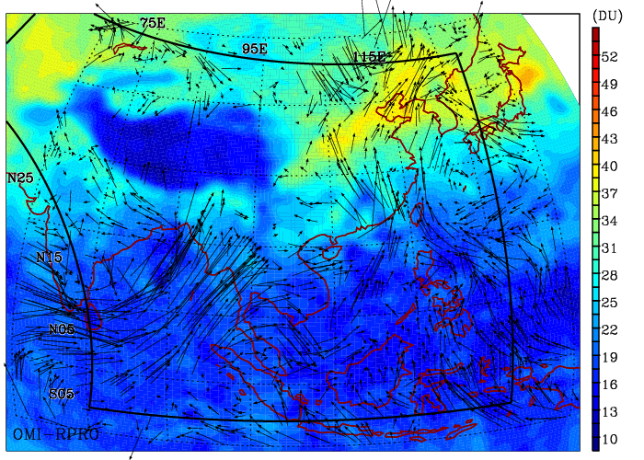
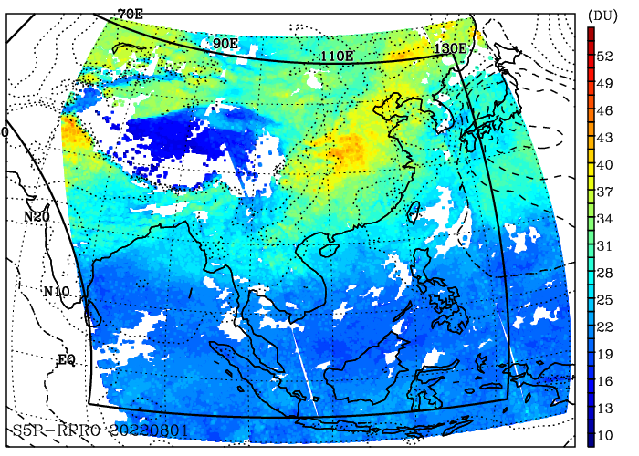
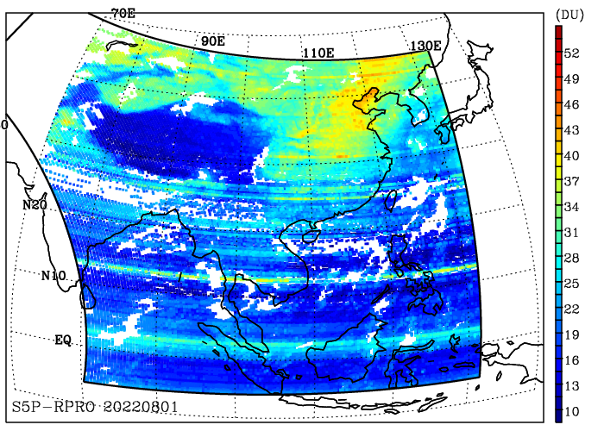
Test TEMPO-like O3PROF Algorithm with OMI/TOPOMI/GEMS Data
OMI-PROFOZ
3 days-mean
GEMS-PROFOZ
04:45 UTC
Daily S5P-PROFOZ
Credit: Juseon Bak
Comparison of tropospheric ozone column (950-300 hPa) from several products over the GEMS domain on August 1, 2022 including TEMPO-like algorithm OMPROFOZ V2 applied to OMI, and S5p-TROPOMI, and GEMS
Apply TEMPO algorithm (OMPROFOZ v2, UV only) to GEMS data without soft calibration (some BTDF correction via wavelength calibration) works reasonably well. Cross-track stripes can be seen.

Slide 29
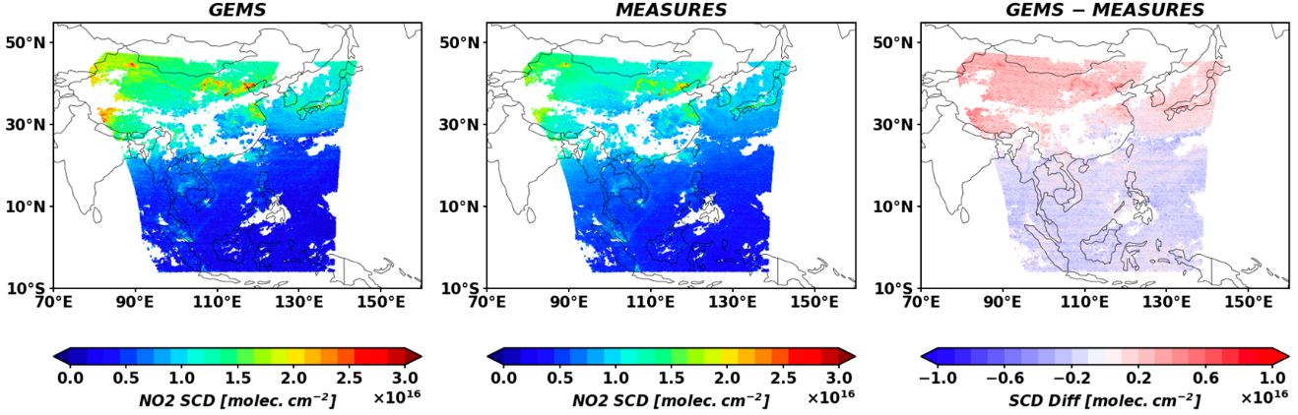
Test TEMPO NO2
Algorithm with GEMS Data
GEMS
GEMS
SAO MEASURES/TEMPO
GEMS-MEASURES
Credit: Hyeong-Ahn Kwon
NO₂ Slant Column Densities (SCDs) observed by GEMS (V1) on June 1, 2021 at 6:45 UTC are similar to SAO TEMPO NO₂ SCDs from the same GEMS data except for some known positive biases in the GEMS V1 operational retrievals.

Slide 30
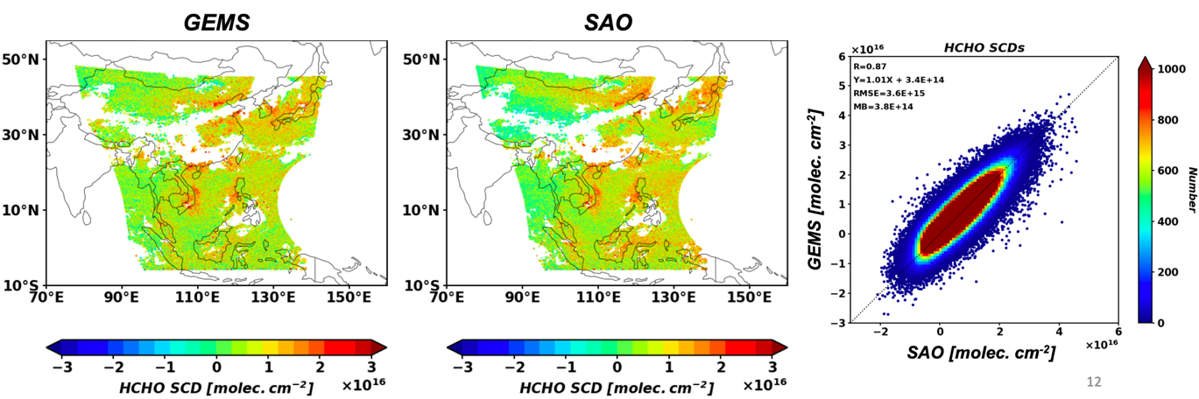
Test TEMPO HCHO Algorithm with GEMS Data
GEMS V2 vs. SAO
HCHO SCDs
Credit: Hyeong-Ahn Kwon
SAO’s GEMS formaldehyde retrievals on June 1, 2021 at 6:45 UTC, compare quite well with GEMS V2 retrievals

Slide 31
Commissioning, Nominal Operation, and Data Release Plan
Nominal operation after Post Launch Acceptance Review (PLAR): ~10/2023
Baseline mission (Phase E, 20 months, 10/2023-5/2025), NASA senior/extension review
Data products sent to ASDC for archival and distribution
Plan for initial public release of baseline products at ASDC after algorithm verification, product validation, algorithm optimization/improvement: L1b, 2/2024; L2/3, 4/2024
Provide earlier access to validation team prior to the public release
Initial public release of NRT products at ASDC (~9 mos behind baseline products): ~1/2025
TEMPO
Power On
Launch
First Light
PLAR
L+0 (4/7/23)
L+60 days (6/6/23)
L+110 days (7/26/23)
L+178 days
(10/2/23)
Outgassing
S/C Activity
(TEMPO Off)
TEMPO Commissioning
Nominal Operations
Activation
Instrument Characterization and Analysis
*Dates are as of 4/25/23 and are subject to change

Slide 32
Calibration and L1b Validation
Verify and update image correction steps in the L0-1 processing during Commissioning Phase (~L+1~L+3 months, ~90 days)
  System linearity, zero-input, relative gains, saturation blooming, dark current variation and temperature-dependent correction, check quality flags, evolution of solar diffuser, noise calculation, straylight
Assess wavelength calibration and its performance
  Will assess performance of routine processing (wavelength calibration in both L0-1b & L1-2 via high-resolution solar reference and atmospheric absorption)
  Pre-launch measured instrument line shape will be compared with that derived from solar irradiance
Assess radiometric calibration using a multi-pronged approach
  Internal assessment of images, Assess performance of routine processing
  Comparison solar irradiance with solar reference and correlative contemporaneous sensors (e.g., OMPS, TROPOMI, GOME-2, EPIC, MODIS, VIIRS)
  Comparison with radiative transfer simulation
Assess geo-location methodology with Image Navigation and Registration (INR) during commissioning phase, accuracy and uncertainty
  Imagery: assess registration offset of fiducial points not used in INR, using other reference imagery
  L2: assess bias and variance in registration offset of known point sources of NO₂

Slide 33
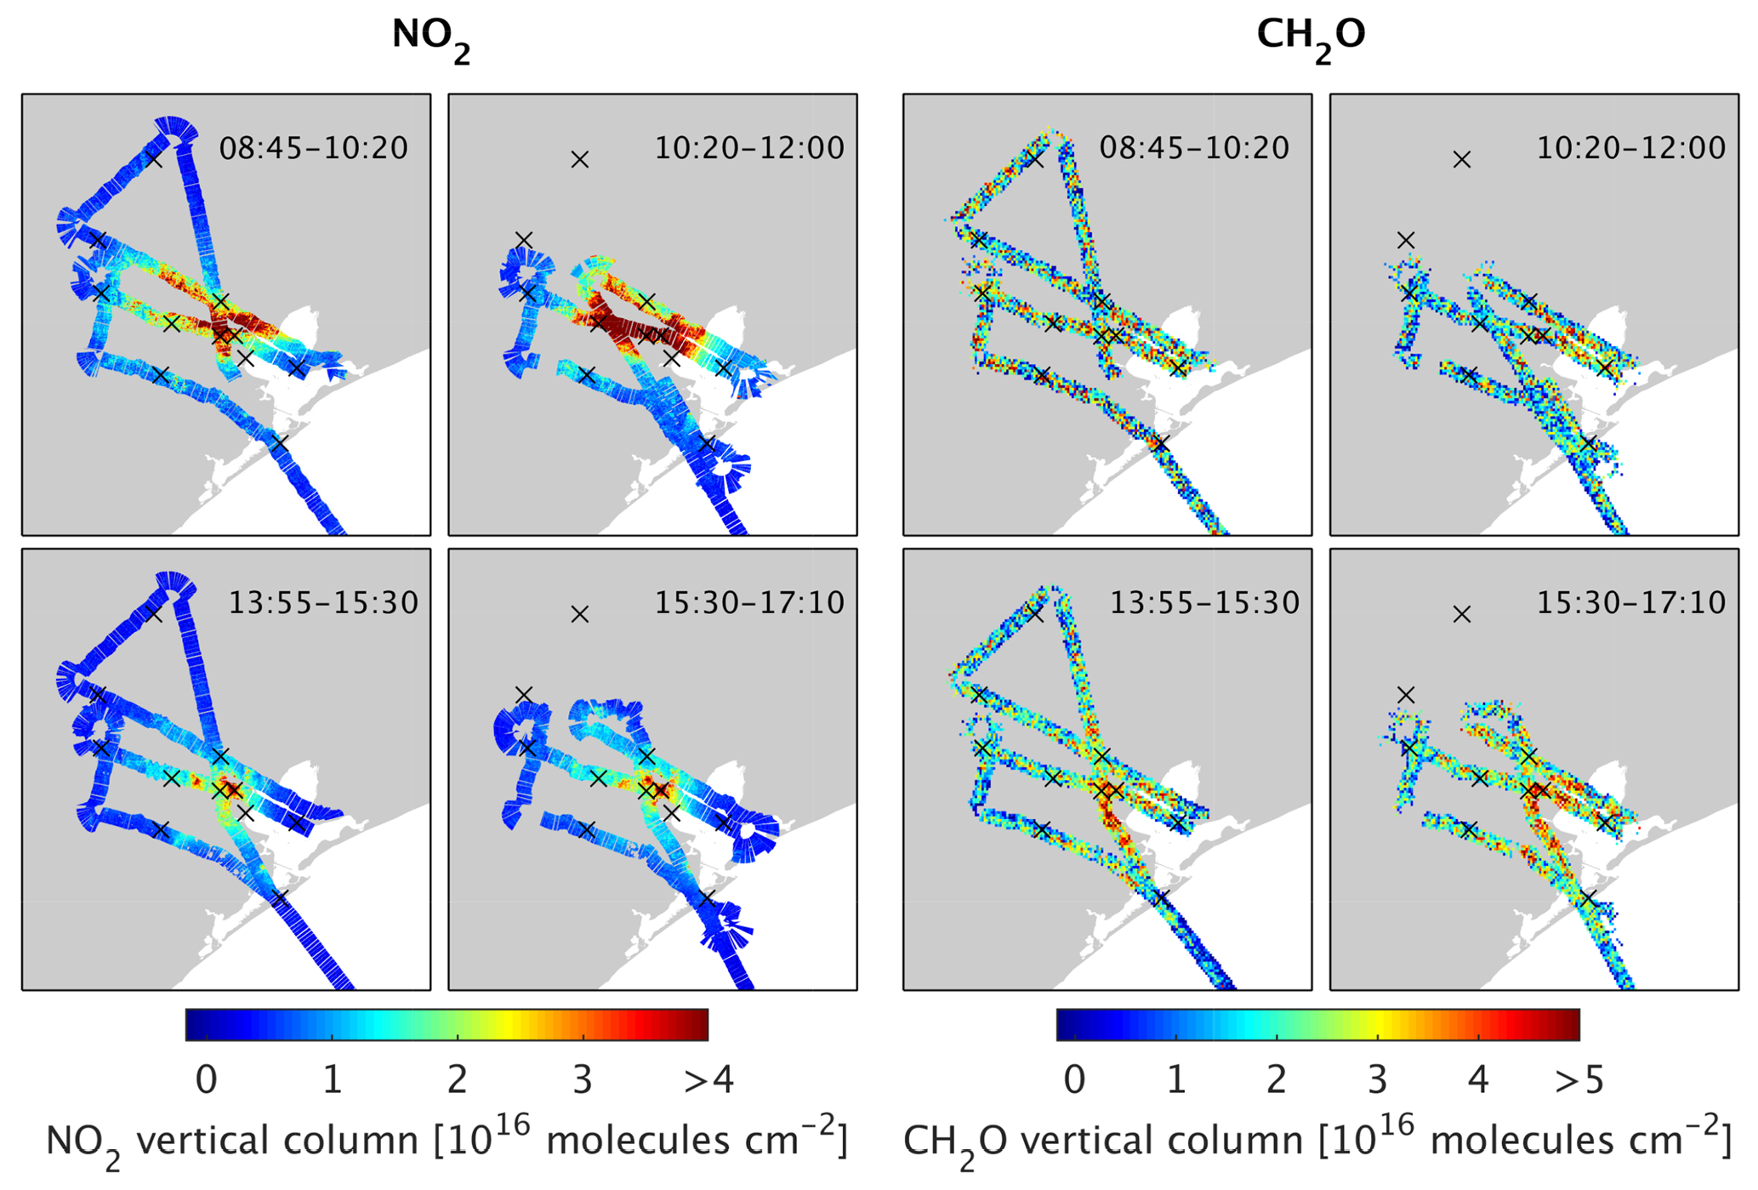
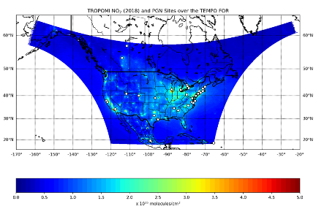
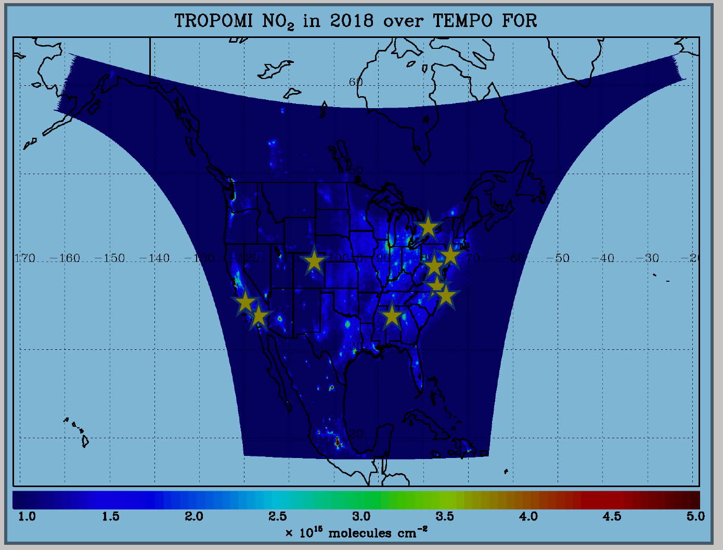
TEMPO L2 Science Validation Plan
TEMPO PLRA has a bare minimum validation requirements (3 Pandoras, 1 month per season)
Jim Szykman has led the development of best-efforts basis validation plan: beta, provisional, full
Use satellite observations (i.e., LEO and EPIC/DSCOVR) for cross validations
Pandora & Pandonia Global Network (PGN): validate NO₂, HCHO, total O₃ and diurnal variation
TOLNet: 8 LIDAR instruments by time of launch to validate tropospheric O₃ & 0-2 km O₃ and diurnal variation
Airborne instruments: GEO-TASO, GCAS, HSRL-2, IAGOS, SeaRey UAV
Other instruments: ozonesonde, Dobson/Brewer, MAXDOAS, FTIR, AERONET, …
Planned flight campaigns AGES+ (e.g., STAQS, AEROMMA+CUPiDS, GOTHAAM) during June-Aug 2003, provide integrated approaches linking TEMPO science, applications, and validation
Indirect validation with chemistry transport models and data assimilation.
https://www.pandonia-global-network.org/
www-air.larc.nasa.gov/missions/TOLNet/
Nowlan et al. (2018) GCAS, DISCOVER-AQ, Texas, Sep 2013
~60 PGNs in TEMPO FoR, ~20 to add in 2 years

Slide 34
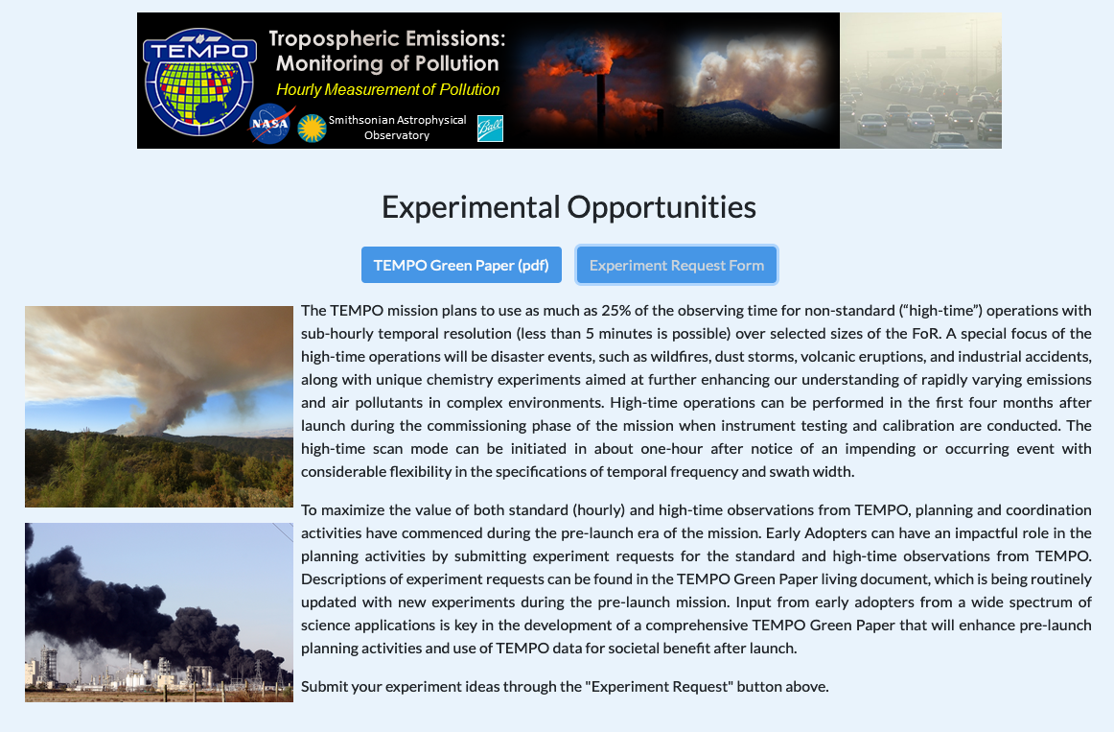

Ways to Get Involved with TEMPO
Join
Early Adopters
Suggest an Experiment
Validation
We hope to collaborate with several Canadian partners on validation
  Pandora spectrometers
  Ozonesondes
  Ozone lidar
  FTIR
  MAX-DOAS
  Brewers, etc…
Request high-time special operations
Program funded by NASA Applied Sciences
Engage spectrum of stakeholders and end-users

Slide 35

TEMPO Early Adopters Program
Led by Aaron Naeger at UAH and NASA-SPoRT, funded by NASA Applied Sciences
User-centric program focused on broadening and enhancing applications of TEMPO data, with special attention to health & air quality
Provide proxy data, organize workshops
Inclusive from all end-users and stakeholders:
  ~400 Early Adopters across TEMPO FoR
  Includes federal, state, and local AQ agencies, Health Organization, NGOs, and international participation
Weather Analysis & Forecasting
Air Quality Modeling & Forecasting
Vegetation & Ocean Monitoring
Air Pollution Emissions & Monitoring
Public Health
Regulatory Science
Join EA Program here!
https: weather.msfc.nasa.gov/tempo/

Slide 36
TEMPO Green Paper:
Chemistry Experiments with TEMPO
NORMAL TIME RESOLUTION STUDIES | Volcanoes
Air quality and health | Socio-economic studies
Ultraviolet exposure | National pollution inventories
Biomass burning | Regional and local transport of pollutants
Synergistic GOES-16/17 Products | Sea breeze studies for Florida and Cuba
Advanced aerosol products | Transboundary pollution gradients
Soil NO_{x} after fertilizer application and after rainfall | Transatlantic dust transport
Solar-induced fluorescence from chlorophyll | HIGH TIME RESOLUTION EXPERIMENTS
Foliage studies | Lightning NO_{x}
Mapping NO₂ and SO₂ dry deposition at high resolution | Morning and evening higher-frequency scans
Crop and forest damage from ground-level ozone | Dwell-time studies and temporal selection to improve detection limits
Halogen oxide studies in coastal and lake regions | Exploring the value of TEMPO in assessing pollution transport during upslope flows
Air pollution from oil and gas fields | Tidal effects on estuarine circulation and outflow plumes
Night light measurements resolving lighting type | Air quality responses to sudden changes in emissions
Ship tracks, drilling platform plumes, and other concentrated sources. | Cloud field correlation with pollution
Water vapor studies | Agricultural soil NO_{x} emissions and air quality
Early Adopters are key to building the TEMPO Green Paper!
The TEMPO Green Paper living document at weather.msfc.nasa.gov/tempo/
Early Adopters can request high-time observations!

Slide 37
Summary
TEMPO will provide revolutionary hourly daytime atmospheric pollution measurements at high spatial resolution over North America and start a new era of air quality monitoring from space over North America
Launch-ready SDPC software has been developed to produce baseline products meeting PLRA, including several major updates (new O₂-O₂ cloud, GEOS-CF, GLER) to significantly improve over heritage algorithms.
Selected by Satellite Needs Working Group (SNWG) to produce NRT products for L1b, cloud, NO2, and HCHO products.
Post-launch science verification and validation activities have been planned to validate and improve the data products
Different ways to get involved with TEMPO: validation, Early Adopters, Special observations

Slide 38










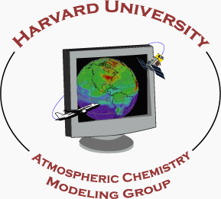




















Slide 41
TEMPO Science Team, U.S.
Team Member | Institution | Role | Responsibility
K. Chance | SAO | PI | Overall science development; Level 1b, H₂CO, C₂H₂O₂
X. Liu | SAO | Deputy PI | Science development, data processing; O₃ profile, tropospheric O₃
J. Al-Saadi | LaRC | Deputy PS | Project science development
J. Carr | Carr Astronautics | Co-I | INR Modeling and algorithm
M. Chin | GSFC | Co-I | Aerosol science
R. Cohen | U.C. Berkeley | Co-I | NO₂ validation, atmospheric chemistry modeling, process studies
D. Edwards | NCAR | Co-I | VOC science, synergy with carbon monoxide measurements
J. Fishman | St. Louis U. | Co-I | AQ impact on agriculture and the biosphere
D. Flittner | LaRC | Project Scientist | Overall project development; STM; instrument cal./char.
J. Herman | UMBC | Co-I | Validation (PANDORA measurements)
D. Jacob | Harvard | Co-I | Science requirements, atmospheric modeling, process studies
S. Janz | GSFC | Co-I | Instrument calibration and characterization
J. Joiner | GSFC | Co-I | Cloud, total O₃, TOA shortwave flux research product
N. Krotkov | GSFC | Co-I | NO₂, SO₂, UVB
M. Newchurch | U. Alabama Huntsville | Co-I | Validation (O₃ sondes, O₃ lidar)
R.B. Pierce | NOAA/NESDIS | Co-I | AQ modeling, data assimilation
R. Spurr | RT Solutions, Inc. | Co-I | Radiative transfer modeling for algorithm development
R. Suleiman | SAO | Co-I, Data Mgr. | Managing science data processing, BrO, H₂O, and L3 products
J. Szykman | EPA | Co-I | AIRNow AQI development, validation (PANDORA measurements)
O. Torres | GSFC | Co-I | UV aerosol product, AI
J. Wang | U. Nebraska | Co-I | Synergy w/GOES-R ABI, aerosol research products
J. Leitch | Ball Aerospace | Collaborator | Aircraft validation, instrument calibration and characterization
D. Neil | LaRC | Collaborator | GEO-CAPE mission design team member

Slide 42
TEMPO Science Team, non-U.S.
Team Member | Institution | Role | Responsibility
R. Martin | Dalhousie U. | Collaborator | Atmospheric modeling, air mass factors, AQI development
Chris McLinden | Environment Canada | Collaborator | Canadian air quality coordination
Michel Grutter de la Mora | UNAM, Mexico | Collaborator | Mexican air quality coordination
Gabriel Vazquez | UNAM, Mexico | Collaborator | Mexican air quality, algorithm physics
Amparo Martinez | INECC, Mexico | Collaborator | Mexican environmental pollution and health
J. Victor Hugo Paramo Figeuroa | INECC, Mexico | Collaborator | Mexican environmental pollution and health
Brian Kerridge | Rutherford Appleton Laboratory, UK | Collaborator | Ozone profiling studies, algorithm development
Paul Palmer | Edinburgh U., UK | Collaborator | Atmospheric modeling, process studies
J. Kim | Yonsei U. | Collaborators, Science Advisory Panel | Korean GEMS, CEOS constellation of GEO pollution monitoring
C.T. McElroy | York U. Canada |  | CSA PHEOS, CEOS constellation of GEO pollution monitoring
B. Veihelmann | ESA |  | ESA Sentinel-4, CEOS constellation of GEO pollution monitoring

Slide 43
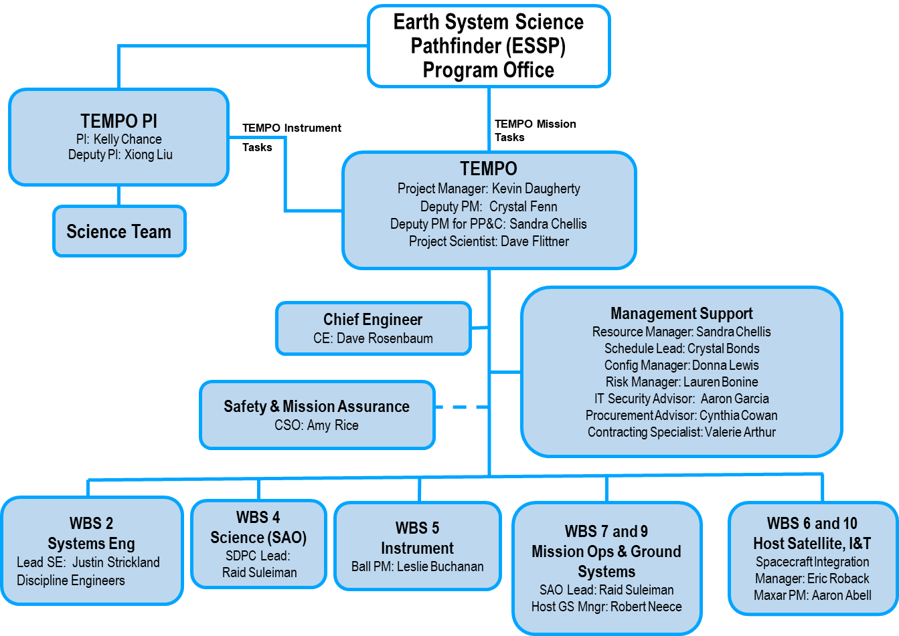
Phase D TEMPO Organization

Slide 44
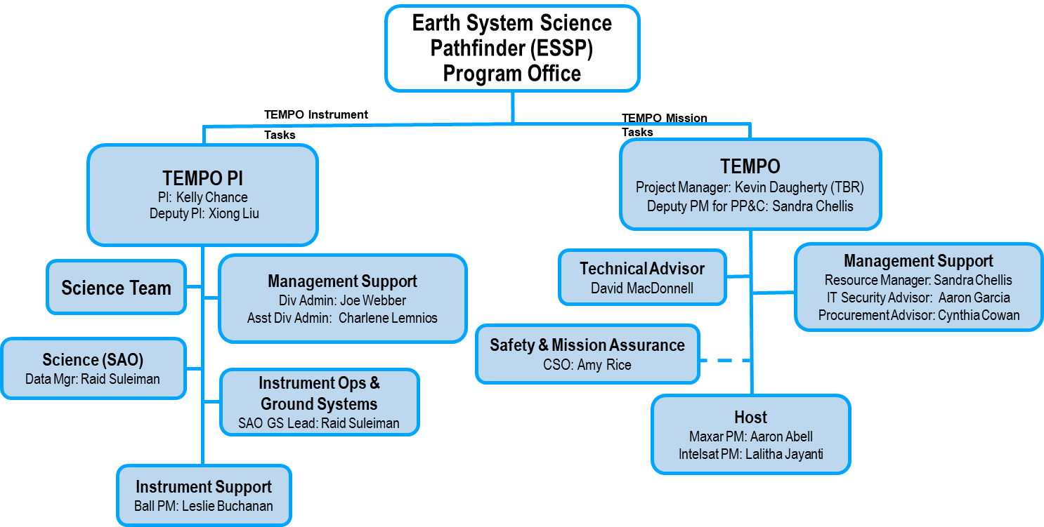
Phase E (after PLAR) TEMPO Organization

Slide 45
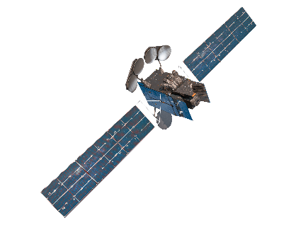
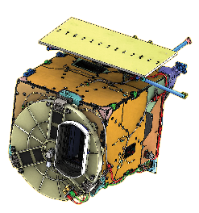


TEMPO Mission Architecture
Mission Data (TEMPO)
IS-40e
Housekeeping Telemetry
Commanding
TEMPO Instrument
Intelsat
Smithsonian Astrophysical Observatory
Spacecraft Operations Center
Spacecraft Command Generation
Satellite H&S Monitoring
Data Products
Command
Loads
Instrument Operations Center
Planning
Instrument Command Load Generation
Instrument Health & Status Monitoring
NASA LaRC ASDC
Raw & Processed Data
Storage & Distribution
TT&C Station
Planning Aids
Mission Data,
Ancillary Data
Riverside Ground Station
Raw Science & Ancillary Data
Queuing & Distribution
Science Data Processing Center
Science Data Processing
Image Navigation and Registration
Command Load Planning and Input
Publicly Released Data Products
Ancillary Data
Ancillary Data
Sources
Science Data User

Slide 46
TEMPO Algorithm Teams
Operational Algorithm | Personnel
Raw to L0 | John Davis
L0-1b | John Houck, Xiong Liu, Dave Flittner, Weizhen Hou, Jim Carr, Chris Chan Miller
Ozone profile | Xiong Liu, Juseon Bak, Weizhen Hou
Total ozone | Dave Haffner, Joanna Joiner
Nitrogen dioxide | Caroline Nowlan, Gonzalo González Abad, Jeff Geddes, Chris Chan Miller
Formaldehyde | Gonzalo González Abad, Caroline Nowlan, Hyeong-Ahn Kwon, Chris Chan Miller
Clouds | Huiqun Wang, Alexander Vasilkov, Eun-Su Yang, Joanna Joiner
Glyoxal | Gonzalo González Abad, Hyeong-Ahn Kwon, Chris Chan Miller
Sulfur dioxide | Can Li, Nicolay Krotkov
Aerosols | Omar Torres, Jun Wang
Operational implementation and IT support @ SAO Science Data Processing Center (SDPC) by John Houck

Slide 47
NRT vs. Off-line Trace Gas Products
(if with additional NRT funding)
Implementing both NRT and off-line trace gas products (e.g., NO₂, HCHO) for NO₂, HCHO, aerosol, SO₂, cloud
Major potential differences between NRT and offline
 | NRT | Off-line
Trace gas profiles/Met data | GEOS-CF | GEOS-CF Replay
Surface | GLER climatology | MODIS/VIIRS albedo/BRDF products
L1B | Skip wavelength calibration One-pass INR Default/No Pol. Correction | Two-pass Kalman Filter INR Improved pol. Correction with L2 retrievals?
L2 algorithms | Smaller fitting windows Avoid waiting for the entire hourly scan | More optimized fitting windows Improve radiance reference & cross-track correction
Data Latency | Within 2-3 hours upon receipt of raw data at SAO Ground System | + 8 days as MODIS BRDF is produced using data +/- 8 days

Slide 48
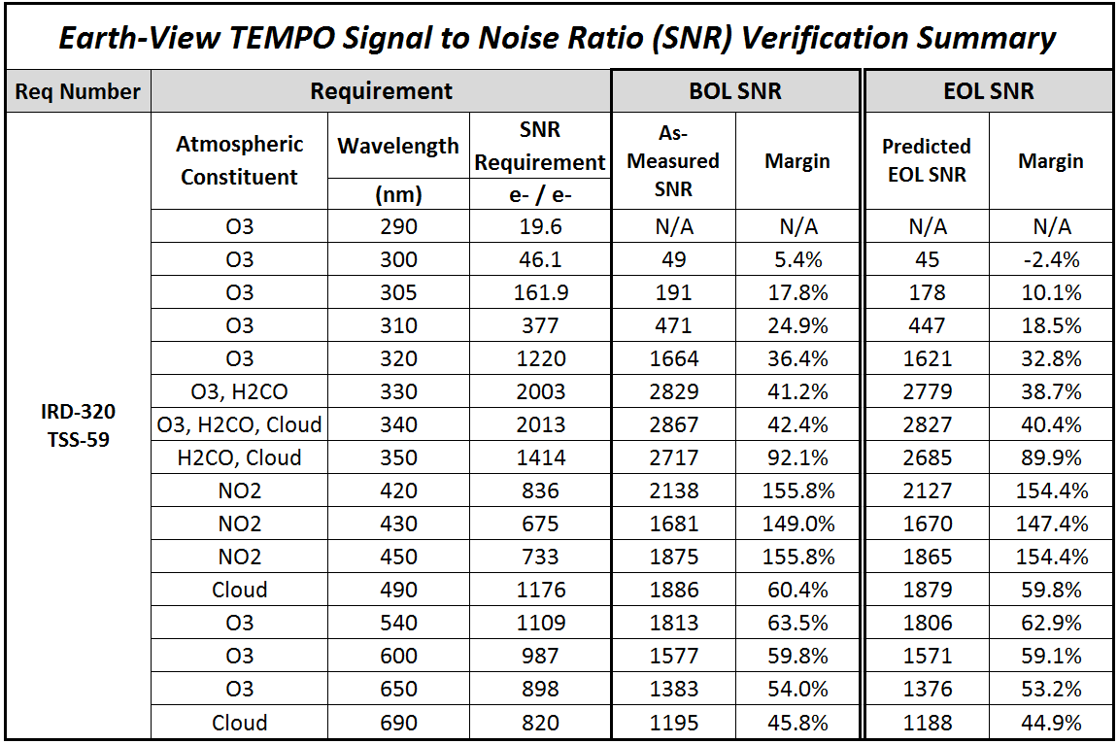
L1b Requirements
L1b products: Spectral Radiance, Irradiance and Uncertainty, Spectral Scale, Geo-location (lat/lon)
PLRA: no requirement for radiance or irradiance, geolocation accuracy < 4km
Instrument design & performance requirements were derived from L2 precision req.
Signal to Noise Ratio (SNR) was the dominate factor for radiance performance
Table of SNR req. and with Beginning of Life (BOL) as-built performance (4 Pixels coadded)
Radiometric Uncertainty: < 4% (1-sigma) for both irradiance & radiance
Albedo uncertainty: wavelength independent < 2%, dependent < 1%
Long-term (20 months) radiometric drift detection: < 0.9%
Nonlinearity: <2% of 98% well response, and knowledge (after corr.) < 0.5% from 2-98% of well response
Pre-launch Wavelength mapping uncertainty: < 0.02 nm
Spectral stability (within 24 hours): < 0.1 nm for radiance & irradiance
Spectral co-registration error: < 0.7 pixel between 2 bands, < 0.4 pixel within UV or visible bands

