Slide 1
TEMPO Overview and Status
Xiong Liu¹, Kelly Chance¹, Raid Suleiman¹
Wendy Pennington², Dave Flittner², Jay Al-Saadi²,
John Houck¹, John Davis¹, Ewan O’Sullivan¹,
Chris Chan-Miller¹, Peter Zoogman¹, Jeff Geddes⁵
Gonzalo Gonzalez Abad¹, Jim Carr³, Brian Baker⁴,
and the TEMPO Team
1. SAO 2. NASA LaRc
3. Carr Astronautics 4. BATC 5 BU
OMI Science Team Meeting
NASA GSFC
September 14, 2017

Slide 2

Hourly atmospheric pollution from geostationary Earth orbit
PI: Kelly Chance, Smithsonian Astrophysical Observatory
Instrument Development: Ball Aerospace
Project Management: NASA LaRC
Other Institutions: NASA GSFC, NOAA, EPA, NCAR, Harvard, UC Berkeley, St. Louis U, U Alabama Huntsville, U Nebraska, RT Solutions, Carr Astronautics
International collaboration: Mexico, Canada, Cuba, Korea, U.K.,
ESA, Spain
Selected Nov. 2012 as NASA’s first Earth Venture Instrument
  Instrument delivery March 2018
  NASA will arrange hosting on commercial geostationary communications satellite with launch expected NET 2019
Provides hourly daylight observations to capture rapidly varying emissions & chemistry important for air quality
  UV/visible grating spectrometer to measure key elements in tropospheric ozone and aerosol pollution
  Distinguishes boundary layer from free tropospheric & stratospheric ozone
Aligned with Earth Science Decadal Survey recommendations
  Makes many of the GEO-CAPE atmosphere measurements
  Responds to the phased implementation recommendation of GEO-CAPE mission design team
  North American component of an international constellation for air quality observations

Slide 3
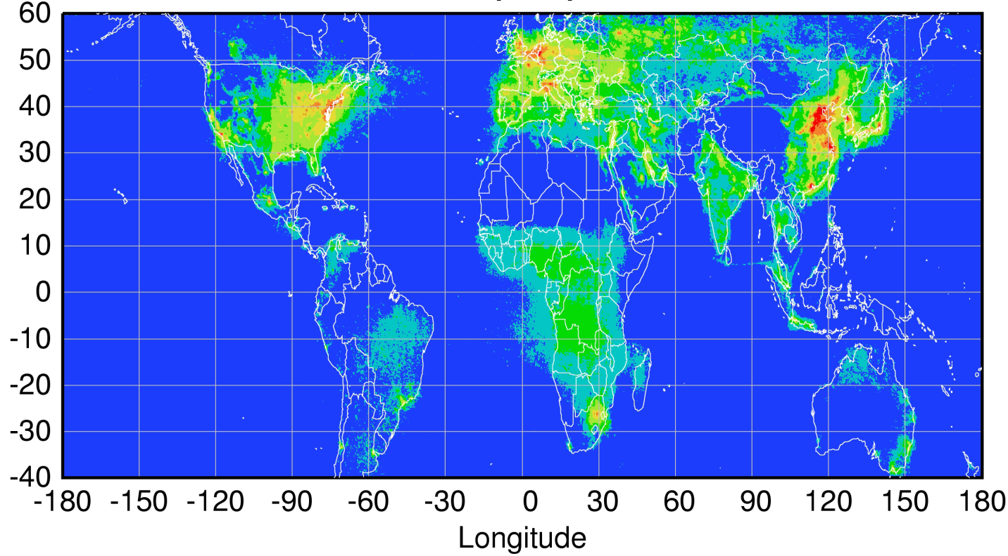
Global pollution monitoring constellation
Sentinel-4
(hourly)
TEMPO
(hourly)
GEMS
(hourly)
80-115°W
0°
2021+ launch
128.2°E
2019 launch
2019-2021 launch
Sentinel-5P (once per day),
OMPS, GOME-2
Courtesy Jhoon Kim,
Andreas Richter

Slide 4
TEMPO Status/Schedule
Currently on-budget and close to on-schedule
  SRR/MDR in November 2013
  KDP-B in April 2014, PDR in July 2014
  Converted instrument to firm fixed price in March 2015
  Now in Phase C: Passed KDP-C in April 2015
  Passed instrument CDR in June 2015 & GS CDR in May 2016
  PER/TRR in August 2016
  Currently undergoing assembly, integration, and testing
Instrument delivery in March 2018.
Satellite host selection in early 2018. Launch NET 2019, mostly likely in 2020 and 2021.
IOC and SDPC software testing (L0-L3) to be completed by late-2018, ready 6 months before launch
  V1 L0-1 processor: ~March 2018
  V2 L0-1 processor: ~December, 2018

Slide 5


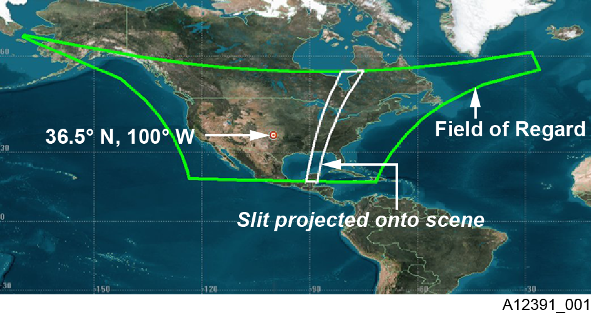
TEMPO
  Imaging grating spectrometer measuring solar backscattered Earth radiance
    0.6 nm FWHM, 0.2 nm sampling
    290-490 + 540-740 nm, 2 channels (1 focal plane but with 2 2-D 2 k x 1k detectors )
  Geostationary, operating on commercial communication satellite as a hosted payload, with acceptable longitude range 115∘W-80∘W
  Great North America: Mexico City to Canadian tar sands, Atlantic to Pacific
  Instrument slit aligned N/S and sweep across the Field of Regard (FOR) in the E/W in 1 hour at ~2.1x4.5 km² (center of FOR) with ~2.5M spatial pixels/hr
290-490 nm
540-740 nm
X
x
λ
y(t)
y (t)

Slide 6
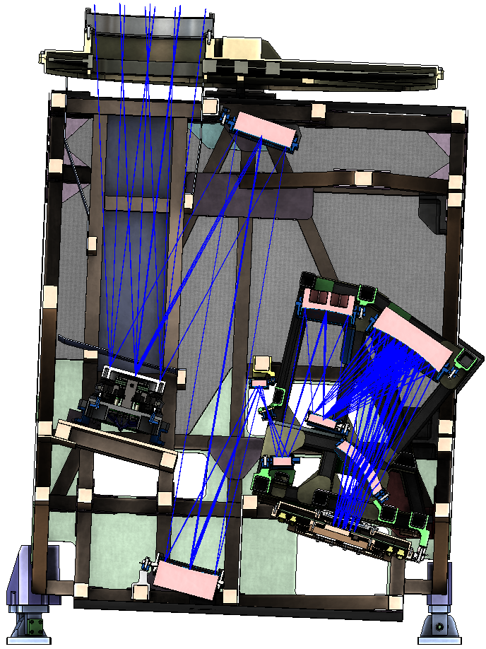
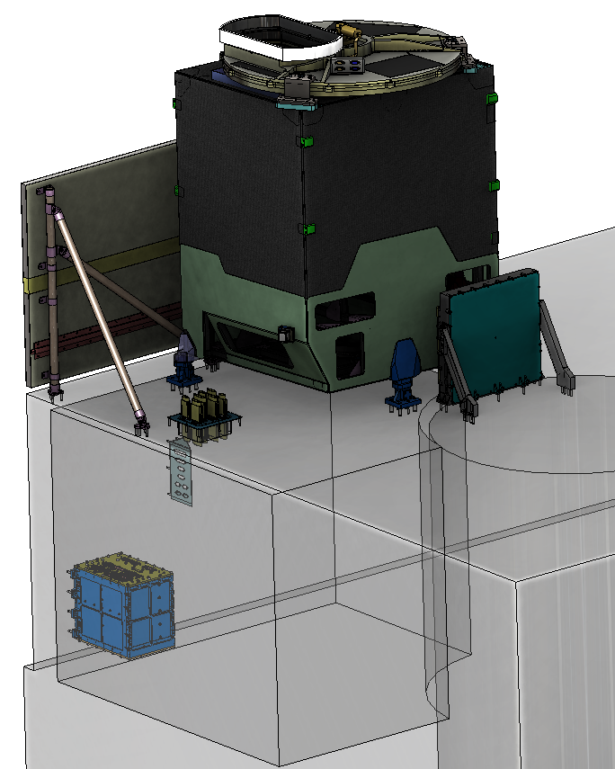

Instrument layout
Calibration Mechanism Assembly
Telescope Assembly
Scan Mechanism Assembly
Spectrometer Assembly
Radiator Assembly
Focal Plane Electronics
Focal Plane
Assembly
Instrument
Control Electronics
Instrument Support
Assembly
Calibration wheel with transmissive diffusers for daily solar calibration
Step/stare 2-axis scan mechanism
Detectors operating at -20°C
Instrument Control Electronics (ICE) mounted below spacecraft deck
Volume: 1.4 m x 1.1 m x 1.2 m Mass: 148 kg Avg. Power: 134W
Notes:
Most of final drawings done; detectors in-house; grating ordered; optical bench ordered

Slide 7
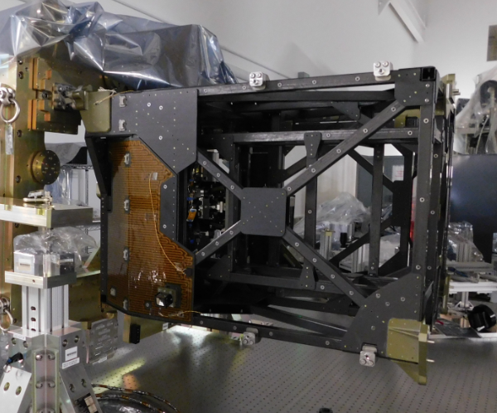
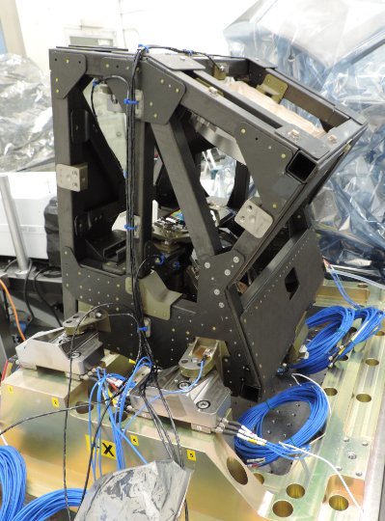
TEMPO Integrated into Higher Level Assemblies, and Undergo Sensor Integration
TEMPO Telescope with optics, scan mechanism and thermal installs completed.
TEMPO Spectrometer subsystem complete and ready for vibe test

Slide 8
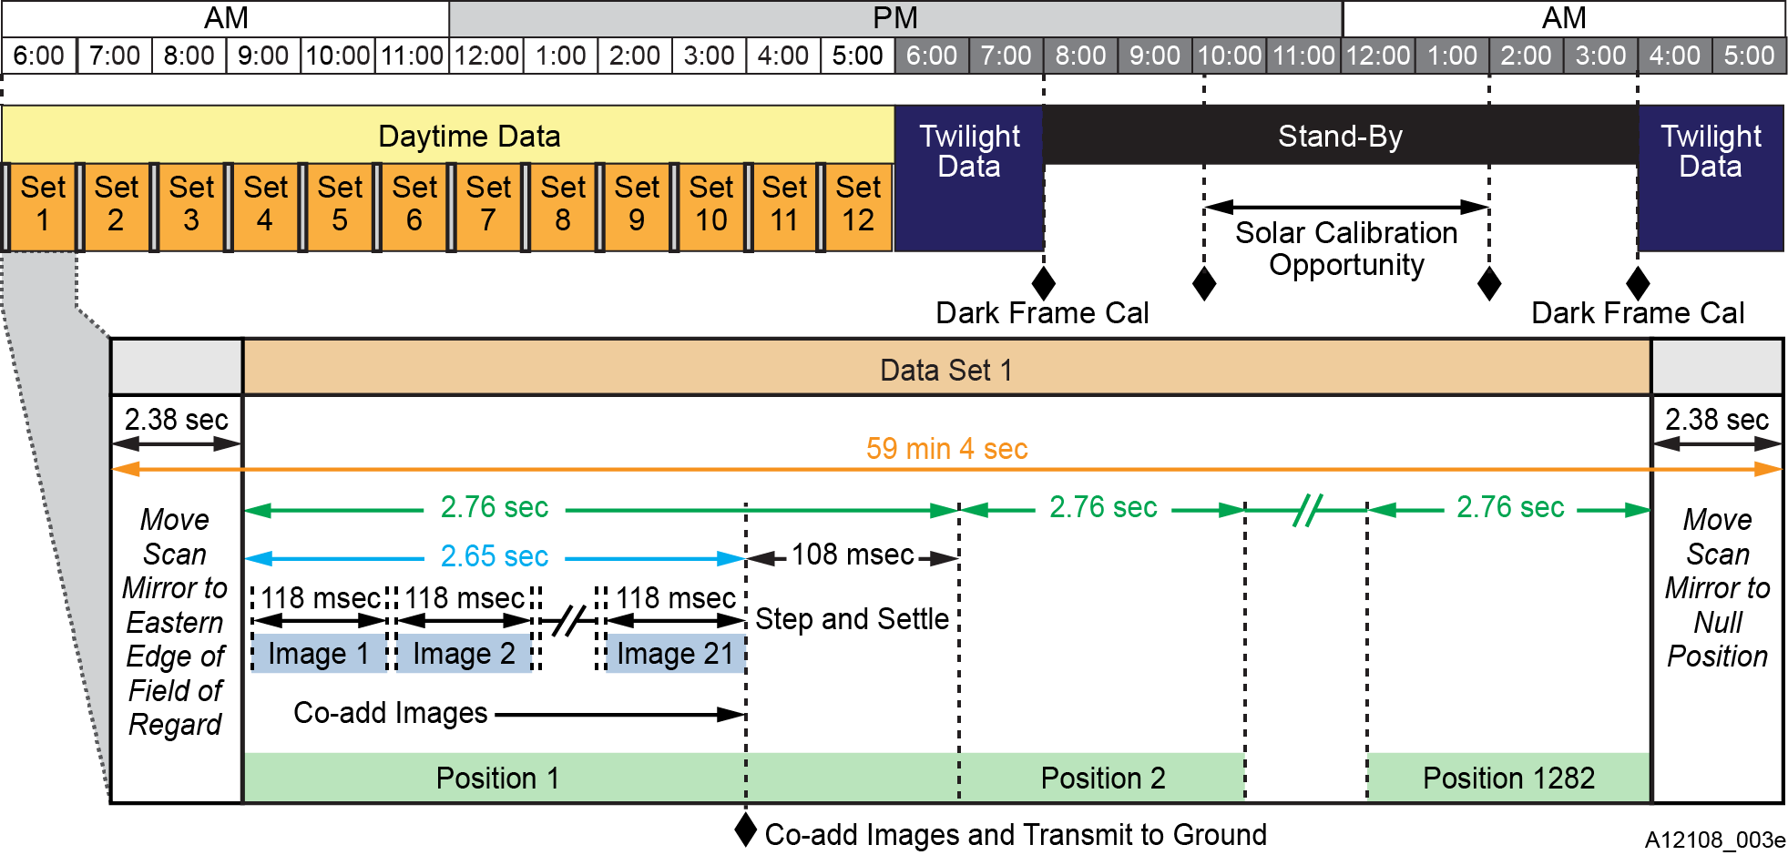
A day in the life

Slide 9
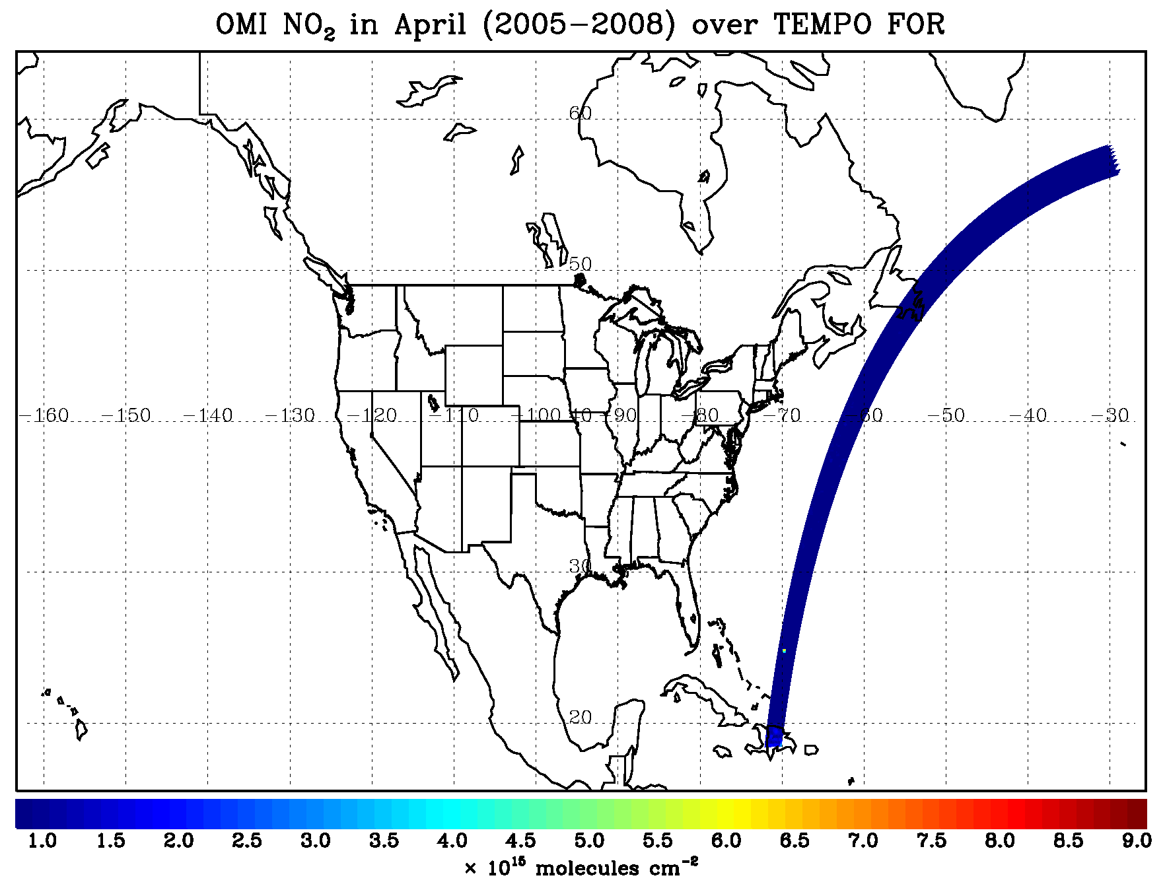
TEMPO hourly NO₂ sweep
~ 1283 steps/hr
~ 2.6 M pixels/hr
N.B. special operations
give 10-minute resolution
for selected longitude
Regions
Courtesy of L. Lamsal &
N. Krotkov

Slide 10
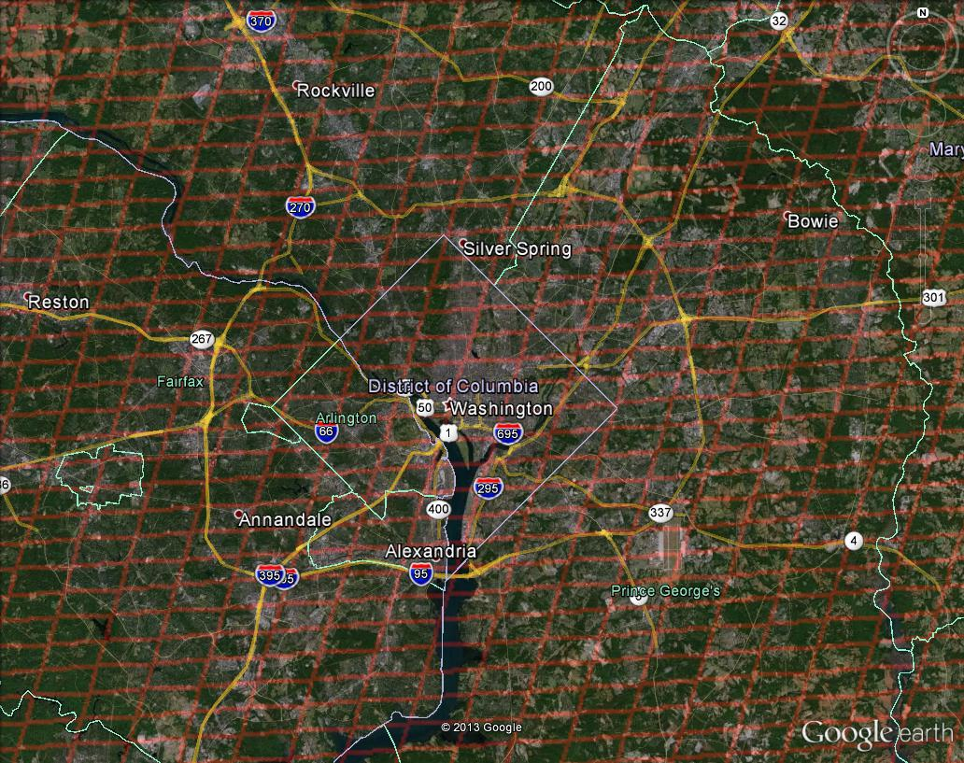
Washington, DC coverage
Hourly!

Slide 11
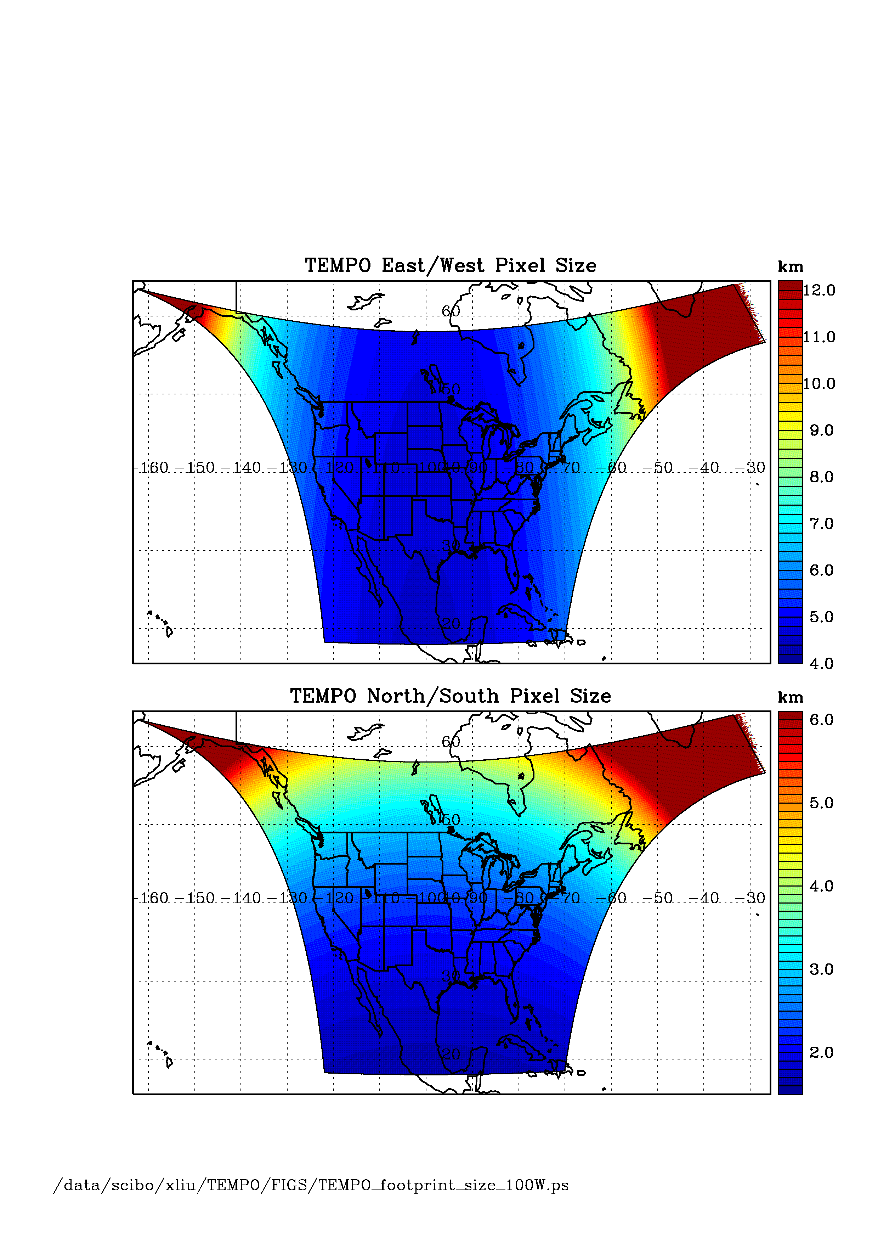
TEMPO footprint (GEO at 100º W)
Location | N/S (km) | E/W (km) | GSA (km²)
36.5ºN, 100ºW | 2.11 | 4.65 | 9.8
Washington, DC | 2.37 | 5.36 | 11.9
Seattle | 2.99 | 5.46 | 14.9
Los Angeles | 2.09 | 5.04 | 10.2
Boston | 2.71 | 5.90 | 14.1
Miami | 1.83 | 5.04 | 9.0
Mexico City | 1.65 | 4.54 | 7.5
Canadian oil sands | 3.94 | 5.05 | 19.2
Assumes 2000 N/S pixels
For GEO at 80ºW, pixel size at 36.5ºN, 100ºW is 2.2 km × 5.2 km.

Slide 12
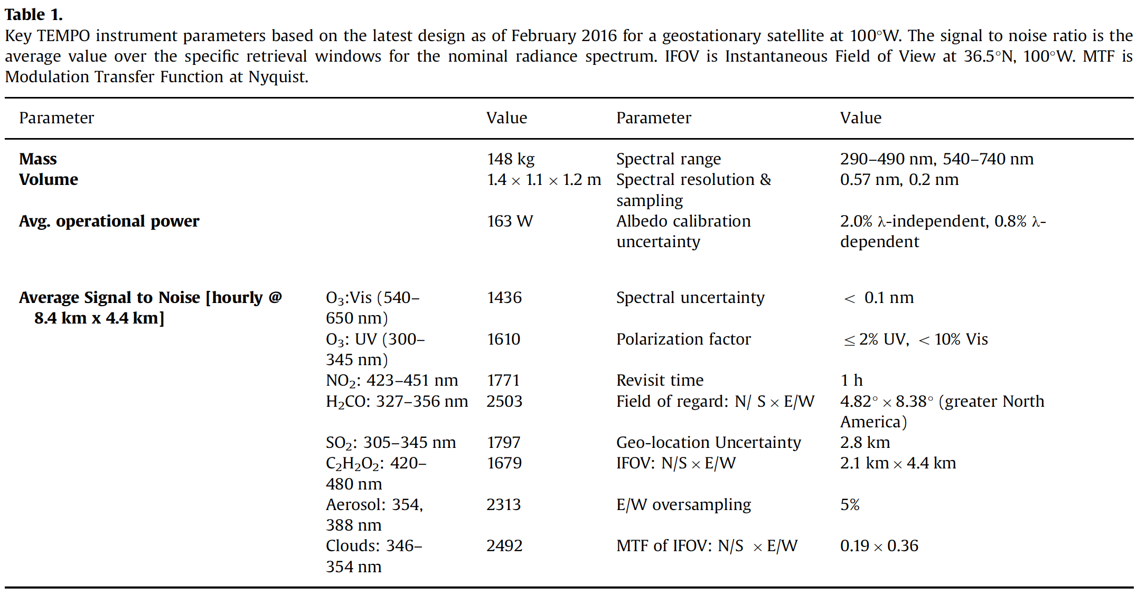
TEMPO Performance
* SNR are for 4 pixels coadded as requirements are derived from coadding 4 pixels at 8.4 x 4.5 km²!

Slide 13
Baseline and threshold data products
Species/Products | Required Precision | Temporal Revisit
0-2 km O₃ (Selected Scenes) Baseline only | 10 ppbv | 2 hour
Tropospheric O₃ | 10 ppbv | 1 hour
Total O₃ | 3% | 1 hour
Tropospheric NO₂ | 1.0 × 10¹⁵ molecules cm⁻² | 1 hour
Tropospheric H₂CO | 1.0 × 10¹⁶ molecules cm⁻² | 3 hour
Tropospheric SO₂ | 1.0 × 10¹⁶ molecules cm⁻² | 3 hour
Tropospheric C₂H₂O₂ | 4.0 × 10¹⁴ molecules cm⁻² | 3 hour
Aerosol Optical Depth | 0.10 | 1 hour
Minimal set of products sufficient for constraining air quality
Across GNA: 18°N to 58°N near 100°W, 67°W to 125°W near 42°N
Data products at urban-regional spatial scales
  Baseline ≤ 60 km² at center of Field Of Regard (FOR)
  Threshold ≤ 300 km² at center of FOR
Temporal scales to resolve diurnal changes in pollutant distributions
Geolocation uncertainty of less than 4 km
Mission duration, subject to instrument availability
  Baseline 20 months
  Threshold 12 months

Slide 14
Other Research Products
Aerosols, SO₂, C₂H₂O₂ were removed from the baseline products during KDPC
  Will use reserve to bring it back during the gap period
TEMPO research products will greatly extend science and applications
  H₂O, BrO, OClO, IO, volcanic (SO₂ plume height and VCD), and more species (e.g., HONO?)
  Additional cloud with O₂-O₂ bands or O₂-B bands
  Additional aerosol products from hyperspectral spectra, and TEMPO + GOES-R synergy at @U Iowa, GSFC, NOAA
  UVB
  Vegetation products (SIF)
  Diurnal out-going shortwave radiation and cloud forcing
  City lights
Higher-level products: Near-real-time pollution/AQ indices, UV index

Slide 15
TEMPO Launch Algorithms
NO₂, H₂CO, SO₂, C₂H₂O₂ vertical columns
  Direct fitting to TEMPO radiances (e.g., OMHCHO)
  AMF-corrected reference spectra, Ring effect, etc.
  NO₂ strat/trop separation (STS) adapted from OMI
  Research products could include H₂O, BrO, OClO, IO
O₃ profiles and tropospheric O₃
  SAO OE-based ozone profile method developed for GOME and OMI
  Add visible to improve retrieval sensitivity in the lower troposphere
  May be extended to SO₂, especially volcanic SO₂
TOMS-type total ozone retrieval (OMTO3) included for heritage
Aerosol products based on OMAERUV: AOD, AAOD, Aerosol Index
  Advanced/improved products likely developed @ GSFC, U. Iowa
Cloud Products from OMCLDRR: CF, CTP
  Advanced/improved products likely developed at GSFC
UVB research product based on OMI heritage (FMI, GSFC)
Nighttime research products include city lights (Carr Astronautics)

Slide 16
Ozone Profile Retrievals
UV only algorithm implemented for TEMPO. Need to add UV/Visible.
Retrieval averaging kernels based on iterative nonlinear retrievals from synthetic TEMPO radiances with the signal to noise ratio (SNR) estimated using the TEMPO SNR model at instrument critical design review in June 2015 for (a) UV (290-345 nm) retrievals and (b) UV/Visible (290-345 nm, 540-650 nm) retrievals for clear-sky condition and vegetation surface with solar zenith angle 25°, viewing zenith angle 45° and relative azimuthal angle 86°. DFS is degrees of freedom for signal, the trace of the averaging kernel matrix, which is an indicator of the number of pieces of independent information in the solution.

Slide 17
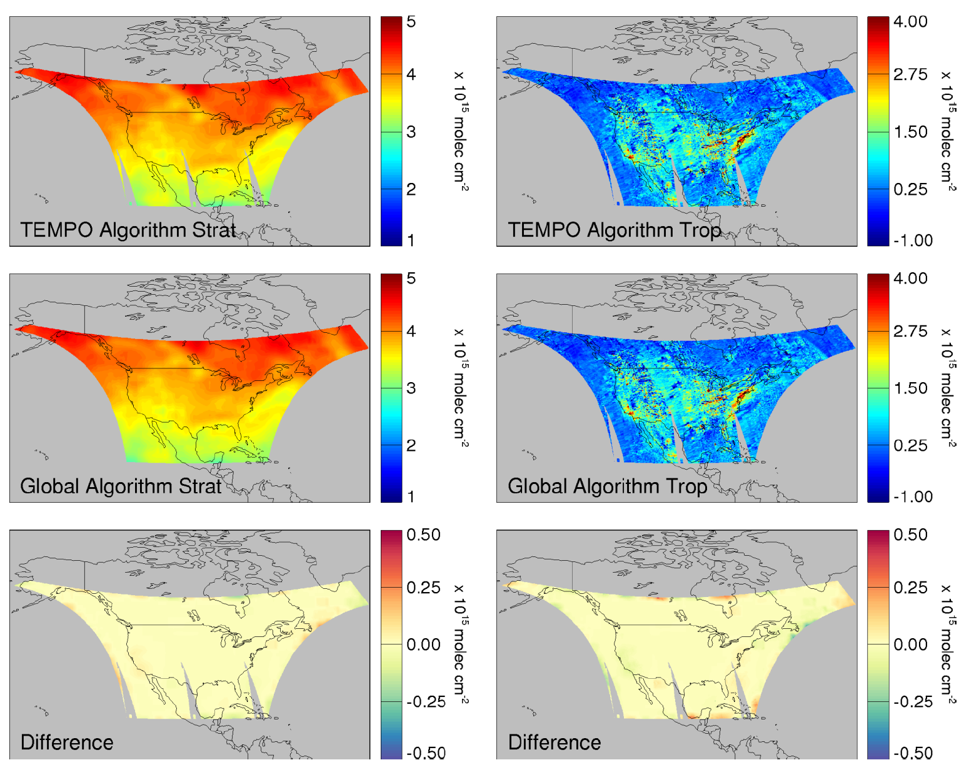
TEMPO NO2 Strat./Trop. Separation
J. Geddes and R. Martin adapted OMI NO₂ STS algorithm to TEMPO and found small errors of ~2.0E14 molecules at the edge. It is being implemented by our software engineers.

Slide 18
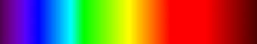
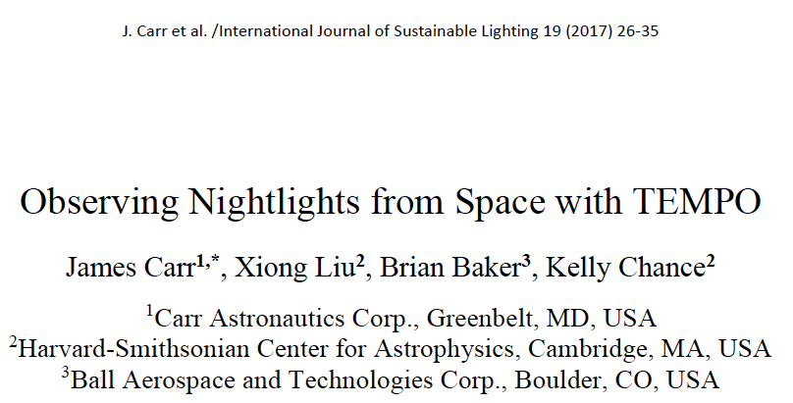
Night Lights
Spectroscopic Signatures
Laboratory Spectra of Lighting Types (C. Elvidge): http://www.ngdc.noaa.gov/eog/night_sat/spectra.html
VIIRS – Day-Night Band (DNB)
TEMPO
Ultraviolet
TEMPO
Visible

Slide 19
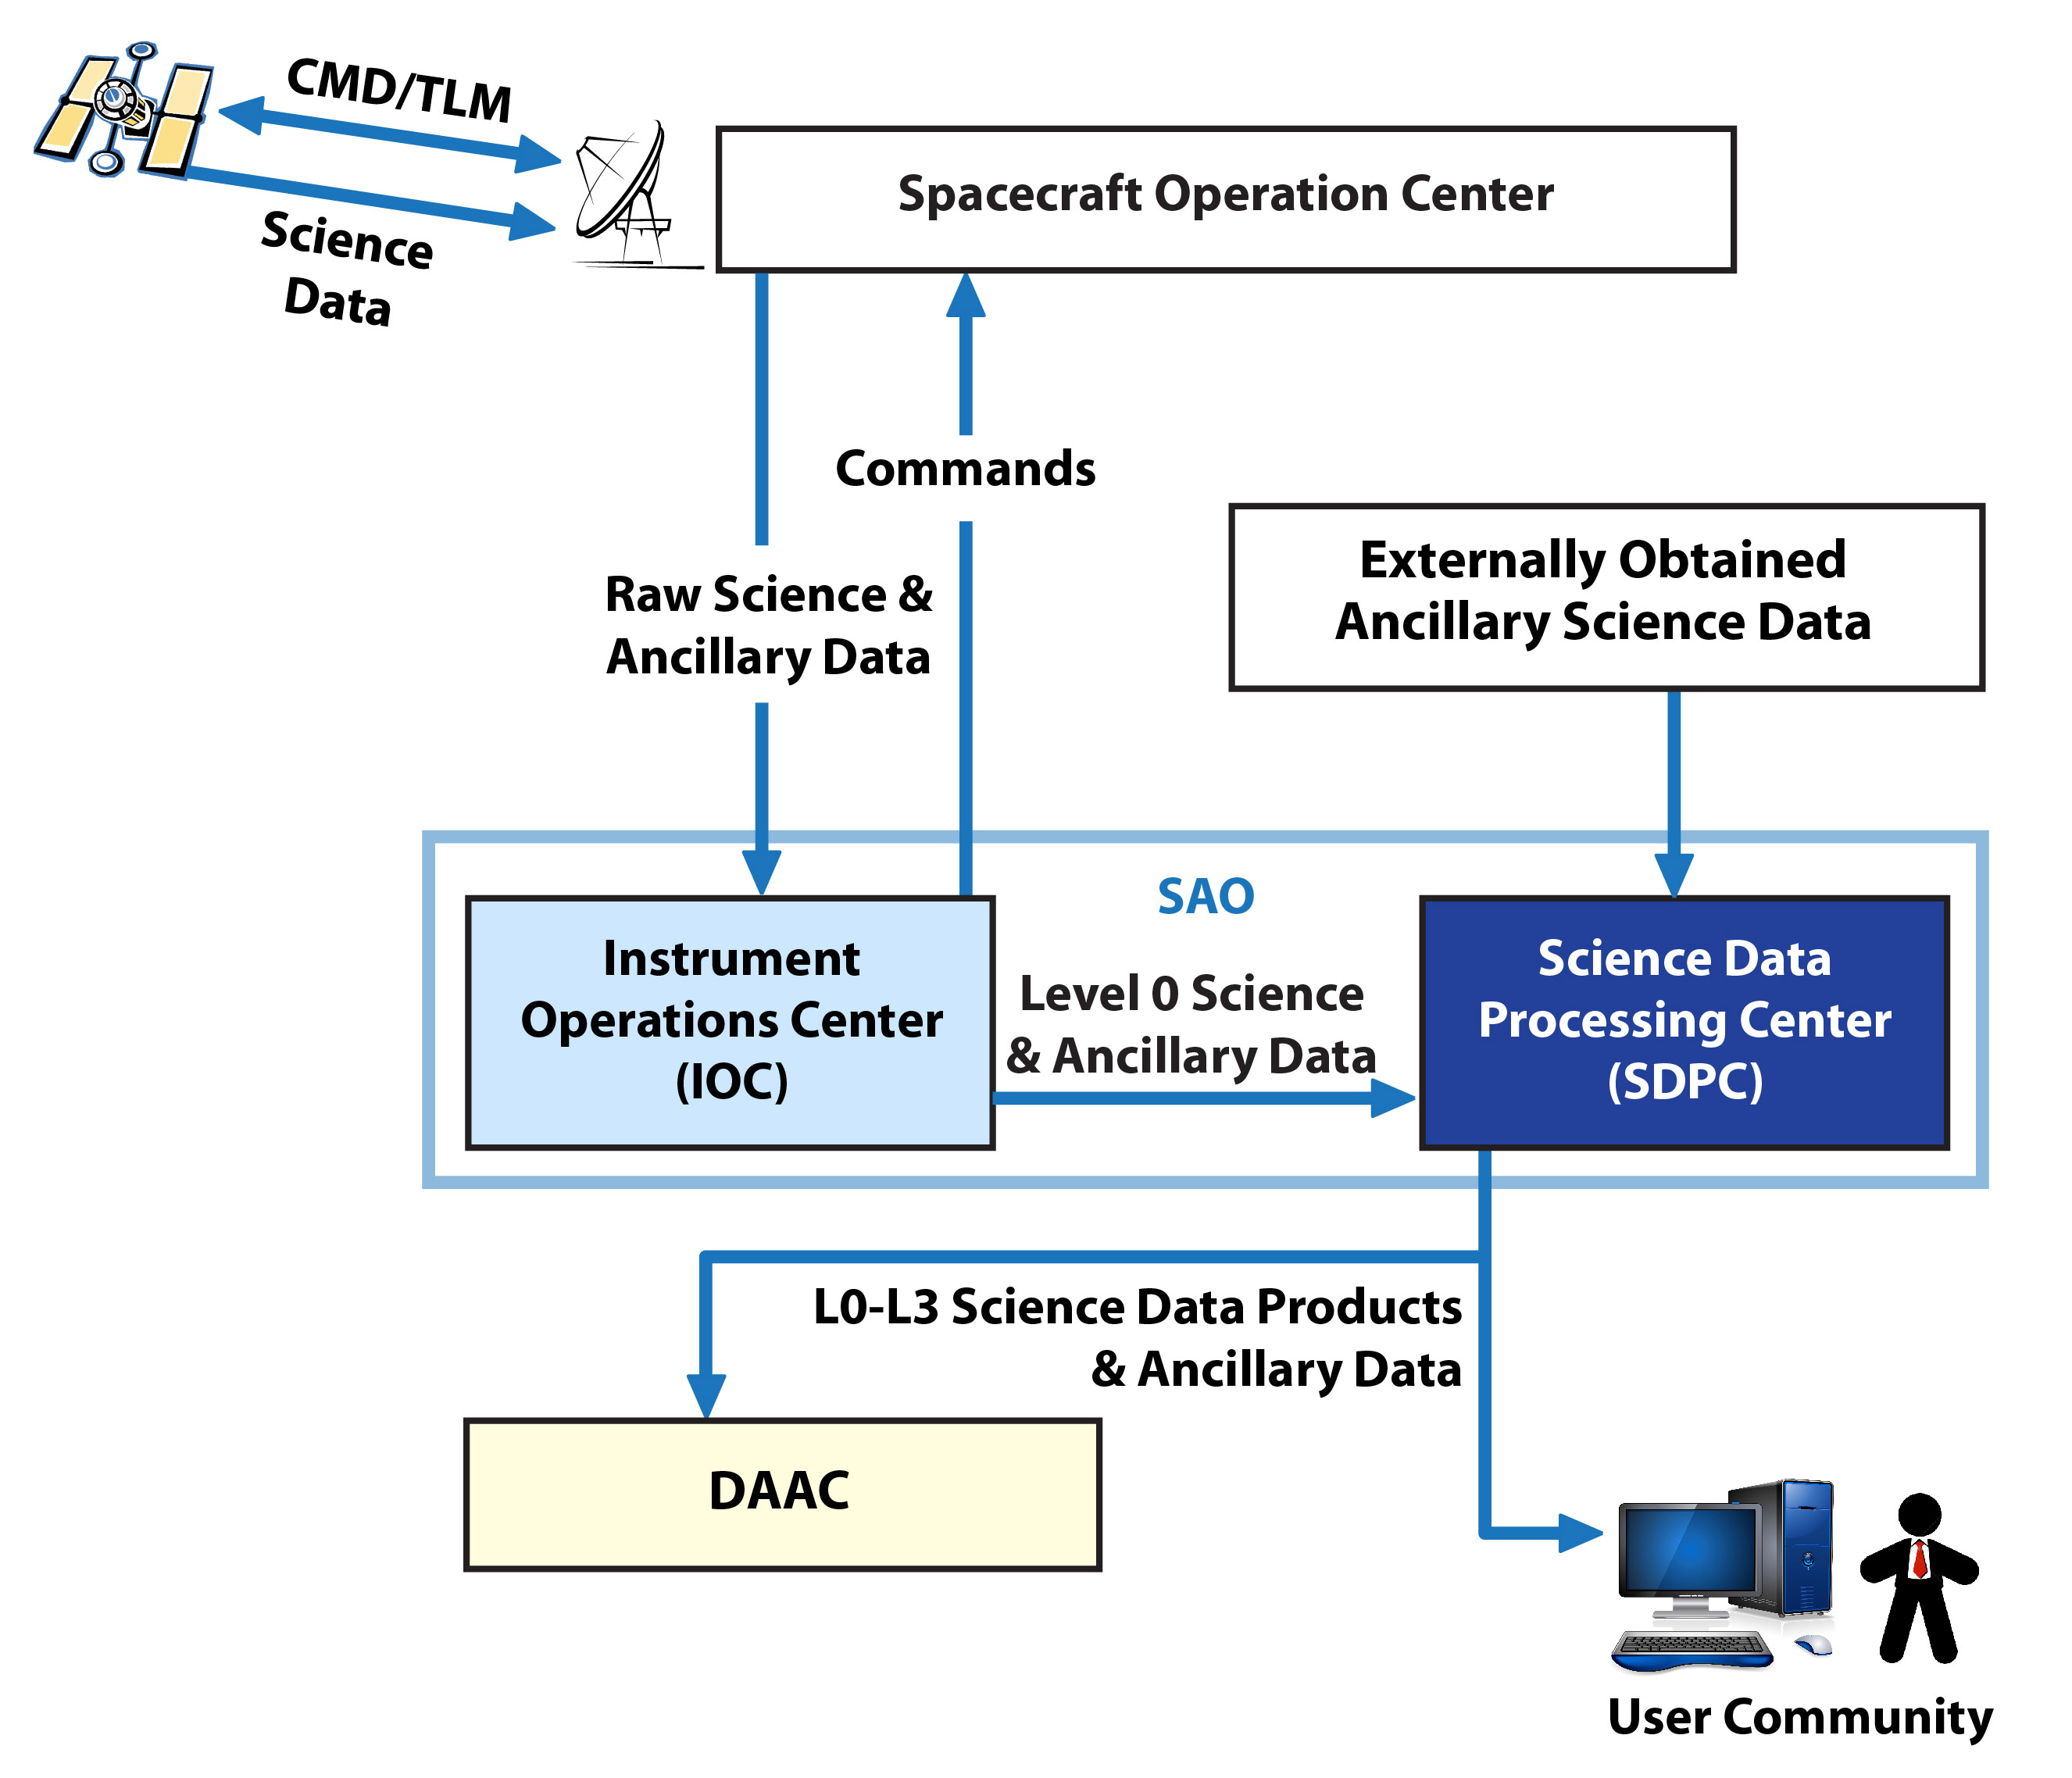
Ground Systems Overview
TEMPO Instrument Project
TEMPO
Mission
Project
Class C

Slide 20
Science data processing center (SDPC) overview
Prototype to production iterative development
L1/L2 science data formats specified. netCDF4/HDF-5 I/O & error libraries were built.
Cloud, total ozone, & trace gas code adapted and tested with TEMPO I/O and errors.
Ozone profile (UV) adapted.
L0-L1 algorithm is being developed

Slide 21
L0-1 Processor Overview
Heritages from: OMI, TROPOMI, OMPS, GOME/GOME-2, GEOTASO
TEMPO specifics
  INR (geo-location) by Carr Astronautics
  T-dependent dark current correction
  Polarization correction
Requirements from SDPCRD [TEMPO-09-0003] labeled as 4.X.X

Slide 22
Image Navigation and Registration (INR)
L0_inrprep, L0_inr
L0_inrprep: add spacecraft position & scan mirror orientation
L0_inr: provide geo-location coordinates to all spatial pixels by transferring GOES geo-location accuracy to TEMPO, calculate viewing geometry
Combine Earth orientation and spacecraft tracking to align tie points in the GOES imagery with TEMPO data
Two-pass Kalman filter
Archive tie points
Provide scan tailoring parameters
INR System Block Diagram
(or GOES-NOP)

Slide 23
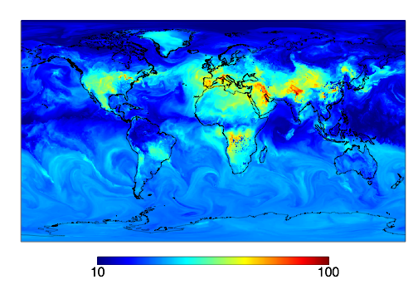
GEOS-5 Truth Atmosphere
Surface Ozone - 20130715 - 13:00 EST
ppbv
“G5NR” - GEOS-Chem coupled to the GEOS-5 GCM run globally at ~12x12 km² resolution
Courtesy of Christoph Keller

Slide 24
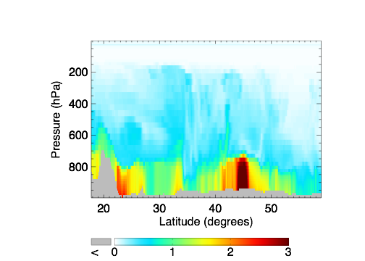
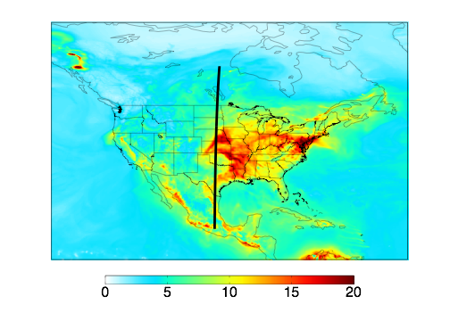
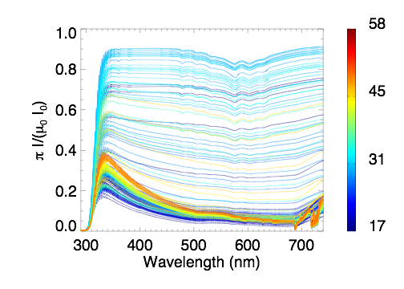
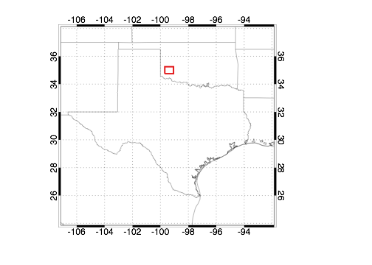
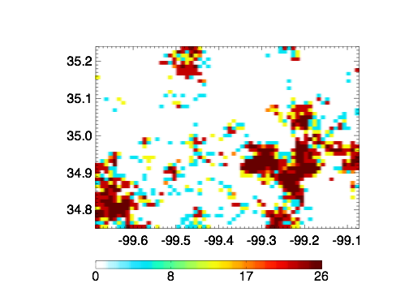
Synthetic radiance simulation
Truth Atmosphere
Sampled Profiles
Synthetic Radiances
Scan Line
Sampling
VLIDORT
Latitude
HCHO VCD (10¹⁵ molecules cm⁻²)
Simulation Details
Absorption by all TEMPO target molecules with p/T dependence where possible
Topography correction based on GMTED2010
Scan geolocation from Carr Astronautics instrument pointing model
Aerosols (GEOS-Chem types) with RH dependence
Plant fluorescence (GOME-2 downscaled by MODIS NDVI)
Ring effect (parameterization following Wagner et al. (2009))
Scattering clouds with generated with stochastic downscaling algorithm follow MRAN assumption (right)
Surface reflection: MODIS BRDF w/ USGS+ASTER PC fit (land) or Cox-Monks kernel (ocean)
MRAN Cloud Downscaling (0.01ºx0.01º)
Cloud Column
Optical Depth

Slide 25
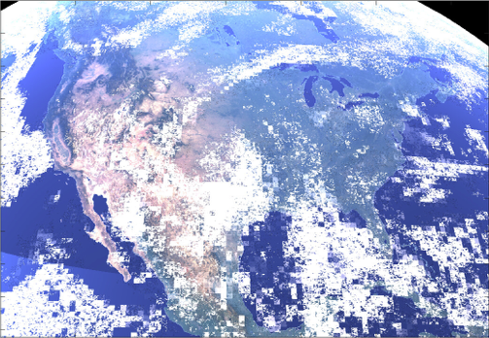
The Synthetic View From TEMPO
Synthetic data will be used to tested L0-L3 algorithms and verify retrieval performance.

Slide 26
The Green Paper: Science studies, Special operations
The TEMPO Green Paper is a living community document – see http://tempo.si.edu/presentations.html. Please make additions and corrections.
Scientific studies using high temporal resolution special observations:
  Lightning NOx/Soil NOx
  Traffic/urban pollution: Morning and evening higher-frequency scans
  Biomass burning
  Atmospheric chemistry of halogen oxides over the ocean, and in particular in coastal regions
  Fluorescence and other spectral indicators
  Assessing pollution transport during upslope flows
  Tidal effects on estuarine circulation and out flow plumes
  Cloud field correlation with pollution

Slide 27
TEMPO Meetings and Workshops
TEMPO Science Team Meeting: Cambridge, May 31-June 1, the theme of this year is early adopters
TEMPO Validation Workshop: April 26-27, UC Berkley, organized by Ron Cohen. Discussions focused on experimental strategies that will
  Give confidence in the TEMPO data, especially with respect to its unique features—hourly with spatial resolution of ~10km²
  Emphasize observations that could identify systematic errors in retrievals.
  The evolving Pandora network within TEMPO FOR through NASA & EPA efforts is key to validate TEMPO, but not solely sufficient. Need surface networks, TOLNet, GeoTASO/GCAS, profiling aircraft etc.
TEMPO Aerosol Workshop: September 11, NOAA, organized by Omar and Shoba
  Individual TEMPO/GEMS, ABI(AMI), MAIC algorithms
  TEMPO(GEMS)/ABI(AMI) synergy: cloud clearing, multi-view, combine UV aerosol absorption to ABI

Slide 28
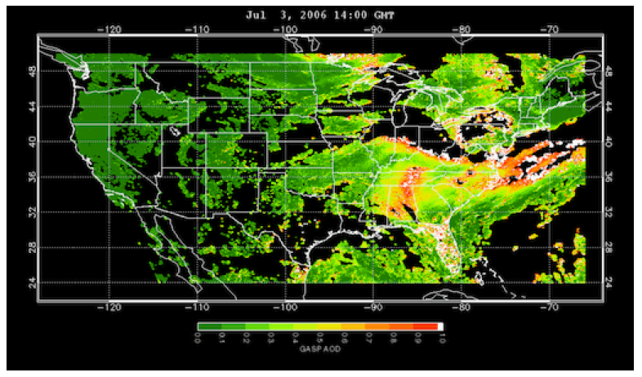
www.epa.gov/rsig
TEMPO will use the EPA’s Remote Sensing Information Gateway (RSIG) for subsetting, visualization, and product distribution – to make TEMPO YOUR instrument
There will be a TEMPO data distribution workshop this winter in Ft. Collins, CO, sponsored by the Western States Air Resources Council

Slide 29
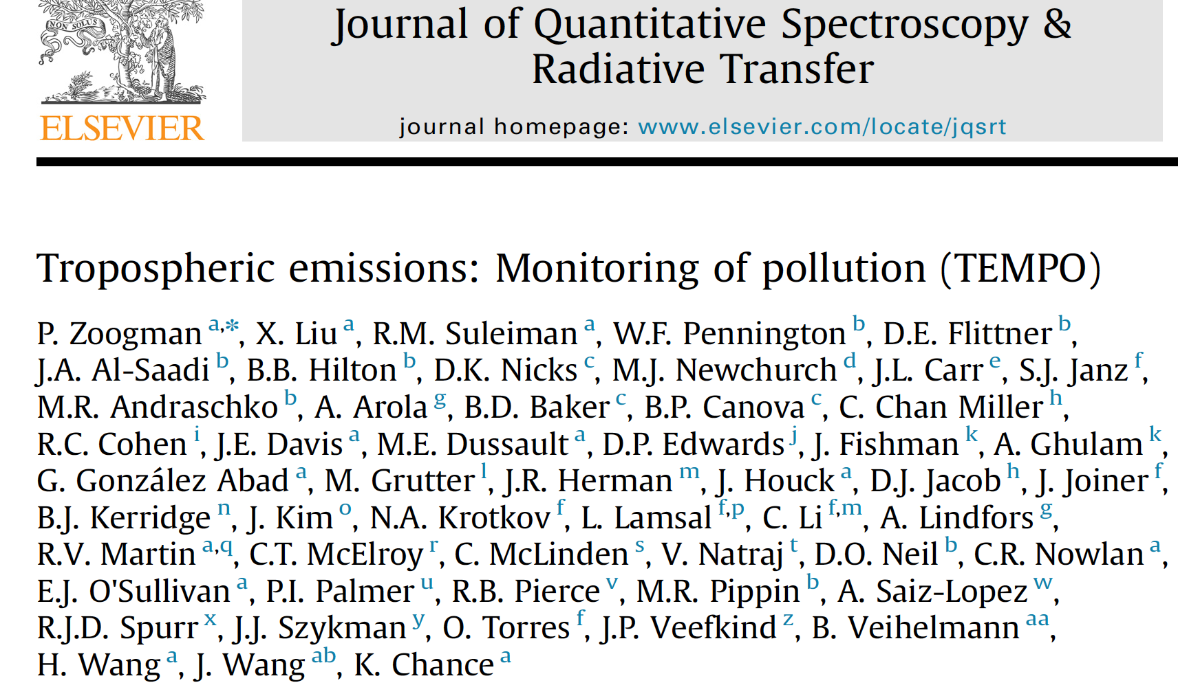
Summary
TEMPO will provide hourly atmospheric pollution at high spatial resolution (~10 km² at center of FOR) over North America from the GEO orbit.
TEMPO currently on budget and close to on schedule.
Instrument delivery in March 2018, host selection in middle 2018 with launch NET 2019, most likely in 2020 & 2021.
  See Zoogman et al. (2017), JQSRT for more detail.

Slide 30






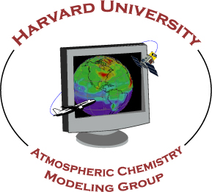














The end!
Thanks to NASA, ESA, Ball Aerospace &
Technologies Corp., The Boeing Company

Slide 31
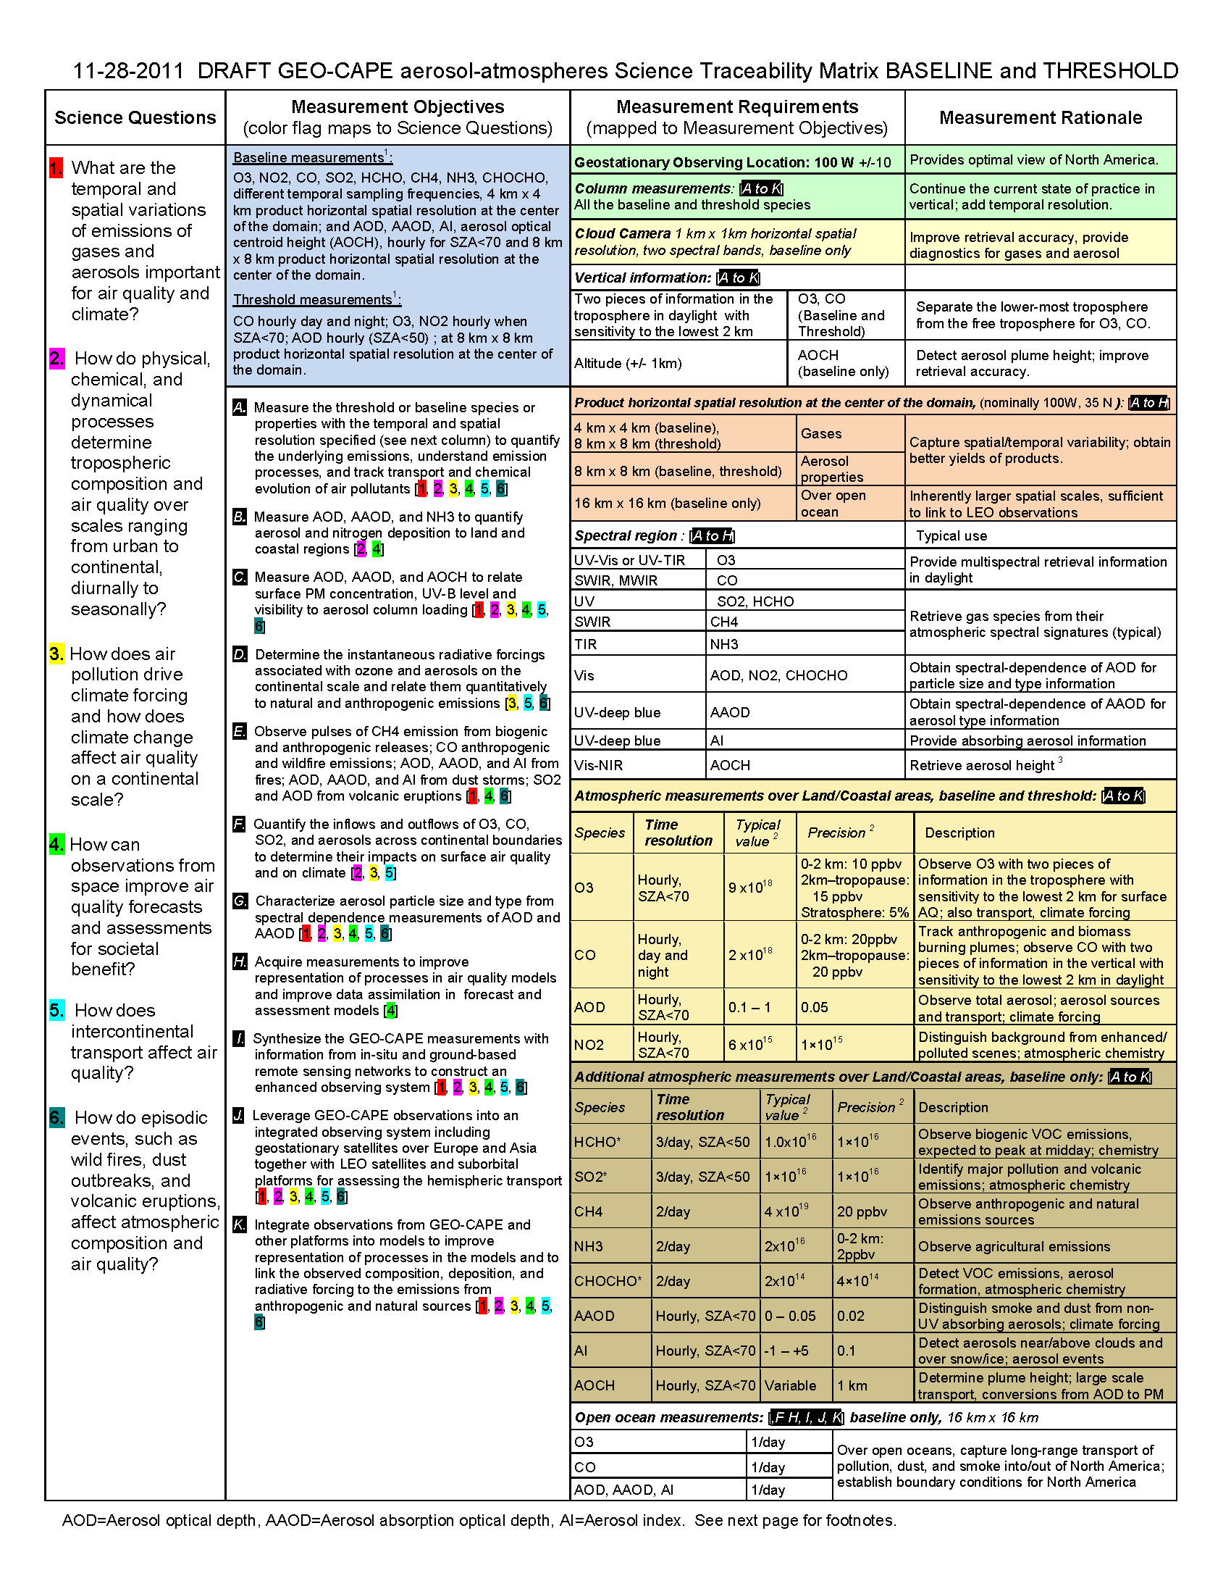

Air quality requirements from the GEO-CAPE Science Traceability Matrix

Slide 32
Infrared
species
Ultraviolet/
visible species
(GOME, SCIA, OMI, OMPS, TROPOMI, S-4, GEMS, TEMPO, etc.)
Notes:
Might GOES-16 help with AOCH?

Slide 33
TEMPO Science Team, U.S.
Team Member | Institution | Role | Responsibility
K. Chance | SAO | PI | Overall science development; Level 1b, H₂CO, C₂H₂O₂
X. Liu | SAO | Deputy PI | Science development, data processing; O₃ profile, tropospheric O₃
J. Al-Saadi | LaRC | Deputy PS | Project science development
J. Carr | Carr Astronautics | Co-I | INR Modeling and algorithm
M. Chin | GSFC | Co-I | Aerosol science
R. Cohen | U.C. Berkeley | Co-I | NO₂ validation, atmospheric chemistry modeling, process studies
D. Edwards | NCAR | Co-I | VOC science, synergy with carbon monoxide measurements
J. Fishman | St. Louis U. | Co-I | AQ impact on agriculture and the biosphere
D. Flittner | LaRC | Project Scientist | Overall project development; STM; instrument cal./char.
J. Herman | UMBC | Co-I | Validation (PANDORA measurements)
D. Jacob | Harvard | Co-I | Science requirements, atmospheric modeling, process studies
S. Janz | GSFC | Co-I | Instrument calibration and characterization
J. Joiner | GSFC | Co-I | Cloud, total O₃, TOA shortwave flux research product
N. Krotkov | GSFC | Co-I | NO₂, SO₂, UVB
M. Newchurch | U. Alabama Huntsville | Co-I | Validation (O₃ sondes, O₃ lidar)
R.B. Pierce | NOAA/NESDIS | Co-I | AQ modeling, data assimilation
R. Spurr | RT Solutions, Inc. | Co-I | Radiative transfer modeling for algorithm development
R. Suleiman | SAO | Co-I, Data Mgr. | Managing science data processing, BrO, H₂O, and L3 products
J. Szykman | EPA | Co-I | AIRNow AQI development, validation (PANDORA measurements)
O. Torres | GSFC | Co-I | UV aerosol product, AI
J. Wang | U. Nebraska | Co-I | Synergy w/GOES-R ABI, aerosol research products
J. Leitch | Ball Aerospace | Collaborator | Aircraft validation, instrument calibration and characterization
D. Neil | LaRC | Collaborator | GEO-CAPE mission design team member

Slide 34
TEMPO Science Team, non-U.S.
Team Member | Institution | Role | Responsibility
Randall Martin | Dalhousie U. | Collaborator | Atmospheric modeling, air mass factors, AQI development
Chris McLinden | Environment Canada | Collaborator | Canadian air quality coordination
Michel Grutter de la Mora | UNAM, Mexico | Collaborator | Mexican air quality coordination
Gabriel Vazquez | UNAM, Mexico | Collaborator | Mexican air quality, algorithm physics
Amparo Martinez | INECC, Mexico | Collaborator | Mexican environmental pollution and health
J. Victor Hugo Paramo Figeuroa | INECC, Mexico | Collaborator | Mexican environmental pollution and health
Brian Kerridge | Rutherford Appleton Laboratory, UK | Collaborator | Ozone profiling studies, algorithm development
Paul Palmer | Edinburgh U., UK | Collaborator | Atmospheric modeling, process studies
Alfonso Saiz-Lopez | CSIC, Spain | Collaborator | Atmospheric modeling, process studies
Juan Carlos Antuña Marrero | GOAC, Cuba | Collaborator | Cuban Science team lead, Cuban air quality
Osvaldo Cuesta | GOAC, Cuba | Collaborator | TEMPO validation, Cuban air quality
René Estevan Arredondo | GOAC, Cuba | Collaborator | TEMPO validation, Cuban air quality
J. Kim | Yonsei U. | Collaborators, Science Advisory Panel | Korean GEMS, CEOS constellation of GEO pollution monitoring
C.T. McElroy | York U. Canada |  | CSA PHEOS, CEOS constellation of GEO pollution monitoring
B. Veihelmann | ESA |  | ESA Sentinel-4, CEOS constellation of GEO pollution monitoring
J.P. Veefkind | KNMI |  | ESA Sentinel-5P (TROPOMI)

Slide 35
TEMPO science questions
What are the temporal and spatial variations of emissions of gases and aerosols important for air quality and climate?
How do physical, chemical, and dynamical processes determine tropospheric composition and air quality over scales ranging from urban to continental, diurnally to seasonally?
How does air pollution drive climate forcing and how does climate change affect air quality on a continental scale?
How can observations from space improve air quality forecasts and assessments for societal benefit?
How does intercontinental transport affect air quality?
How do episodic events, such as wild fires, dust outbreaks, hurricanes, and volcanic eruptions, affect atmospheric composition and air quality?

Slide 36
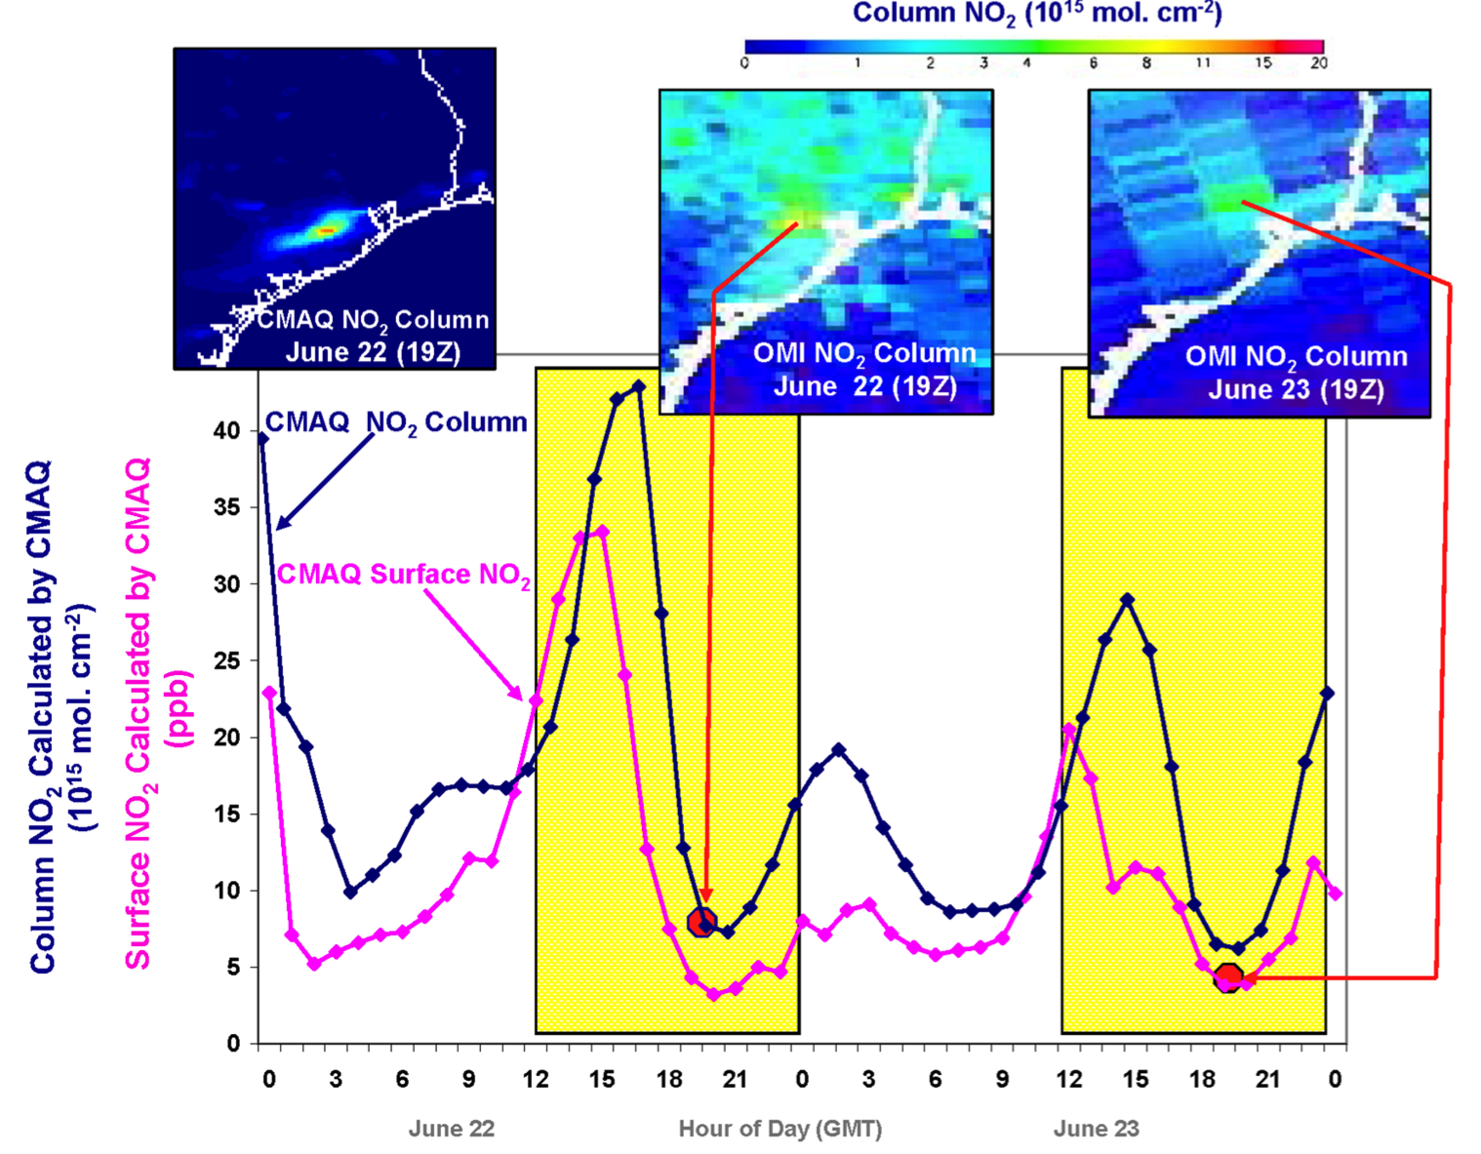
Why geostationary? High temporal and spatial resolution
Hourly NO₂ surface concentration and integrated column calculated by CMAQ air quality model: Houston, TX, June 22-23, 2005
June 22
Hour of Day (UTC)
June 23
LEO observations provide limited information on rapidly varying emissions, chemistry, & transport
GEO will provide observations at temporal and spatial scales highly relevant to air quality processes

Slide 37
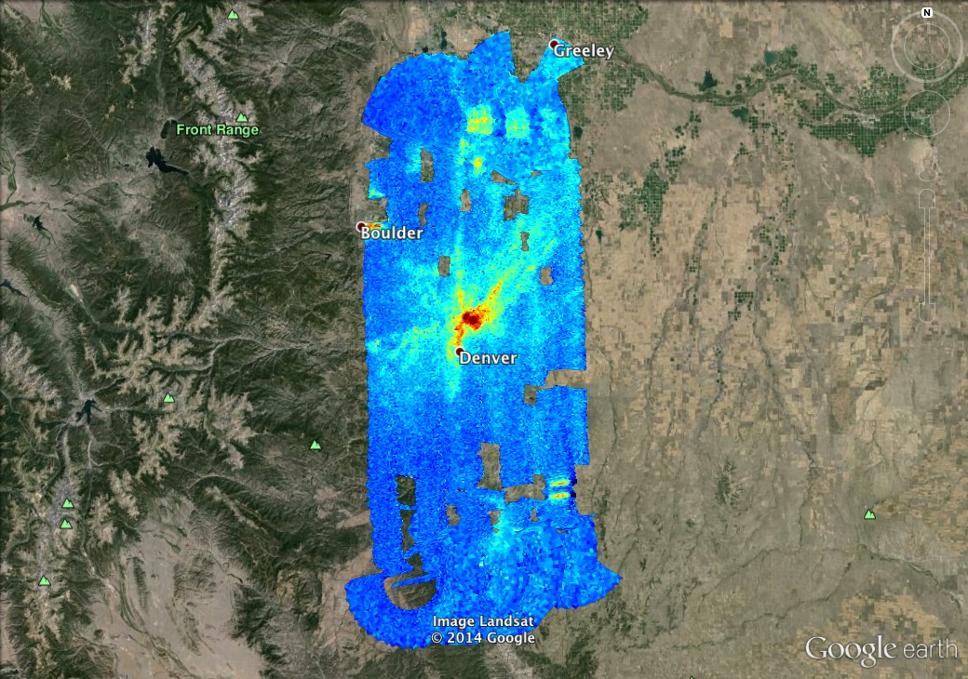

TEMPO measurements will capture the diurnal cycle of pollutant emissions
GeoTASO NO₂ Slant Column, 02 August 2014 Morning
Co-added to approx.
500m x 450m
Morning vs. Afternoon
Preliminary data,
C. Nowlan, SAO

Slide 38
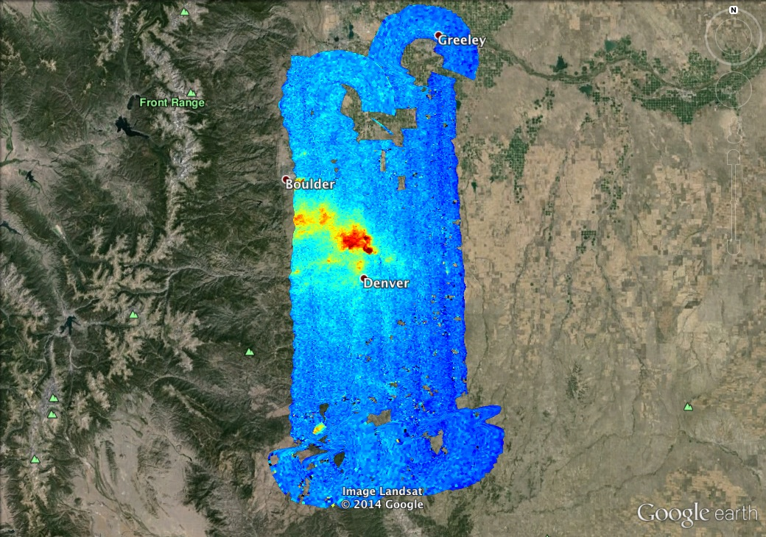
TEMPO measurements will capture the diurnal cycle of pollutant emissions
GeoTASO NO₂ Slant Column, 02 August 2014 Afternoon
Co-added to approx.
500m x 450m
Morning vs. Afternoon
Preliminary data,
C. Nowlan, SAO

Slide 39
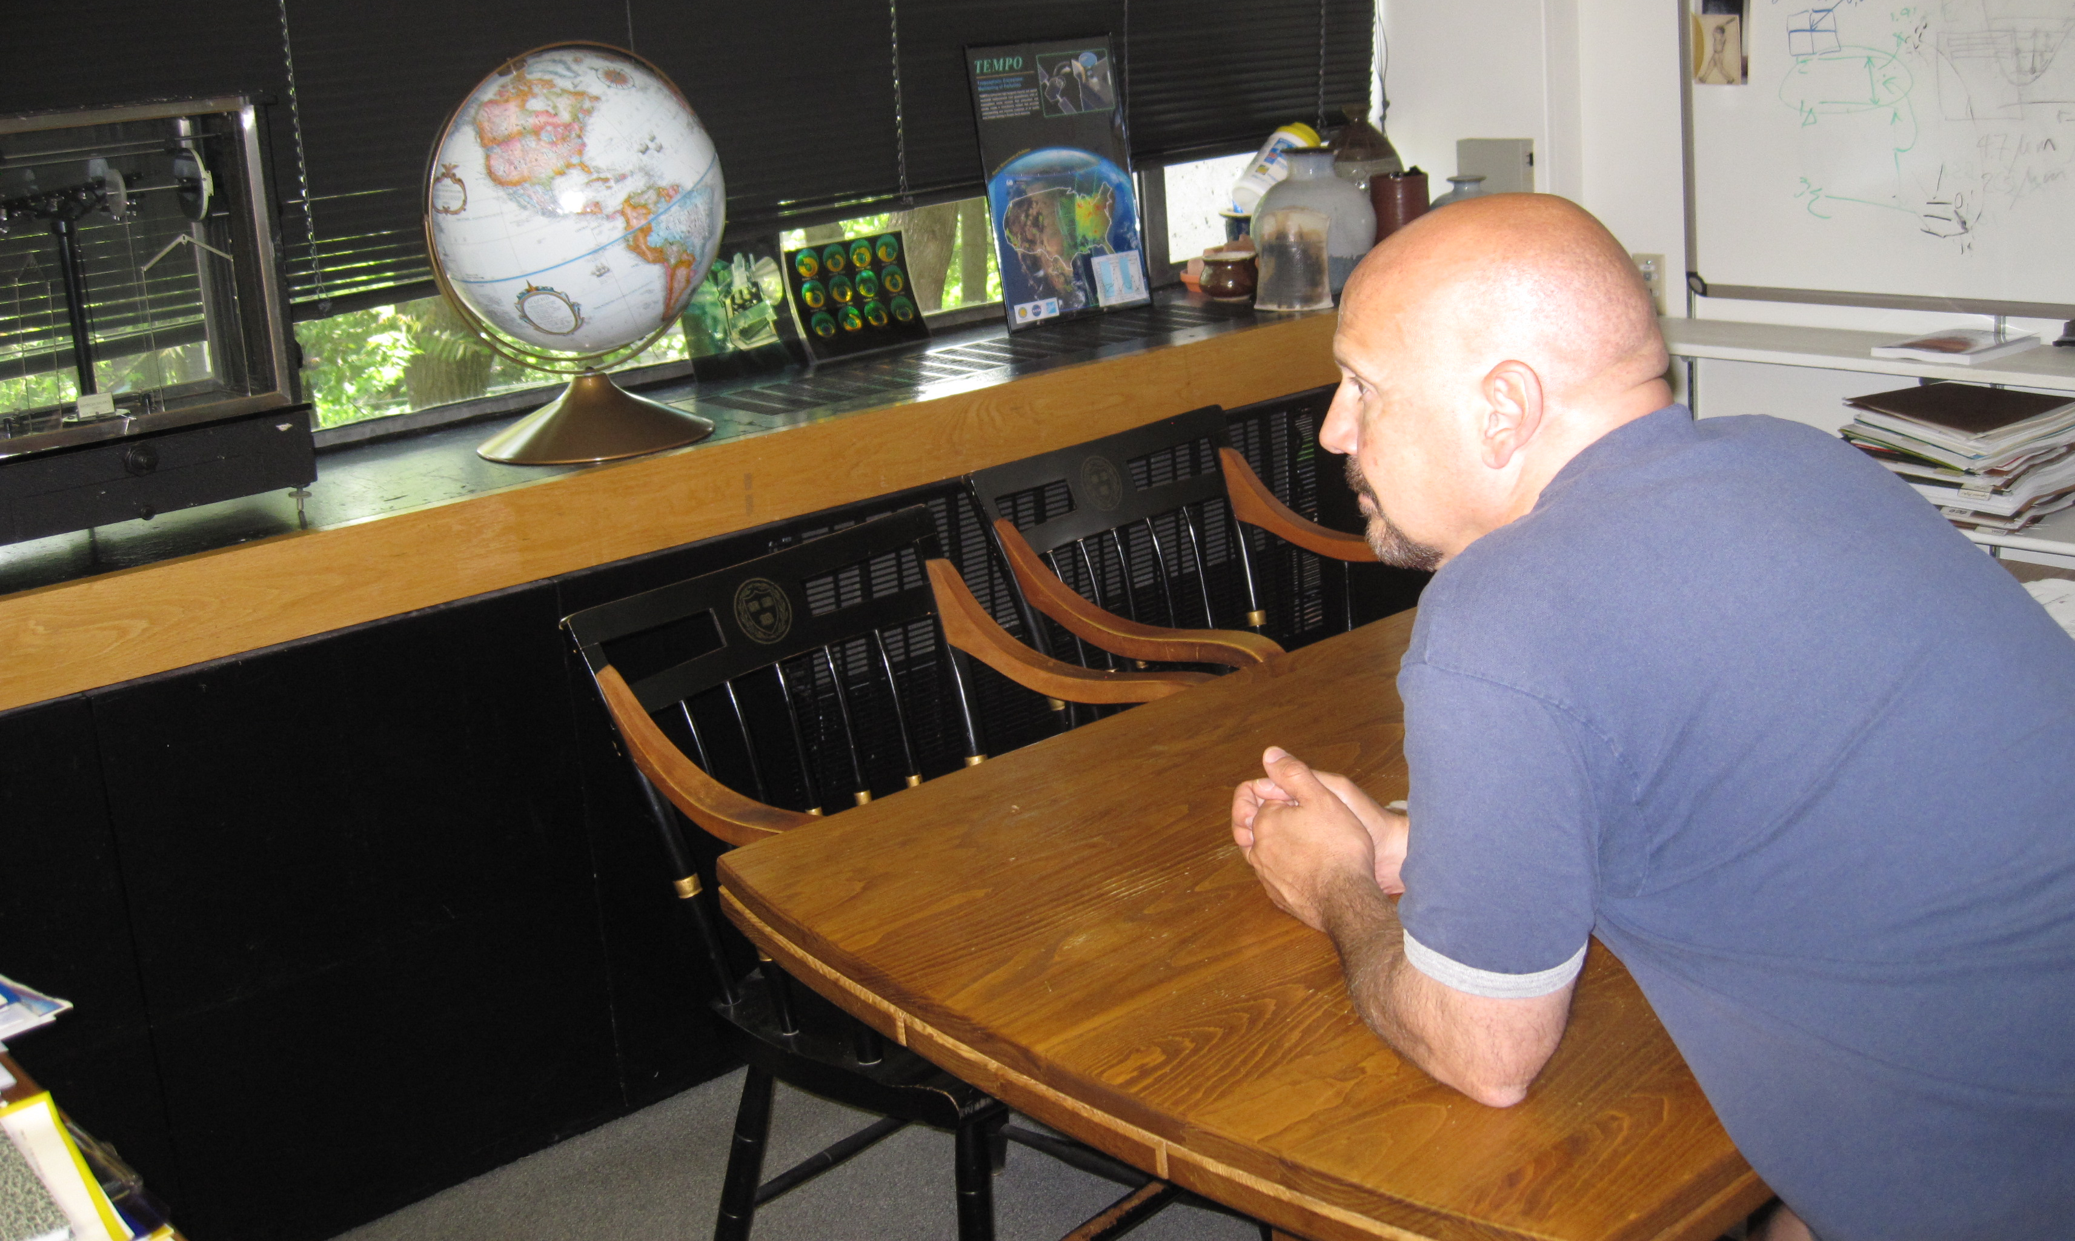

The view from GEO
The old Chance place

Slide 40
Traffic, biomass burning
Morning and evening higher-frequency scans The optimized data collection scan pattern during mornings and evenings provides multiple advantages for addressing TEMPO science questions. The increased frequency of scans coincides with peaks in vehicle miles traveled on each coast.
Biomass burning The unexplained variability in ozone production from fires is of particular interest. The suite of NO₂, H₂CO, C₂H₂O₂, O₃, and aerosol measurements from TEMPO is well suited to investigating how the chemical processing of primary fire emissions effects the secondary formation of VOCs and ozone. For particularly important fires it is possible to command special TEMPO observations at even shorter than hourly revisit time, probably as short as 10 minutes.

Slide 41
NO_{x} studies
Lightning NO_{x} Interpretation of satellite measurements of tropospheric NO₂ and O₃, and upper tropospheric HNO₃ lead to an overall estimate of 6 ± 2 Tg N y-1 from lightning [Martin et al., 2007]. TEMPO measurements, including tropospheric NO₂ and O₃, can be made for time periods and longitudinal bands selected to coincide with large thunderstorm activity, including outflow regions, with fairly short notice.
Soil NO_{x} Jaeglé et al. [2005] estimate 2.5 - 4.5 TgN y⁻¹ are emitted globally from nitrogen-fertilized soils, still highly uncertain. The US a posteriori estimate for 2000 is 0.86 ± 1.7 TgN y⁻¹. For Central America it is 1.5 ± 1.6 TgN y⁻¹. They note an underestimate of NO release by nitrogen-fertilized croplands as well as an underestimate of rain-induced emissions from semiarid soils.
TEMPO is able to follow the temporal evolution of emissions from croplands after fertilizer application and from rain-induced emissions from semi-arid soils. Higher than hourly time resolution over selected regions may be accomplished by special observations. Improved constraints on soil NO_{x} emissions may also improve estimated of lightning NO_{x} emissions [Martin et al. 2000].

Slide 42
Halogens
BrO will be produced at launch, assuming stratospheric AMFs. Scientific studies will correct retrievals for tropospheric content. IO was first measured from space by SAO using SCIAMACHY spectra [Saiz-Lopez et al., 2007]. It will be produced as a scientific product, particularly for coastal studies, assuming AMFs appropriate to lower tropospheric loading.
The atmospheric chemistry of halogen oxides over the ocean, and in particular in coastal regions, can play important roles in ozone destruction, oxidizing capacity, and dimethylsulfide oxidation to form cloud-condensation nuclei [Saiz-Lopez and von Glasow, 2012]. The budgets and distribution of reactive halogens along the coastal areas of North America are poorly known. Therefore, providing a measure of the budgets and diurnal evolution of coastal halogen oxides is necessary to understand their role in atmospheric photochemistry of coastal regions. Previous ground-based observations have shown enhanced levels (at a few pptv) of halogen oxides over coastal locations with respect to their background concentrations over the remote marine boundary layer [Simpson et al., 2015]. Previous global satellite instruments lacked the sensitivity and spatial resolution to detect the presence of active halogen chemistry over mid-latitude coastal areas. TEMPO observations together with atmospheric models will allow examination of the processes linking ocean halogen emissions and their potential impact on the oxidizing capacity of coastal environments of North America.
TEMPO also performs hourly measurements one of the world’s largest salt lakes: the Great Salt Lake in Utah. Measurements over Salt Lake City show the highest concentrations of BrO over the globe. Hourly measurement at a high spatial resolution can improve understanding of BrO production in salt lakes.

Slide 43
Spectral indicators
Fluorescence and other spectral indicators Solar-induced fluorescence (SIF) from chlorophyll over both land and ocean will be measured. In terrestrial vegetation, chlorophyll fluorescence is emitted at red to far-red wavelengths (~650-800 nm) with two broad peaks near 685 and 740 nm, known as the red and far-red emission features. Oceanic SIF is emitted exclusively in the red feature. SIF measurements have been used for studies of tropical dynamics, primary productivity, the length of carbon uptake period, and drought responses, while ocean measurements have been used to detect red tides and to conduct studies on the physiology, phenology, and productivity of phytoplankton. TEMPO can retrieve both red and far-red SIF by utilizing the property that SIF fills in solar Fraunhofer and atmospheric absorption lines in backscattered spectra normalized by a reference (e.g., the solar spectrum) that does not contain SIF.
TEMPO will also be capable of measuring spectral indices developed for estimating foliage pigment contents and concentrations. Spectral approaches for estimating pigment contents apply generally to leaves and not the full canopy. A single spectrally invariant parameter, the Directional Area Scattering Factor (DASF), relates canopy-measured spectral indices to pigment concentrations at the leaf scale.
UVB TEMPO measurements of daily UV exposures build upon heritage from OMI and TROPOMI measurements. Hourly cloud measurements from TEMPO allow taking into account diurnal cloud variability, which has not been previously possible. The OMI UV algorithm is based on the TOMS UV algorithm. The specific product is the downward spectral irradiance at the ground (in W m⁻² nm⁻¹) and the erythemally weighted irradiance (in W m⁻²).

Slide 44
Air quality and health
TEMPO’s hourly measurements allow better understanding of the complex chemistry and dynamics that drive air quality on short timescales. The density of TEMPO data is ideally suited for data assimilation into chemical models for both air quality forecasting and for better constraints on emissions that lead to air quality exceedances. Planning is underway to combine TEMPO with regional air quality models to improve EPA air quality indices and to directly supply the public with near real time pollution reports and forecasts through website and mobile applications. As a case study, an OSSE for the Intermountain West was performed to explore the potential of geostationary ozone measurements from TEMPO to improve monitoring of ozone exceedances and the role of background ozone in causing these exceedances (Zoogman et al. 2014).

Slide 45
AQ indices
What is an AQ index?”
“The Canadian Air Quality Health Index is a multipollutant index based on the sum of PM2.5, NO₂, and O₃,weighted by their contribution to mortality in daily time-series
study across Canadian cities.” [Cooper et al., 2012]
Cooper et al., for example, propose a satellite-based multipollutant index using the WHO Air Quality Guidelines (AQG):
Can we define different indices as appropriate to locations, seasons, times?
Might they be formulated using RSIG?
Might assimilation be included?
Cooper, M., R.V. Martin, A. van Donkelaar, L. Lamsal, M. Brauer, and J. Brook, A satellite-based multi-pollutant index of global air quality, Env. Sci. and Tech., 46, 8523-8524, 2012.

Slide 46
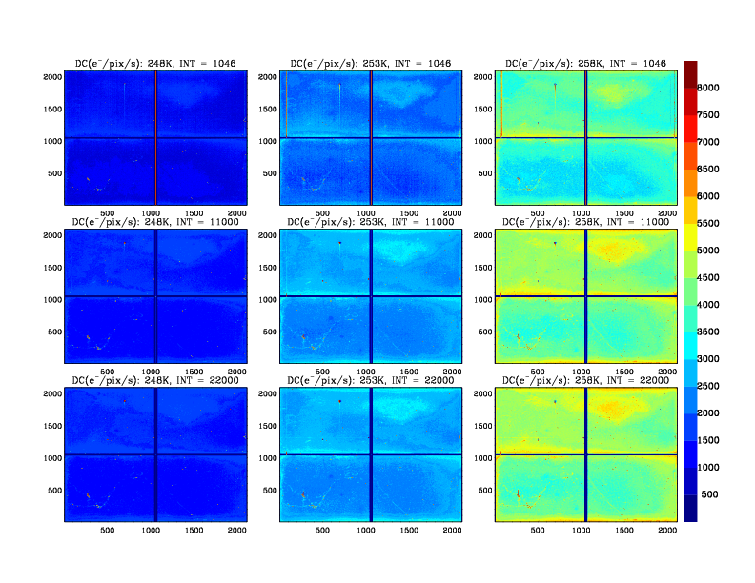
TEMPO CCD Image
2 full-frame transfer CCDs with 4 quadrants, each of which has its serial read-out register and Analog to Digital Converter (ADC)
Besides photo-active pixels that collect photons & dark current,
  Leading buffer/trailing overclock columns: electronic offsets and read-out noise
  Overclocked rows for smear correction
  First/last row: storage region dark current, surrogate for detector T
740 nm
290 nm
North
South

Slide 47
L0_ccd: Dark Measurements
L0_ccd: applied to dark current (DC) calibration measurements to derived corrected DC data
  Flag hot/cold pixels. RTS (random telegraph signals) flagging is done off-line using time series of DC measurements
  Remove electronic offsets using trailing pixels
  Smear correction is not necessary for dark current data

Slide 48
L0_ccd
Radiance and Irradiance
Flag transient, saturated, and missing pixels.
Smear correction: using either smear rows or scaling column average signal by image transfer to integration time
Special solar measurements vs. t_{int} to derive detector ADC non-linearity, flag dead pixels, and estimate read-out noise via standard photon transfer methods
Trending time series of solar measurements from working and reference diffuser to derive degradation in radiometric coefficients and diffuser BTDF
Requirements from TEMPO-09-0004
Software Requirements Specification Document

Slide 49
L0_inrpost
L0_inrpost: additional processing after INR to derive the final radiance product
  Snow/ice from National Snow and Ice Data Center
  Flag pixels affected by sun glint
  Terrain height (GMTED2010, 30 arc s)
  MODIS land cover type product MCD12Q1 (17 classes, 500 m res.)
  Correct for radiance error due to instrument polarization sensitivity

Slide 50
Dark Current (DC) Correction
TEMPO: need to perform DC correction to ~0.1 K equivalent temperature (T) uncertainty and account for its T-dependence
Take a series of DC calibration data during night such that the T range brackets daytime T variation
Monitor average storage region DC (C_{s}) for every image during nominal Earth imaging, solar and dark calibration
Interpolate over T (following Arrhenius Law, i.e., lnC ~ 1/T) or C_{s} (linear, i.e., C_{s} ~ C)
Dark 1
Radiance
Dark 2
T₁, C_{s1}, C₁(x,y)
T₃, C_{s3}, C₃(x,y)=?
T₂, C_{s2}, C₂(x,y)
→ Increasing T or C_{s}
T: Detector temperature, measured at 1 Hz
C(x,y): active image region DC (only available during dark calibration)

Slide 51

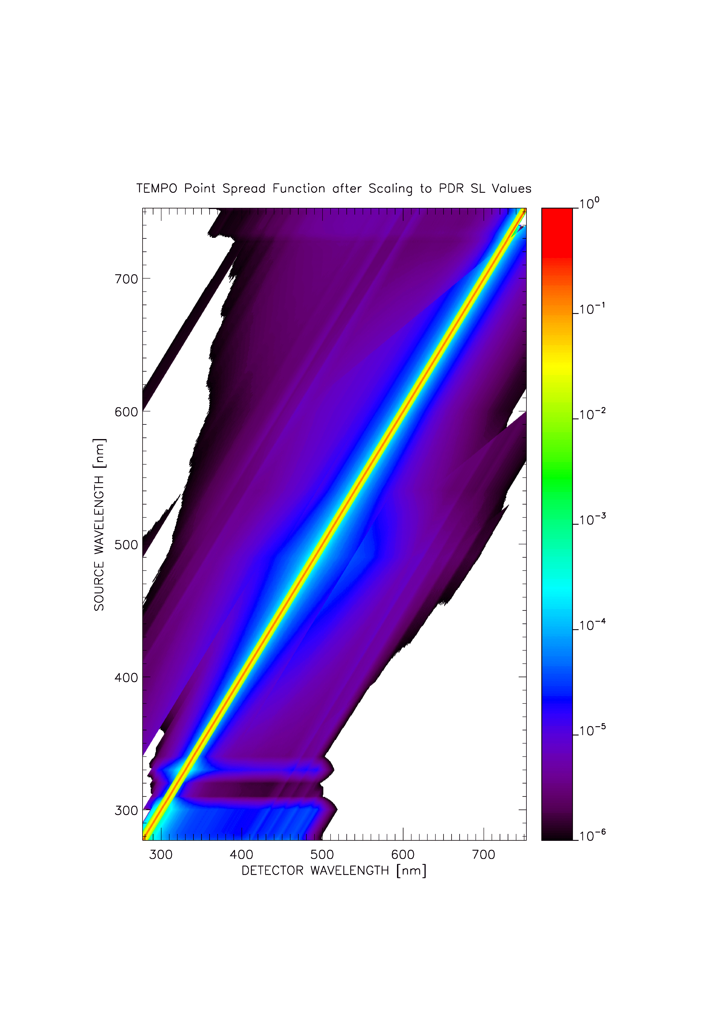
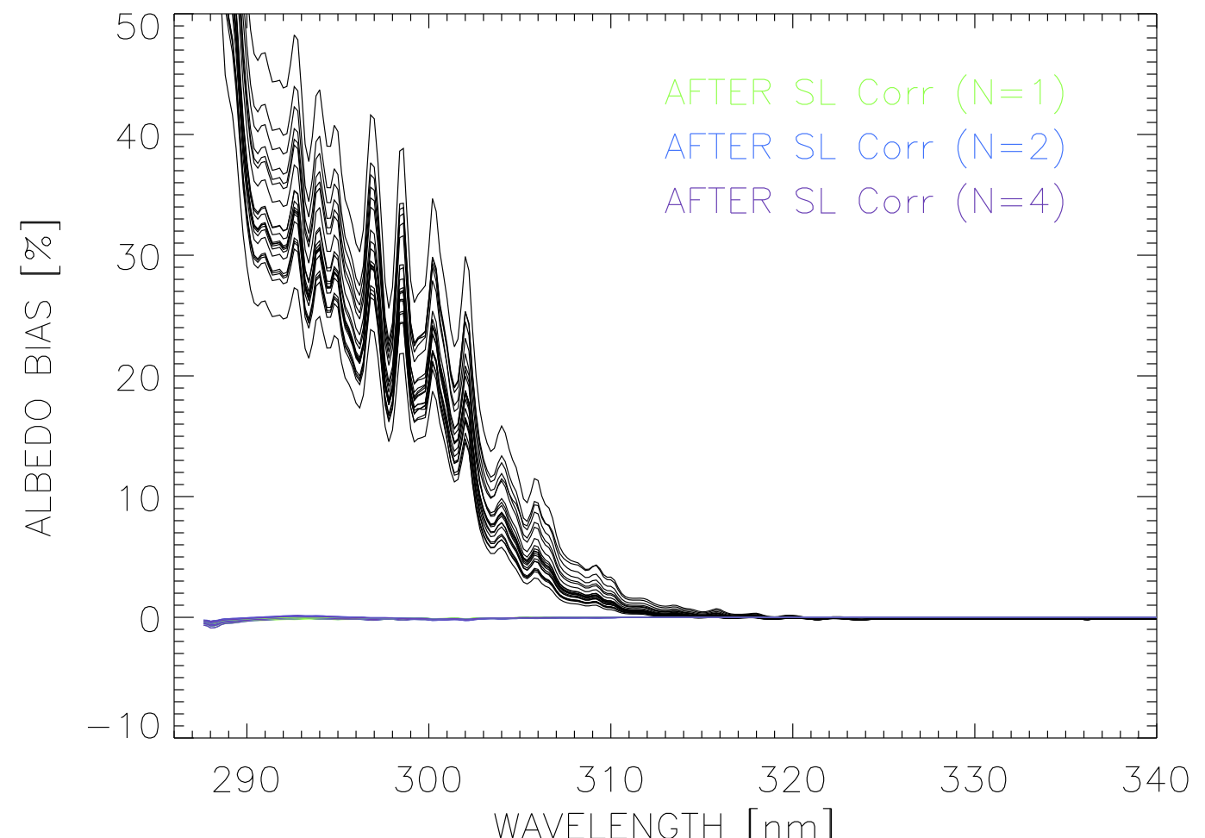
Stray Light Correction
2-D Point Spread Functions (PSF) at selected λ and N/S positions interpolated to every pixel
  Using the wings as core is included in the instrument slit function
  Use iterative Richardson-Lucy de-convolution (Fish et al., 1995, JOSA)
  Account for out of band (OOB) and out of field (OOF) stray light
1-D (spectral) PSF interpolated to every spectral pixel

Slide 52
Stray Light Correction
Challenge of extending 1-D to the 2-D PSF: huge matrix and memory/computational demanding
  OMI/TROPOMI/OMPS approach: Group spectral regions to blocks to reduce the matrix, which might not be able to correct for fine spectral structures.
  Use average PSF for the entire CCD by neglecting the spectral and spatial variation, use Fast Fourier Transform to speed up the calculation
There might have some un-illumilated spatial/spectral pixels that can be used to monitor OOF and OOB stray lights

Slide 53
Spectral Calibration
Initial wavelength registration and slit functions from pre-launch characterization
  Solar measurements: cross-correlation with solar Fraunhofer lines to update the slit functions and perform wavelength calibration → derive look-up tables of wavelength shifts vs. optical bench temperature
Radiance measurements: initialize with solar wavelengths after correcting for Doppler shift and temperature-induced changes
  Cross-correlation with solar Fraunhofer lines (including trace gases and Ring effect), too time-consuming to be applied to all pixels → Derive look up tables of wavelength shifts vs. scene inhomogeneity estimated using radiance gradient between this and adjacent pixels (Voors et al., 2006; Noel et al., 2014)
  Use look-up tables of wavelength shift vs. scene inhomogeneity
  Our trace gas/ozone profile algorithms typically include wavelength correction on the pixel-by-pixel basis

Slide 54
Polarization Correction
TEMPO/GEMS: polarization sensitive and does not measure atmospheric state of polarization on orbit
Stokes I = (I, Q, U, V) can be expressed in degree of linear polarization P, angle of polarization χ in the local meridian plane or x’ in the instrument reference frame (θ: latitude ΦΔ: longitude difference between satellite and given pixel)
Correction to radiance (Sun and Xiong, 2007):
I’ : Intensity reaching the CCD arrays
h : Transmittance
I : Intensity reaching the diffuser
f: instrument polarization sensitivity
a : Degree of polarization
Φ : Angle of maximum transmission
Χ: Phase angle of polarization w.r.t. instrument’s reference plane
I_{max}: maximum transmission
I_{min}: minimum transmission (assume it’s perpendicular to I_{max})

Slide 55
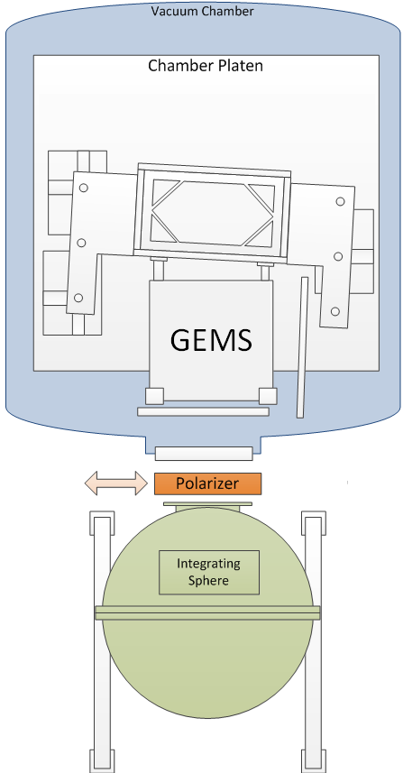
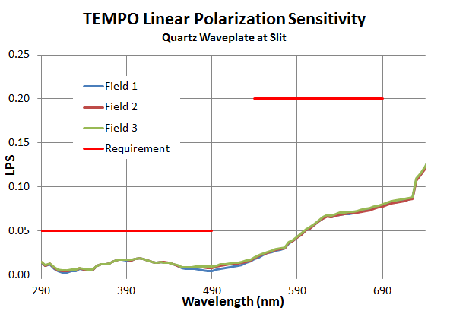
Polarization Correction
  TEMPO/GEMS LPS: using polarization test method: a wire-grid polarizer is placed between the integrating sphere and the instrument. The plane of polarization is varied by rotating the polarizer.
  TEMPO: degree of linear polarization is based on look-up tables of RTM calculations vs. viewing geometry, O₃ profiles (22), surface albedo & pressure

Slide 56
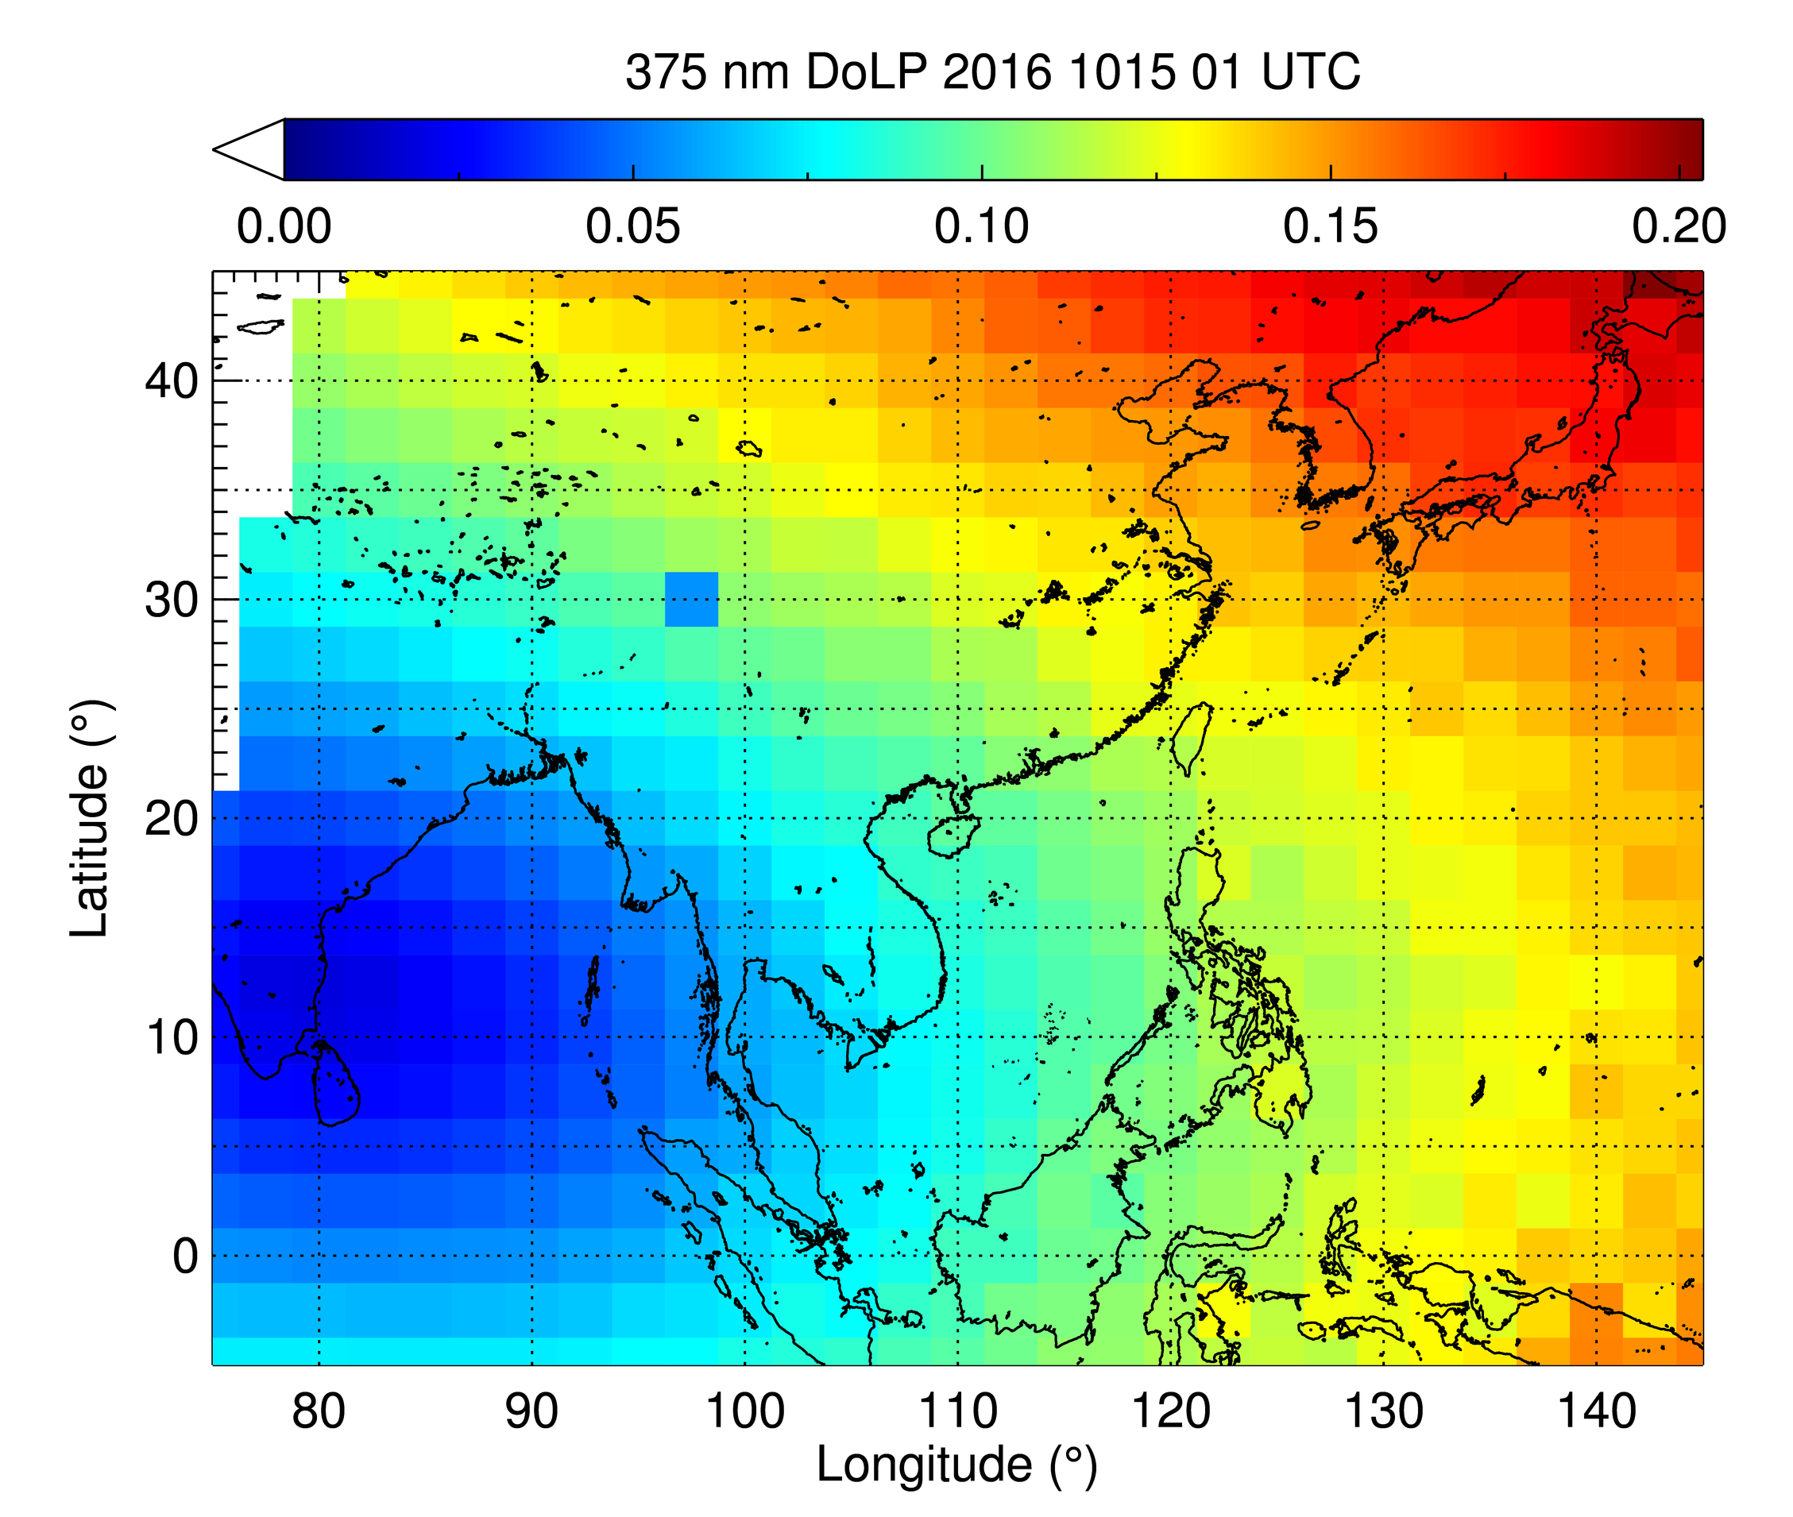
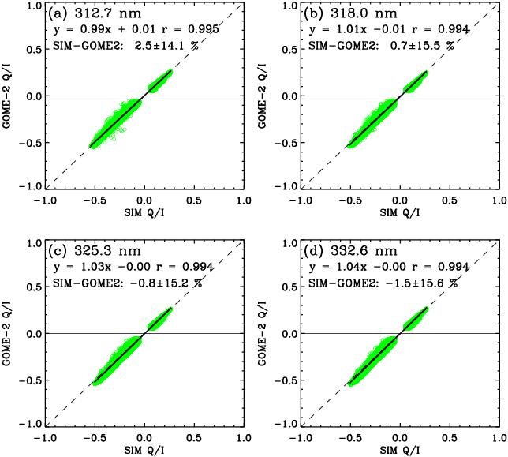
Modeling of Linear Degree of Polarization
Cai et al., JGR, 2012
Compared simulated q with measured q by GOME-2
Simulation of DoLP at 375 nm over the GEMS domain
VLIDORT simulation of q in GOME-2 PMDs 1-4 (UV) agrees very well with measured q, with mean biases less than ±0.05, and 1σ <0.015.
Developed polarization look-up table. Need to optimize the use of look-up table and yet to account for the dependence of polarization on ozone and cloud (using approach similar to first-order total ozone estimate in the TOMS algorithm).

Slide 57
Data product definitions and details
Data Product | Description | Time beyond on-orbit checkout to deliver initial data | Maximum data latency after first release for ≥ 80% of all products†
Level 0 | Reconstructed, Unprocessed Instrument Data | 2 months | Within 2 hours of receipt at SAO
Level 1b | Calibrated, Geolocated Radiances | 4 months | Within 3 hours of Level 0 and ancillary data receipt at SAO
Level 2 | Derived Geophysical Data Products | 6 months | Within 24 hours of production of Level 1 at SAO
Level 3 | Derived Gridded Geophysical Data Products | 6 months | 1 month after completion of data accumulation required for individual geophysical products
Data products are generated in NetCDF4/HDF5 format.
All original observation data and standard science data products listed here shall be delivered to the Atmospheric Science Data Center (ASDC) at NASA LaRc within six months of completion of the prime mission. Data products are publicly distributed during the mission.
†80% of the products, not 80% of the product types, will be produced within this latency time.

