Slide 1






A13F-01A
Tropospheric Emissions:
Monitoring of Pollution
A New Era of Air Quality Monitoring from Space over North America with TEMPO: Commissioning and Early Nominal Operation Results
Xiong Liu¹, Kelly Chance¹, Raid Suleiman¹, John Houck¹, John Davis¹,
Kevin Daugherty², David Flittner², David Rosenbaum², Crystal Fenn²,
Gonzalo Gonzalez Abad¹, Caroline Nowlan¹ , Huiqun Wang¹, Heesung Chong¹, Weizhen Hou¹, Junsung Park¹, Christopher Chan Miller¹, Juseon Bak¹, Jim Carr, James Szykman, Mike Newchurch, Aaron Naeger,Ronald Cohen,Zolal Ayazpour¹,
Christopher Brown², Zachary Fasnacht, Marcellin Feasson¹, Jean Fitzmaurice¹, Jeffrey Geddes, David Haffner, Jay Herman, Joanna Joiner, Laura Judd,
Emma Knowland, Xuming Lei, Nischal Mishra², Robert Neece², Ewan O'Sullivan¹,
Brad Pierce, Wenhan Qin, Eric Roback², Justin Strickland², Robert Spurr,
Luke Valin, Alexander Vasilkov, Eun-Su Yang, and the TEMPO Team
¹CfA | Harvard & Smithsonian
San Francisco, CA, December 11, 2023

Slide 2

Introduction to TEMPO
NASA’s first Earth Venture Instrument (EVI) selected in 2012
PI: Kelly Chance, Smithsonian Astrophysical Observatory (SAO): Science team, ground systems, science data processing center
Instrument Project Management: NASA LaRC → SAO (Phase E)
Instrument Development: Ball Aerospace
Other Institutions: NASA GSFC, NOAA, EPA, NCAR, Harvard, UC Berkeley, St. Louis U, UAH, U Iowa, Sitting Bull College, RT Solutions, Carr Astronautics
International collaboration: Mexico, Canada, Cuba, Korea, U.K., ESA, Spain
NASA’s first host payload
  Mission Project Management: NASA LaRC
  Host Satellite Provider: Maxar Technologies
  Satellite Host: Intelsat (IS-40e)
  Launch: SpaceX
TEMPO: It’s about Time!

Slide 3
TEMPO Commissioning
TEMPO commissioning: SAO + LaRC + Intelsat + Maxar + Ball + Carr Astronautics
  TEMPO power on 6/7
  Dry out (6/9-7/9) and cool down (7/10-7/12)
  First light (7/31-8/2): working/reference diffuser solar & Earth imaging
  Instrument Characterization and Analysis (ICA) activities
  Coordinate with AGES+ campaigns in Aug. and Coastal Texas Air Quality Field Campaign in Sep. (no Earth imaging for only 6 days, special observations over LA and Texas)
Nominal operation: started on 10/19 after successfully passing the Post Launch Acceptance Review (PLAR) on 10/18-19
A13F-02, Suleiman et al.
TEMPO
Power On
Launch
First Light
PLAR
L+0 (4/7/23)
L+61 days (6/7/23)
L+115 days (7/31-8/2/23)
L+194 days
(10/19/23)
Outgassing
S/C Activity
(TEMPO Off)
TEMPO Commissioning
Nominal Operations
Activation
Instrument Characterization and Analysis

Slide 4
Plan for Nominal Operation & Public Release
Baseline mission (Phase E, 20 months, 10/2023-6/2025), NASA senior/extension review
Data products sent to ASDC for archival and distribution
Early access to data ASDC have been provided to TEMPO Science and Validation Teams
Plan for initial public release of baseline products at ASDC after algorithm verification, product validation, algorithm optimization/improvement: ~2/2024 for L1b, ~4/2024 for L2/L3
Data Product | Description | Time beyond On-Orbit Checkout (OOC) to deliver initial data | Maximum data latency after first release for ≥ 80% of products
Level 0 | Reconstructed, Unprocessed Instrument Data | 2 months | Within 2 hours of receipt at SAO
Level 1b | Calibrated, Geolocated Radiances | 4 months | Within 3 hours of Level 0 and ancillary data receipt at SAO
Level 2 | Derived Geophysical Data Products | 6 months | Within 24 hours of production of Level 1 at SAO
Level 3 | Derived Gridded Geophysical Data Products | 6 months | 1 month after completion of data accumulation required for individual geophysical products

Slide 5
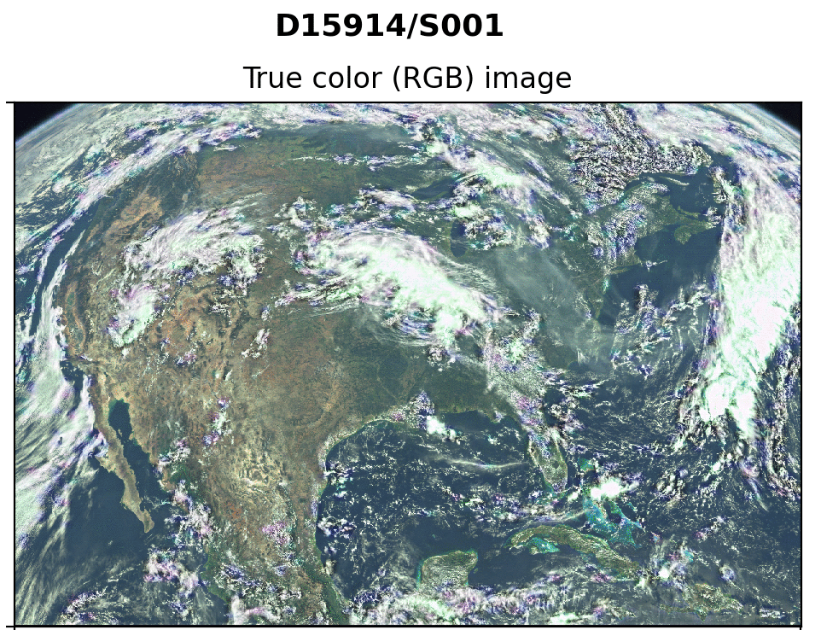

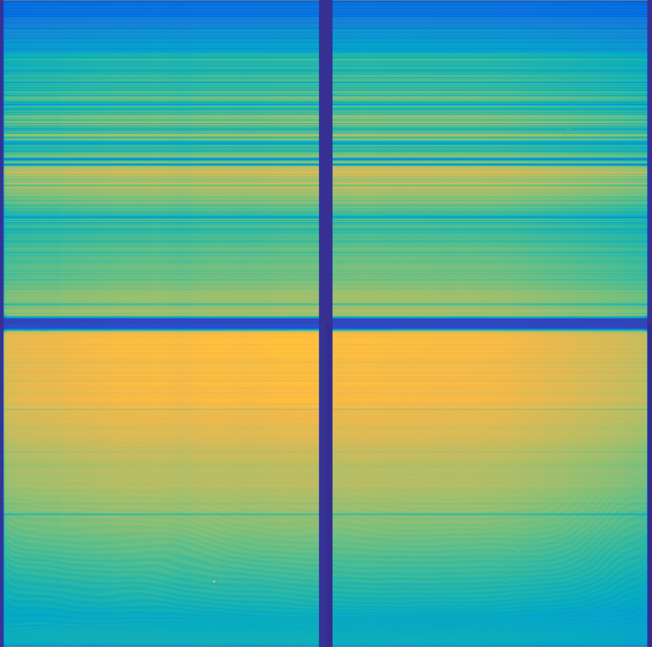
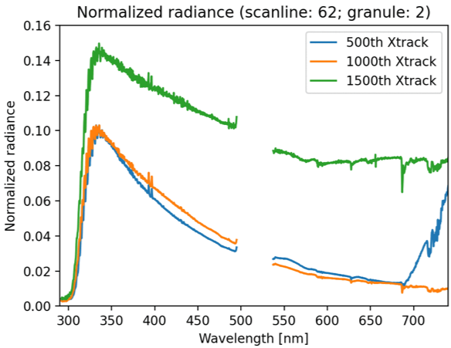
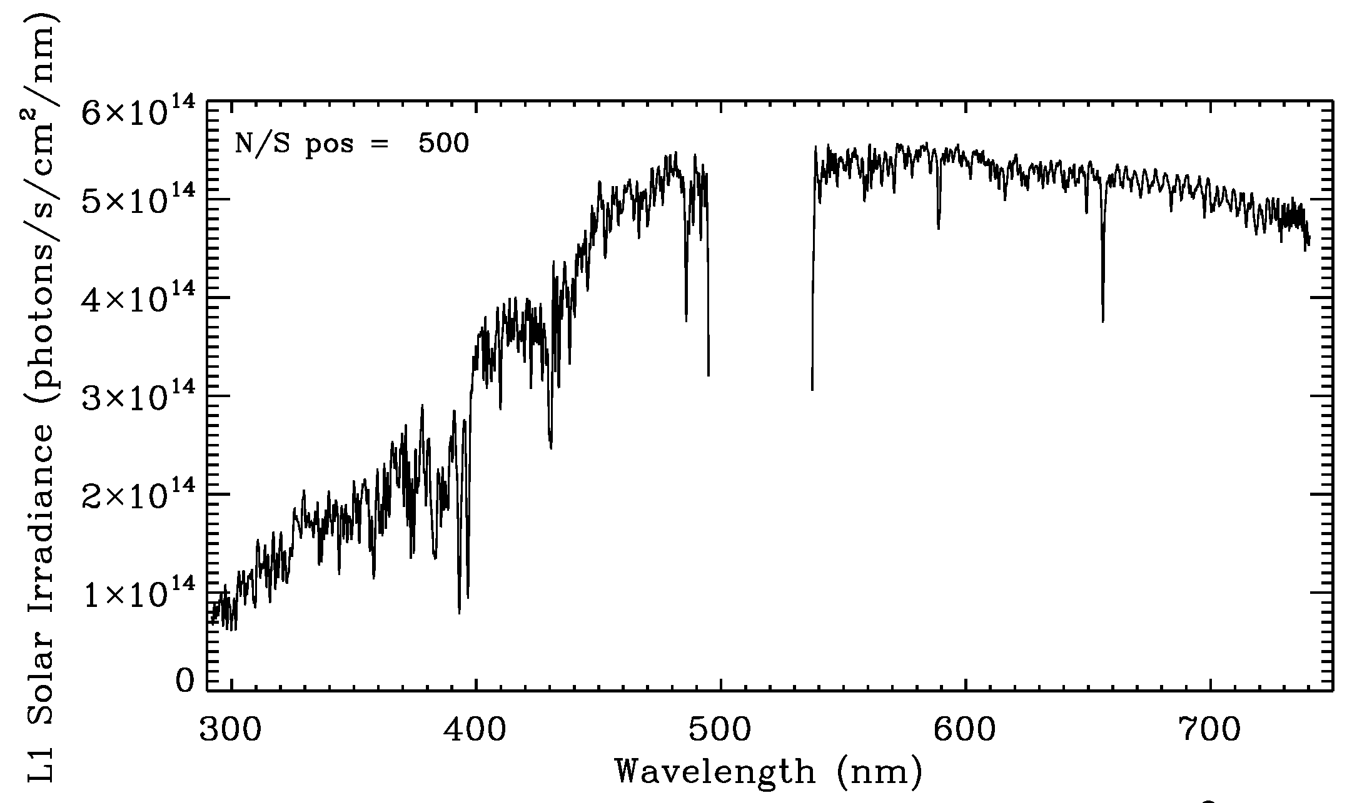
TEMPO Instrument & First Light (8/1-2/2023)
Imaging spectrometer measuring solar irradiance and solar backscattered Earth radiance
~293-494 nm
~538-741 nm
First Light Earth 8/2/2023 @11:13-17:16 ET
RGB Images
First Light Solar
8/1/2023 @12:18 am ET
A11L-2151, Chong et al.
A11L-2150, Hou et al.

Slide 6

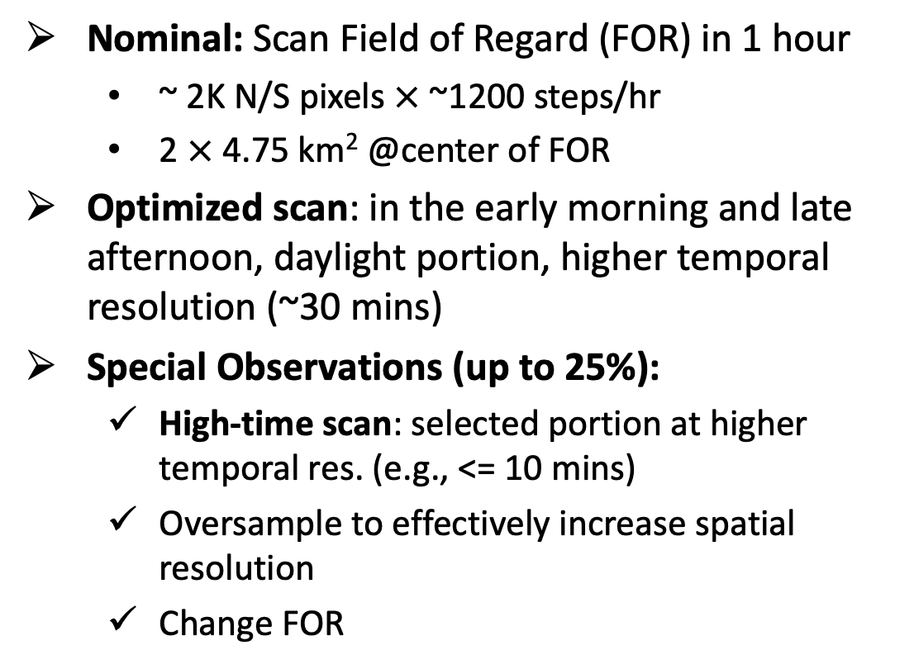
TEMPO Operation
  Operate on geostationary communications satellite Intelsat 40e (IS-40e) at 91 ∘ W
Nominal: Scan Field of Regard (FOR) in 1 hour
  ~ 2K N/S pixels $×$ ~1200 steps/hr
  2 $×$ 4.75 km² @center of FOR
Optimized scan: in the early morning and late afternoon, daylight portion, higher temporal resolution (~30 mins)
Special Observations (up to 25%):
  High-time scan: selected portion at higher temporal res. (e.g., <= 10 mins)
  Oversample to effectively increase spatial resolution
  Change FOR
A11L-2148, Naeger et al.
Field of regard is optimized to cover both Puerto Rico and Canadian tar sands.
S5p-TROPOMI NO₂ product oversampled by Kang Sun.
Request special observation
→https://weather.ndc.nasa.gov/tempo/green_paper.html

Slide 7
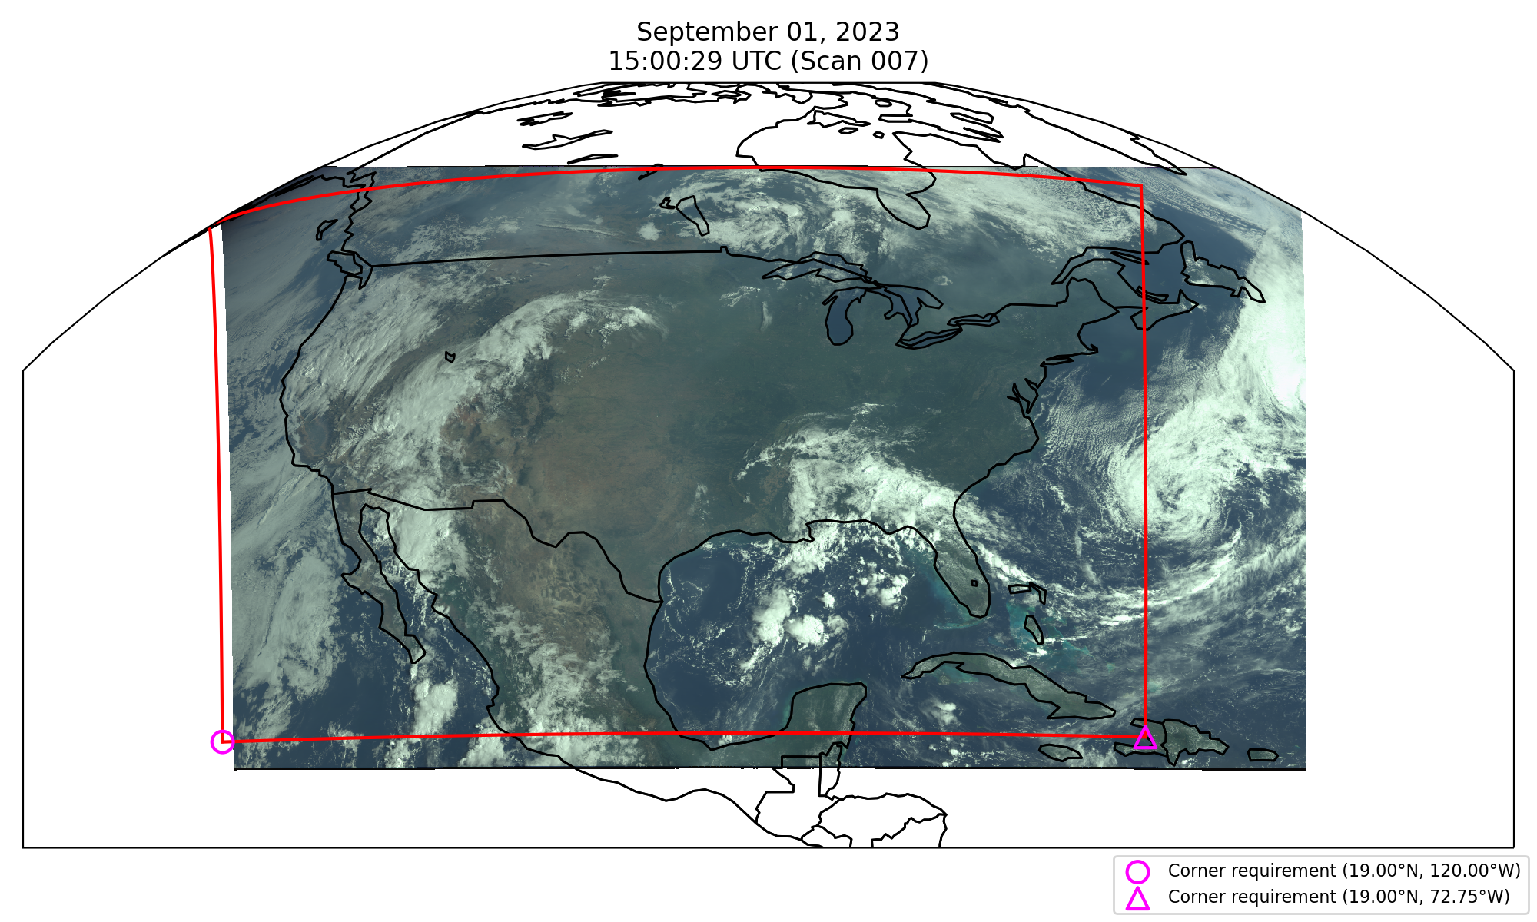
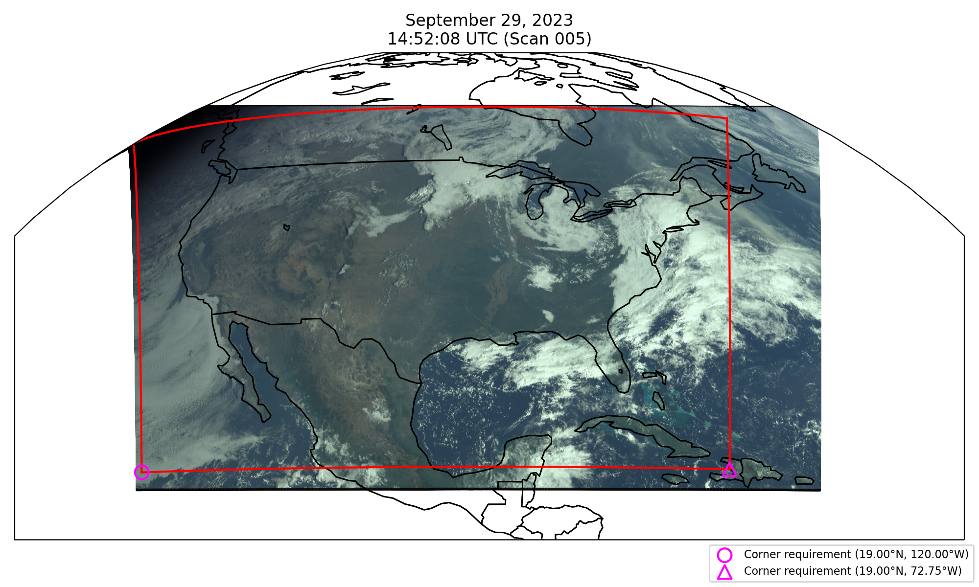
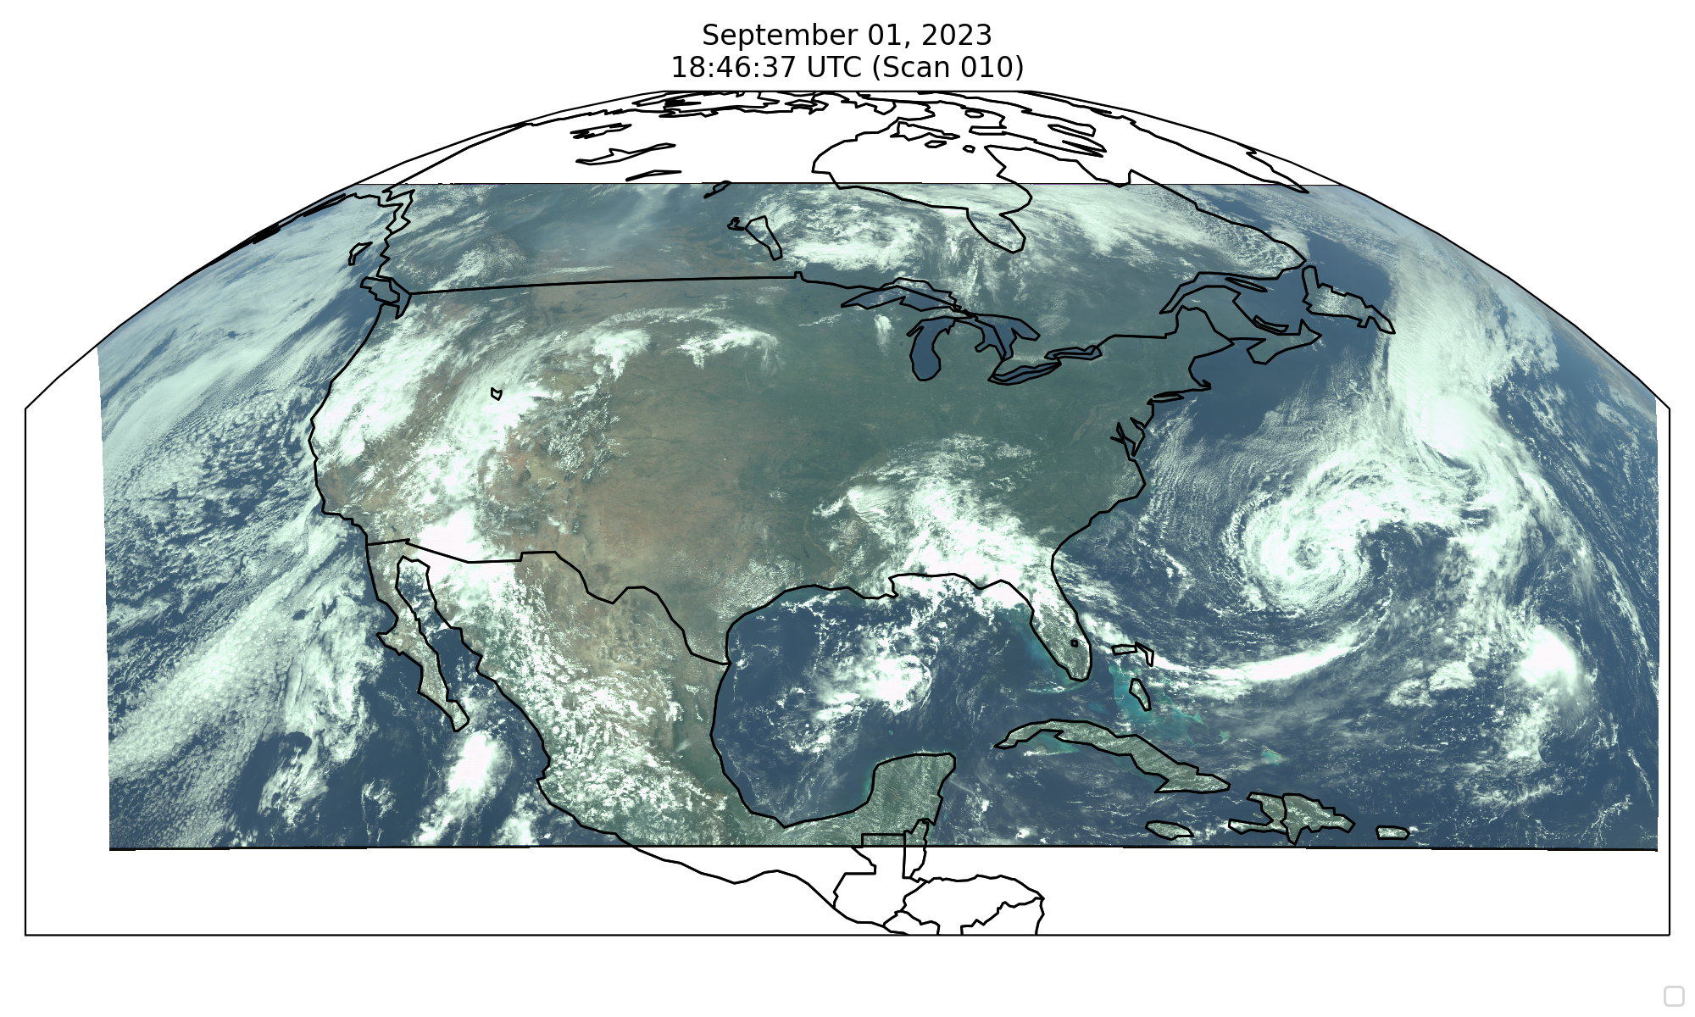
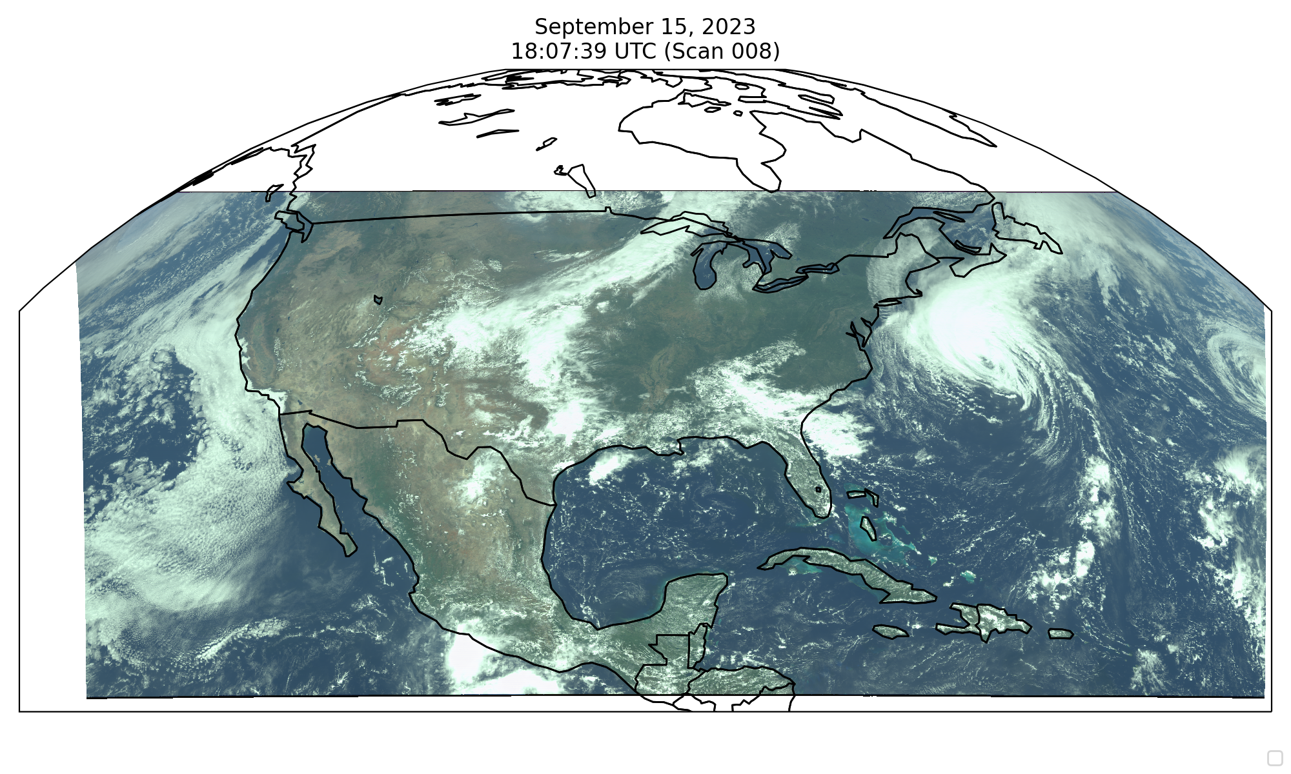
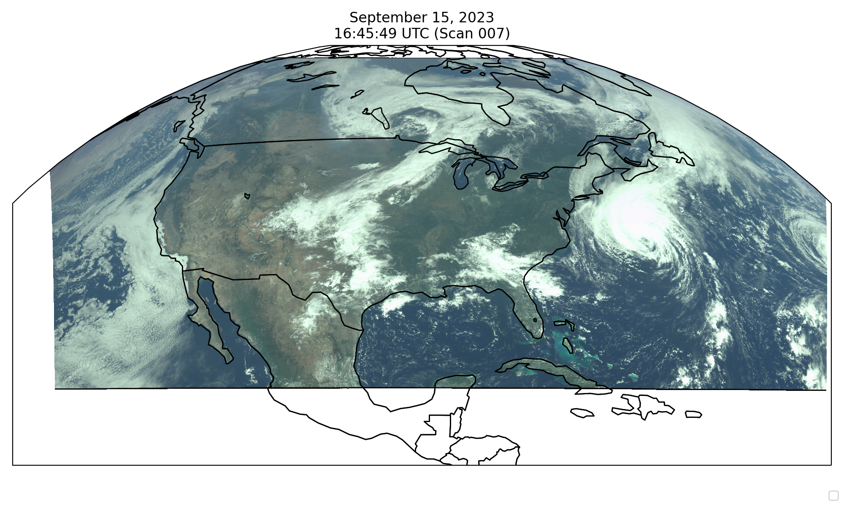
Field of Regard
Requirement
Performance
First light 8/2 field of Regard: 62.7 mins
(100 ms integration time, 26 coadds, 61.5 µrad)
Optimized field of Regard in late Sep.: 59.75 mins
(100 ms integration time, 26 coadds, 64 µrad)
Fields of regard characterization (FOR mapping) with different N-S SMA angles

Slide 8
Baseline and Threshold
Measurements Requirements
Species/Products | Required Precision | Temporal Revisit*
0-2 km O₃ (Selected Scenes) Baseline only | 10 ppbv | 2 hour
Tropospheric O₃ | 10 ppbv | 1 hour
Total O₃ | 3% | 1 hour
Tropospheric NO₂ | 1.0 × 10¹⁵ molecules cm⁻² | 1 hour
Tropospheric H₂CO | 1.0 × 10¹⁶ molecules cm⁻² | 3 hour
* # of hourly measurements to be averaged to achieve required precision
Mission duration: 20 months for baseline, 12 months for threshold
Spatial resolution: < 60 km² for baseline (4 native pixels coadded), < 300 km² for threshold

Slide 9
TEMPO Data Products
Baseline + SNWG TEMPO NRT
Level | Product | Algorithm | Major Outputs | A Priori (L2) | Res km^{2 *} | Freq/Size
L0 | Digital counts | Raw to L0 | Reconstructed/reformatted digital counts |  | 2.0 x 4.75 | Daily/hourly
L1-b | Irradiance ^{NRT} | SAO L0-1 | Calibrated & quality flags |  |  | daily
 | Radiance ^{NRT} | SAO L0-1 | Geolocated, calibrated, viewing, geolocation & quality flags |  | 2.0 x 4.75 | Hourly, granule
L2 | Cloud ^{NRT} | OMI O₂-O₂ | Cloud fraction, cloud pressure | GEOS-CF | 2.0 x 4.75 | Hourly, granule
 | O₃ profile | SAO O₃ profile | O₃ profile, total/strat/trop/0-2 km O₃ column, errors, a priori, AKs | Climatology+GEOS-CF | >= 8.0 x 4.75** | Hourly, granule
 | Total O₃ | TOMS V8.5 | Total O₃, AI, cloud fraction | Climatology | 2.0 x 4.75 | Hourly, granule
 | NO₂ ^{NRT} | SAO trace gas, BU strat./trop. sep. | SCD, strat./trop. VCD, error, shape factor, scattering weights | GEOS-CF | 2.0 x 4.75 | Hourly, granule
 | HCHO ^{NRT} | SAO trace gas | SCD, VCD, error, shape factor, scattering weights | GEOS-CF | 2.0 x 4.75 | Hourly, granule
L3 | Gridded L2 | SAO L2-3 | Same as L2 |  | 5 x 5→ 2 x 2 | Hourly, scan
* Spatial resolution at center of FOR. ** Might be at 8 x 9.5 km²
Satellite Needs Working Group (SNWG) will fund TEMPO NRT products (L2 products < 3 hours from observation time): 1/1/2023-12/31/2025, NOAA GeoXO team to produce TEMPO/GOES-R NRT aerosol products
A11L-2154, Ciren and Kondragunta
A41O-2839, Zhang, Kondragunta, et al.

Slide 10
Algorithm/Data Product Status
First Light NO₂ Images Release (8/24): updates to pre-launch (SDPC v4.0) for (offline/development):
  Use initial wavelength grid for radiance from calibrated first light working solar irradiance
  No straylight correction and polarization correction
  Specialized Image Navigation and Registration (INR)
  Optimization to clouds & NO₂ algorithms
First SDPC update: SDPC v4.1 approved on 10/16, operational on 10/17, L0-1b, cloud, NO₂, HCHO, total O₃ produced and sent to ASDC
  INR: working well meeting science requirements.
  L0-1b: gain/non-linearity, bad pixel map, improved saturation flagging, Octant phase (odd/even)
  Further optimization in cloud and NO₂
  Major changes to HCHO: radiance reference, and background/reference correction
  O₃ profile not ready due to absolute radiometric calibration
SDPC v4.2: approved on 11/17, operational on 11/18
  INR: remove UV/Visible biases, accurate at subpixel level, tested to work for special observation
  Data processing pipeline: more robust, automatically recover from INR crash, other minor updates
  Used to reprocess TEMPO commissioning observations

Slide 11
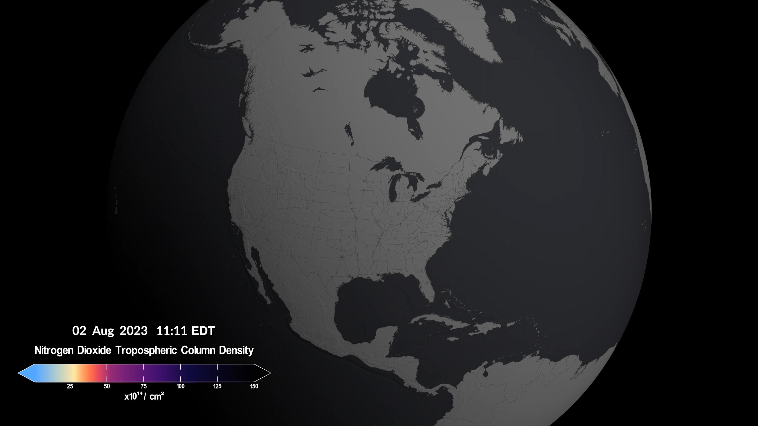
First Light NO₂ (2 August 2023)
A13F-03, Nowlan et al.
Credit: NASA Scientific Visualization Studio
Notes:
Caroline
- First mention these are from first-light. Got a lot of media attention.
I will talk about first light and describe the sources of NO2 as I go along on this slide: transportation, fires, lightning, soils
Mention how we can’t measure below clouds
Will point out these data are novel because we can measure every hour

Slide 12
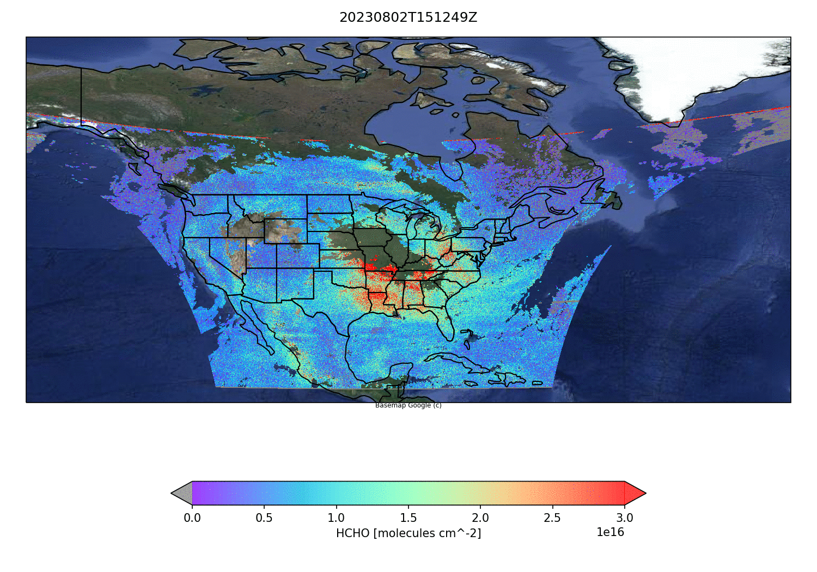
First Light HCHO (2 August 2023)
A13F-04, Gonzalez Abad et al.

Slide 13
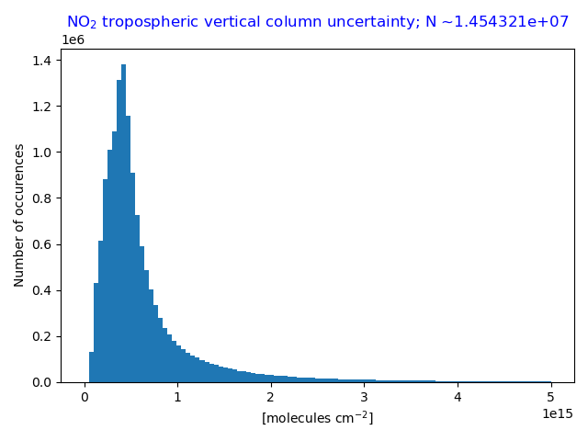
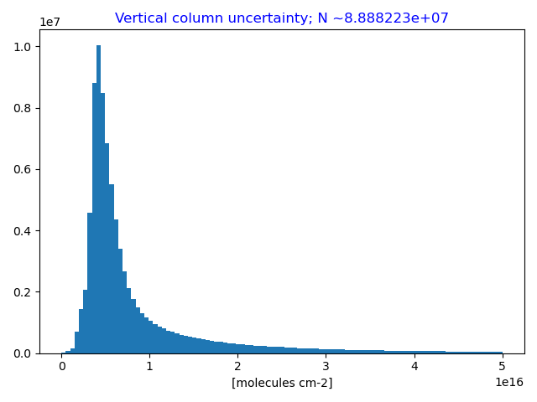
NO₂ Tropospheric Column &
HCHO Column Uncertainties
Single pixel performance
Single pixel performance
Aug. 29-Sep. 1
SZA < 70°
All cloud fractions
All scans
Aug. 29-30
SZA < 70°
All cloud fractions
All scans
Requirement
Coadd 4 pixels
Requirement
Coadd 12 pixels
NO₂ Median uncertainty = 0.46 × 10¹⁵ molecules/cm² (SZA < 70°, all clouds)
HCHO Median uncertainty = 5.5 x 10¹⁵ molecules/cm² (SZA < 70˚, all clouds)
TEMPO NO₂ & HCHO meets requirement for >90% of cloud-free scenes with no pixel coadding!

Slide 14
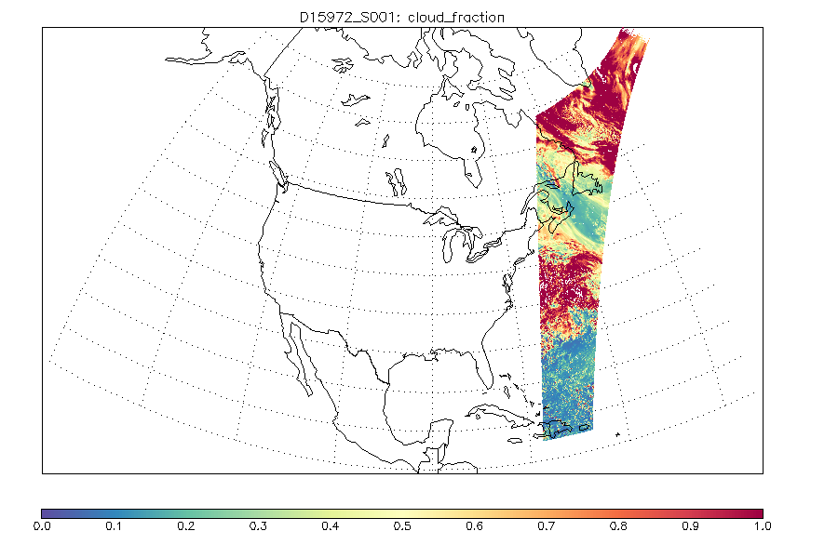
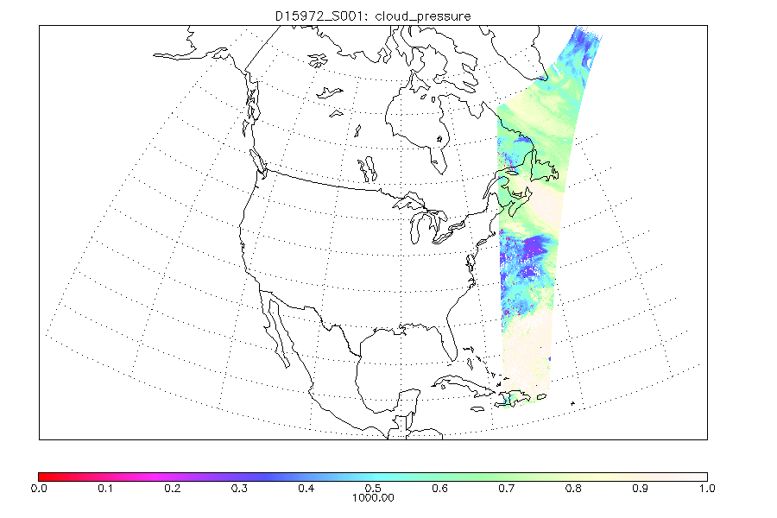
Cloud Products (29 September 2023)
Cloud fraction
Cloud pressure
Saturation causes no retrieval under very cloudy conditions.
A11L-2149, Wang et al.

Slide 15
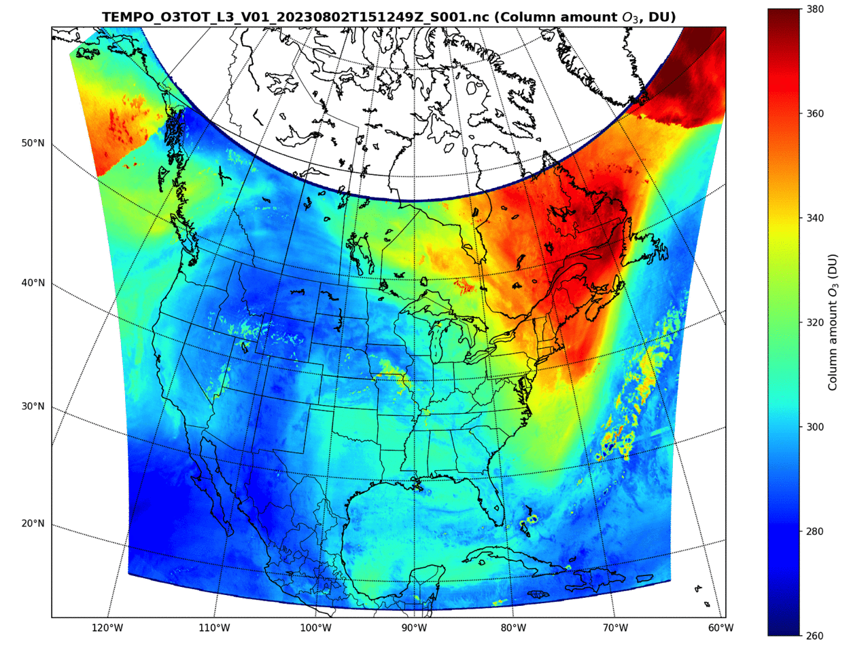
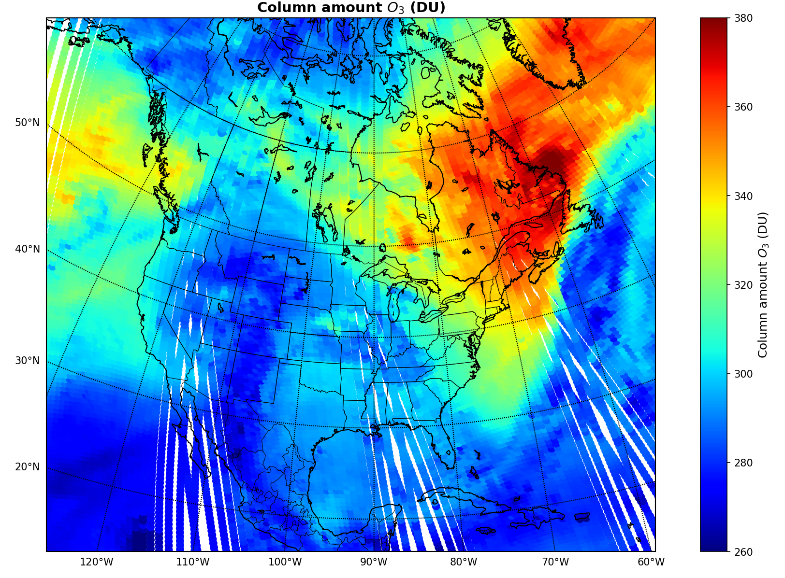
First Light Total Ozone (02 August 2023)
Similar spatial distribution with OMPS total ozone
Total ozone will be further improved with improved radiometric calibration (e.g., image processing, straylight correction)
TEMPO
OMPS

Slide 16
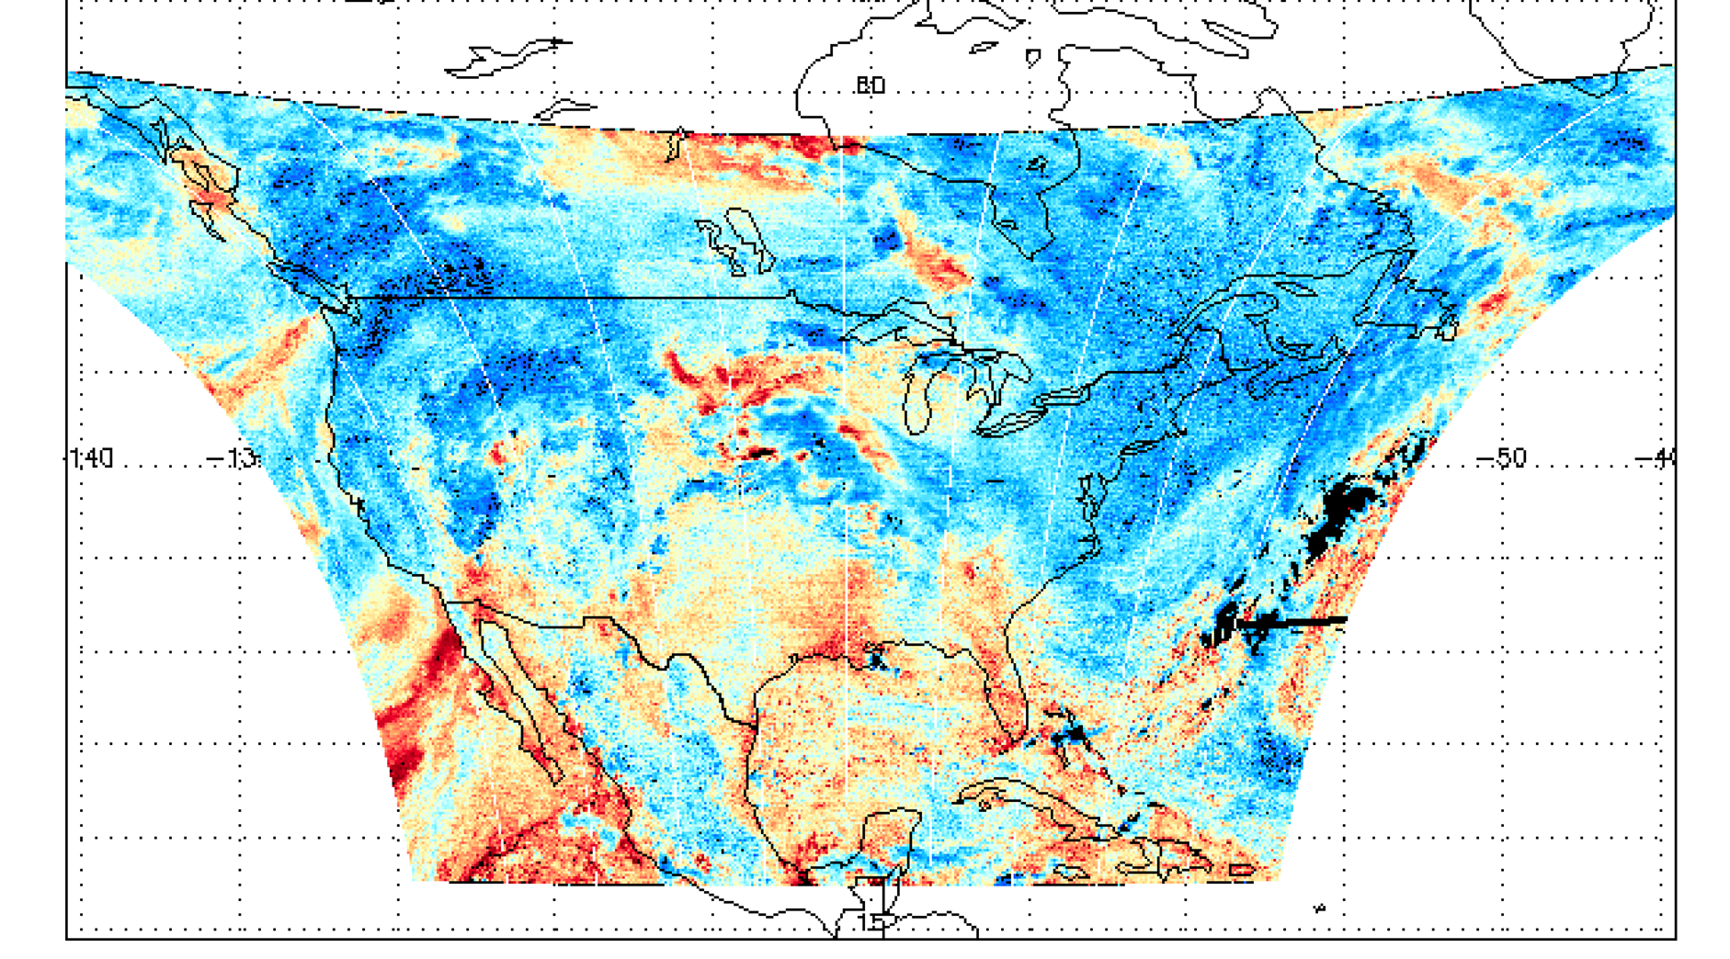
First Light H₂O SCD (2 August 2023)

Slide 17
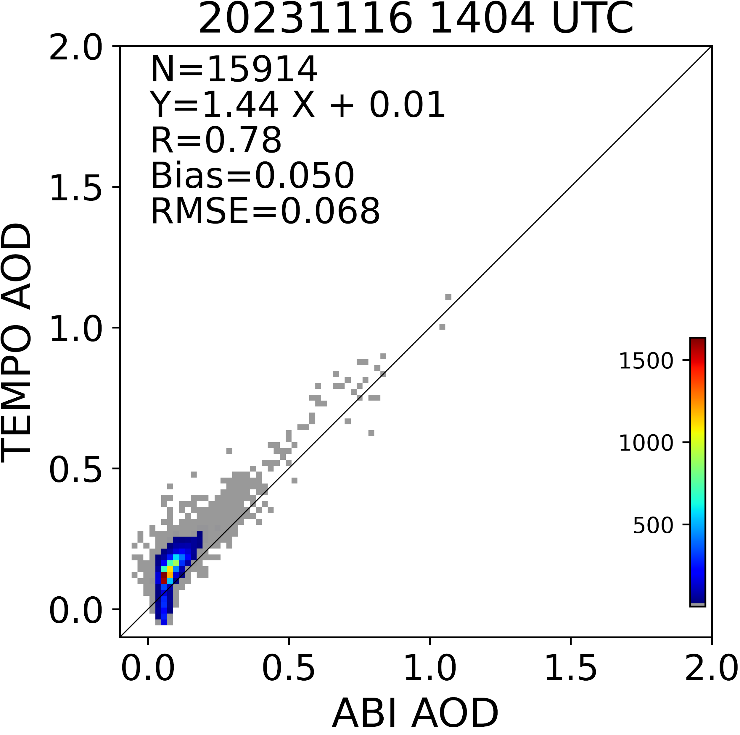
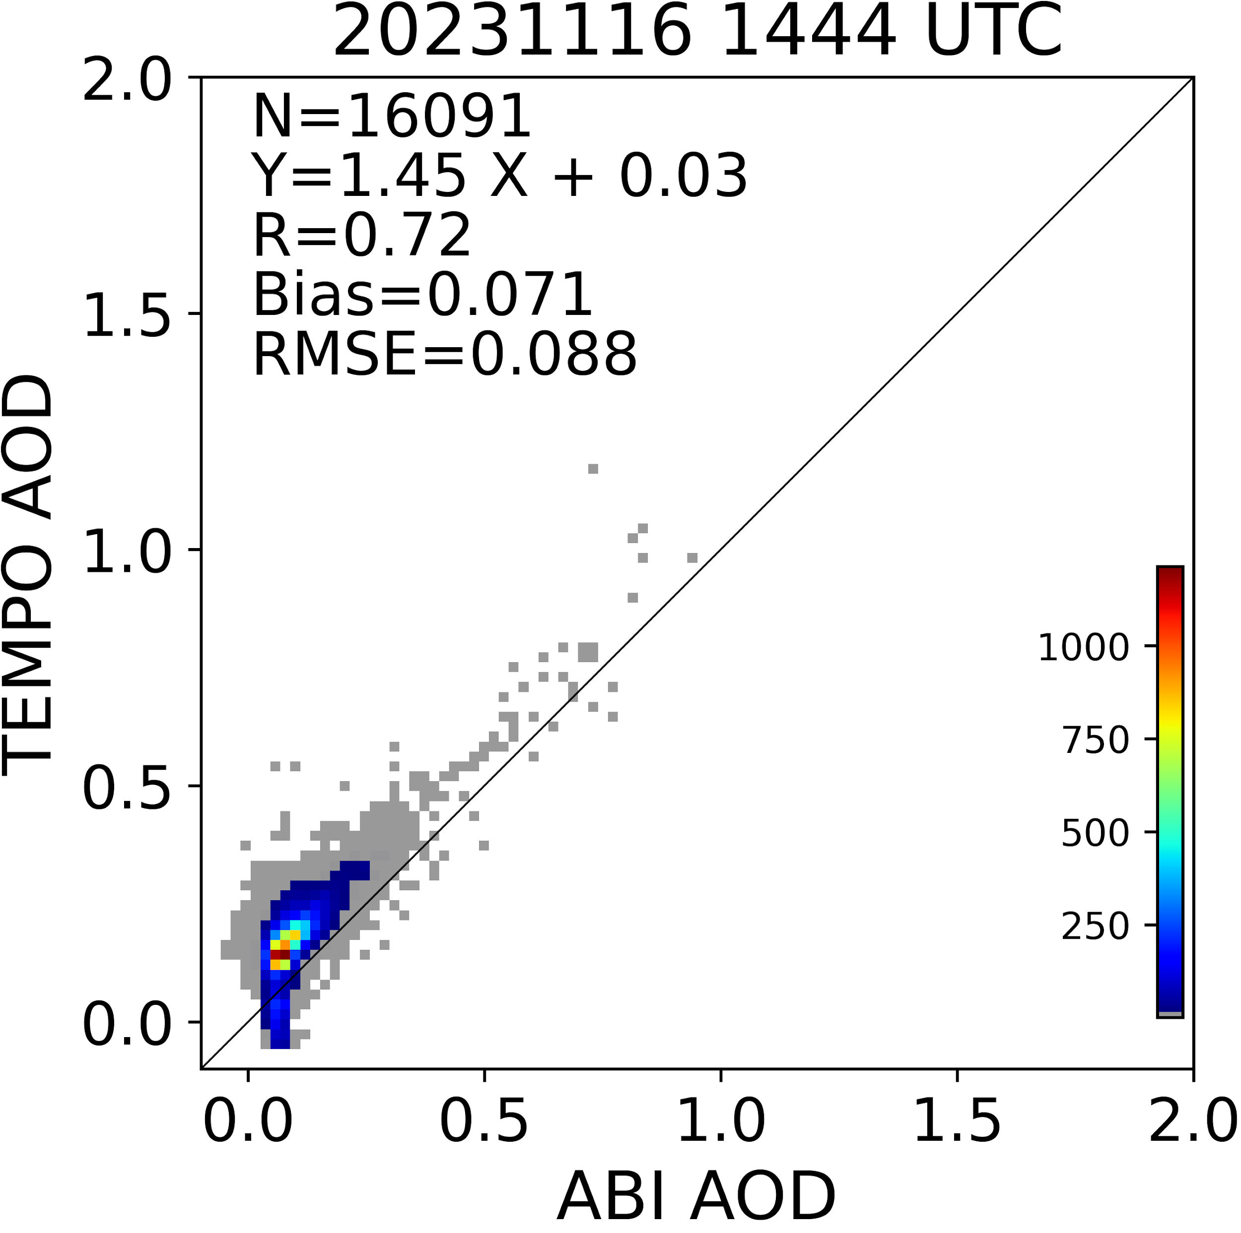
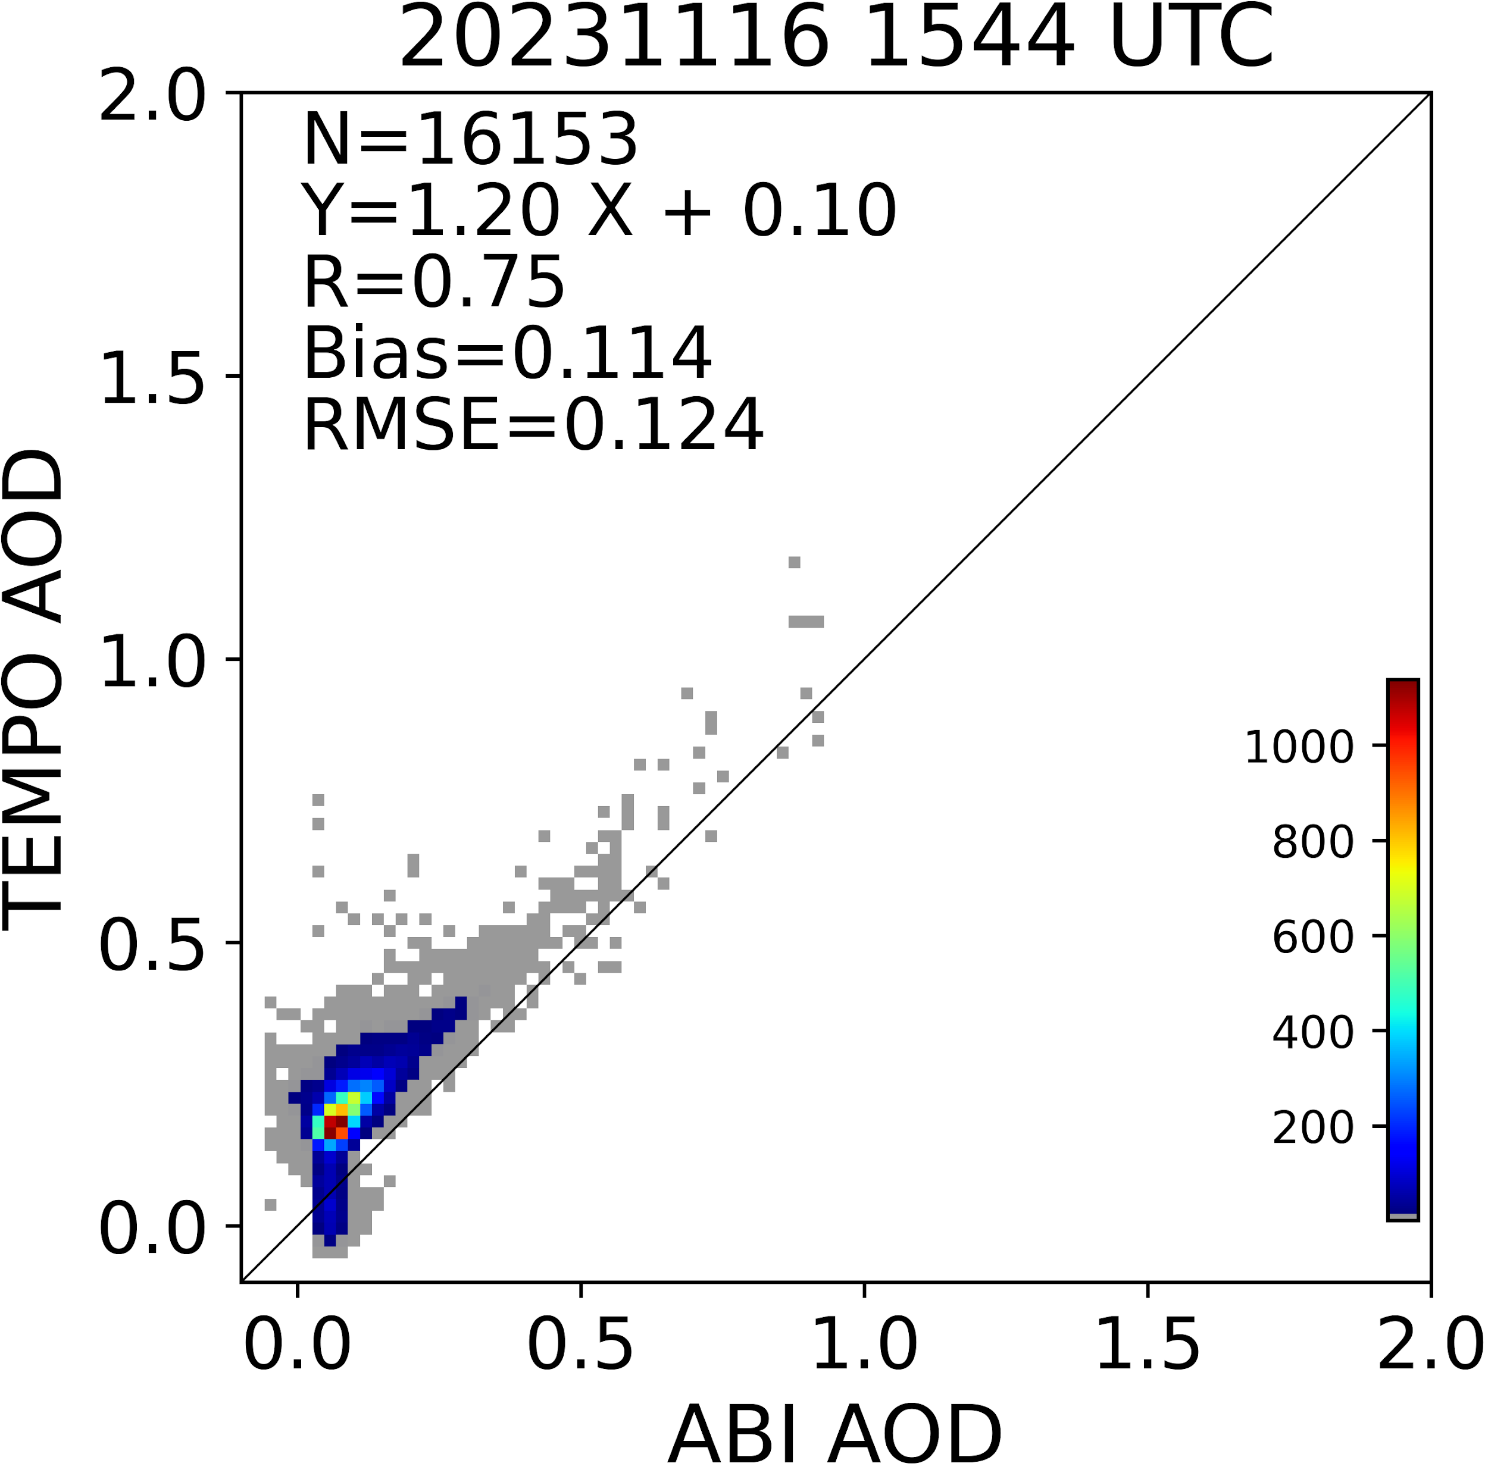
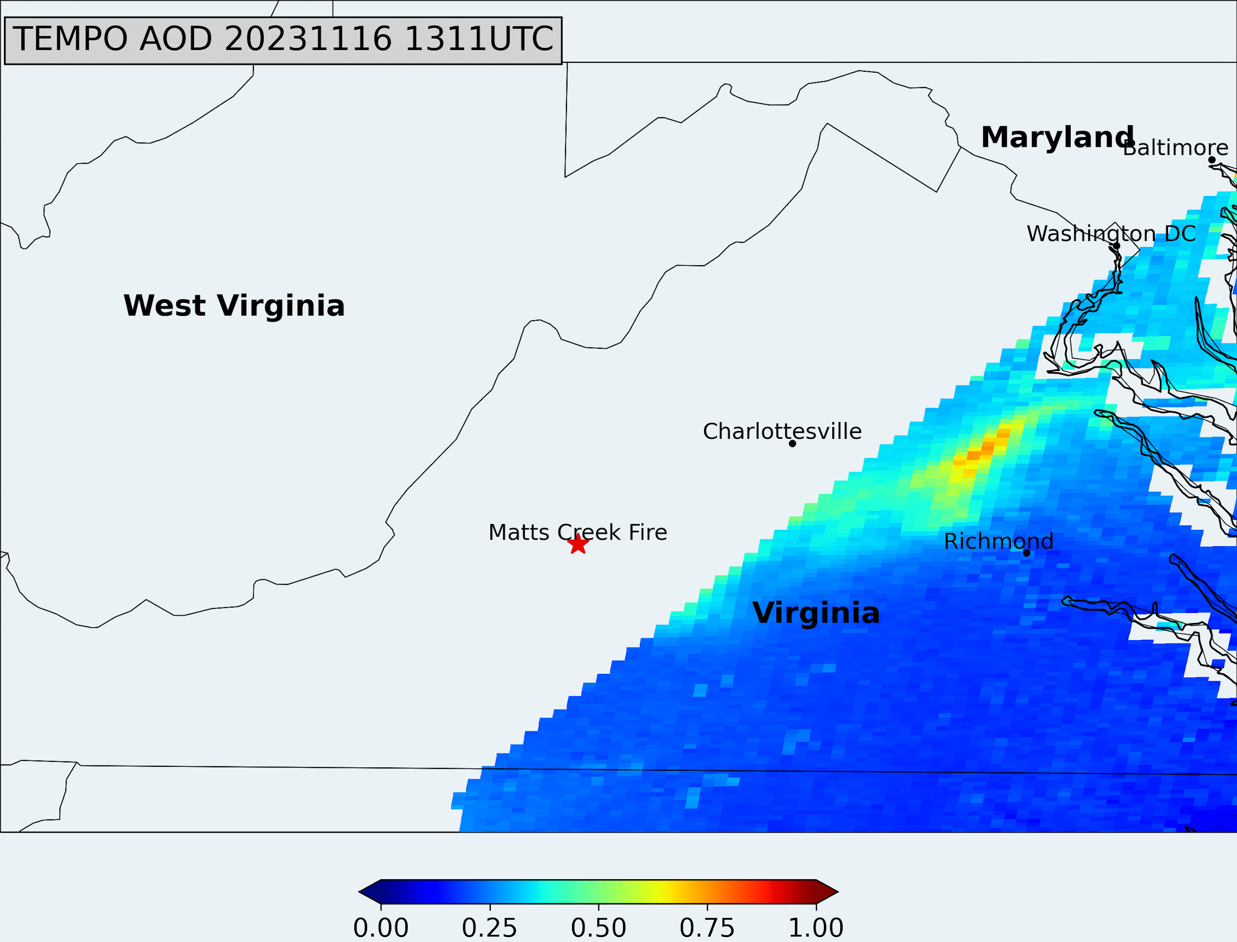
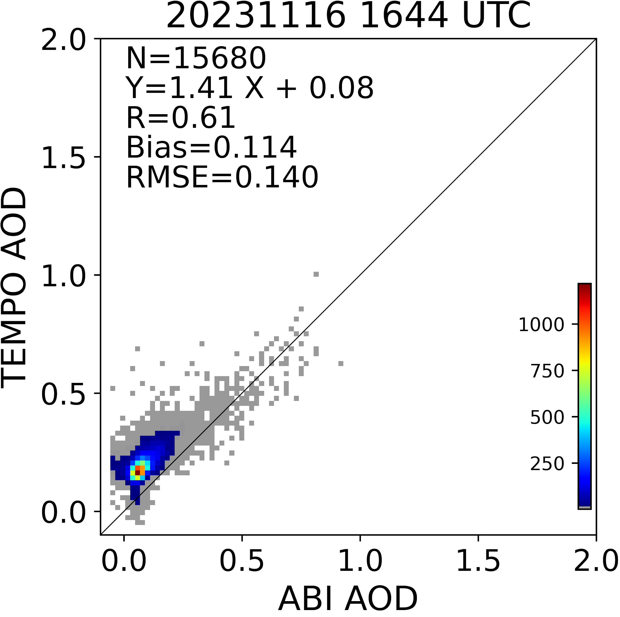
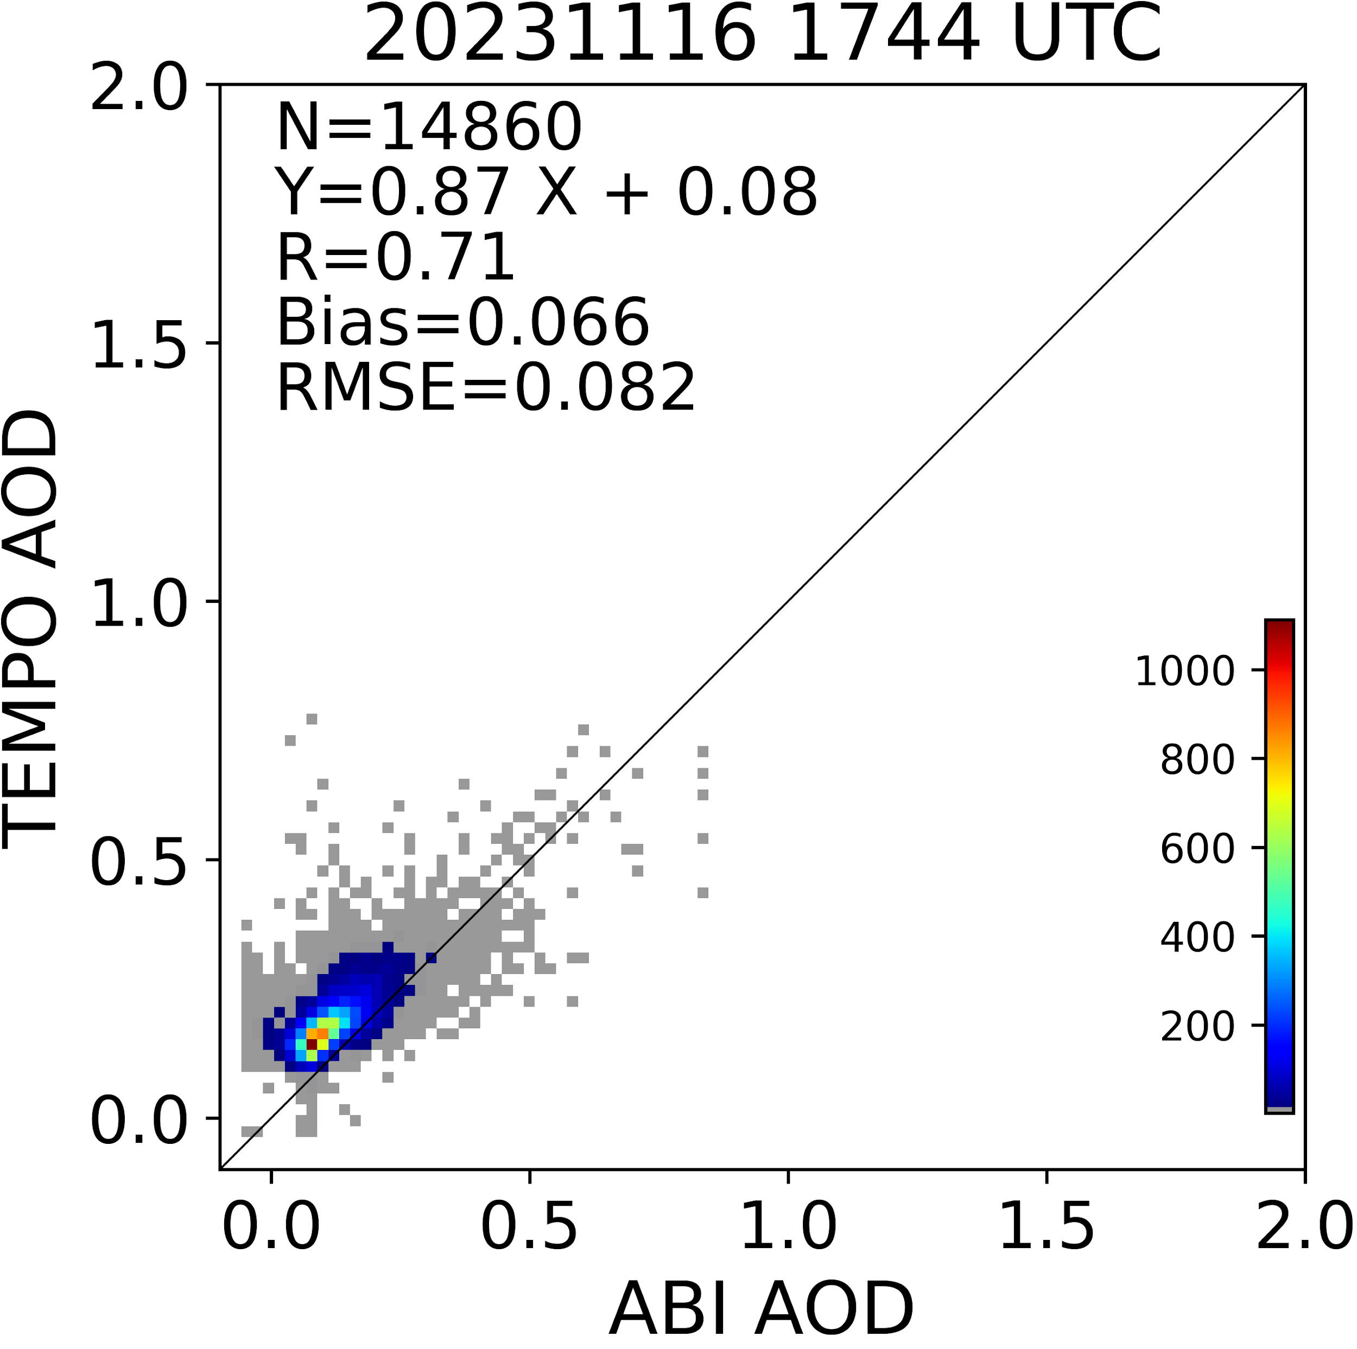
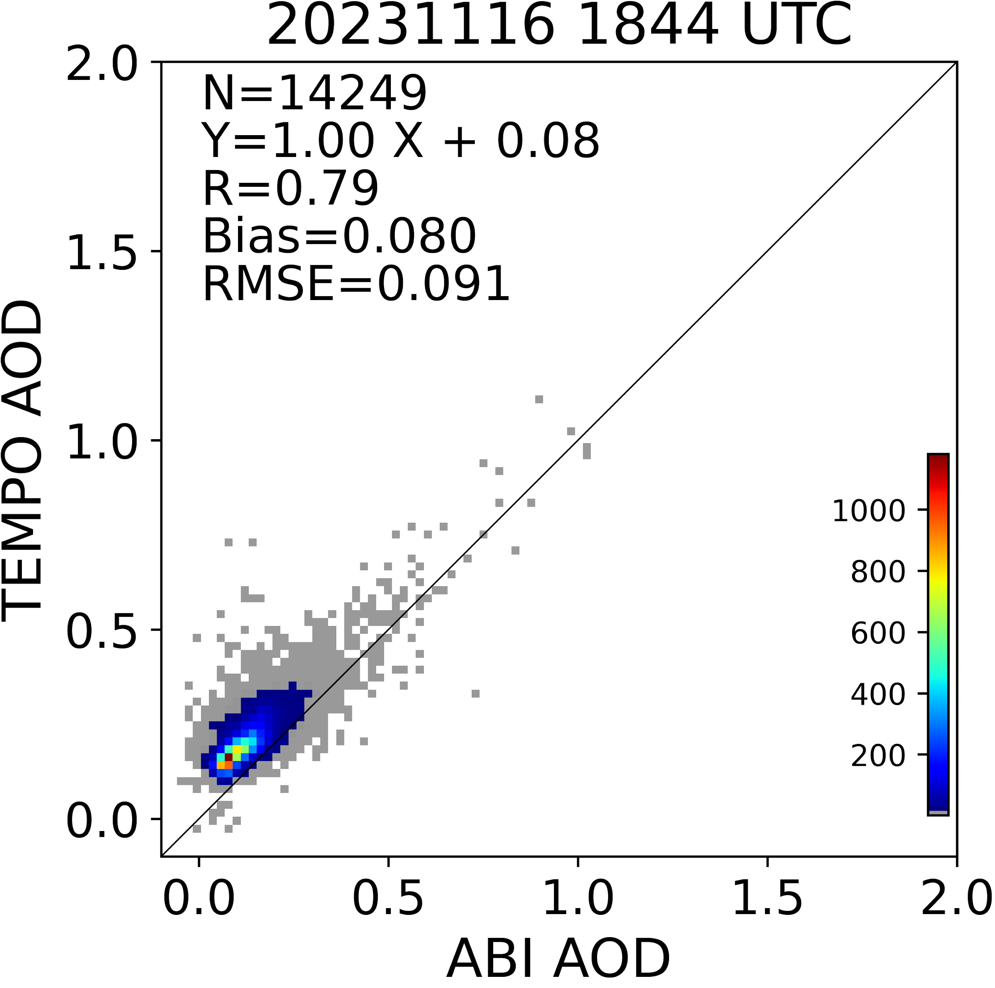
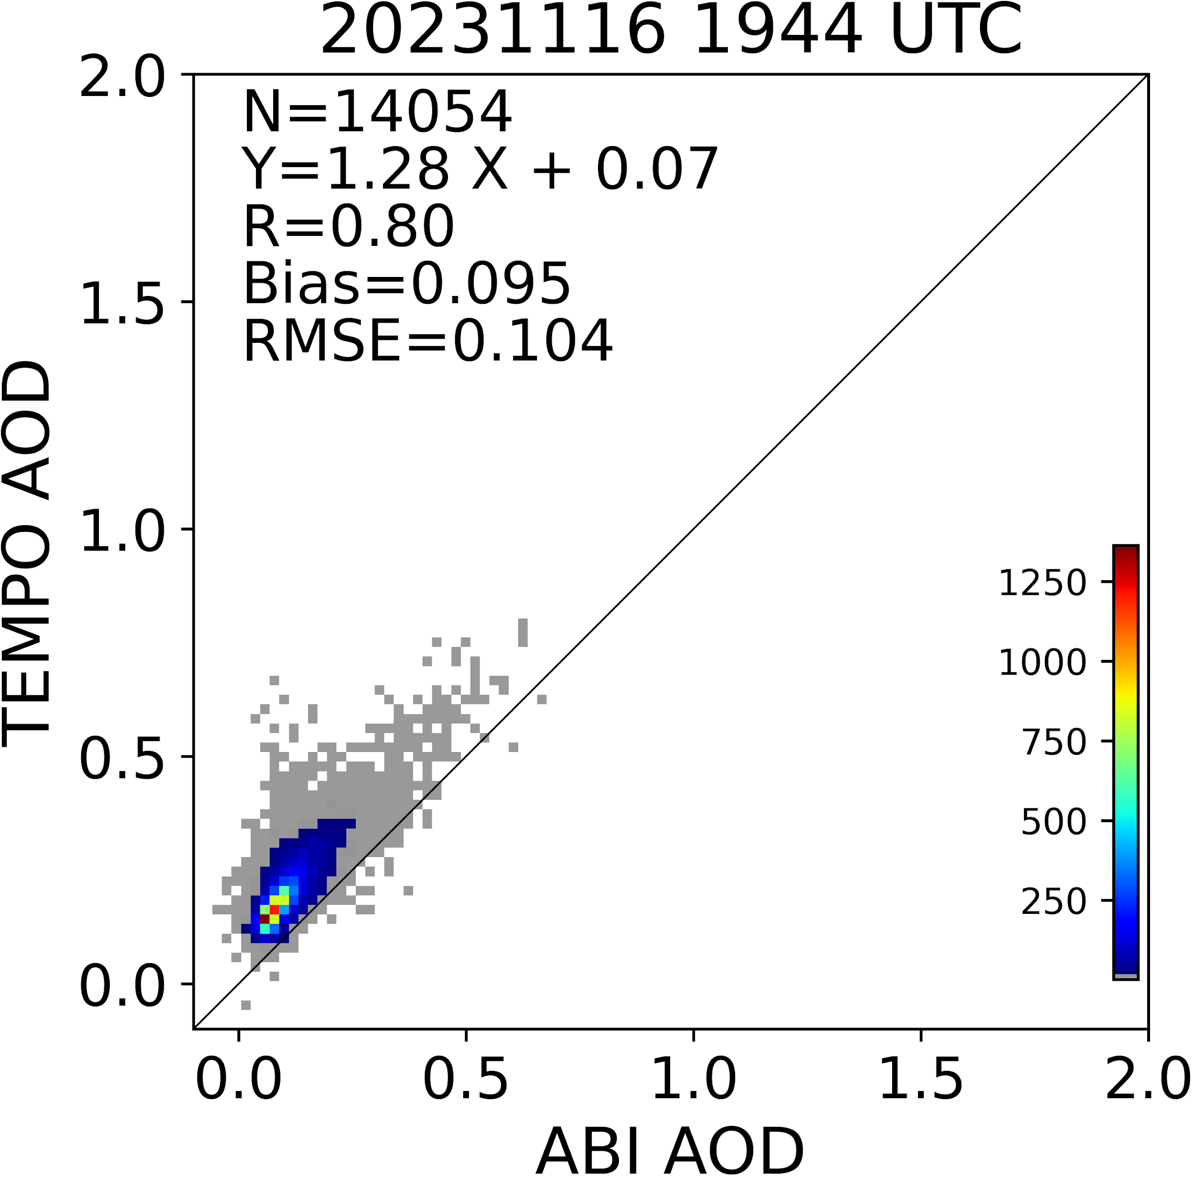
TEMPO AOD vs ABI AOD in the VA fire region
Credits: NOAA GeoXO Team, Pubu, Hai, Zigang and Shobha

Slide 18
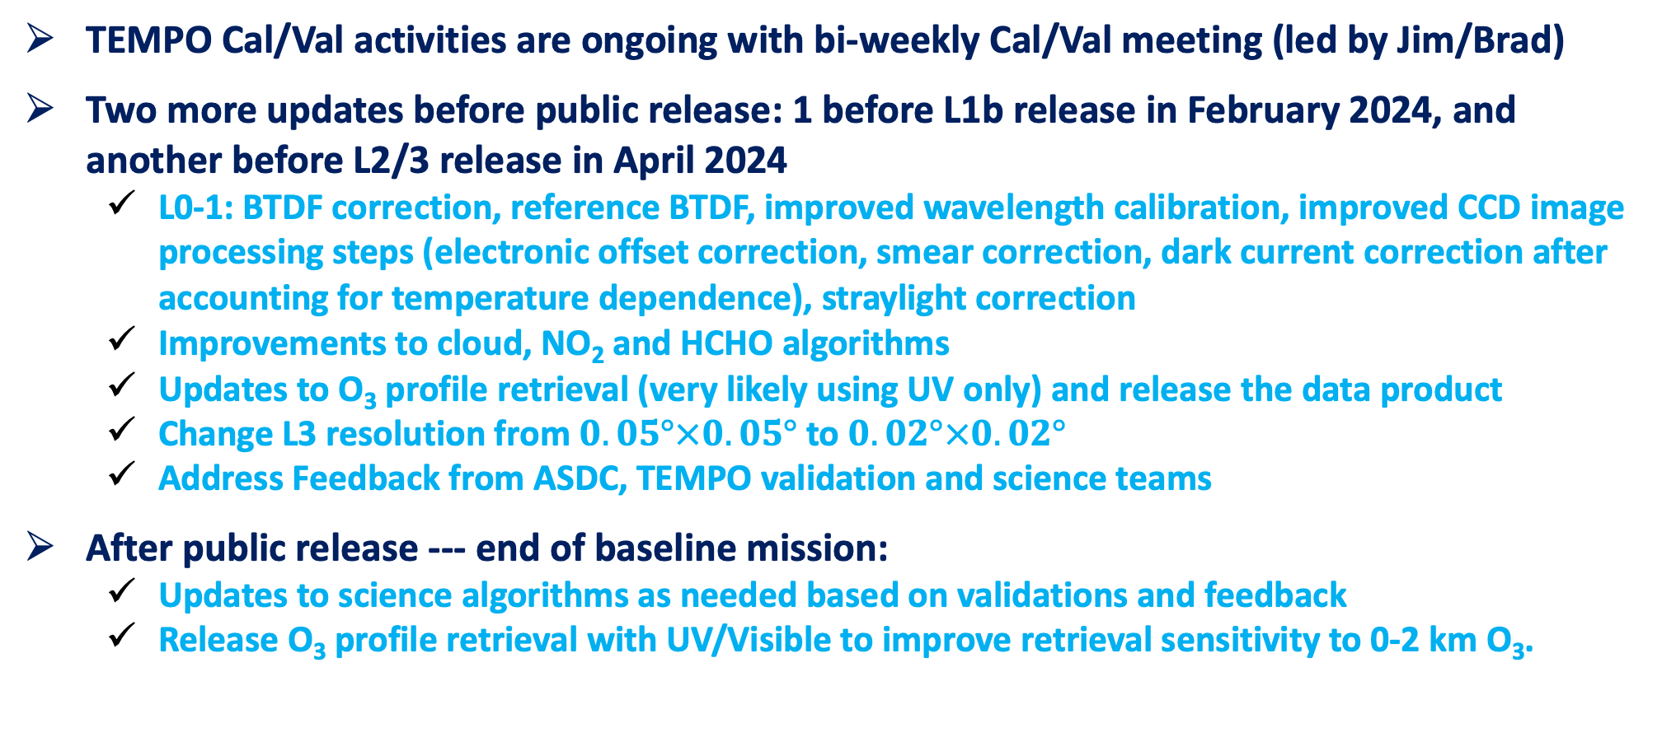
Ongoing and Forward Work
TEMPO Cal/Val activities are ongoing with bi-weekly Cal/Val meeting (led by Jim/Brad)
Two more updates before public release: 1 before L1b release in February 2024, and another before L2/3 release in April 2024
  L0-1: BTDF correction, reference BTDF, improved wavelength calibration, improved CCD image processing steps (electronic offset correction, smear correction, dark current correction after accounting for temperature dependence), straylight correction
  Improvements to cloud, NO₂ and HCHO algorithms
  Updates to O₃ profile retrieval (very likely using UV only) and release the data product
  Change L3 resolution from $0.05°×0.05°$to $0.02°×0.02°$
  Address Feedback from ASDC, TEMPO validation and science teams
After public release --- end of baseline mission:
  Updates to science algorithms as needed based on validations and feedback
  Release O₃ profile retrieval with UV/Visible to improve retrieval sensitivity to 0-2 km O₃.
A11L-2151, Chong et al.
A11L-2150, Hou et al.

Slide 19
Summary
Started nominal operation on Oct. 19 after a successful TEMPO commissioning phase and Post Launch Acceptance Review (PLAR)
TEMPO is providing revolutionary hourly daytime atmospheric pollution measurements at high spatial resolution over North America
Most data products (L1b, cloud, NO₂, HCHO, total O₃) are in good quality at this early stage, showing that the TEMPO instrument and science algorithms are working very well
We have a good understanding about the improvements needed for the ozone profile product before the public release
Calibration and validation activities are being conducted to validate and improve the data products

Slide 20































Slide 22
TEMPO Software/Algorithm Teams
Operational Algorithm | Personnel
Instrument Operation Center (IOC) including Raw-L0 | John Davis
L0-1b | Heesung Chong, John Houck, Weizhen Hou, Xiong Liu, Dave Flittner, Jim Carr
Ozone profile | Xiong Liu, Junsung Park
Total ozone | GSFC / Xiong Liu
Nitrogen dioxide | Caroline Nowlan, Gonzalo González Abad
Formaldehyde | Gonzalo González Abad, Caroline Nowlan
Clouds | Huiqun (Helen) Wang, Eun-Su Yang, Alexander Vasilkov, Joanna Joiner
Science Data Processing Center Operational Implementation & Processing Pipeline | John Houck

Slide 23
Science Algorithms
Launch-ready Science Data Processing Center (SDPC) V4 software completed in Mar 2023
Algorithm mostly based on OMI heritage algorithms except for new L0-1b processor including Imaging Navigation and Registration (INR) using GOES-R by Carr Astronautics
SAO trace gas algorithm (HCHO, NO₂): spectral fitting to derive Slant Column Densities (SCDs), calculate air mass factor (AMFs) and derive Vertical Column Densities (VCDs)
  NO₂ requires stratospheric/tropospheric separation based on spatial filtering method (Geddes et al., 2018)
Cloud algorithm: SAO O₂-O₂ fitting + NASA GSFC’s O₂-O₂ cloud at ~477/466 nm
Total ozone algorithm: heritage TOMS V8.5, using ozone absorbing and non ozone absorbing pairs to derive total ozone column
Ozone profile algorithm: heritage SAO OMI O₃ profile, using 290-340, 540-650 nm, retrieve O₃ profile at 24 layers, including total, stratospheric, tropospheric, and 0-2 km O₃
Main L1-2 algorithms updates include:
  NASA GMAO’s GEOS-CF trace gas profiles and meteorology
  Hourly resolved monthly mean Geometry-dependent Lambertian Equivalent Reflectivity (GLER) climatology

Slide 24
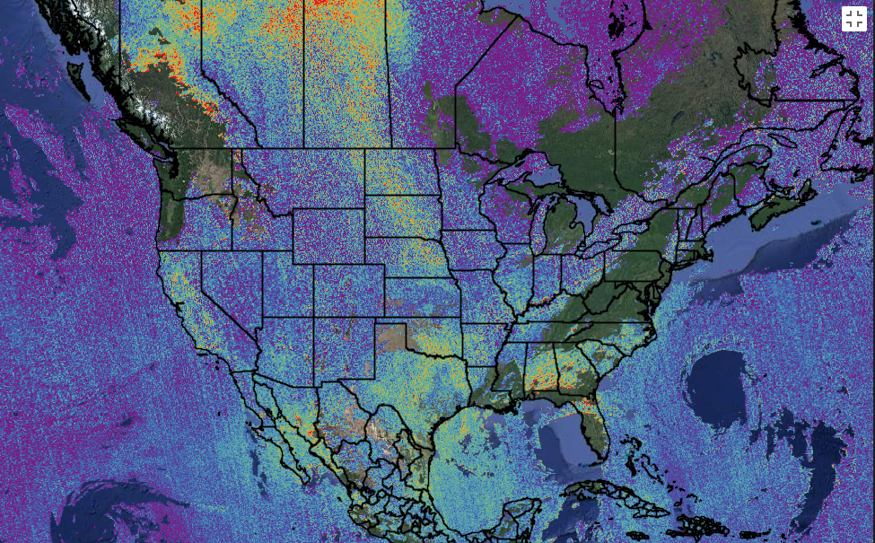
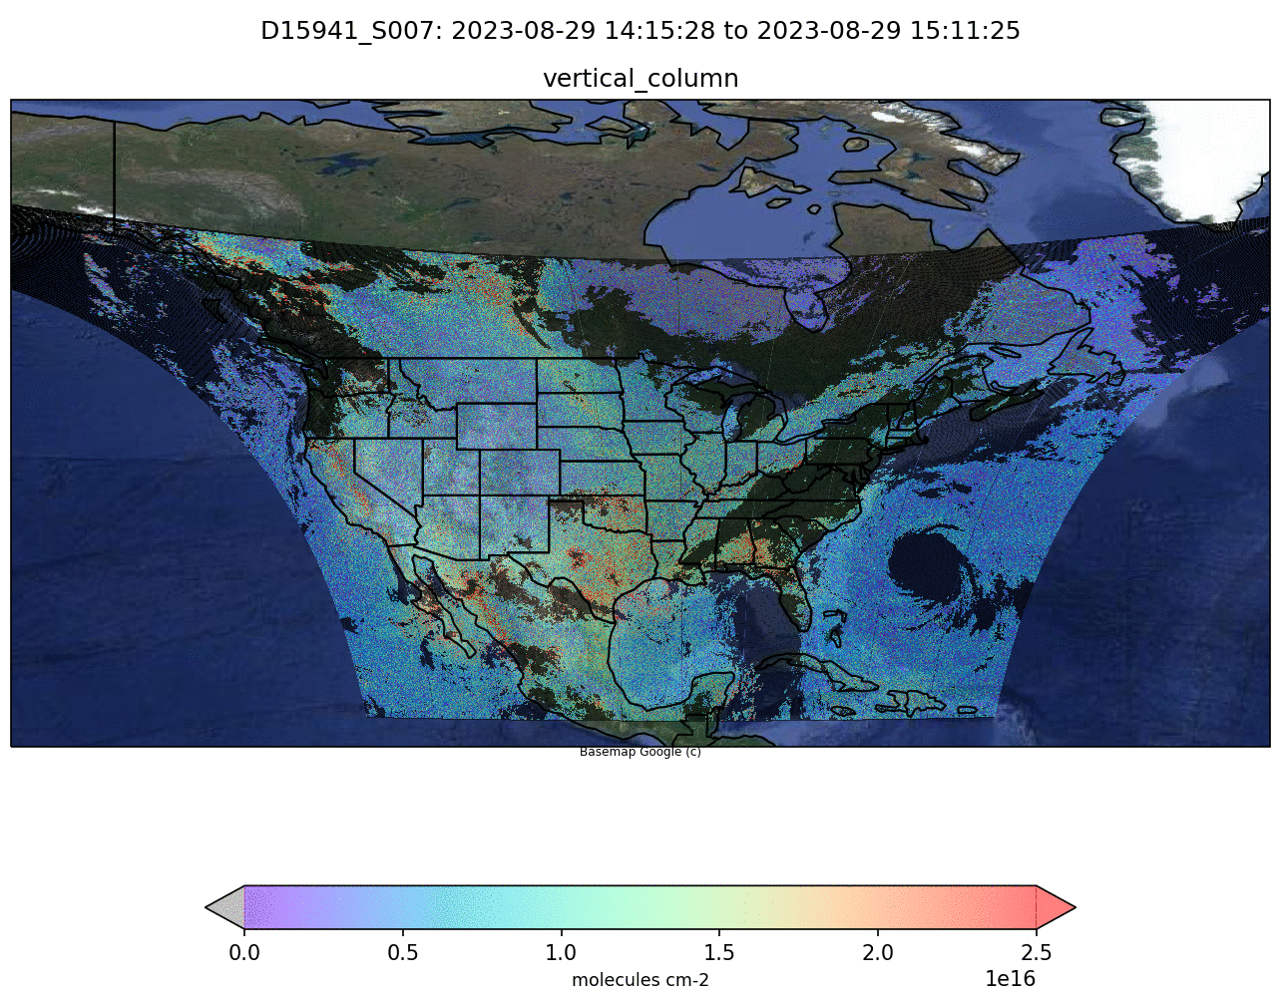
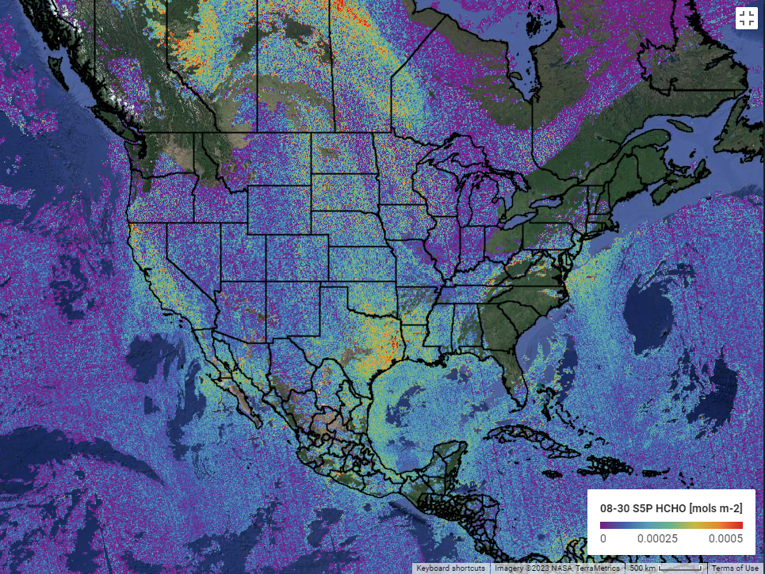
TEMPO and TROPOM HCHO
(29-30 August 2023)
Google Engine S5P HCHO 0829
Google Engine S5P HCHO 0830
TEMPO HCHO 0829-0830 (scans close to S5P overpass)
TEMPO vs TROPOMI shows spatial agreement in HCHO columns. TEMPO shows small noise and almost no striping. Systematic biases are expected associated with AMF, radiance reference and background corrections.

Slide 25
Including Visible to Improve
Tropospheric Ozone Retrieval Sensitivity
This example is for solar zenith angle =25, viewing zenith angle 45, relative azimuthal angle 86, Signal to noise Ratio (SNR) with 4 pixels coadded
Add visible to improve retrieval sensitivity in the lower troposphere and help separate free tropospheric O₃ from boundary layer O₃
Under ideal conditions: 3-5 total Degree of Freedom for Signal (DFS) with up to ~1.5 in the troposphere, and up to ~0.5 DFS in 0-2 km
Adapted from OMI (Liu et al., 2010): Spectral fitting + VLIDORT + Optimal Estimation (OE) from Fitting windows: 293-345 nm, 540-650 nm
Retrieve partial O₃ columns at ~24 layers (bottom layer is 0-2 km above the surface) as well as total, stratospheric, and tropospheric O₃ columns, other trace gases, and auxiliary parameters.
A priori: a combination of tropopause-based climatology (Bak et al., 2013) with diurnally-resolved GEOS-CF data

Slide 26
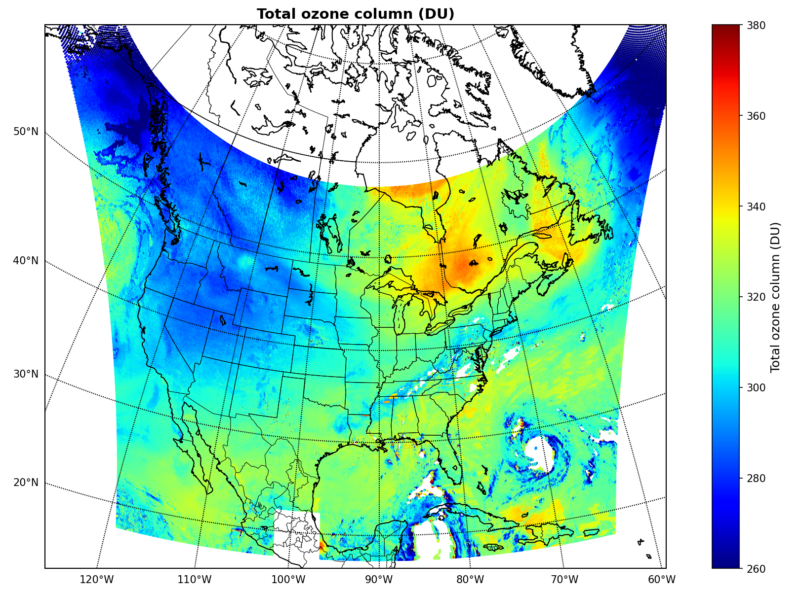
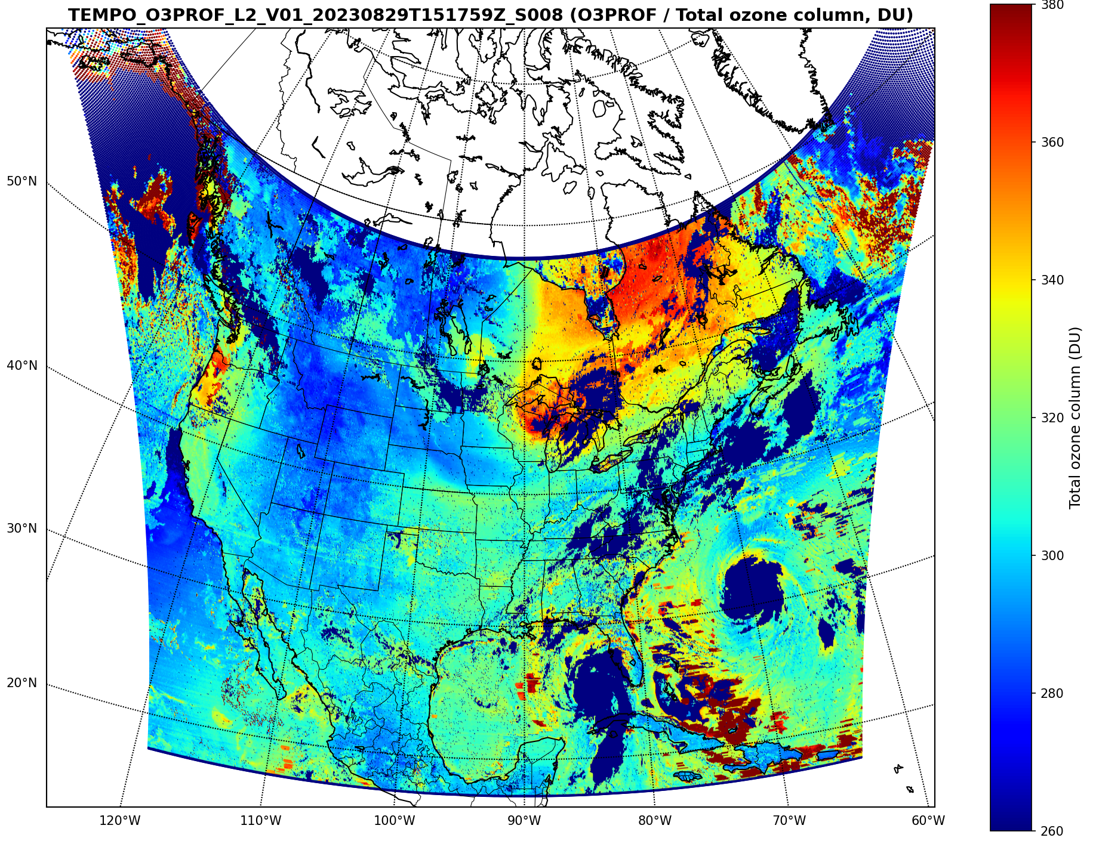
Total Ozone from Ozone Profile Product:
UV (8/28) vs. UV/VIS (8/29)
Large total ozone bias due to large positive biases (~20-30%) in radiance below ~305 nm, and the fitting of a first-order wavelength dependent surface albedo. Necessary to improve UV radiometric calibration (e.g., solar diffuser BTDF, image processing, straylight correction) and derive soft calibration
Less stable with UV/VIS retrievals than UV only retrievals. In addition, need to improve VIS spectral dependence of surface albedo and UV/VIS radiometric calibration consistency.
Ozone Profile (UV only) on 8/28
Ozone Profile (UV/VIS)
on 8/29
Ozone profile algorithm has been tested and we know how to improve the data product!

Slide 27
Calibration and L1b Validation
Verify and update image correction steps in the L0-1 processing during Commissioning Phase and Nominal Operation
  System linearity, zero-input, relative gains, saturation blooming, dark current variation and temperature-dependent correction, check quality flags, evolution of solar diffuser, noise calculation, straylight
Assess wavelength calibration and its performance
  Will assess performance of routine processing (wavelength calibration in both L0-1b & L1-2 via high-resolution solar reference and atmospheric absorption)
  Pre-launch measured instrument line shape will be compared with that derived from solar irradiance
Assess radiometric calibration using a multi-pronged approach
  Internal assessment of images, assess performance of routine processing
  Comparison solar irradiance with solar reference and correlative contemporaneous sensors (e.g., OMPS, TROPOMI, GOME-2, EPIC, MODIS, VIIRS)
  Comparison with radiative transfer simulation
Assess and improve INR accuracy
  Alignment issue, ephemeris reliability, IRU time synchronization, scan tailoring verification
  Different configuration for special observation

Slide 28
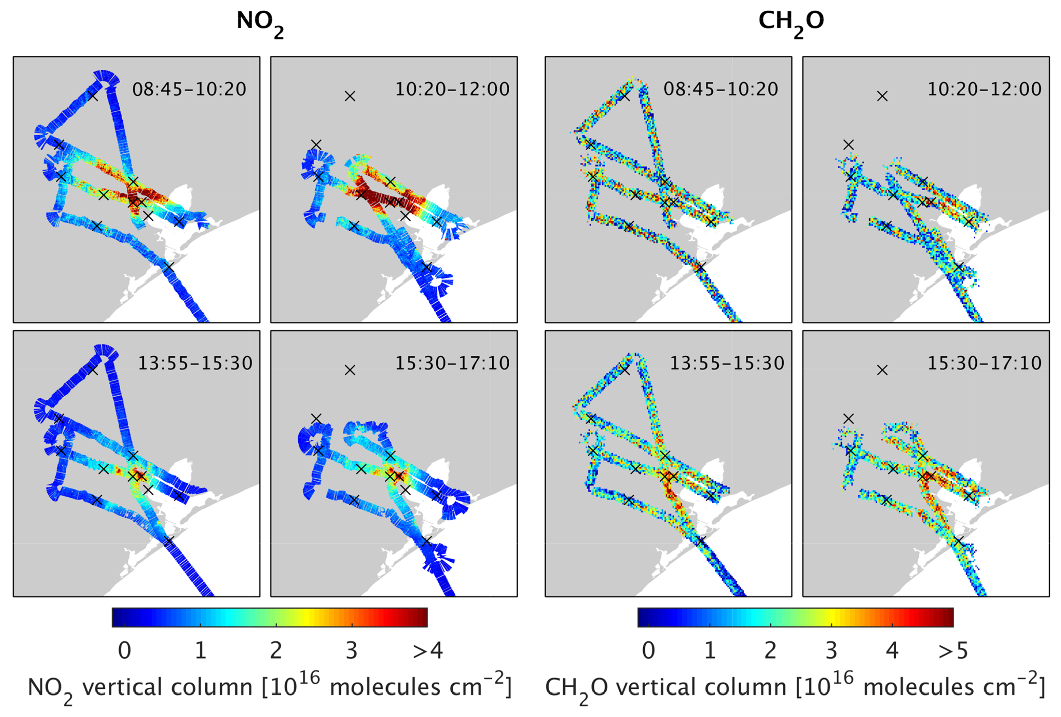
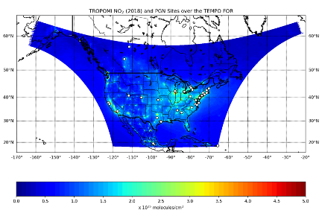
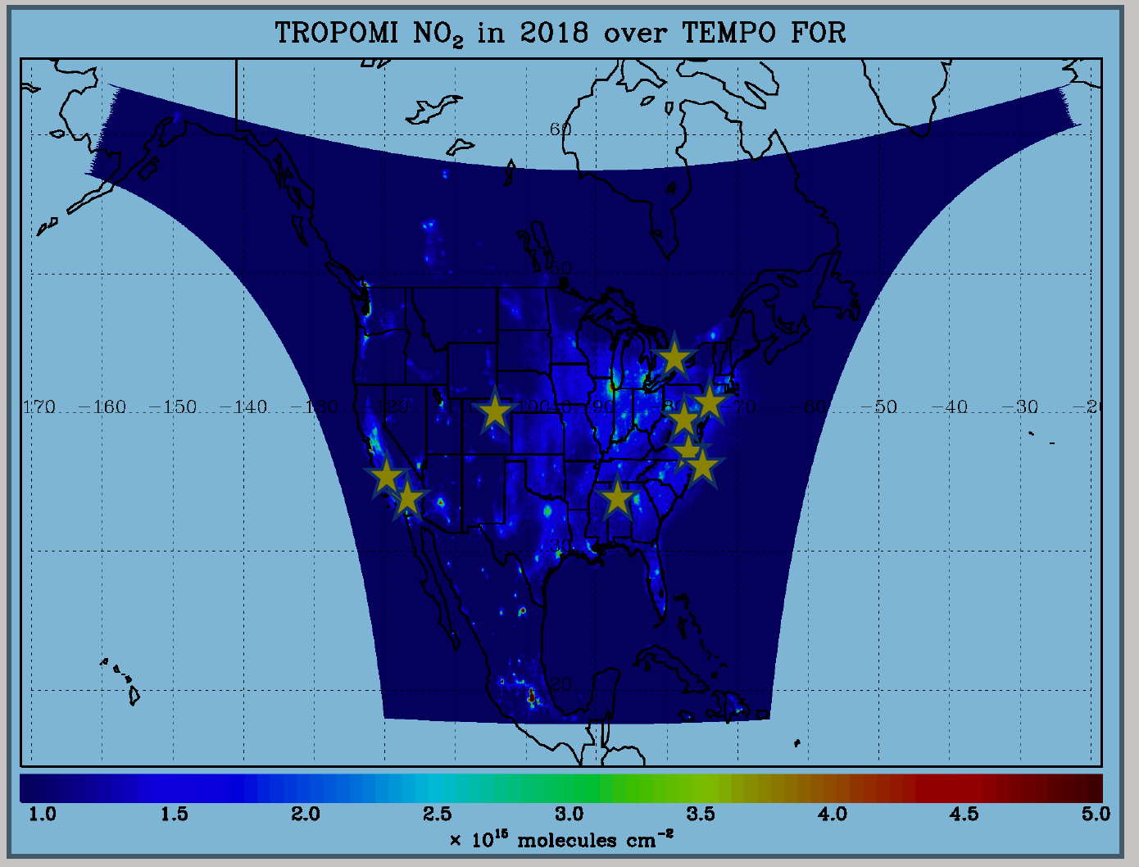
TEMPO Level 2 Data Products
Validation Plan
TEMPO PLRA validation requirements: 3 Pandoras, 1 month per season
Jim Szykman has led the development of best-efforts basis validation plan: beta, provisional, full
Use satellite observations (i.e., LEO and EPIC/DSCOVR) for cross validations
Pandora & Pandonia Global Network (PGN): validate NO₂, HCHO, total O₃ and diurnal variation
TOLNet: 8 LIDAR instruments by time of launch to validate tropospheric O₃ & 0-2 km O₃ and diurnal variation
Airborne instruments: GEO-TASO, GCAS, HSRL-2, IAGOS, SeaRey UAV
Other instruments: ozonesonde, Dobson/Brewer, MAXDOAS, FTIR, AERONET, …
Planned flight campaigns AGES+ (e.g., STAQS, AEROMMA+CUPiDS, GOTHAAM) during Aug 2003, provide integrated approaches linking TEMPO science, applications, and validation
Indirect evaluation with chemistry transport models and data assimilation
https://www.pandonia-global-network.org/
www-air.larc.nasa.gov/missions/TOLNet/
Nowlan et al. (2018) GCAS, DISCOVER-AQ, Texas, Sep 2013
~60 PGNs in TEMPO FoR, ~20 to add in 2 years

