Slide 1





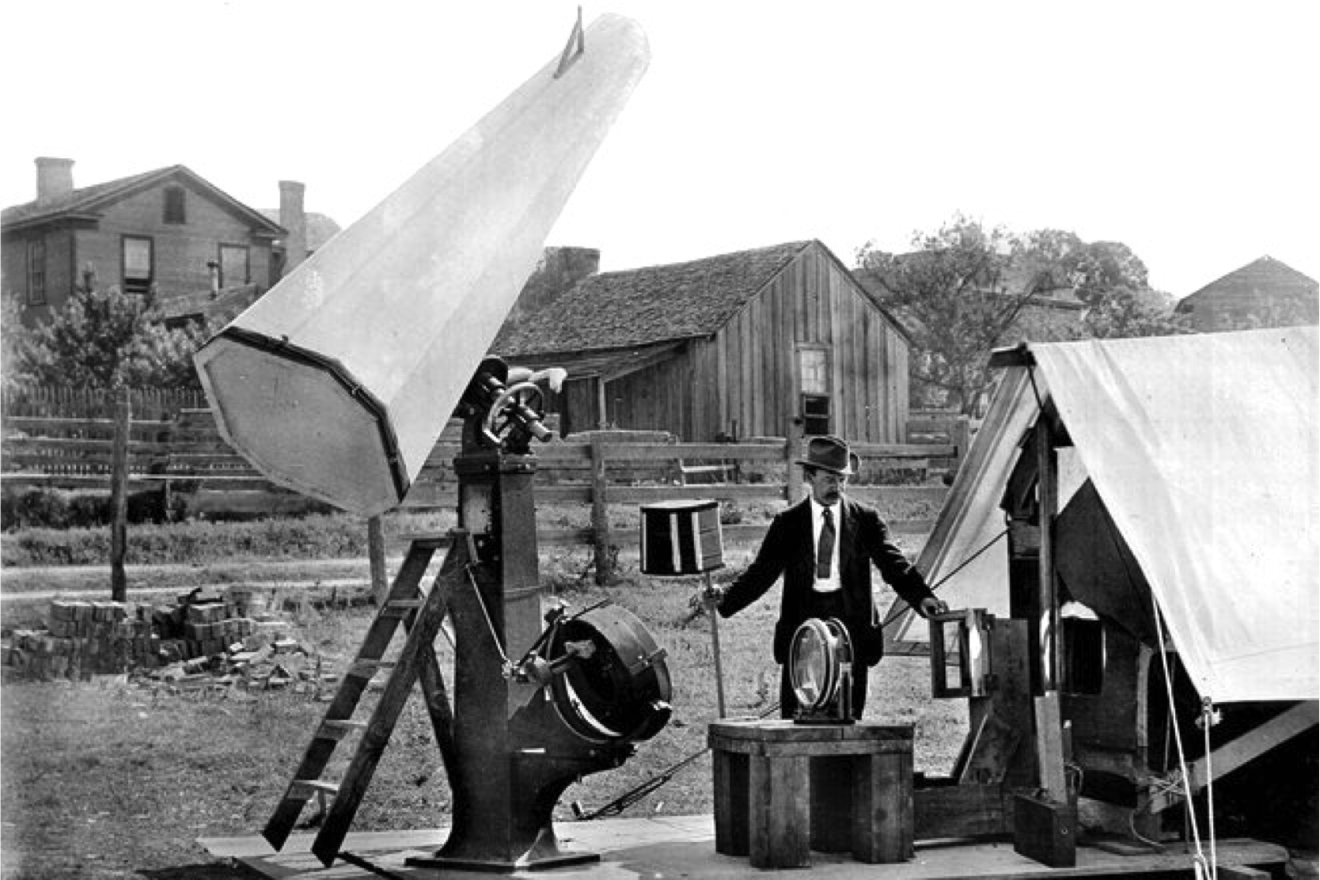
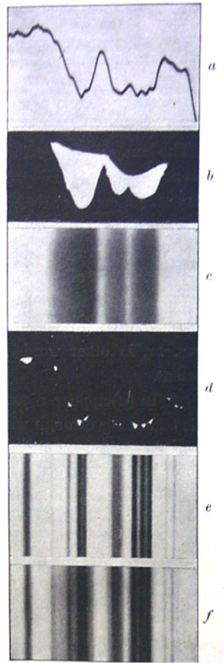
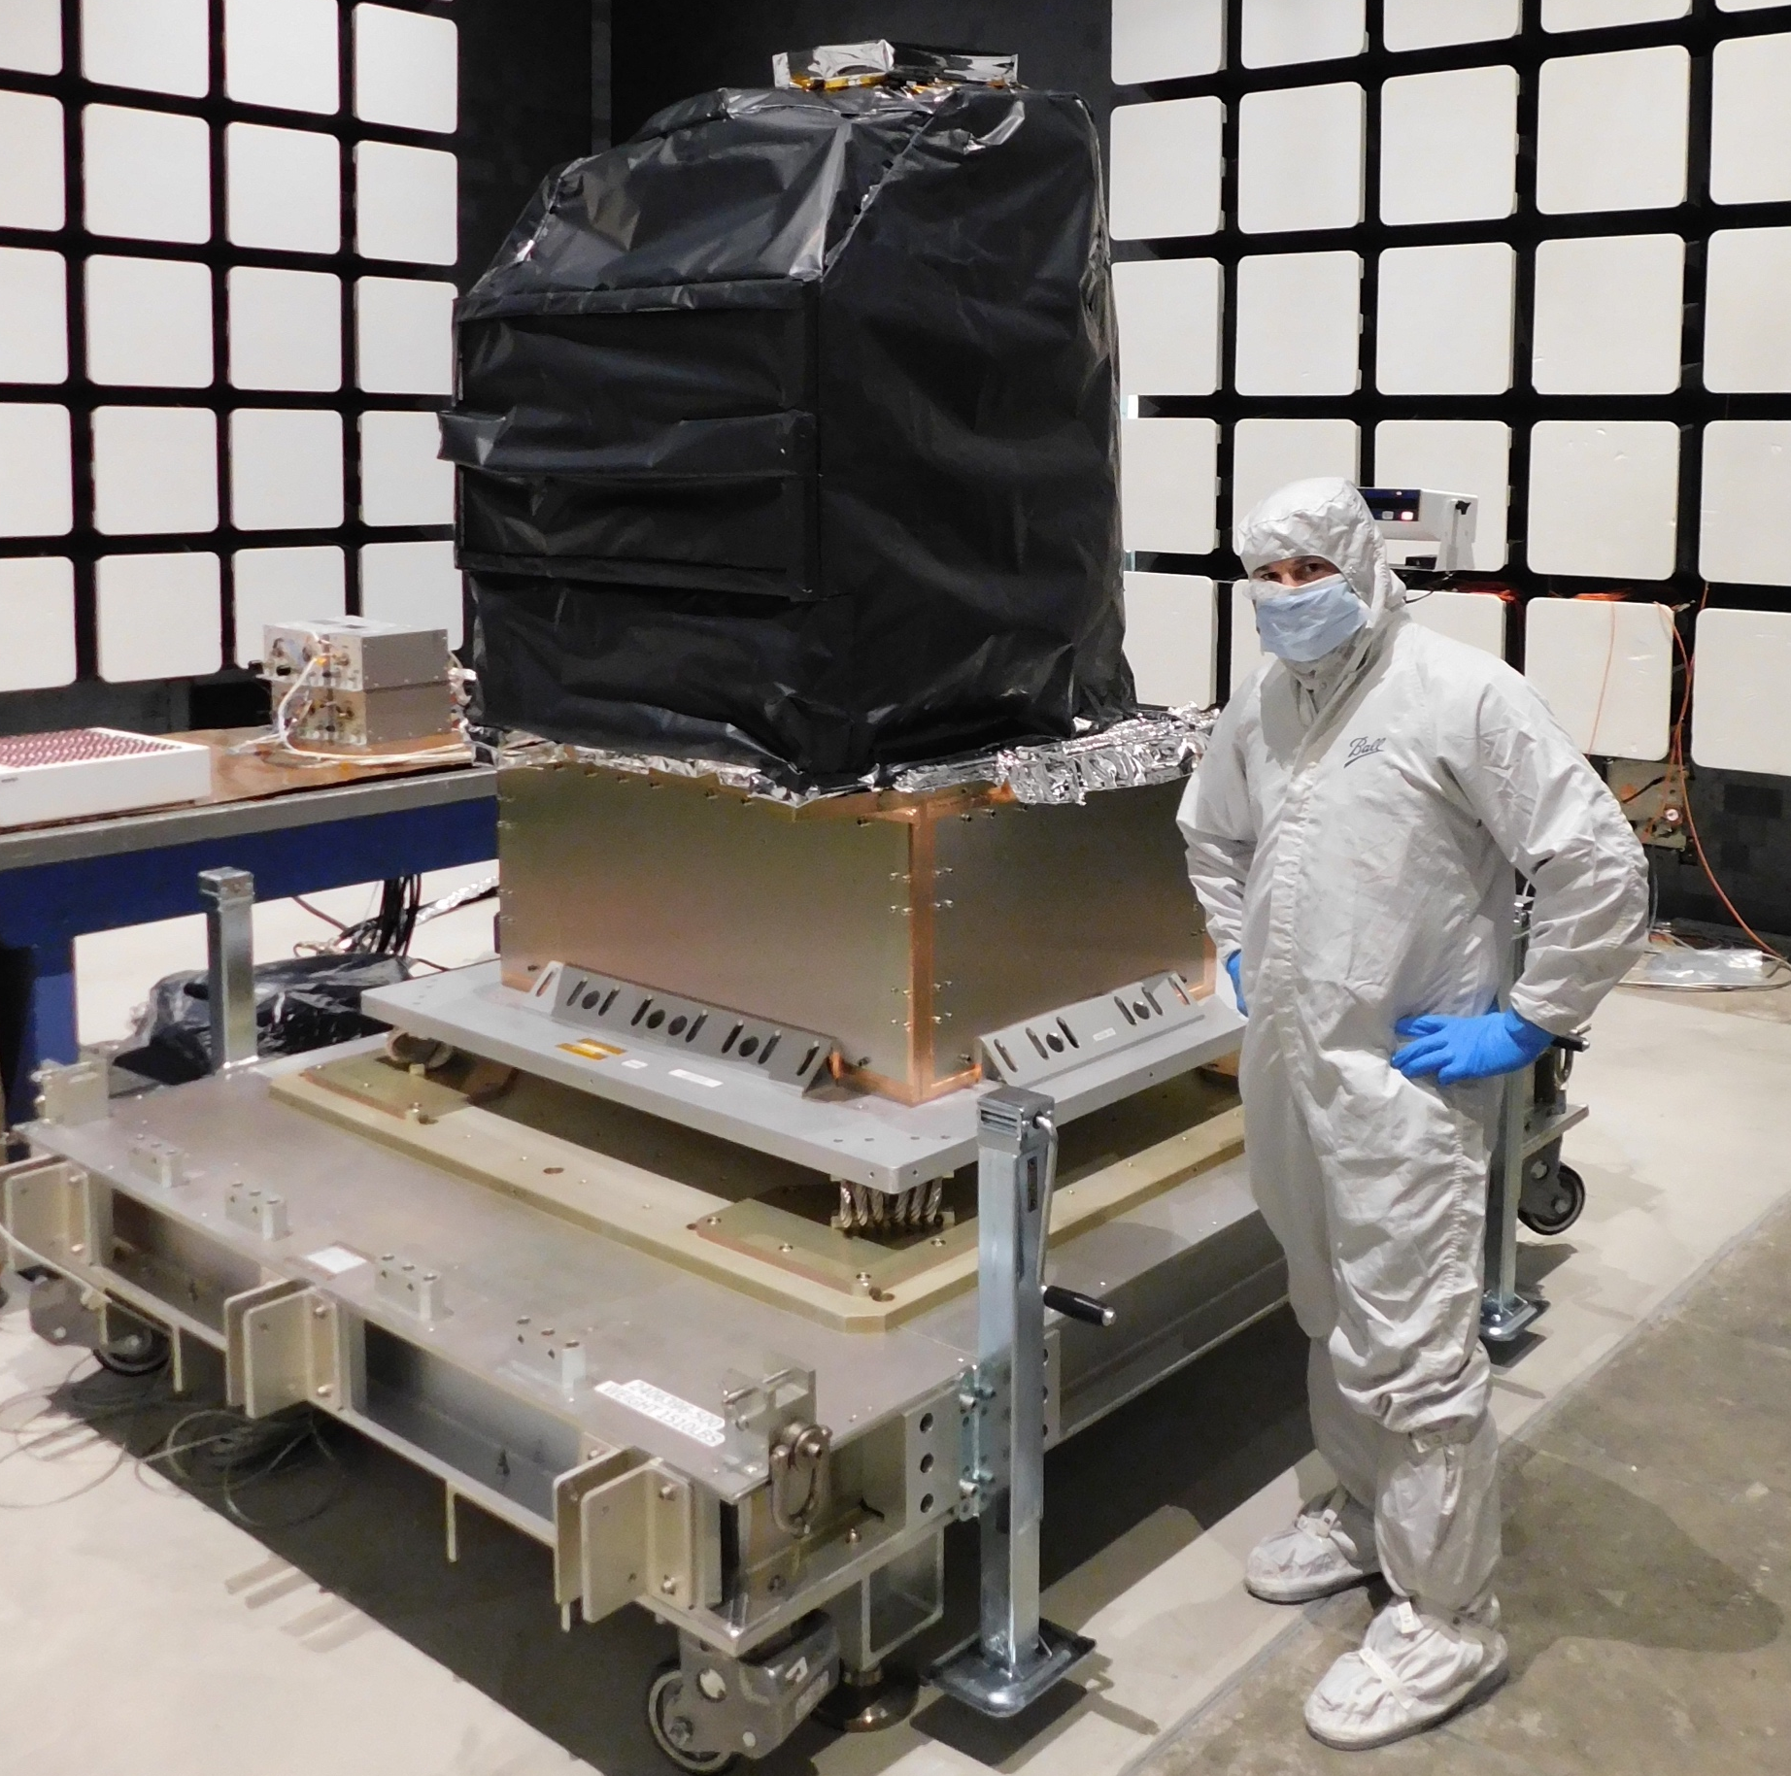
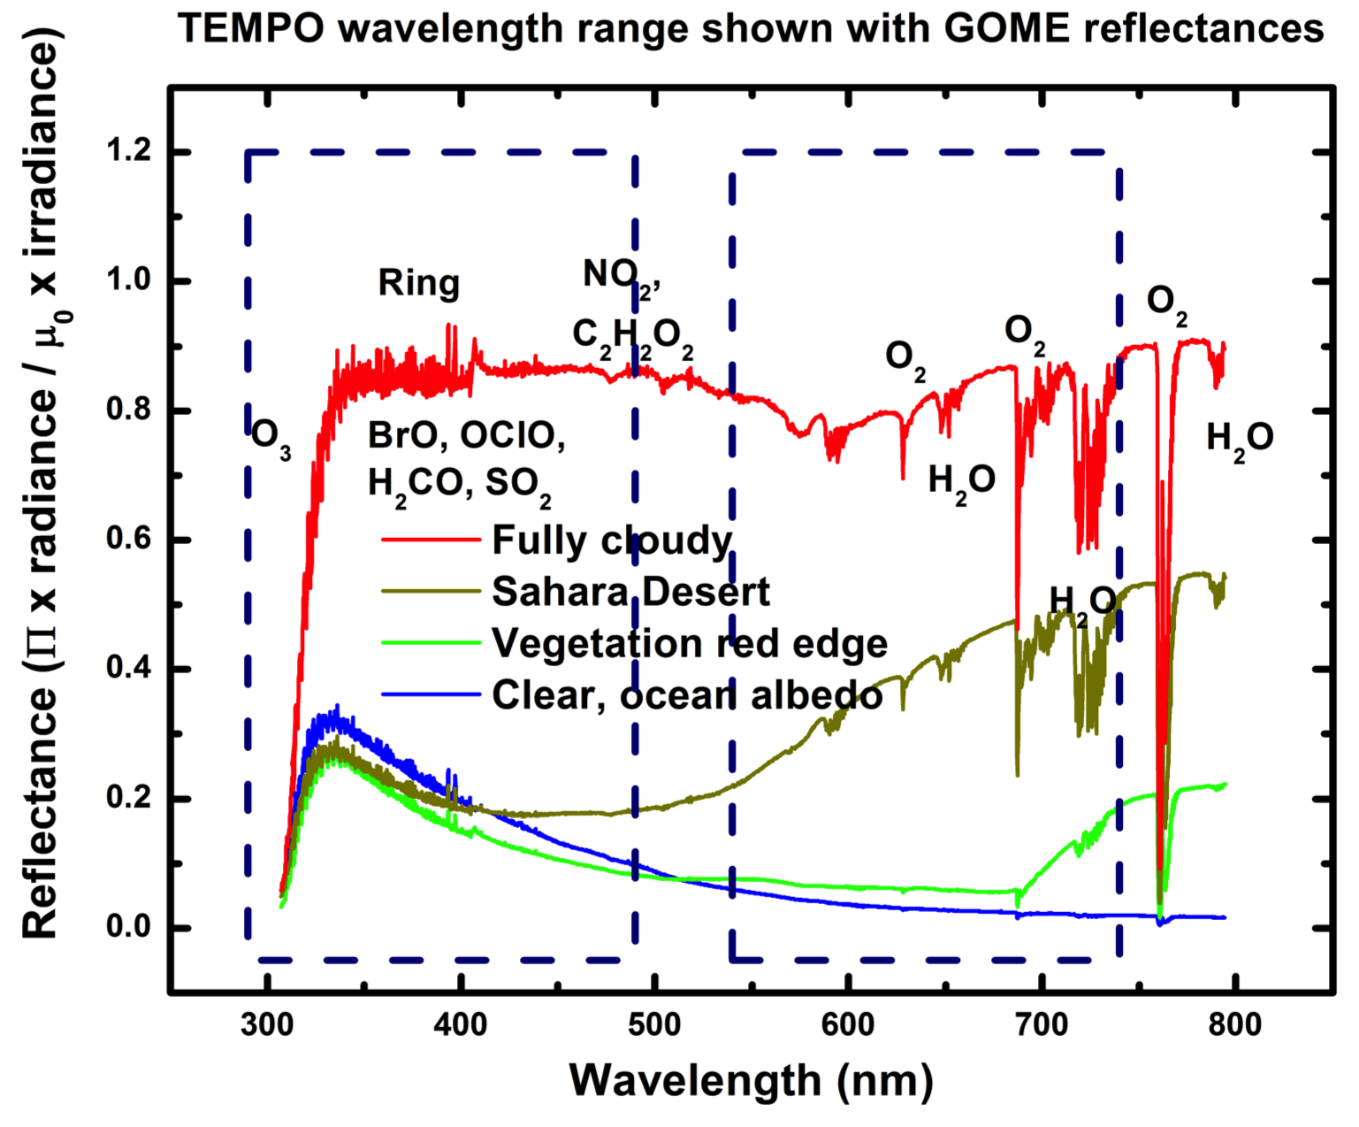
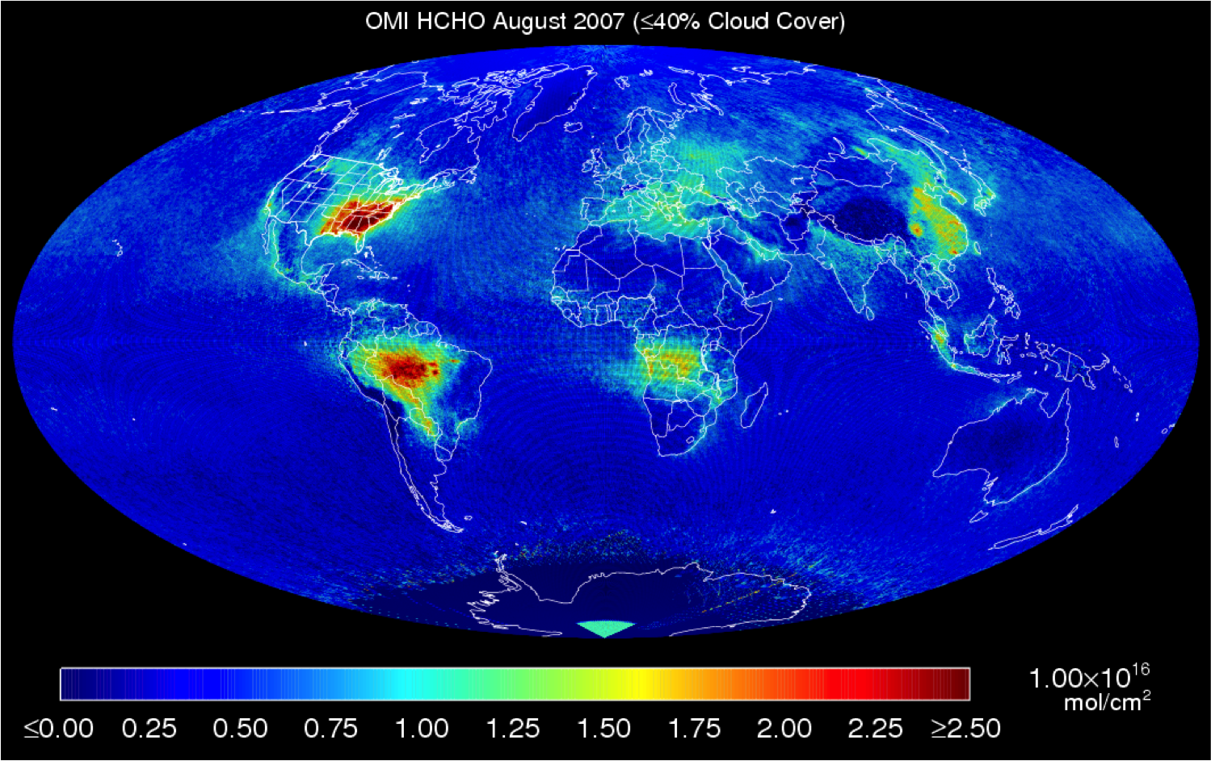
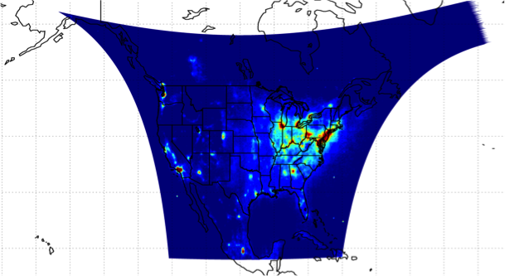
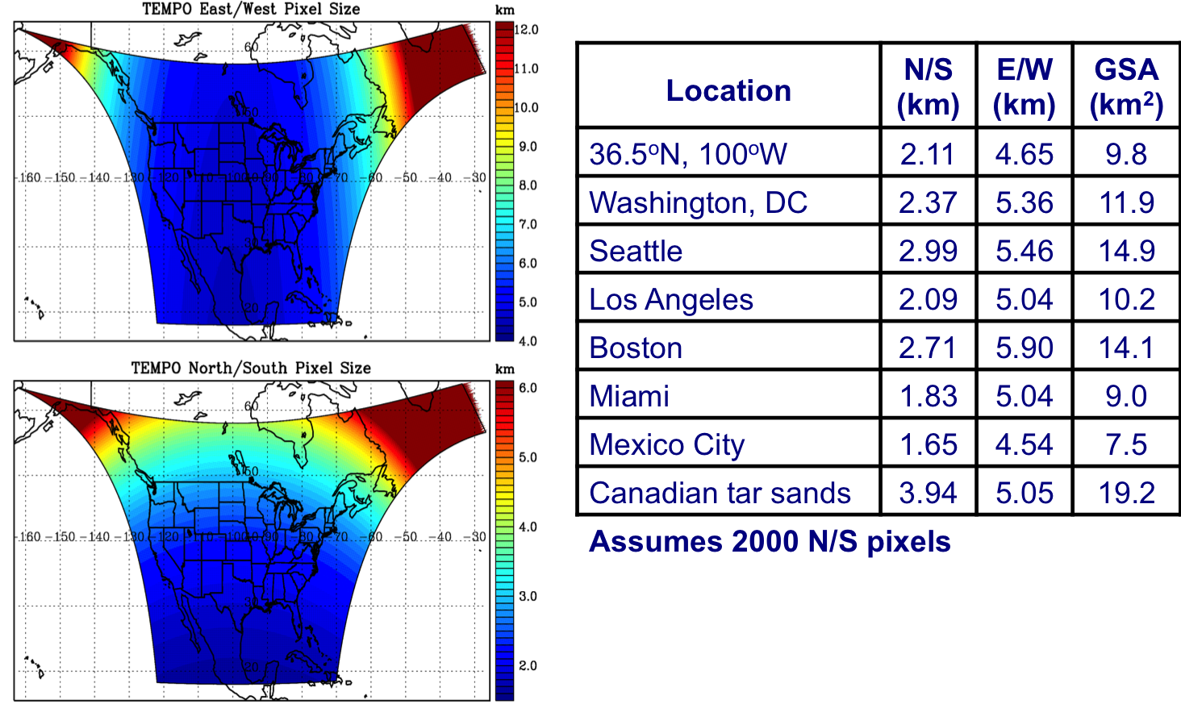
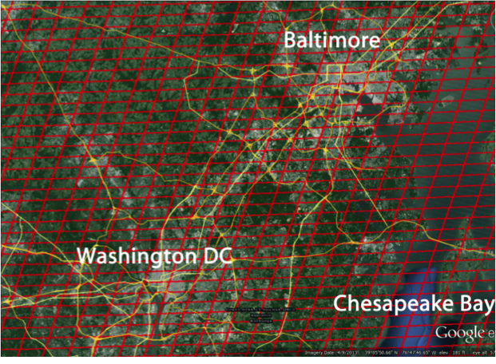
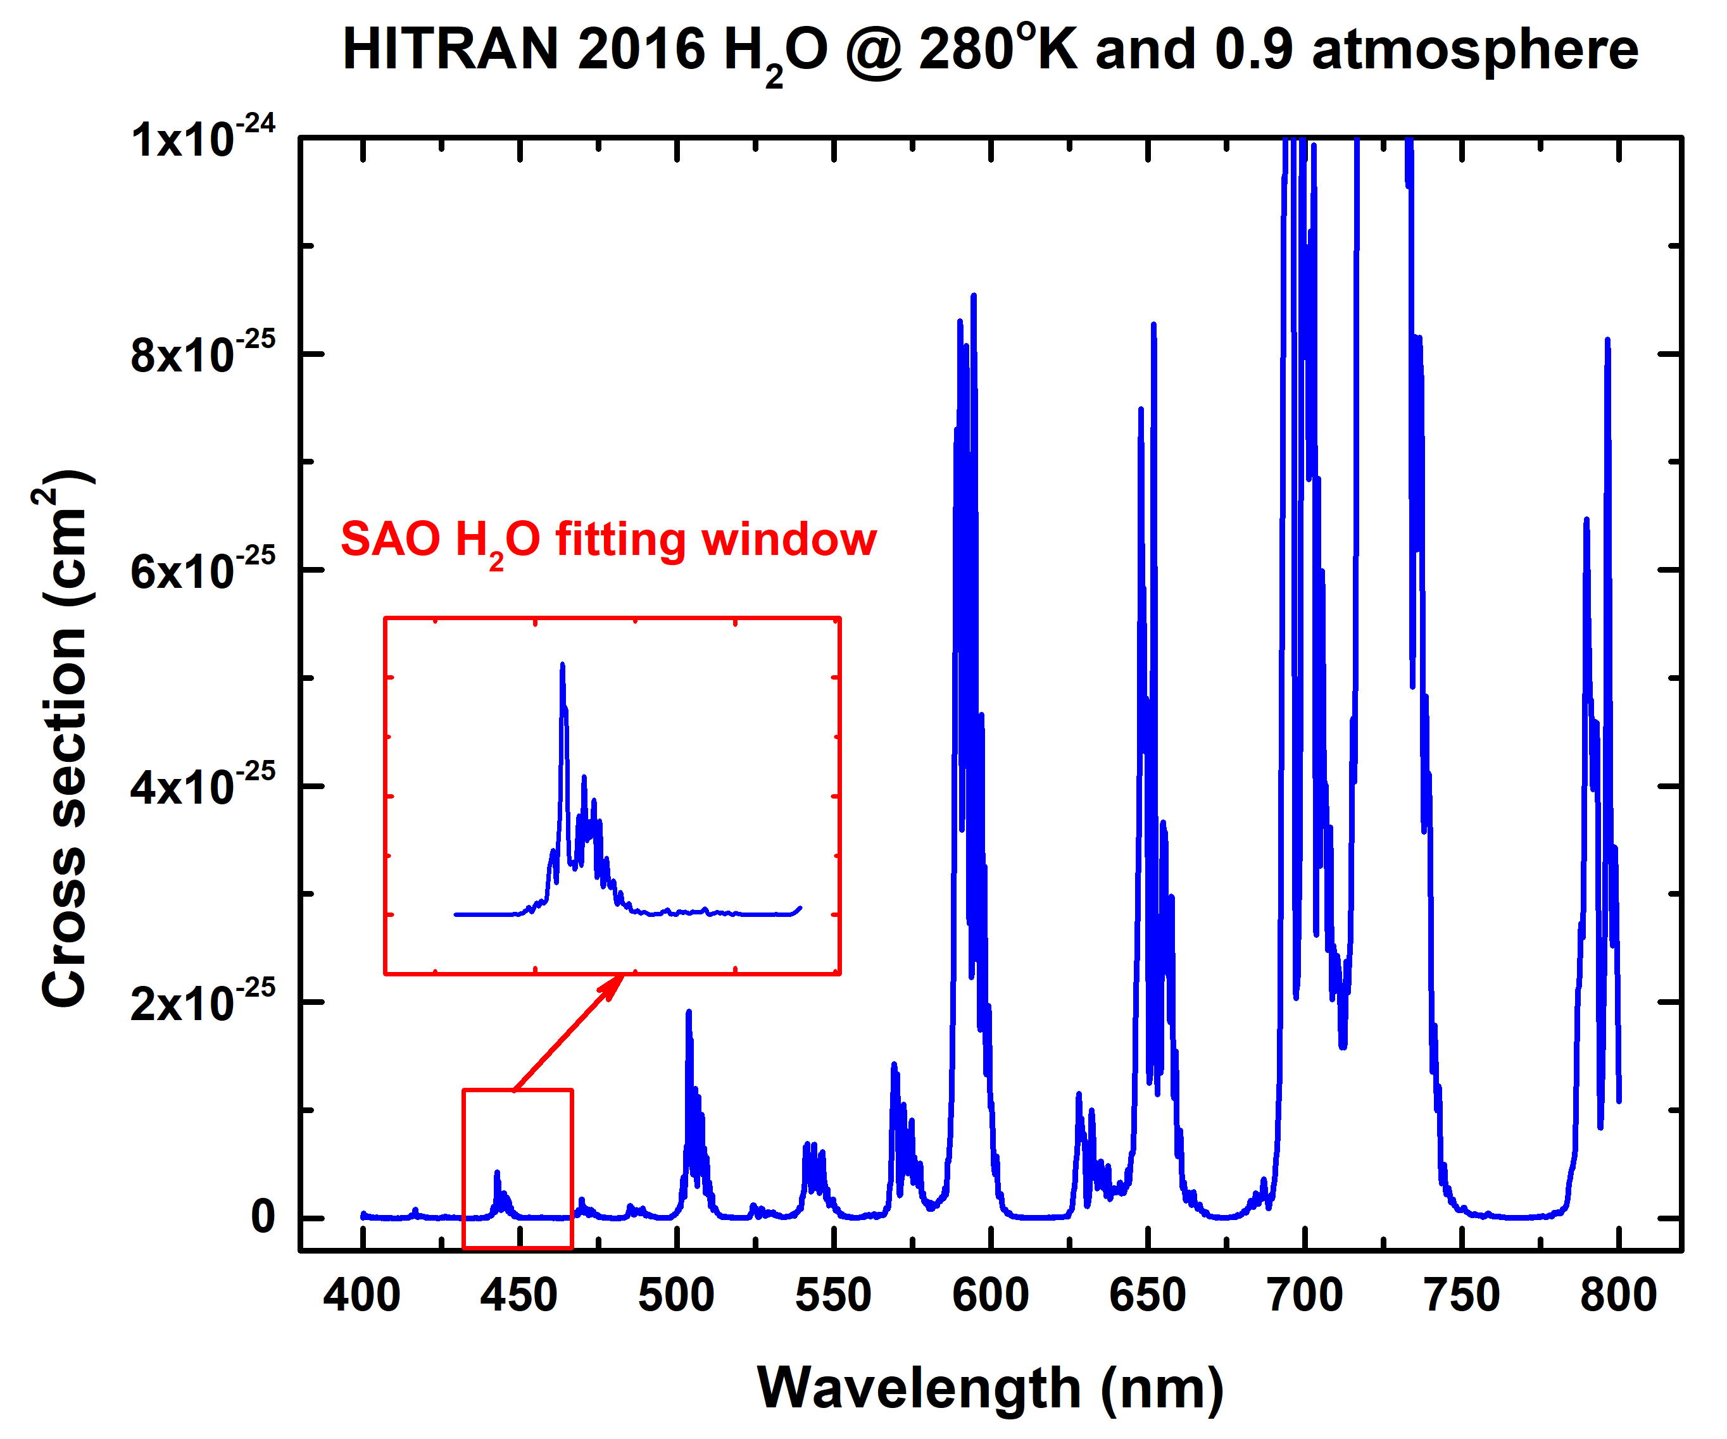
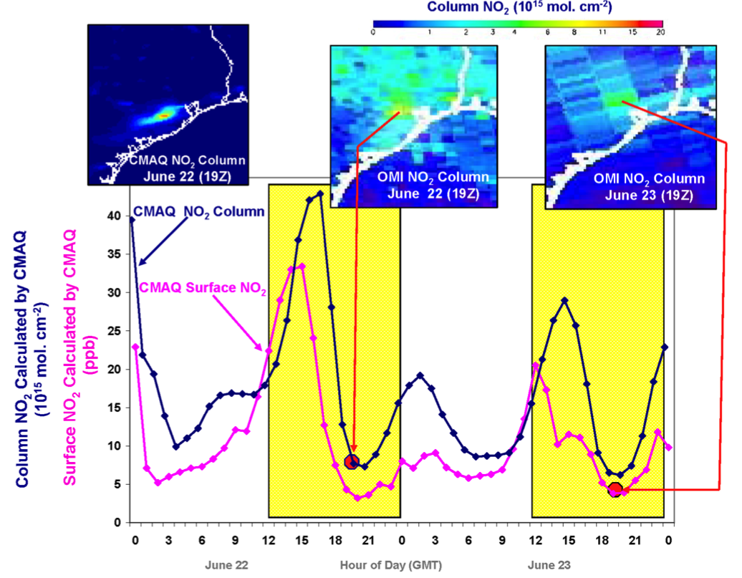
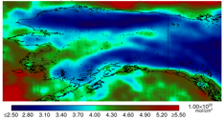
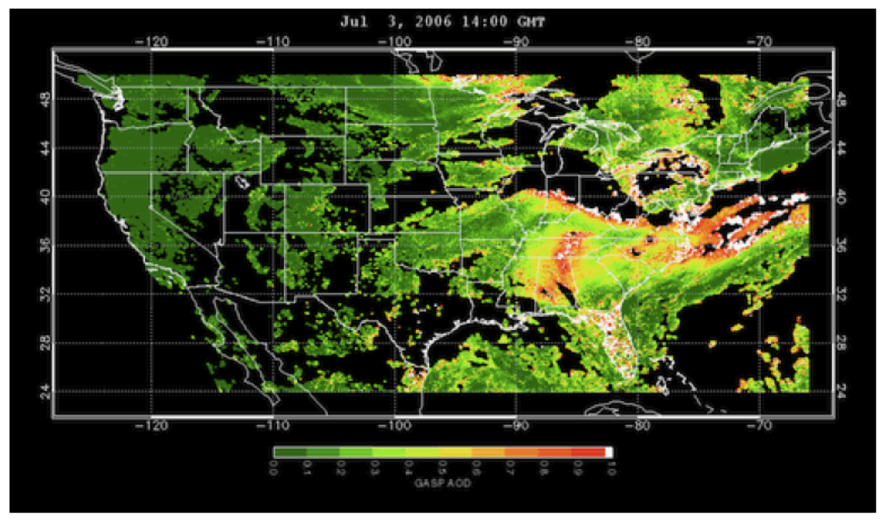
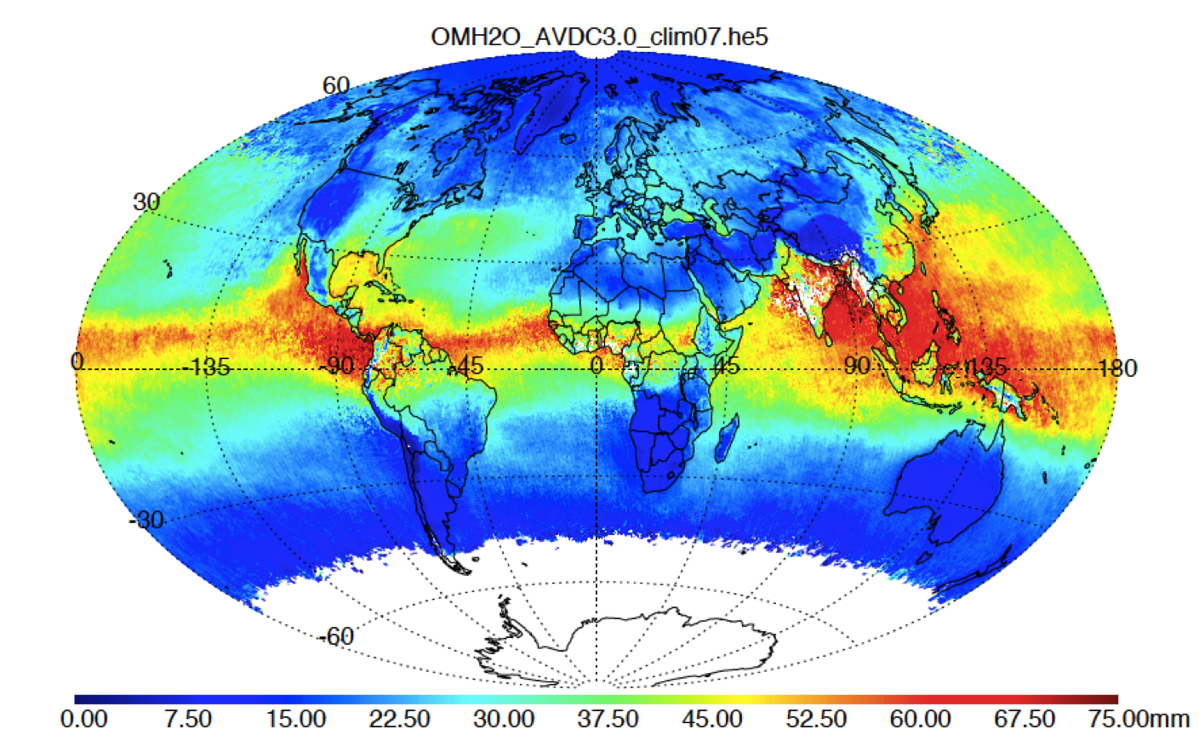
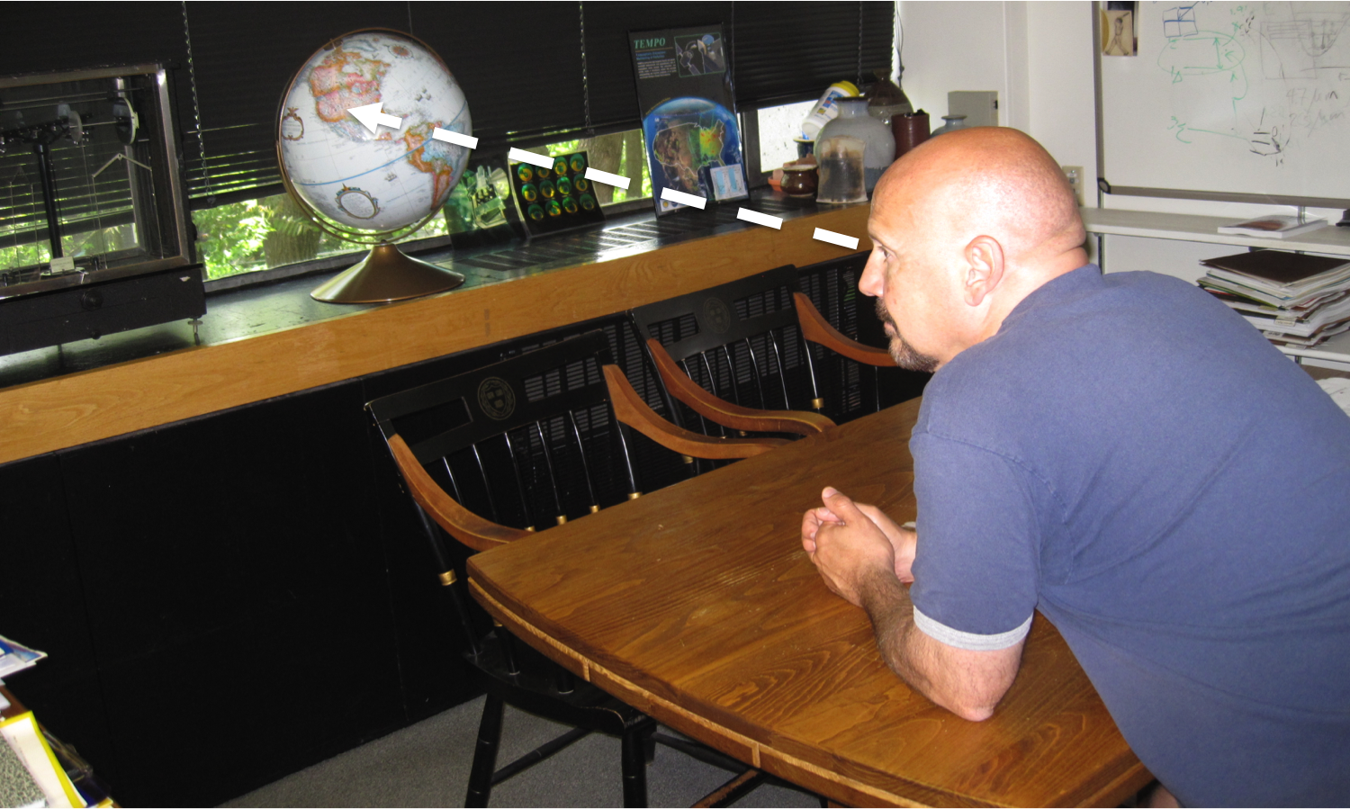
North American Pollution Measurements from
Geostationary Orbit with Tropospheric
Emissions: Monitoring Of Pollution (TEMPO) xxx
K. Chance, X. Liu, R.M. Suleiman, H. Wang, C.R. Nowlan, G. González Abad, P. Zoogman,
C. Chan Miller, A.H. Souri, Y. Jung, and J. Bak, Smithsonian Astrophysical Observatory
David Flittner, Jay Al-Saadi, NASA LaRC
Scott Janz, NASA GSFC
Plus Team TEMPO
MethaneSat!
Abstract
The Smithsonian Astrophysical Observatory-led TEMPO is the first NASA Earth Venture Instrument. It is to be launched between 2021 and 2022 to measure atmospheric pollution from Mexico City and Cuba to the Canadian oil sands, and from the Atlantic to the Pacific. It does this hourly at high spatial resolution, ~10 km², to measure the key elements of air pollution chemistry. Geostationary daytime measurements capture the variability in the diurnal cycle of emissions and chemistry at sub-urban scale to improve emission inventories, monitor population exposure, and enable emission-control strategies. TEMPO is now completed and is awaiting selection of its commercial host satellite.
TEMPO will measure UV/visible Earth reflectance spectra to retrieve ozone (O₃, including tropospheric and planetary boundary layer O₃), NO₂, HNO₂, SO₂, H₂CO, C₂H₂O₂, H₂O, BrO, OClO, IO, aerosols, cloud parameters, and UVB radiation. It will track pollution loading, transport, and transformation. It will provide near-real-time air quality products. TEMPO is the North American component of the upcoming global geostationary constellation for pollution monitoring, together with the European Sentinel-4 and the Korean Geostationary Environmental Monitoring Spectrometer (GEMS) [1].
SAO developments leading to TEMPO
The SAO was established in 1890
by Smithsonian Secretary Samuel P.
Langley for the purpose of making
solar & atmospheric measurements.
Langley’s recently invented bolo-
meter was used to make measure-
ments from the infrared through the near ultraviolet in order to determine the mean value of the solar constant
and its variation. Langley and Abbot also developed substantial new experimental techniques (such as an
early chart recorder) and various analysis techniques
(e.g., the “Langley plot,” which introduced the air
mass factor), including photographic techniques for
high pass filtering to produce line spectra from
“bolographs” (spectra – illustrated), foreshadowing the
high pass filtering used today by researchers employing the DOAS technique for analyzing atmospheric spectra [3].
The development of TEMPO and other satellite UVN spectrometers for pollution measurements has been greatly enabled by research done at the SAO, as documented in www.cfa.harvard.edu/atmosphere/publications.html. Algorithm physics studies applicable to TEMPO include:
Calibrated high resolution solar reference spectra;
In-flight wavelength and slit width calibration;
Undersampling correction;
Common-mode correction;
Raman scattering (Ring effect), including the molecular oxygen ground state a ³Σ_{g}⁻ triplet electronic structure.
In early studies for SCIAMACHY, done in collaboration with the Max Planck Institute, we determined [4]:
Ozone profiles, including tropospheric and boundary layer ozone, can be retrieved from nadir UV/vis spectra, now demonstrated for several satellite spectrometers beginning with GOME-1. TEMPO is the first satellite spectrometer specifically designed to be able to use UV and visible together to optimize this;
Formaldehyde (HCHO) in the troposphere
can be retrieved globally from satellite
spectra, first demonstrated by SAO in 1998;
BrO measurements may be made globally rather than just in the South polar vortex, predicted by SAO in the late 1980s and demonstrated in 1998.
Additionally, SAO made the first measurements of glyoxal (C₂H₂O₂) from space (2005) and first developed precipitable water (H₂O) measurements using the blue 7ν polyad (2010).
Example: H₂O data products using the blue 7ν polyad
OSIRIS limb measurements made during the
2009 Black Saturday bushfires in Australia
showed substantial change in the stratospheric
spectrum, which SAO identified as water vapor
from heightened convection.
SAO then performed a modeling study for the
UVN spectrum to compare with the satellite
spectra. The 7ν polyad, centered at 445 nm,
turned out to be the “Goldilocks band” for H₂O.
It is in a clean location, strong enough to be
measured precisely yet weak enough that spectral saturation is not an issue.
Preliminary studies gave robust retrievals
as in the example from our 2010 proposal
to NASA at right, showing OMI observa-
tions of an Alaskan forest fire in August 2005.
SAO now produces H₂O columns for all OMI measurements, available from the NASA
GSFC AVDC. The right figure is for July 2015.
Visible H₂O measurements have the
significant advantage over microwave measurements in that they may be made over land and ocean with comparable accuracies. Demonstrated applications include following atmospheric rivers, quantifying the patterns associated with El Niño and La Niña, and measuring the enhanced humidity from corn sweat events.
TEMPO Green Paper: Chemistry experiments with the Tropospheric Emissions: Monitoring of Pollution instrument
http://tempo.si.edu/publications.html
K. Chance, X. Liu, R. Suleiman, G. González Abad, P. Zoogman, H. Wang, C. Nowlan, G. Huang, K. Sun, J. Al-Saadi, J.-C. Antuña, J. Carr, R. Chatfield, M. Chin, R. Cohen, D. Edwards, J. Fishman, D. Flittner, J. Herman, J. Geddes D.J. Jacob, S. Janz J. Joiner, J. Kim, N.A. Krotkov, B. Lefer, R.V. Martin, M. Newchurch, P.G. Pfister, K. Pickering, R.B. Pierce, A. Saiz-Lopez, W. Simpson, R.J.D. Spurr, J.J. Szykman, O. Torres, and J. Wang.
TEMPO is required to spend much of its observing time scanning the full field of regard (FOR) each hour, for as much of the daylight portion of the diurnal cycle as we can arrange (but certainly to 70º solar zenith angle). However, some observing time, perhaps as much as 25%, is available for non-standard observations. Non-standard operations simply mean observing a portion of the FOR (an East/West slice, as North/South is fixed) at higher temporal resolution.
Non-standard observations are of two types: First, events, which might include volcanic eruptions, forest fires, dust outbreaks, and significant storms. Second, “chemistry experiments,” which use the world’s highest chemistry set to inform atmospheric pollution science in general and satellite retrievals of pollution (especially for TEMPO) in particular. Special operations normally have 10-minute time resolution and 1000 km E/W swath but they don’t have to. For oversampling studies, for example, they could be quicker and narrower. Anything down to step and stare (with several km jitter) is possible.
TEMPO science studies may include: Solar-induced fluorescence from chlorophyll over land and in the ocean to study tropical dynamics, primary productivity and carbon uptake, to detect red tides, and to study phytoplankton; measurements of stratospheric O₃ intrusions that cause air quality exceedances; measurements at peaks in vehicle travel to capture the variability in emissions from mobile sources; measurements of thunderstorm activity, including outflow regions to better quantify lightning NO_{x} and O₃ production; cropland measurements to follow the temporal evolution of emissions after fertilizer application and from rain-induced emissions from semi-arid soils; investigating the chemical processing of primary fire emissions and the secondary formation of volatile organic compounds and O₃; prognostics of fire danger using VOCs, CO, and H₂O; examining ocean halogen emissions and their impact on the oxidizing capacity of coastal environments; measuring spectra of nighttime lights, resolved by lighting type, as markers for human activity, energy conservation, and compliance with outdoor lighting standards intended to reduce light pollution [5].
TEMPO Mission Snapshots
The TEMPO instru-
ment, delivered,
ready for storage
TEMPO spectral coverage
(two dashed rectangles),
illustrated using ESA GOME
spectra for the range of
Earth conditions
The TEMPO Field-
of-Regard, as measured
hourly during daylight
Courtesy Svetlana Petelina
Spatial coverage versus
location in North America
TEMPO hourly foot-
prints for the Baltimore-
Washington area (Google
Earth/Landsat)
References
[1] P. Zoogman, X. Liu, R.M. Suleiman, et al., Tropospheric Emissions: Monitoring of Pollution (TEMPO), J. Quant Spectrosc. Radiat. Transfer, 186, 17-39, doi:10.1016/j.jqsrt.2016.05.008, 2017.
[2] Fishman, J., et al., The United States’ Next Generation of Atmospheric Composition and Coastal Ecosystem Measurements: NASA’s Geostationary Coastal and Air Pollution Events (GEO-CAPE) Mission, Bull. Amer. Met. Soc., 93(10), 1547–1566, 2012.
[3] Langley, S.P., and C.G. Abbot, Annals of the Astrophysical Observatory of the Smithsonian Institution, Volume 1 (1900).
[4] Chance, K.V., J.P. Burrows, and W. Schneider, Retrieval and molecule sensitivity studies for the Global Ozone Monitoring Experiment and the SCanning Imaging Absorption spectroMeter for Atmospheric CHartographY, Proc. SPIE, Remote Sensing of Atmospheric Chemistry, 1491, 151-165, 1991.
[5] Carr, J., X. Liu, B. Baker, and K. Chance, Observing nightlights from space with TEMPO, International Journal of Sustainable Lighting, 36, 17-26, 2017. http://doi.org/10.22644/ijsl.2017.36.1.017
The advantage of hourly
measurements during daylight
[2].
TEMPO will use the EPA’s Remote Sensing Information Gateway and other data distribution tools for subsetting, visualization, and product distribution to make TEMPO your instrument!
The view from GEO
Acknowledgements
TEMPO is the first NASA Earth Venture Instrument (EVI-1). It is supported by contract NNL13AA09C to the Smithsonian Astrophysical Observatory. It is a pleasure to thank the European Space Agency for the use of GOME data.

