Slide 1
Urban NOx Emissions from TEMPO
Shobha Kondragunta (NESDIS)
Zigang Wei (STC at NOAA)
Barry Baker (NWS)
Brian McDonald (OAR)
June 15-18, 2026 | TEMPO DART Workshop | University of Iowa
Disclaimer: The scientific results and conclusions, as well as any views or opinions expressed
herein, are those of the author(s) and do not necessarily reflect those of NOAA or
the Department of Commerce.

Slide 2
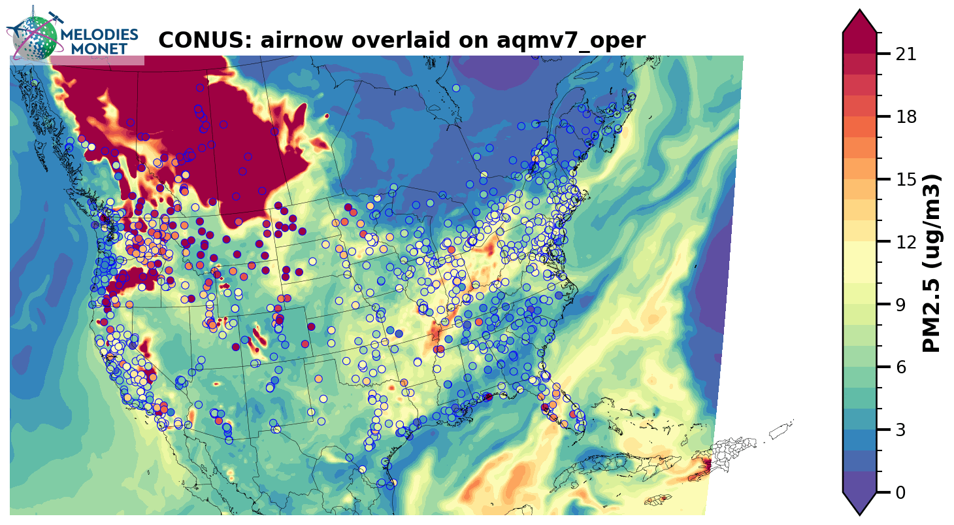
National Weather Service Unified Forecast System – Air Quality Model Forecast of Canadian Smoke
July – August 2024
Anthropogenic emissions inventories and near real time satellite-based fire emissions drive the model forecasts for ozone and PM2.5. Goal of deriving TEMPO urban NOx emissions is for timely updates of anthropogenic NOx emissions.

Slide 3
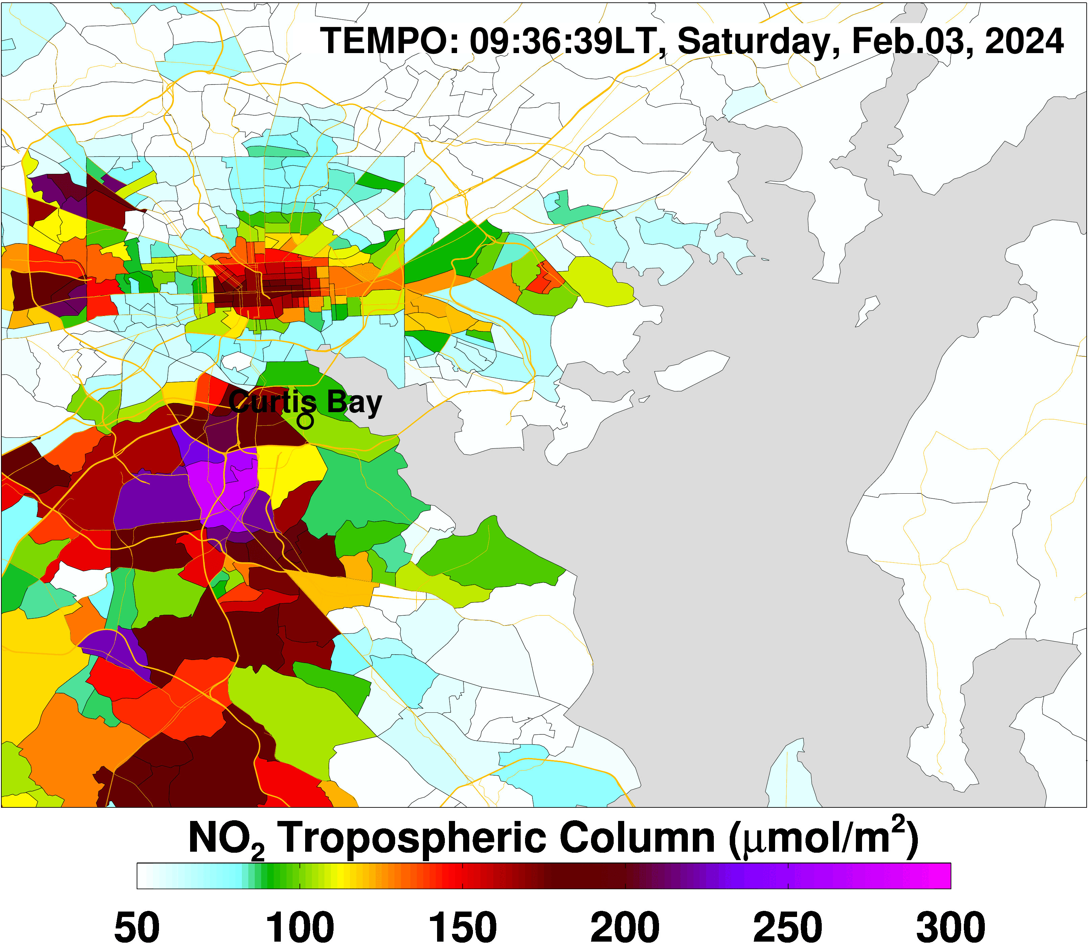
NOAA’s Community Emissions Computing Engine (CECE)
CECE is a modern, high-performance C++ software component designed to manage and calculate atmospheric emissions for Earth system models. It is built as a next-generation tool for the Unified Forecast System (UFS) community, functioning similarly to legacy systems like HEMCO (Harvard-NASA Emissions Component) but optimized for modern computing architectures.
CECE’s hybrid ingestion allows for:
Offline
Emissions derived using satellite data via data assimilation and inverse modeling.
Use satellite-based emissions to derive time-varying and space-varying scaling factors to adjust base inventory.
Inline
Weather driven emissions where the weather information comes from the model itself (e.g., dust emission).
CECE Lead: Barry Baker (NWS)

Slide 4
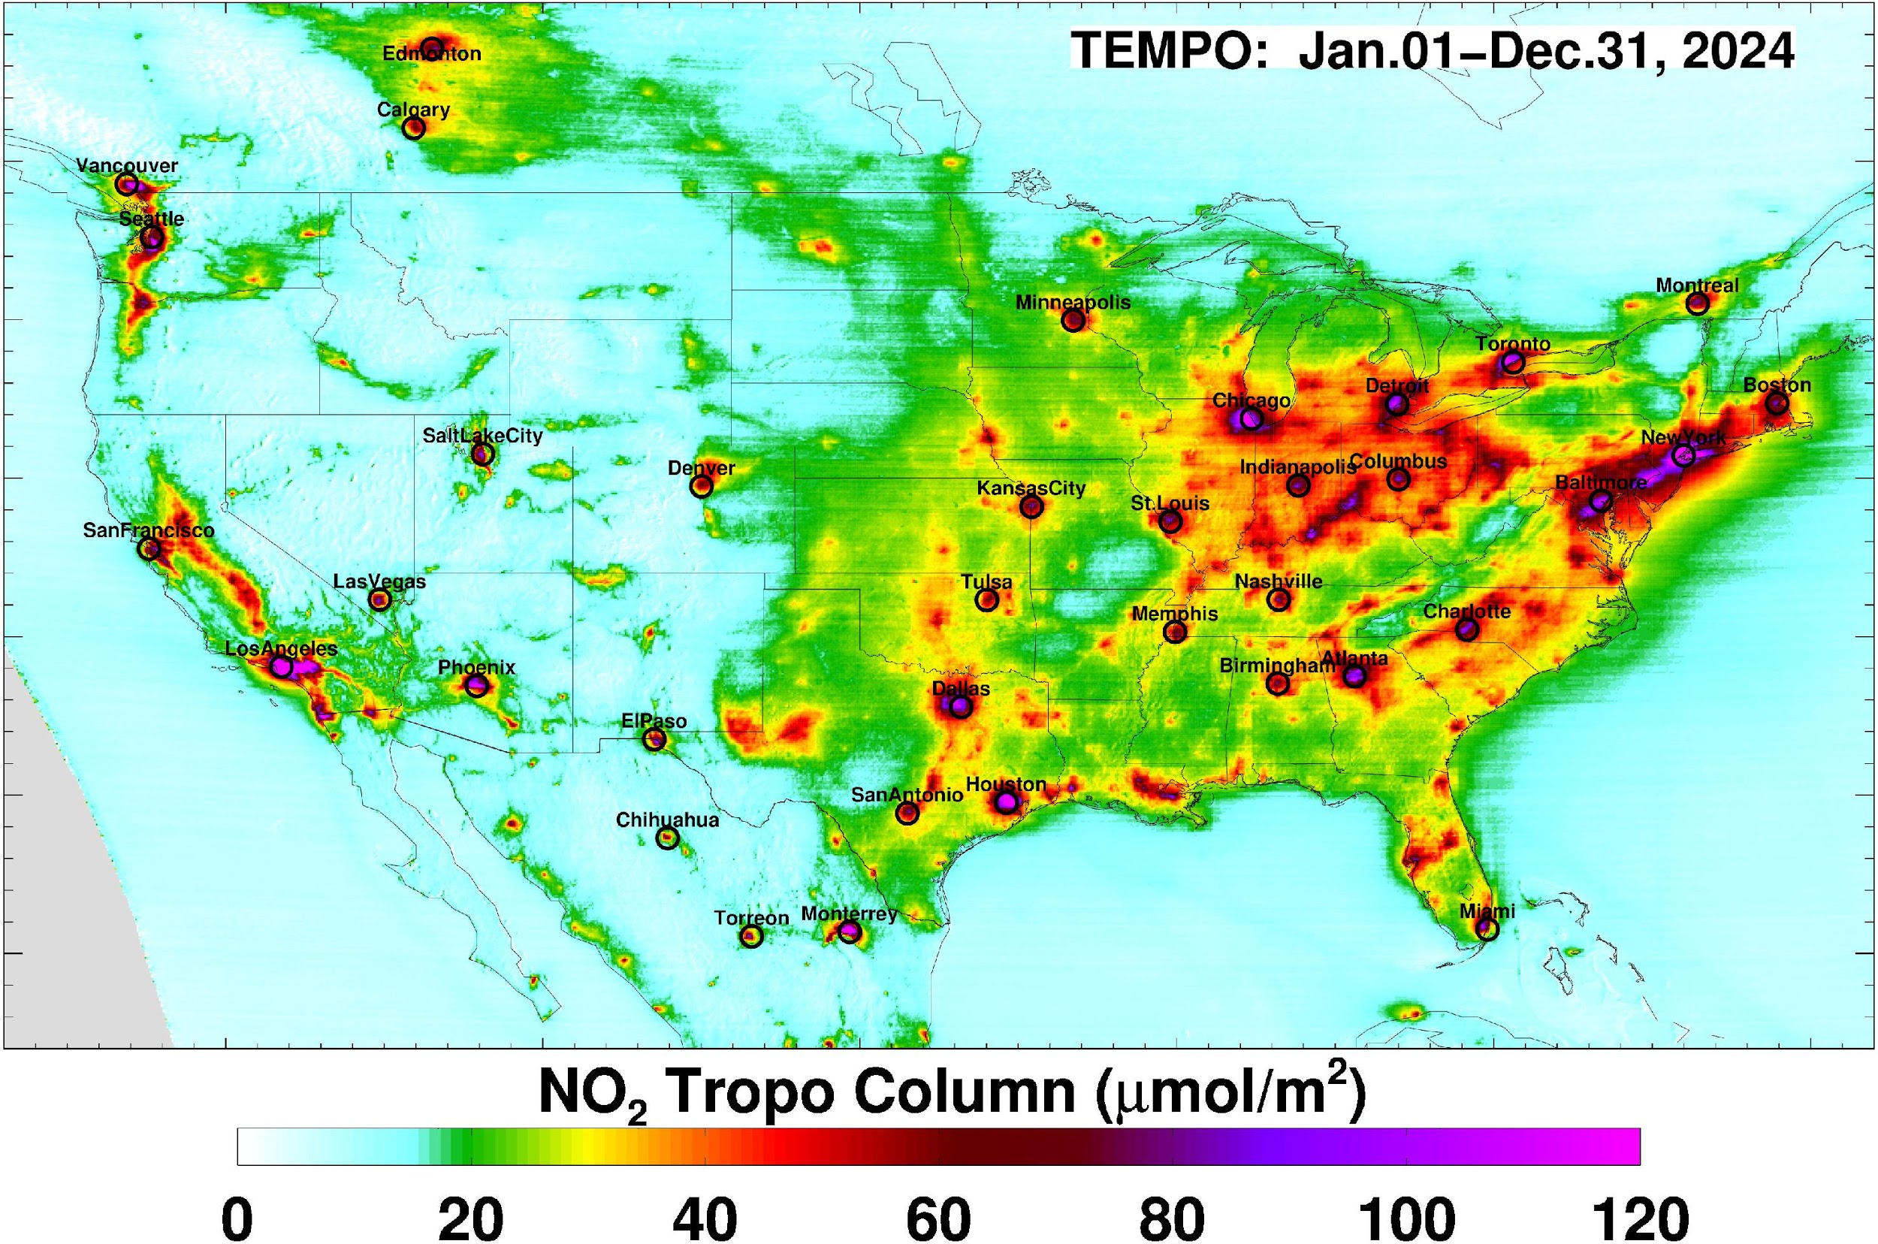
Selection of Urban Areas to Apply EMG Method
City selection is based on the major hotspots on TEMPO tropNO₂ annual mean maps.
Fitting domain: Dynamic

Slide 5
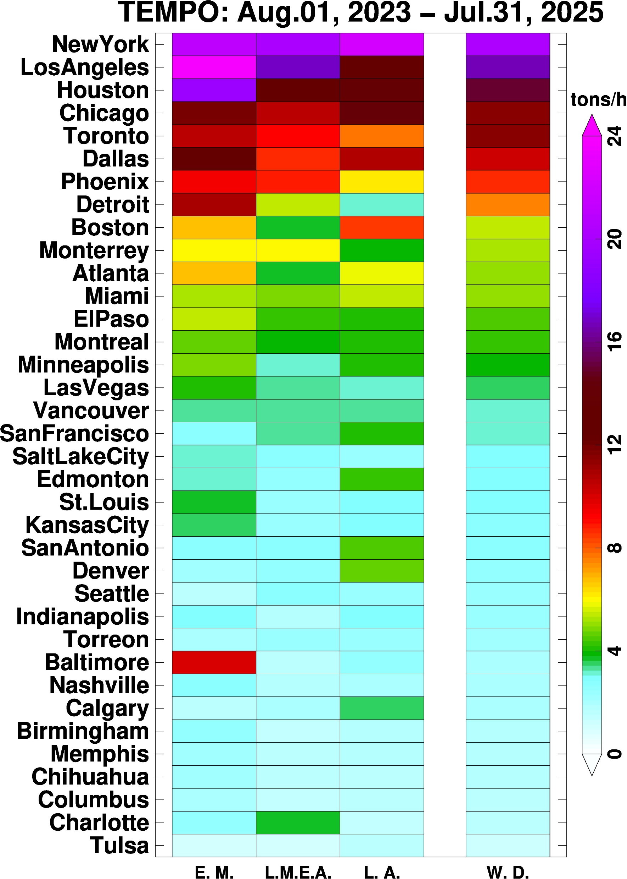
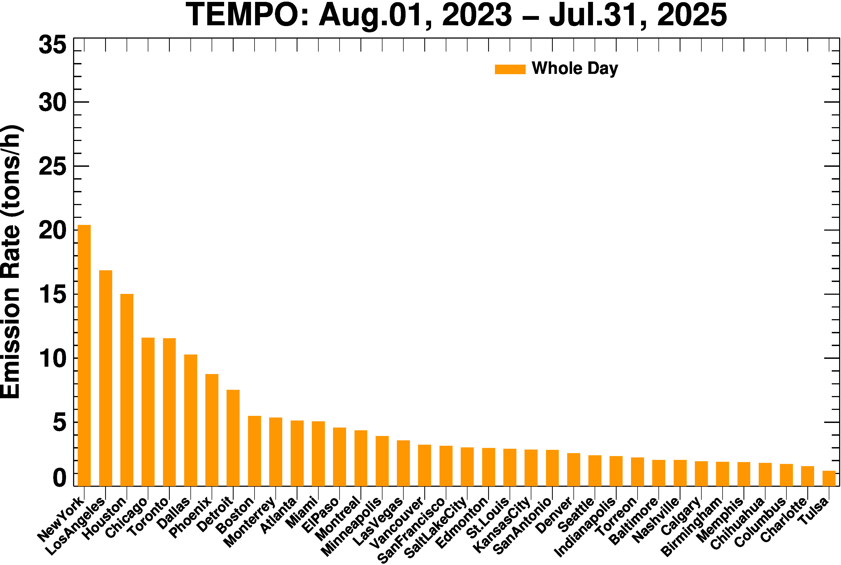
TEMPO NOx Emissions Variability

Slide 6
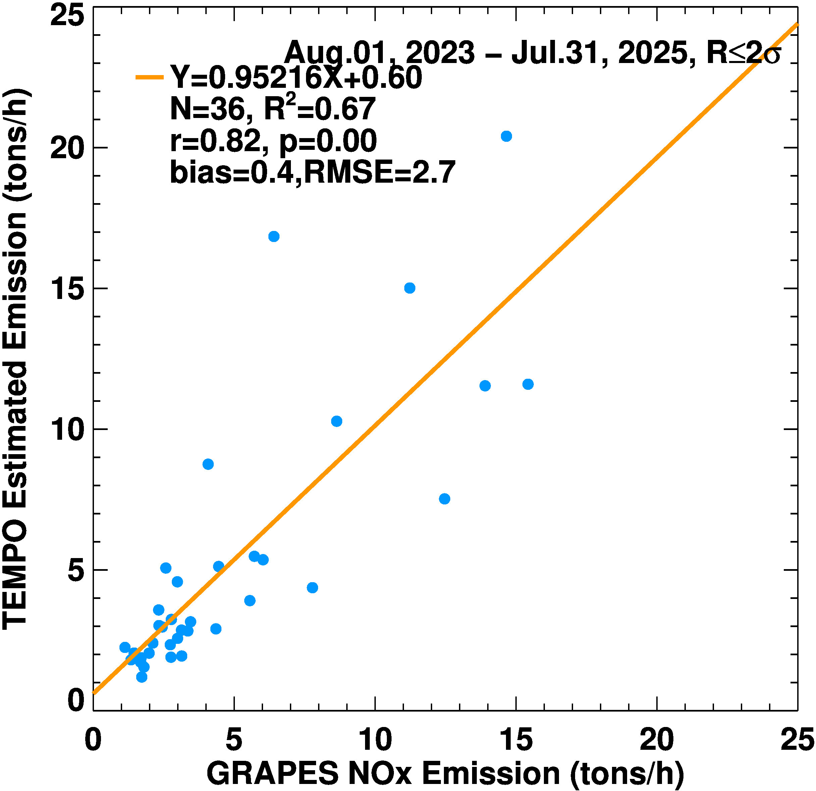

Lyu, C., Harkins, C., Li, M., Mueller, K., Prothero, J., Verreyken, B., et al. (2025). Development of the United States GReenhouse gas and Air Pollutants Emissions System (GRA2PES). Journal of Geophysical Research: Atmospheres, 130, e2025JD043597. https://doi.org/10.1029/2025JD043597

Slide 7
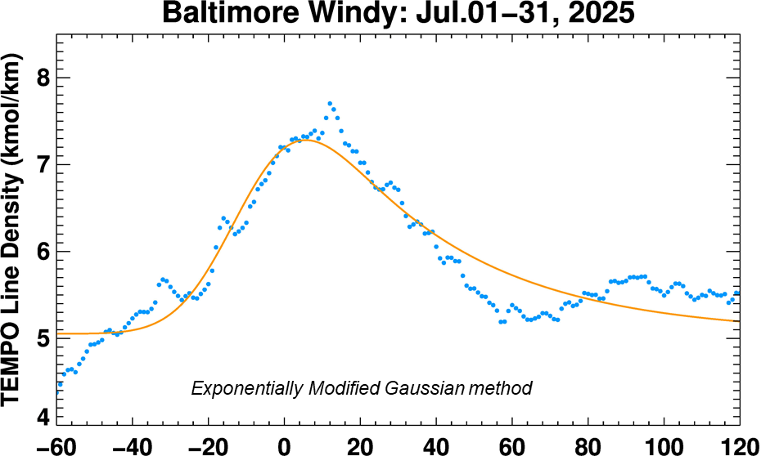
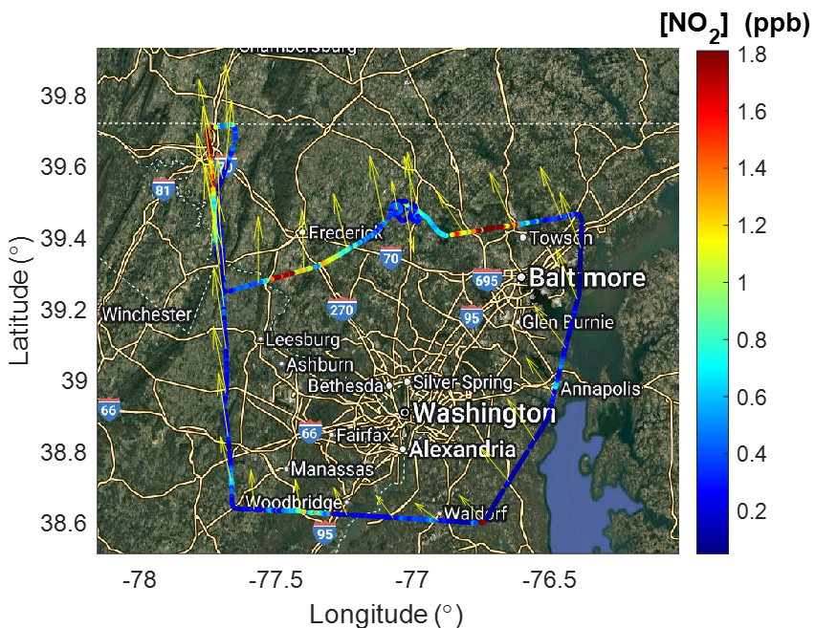
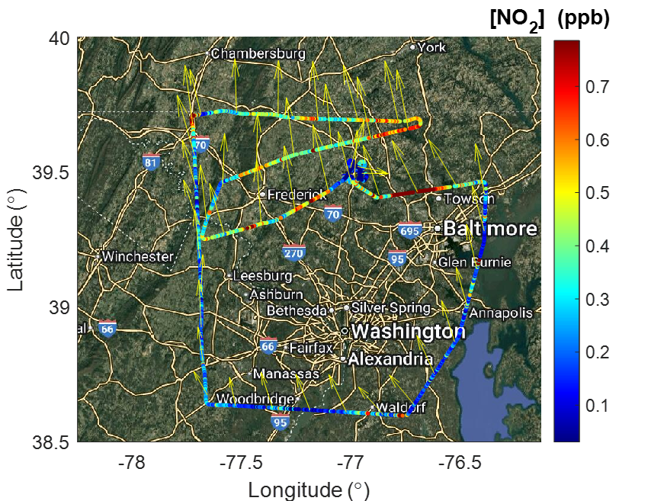
July 23, 2025 aircraft flights
Morning flight
Afternoon flight
System | NOx Flux (kg/hr)
TEMPO (July 2025) | 803.16
Aircraft (July 2025) | 657

Slide 8
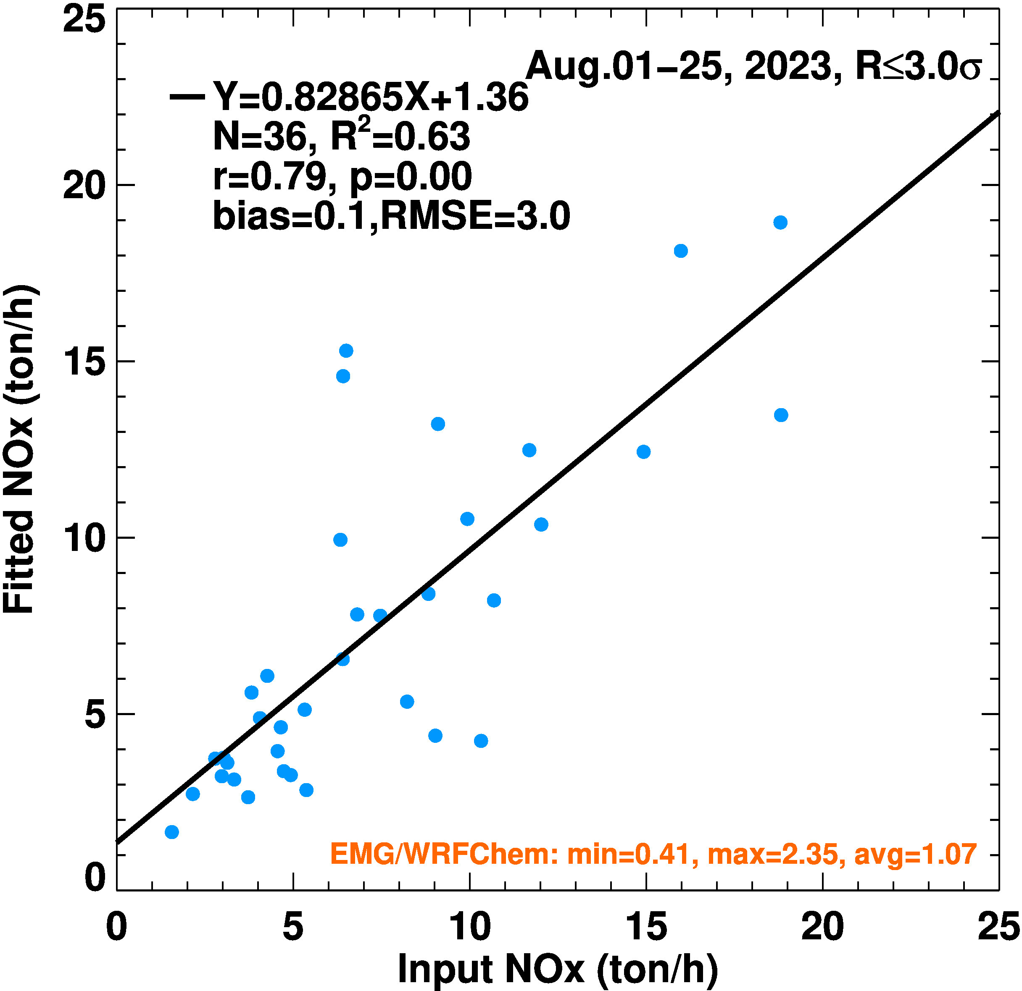
Independent Verification of EMG
Run EMG method on model forecast of tropNO2. Because the model uses known emissions, we can compare them to those derived from EMG.
All else (fitting domain, wind fields, realigning pixels in the wind direction) etc. in the EMG method remain the same.

Slide 9
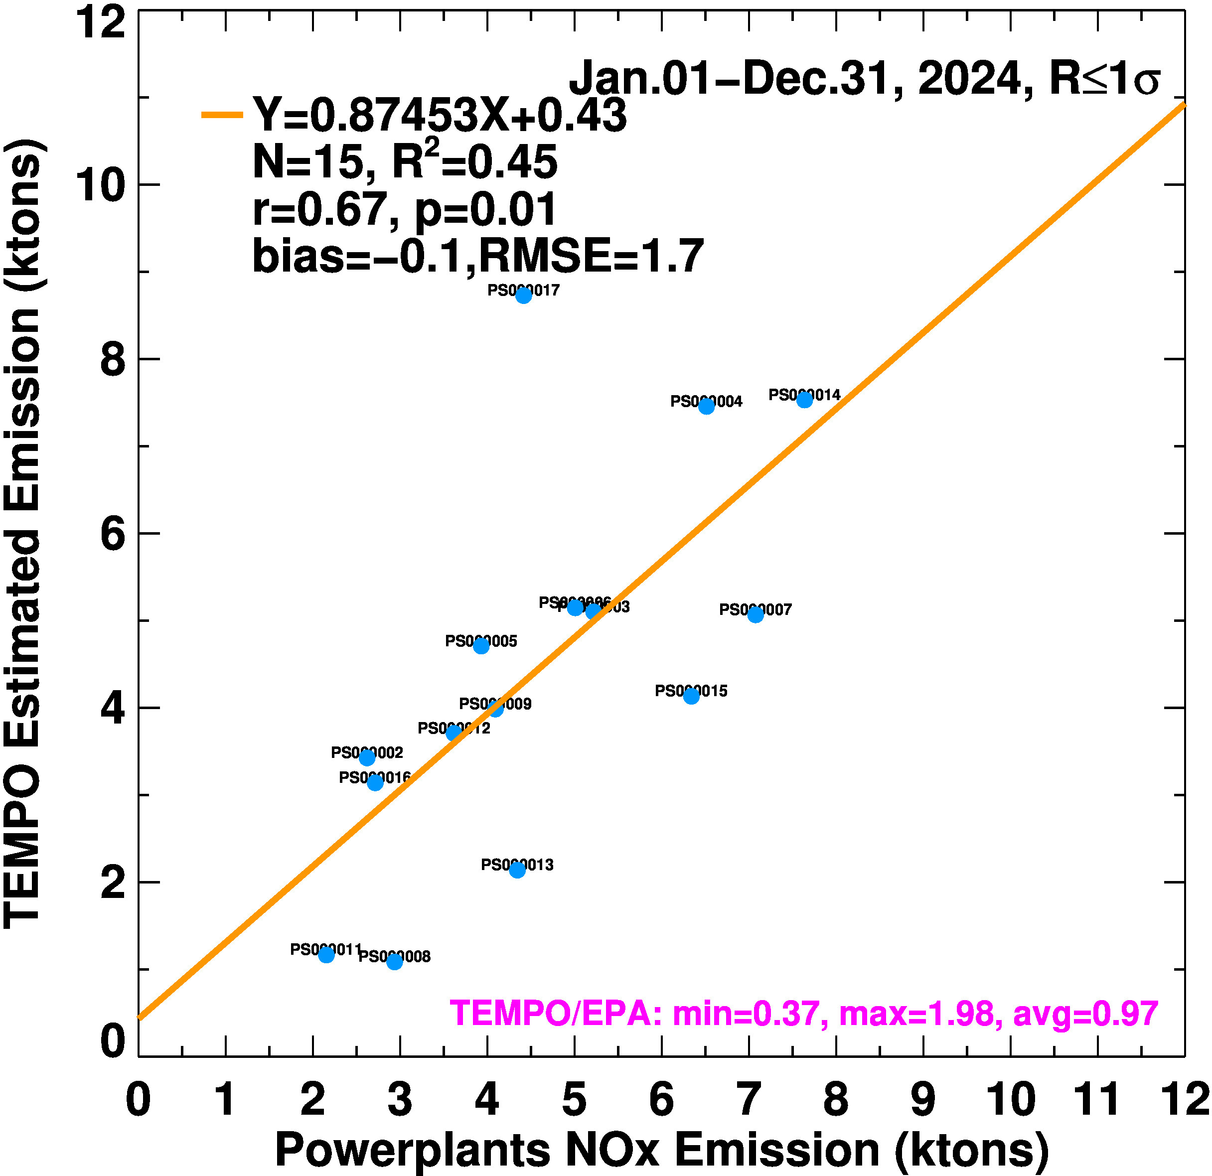
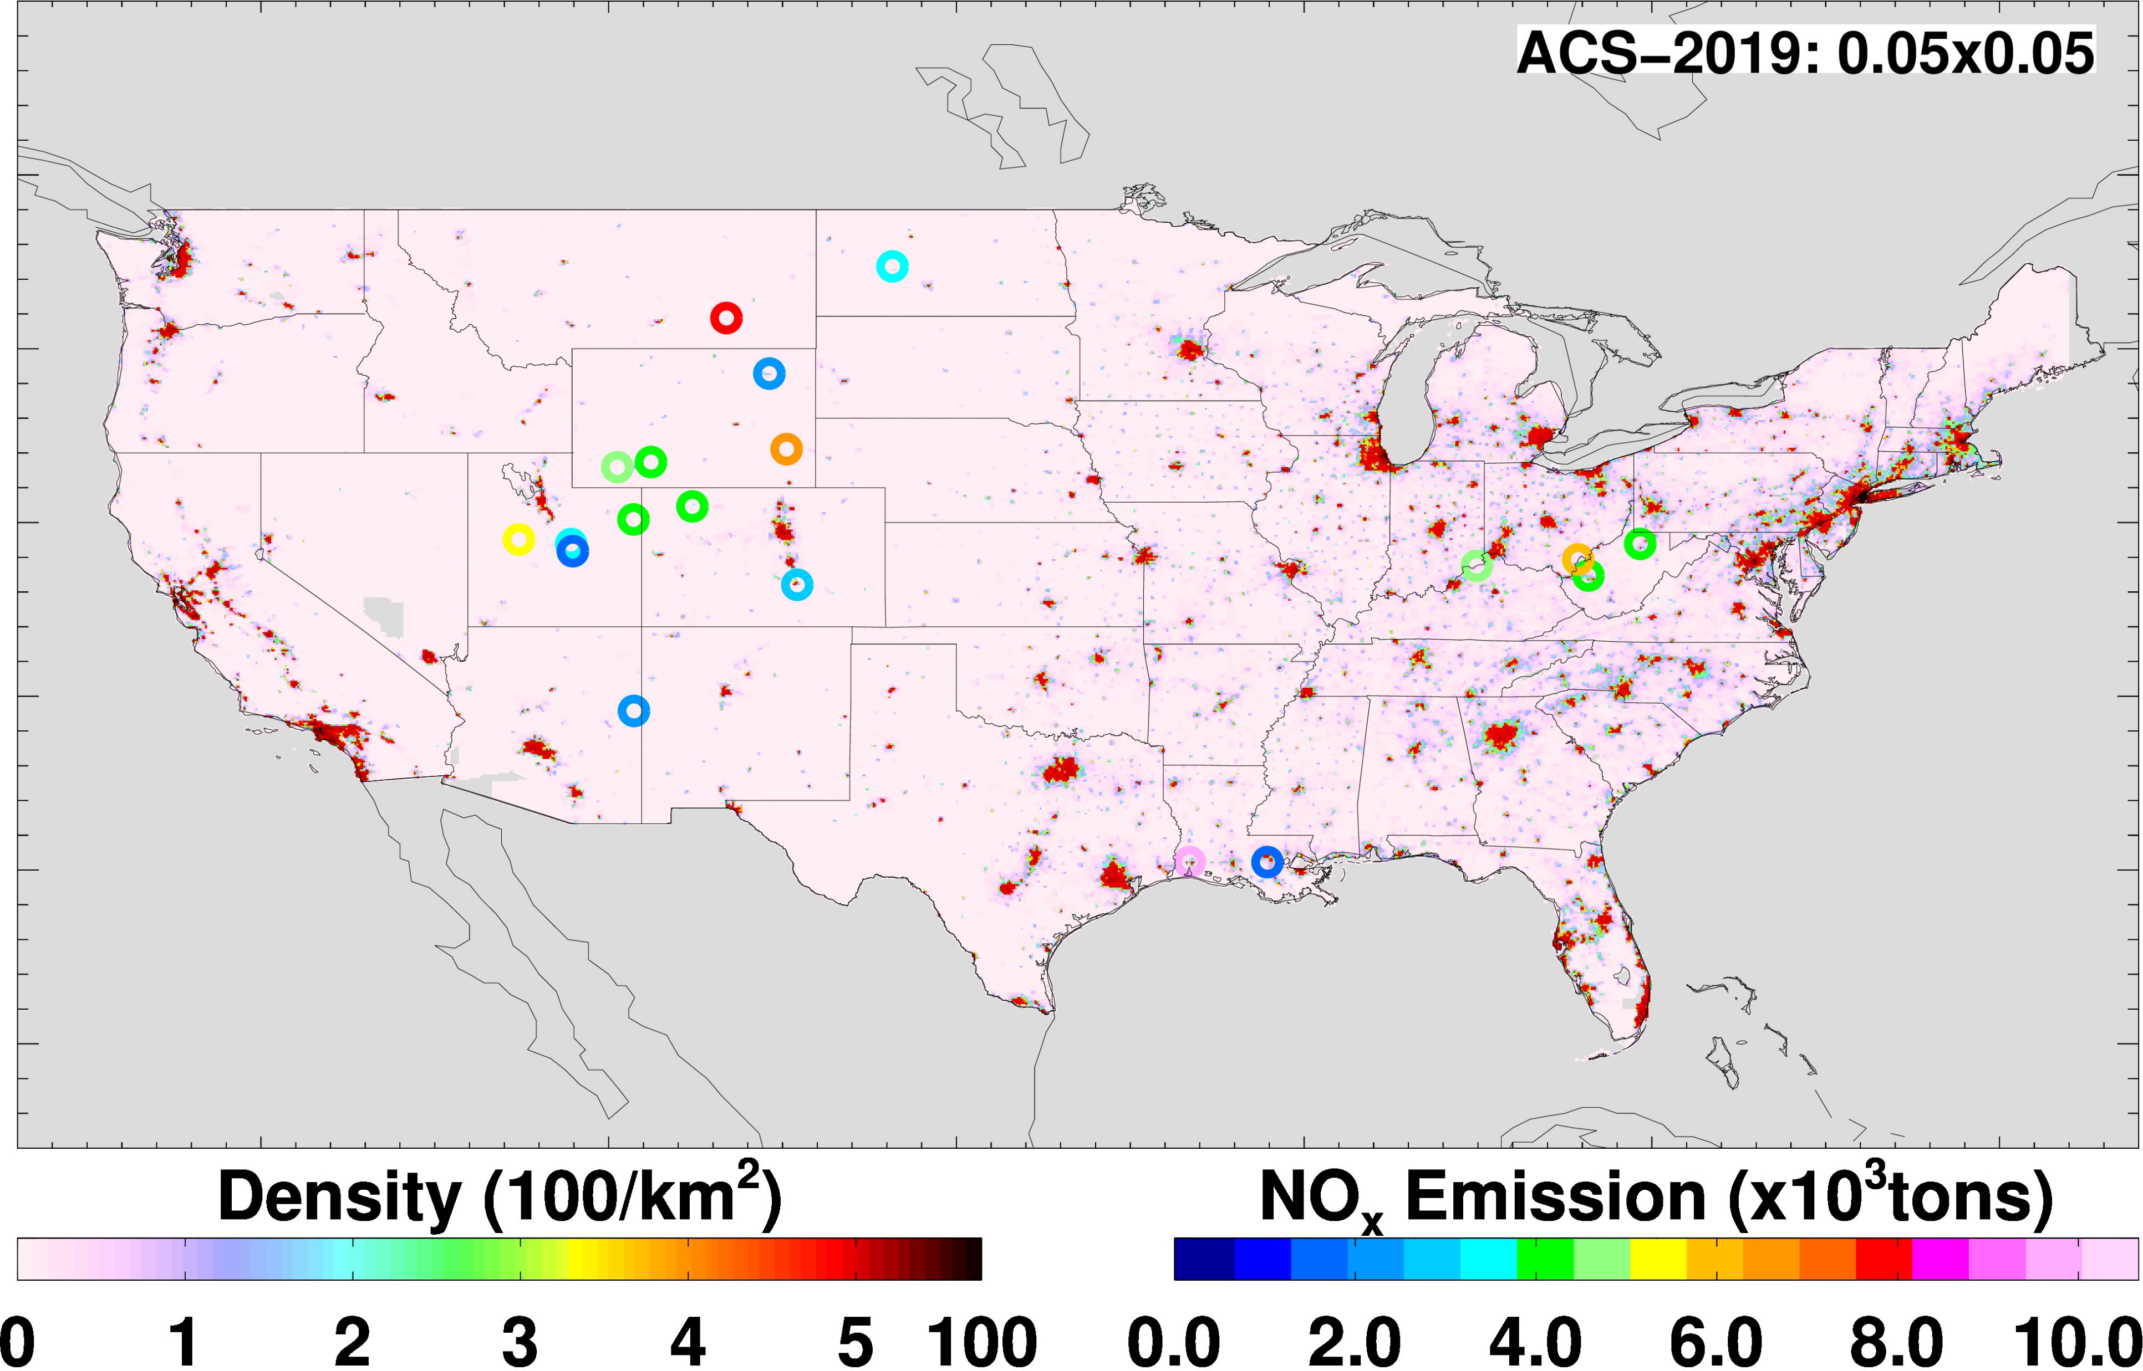
Independent Verification of EMG
Run EMG method on tropNO2 over power plants.
Data for power plants available from EPA

Slide 10
Conclusions
Conducted initial analysis to understand if the EMG method can be applied to TEMPO tropNO2 data on an hourly basis and demonstrated that it can be done
Case study analysis
  Baltimore Key bridge collapse
Repeat the analysis with V4 reprocessed TEMPO tropNO2 data
Work with NWS in incorporating emissions updates into CECE

