Slide 1


Classification of Daylight HCHO Hourly Variability Across North America and Comparison Against WRF-CMAQ: Insights from TEMPO's First Growing Season in 2024
Amir H. Souri^{1,2}, Sarah A. Strode^{1,2}, Junhua Liu^{1,2}, Barron Henderson³, Gonzalo Gonzalez Abad⁴, and Bryan N. Duncan¹
(1) NASA GSFC, (2) GESTARII, (3) EPA, (4) CFA
TEMPO DART 2026 - Iowa

Slide 2
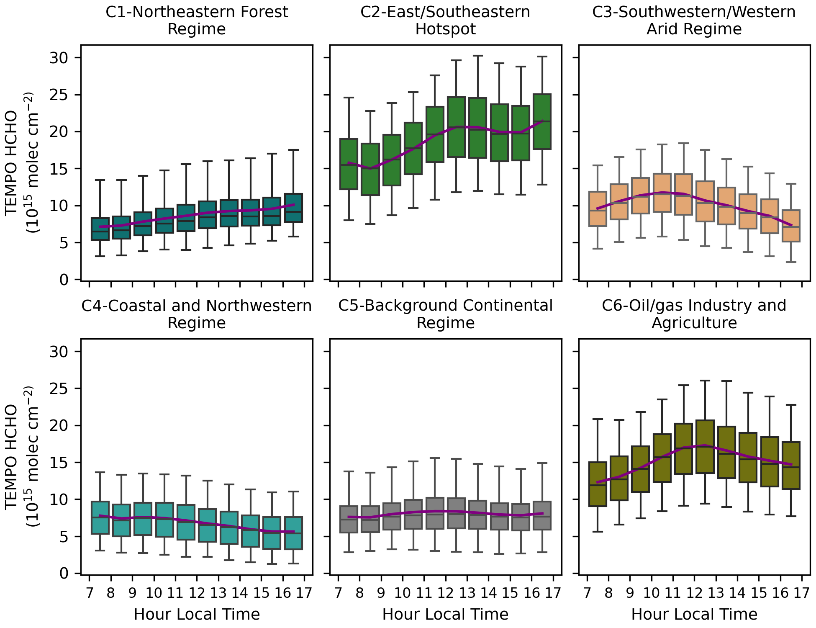
Objectives and Short Answers
What distinct hourly patterns of HCHO VCDs does TEMPO reveal across North America during the 2024 growing season?
Can a fine resolution regional model explain these patterns through the fundamental language of transport, emissions, chemistry, and dry/wet deposition?
Not really! WRF-CMAQ aligns well with TEMPO monthly-mean spatial patterns but fails to capture hourly HCHO evolution across most regimes except for C2.
So, what are the implications of the model being too flat?

Slide 3
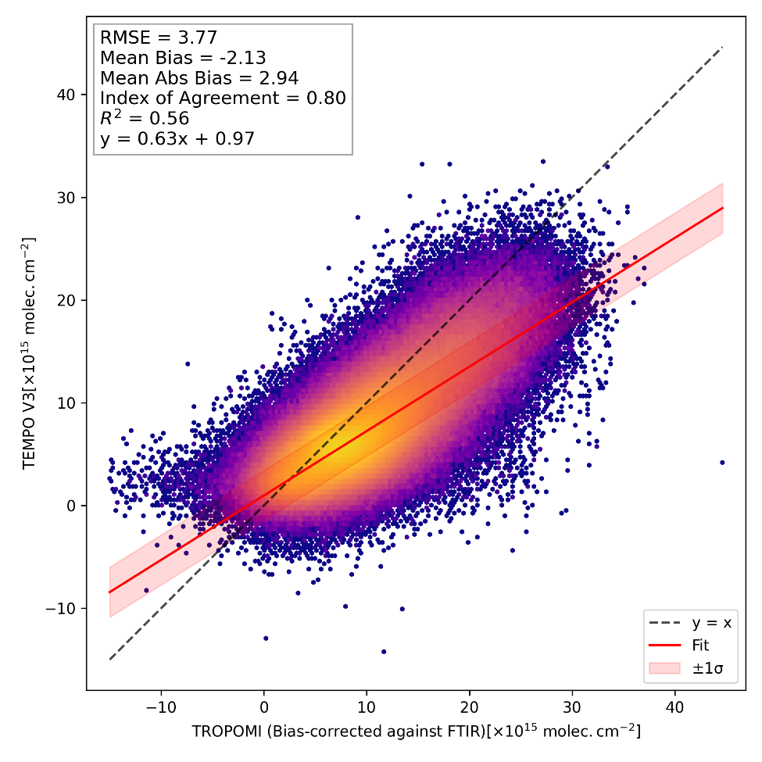
Tools and Data: Bias-Corrected TEMPO V3 HCHO
TEMPO L2 HCHO V3, hourly, monthly-mean May-Sep 2024
Quality screening: QF=0, SZA<70°, CF<0.2, 7AM-5PM LST, ≥5 obs/month (>15 samples per month per hour)
Regridded to 8 km² domain, monthly averaged
AMFs recalculated with WRF-CMAQ profiles to have consistent a priori assumption
Bias-corrected against TROPOMI/FTIR network (Souri et al., 2025)
Both TROPOMI and TEMPO errors are considered.
Two recent studies (Rawat et al. 2026 and Ortega et al. 2026) have shown little variations of TEMPO’s HCHO biases as function of time of the day.
Both studies found a good degree of correponsondance between TEMPO and FTIR/Pandora.

Slide 4
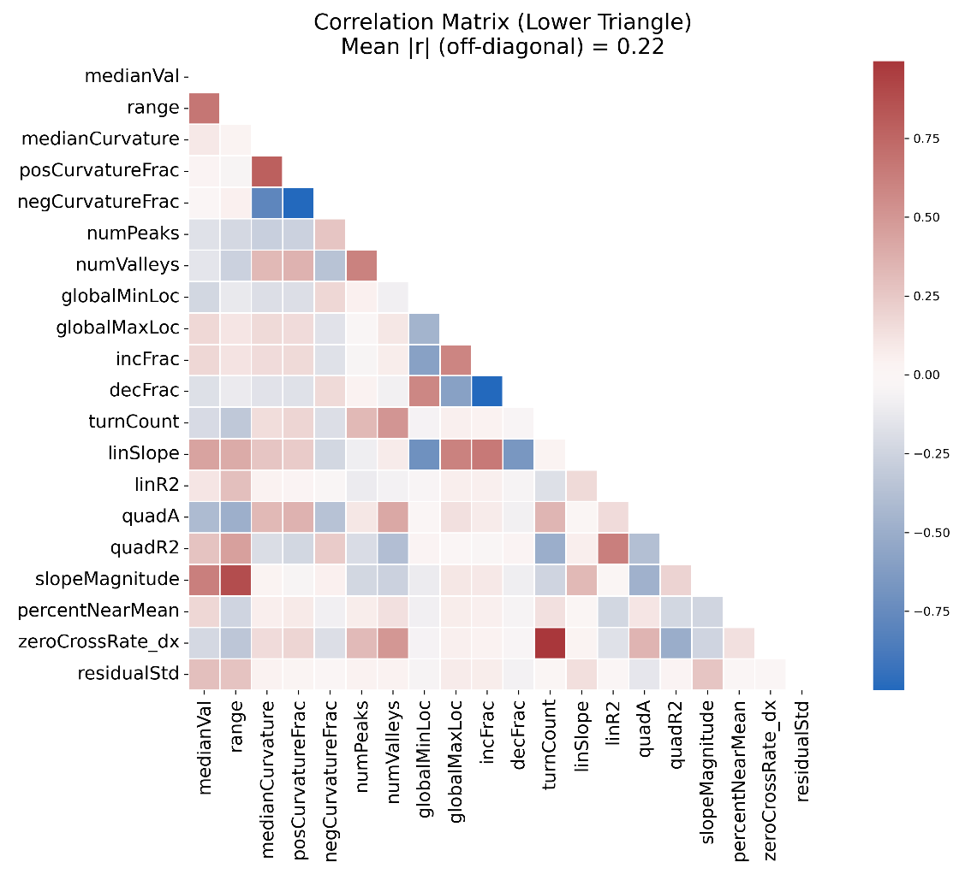
Tools and Data: Geographically-agnostic Classifier
Monthly-averaged profiles, 24 km² smoothing, ≥7 hrs/pixel → 1.2M profiles out of 1.8M
20 shape/magnitude features extracted per profile:
  Geometric: median, range, curvature, peaks/valleys locations
  Statistical: monotonicity, linear/quadratic trends, flatness, oscillatory behavior
  Noise proxy: standard deviation of residuals from interpolated profiles
Correlation matrix was deceiving, VIF showed high values for half of the features
PCA reduces multicollinearity → 10 PCs explaining >90% variance
K-means clustering → 6 distinct regimes
The number of PCAs and clusters is determined through trial-error.

Slide 5
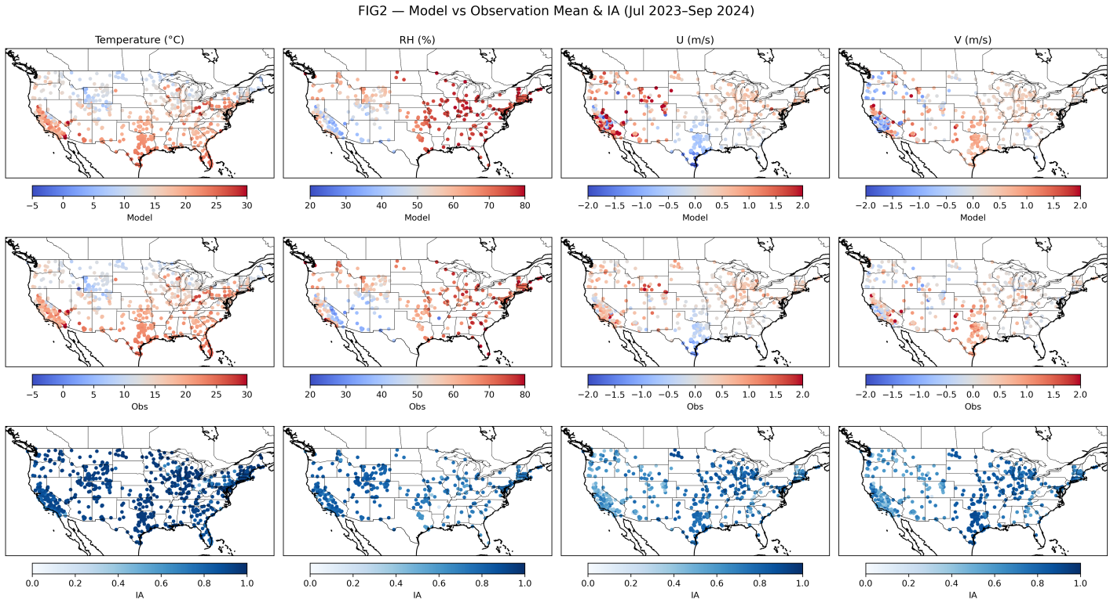
Tools and Data: WRF-CMAQ model (8x8 km²)
WRFv4.5 Meteorology:
Initialized with 3-hourly NCAR NARR reanalysis
Above-PBL nudging for temperature, winds, and moisture
Soil moisture/temperature constrained by 6-hourly surface observations
Key schemes: Thompson microphysics, Tiedtke cumulus, RRTMG radiation, ACM2 PBL, Pleim-Xiu LSM
CMAQv5.5 Chemistry:
Gas-phase: CB06r7 carbon-bond mechanism
Aerosols: AERO7 modal scheme
Boundary conditions: GEOS-CFv1 (3-hourly)
Emissions:
Anthropogenic: NEI2022v2 (hourly)
Biogenic: BEISv4 (interactive)
Lightning NOX: Kang et al. (2019)
Biomass burning: FINNv1 (65% PBL, 35% free troposphere)
Hourly 1:1 correlation was found > 0.9 for surface air temperature and RH and > 0.6 for U and V wind components.

Slide 6
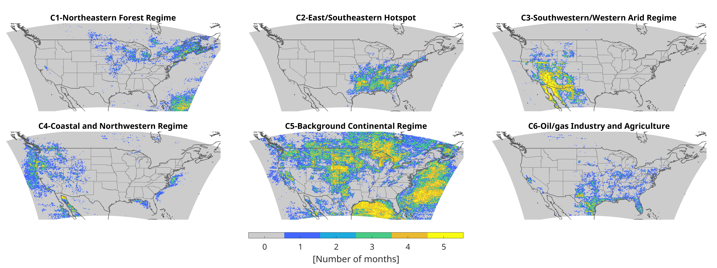
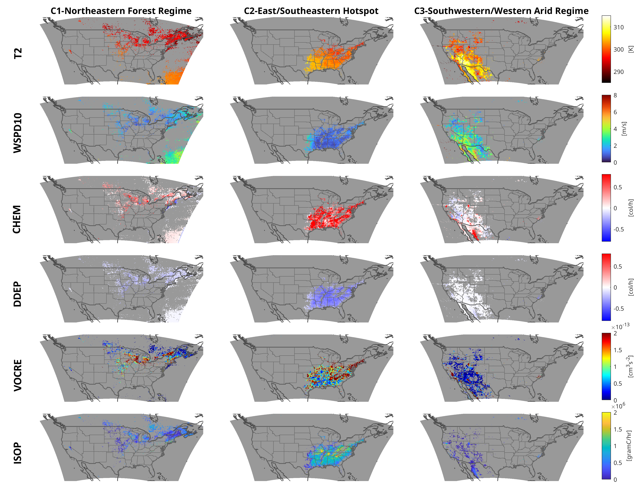
Spatial and temporal variability
13.5% occurrence 6.9% occurrence 11.0% occurrence

Slide 7
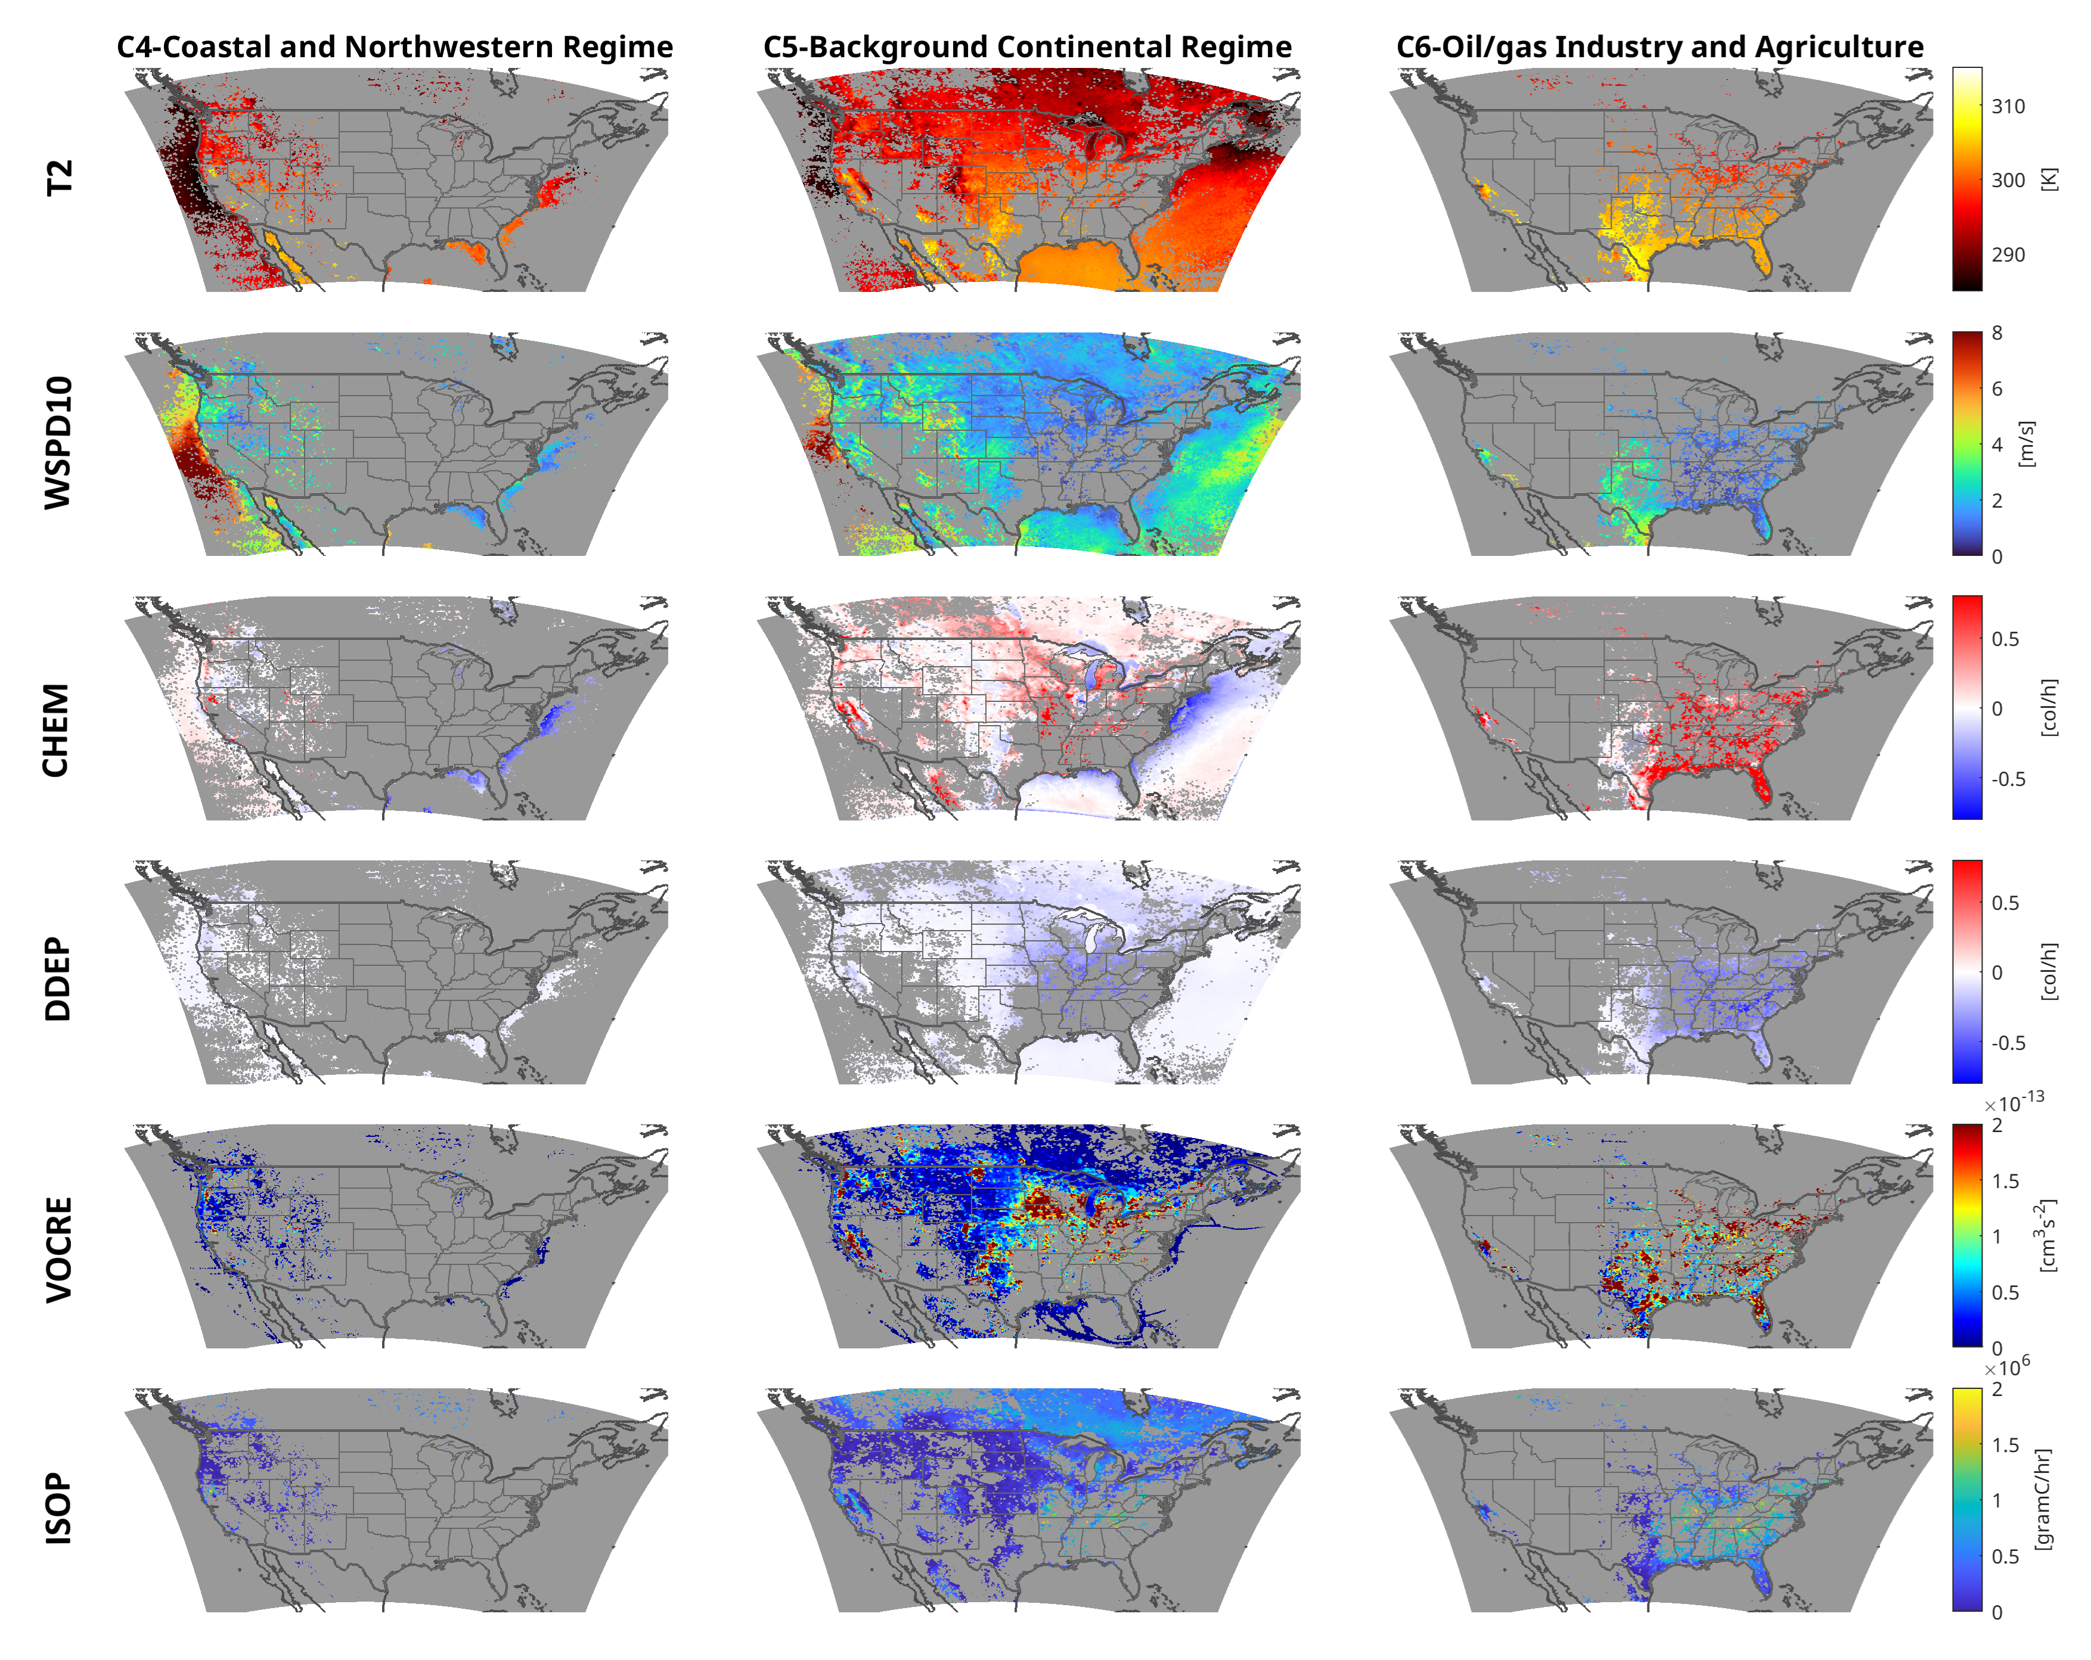
Spatial and temporal variability
11.8% occurrence 47.7% occurrence 9.1% occurrence

Slide 8
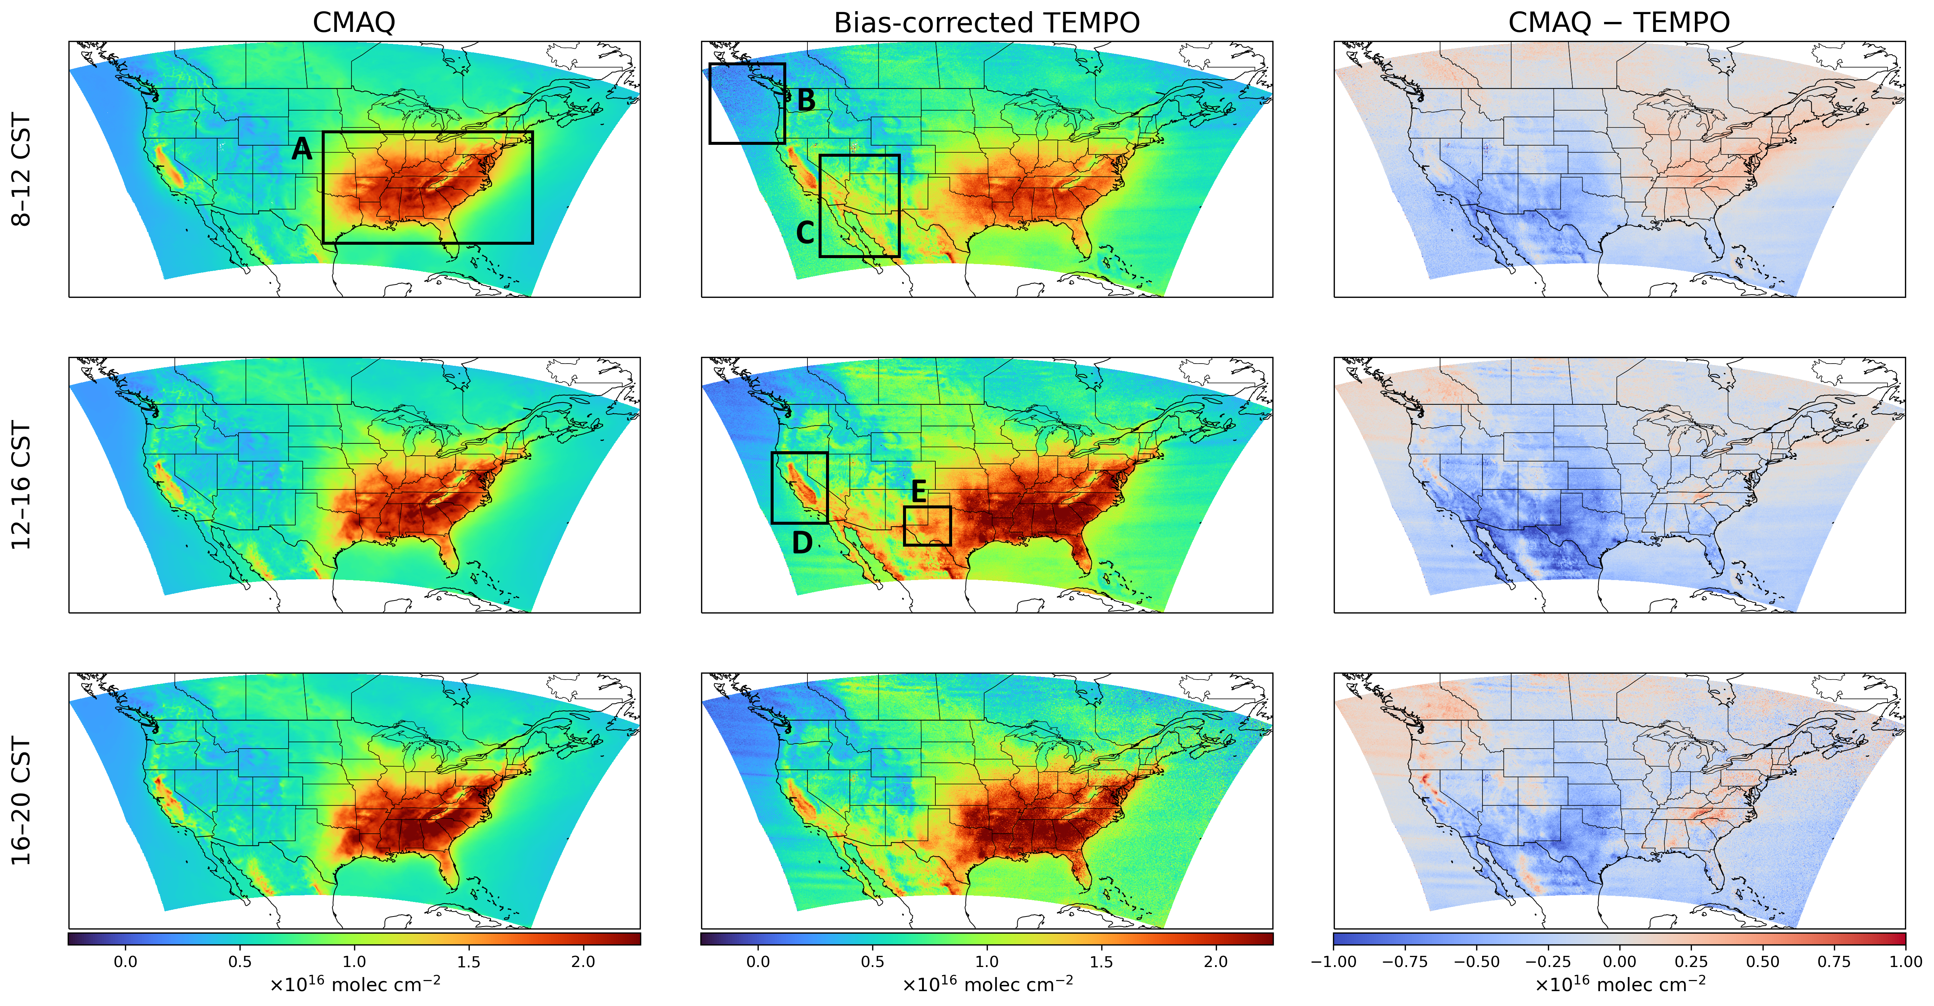
WRF-CMAQ vs. TEMPO
Box A (Southeast, C2):
HCHO: biogenic isoprene + anthropogenic VOCs
CMAQ: good spatial pattern but delayed morning buildup
Boxes C/E (Southwest/Permian, C3/C6):
HCHO: urban VOCs + oil/gas
CMAQ: largest underestimation, worst at midday
Confirmed across multiple studies (Skipper et al., 2024; Hoque et al., 2024)
TEMPO reveals midday peak of bias
Comparison of May–September 2024 mean total HCHO columns from CMAQ simulations (left column), bias-corrected TEMPO observations (middle column), and their differences (CMAQ minus TEMPO, right column) at three times of day

Slide 9
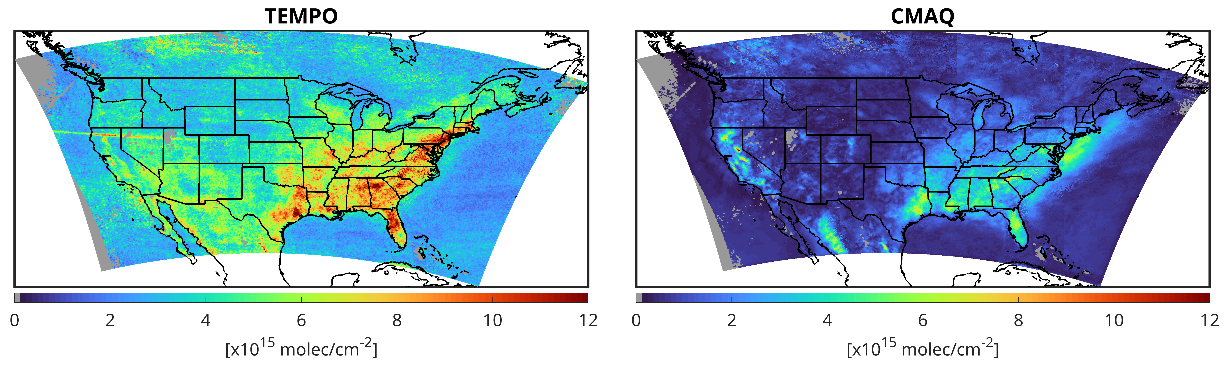
Amplitude of the diurnal cycle
TEMPO: large daylight amplitude (>8×10¹⁵) over eastern US NOX/isoprene hotspots
CMAQ captures spatial pattern (R=0.54) but underestimates amplitude by 3.6×10¹⁵ universally
Universal deficit (ocean, mountains, deserts) points to a more fundamental issue
Likely causes: missing oxygenated VOCs, CB06r7 HCHO yield errors, boundary conditions, and insufficient OH daily variability

Slide 10
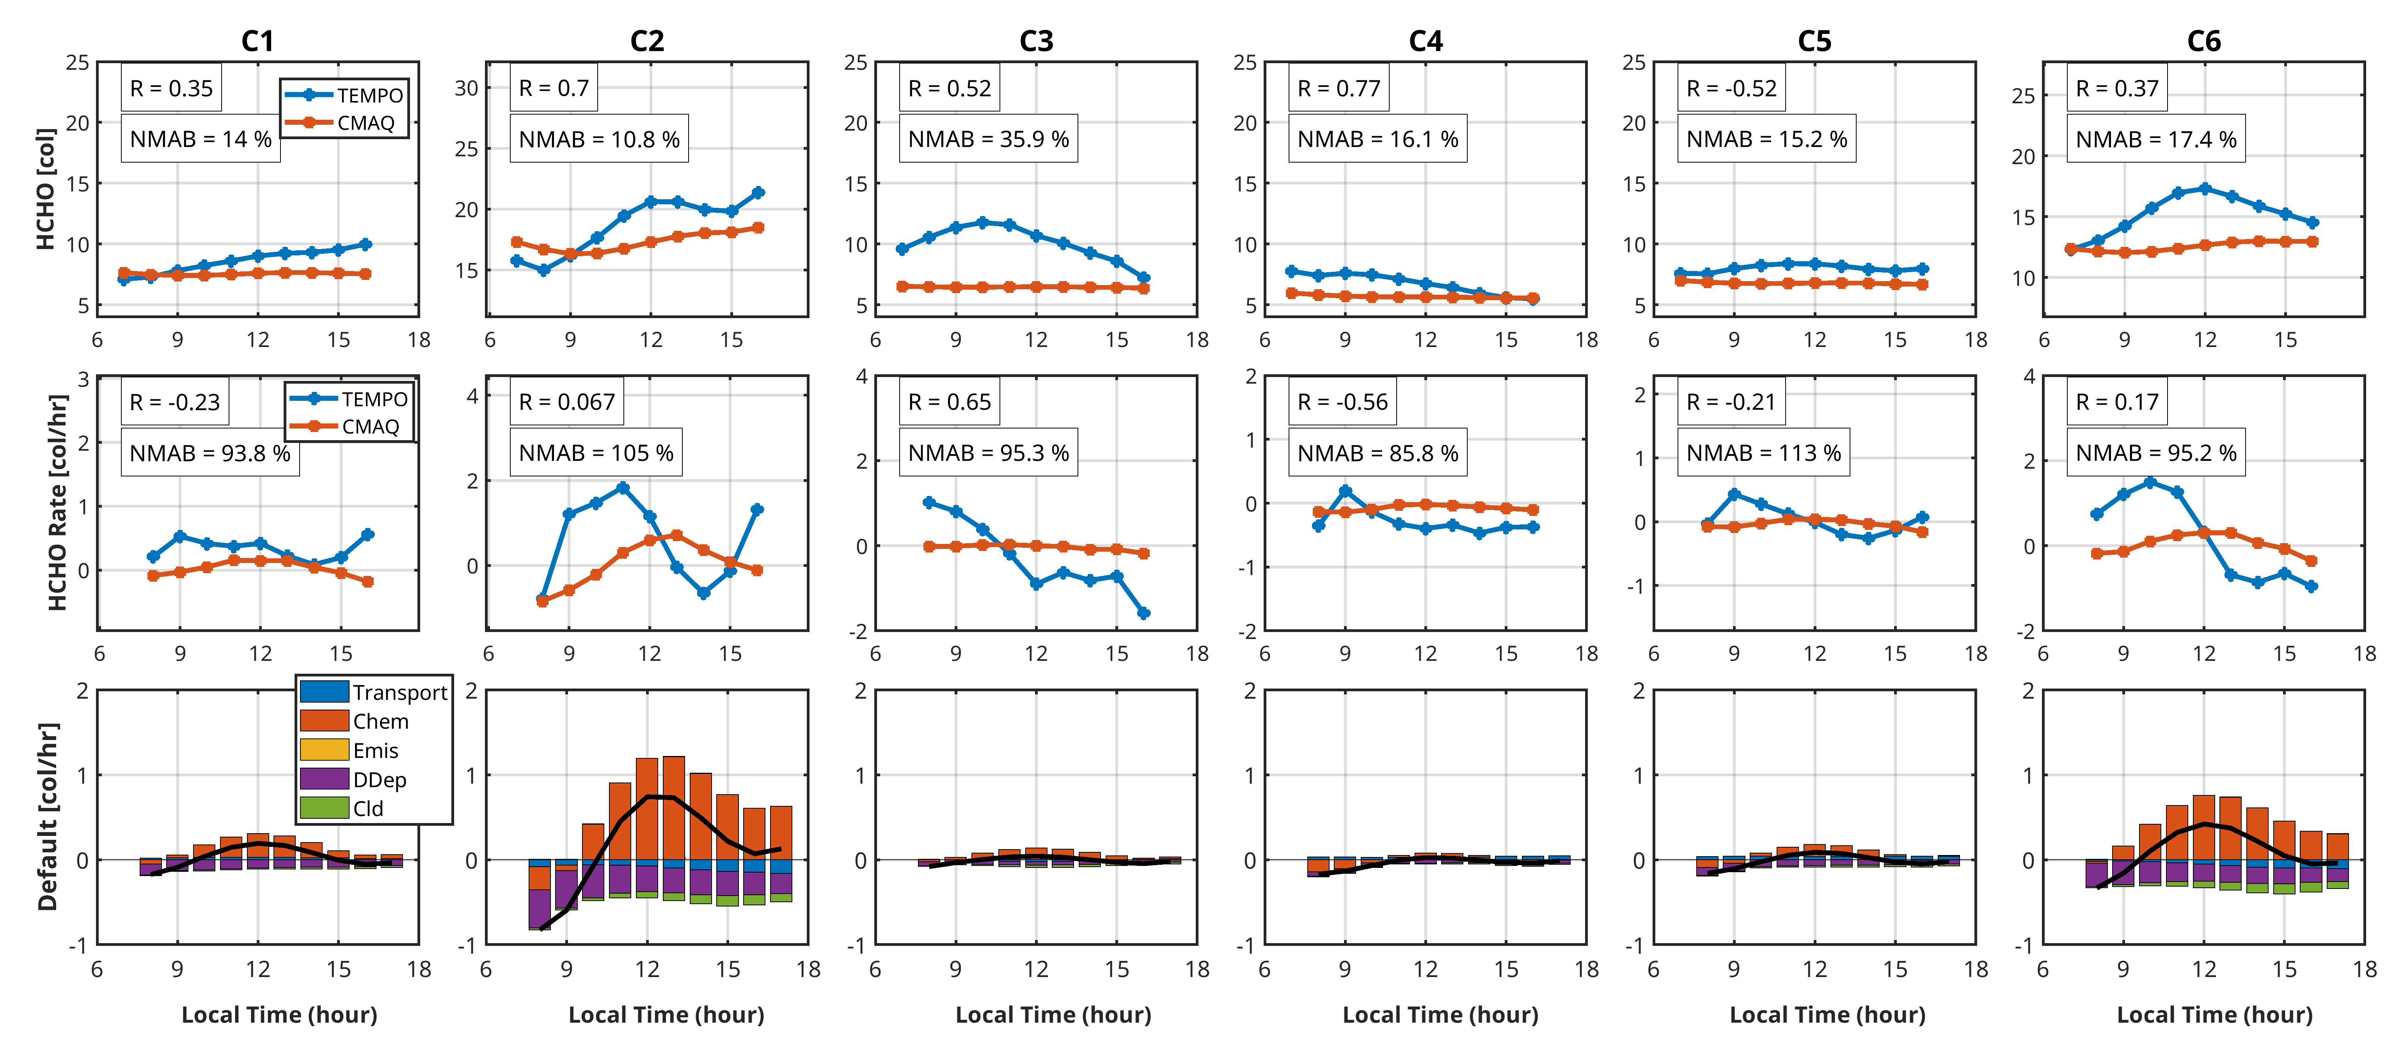
WRF-CMAQ: Spatially Gifted, Temporally Challenged
C2/C6: Delayed chemistry onset; wrong NOX-VOC regime; HCHO yields from CB06; M3Dry overestimates dry deposition (×4) (Hogrefe et al., 2023)
C3: Missing morning production + insufficient afternoon ventilation signal from weak HCHO gradients
Universal: Amplitude deficit

Slide 11
Summary
TEMPO reveals six distinct daylight HCHO regimes across North America that develop naturally from the data without geographic constraints
WRF-CMAQ gets the spatial picture approximately right (within 10% for strong signals) but fundamentally misrepresents the timing and amplitude of hourly HCHO evolution.
  ☠These deficiencies are completely hidden from LEO satellite observations
A universal daylight amplitude deficit across all surface types points to missing chemistry beyond regional emission errors
Our work shows a new template for exploiting geostationary observations to systematically diagnose and prioritize model development, but multi-model studies are needed to distinguish universal from model-specific failures.
  This underestimation of daylight HCHO amplitude is not unique to our simulation, having been independently reported across multiple chemical transport models (Tao et al., 2025; Zhao et al., 2025).

Slide 12
Thanks for your attention!
This project is funded by the TEMPO/ACX DART program.
Contact: a.souri@nasa.gov

Slide 13
Backup slides

Slide 14
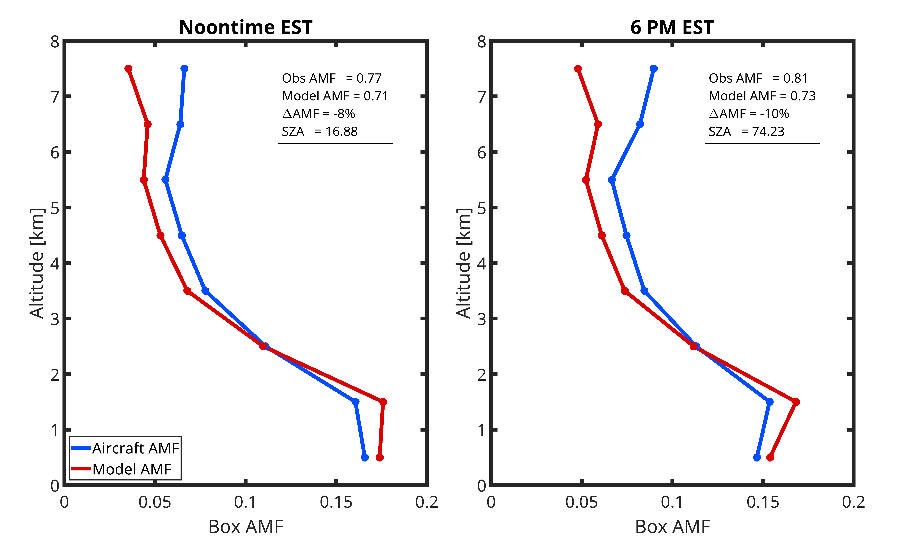
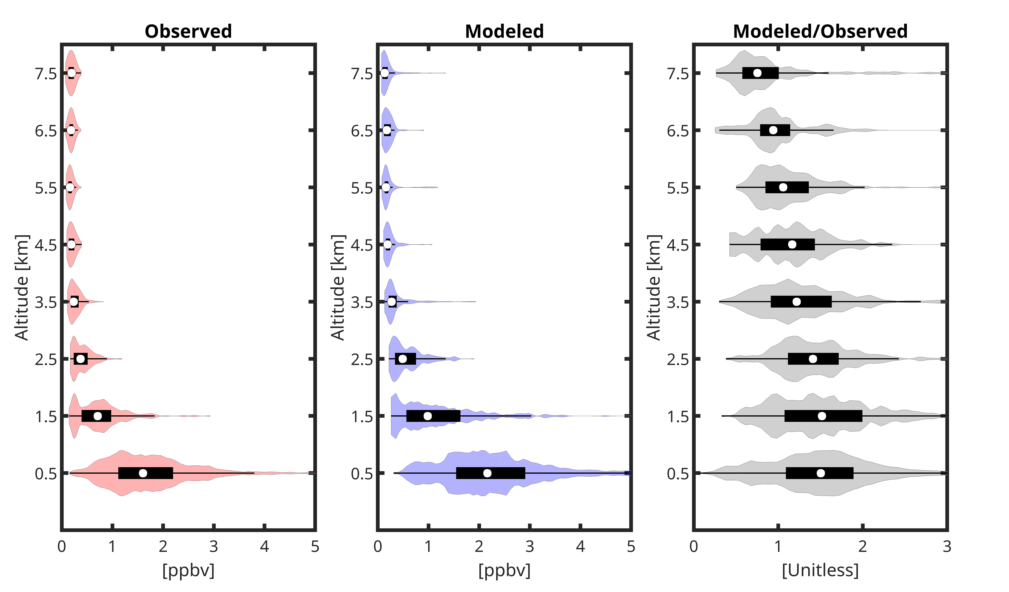
AEROMMA AMFs

Slide 15
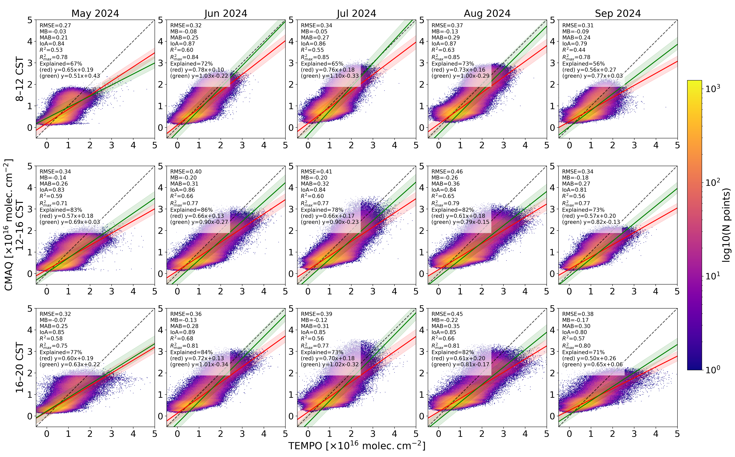
Scatterplots for TEMPO vs. CMAQ

Slide 16
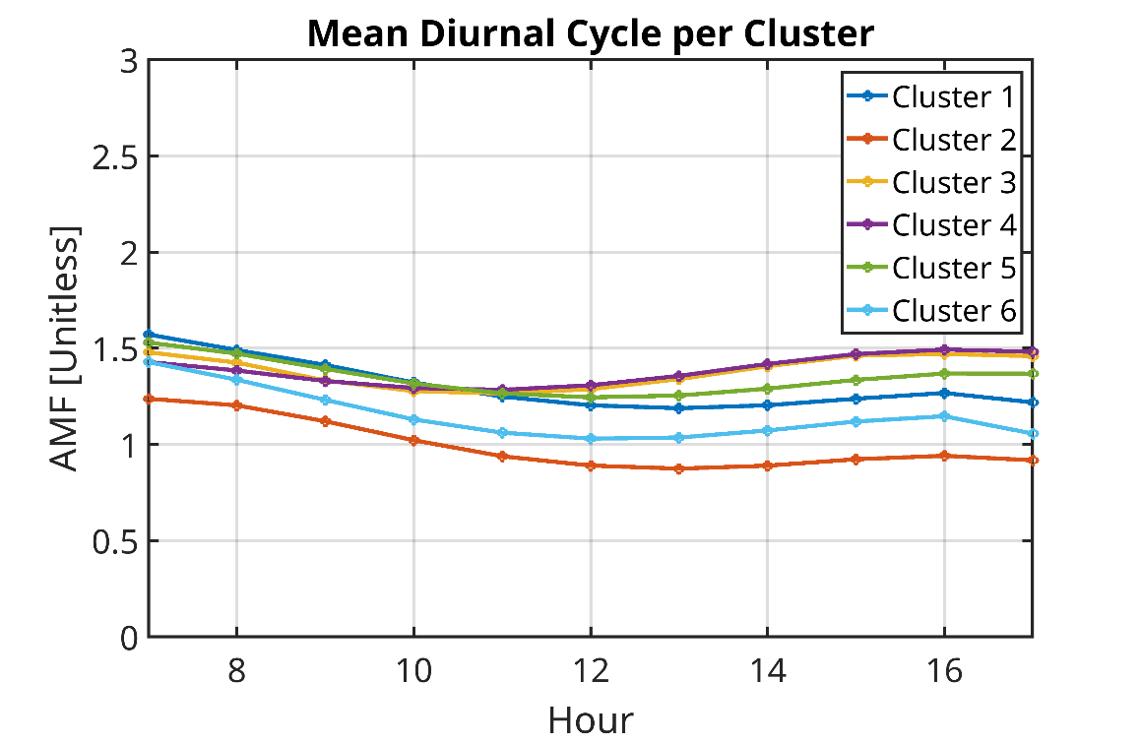
AMFs don’t explain the clusters

Slide 17
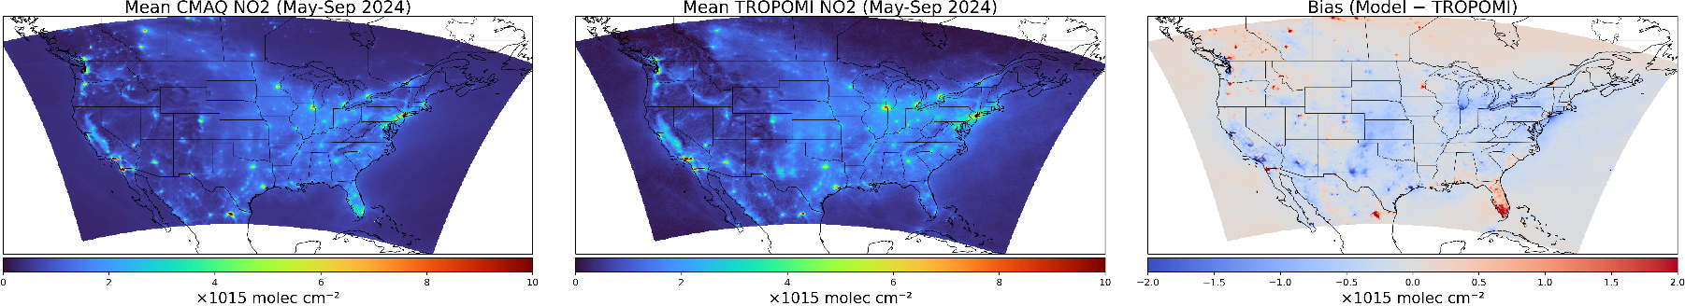
CMAQ NO2 vs. Bias-corrected TROPOMI NO2

