Slide 1
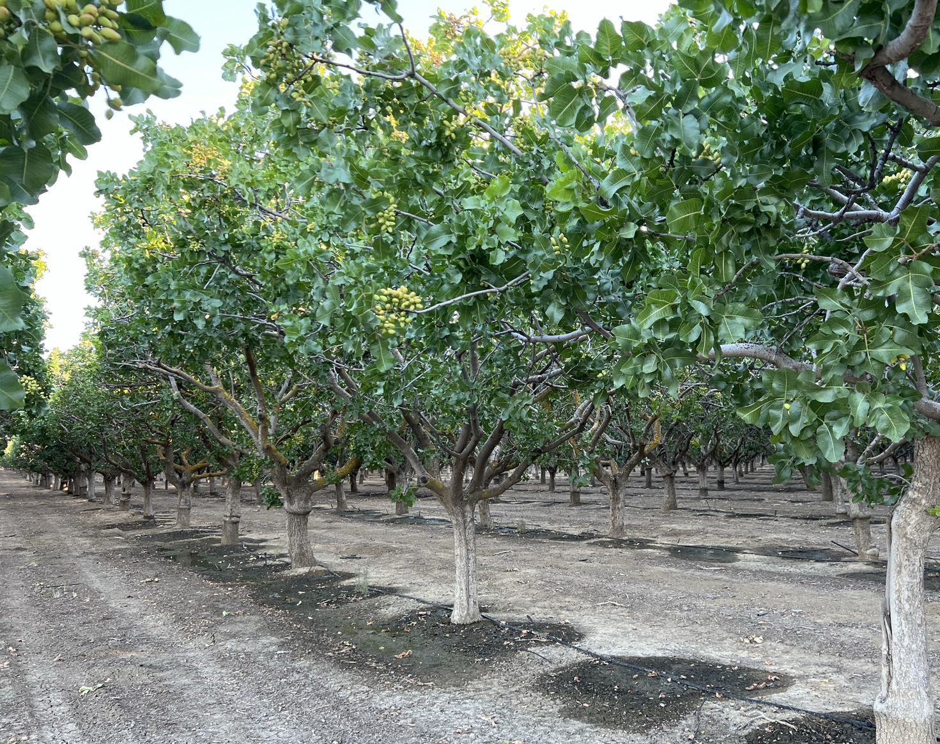


Towards Quantifying NO_{x} Fluxes from Agricultural Land
TEMPO DART meeting
Jun 18, 2026 @Iowa City
PI: Dien Wu (CSU Atmos Sci)
Co-Is: Stephen Ogle, Zhuangji Wang (CSU Ecology), Anping Chen (CSU Biology)
Collaborators: Joshua Laughner & Le Kuai (Caltech/JPL)
Grant #: 80NSSC26K0139
Notes:
L-A interaction

Slide 2

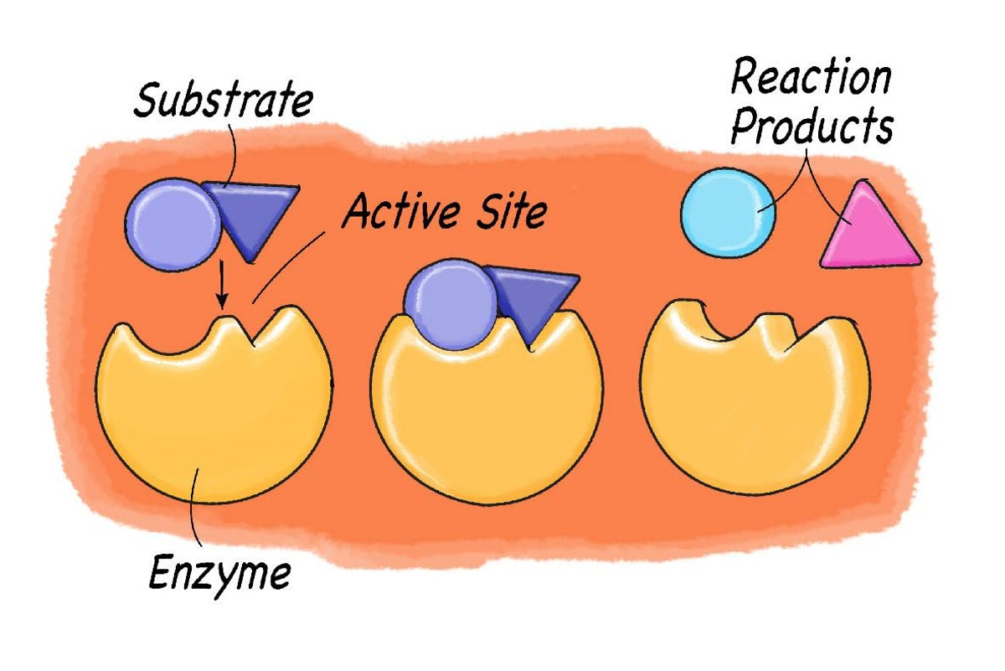

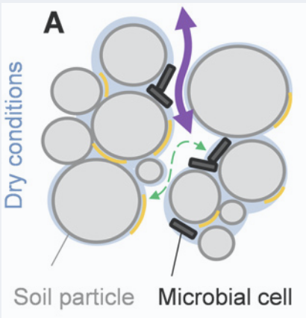
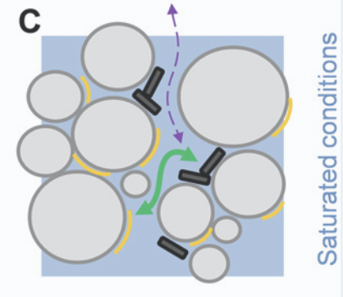
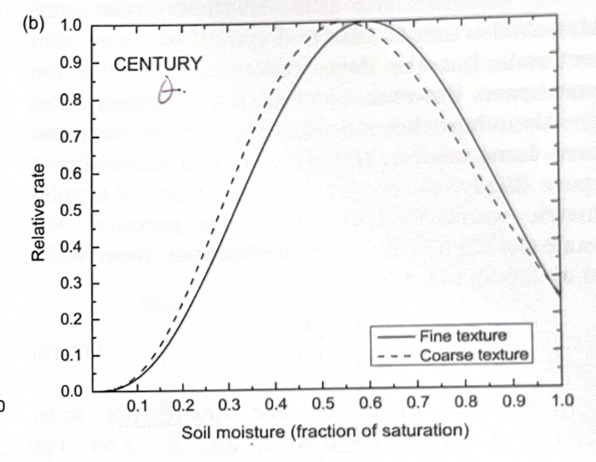
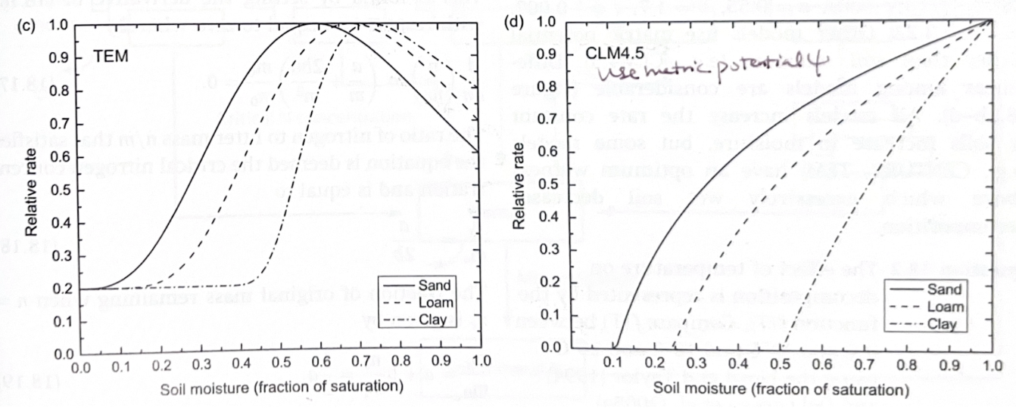
Large Discrepancies in Soil Respiration (C) Response in Land Surface Models
Microbial activity (H₂O) and Microbial pathways (O₂)
microbes
CENTURY model Terrestrial Ecosystem model Community Land Model v4.5
Water limited
O₂ limited
Finer
Coarser sandy
Coarser
Finer clay
[Moyano et al. 2013; Bonan et al., 2018]
Notes:
Models differ – e.g., CLM important for long-term predictability

Slide 3
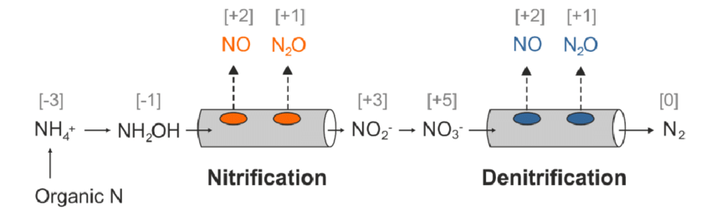
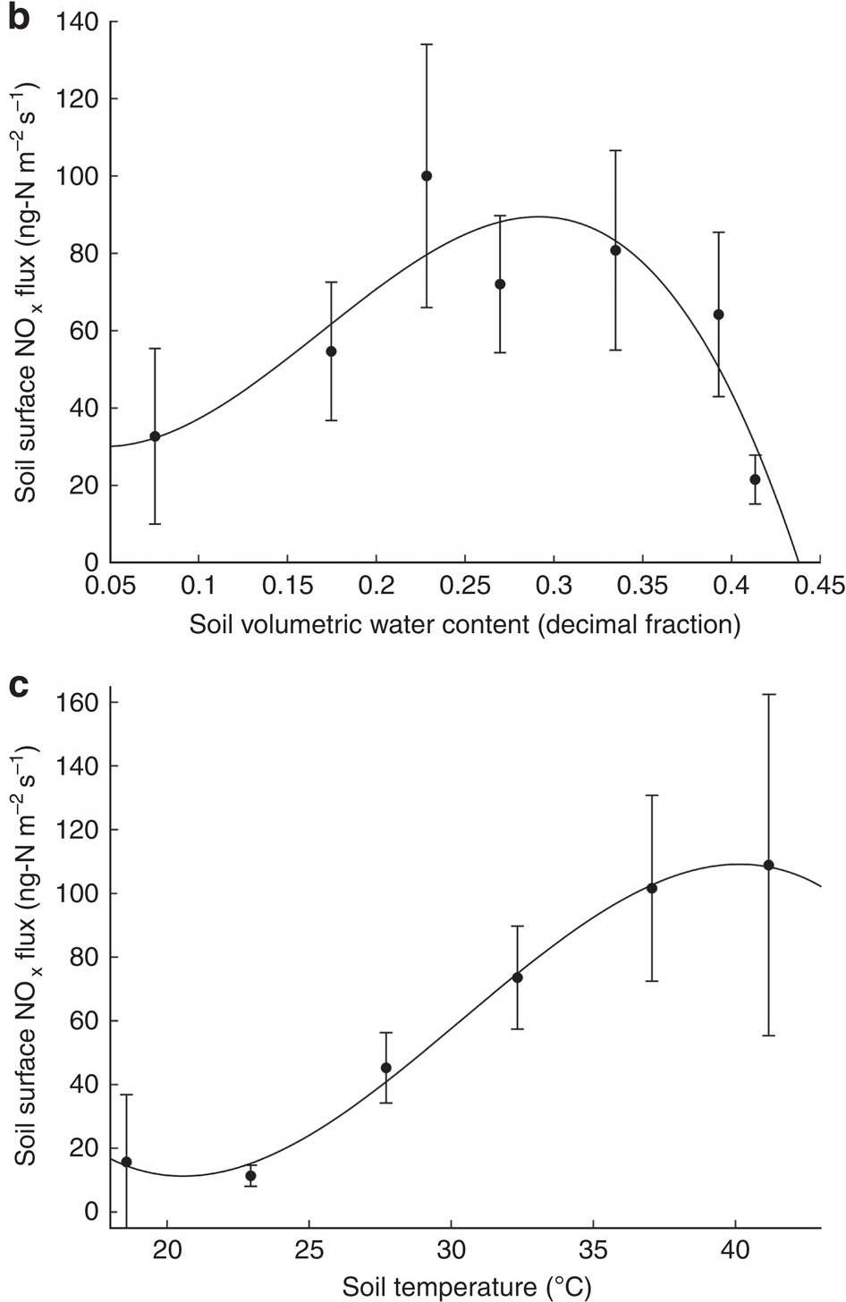
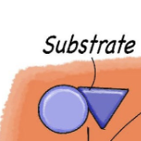
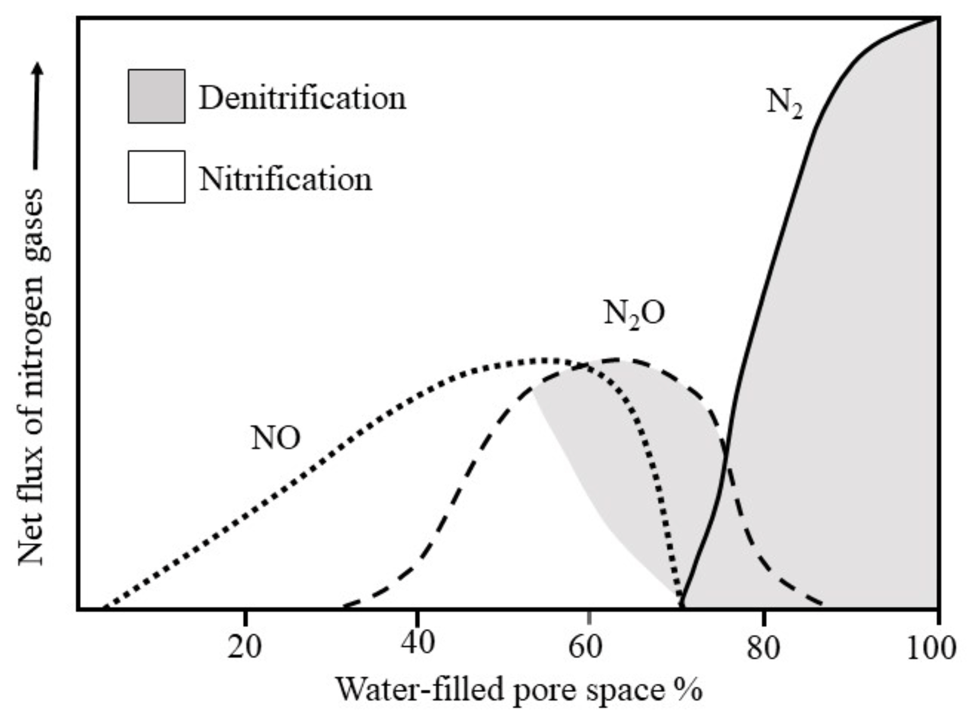
Under-constrained Responses of Soil N Fluxes vs. Soil Moisture
Limited in situ flux samples (tower, chamber, aircraft)
Limited ¹⁵N for tagging nitrification vs. denitrification
O₂ limited
Soil temperature response
Water limited
[Oikawa et al., 2015]
Notes:
Eddy covariance for atmos N fluxes; or soil chamber for soil-atm exchanges
Mineralization vs. ammonization – depending on substrate C:N ratios
Nitrifiers need O2 → more into de-nitrification with can occur under O2-depleted regimes

Slide 4
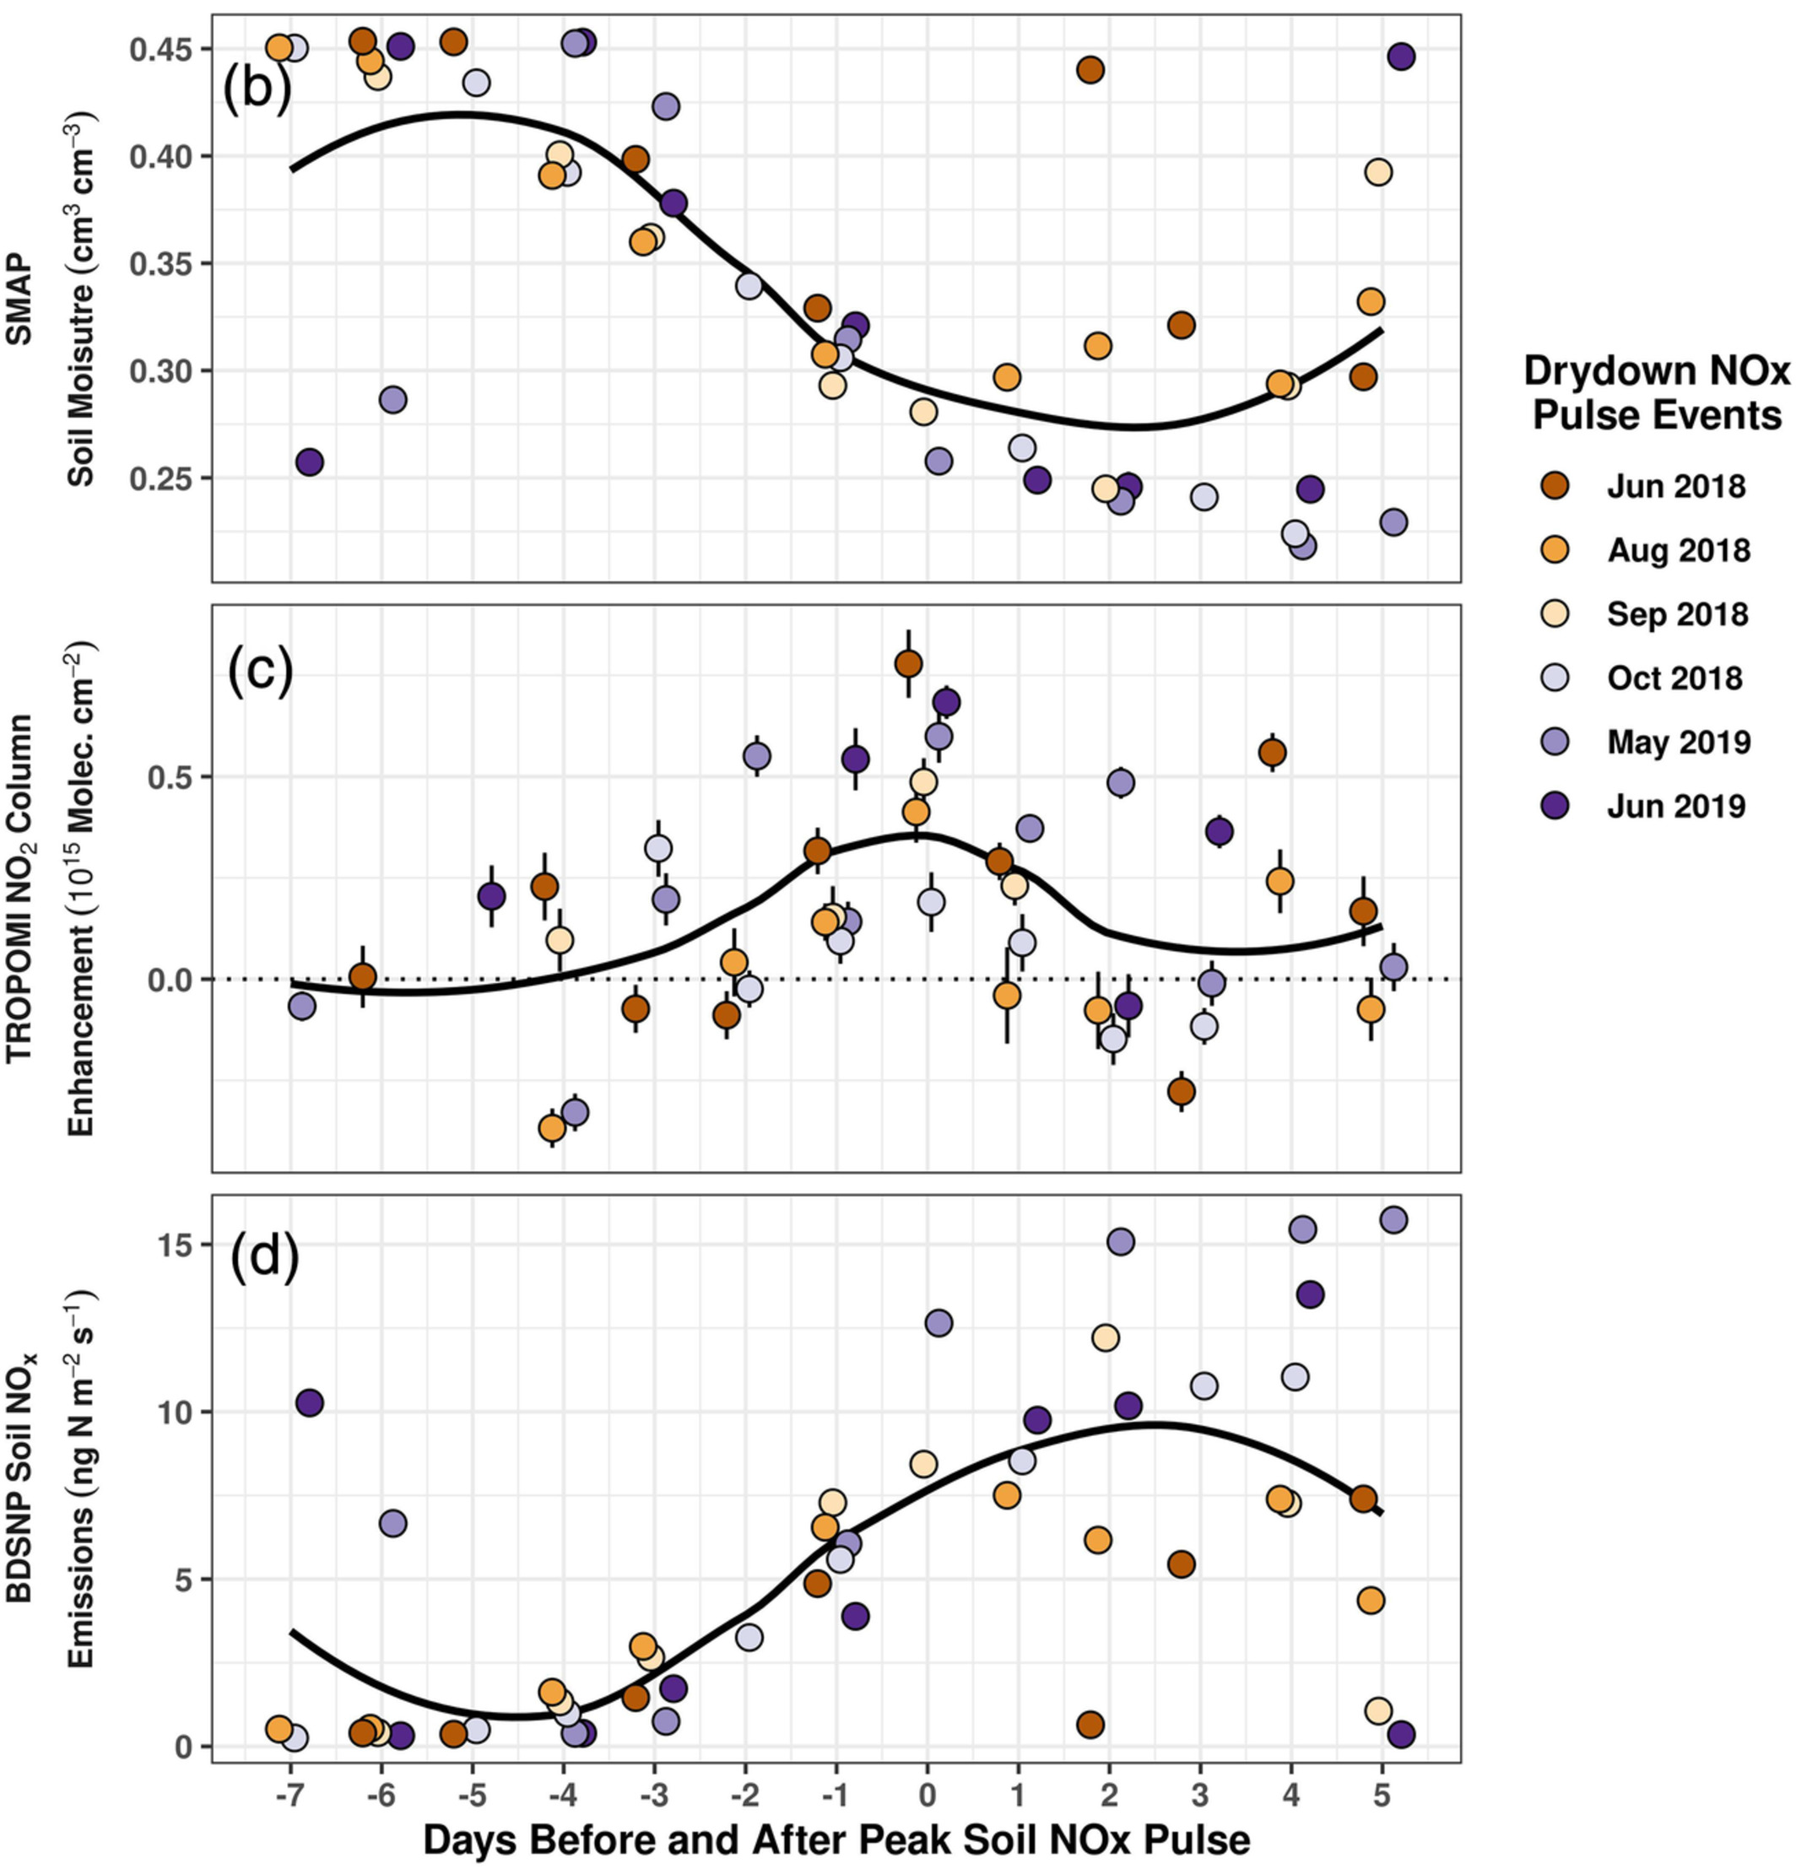
TROPOMI NO2 vs. SMAP Soil Moisture
Previous evidence: NOx pulses and noonish tropo NO2 after the rain
[Huber et al., 2020]
Notes:
Identify the regimes of soil moisture vs. soil fluxes

Slide 5
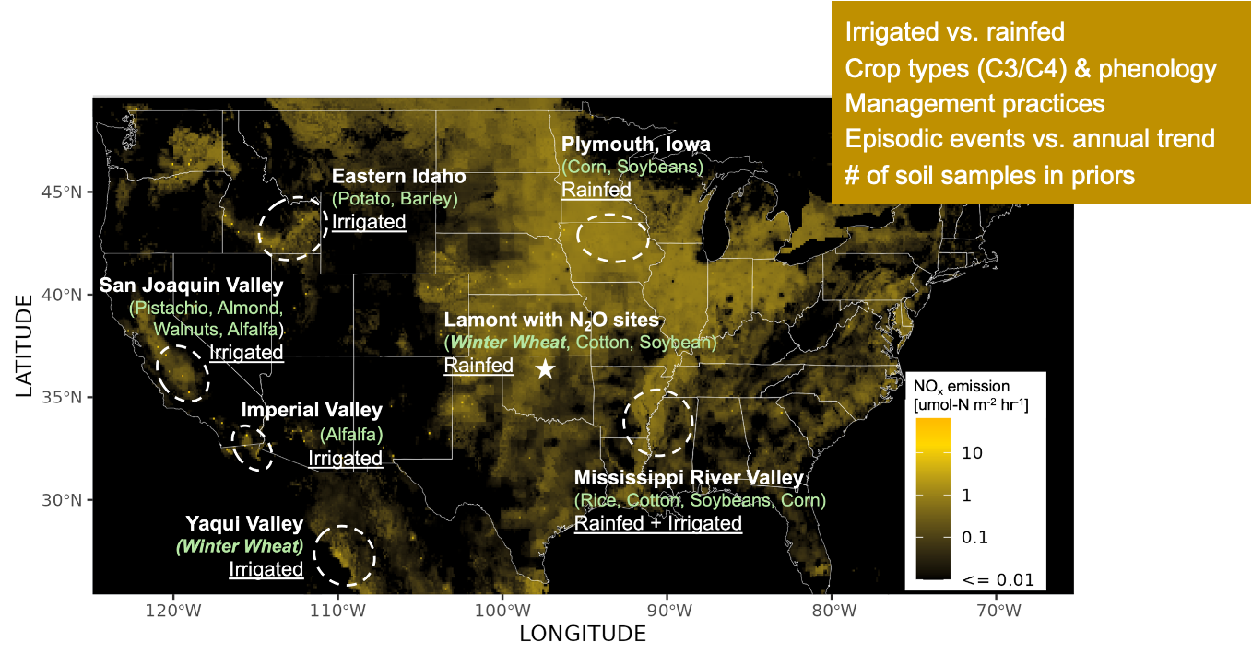
Goal
Investigate the magnitude, variability, and responses of soil NOx fluxes to environmental and management factors

Slide 6
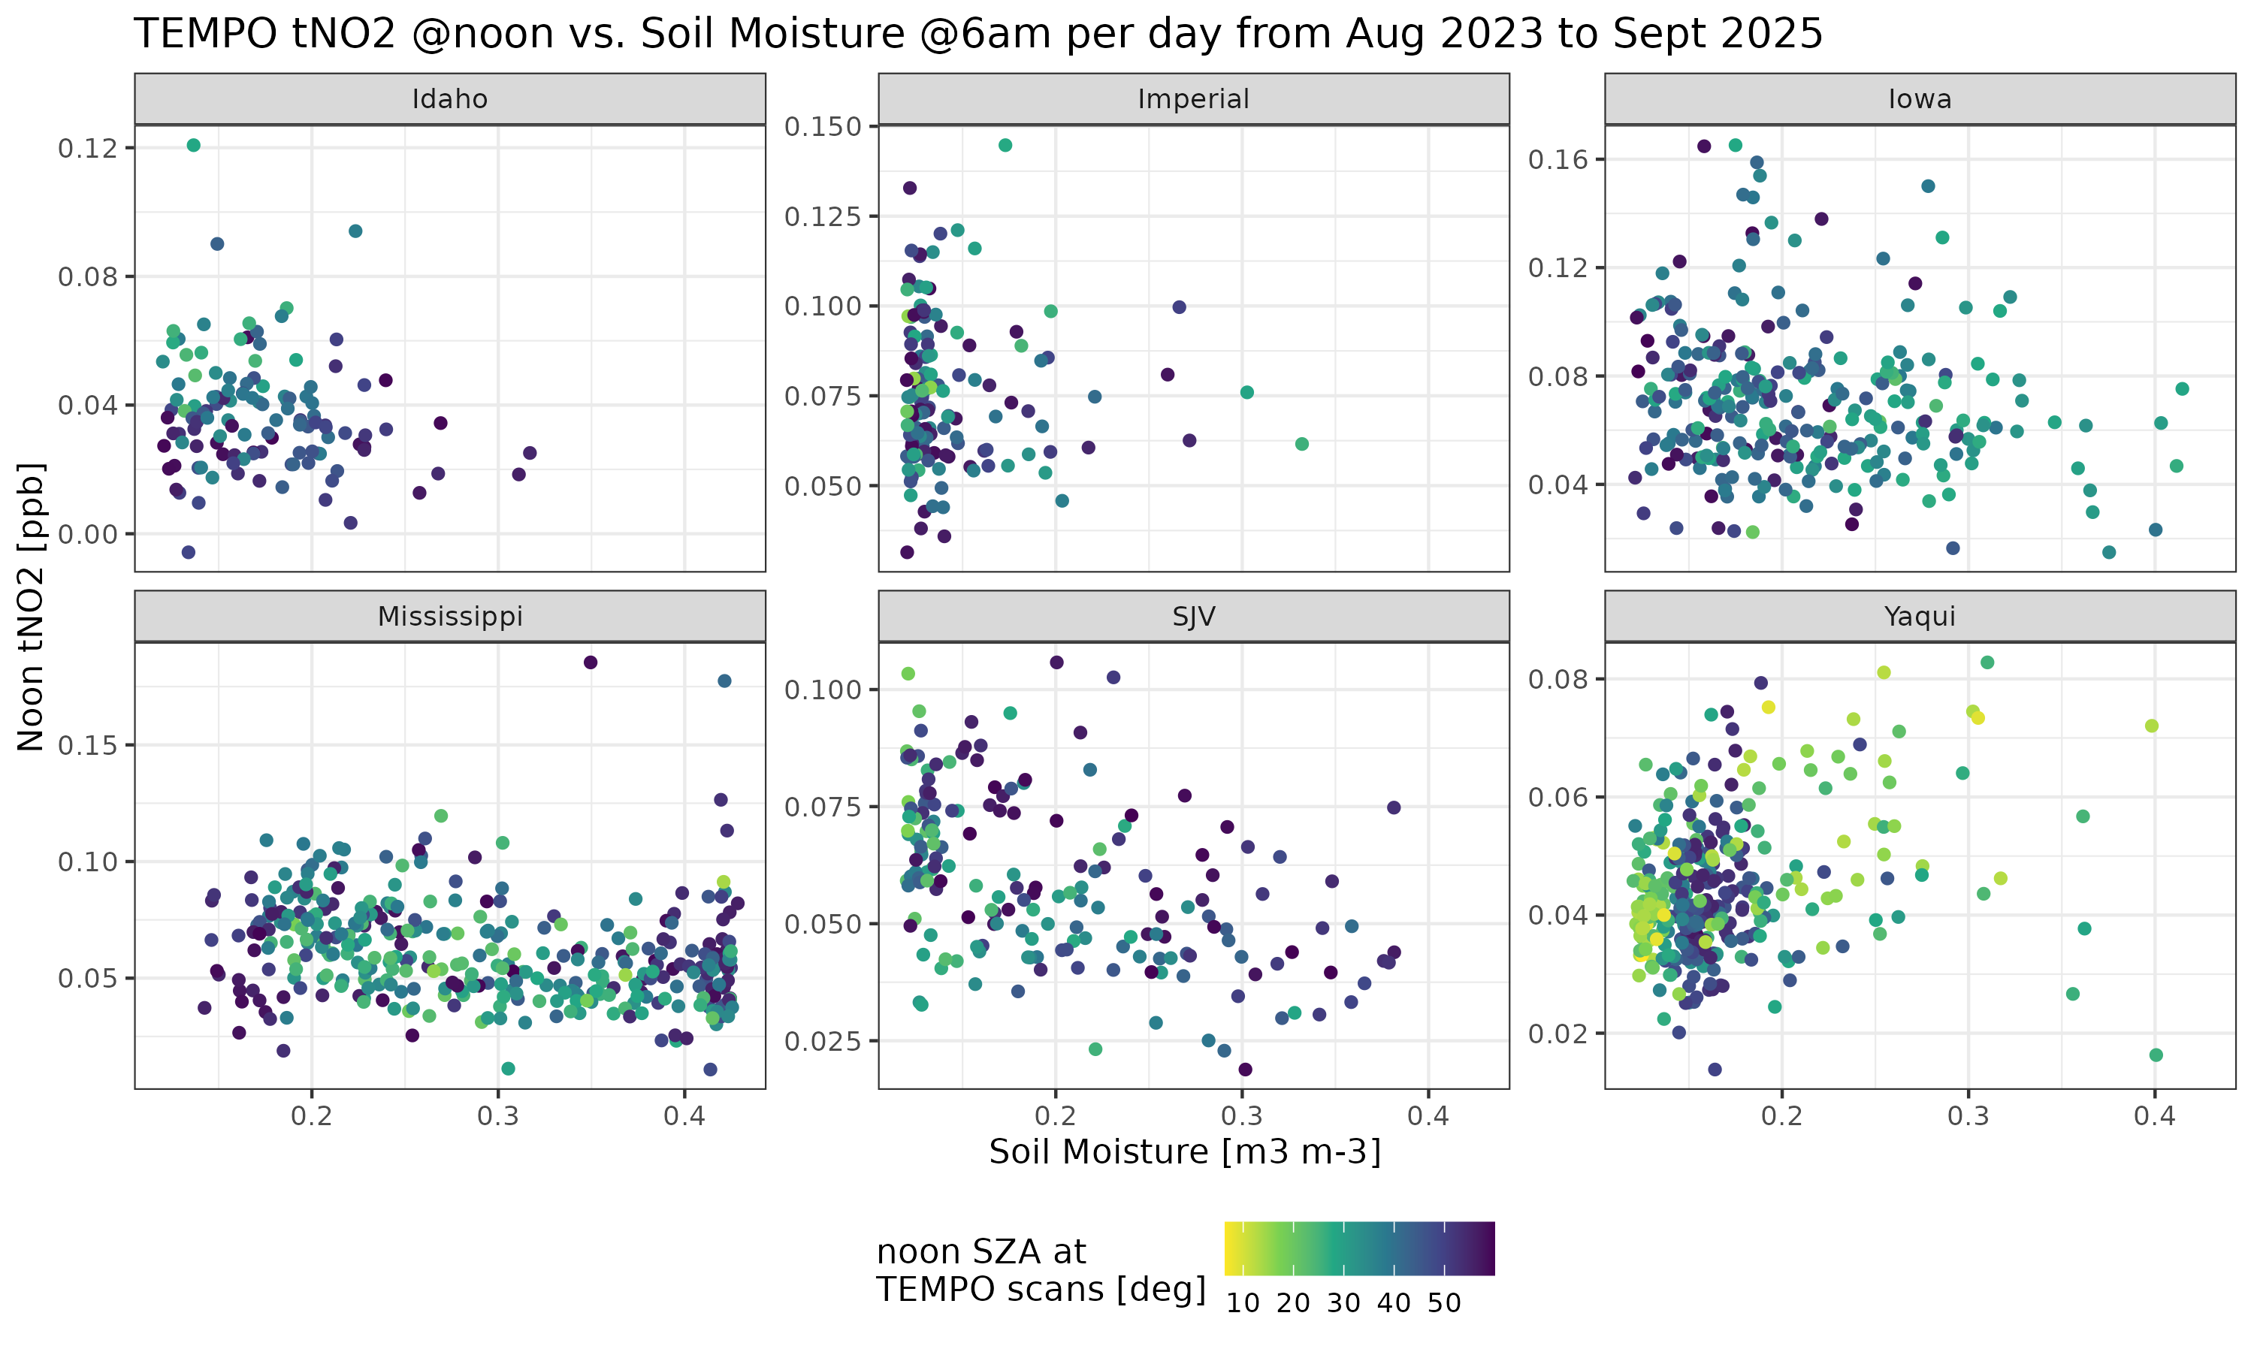
TEMPO Tropo NO₂ @noon vs. SMAP θ @6 am (prelim)
Irrigated
Rainfed
Idaho
Imperial
Iowa
Is spatial variability physically meaningful?
Lower Mississippi
SJV
Yaqui, Mexico
← Semi-arid climate with intensive irrigation and fertilizer apply rates with Low population
Spatial mean from
Aug 2023 to Sept 2025
Notes:
Water limited vs. o2 limited
Larger SZA, NOx lifetime longer, NO2 larger; Or true NOx should be lower
May be delayed (so not matching no2 and SM from the same day)
No cloud cover filter ecf < 0.1 yet
Identify response regimes

Slide 7
De-noising?
Tropo NO₂
Soil moisture θ
Soil temperature
Management practices
Soil NO_{x} fluxes
Notes:
FF should not scale with soil moisture
Top soil layer

Slide 8
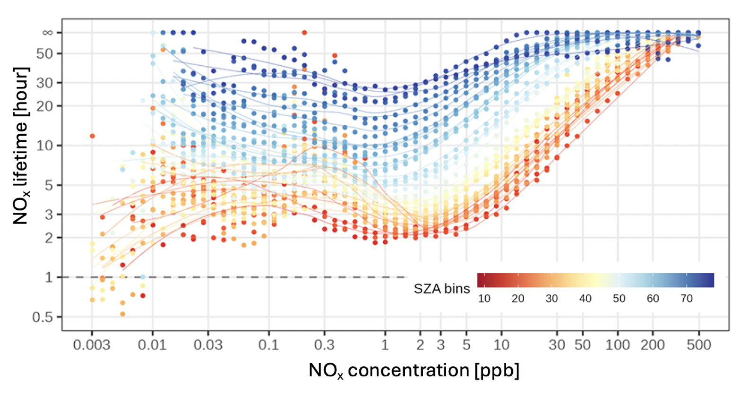
1st Order Correction Factors
Tropo NO₂
NO_{x} lifetime ← SZA, temp, [NOx], VOCR
NO₂:NO_{x} ratio ← SZA and distance from sources (~[Ox])
Mixing effects (θ) ← wind speed + PBLH
Different sources ← wind direction
tNO2 averaging kernels
Combustion sources ← TROPOMI CO & Activity data
Canopy interception (θ) ← Vegetation water content + LAI
Soil textures ← saturation θs, soilGrids
Lagrangian chem transport model
(STILT-NOx or -PECAN)
Soil moisture θ
Soil temperature
Management practices
Soil NO_{x} fluxes
[Wu et al., 2023; Laughner and Cohen, 2019]
Notes:
FF should not scale with soil moisture
Top soil layer

Slide 9
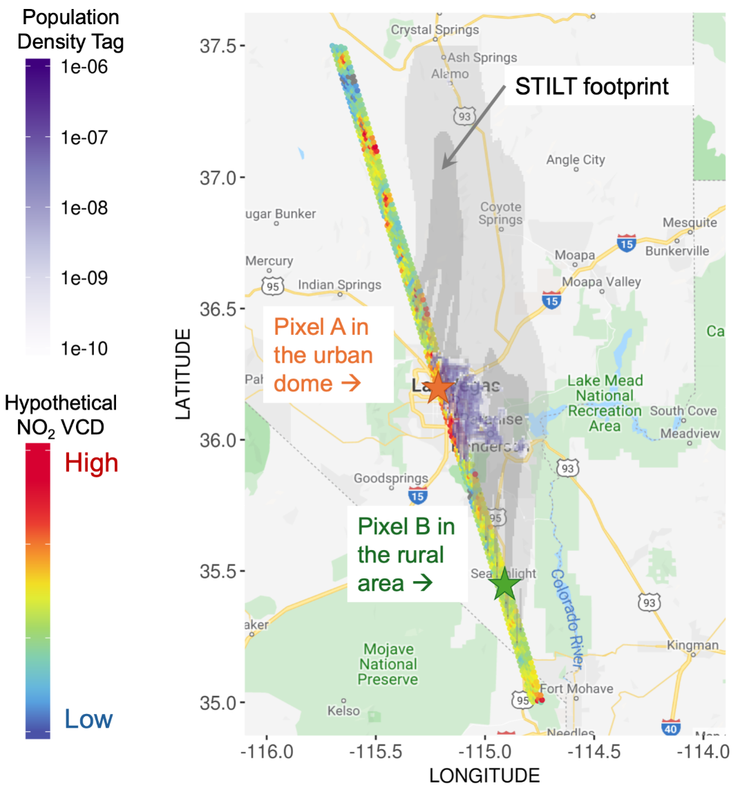
TEMPO Pixel Selection – Contributions from Upwind Activities
X-STILT Footprint x Activity Data
← e.g., Population Density

Slide 10
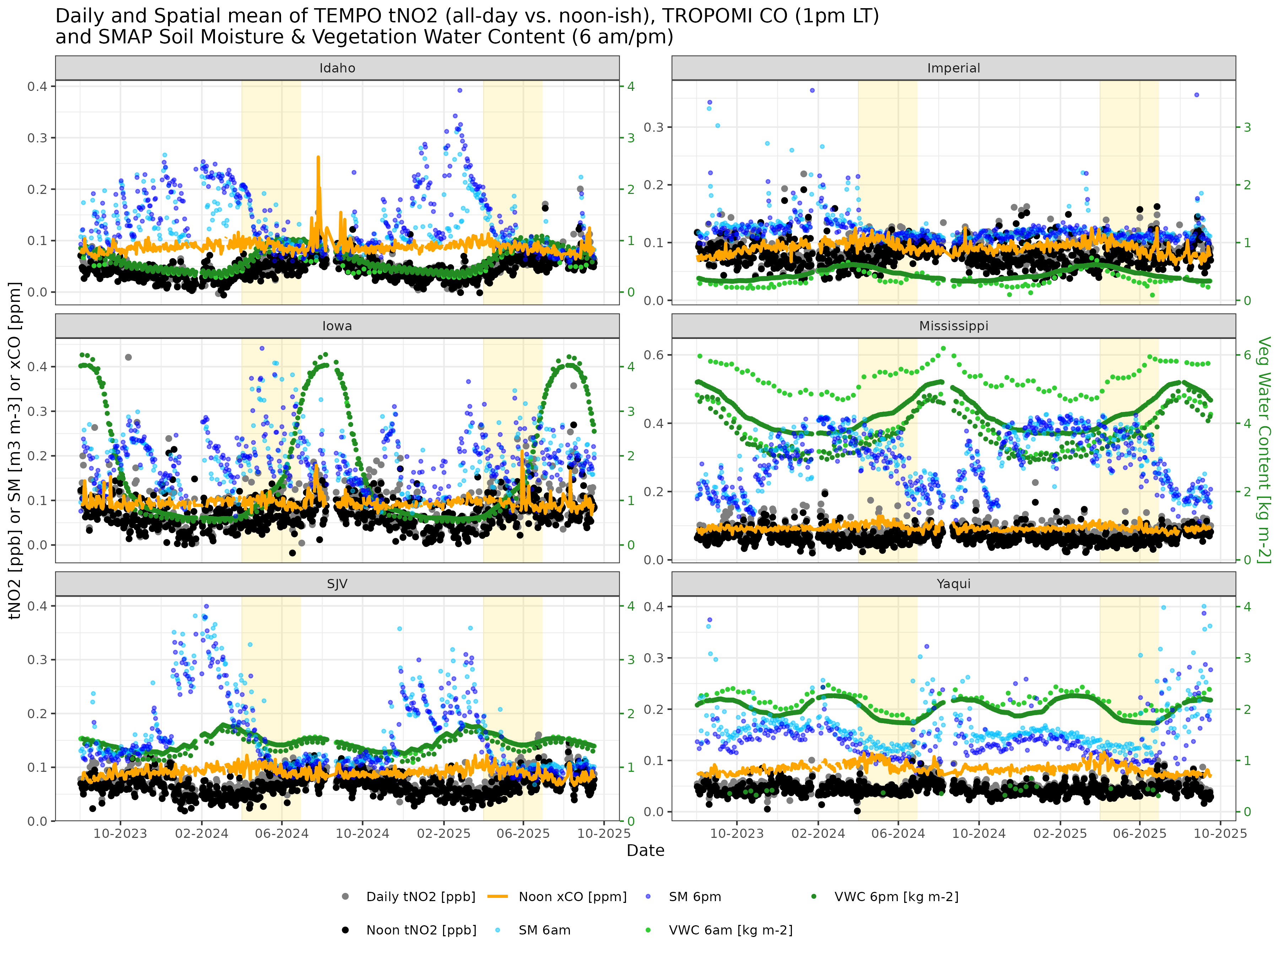

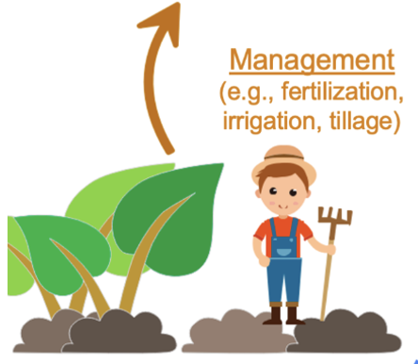
TEMPO Overpass Date Selection – Co-emitted tracers + Canopy
TROPOMI CO → combustion signals
TEMPO
Seasonality in
← vegetation water content (soil moisture bias)
leaf area index (canopy interception)
Notes:
FF vs. ag may not have the same seasonality
April to June
CrIS NH3

Slide 11
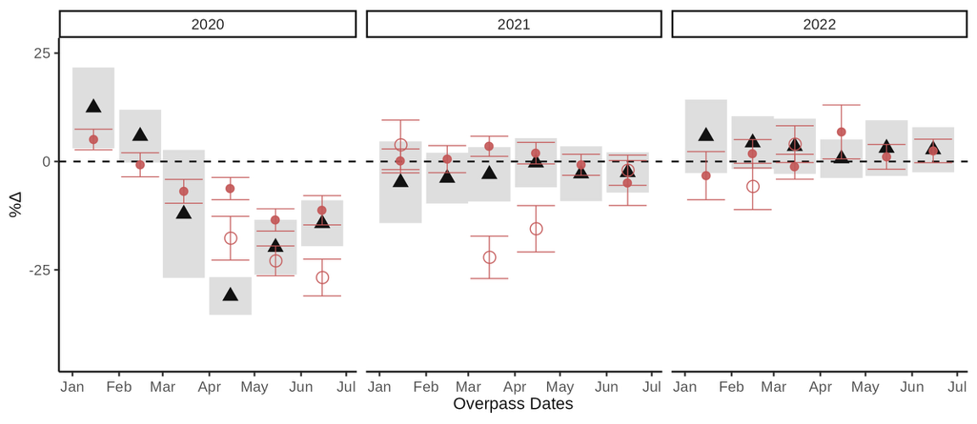
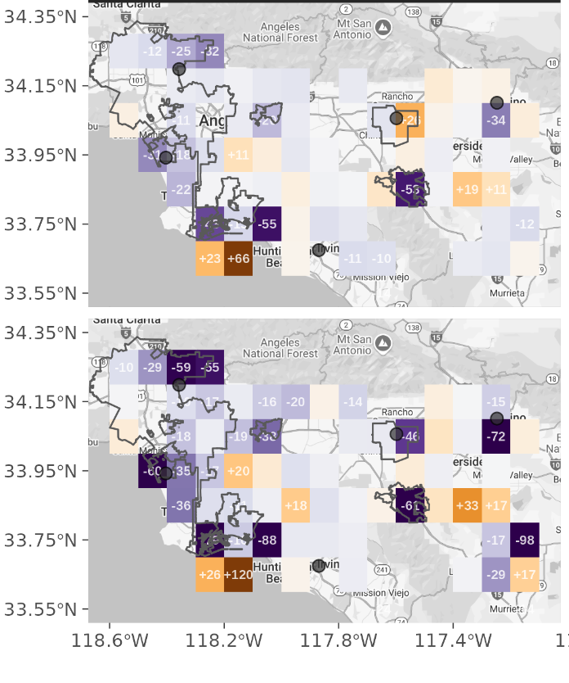
STILT-NOx + TROPOMI NO2 + LETKF Captures $∆$ in urban NOx
Spatially resolved estimates over “short pulses”
Spatially integrated, multi-year estimates
Weekdays
Posterior on Weekdays
Weekends
Posterior on Weekends
Traffic Counts
[Hunt et al., 2007; Miyazaki et al., 2012; Wu et al., 2023; in prep]

Slide 12
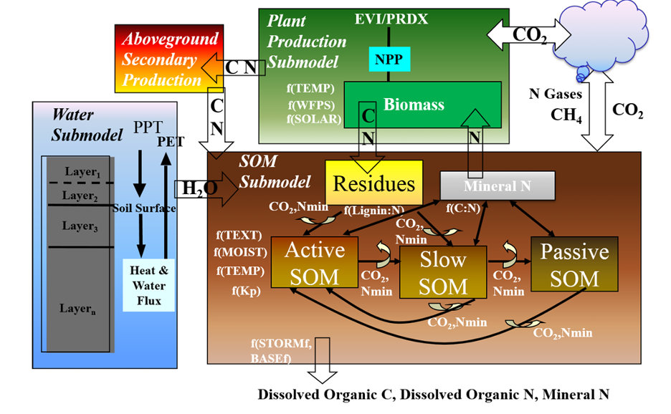
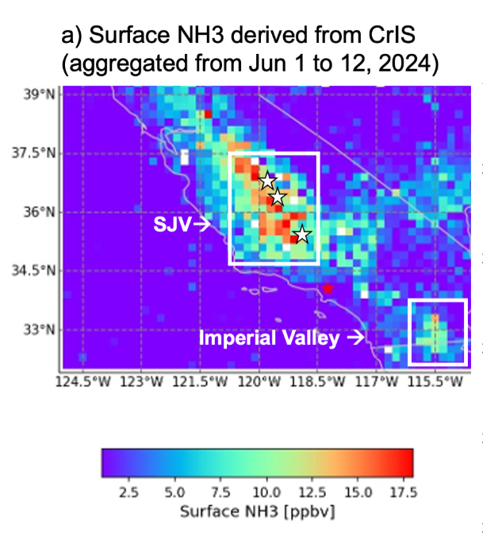

🌾 Plant growth
💨 Trace gas fluxes
Work in Progress
Ogle & Wang: Extended period of DayCent model calibration to adjust crop production → bottom-up simulations beyond 2020 (Aug 2026)
Chen: C flux pulses to soil moisture using SMAP
Next steps
* More thorough data quality filter, e.g., check ecf < 0.1
* Develop an algorithm to convert tropo NO2 to soil NOx flux in a more efficient way (excluding SMAP)
* Add hourly varying TEMPO data
* Examine impacts from precip or irrigation frequency
* Flux Validation of TEMPO pixels against FarmFlux
💧Soil water and temp flows between layers
Organic matter formation and decomposition; Nitrification and denitrification; NH3 volatilization; Methanogenesis
Olivia Griffith
(B.S. from UMD)

Slide 14
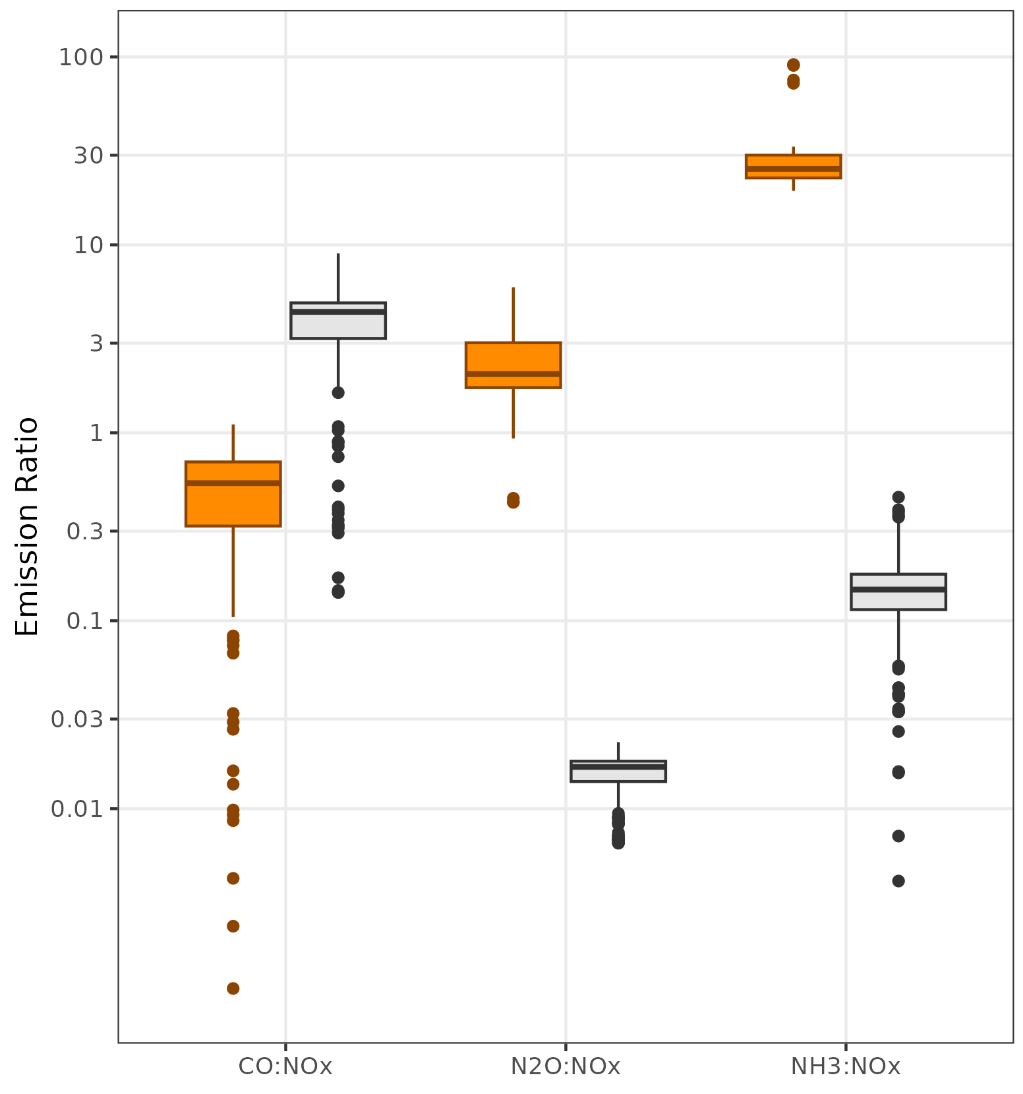
CO:NO_{x} ratio
N₂O:NO_{x} ratio
NH₃:NO_{x} ratio
Ag
Traffic

Slide 15
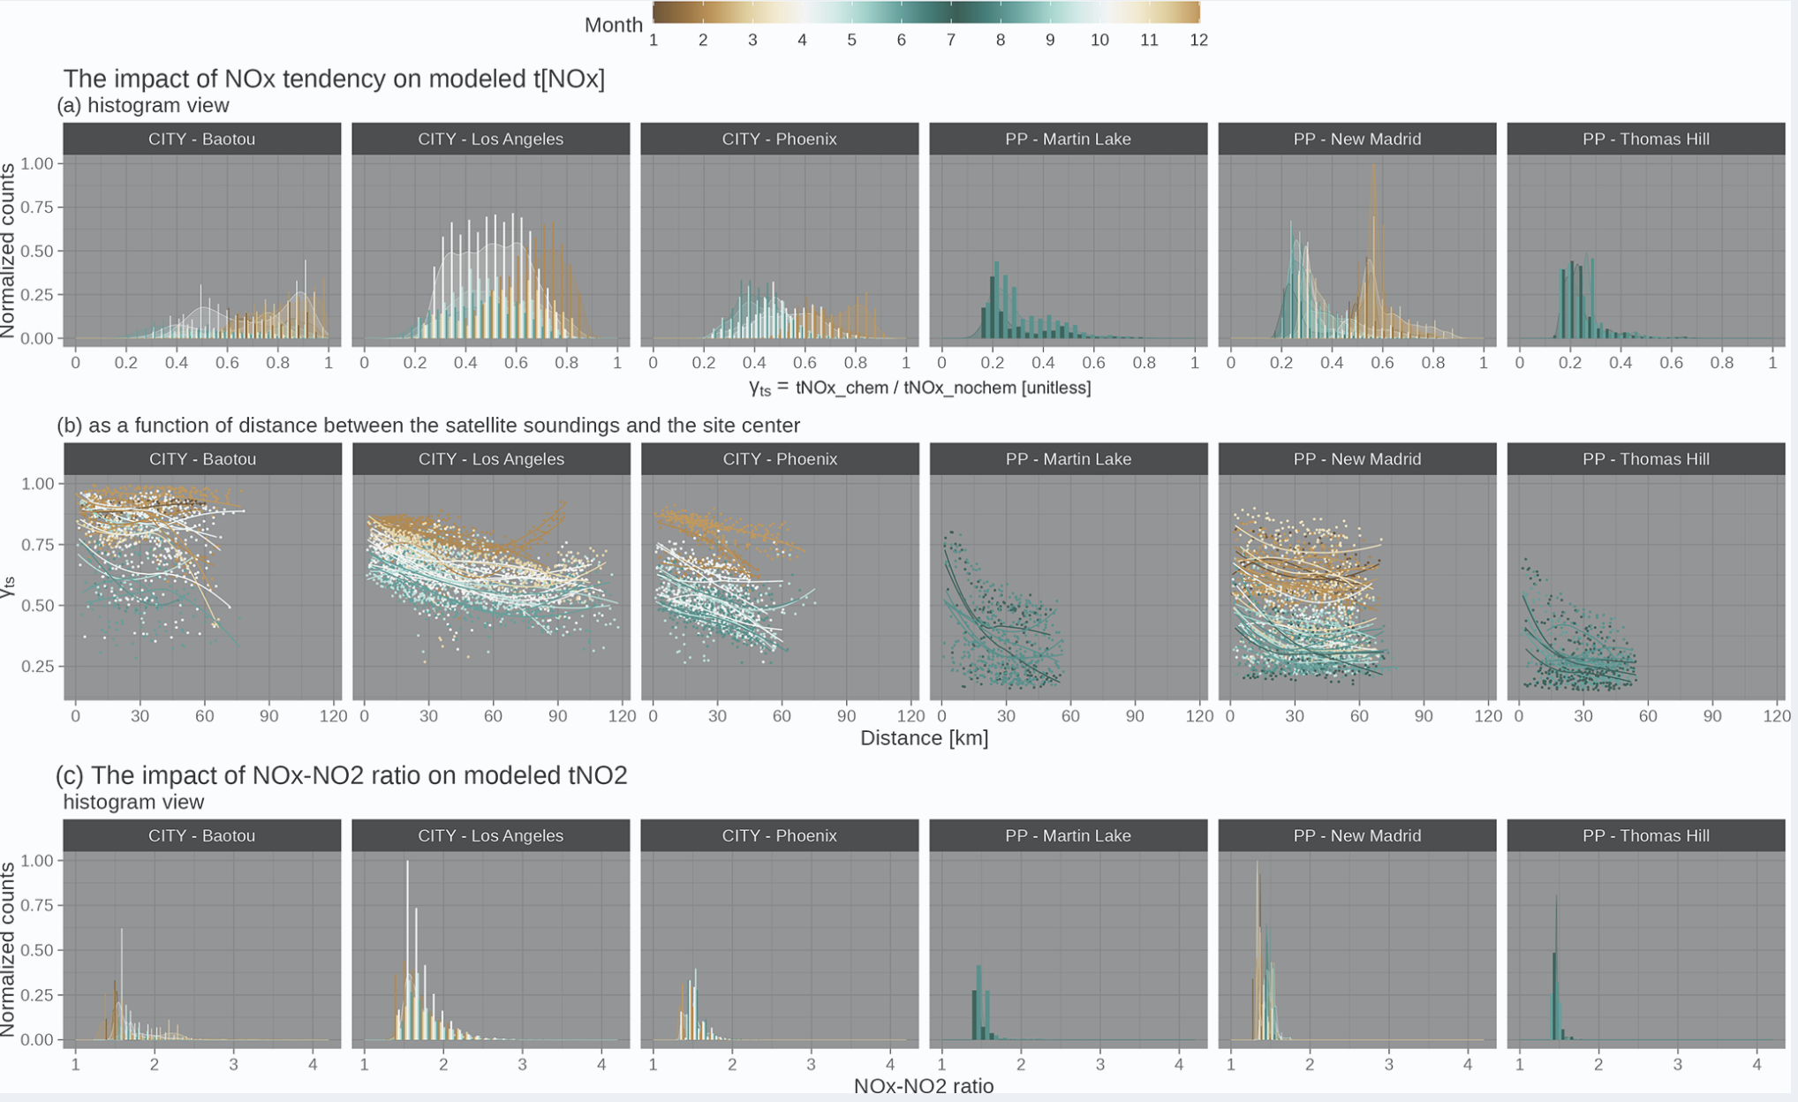

Slide 16
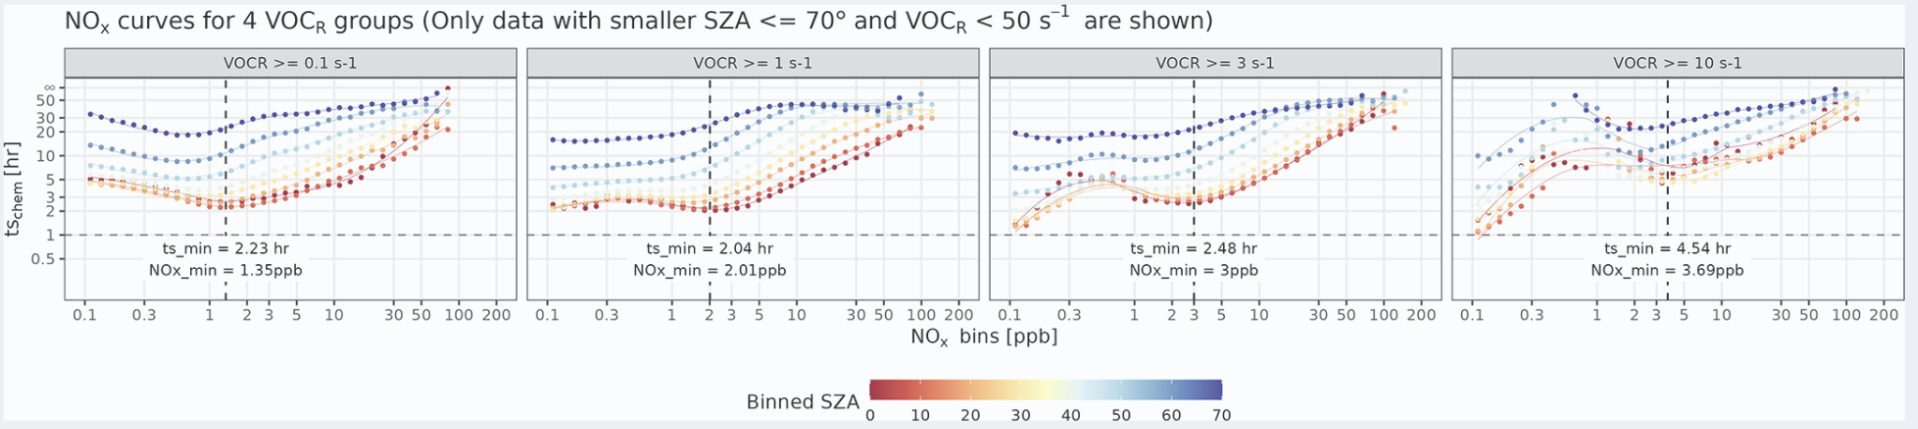

Slide 17
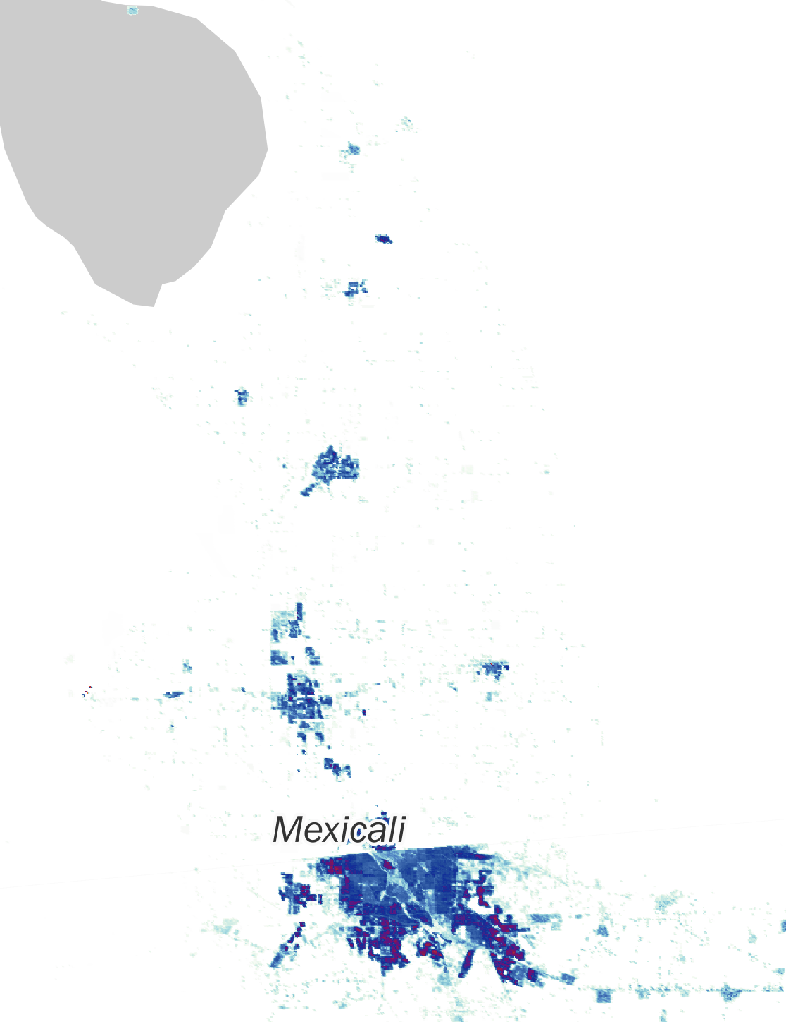
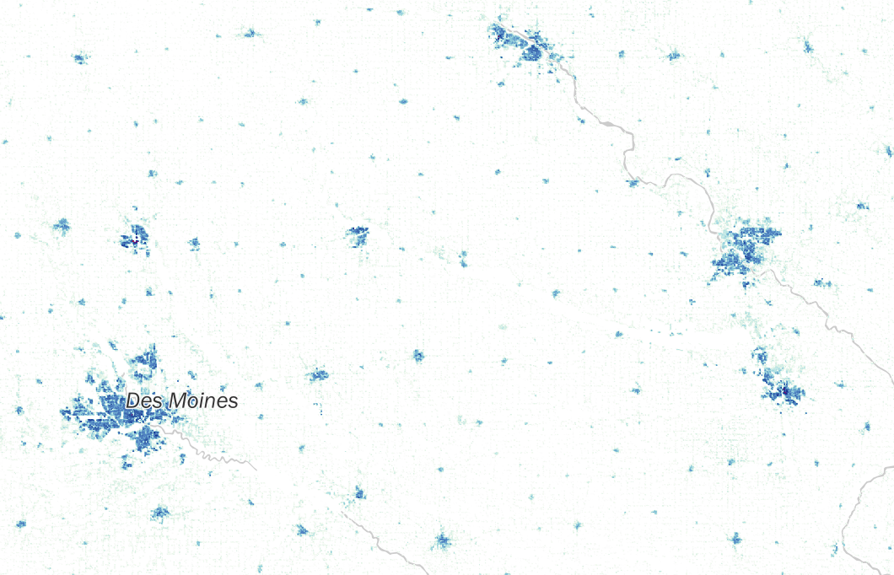
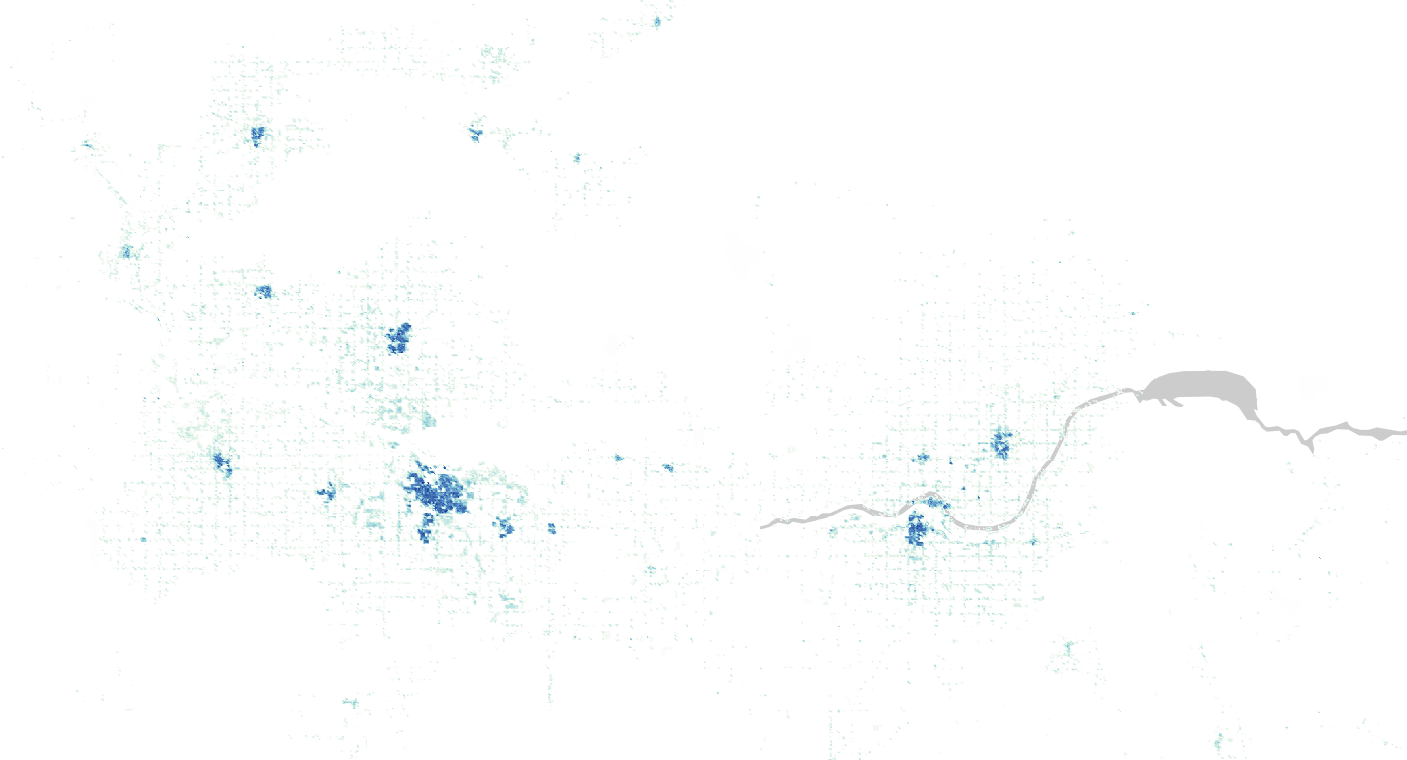
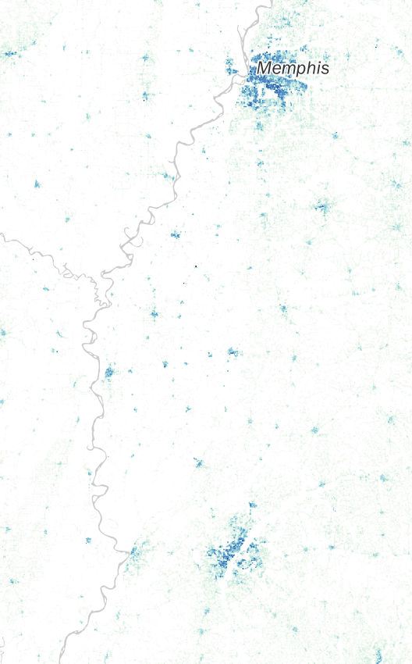
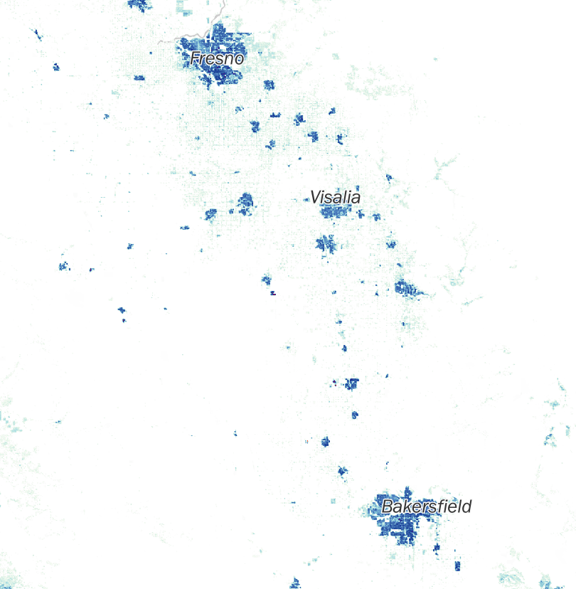
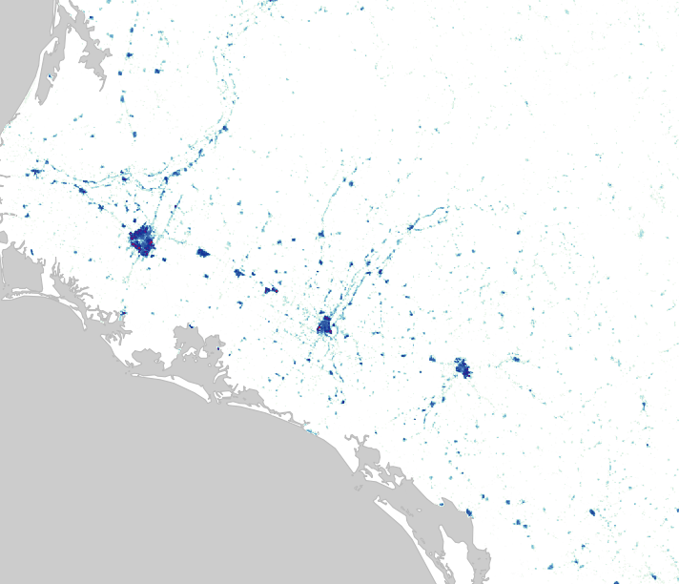
Population density

Slide 18
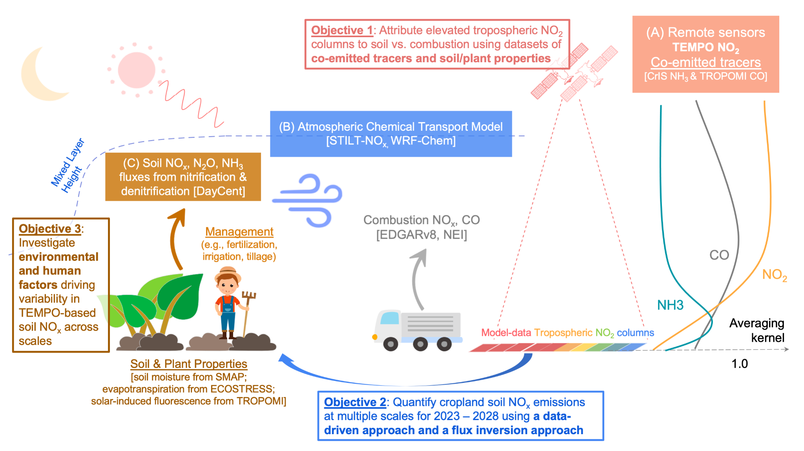
Objective: Investigate the magnitude, variability, and responses of SNOx to environmental and management factors
“Soil-Canopy-Atmosphere Continuum”
Obj 1. Source Attribution
Obj 3. Identify the drivers of posterior fluxes
Obj 2. Flux Estimates
Notes:
From a land-atmosphere interaction viewpoint

