Slide 1

A Large Catalog of Soil NOx Emission Pulses in the Agricultural Midwest: Evidence for Mechanisms Driving Emissions
Toireasa-Marie O’Rourke, Sam Beaudry, Ron Cohen
UC Berkeley

Slide 2
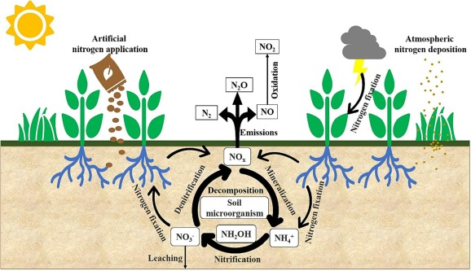
Soil NO_{x} Emissions
Produced by microbial processes
Strongly controlled by
  Soil moisture
  Temperature
  Nitrogen availability
Pilegaard et al. 2013
Notes:
Nitrification -- aerobic conditions
Denitrification – anaerobic conditions

Slide 3
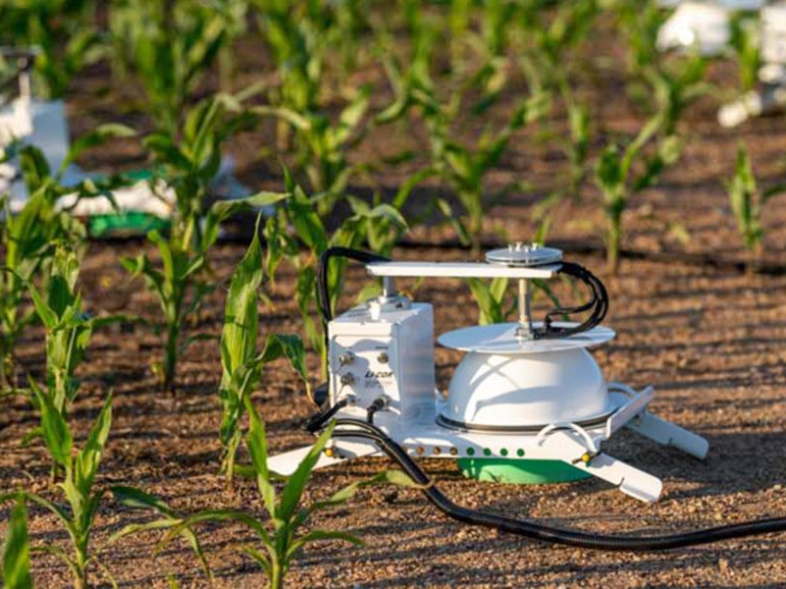
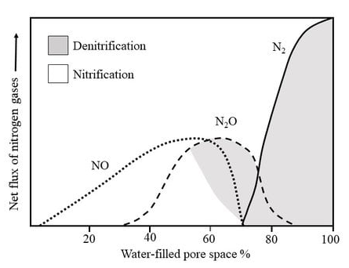
Soil NO_{x} Emissions
Thought to occur as short duration pulses initiated by rainfall
Lots of point measurements for short time windows (weeks), almost no long-term flux measurements
Most satellite observations have focused on the continental scale seasonal cycle and not the process scale
We have limited evidence one way or the other to show we understand the scaling from point measurements to ecosystems (e.g. aircraft eddy-flux measurements in SJV by Zhu, … and RCC, ACP 2023.)
A.F. Bouwman et al. 1998
Notes:
Nitrification -- aerobic conditions
Denitrification – anaerobic conditions

Slide 4
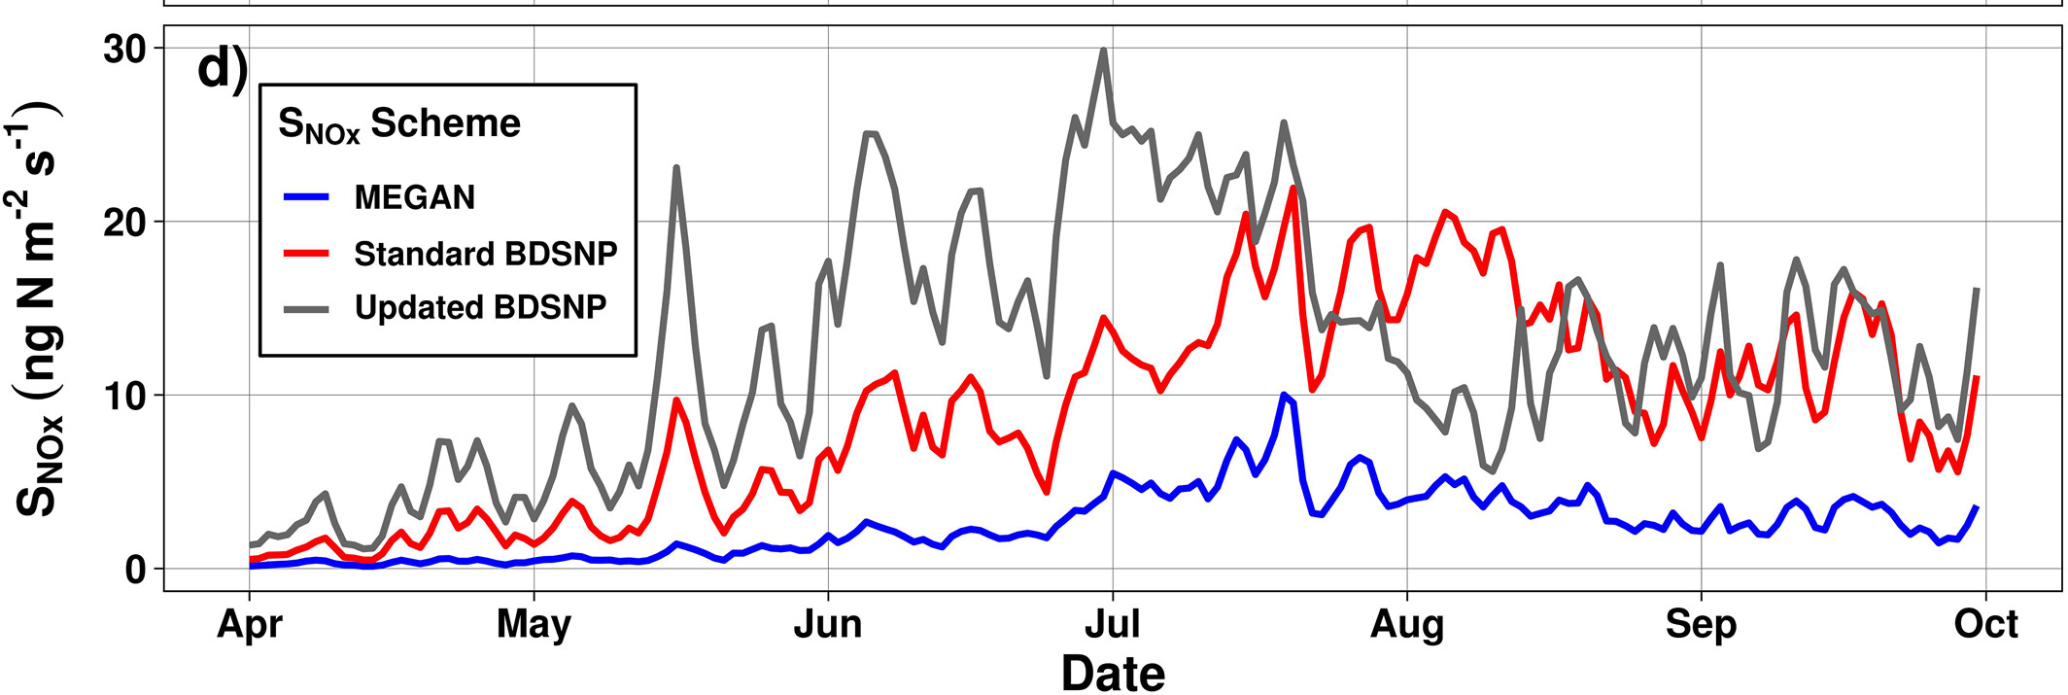
Main starting point is a model from my group:
Hudman, … and RCC, ACP 2012
Soil Moisture dependence updated by Huber, Kort and Steiner (2024)
Temperature dependence separately updated by Jun Wang’s group

Slide 5
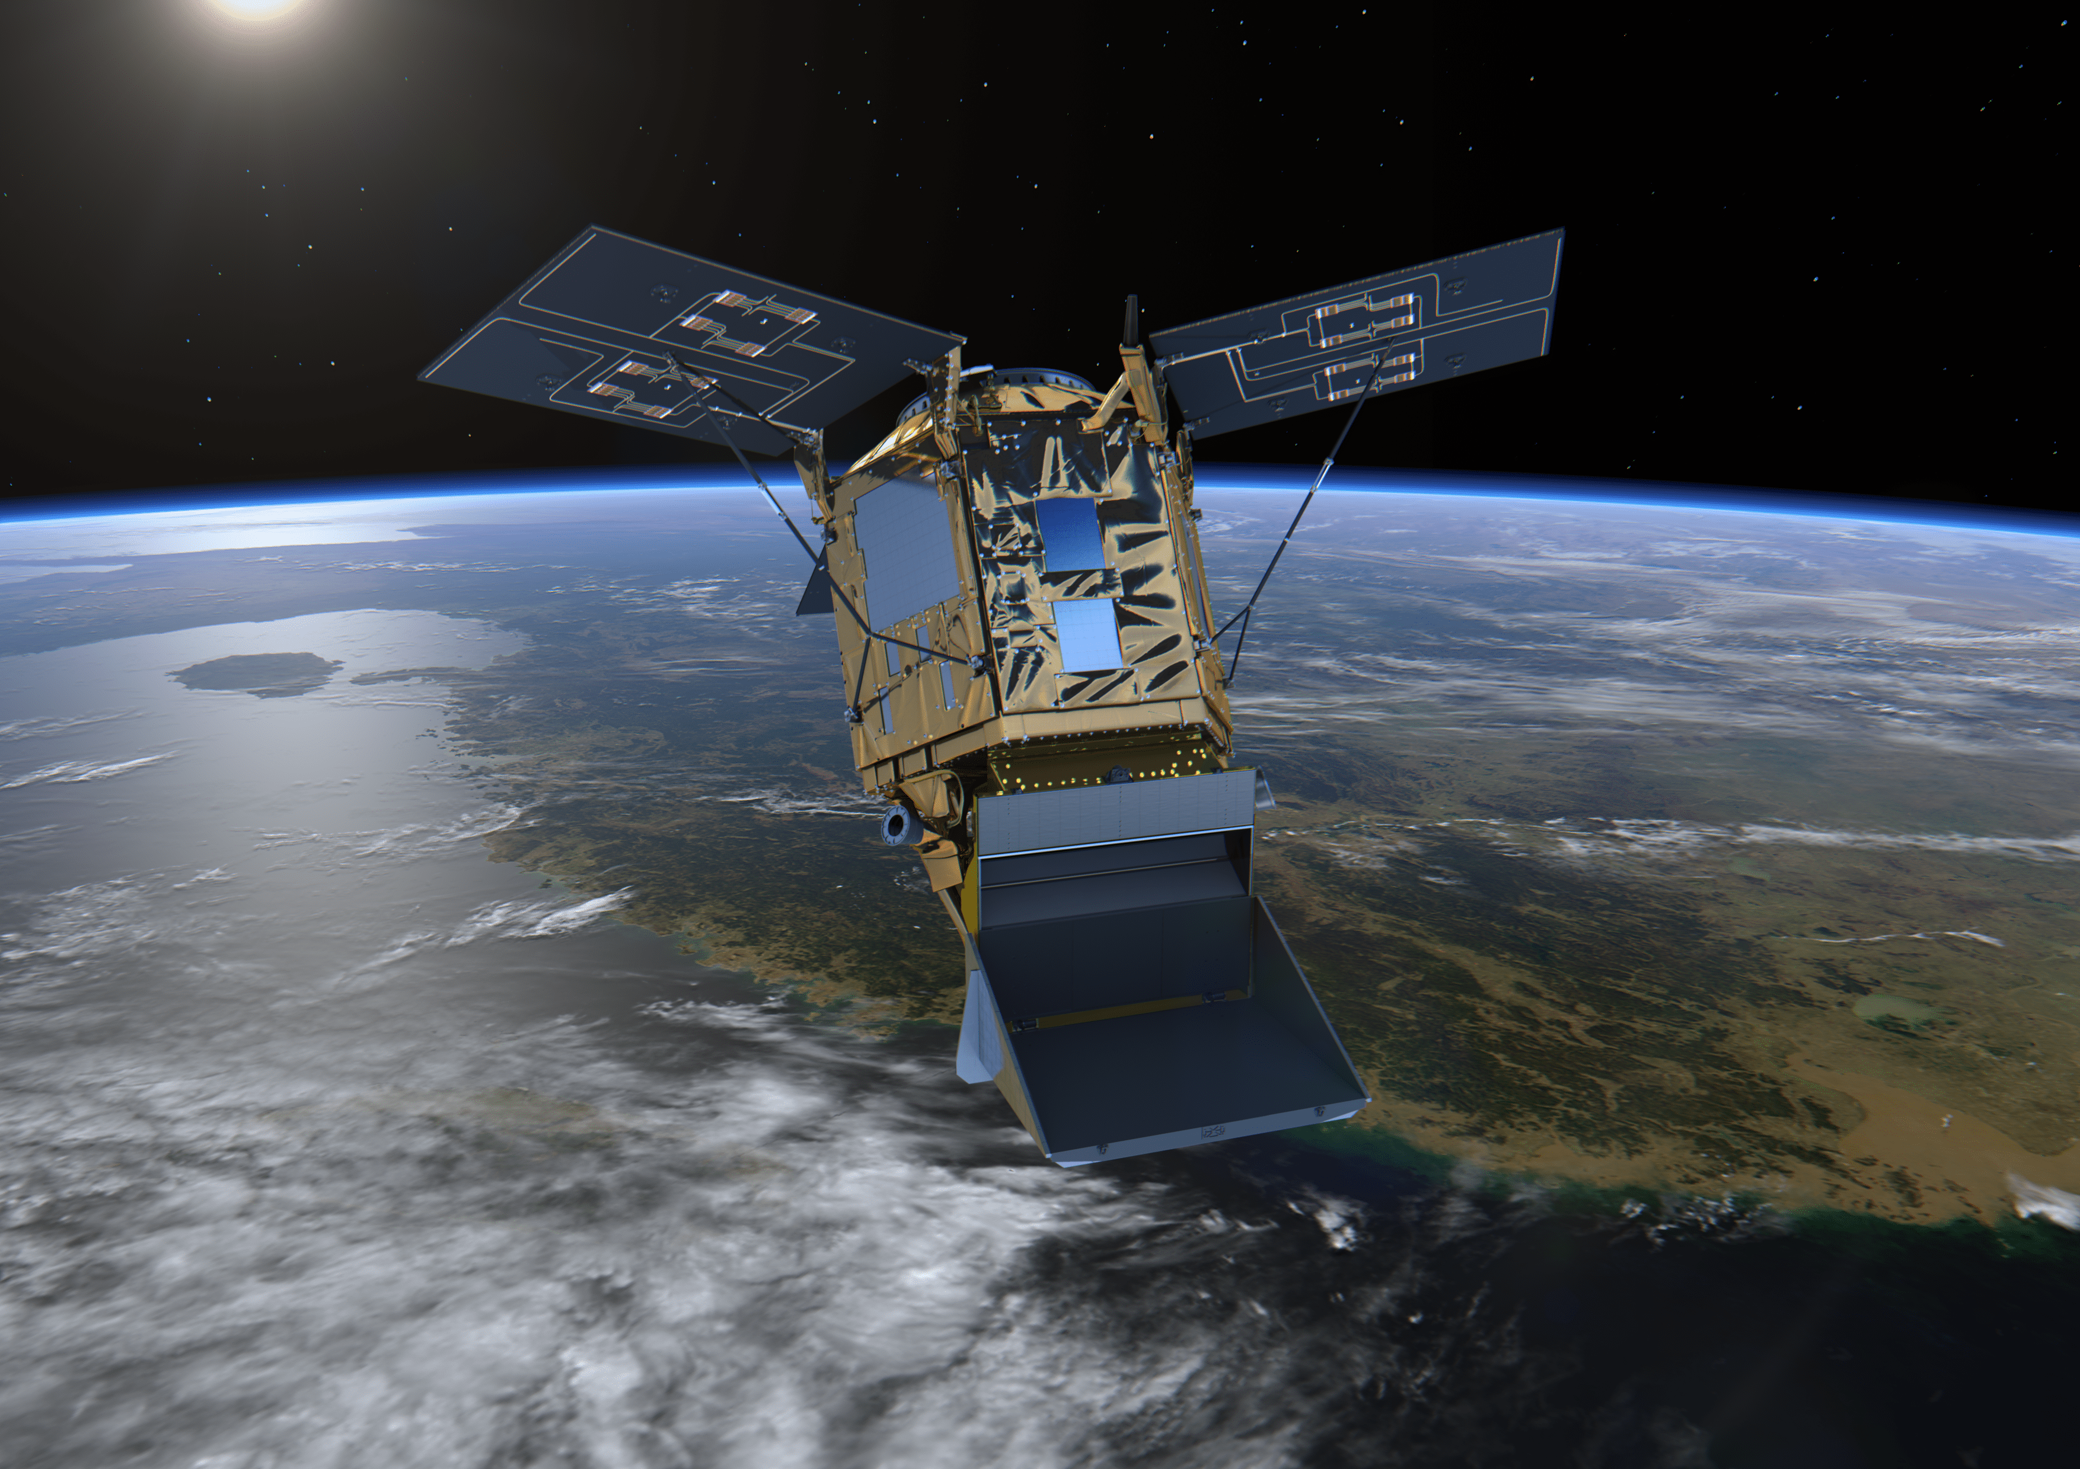
Insights from Satellites
Most approaches to using space-based measurements treat soil NOx as a seasonal anomaly to be separated from lightning.
Bertram, … and RCC 2005, example from winter wheat fields in Montana
Huber, Kort and Steiner, 2020 show example from TROPOMI in the Mississippi delta
HKS 2024 paper does a seasonal evaluation of models compared to TROPOMI; their moisture update is favored by the comparison

Slide 6
TEMPO
TEMPO has more than 10 times the number of observations of prior satellites and higher spatial resolution
Exactly what we need for re-evaluating our approach to pulsing events

Slide 7
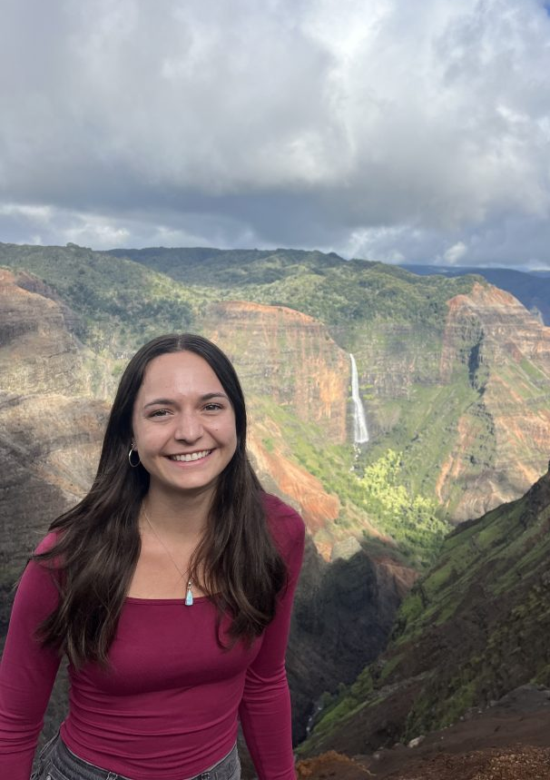
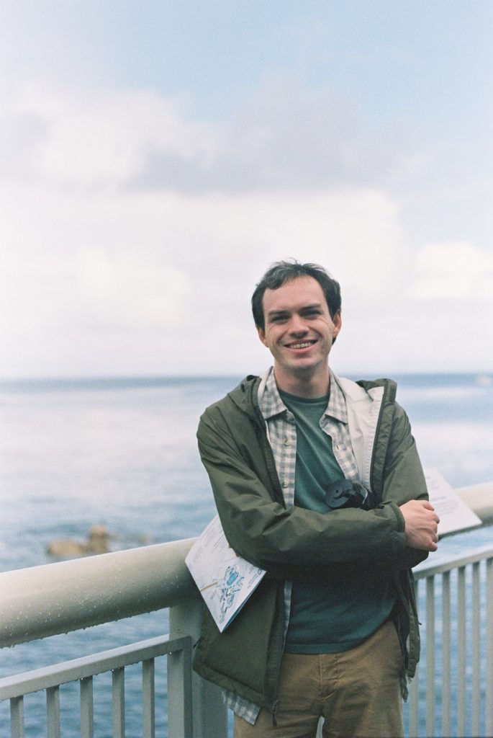
Toireasa-Marie O’Rourke Sam Beaudry

Slide 8
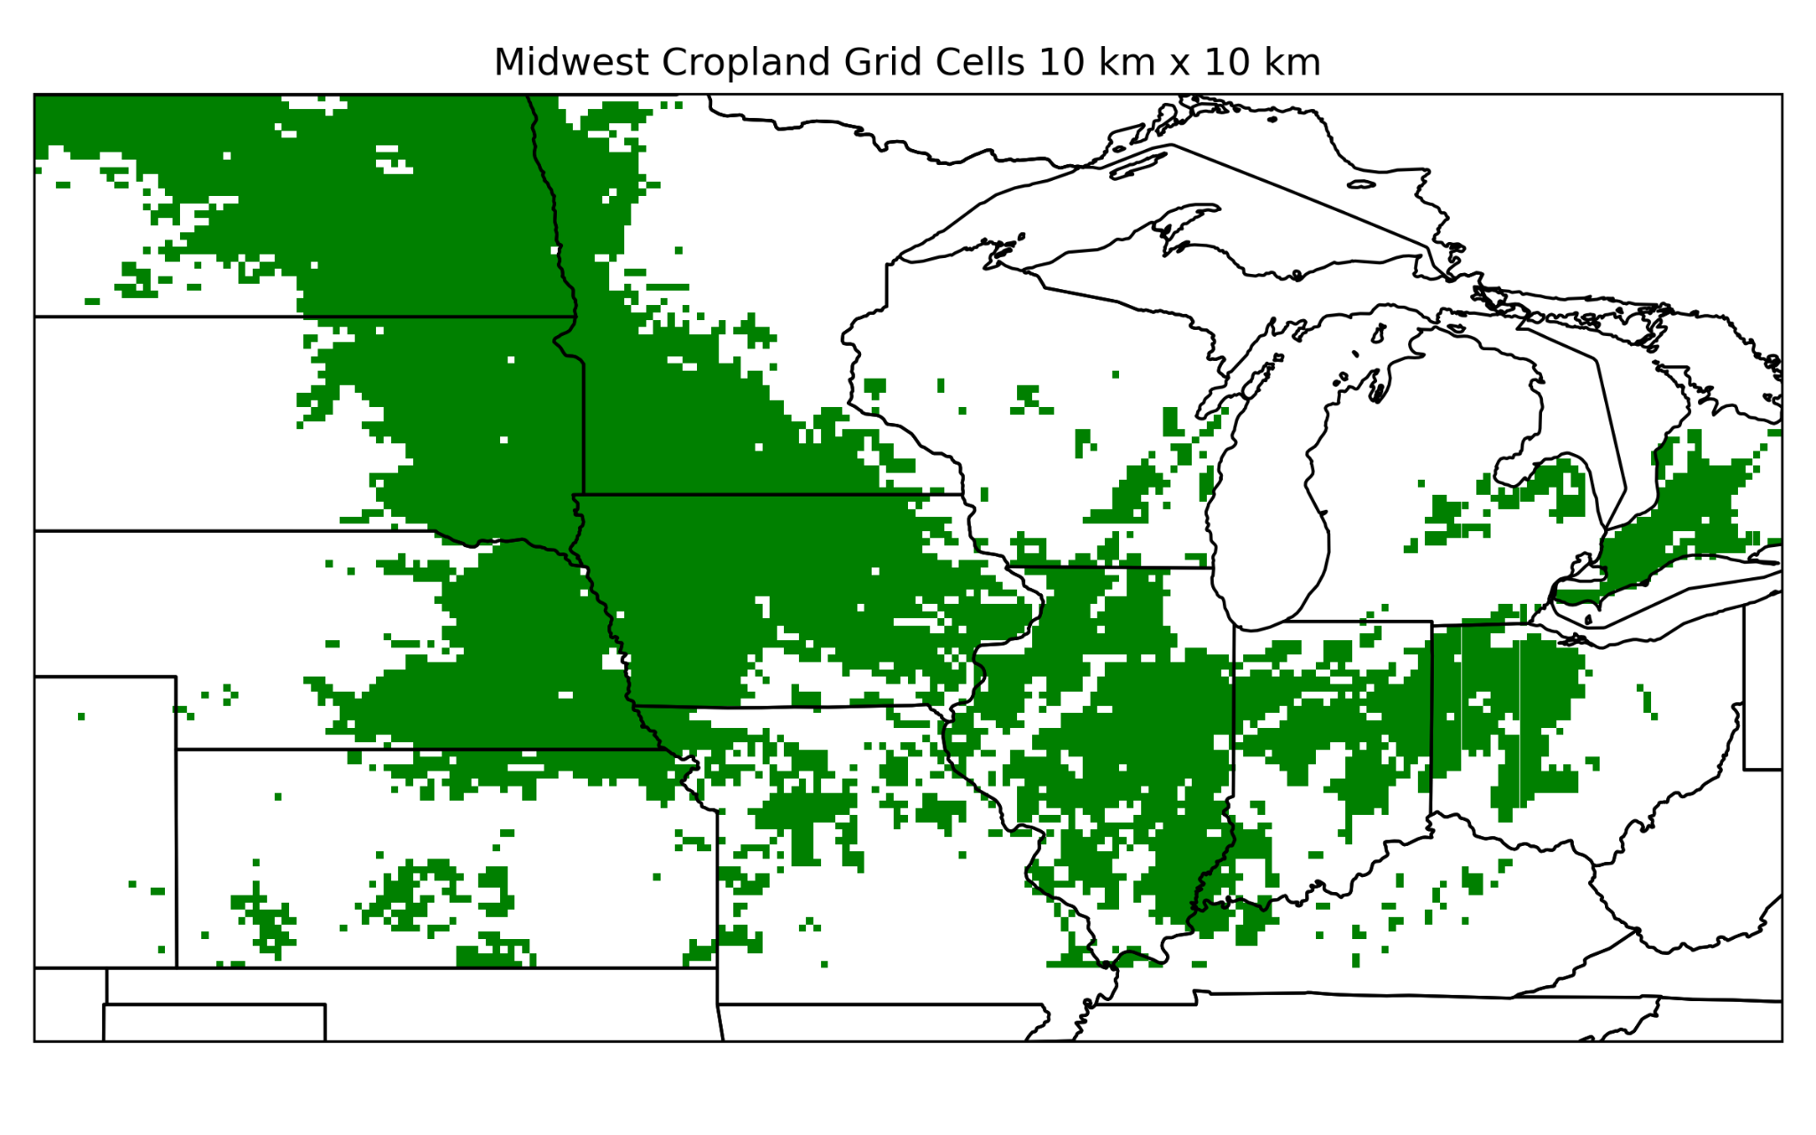
Study domain & multi satellite datasets
Midwest March-July 2024
Re-gridded to a 10km x 10km hourly grid
Dataset | Variables | Resolution
TEMPO V03 | NO₂ [molecules/cm²] | 2.5 km x 4.5 km hourly
SMAP | Soil moisture, soil porosity, leaf area index, soil temperature | 9km x 9km 3-hourly
IMERG GPM | Precipitation [mm/hr] | 10km x 10km half-hourly
MODIS | Cropland Layer | ~5.6km x 5.6km
CA Soil Resource Lab (UC Davis) | Soil Type | 800 m x 800m
Notes:
[m³/m³],

Slide 9
Identifying Pulses in TEMPO data
Quality filtering
Re-grid with area-weighted averages to 10km x 10km and apply crop filter
Hourly scaling of NO₂ from V03 to match V04
Identify NO₂ pulses
  3 SD above 14-day rolling mean
  ≥2 hours
Interpolate SMAP hourly
Group pulses
Quality Filter | Condition
Quality flag | =0
Cloud fraction | ≤ 0.10
Snow ice fraction | ≤ 0.01
Solar zenith angle | < 70 º
Notes:
[m³/m³],

Slide 10
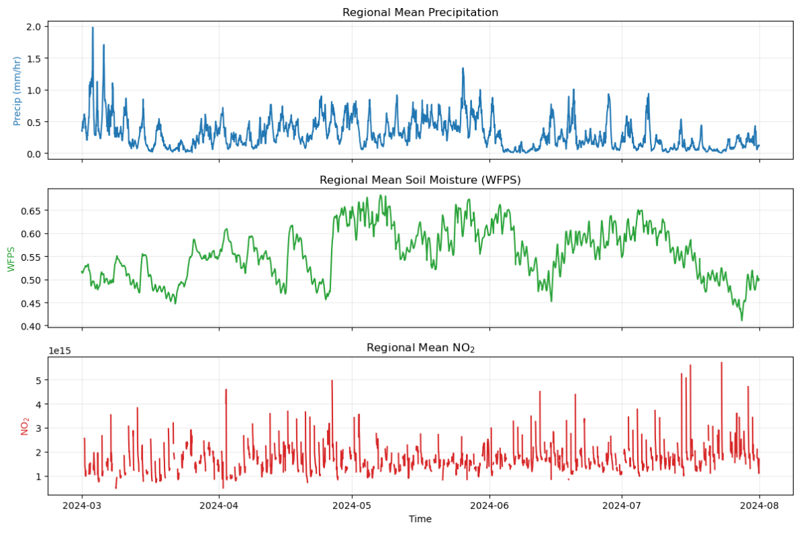
5 month Agricultural Midwest Time series 2024
Notes:
This is showing an average of precip, SM, and NO2 over the region
Looks very messy!
Point out the middle of the time with relatively high SM, low NO2, when SM falls, get spikes in NO2
Hard to pick anything out from this picture, we want to know what individual events look like

Slide 11
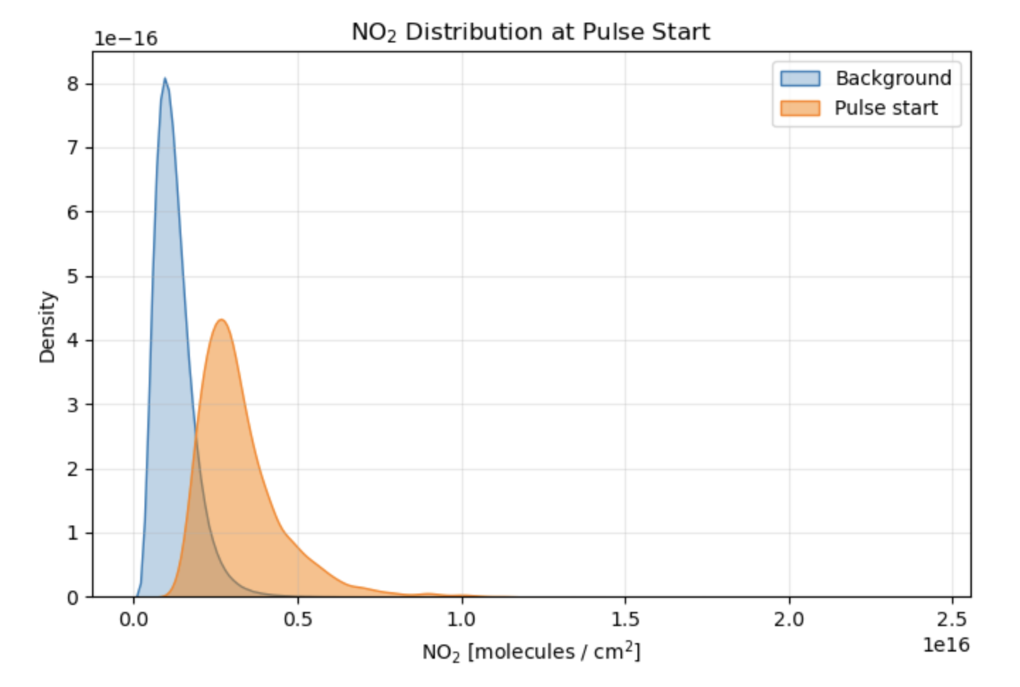
~5600 Pulses
Notes:
Looking at all of the pulses that are detected, we find around 5,606 pulses. And I impose a grouping criteria on them to see if they are spatiotemporally correlated with each other. To be grouped together, they must be within 0.2 degees and 24 hours of lighting up as a ”pulse”. Thorughout the Midwest, grouping reduces the number events by 3, showing that most of them are correlated together. (show bottom plot)
Additionally, so, I used to filter my pulse events to only be when a certain amount of precipitation occurs prior to the event, however, because soil moisture is the factor that has a control on soil nox emissions, and because soil moisture often fluctuates regardless of active precipitation, we want to just focus on soil moisture. So, here is showing the sum of precipitation for every pulse event. I was really happy to see this because I was afraid that most of them were not related to precipitation, but rather it shows that most do have precip, yet there are a good amount that have little to no precip leading up to the pulse.
Additionally, we can look at the amount of NO2 at pulse starts relative to background no2 (not pulses), and we can see that they are relatively higher than background. Remember this number (3x10^15)

Slide 12
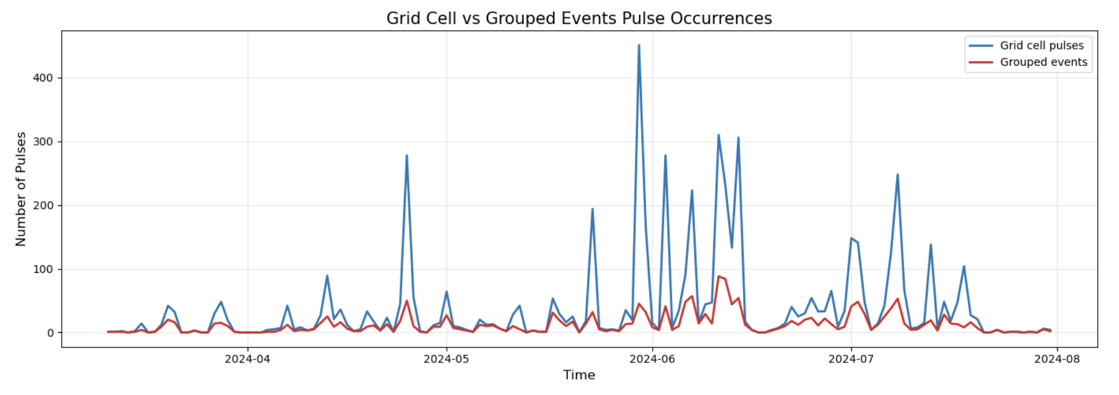
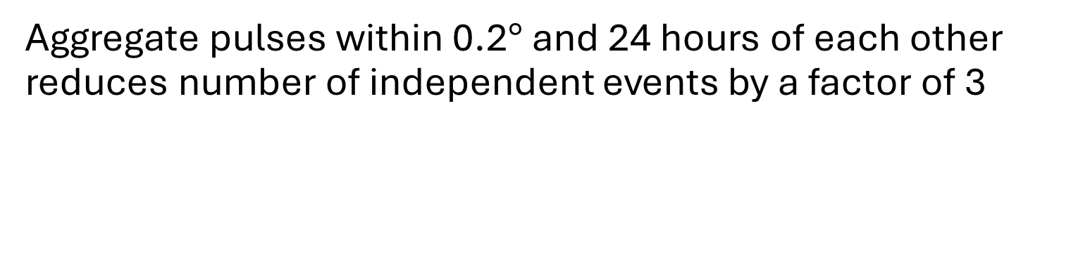
Aggregate pulses within 0.2$°$ and 24 hours of each other reduces number of independent events by a factor of 3
Notes:
Looking at all of the pulses that are detected, we find around 5,606 pulses. And I impose a grouping criteria on them to see if they are spatiotemporally correlated with each other. To be grouped together, they must be within 0.2 degees and 24 hours of lighting up as a ”pulse”. Thorughout the Midwest, grouping reduces the number events by 3, showing that most of them are correlated together. (show bottom plot)
Additionally, so, I used to filter my pulse events to only be when a certain amount of precipitation occurs prior to the event, however, because soil moisture is the factor that has a control on soil nox emissions, and because soil moisture often fluctuates regardless of active precipitation, we want to just focus on soil moisture. So, here is showing the sum of precipitation for every pulse event. I was really happy to see this because I was afraid that most of them were not related to precipitation, but rather it shows that most do have precip, yet there are a good amount that have little to no precip leading up to the pulse.
Additionally, we can look at the amount of NO2 at pulse starts relative to background no2 (not pulses), and we can see that they are relatively higher than background. Remember this number (3x10^15)

Slide 13
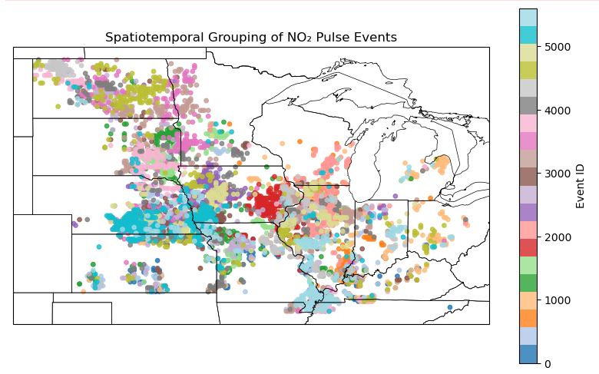
Notes:
Unsure if the early morning hours are still artifacts from the V03 bias after scaling, but we still see a good amount of pulses occur throughout the day.

Slide 14
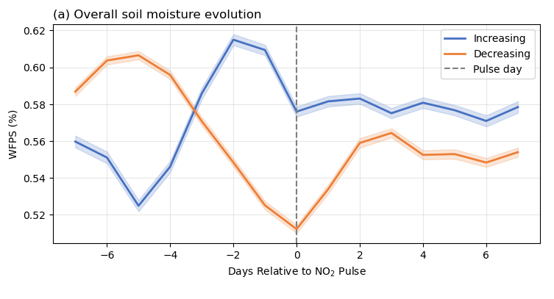
2/3 of Pulses initiating by drying, 1/3 wetting
Notes:
End slide with ”this figure was great, but it likely doesn’t represent every grid cell due to soil moisture differences… so look to soil type!

Slide 15
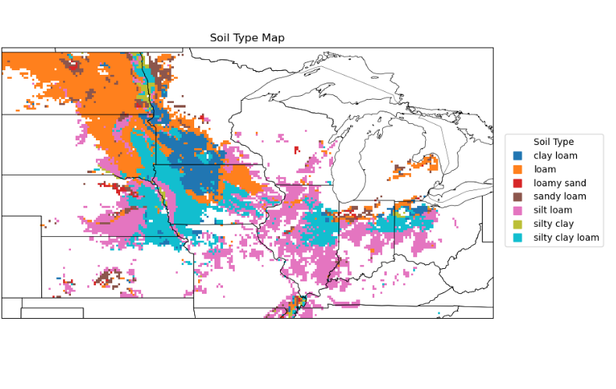
Soil type

Slide 16
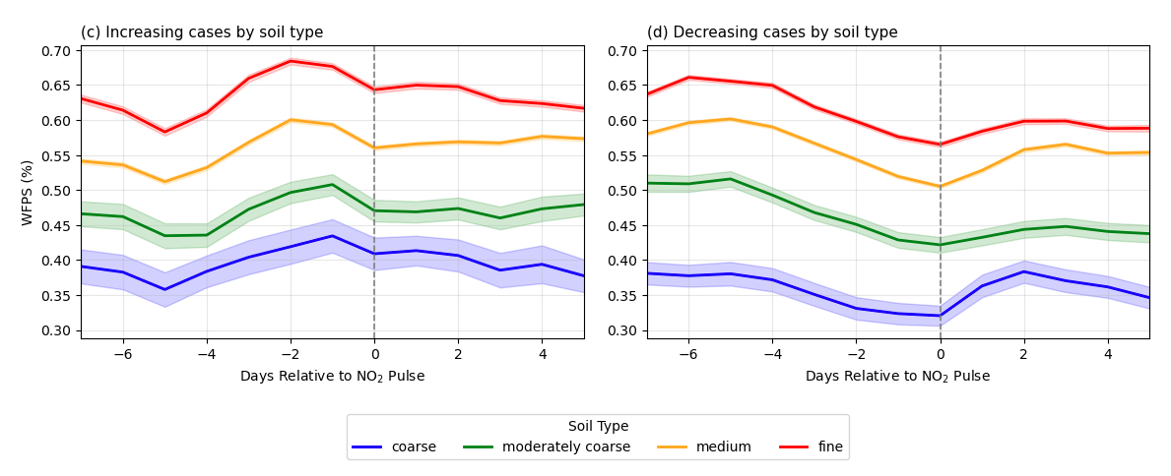
Soil type
Notes:
Put notes on coarse, moderately coarse, medium, and fine categories here

Slide 17
Summary
The massive increase in data collected by TEMPO allows detection of short-lived NO_{x} pulse events across the Midwest.
Getting the right absolute values requires TEMPO V04 and since the a priori doesn’t have the right emissions in the right location, SDR to correct (Beaudry and Cohen, JGR 2026).
2/3 of pulses occur during soil drying, not immediately following re-wetting.
Pulses occur at soil moisture specific to a soil types.
Most current model implementations grossly misrepresent these pulses, their timing and underestimate their frequency.
Describing this behavior requires a major model revision. Huber, Kort and Steiner (2023 and 2024) are a starting point for that revision but direct pulsing comparisons are needed.

Slide 18



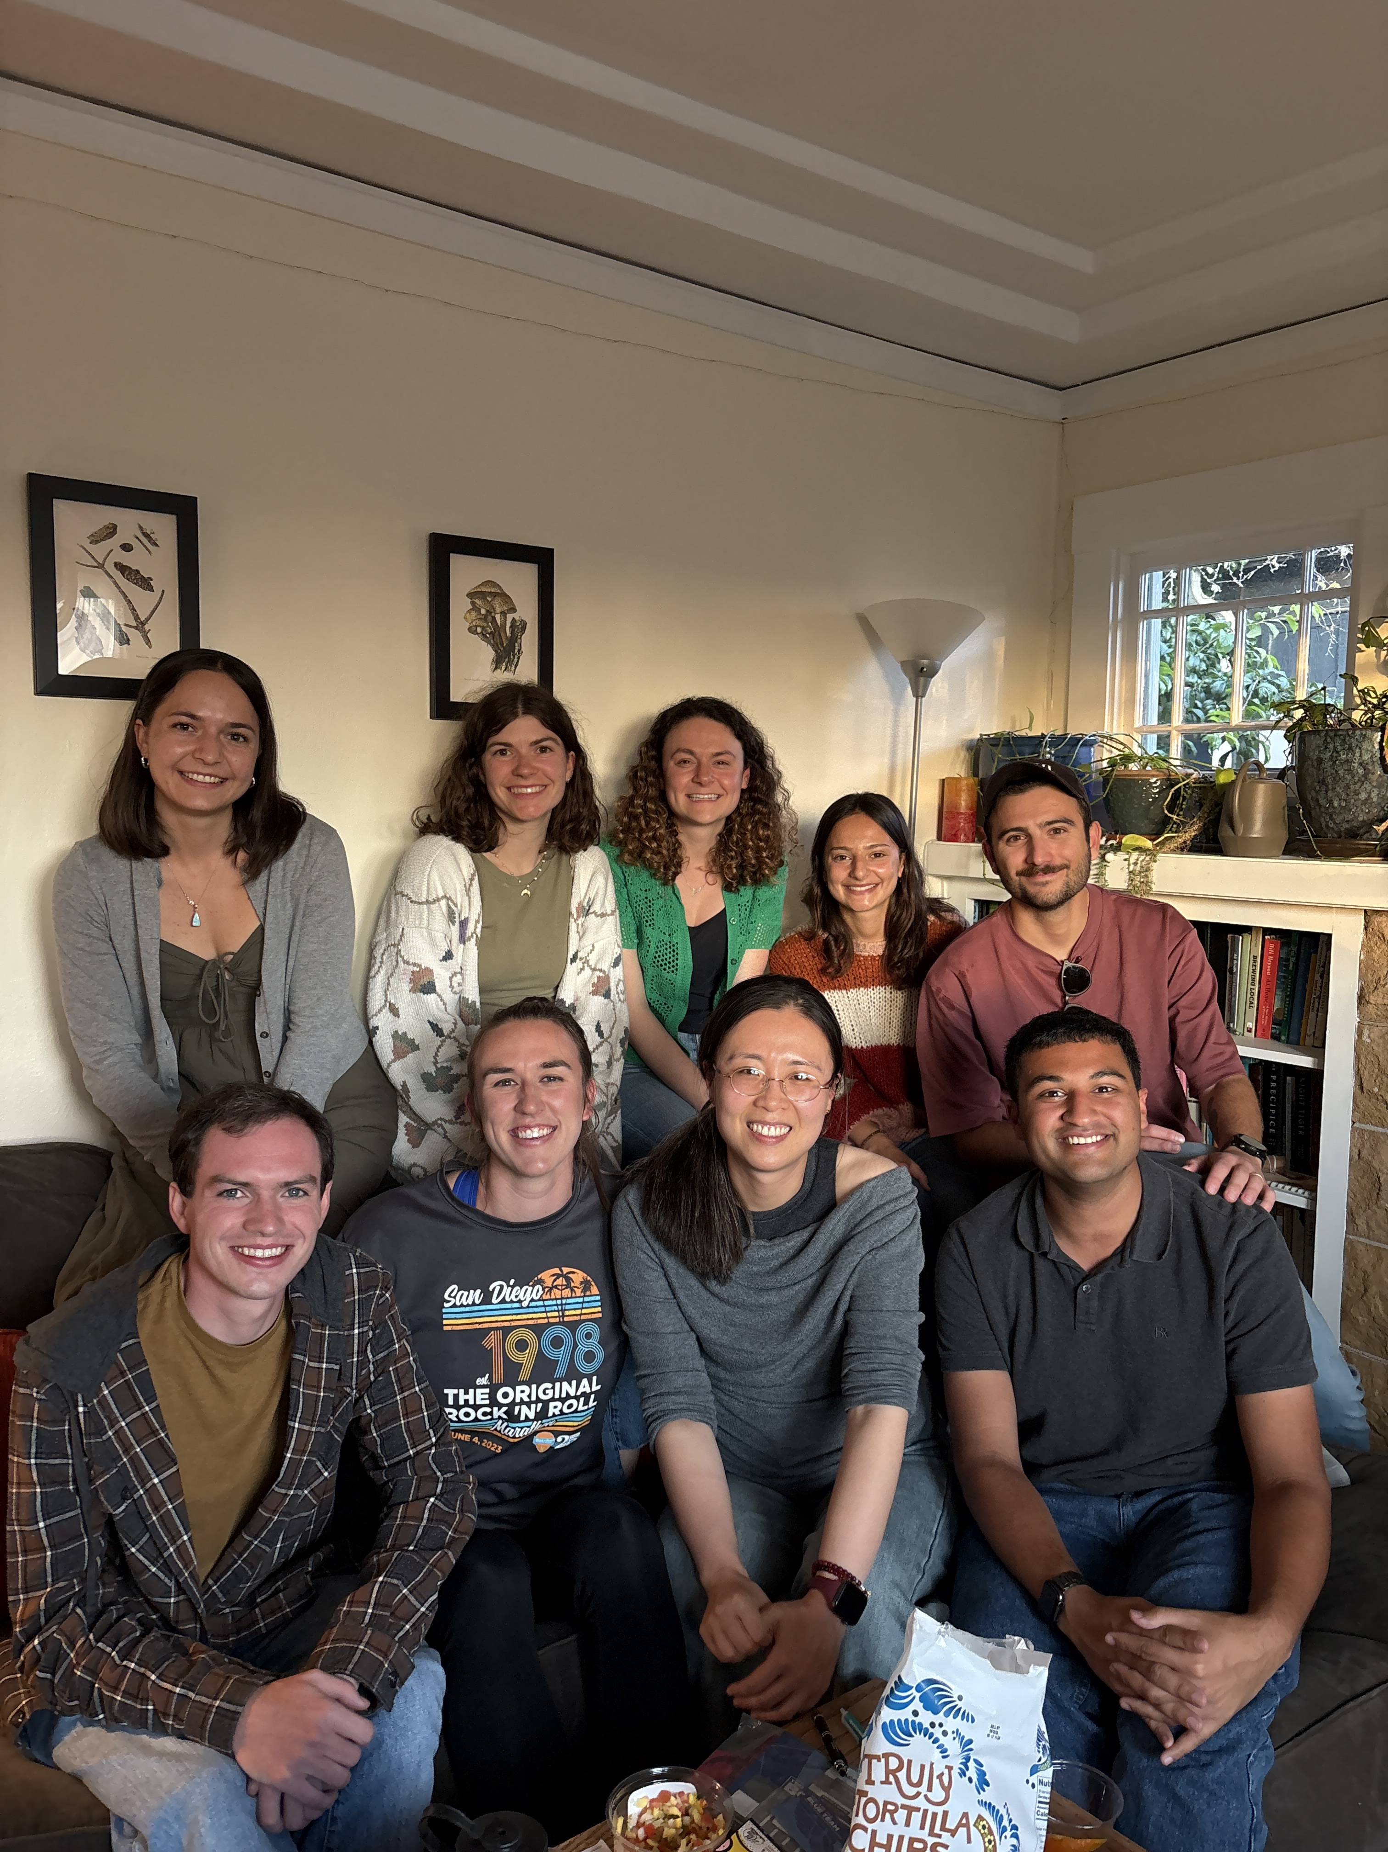








At UCB
Hikari Murayama Toireasa-Marie O’Rourke
Sol Hsiang (now Stanford) Danika Heaney
Luke Sherman Naomi Asimow (now at Terradot)
Ryan Giordano Natalie Schur
Sequoia Andrade Pietro Vannucci
Sherry Wang (now MIT) Sam Beaudry
Anna Winter
Will Berelson (USC) Yishu Zhu
Craig Michie (U. Strathclyde) Milan Patel
Meredith Hastings (Brown U.) Serena Peters
Angela Guzman Hernandez
(University of Atlantico)
Sanam Vardag (U. Heidelberg)
Thank you!

