Slide 1
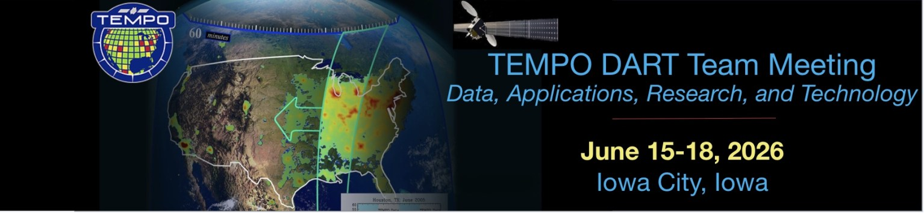
http://tempo.si.edu/
Data Product Overview & Use Case Demonstration
Aaron Naeger
& TEMPO Team
NASA Marshall Space Flight Center, Huntsville, AL

Slide 2

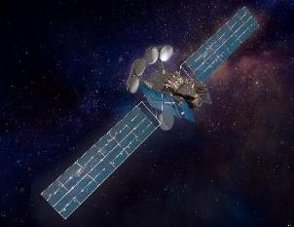

How Does TEMPO Observe Pollutants?
Vertical Column Density (VCD)
UV-VIS Spectrometer
TEMPO’s trace gas retrievals are based on multi-step approach.
  Derive slant column densities (SCD) via spectral fitting to measured TOA radiances in known trace gas absorption windows
  Calculation of vertical column densities (VCDs) using Air Mass Factors (AMF) calculated offline with a radiative transfer model accounting for surface, atmospheric, and viewing geometry conditions
  For NO₂ retrieval, perform Stratosphere-Troposphere separation for retrieving tropospheric NO₂ VCDs
TOA = Top-Of-Atmosphere
TEMPO
Vertical Column Density (VCD)
Slant Column Density (SCD)
TOA Radiances
Slant Column Density (SCD)
UV-VIS Radiation
Cloud Reflectance
Aerosol Absorption/Scattering
$$VCD=\frac{SCD}{AMF}$$
Trace Gas Absorption (NO₂)
Surface Reflectance
Aerosol effects are not explicitly treated in the retrieval
2
2

Slide 3
TEMPO Data Product Updates

Slide 4
TEMPO Products: SAO Baseline + SNWG NRT + NOAA Aerosol
Level | Product | Filename | Developer | Notable File Variables | Validation Status | Resolution (km²)
L1 | Radiance | RAD | SAO + SNWG | Radiances | Provisional | 2.0 x 4.75
 | Radiance (twilight) | RADT | SAO | Radiances | Provisional | 2.0 x 4.75
L2 | Cloud | CLDO4 | SAO/GSFC + SNWG | Cloud Fraction, Cloud Pressure | Provisional | 2.0 x 4.75
 | Ozone Total Column | O3TOT | SAO/GSFC | Total Column O₃, UV Aerosol Index | Provisional | 2.0 x 4.75
 | Nitrogen Dioxide | NO2 | SAO + SNWG | Tropospheric VCD, Total VCD | Provisional | 2.0 x 4.75
 | Formaldehyde | HCHO | SAO + SNWG | Total VCD, Cloud Fraction | Provisional | 2.0 x 4.75
 | Ozone Profile | O3PROF | SAO | O₃ Profile, Tropospheric O₃ column | Beta | 8.0 x 4.75
 | AOD & ALH | AODALH | NOAA | AOD 550 nm, ALH | N/A | 2.0 x 4.75
 | Aerosol Detection Product (ADP) | ADP | NOAA | Dust/Smoke Discrimination, UV Aerosol Index | N/A | 2.0 x 4.75
L3 | Same as L2 | Same as L2 | SAO/GSFC + SNWG | Same Variables as L2 | Same as above | 0.02°x 0.02°
L4 | Surface PM_{2.5} | PM25 | NOAA | Hourly PM_{2.5} Estimation | N/A | 2 km x 2 km
*
AOD: Aerosol Optical Depth
ALH: Aerosol Layer Height
*
Latest product versions: Version 4 (standard) & Version 2 (NRT)
SNWG: Satellite Needs Working Group - near real-time products (~2-3 hours) – public release Sept. 17, 2025
NOAA: National Oceanic and Atmospheric Administration
*
@Center of Field of Regard
33.7°N, 91.7°W
4
4
SAO: Smithsonian Astrophysical Observatory
*
4
O3PROF L3 Product → 0.04 x 0.04° Resolution
Notes:
The level 3 product provides the same type of product variables as the level 2 product except the level 3 product is on a standard, regular grid of 0.02 degrees or about 2 km across the TEMPO Field of Regard. The level 3 product essentially stitches together the level 2 granules (9 granules or slices across the full TEMPO Field of Regard) and uses an area-weighted re-gridding method to remap the level 2 data onto the regular 0.02 degree grid of the level 3 product.

Slide 5
Future TEMPO Products: SNWG NRT & Enhanced
These products have no formal release date yet but are officially funded for the TEMPO mission
Level | Product | Filename | Source | Key Product Variables | Resolution (km²)
L2 | Glyoxal (C₂H₂O₂) | GLYX | SNWG Enhanced | Total VCD, Cloud Fraction | 2.0 x 4.75
 | Water Vapor (H₂O) | H2O | SNWG Enhanced |  | 2.0 x 4.75
 | Bromine (BrO) | BRO | SNWG Enhanced |  | 2.0 x 4.75
 | Sulfur Dioxide (SO₂) | SO2 | SNWG NRT | Total VCD | 2.0 x 4.75
 | UVAOD | TBD | SNWG Enhanced | AOD 354, 388, 500 nm | 2.0 x 4.75
 | ALH | TBD | SNWG Enhanced | ALH | 2.0 x 4.75
 | UVB | TBD | SNWG Enhanced | UVB | 2.0 x 4.75
*
@Center of Field of Regard
33.7°N, 91.7°W
UVB (Ultraviolet B) radiation retrievals support analyses on UV exposure trends, human health risks (skin cancer), and environmental impacts such as ecosystem damage.
Glyoxal forms from vegetation and wildfires with human activities (i.e., fossil fuels burning) contributing smaller amounts
Sources of bromine include volcanic emissions, biomass burning, industrial emissions, and marine processes
5
Notes:
Note the SO2 product will be a near real-time product with < 2 hour data latency.

Slide 6


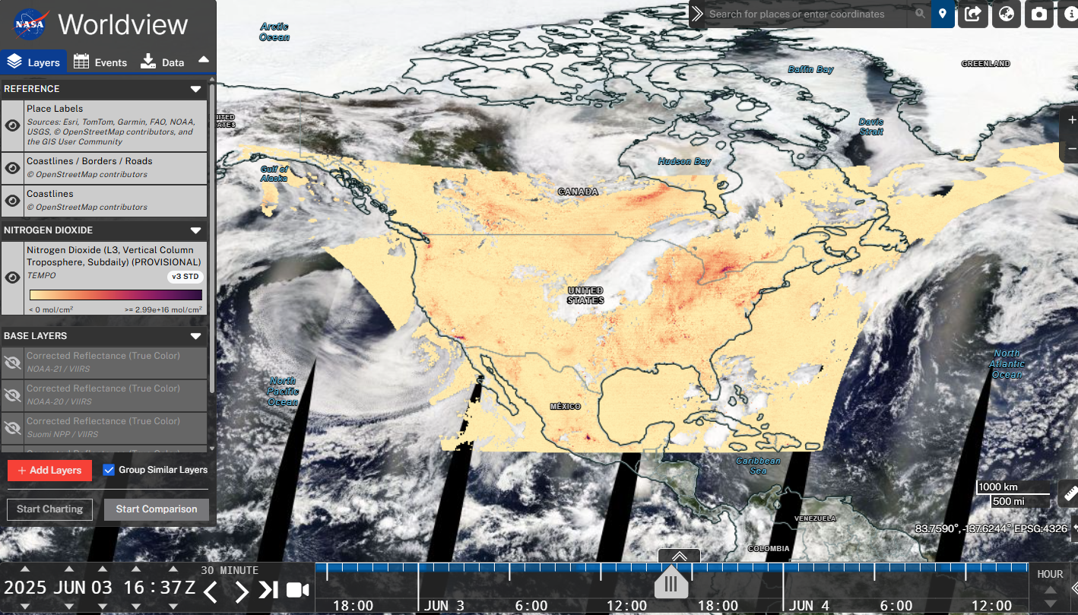
TEMPO Product Release & Tools
Public Release | Date | Details
V01 | 2/5/2024 | Limited 3 weeks released
V02 | 2/26/2024 | Level 1 (spectra) released
V03 | 5/20/2024 | L1, L2/3 cloud, NO₂, H₂CO, total O₃ (provisional) V3 O₃ profile (ASDC 6/9/2025, not for the public)
V04 | 9/17/2025 | Ozone Profile (beta), L1 + other L2/L3 (provisional) Reprocessing starting this week
NRT V02 | 9/17/2025 | L1, L2/3 cloud, NO₂, H₂CO (funded by SNWG)
TEMPO data publicly available at NASA’s ASDC (~6 hours latency, NRT with 2-3 hours latency).
TEMPO website for data access, visualization tools, and user guides links
Wealth of tools:
  Earthdata Search
  NASA Worldview
  NASA ArcGIS services
  RSIG (EPA)
  TEMPO-Lite (SAO)
  NASA SPoRT Viewer
  Google Earth Engine
NASA SPoRT Viewer for NRT imagery
Worldview for visualizing TEMPO
6
Notes:
Graphic to stress the point that TEMPO makes atmospheric column measurements, rather than surface-level measurements, and relies on complex retrievals that account for surface and atmospheric conditions and TEMPO viewing geometry, which leads to important errors / uncertainties that users must consider.

Slide 7
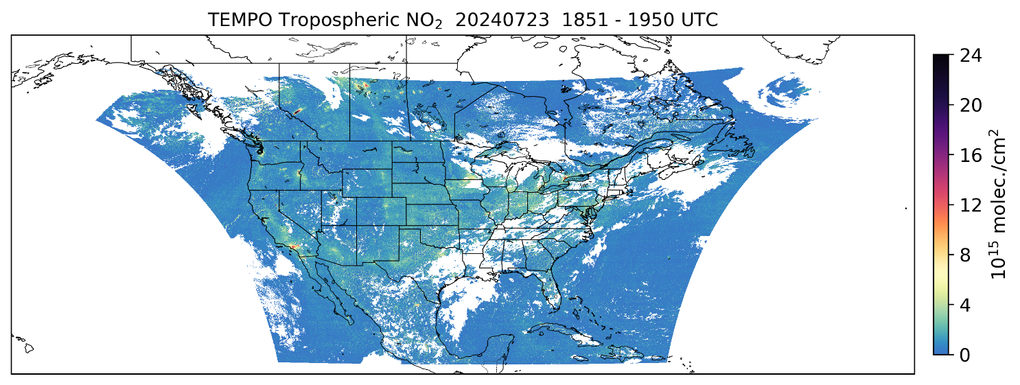
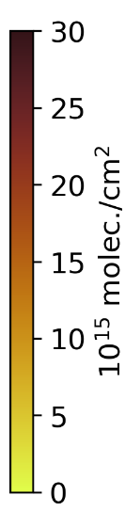


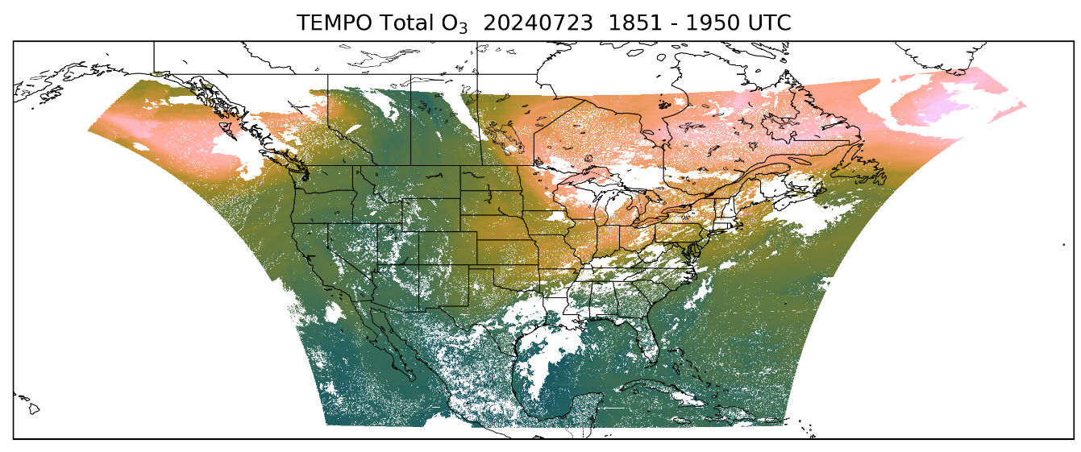
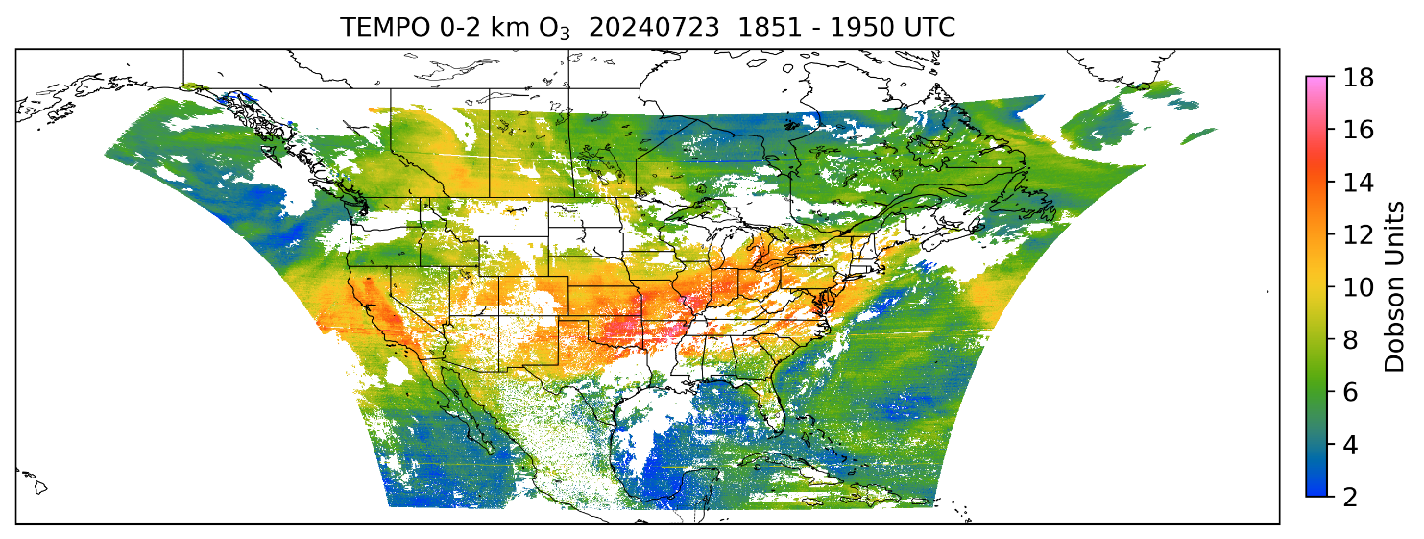


TEMPO L2 Data Across Field of Regard (FoR)
Tropospheric NO₂ VCDs
Total HCHO VCDs
Total O₃ columns
0-2 km O₃ columns
VCDs – total amount of trace gas in the vertical column of air directly above a specific area of Earth’s surface to the top of the atmosphere
  molecules cm⁻² - total number of gas molecules found in the vertical column of air
  Dobson Units (DU) – measures thickness of a gas layer if compressed to sea-level pressure
7
7

Slide 8
Data Filtering for Version 4 Products

Slide 9
Data Filtering Guidance – NO₂ & HCHO
QA Parameter | Variable (group) | Range | Qualitative Use (Worldview) | Quantitative Use
Effective Cloud Fraction (ECF) | eff_cloud_fraction (support_data) | 0 – 1.0 | > 0.5 | > 0.1
Solar Zenith Angle (SZA) | solar_zenith_angle (geolocation) | 0 – 90° | > 80° | > 70°
Main Data Quality Flag (QF) | main_data_quality_flag (product) “0” = High-quality “1” = Suspect due to AMF & viewing geometry “2” = Outlier retrievals or no successful AMF calculation | 0 to 2 | ≠ 2 | > 0
Users must apply data filtering for both Level 2 and Level 3 NO₂ and HCHO products
9
9
Notes:
TEMPO validation against the Pandora ground-based network using the latest Version 3 TEMPO data shows overall good results for NO2 and HCHO. The maps show correlation and normalized mean bias (in percent) for TEMPO NO2 and HCHO versus Pandora NO2 and HCHO at each of the Pandora sites across the TEMPO Field of Regard. Key point is TEMPO NO2 and HCHO compares well to the Pandora sites, with overall better performance of the TEMPO NO2 product. The good validation results led to the previous ‘beta’ version of TEMPO products being upgraded to ‘provisional status’, indicating TEMPO data products are suitable for scientific research. Note these validation results were done using the strictest quality assurance thresholds to retain the highest quality TEMPO data.

Slide 10
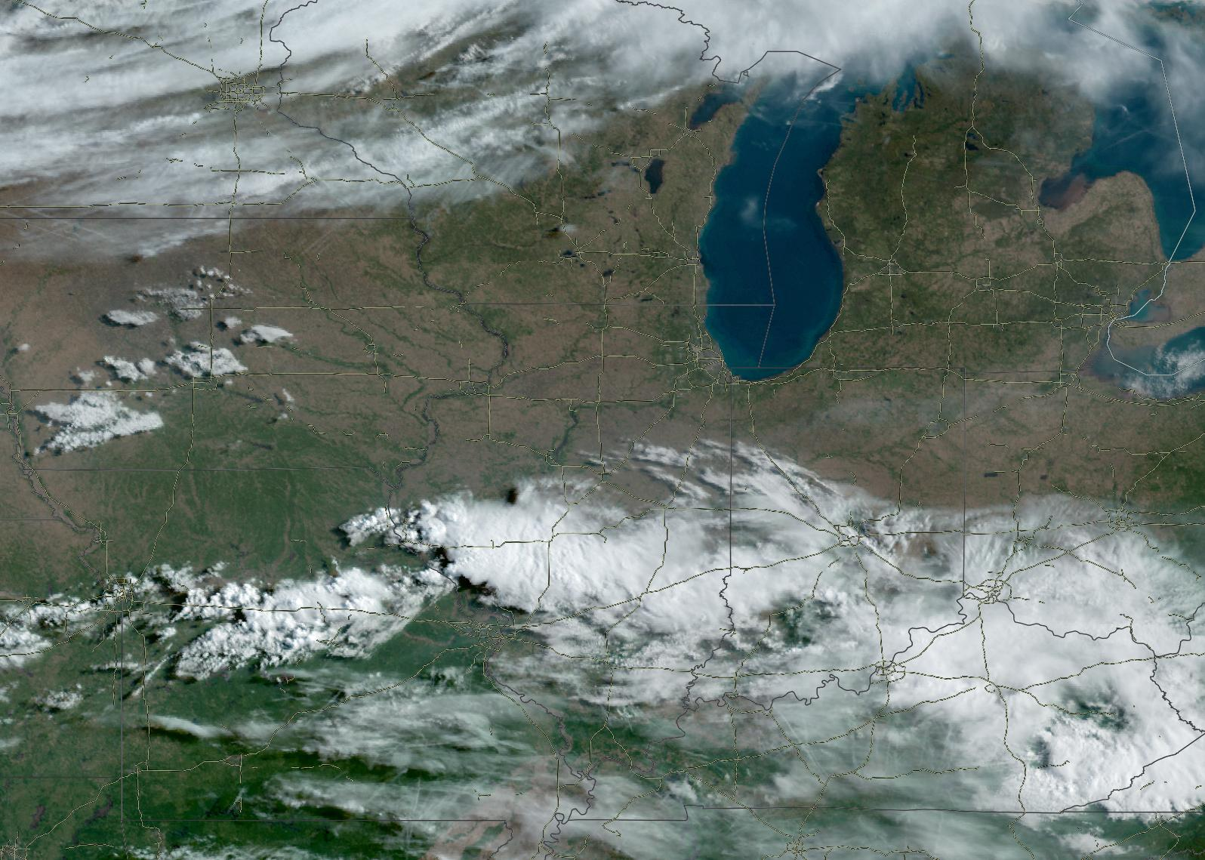
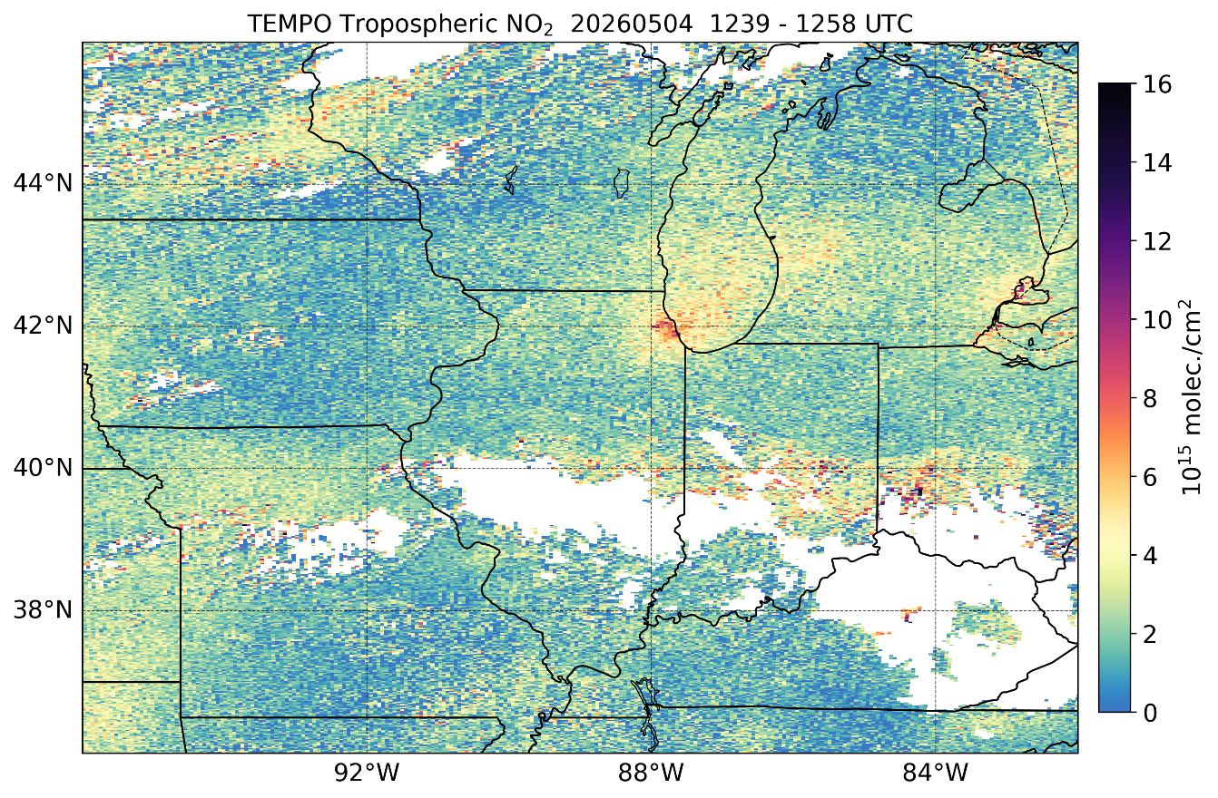
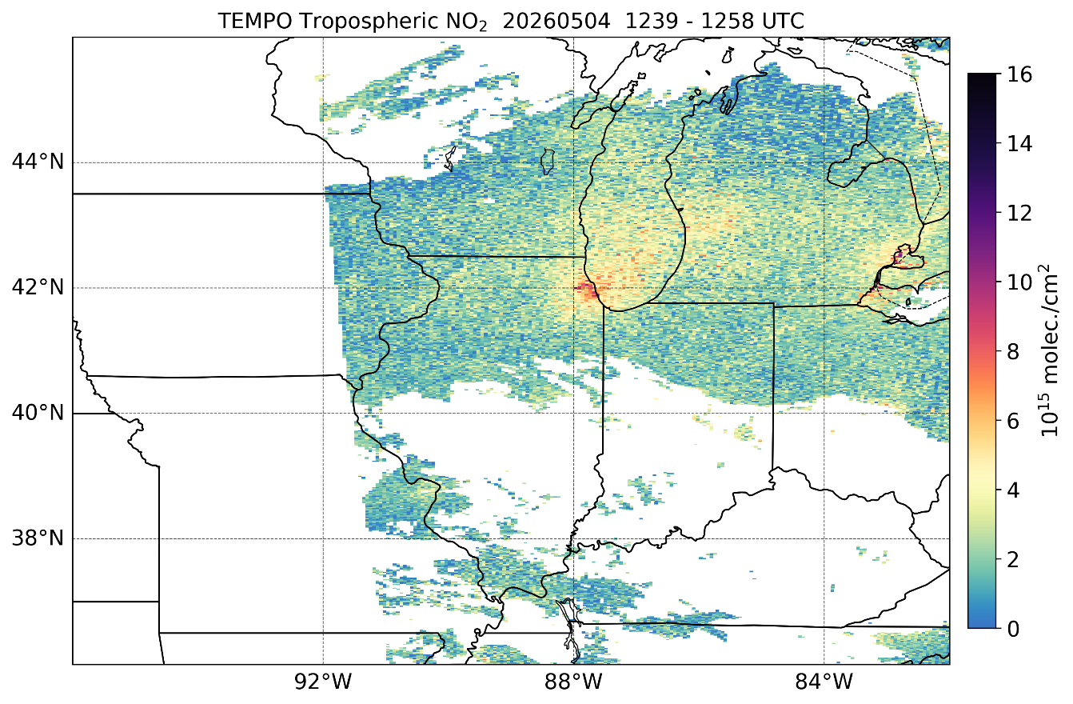
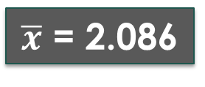
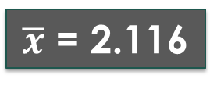
May 4, 2026 NO₂ Example
GOES ABI True Color ~1250 UTC
SZA > 80°
QF ≠ 2
ECF > 0.5
SZA > 80°
QF ≠ 2
ECF > 0.1
SZA > 70°
QF > 0
$\overline{x}$ = 2.116
$\overline{x}$ = 2.086
No data due to SZA > 70°
10
10
Notes:
TEMPO validation against the Pandora ground-based network using the latest Version 3 TEMPO data shows overall good results for NO2 and HCHO. The maps show correlation and normalized mean bias (in percent) for TEMPO NO2 and HCHO versus Pandora NO2 and HCHO at each of the Pandora sites across the TEMPO Field of Regard. Key point is TEMPO NO2 and HCHO compares well to the Pandora sites, with overall better performance of the TEMPO NO2 product. The good validation results led to the previous ‘beta’ version of TEMPO products being upgraded to ‘provisional status’, indicating TEMPO data products are suitable for scientific research. Note these validation results were done using the strictest quality assurance thresholds to retain the highest quality TEMPO data.

Slide 11
May 4, 2026 NO₂ Example
GOES ABI True Color ~1250 UTC
SZA < 80°
QF < 2
ECF > 0.5
SZA > 80°
QF > 0
Limited QF impact
ECF > 0.1
SZA > 70°
QF > 0
$\overline{x}$ = 2.116
$\overline{x}$ = 2.086
No data due to SZA > 70°
11
11
Notes:
TEMPO validation against the Pandora ground-based network using the latest Version 3 TEMPO data shows overall good results for NO2 and HCHO. The maps show correlation and normalized mean bias (in percent) for TEMPO NO2 and HCHO versus Pandora NO2 and HCHO at each of the Pandora sites across the TEMPO Field of Regard. Key point is TEMPO NO2 and HCHO compares well to the Pandora sites, with overall better performance of the TEMPO NO2 product. The good validation results led to the previous ‘beta’ version of TEMPO products being upgraded to ‘provisional status’, indicating TEMPO data products are suitable for scientific research. Note these validation results were done using the strictest quality assurance thresholds to retain the highest quality TEMPO data.

Slide 12
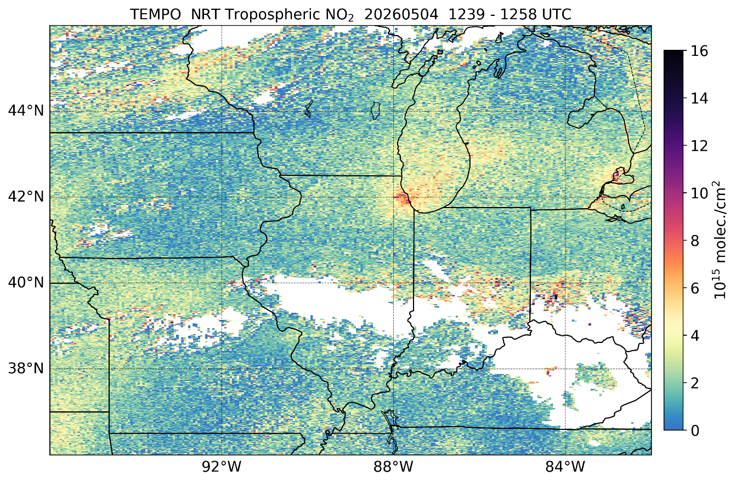

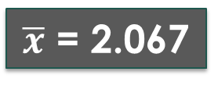
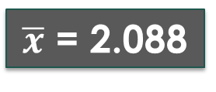
May 4, 2026 NRT NO₂ Example
GOES ABI True Color ~1250 UTC
SZA < 80°
QF < 2
ECF > 0.5
SZA > 80°
QF ≠ 2
ECF > 0.1
SZA > 70°
QF > 0
$\overline{x}$ = 2.088
$\overline{x}$ = 2.067
No data due to SZA > 70°
12
12
Notes:
TEMPO validation against the Pandora ground-based network using the latest Version 3 TEMPO data shows overall good results for NO2 and HCHO. The maps show correlation and normalized mean bias (in percent) for TEMPO NO2 and HCHO versus Pandora NO2 and HCHO at each of the Pandora sites across the TEMPO Field of Regard. Key point is TEMPO NO2 and HCHO compares well to the Pandora sites, with overall better performance of the TEMPO NO2 product. The good validation results led to the previous ‘beta’ version of TEMPO products being upgraded to ‘provisional status’, indicating TEMPO data products are suitable for scientific research. Note these validation results were done using the strictest quality assurance thresholds to retain the highest quality TEMPO data.

Slide 13
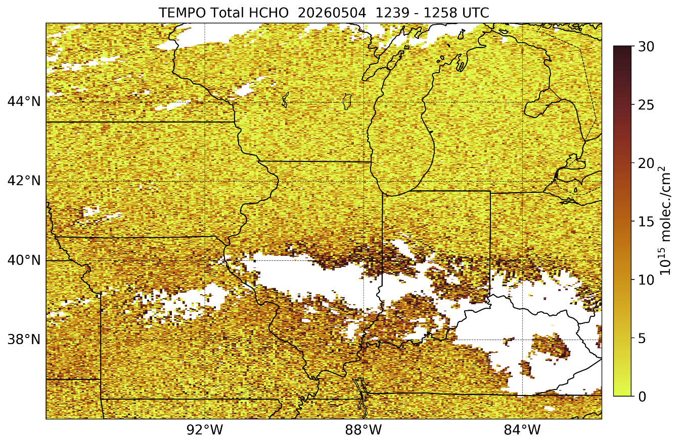
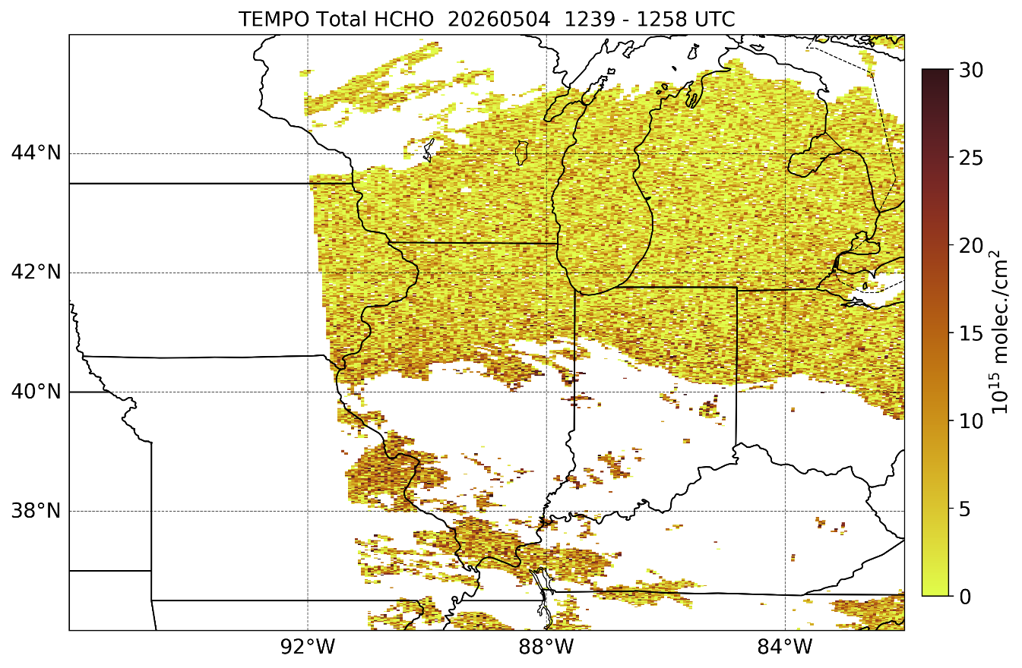
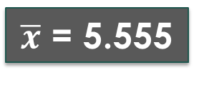
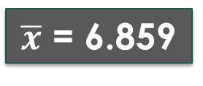
May 4, 2026 HCHO Example
GOES ABI True Color ~1250 UTC
SZA < 80°
QF < 2
ECF > 0.5
SZA > 80°
QF ≠ 2
ECF > 0.1
SZA > 70°
QF > 0
$\overline{x}$ = 6.859
$\overline{x}$ = 5.555
No data due to SZA > 70°
13
13
Notes:
TEMPO validation against the Pandora ground-based network using the latest Version 3 TEMPO data shows overall good results for NO2 and HCHO. The maps show correlation and normalized mean bias (in percent) for TEMPO NO2 and HCHO versus Pandora NO2 and HCHO at each of the Pandora sites across the TEMPO Field of Regard. Key point is TEMPO NO2 and HCHO compares well to the Pandora sites, with overall better performance of the TEMPO NO2 product. The good validation results led to the previous ‘beta’ version of TEMPO products being upgraded to ‘provisional status’, indicating TEMPO data products are suitable for scientific research. Note these validation results were done using the strictest quality assurance thresholds to retain the highest quality TEMPO data.

Slide 14
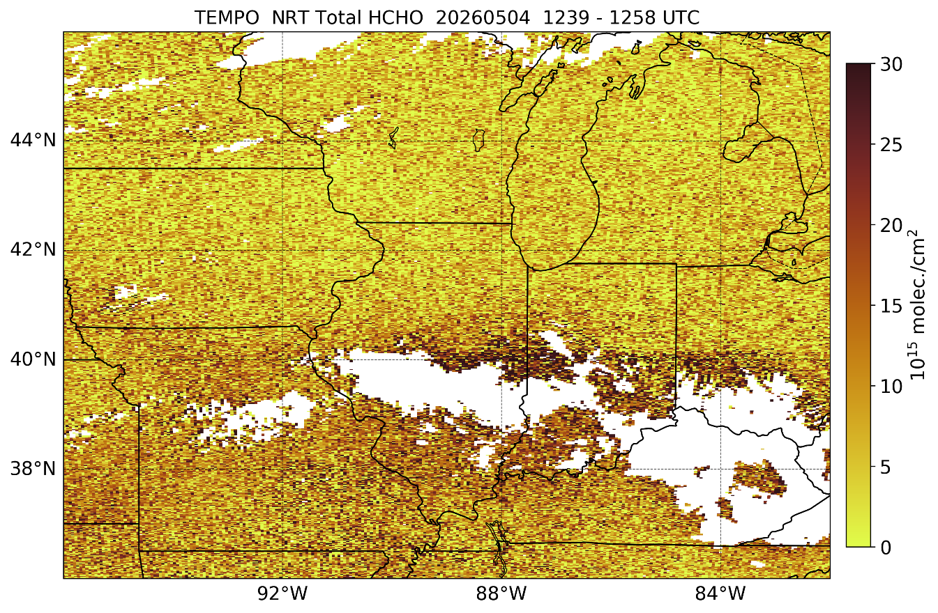
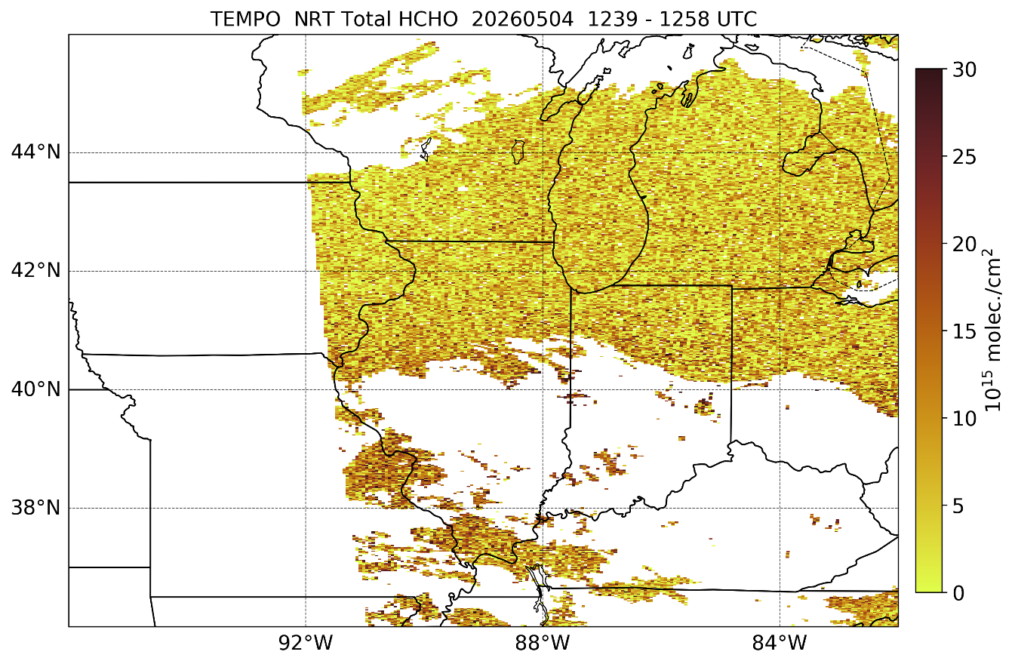
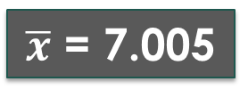
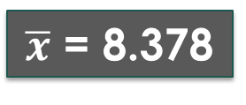
May 4, 2026 NRT HCHO Example
GOES ABI True Color ~1250 UTC
SZA < 80°
QF < 2
ECF > 0.5
SZA > 80°
QF ≠ 2
ECF > 0.1
SZA > 70°
QF > 0
$\overline{x}$ = 8.378
$\overline{x}$ = 7.005
No data due to SZA > 70°
14
14
Notes:
TEMPO validation against the Pandora ground-based network using the latest Version 3 TEMPO data shows overall good results for NO2 and HCHO. The maps show correlation and normalized mean bias (in percent) for TEMPO NO2 and HCHO versus Pandora NO2 and HCHO at each of the Pandora sites across the TEMPO Field of Regard. Key point is TEMPO NO2 and HCHO compares well to the Pandora sites, with overall better performance of the TEMPO NO2 product. The good validation results led to the previous ‘beta’ version of TEMPO products being upgraded to ‘provisional status’, indicating TEMPO data products are suitable for scientific research. Note these validation results were done using the strictest quality assurance thresholds to retain the highest quality TEMPO data.

Slide 15
TEMPO L2 Data Across Field of Regard (FoR)
Tropospheric NO₂ VCDs
Total HCHO VCDs
Total O₃ columns
0-2 km O₃ columns
VCDs – total amount of trace gas in the vertical column of air directly above a specific area of Earth’s surface to the top of the atmosphere
  molecules cm⁻² - total number of gas molecules found in the vertical column of air
  Dobson Units (DU) – measures thickness of a gas layer if compressed to sea-level pressure
15
15

Slide 16
Data Filtering Guidance – O₃ Total
QA Parameter | Variable (group) | Range | Qualitative Use (Worldview) | Quantitative Use
Quality Flag | quality_flag (product) 0 = highest-quality 1 = Glint contamination 2 = SZA > 84° 5 = SO2 present <1024 = ONLY disregard radiance/irradiance data which are missing or contain errors | 0 to 32768 | ≠ [0, 1, 2, 5] (adequate) | > 0 (best)
Effective Cloud Fraction (ECF) | fc (product) | 0 – 1.0 | No Filter | > 0.5
Solar Zenith Angle (SZA) | solar_zenith_angle (geolocation) | 0 – 90° | > 80° | > 80°
Viewing Zenith Angle (VZA) | viewing_zenith_angle (geolocation) | 0 – 90° | > 80° | > 80°
16
16
Notes:
TEMPO validation against the Pandora ground-based network using the latest Version 3 TEMPO data shows overall good results for NO2 and HCHO. The maps show correlation and normalized mean bias (in percent) for TEMPO NO2 and HCHO versus Pandora NO2 and HCHO at each of the Pandora sites across the TEMPO Field of Regard. Key point is TEMPO NO2 and HCHO compares well to the Pandora sites, with overall better performance of the TEMPO NO2 product. The good validation results led to the previous ‘beta’ version of TEMPO products being upgraded to ‘provisional status’, indicating TEMPO data products are suitable for scientific research. Note these validation results were done using the strictest quality assurance thresholds to retain the highest quality TEMPO data.

Slide 17
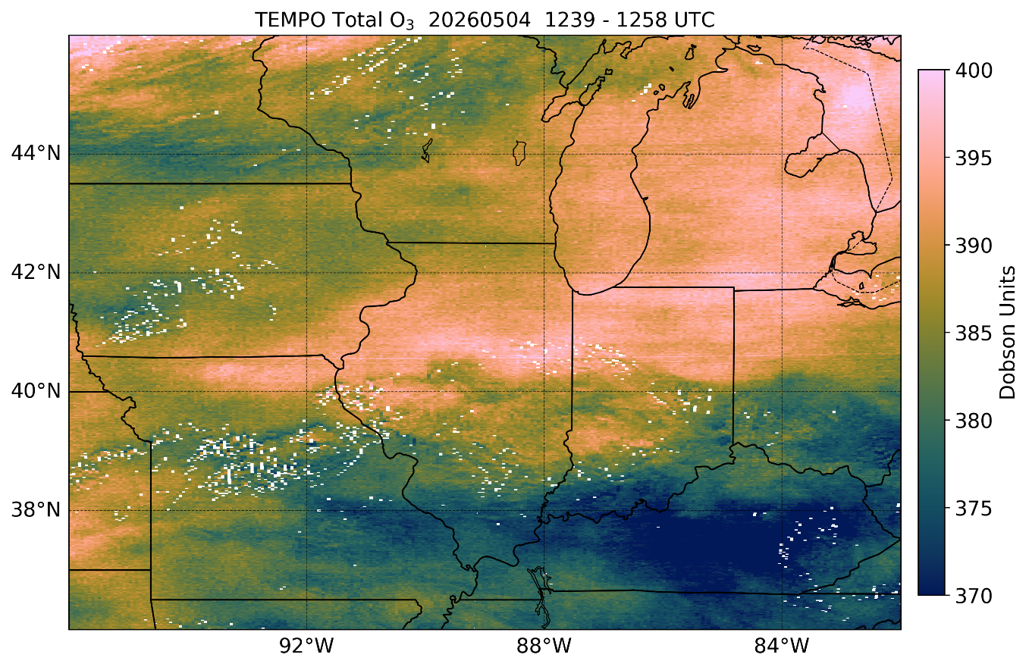
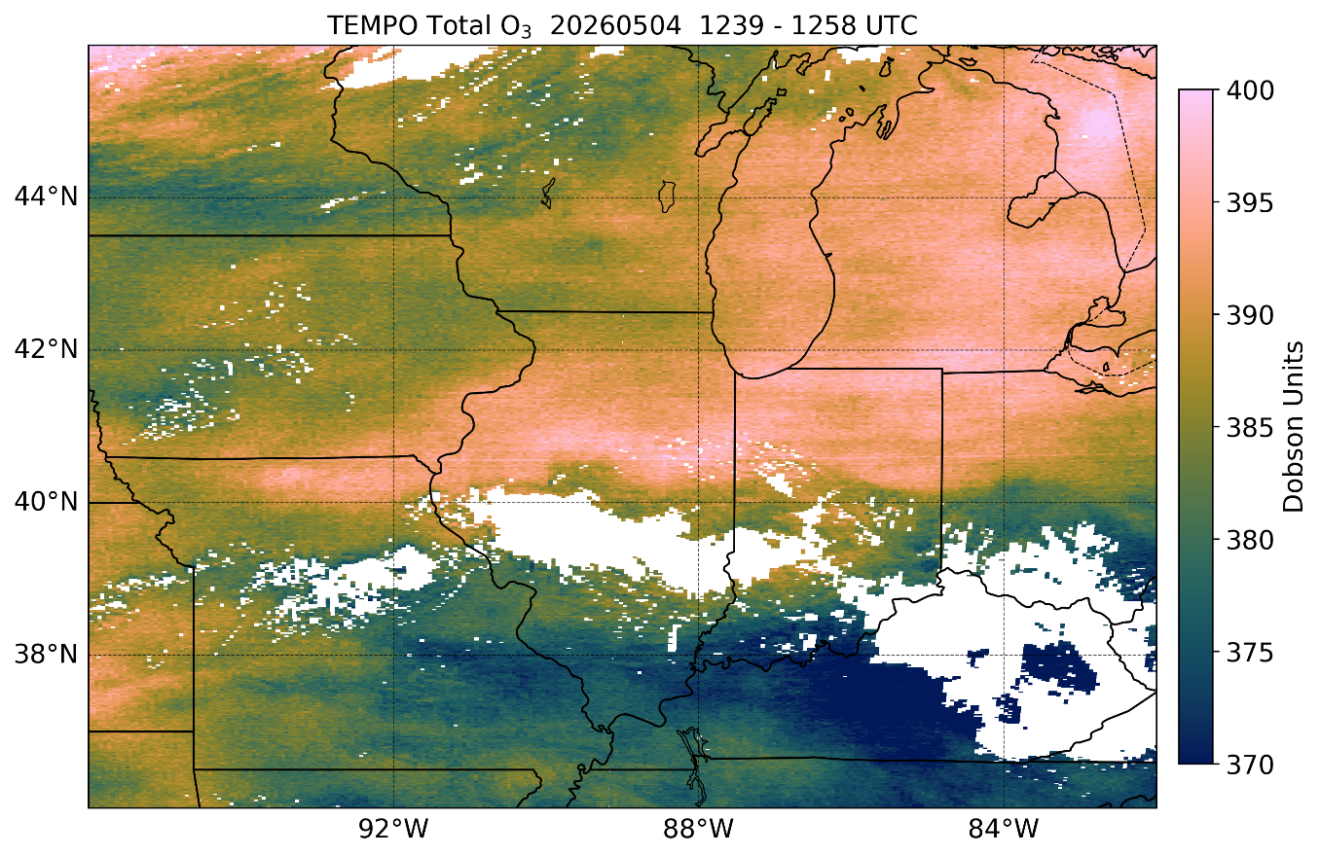
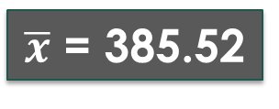
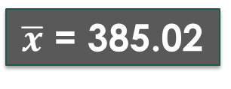
May 4, 2026 O₃ Total Example
GOES ABI True Color ~1250 UTC
NO ECF
ZA > 80°
QF ≠ 0,1,2,5
ECF > 0.5
ZA > 80°
QF > 0
$\overline{x}$ = 385.02
$\overline{x}$ = 385.52
17
17
Notes:
TEMPO validation against the Pandora ground-based network using the latest Version 3 TEMPO data shows overall good results for NO2 and HCHO. The maps show correlation and normalized mean bias (in percent) for TEMPO NO2 and HCHO versus Pandora NO2 and HCHO at each of the Pandora sites across the TEMPO Field of Regard. Key point is TEMPO NO2 and HCHO compares well to the Pandora sites, with overall better performance of the TEMPO NO2 product. The good validation results led to the previous ‘beta’ version of TEMPO products being upgraded to ‘provisional status’, indicating TEMPO data products are suitable for scientific research. Note these validation results were done using the strictest quality assurance thresholds to retain the highest quality TEMPO data.

Slide 18
May 4, 2026 O₃ Total Example
GOES ABI True Color ~1250 UTC
NO ECF
ZA > 80°
QF ≠ 0,1,2,5
ECF > 0.5
ZA > 80°
QF ≠ 0,1,2,5
$\overline{x}$ = 385.02
$\overline{x}$ = 385.52
18
18
Notes:
TEMPO validation against the Pandora ground-based network using the latest Version 3 TEMPO data shows overall good results for NO2 and HCHO. The maps show correlation and normalized mean bias (in percent) for TEMPO NO2 and HCHO versus Pandora NO2 and HCHO at each of the Pandora sites across the TEMPO Field of Regard. Key point is TEMPO NO2 and HCHO compares well to the Pandora sites, with overall better performance of the TEMPO NO2 product. The good validation results led to the previous ‘beta’ version of TEMPO products being upgraded to ‘provisional status’, indicating TEMPO data products are suitable for scientific research. Note these validation results were done using the strictest quality assurance thresholds to retain the highest quality TEMPO data.

Slide 19
O₃ Total Column – Level 3 Product
When regridding TEMPO Level 2 data to the regular 0.02° Level 3 grid, data filtering is used during the procedure
  “Best” Quality flag (QF = 0)
  Solar (SZA < 80°) & viewing zenith angles (VZA < 80°)
Effective cloud fraction is NOT used for filtering when producing the O₃ Total Column product
Users need to apply fc (effective cloud fraction) variable for filtering clouds from Level 3 O₃ Total Column product
19
19
Notes:
TEMPO validation against the Pandora ground-based network using the latest Version 3 TEMPO data shows overall good results for NO2 and HCHO. The maps show correlation and normalized mean bias (in percent) for TEMPO NO2 and HCHO versus Pandora NO2 and HCHO at each of the Pandora sites across the TEMPO Field of Regard. Key point is TEMPO NO2 and HCHO compares well to the Pandora sites, with overall better performance of the TEMPO NO2 product. The good validation results led to the previous ‘beta’ version of TEMPO products being upgraded to ‘provisional status’, indicating TEMPO data products are suitable for scientific research. Note these validation results were done using the strictest quality assurance thresholds to retain the highest quality TEMPO data.

Slide 20
Data Filtering Guidance – O₃ Profile
QA Parameter | Variable (group) | Range | Quantitative Use
retrieval exit status | exit_status (qa_statistics) 0 = not converged 1-99 = converged 100-110 = converged but with negative O₃ value | (-10) – 110 | < 1 or > 99
ratio of fitting residual to measurement error | fit_RMS (qa_statistics) | 0 - 100 | > 3
average fitting residuals | avg_residuals (qa_statistics) | 0 - 100 | > 0.3
Effective Cloud Fraction (ECF) | eff_cloud_fraction (support_data) | 0 – 1.0 | > 0.5
Solar Zenith Angle (SZA) | solar_zenith_angle (geolocation) | 0 – 90° | > 80°
Viewing Zenith Angle (VZA) | viewing_zenith_angle (geolocation) | 0 – 90° | > 80°
20
20
Notes:
TEMPO validation against the Pandora ground-based network using the latest Version 3 TEMPO data shows overall good results for NO2 and HCHO. The maps show correlation and normalized mean bias (in percent) for TEMPO NO2 and HCHO versus Pandora NO2 and HCHO at each of the Pandora sites across the TEMPO Field of Regard. Key point is TEMPO NO2 and HCHO compares well to the Pandora sites, with overall better performance of the TEMPO NO2 product. The good validation results led to the previous ‘beta’ version of TEMPO products being upgraded to ‘provisional status’, indicating TEMPO data products are suitable for scientific research. Note these validation results were done using the strictest quality assurance thresholds to retain the highest quality TEMPO data.

Slide 21
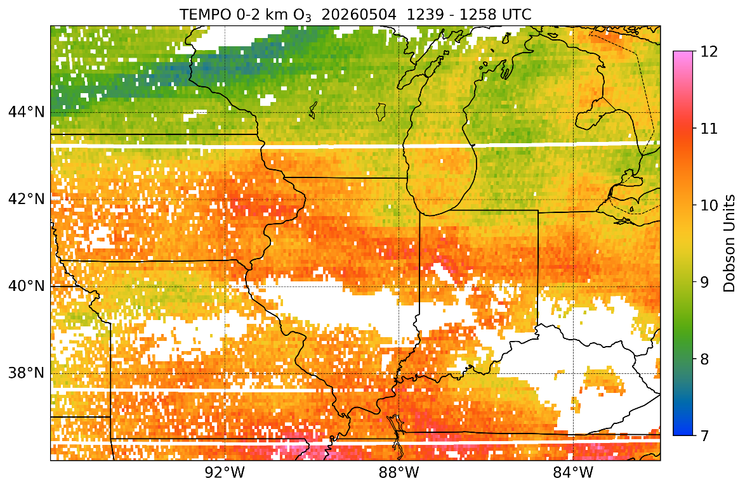
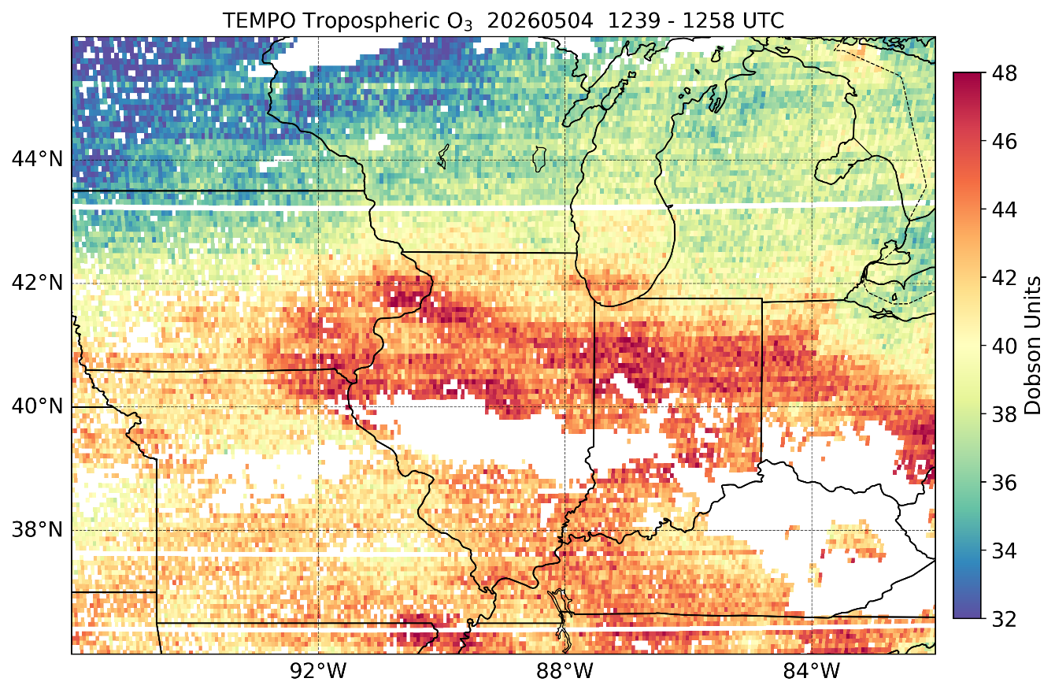
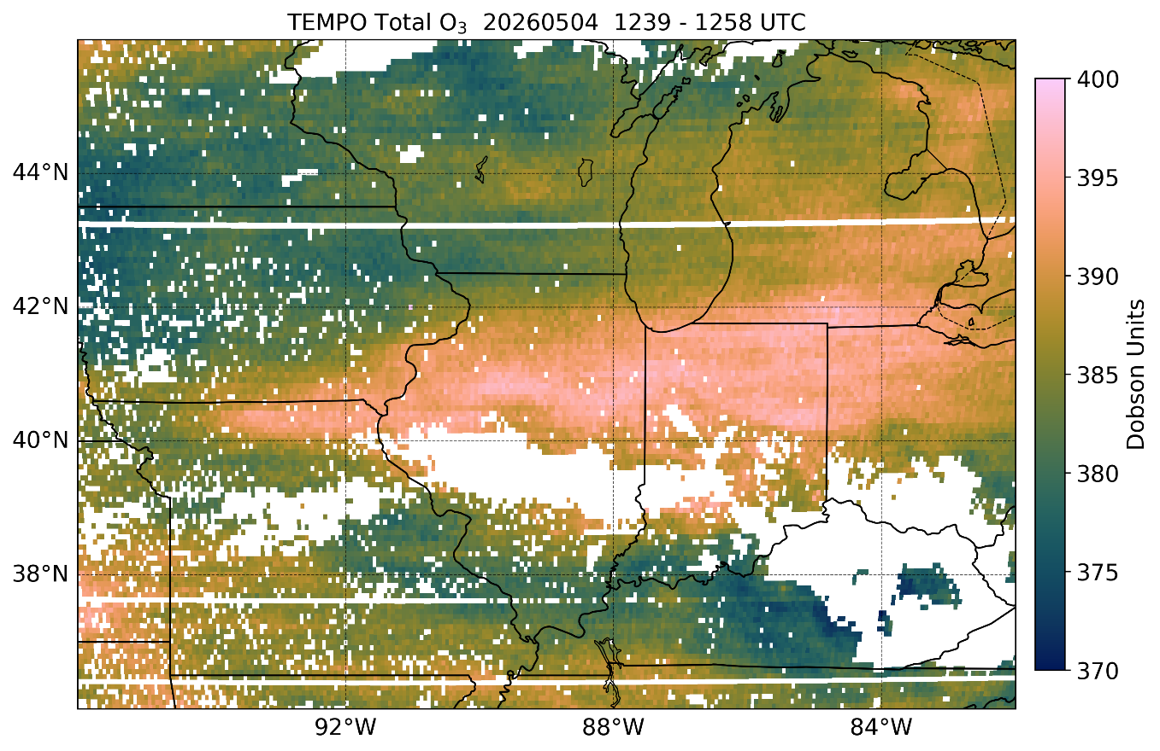
May 4, 2026 O₃ Profile Example
0-2 km O₃
Data filtering recommendation
ECF > 0.5
SZA > 80°
VZA > 80°
fit_RMS > 3
avg_residual > 0.3
exit_status < 1 or > 99
Tropospheric O₃
Total O₃
21
21
Notes:
TEMPO validation against the Pandora ground-based network using the latest Version 3 TEMPO data shows overall good results for NO2 and HCHO. The maps show correlation and normalized mean bias (in percent) for TEMPO NO2 and HCHO versus Pandora NO2 and HCHO at each of the Pandora sites across the TEMPO Field of Regard. Key point is TEMPO NO2 and HCHO compares well to the Pandora sites, with overall better performance of the TEMPO NO2 product. The good validation results led to the previous ‘beta’ version of TEMPO products being upgraded to ‘provisional status’, indicating TEMPO data products are suitable for scientific research. Note these validation results were done using the strictest quality assurance thresholds to retain the highest quality TEMPO data.

Slide 22
TEMPO Nominal “Standard” Operations
July 23, 2024 West U.S. Wildfires

Slide 23
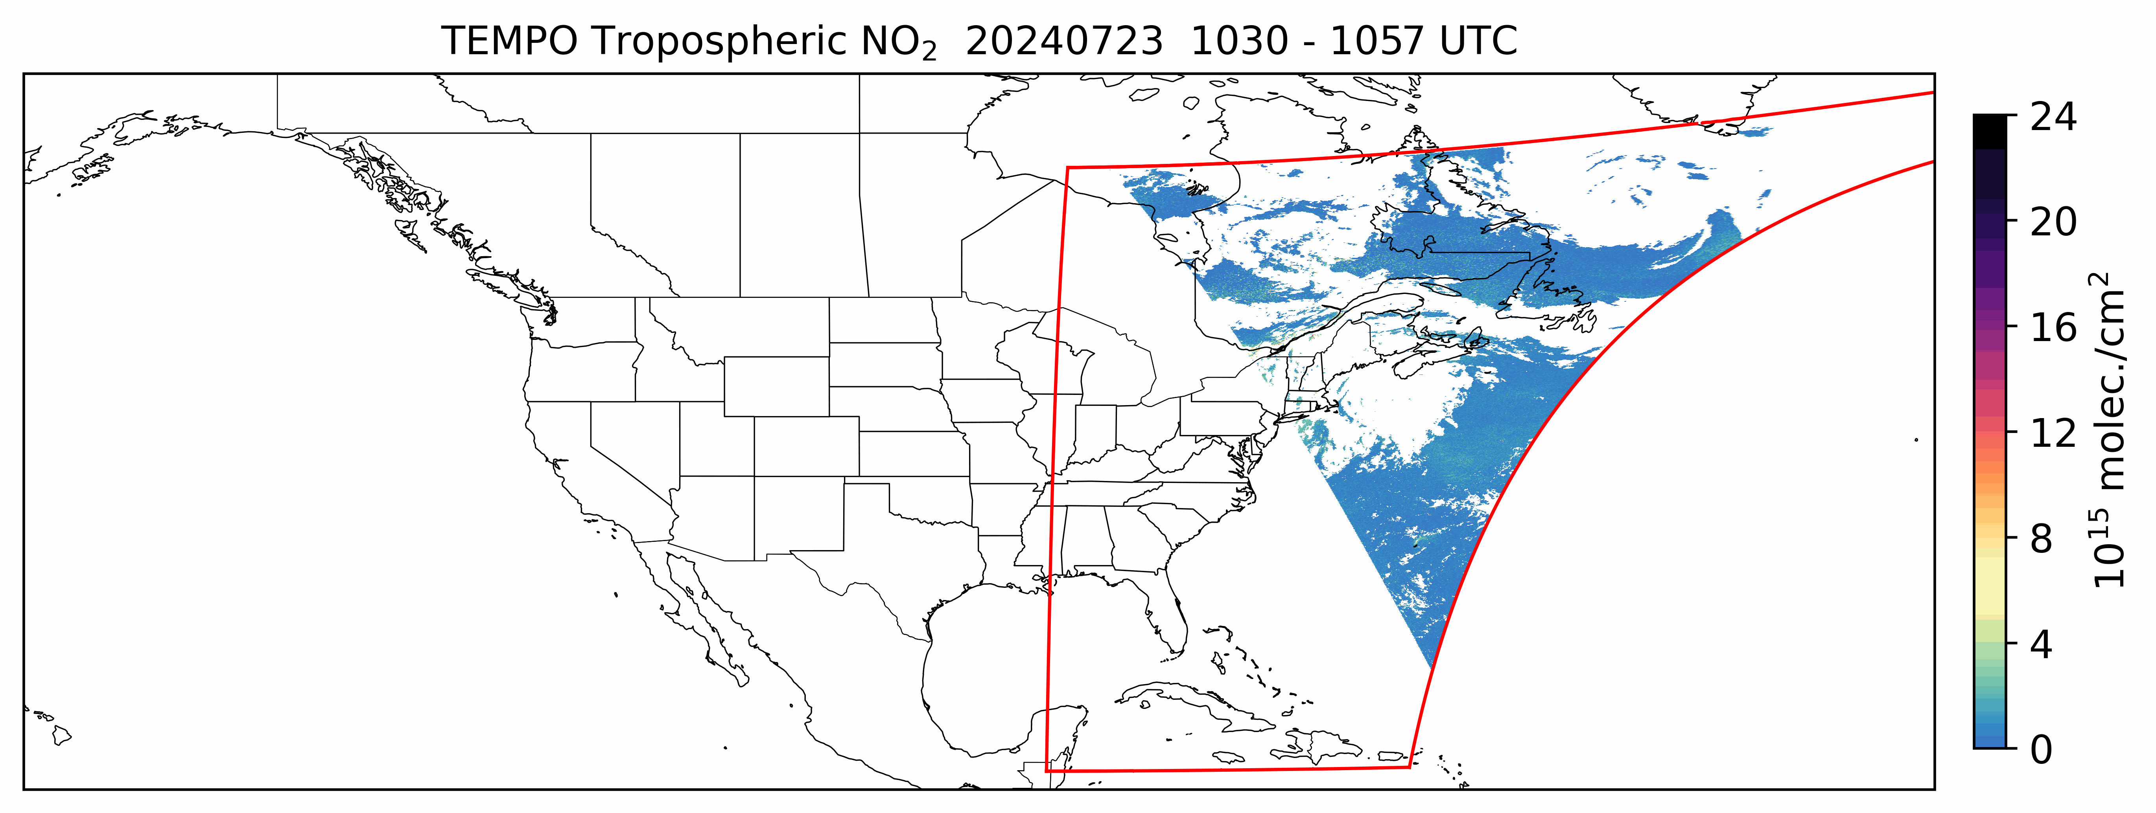
L2 NO₂ Product Animation – July 23, 2024
2 x 4.75 km² @ center of FoR
Filter using
Cloud Fraction < 50%
SZA < 80°
Filter using
Cloud Fraction < 50%
SZA < 80°
Nominal operations consist of standard (hourly) daytime scans over full FoR and optimized (~30-40 minute) scans over daylight portions of the FoR during the morning and afternoon
23
23
Notes:
Animation showing one day in the life of TEMPO as it scans east to west across the TEMPO FoR, showing large tropospheric NO2 columns from urban areas like Chicago and Los Angeles, NO2 plumes related to wildfires in the western U.S. especially in California, and notable NO2 columns over the Permian Basin.

Slide 24
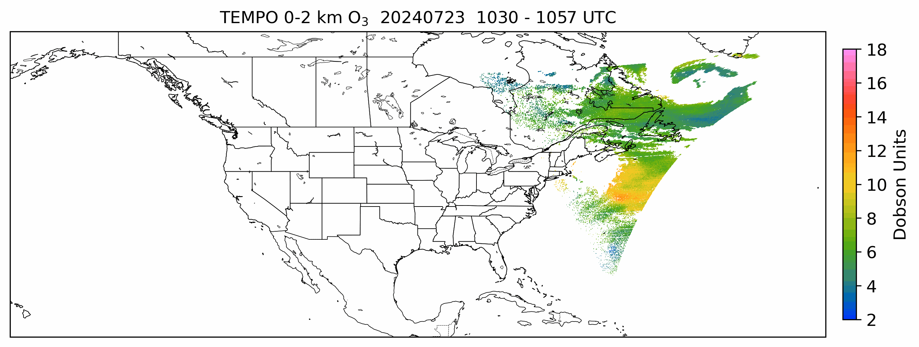
L2 O₃ Profile Product Animation – July 23, 2024
8 x 4.75 km² @ center of FoR
Filter using
Cloud Fraction < 50%
SZA < 80°
VZA < 80°
Nominal operations consist of standard (hourly) daytime scans over full FoR and optimized (~30-40 minute) scans over daylight portions of the FoR during the morning and afternoon
24
24
Notes:
Animation showing one day in the life of TEMPO as it scans east to west across the TEMPO FoR, showing large tropospheric NO2 columns from urban areas like Chicago and Los Angeles, NO2 plumes related to wildfires in the western U.S. especially in California, and notable NO2 columns over the Permian Basin.

Slide 25
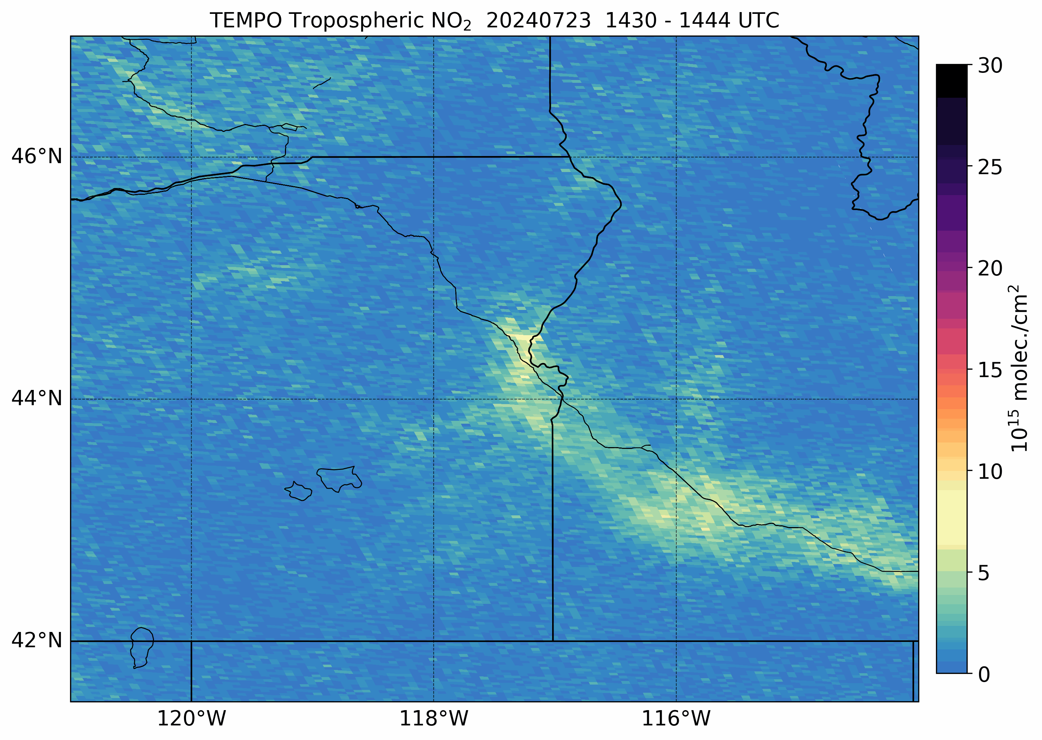
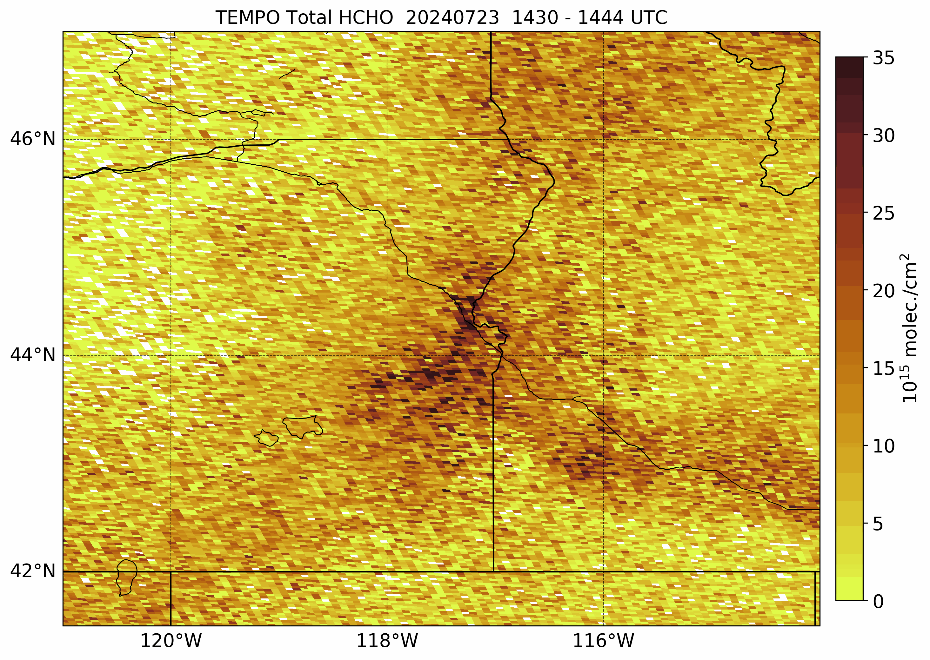
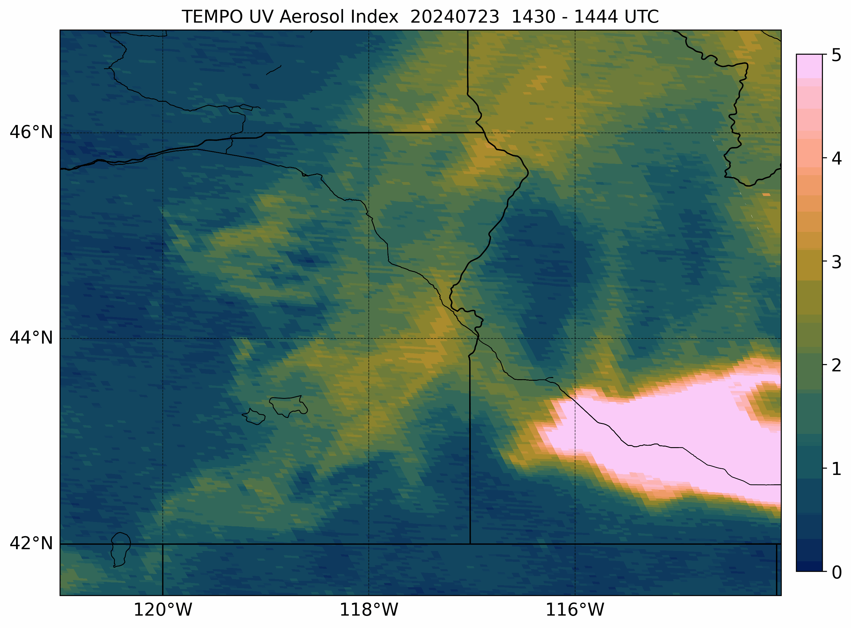
TEMPO NO₂, HCHO, UVAI - West U.S. Zoom
Tropospheric NO₂ VCDs
Total HCHO VCDs
ECF > 0.5
SZA > 80°
QF > 0
No ECF
SZA > 80°
VZA > 80°
UV Aerosol Index
TEMPO observed large NO₂ and HCHO plumes associated with the wildfire smoke plumes
Elevated HCHO columns within the smoke plumes transported further downwind
The absorbing smoke aerosols lead to the strongly positive UV Aerosol Index values
25
25
Notes:
TEMPO validation against the Pandora ground-based network using the latest Version 3 TEMPO data shows overall good results for NO2 and HCHO. The maps show correlation and normalized mean bias (in percent) for TEMPO NO2 and HCHO versus Pandora NO2 and HCHO at each of the Pandora sites across the TEMPO Field of Regard. Key point is TEMPO NO2 and HCHO compares well to the Pandora sites, with overall better performance of the TEMPO NO2 product. The good validation results led to the previous ‘beta’ version of TEMPO products being upgraded to ‘provisional status’, indicating TEMPO data products are suitable for scientific research. Note these validation results were done using the strictest quality assurance thresholds to retain the highest quality TEMPO data.

Slide 26
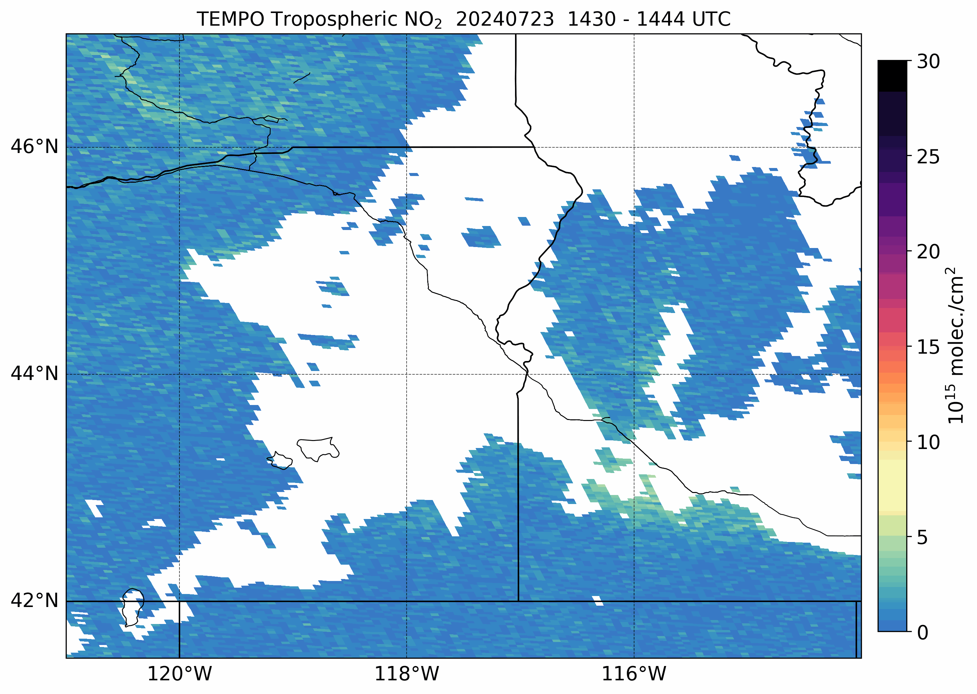
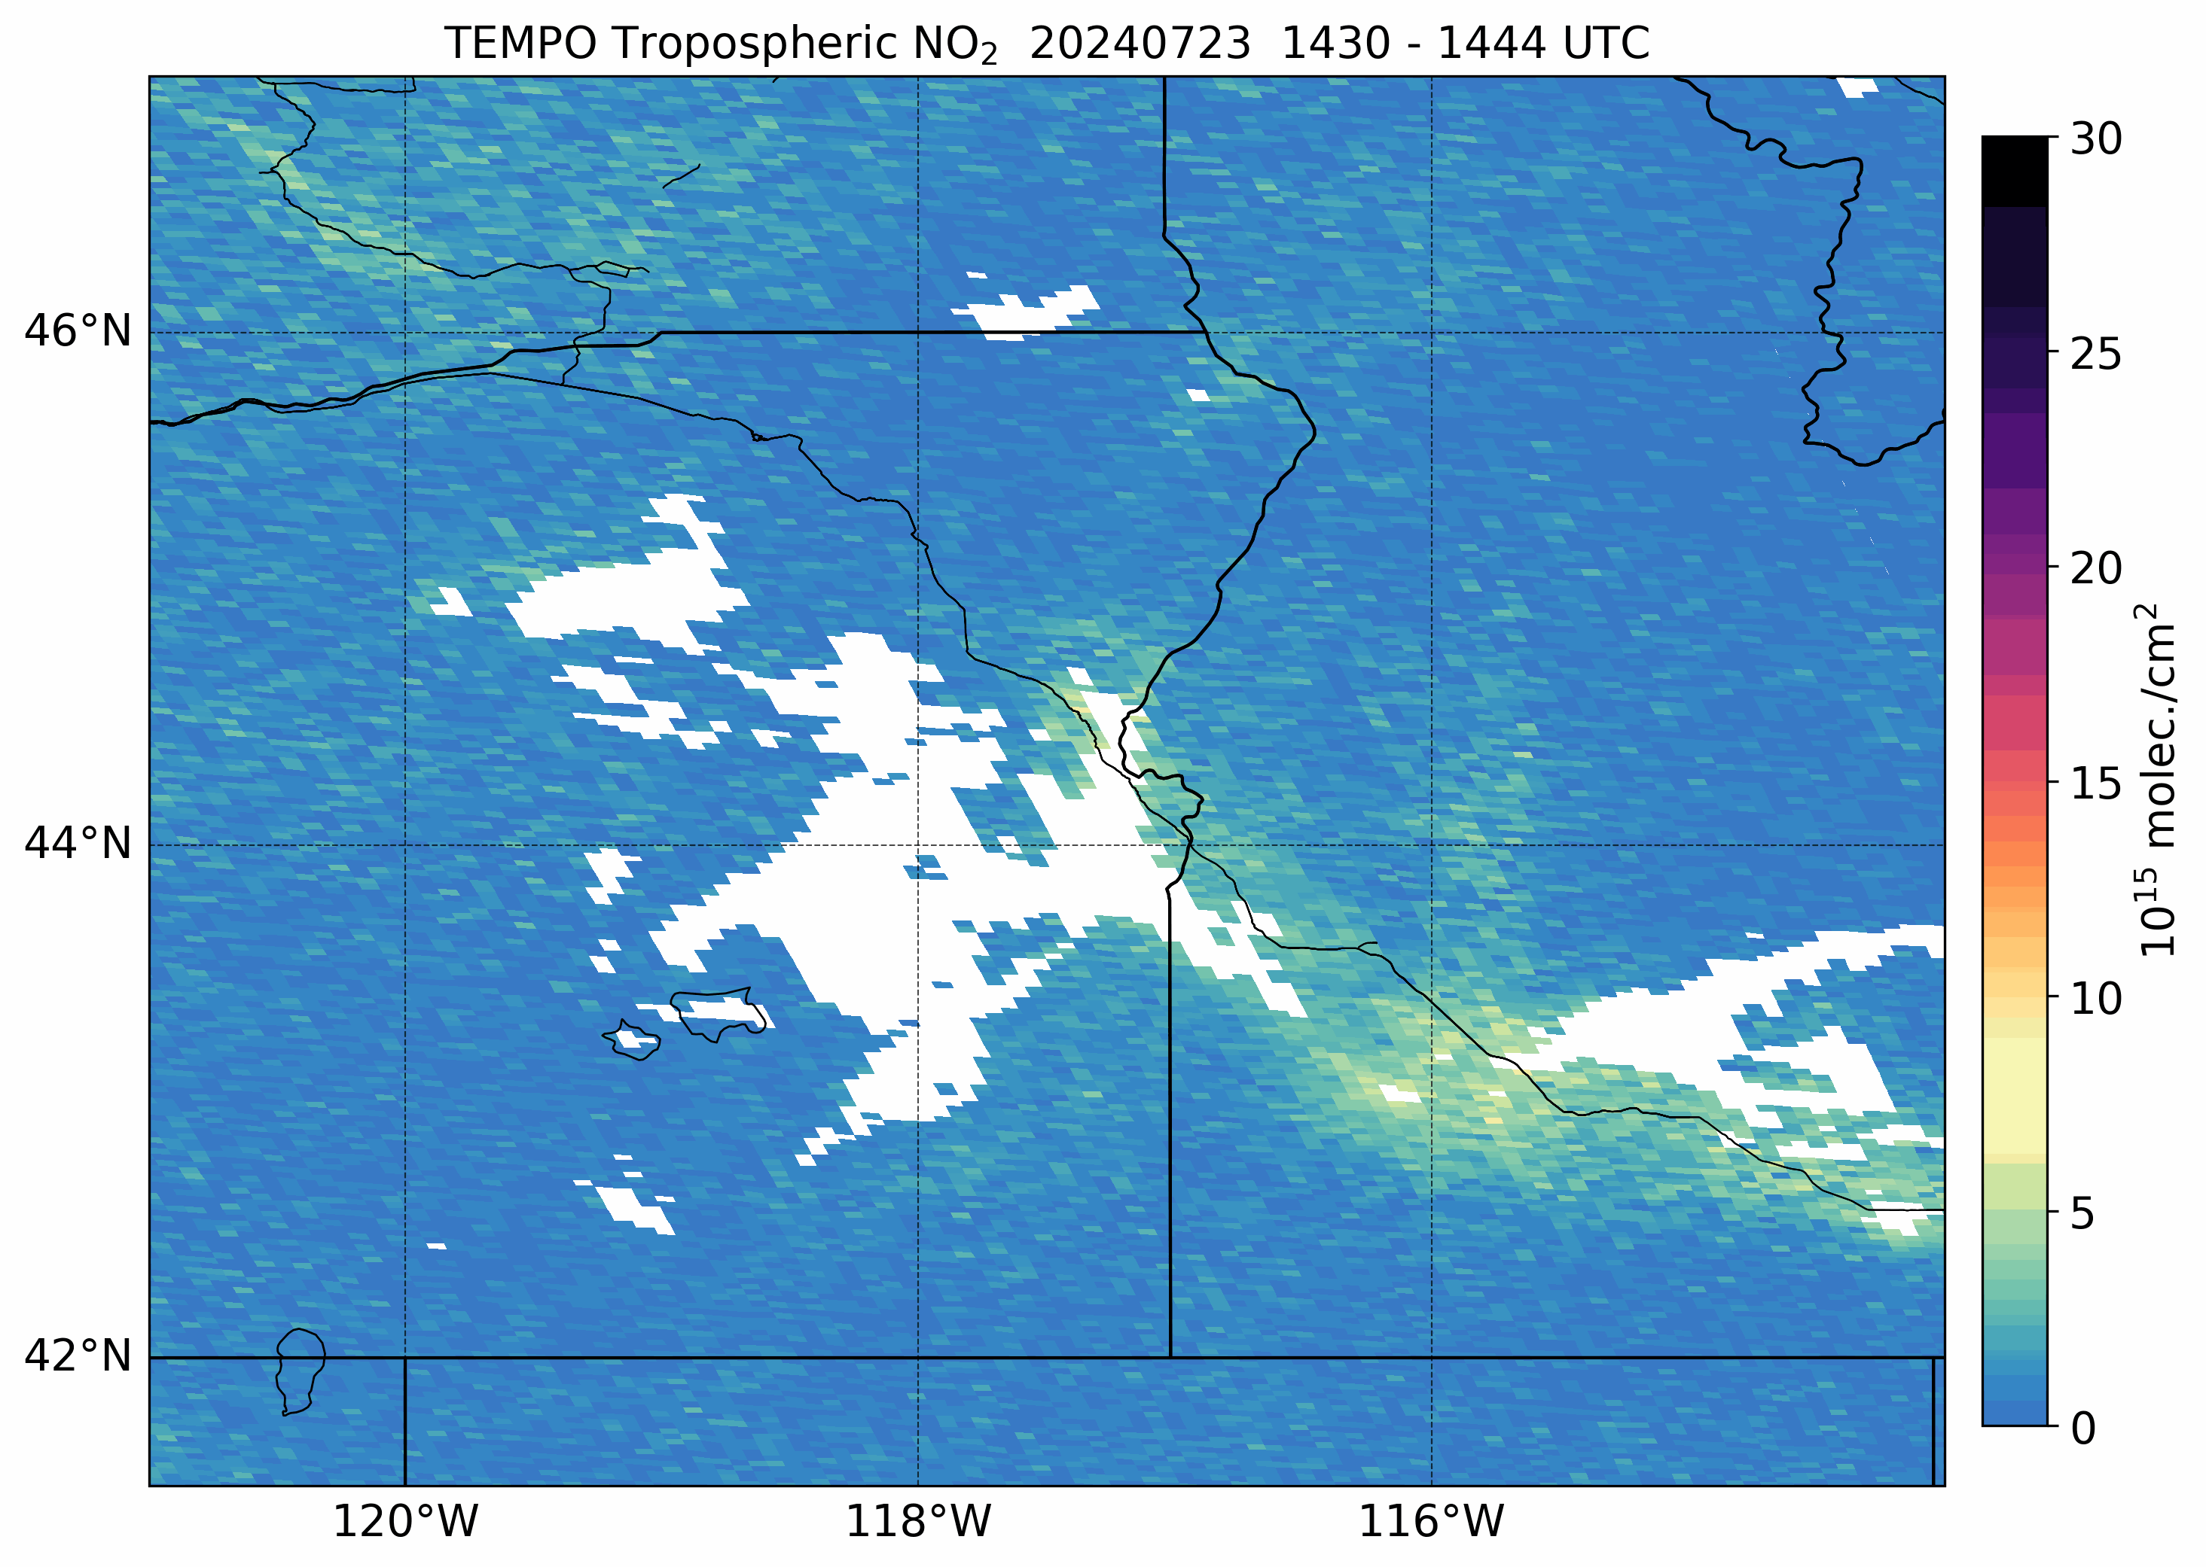
TEMPO NO₂ & ECF - West U.S. Zoom
ECF > 0.1
ECF > 0.2
No ECF
SZA > 80°
VZA > 80°
UV Aerosol Index
Tropospheric NO₂ VCDs
Using ECF > 0.1 for data filtering removes the vast majority of NO₂ within the smoke plumes
Using ECF > 0.2 retains slightly more NO₂ within the smoke plumes
26
26
Notes:
TEMPO validation against the Pandora ground-based network using the latest Version 3 TEMPO data shows overall good results for NO2 and HCHO. The maps show correlation and normalized mean bias (in percent) for TEMPO NO2 and HCHO versus Pandora NO2 and HCHO at each of the Pandora sites across the TEMPO Field of Regard. Key point is TEMPO NO2 and HCHO compares well to the Pandora sites, with overall better performance of the TEMPO NO2 product. The good validation results led to the previous ‘beta’ version of TEMPO products being upgraded to ‘provisional status’, indicating TEMPO data products are suitable for scientific research. Note these validation results were done using the strictest quality assurance thresholds to retain the highest quality TEMPO data.

Slide 27
August 2, 2023
Canadian Wildfires

Slide 28
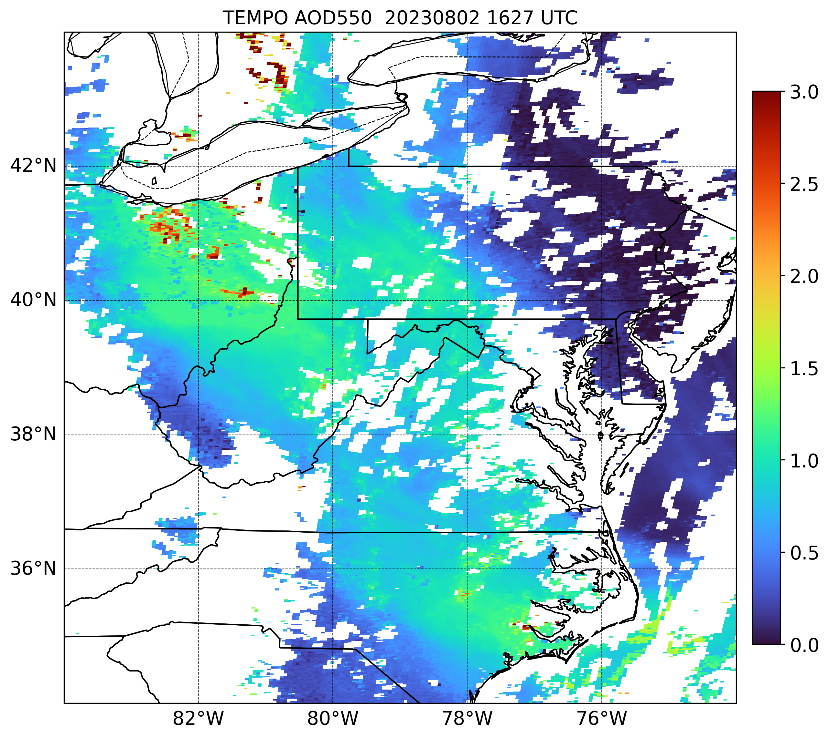
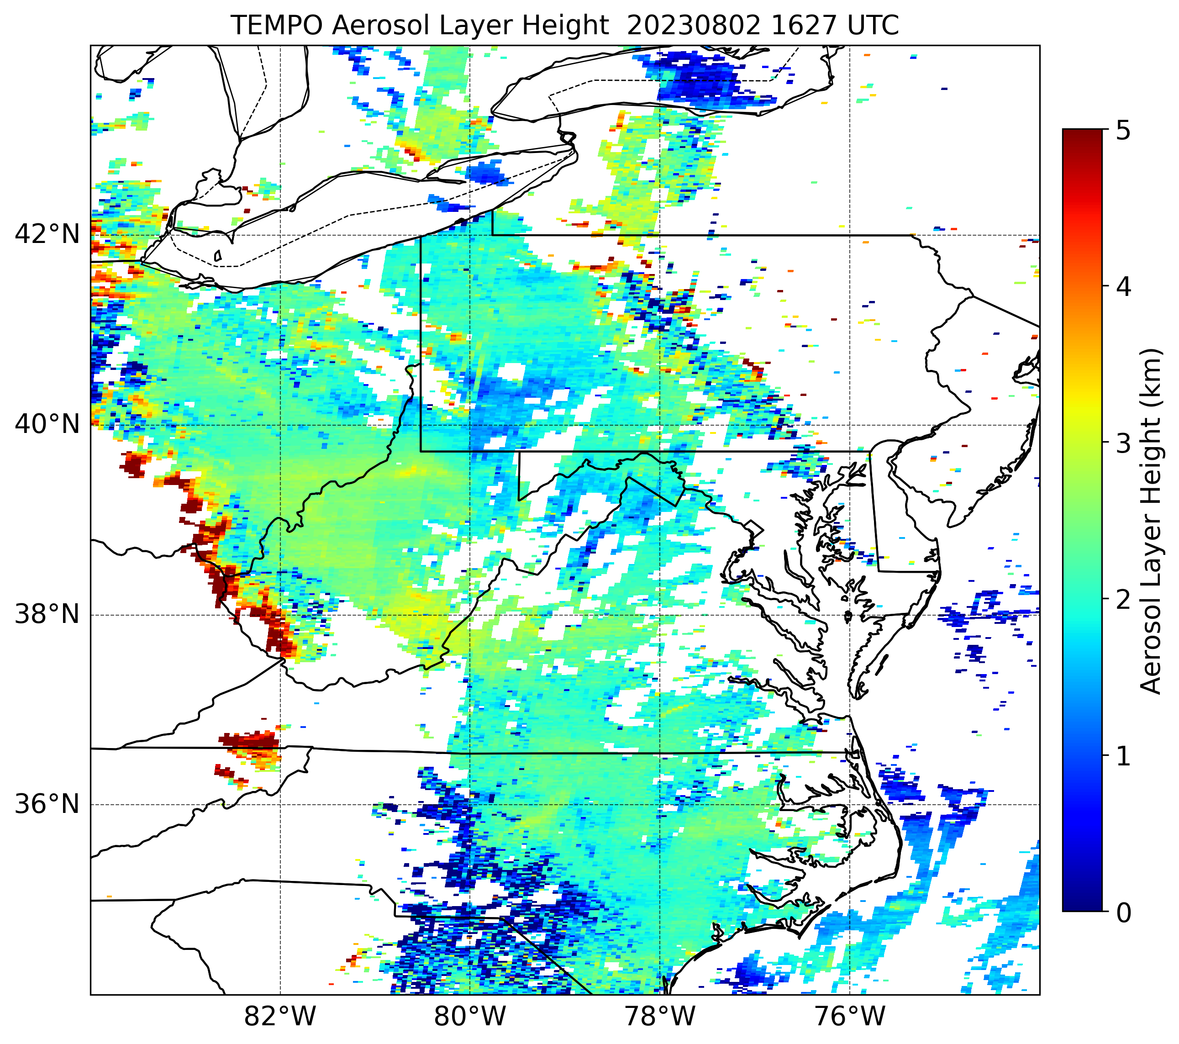
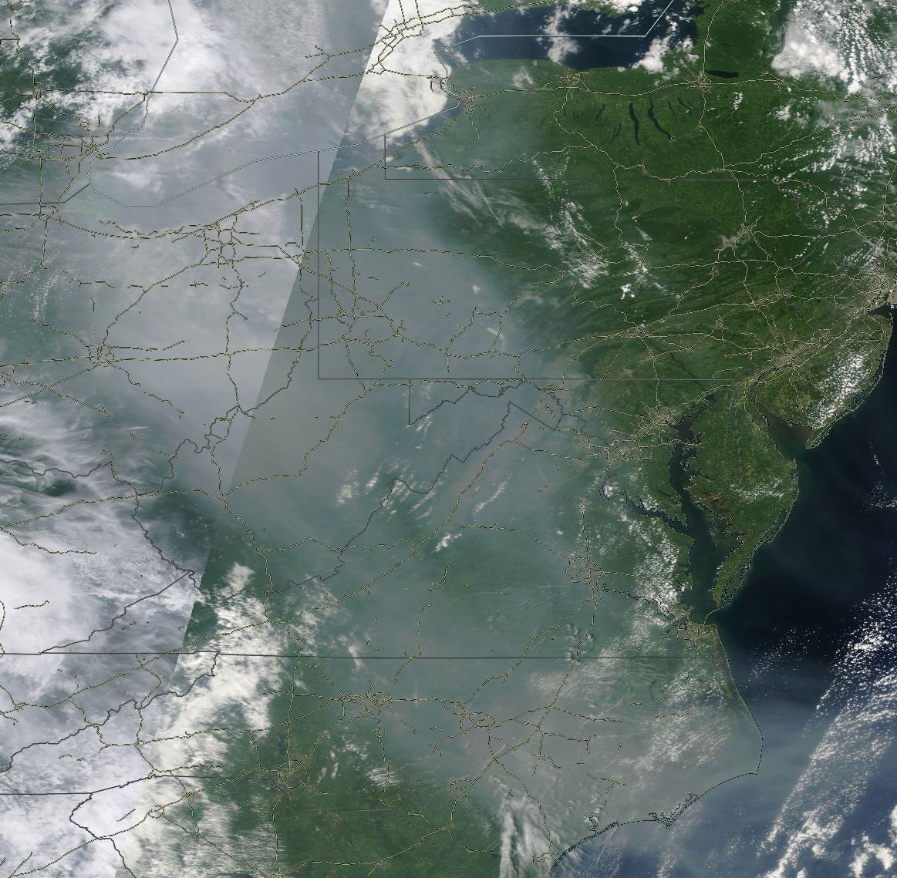
TEMPO Aerosol Data – AOD & Aerosol Layer Height (ALH)
MODIS Terra True Color
TEMPO AOD
TEMPO Aerosol Layer Height
Large smoke plumes were transported from Canada over the eastern U.S. in early August 2023
TEMPO AOD observed values exceeding 1 within much of the transported smoke plume
TEMPO ALH showed the variability of smoke plume height with generally lower heights (smoke plume closer to the surface) as the smoke was transported farther downwind from the source

Slide 29
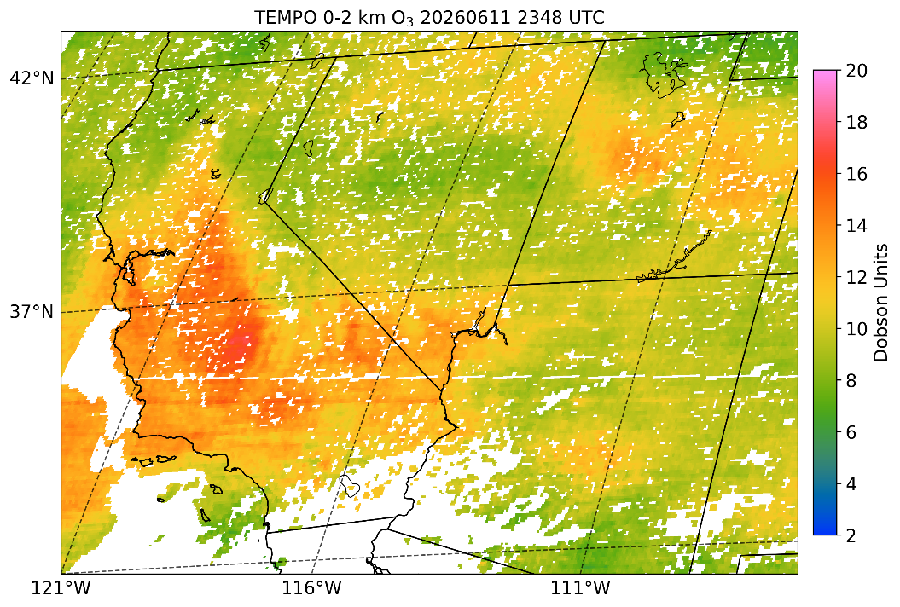

Thank You!
NASA SPoRT Viewer
TEMPO Operations Log
aaron.naeger@nasa.gov

