Slide 1


TEMPO Version 4 Twilight Radiances
James L. Carr¹, Heesung Chong², Xiong Liu², John C. Houck², Virginia Kalb³, Zhuosen Wang³, Houria Madani¹, Daniel T. Lindsey⁴, Steven D. Miller⁵, Sergey V. Marchenko³, Zhixin Xue⁶, Jun Wang⁶, Dong L. Wu³, David E. Flittner⁷, Kelly Chance²
June 17, 2026
jcarr@carrastro.com
¹Carr Astronautics, ²SAO,³NASA/GSFC, ⁴NOAA/NESDIS, ⁵CIRA, ⁶Univ. of Iowa ⁷NASA/LaRC,

Slide 2
TEMPO at Night
Clearest-Sky Composite Radiance nW/(cm² sr)
February 2025 VIS Band: 540 – 640 nm

Slide 3
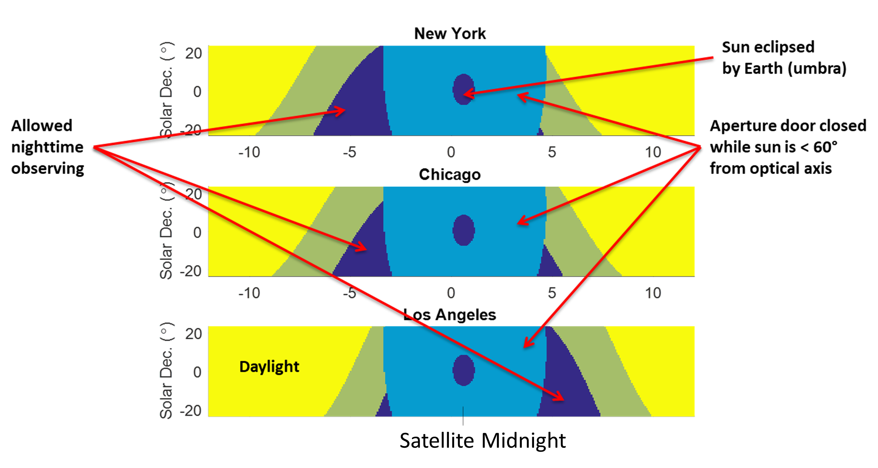
Nighttime Observation Season
Sun Safety Drives Seasonal Observing: August-to-April
“Twilight Radiances” RADT in ASDC

Slide 4
City Lights Classification

Slide 5
Auroura
See Poster: V. Kalb
N₂⁺ (391.4 nm)
Limb
Auroral Ring
11 Oct 2024 S001
N₂⁺
O
Mean Spectral Radiance
N₂⁺
N₂
N₂⁺
O

Slide 6
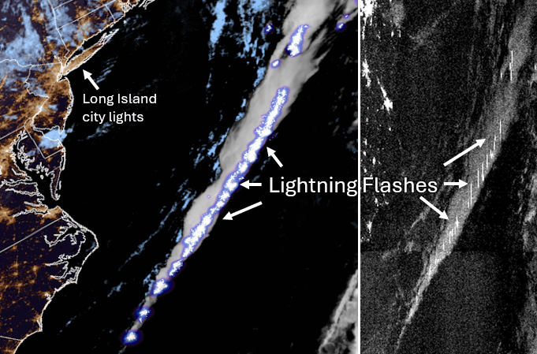
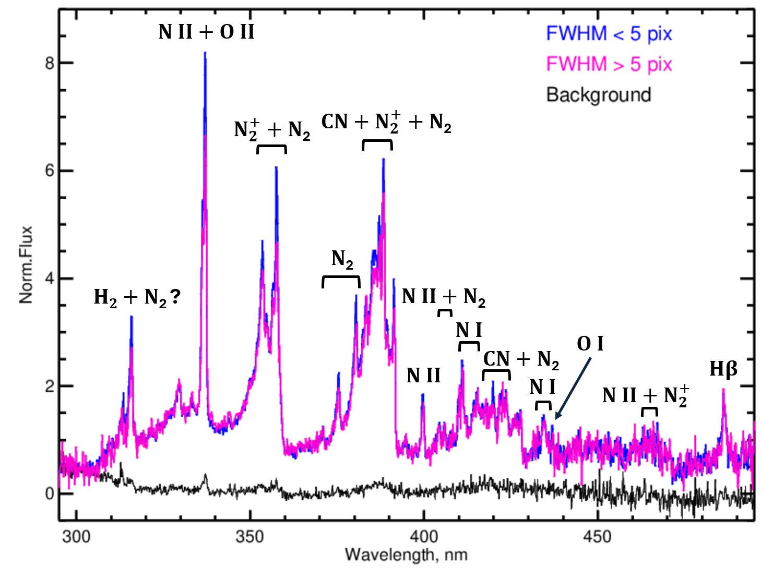
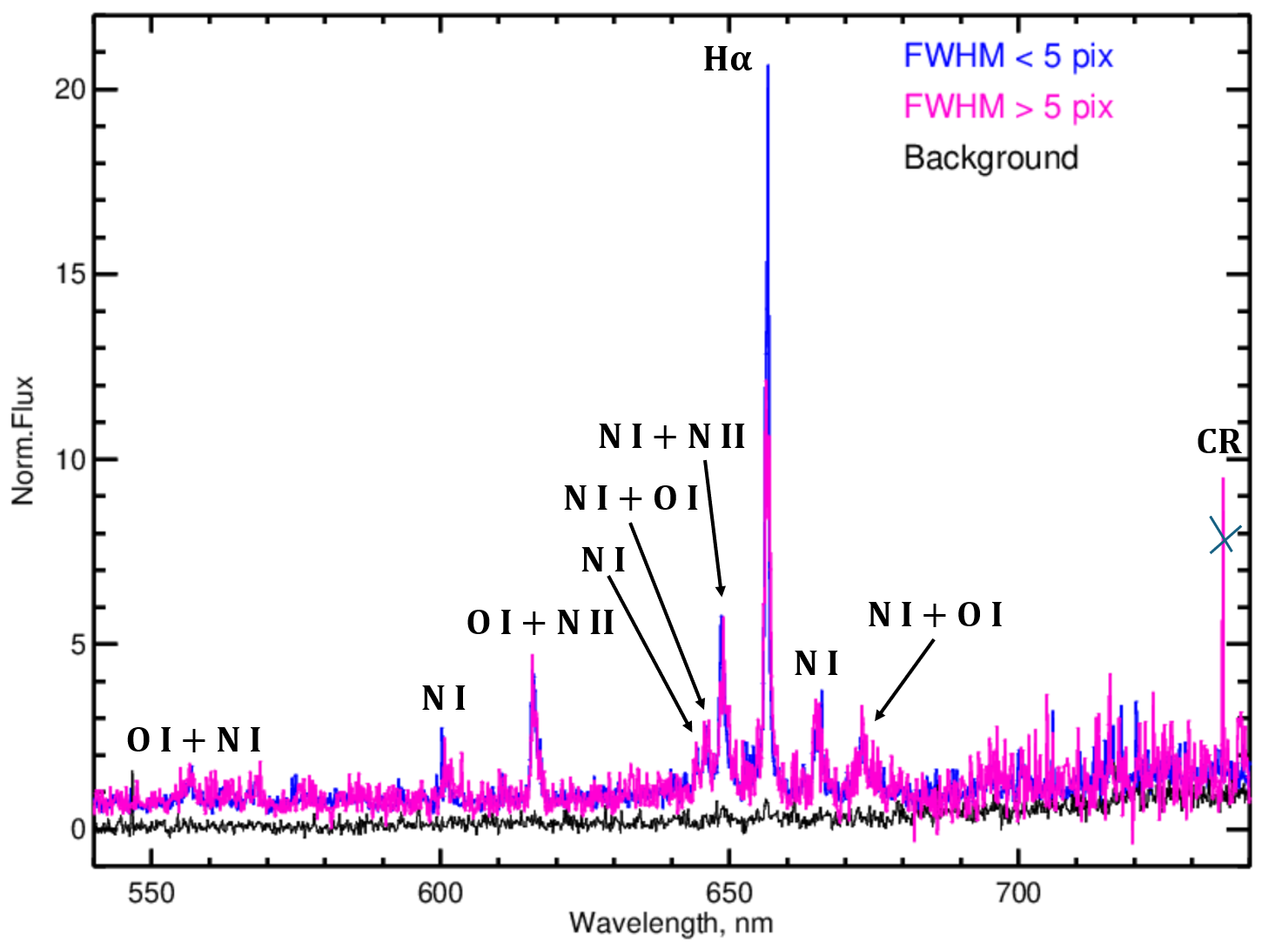
Lightning
Lindsey, Miller
CIRA GeoColor + GLM
TEMPO
Insight into Physics of Flashes
Potential to Retrieve Plasma Temperatures and E-Fields
Preliminary Line ID’s: Sergey Marchenko
Moonlight
Marchenko

Slide 7
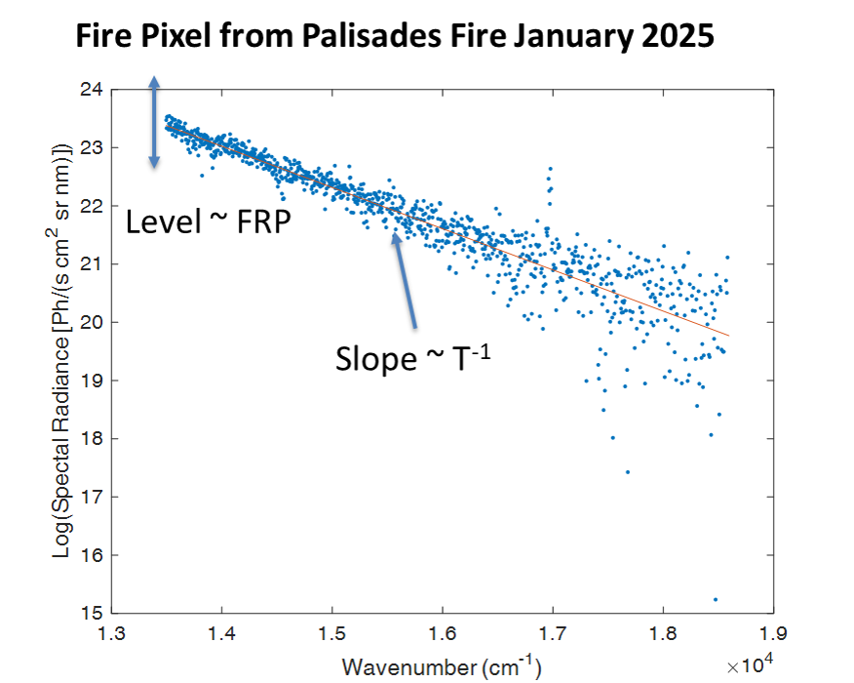
Mapping Thermal Sources
Palisades & Eaton, 2025
Gas Flares & Wildfires
Spectral Fit for FRP & T
Na
Oil & Gas
Oil & Gas
Palisades & Eaton Fires
Oil & Gas

Slide 8
RADT Version 4
Working with Twilight Radiances (RADT) is Easy: Post-Processing is Now Unnecessary
Version 4 Improvements
  Temperature-Sensitive Dark Current Subtraction
  Odd-Even Calibration Artifact Compensation
  Reversable Background Subtraction
  Registration to VIIRS Day-Night Band Sub-Pixel Accurate
  Context Images for Discovery
Entire Collection of 3 Seasons will be Reprocessed by mid-July

Slide 9
Background Subtraction

Slide 10
Coregistration with VIIRS-DNB
Collocated VIIRS-DNB Radiances included as Context Image
(Most Recent Clear-Sky Monthly Composite from Black Marble)
VNP46A3

Slide 11
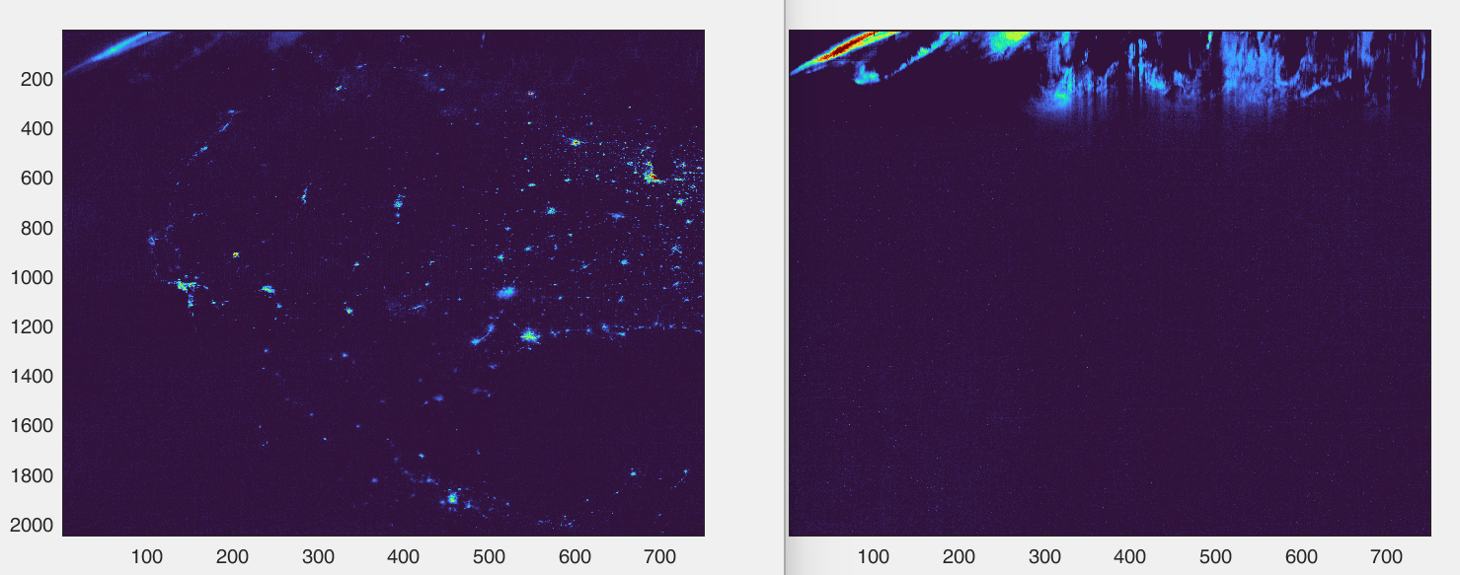
Context Images
Context Images Included in Granules
Plus UV City Lights, Full VIS & UV Band, Lightning, Collocated VIIRS-DNB
Visible City Lights Context Image
UV Aurora Context Image
1/20/26

Slide 12
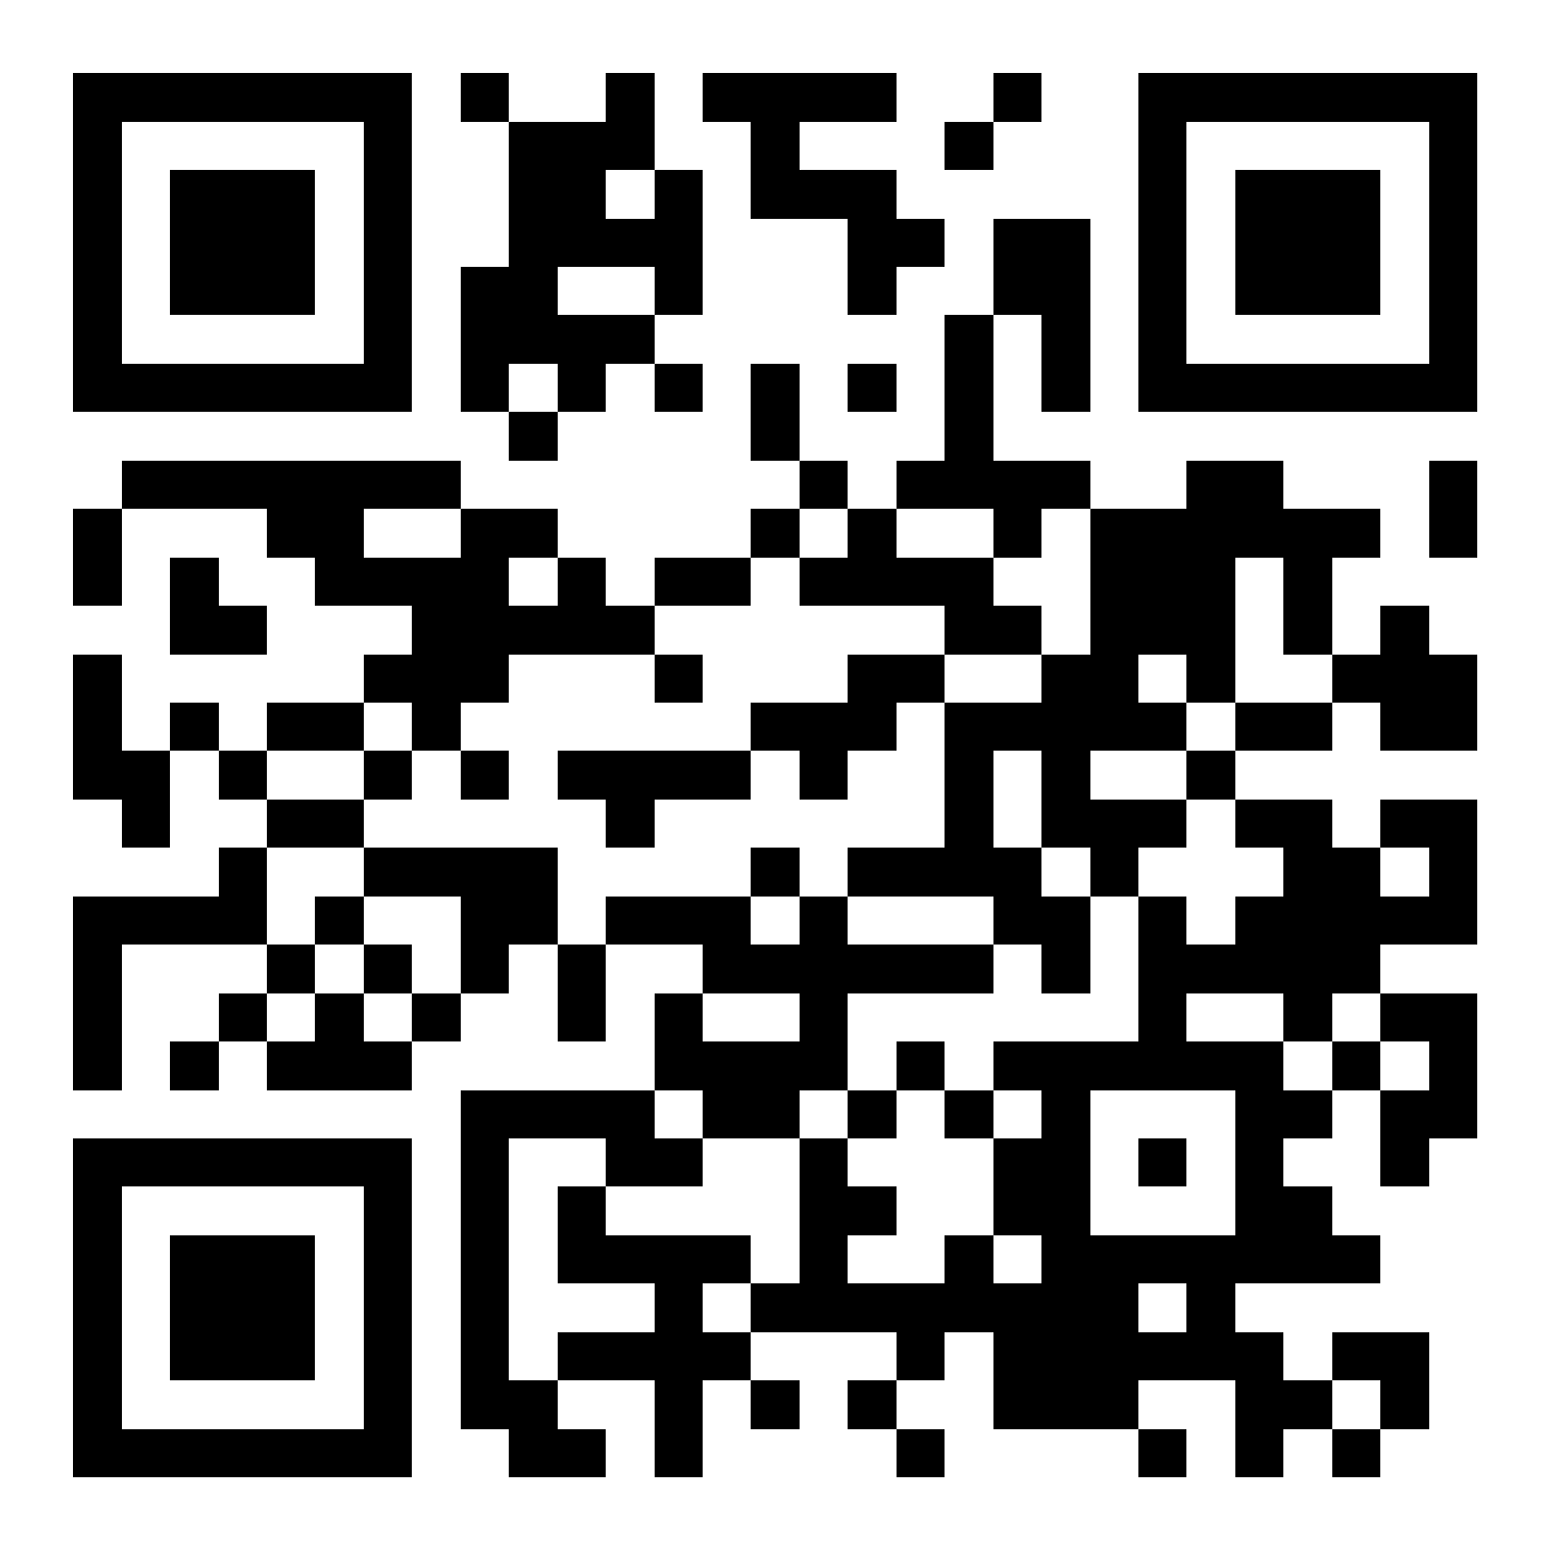
Content & Quality Inventory
Inventory of RADT Granules (CSV) with
  Exposure Time
  N/S Pointing Bias
  Auroura, Lightning & Solar Contaminated Pixels
  Lunar Illumination Conditions
  Registration Error versus VIIRS
  Dark Target Noise Equivalent Radiance
Inventory: https://github.com/Smithsonian/TEMPO-Twilight
User Guide: https://asdc.larc.nasa.gov/documents/tempo/guide/ TEMPO_Level-1_user_guide_V3.0.pdf
Carr, et. al. 2025

