Slide 1
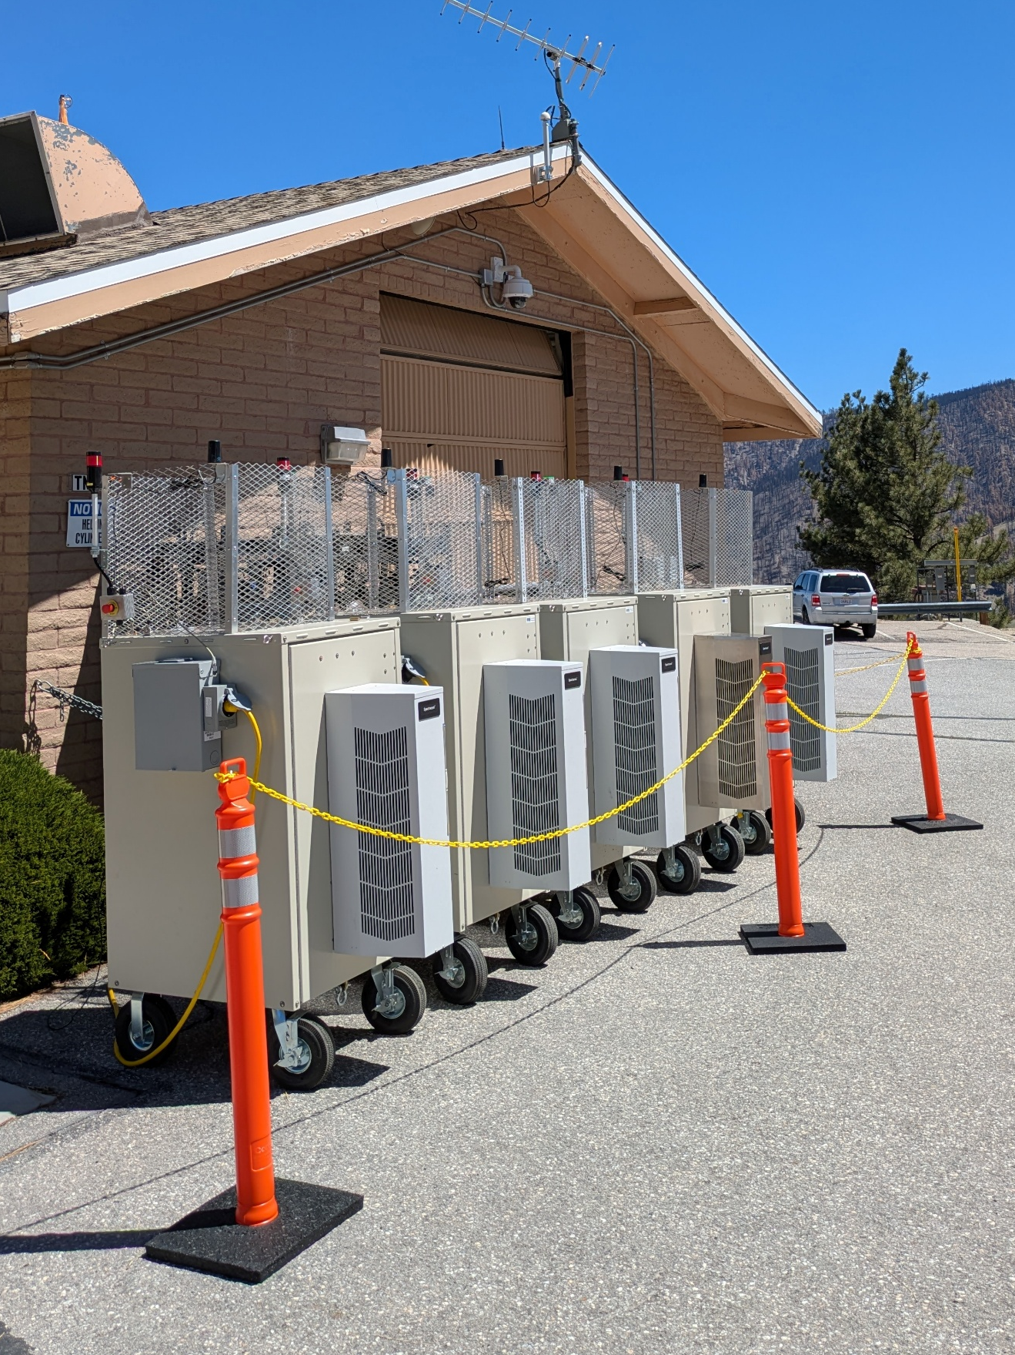
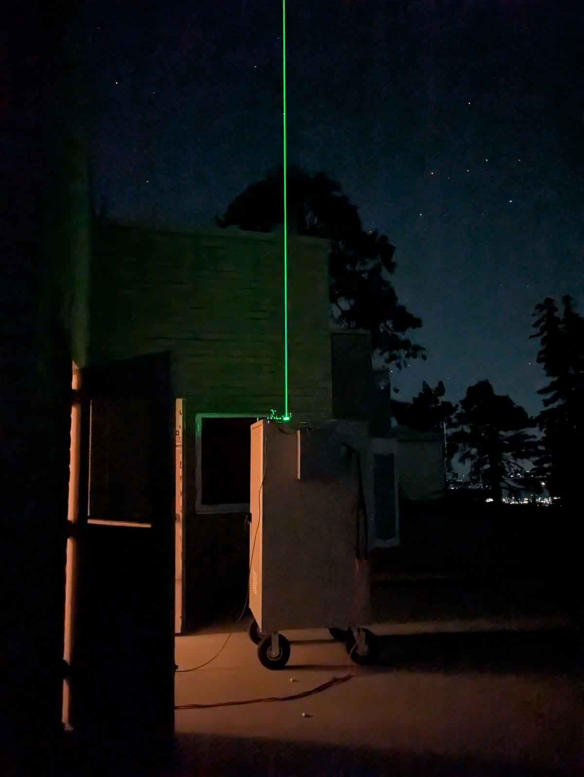

Combining TOLNet SMOL lidar and GEOS-CF Model Results to Investigate
Elevated Ozone Events in the Southwest United States
Thierry Leblanc and Fernando Chouza
Jet Propulsion Laboratory, California Institute of Technology,
Table Mountain Facility, Wrightwood, CA 92397 USA
© 2026 California Institute of Technology,
Government sponsorship acknowledged

Slide 2




ACKNOWLEDGEMENTS
Emma Knowland and John Sullivan, NASA HQ, TOLNet Support
Pam Wales and GMAO colleagues, GEOS-CF Model Support
Jake Swanson, Arizona State University, SMOL-4 and SMOL-5 GLOR Campaign Funding Support
Eric Pool, Maricopa County, Arizona, SMOL-4 and SMOL-5 GLOR Campaign Logistic Support
Mark Reynolds, California State University, San Bernardino, CA, SMOL-3 Logistic Support

Slide 3
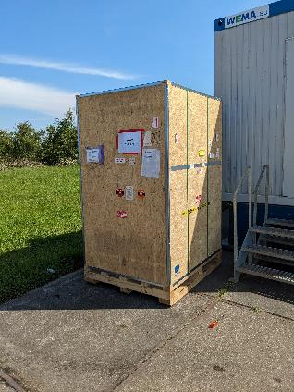
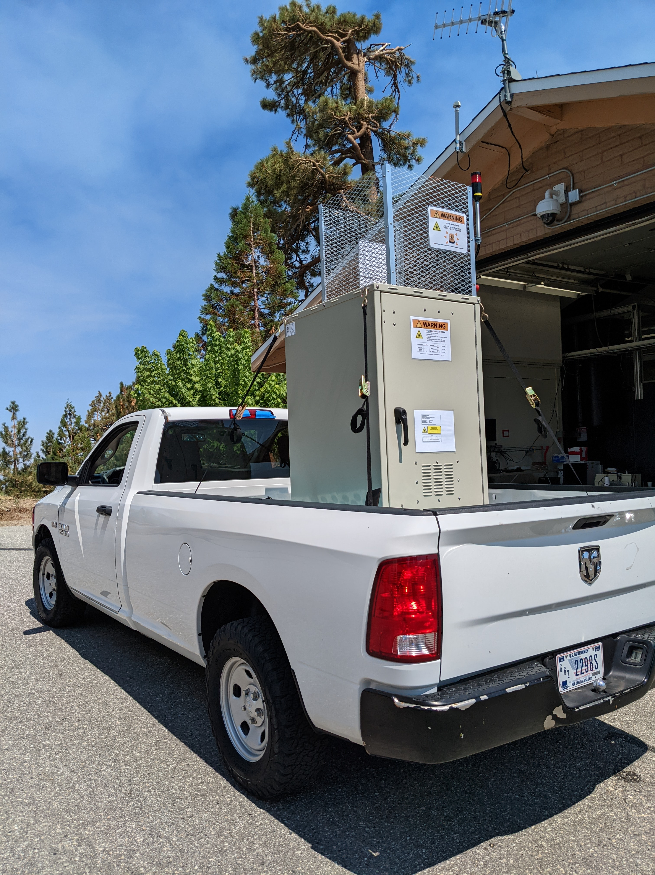


Context/Motivation
SMOL (Small Mobile Ozone Lidar): Compact, automated, remotely-operated, Ozone Differential Absorption Lidar
Designed and and built at JPL-Table Mountain Facility, sponsored by NASA TOLNet
Two AQ campaigns + TEMPO validation ➔ 5 deployment locations during summer 2025
Not covered in this talk (analysis ongoing)
Part 1 of this talk
Part 2 of this talk
SMOL-1
Baltimore, MD
GLOR campaign
CoURAGE campaign
SMOL-2
Hart Miller Is., MD
SMOL-3
CSU San Bernardino, CA
SMOL-4
Buckeye, AZ
SMOL-5
Phoenix, AZ

Slide 4
Part 1
SMOL-3 at CSU San Bernardino, CA
SMOL-3
CSU San Bernardino, CA
Eastern end of the L.A. Basin
at the bottom of the San Bernardino Mtns.

Slide 5
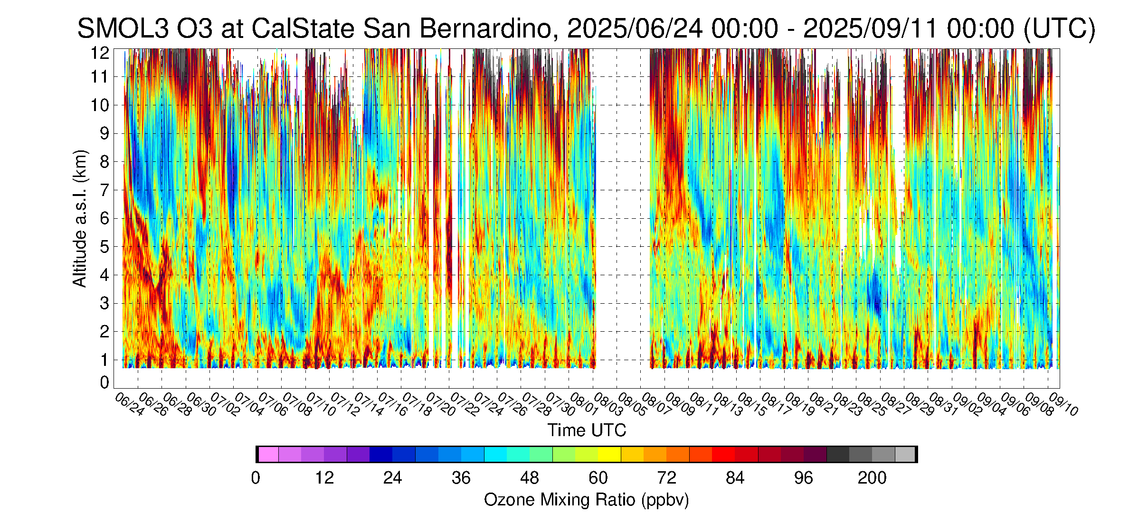
SMOL-3 Ozone Profiles at CSU San Bernardino, CA
Ozone curtain plot summer 2025 (6/24 to 9/11, 80 days, 48 profiles per day ➔ 3000+ profiles)
  In the PBL (below 1.5 km a.s.l.): Strong diurnal cycle
  In the free troposphere: Alternation of high and low ozone at longer timescales (several days)
  Minima in the 20s ppb, maxima in the 90s ppbv

Slide 6
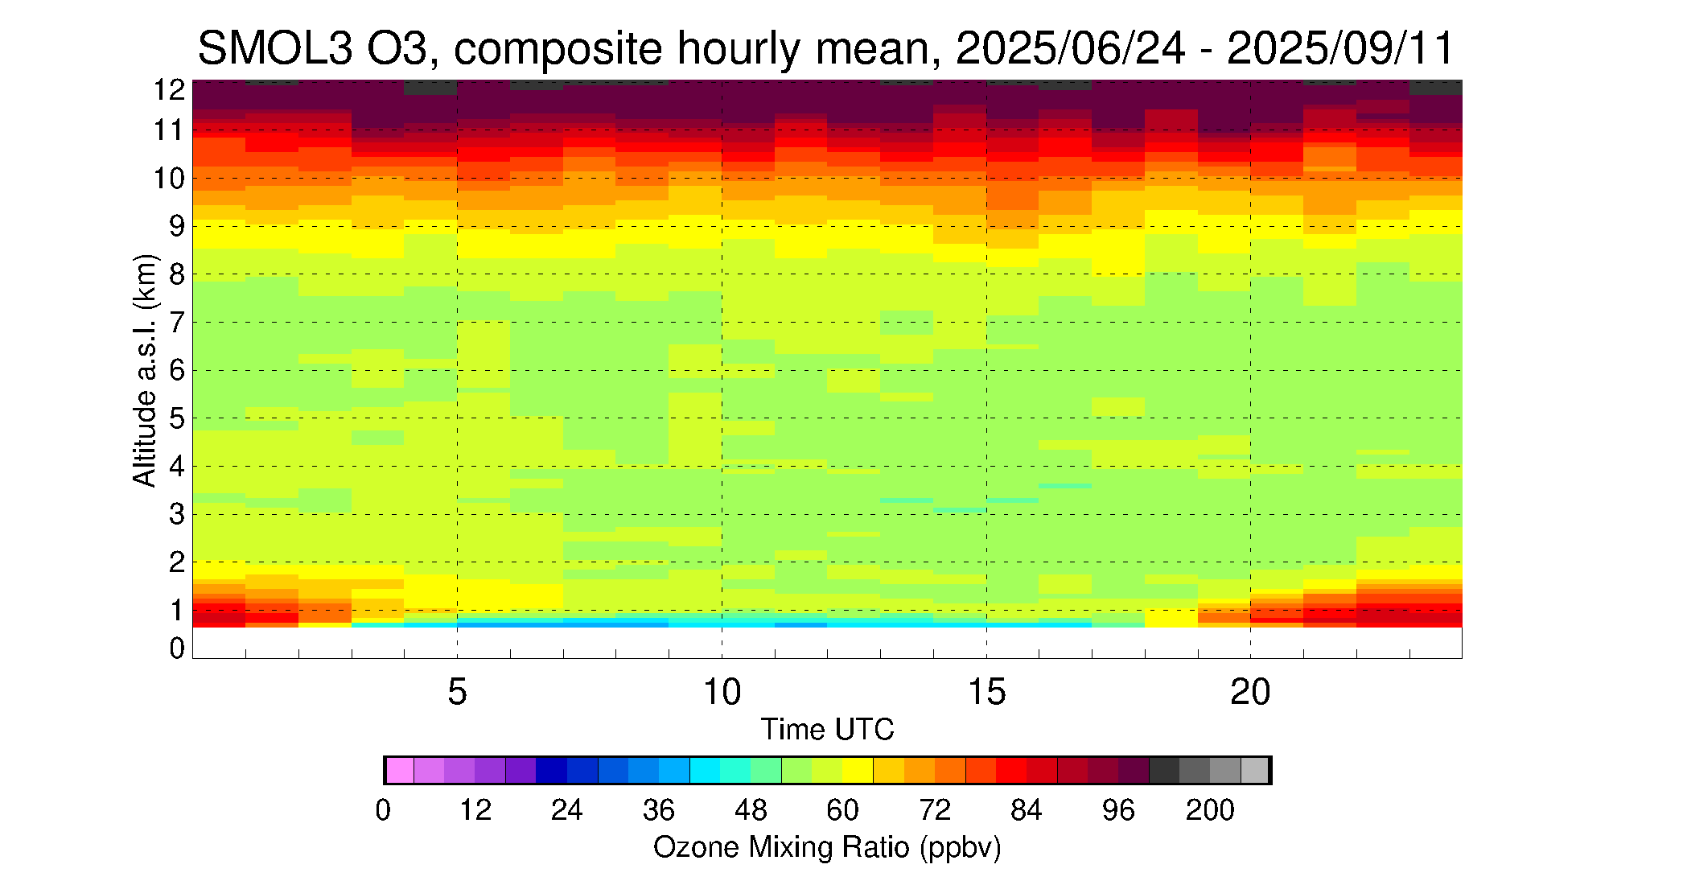
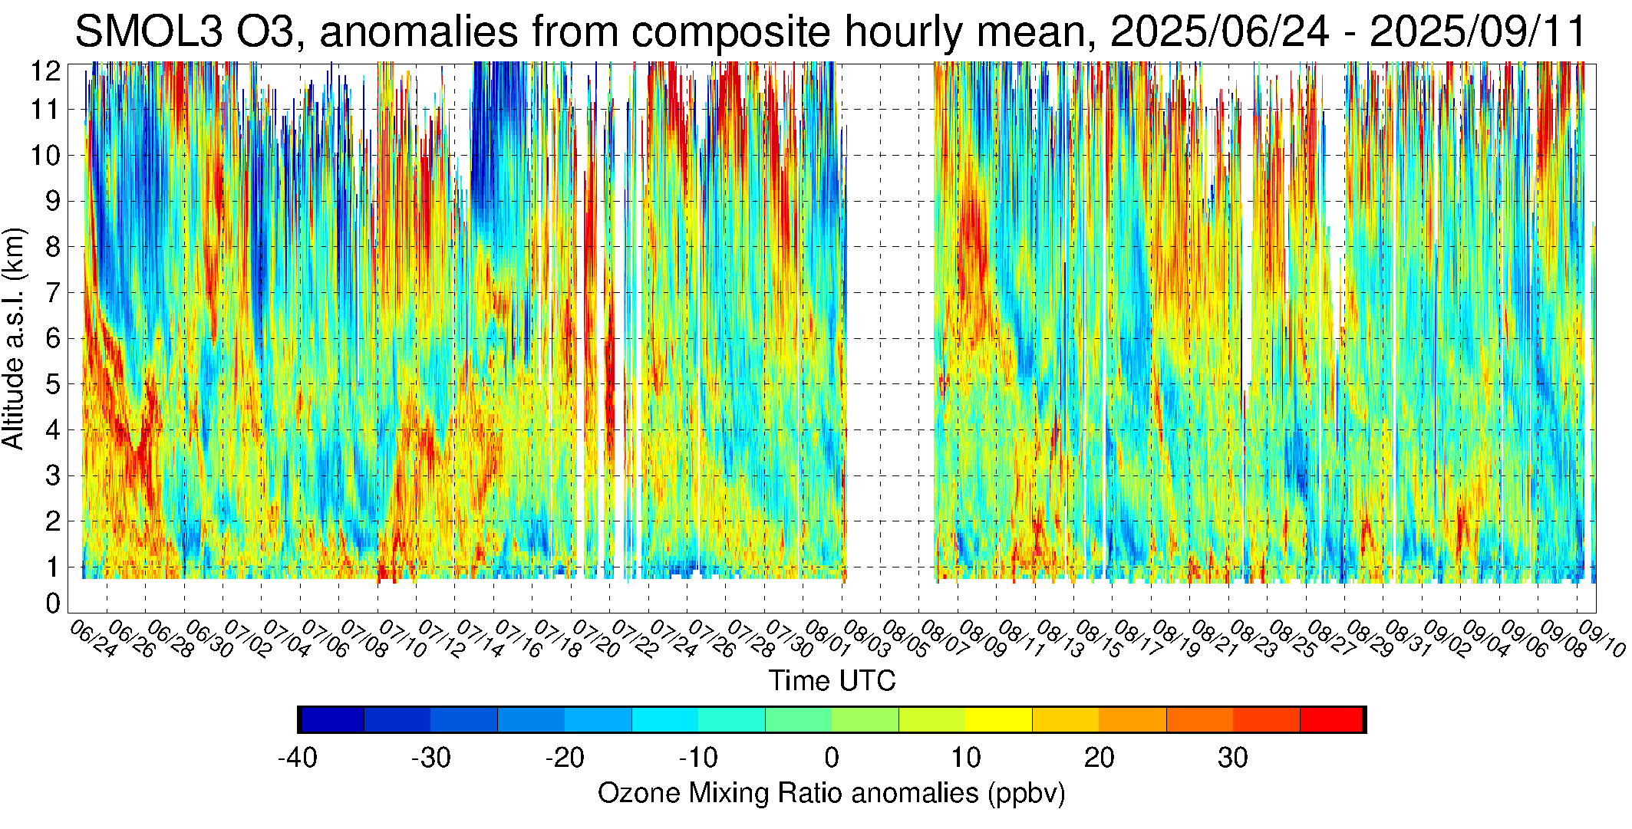
SMOL-3 Ozone Diurnal Cycle and Anomalies From it
➔
Composite hourly mean ozone computed over 80 days
  PBL (<1.7 km): Large diurnal cycle, from 40 ppb late night to 100 ppb afternoon
  Free troposphere (z > 2 km): 55 ppb mean, no LST dependence
⬅
Anomalies from composite hourly
  PBL diurnal cycle is removed
  Remaining anomalies reflect changes in synoptic weather and long-range transport

Slide 7
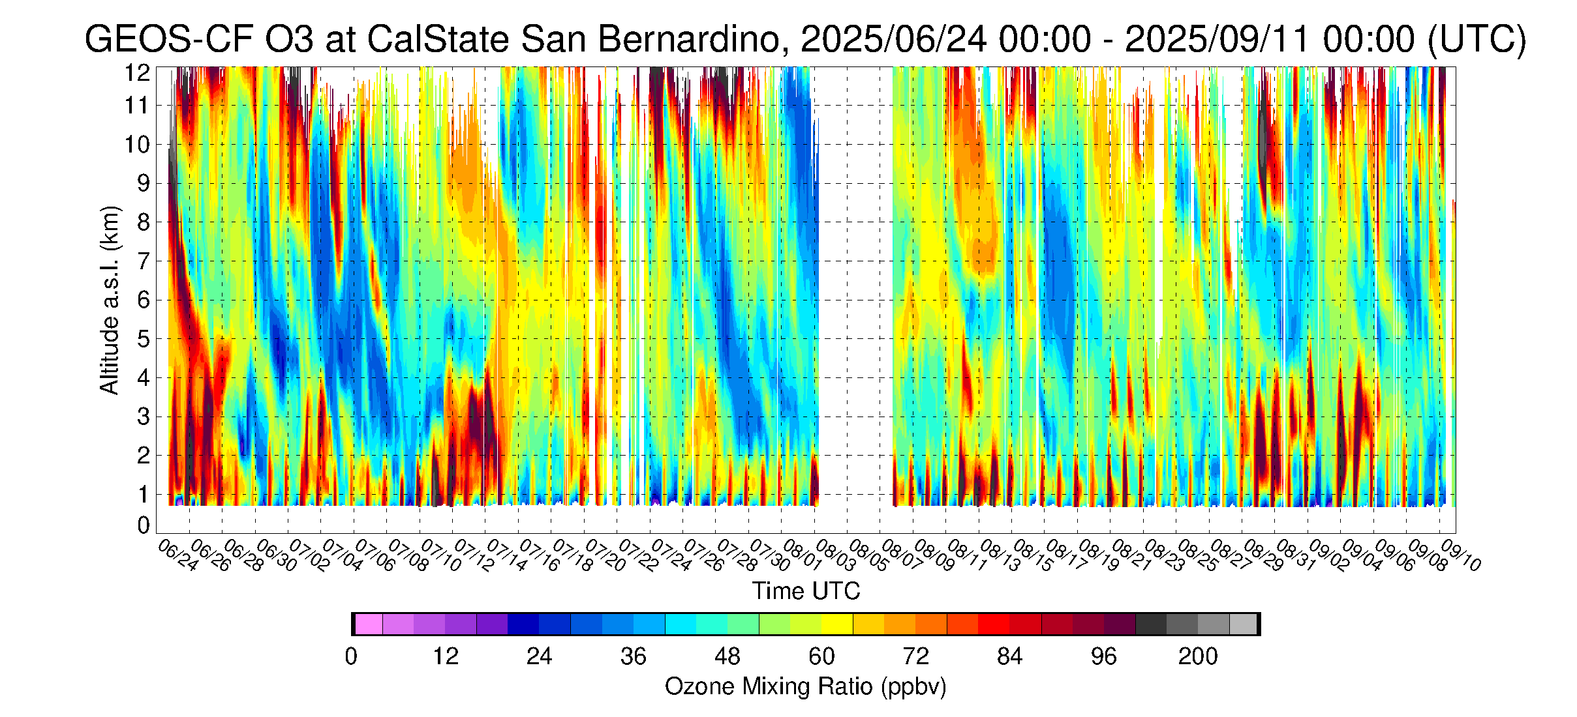
Ozone comparison SMOL-3 vs GEOS-CF
SMOL-3 ozone curtain plot
➔
GEOS-CF ozone curtain plot
➔
Excellent qualitative agreement, both in
PBL and free troposphere
  GEOS-CF PBL ozone slightly overestimated
  A few timing differences (+/- 4 hours)

Slide 8
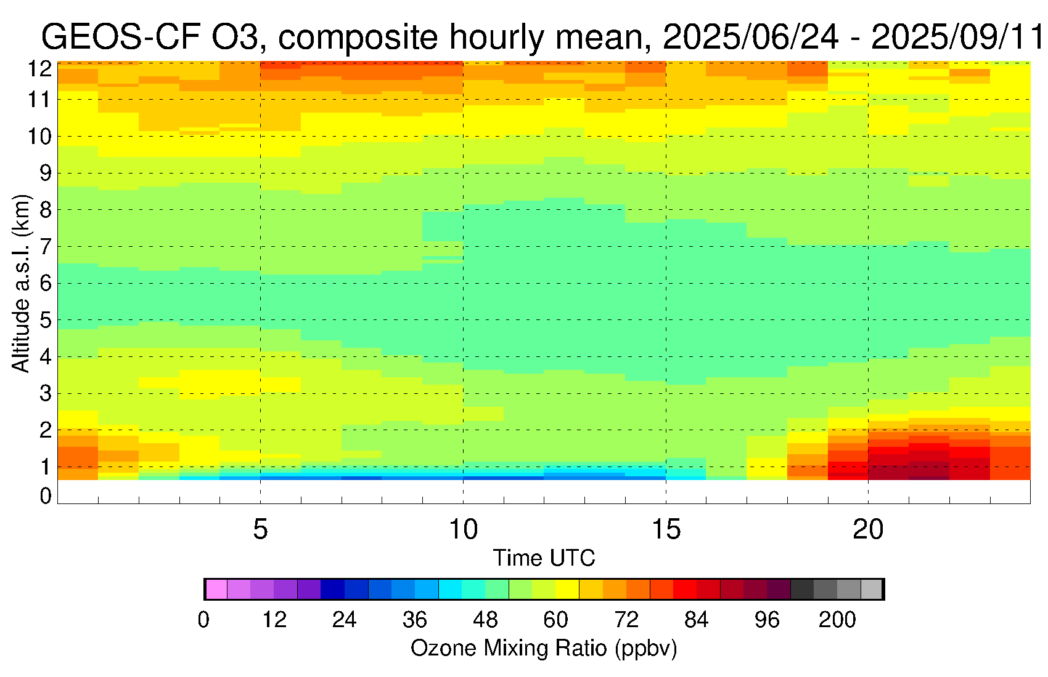
Composite hourly mean comparison SMOL-3 vs GEOS-CF
SMOL-3
➔
GEOS-CF
➔
Overall good agreement, some quantitative differences:
  GEOS-CF PBL ozone diurnal cycle overestimated
  GEOS-CF PBL ozone diurnal cycle not as shallow as SMOL-3
  GEOS-CF PBL ozone diurnal cycle occurs 2-hour earlier than SMOL-3

Slide 9
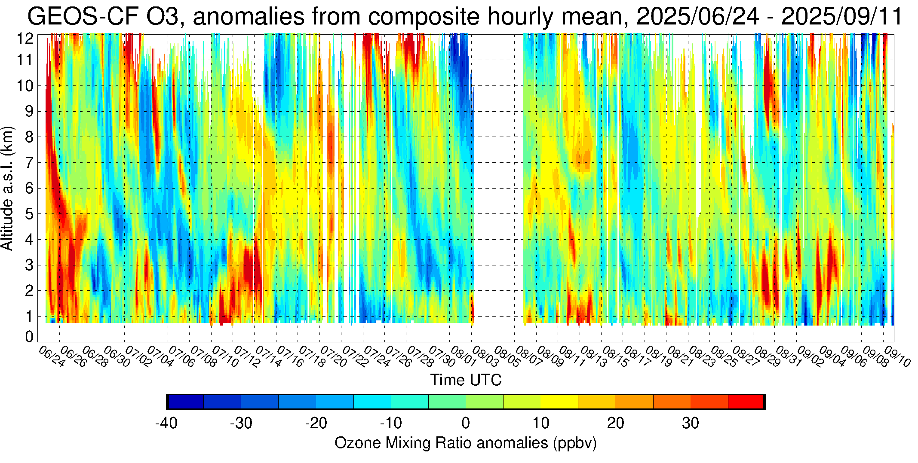
Anomalies from composite hourly mean: SMOL-3 vs GEOS-CF
SMOL-3 anomalies
➔
GEOS-CF ozone anomalies
➔
Agreement and consistency found in raw
curtain plots is confirmed in the anomalies

Slide 10
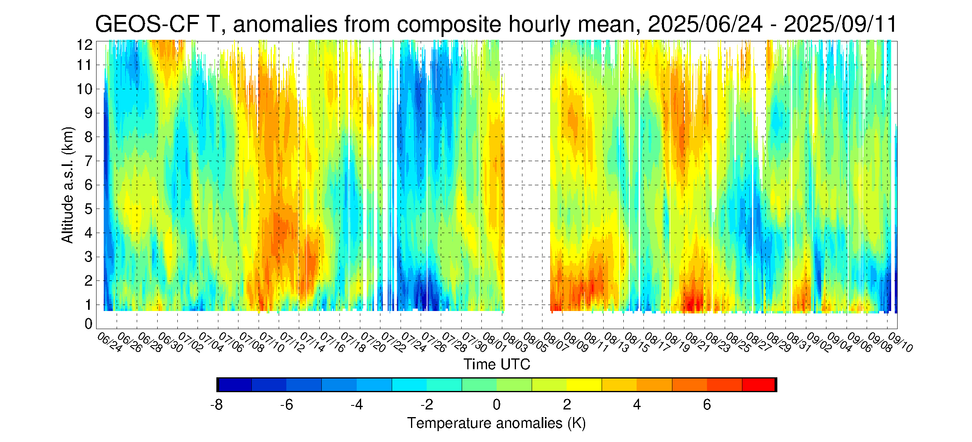
SMOL-3 ozone anomalies vs. GEOS-CF temperature anomalies
SMOL-3 ozone anomalies
➔
GEOS-CF temperature anomalies
➔
Positive O3/T correlation points to
contribution of synoptic changes during
episodes of highest ozone in the PBL
One exception is the stratospheric
intrusion of 6/25 (lower T, higher O3)
reaching the PBL

Slide 11
Part 2
SMOL-5 (and SMOL-4) in Phoenix, AZ
as part of the GLOR (Ground Level Ozone Research) Campaign
GLOR campaign
SMOL-4
Buckeye, AZ
SMOL-5
Phoenix, AZ

Slide 12
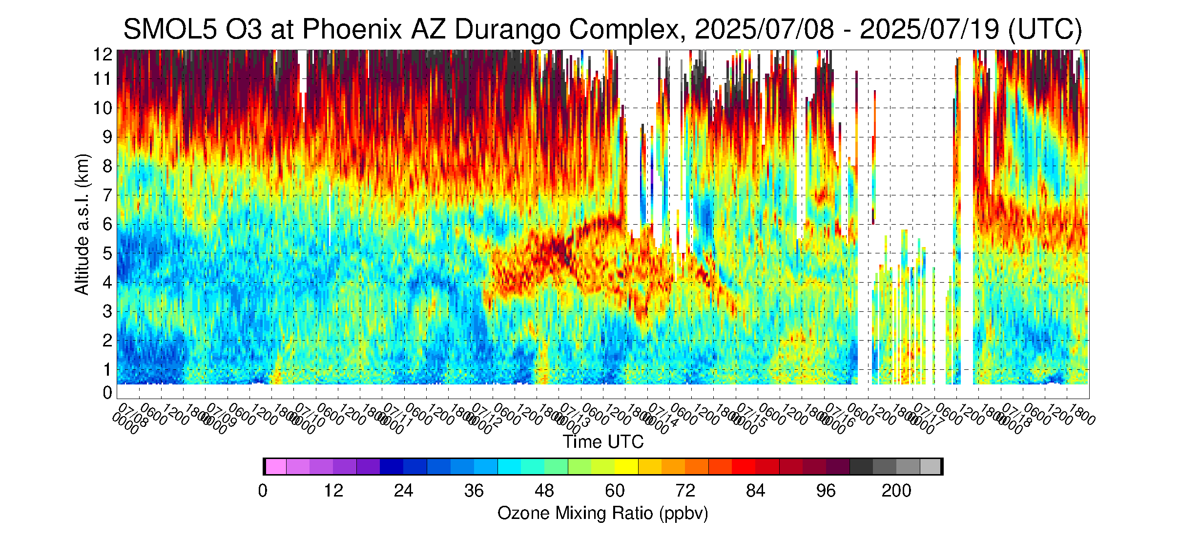
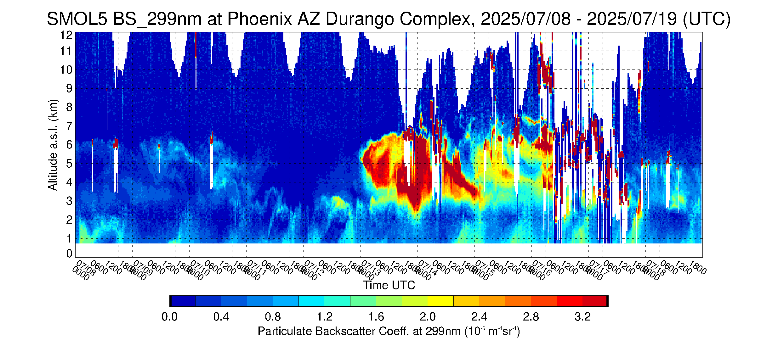
High ozone event in the lower troposphere mid-July 2025
SMOL-5 Ozone, July 8-19, 2025, Phoenix, AZ
  High ozone (80+ ppb) at 4-5 km starts on 7/12
  Enhances and continues on 7/13-7/14
➔
SMOL-5 Aerosol BSC
  Thick aerosol layer at 4-5 km starts on 7/13
  After 7/13, aerosol layer mimics high ozone layer
➔
  No aerosol layer on 7/12 !!
Need to investigate this 1-day delay :
➔ GEOS-CF and 5-day back trajectories at 4 km

Slide 13
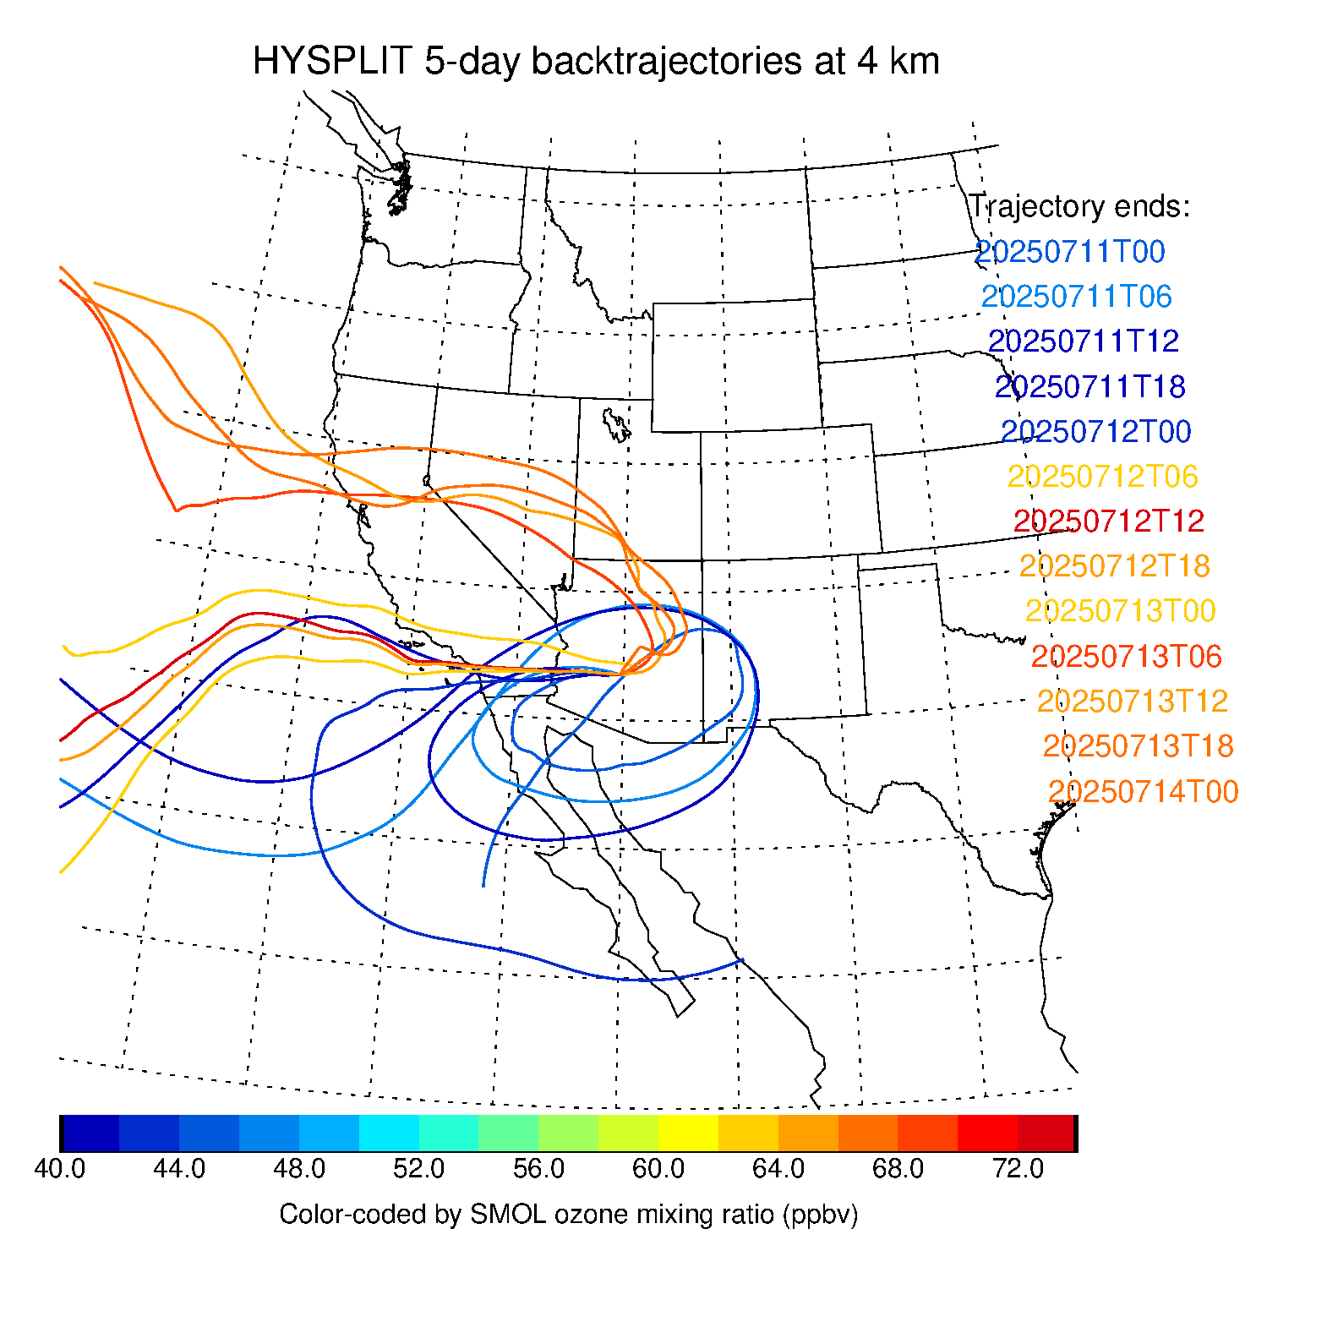
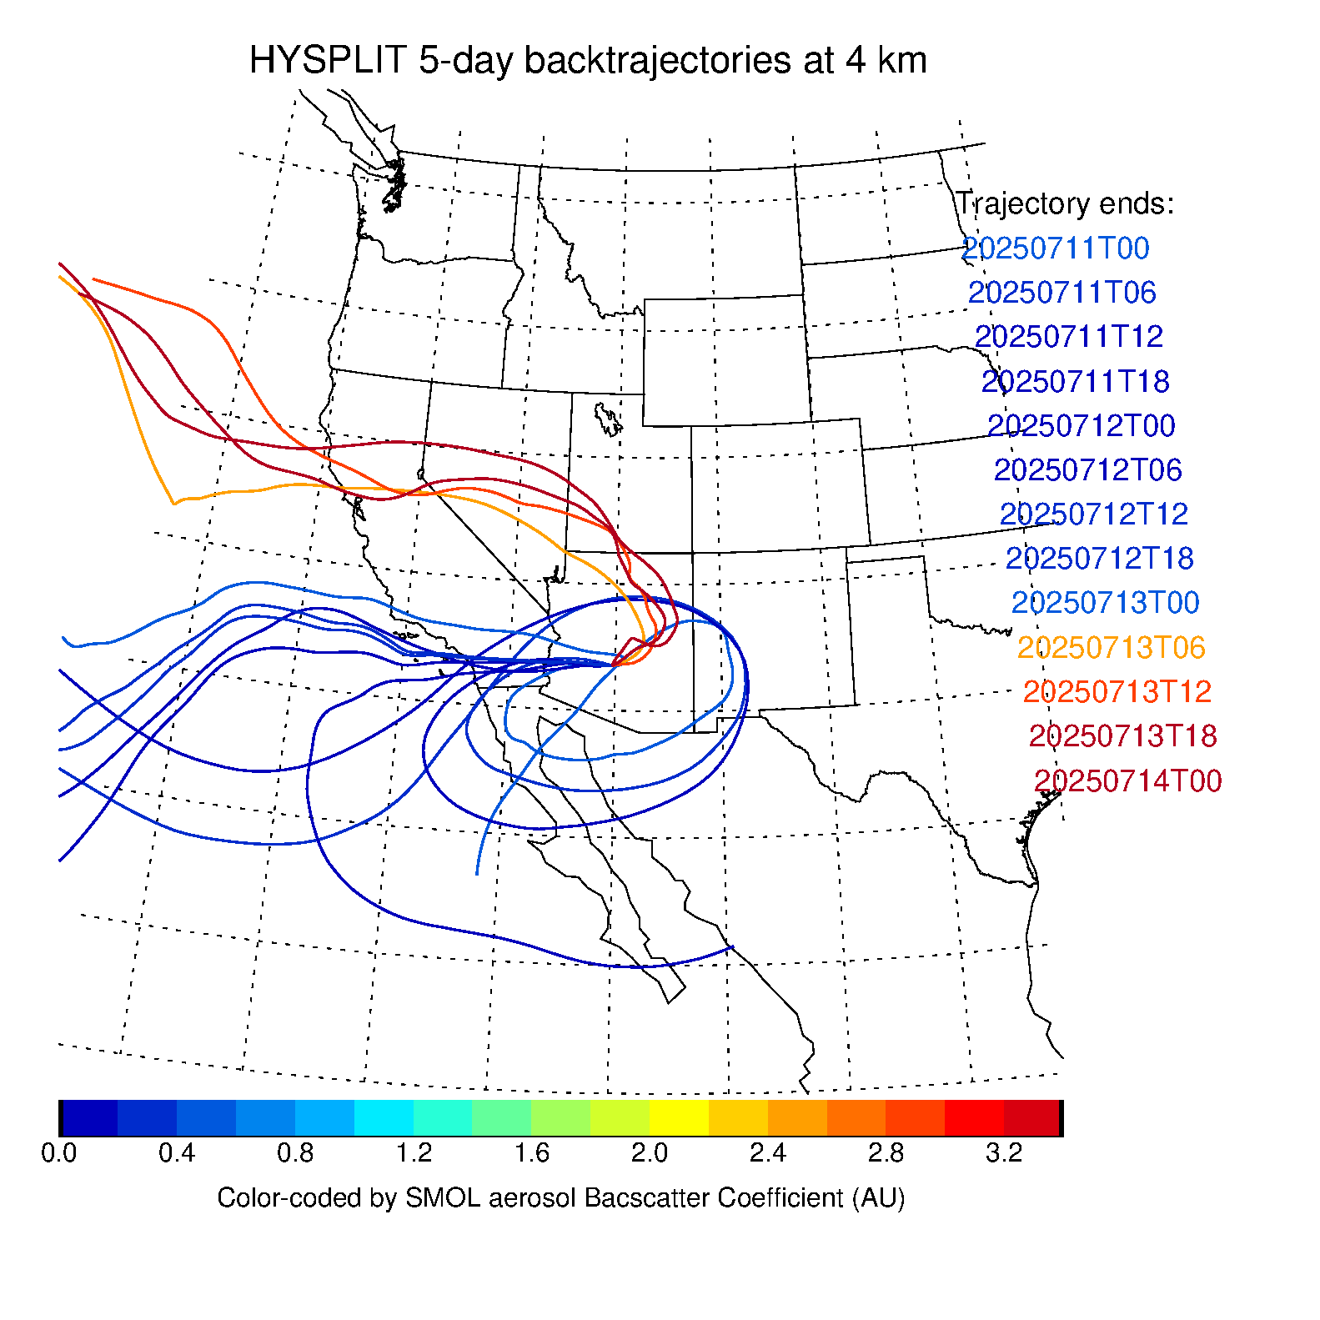
5-day HYSPLIT back-trajectories at 4 km ending over Phoenix, AZ
Color-coded by O3 vmr
measured by SMOL-5
at trajectory end date
Color-coded by Aerosol Backscatter Coef.
measured by SMOL-5
at trajectory end date
7/13
7/13
7/12
7/12
7/11
7/11
High ozone 1-day ahead
of high aerosols

Slide 14
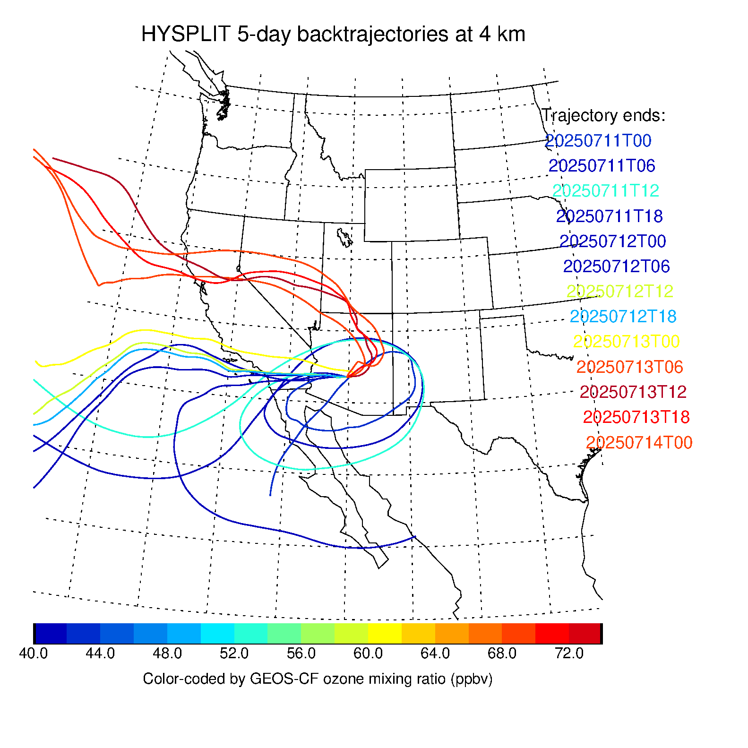
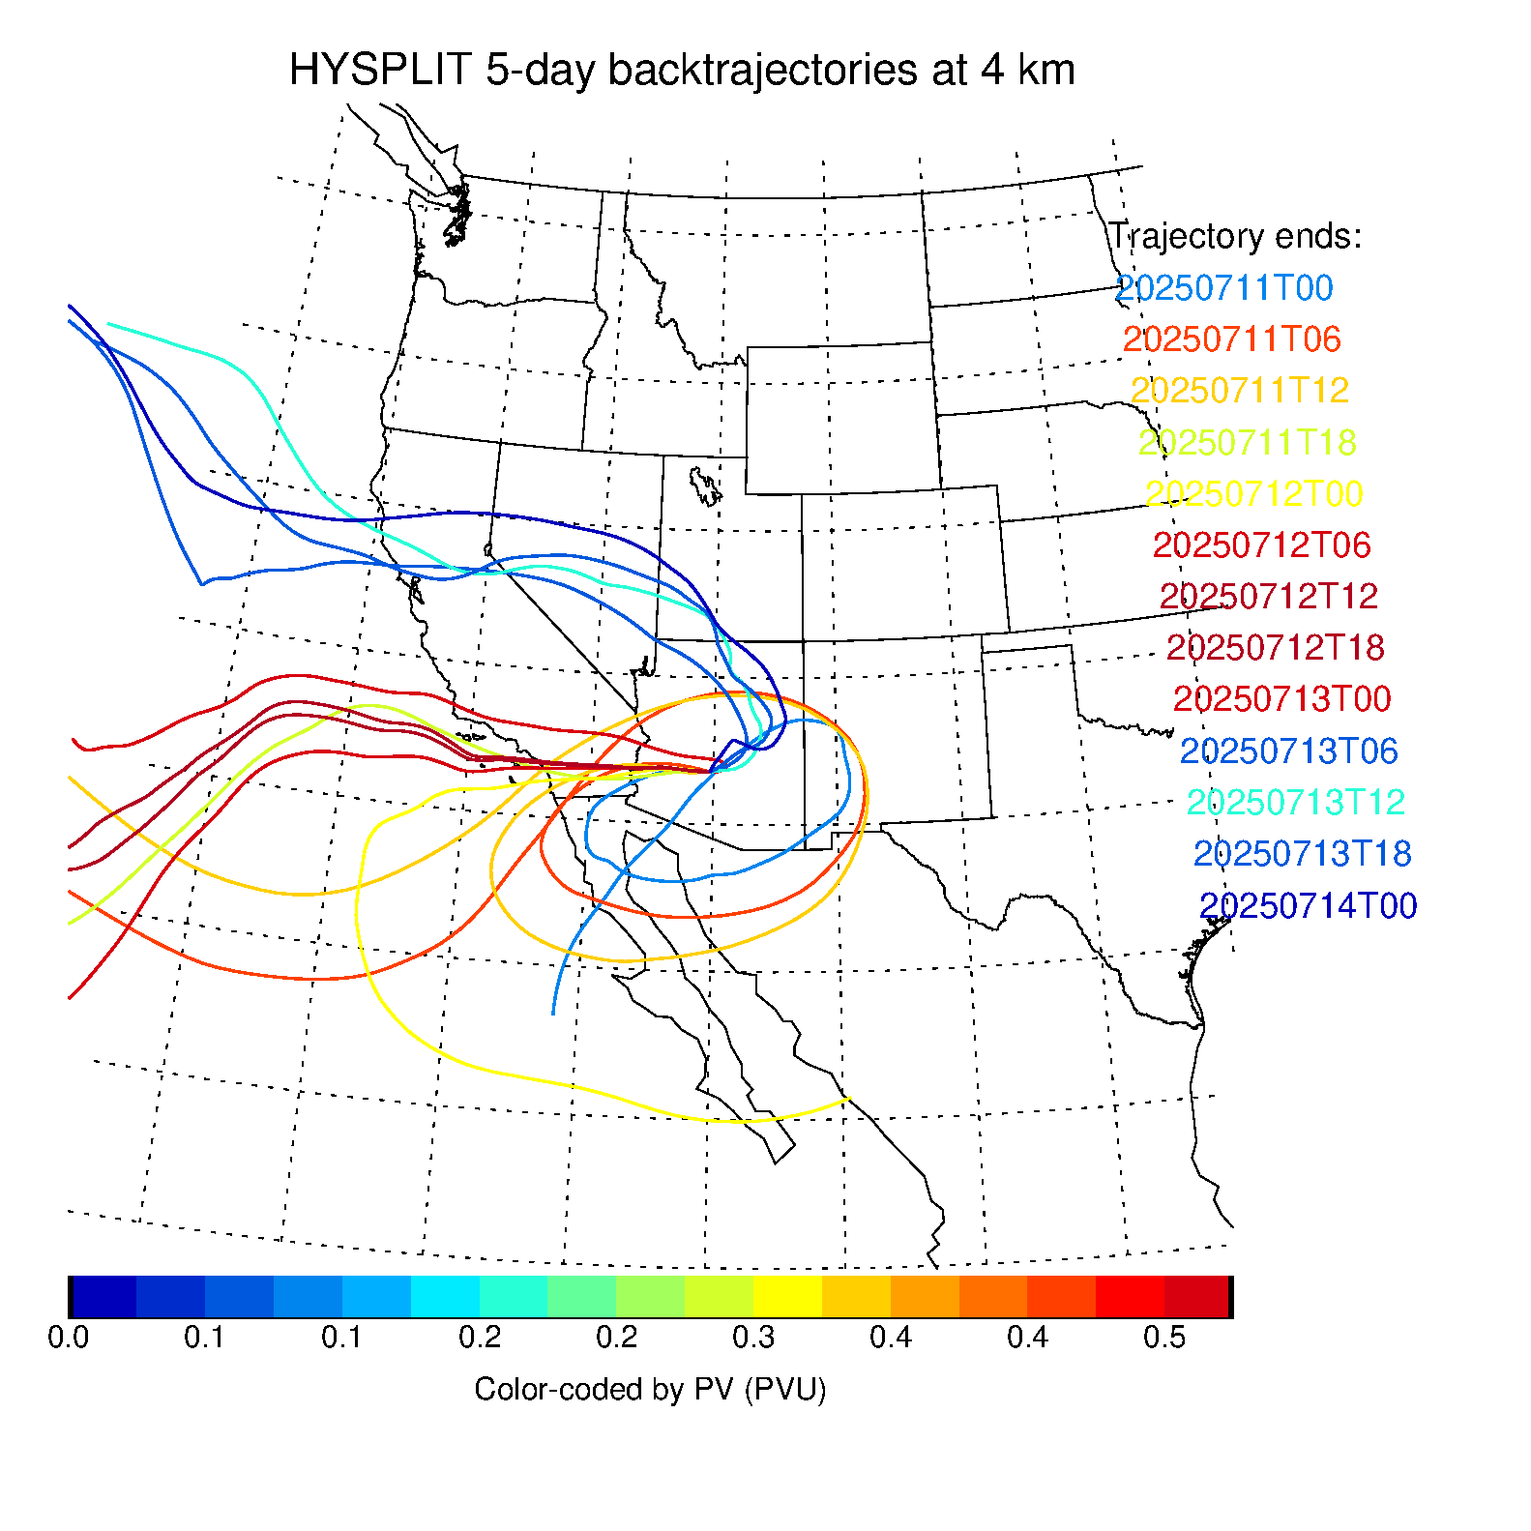
SMOL-5 vs. GEOS-CF Ozone and EPV
Color-coded by SMOL-5 O3
at trajectory end date
Color-coded by GEOS-CF O3
at trajectory end date
Color-coded by GEOS-CF PV
at trajectory end date
GEOS-CF misses the high ozone on 7/12, but shows high PV on 7/12 from the remains of a stratospheric intrusion
➔ SMOL-5 lidar = key source of information to validate and improve mixing scheme in models

Slide 15
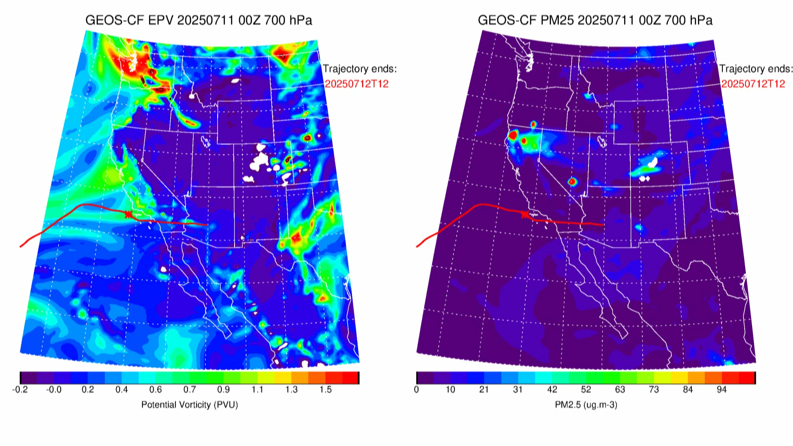
July 12 12Z Air Parcel Recent History
On July 12 at 12Z:
High PV, low PM2.5
Air parcel follows
high PV tongue
Air parcel remains
far from any PM2.5 sources

Slide 16
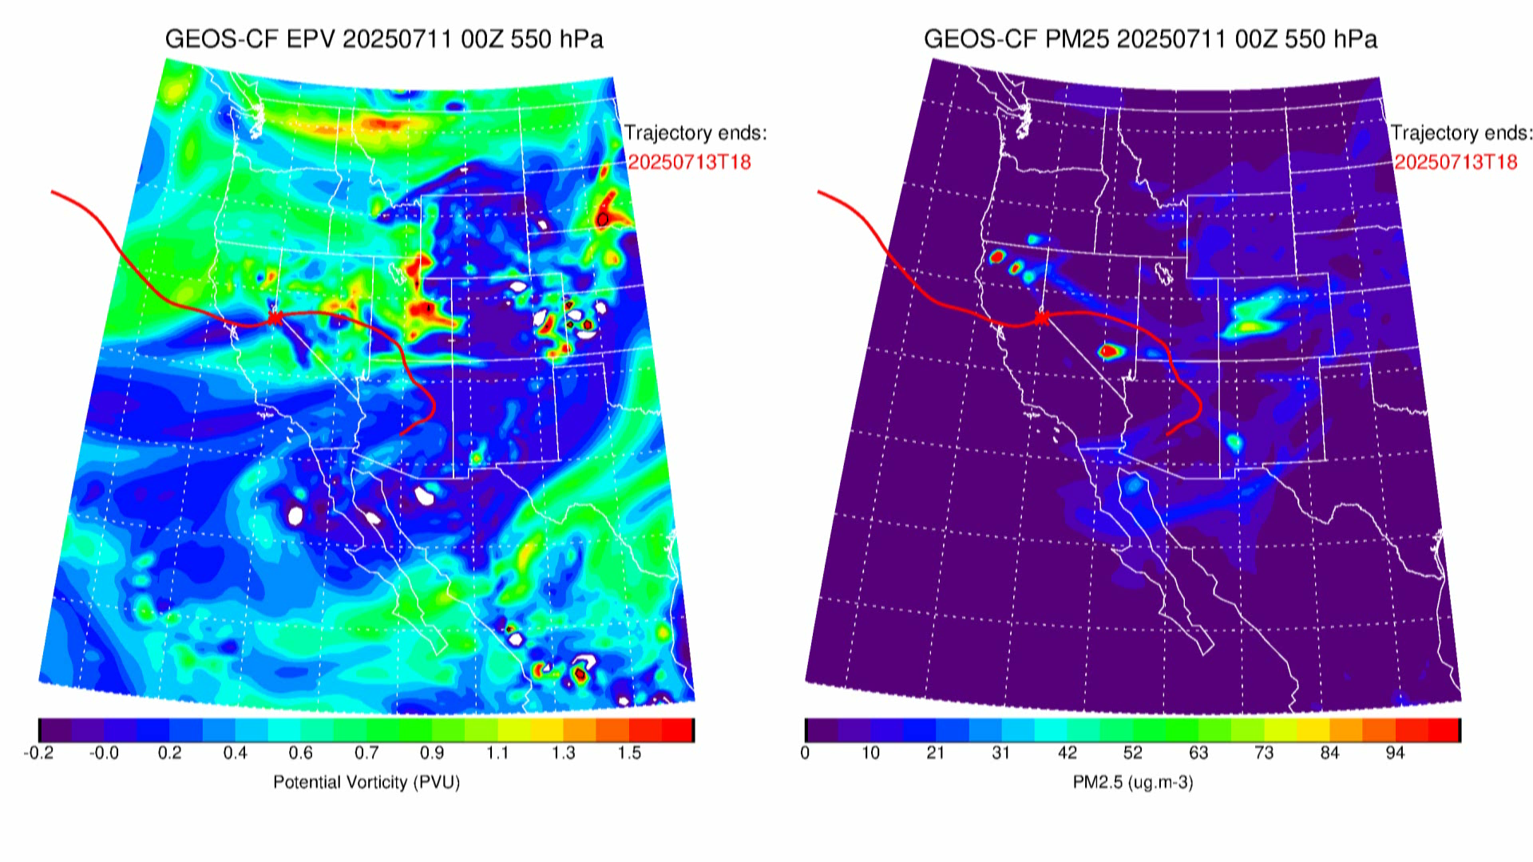
July 13 18Z Air Parcel Recent History
On July 13 at 18Z:
Low PV, high PM2.5
Air parcel misses
high PV tongue
Air parcel catches
PM2.5 source
(Grand Canyon Fires)

Slide 17
CONCLUSION
Sustained consistency between the SMOL lidars and GEOS-CF model enables the separation and study of chemical and meteorological processes responsible for ozone changes in the PBL and free troposphere
Combining lidar and model data at a broad range of vertical and temporal scales provides valuable context for the validation of TEMPO ozone profiles
TOLNet currently comprises 10 ozone lidars, including 5 SMOLs. Adding more low cost SMOL instruments to the network would enable significant investigative capability, dearly needed to address contemporary AQ issues
THANK YOU

Slide 18
BACKUP SLIDES

Slide 19
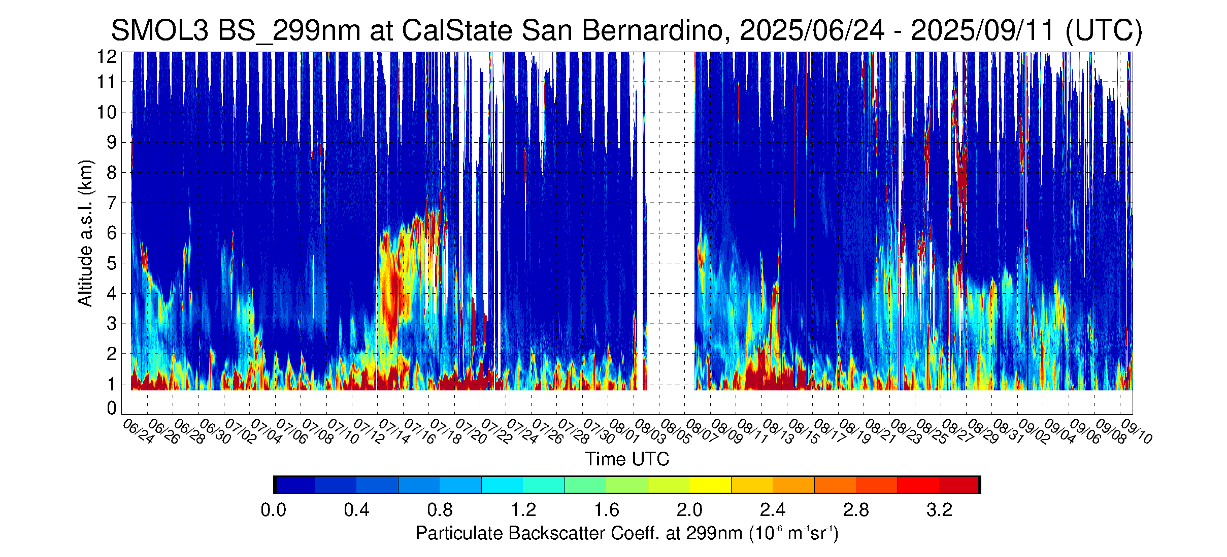
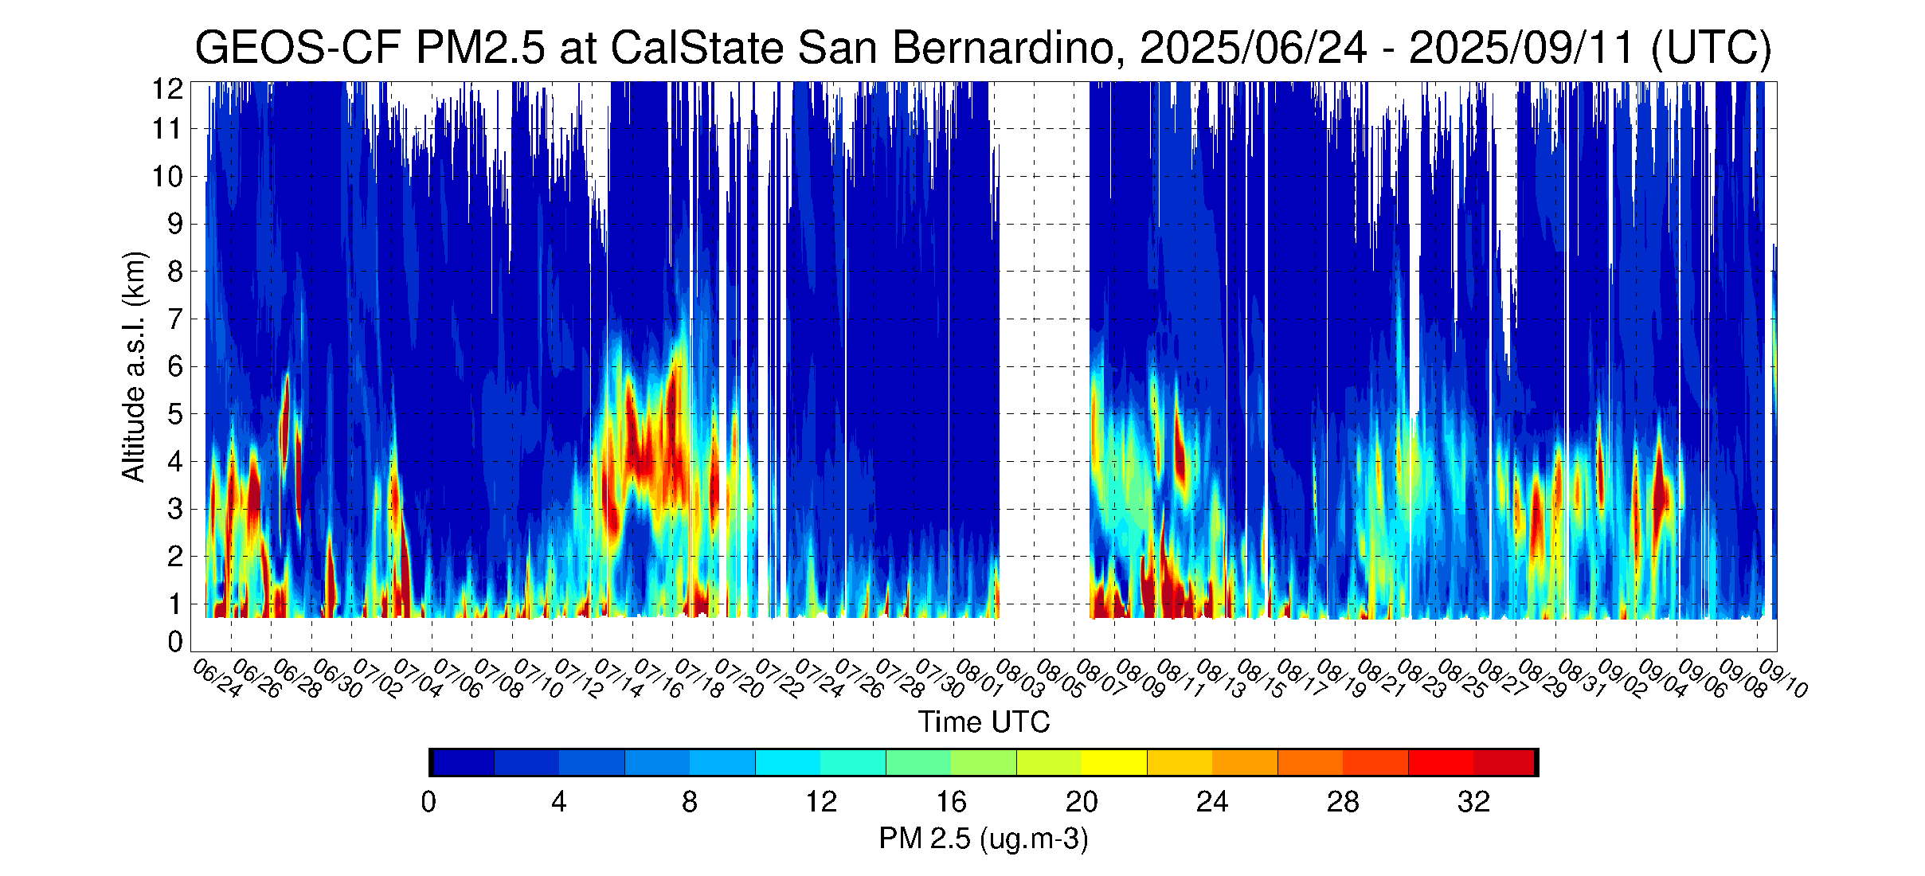
SMOL-3 Aerosol Product Validation
SMOL-3 backscatter coef.
➔
GEOS-CF PM 2.5
➔
Excellent lidar-model agreement provides
confidence in the new SMOL-3 aerosol product
  Note episodes of wildfire smoke in the lower troposphere, especially during the 7/12-7/20 timeframe

Slide 20
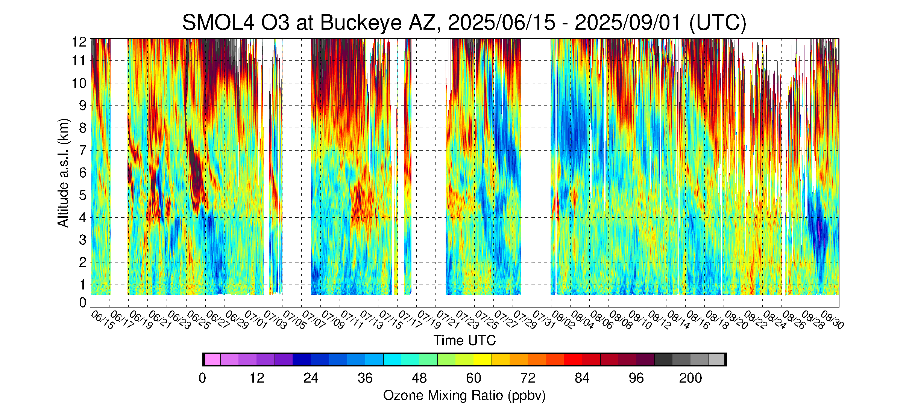
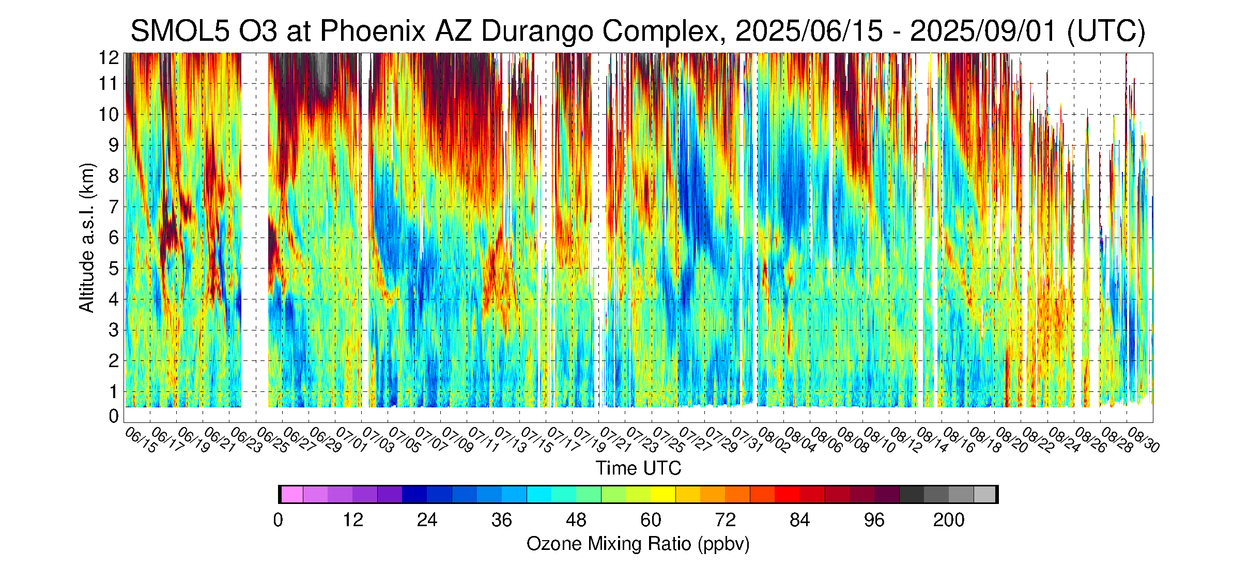
SMOL-4 in Buckeye, AZ and SMOL-5 in Phoenix, AZ
Both curtain plots from 6/15 to 9/01
(80 days, one tick-mark every 2 days)
➔
SMOL-4 ozone curtain plot
  Buckeye: Upwind location, 30 miles W of downtown Phoenix
  Almost no diurnal cycle (unlike San Bernardino, CA)
  Downward-propagating of high and low ozone periods
  in the free troposphere (as for San Bernardino, CA)
  Very few ozone exceedance days, typical values: 50-60 ppbv
➔
SMOL-5 ozone curtain plot
  Durango complex: Urban location, near downtown Phoenix
  Very weak diurnal cycle
  Same downward-propagating of high and low ozone periods
  in the free troposphere
  Very few ozone exceedance days, typical values: 50-60 ppbv

Slide 21
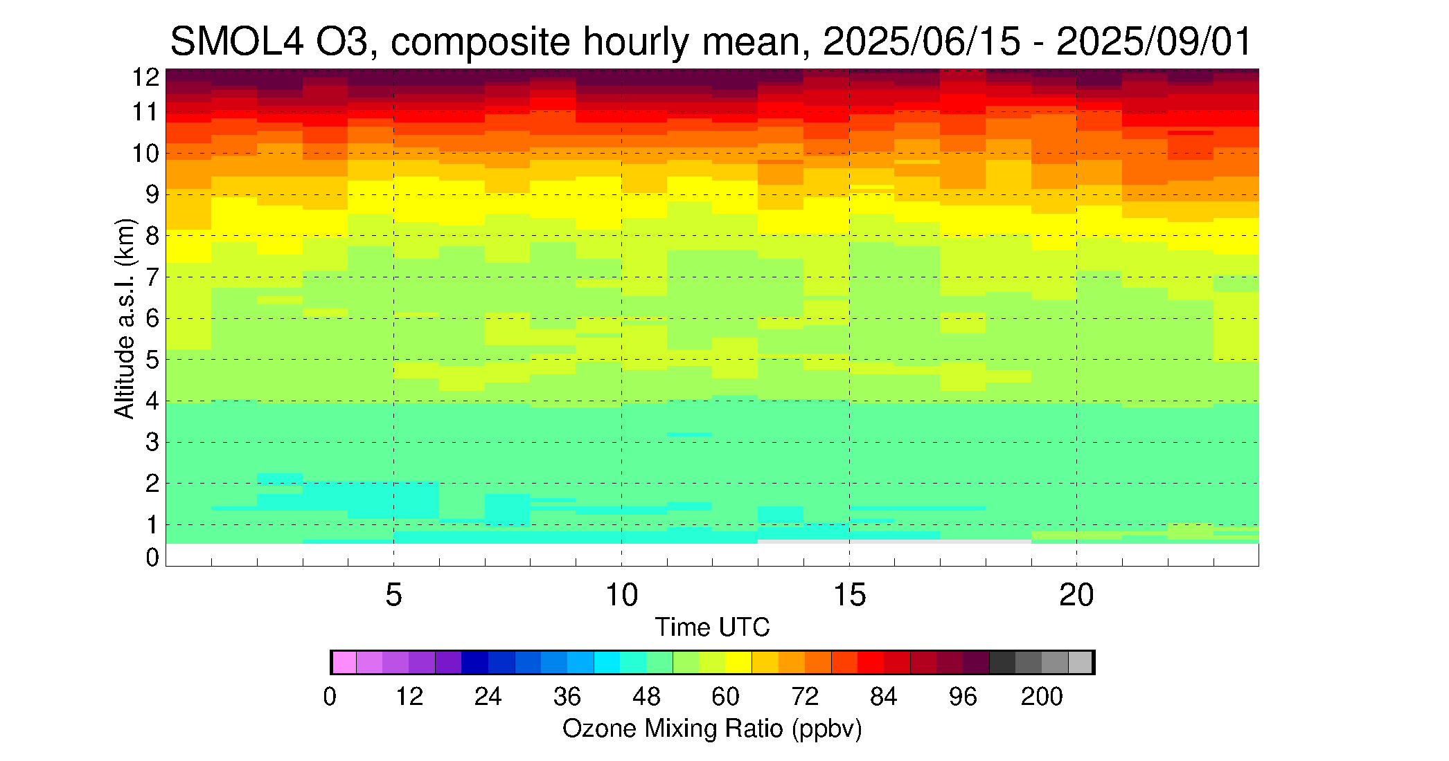
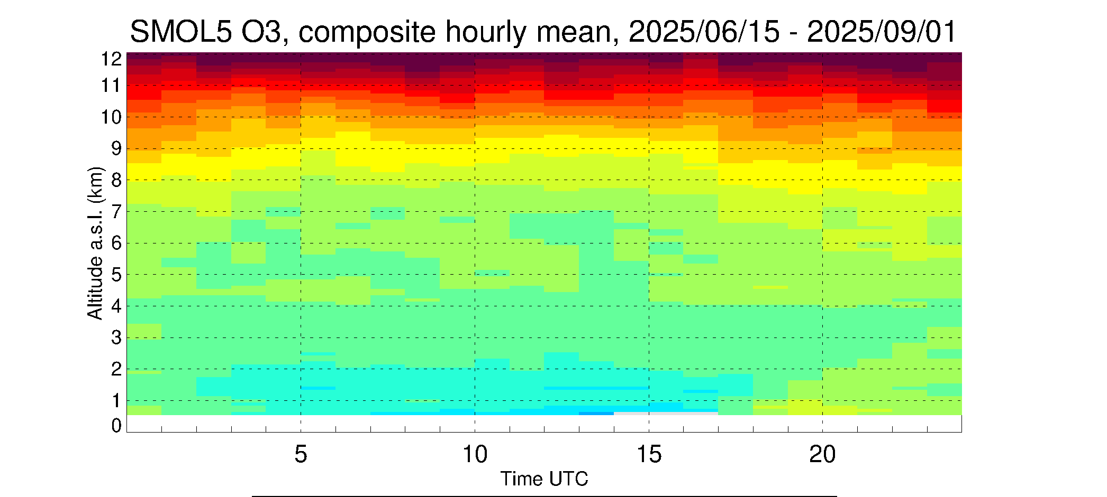
Composite hourly mean, comparison SMOL-4, SMOL-5 and SMOL-3
➔
SMOL-4 (Buckeye, AZ)
  PBL ozone MR range 40-50 ppbv,
  PBL diurnal change magnitude < 10 ppbv
➔
SMOL-5 (Phoenix, AZ)
  PBL ozone MR range 40-60 ppbv,
  PBL diurnal change magnitude < 20 ppbv
➔
SMOL-3 (San Bernardino, CA)
  PBL ozone MR range 40-90 ppbv,
  PBL diurnal change magnitude ~ 50 ppbv
Diurnal cycle is negligible in Buckeye, AZ, weak in Phoenix, AZ
Both are much weaker than San Bernardino, CA

Slide 22
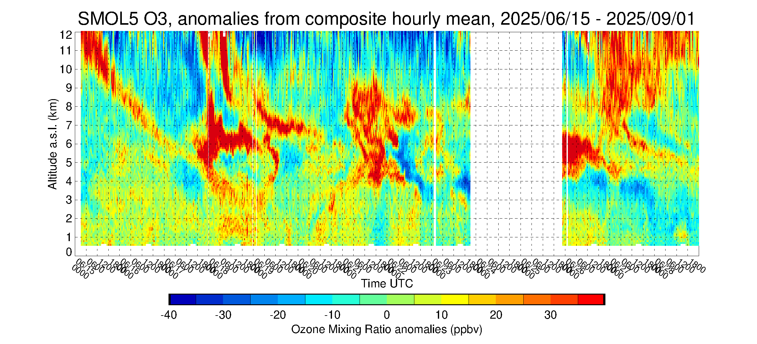
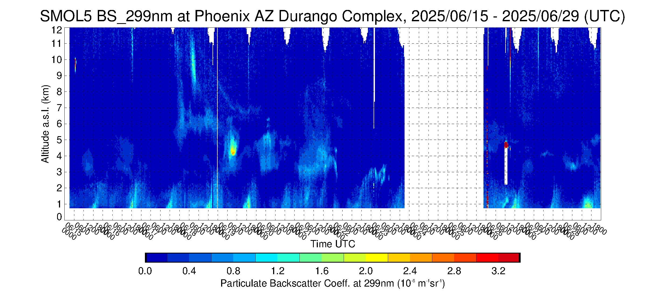
Phoenix, AZ high PBL ozone event # 1 (6/18-6/20)
SMOL-5 ozone anomaly curtain plot
  Date range: 6/15-6/29 (14 days)
➔
  PBL high ozone anomaly 20 ppbv
  Elevated O3 tongue subsides over 6/15-6/18 timeframe
  Apparent mixing of free tropospheric O3 on 6/18
SMOL-5 aerosol BSC curtain plot
  Same date range: 6/15-6/29 (14 days)
➔
  “Clean” troposphere most of the period
  Slight enhancement on 6/18
High ozone, low aerosol hints towards
contribution of stratospheric intrusion
for this particular high ozone event,
possibly mixed with thin smoke

Slide 23
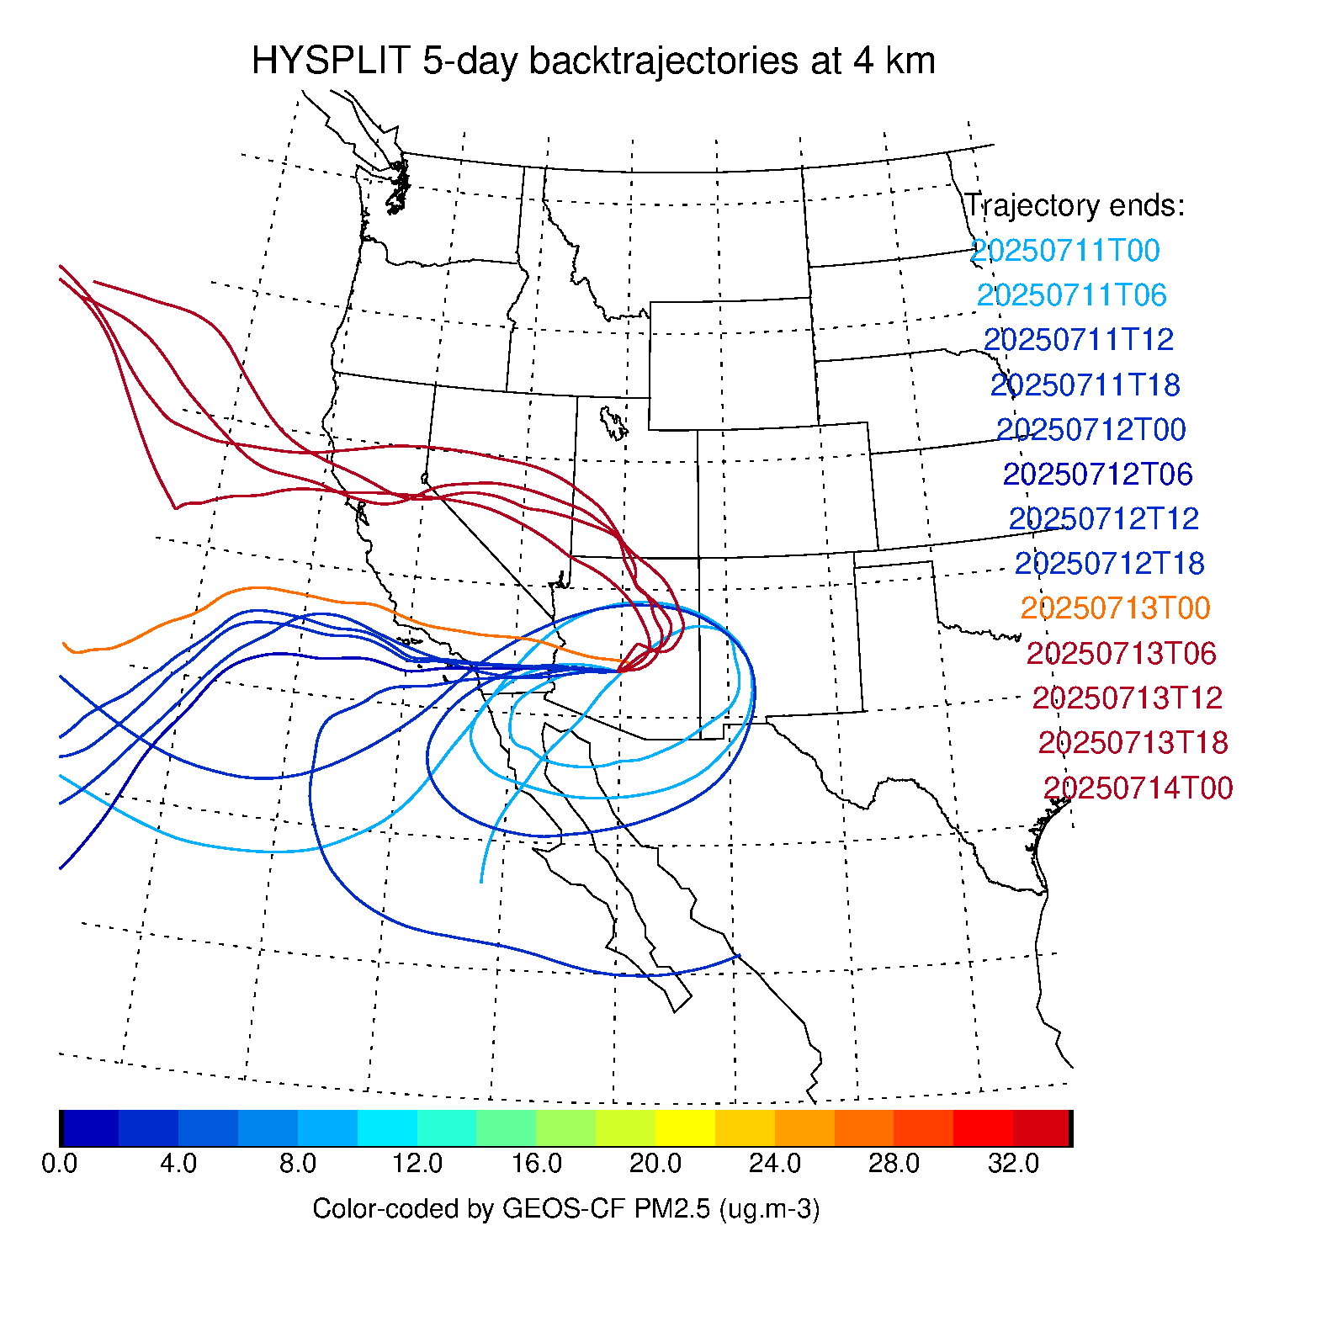
Color-coded by Aerosol Backscatter Coef.
measured by SMOL-5
at trajectory end date
Color-coded by PM2.5
output by GEOS-CF replay
at trajectory end date

Slide 24
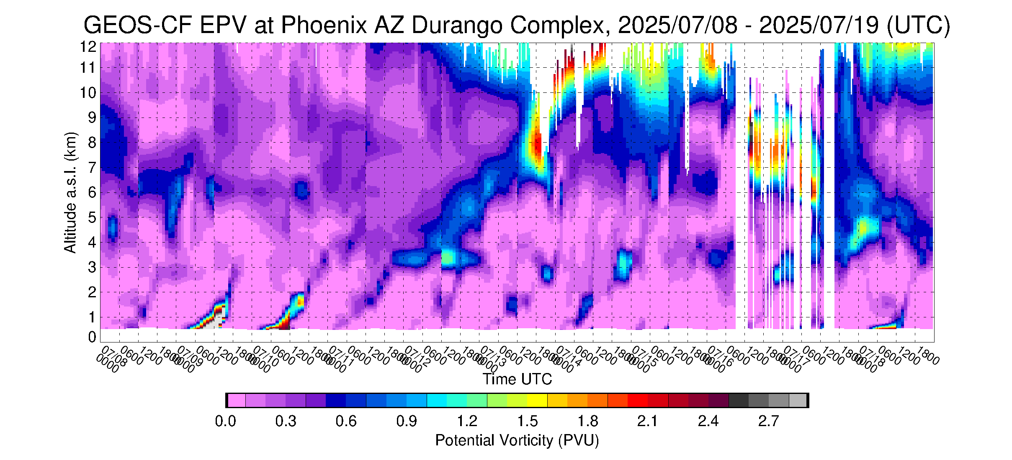
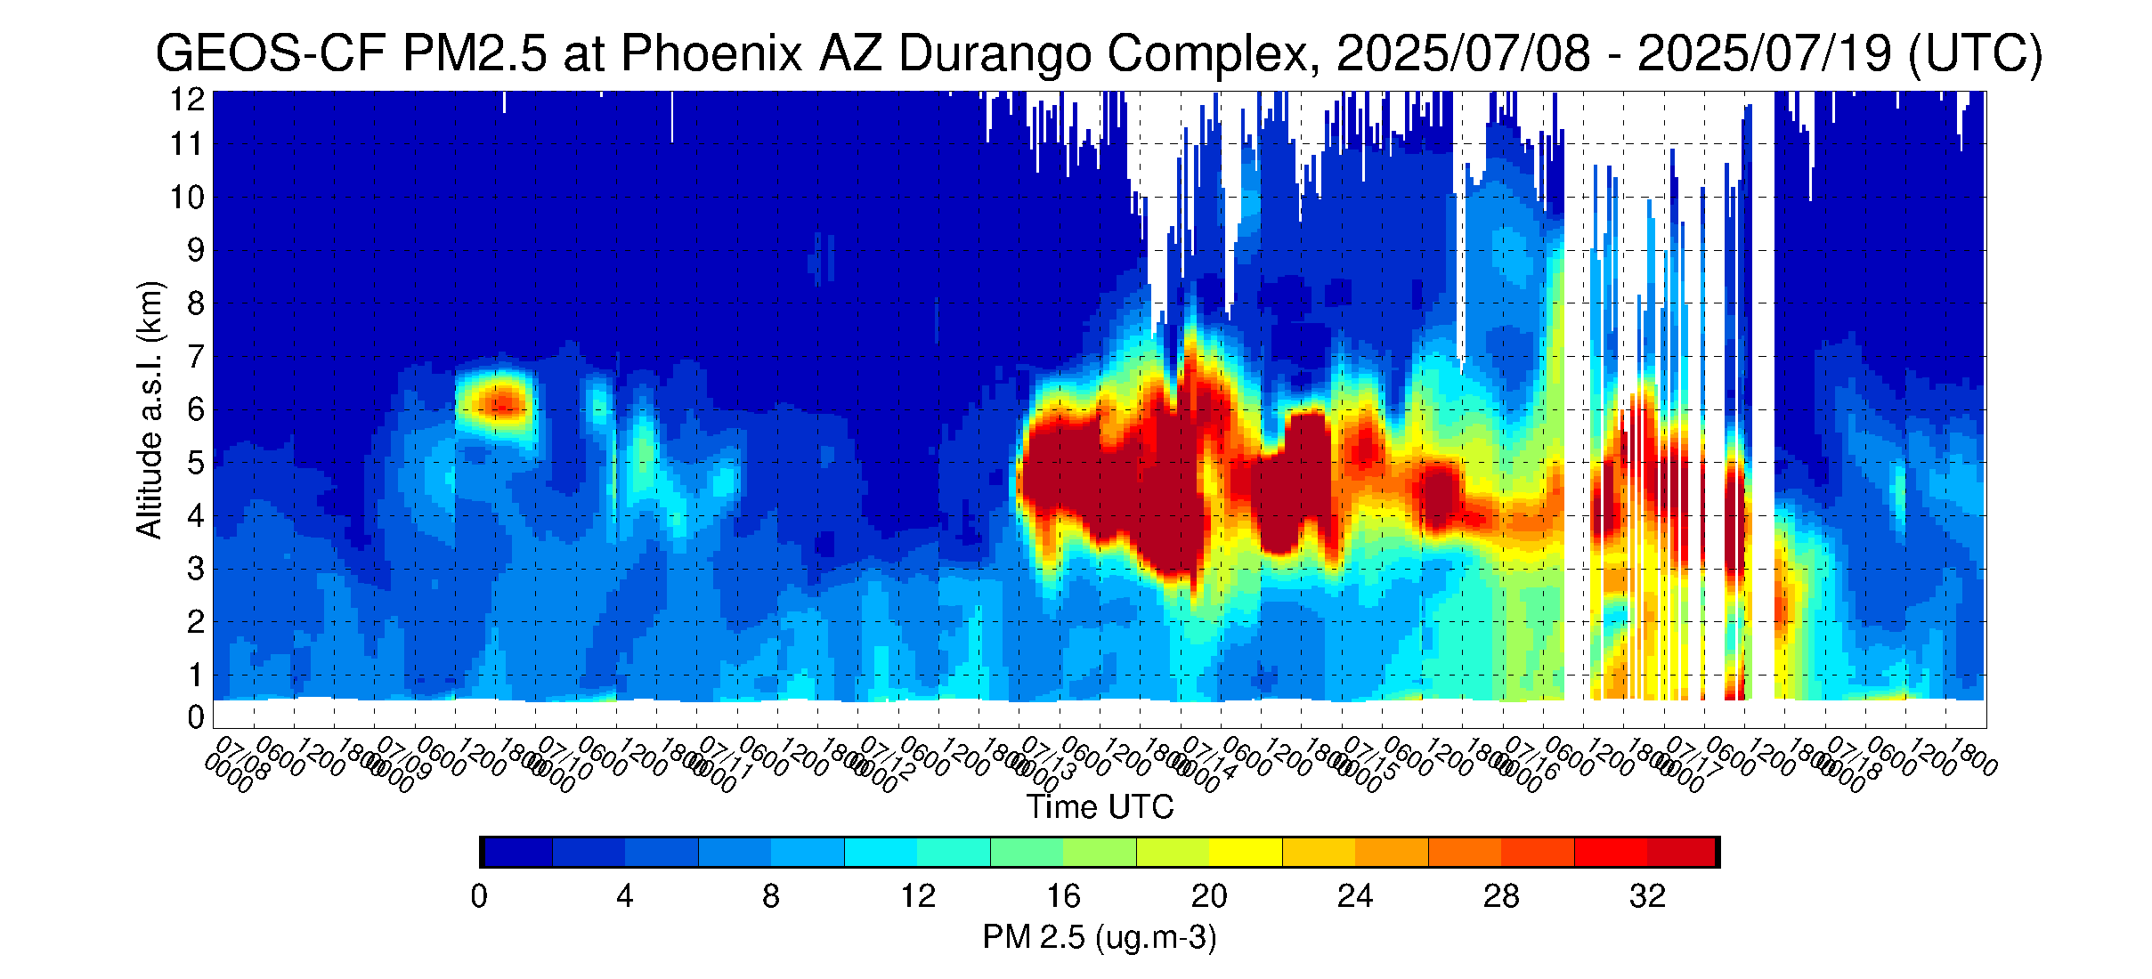
GEOS-CF EPV and PM 2.5 at SMOL-5 location (Phoenix, AZ)
GEOS-CF Ertel’s Potential Vorticity curtain plot
  Same date range as SMOL-5: 7/8-7/19 (14 days)
  High PV tongue from 7/12 (3-4 km) to 7/14 (7-8 km)
GEOS-CF PM 2.5 curtain plot
  Same date range as SMOL-5: 7/8-7/19 (14 days)
  Same thick aerosol layer starts on 7/13 at 4-6 km
  “Clean” troposphere on 7/12 at 4-5 km
High PV tongue, coincides with low aerosol
and high ozone on 7/12 at 4-5 km
(bottom half of white line)

Slide 25
Phoenix, AZ high ozone event # 2 (cont.)
Back to SMOL-5….
SMOL-5 ozone VMR curtain plot
➔
SMOL-5 aerosol BSC curtain plot
➔
High ozone event in free troposphere starts
on 7/12 with “clean” stratospheric intrusion,
followed by smoke event

