Slide 1

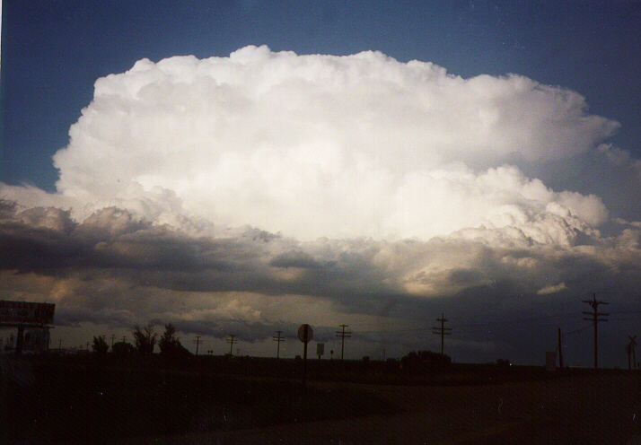
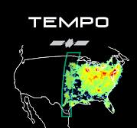


Observations of late afternoon
Lightning NO_{x} Production
from TEMPO
Case Studies over the U.S.
Dale Allen¹
Kenneth Pickering¹, Eric Bucsela²,
Jeff Lapierre³ Katrina Virts⁴, and Caroline Nowlan⁵
¹University of Maryland, College Park
² Astralis Technologies
³AEM Earth Networks
⁴NASA MSFC & Univ. of Alabama in Huntsville
⁵Center for Astrophysics, Harvard & Smithsonian
June 2026 TEMPO DART Meeting

Slide 2
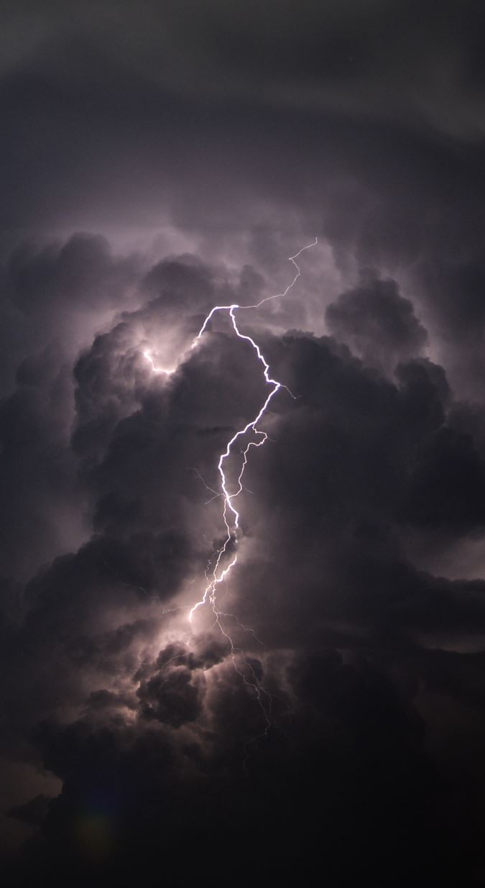
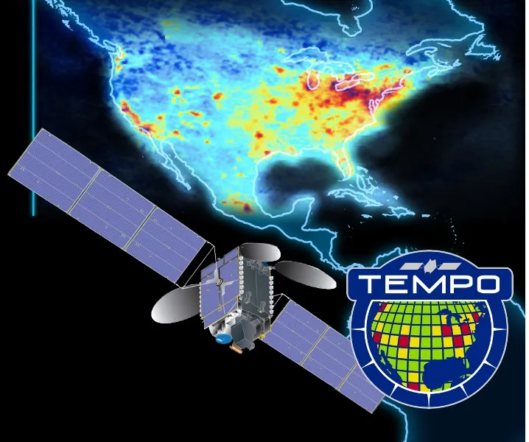
Introduction
Lightning produces NO because extreme temperatures (>1800 K) in lightning channels dissociate O₂ and N₂, which combine to form NO, which quickly reacts with O₃ to form NO₂.
Lightning-NO_{x} (LNO_{x}) accounts for 10-15% of NO_{x} production globally; however, its impact on atmospheric composition and climate is substantial because much of it is injected into the mid- and upper-troposphere where the lifetime of NO_{x} is longer.
LNO_{x} enhances NO_{y}, OH, and O₃ while decreasing CH₄; thus contributing to enhanced longwave radiation absorption by O₃ and decreased longwave radiation absorption by CH₄.
Here, we estimate the moles of NO_{x} produced per flash (LNO_{x} PE) using NO₂ and cloud products from TEMPO and flash counts from a ground- (ENTLN) and satellite- (GLM) based network.

Slide 3
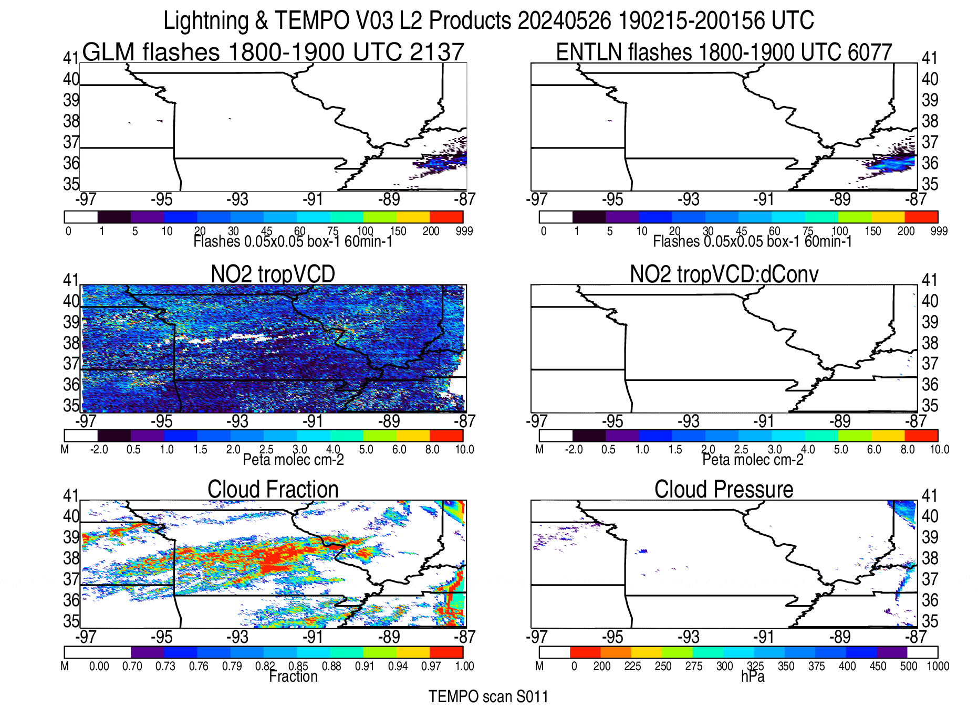
Lightning-NO₂ signal obtained
by subtracting median NO₂
column of background
retrievals from median column of lightning-influenced columns, after
replacing operational
AMF with an AMF that
includes a shape function
appropriate for deep
convective conditions.
Best method of determining
background pixels is still
being determined. Currently,
we use pixels from L3
grid boxes that have been flash free for the last 3 hrs.
Animation showing
flashes (top)
TEMPO NO₂
columns (mid)
& TEMPO cloud products
(bottom) for
convective
system observed over Missouri on
May 26, 2024
LNO_{x} PE estimation performed using deep convective retrievals,
i.e., retrievals with cloud fraction > 0.97 and OCP < 350 hPa
Notes:
Lightning commences over central Missouri after 19 UTC. System moves east producing plentiful lightning and NO2; While saturation of the TEMPO sensors is evident early most of the system occurs later in the day when saturation is minor. To first order, LNOx PE is proportional to the change in NO2 between scans divided by the flash count.

Slide 4
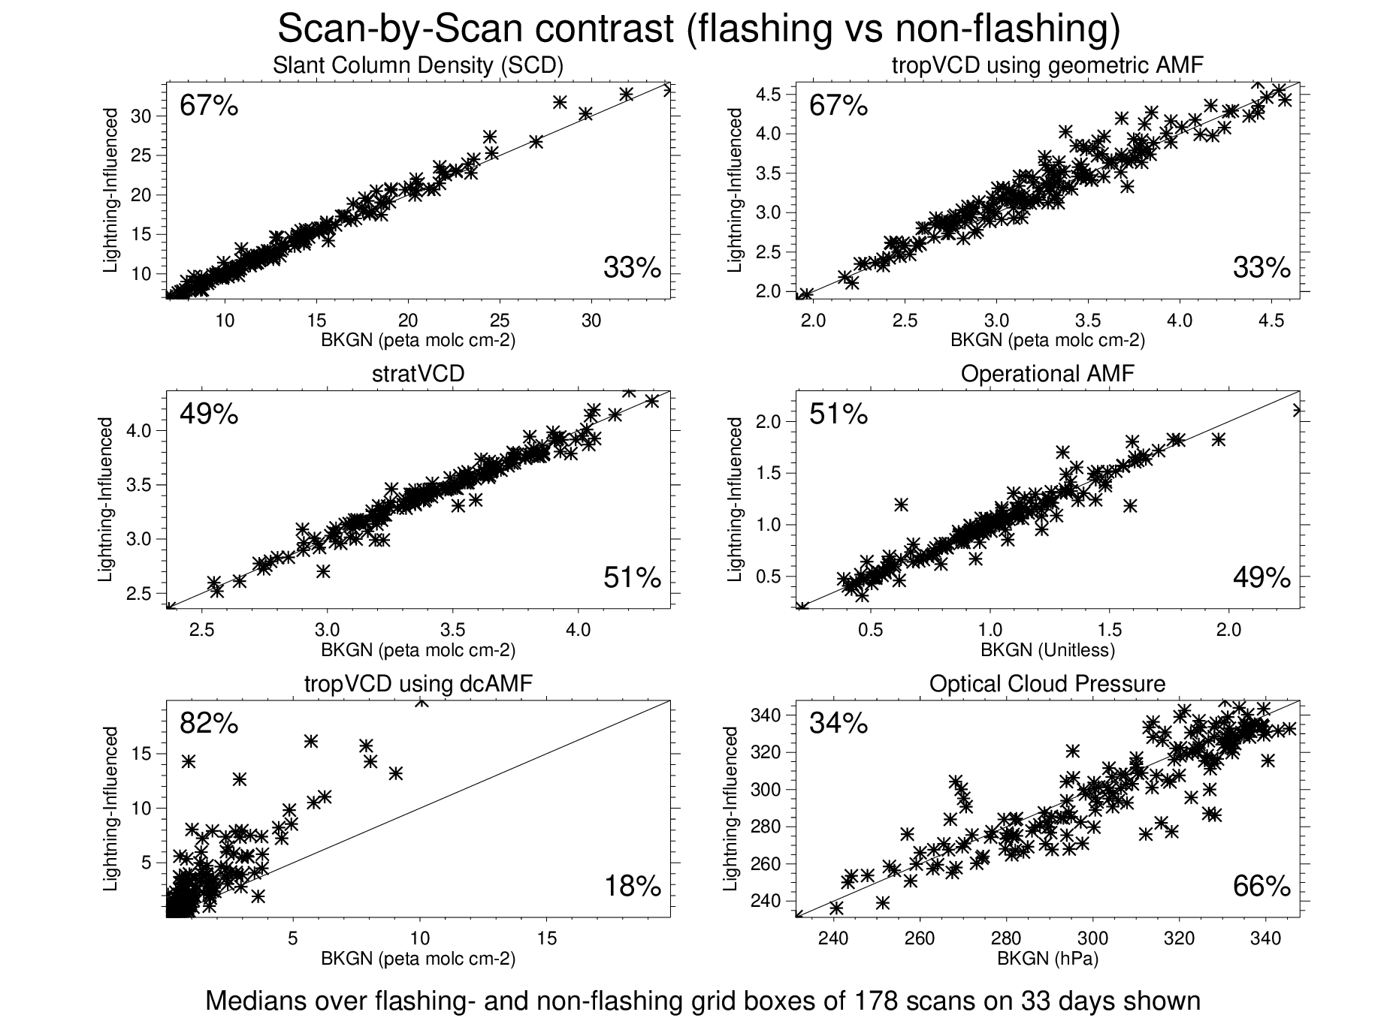
Differences in median TEMPO NO₂ columns, AMFs, and OCPs between background and lightning-influenced pixels for 178 scans of 33 convective systems during 2024 and 2025.
For 67% of the scans, SCDs were higher for retrievals within flashing grid boxes than
retrievals within non-flashing boxes.
For 82% of the scans, the median tropVCD,
obtained after subtraction of the stratVCD and division by the adjusted tropAMF, was higher for retrievals within flashing boxes.
Finally, median OCPs for retrievals within flashing grid boxes were usually lower than those for retrievals within non-flashing boxes. This is consistent with stronger convection but also confirms that the TEMPO sensor cannot see as far down into very strong storms and may miss some LNO_{x}.

Slide 5
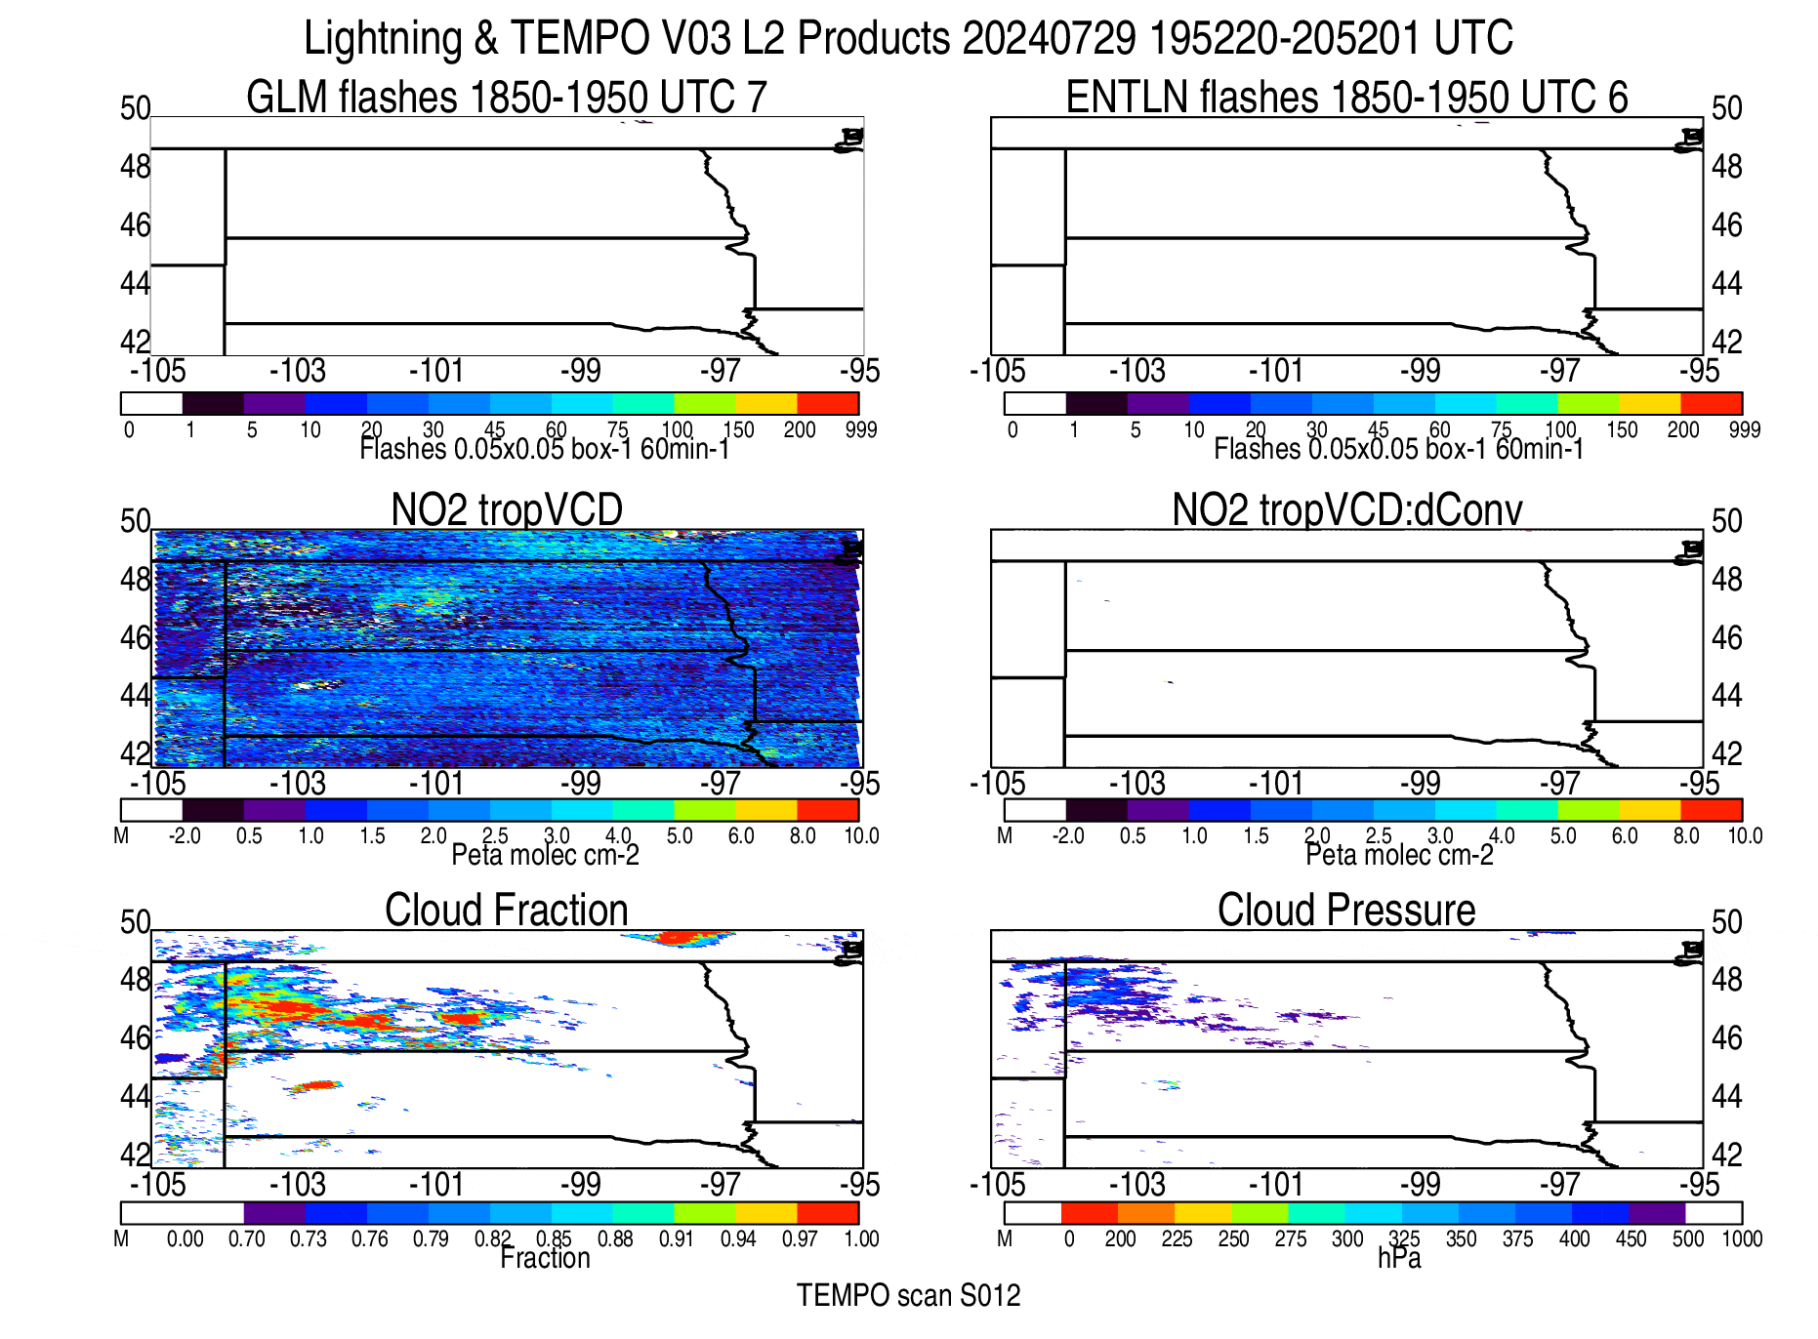
Animation showing
flashes (top)
TEMPO NO₂
columns (mid)
& TEMPO cloud products
(bottom) for
convective
system observed over the Dakotas on
July 29, 2024
LNO_{x} signal obtained by
multiplying LNO₂ signal
by UT NO_{x}/NO₂ ratio
from GEOS-CF
Moles of LNO_{x} obtained by
multiplying LNO_{x} signal
by storm area.
3-5 LNO_{x} PE estimates for
each system were obtained
by dividing scan-by-scan
differences in the moles
of LNOx by flashes.
Medians of these
estimates were calculated
and assumed to be
representative of
each system.
Notes:
Deep convection and lightning break out over the Dakotas during the early afternoon and strengthen with time.

Slide 6
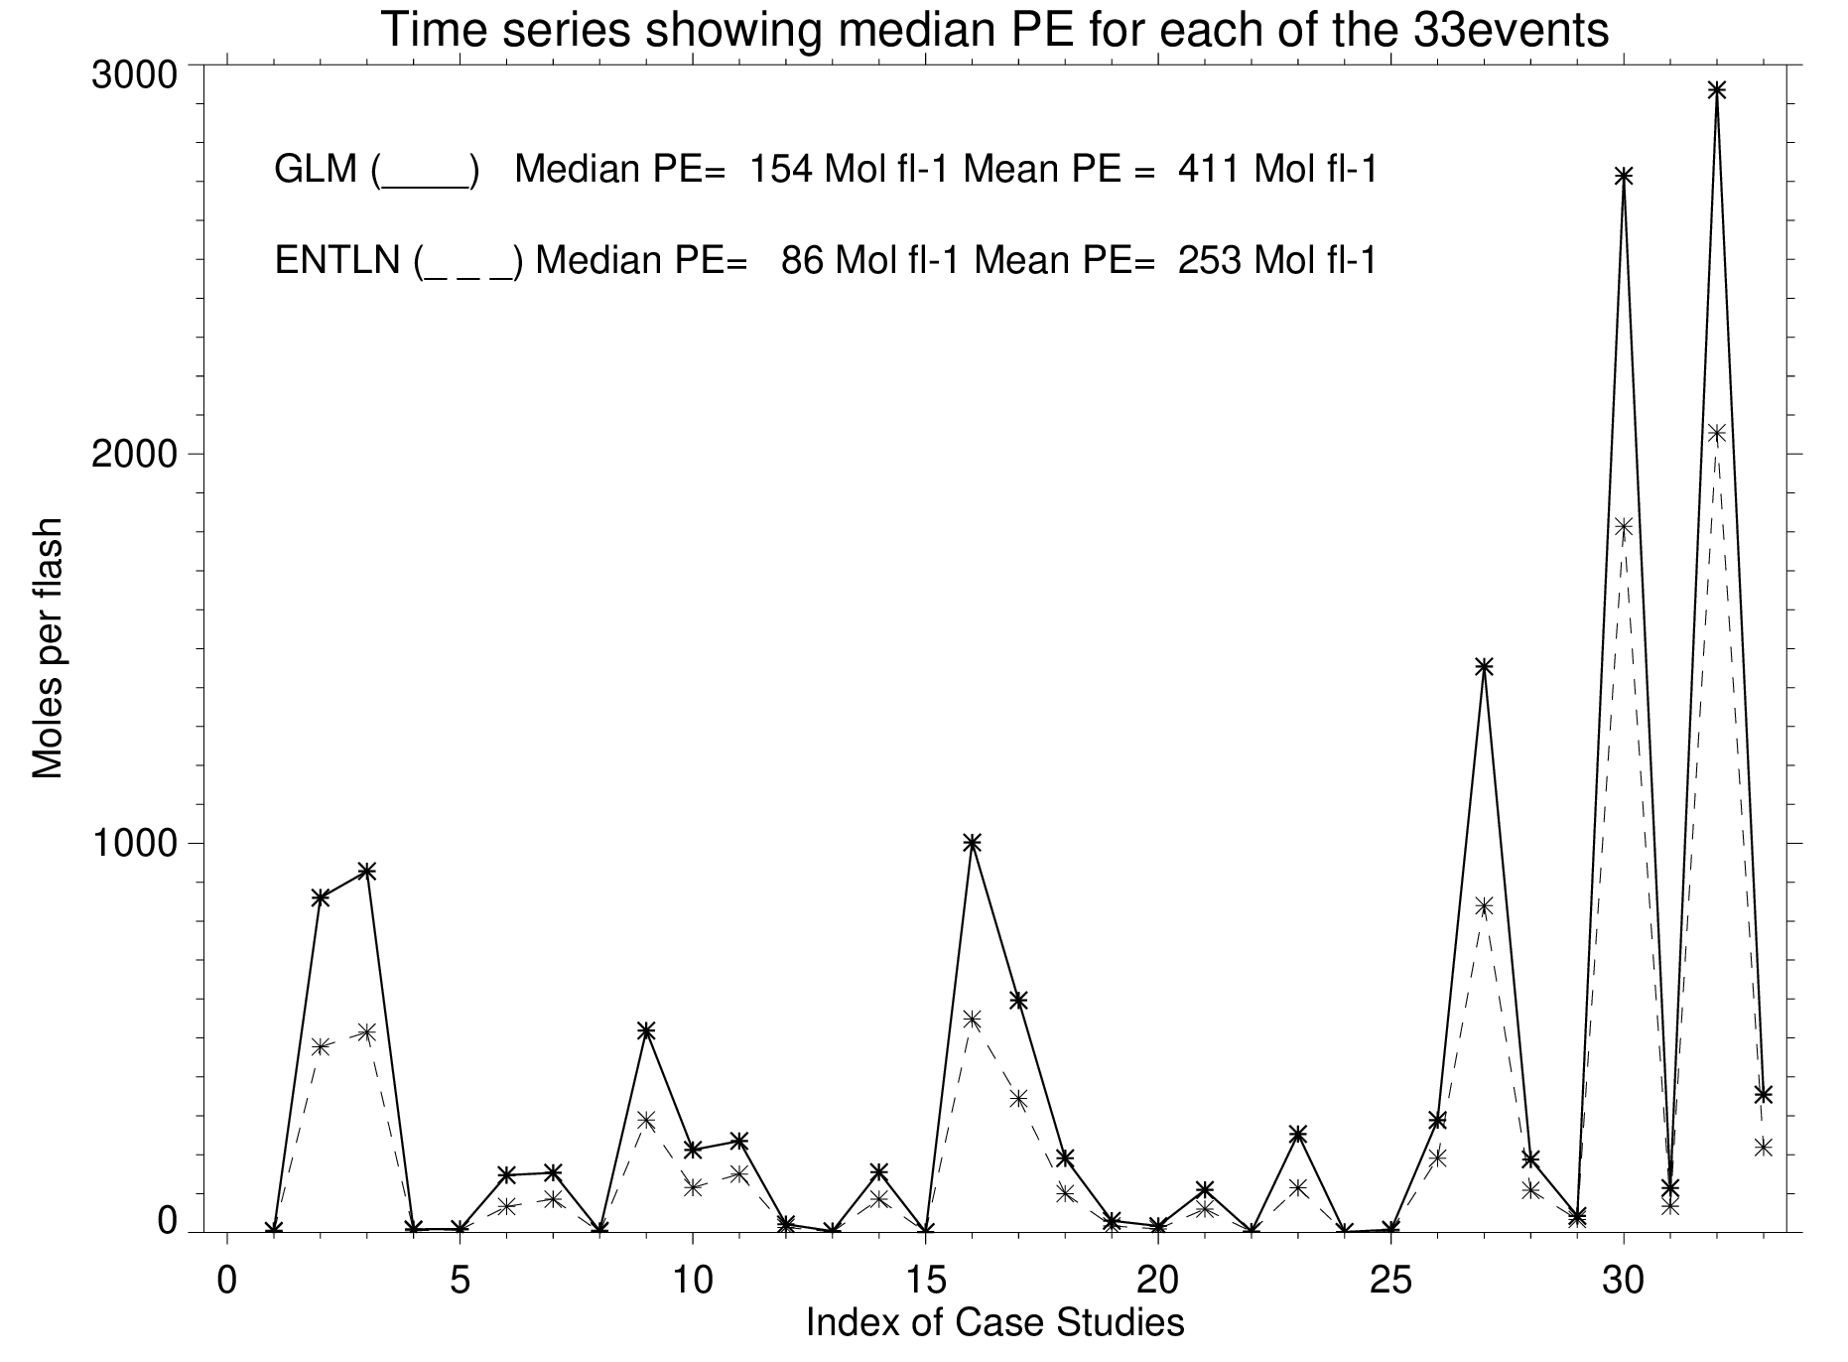
Asterisks show median PE values for each of the 33 systems. The many medians near zero indicate that the
method of separating bkgn and lightning-influenced retrievals needs to be improved. The extremely high values
are likely noise.
The values assume a 70% DE for GLM
and a 100% DE for ENTLN. Despite this,
the DE using GLM flashes > the
DE using ENTLN flashes. This needs
further investigation.
How much of the variability is due to
noise versus variations in flash energy
or multiplicity with time? Stay tuned.

Slide 7
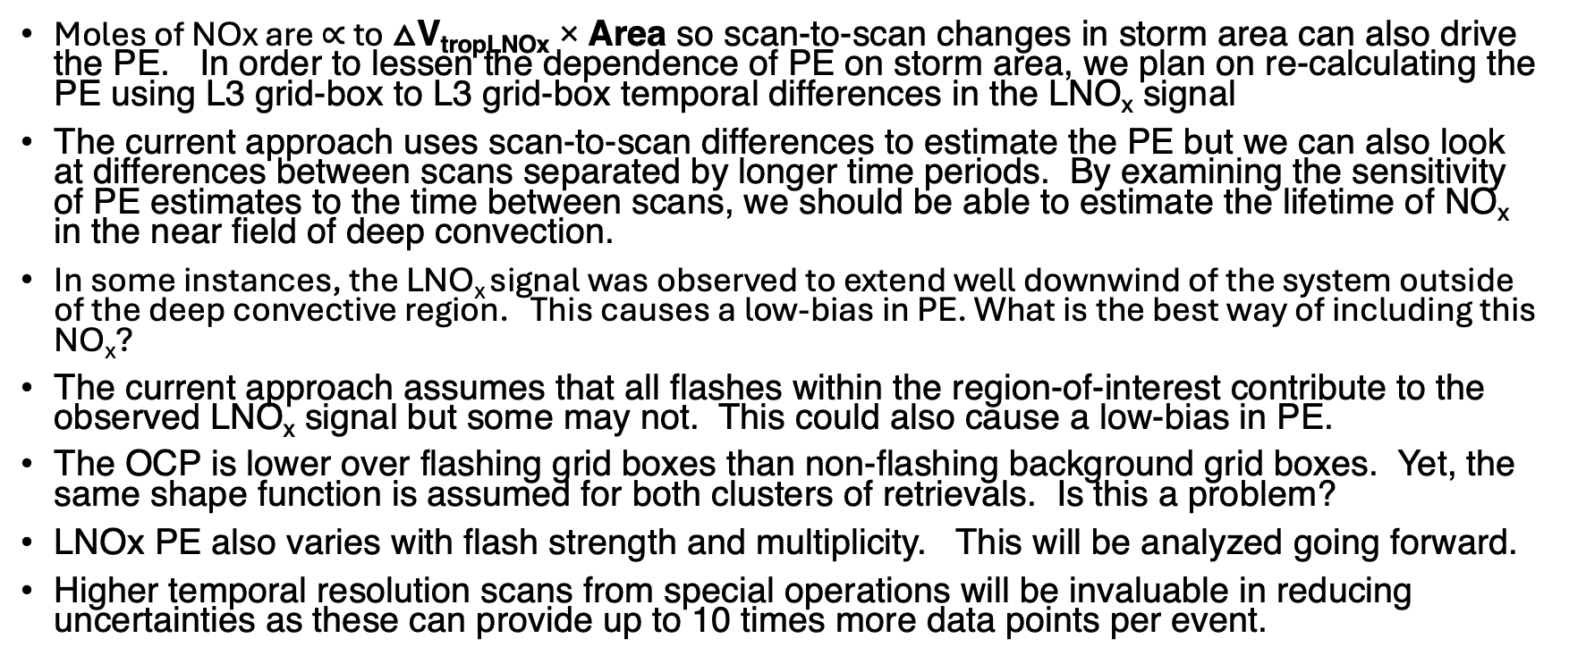
Selected uncertainties in this analysis
Moles of NOx are $∝$ to △V_{tropLNOx} × Area so scan-to-scan changes in storm area can also drive the PE. In order to lessen the dependence of PE on storm area, we plan on re-calculating the PE using L3 grid-box to L3 grid-box temporal differences in the LNO_{x} signal
The current approach uses scan-to-scan differences to estimate the PE but we can also look at differences between scans separated by longer time periods. By examining the sensitivity of PE estimates to the time between scans, we should be able to estimate the lifetime of NO_{x} in the near field of deep convection.
In some instances, the LNO_{x} signal was observed to extend well downwind of the system outside of the deep convective region. This causes a low-bias in PE. What is the best way of including this NO_{x}?
The current approach assumes that all flashes within the region-of-interest contribute to the observed LNO_{x} signal but some may not. This could also cause a low-bias in PE.
The OCP is lower over flashing grid boxes than non-flashing background grid boxes. Yet, the same shape function is assumed for both clusters of retrievals. Is this a problem?
LNOx PE also varies with flash strength and multiplicity. This will be analyzed going forward.
Higher temporal resolution scans from special operations will be invaluable in reducing uncertainties as these can provide up to 10 times more data points per event.

Slide 8
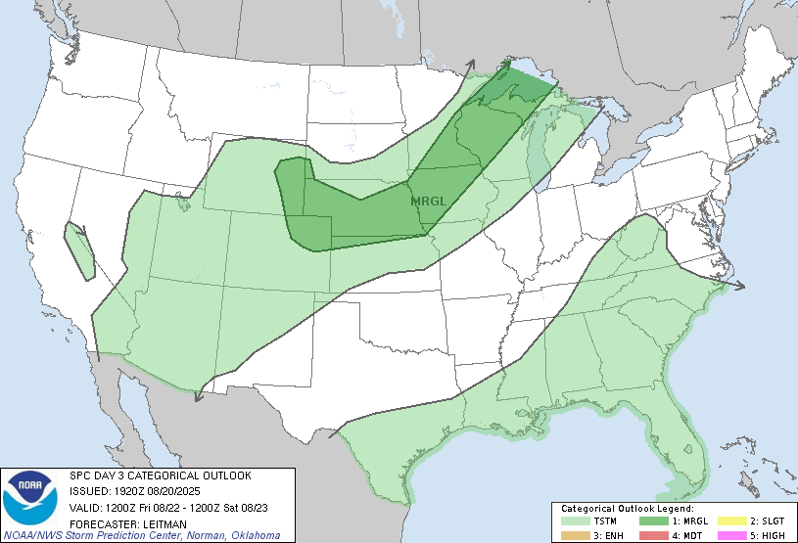
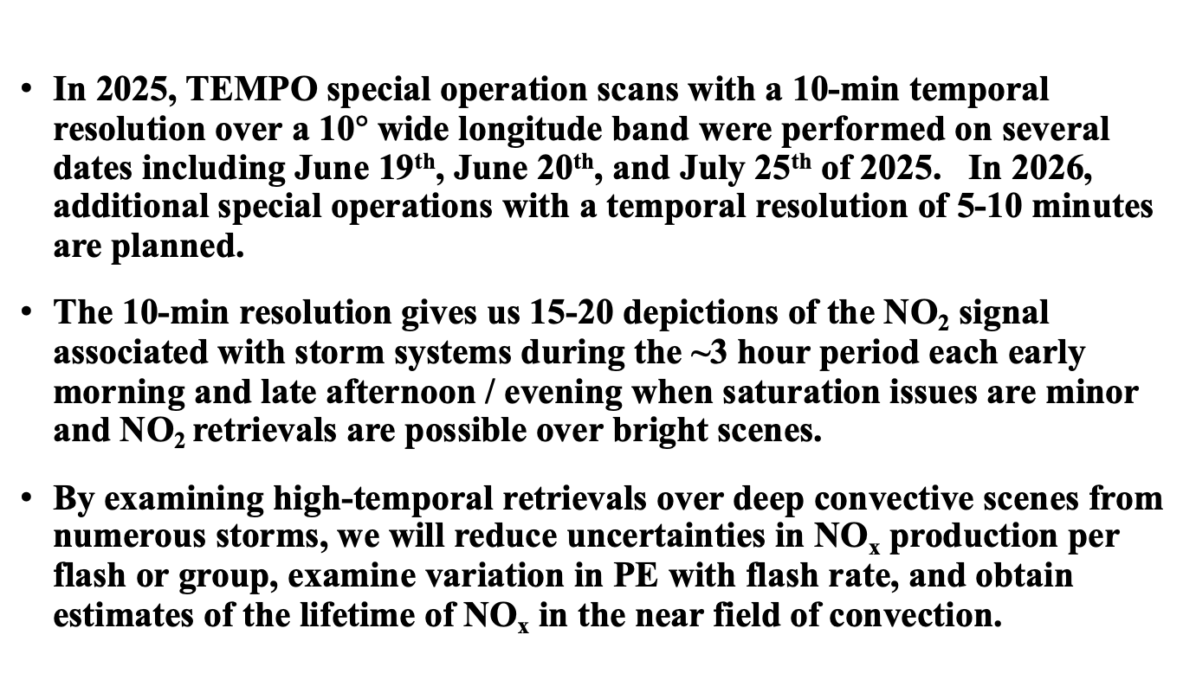

TEMPO High-Resolution Lagrangian
Lightning NO_{x} (LNO_{x}) Experiments
In 2025, TEMPO special operation scans with a 10-min temporal resolution over a 10$°$ wide longitude band were performed on several dates including June 19th, June 20th, and July 25th of 2025. In 2026, additional special operations with a temporal resolution of 5-10 minutes are planned.
The 10-min resolution gives us 15-20 depictions of the NO₂ signal associated with storm systems during the ~3 hour period each early morning and late afternoon / evening when saturation issues are minor and NO₂ retrievals are possible over bright scenes.
By examining high-temporal retrievals over deep convective scenes from numerous storms, we will reduce uncertainties in NO_{x} production per flash or group, examine variation in PE with flash rate, and obtain estimates of the lifetime of NO_{x} in the near field of convection.
Medium-range forecasts such as the SPC convective outlooks were useful in
determining the dates of the special operations.
$$°$$

Slide 9
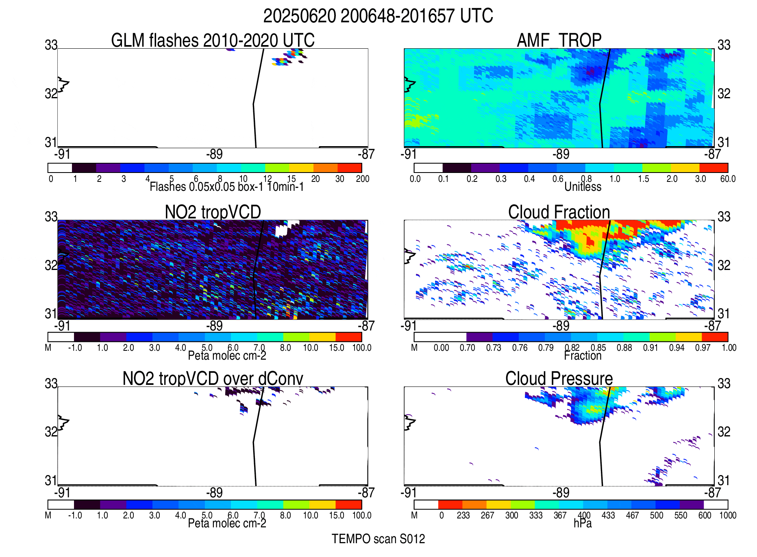
Animation of June 20, 2025 convective
system. The 10-min resolution allows
for 16 estimates of the flash rate from
17 scans and reduces uncertainties
caused by advection, the lifetime of
NO_{x} in the near field of convection.

