Slide 1


TEMPO NO₂ Observations of a Brushfire-Influenced High-Ozone Event in Austin, Texas
Iyare Oseghae¹, Alberto M. Mestas-Nuñez¹, Paul Walter², Chloe Roque², Nicolas Talavera², Josiah Guajardo², James H. Flynn III³.
¹University of Texas at San Antonio, San Antonio, Texas; ²St. Edward’s University, Austin, Texas
³University of Houston, Houston, Texas
October 10, 2024 was Austin's highest ozone day of the year.
TEMPO DART Meeting, Iowa City, IA, 15-18 June 2026

Slide 2
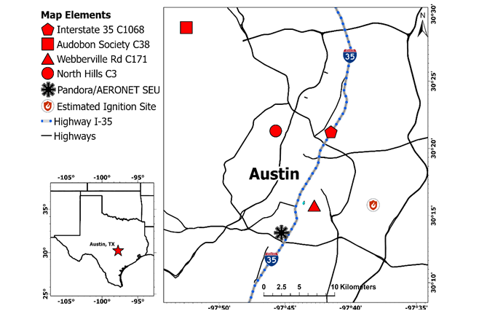
Motivation and Study Area
Austin exceeded the ozone standard.
Small brushfire ignited in East Austin.
Did the afternoon brushfire contribute?
What can TEMPO reveal?

Slide 3
Multi-platform observations
Datasets:
TEMPO NO₂/HCHO
Pandora
AERONET
TCEQ monitors
Ozonesonde
HYSPLIT
We combined surface, column, vertical-profile, and satellite observations to reconstruct the event.

Slide 4
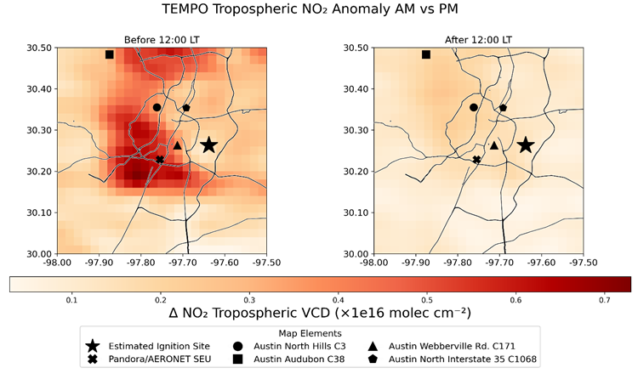
TEMPO NO₂ anomalies for October 10, 2024

Slide 5
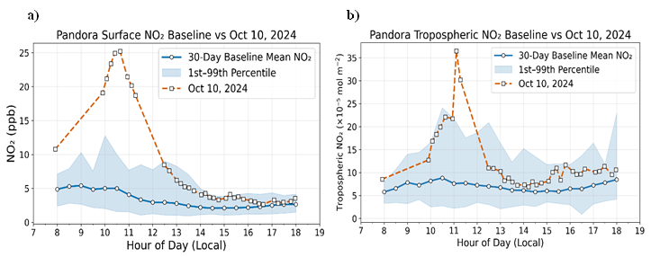
Pandora Observations
Surface
Tropospheric
Pandora observations show elevated morning NO₂ before brushfire ignition, consistent with TEMPO observation.

Slide 6
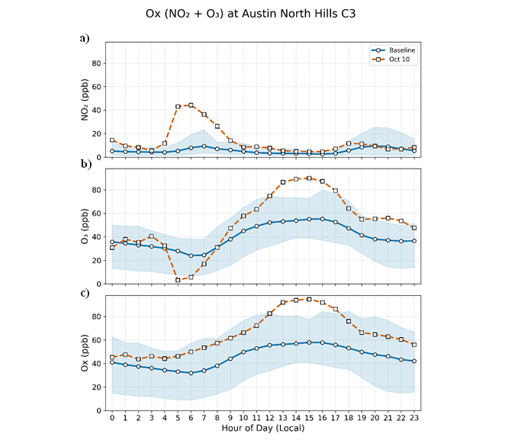
The atmosphere was already primed for O₃ before fire started
Surface monitoring data high morning NO₂ also agrees with TEMPO and Pandora observations

Slide 7
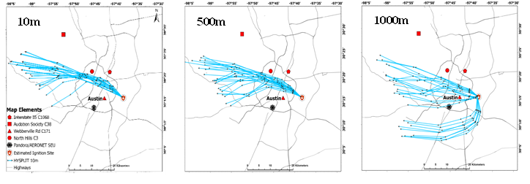
Meteorology and plume transport
Weak winds favored pollutant accumulation and transport of brushfire emissions across Austin.

Slide 8
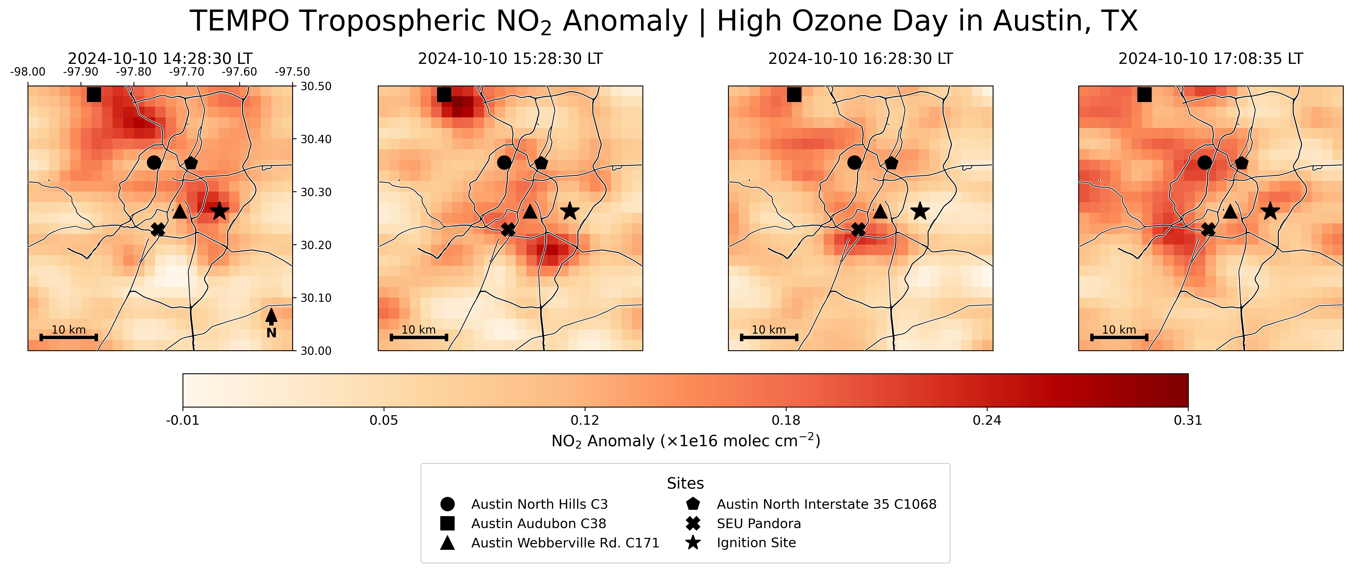
TEMPO plume evolution sequence
TEMPO anomalies reveal evolving NO₂ enhancements during the event.

Slide 9
Conclusions:
Austin's highest ozone day of 2024 occurred under:
  elevated NO₂
  enhanced HCHO
  weak winds and stagnant condition
  strong sunlight
The brushfire likely intensified, but did not initiate, the ozone event.
TEMPO Contribution:
TEMPO's hourly NO₂ observations provided critical spatial and temporal context for tracking the plume and interpreting the event.

