Slide 1



Informing Monitoring Strategies for Ozone and PM_{2.5} using
TEMPO HCHO
Prajjwal Rawat¹*, James H. Crawford¹, Katherine R. Travis (katherine.travis@nasa.gov)¹, Laura M. Judd¹, Mary Angelique G. Demetillo¹†, Tabitha C. Lee¹, James J. Szykman², Thomas F. Hanisco³, Gonzalo Gonzalez Abad⁴, Angela F. Dickens⁵, Zac Adelman⁵
¹NASA Langley Research Center, ²Environmental Protection Agency, ³NASA Goddard Space Flight Center, ⁴Center for Astrophysics | Harvard & Smithsonian, ⁵Lake Michigan Air Directors Consortium, *now at: Hampton University †now at: University of Southern California

Slide 2

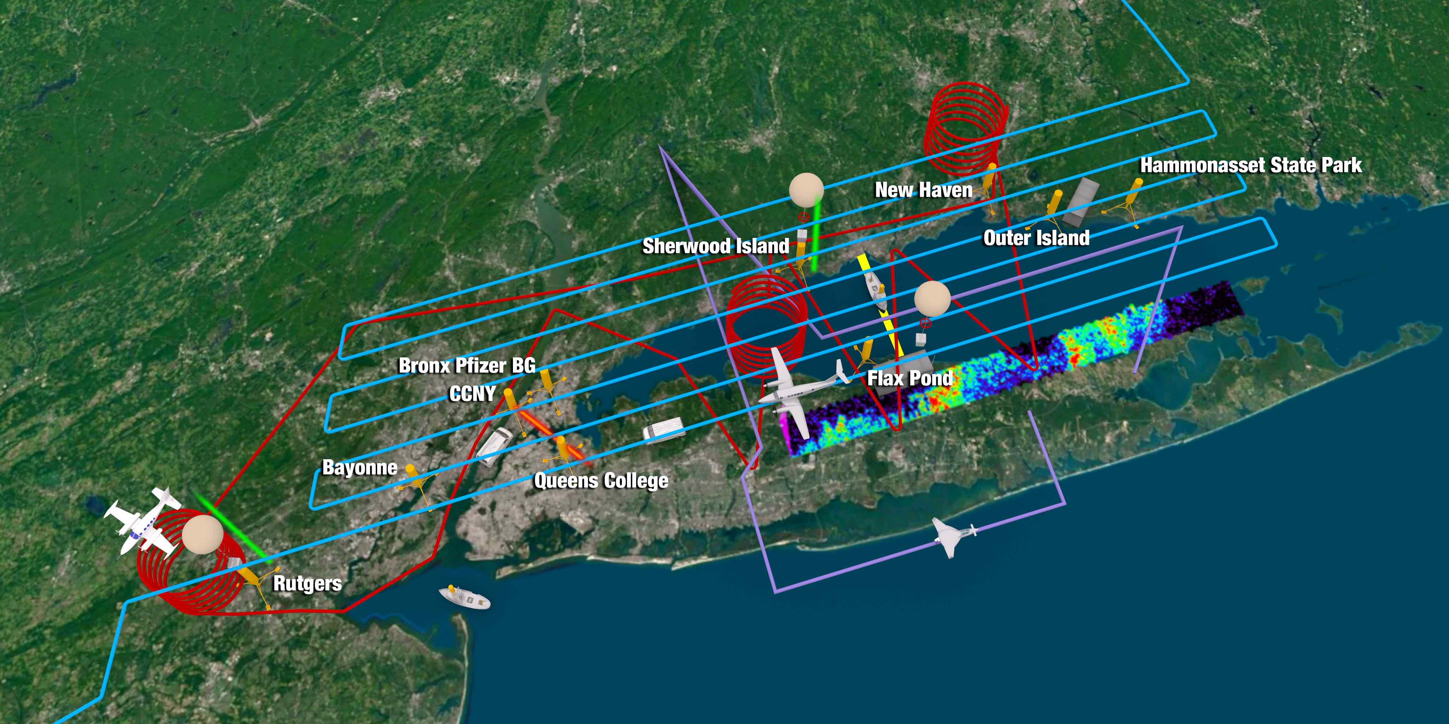
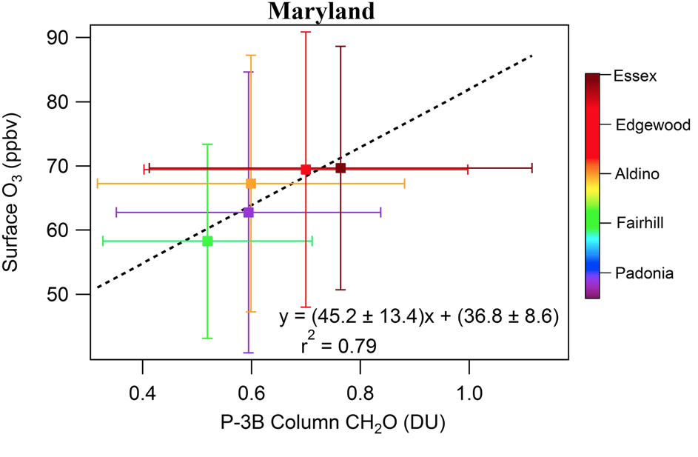
Observing surface ozone from space is challenging
Evidence of column (Ω) HCHO correlation with surface ozone during field campaigns
(Schoeder et al. (2016): doi:10.1002/2016JD025419) and LISTOS (Travis et al. (2022): doi:10.1029/2022JD036638)
Aircraft in situ
GCAS remote sensing
Motivates exploring the use of ΩHCHO to identify areas of unhealthy surface ozone in polluted regions to identify gaps in air quality monitoring efforts.
Notes:
hindered a combination of poor retrieval sensitivity and the largest signal being in the stratosphere
1.
HCHO and ozone are co-produced through the photochemical oxidation of volatile organic compounds (VOCs) in the presence of NO_{x}. The short lifetime of HCHO (several hours) results in a close correlation between the column amount and surface photochemistry.
2. Surface ozone continues to exceed recommended air quality standards created to protect human health and the environment in many regions of the world (Cooper et al., 2014; Gaudel et al., 2018).
3. Monitoring ozone levels to assess exposure and inform efforts to adhere to these standards is challenged by sparse surface networks and limited sensitivity of satellite sensors to the lower troposphere (Costantino et al., 2017; Gonzalez Abad et al., 2019).
4. The use of satellite information to inform ozone air quality has largely been confined to observations of ozone precursors such as nitrogen dioxide (NO₂) and formaldehyde (HCHO). Tonnesen and Dennis (2000) first proposed that in-situ HCHO/NO₂ was a useful metric for ground-level ozone sensitivity (NO_{x}- vs. VOC-limited), particularly when conditions were removed from the transition between those two regimes.
5. The ratio of column HCHO/NO₂ from satellite retrievals has been applied in a similar manner (Martin et al., 2004; Duncan et al., 2010; Jin & Holloway, 2015; Jin et al., 2020) but is subject to additional ambiguity due to differences in the vertical distribution of HCHO vs. NO₂ (Schroeder et al., 2017).

Slide 3
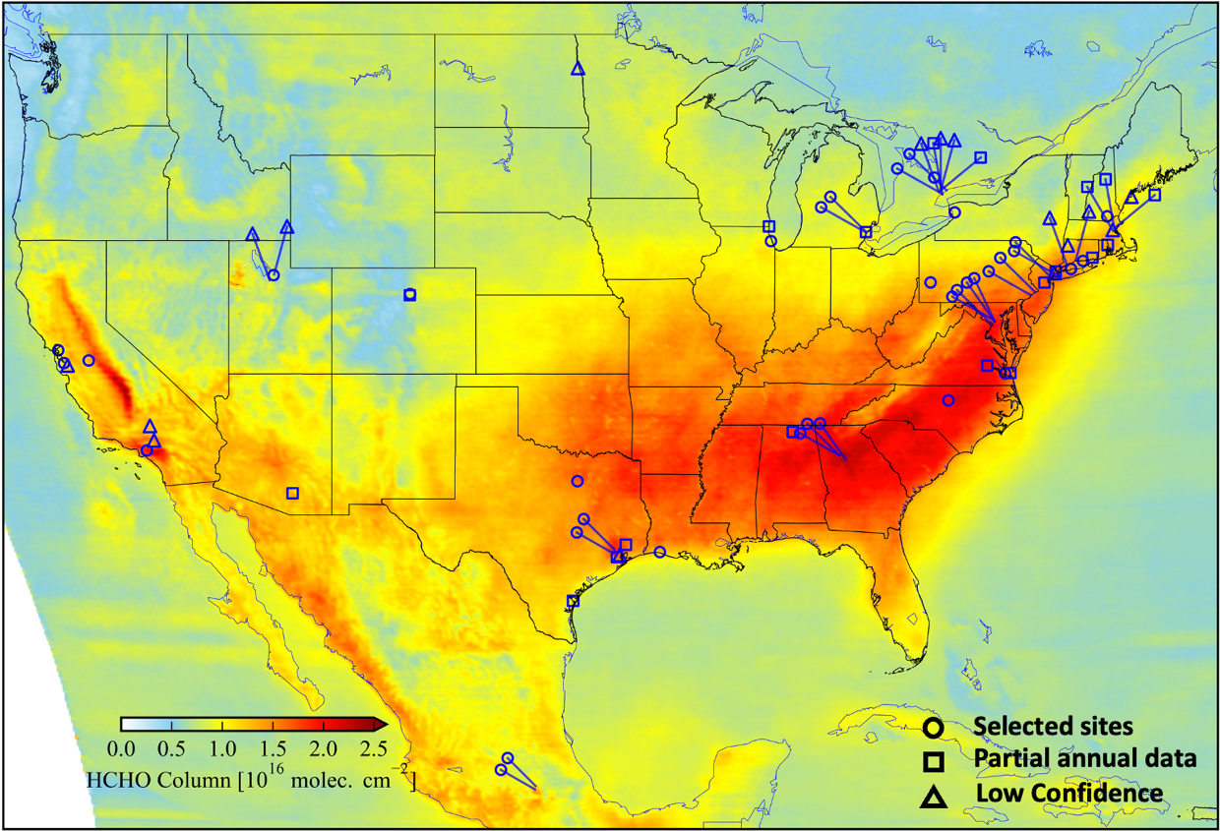
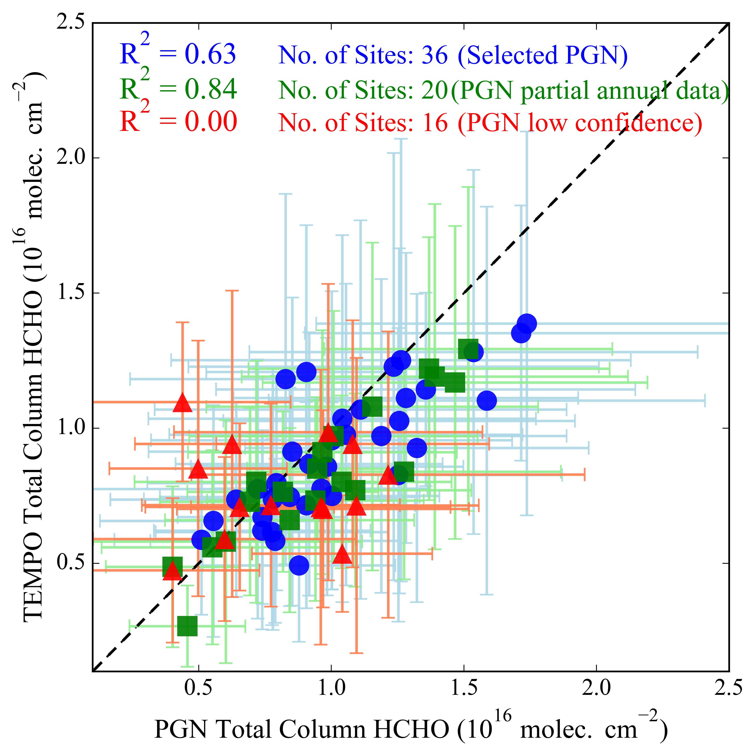

TEMPO HCHO shows excellent performance against Pandora observations
Rawat et al., 2026: 10.1029/2025JD044788

Slide 4
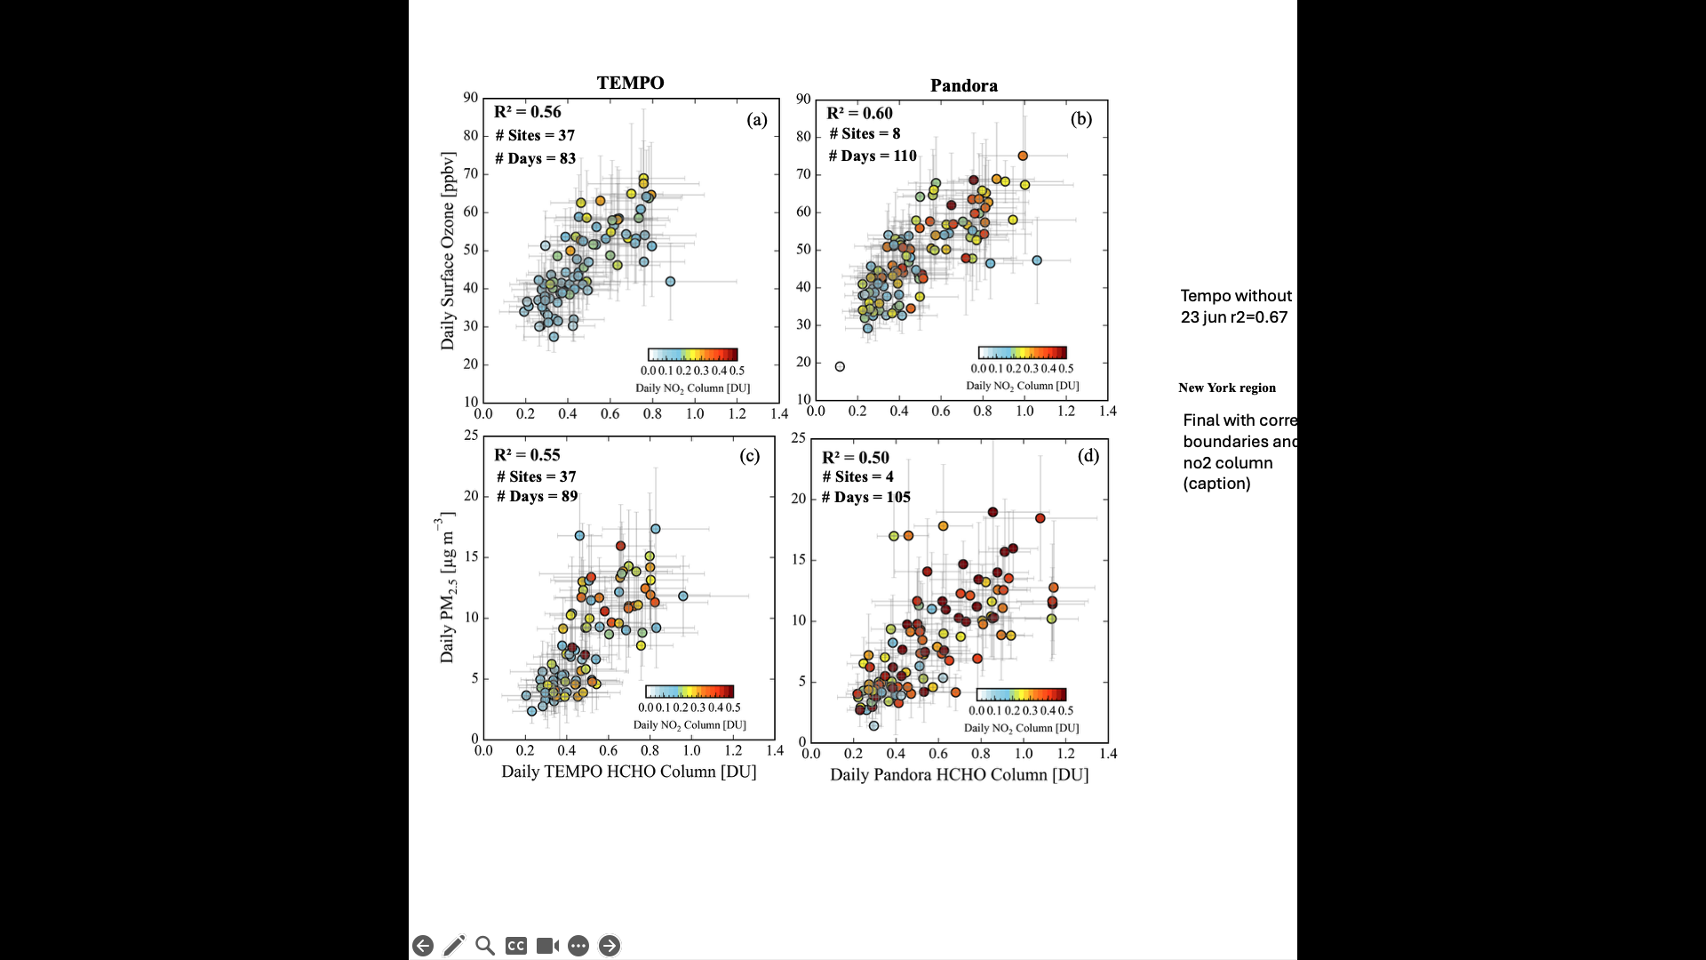
TEMPO performance compared against surface ozone is comparable to Pandora

Slide 5
PM_{2.5} performs similarly to ozone

Slide 6
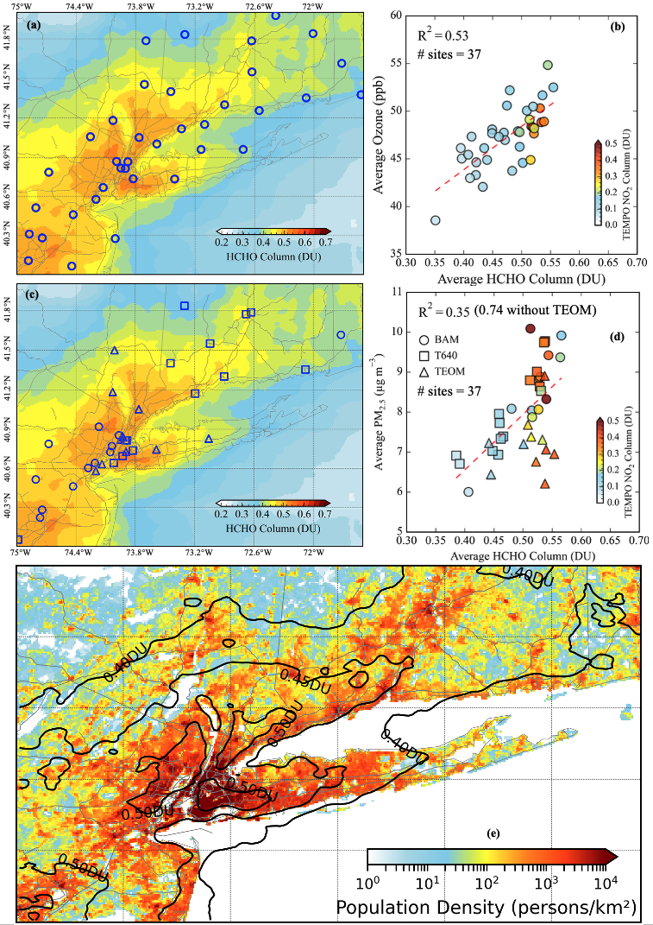
TEMPO HCHO correlates well with ozone across NY-NJ-CT and includes unmonitored areas to investigate
June–September 2024 (10:00–18:00 LT)
Notes:
Spatially oversampled map of TEMPO HCHO column over New-Jersey-New York-Connecticut for June–September 2024 (10:00–18:00 LT), overlaid with location of the surface ozone ground monitoring sites (n=37). (b) Spatial correlation between average surface ozone and TEMPO HCHO column. (c) Spatially oversampled map of TEMPO HCHO column overlaid with PM_{2.5} ground monitoring sites (n=37), with open symbol shapes denoting different measurement methods. (d) Spatial correlation between average PM_{2.5} and TEMPO HCHO column. (e) Population density across the study domain overlaid with TEMPO HCHO column contours at 0.05 DU intervals above 0.4 DU.

Slide 7
PM_{2.5} Performs Well (without TEOM Monitors)
June–September 2024 (10:00–18:00 LT)
June–September 2024 (10:00–18:00 LT)
Notes:
Spatially oversampled map of TEMPO HCHO column over New-Jersey-New York-Connecticut for June–September 2024 (10:00–18:00 LT), overlaid with location of the surface ozone ground monitoring sites (n=37). (b) Spatial correlation between average surface ozone and TEMPO HCHO column. (c) Spatially oversampled map of TEMPO HCHO column overlaid with PM_{2.5} ground monitoring sites (n=37), with open symbol shapes denoting different measurement methods. (d) Spatial correlation between average PM_{2.5} and TEMPO HCHO column. (e) Population density across the study domain overlaid with TEMPO HCHO column contours at 0.05 DU intervals above 0.4 DU.

Slide 8
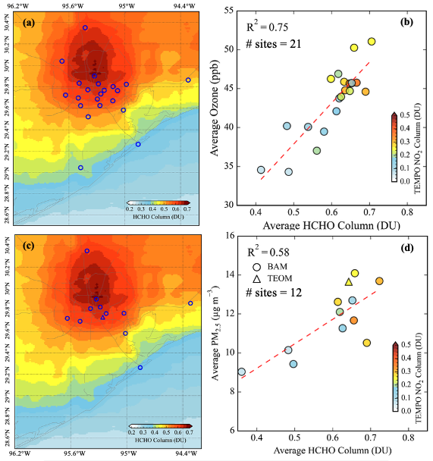
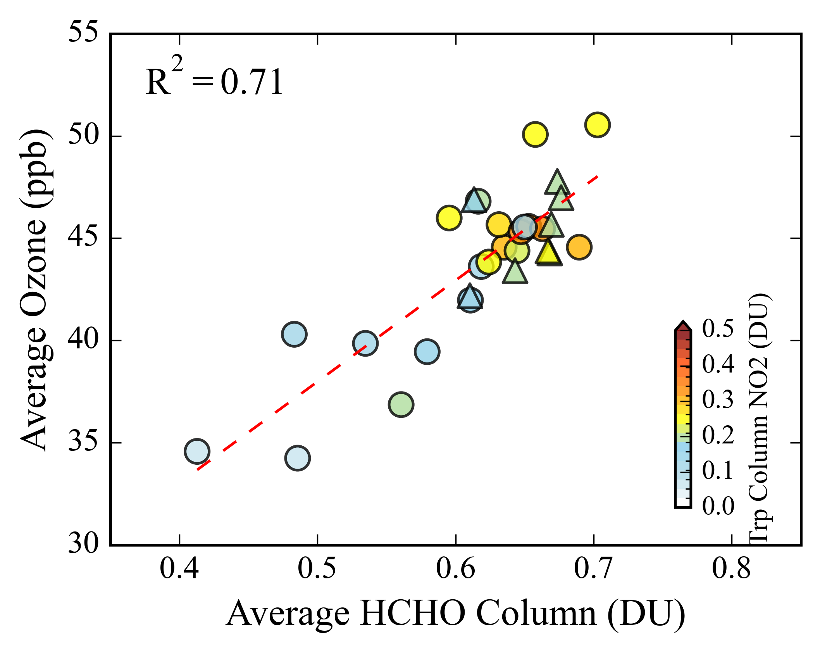
Houston shows a more distinct unmonitored hotspot
Local ozone monitors confirm elevated ozone in this hotspot

Slide 9
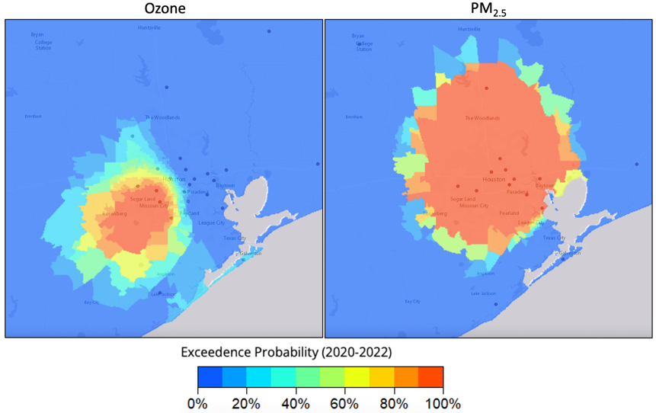
NetAssess2025 tool provided for monitoring assessment does not agree with TEMPO HCHO
https://rconnect-public.epa.gov/NetAssess2025/

Slide 10
Conclusions
TEMPO HCHO shows good correspondence with surface ozone and PM_{2.5} and highlights regions that merit further investigation.
TEMPO HCHO may be another tool for performing monitoring network assessments.
For a monitor cost of between $6,500 (small sensors) to $100,000 (FRM/FEM), TEMPO provides value of between $7 and $106 million to an additional ~1,000 high density areas (>50,000 people/km²) without a monitor.

