Slide 1
TEMPO Science and Applications
Shobha Kondragunta
Fangjun Li (SDSU)
Hai Zhang, Hongqing Liu, Pubu Ciren (STC at NOAA)
June 15-18, 2026 | TEMPO DART Workshop | University of Iowa
Disclaimer: The scientific results and conclusions, as well as any views or opinions expressed
herein, are those of the author(s) and do not necessarily reflect those of NOAA or
the Department of Commerce.

Slide 2
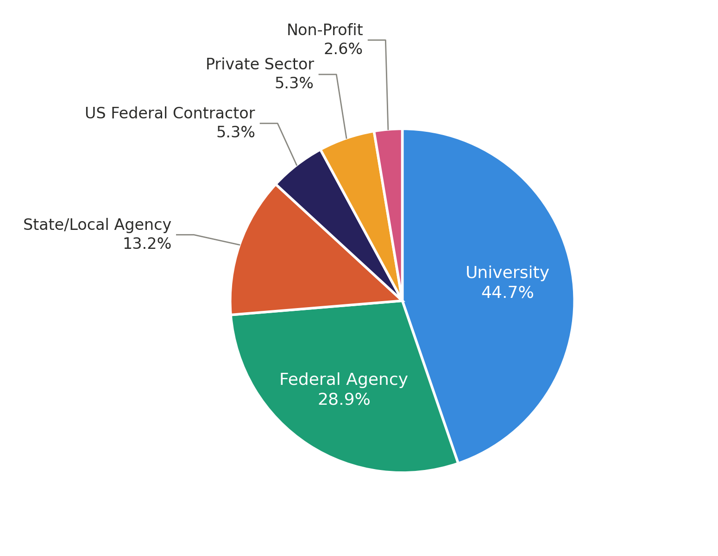
NOAA TEMPO Science Activities
Developing TEMPO aerosol algorithms for air quality monitoring and forecasting (presentation by Hai Zhang, Day 1).
Developing methods to update NOx emissions in operational air quality forecasting models (presentation by Daven Henze, Day 2; presentation by Zigang Wei, Day 4).
Stakeholder outreach and training via NOAA as well as via AIR4US (training by Amy Huff, Day 3).
Supporting TEMPO science related field campaigns (presentations by Brian McDonald and Han Huynh, Day 2).
Improvements to dust aerosol optical depth retrievals.
Novel use of TEMPO data in validation of fire emissions.
Thirty eight unique users testing NOAA TEMPO aerosol products
Aerosol algorithm papers published in TEMPO special issue:
Zhang et al., 2025, JGR-Atmospheres
Zhang et al., 2026, Earth and Space Science
Ciren et al., 2026, JGR-Atmospheres (under review)

Slide 3
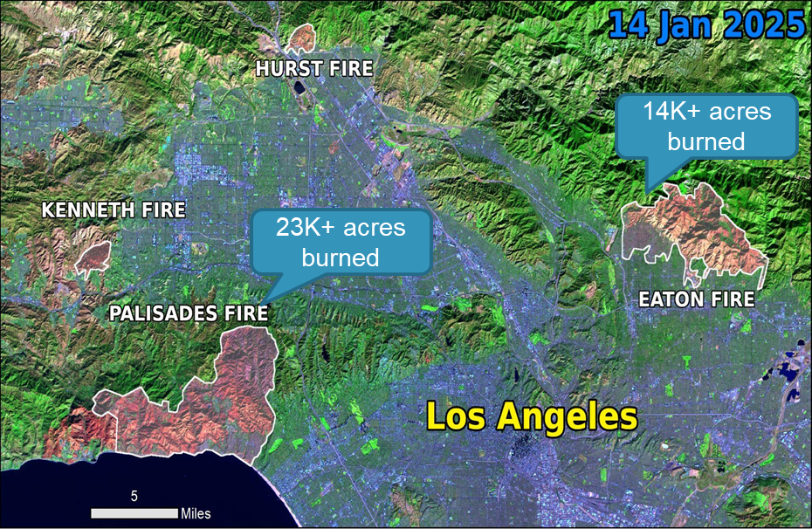
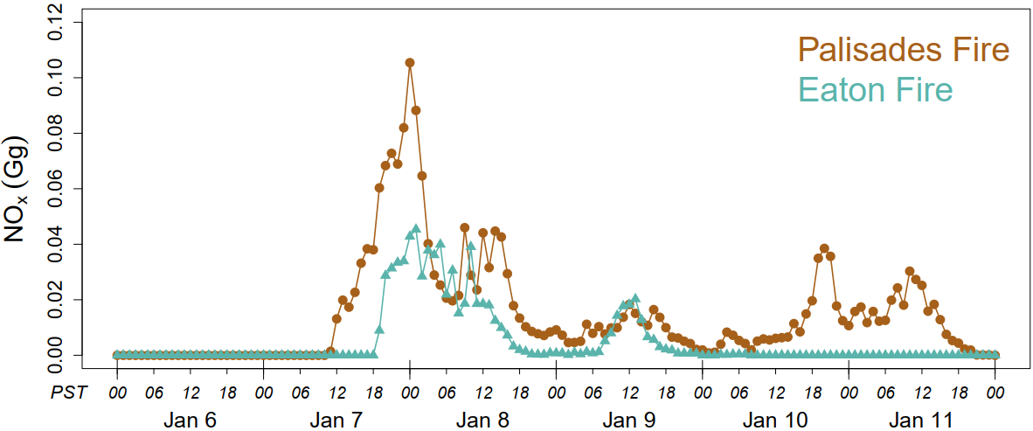
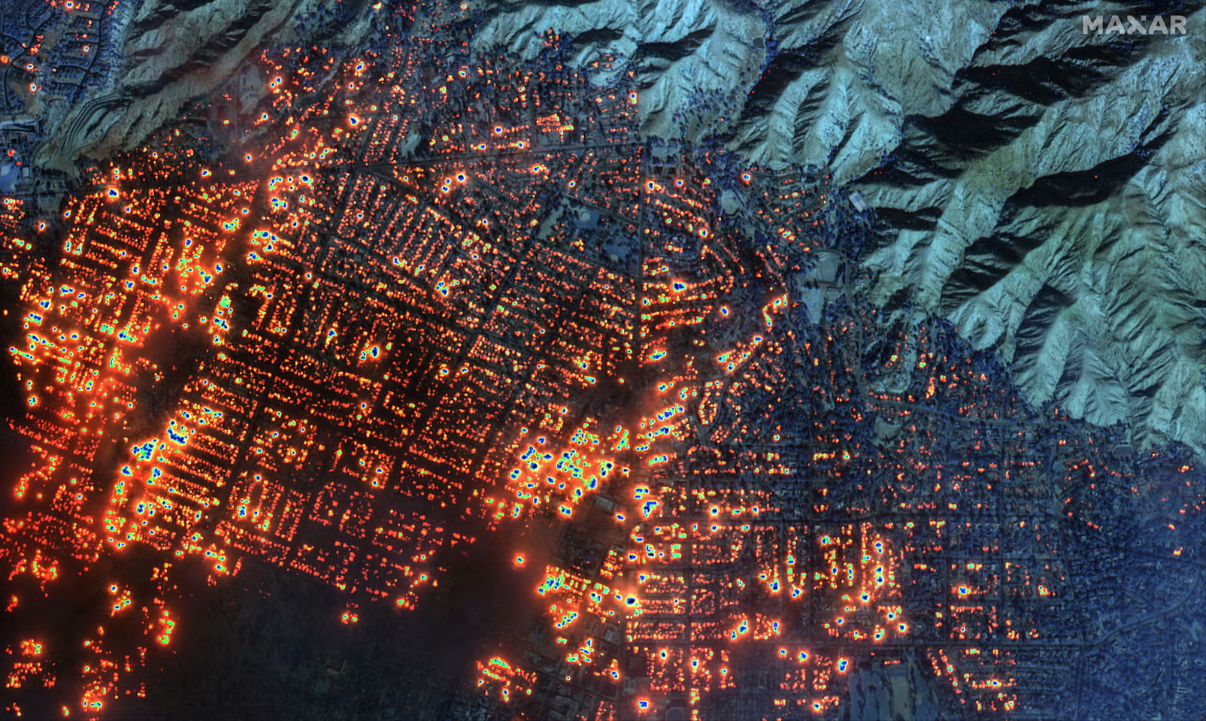
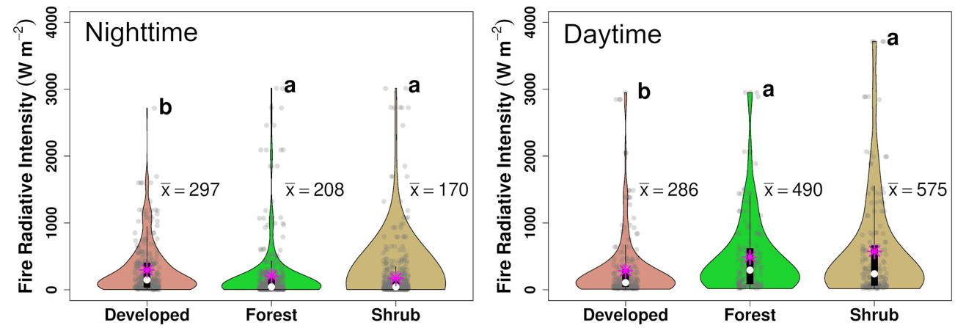

Slide 4
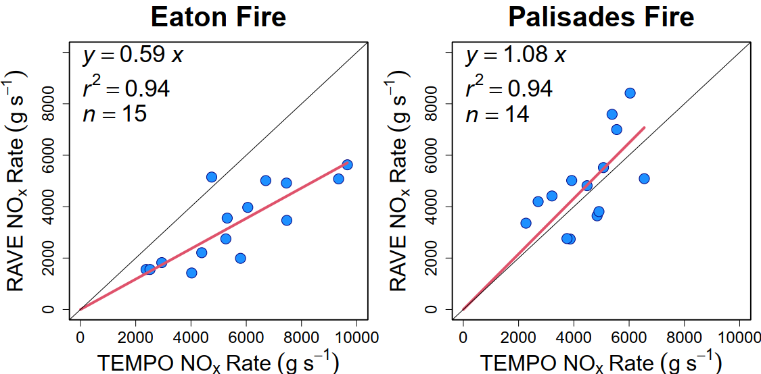
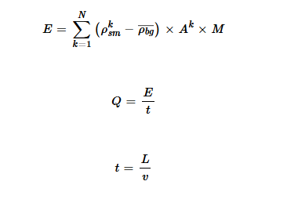
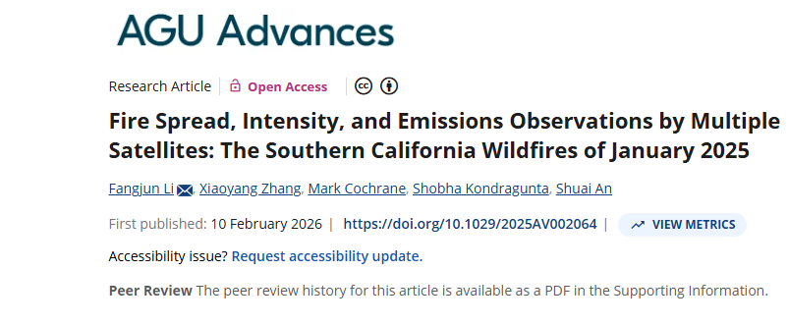
Sources of uncertainty in integrated mass approach to calculating emissions from TEMPO. But we also know that Eaton fire burned more structures than Palisades fire. In RAVE we treat pixels with structures as “vegetation fires” because we do not know what the emissions factors are for burning built structures.

Slide 5
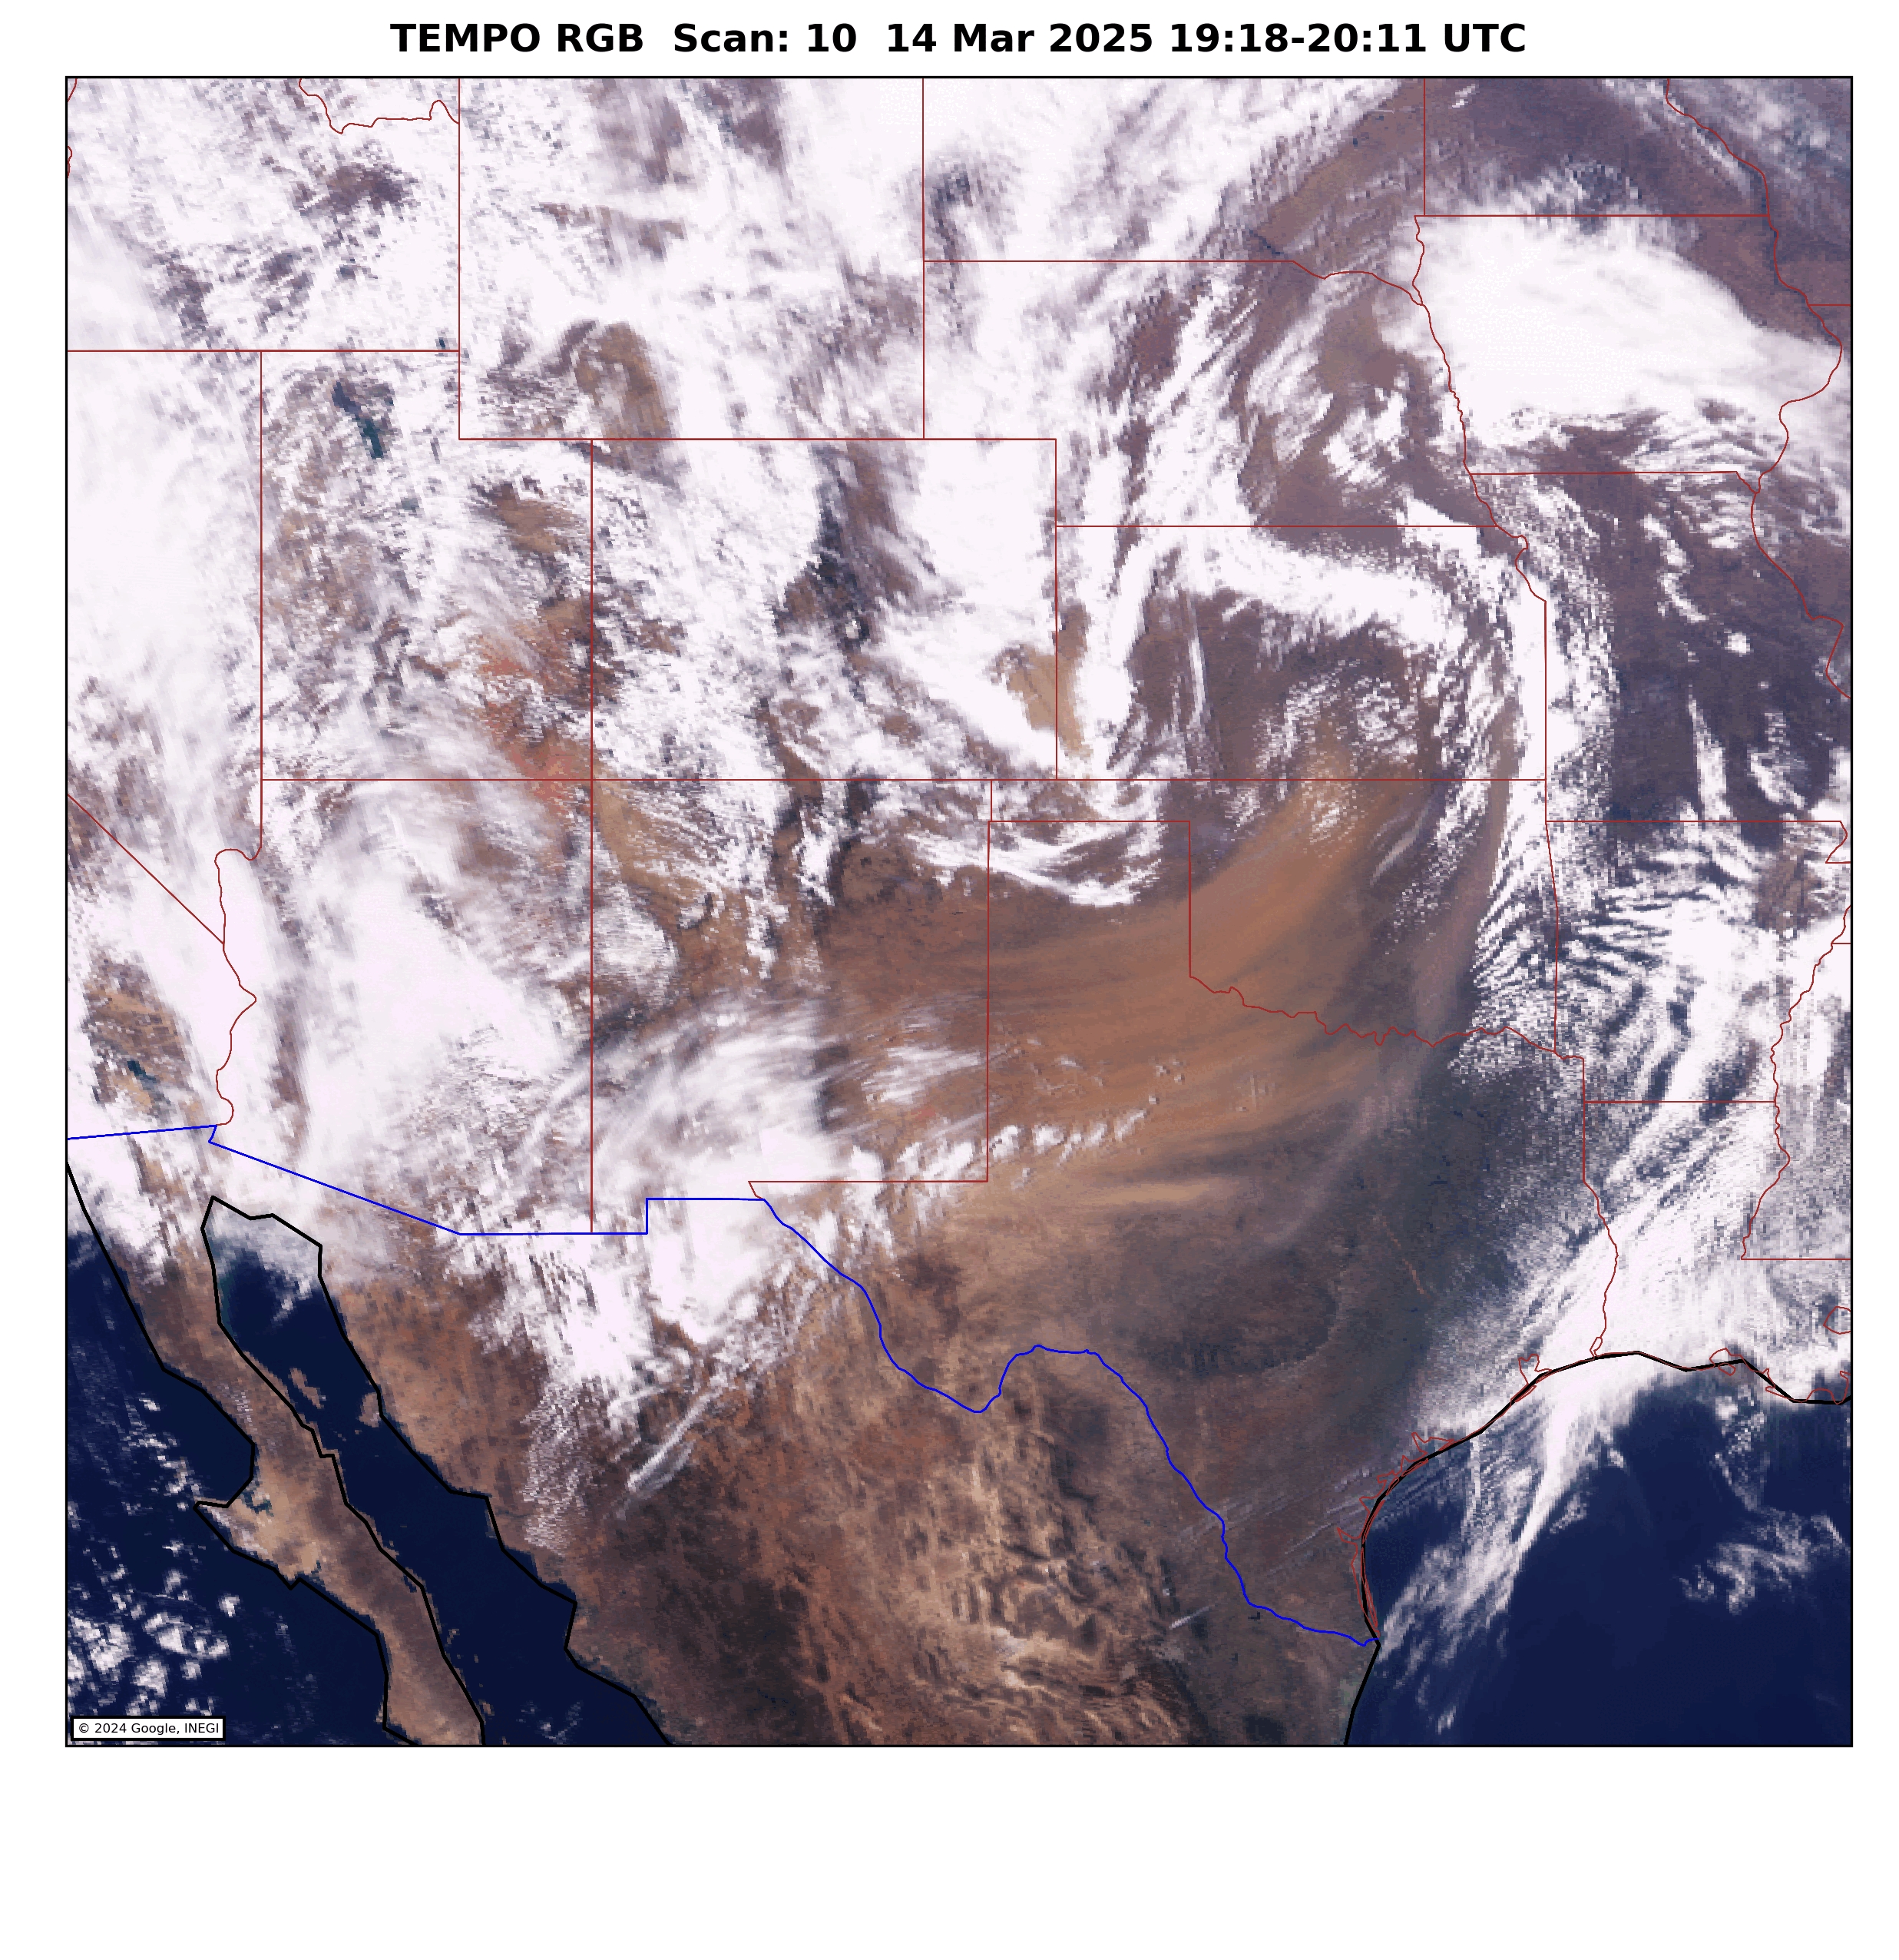
TEMPO Dust Retrievals

Slide 6
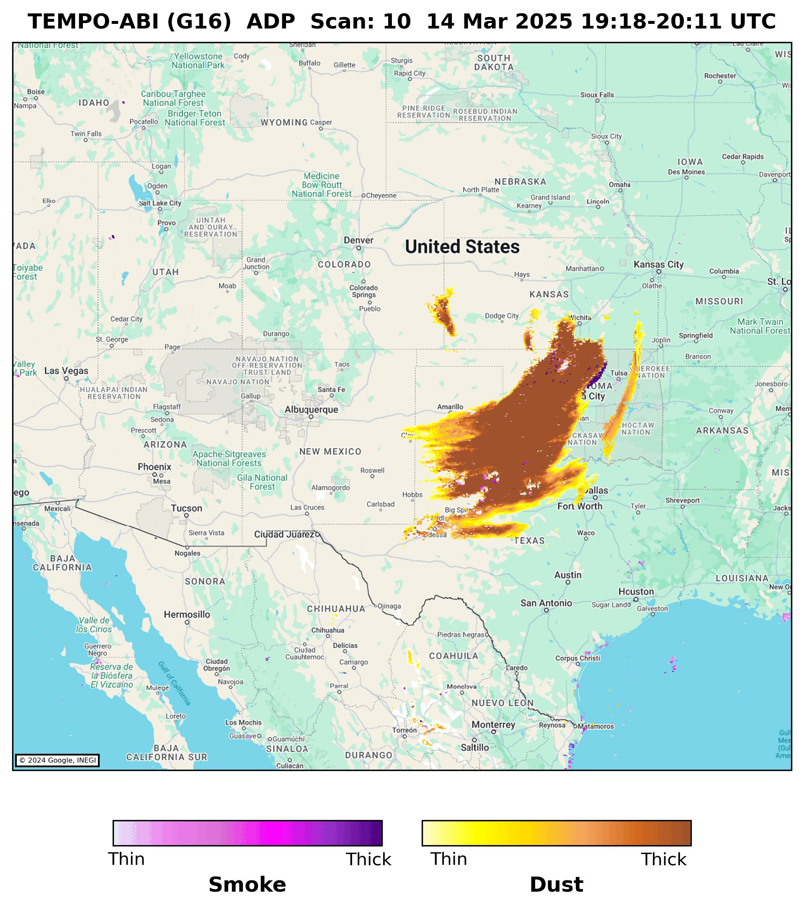
TEMPO Dust Retrievals

Slide 7
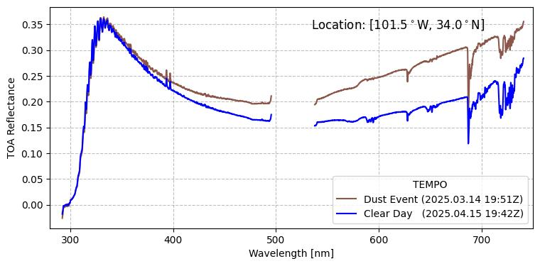
Dust appearing very red in the RGB imagery is indicative of high absorption in shorter visible wavelengths (blue) than longer visible wavelengths (red) as evident in this TEMPO spectra.

Slide 8
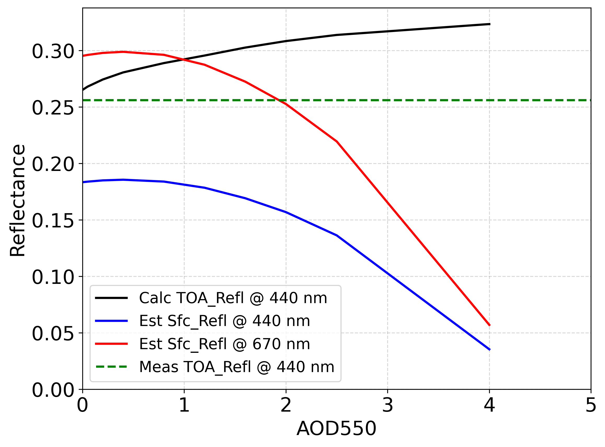
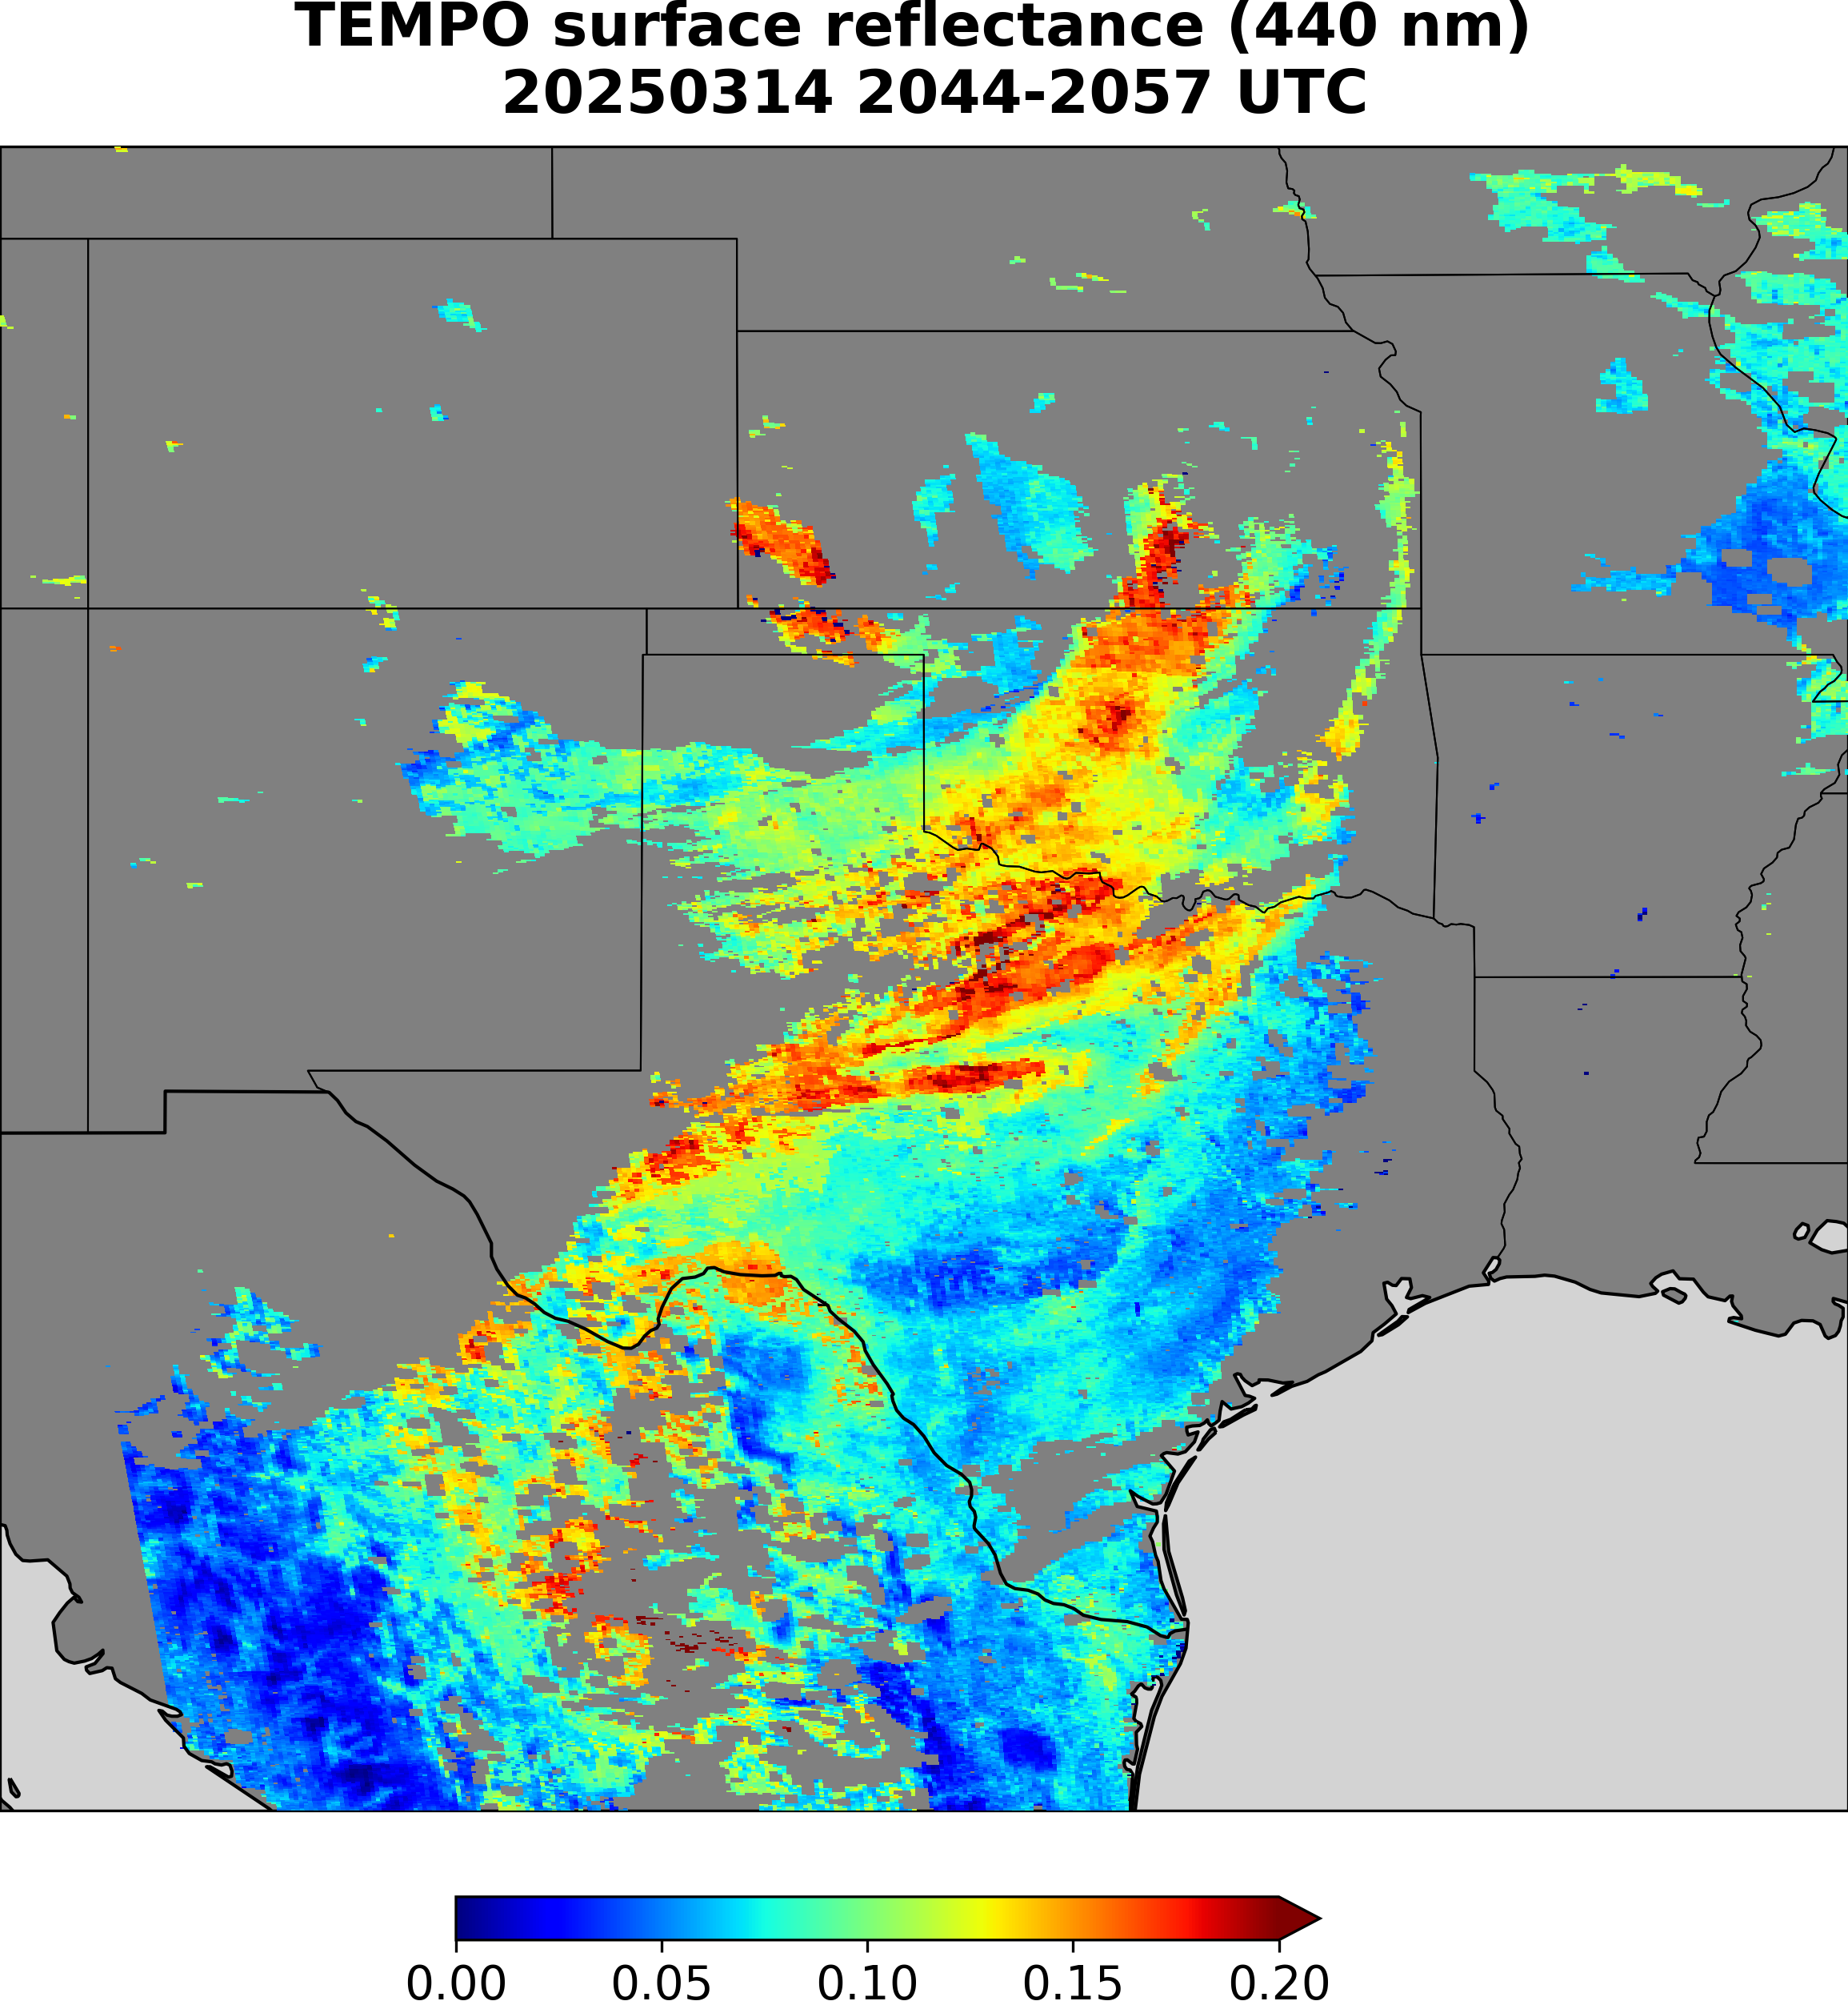
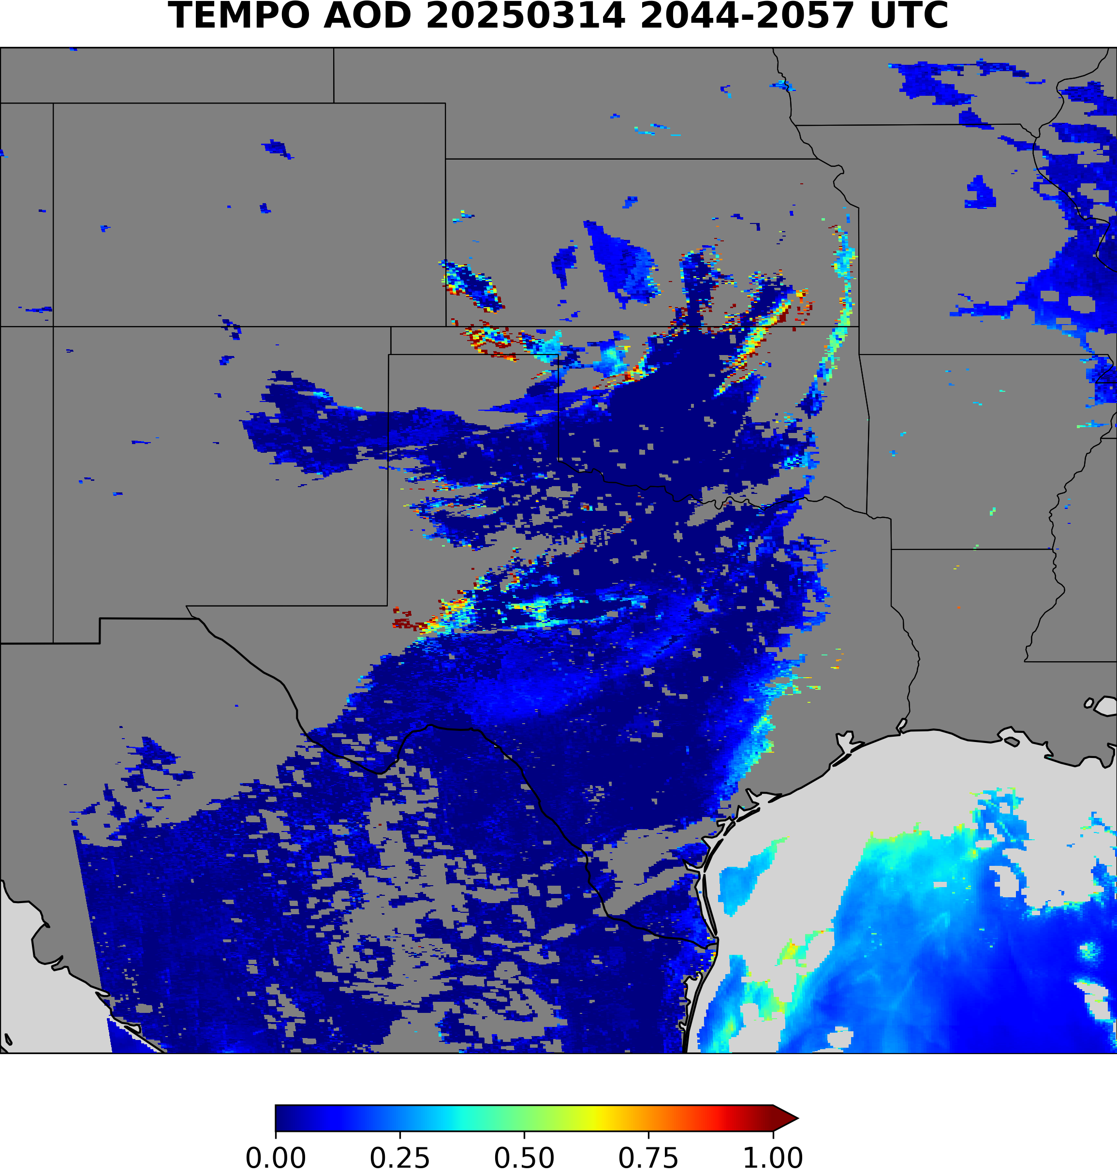
Dust aerosol model used in our LUT is not as absorbing as the dust in the US

Slide 9
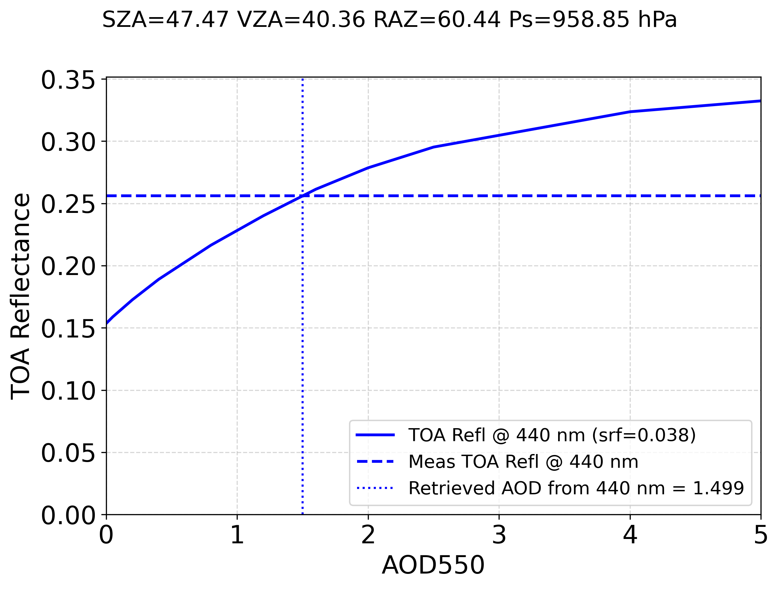
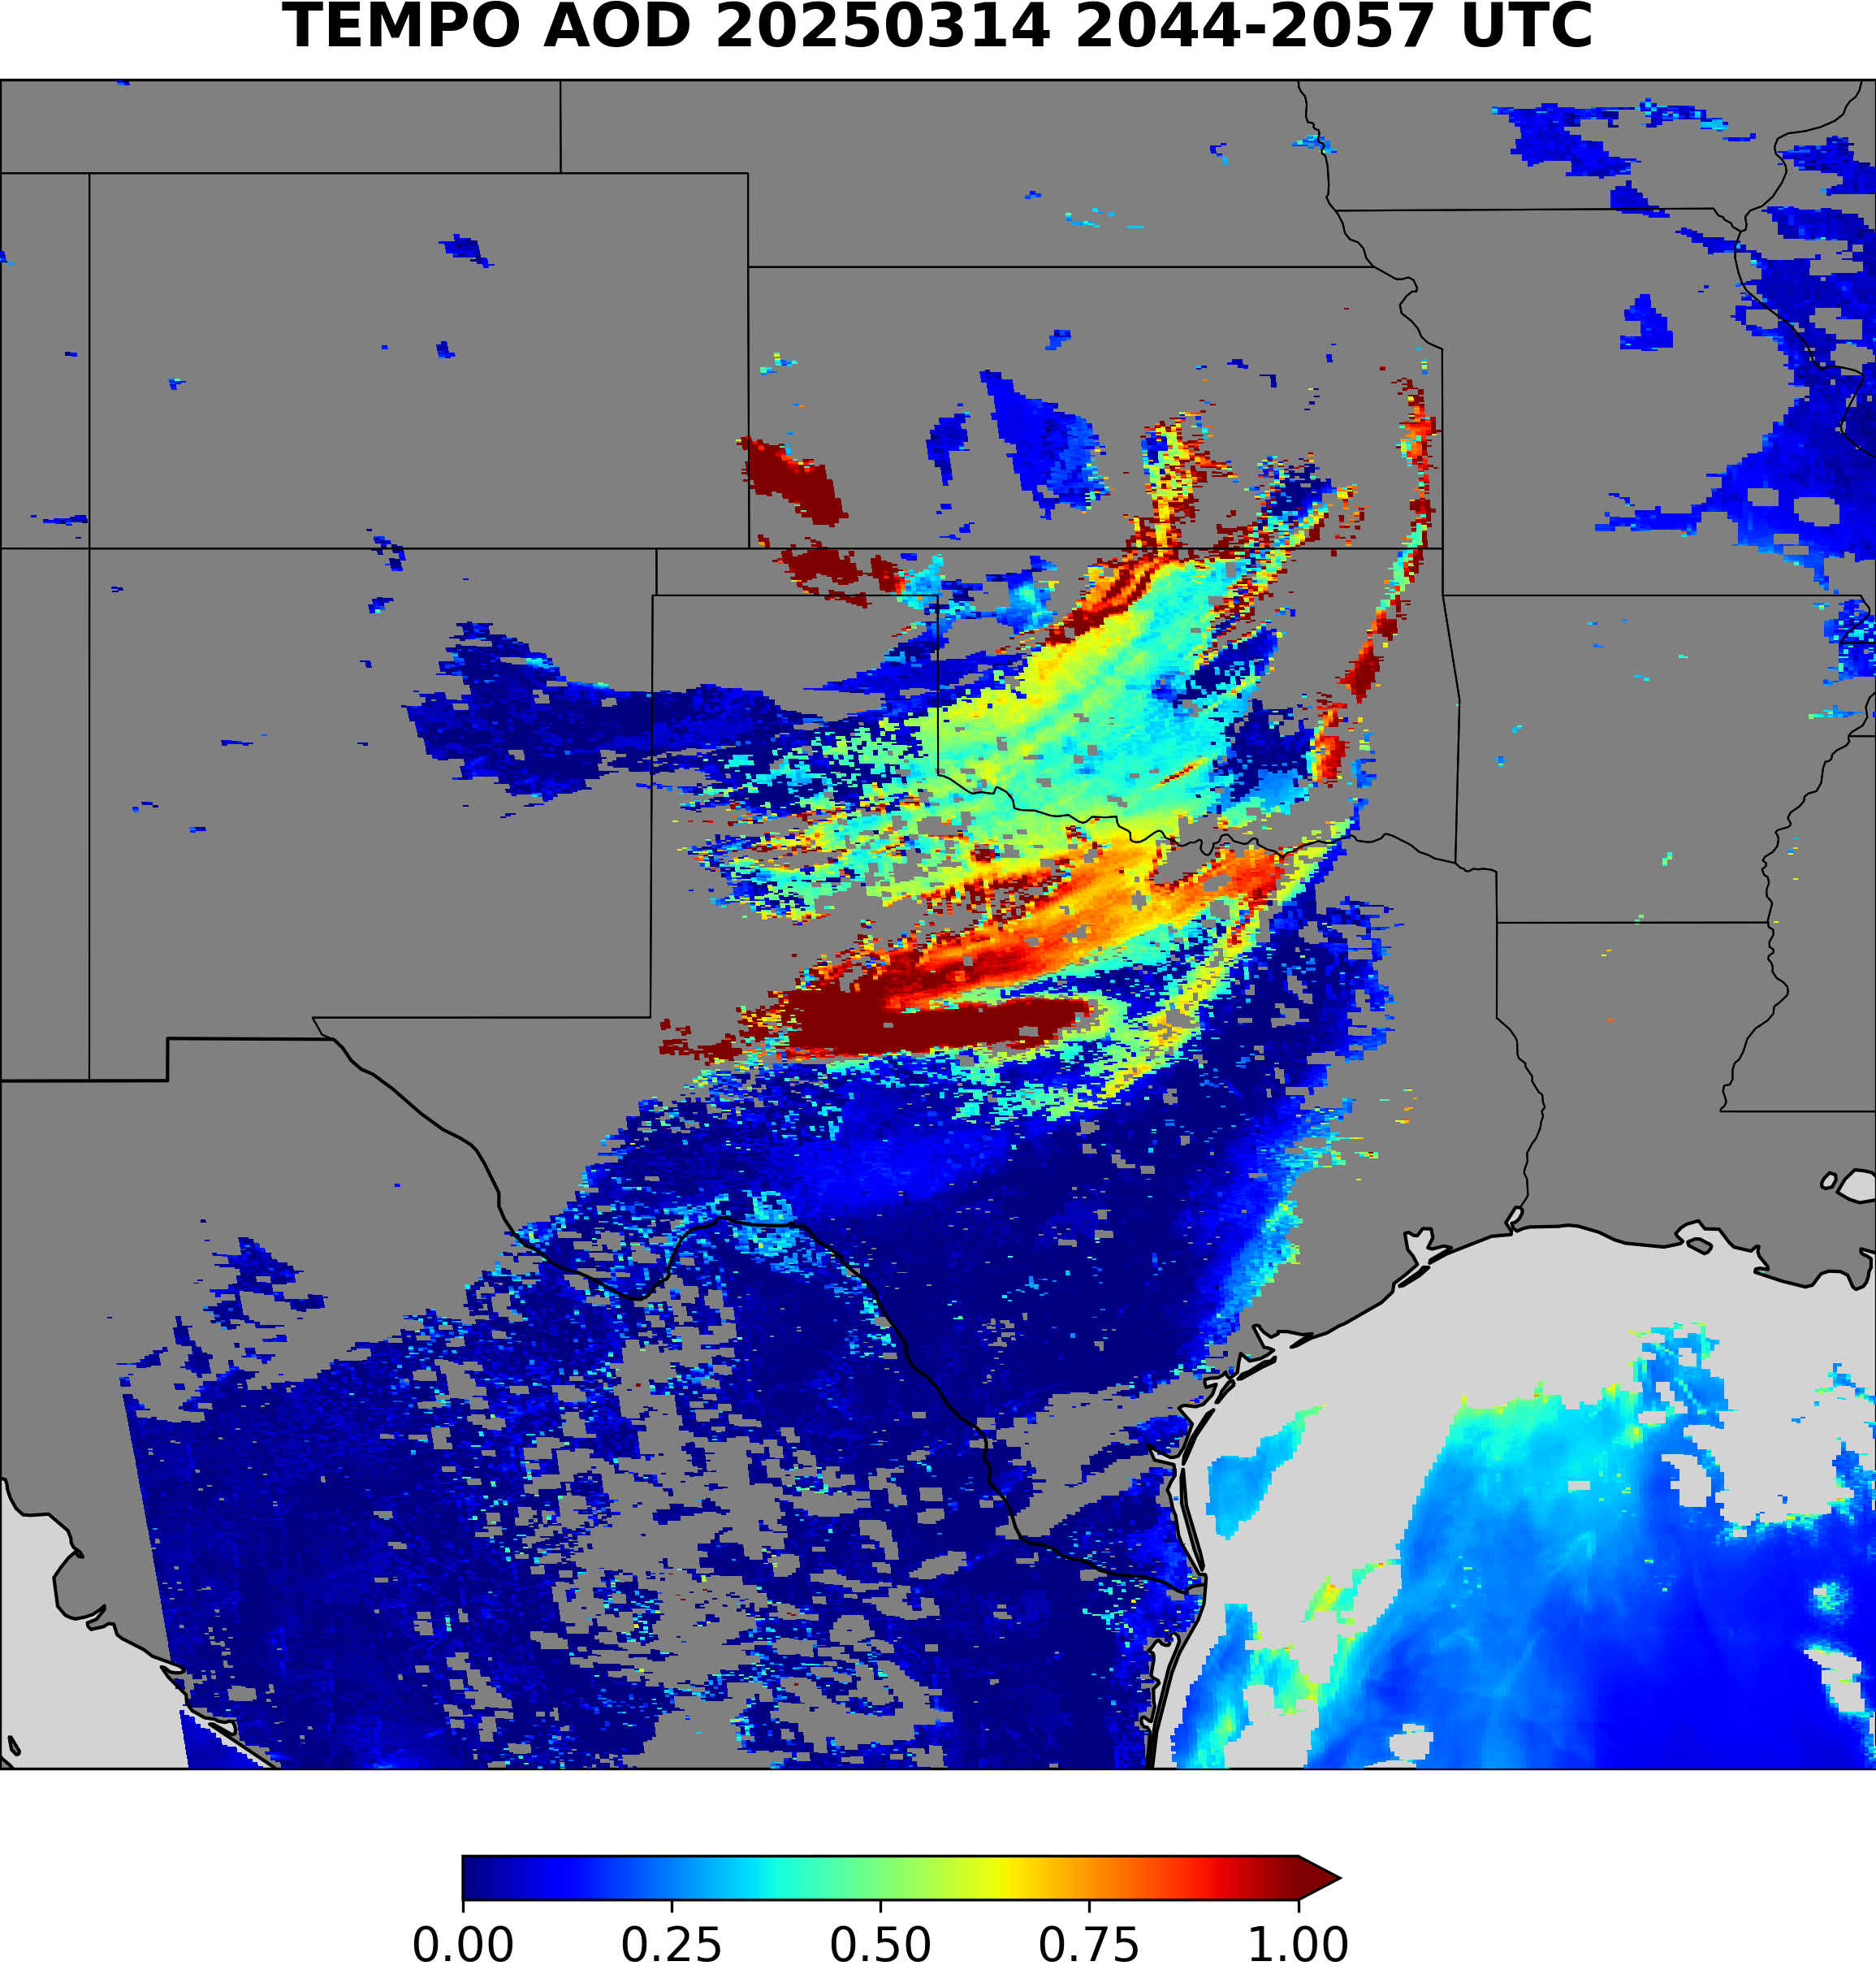
Prescribing the surface reflectance and using blue channel to retrieve AOD gives a better result.

Slide 10
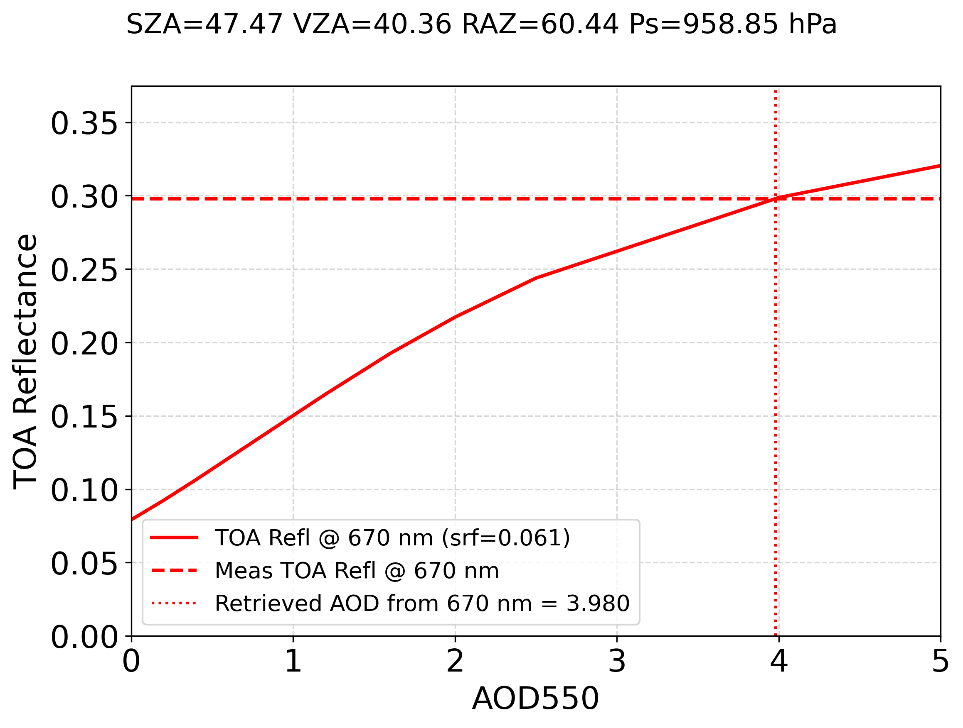
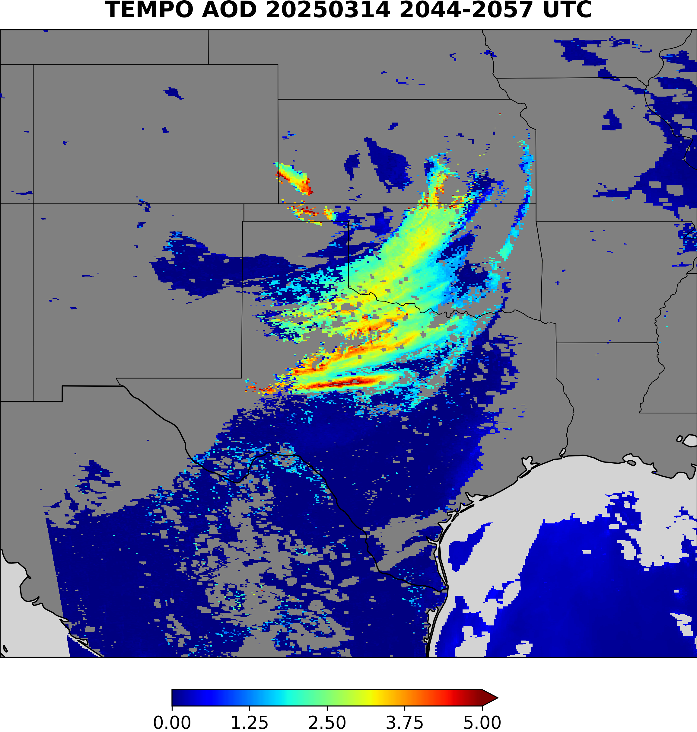
Prescribing the surface reflectance and using red channel to retrieve AOD gives a better result.

Slide 11
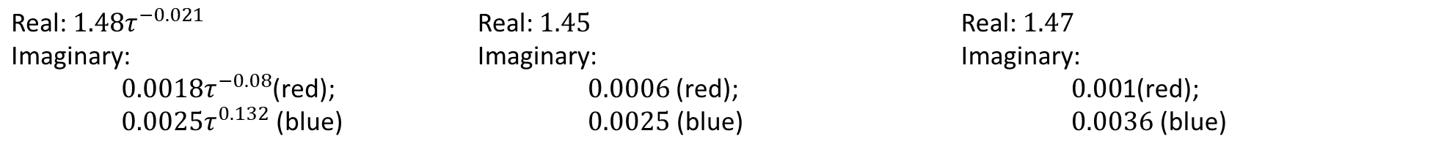
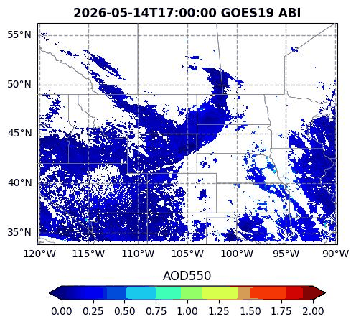


Next Steps for TEMPO: For dust plumes, force the algorithm to use surface reflectance from the DLER data base and the red channel to do AOD retrieval. Testing using GOES-19 ABI indicates that red channel is relatively insensitive to aerosol model assumptions.

