Slide 1
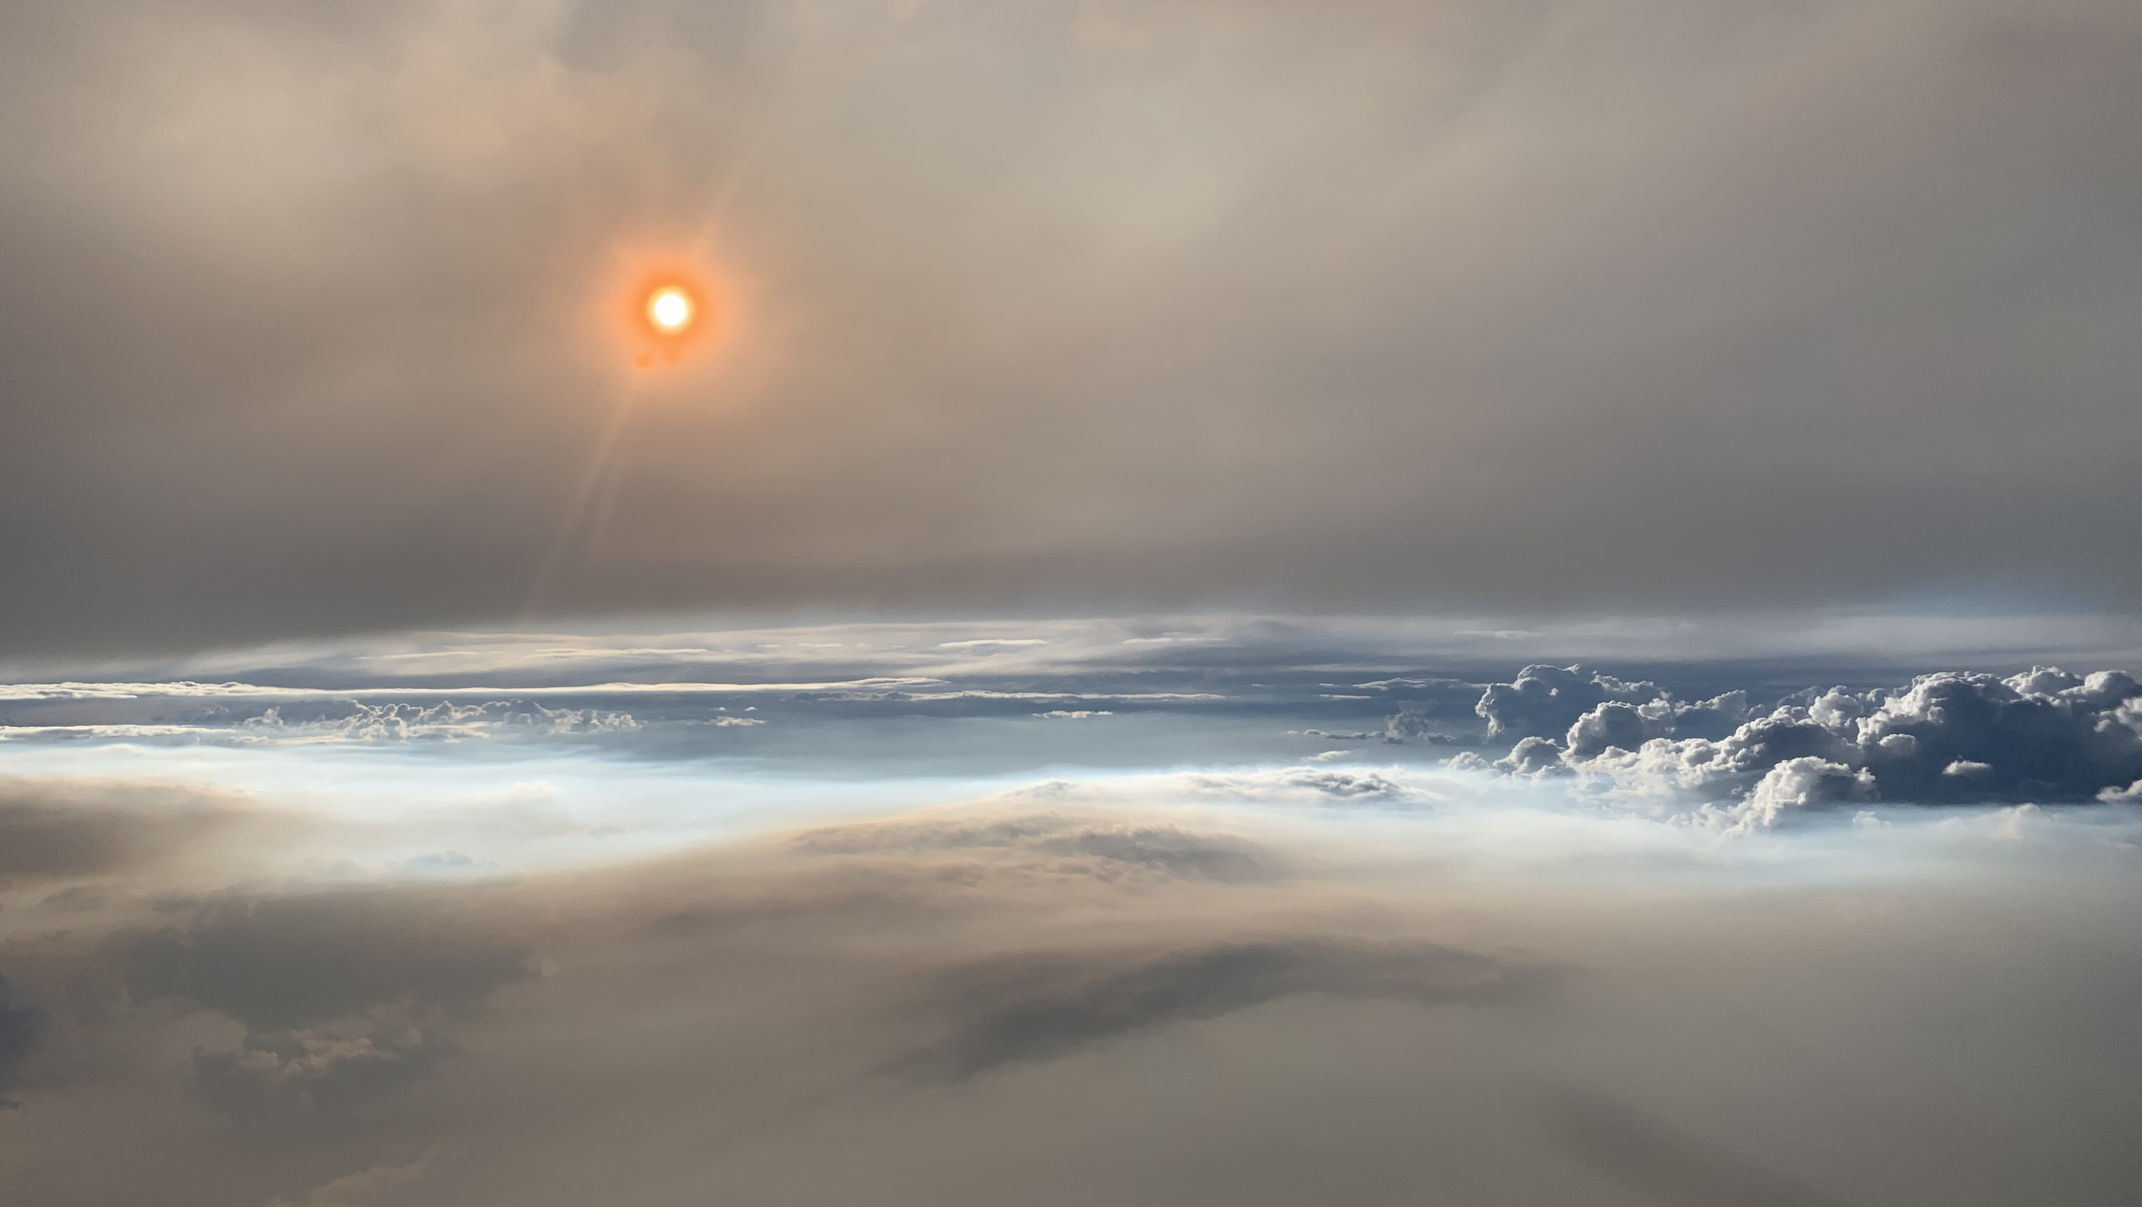
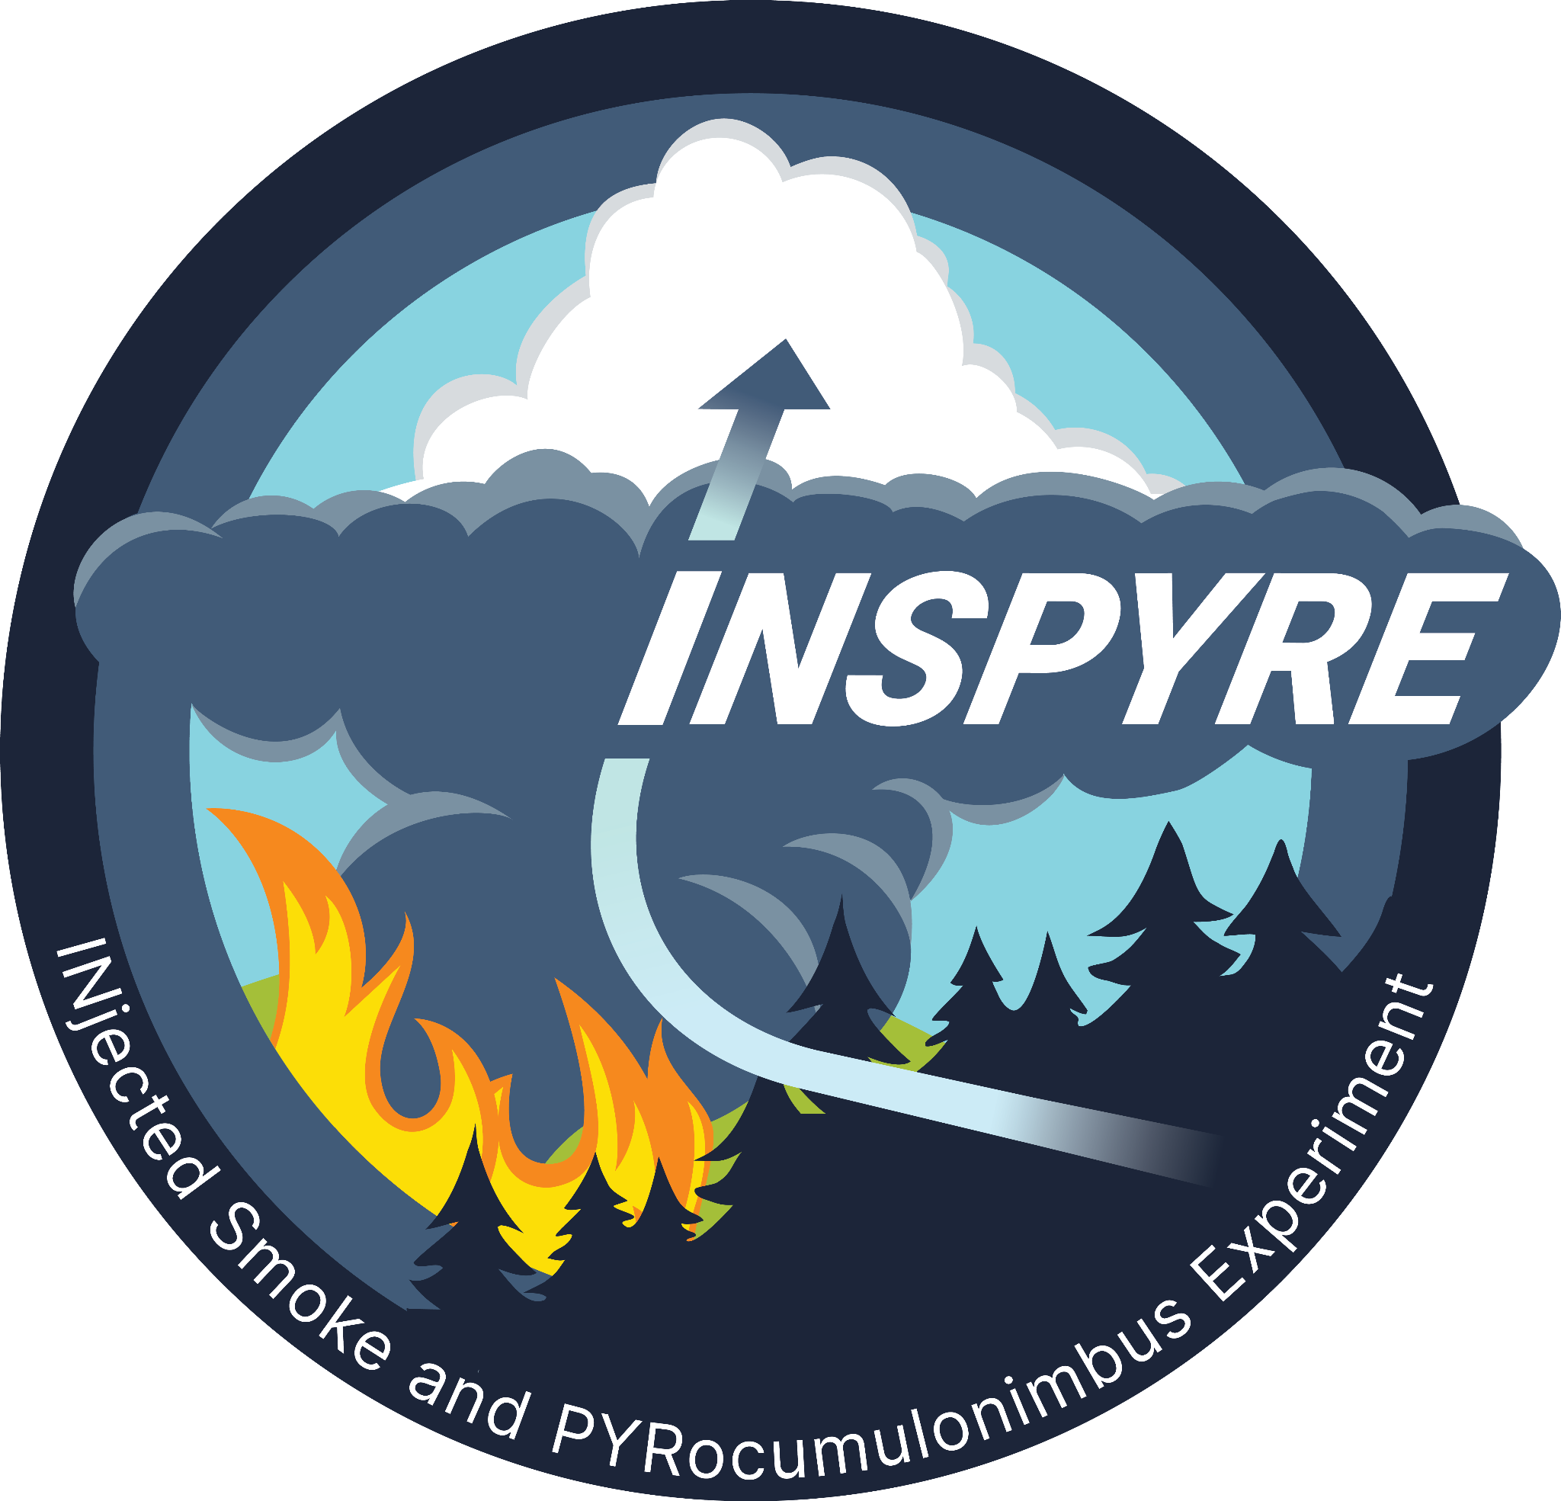




TEMPO Data Applications:
INjected Smoke and PYRocumulonimbus Experiment (INSPYRE)
David Peterson Naval Research Laboratory - Monterey, CA
Neil Lareau University of Nevada, Reno
Olga Kalashnikova Jet Propulsion Lab/California Institute of Technology
Vidal Salazar Investigation Manager, NASA ARC
~150 Science Team Members
Logo Almost ready!!!!!
TEMPO DART Team Meeting
June 17, 2026

Slide 2
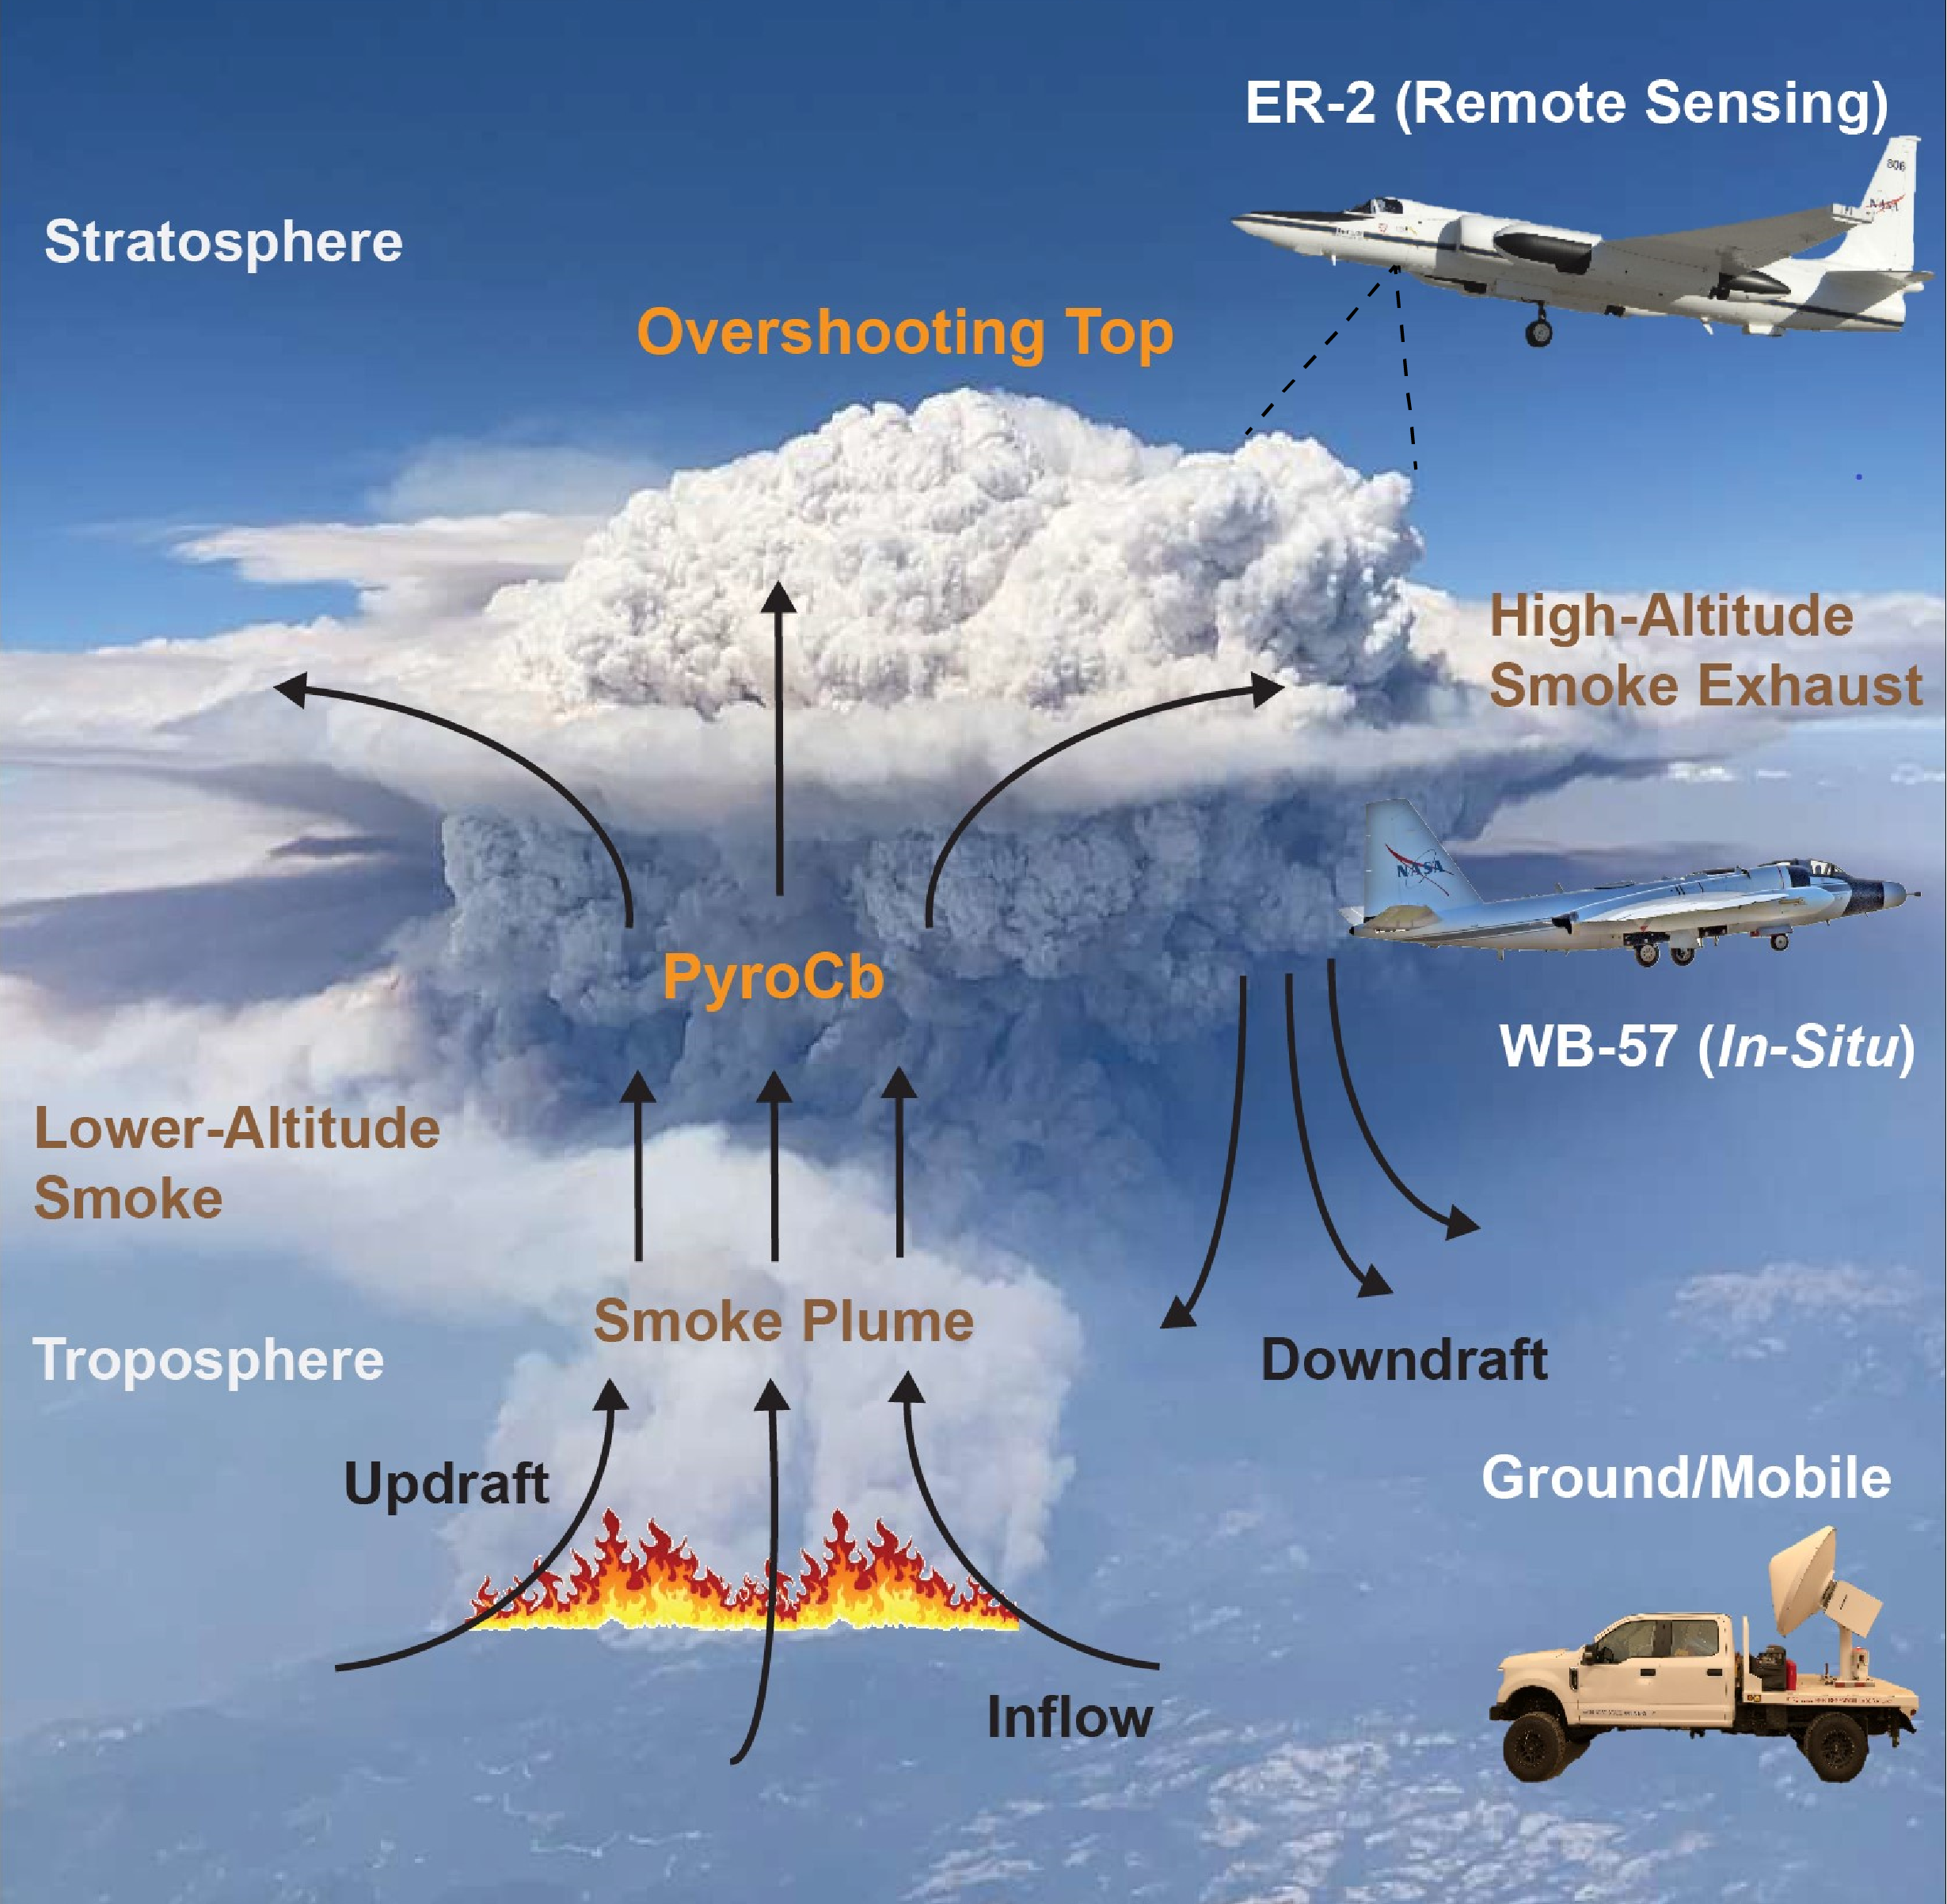
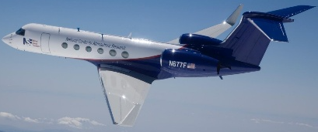
INSPYRE Overview and Science Objectives
Goals:
Characterize physical links between pyroCb development and extreme wildfire behavior.
Constrain the role of pyroCb activity in the Earth system.
Objectives:
Determine the fire and atmospheric conditions that produce pyroCbs.
Identify the mechanisms that control stratospheric smoke injection.
Assess how pyroCb-injected smoke plumes alter the upper troposphere and lower stratosphere (UTLS).
NSF/NCAR GV
(in-situ)

Slide 3
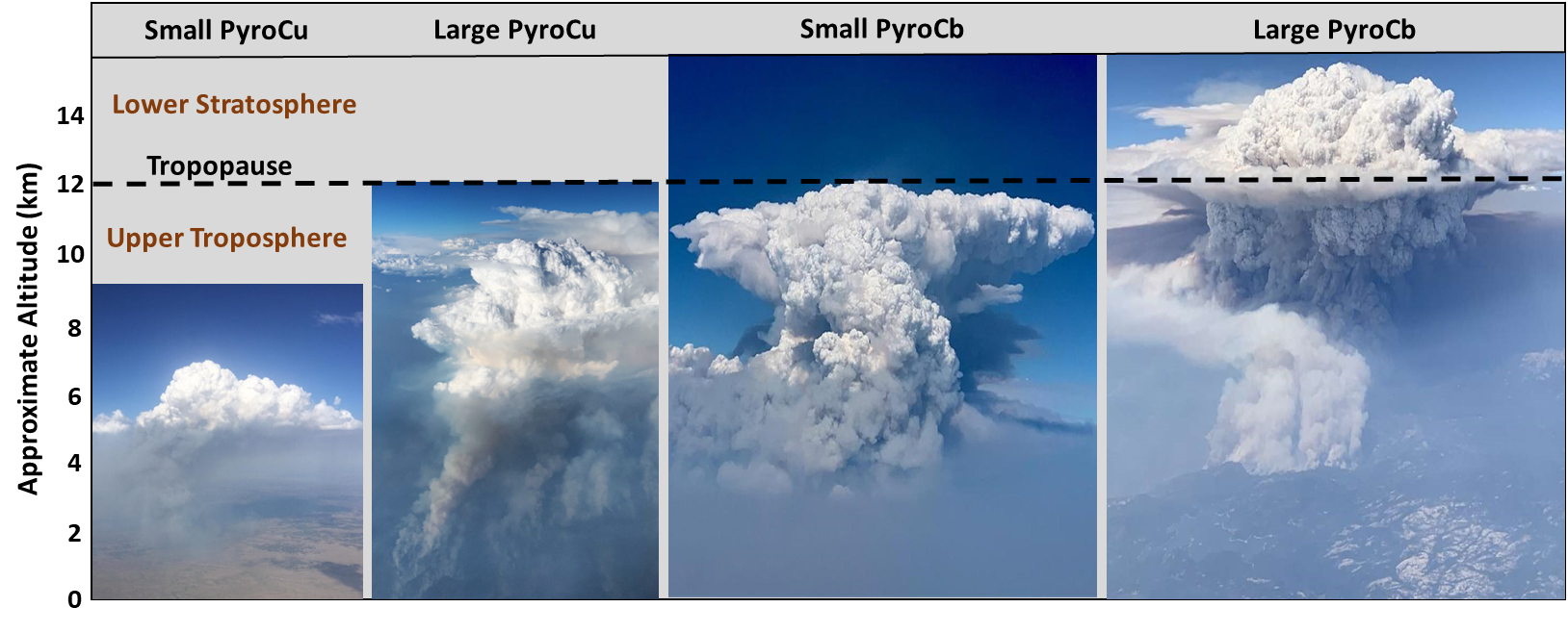
INSPYRE Includes Full Spectrum of Pyroconvection
Typical pyroCb definition requires a minimum 11 µm brightness temperature (BT₁₁) less than -40˚C
-40˚C
More common
Less common

Slide 4
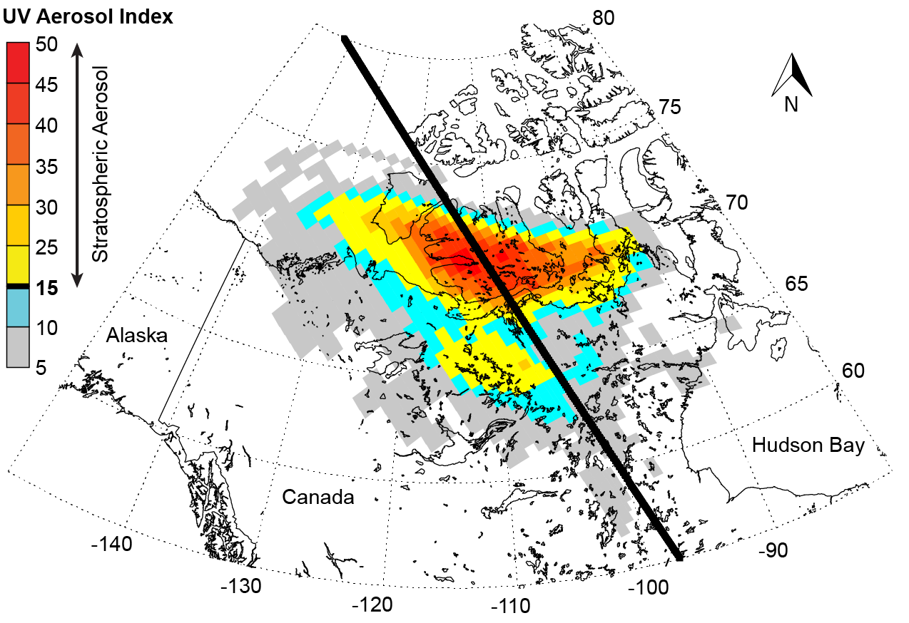
How can TEMPO data products help INSPYRE?
14 August 2017
Ultra-Violet Aerosol Index (UVAI):
PyroCb smoke analysis & tracking currently based on LEO sensors (e.g., OMPS).
TEMPO’s hourly aerosol products have potential to transform this field!
We would use UVAI to support mission operations and data analysis
Aerosol Layer Height and AOD:
Critical for understanding plume transport
Integrate with lidar profiles and trajectory analysis
Gas Phase Products:
Aid analyses of smoke plume composition in isolated plume scenarios
~48 hr After PyroCb
Peterson et al. 2018
(Nature PJ, Climate and Atmos. Science)
CALIPSO Orbit Track

Slide 5
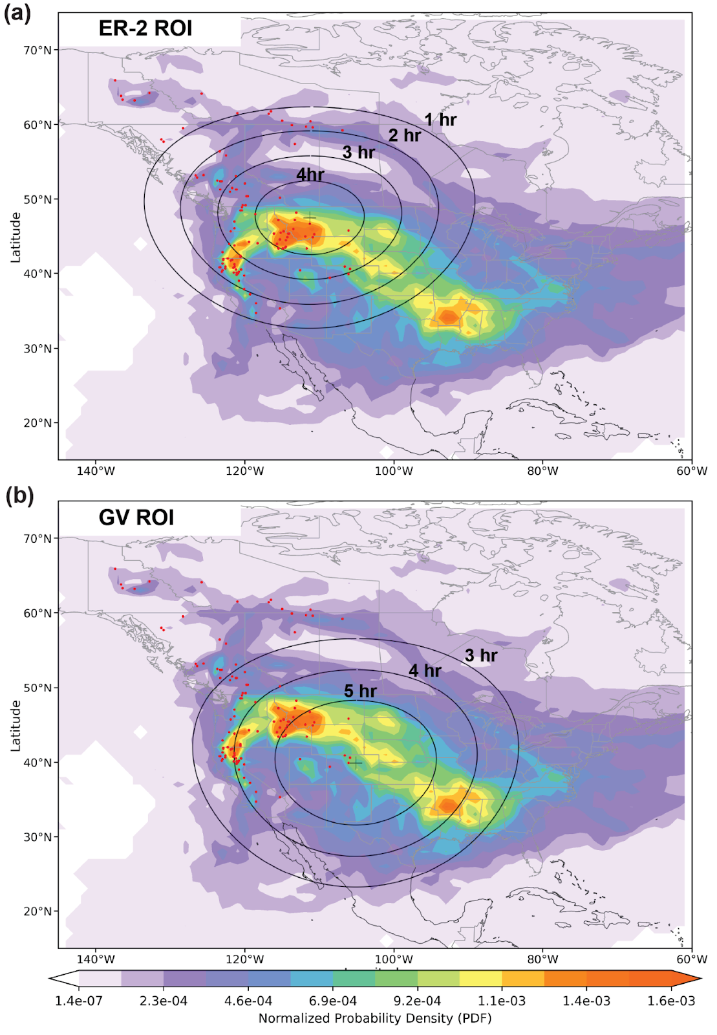
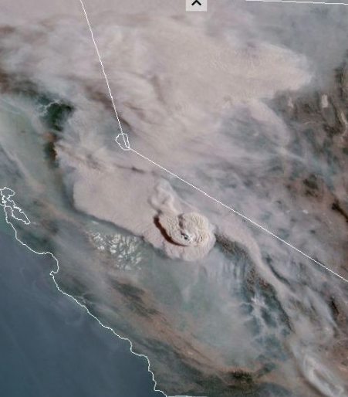
How can INSPYRE help the TEMPO Science Team?
Deployment July 27-Sept 9:
ER-2 in Great Falls, MT (2026 & 2027)
NSF/NCAR GV in Broomfield, CO (2026 only)
Mission Concept 2:
Detrained smoke layers downstream of active pyroconvection
Sampling aged plumes in the UTLS
Measure aerosol composition, size distributions, and radiative properties critical for understanding impacts across large regions
Detrained smoke
Active pyroCb

Slide 6
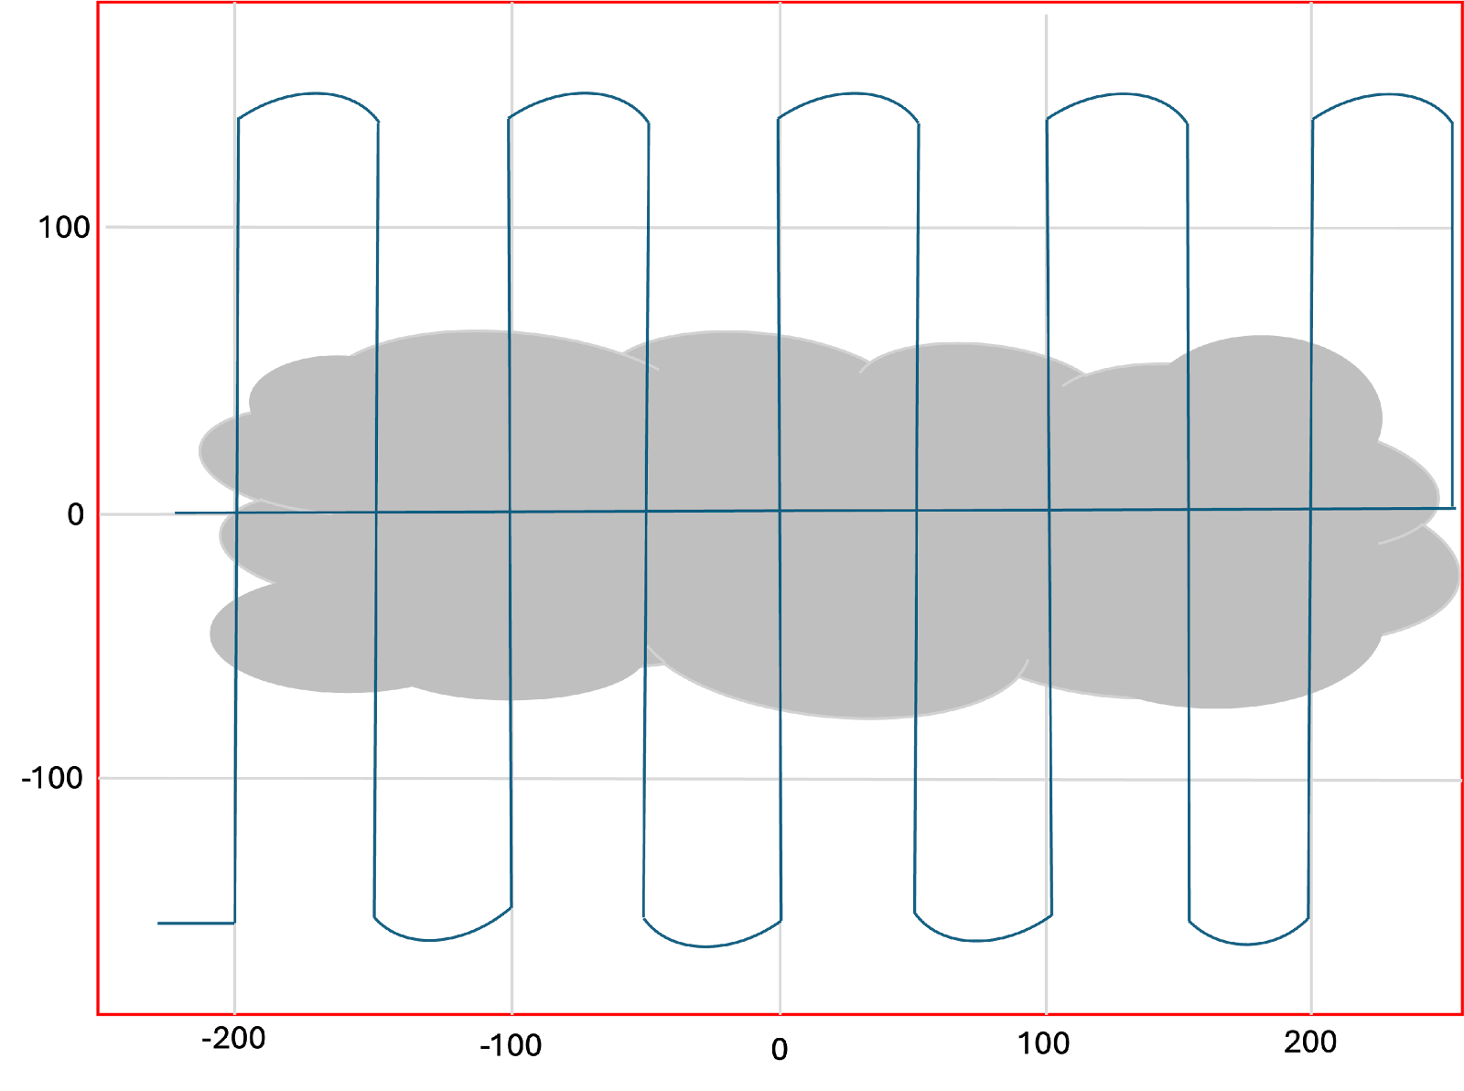
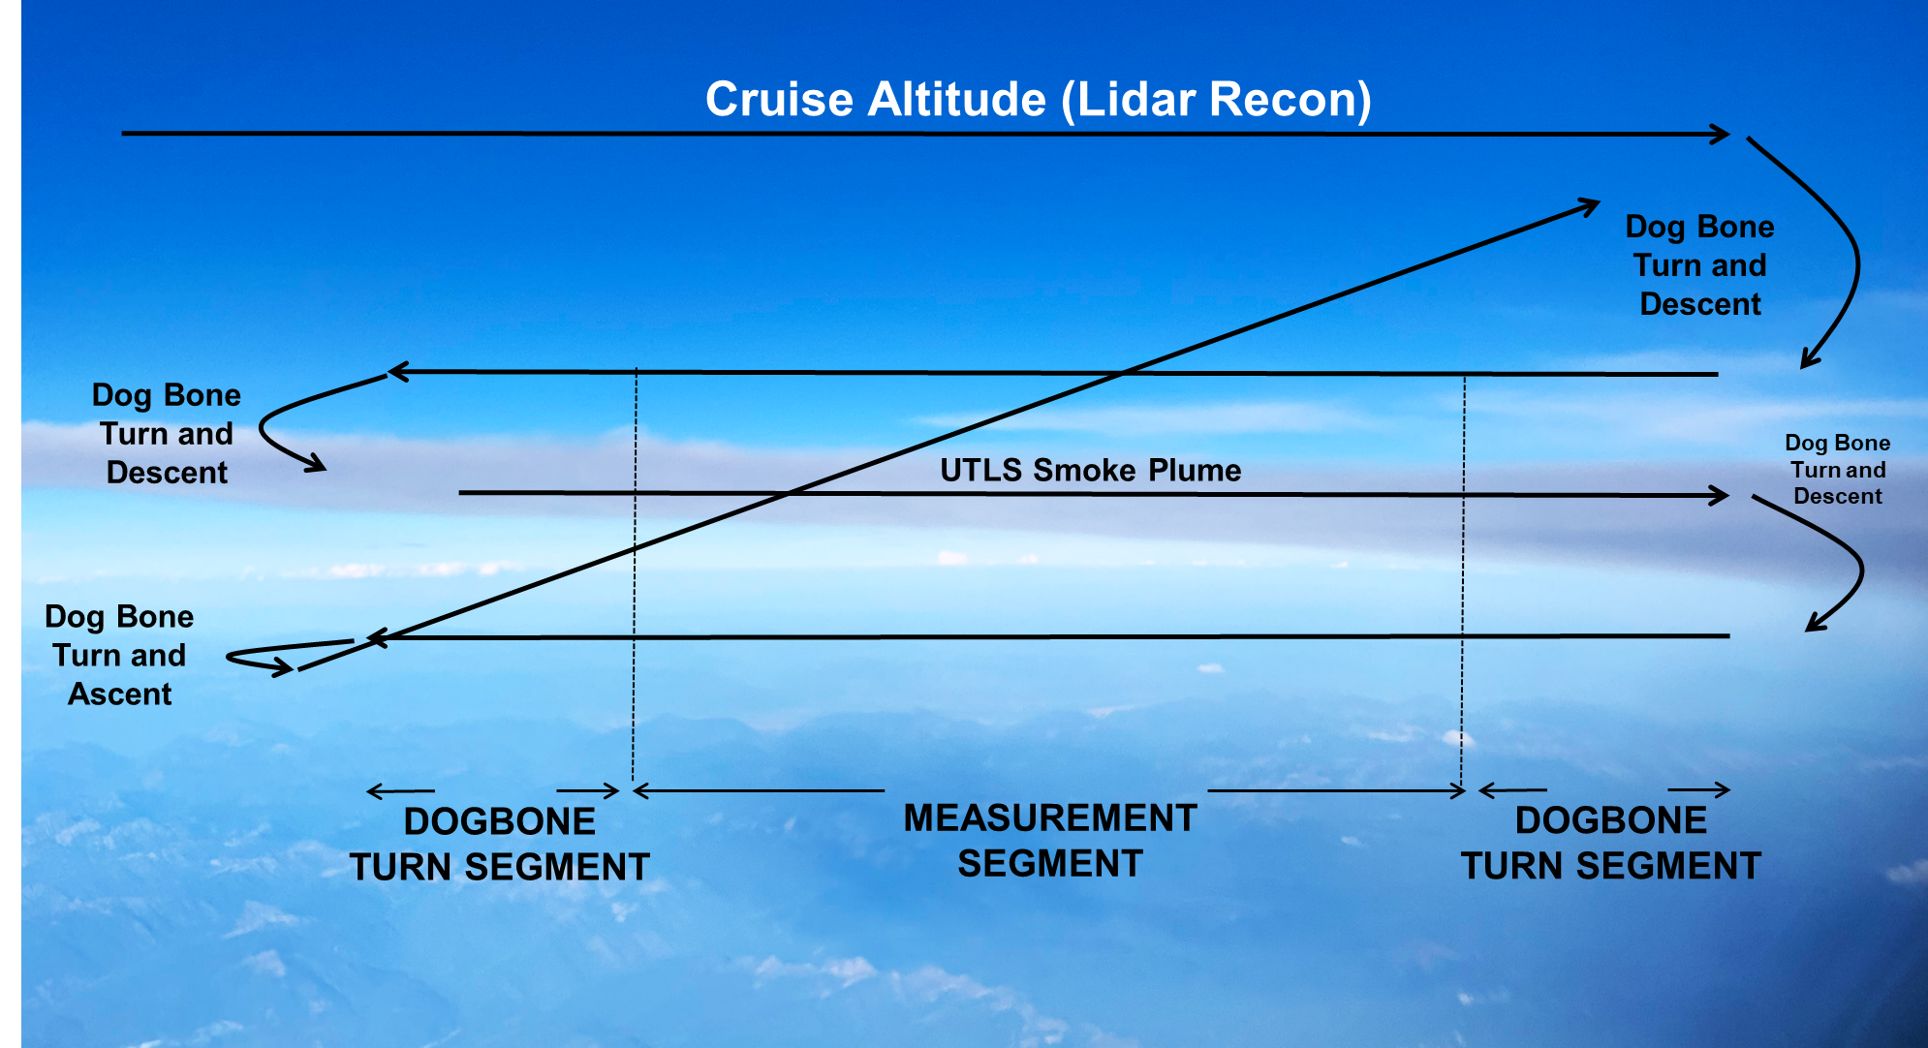
Airborne Strategy: Detrained Smoke Layers
Lawnmower (*ER-2 & GV)
Stack Maneuver (*GV & ER-2)
Porpoising (GV only)
30s legs – wings level
1000 ft/min climb rate

Slide 7
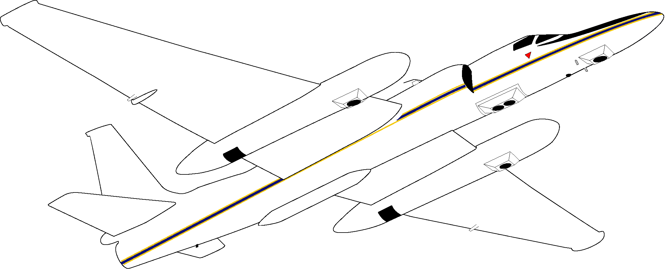
ER-2 Team
EXRAD
LIP
BBR
Instrument | Measurements
MASTER | Fire Energetics
IR Camera
CFI (FireSense)
EXRAD, CRS | Radars
CPL | Lidar
AirHARP-2 | Polarimeter
POPS/MOUDI | In-Situ Aerosol Measurements
BBR | Radiation (solar & IR irradiance)
LIP | Lightning and electric field
EFCM
iSTORM
S-HIS (NOAA) | IR Sounder
Mavo Edge Camera | Cinema quality camera
MVIS | Visible Imagery Camera
MVIS
CPL
POPS/MOUDI
Mavo Edge Camera
CFI
CRS,
IR Camera
AirHARP-2
EFCM
iSTORM
S-HIS
MASTER
Green – Funded by INSPYRE
Blue – No cost contributions
Brown – Funded by collaborators

Slide 8
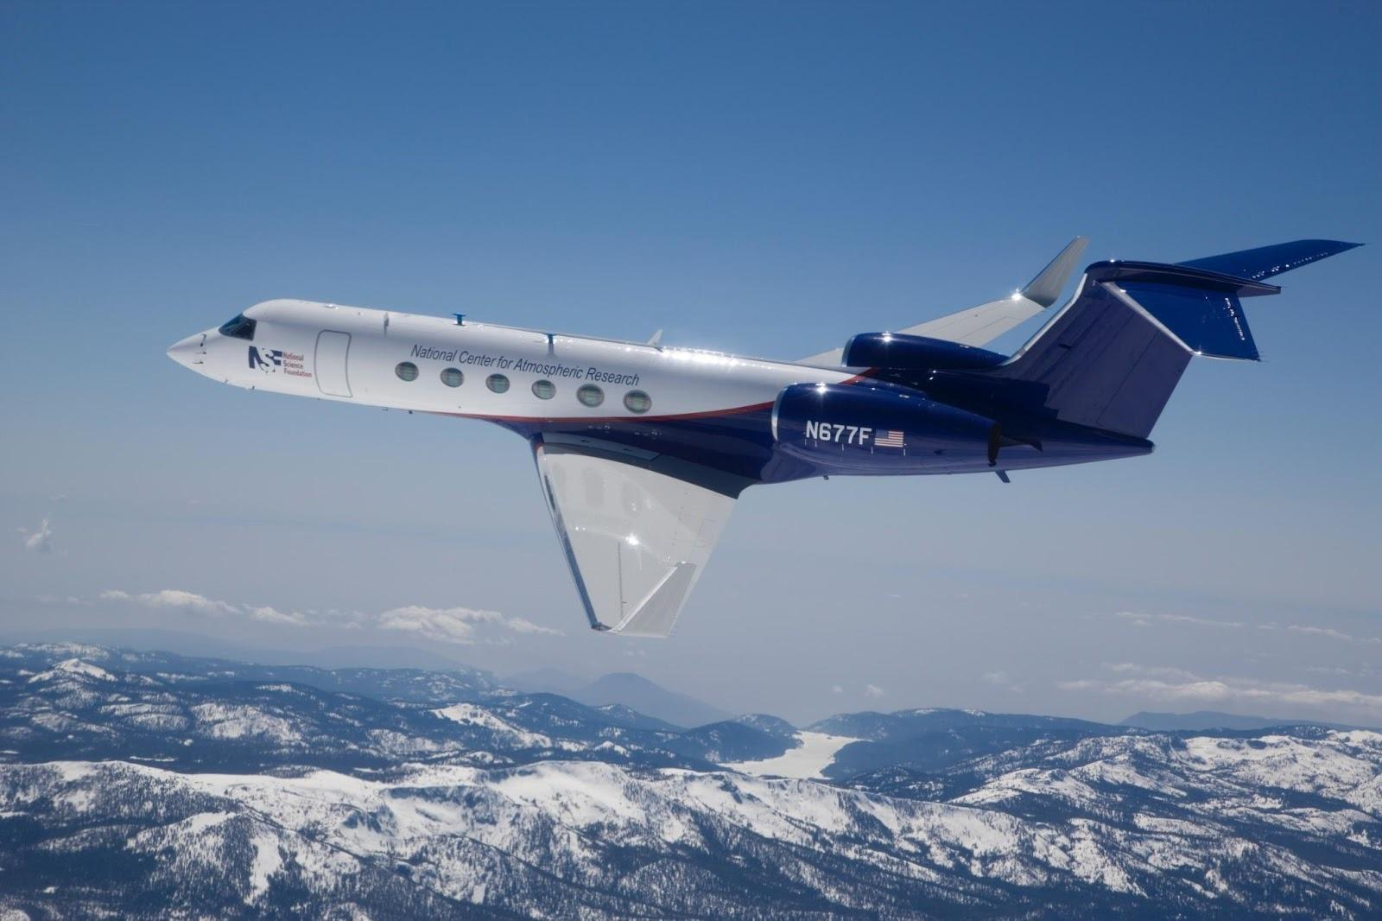
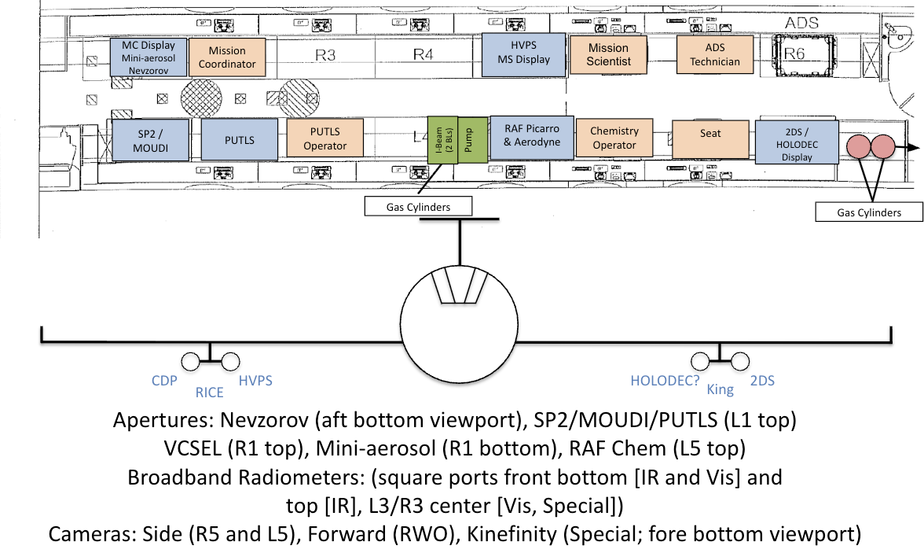
NSF/NCAR GV Team
Provides in-situ measurements for 2026 deployment
Instrument | Measurements
HVPS-3 | Large hydrometeor size/shape/concentration
2DS | Small–mid hydrometeors, ash
CDP-2 | Droplet size & concentration
RICE | Supercooled liquid water
King LWC, Nevzorov | Liquid & total water
PUTLS | Aerosol number & size
SP2 | Black carbon mass & size
CAPS-SSA | Aerosol extinction and scattering coefficients to determine the single-scattering albedo
MOUDI | Micro-Orifice Uniform Deposit Impactor
Mini-Aerosol Package | Aerosol sampler, absorption, filters
TILDAS | N2O, CO
Picarro | CH4, CO2, CO
VCSEL Hygrometer | Water vapor
BBR Suite | Radiation: Solar & IR irradiance (similar to ER-2)
State Variables | T, P, etc.
Radome 3D Winds | Winds
Mavo Edge Camera | Downward looking cinema camera
GV camera/video | forward-looking, downward-looking, side-looking

Slide 9
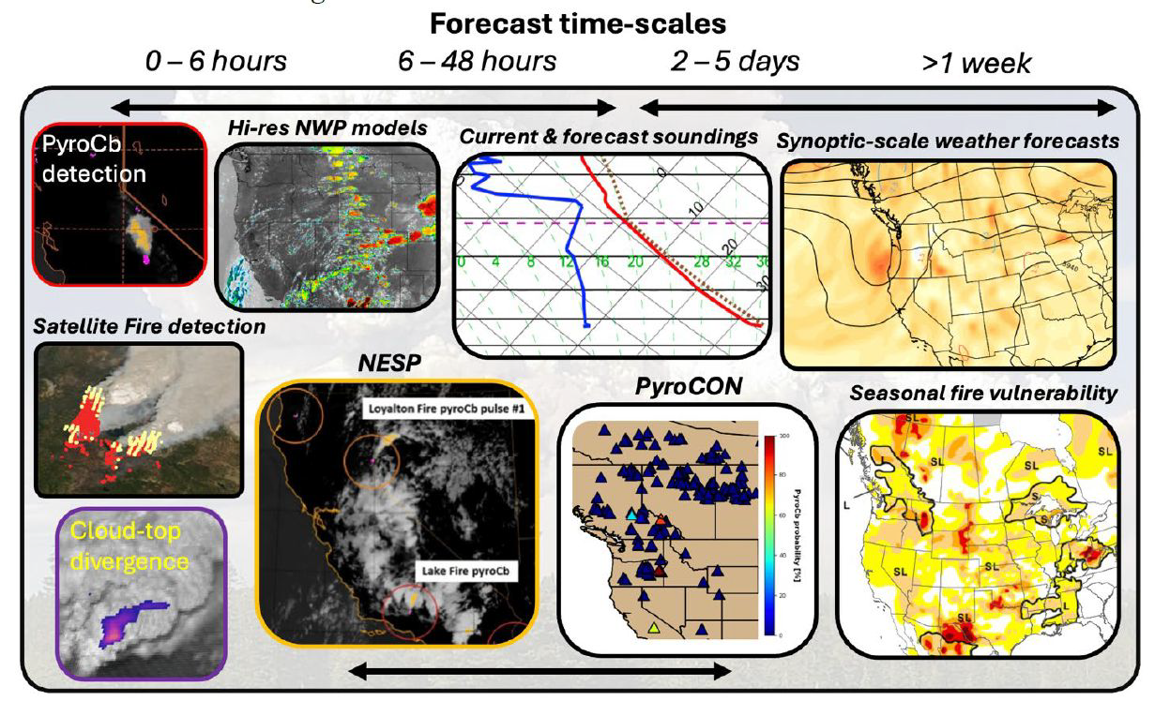
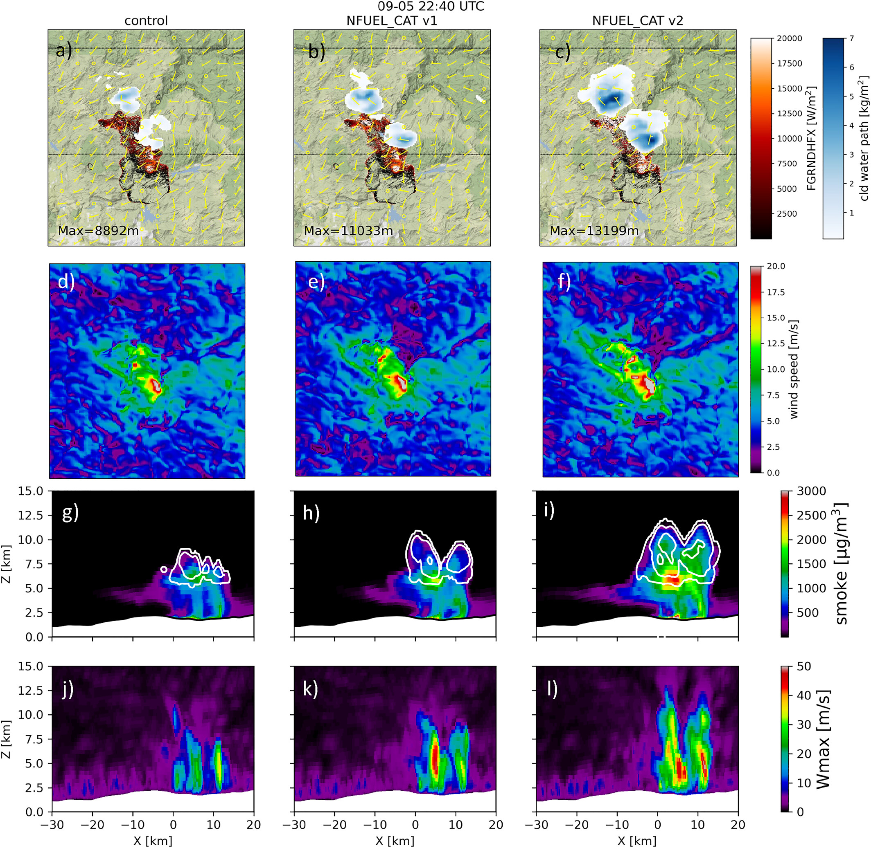
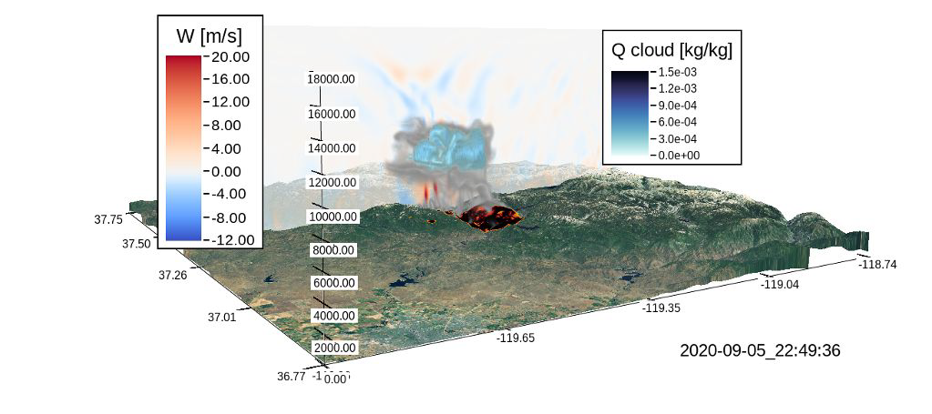
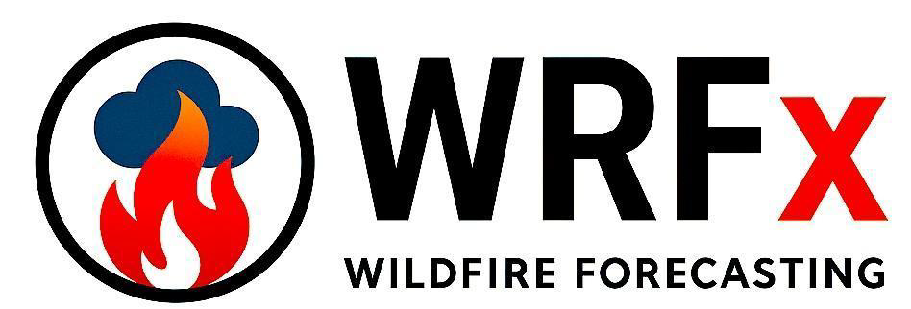
Modeling & Forecasting Team: Filling the Prediction Gap
Long-range forecasting tools:
Experimental pyroCb prediction products based on thermodynamic profiles
Statistical and physical methods
Coupled fire-atmosphere models:
High-res with up-to-date fuel states and perimeters for target selection
Smoke plume injection:
Plume rise models and injection height ensembles
Coupled with trajectories for smoke plume tracking downstream
Mission support aids development:
INSPYRE provides a critical testing theatre
Improved knowledge for future development of better forecasting tools
Lee et al. 2023

Slide 10
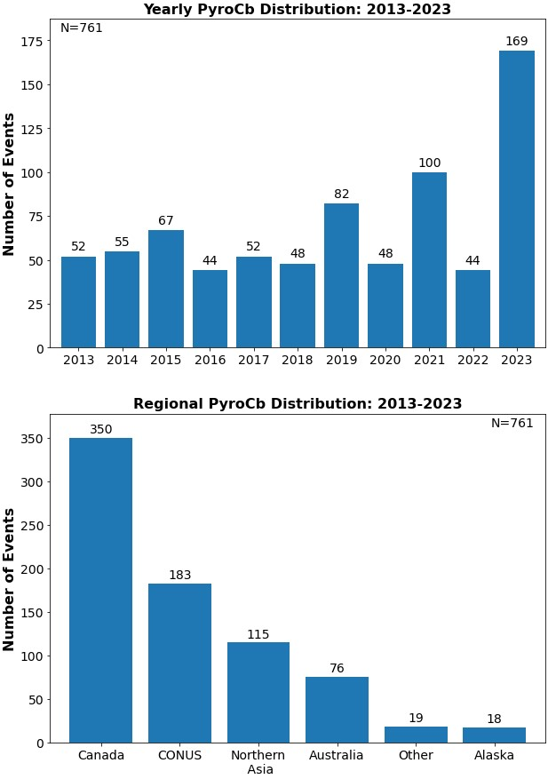
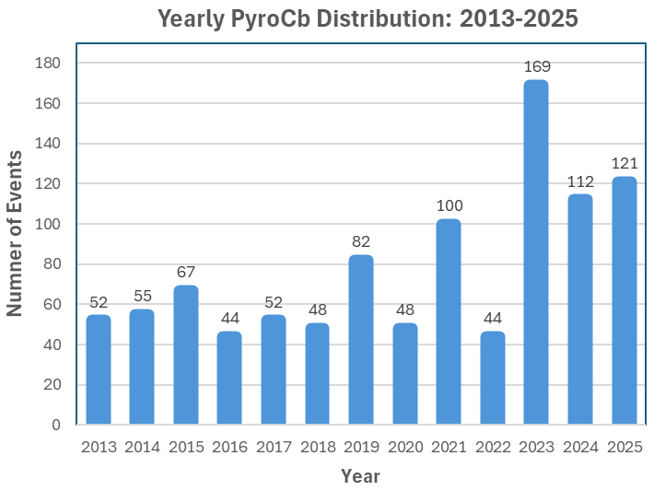
Worldwide PyroCb Inventory
How common are pyroCbs? Where do they develop?
Available to the community: Peterson et al. (2025, npj Climate & Atm. Sci.)
https://www.nature.com/articles/s41612-025-01188-5

Slide 11
Questions?
INSPYRE Goals:
Characterize physical links between pyroCb development and extreme wildfire behavior.
Constrain the role of pyroCb activity in the Earth system.
Objectives:
Determine the fire and atmospheric conditions that produce pyroCbs.
Identify the mechanisms that control stratospheric smoke injection.
Assess how pyroCb-injected smoke plumes alter the upper troposphere and lower stratosphere.
NRL is interested in TEMPO and GEMS aerosol data assimilation for maritime forecasting applications
NSF/NCAR GV
(in-situ)

Slide 12
Extra Slides

Slide 13
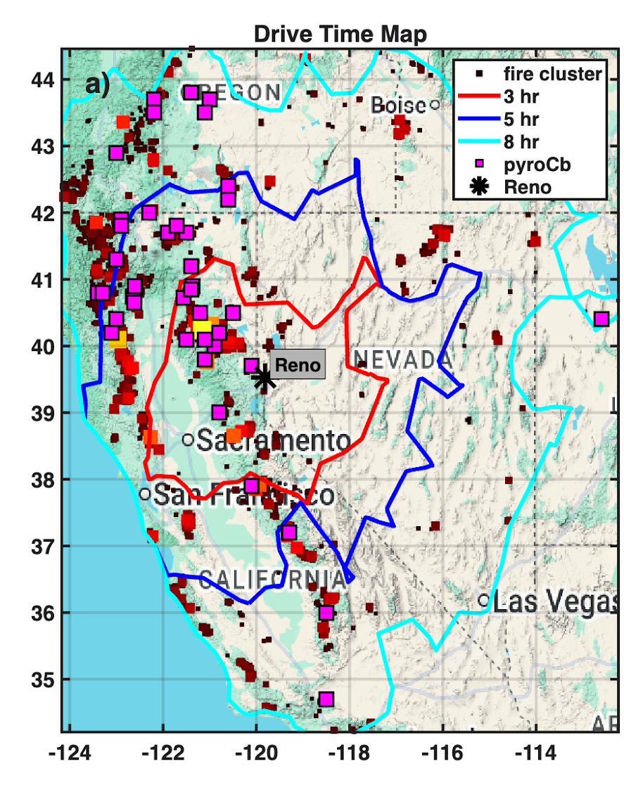
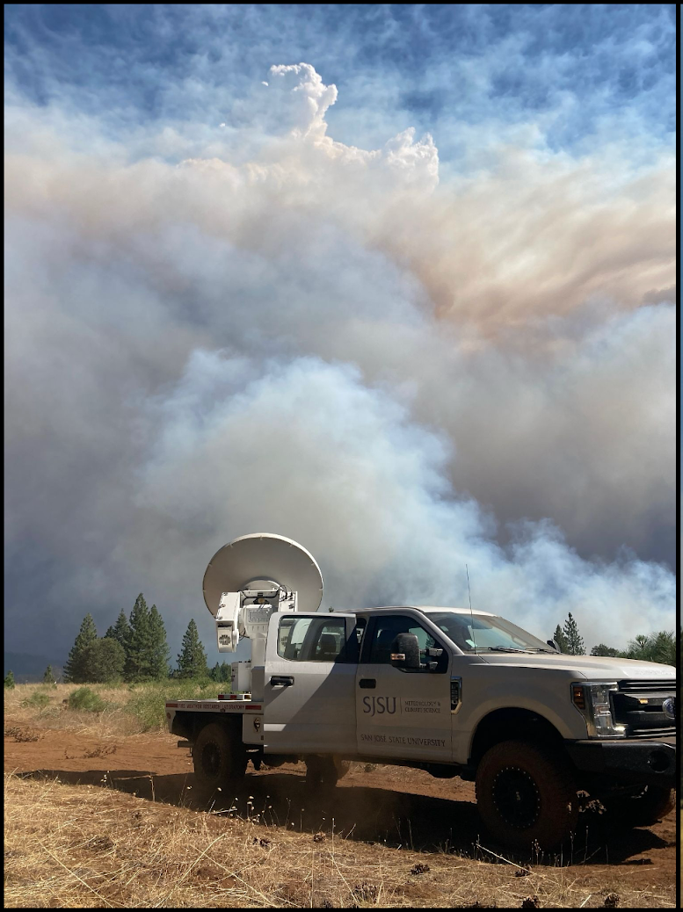
Ground Mission Sampling Domain
Linking plume dynamics to fire-behavior:
Radars, lidars, weather balloons will sample:
Plume-dynamics
Fire-generated winds
Cloud microphysics (polarimetry)
Thermodynamic Environment
These data close the feedback loop between the pyroCb initiation and fire evolution.
Primary base: Reno, NV
Secondary bases: Missoula, MT, Salt Lake City, UT, Boise, ID

Slide 14
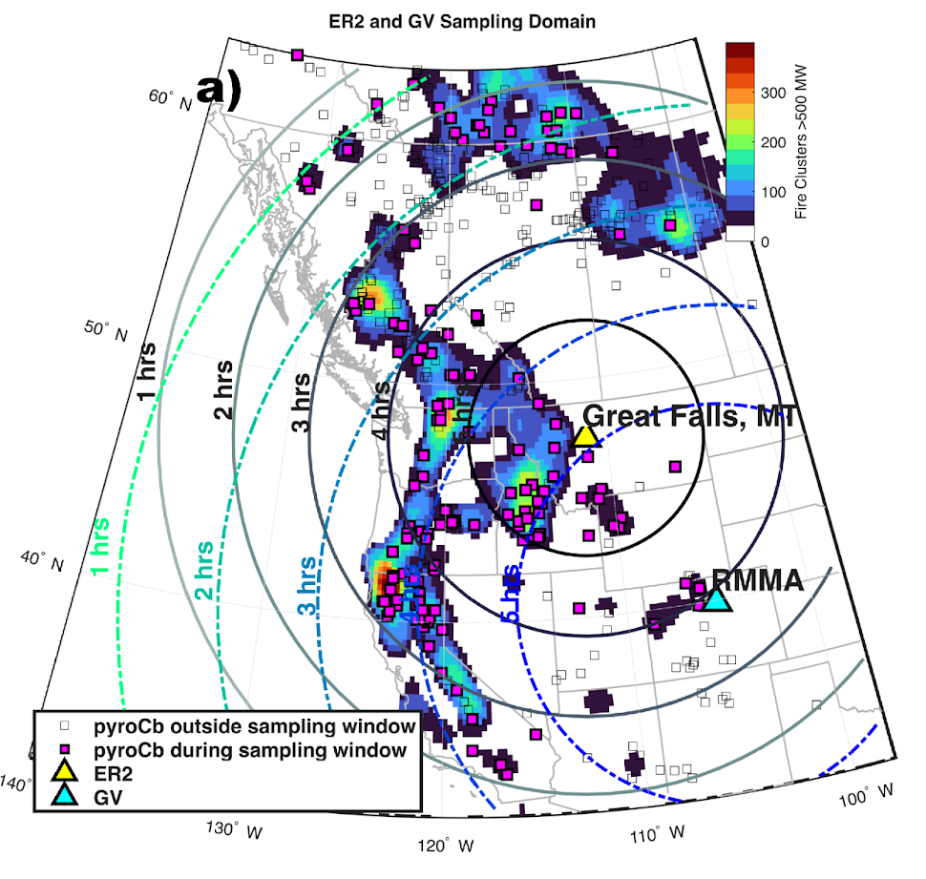
Airborne Mission: Active Pyroconvection Sampling
Deployment July 27-Sept 9:
ER-2 in Great Falls, MT (2026 & 2027)
NSF/NCAR GV in Broomfield, CO (RMMA 2026 only)
Mission Concept 1:
Active pyroconvection
Primary goal of the mission
Capturing the co-evolution of fire activity, plume rise, cloud development, electrification, and smoke injection in real time
Maximum observed: 34 pyroCb
Minimum observed: 4 pyroCb
Mean occurrence: ~17 events per season
PyroCb data from NRL (Peterson et al 2025):
https://www.nature.com/articles/s41612-025-01188-5

Slide 15
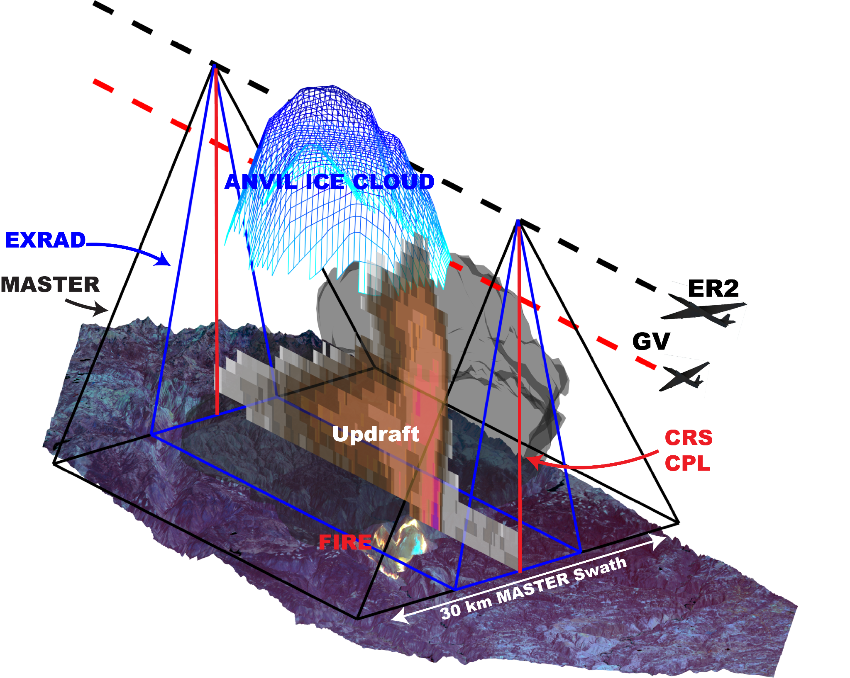
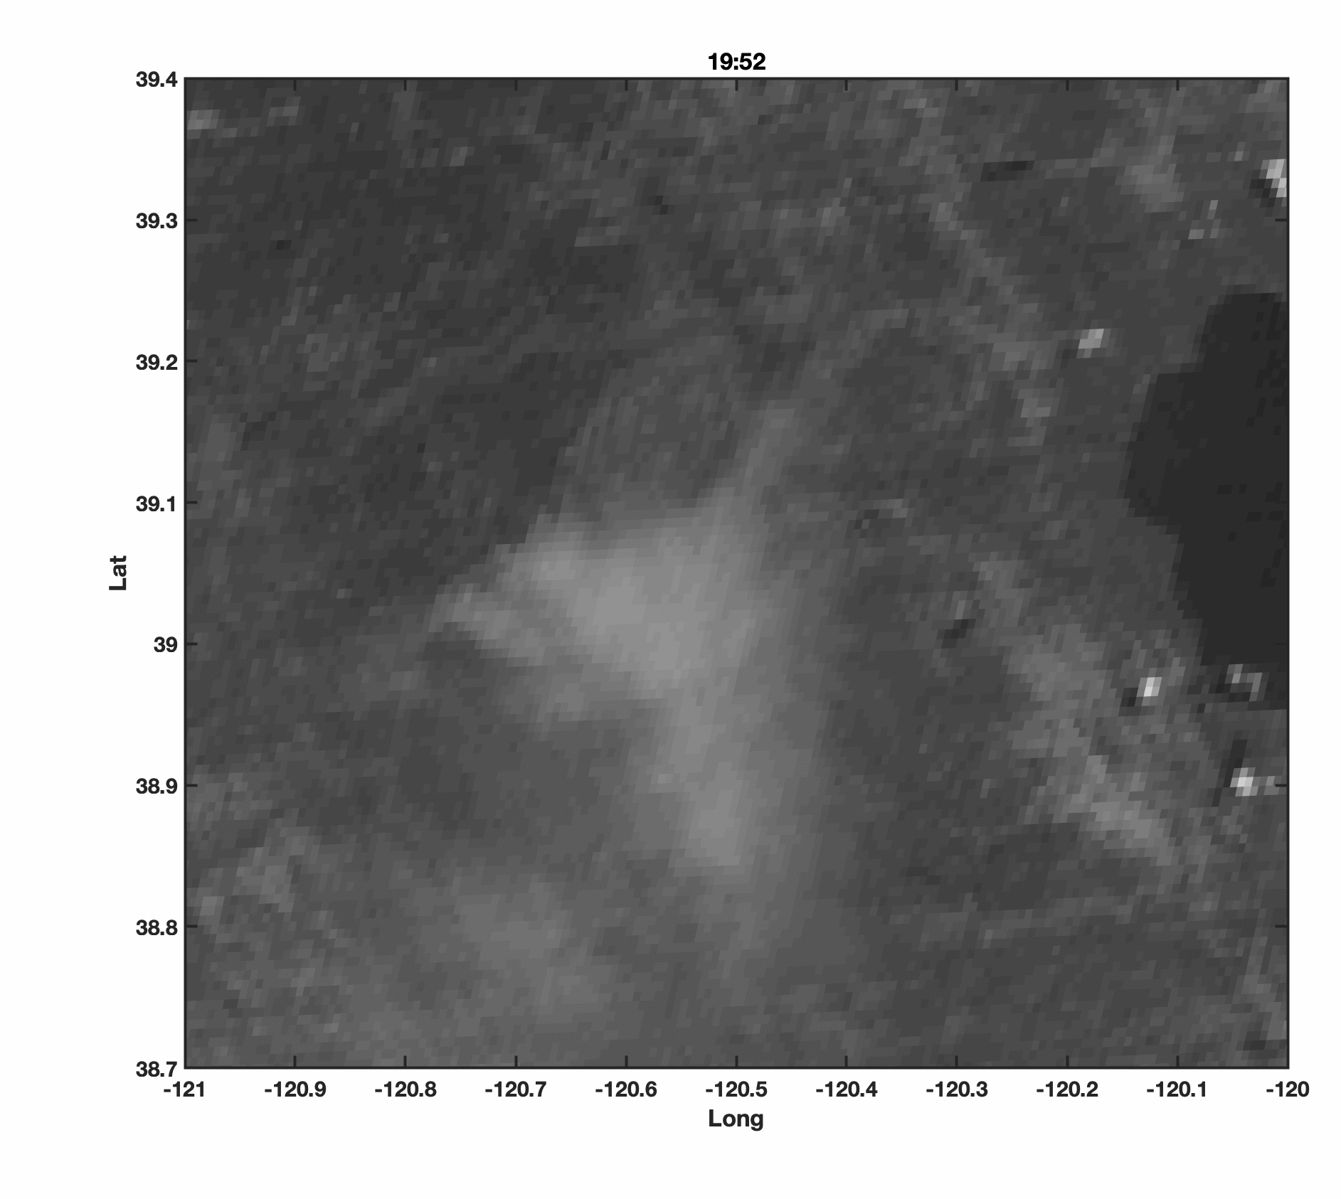
Airborne Strategy: Active Pyroconvection
Mosquito Fire
8-Sept, 2022

Slide 16
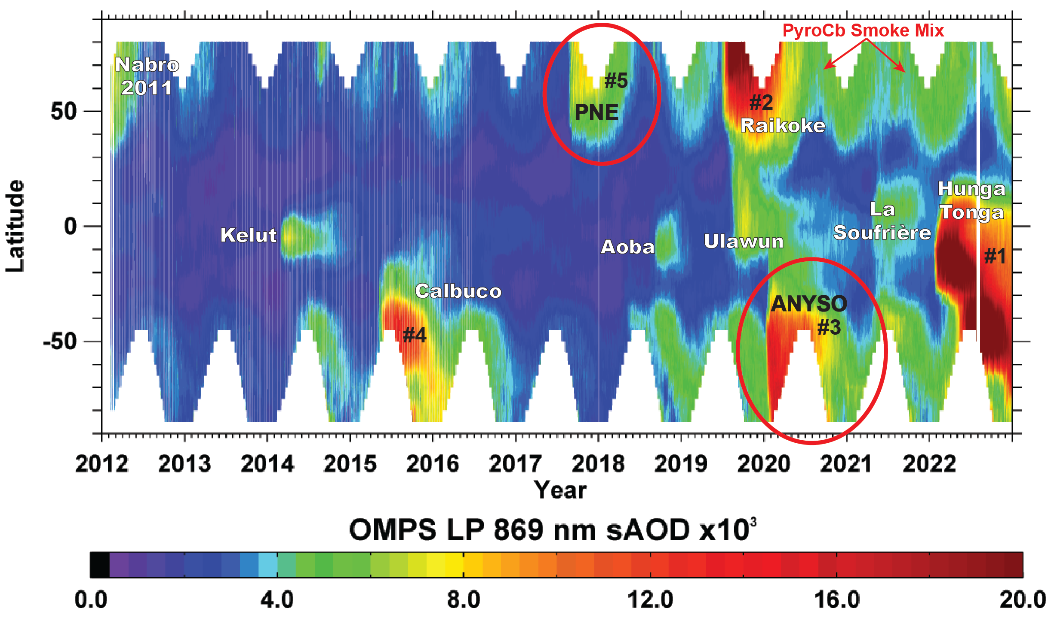
Why do pyroCbs matter? (Climate-scale Impacts)
OMPS LP stratospheric aerosol optical depth (sAOD)
Two of the five largest plumes since 2012 are from pyroCbs
2019-2022 featured the highest levels of sAOD during the entire post-Pinatubo era:
  ANYSO played a significant role
  Impact from additional pyroCbs in N. Hemisphere: 2020-2024
PyroCbs are a first-order driver of variations in stratospheric composition and structure
Peterson et al. 2021
(Nature PJ, Climate and Atmos. Science)
Updated by Ghassan Taha, 2022

Slide 17
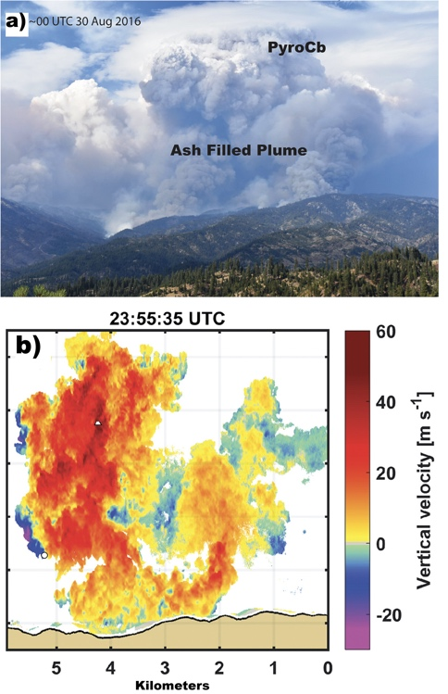
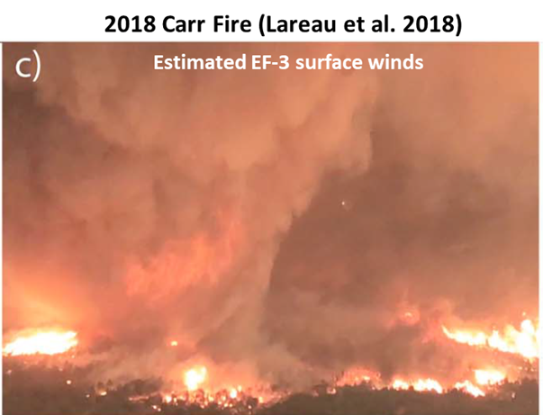
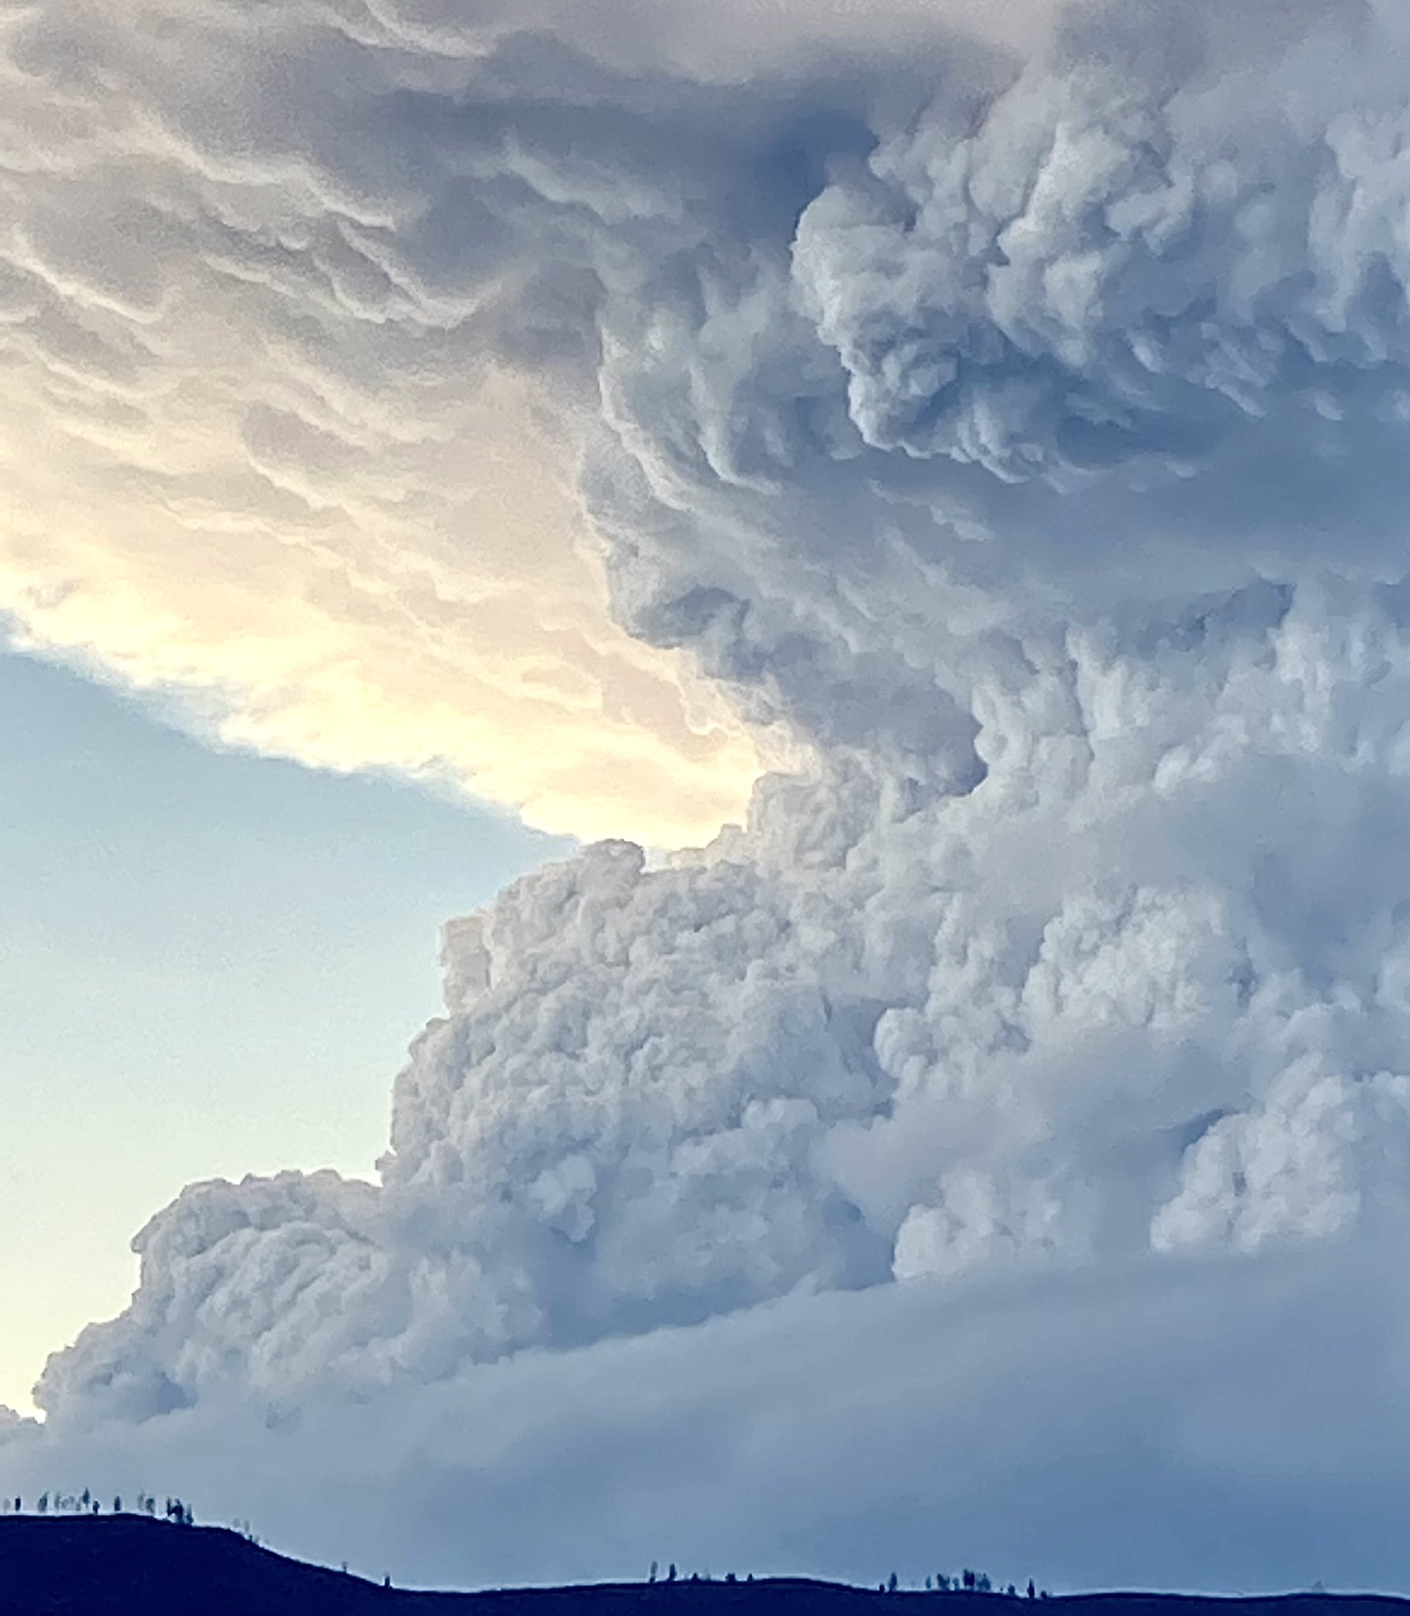
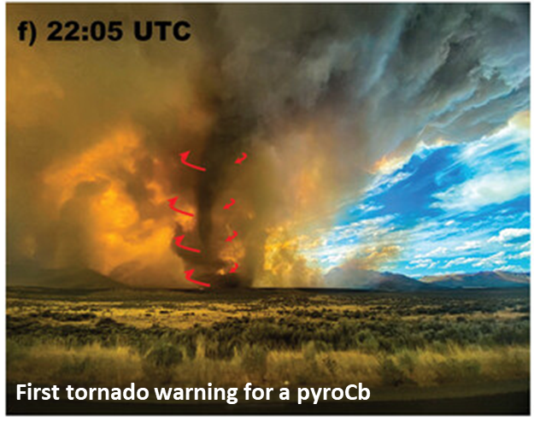
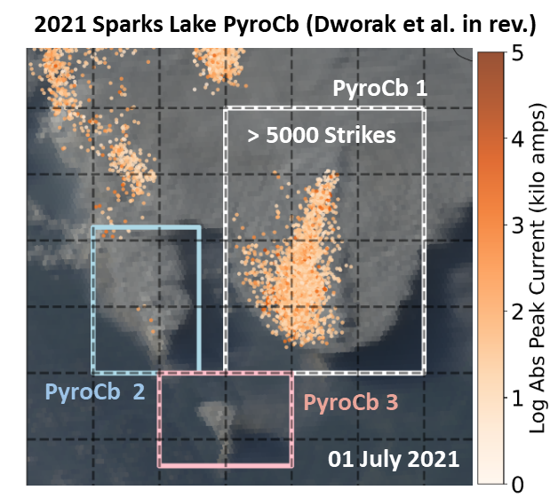
Why do pyroCbs matter? (Fire-scale Impacts)
Extreme Updrafts Near Cloud Base
Fire-Generated Tornadoes
Lightning Strikes
Rodriguez et al. 2020
2018 Carr Fire (Lareau et al. 2018)
2021 Sparks Lake Fire (Dworak et al. 2025)
2020 Loyalton Fire (Lareau et al. 2022)

