Slide 1


Closing the spatial gap in ozone monitoring with TEMPO and machine learning
Dan Anderson, Doyeon Ahn, Bryan Duncan
TEMPO DART Meeting, Iowa City, IA
17 June 2026

Slide 2
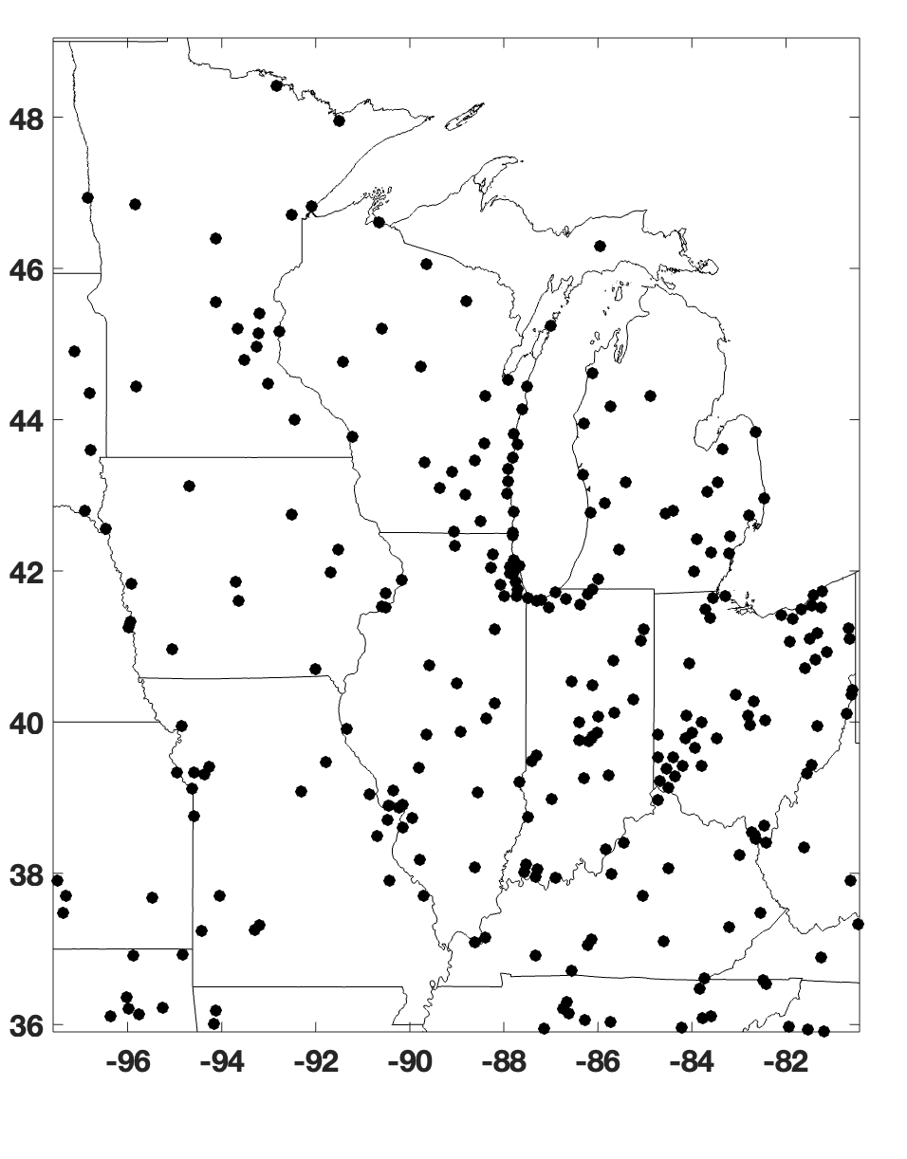
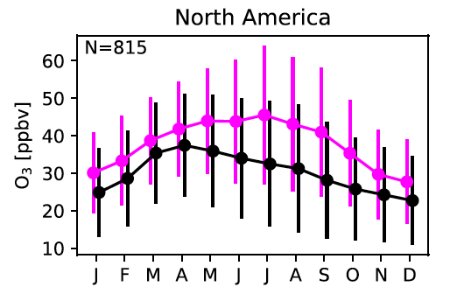

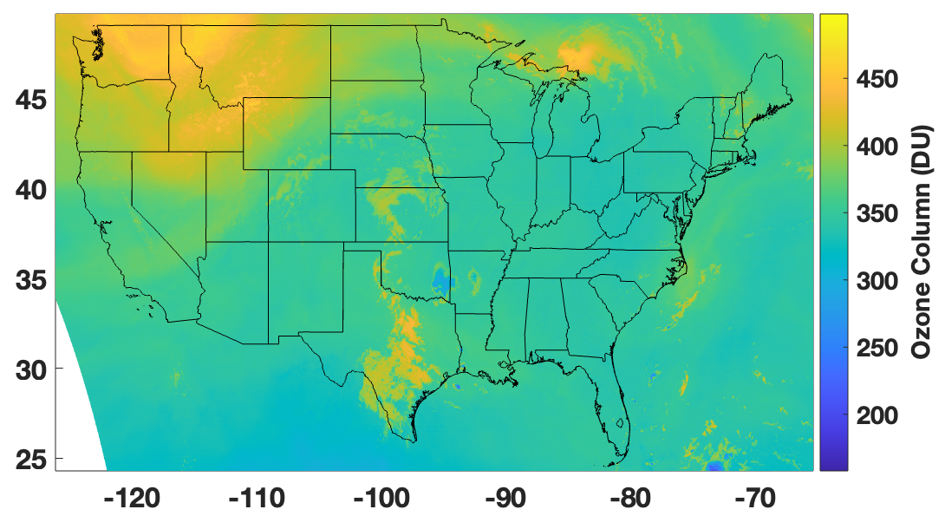
Limitations of the current surface ozone monitoring system
EPA O₃ Monitors
Evaluation of the NASA GEOS-CF model with surface observations
Tools are needed to constrain O₃ elsewhere.
TEMPO total column O₃ (15Z May 1, 2024)
Keller et al, 2021, Description of NASA GEOS CF, JAMES
O₃ monitors provide highly accurate observations but are sparsely distributed.
Air quality models often have significant biases
Satellites don’t provide surface concentrations

Slide 3





TEMPO and ML can fill in the gaps
Recent advances in machine learning (ML) and the launch of TEMPO present an opportunity to improve our ability to constrain diurnal O₃ outside monitoring sites.
Project goal:
  Satellite-constrained, near real time surface O₃ at derived from machine learning, satellite data, and in situ observations.
  Ideal is to provide product at hourly resolution across the TEMPO domain.
Work closely with air quality managers/stakeholders to make product as useful as possible.
Results shown today are preliminary and will likely change.

Slide 4
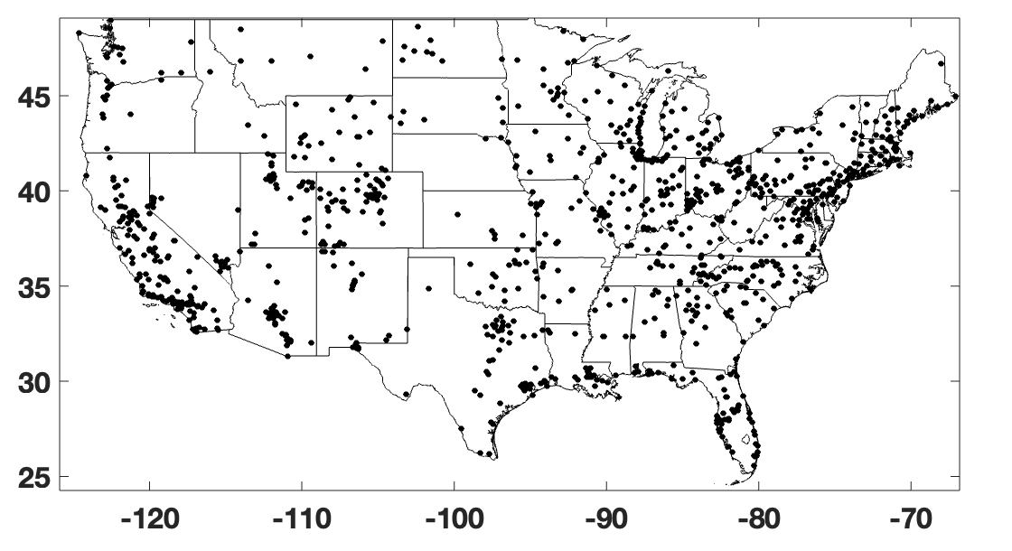
Machine learning framework
Gradient Boosted Regression Tree Model Training
Training Targets (Surface O₃)
ML Model Inputs
Trop. Column NO₂ & HCHO
Total Column O₃
TEMPO
Viewing Geometry
Reflectivity
T, P, Humidity
Wind speed
HRRR Meteorology
Wind direction
EPA Ozone Monitoring (824 Sites)
PBL Height
Latitude
TEMPO data are V3, Level 2 and have been cloud filtered.
Trained on data from May – Aug. 2024.
O₃ product is hourly at the TEMPO pixel resolution.
Population
Month, Hour
Other
Road Density
Test model performance at 114 independent EPA O₃ sites
Day of Week
NDVI

Slide 5
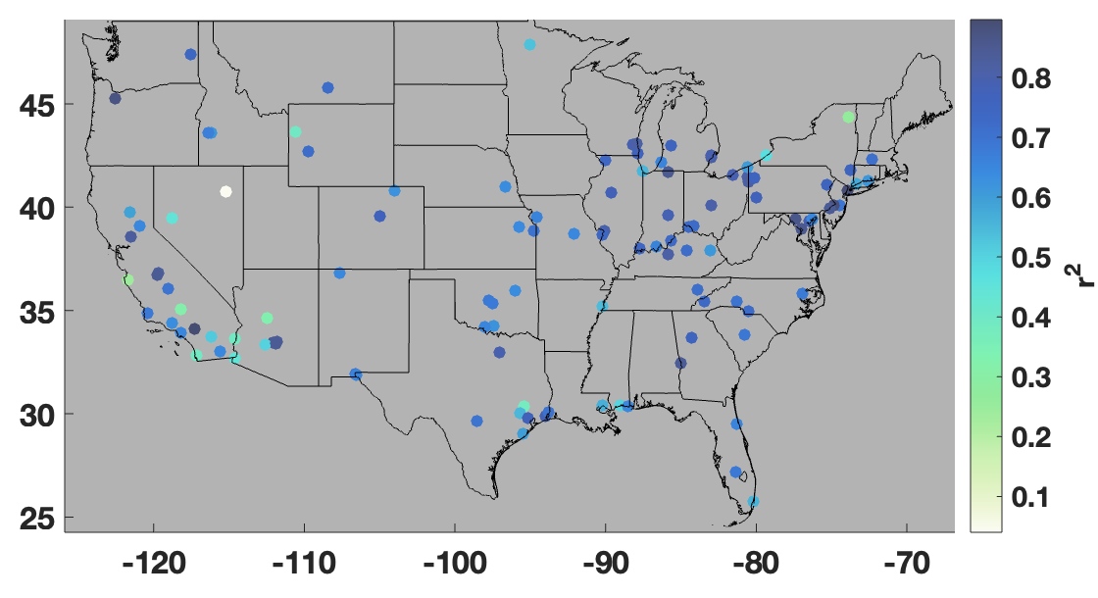
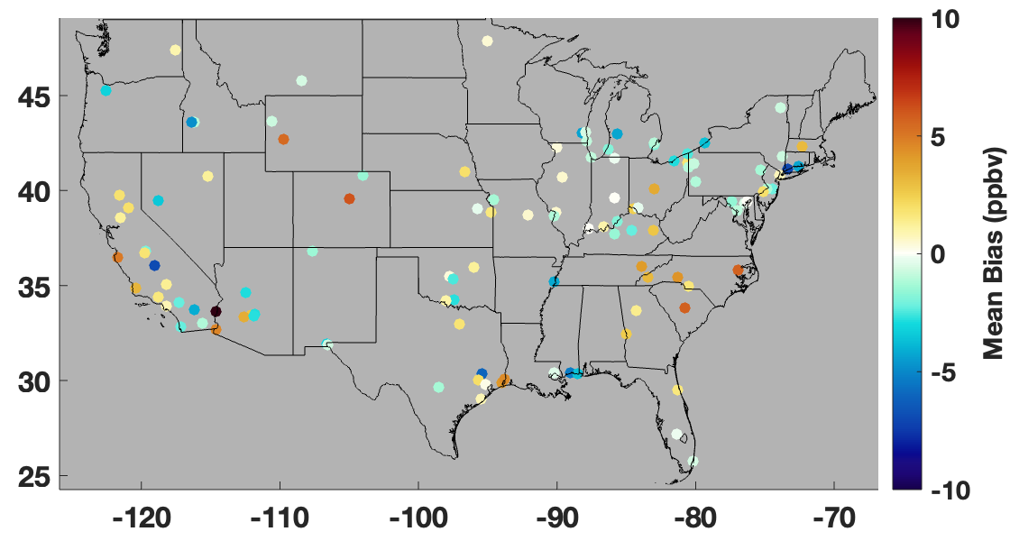
TEMPO-derived surface O₃ reproduces variability of surface monitors
Correlation between EPA and TEMPO-Derived O₃
TEMPO O₃ at individual sites is generally within 5 ppb of EPA.
Bias between EPA and TEMPO-Derived O₃
Satellite data can constrain surface O₃ variability over many regions of the continental US (median r² = 0.70).
Results are preliminary and may change.

Slide 6
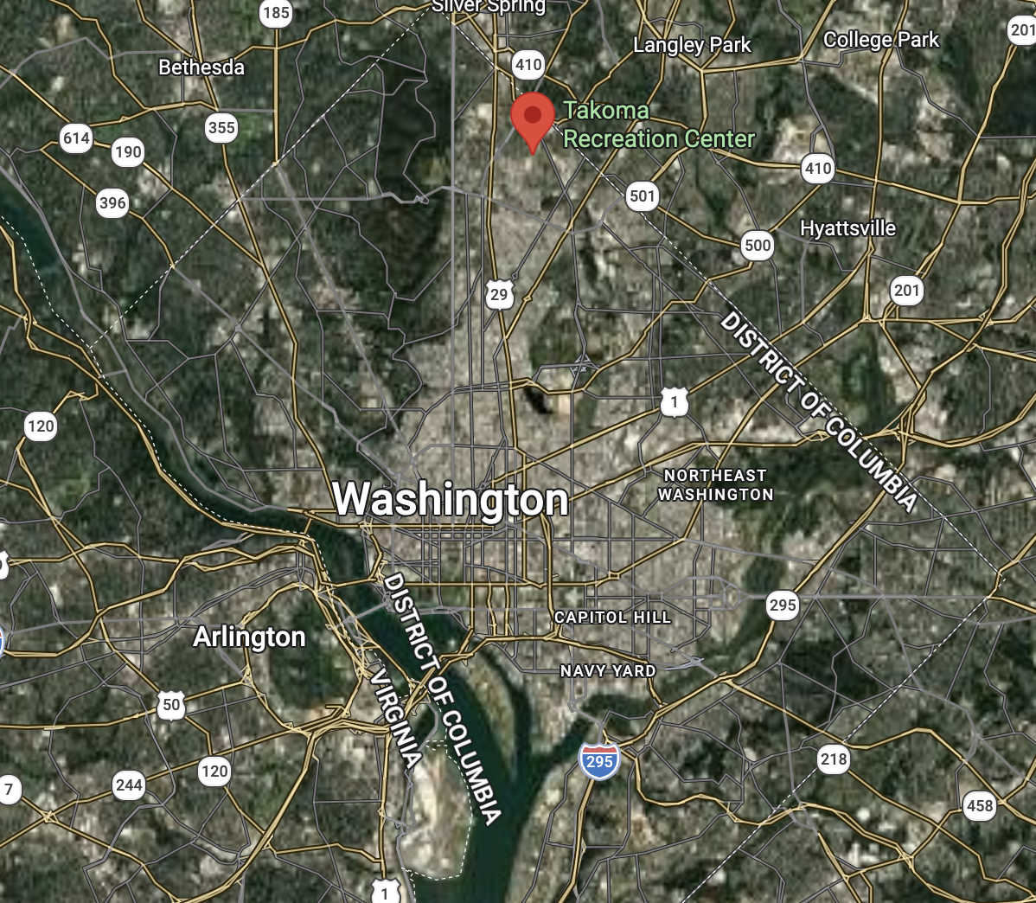
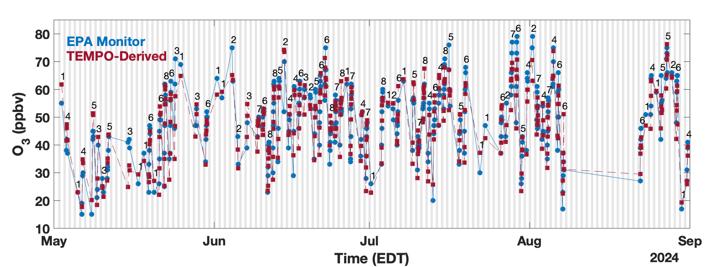
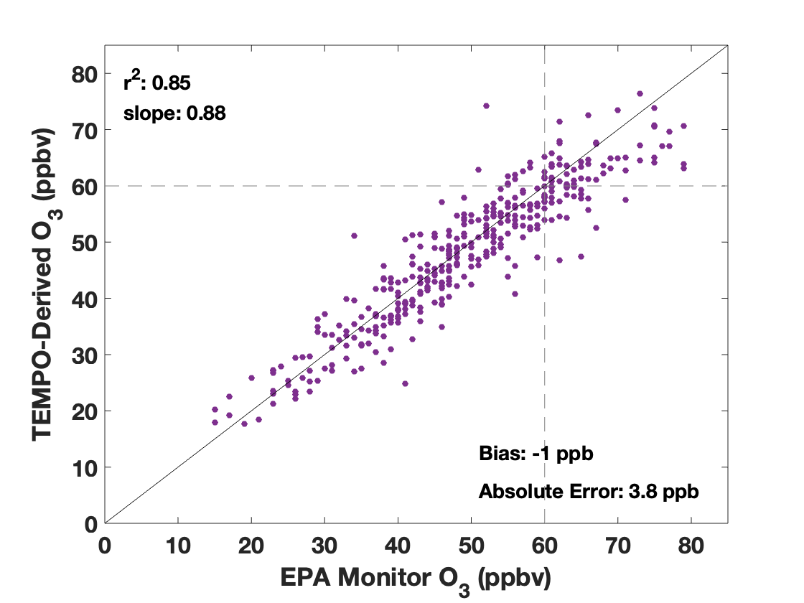
TEMPO-derived captures diurnal variability but often misses peak O₃
O₃ variability at DC Takoma Rec Center EPA site
O₃ variability at UW – Milwaukee EPA site
Shading indicates nighttime (8pm – 7am), and numbers indicate number of TEMPO-Derived observations per day.
TEMPO-derived product captures high O₃ (O₃ > 60 ppb) 70% of the time.
Results are preliminary and may change.

Slide 7
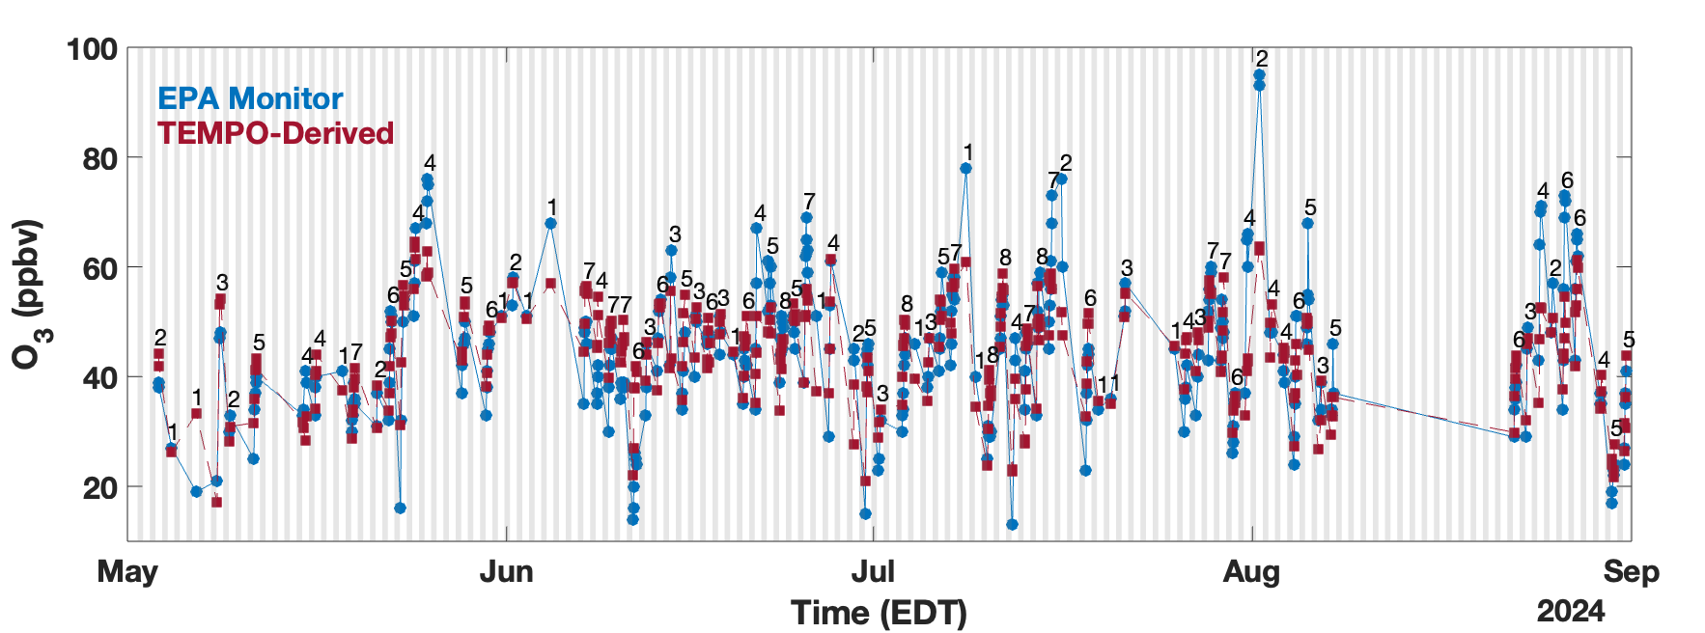
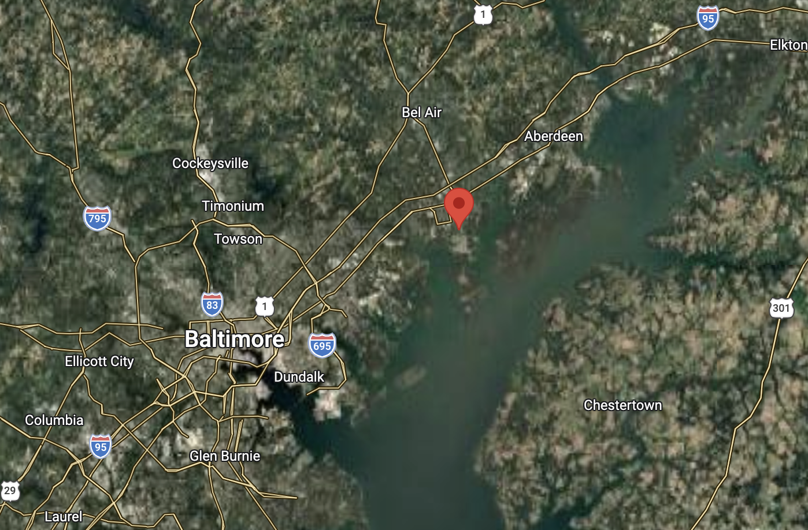
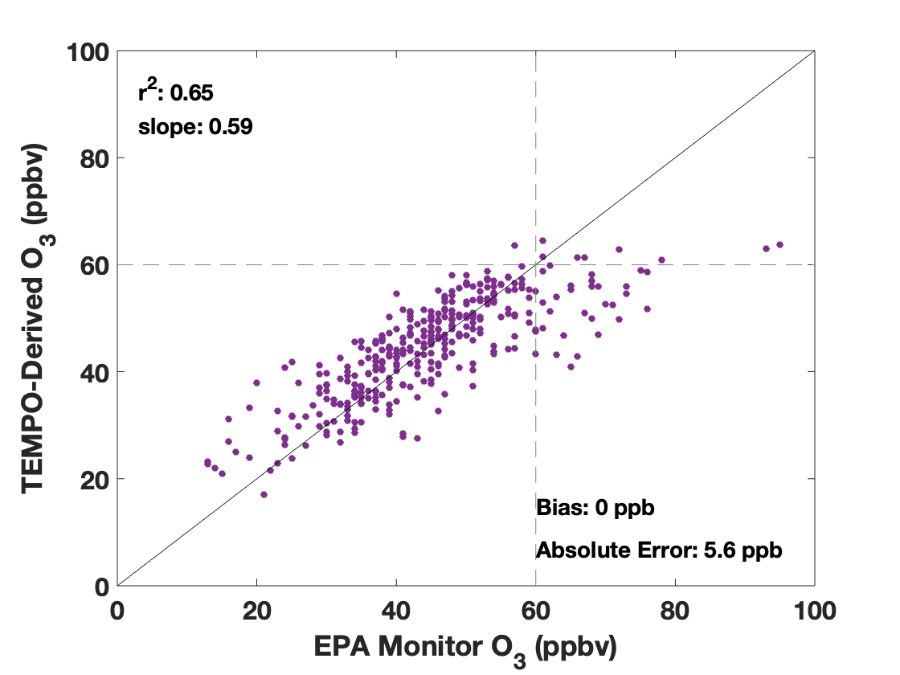
Performance declines at some sites near land/water interface
O₃ variability at Edgewood EPA site
O₃ variability at UW – Milwaukee EPA site
Shading indicates nighttime (8pm – 7am), and numbers indicate number of TEMPO-Derived observations per day.
TEMPO-derived product captures high O₃ (O₃ > 60 ppb) 23% of the time.
Results are preliminary and may change.

Slide 8
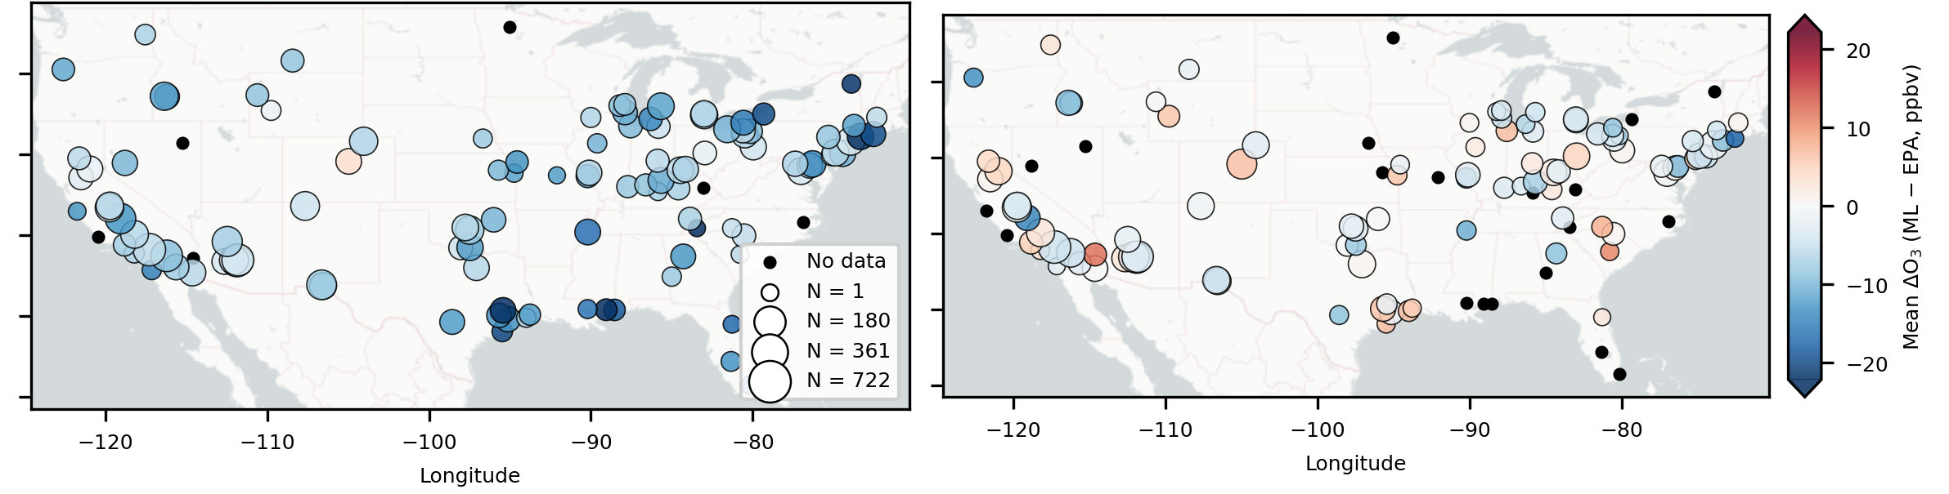
Consistent low bias at high O₃ across sites
Bias in ML O₃ when EPA monitor > 60 ppb
Bias in ML O₃ when ML O₃ > 60 ppb
Near term focus is improving ML model performance for these high O₃ cases.
Results are preliminary and may change.

Slide 9
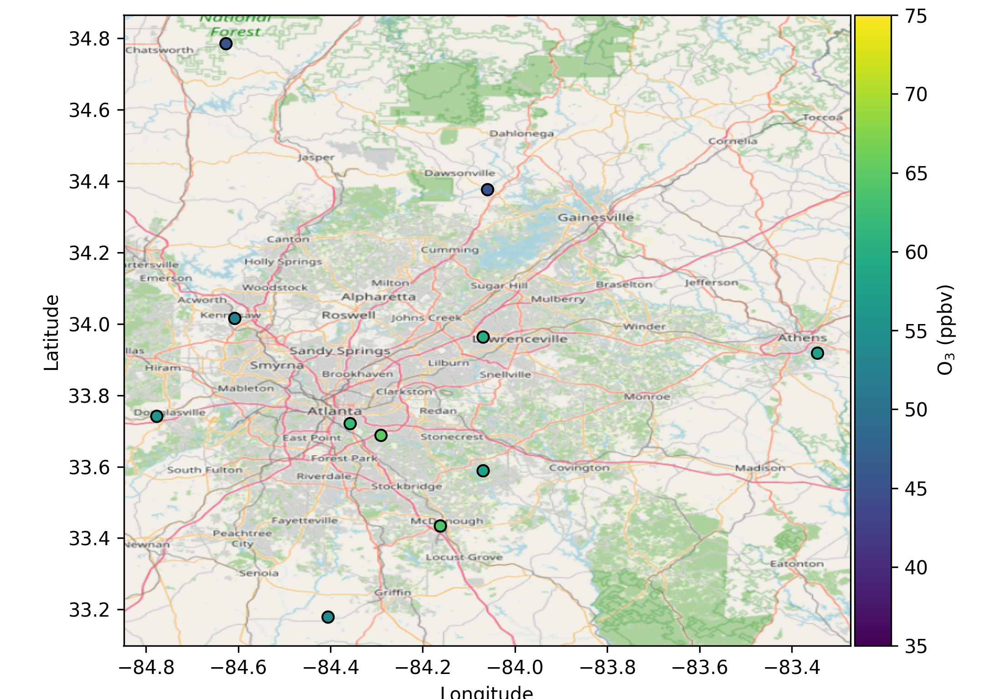
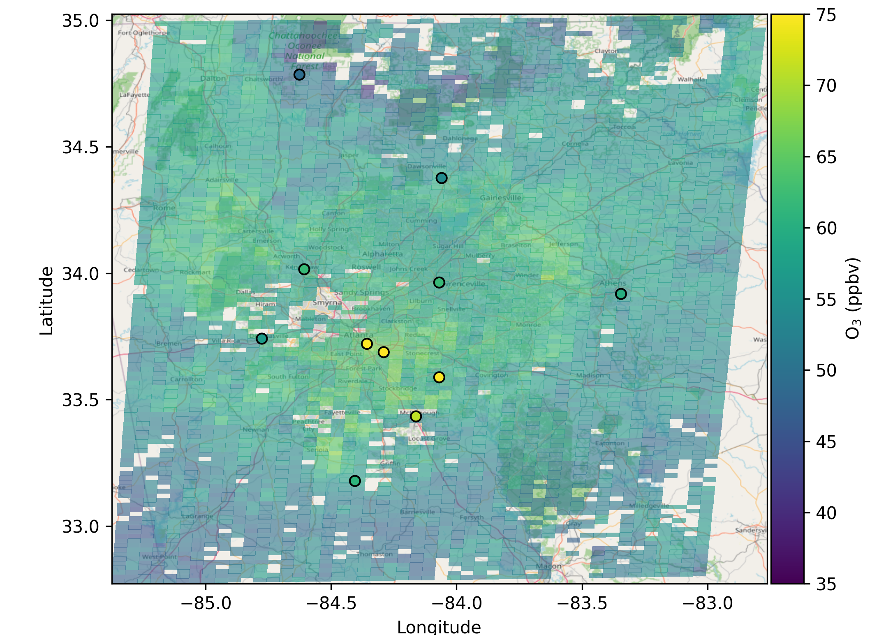
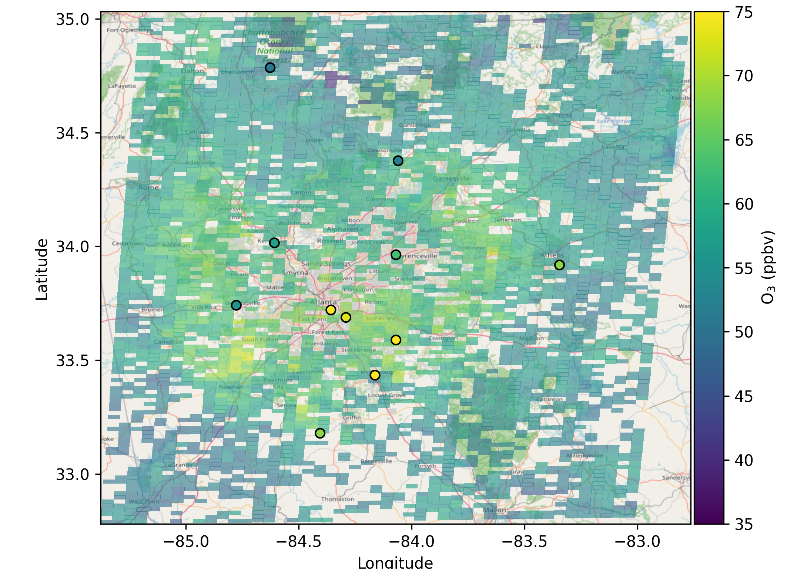
Capturing O₃ exceedances in metro Atlanta
10:00 AM
12:00 PM
2:00 PM
Metro
Atlanta
TEMPO-Derived (background) and EPA monitor (circles) O₃ in northern Georgia on June 14, 2024, a day with several exceedances.
TEMPO-derived O₃ qualitatively captures the regional nature of air quality episodes.
Results are preliminary and may change.

Slide 10
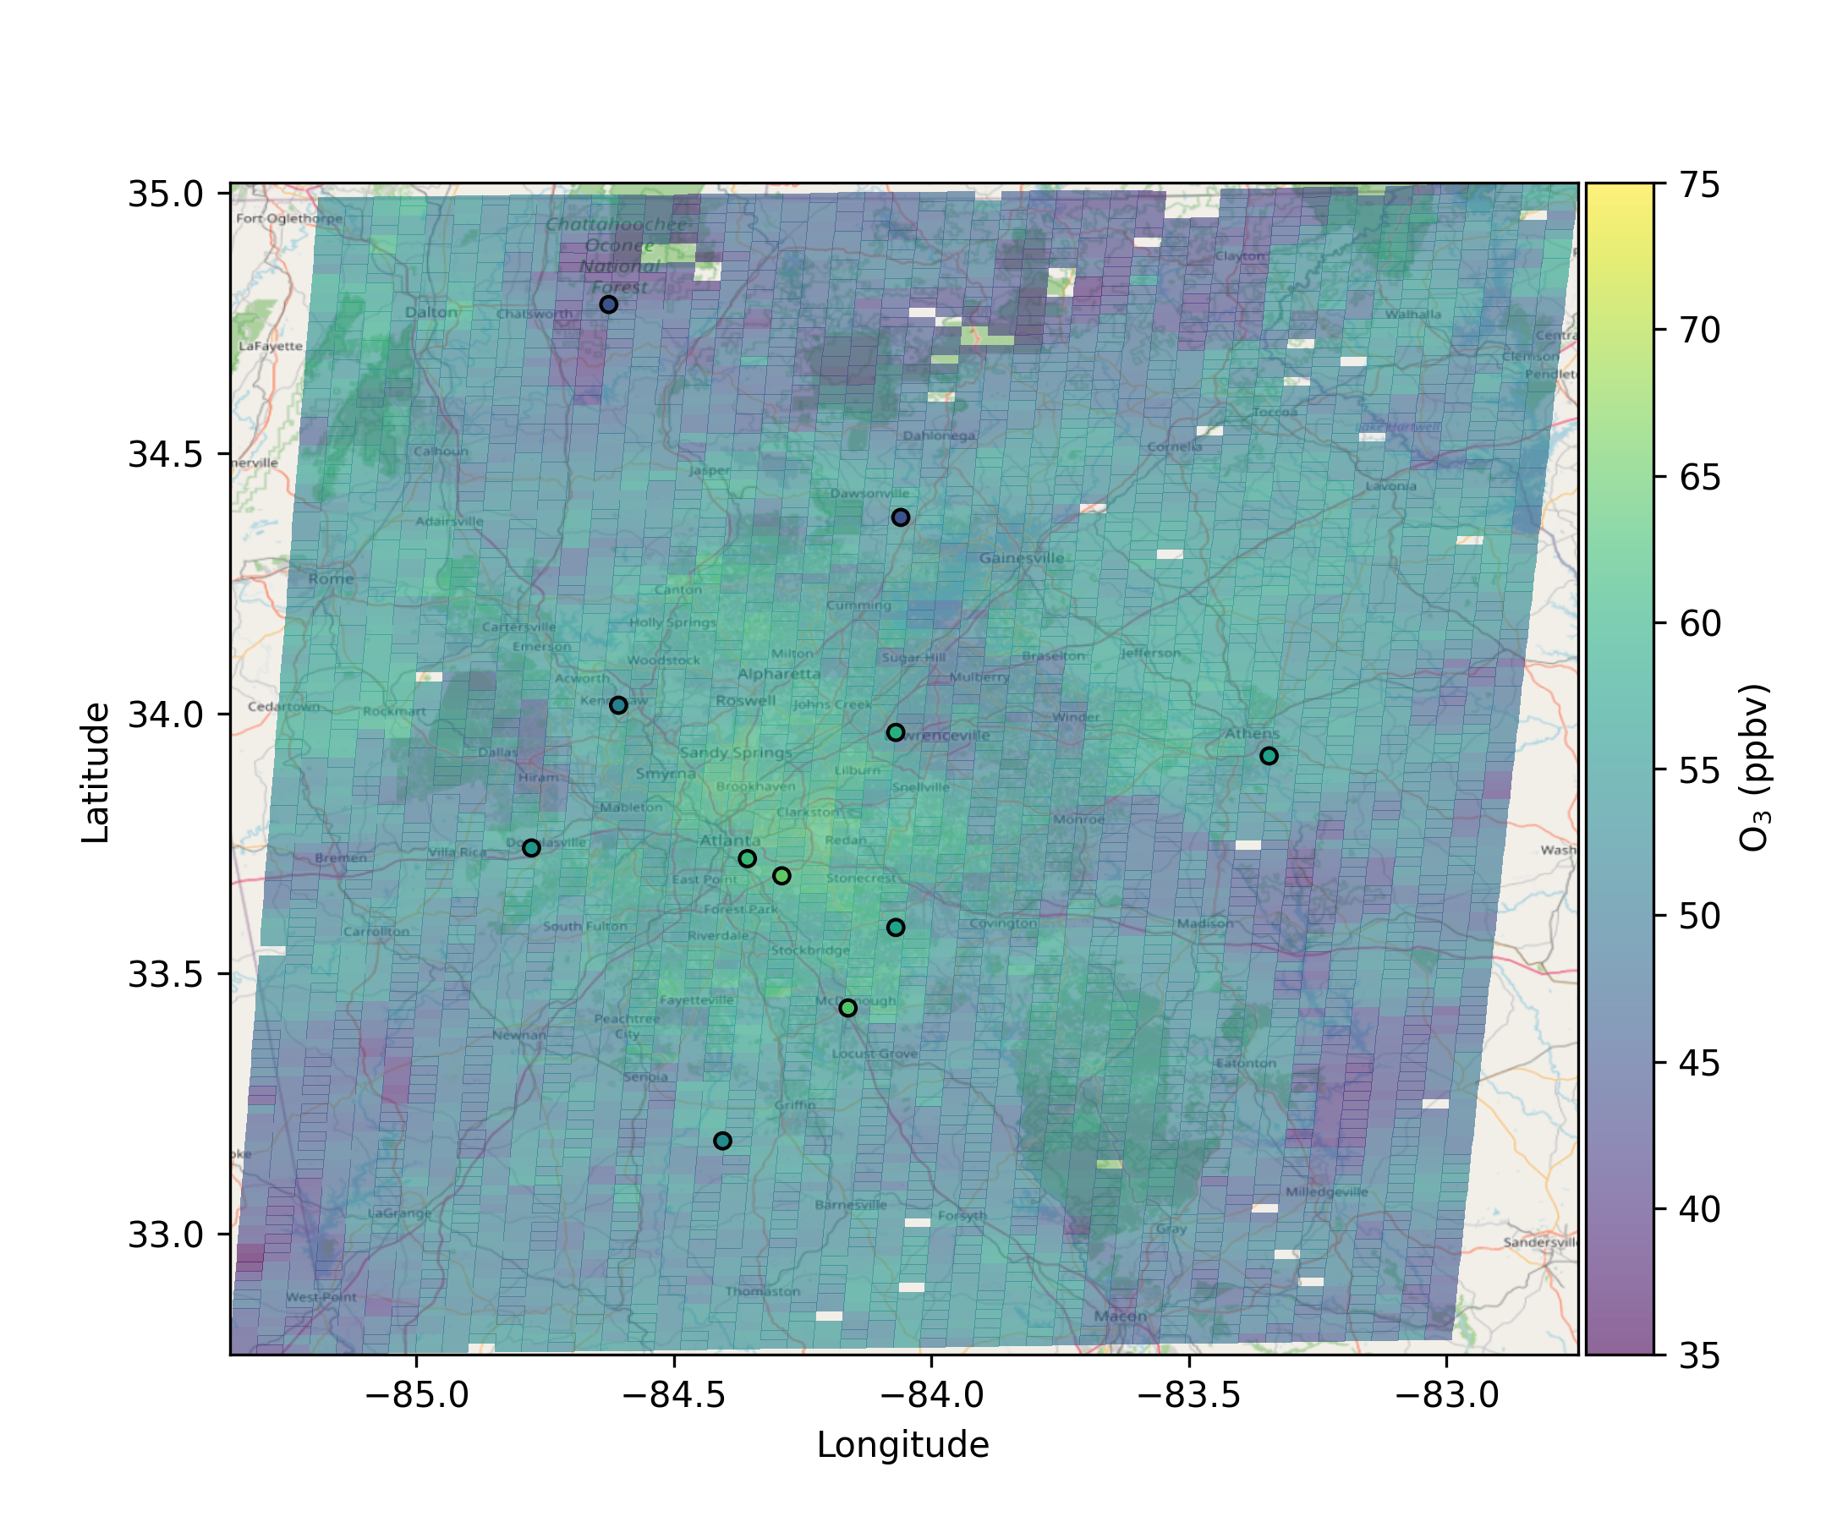
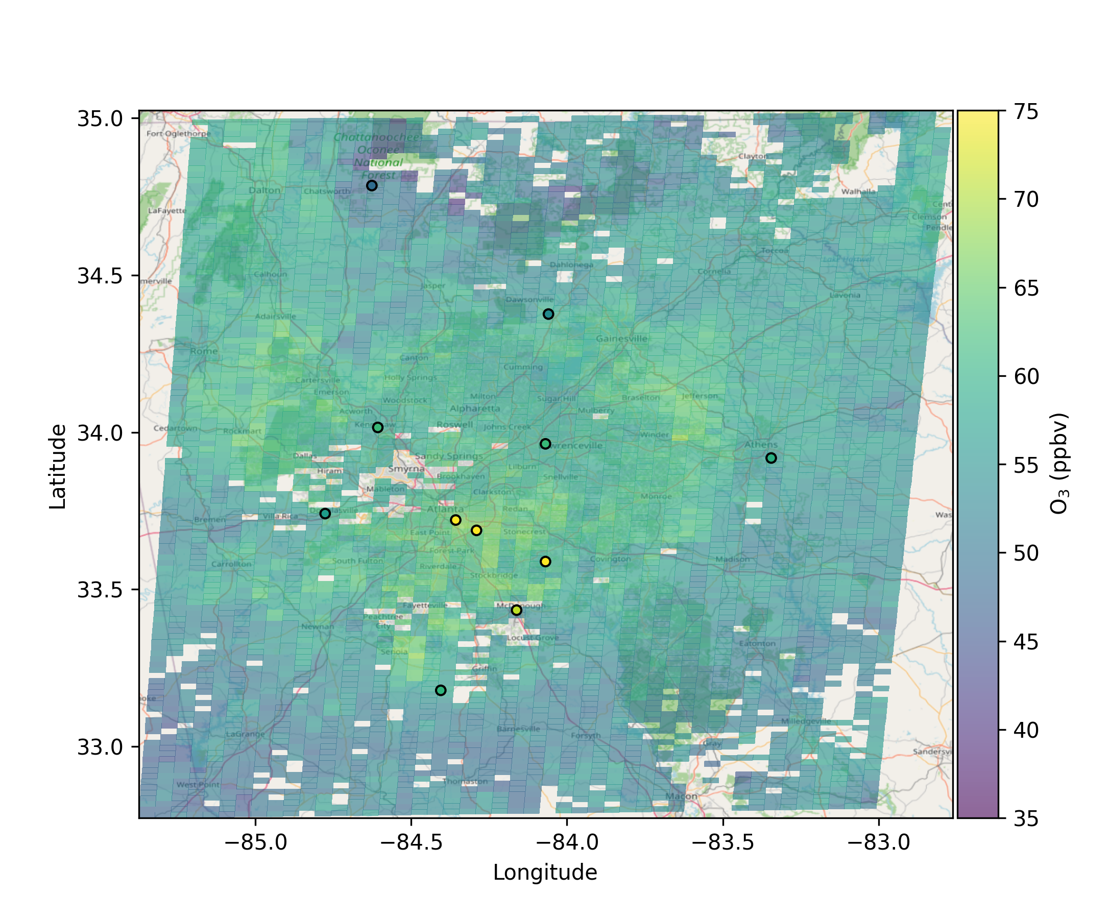
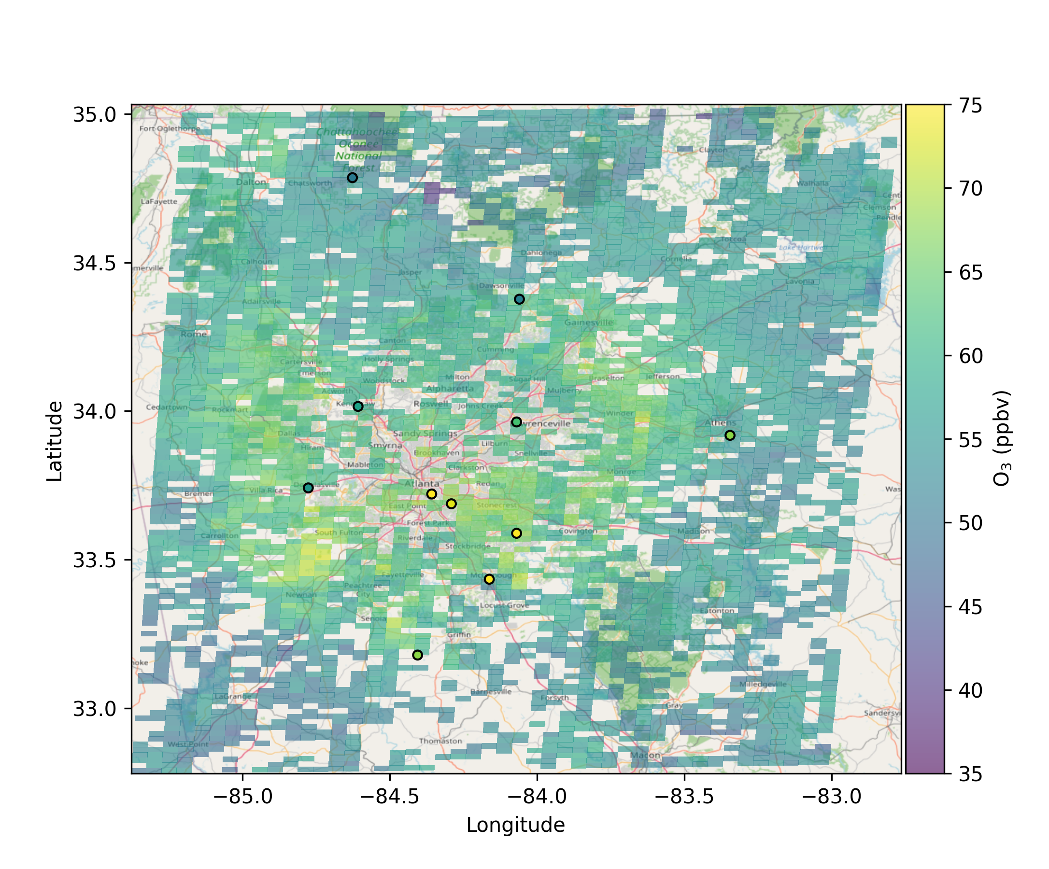
Capturing O₃ exceedances in metro Atlanta
10:00 AM
12:00 PM
2:00 PM
TEMPO-Derived (background) and EPA monitor (circles) O₃ in northern Georgia on June 14, 2024, a day with several exceedances.
TEMPO-derived O₃ qualitatively captures the regional nature of air quality episodes.
Results are preliminary and may change.

Slide 11
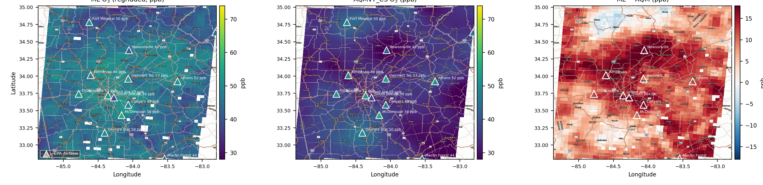
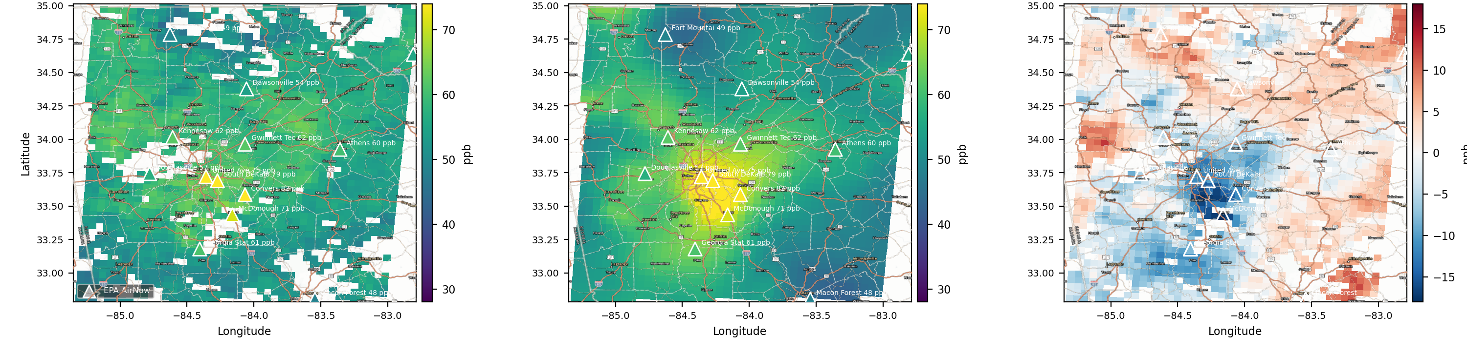
Evaluating regional performance
TEMPO-Constrained O₃
NOAA AQ Forecast Model
Difference (TEMPO – NOAA)
Goal is to have TEMPO-constrained product to perform better than AQ forecasts.
10:00 AM
1:00 PM
EPA monitor (triangles). June 14, 2024. TEMPO data have been gridded to NOAA grid.
Results are preliminary and may change.

Slide 12
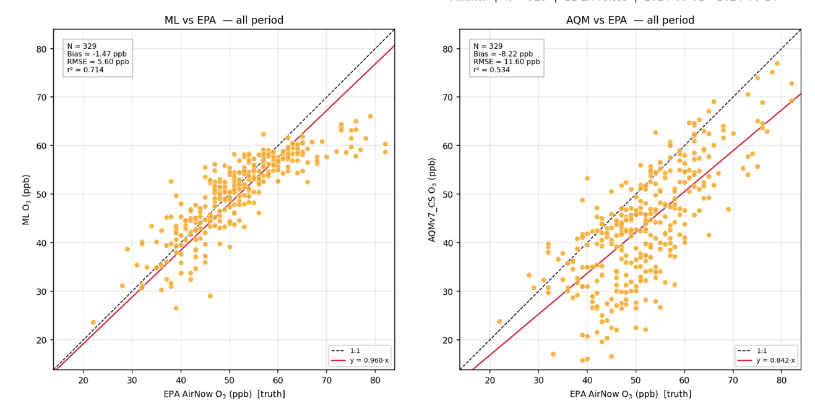
Evaluating regional performance
TEMPO-constrained product performs better for O₃ < 60 ppb, suggesting potential utility of product.
TEMPO-Constrained O₃
NOAA AQ Model O₃
EPA O₃
EPA O₃
Data from metro Atlanta for June 1 – 14, 2024.
Results are preliminary and may change.

Slide 13
Conclusions and future work
Strong performance at many sites for O₃ < 60 ppb
Qualitatively captures regional O₃ issues
Many potential air quality applications for AQ management: informing O₃ events in NRT, siting future monitors, understanding exceptional events, etc.
Future:
  Improving performance at high O₃
  Understanding reasons behind poor performance at some sites.
  Case studies: wildfires, stratospheric intrusions
  Short-term O₃ forecast
  Evaluation of TEMPO 0 – 2 km product
Contact: daniel.c.anderson@nasa.gov
Results are preliminary and may change.

Slide 14
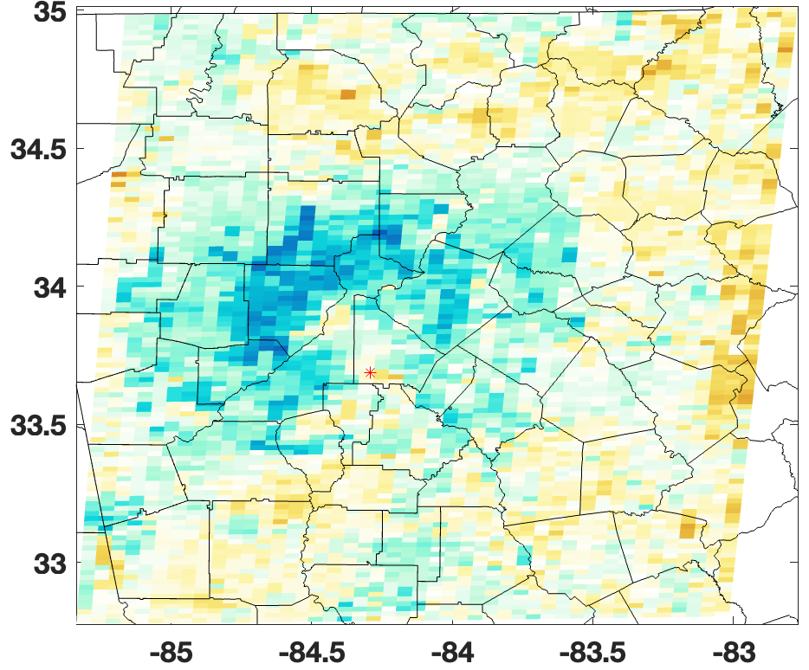
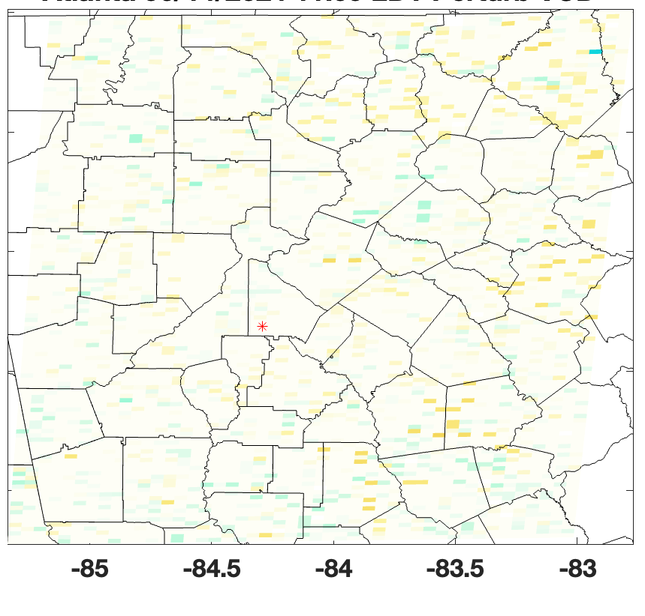
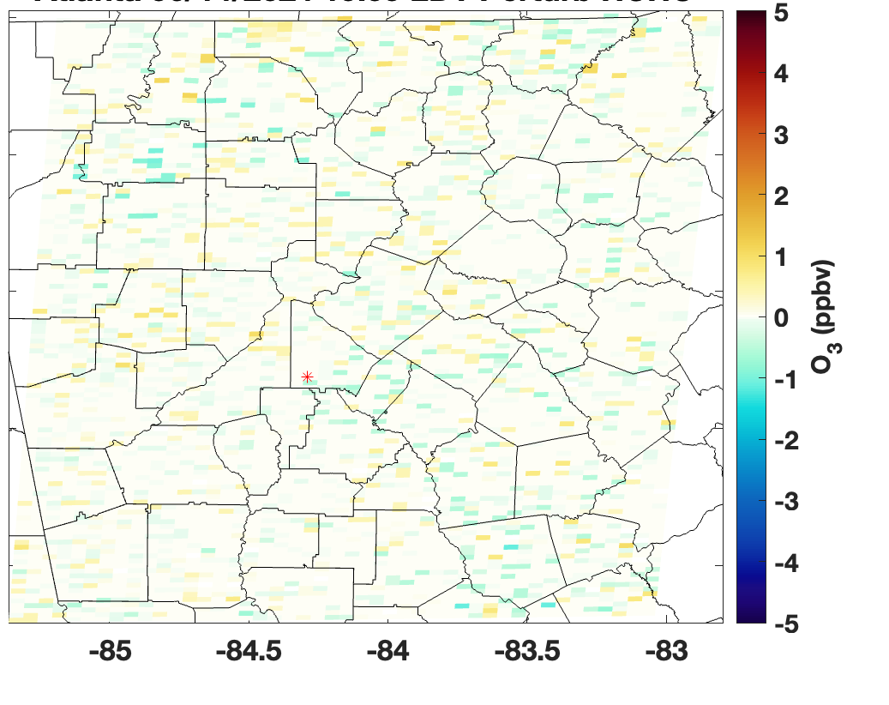
Current model relatively insensitive to TEMPO NO₂ and HCHO
Total Column O₃
Trop. Column NO₂
Trop. Column HCHO
Absolute difference in TEMPO-derived O₃ when indicated ML input was perturbed by 10% for 6/14/24 in metro Atlanta.
Goal is to develop methods to increase model sensitivity to chemical inputs (e.g., spatial averaging, shape factors to estimate surface values).
Results are preliminary and may change.

