Slide 1




TEMPO DART Team Meeting
High-resolution Column NO₂ from GCAS:
Implications and Synergy with Pandora and Satellite Observations
June 17, 2026
Jonguk Park, Tom Hanisco, Apoorva Pandey, Bryan Place
and GCAS team

Slide 2
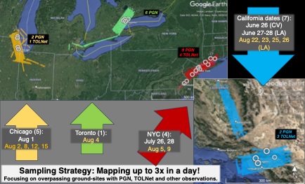
Airborne GCAS observations during the STAQS campaign
STAQS
(Synergetic TEMPO Air Quality Science)
AQ
Campaign period
June – August 2023 (GCAS flights)
OC
Mission objectives
Integrate TEMPO satellite observations with traditional air quality monitoring to improve understanding of air quality science and increase social benefit
GEO-CAPE Airborne Simulator (GCAS)
specification (AQ)
GCAS flew over major U.S. cities
17 flight days × maximum 3 rasters/day
Chicago (5 days), Toronto (1), NYC (4), California (7)
JSC G-V: ~ Aug 15 (13 flights) / with HSRL-2
LaRC G-Ⅲ: Aug 22~ (4 flights) / with HALO
Weight (dimensions) | 80 lbs, 19”×19”×18”
Spectral resolution | 0.6 nm
Spectral sampling | 0.2 nm
Spectral range | 300 – 490nm
FOV (iFOV) | 45° (0.8 mrad)
Native detector (spectral × spatial) | 1072 × 1024
SNR | 600 (340 nm) 900 (440 nm)
Nominal spatial resolution * at nadir, alt=33,000 ft ** Typical, with sampling cadence ≈ 2.3 s | x-track: | 250 m*
 | a-track: | 250 m**
NO₂ fitting window | 430 – 460 nm
2-σ detection limit | 1.6e15 molec cm⁻²

Slide 3
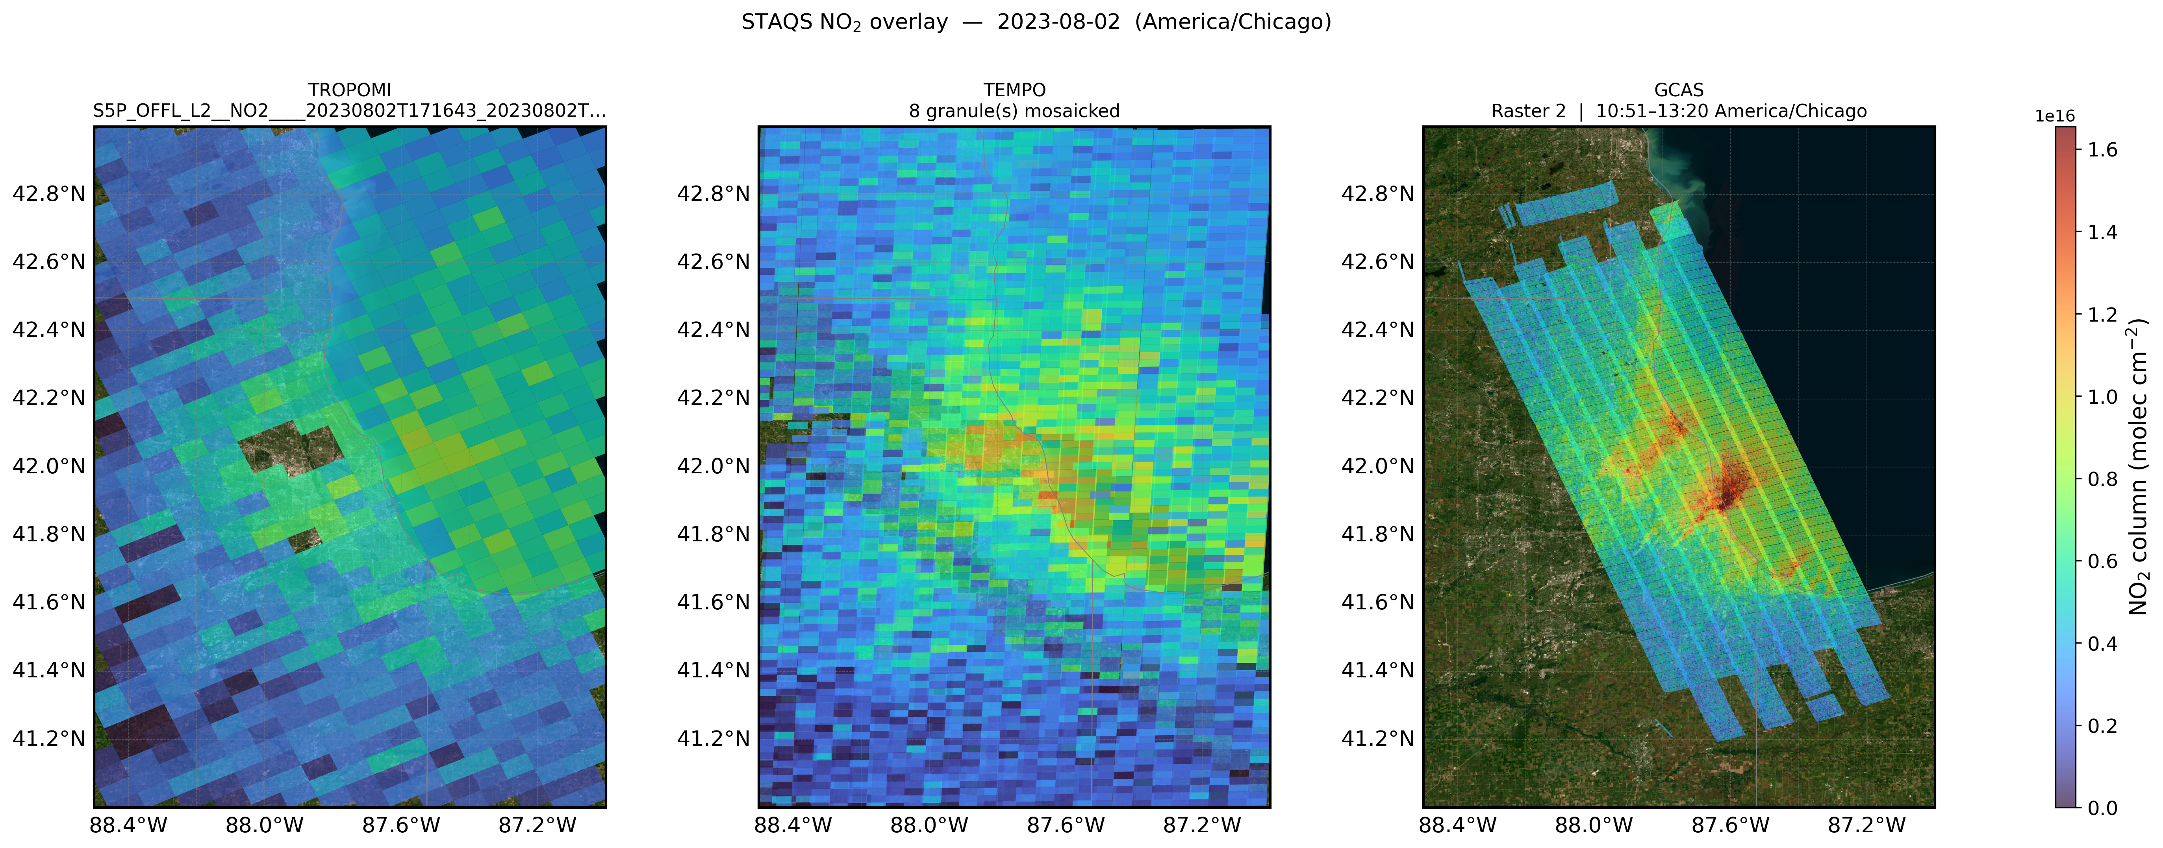
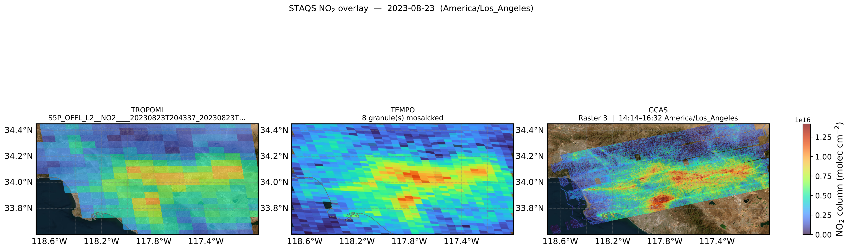
Airborne GCAS observations during the STAQS campaign
TROPOMI
TEMPO
GCAS
20230802 Chicago
20230823 California
Notes:
Virtue of high-resolution observations

Slide 4

Methods to co-locate GCAS and Pandora for intercomparison
Conventional co-location
(single pixel, spatial window)
Ray-tracing
Calculating synthetic GCAS data along the line of sight (LOS) of Pandora measurements
 |  | Method (how)
Conventional | Pixel | GCAS (satellite) pixel containing the ground-based instrument location
 | Spatial average | 3×3 mean (mean of the 9 nearest pixels)
Ray-tracing | Accumulated SCD along the LOS “n(z)-stacked VCD” | Create 3-D number-density field based on model profiles scaled to match GCAS VCD. Integrate n·ds along the solar LOS (zenith=SZA, az=SAA) from ground to the aircraft altitude; report SCD and SCD·cosSZA as a below-aircraft VCD-equivalent.
 | n(z)-weighted LOS pixel-VCD “n(z)-weighted VCD” | Walk the LOS, weight each probed pixel's retrieved VCD by the local model number density n(z); report the weighted mean. DS uses SAA/SZA; sky uses VAA / VZA=75°. Sky also reports the unweighted simple mean.
It is more intuitive (physical) to compare ground-based Pandora observations with raytraced synthetic GCAS data
Notes:
Used number densities of target species along the line of sight (LOS) based on a priori model profiles used in GCAS retrievals

Slide 5
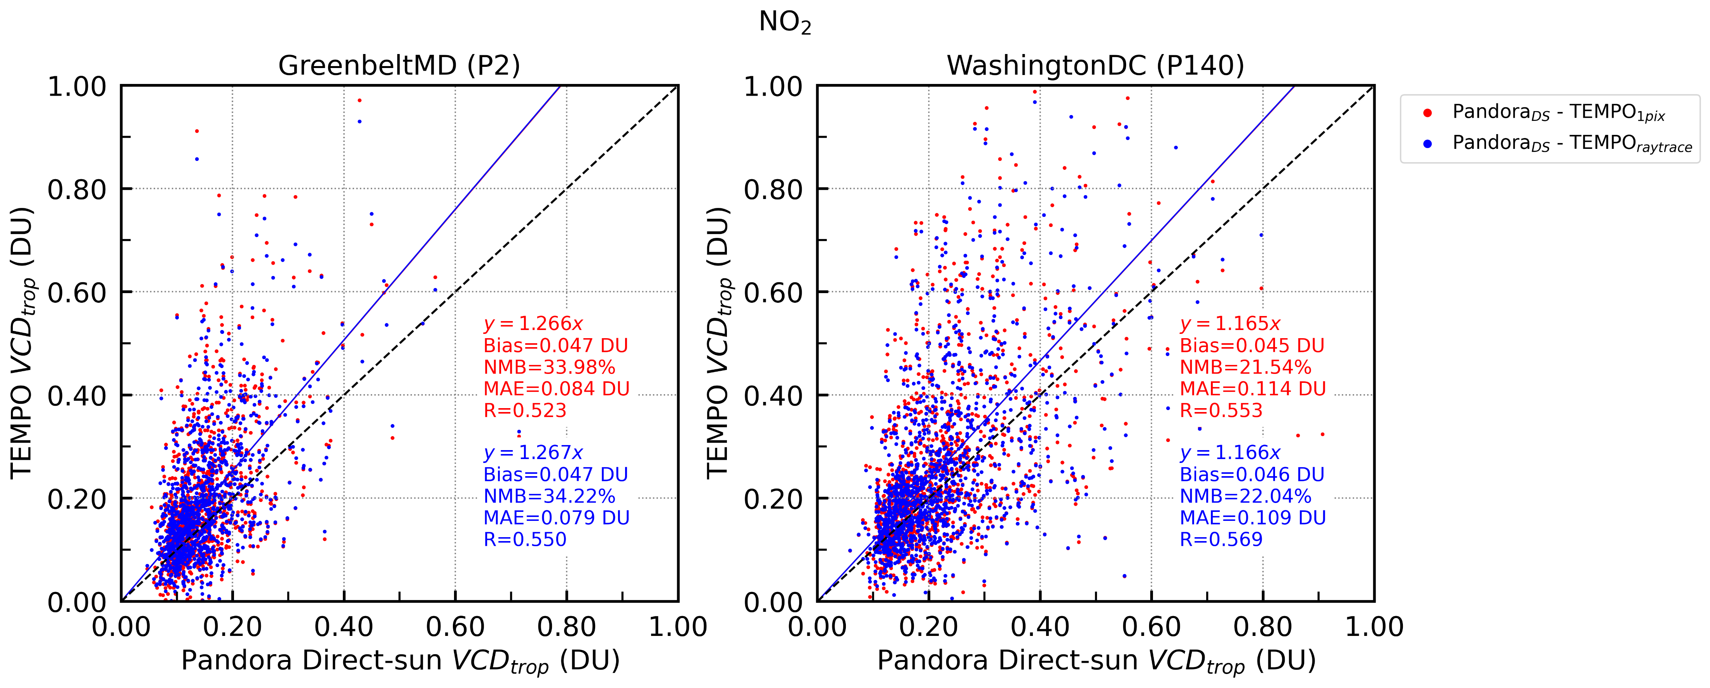
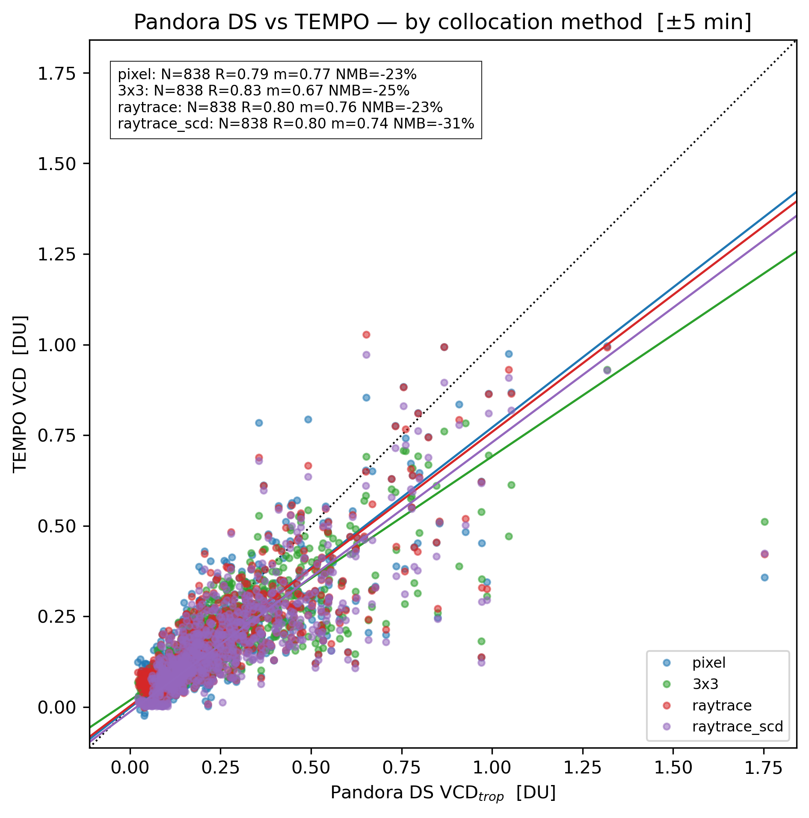
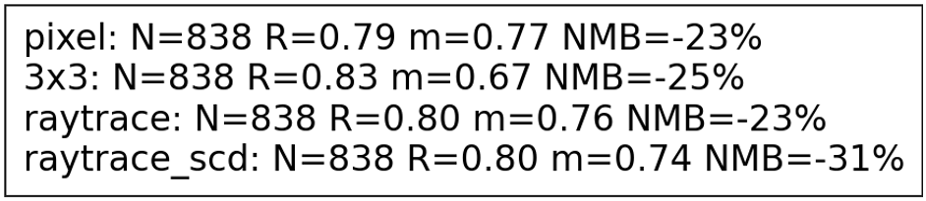
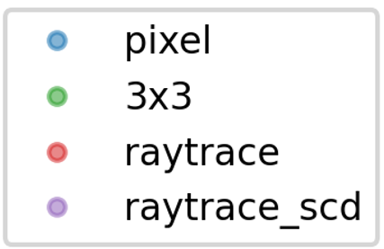
Ray-tracing vs conventional: TEMPO–Pandora intercomparison
Greenbelt (MD), year 2024
During STAQS & in STAQS domain
* TEMPO NO₂ VCDs in this figure are V4
TEMPO NO₂ VCD [DU]
Pixel
3×3
n(z)-stacked
n(z)-weighted
* TEMPO NO₂ VCDs in this figure are V3
Pandora NO₂ VCD [DU]
Ray-tracing slightly improves TEMPO–Pandora intercomparison score, but not significantly
GCAS has significantly higher spatial resolution than TEMPO (×~10)
  Raytracing can significantly reduce artifacts in GCAS–Pandora intercomparison by matching the air-mass they are measuring as close as possible to each other

Slide 6
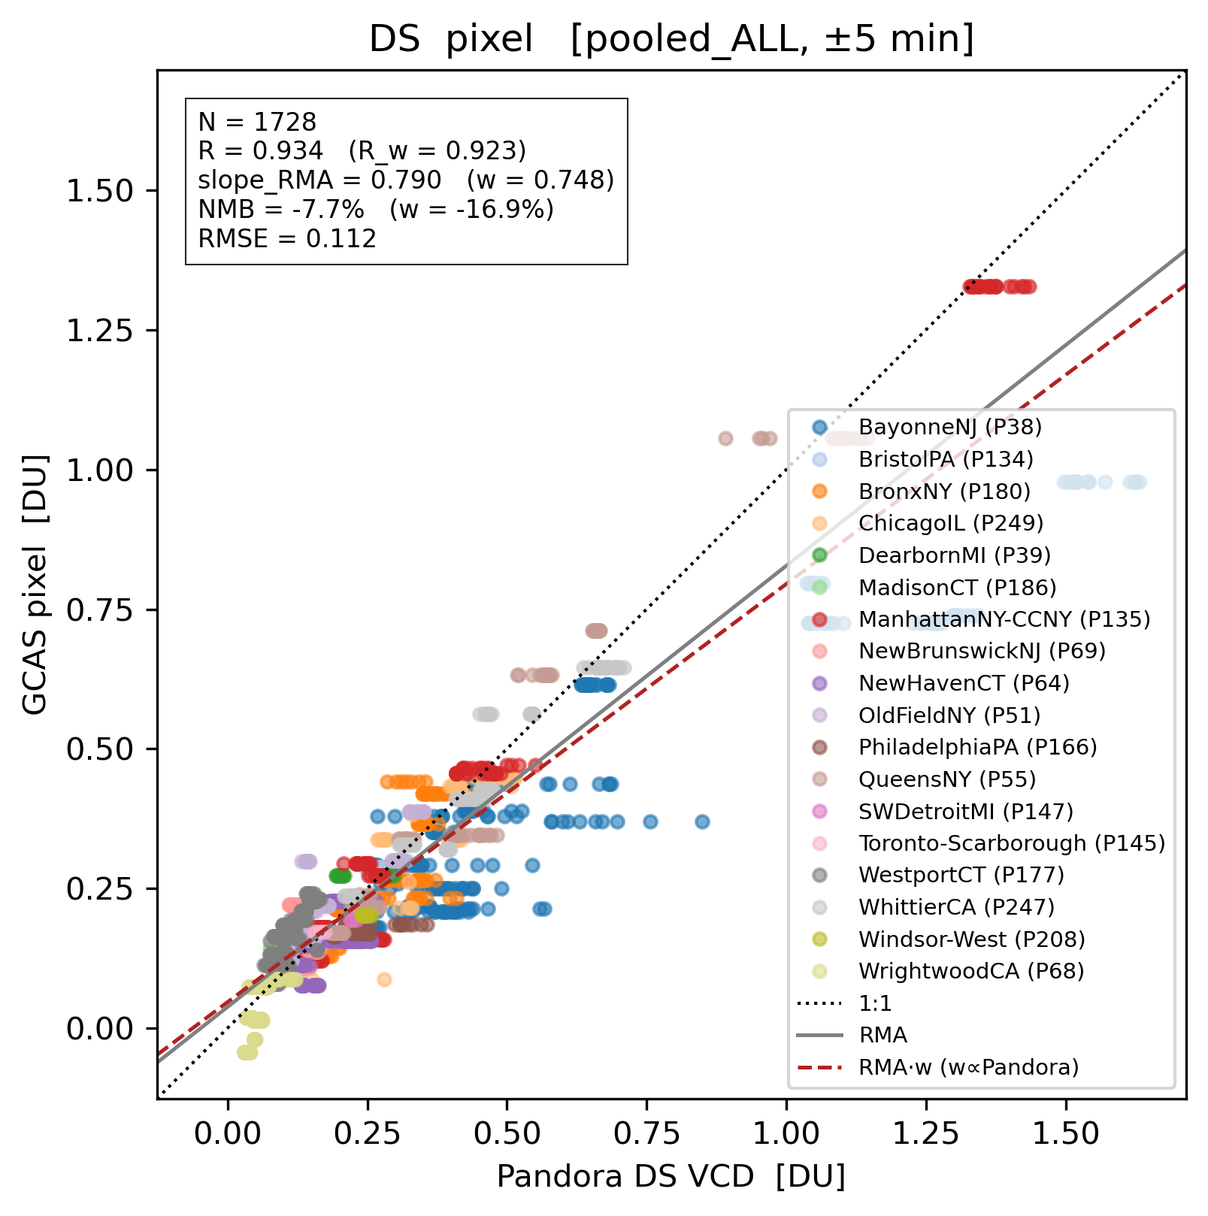
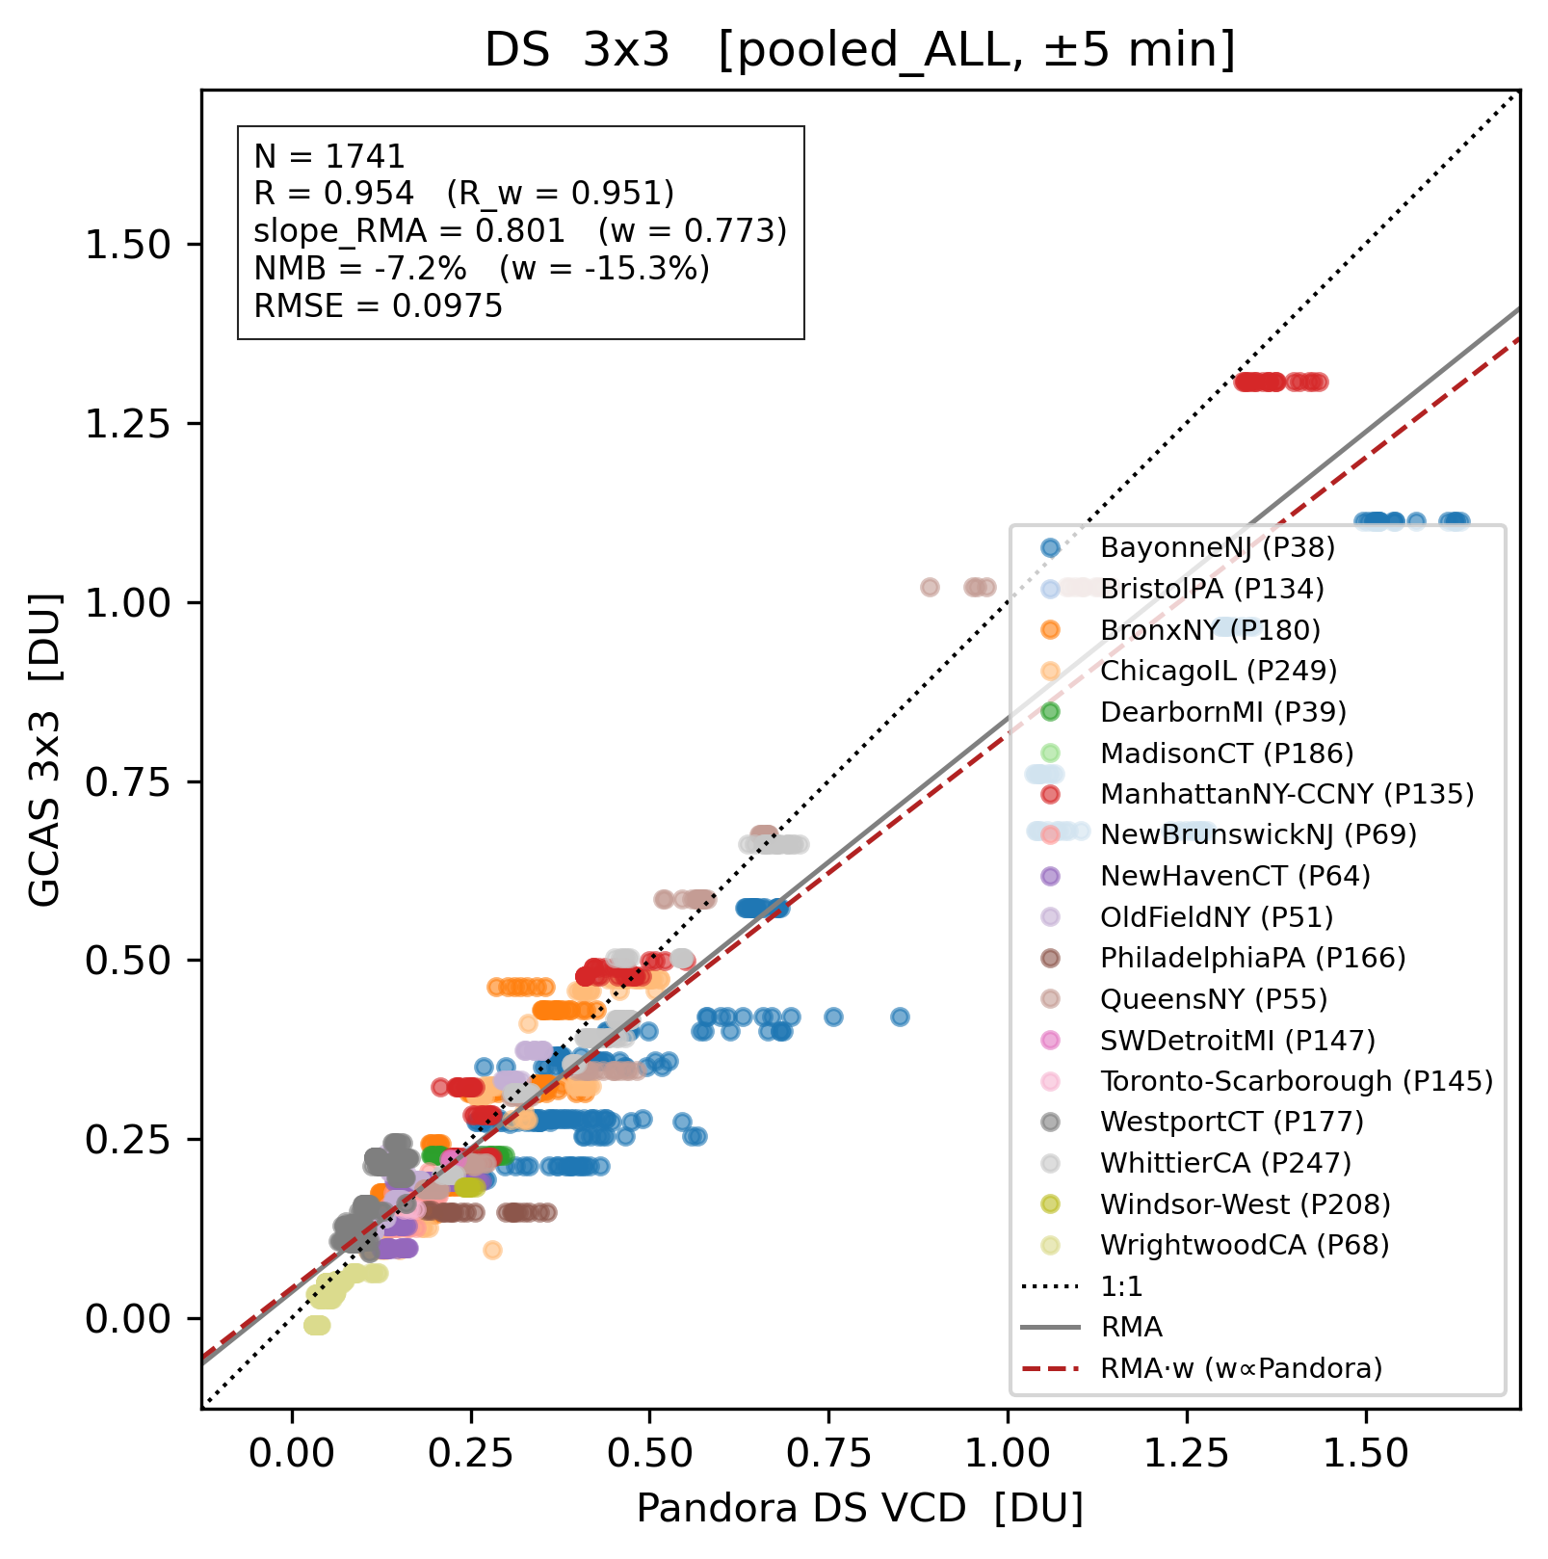
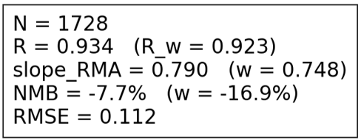
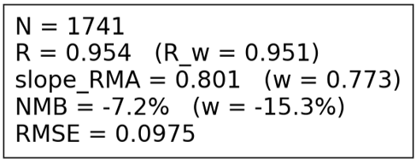
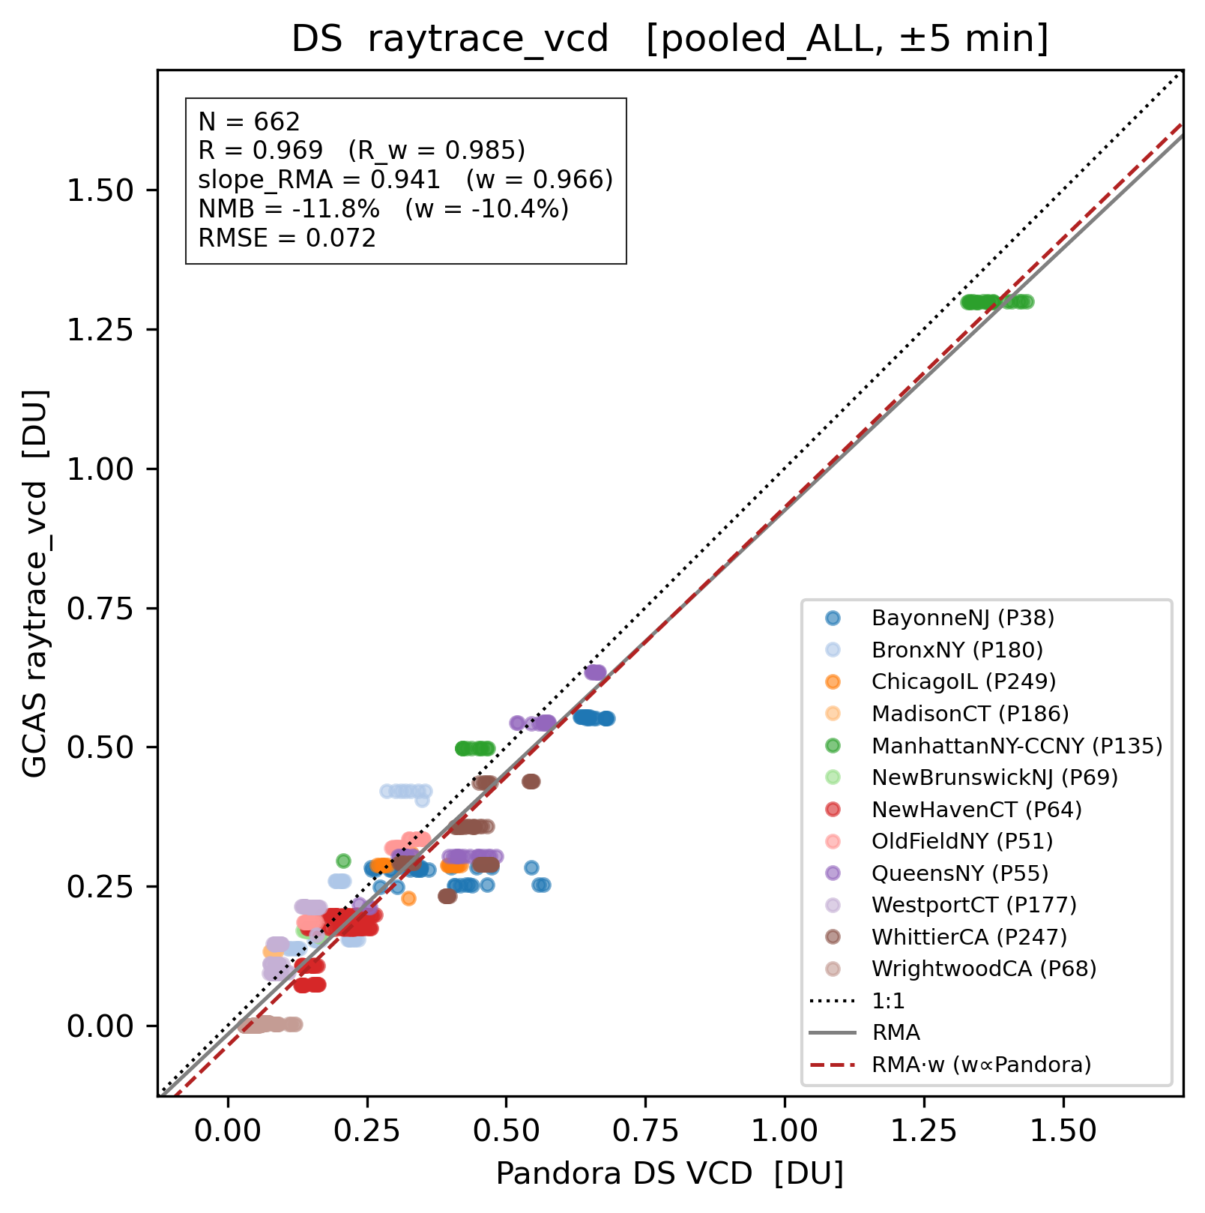
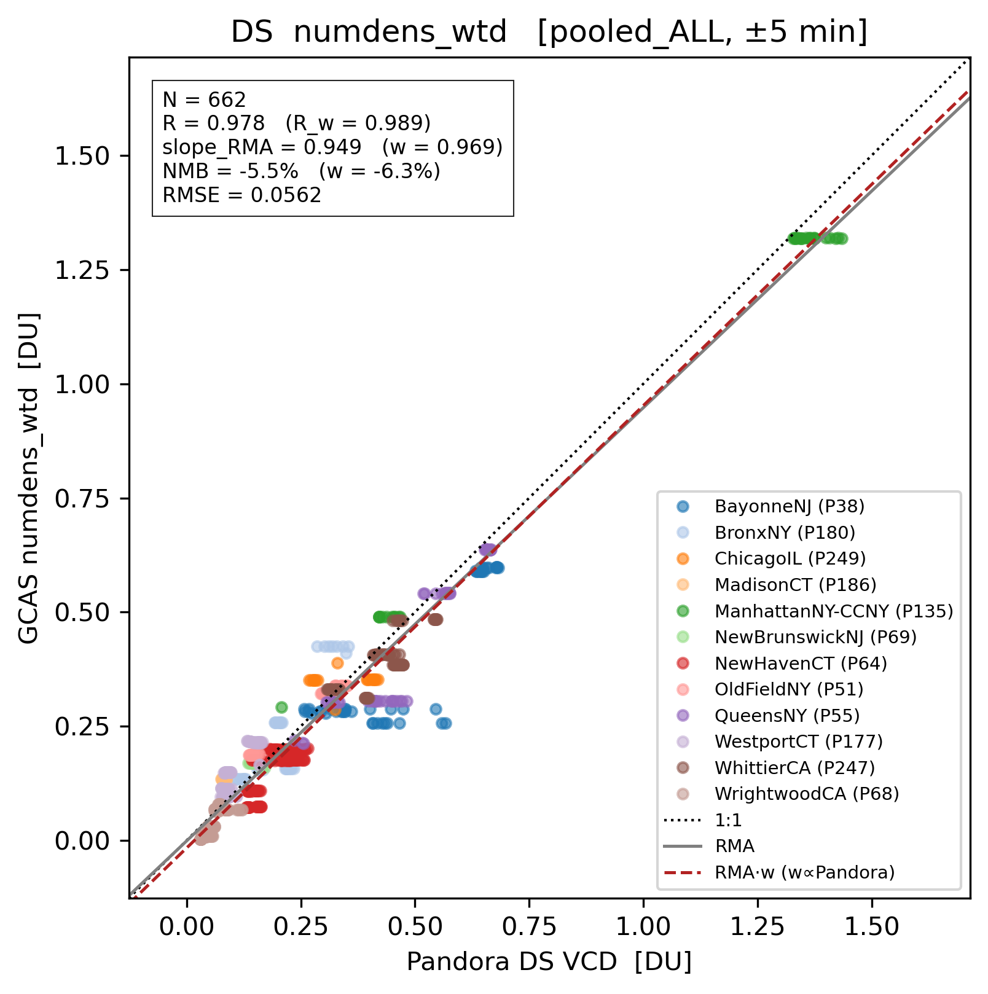
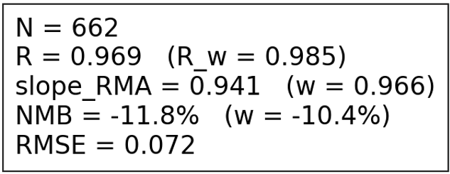
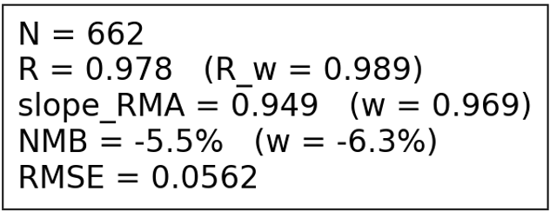
Ray-tracing vs conventional: GCAS–Pandora intercomparison
1 pixel
spatial average (9 pix)
Conventional
n(z)-stacked
n(z)-weighted
LOS-tracing
Temporal co-location window:
GCAS overpass ± 5 min

Slide 7
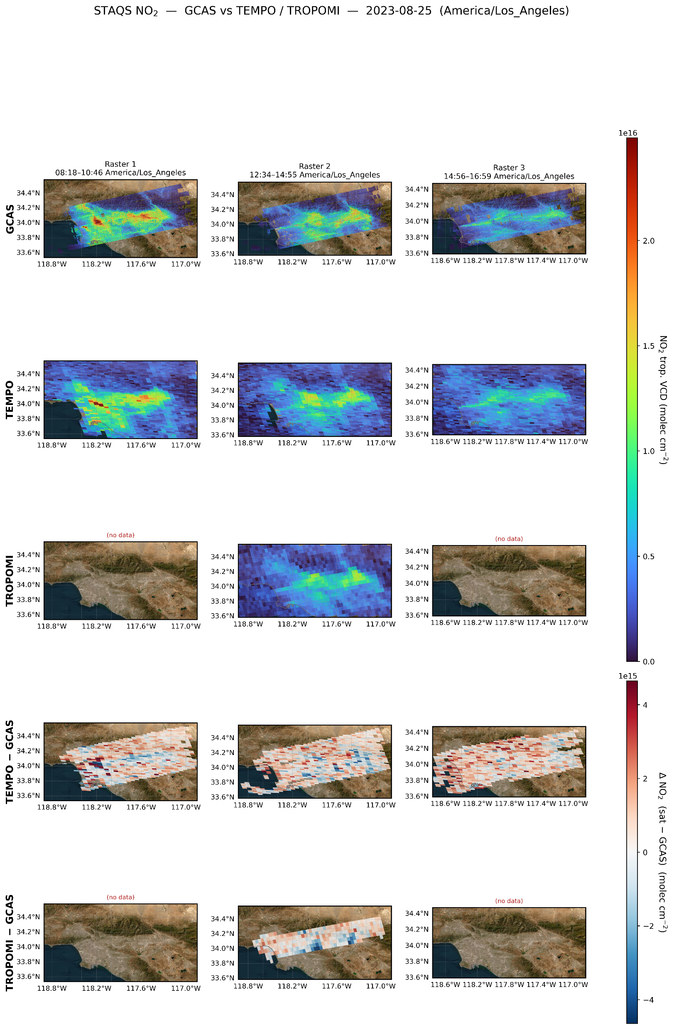
GCAS compared with TEMPO and TROPOMI (NO₂ VCD_{Trop})
ΔNO₂ (TEMPO-GCAS)
TEMPO
GCAS
ΔNO₂ (TROPOMI-GCAS)
August 25, 2023
TROPOMI
Satellite–GCAS are temporally co-located by: Satellite overpass ± 30 min
The temporal disparity may contribute to the spatially random differences between satellite (TEMPO, TROPOMI) and GCAS NO₂
Notes:
Now we know that GCAS observations conforms with Pandora direct-sun measurements, which can be an indicative of its high accuracy.
It is hard to narrow down temporal co-location window for satellite-GCAS comparison. (Maybe higher temporal res TEMPO measurements during the GCAS flights?)

Slide 8
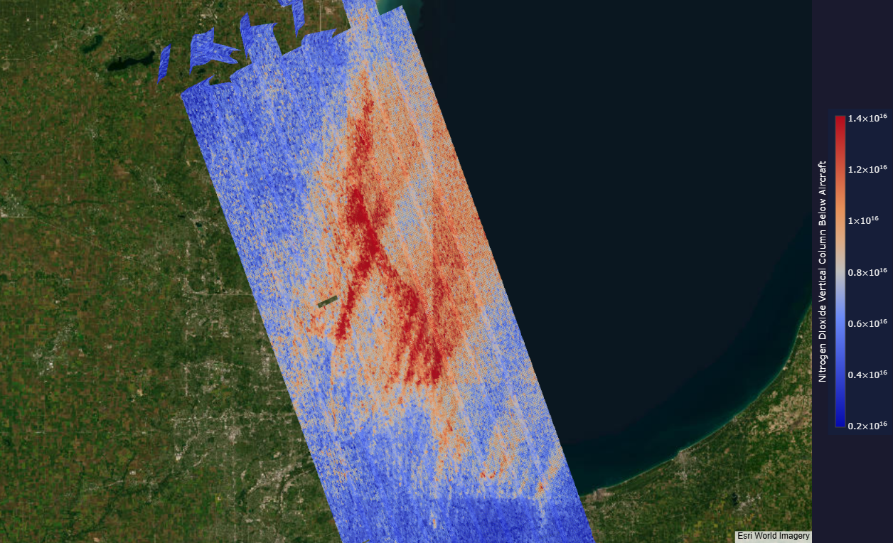
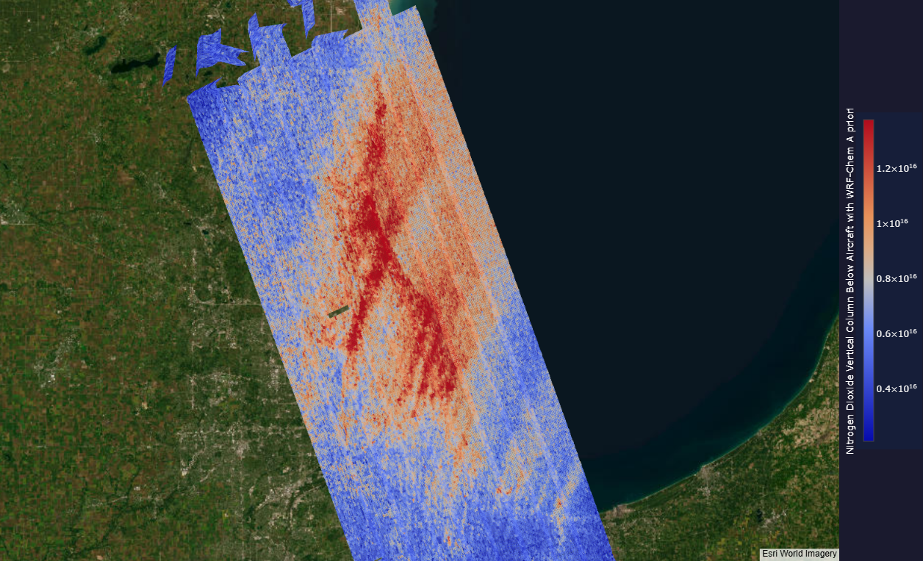
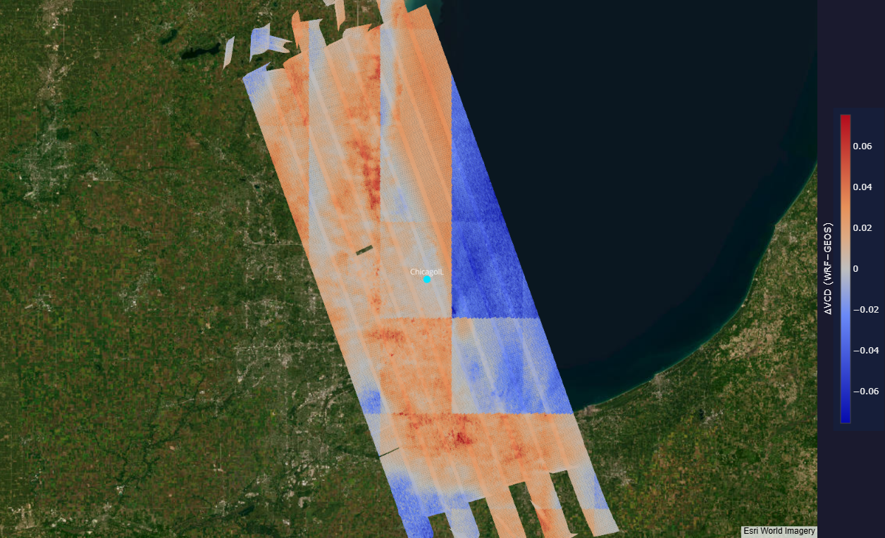
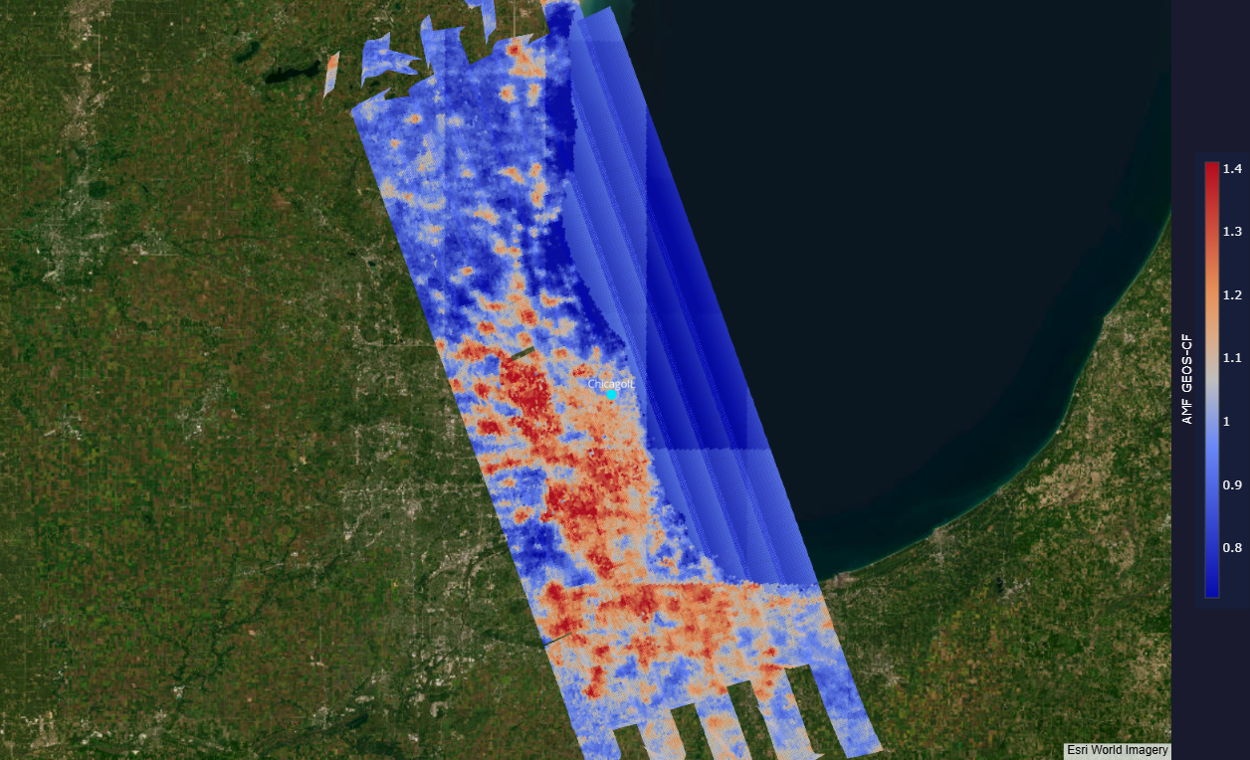
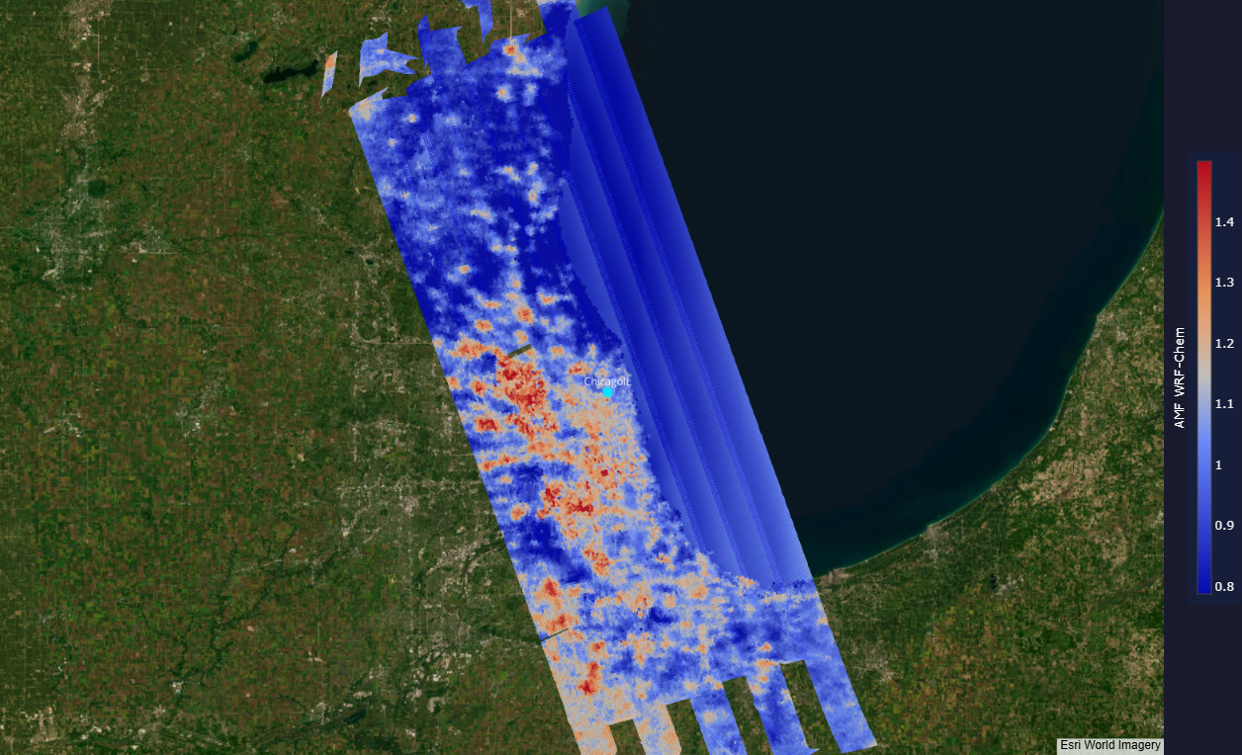
GCAS NO₂ VCD retrieval sensitivity on input model (GEOS-CF, WRF-Chem)
Aug 2, Chicago
GEOS-CF: 0.25° (~ 25 km)
WRF-Chem*: 4 km
NO₂ VCD (GEOS-CF)
NO₂ VCD (WRF-Chem)
ΔNO₂ VCD (WRF–GEOS)
*Special Thanks to:
Brad Pierce _{(UW-Madison)}
Jerrold Acdan (NCAR, previously at UW-Madison)
AMF (GEOS-CF)
AMF (WRF-Chem)
Higher-resolution model a priori yields spatially more continuous (physically reasonable) GCAS NO₂ VCD field

Slide 9
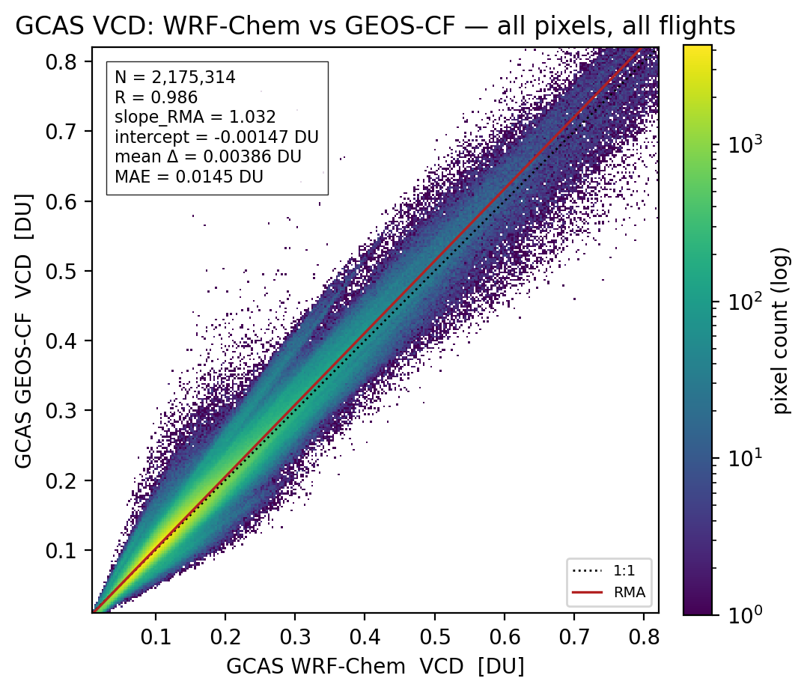
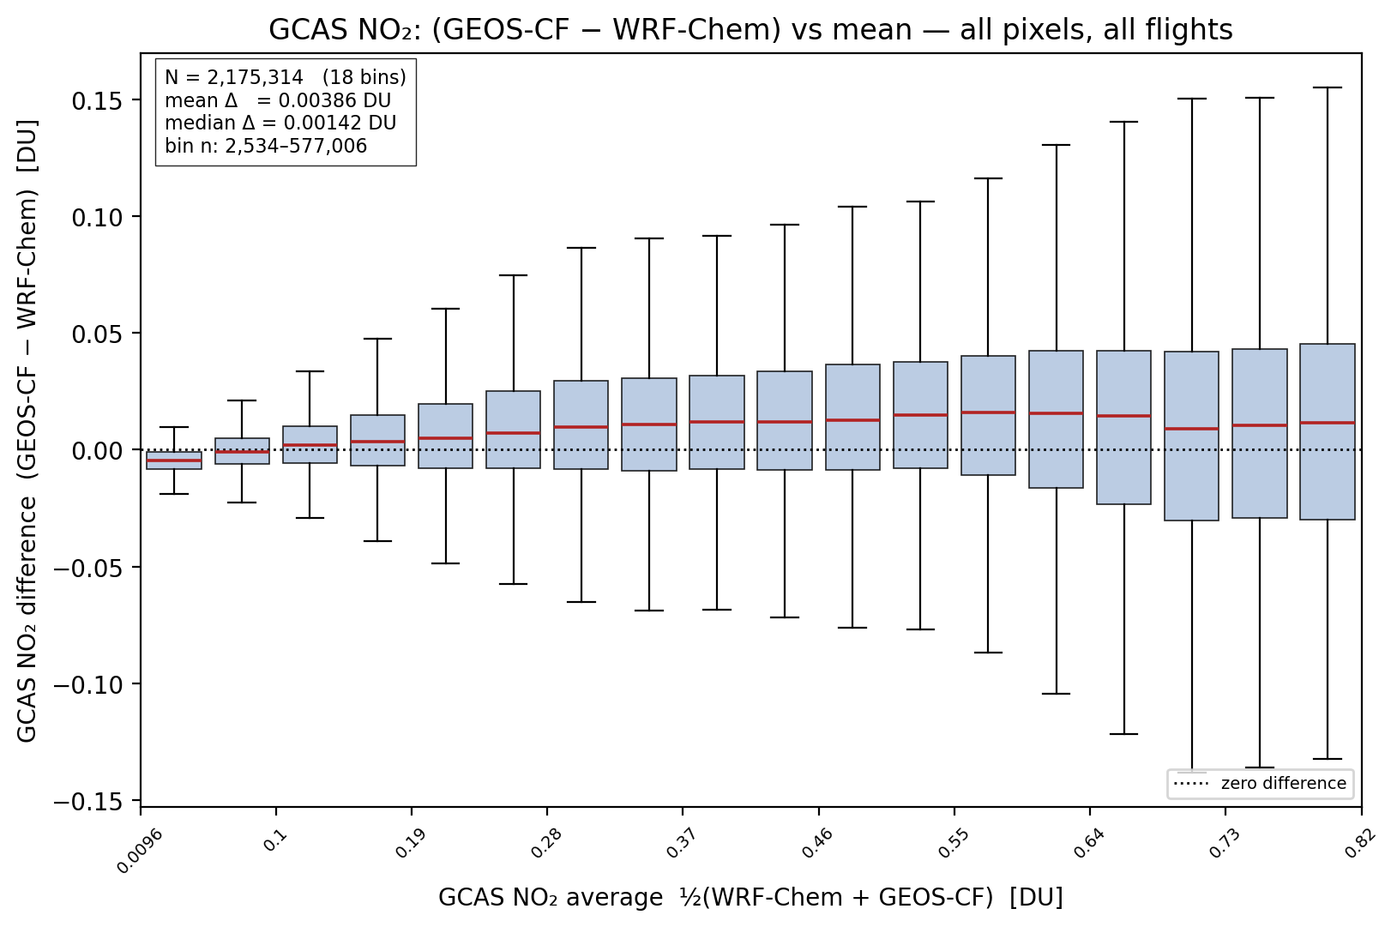
GCAS NO₂ VCD retrieval sensitivity on input model (GEOS-CF, WRF-Chem)
GCAS NO₂ VCDs retrieved with GEOS-CF and WRF-Chem agreed well (R > 0.98, MAE < 0.015 DU), but with greater deviation at higher NO₂

Slide 10
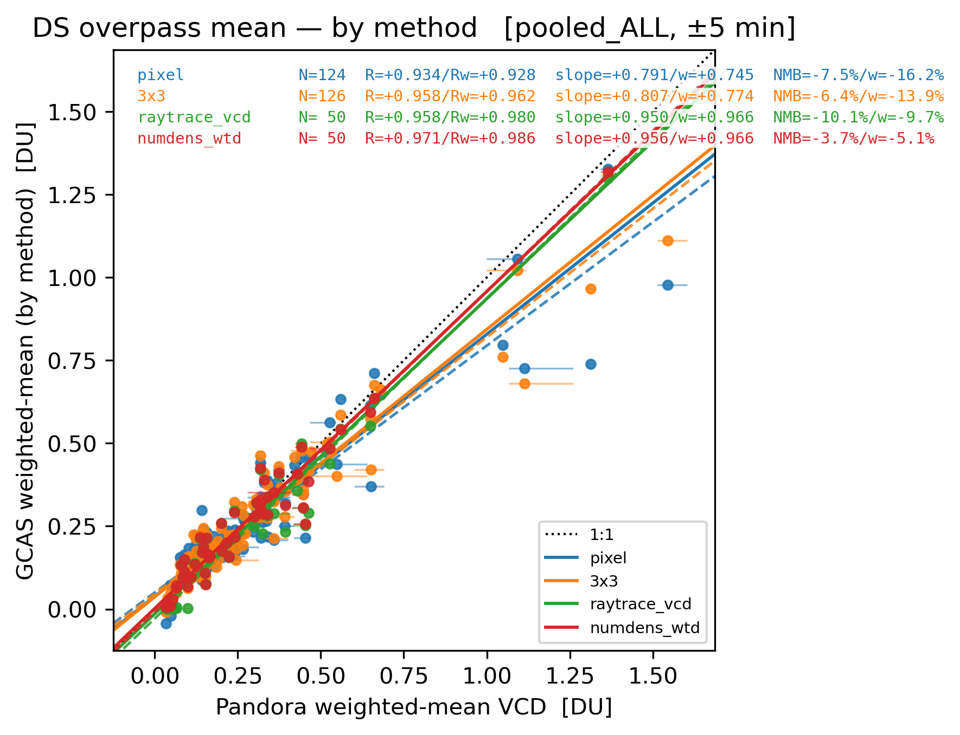
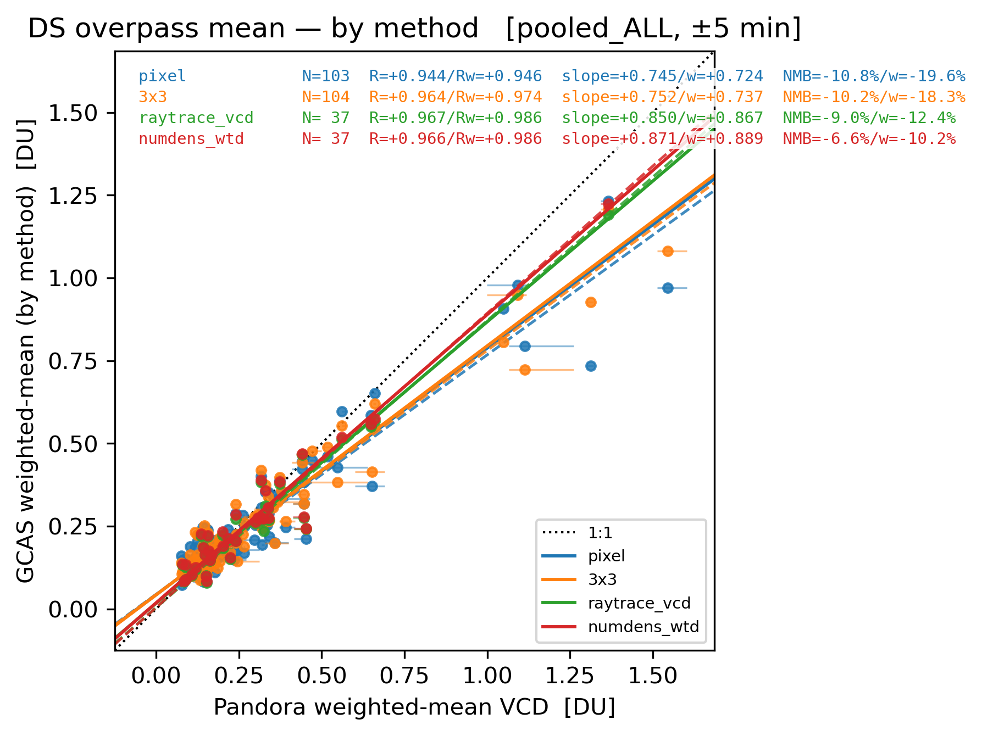
GCAS NO₂ VCD retrieval sensitivity on input model (GEOS-CF, WRF-Chem)
GCAS (GEOS-CF)
GCAS (WRF-Chem)
Pixel
3×3 pixels
LOS: n(z)-stacked
LOS: n(z)-weighted
Pixel
3×3 pixels
LOS: n(z)-stacked
LOS: n(z)-weighted
GCAS NO₂ VCD (by method) [DU]
GCAS NO₂ VCD (by method) [DU]
Pixel
3×3
n(z)-stacked
n(z)-weighted
Pixel
3×3
n(z)-stacked
n(z)-weighted
Pandora NO₂ VCD [DU]
Pandora NO₂ VCD [DU]
Higher-resolution model a priori does not necessarily guarantee better accuracy
Regardless of the input model resolution, GCAS accurately captures most of the spatial information (e.g., spatial inhomogeneity)
Temporal co-location window: GCAS overpass ± 5 min

Slide 11

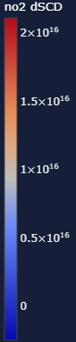
Tokyo-FC campaign
Pandora
GCAS data (dSCD) are preliminary
Campaign period
Mar 8 – Mar 29, 2026 (flights)
Mission objectives
Validation of recently launched GOSAT-GW data (GHG, NO₂)
Total 11 Science Flights (40 hrs)
Tokyo: Mar 11, 14, 24, 29
Nagoya: Mar 8
Nagoya-Osaka: Mar 12, 17, 27
Hokkaido: Mar 20, 25
Survey (Kyushu): Mar 21
Tokyo, March 24
Nagoya, March 12

Slide 12
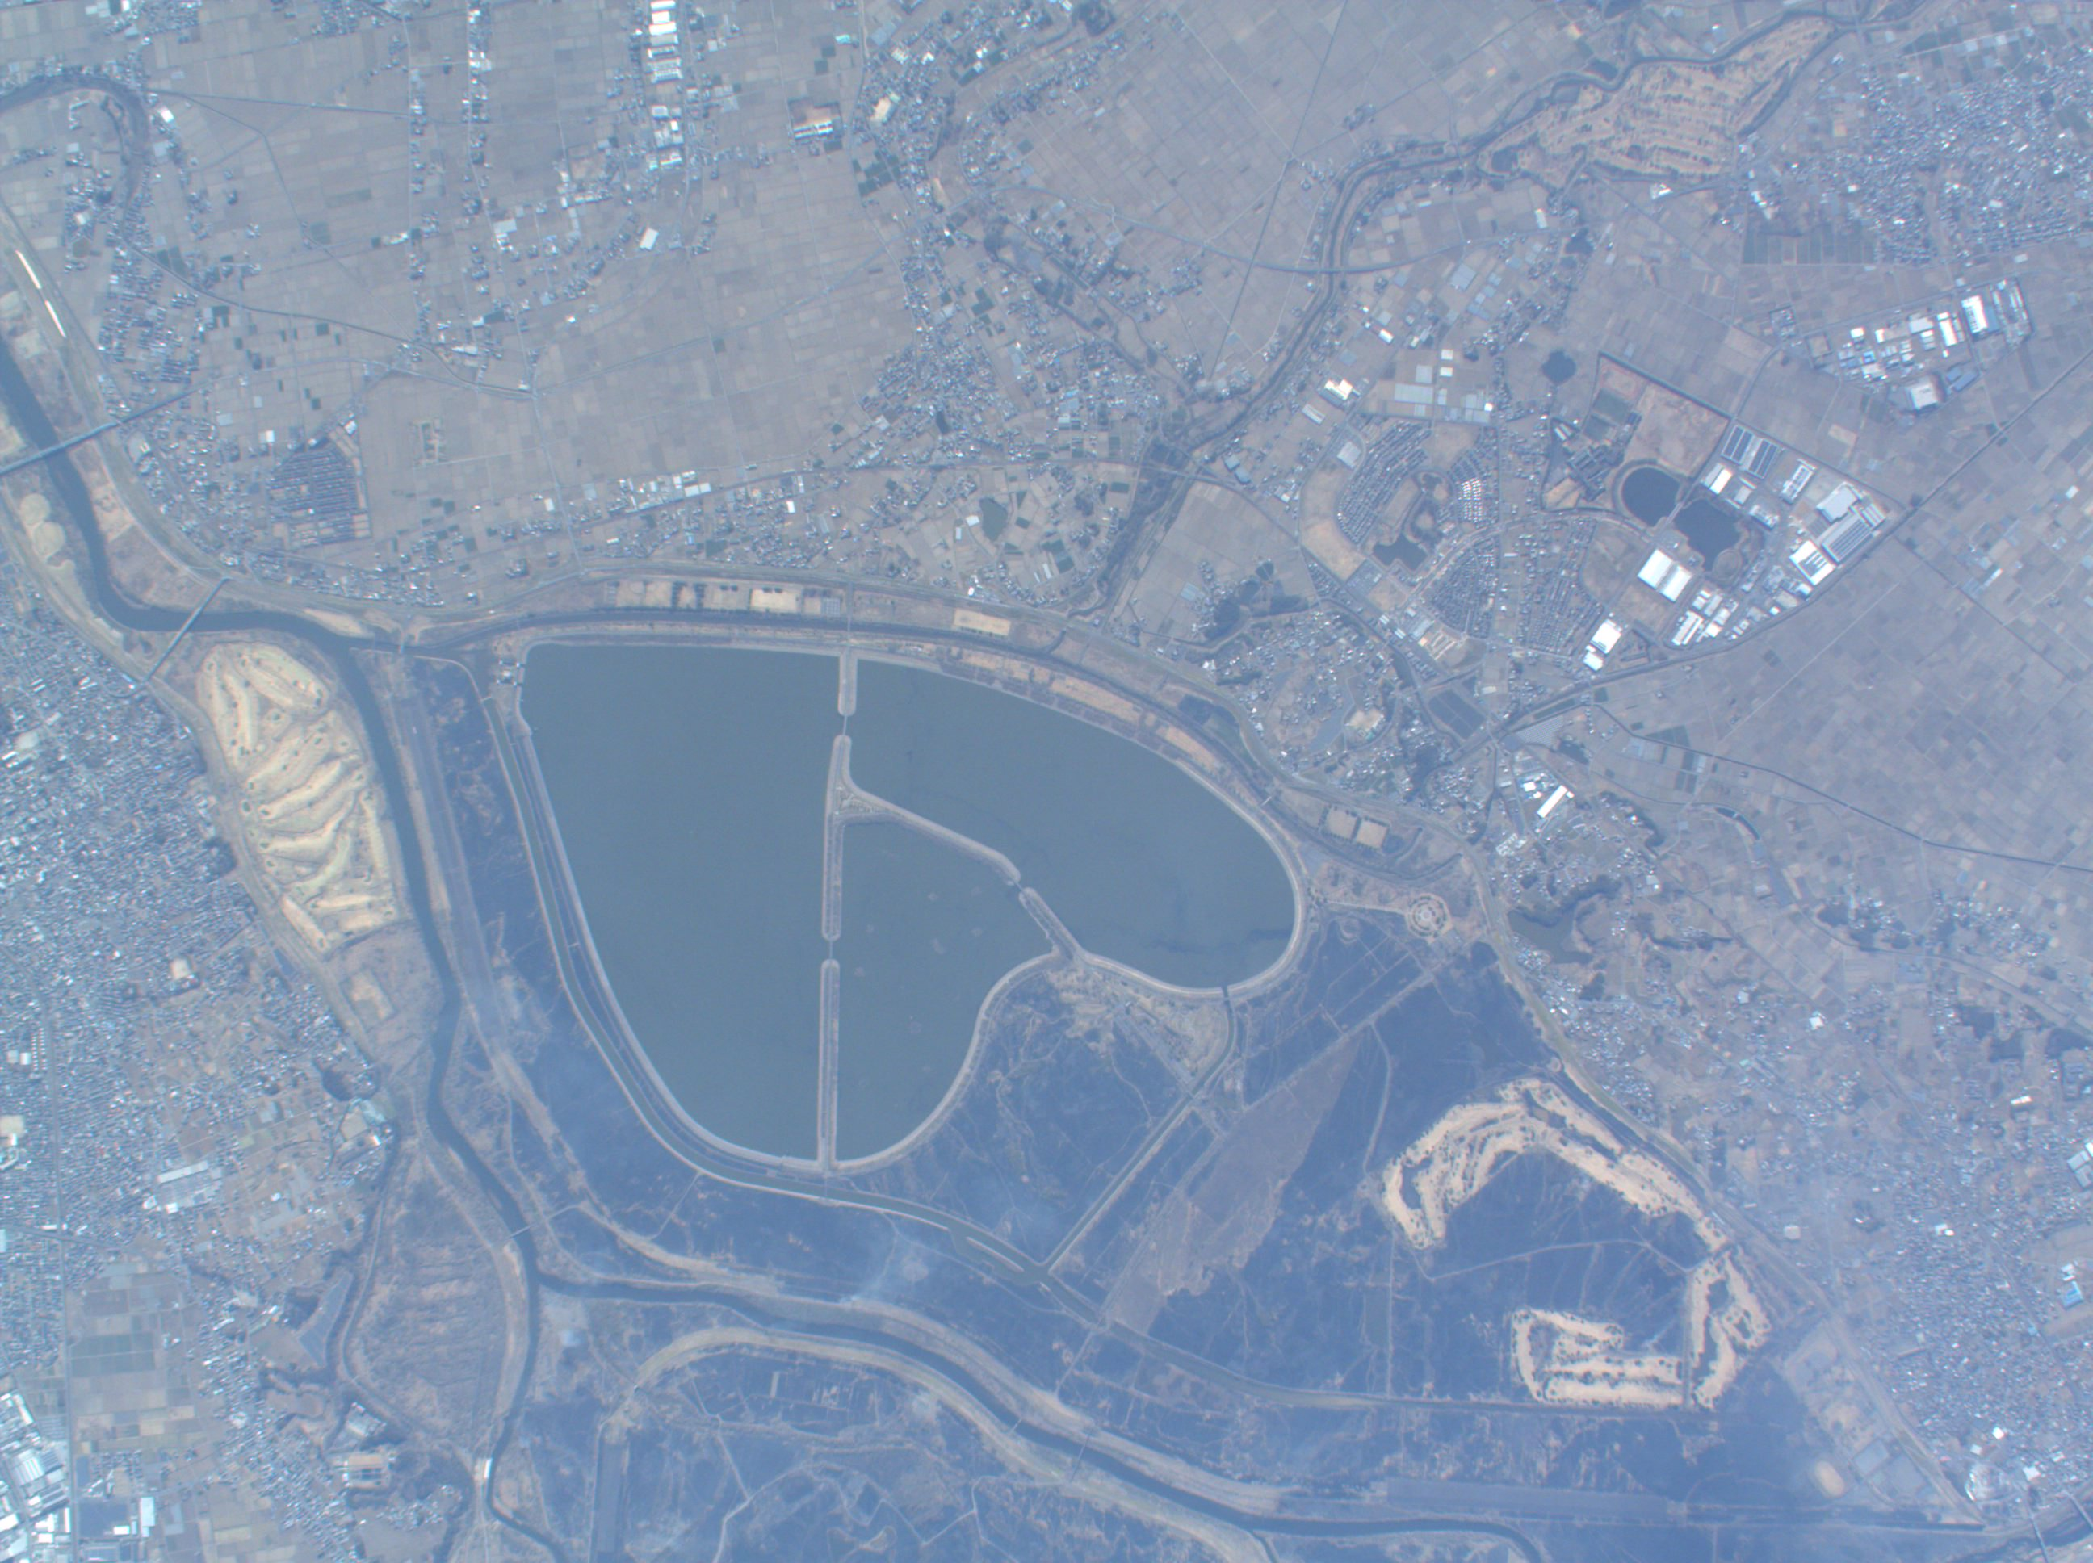
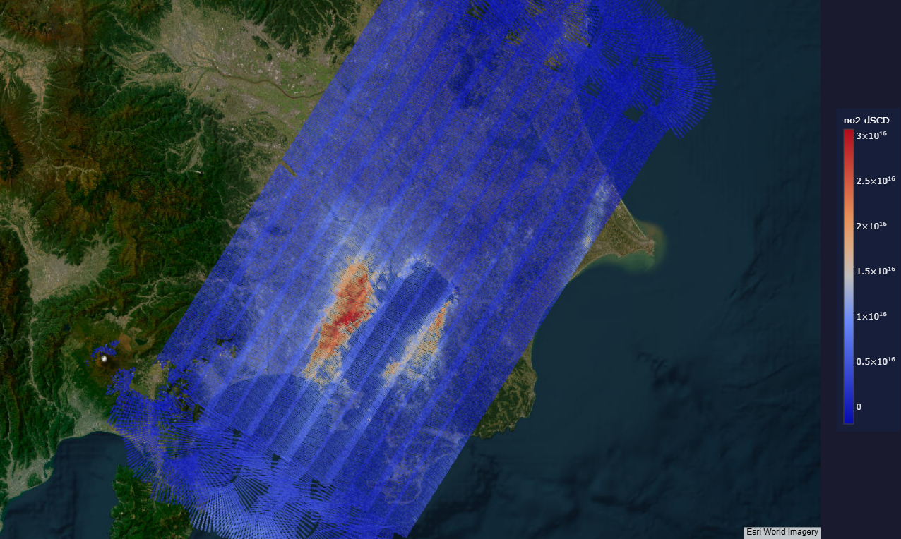
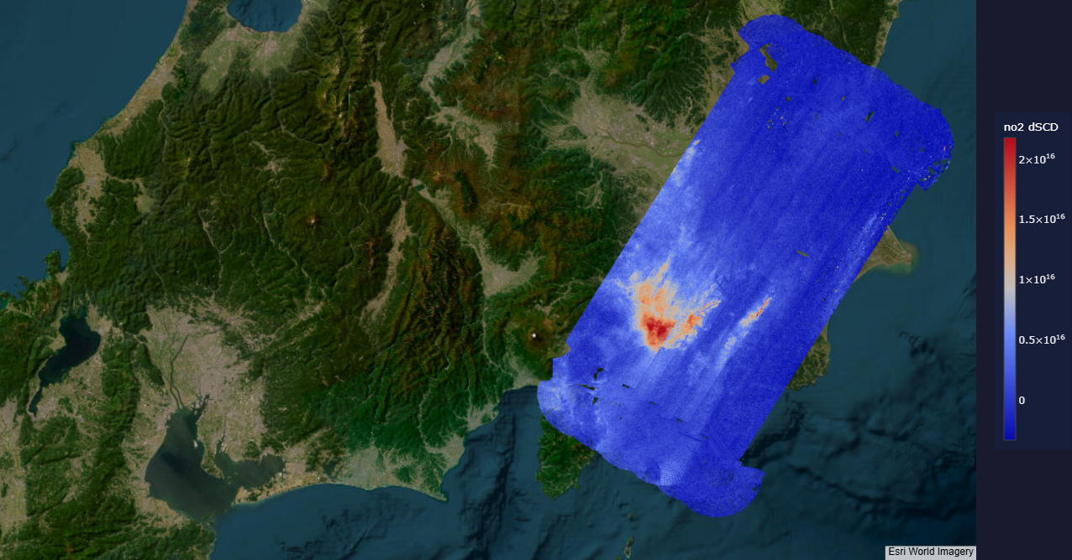
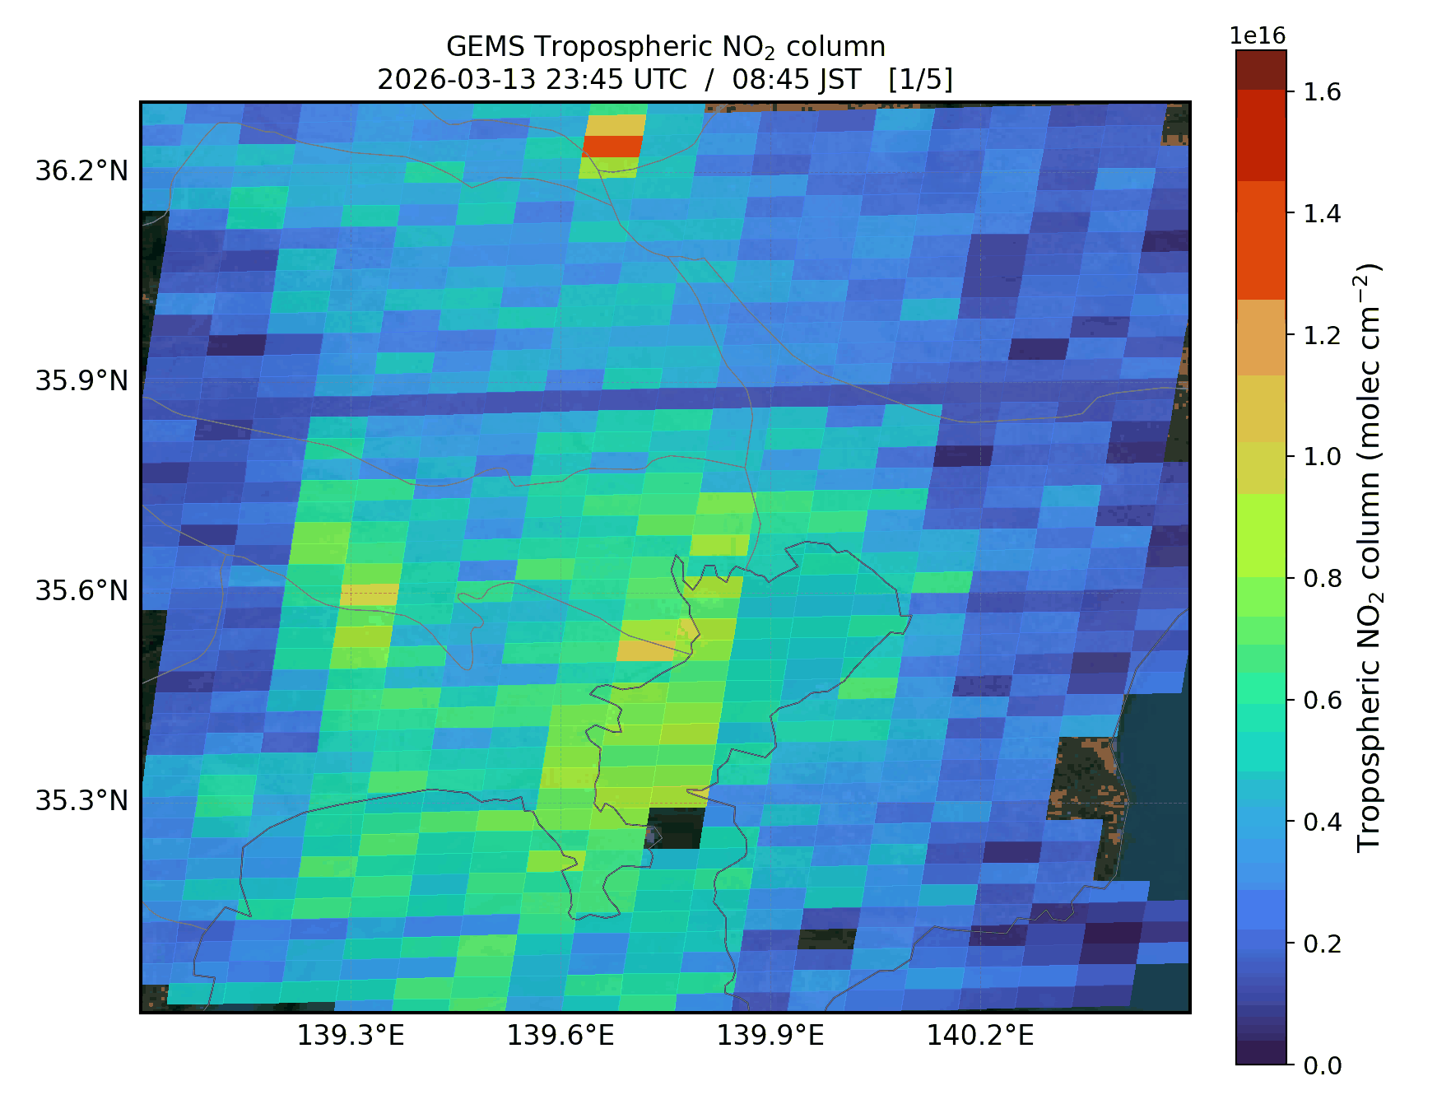
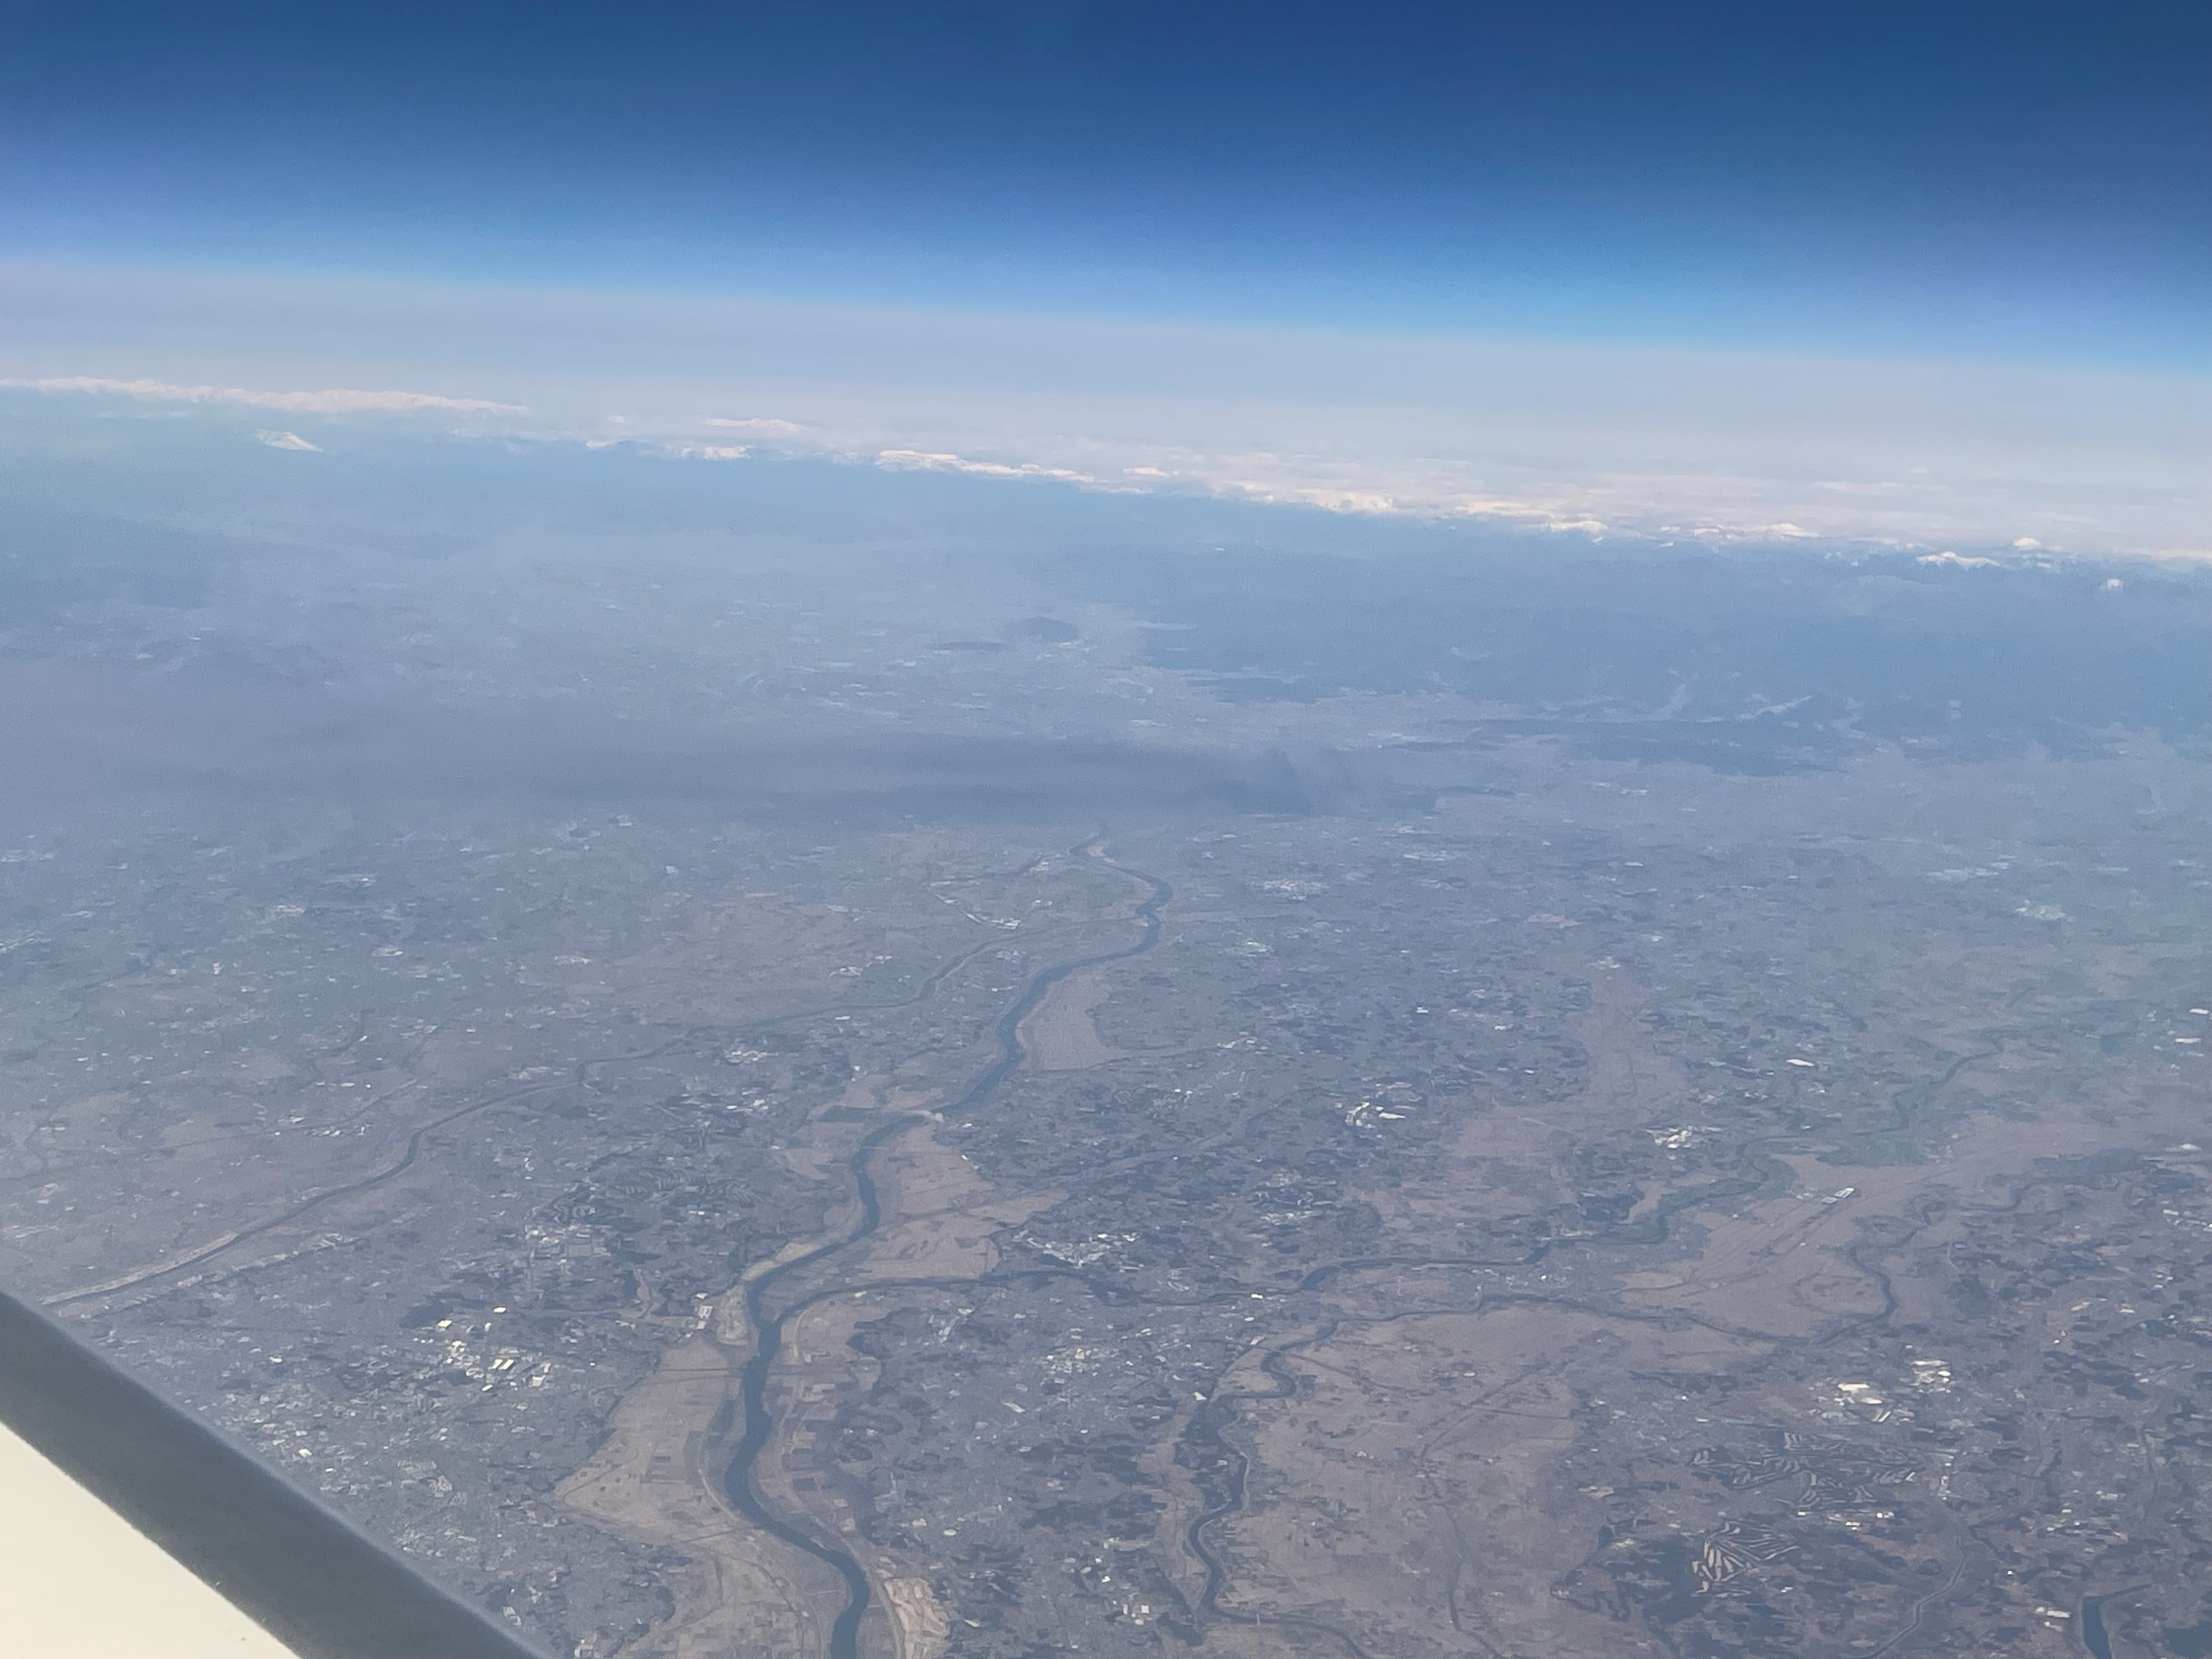
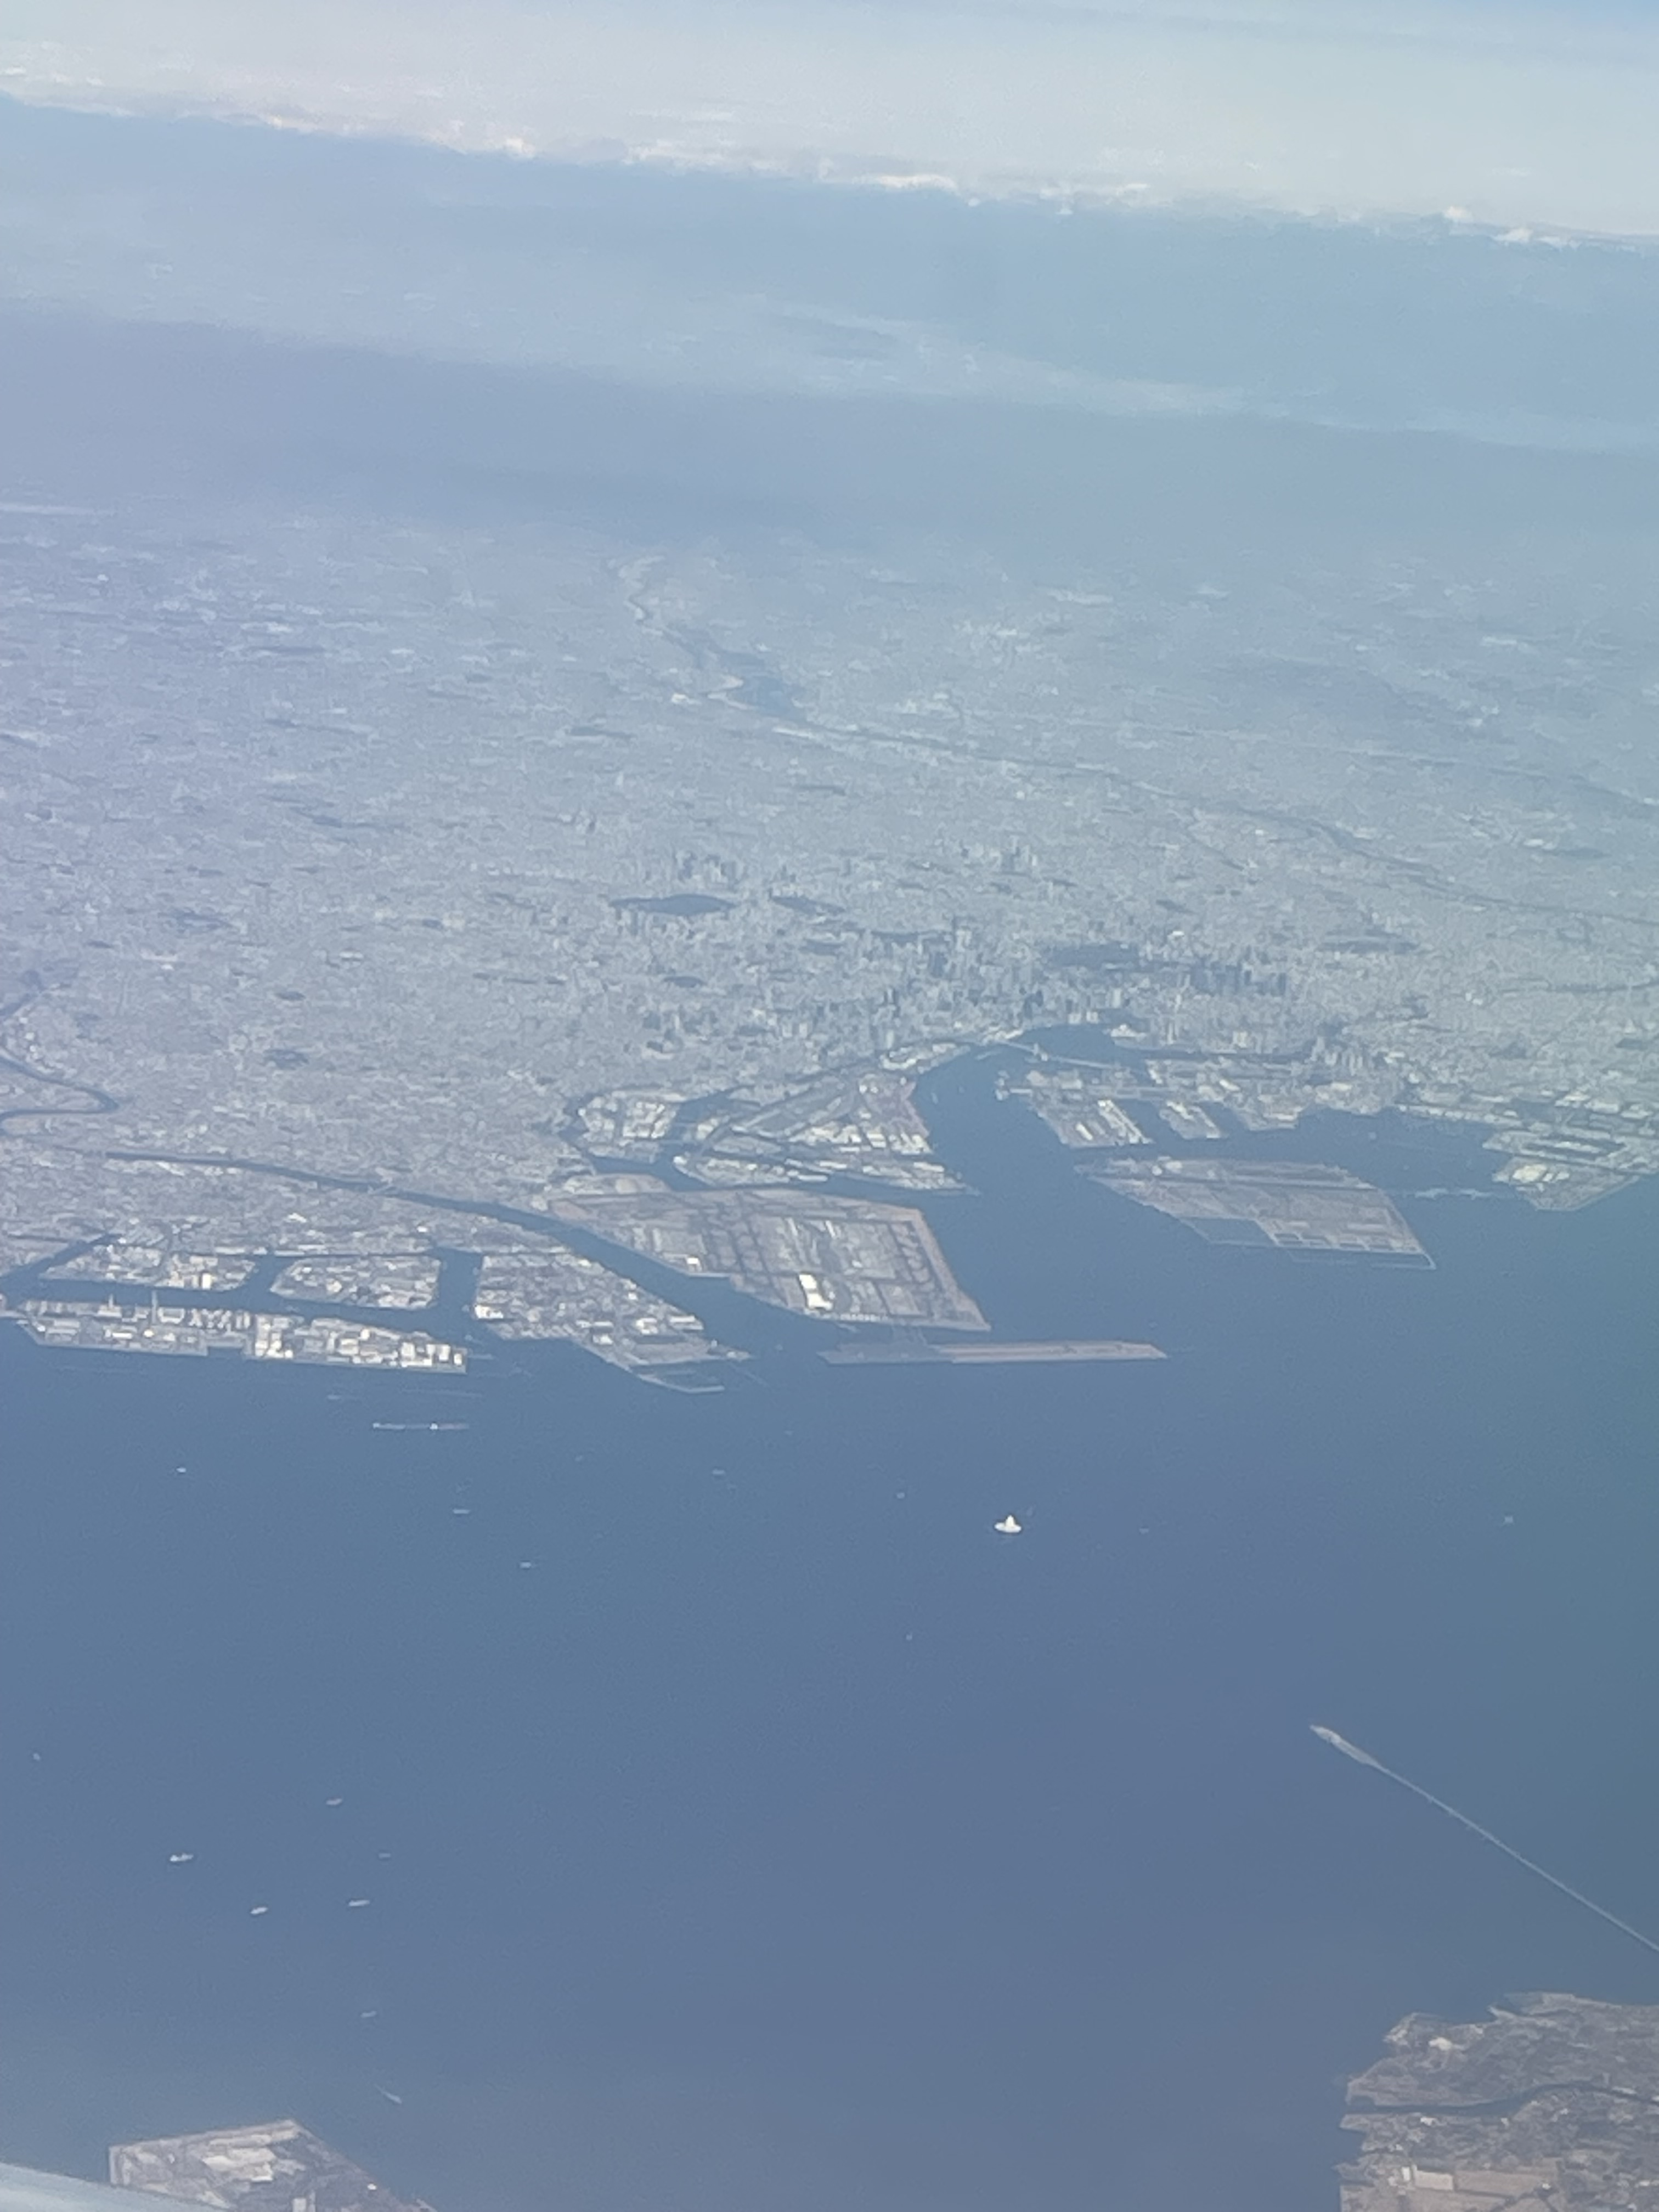
Tokyo-FC campaign – wildfire plume!
Wildfire occurred around the time we approached Tokyo area
March 24
March 14
wind
Plume advected S–SW
Advantages of GEO!

Slide 13

Summary and Remarks
Ray-tracing (consideration of Pandora viewing LOS) effectively reduces the artifact when comparing high resolution GCAS data against ground-based Pandora observations.
The highly variable nature of NO₂ can introduce (random) biases when a larger temporal co-location window is employed for GCAS – TEMPO (satellite) intercomparisons, which warrants further investigation.
Higher-resolution model a priori yields spatially more continuous (physically reasonable) GCAS NO₂ VCD field but does not necessarily guarantee better accuracy.
GCAS accurately captures most of the spatial information (e.g., spatial inhomogeneity) in general, even with the coarse model input (e.g., GEOS-CF)
→ High-res observations (e.g., GCAS) have standalone significance!
GCAS is actively enrolled in recent field campaigns and will continue to make high-res NO₂ column measurements in upcoming ones!
GCAS team is seeking a way to improve HCHO column measurements
→ coincident high-res NO₂ and HCHO observations
+ and more!

