Slide 1




NO₂ Variability Over Oil and Gas Along the U.S. Gulf Coast: Observations From TEMPO and SCOAPE-II
Niko M. Fedkin (STC/NASA-GSFC), Ryan Stauffer (NASA-GSFC), Anne Thompson (UMBC/NASA), Debra Kollonige (ADNET/NASA) , Holli Wecht (BOEM), Lok Lamsal (BOEM), Laura Judd (NASA-LaRC), Bryan Place (SciGLOB), Jonathan Gallegos (SciGLOB), Thomas Hanisco (NASA-GSFC)
TEMPO DART Science Team Meeting
17 June 2026

Slide 2
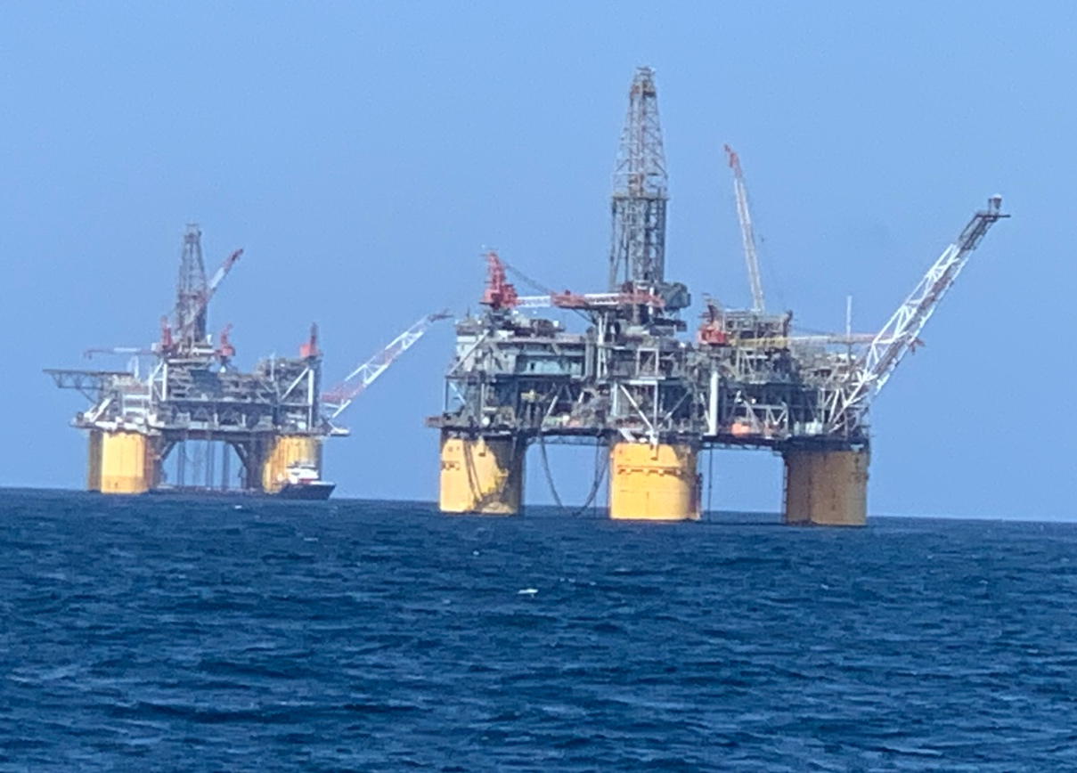
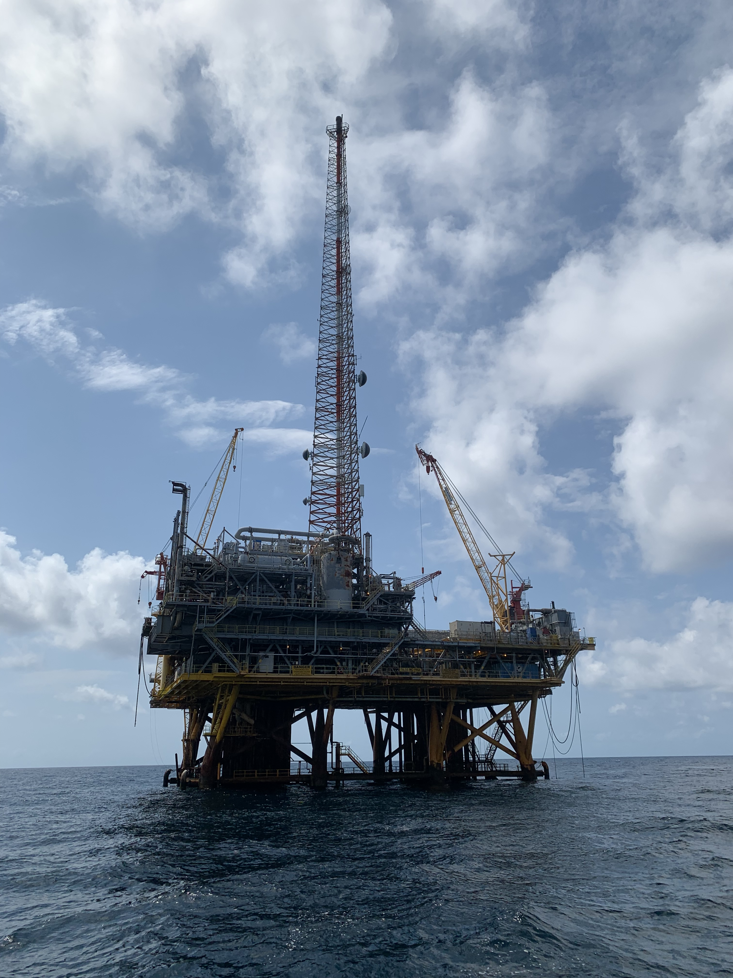
Background
Why look at NO₂ over the Gulf of America?
  Largely developed area for oil and gas (ONG) production – NO_{x} emissions are a byproduct
  Bureau of Ocean Energy Management (BOEM) has air quality jurisdiction on the Outer Continental Shelf of the U.S. Coast
  NASA-BOEM interagency agreements (starting in 2017) have set out to explore using satellites as tools to monitor ONG emissions
BOEM emission inventories from ONG are estimates from activity data and emission factors
  Real measurements needed!
Two ship campaigns resulted from the NASA-BOEM collaboration – SCOAPE (May 2019) and SCOAPE-II (June 2024).

Slide 3
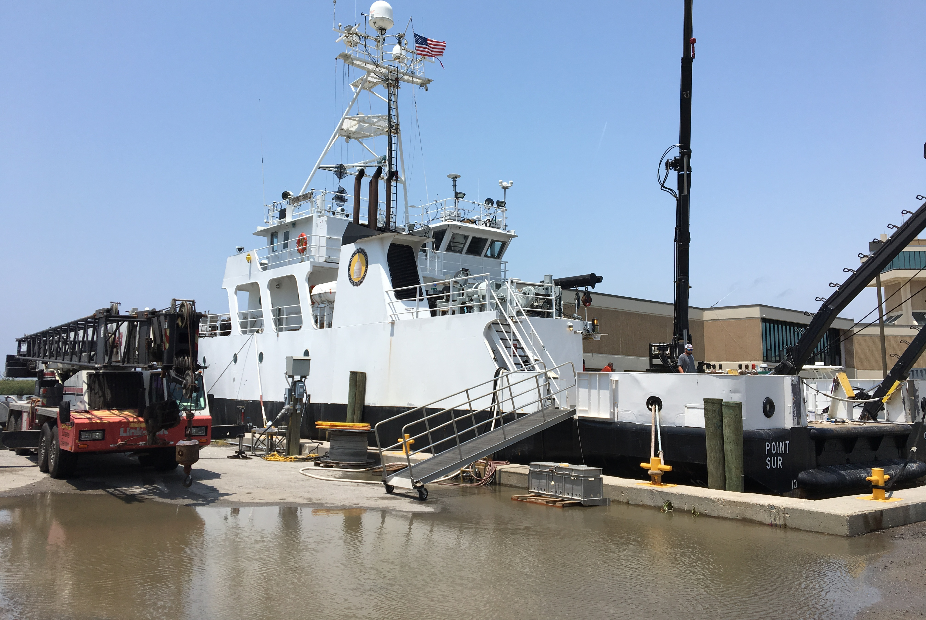
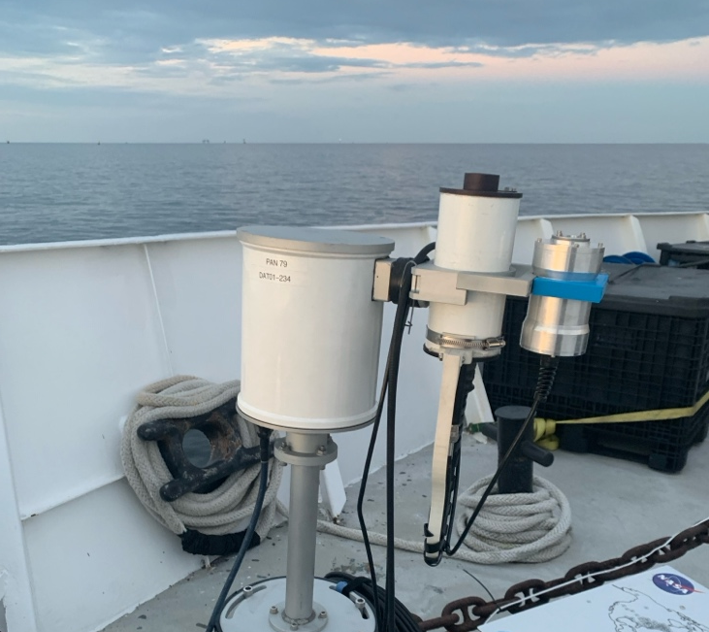
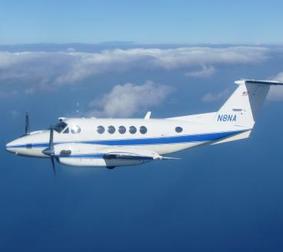
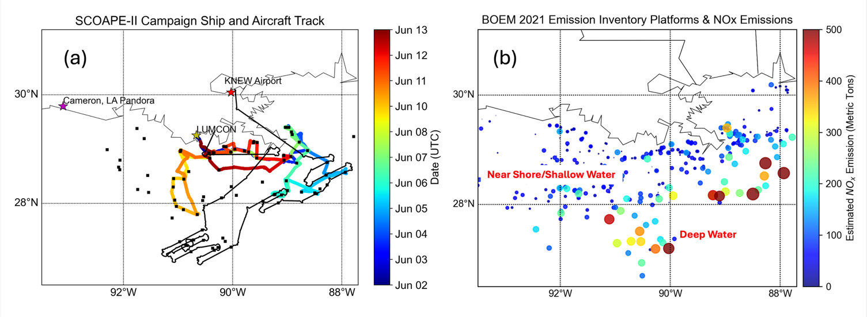
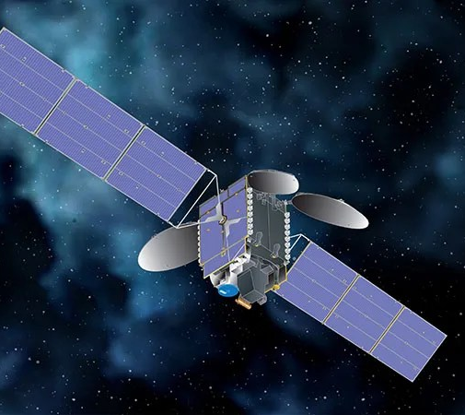
SCOAPE-II (June 2-13, 2024)
R/V Point Sur
Pandora
SCOAPE-II combined multi-platform observations: ship, airborne, and satellite
One of the goals was assessing performance of TEMPO retrievals over water/coastal region, in addition to collecting surface level data near ONG platforms
King Air B200 Aircraft + GCAS
TEMPO

Slide 4
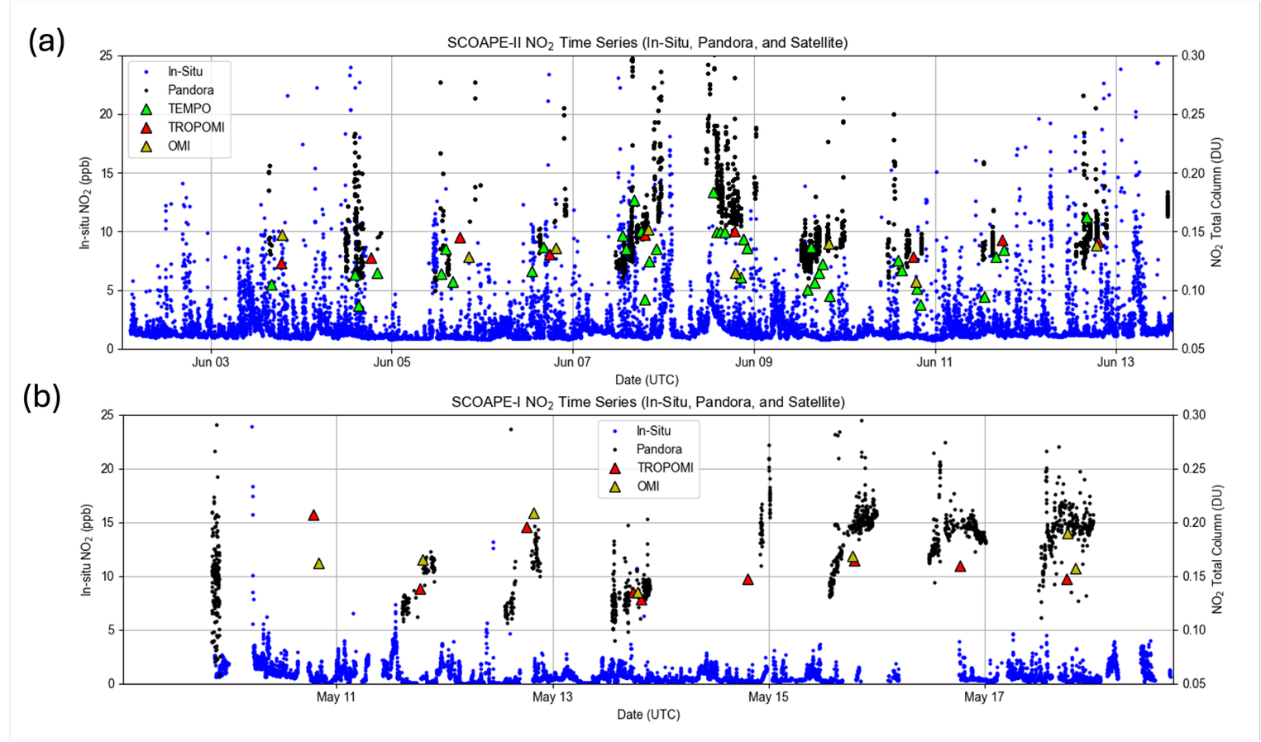
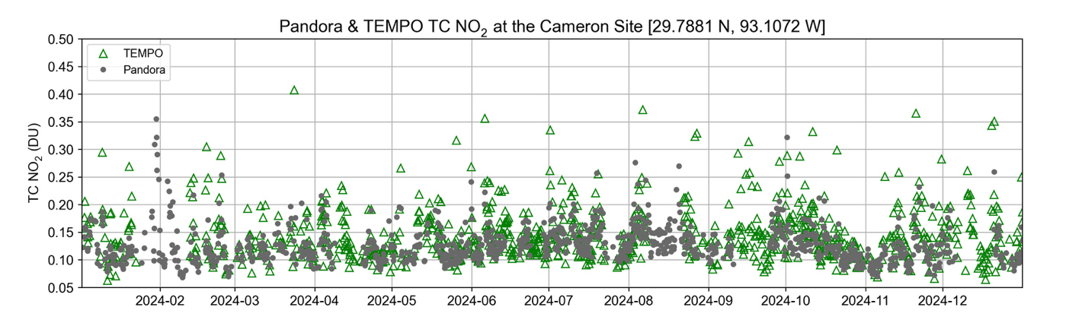
NO₂ Observations
Numerous NO₂ spikes(> 10 ppb) encountered near ONG platforms, captured by in-situ and Pandora on the ship
Satellite measurements also detected enhancements but at lower magnitude than Pandora
The BOEM monitoring site in Cameron, LA was used as a land reference and for extended analysis
Appomattox Platform
Mars/Olympus/Ursa Platforms
Near Shore Pollution

Slide 5
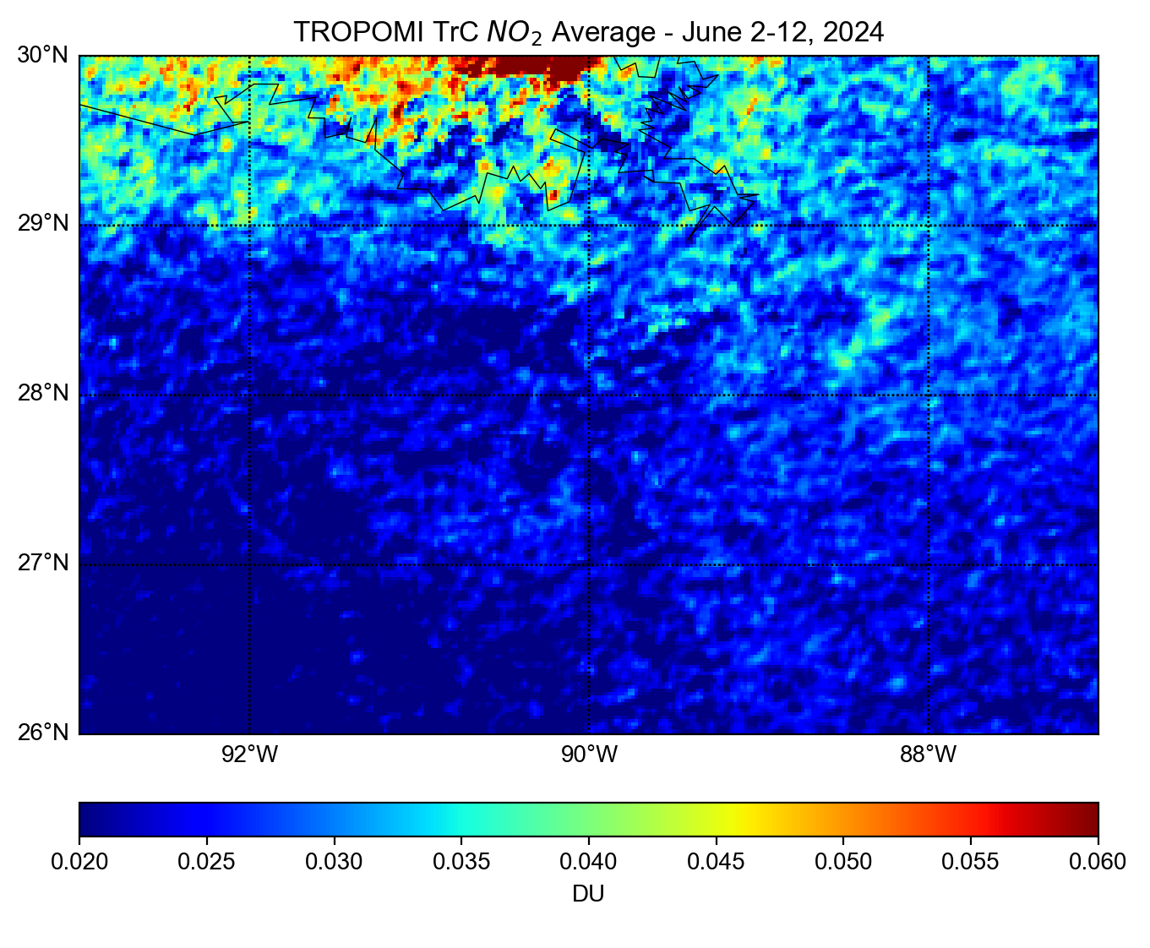
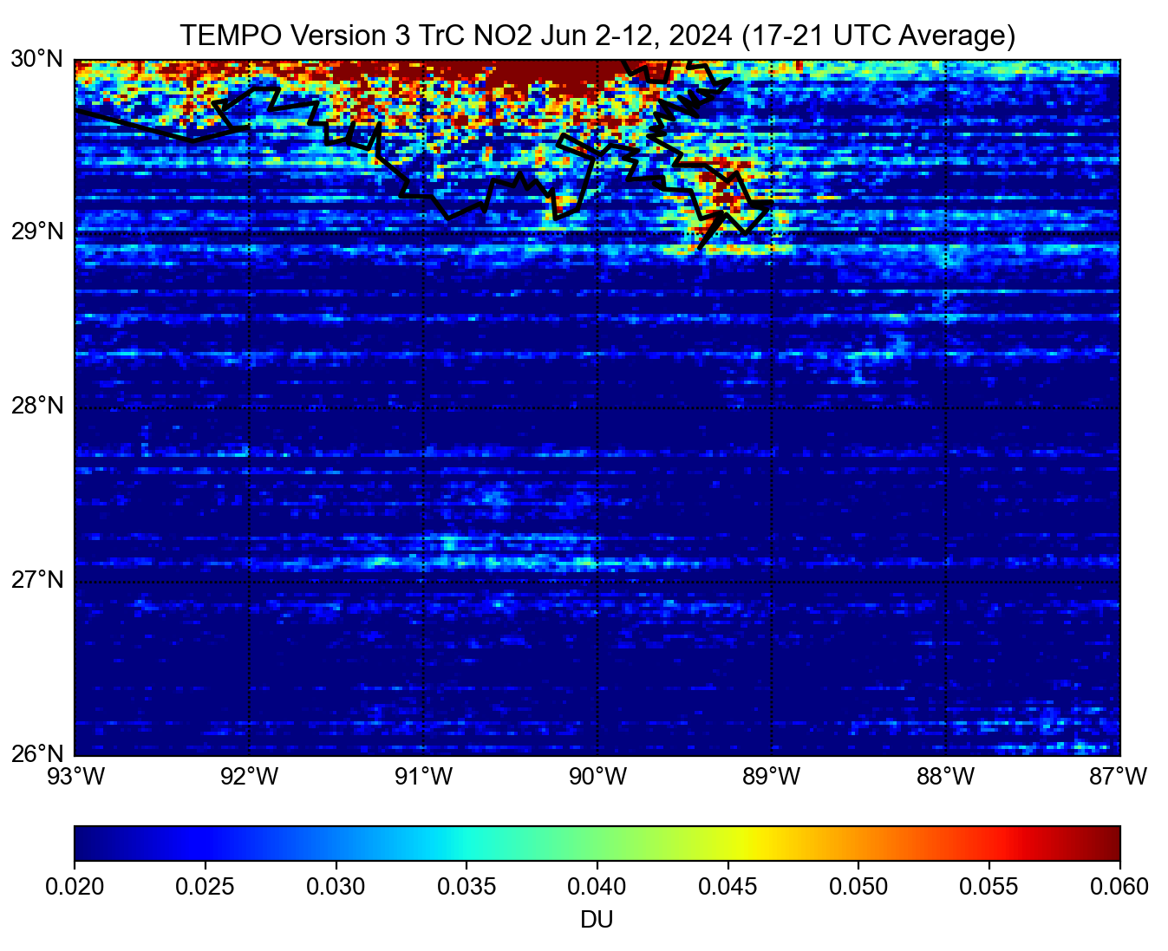
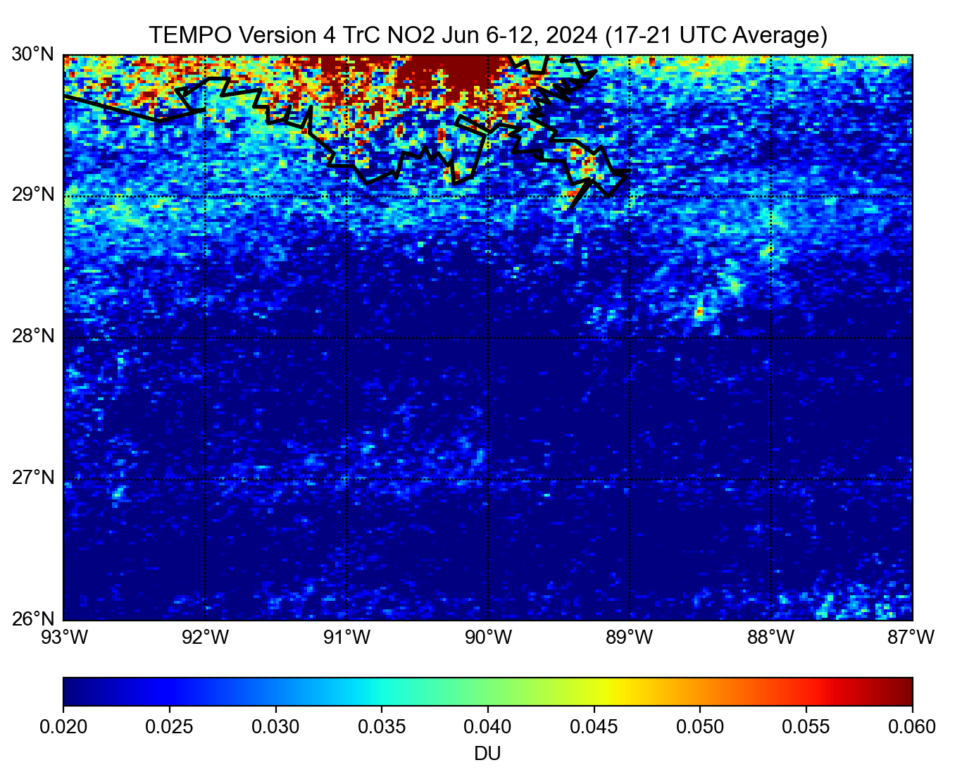
SCOAPE-II Satellite NO₂ Observations
During campaign winds were generally calm – not much transport of pollution
Hotspots stand out in TEMPO V4 tropospheric column (TrC) NO₂ average for June 6-12, 2024 (right)
  Big improvement in detection compared to V3 (middle) with removal of striping
TROPOMI (left) measured a higher background over water while TEMPO is higher on land and urban areas
  Difference between satellites are linked to treatment of surface albedo and a-priori assumptions in each retrieval
TROPOMI
TEMPO v3
TEMPO v4

Slide 6
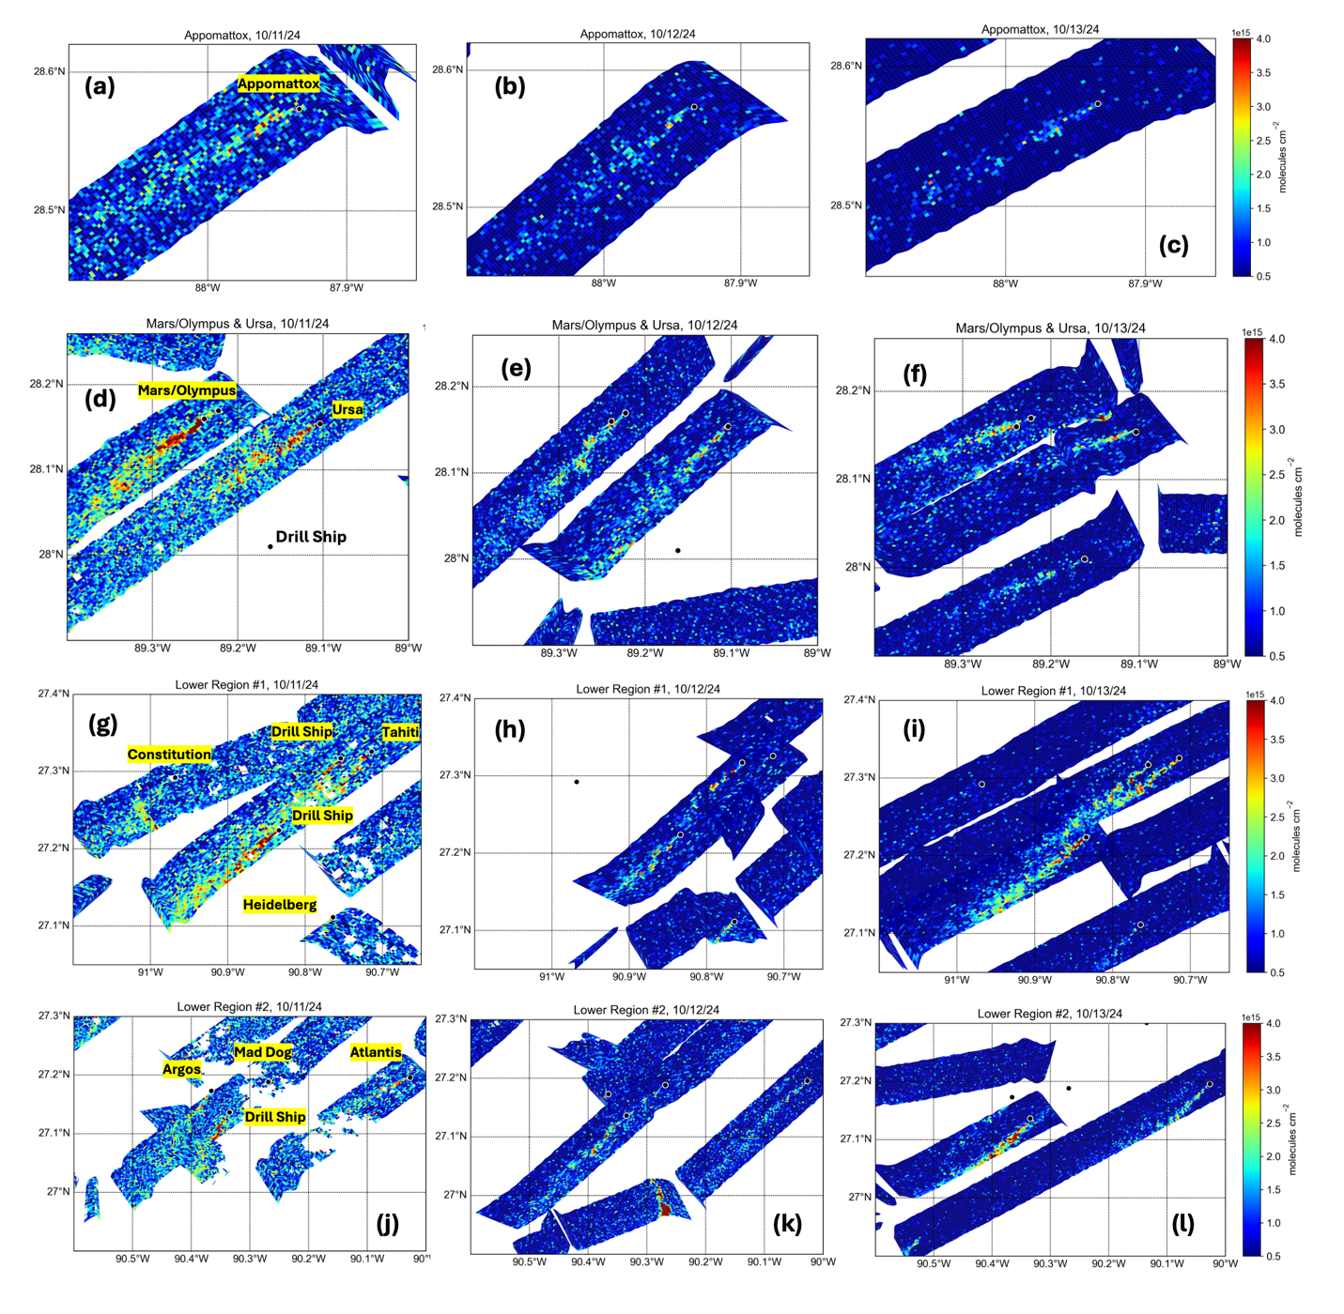
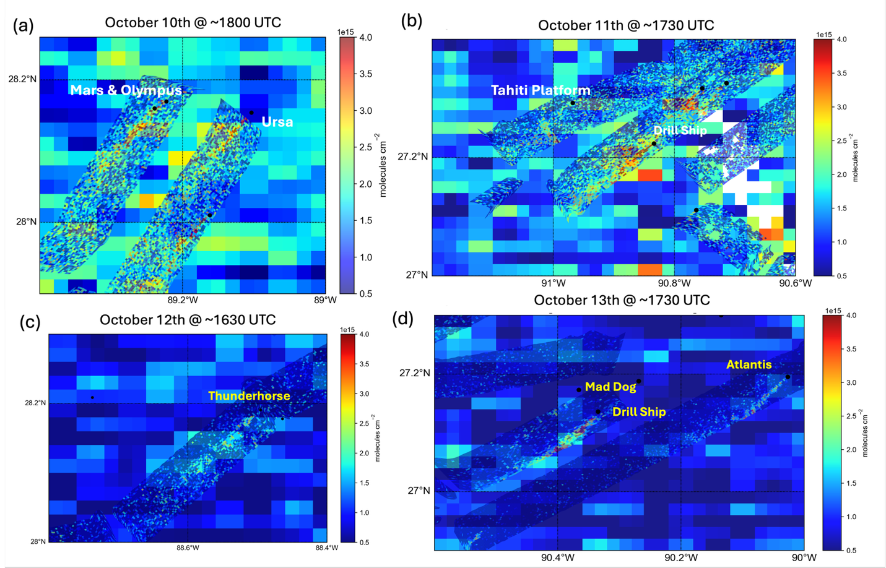
GEO-CAPE Airborne simulator (GCAS) Flights
GCAS was flown onboard the NASA-LaRC King Air B200 aircraft over 6 flights – October 7,8,10,11,12, and 13, 2024.
Consistent plumes observed Oct 11-13 in several areas (right)
Several cases of TEMPO V3 NO₂ pixels indicating enhancement over the same area as GCAS (below)

Slide 7
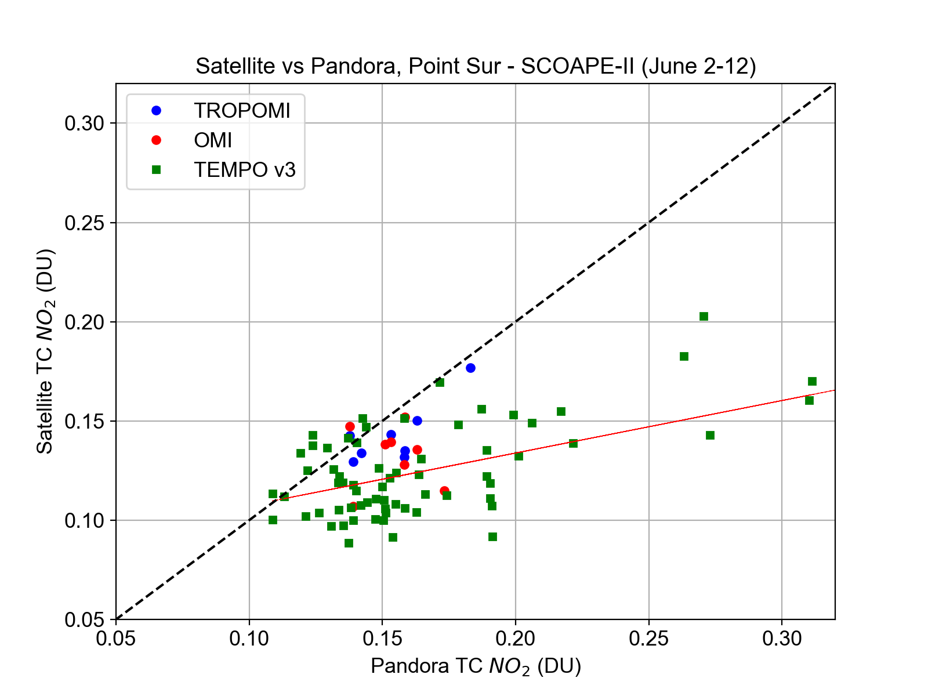
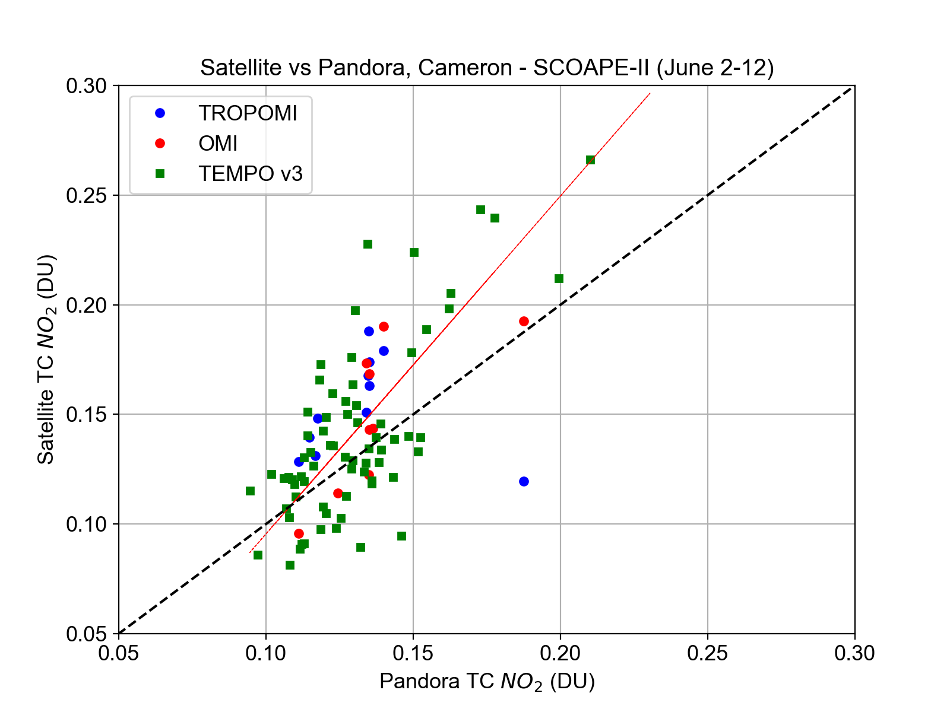
Satellite Performance during SCOAPE-II
Comparisons use time-matched observations of Pandora within 15 min of satellite overpass/scan
All three satellite instruments are low biased over water and high biased at Cameron, LA especially at higher NO₂ amounts
TEMPO v3 still shows reasonable correlation with the limited sample size
r = 0.59
MB = -0.042 DU (-22.1%)
MAPB = 23.6%
r = 0.79
MB = +0.012 DU (+8.3%)
MAPB = 18.3%

Slide 8
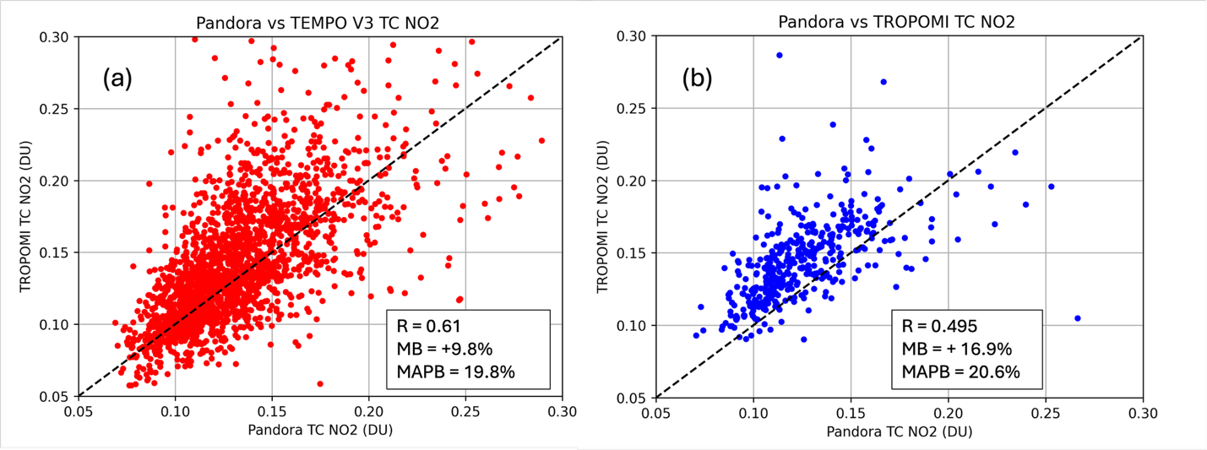
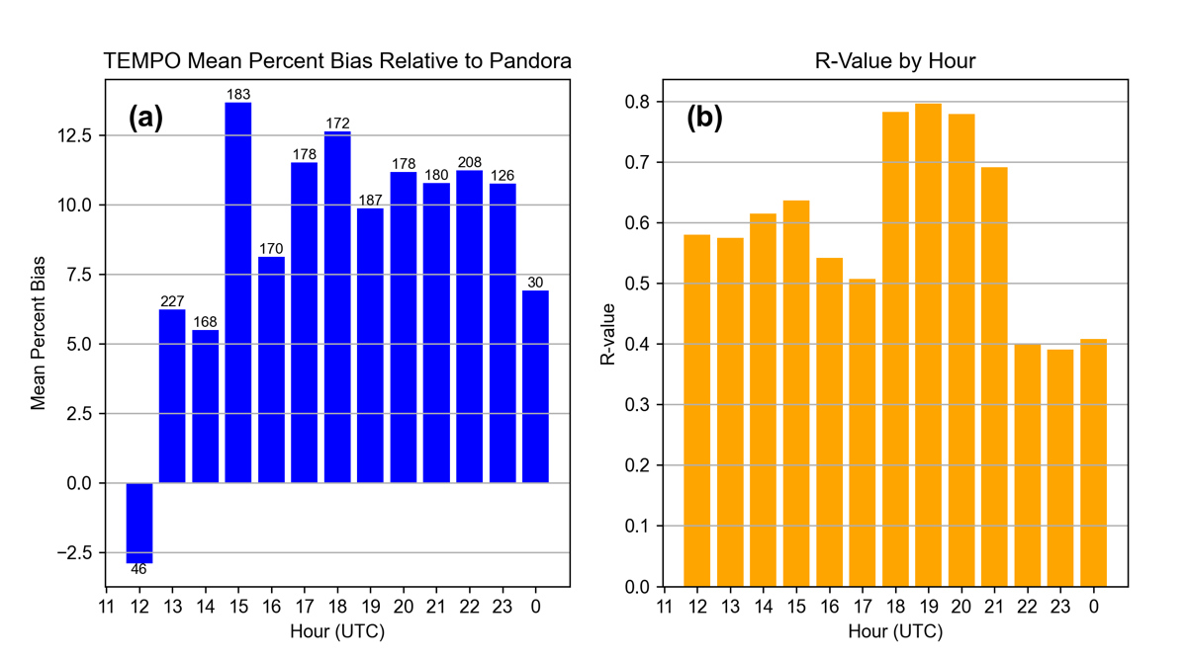
Extended comparison
Comparison period: August 2023-Dec 2024
Both satellite datasets have a high bias; TEMPO V3 (r = 0.61) performs better than TROPOMI (r = 0.49)
Highest mean biases in TEMPO V3 occurs in late morning-late afternoon (15-23 UTC scans)
Best correlation in the 18-21 UTC lowest 22-00 UTC

Slide 9
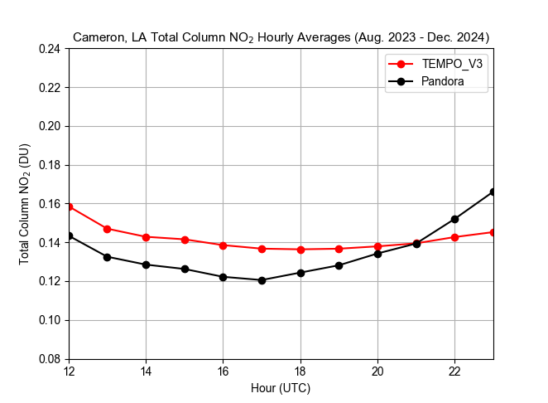
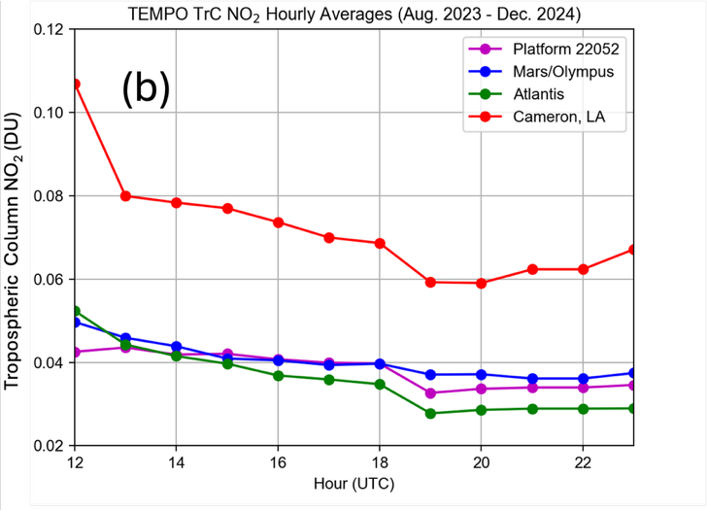
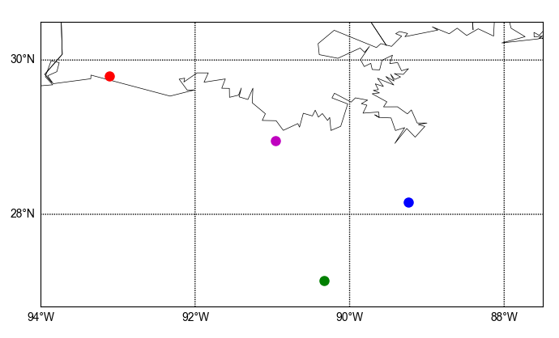
Hourly Averages
Time series of Pandora & TEMPO hourly averages (all data) for Aug 2023-Dec 2024 shown below in (a)
Generally, Pandora has a more defined diurnal pattern and lower amounts than TEMPO except at the end of the day
Offshore diurnal pattern is higher NO₂ in morning, lower in afternoon/evening
TrC NO₂ is substantially lower (around 50% less) offshore than on the coast (b), even at Mars/Olympus
TrC pattern at Cameron maximum at 12 UTC (7am CDT), minimum at 19-20 UTC (14-15 CDT)
(a))

Slide 10
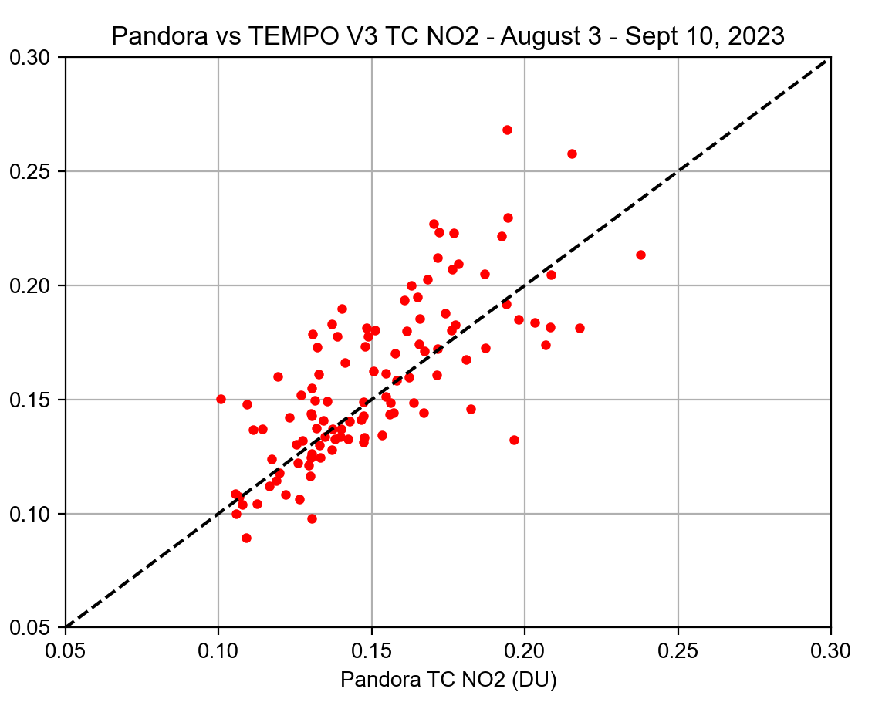
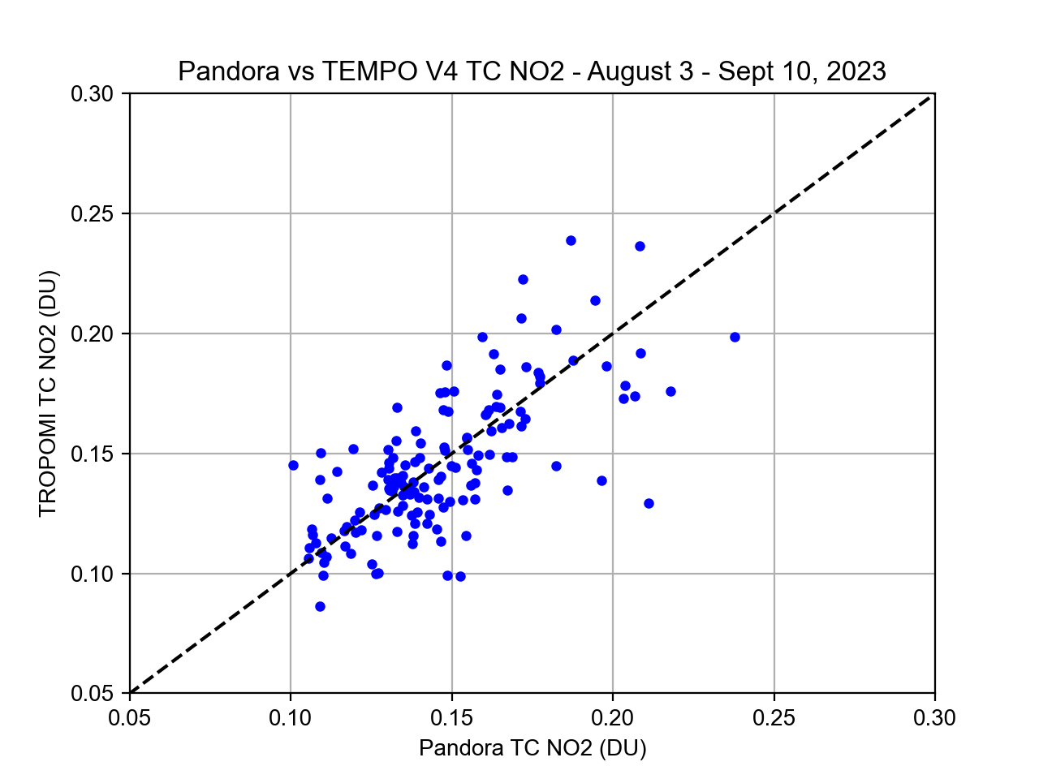
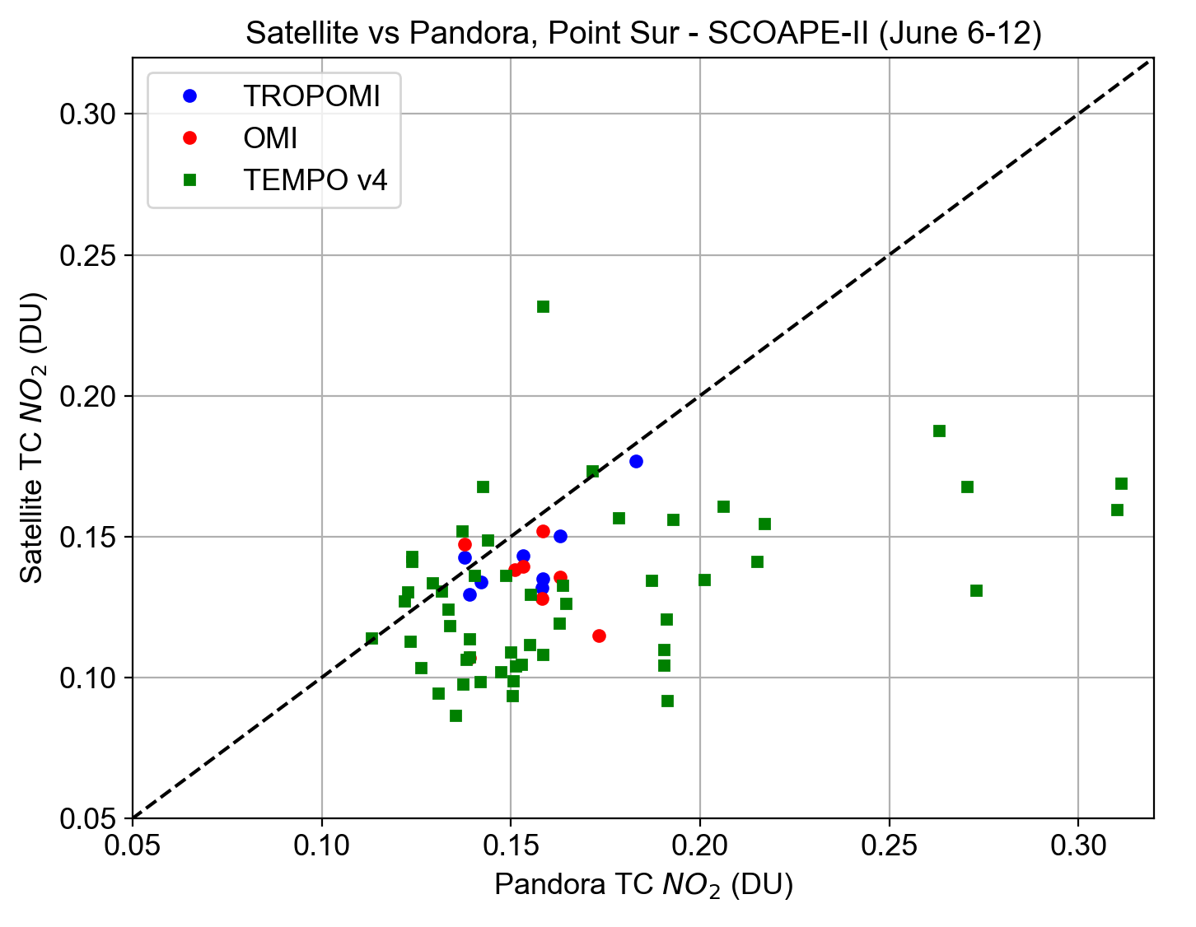
TEMPO Version 4
As shown previously, Version 4 is visually a major improvement for hotspot detection and monitoring over water
Little change in accuracy (r-coeff) with respect to Pandora when comparing ~1 month worth of data (Aug 3 – Sept 10, 2024)
High bias at Cameron, LA improved with Version 4; low bias persists over water
TEMPO V3 - Cameron
TEMPO V4 - Ship
TEMPO V4 - Cameron
TC NO₂ (DU)
TC NO₂ (DU)
r = 0.74
MB = +5.8%
MAPB = 13.1%
r = 0.70
MB = -0.5%
MAPB = 10.6%
r = 0.41
MB = -20%
MAPB = 24.5%

Slide 11
Conclusions
SCOAPE-II ship campaign in June 2024 and GCAS flights in October 2024 focused on measuring NO₂ near offshore ONG and TEMPO validation
TEMPO V4 shows improvements in hotspot detection; awaiting further reprocessing for full comparisons and statistics
Satellite offshore plume detection is generally limited by spatial resolution and retrieval noise
GCAS revealed plumes over several days from multiple deep water targets (platforms and drill ships)
Average Trop. column NO₂ at the coast is almost double than that over offshore ONG platforms
This study was funded by the U.S. Department of Interior, Bureau of Ocean Energy Management, Environmental Studies Program, Washington, DC through Inter-Agency Agreement Number A2501-014-080-073354
niko.m.fedkin@nasa.gov

