Slide 1

Advancing Wildfire Monitoring with TEMPO and ML tools: Hourly Smoke and Fire‑Front Mapping and Near‑Surface NO₂ Predictions
  PI: Xiaohua Pan 1
  Co-Is: Hugo Lee 2, Nicholas LaHaye 3, Thilanka Munasinghe 4
  Collaborators: Jennifer Wei 5, Gonzalo Gonzalez Abad 6, Hazem Mahmoud 1, and Kyunghwa Lee 7
Proposal Number: 24-TEMPOACX24-0058
1. Adnet Systems (United States); 2. Jet Propulsion Laboratory; 3. Spatial Informatics Group, LLC; 4. Rensselaer Polytechnic Institute(RPI); 5. Goddard Space Flight Center; 6. Center for Astrophysics Harvard & Smithsonian; 7. National Institute of Environmental Research
TEMPO DART meeting June 15-18, 2026
Notes:
Good morning, everyone. Today I’m presenting our TEMPO funded project titled ‘Advancing Wildfire Monitoring with TEMPO and Machine Learning Tools: Hourly Smoke and Fire‑Front Mapping and Near‑Surface NO₂ Predictions.’
My name is Pan, Xiaohua, and I am the Principal Investigator for this effort. I’m joined by a strong team.

Slide 2
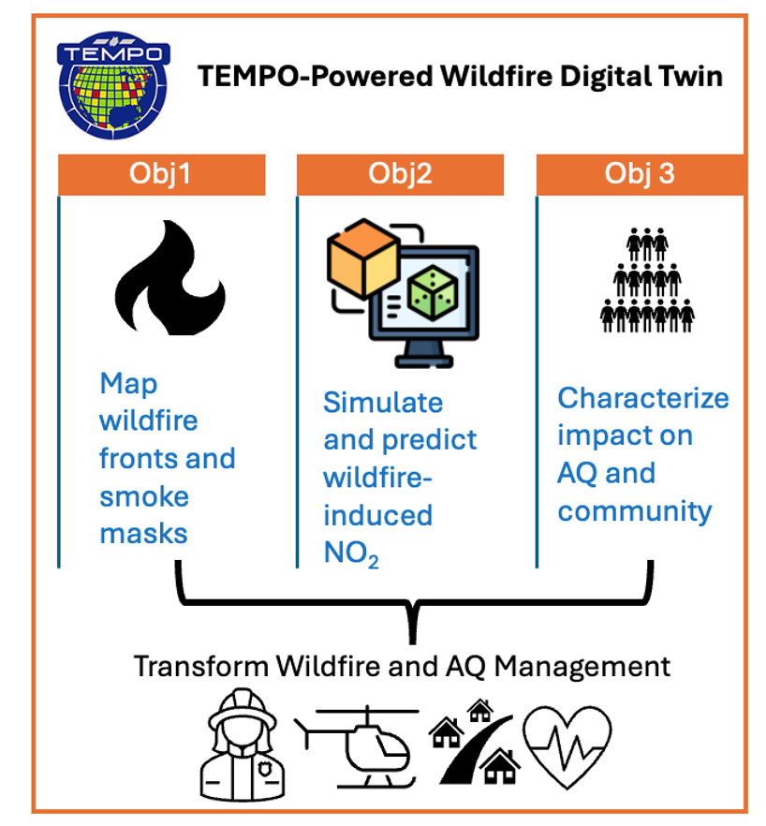
Objectives
Methods:
Leverage TEMPO data’s unprecedented advantages and advanced technologies (e.g., machine learning and wildfire digital twin)
Impacts by Enabling Earth‑actionable science:
Transform wildfire and AQ management by enabling hourly wildfire watches and air quality warnings.
Protect lives and property across wildfire-prone regions of North America
Stakeholders:
Wildfire and AQ management agencies, such as FEMA.
Notes:
Our proposal—what we call the TEMPO‑powered wildfire digital twin—is built around three core objectives.
Methods: We will achieve these objectives by leveraging TEMPO’s hourly, high‑spatial‑resolution observations together with advanced technologies, including machine learning and the wildfire digital‑twin framework.
Our goal is to drive meaningful impact by enabling Earth‑actionable science—particularly by transforming wildfire and air‑quality management by enabling hourly wildfire watches and air quality warnings.
Ultimately, this work helps protect lives and property across wildfire‑prone regions of North America
And importantly, we are building these capabilities with our stakeholders in mind—agencies such as FEMA and state and local air‑quality managers—who rely on reliable, near‑real‑time information to support response, mitigation, and preparedness."

Slide 3
The Concrete Deliverables
Hourly level 3 wildfire front maps product, a value-added product for TEMPO.
Hourly level 3 wildfire smoke plume mask product, a value-added product for TEMPO.
Hourly predicted wildfire-induced near-ground NO₂ outputs with a few hours of lead-time.
Enabling visualizations of the products from 1), 2), and 3) in the user-friendly Wildfire Digital Twin (DT) platform.
Characterizing wildfire's impacts using the social vulnerability index (SVI).
TEMPO datasets used in our project
Spatial coverage: Western U.S.
Collections: TEMPO_NO2_L3 and TEMPO_RAD_L1
Version: 3
Notes:
This slide outlines five concrete deliverables from our TEMPO project.
In today’s talk, I will focus on presenting our preliminary results related to the first three deliverables.

Slide 4
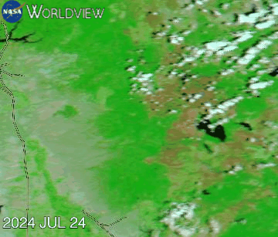
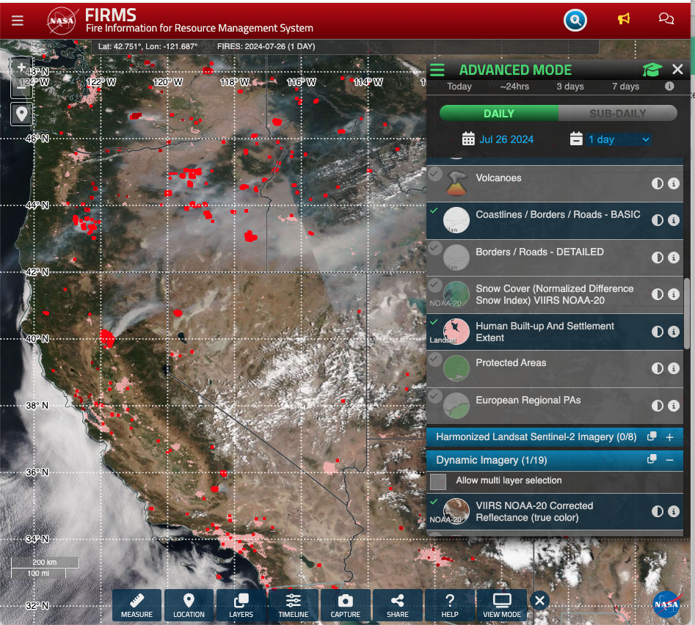
Case Study: 2024 Park Fire, CA
Over 700 structures destroyed or damaged
Firefighting alone costed ~ $351 million
Burned from 07/24/2024 to 09/26/2024
Burned about 429,603 acres (≈ 2.2* NYC)
Fourth-largest wildfire in CA history
Daily Corrected Reflectance (Bands 7-2-1) Aqua/MODIS from 07/24-07/31/24
Daily Fire Hotspots VIIRS+MODIS 07/26/24
Park fires
Credit: NASA Worldview
Credit: NASA FIRMS
Notes:
Today, I will use 2024 Park Fires case study to demonstrate our capability so far, and additional results will be shared as they become available over time.
In the left panel, you see the daily burn scars detected by MODIS from July 24 through July 31. The right panel provides a zoomed‑out view, showing the broader spatial distribution of daily hotspots captured by both VIIRS and MODIS."

Slide 5
Obj 1: Map the hourly Wildfire Fronts and Smoke Masks using TEMPO
Led by Nicholas LaHaye

Slide 6

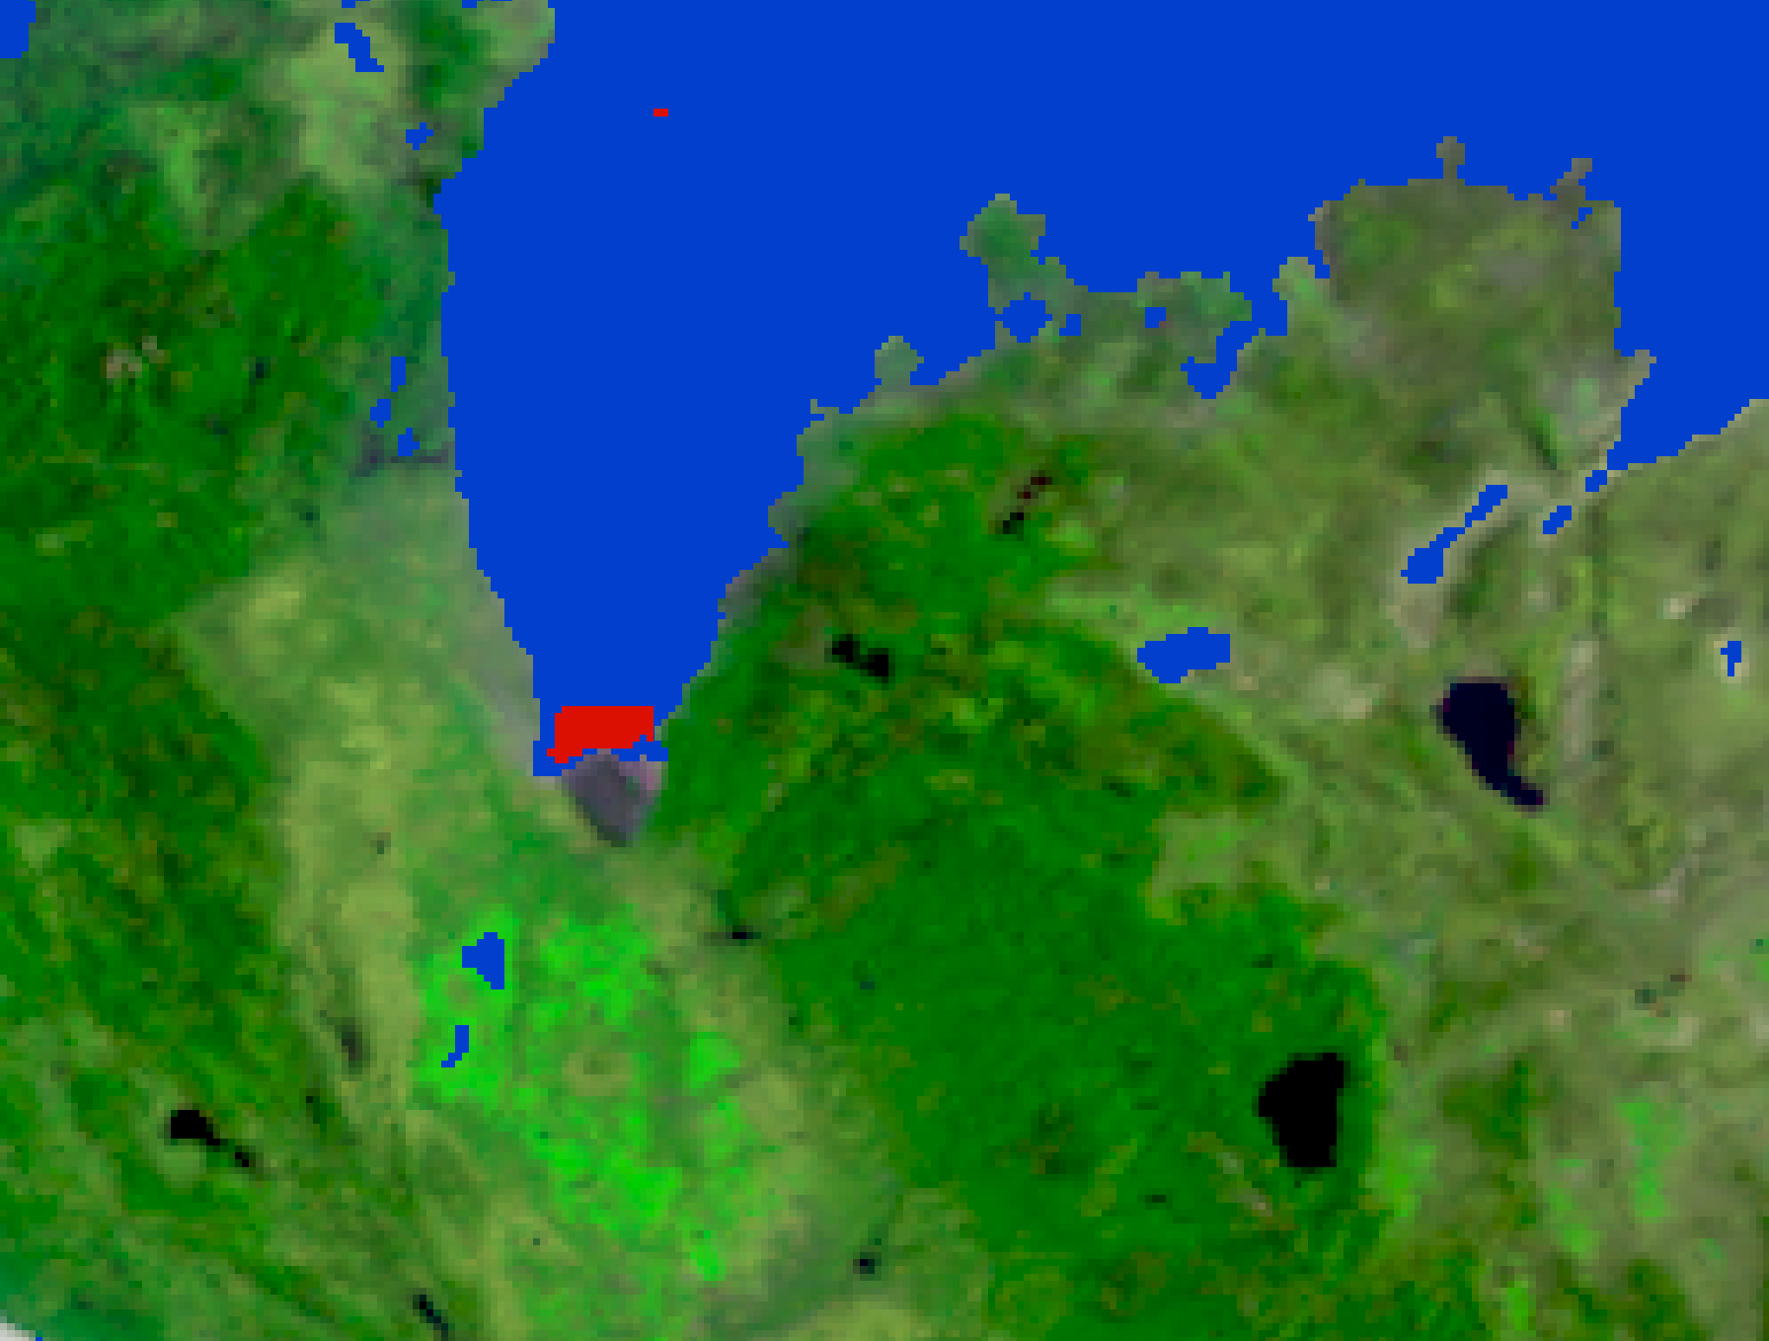
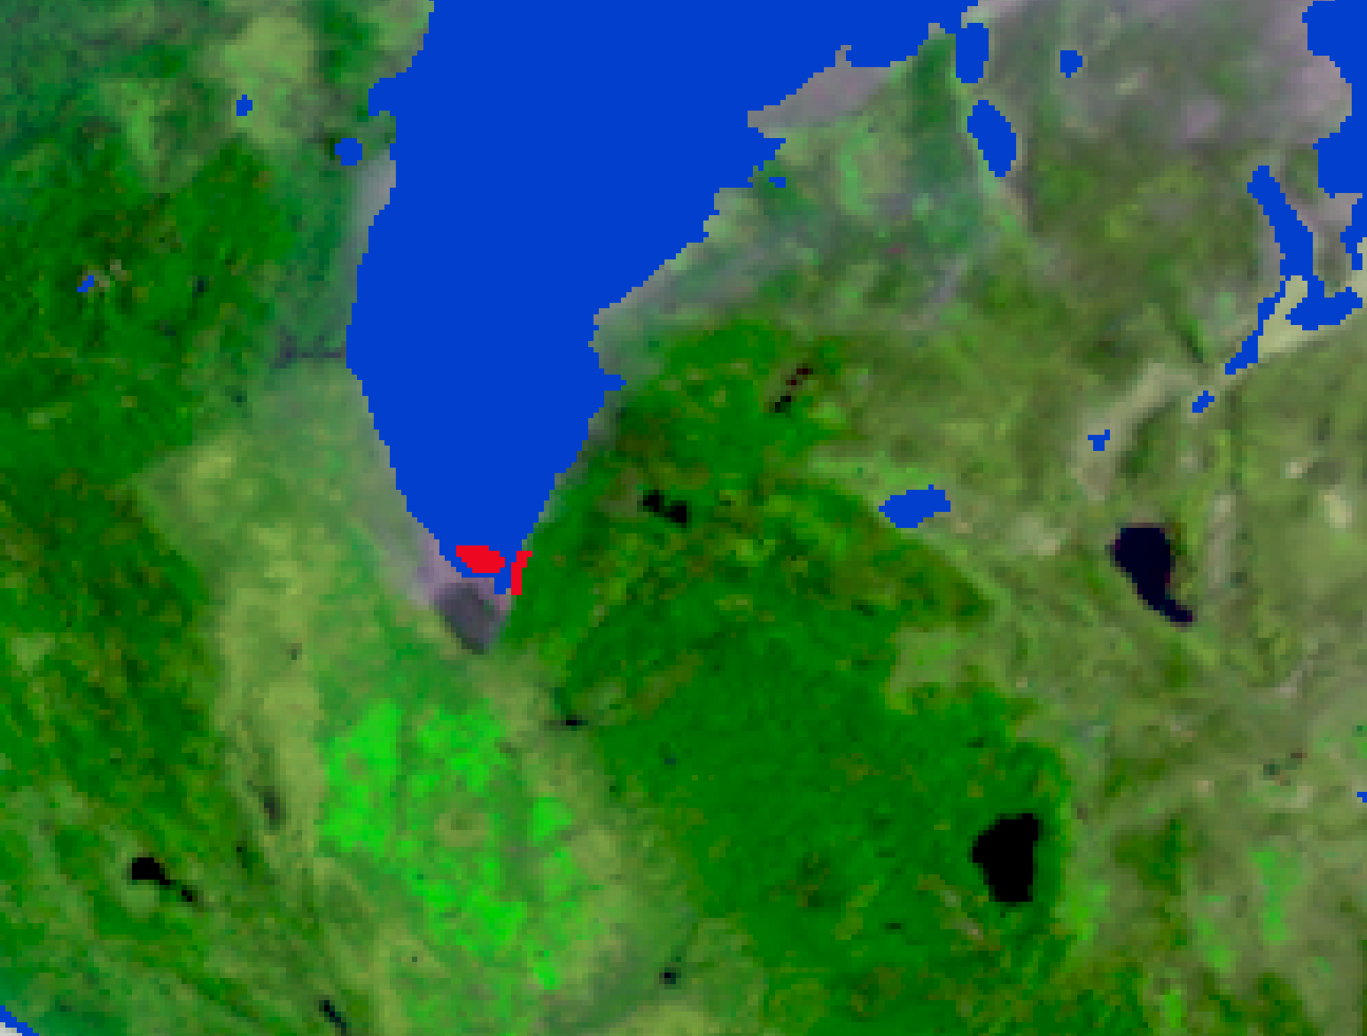
Tracking Hourly Wildfire Fronts and Smoke Progress
07/26/2024 16:00 UTC
07/26/2024 17:00 UTC
Method: SIT-FUSE (Segmentation, Instance Tracking, and data Fusion Using multi-SEnsor imagery ), a deep learning framework for self-supervised segmentation using multi-sensor data (GOES-18 and TEMPO radiance) to create wildfire fronts and smoke masks.
Wildfire products:
Temporal resolution: hourly
Spatial resolution: 10 x 10 km²
Smoke
Fire
Our wildfire‑front products enable hourly tracking of wildfire progression, providing time‑sensitive information for wildfire‑management decision makers.

Slide 7
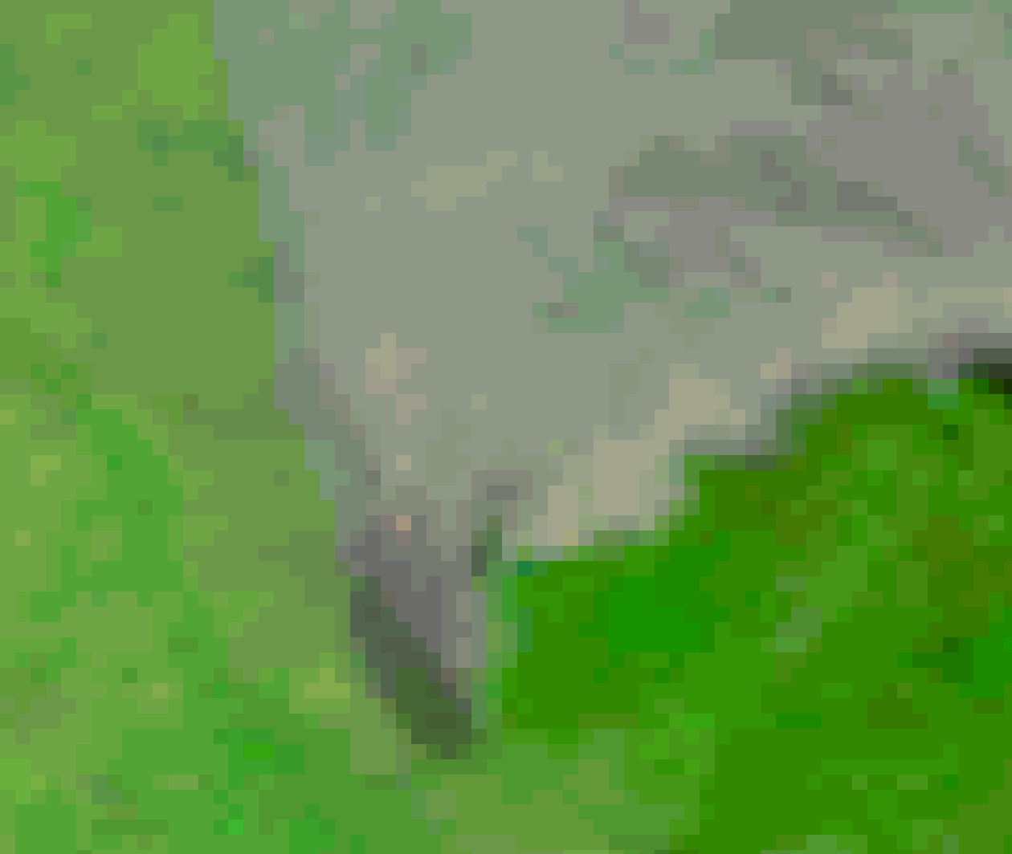
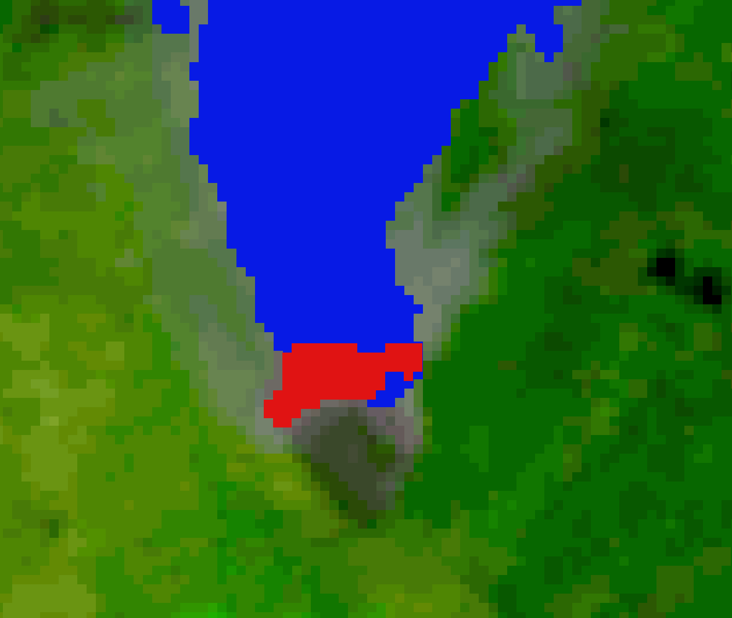
Tracking Hourly Wildfire Fronts and Smoke Progress (cont.)
Two-day animation: 07/25/2024 13:51 UTC - 07/26/2024 22:51 UTC
RGB
Wildire fronts + Smoke masks
Smoke
Fire
Notes:
Here are the two‑day animations: on the left you see the RGB imagery, and on the right the wildfire front and smoke mask overlaid. With these, we can track wildfire‑front movement and smoke progression on an hourly basis

Slide 8
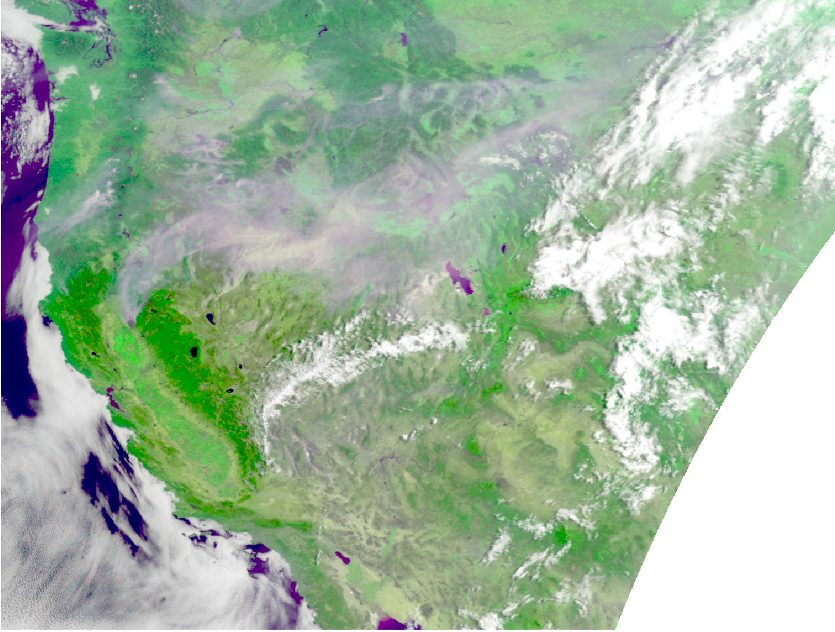
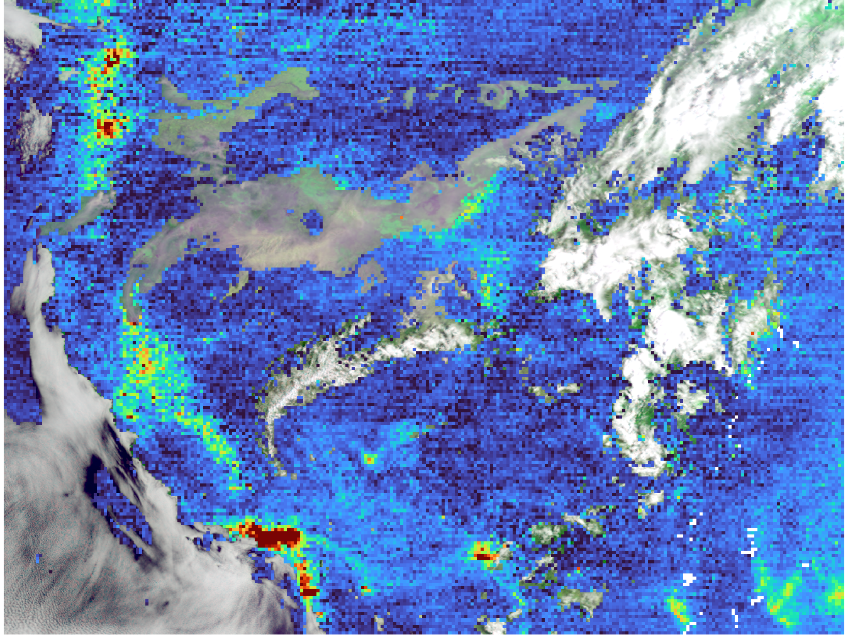
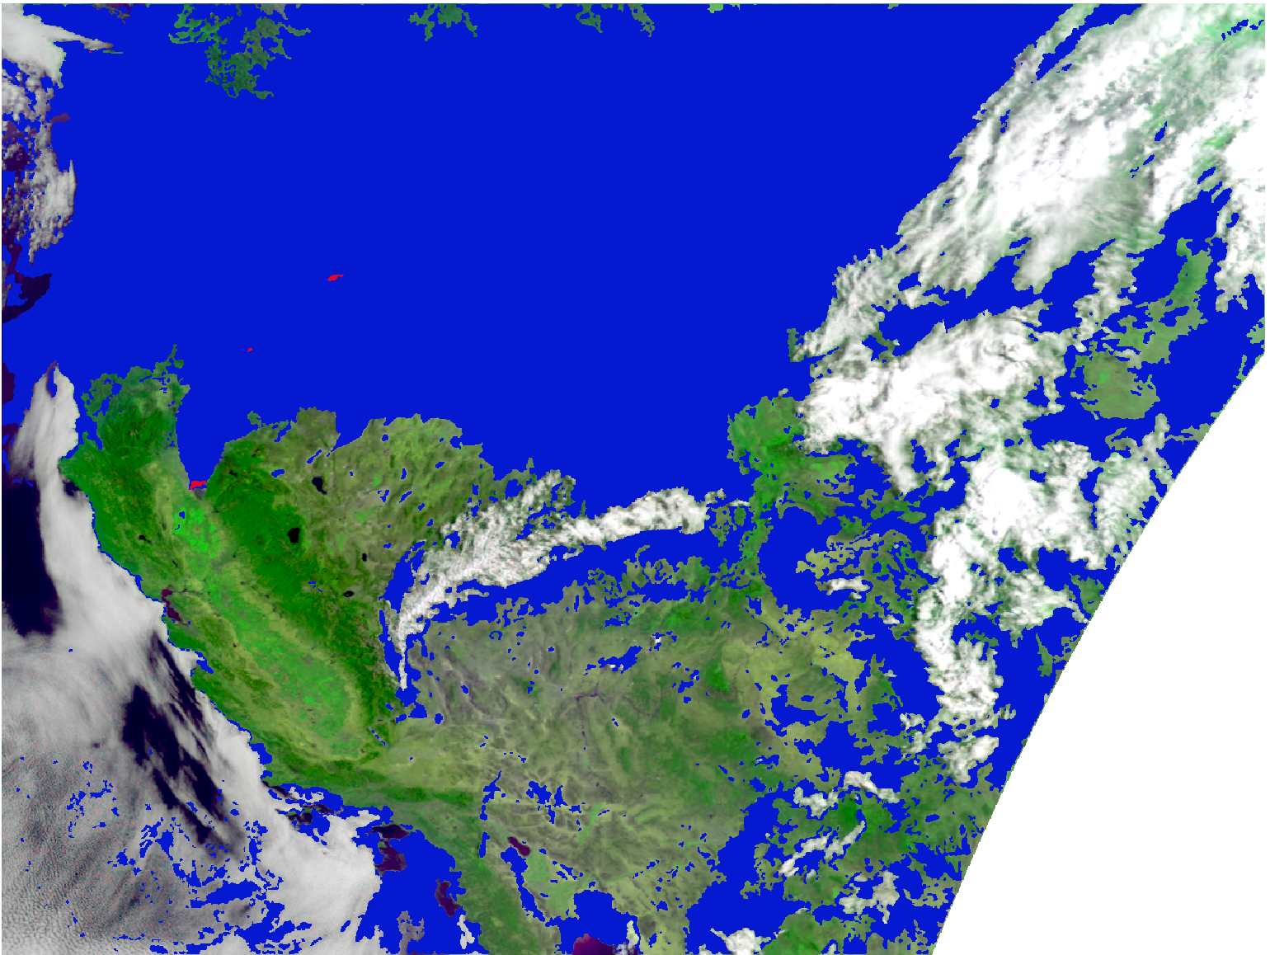
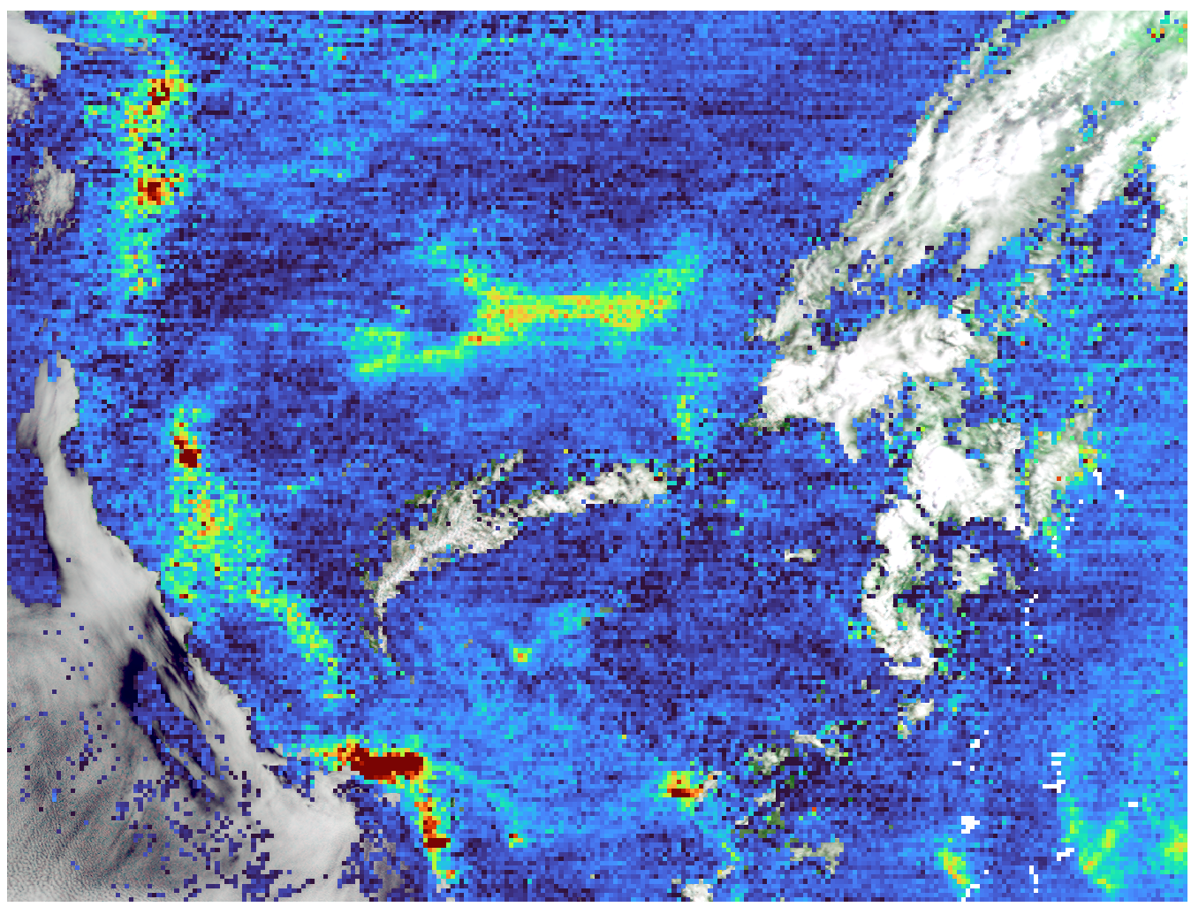

Restored NO2 data with Hourly Wildfire Smoke Plume Masks
TEMPO: 07/26/2024 15:51 UTC
RGB
Before our work
GOES-18 RGB on July 26, 2024
Time = 16:01 UTC
TEMPO NO2 with Operational Cloud Mask Applied (0.2 threshold)
Park fires
Smoke plume mask developed by our project
After our work
SIT-FUSE Binary Smoke and Fire Mask on GOES-18 Image
Smoke and Fire Masked TEMPO NO2 (From our Project)
Missing NO2 data because thick smokes are misclassified as clouds
Smoke
Fire
Park fires
Restore missing NO₂ data
NO2 (Molecules cm²)
1.0e+15
5.0e+15
9.0e+15
Notes:
The first image shows the GOES‑18 RGB composite at 15:51 UTC on July 26, 2024, where smoke plumes and clouds are clearly distinguishable.
The second image overlays TEMPO NO₂ retrievals, revealing that the operational cloud mask often misclassifies thick smoke as clouds. We have to remove TEMPO NO₂ data when cloud fraction exceeds 0.2. This leads to missing values over thick smoke regions.
To address this issue, we applied smoke‑plume masks to NO2 data.
These masks allow us to restore missing NO₂ within thick smoke plumes. The initial combined mask product is under development and will be completed within the first project year.

Slide 9
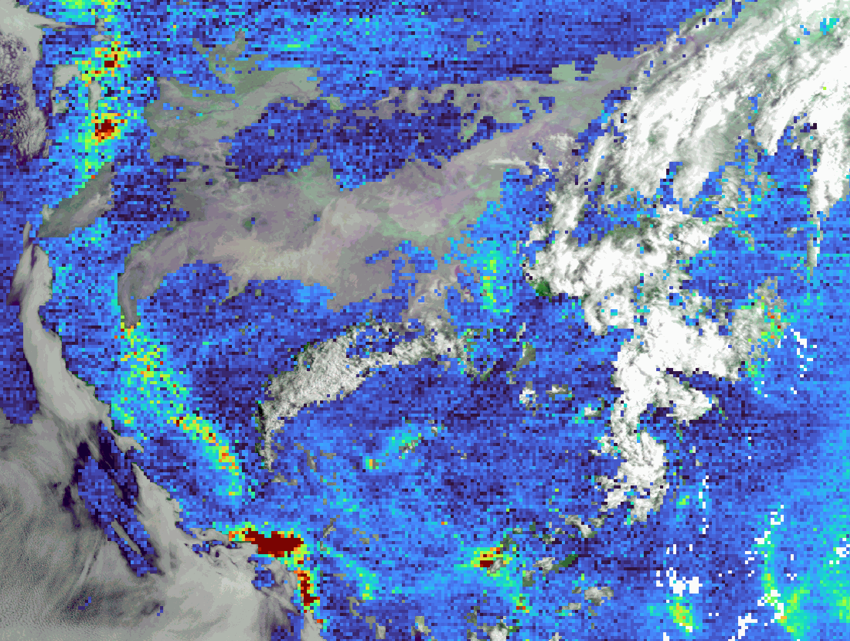
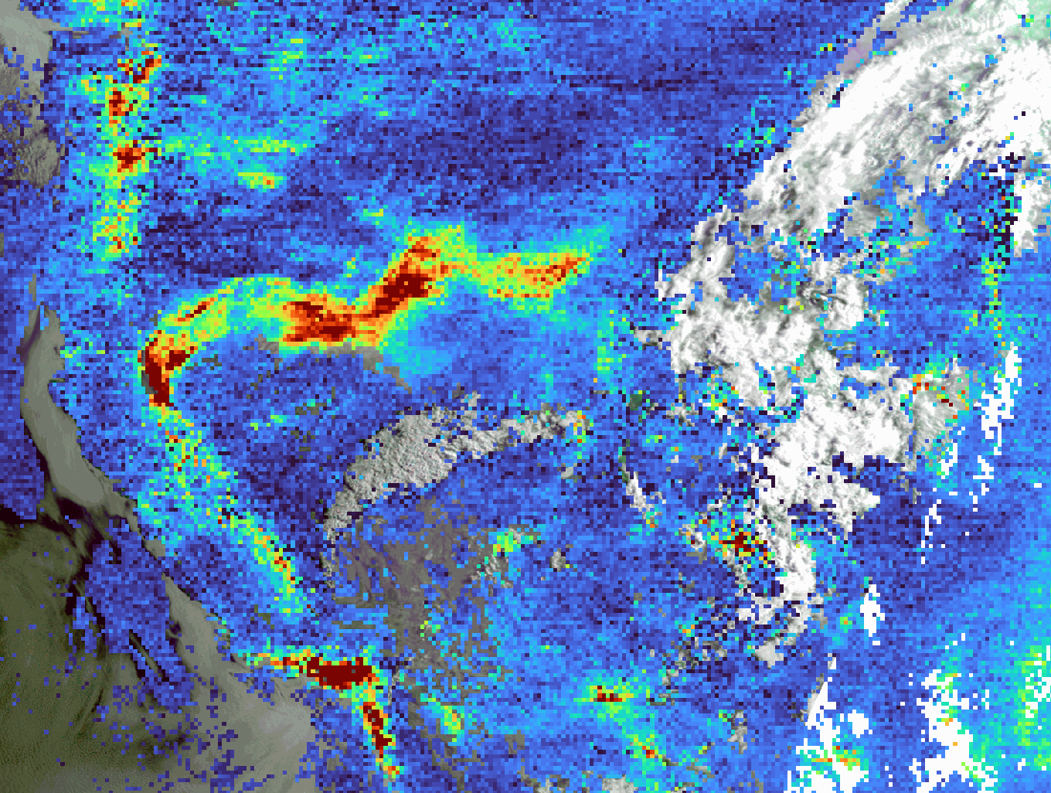
Restored NO2 data with Hourly Wildfire Smoke Plume Masks (cont.)
One-day animation: 07/26/2024 13:51 - 22:51 UTC
Before applying smoke plume masks
After applying smoke plume masks
Park fires
LA
1.0e+15
5.0e+15
9.0e+15
Restore missing TEMPO NO₂ data
Notes:
The first animation shows the hourly TEMPO tropospheric NO2 on day July 26, 2024 during Park fire before applying smoke plume masks and the second animation shows NO2 after applying apply smoke plume masks. Clearly, our method restored missing TEMPO NO2 data over thick smoke plume.

Slide 10
Obj 2: Simulate and Predict hourly wildfire-induced surface NO₂ using TEMPO
Led by Kyo Lee

Slide 11
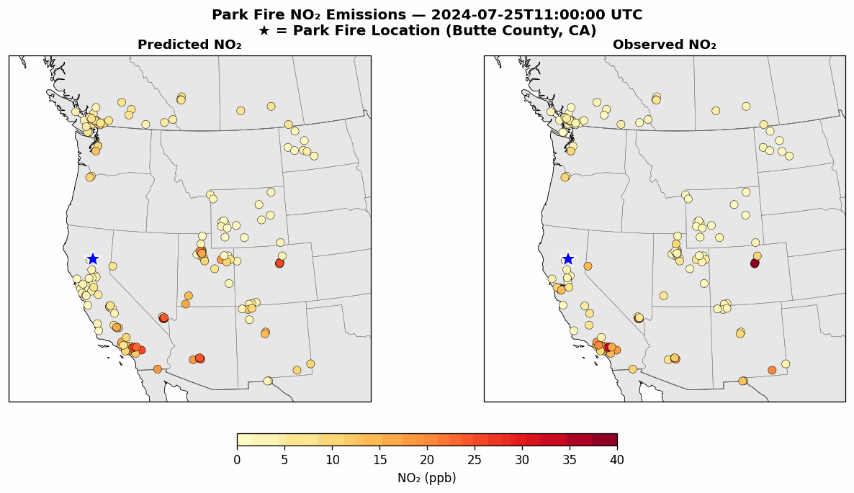
Estimated Surface NO₂ with TEMPO data and GNN Model
Surface NO₂ concentration
Estimated surface NO₂ at AirNow stations for July 25-26, 2024, using TEMPO column NO₂ in a graph neural network (GNN) model (Left panel)
The GNN was trained with one year of TEMPO data (July 2023–June 2024) to learn spatial patterns across AirNow and satellite observations
Notes:
This slide shows our graph neural network (GNN) model for estimating surface NO₂ at EPA AirNow stations. The model uses TEMPO Version 3 tropospheric column NO₂ as the main satellite predictor. We trained the GNN on one year of data—from July 2023 to June 2024—so it can learn spatial relationships among monitoring sites and the satellite‑observed NO₂ patterns.
The animation illustrates the model’s evaluation for the next three months, July through September 2024. The left column shows the GNN‑estimated surface NO₂, and the right column shows the corresponding AirNow observations. This side‑by‑side view helps us assess how well TEMPO column NO₂ can be translated into near‑surface concentrations.
A key challenge is the temporal mismatch: AirNow provides hourly measurements, while TEMPO observes only during daytime and does not align perfectly with AirNow’s timing. Both datasets also have missing values. To address this, we are integrating Mamba for the temporal component—a compact and efficient sequence‑modeling architecture that can learn NO₂ evolution from irregular time series without the heavy computational cost of Transformers

Slide 12
Bonus: Estimate hourly near-ground O3 using TEMPO
Led by Kyunghwa Lee

Slide 13
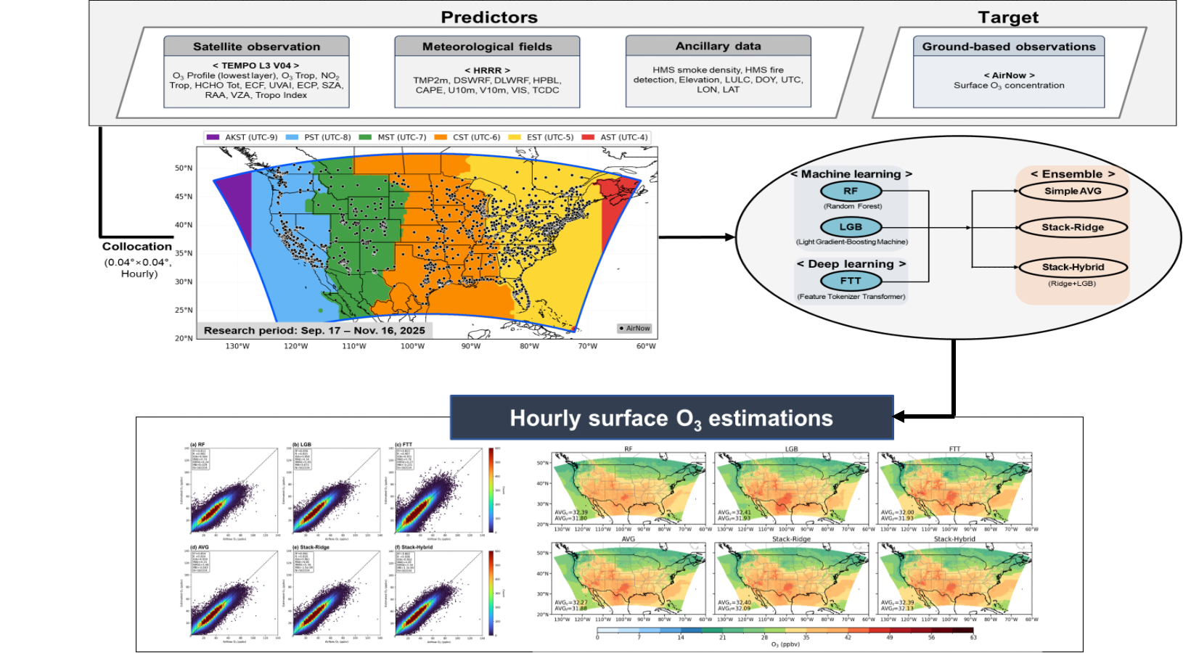
Estimated Hourly Surface O₃ using TEMPO data and ML
Kyunghwa Lee et al. to be submited
The results show promising skill in estimating hourly surface O3.
Notes:
Following the surface NO₂ work, we extended TEMPO observations to estimate hourly surface ozone across the CONUS. This work is lead by Kyunghwa Lee. To do this, we developed a machine‑learning ensemble framework that uses TEMPO Level‑3 Version 04 products, including ozone profiles, NO₂, and HCHO columns, along with HRRR meteorology and ancillary datasets. AirNow hourly ozone measurements serve as the training and evaluation target.
The framework integrates three base models: Random Forest, LightGBM, and the Feature Tokenizer Transformer. We then generated ensemble estimates using simple averaging and two stacking methods, evaluated through out‑of‑fold predictions.
These results show promising skill in estimating hourly surface O3. Across the board, the stacking‑based ensembles outperformed the individual models.
These results highlight the value of TEMPO observations, especially the ozone profile information, for producing reliable, high‑resolution, hourly surface ozone estimates
Research period: 17 September–16 November 2025
Research domain: 0.04° × 0.04° target grid over CONUS, divided by U.S. time zones for local-time-based O₃ analysis
Predictors: TEMPO L3 V04 satellite observations, including the O₃ profile product and NO₂ & HCHO column information; HRRR meteorological fields, including 2 m temperature, radiation flux, and wind variables; and ancillary data, including elevation, land cover, and wildfire-related information
Target: AirNow hourly surface O₃ observations
Base models: Random Forest (RF), LightGBM (LGB), and Feature Tokenizer Transformer (FTT)
Ensemble methods: Simple averaging, Stack-Ridge, and Stack-Hybrid
Evaluation: Six methods (base and ensemble methods) were evaluated against AirNow observations using out-of-fold predictions, with additional analyses of statistical performance, density scatter plots, and spatial distributions
Conclusion:?

Slide 14
Take-Home Messages: Applying TEMPO Data on Wildfires
Map smoke plume masks: By applying the smoke plume masks developed in our project, we successfully restored hourly TEMPO NO₂ observations over thick smoke plumes.
Map wildfire fronts: Our wildfire‐front products may enable hourly tracking of wildfire progression, providing critical, time‑sensitive information for wildfire‑management decision makers.
Estimate surface wildfire‑induced NO₂: The graph neural network model shows promising skill in estimating wildfire‑induced surface NO₂.

