Slide 1



Geostationary Satellite Observation Informed Modeling of Ozone Dynamics and Their Association with Sleep Health
Aodong Meiª, Zhengyi Cuiª, Kari North^{b}, Heather Highland^{b}, Juan Aguilera^{c}, Yang Liu^{d}, Xiong Liu^{e}, Qian Xiao^{f}, Yun Hang^{a,}*
ª Department of Environmental and Occupational Health Sciences, School of Public Health, University of Texas Health Science Center at Houston, Houston, TX 77030, United States
^{b} Department of Epidemiology, School of Public Health, University of Texas Health Science Center at Houston, Brownsville, TX 78520, United States
^{c} Department of Health Promotion and Behavioral Sciences, School of Public Health, University of Texas Health Science Center at Houston, El Paso, TX 79905, United States
^{d} Gangarosa Department of Environmental Health, Rollins School of Public Health, Emory University, Atlanta, GA 30322, United States
^{e} Atomic and Molecular Physics Division, Center for Astrophysics | Harvard & Smithsonian, Cambridge, MA 02138, United States
^{f} Department of Epidemiology, School of Public Health, University of Texas Health Science Center at Houston, Houston, TX 77030, United States

Slide 2
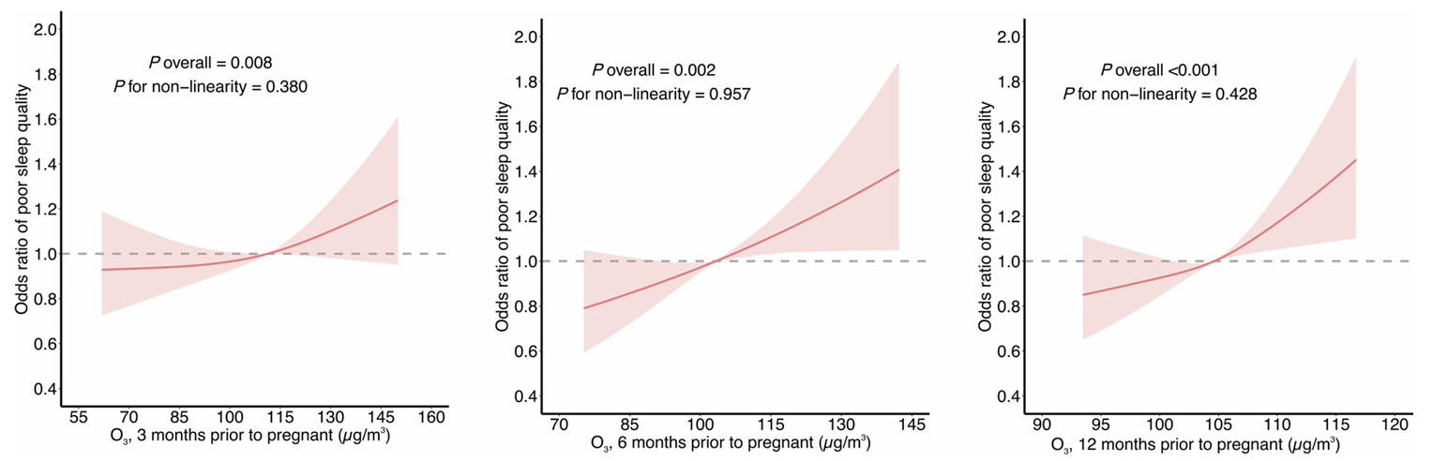
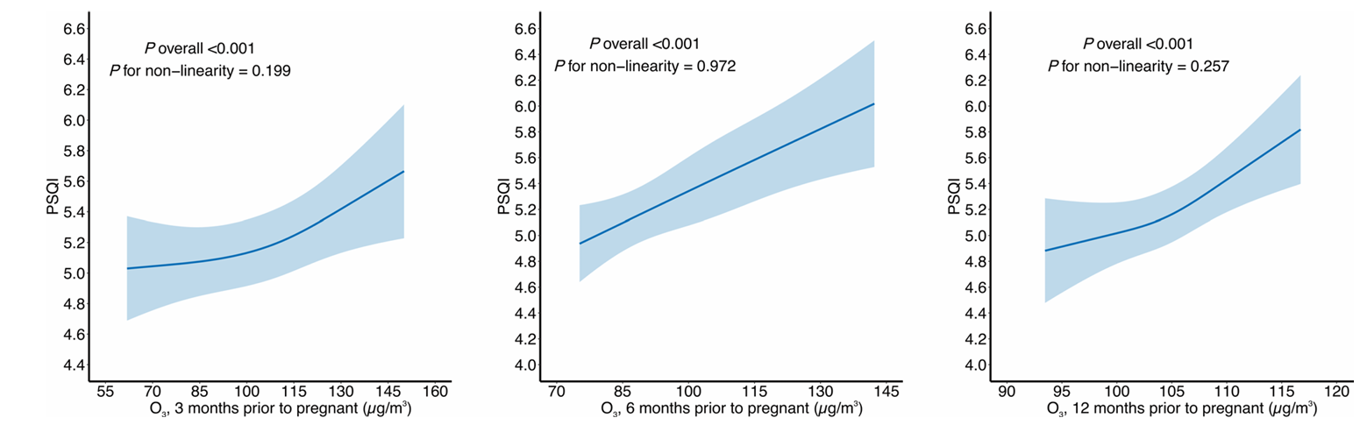
Motivation
Exposure to ozone pollution is a significant risk factor for respiratory, cardiovascular diseases, and premature mortality (Wang et al., 2025; Jiang et al., 2023; Niu et al., 2018)
Ambient ozone could also lead to worse sleep health in pregnant women
The U.S.–Mexico border is highly vulnerable due to intense population, industrial activities and heavy cross-border traffic emissions
Figure 1. Association of exposure to ambient ozone with sleep quality in pregnant women
Huang et al., 2025

Slide 3
Monitoring Gaps & Innovation
Sparse ground networks, especially in rural areas
OMI and TROPOMI provide data with low spatiotemporal resolution
TEMPO: Hourly observations at ~2 × 4.75 km resolution to capture short-term ozone changes
Figure 2. Population and O₃ stations in the study area
Mei et al., under revision

Slide 4
Objectives
Develop 1-km hourly ozone predictions with TEMPO + ML
Detect ozone hotspots and gradients
Link ozone exposure with Border Health Research Cohort (BHRC) data to assess health effects
Figure 3. Annual mean MDA8 O₃ (August 2023–August 2024)
Mei et al., under revision

Slide 5
Data and Methods
TEMPO data: Hourly Level-2 total column ozone, quality flag filtered. Missing values are gap filled.
Resampling: All predictors harmonized to a 1-km grid for consistency across datasets.
Predictors: GEOS reanalysis, HRRR meteorology, EDGAR emissions, land use, elevation, road proximity, nightlight, and population density.
Model: Final XGBoost trained with full dataset; validated via random, spatial, and temporal cross-validation.
Figure 4. Predictor importance
Mei et al., under revision

Slide 6
Model Performance
R² ≈ 0.89, RMSE ≈ 5.6 ppb
TEMPO model outperforms model without TEMPO
Validated by Synergistic TEMPO Air Quality Science (STAQS) ozone observations
Model with total column ozone
Model without total column ozone
Figure 5. Comparison of modeled O₃
Mei et al., under revision

Slide 7
Spatial and Seasonal Dynamics
High ozone in Permian Basin, and some urban cities, such as Monterrey and El Paso
Coastal area has lower ozone
Summer: urban cores elevated ozone
Winter: NOx titration lowers city ozone
Figure 6. Seasonal O₃ variations
Mei et al., in review

Slide 8
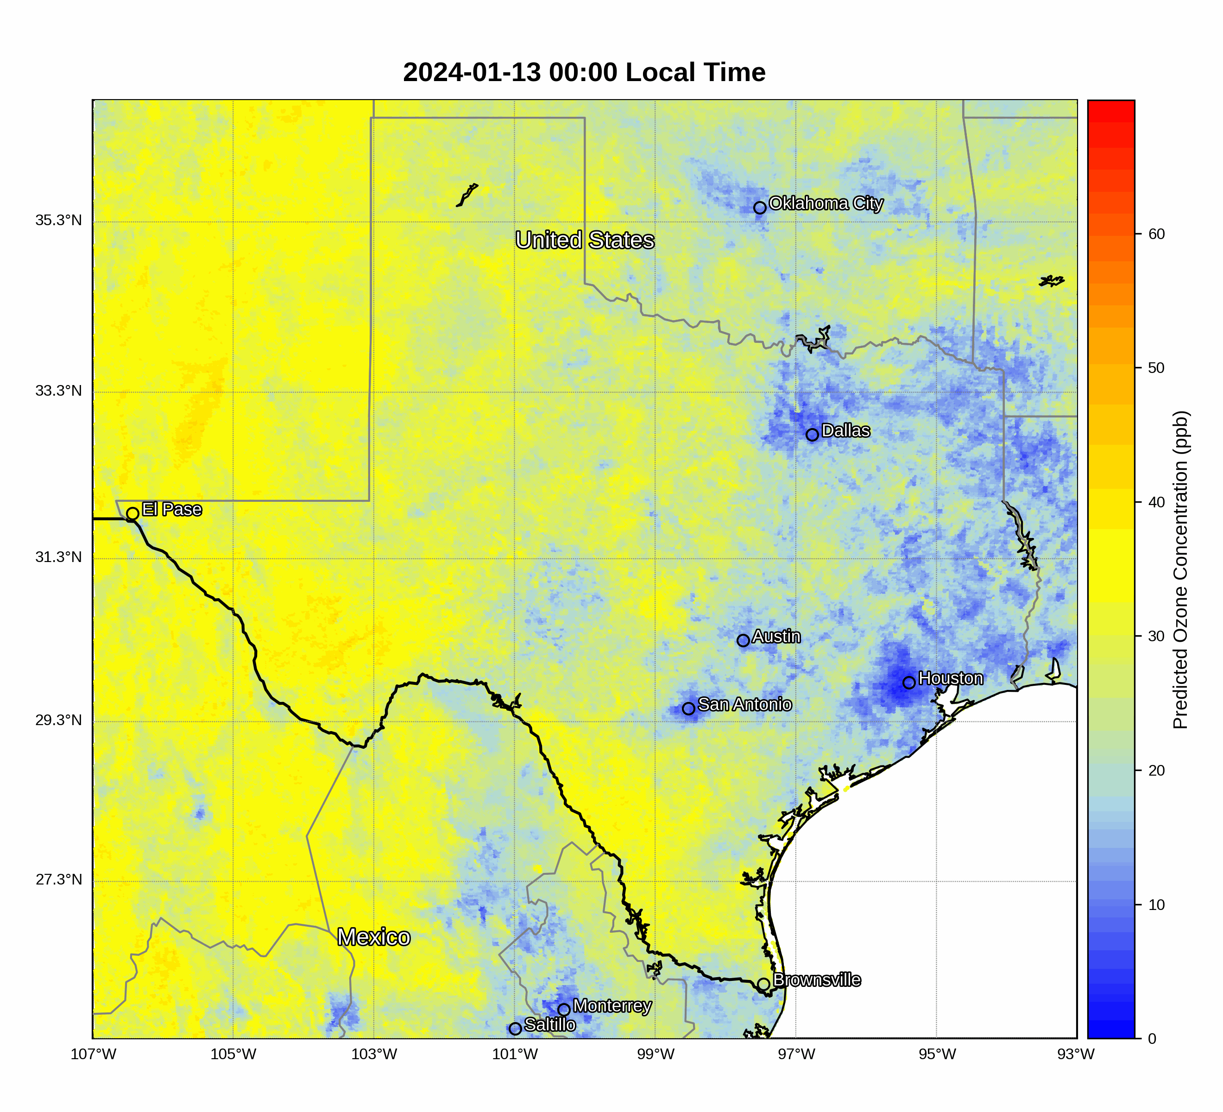
Hourly Dynamics
TEMPO reveals short-term changes
Colonia communities are disproportionately exposed
Figure 7. O₃ hotspots in U.S.–Mexico border cities during high O₃ events
Mei et al., under revision

Slide 9
Sleep Health and Ozone
Each 1 ppb increase in annual MDA8 O₃ is associated with a 0.28-point increase in Individual Pittsburgh Sleep Quality Index (PSQI) sleep medication use among male participants
Remained robust across annual daily mean O₃ and multiple sensitivity analyses adjusting for hypertension, obesity and diabetes.
Figure 8. Sleep health with O₃ exposure
Mei et al., under revision

Slide 10
Next Step
Mei et al., in submission

Slide 11
Thank you!

