Slide 1
Use of TEMPO Data at Georgia EPD
Asher Mouat, Ph.D.
Xiangyu Jiang, Ph.D.
Byeong-Uk Kim, Ph.D.
Data and Modeling Unit
Georgia Air Protection Branch
Applications and Stakeholder Needs, Pt. 1
June 17, 2026

Slide 2
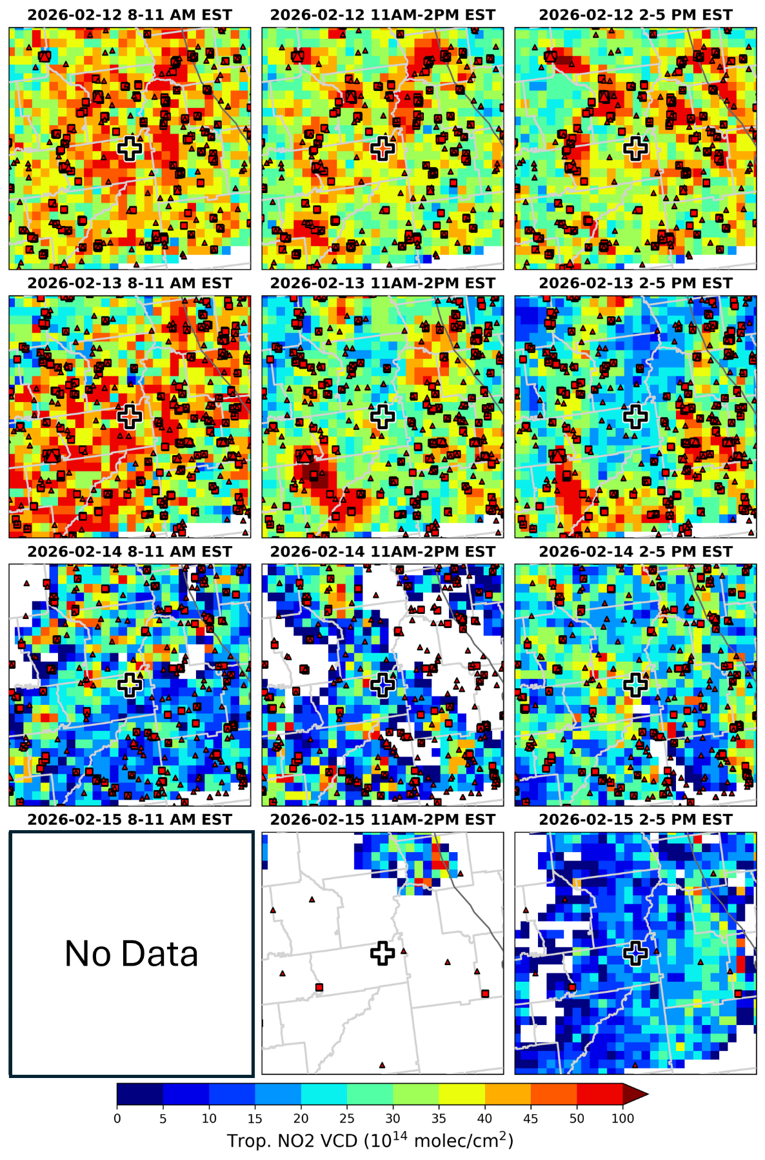
Column data Most Commonly used for documenting pollutant exceedances
Since 2016, Georgia EPD has written detailed reports for every exceedance of the NAAQS.
    INITIAL REPORT: Must be completed within 3 business days after the exceedance.
    FINAL REPORT: Submitted after all relevant information has been collected.
Reports include discussions on meteorology, urban/fire emissions, plume tracking, air quality, and cause of the exceedance.
    Data from multiple sources (HMS, HYSPLIT, etc.)
    TEMPO VCDs used to gauge emissions / plume tracking.

Slide 3
Column data Most Commonly used for documenting pollutant exceedances
Since 2016, Georgia EPD has written detailed reports for every exceedance of the NAAQS.
    INITIAL REPORT: Must be completed within 3 business days after the exceedance.
    FINAL REPORT: Submitted after all relevant information has been collected.
Reports include discussions on meteorology, urban/fire emissions, plume tracking, air quality, and cause of the exceedance.
    Data from multiple sources (HMS, HYSPLIT, etc.)
    TEMPO VCDs used to gauge emissions / plume tracking.

Slide 4
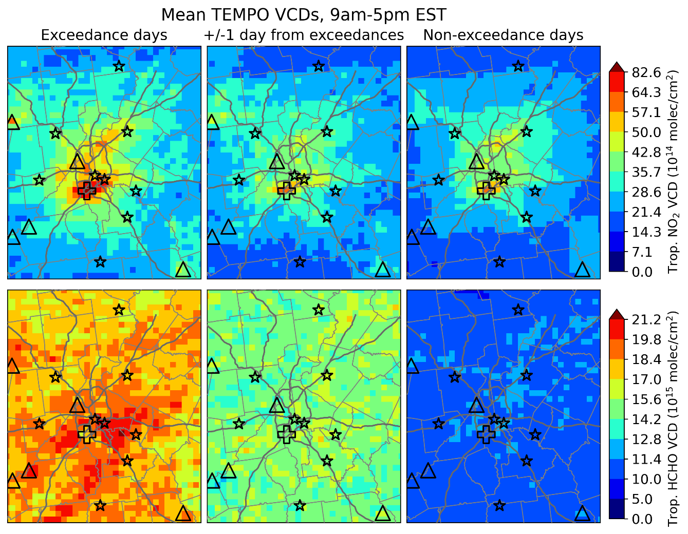
TEMPO columns now included in annual ozone exceedance report
Georgia EPD produces a final report that details a retrospective analysis on pollutant exceedances for a given period.
    Report is a more in-depth look at the same factors from the initial exceedance report.
    TEMPO NO₂ and HCHO VCDs are used to for source identification, quantifying spatial distributions, and understanding how O₃ precursor emissions differ between exceedance and non-exceedance days.
These reports will be the foundation of Georgia EPD’s control strategy development for State Implementation Plans.
Notes:
We’ve found pyrsig and geopandas work great together to make highly customizable figures. We have code written to use xarray as well.

Slide 5
expect to use TEMPO in future Events Demonstrations and Network Assessments
Exceptional Event Demonstrations are reports used to exclude data for the purpose of calculating design values (DVs) at ground monitoring sites.
    DVs are used to determine the pollutant concentrations that cannot be exceeded at some site to remain in compliance with the NAAQS.
    Exceedances caused by certain events like Canadian wildfires can be excluded when calculating DVs, provided there is a “clear causal relationship.”
    This will be a critical tool for Georgia EPD’s compliance with NAAQS.
Network Assessments are conducted to design and locate statutorily required ground monitoring sites.
  TEMPO’s high spatiotemporal resolution is expected to be invaluable when establishing causal relationships and locating new sites.

Slide 6
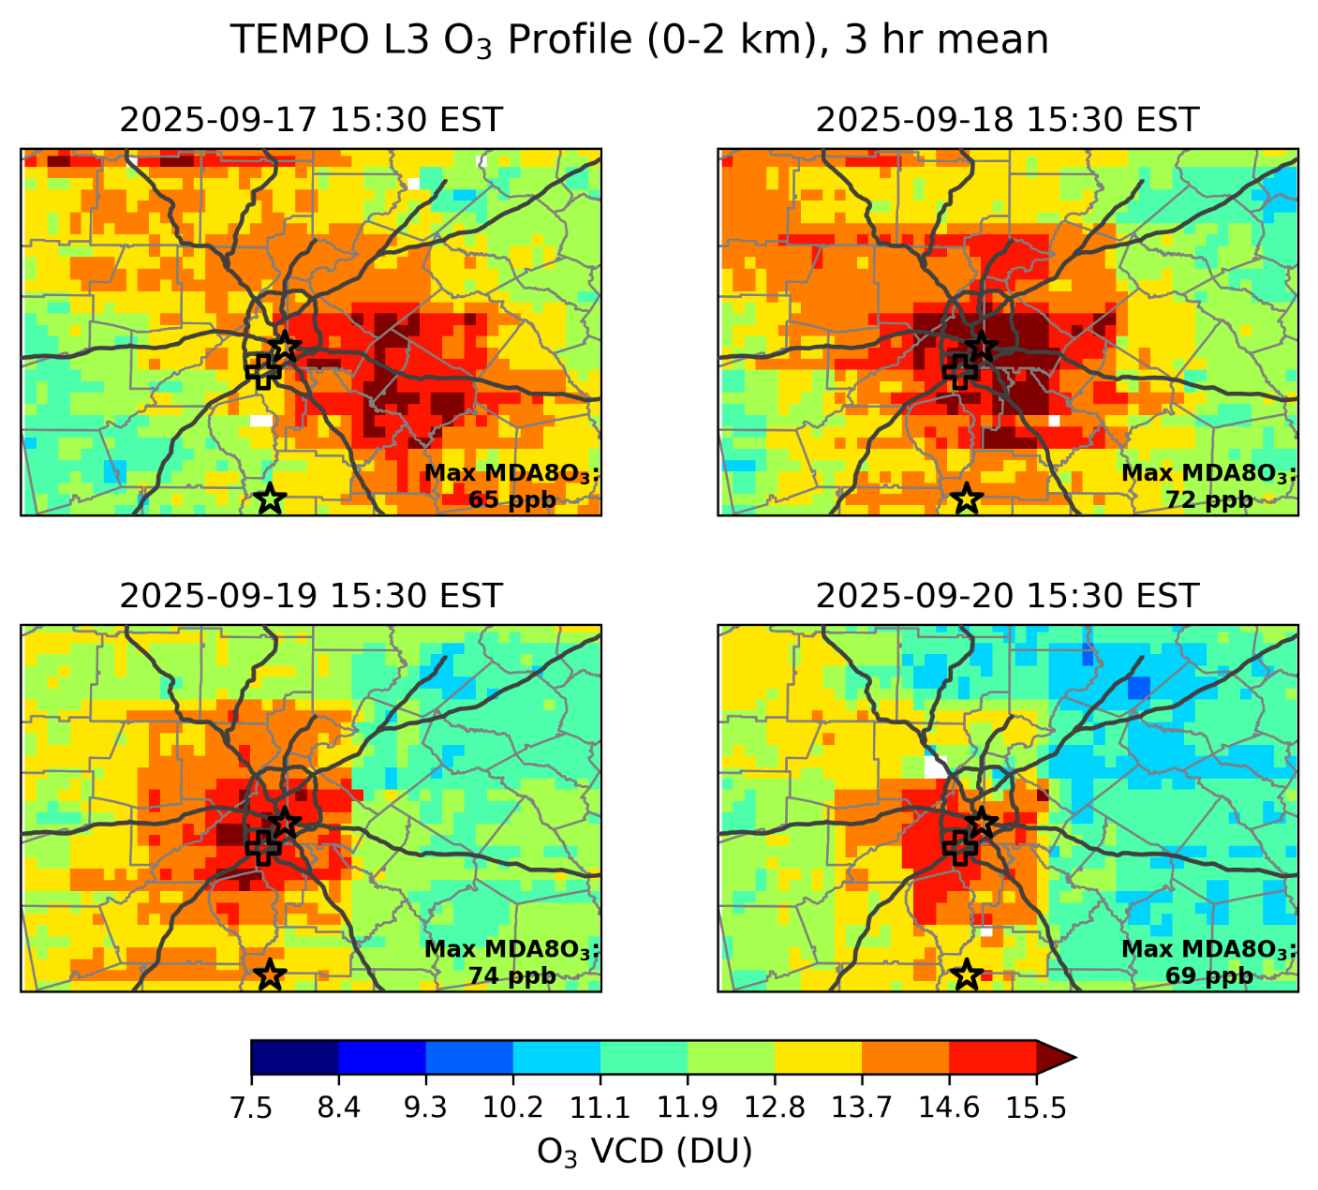
Future Projects with Satellite Data
Understanding what leads to high ozone events
  Incorporate TEMPO O₃ profile product into future analyses of elevated ground-level O₃ events
  Analyzing trends between near-surface VCDs and surface observations.
  Regridding and comparing trop. O₃, NO₂, and HCHO VCDs to diagnose ozone formation regime.

Slide 7
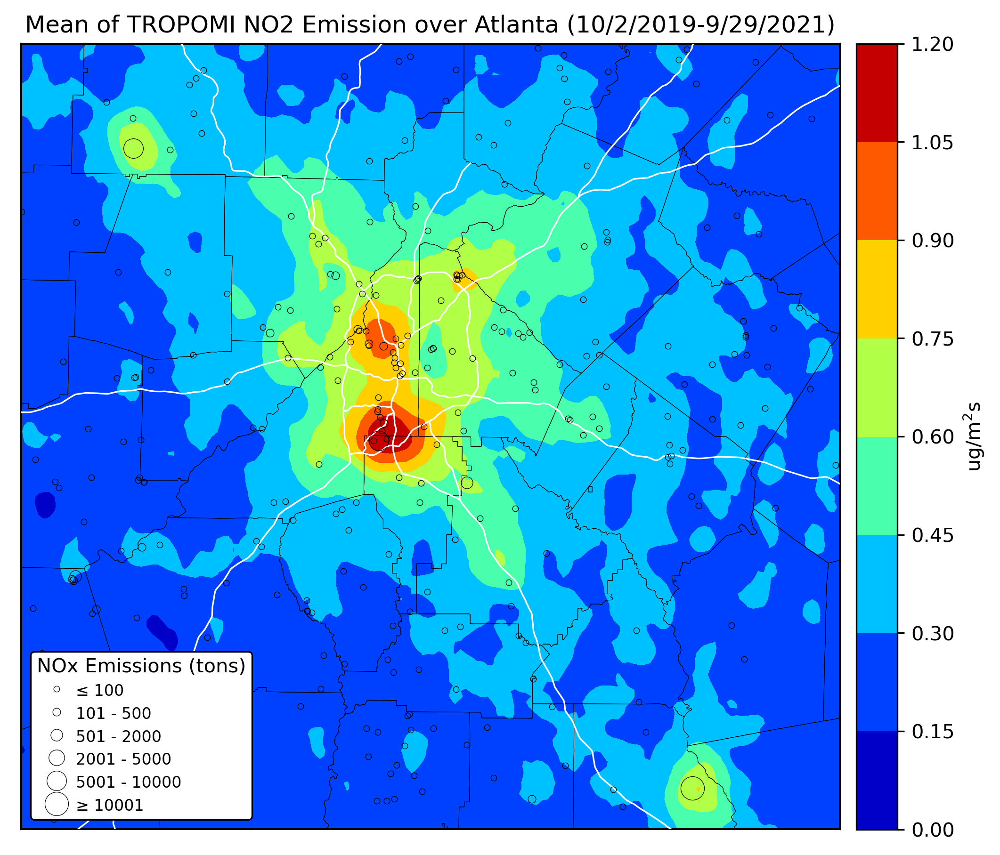
TEMPO-Informed Top-Down Emissions Estimates
Georgia EPD plans to develop its own top-down emission datasets, either through flux divergence or model inversion methodologies.
Plan includes accounting for biases in TEMPO VCDs.
  Apply bias correction factors using ground-based remote sensing observations.
  Run CTMs at high spatial res over a state-wide domain to generate new AMFs for NO₂ and HCHO.
Assess the impact of these methods on emissions estimates.
de Foy et al. (2022)

Slide 8
Georgia EPD plans to expand the use of TEMPO data for air quality management
Incorporating TEMPO+ABI products into PM exceedance reports and more.
    Focus on AOD, ALH, and estimated surface [PM_{2.5}].
Interested in how TEMPO can enhance our forecasting capabilities.
    Georgia EPD has an [O₃] and [PM_{2.5}] forecasting team, but forecasts are spatially limited.
    TEMPO + machine-learning approaches may offer more spatially detailed forecasts.
    Predicted surface [PM_{2.5}] and [O₃] are products that our team could use.
We appreciate NASA (and U.S. EPA) for the guidance and resources they’ve provided.
    RSIG/pyrsig, harmony-py, Colab and jupyter notebooks and seminars
    Meetings with scientists to discuss topics like determining O₃ production/sensitivity, using TEMPO to predict RX-smoke spread probabilities.

Slide 9
Contact Information
Asher Mouat, Ph.D.
Georgia Dept. of Natural Resources
4244 International Parkway, Suite 120
Atlanta, GA 30354
asher.mouat@dnr.ga.gov
(470)-938-3383

Slide 10
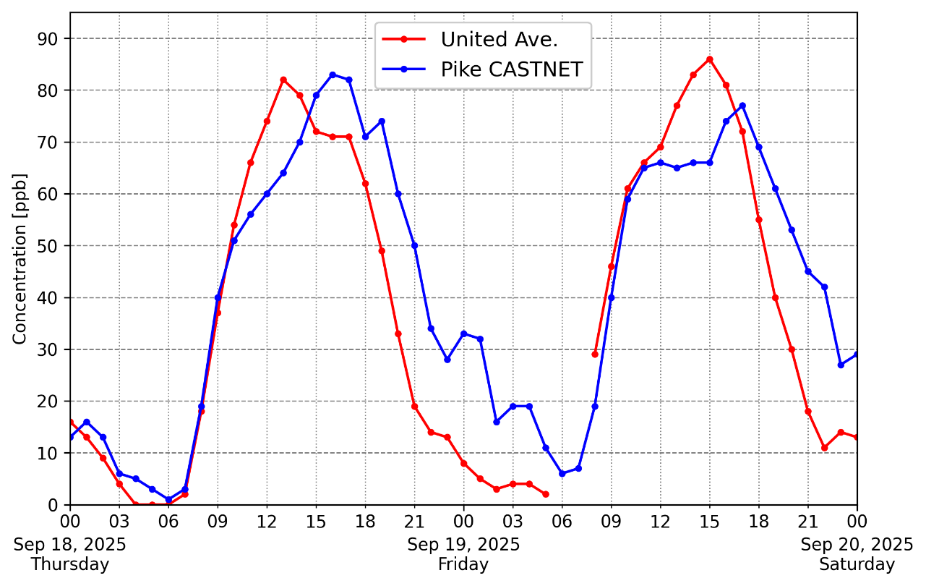
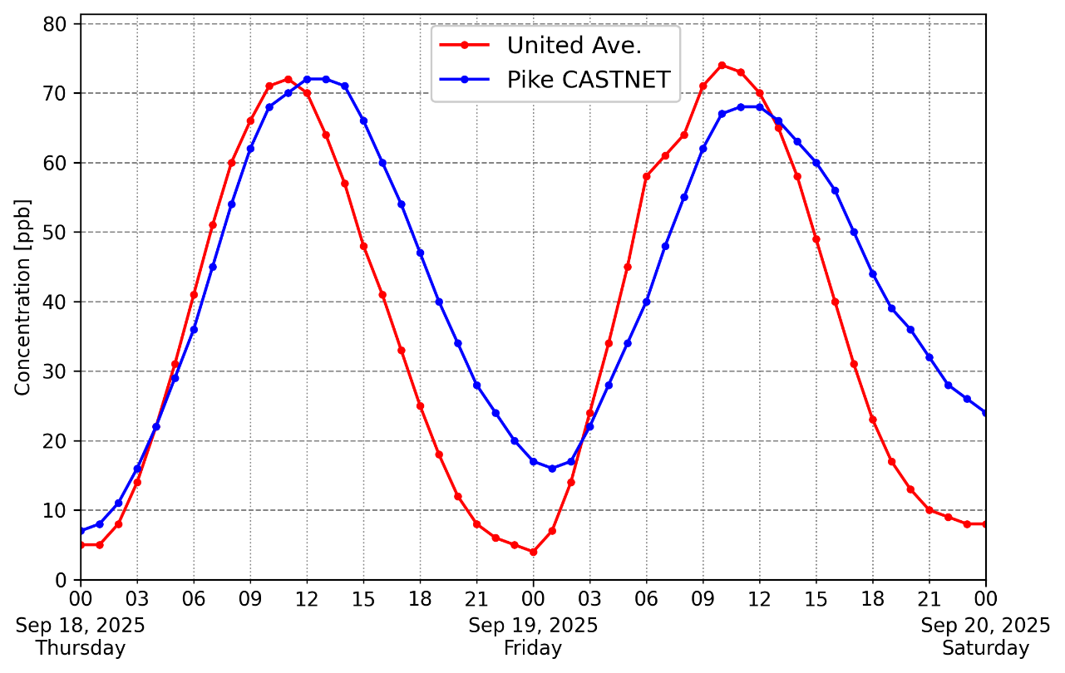
1 hr
MDA8O₃

