Slide 1
TEMPO & ABI Aerosol Observations of a Recent Dust Event
Amy K. Huff¹
Pubu Ciren¹, Hai Zhang¹ & Shobha Kondragunta²
¹STC at NOAA/NESDIS
²NOAA/NESDIS
Application and Stakeholder Needs, Part 1
TEMPO DART Team Meeting
June 17, 2026

Slide 2
What Stakeholders Need to Know about TEMPO Aerosol Products
Transition of algorithms from research to operations is in progress
  Completion expected by September! (delayed from April)
Operational data files will be distributed by NASA Earthdata
Anticipated latency of ~2 hours once products become operational
User’s Guides are available for each product file
Test files for Aug 2, 2023 to Sep 16, 2025 are available by request
File Prefix | Notable Included Products | Data Processing Level | File Type
TEMPO-ABI-G19_ADP_L2 | UV AAI Smoke/Dust mask | Level 2 | TEMPO granule
TEMPO_AODALH_L2 | Aerosol Optical Depth Aerosol Layer Heigh | Level 2 | TEMPO granule
TEMPO-ABI_PM25_L4 | Hourly estimated surface PM_{2.5} | Level 4 | Gridded (ABI fixed grid)

Slide 3
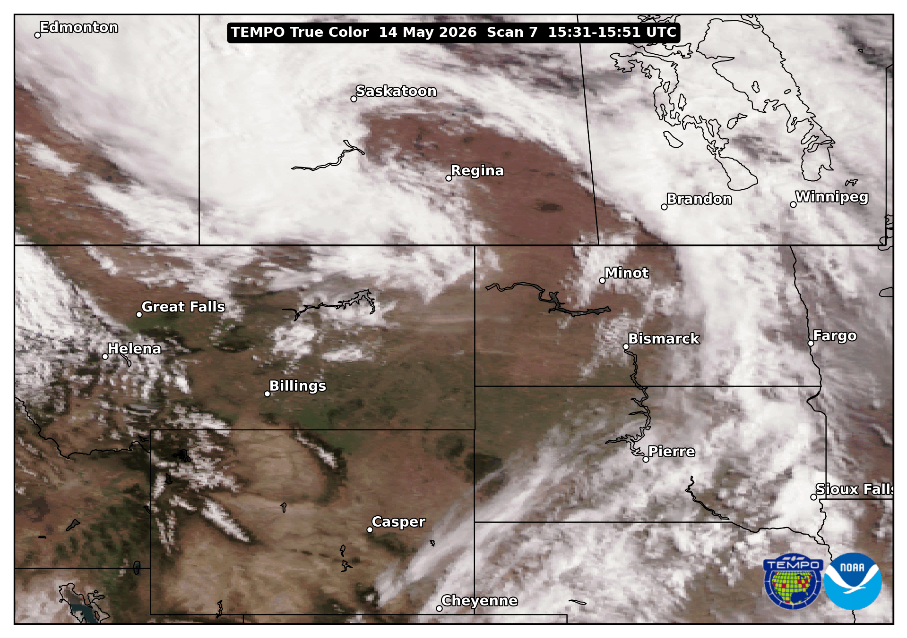
Blowing Dust across Northern Plains, 14 May 2026
Large blowing dust event along the US-Canada border
TEMPO observed the dust ~15:30-23:30 UTC
Dust caused exceedances of the US daily National Ambient Air Quality Standard (NAAQS) for PM_{2.5} (>35 μg/m³) in North Dakota
Utilize all of the TEMPO aerosol products to get a full picture of the event!

Slide 4
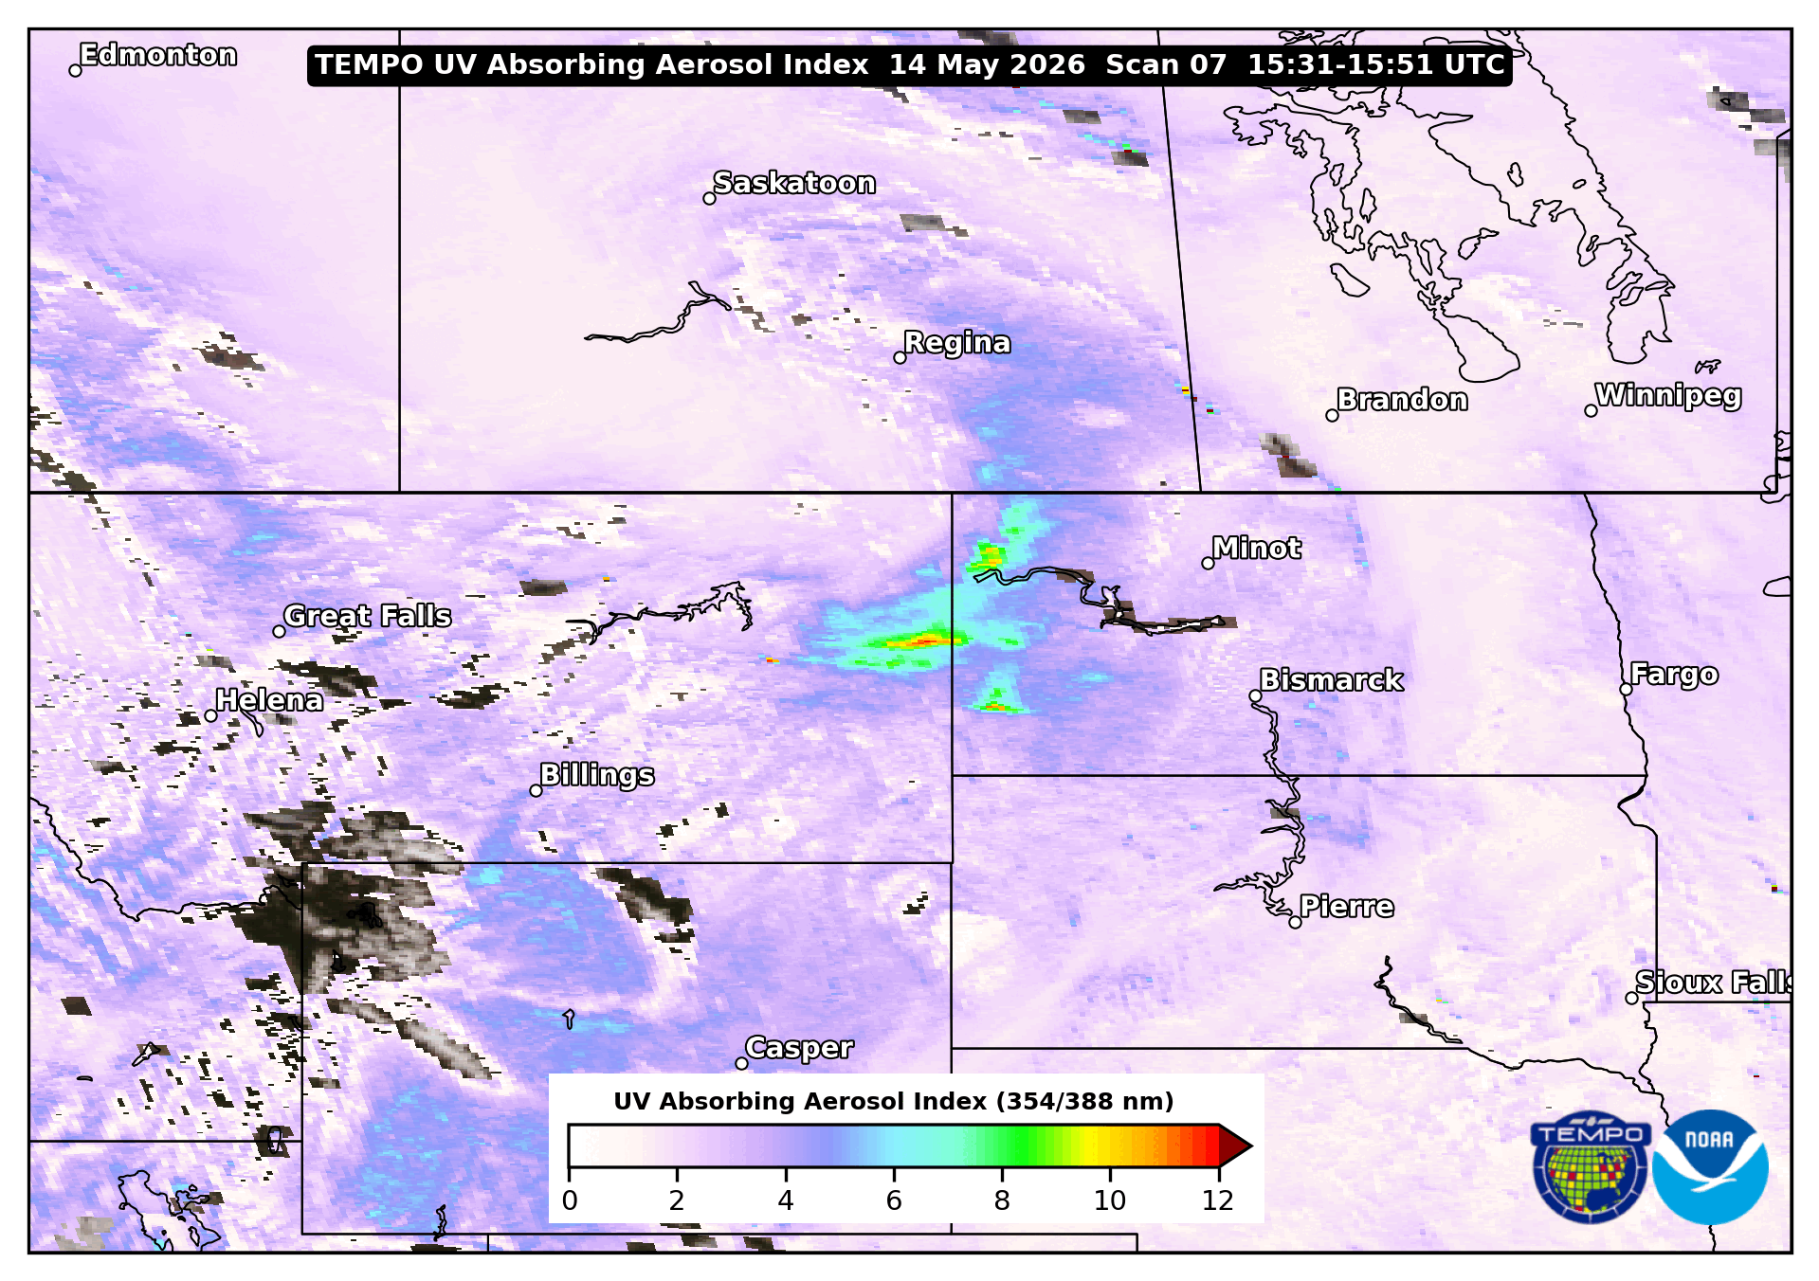
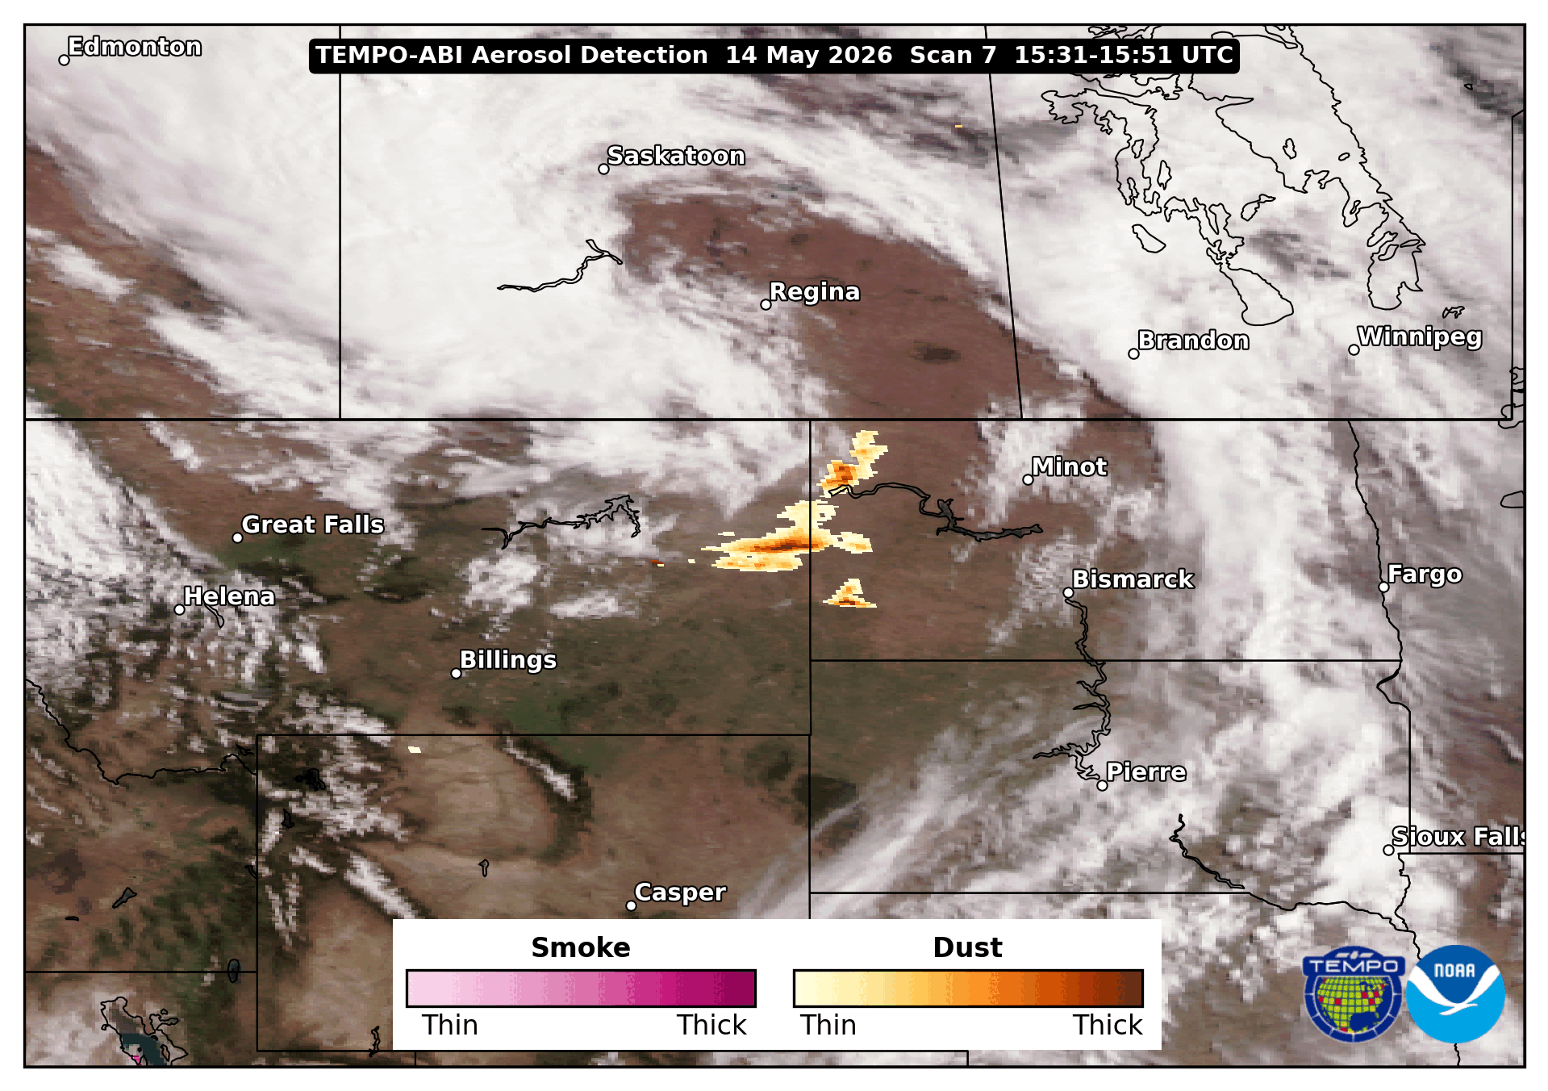
TEMPO UV Absorbing Aerosol Index
TEMPO-ABI Aerosol Detection Product (ADP) Smoke/Dust Mask
Qualitatively identifies absorbing aerosols, including smoke & dust
  New! Not available from ABI
Qualitative indicator of the relative intensity (thickness) of smoke & dust
  Increased detection vs. ABI Aerosol Detection product

Slide 5
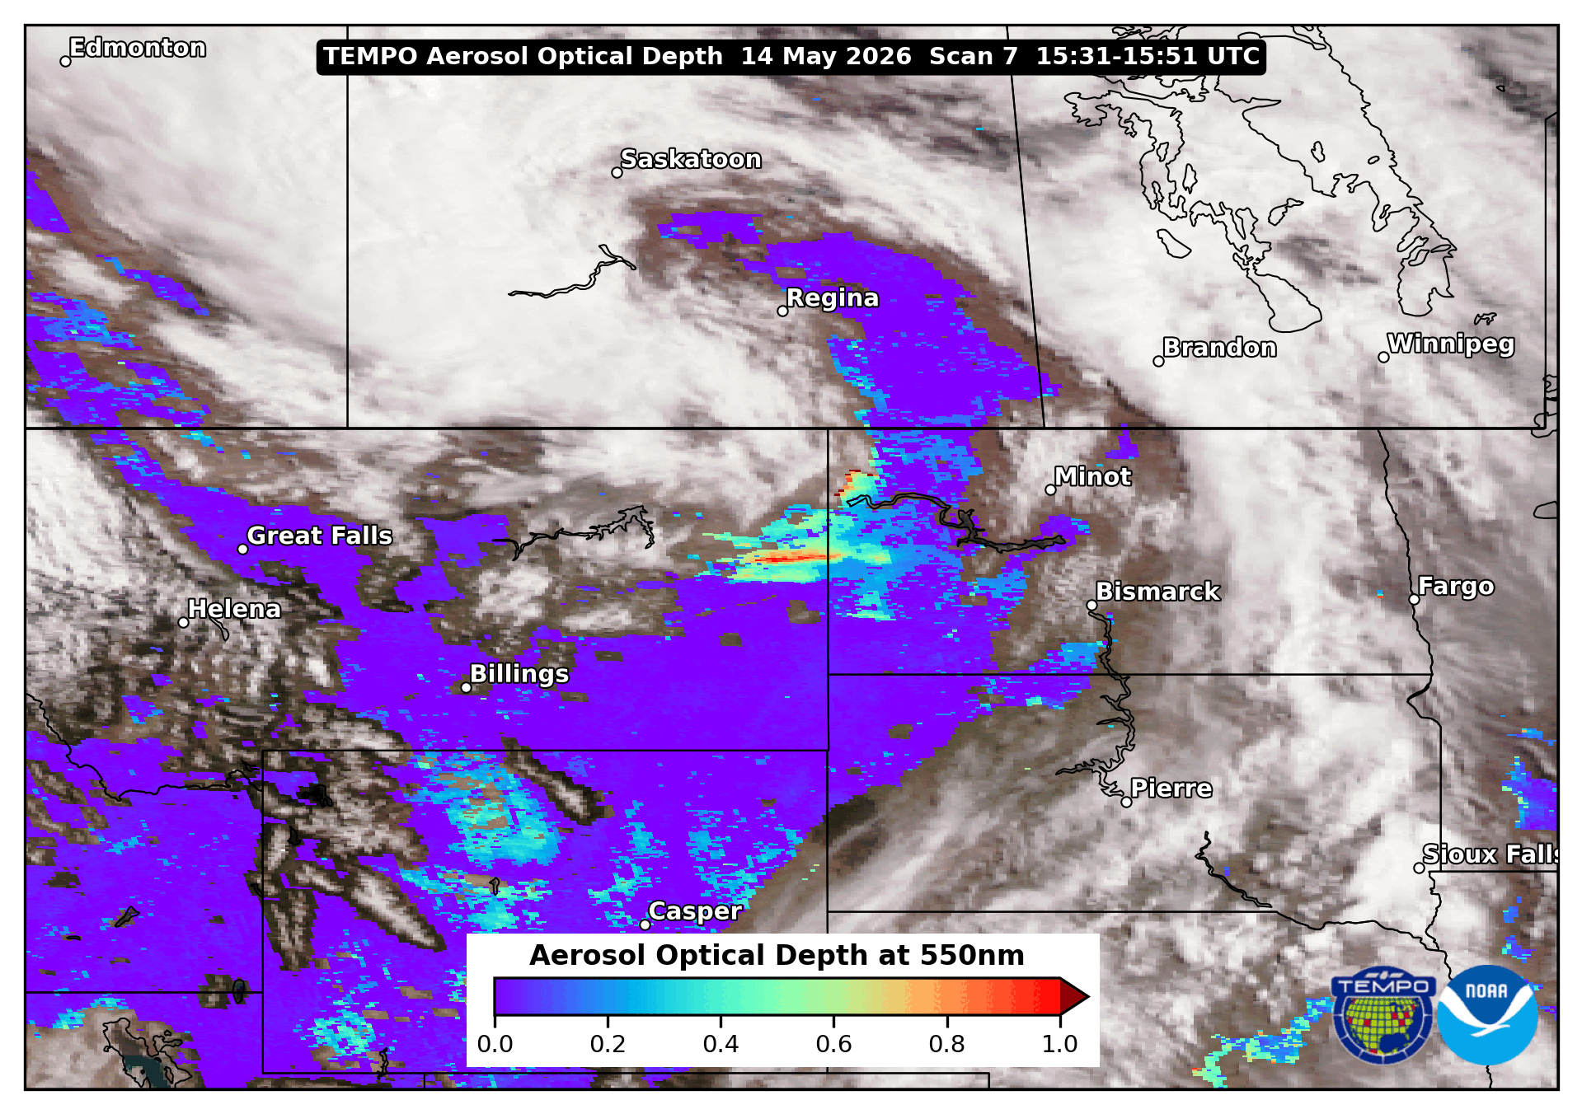
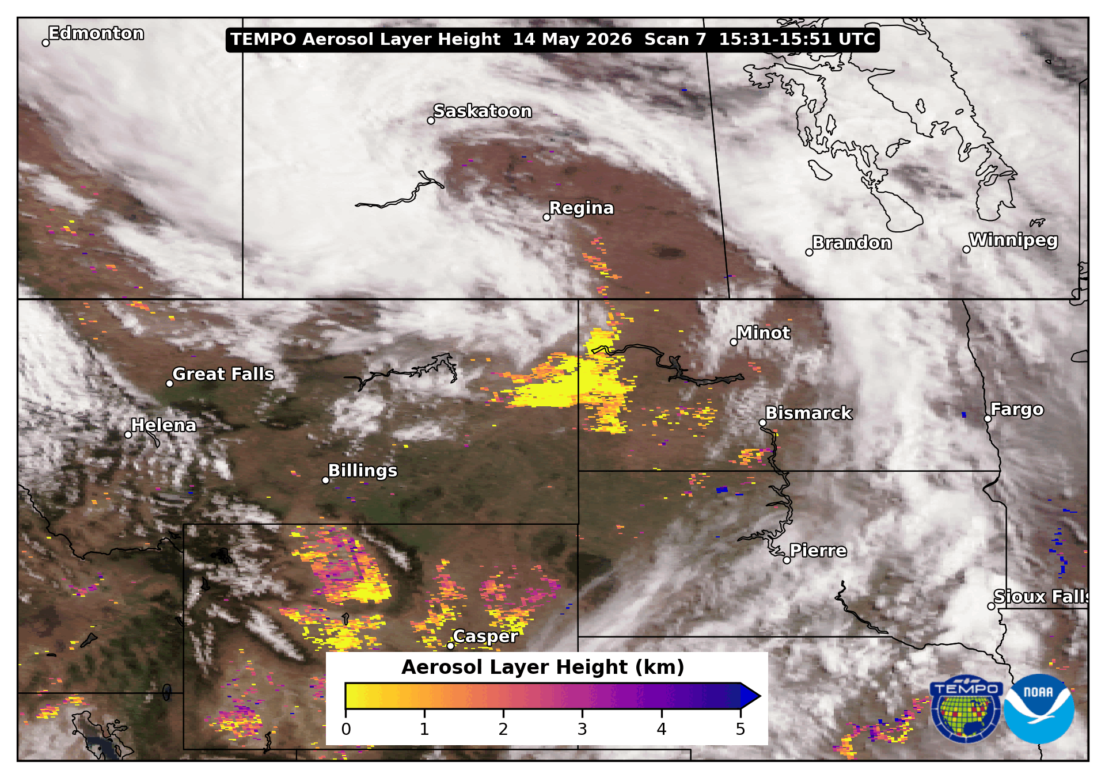
Aerosol Optical Depth (AOD)
Aerosol Layer Height (ALH)
Quantitative measure of aerosol loading
  Uses TEMPO-ABI Aerosol Detection product to identify aerosol type
  Improved retrieval of dust vs. ABI AOD
Estimate of the altitude of aerosol layers in the troposphere
  New! Not available from ABI
  Only for pixels that have AOD >0.2

Slide 6
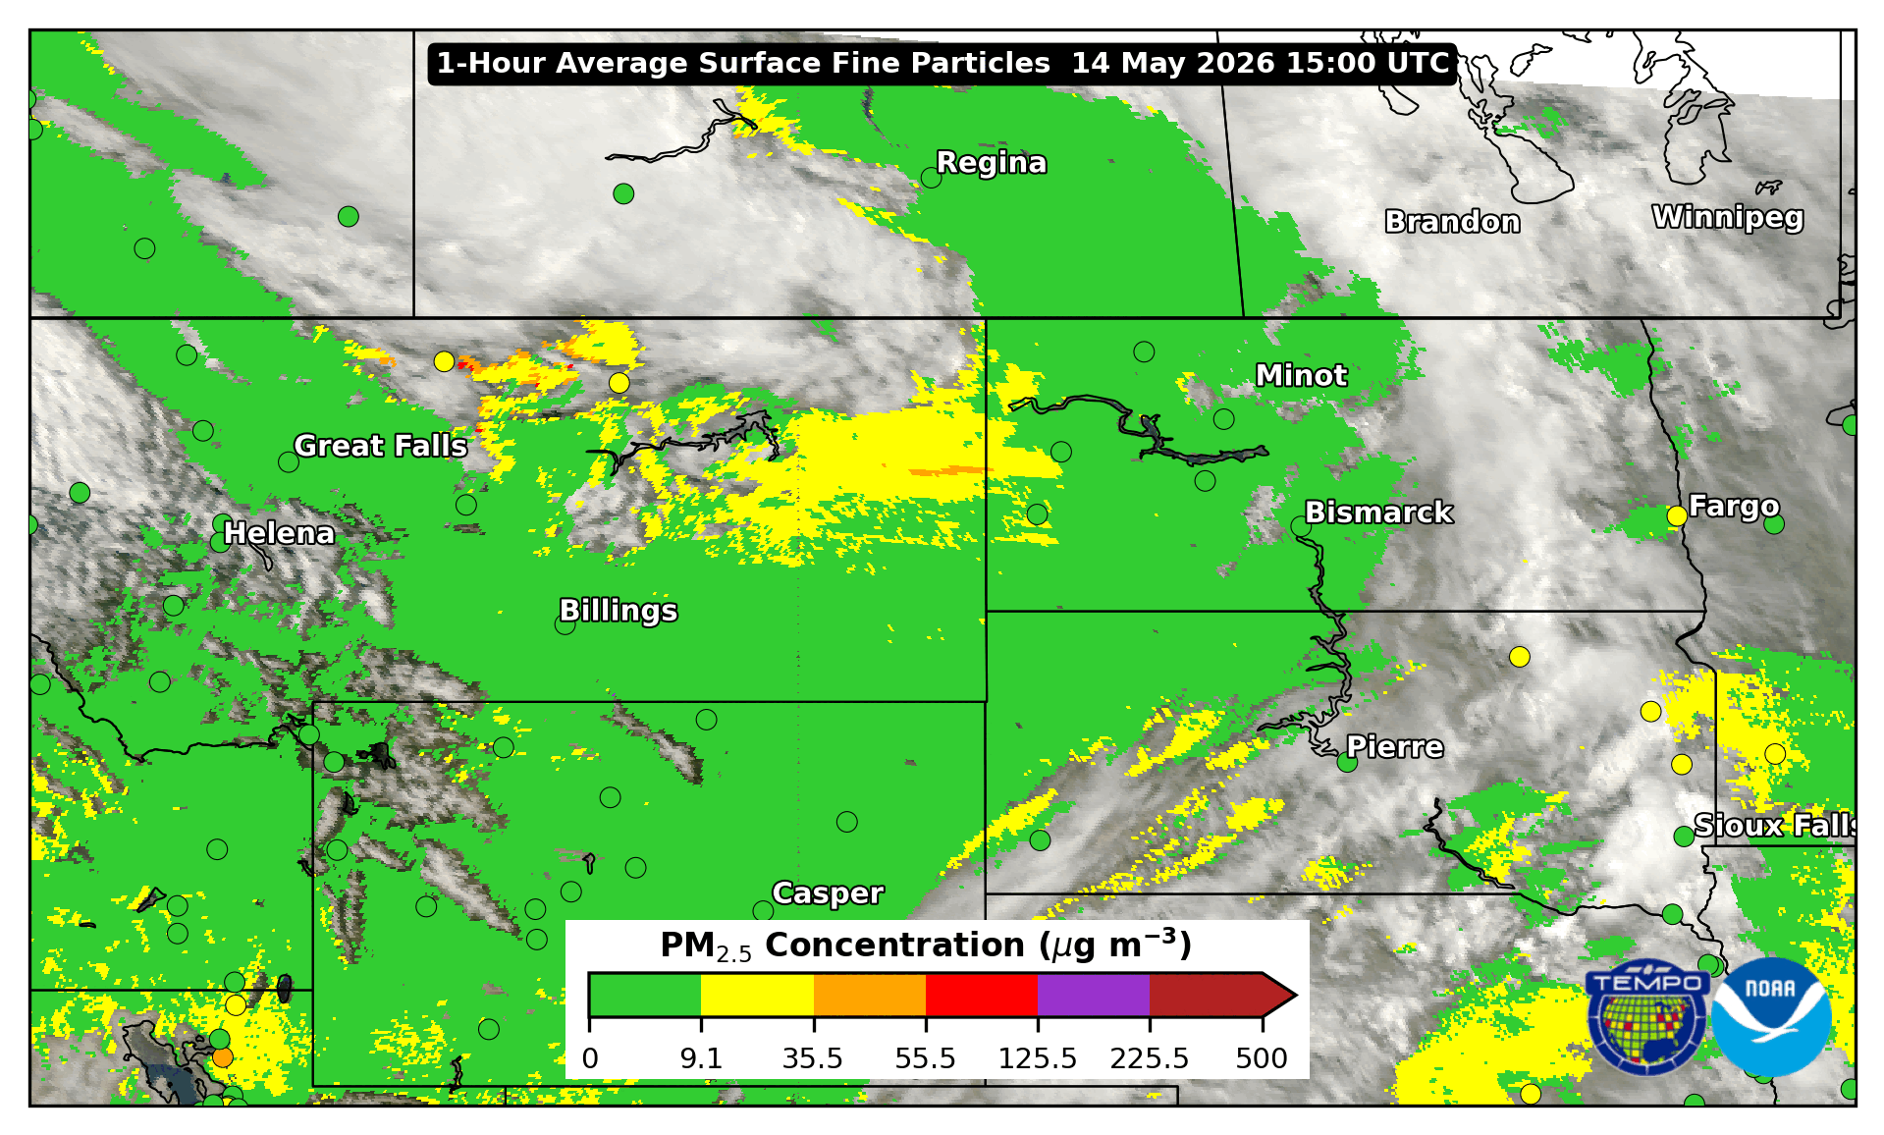
TEMPO-ABI Estimated Hourly Surface PM_{2.5}
1-hour average PM_{2.5} surface concentration
  Matches cadence of AirNow regulatory monitors
Derived from AOD retrieved by ABI and TEMPO
Outperforms ABI-only product, especially for:
  Aerosols above the PBL (ALH >3km)
  Dust events

Slide 7
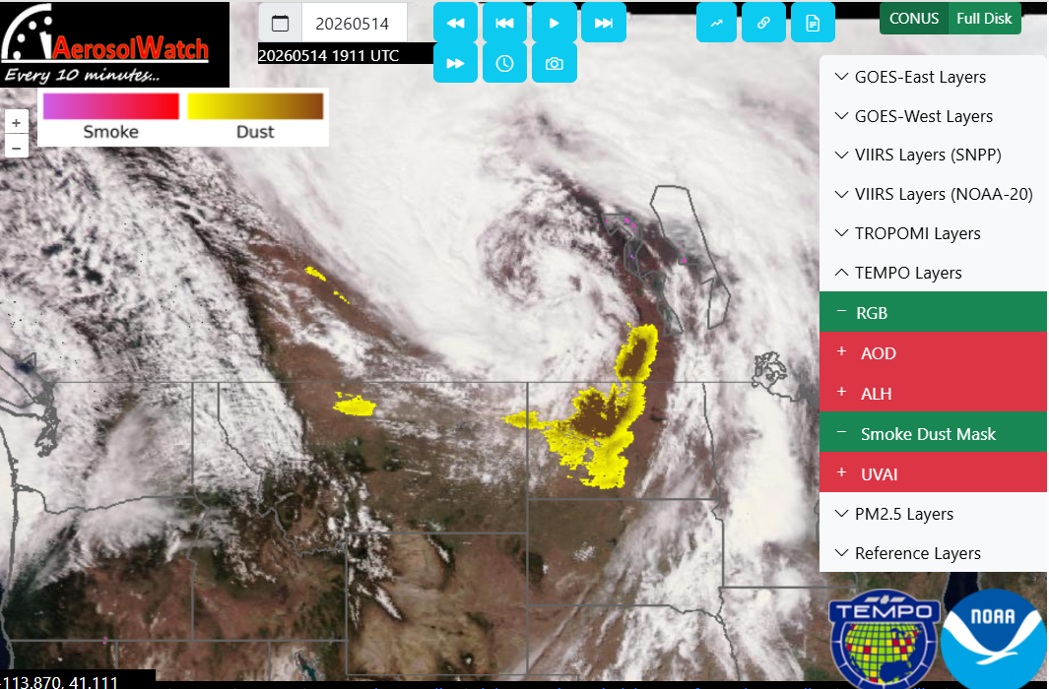
TEMPO Aerosol Imagery is Now on AerosolWatch!
Enter “NOAA Aerosol Watch” in your browser
Near real-time & archived aerosol imagery
  TEMPO archive extends back to
  Sep 2025
Remember! TEMPO aerosol products aren’t operational yet!
  NRT image latency can be 4-8 hours
  Sometimes granules/scans are missing
Need help? Email:
amy.huff@noaa.gov
https://www.star.nesdis.noaa.gov/smcd/spb/aq/AerosolWatch/
Hai Zhang maintains the AerosolWatch website

