Slide 1
Hourly Aerosol Top Height over North America from TEMPO–GOES Constellation and stereoscopy
Guanyu Huang¹ ² (guanyu.huang@stonybrookmedicine.edu)
Yuhan Wu¹, Minseok Kim³, Jhoon Kim³, Hai Zhang⁴
¹School of Marine and Atmospheric Sciences & ²Program in Public Health, Stony Brook University
³Yonsei University ⁴Science and Technology Corporation at NOAA
TEMPO DART Team Meeting
University of Iowa, Iowa City, IA 6/17/2026

Slide 2
Introduction
Aerosol height information is important (e.g., surface PM₂.₅, radiative forcing, and plume transport).
Wildfires over North America are becoming more intense, frequent, and widespread.
Rapidly evolving smoke events demand continuous smoke height observations at high spatial and temporal resolution.
Stereoscopy and redundant observations from the TEMPO-GOES constellation can provide continuous observations of aerosol layer top heights and wildfire plumes.

Slide 3
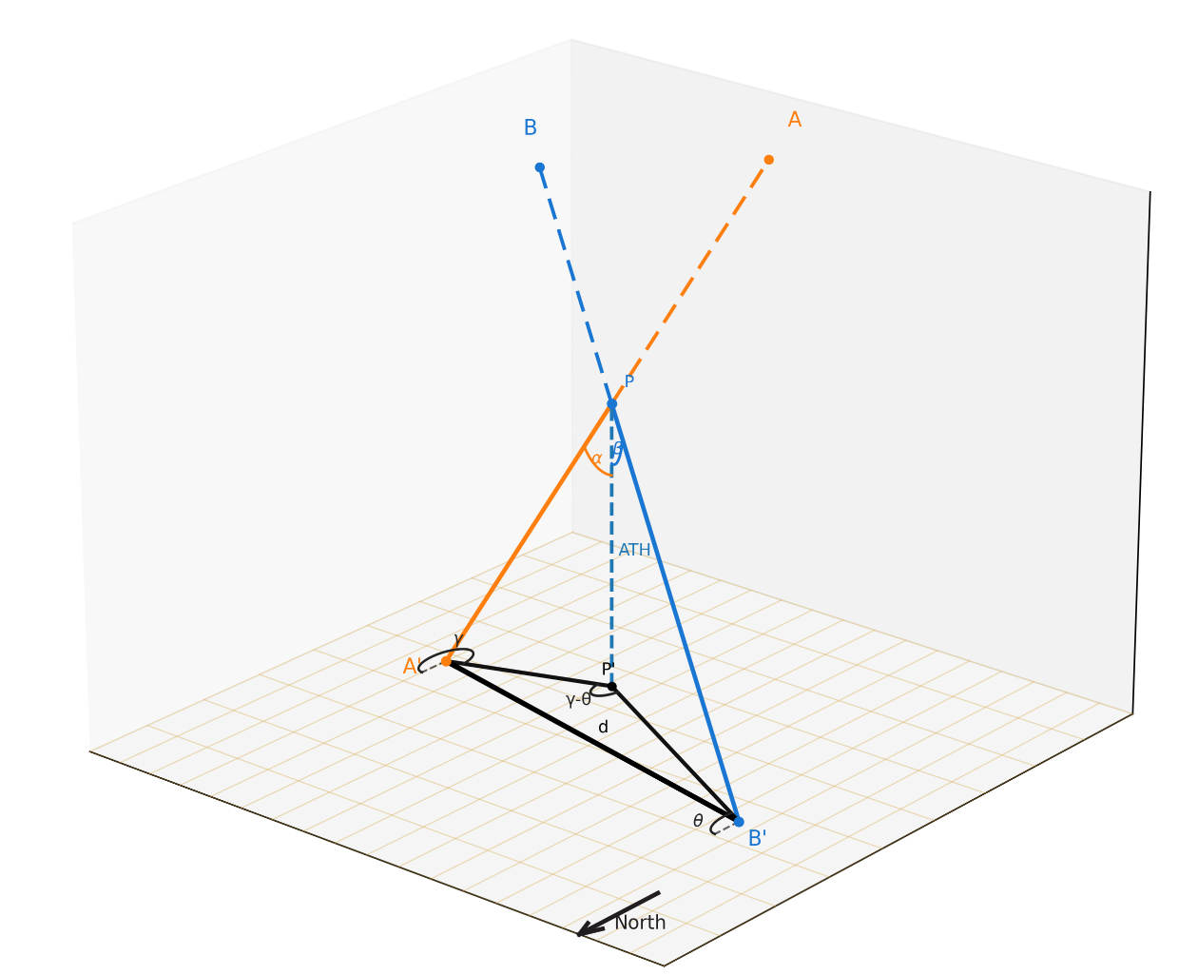
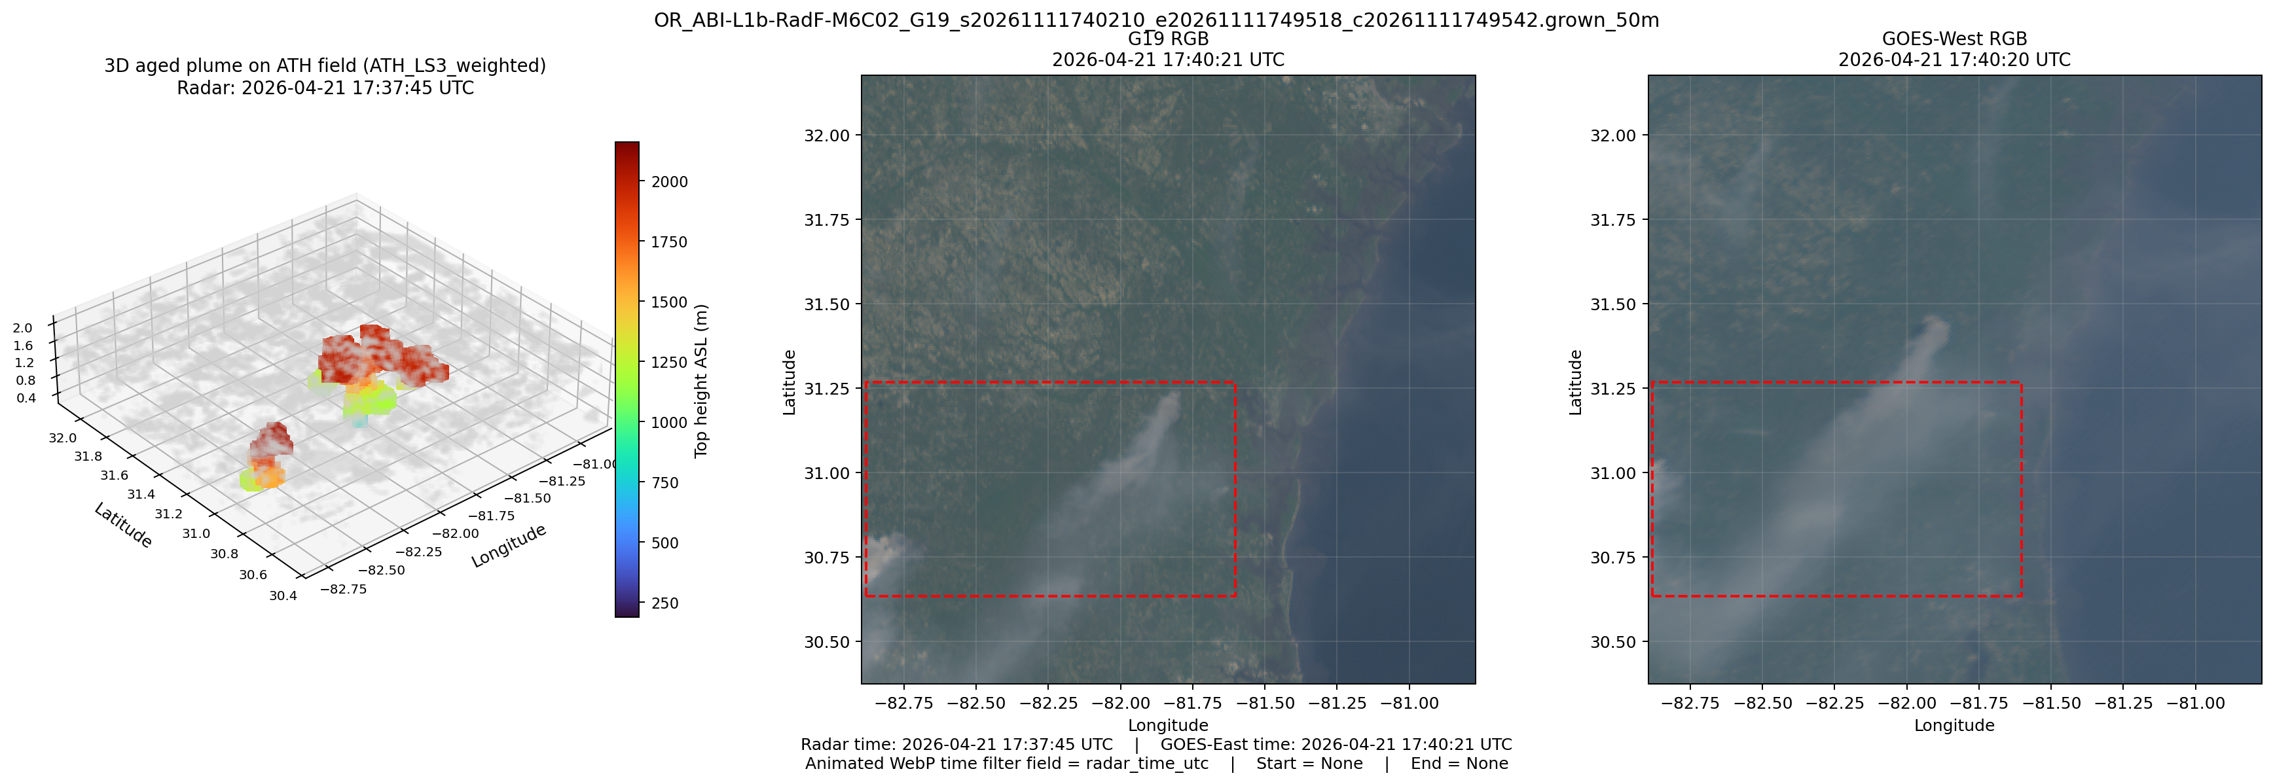
METHOD: stereoscopy
Parallax geometry for a satellite pair
(Kim et al., 2023, Wu et al., 2026A and 2026B)
The parallax of Brantley Highway Smoke on April 21, 2026, Georgia/Florida.
(GOES-East and GOES-West)

Slide 4
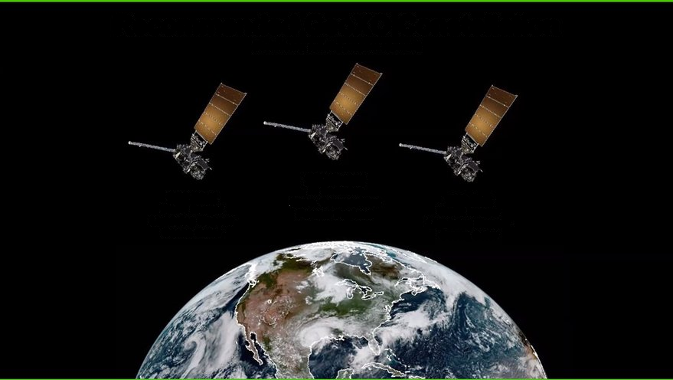
Method: Redundant obs. From tempo-goes constellation
TEMPO(640nm)/GOES-West(640nm) and GOES-East(640nm)/GOES-West(640nm) provide redundant observations on the same aerosol layer tops.
We can obtain the most probable aerosol top height using the least-squares adjustment.
TEMPO/GOES-East was not used because of the large uncertainties of parallax estimate caused by the close distance between TEMPO and GOES-East.
TEMPO
91°W
GOES-West
137°W
GOES-East
75°W

Slide 5
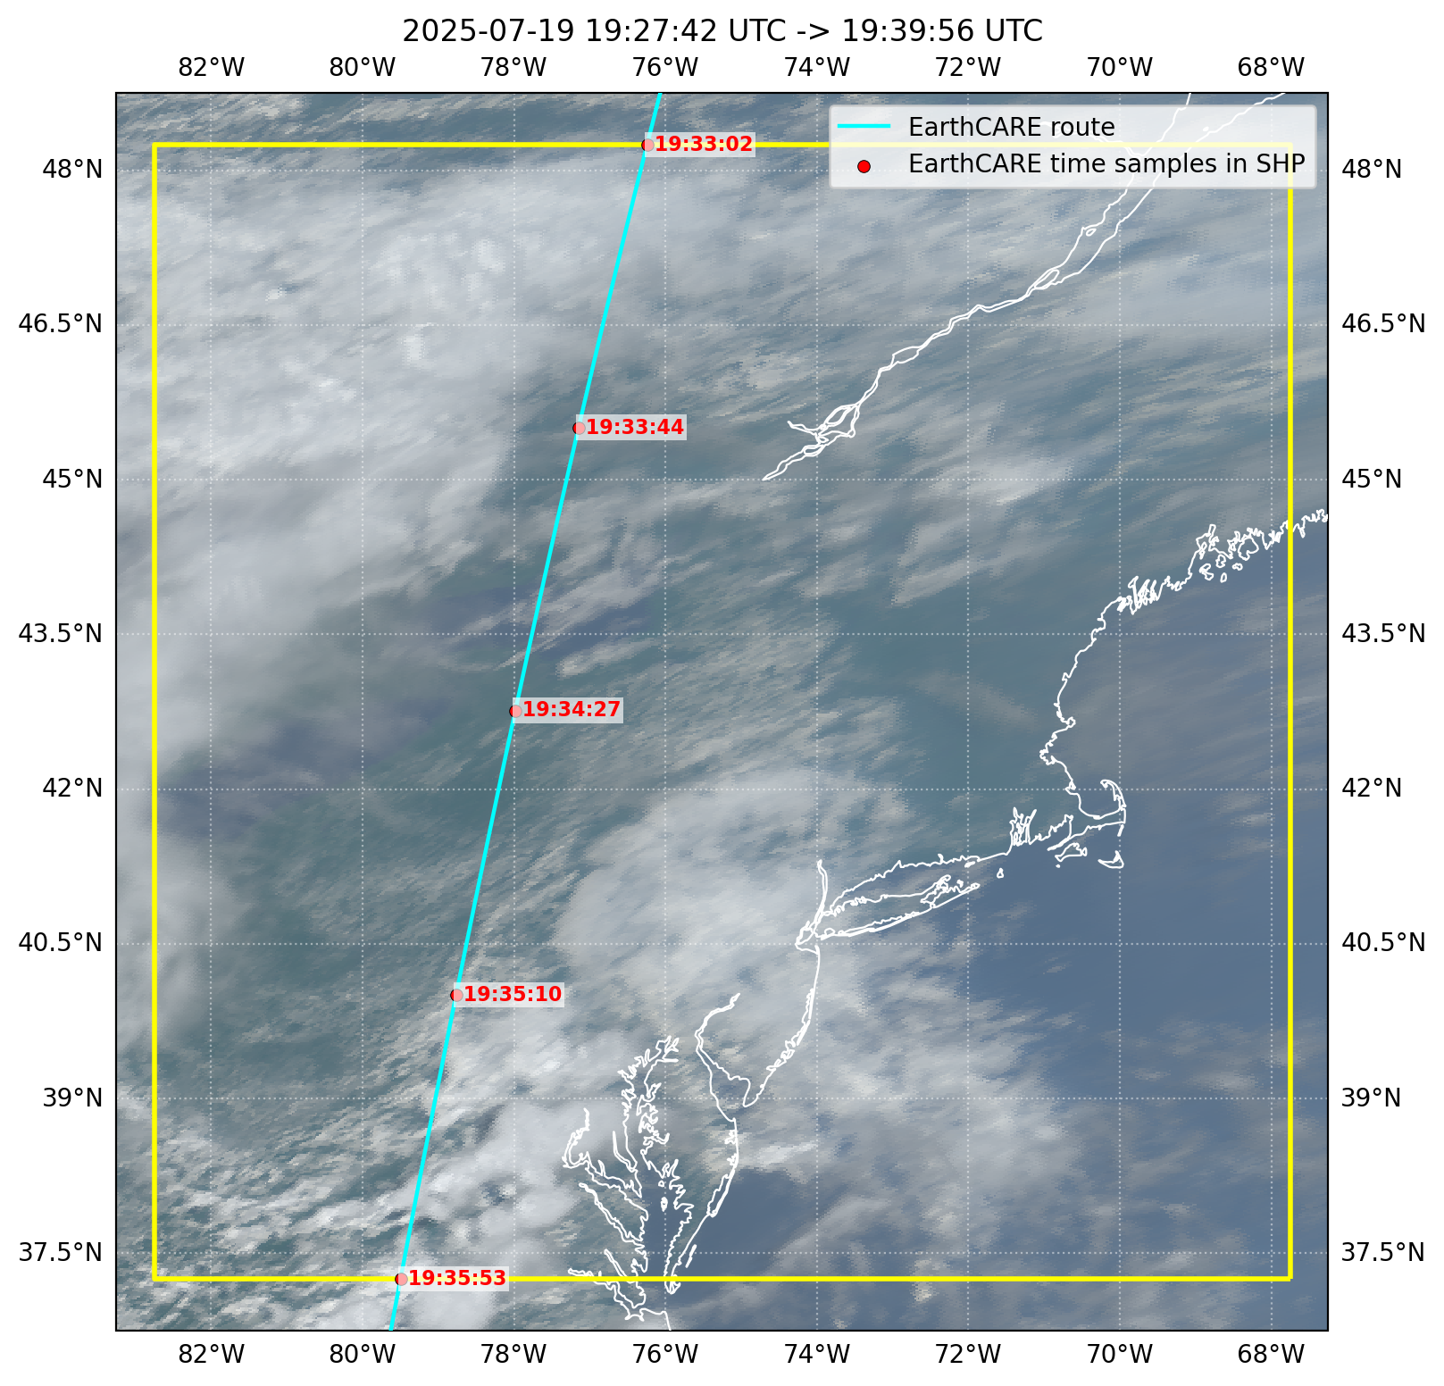
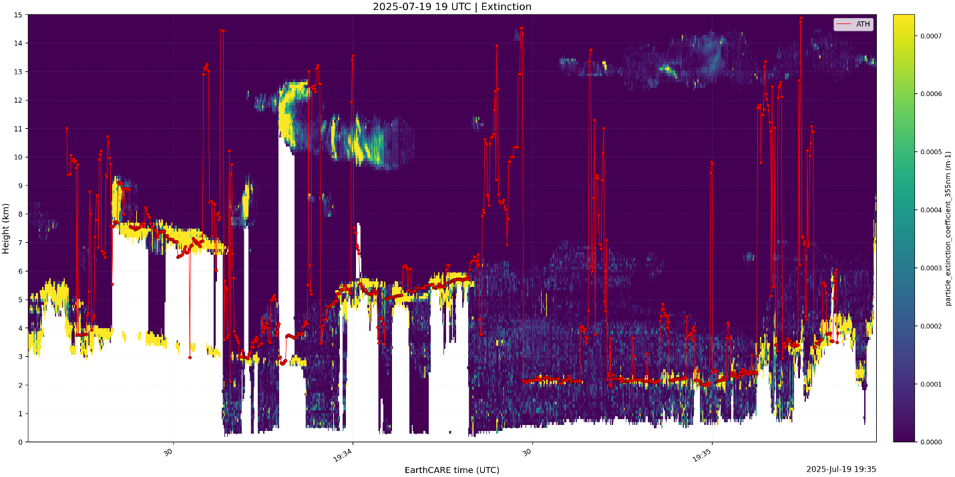
Good agreement with EarthCARE lidar
Excellent agreement between TEMPO-GOES ATHs and EarthCARE.
Capture cloud/aerosol at high altitude.
GOES image with EarthCARE Atmospheric Lidar pathway on July 19, 2025.

Slide 6
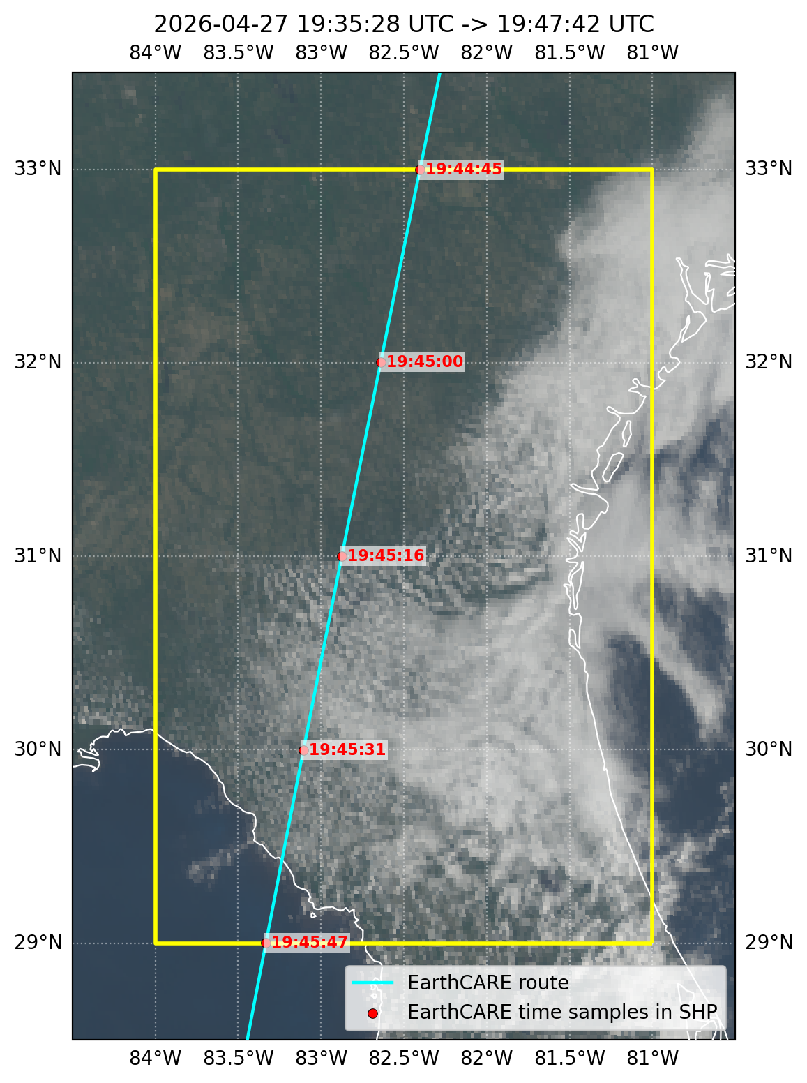
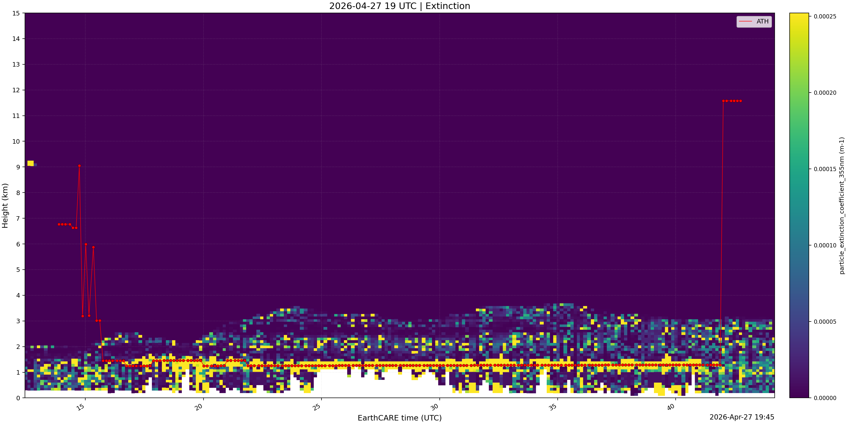
Good agreement with EarthCARE lidar (cloud)
Excellent agreement between TEMPO-GOES ATHs and EarthCARE.
Capture low cloud/aerosol.
GOES image with EarthCARE Atmospheric Lidar pathway on April 27, 2026.

Slide 7
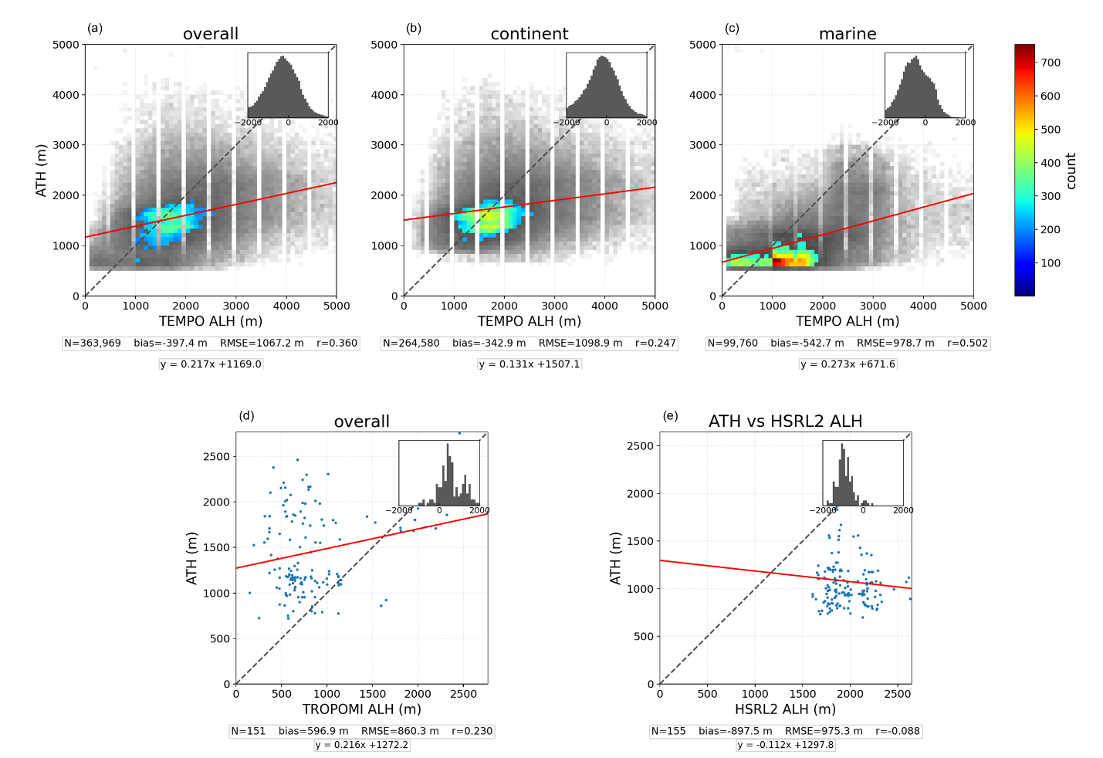
COMPARISON: three independent products (August 2023)
vs TEMPO ALH (NOAA products)
vs TROPOMI ALH
vs HSRL-2 lidar (STAQ/AEROMMA SUMMER 2023)
−0.40 km bias
+0.60 km bias
−0.90 km bias
N = 363,969; slight low bias, consistent over land and ocean
TROPOMI is known to underestimate ALH
Sample size is too small.
(ongoing assessment with other products, e.g., IU products)
7

Slide 8
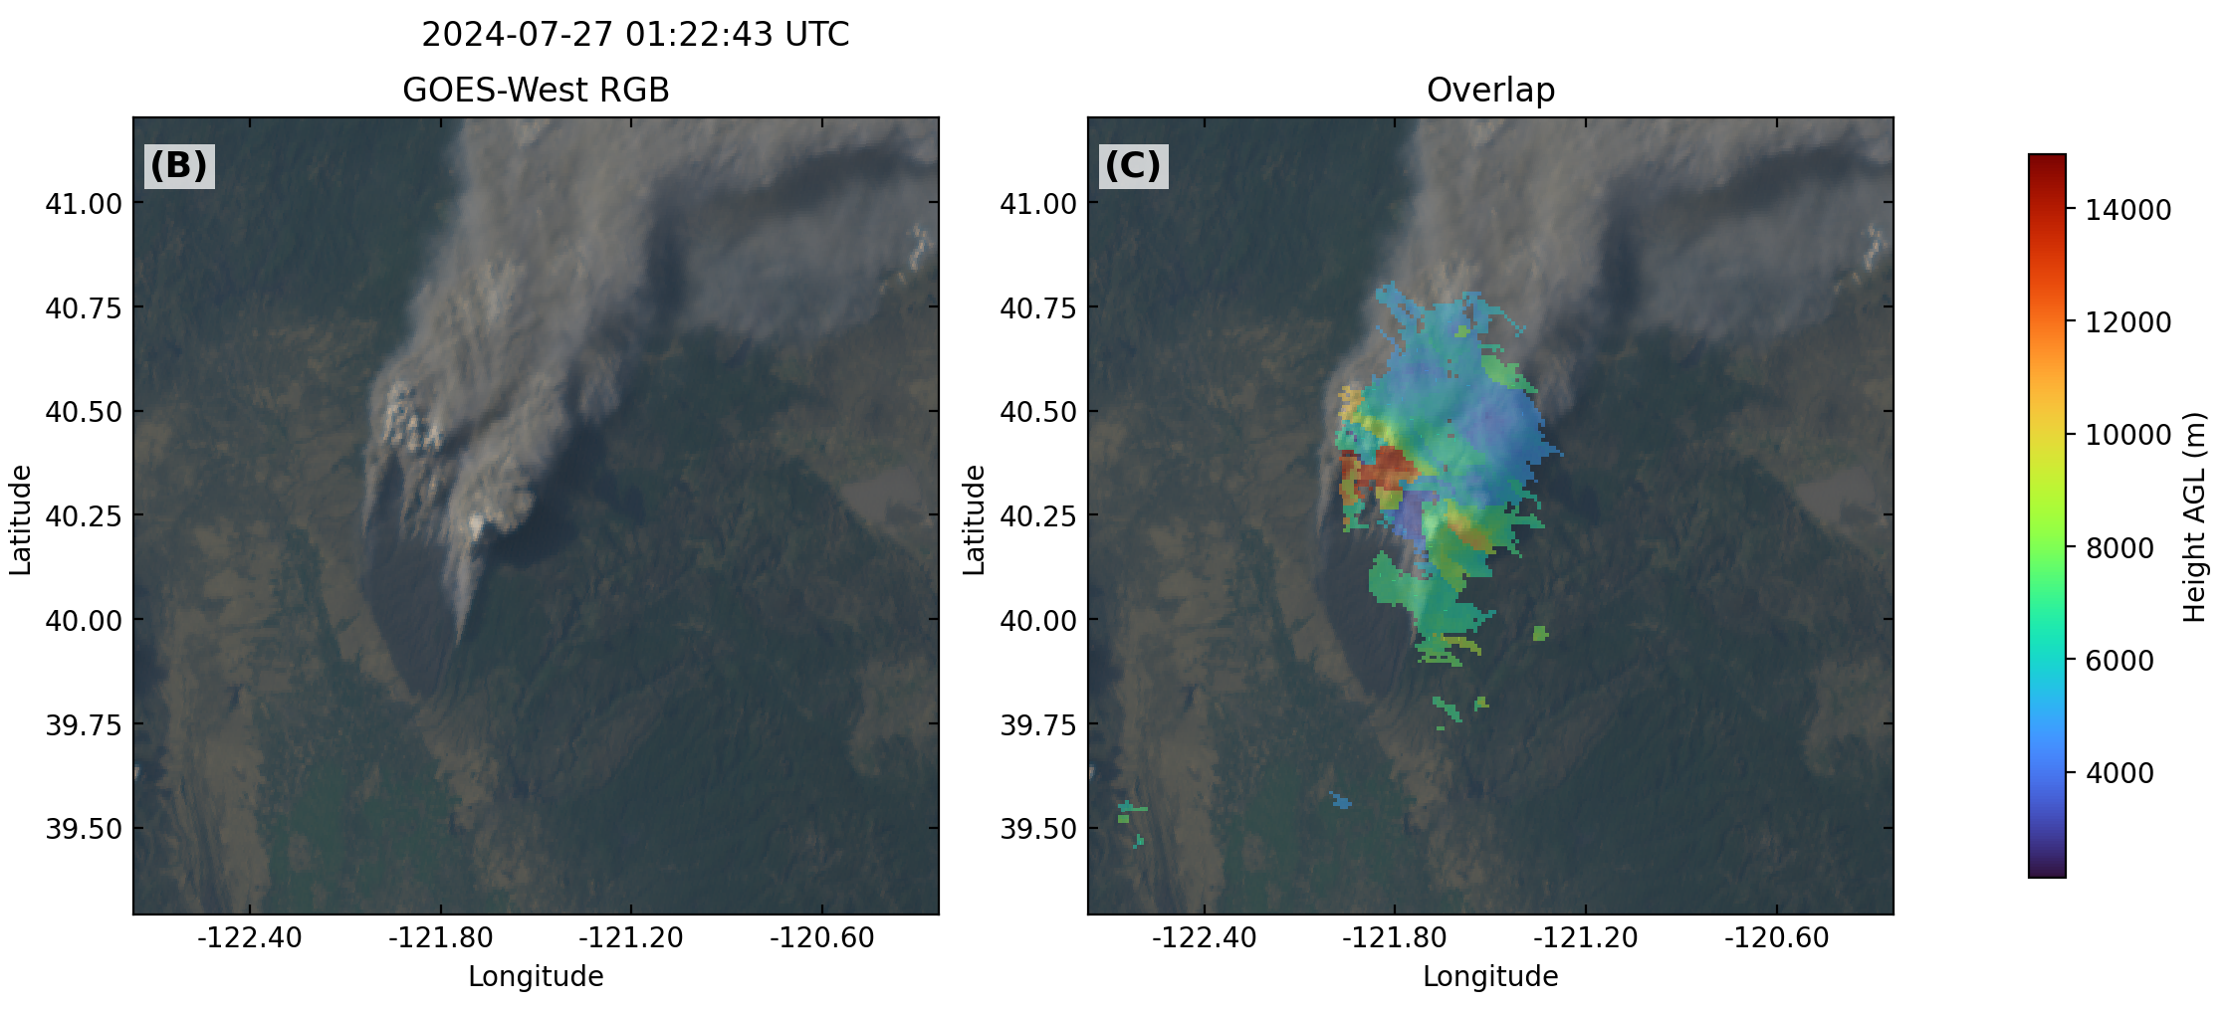
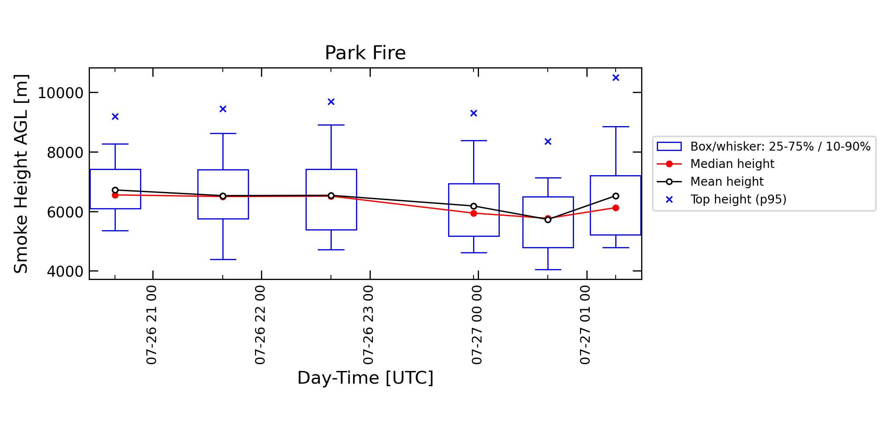
CONTINUOUS OBSERVATIONS ON smoke injection heights
Smoke injection heights derived from TEMPO-GOES constellation over a wildfire in North California.
Please note the displacement of elevated plumes in GOES images.
Hourly continuous observations on smoke injection heights from TEMPO-GOES constellation.
Scale up to all wildfires.

Slide 9
Summary
Stereoscopy applied to the TEMPO–GOES constellation retrieves aerosol layer-top height hourly over North America, using redundant observations.
Retrievals show good agreement with EarthCARE lidar, and other satellite products.
Delivers the high-resolution, continuous height observations needed to track rapidly evolving smoke events.
Wu et al., 2026 GRL under review, TEMPO Special Issue
Wu et al., 2026 IEEE TGRS, under review
NASA IPMSI
Guanyu Huang, guanyu.huang@stonybrookmedicine.edu

