Slide 1



Connecting the TEMPO Community with Health and Air Quality
Information Needs through HAQAST
Jenny Bratburd, PhD
University of Wisconsin-Madison
TEMPO DART Meeting – Applications and Stakeholder Needs
17 June 2026

Slide 2
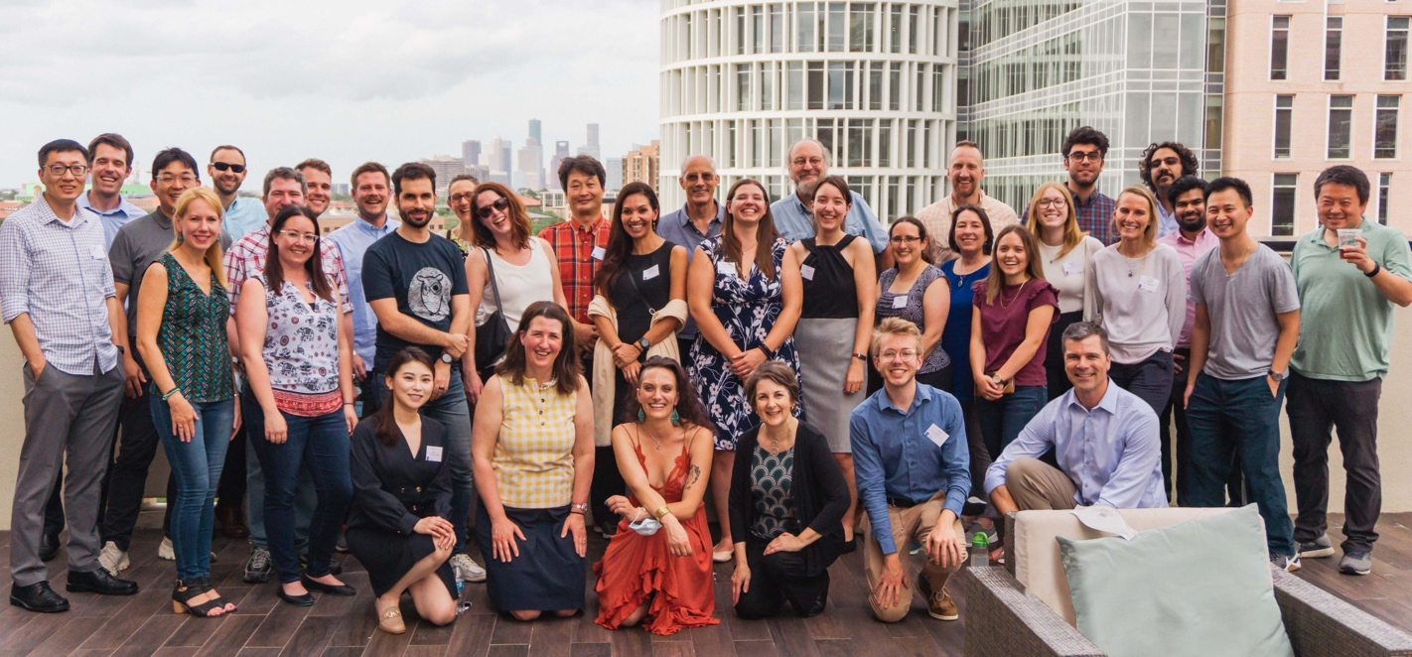
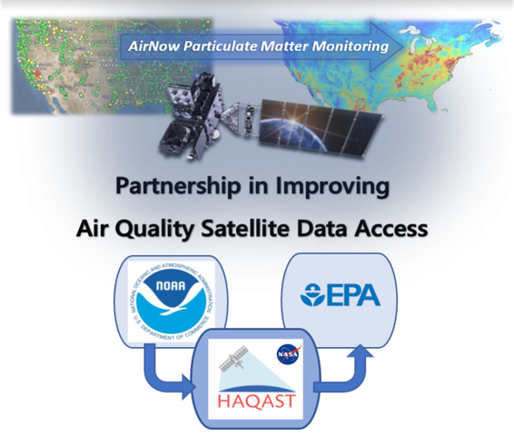
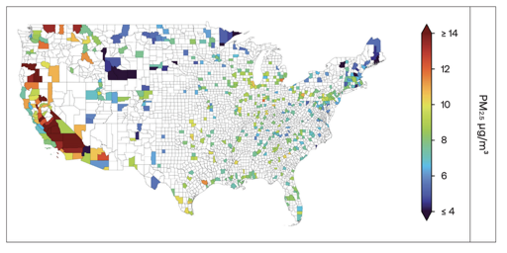
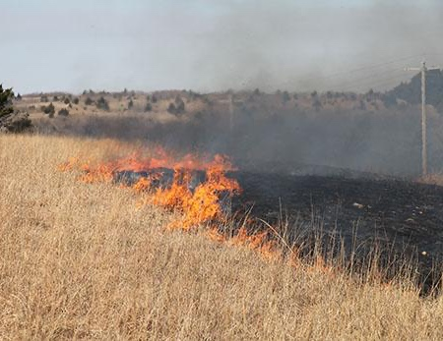
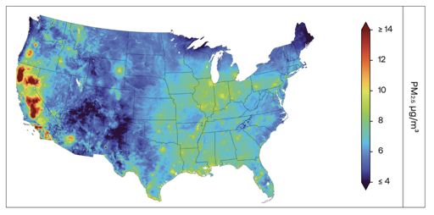
What is “hay-kast”?
Health and Air Quality Applied Sciences Team
Mission: Connect NASA science with air quality and health applications
14 member PIs, 60+ co-investigators, 22 ambassadors, 100s of stakeholders
Three types of work – scaled to different needs
  Member projects
  Tiger Teams
  Outreach, engagement, rapid response
QUANTIFYING SMOKE EXPOSURES FROM PRESCRIBED BURNS
Using satellite data and sensors, researchers quantified PM2.5 concentrations from prescribed burns in Flint Hills, Kansas
SATELLITE DATA INCORPORATED INTO EPA AIRNOW
Satellite data added to widely used near-real time tools to assist states in communicating about risks of air pollution.
LEVERAGING SATELLITE DATA FOR UNDERMONITORED REGIONS
The American Lung Association to explore incorporation of satellite data using HAQAST data.
  https://haqast.org/
haqast.org/

Slide 3





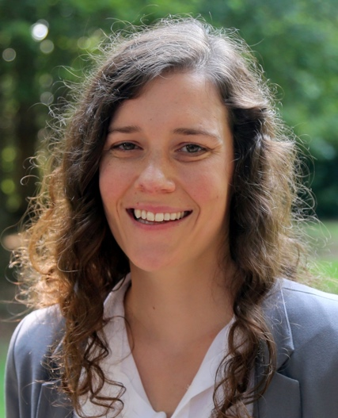
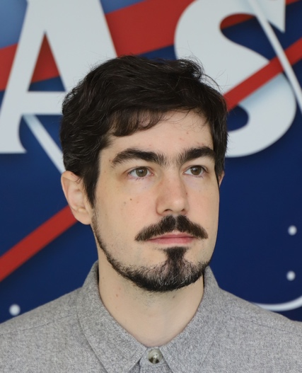






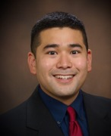


NASA Health and Air Quality
Applied Sciences Team Members (HAQAST)
2025-2029
Tracey Holloway (Team Lead, UW-Madison)
Daniel Anderson (University of Maryland Baltimore County)
Xi Chen (University of Iowa)
Arlene Fiore (Massachusetts Institute of Technology)
Pawan Gupta (NASA Goddard)
Jennifer Kaiser (Georgia Tech)
Carl Malings (Morgan State University)
Jingqiu Mao (University of Alaska, Fairbanks)
Randall Martin (Washington University)
Aaron Naeger (NASA Marshall)
Jeffrey Pierce (Colorado State University)
Amber Soja (National Institute of Aerospace)
Travis Toth (NASA Langley)
Christopher Uejio (Florida State University)
haqast.org

Slide 4
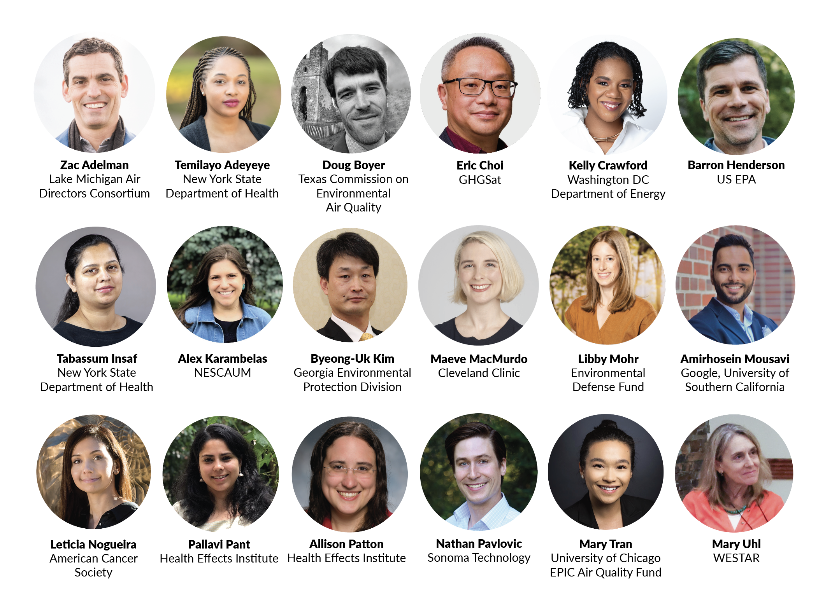





Tapan Acharya
Caterpillar Inc
Amanda Fritz
Connecticut DEEP
Eric Choi
Mission Control
Kelly Crawford
Bay Area Air District
Ebrahim Eslami
Houston-Galveston Area Council
Pat Reddy
Independent & Univ. of Wisconsin

Slide 5
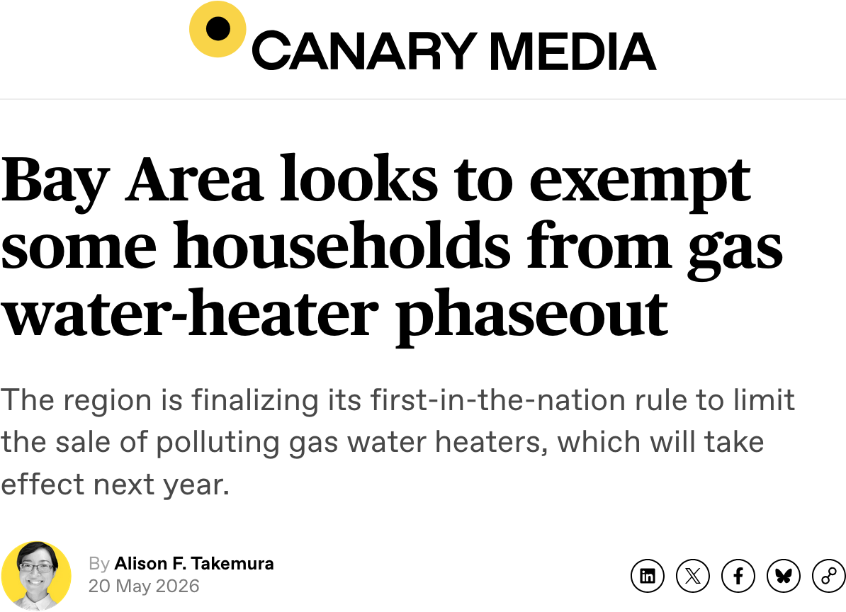
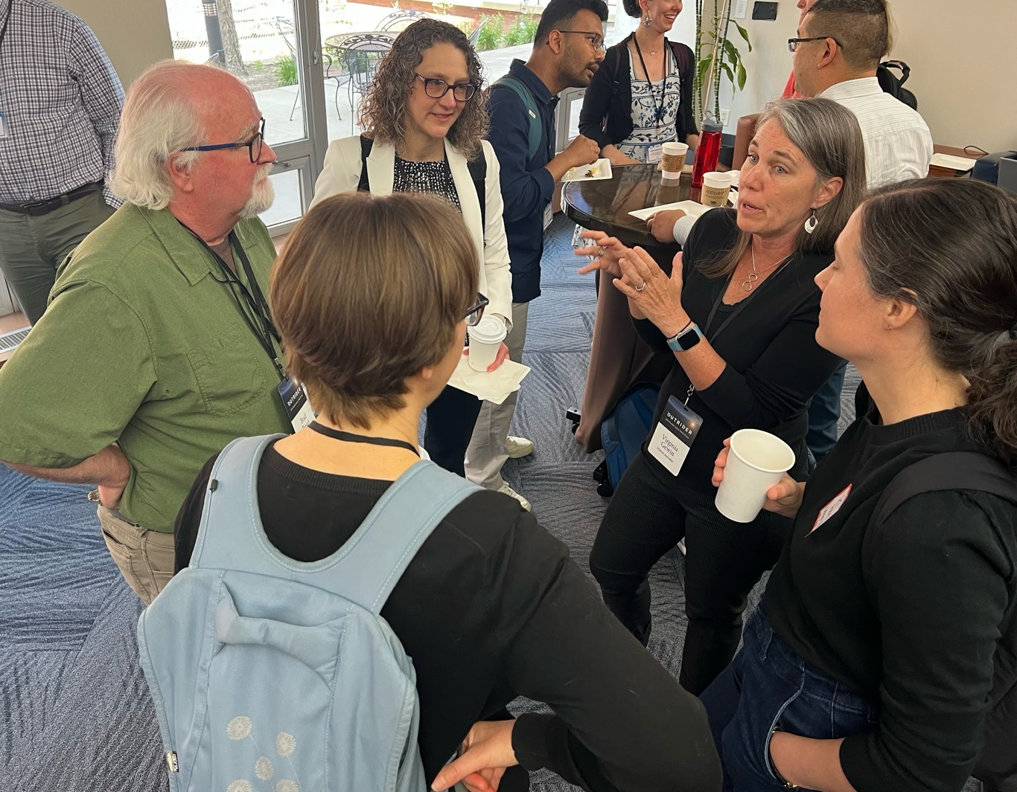
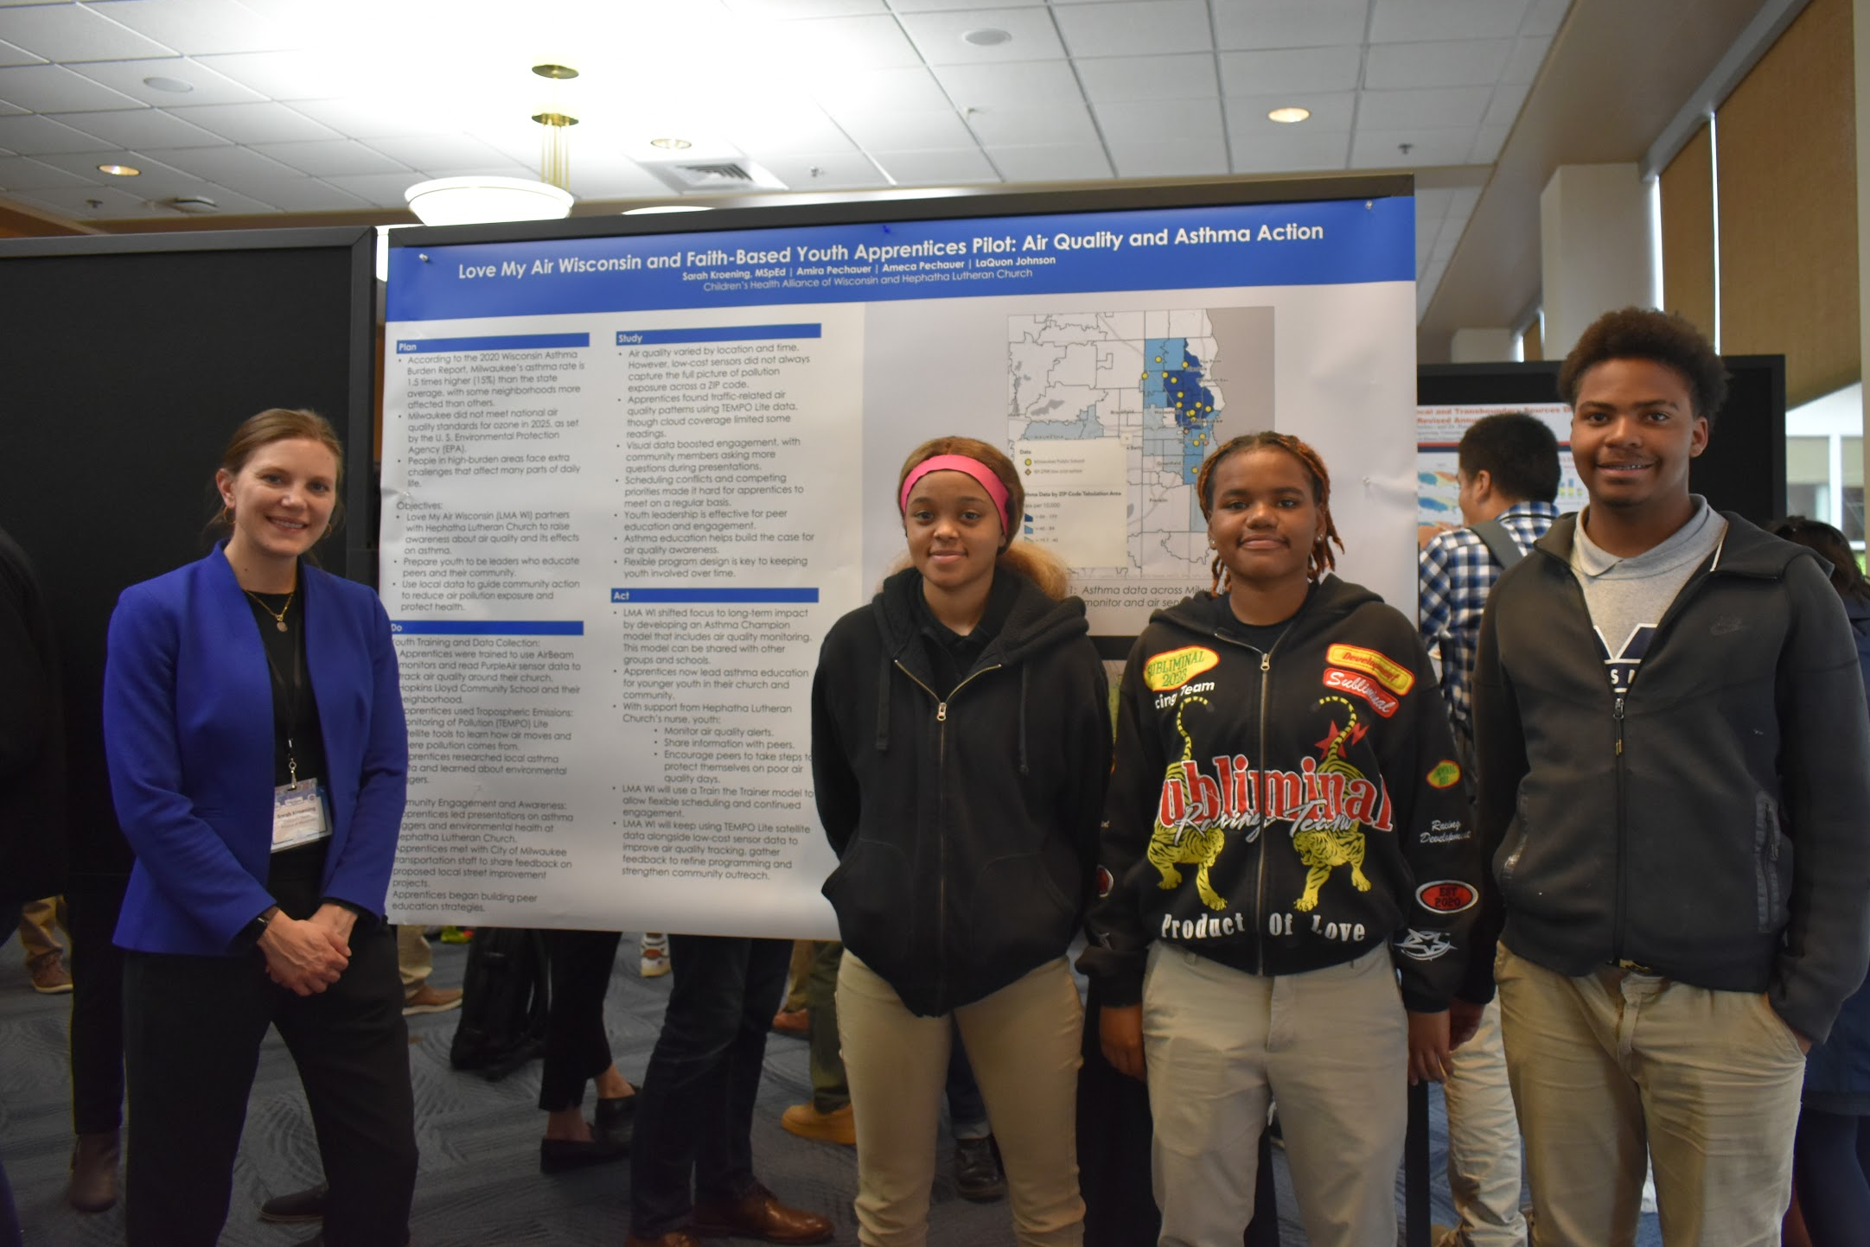
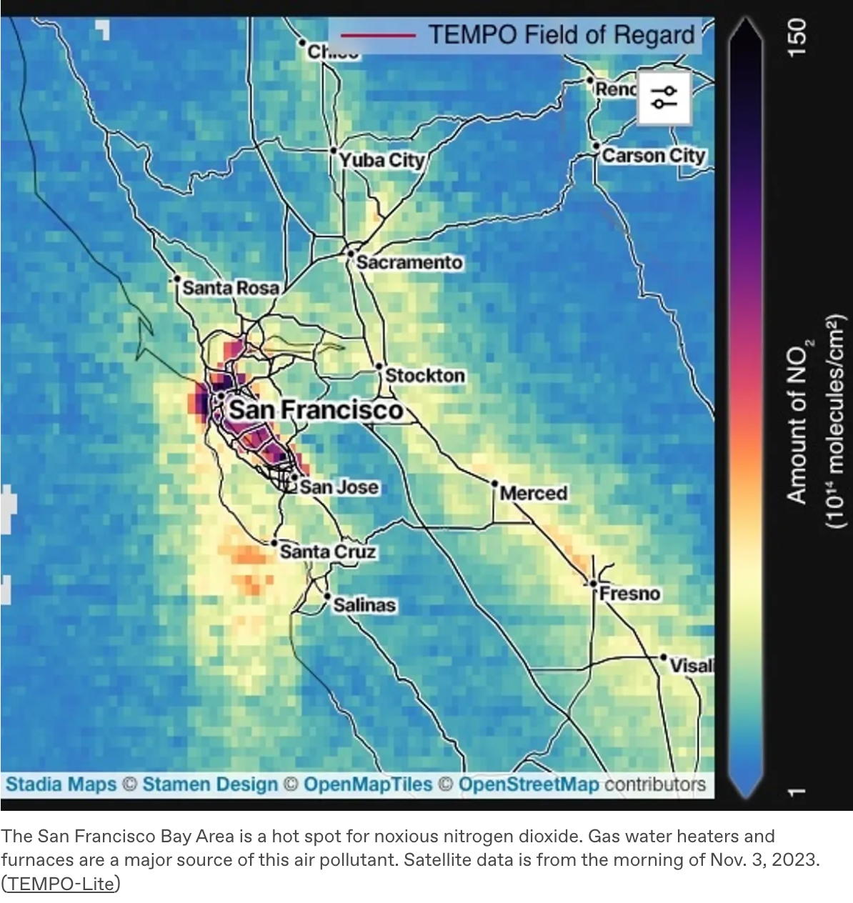
HAQAST Madison – Outrider Science Media Forum

Slide 6
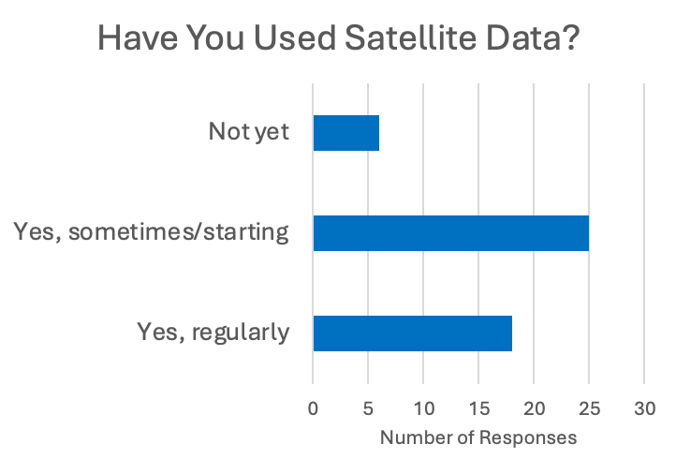
Stakeholders Use Different Tools
Total response = 50
HAQAST Madison “Improving access, analysis, and awareness of satellite data for air quality and health” (5/13)

Slide 7
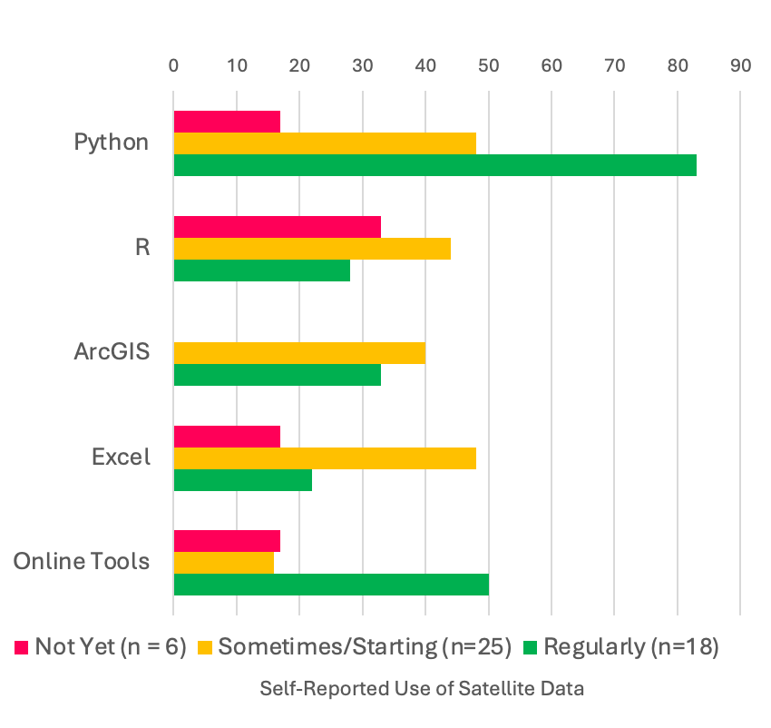
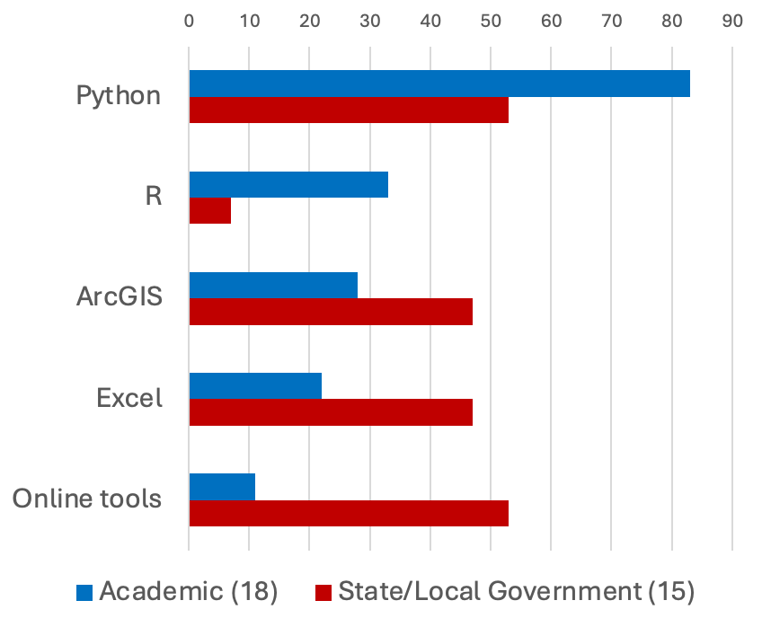
Stakeholder Community Tool Usage
Percentage of Responses

Slide 8
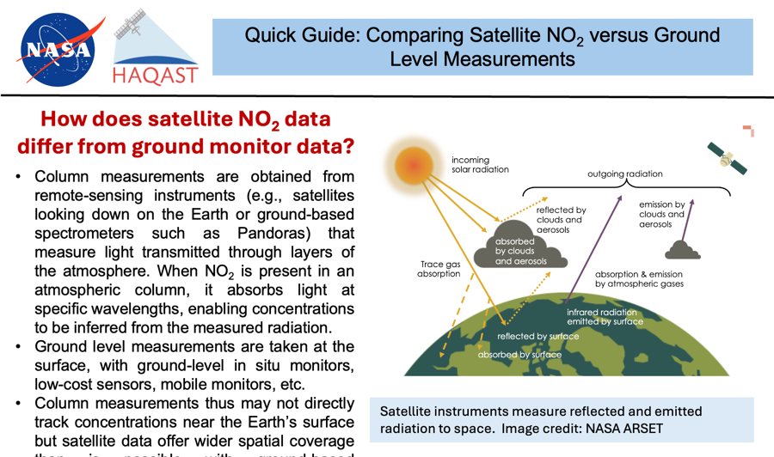
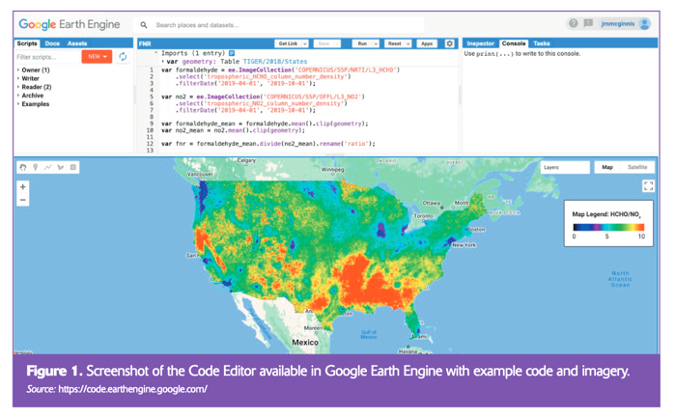

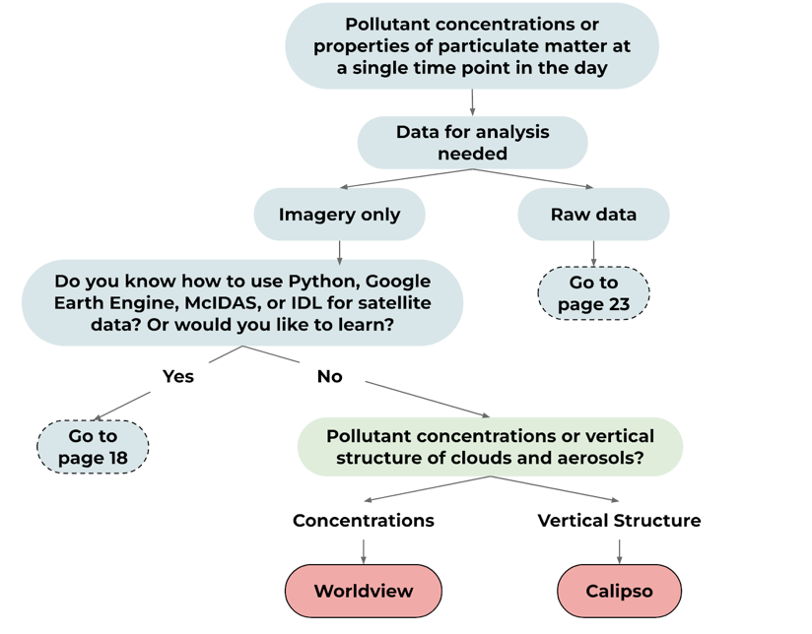
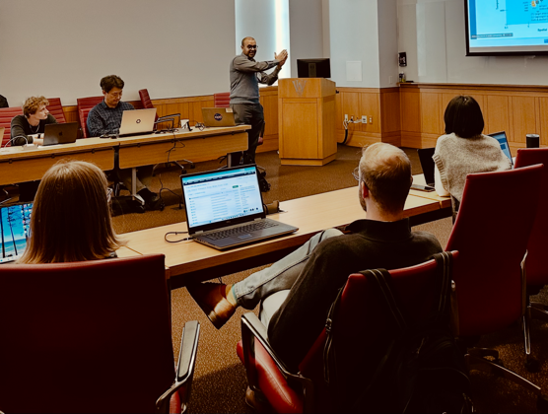
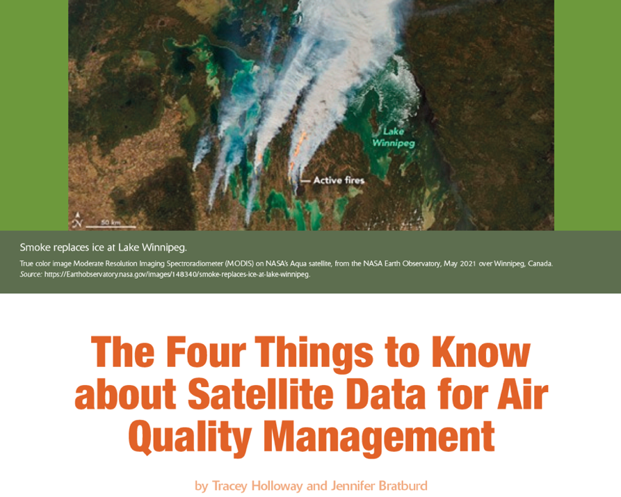
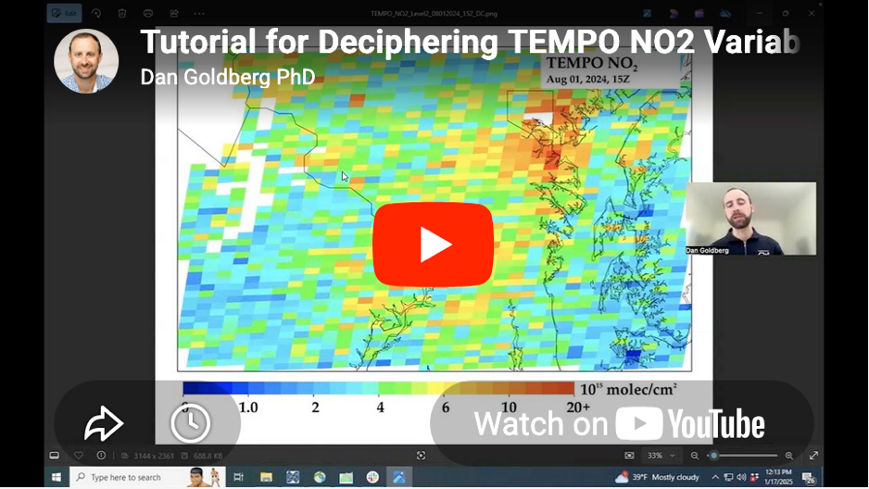
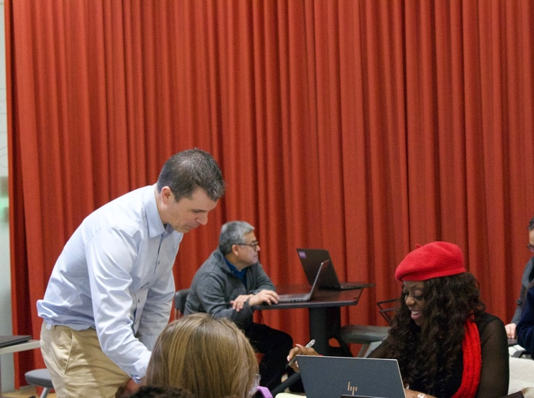
Engaging New Users
Finding Datasets and Tools
(HAQAST Flowchart)
Improving Awareness and Understanding
Tutorials
Trainings
https://haqast.org/getting-started/
https://haqast.org/data-and-tools

Slide 9
Tiger Teams
Short-term, high-impact collaborative effort between HAQAST members and stakeholders to identify and solve an immediate problem using NASA data and products
Anyone welcome to get involved!
  Example from 2023 TEMPO for Ozone Tiger Team https://haqast.org/tempo-applications-for-surface-ozone-tiger-team/
    Deliverables include Quick Guides, Video Tutorials, Training session at HAQAST Showcase, and relationship building / information sharing with the broader community

Slide 10



Data Access and Continuity
Tiger Teams
Curating a Remote Sensing Training Atlas for Health and Air Quality – Pawan Gupta
HAQAST Support for AIR4US Implementation – Carl Malings
Ensuring Continuity Across Satellite Transitions: Quantifying Uncertainty in Long-Term Air Quality and Fire Records – Amber Soja

Slide 11
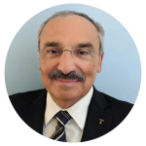


Fire, Smoke, and Dust Tiger Teams
Distinguishing Prescribed Fire versus Wildfire in the Contiguous US for Fire Management and Health and Air Quality Organizations – Talat Odman
Leveraging Low-Cost Sensor Networks and Satellite-Derived Products for Air Quality Advisories – Jingqiu Mao
Using NASA Observations to Characterize Dust Plume Transport for Air Quality and Public Health Solutions – Travis Toth

Slide 12


Trace Gases Tiger Teams
Analysis of TEMPO Ozone Profile Data for Monitoring Ozone Exceedances – Aaron Naeger
Establishing Best Practices for TEMPO Formaldehyde Observations in Regulatory Applications: Demonstrations in Chicago, St. Louis, and New York – Jen Kaiser

Slide 13

Opportunities to Engage!
HAQAST website
  haqast.org
HAQAST Tiger Teams
HAQAST Atlanta – January 7-8, 2027
Newsletter
  https://explore.wisc.edu/haqastlanding
LinkedIn
  https://www.linkedin.com/company/nasa-health-and-air-quality-applied-sciences-team

