Slide 1
Atmospheric Science Data Center (ASDC):
TEMPO Data Services
Georgina Hayes-Crepps^{1,3)}, Alexander Radkevich^{2,3)}
AMA, Inc.
ADNET, Inc.
Atmospheric Science Data Center (ASDC)
June 17, 2026

Slide 2
Agenda
Upcoming TEMPO datasets
Data services: current, new features, and future plans
New Earthdata TEMPO site
ASDC resources
Additional TEMPO information
Notes:
Today I am going to go over the status of the current TEMPO data services, upcoming data and services, some helpful tips, and then additional resources.

Slide 3
Upcoming Data Products
End of calendar year 2026 (tentative)
TEMPO aerosol products (PM 2.5, AOD ALH, TEMPO-ABI ADP)
V03 reprocessing to V04 completed
Notes:
With a more tentative timeline, we are also working with NOAA on the release of the TEMPO aerosol products, with the aim of the end of this year.
All of the upcoming data products are expected to have equivalent services to current V03 collection services. However, some services may come after initial public release of the data. For example, creating the imagery services for Worldview and ArcGIS may take longer.
Aerosol optical depth and aerosol layer height
Aerosol detection product (smoke/dust flags)

Slide 4
Current TEMPO Data Services
Tool and Service Availability | L1 | L2 | L3
Available in Earthdata Search (EDS) | Yes | Yes | Yes
Subsetting (temporal, spatial, variable) | No | Yes | Yes
OPeNDAP | No | Yes | Yes
Concatenation/Aggregation | No | Yes | No
Worldview/GIBS Imagery | No | Yes (selected variables) | Yes (selected variables)
ArcGIS Image Service | No | No | Yes (selected variables)
Remote Sensing Information Gateway (RSIG) | No | Yes | Yes
Thumbnails in EDS | Yes | Yes | Yes
For V03 and V04 standard and NRT V02 data products
Notes:
This shows the scope of data services available for the TEMPO data—all data are available for download through NASA’s Earthdata Search interface. There are various subsetting options including temporal, spatial, and variable, as well as some concatenation functionality. We are also providing support to the EPA’s RSIG tool, in addition to the Worldview imagery, ArcGIS image services, and thumbnail imagery.

Slide 5
New Services
New service features:
CSV Automation Service for Processing & Easy Retrieval (CASPER) available through the Subsetter And Multi-dimensional Batched Aggregation in Harmony (SAMBAH) via harmony-py. More Info
Vertical range subsetting for TEMPO Level-2 data by specifying a coordinate name and numeric range via harmony-py. More Info
Investigating potential future services:
0-2 km Column Ozone (O3PROF) Worldview layer
Virtualizarr
Notes:
We are also exploring additional potential services including Virtualizarr – a method of virtual access to datasets so you don’t have to download whole files and creating 0-2 km column ozone imagery from the O3PROF data as a Worldview layer.

Slide 6
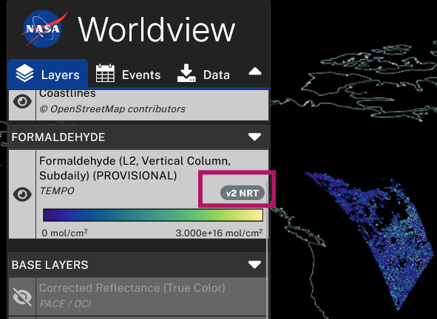
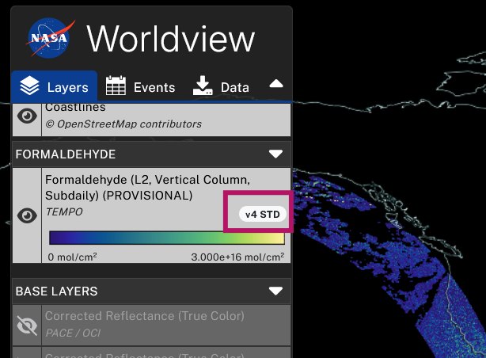
Worldview Updates
Imagery version is shown in “badge”
New imagery:
  NRT V02
  V04 imagery, including O3PROF total column ozone & ozone profile troposphere
  *V03 imagery is being replaced as V04 is backprocessed (mix of V03 and V04 imagery between August 2023 – September 2025)
Worldview shows “best available” imagery (NRT < V03 < V04)
Older imagery available via Global Imagery Browse Services (GIBS) API, even if no longer shown in Worldview
https://nasa-gibs.github.io/gibs-api-docs/
Notes:
Worldview “best available” imagery means: NRT imagery shown until standard data product is available. Newer versions replace older versions (V04 replaces V03).
Note: because the TEMPO ST is backprocessing in priority order, there is a mix of V03 and V04 imagery between August 2023 – September 2025
FYI Alex! There is no L3 V03 TEMPO data in Worldview. There is a warning about it on the collections in Worldview. This is the message: “The TEMPO V03 imagery from August 2, 2023 to September 16, 2025 has been removed and is being reprocessed utilizing the latest V04 algorithms, with the V04 imagery becoming publicly available upon reprocessing. The imagery is being reprocessed nonchronologically based on operational priorities. The TEMPO V03 imagery will remain accessible via NASA's Global Imagery Browse Services (GIBS) API.”

Slide 7
TEMPO ArcGIS Image Services
Pre-filtered, analysis ready data
Available in NASA’s Earthdata GIS Portal and Esri’s Living Atlas of the World
V04 services updated daily
NRT updated hourly
V03 being reprocessed into V04; will be added to V04 services; V03 services will be retired
2-day Rolling Archive Near Real-Time (V02)
HCHO Vertical Column
NO2 Troposphere Vertical Column
Cloud Fraction
Sept 2025-present (V04)
HCHO Vertical Column
NO2 Troposphere Vertical Column
Ozone Total Column
0-2 km Column Ozone
Aug 2023-Sept 2025 (V03)
HCHO Vertical Column
NO2 Troposphere Vertical Column
Ozone Total Column
https://gis.earthdata.nasa.gov/portal/home/index.html
https://livingatlas.arcgis.com/en/home/
Notes:
Focuing on TEMPO, we currently have four variables available as ArcGIS image services: nitrogen dioxide troposphere vertical column, formaldehyde vertical column, ozone total column, and cloud fraction. You can see from this list that the NO2, formaldehyde and ozone have separate versions with different time ranges. The TEMPO Science Team is currently reprocessing the TEMPO V03 into V04 data and the updated data will be added to the V04 services as they become available. Once that occurs, the V03 services will be retired.
Our newest services are our near real-time services for NO2, formaldehyde and cloud fraction.
All of these services are from the Level 3 data (which means they are a gridded product) and have been pre-filtered to remove low quality data per the Science Team’s recommendations to create analysis ready data for users. Unlike the Worldview imagery, these retain the actual data values so various data analyses can be done. The near-real time services are updated hourly during daylight hours, and the standard data services (the V03 and V04) are updated daily.
The Living Atlas of the World is Esri’s premier data catalog and is seen as a source of authoritative data in the GIS community. Within the last two months, the TEMPO Ozone Total Column and Formaldehyde Vertical Column image services were accepted into the Living Atlas, joining the TEMPO NO2 image service already available in the Living Atlas. Providing the TEMPO data in this data catalog significantly increases the findability and accessibility of the data.
We are aiming to have V04 image services of the existing variables in September. We will then work on supporting image services for selected NRT variables, as well as additional standard product variables.

Slide 8
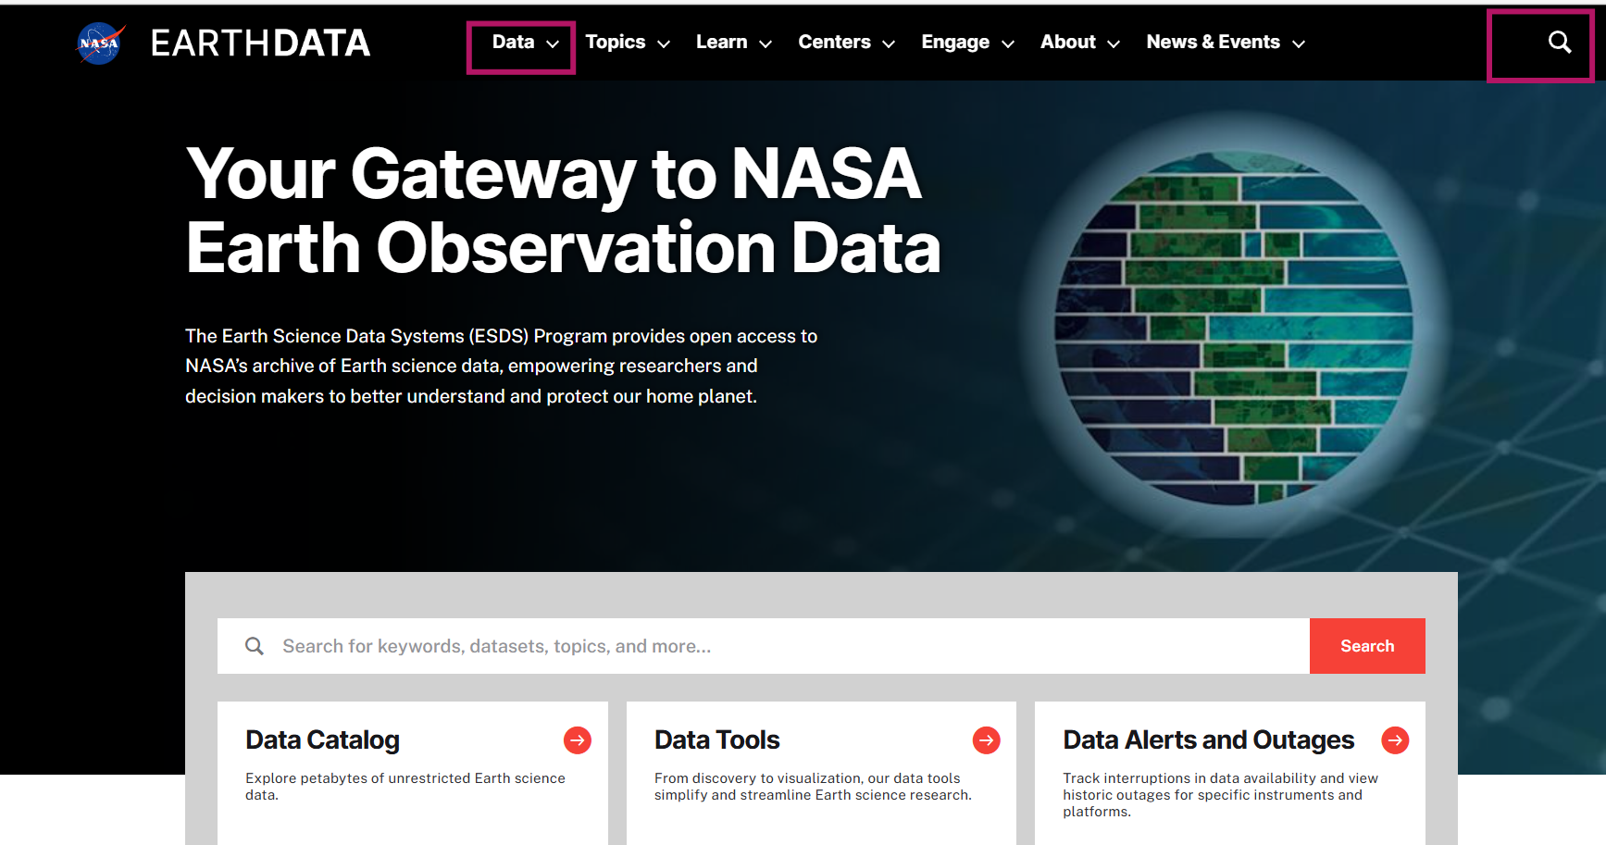
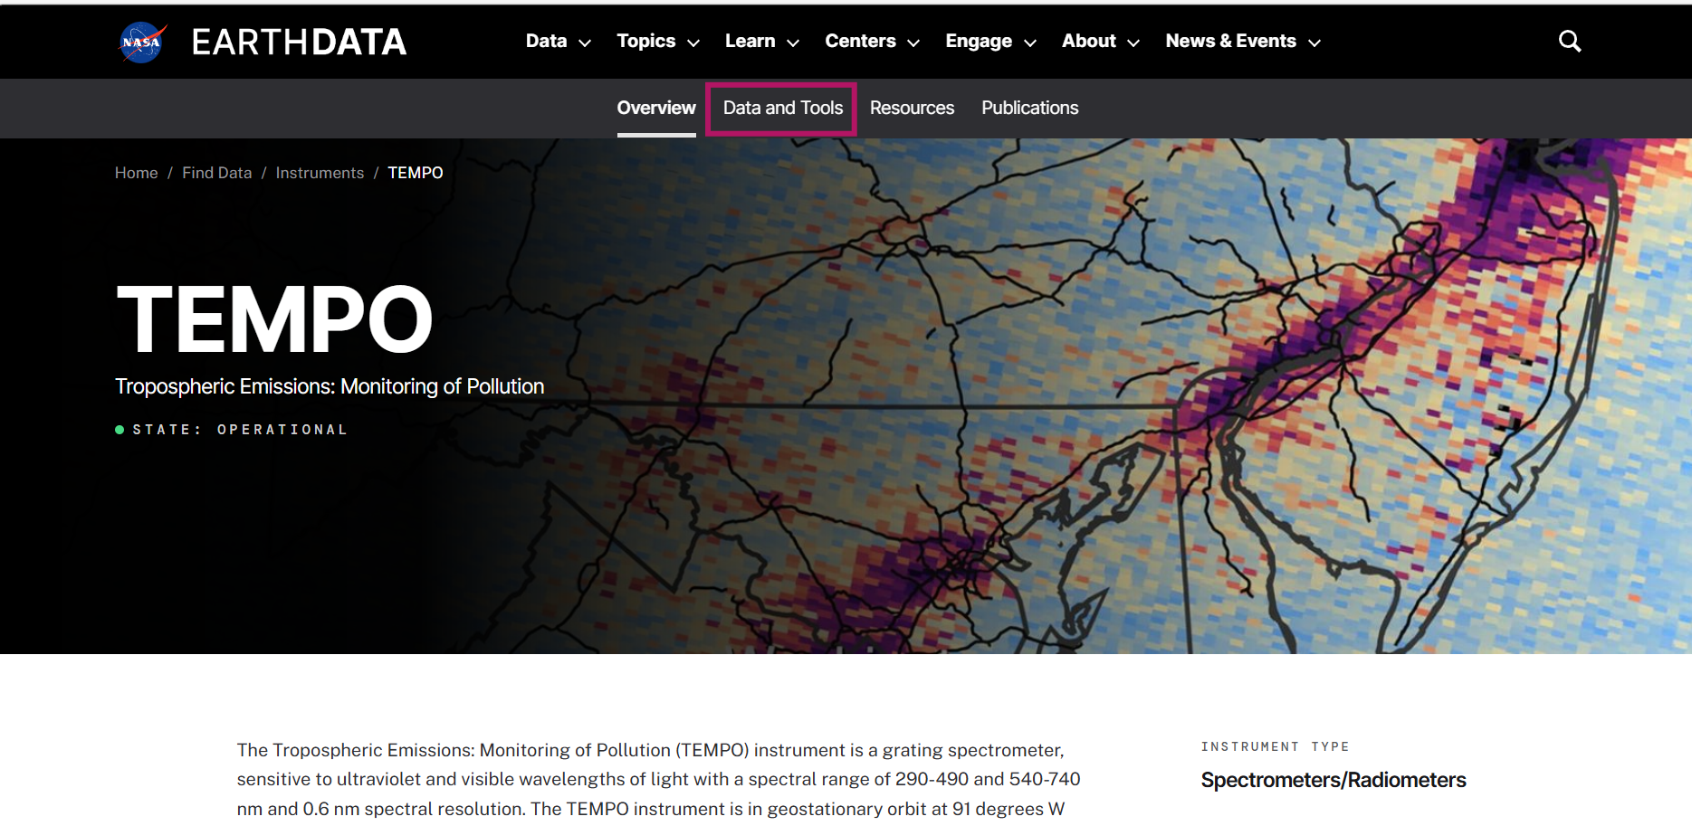
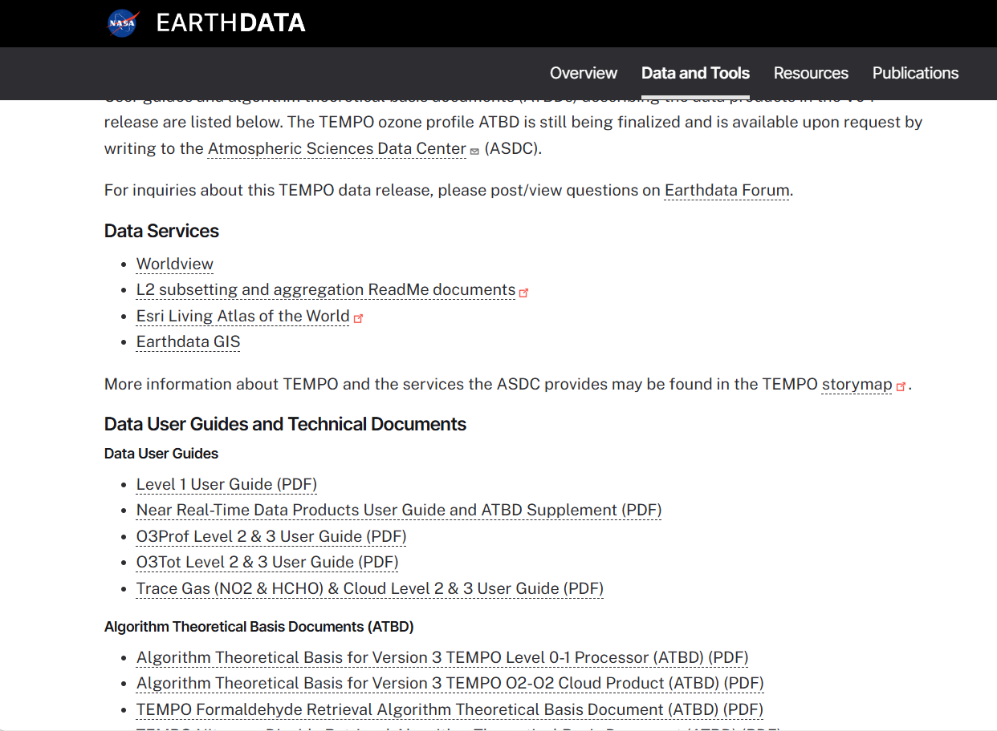
NEW Earthdata TEMPO Website
ASDC website migrated to Earthdata
TEMPO > Data & Tools: documentation previously on ASDC TEMPO page
NEW: TEMPO Radiance Twilight V04 Inventory Tables
https://www.earthdata.nasa.gov/data/instruments/tempo
Notes:
ASDC website migrated to Earthdata
TEMPO > Data & Tools: documentation previously on ASDC TEMPO page

Slide 9
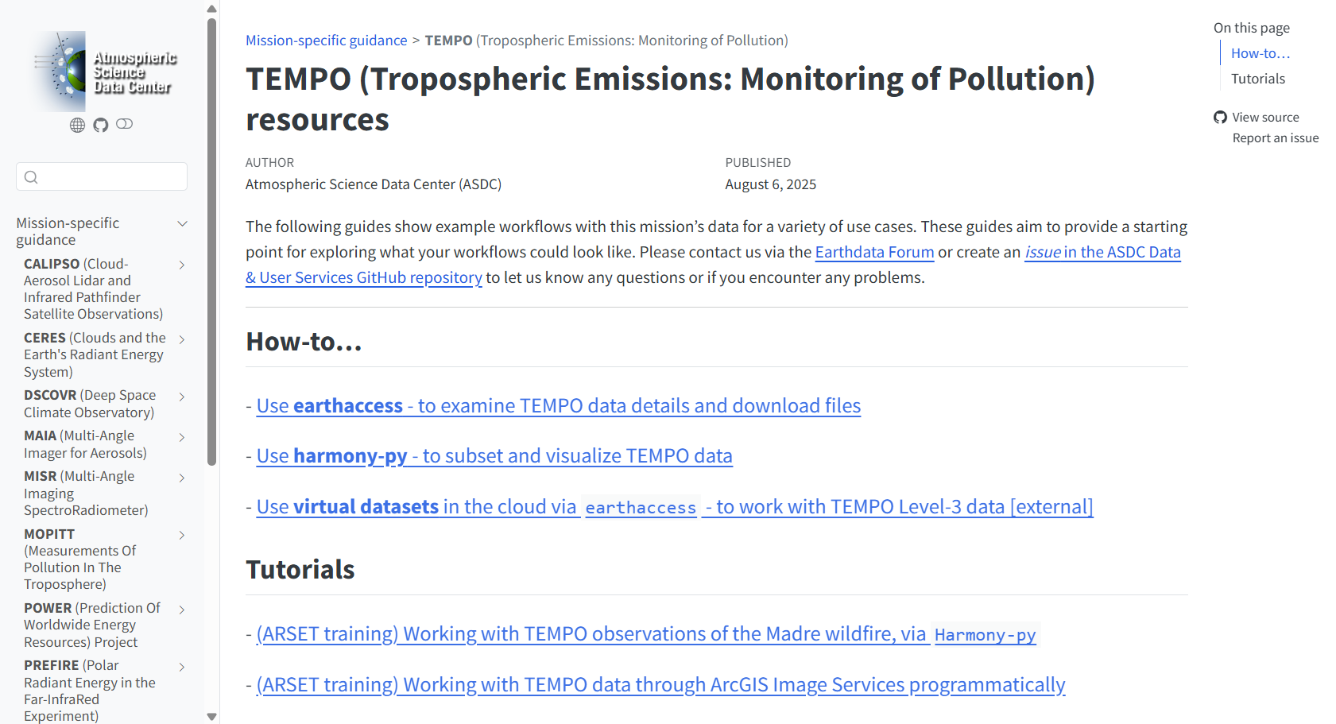
ASDC Github: Codes & Tutorials
https://nasa.github.io/ASDC_Data_and_User_Services/TEMPO/
Notes:
The ASDC also has a GitHub repository that contains codes, tutorials, and resources for using ASDC data, including examples of data processing specific for TEMPO.

Slide 10
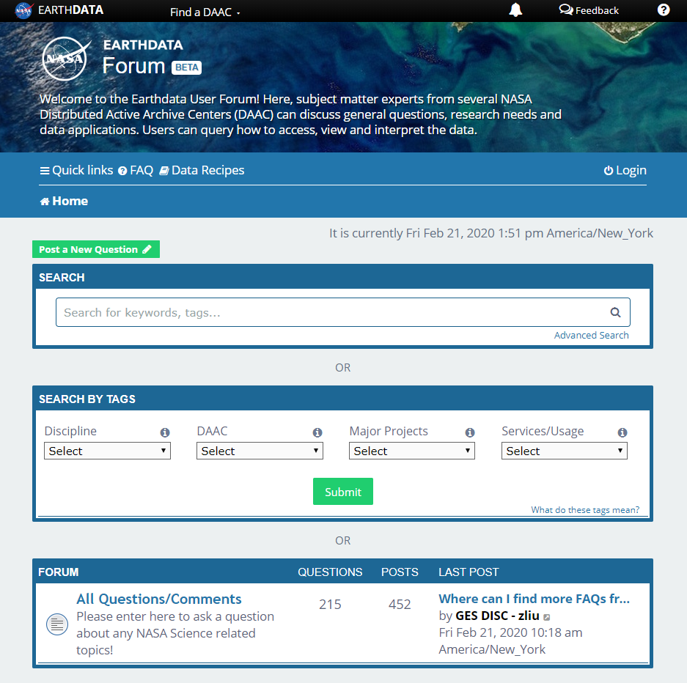
Earthdata Forum
Science Data Users can seamlessly search for information even if they do not know which DAAC the data belongs to.
Scientists & Data Providers can effectively assist their user community in more accurately using their products.
DAACs & Subject Matter Experts (SMEs) can quickly link users to existing resources.
DAAC User Services can swiftly provide inquirers with an authoritative source related to DAAC data products & services.
Tag posts with “ASDC” or “TEMPO”
https://forum.earthdata.nasa.gov
https://forum.earthdata.nasa.gov/
Notes:
The Earthdata Forum is an online platform where users can interact with NASA’s Data Center experts and the Science Teams directly to discuss data applications, research needs, and get help with accessing, visualizing, and manipulating NASA's Earth observation data. Anything tagged with “ASDC” or “TEMPO” will come to us and the TEMPO science team.

Slide 11
Additional Resources
ASDC Github: https://github.com/nasa/ASDC_Data_and_User_Services
Earthdata TEMPO project page: https://www.earthdata.nasa.gov/data/instruments/tempo
Earthaccess: https://github.com/nsidc/earthaccess
Earthdata GIS: https://gis.earthdata.nasa.gov/portal/home/index.html
Esri Living Atlas of the World: https://livingatlas.arcgis.com/en/home/
Harmony.py API: https://harmony.earthdata.nasa.gov/docs#using-the-service-apis
Notes:
Lastly, for reference, here is a list of additional useful links and tools listed here.

Slide 12
For TEMPO-related questions or feedback, please contact us at:
larc-dl-asdc-tempo@mail.nasa.gov
or
post on Earthdata Forum using “TEMPO” tag
Atmospheric Science Data Center
NASA Langley Research Center
Hampton, Virginia (USA)
https://asdc.larc.nasa.gov/
support-asdc@earthdata.nasa.gov
Notes:
Thank you for your time this morning. We are happy to answer any questions today and please reach out with any you may have in the future.

