Slide 1



TEMPO Applications to Air Quality Management
Tracey Holloway
University of Wisconsin-Madison; NASA HAQAST Lead
TEMPO DART Meeting – Applications and Stakeholder Needs
17 June 2026

Slide 2
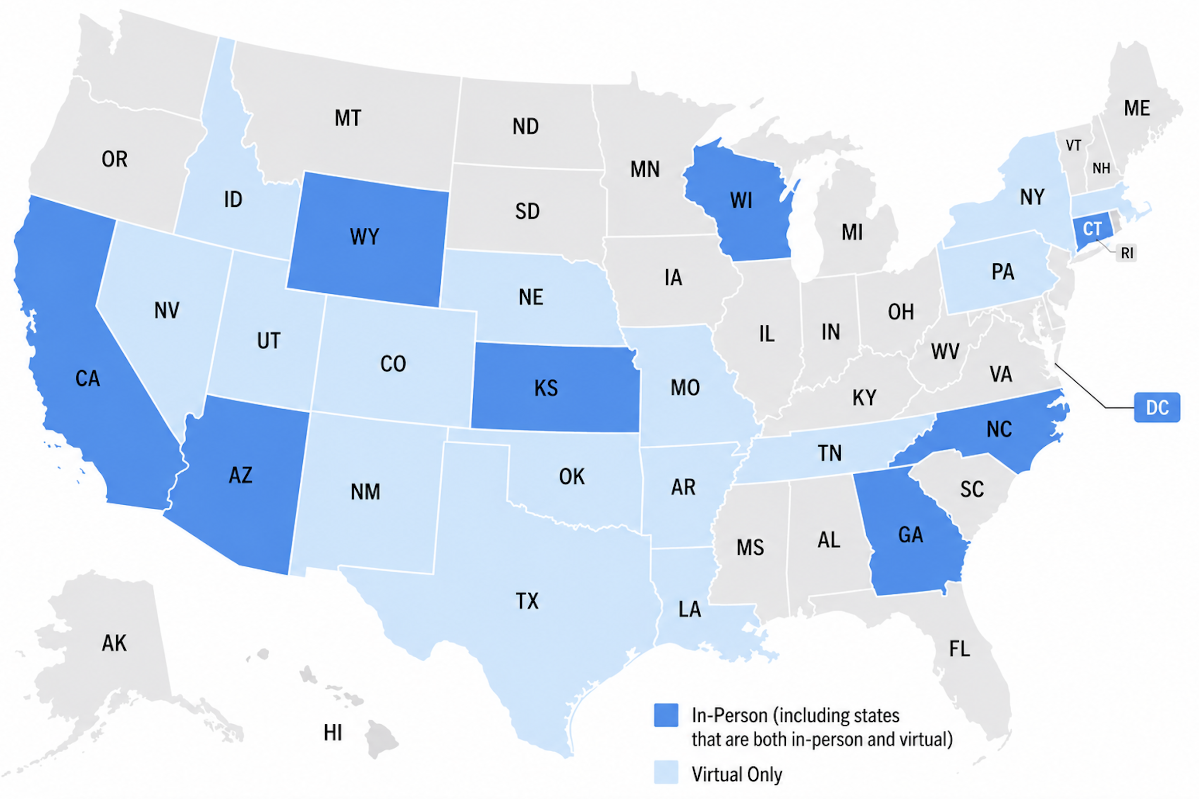
What is “hay-kast”?
Health and Air Quality Applied Sciences Team
Mission: Connect NASA science with air quality and health applications
Meetings every 6 months, with ~50% stakeholders (last month in Madison, 23 states AQ agencies)
15 years so far
  AQAST 2011-2016
  HAQAST 2016-2020
  2020-2025
  2025-2029
  HAQAST Madison 2026 Meeting – Attendance from state and local air quality management agencies; plot created with ChatGPT
haqast.org/

Slide 3
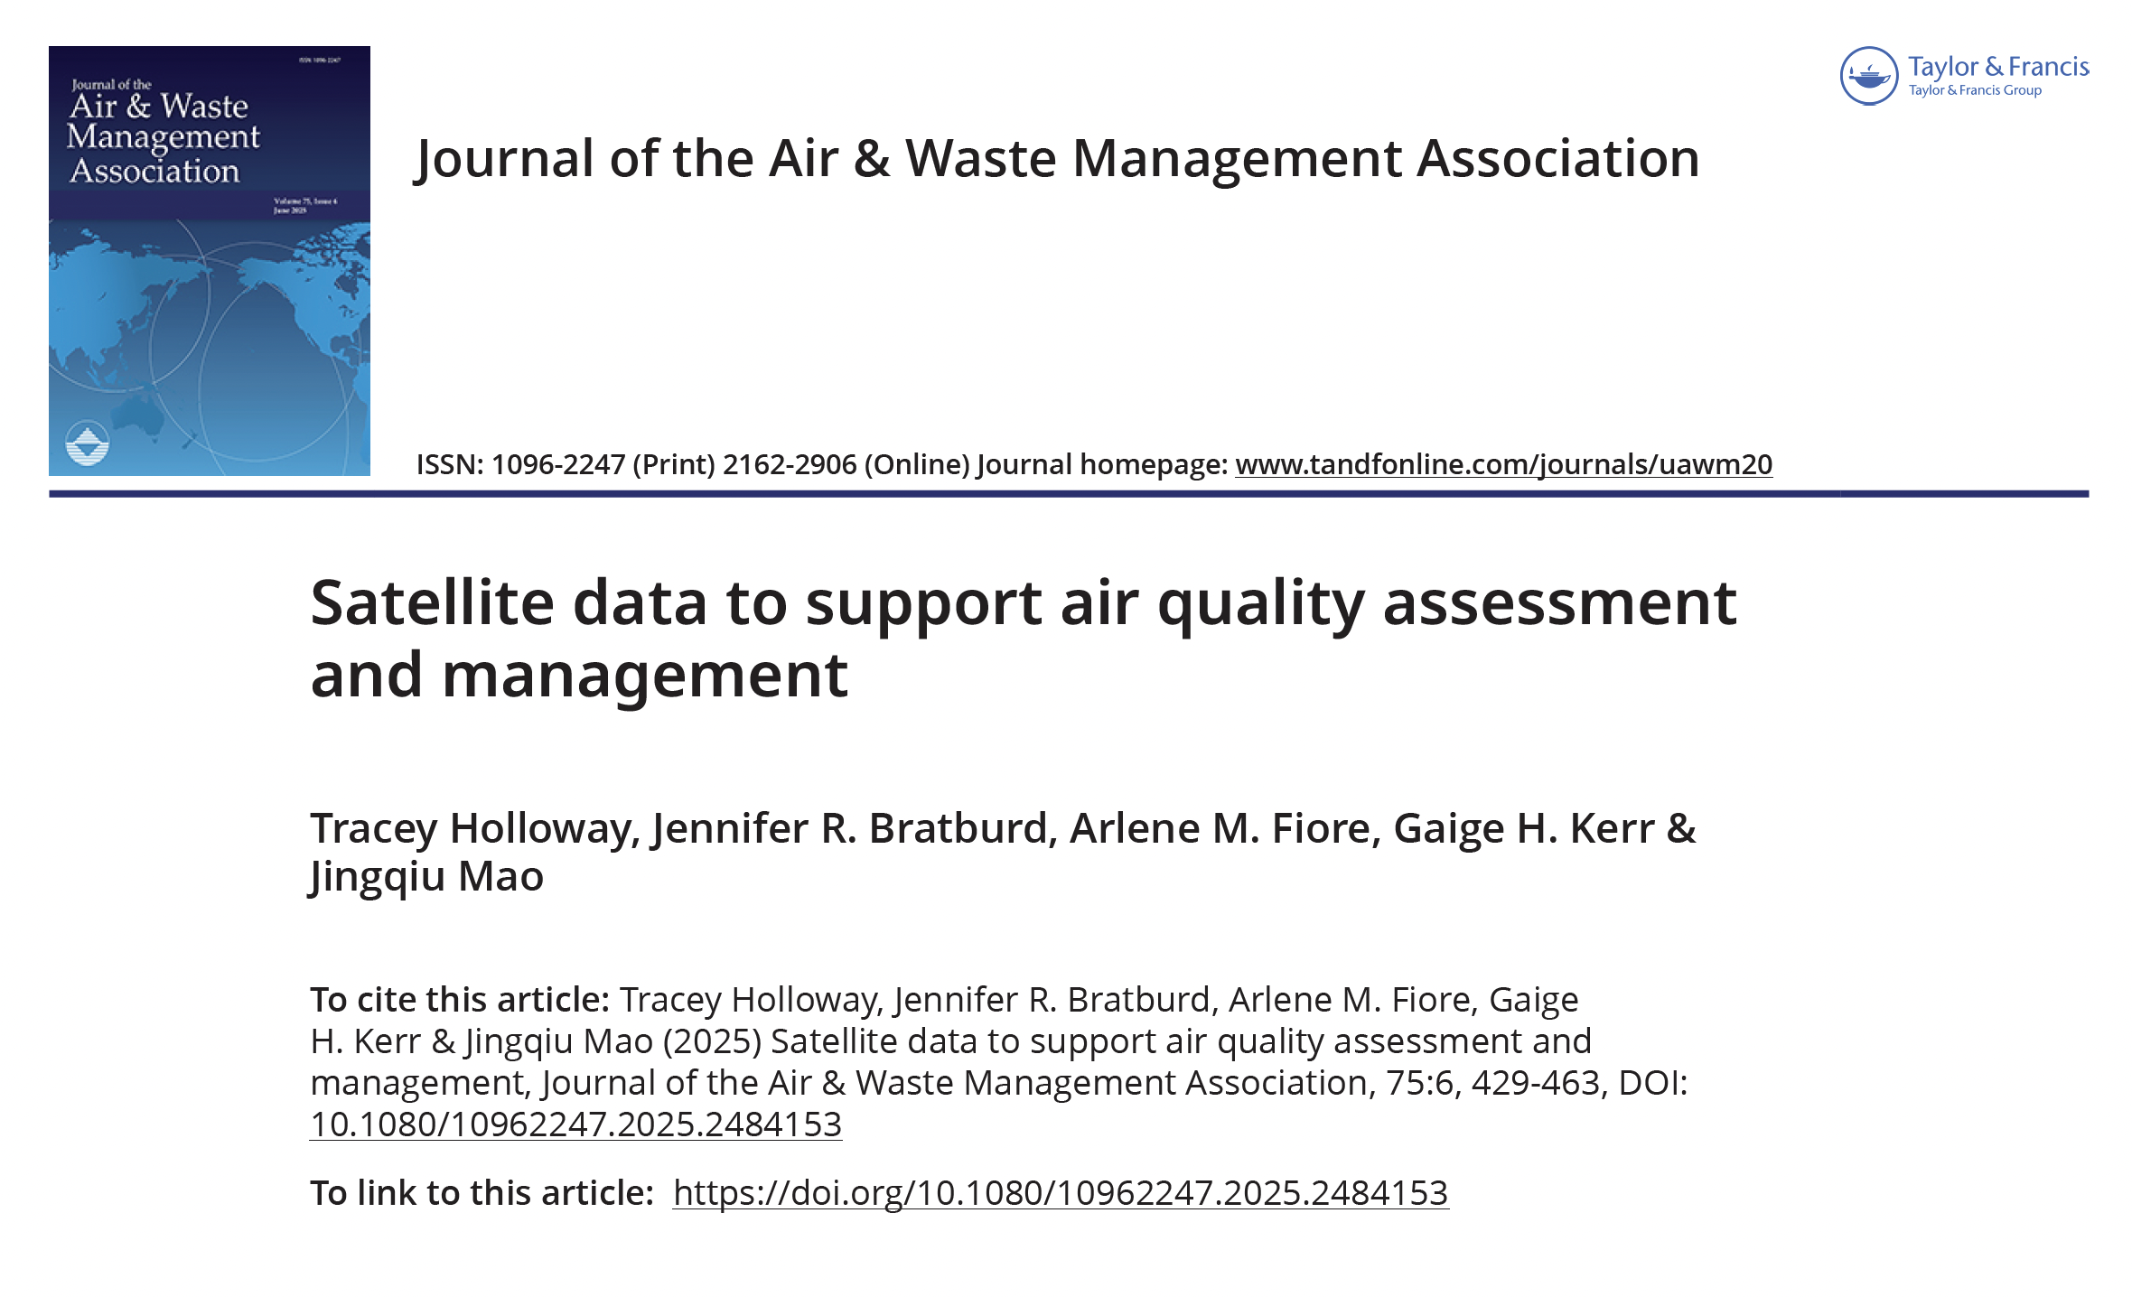

Slide 4
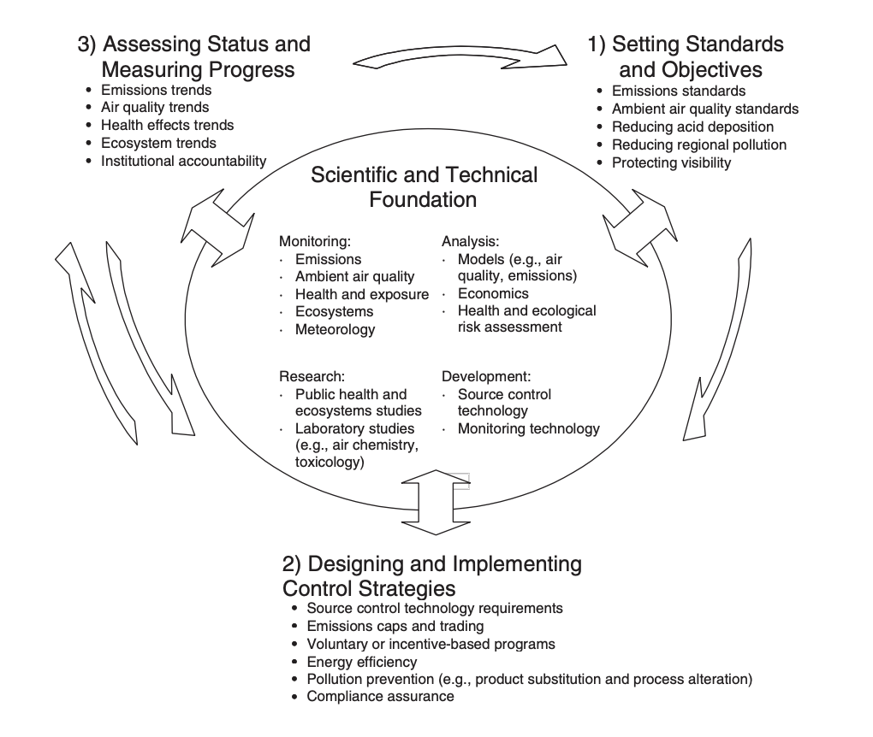
National Research Council, 2004

Slide 5


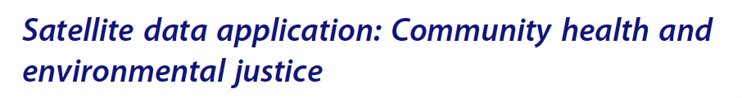

Slide 6

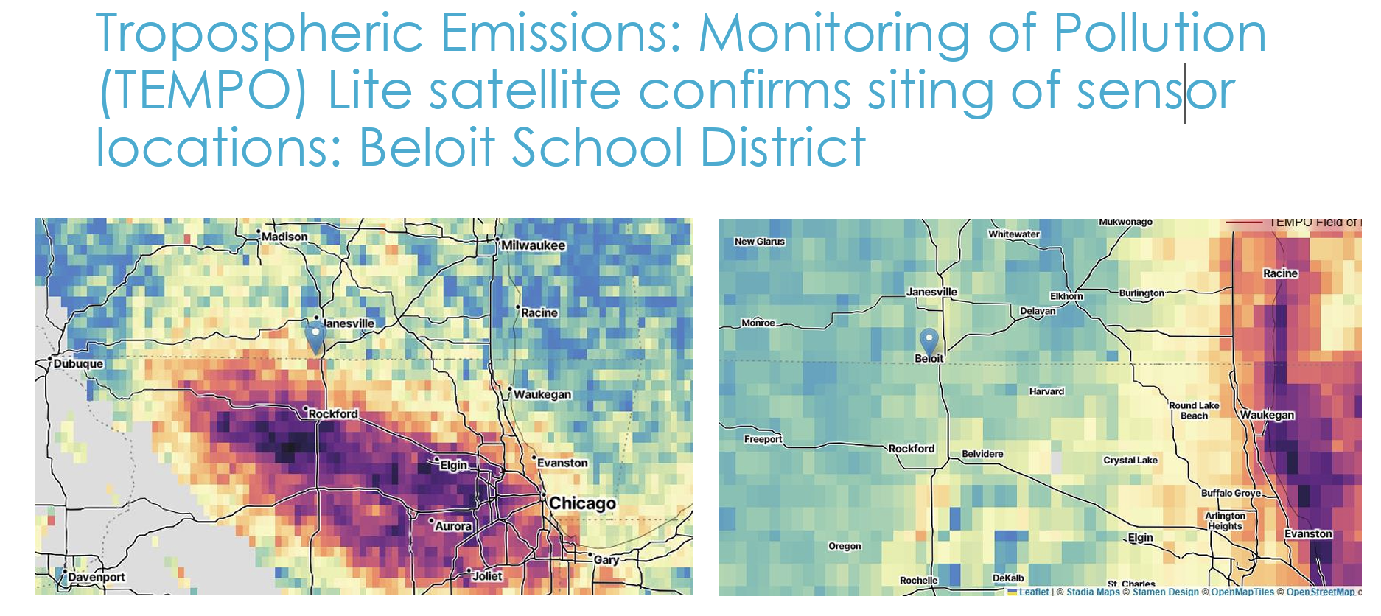


https://haqast.org/wp-content/uploads/sites/91/2026/06/Sara_Kroening_Slides.pdf

Slide 7

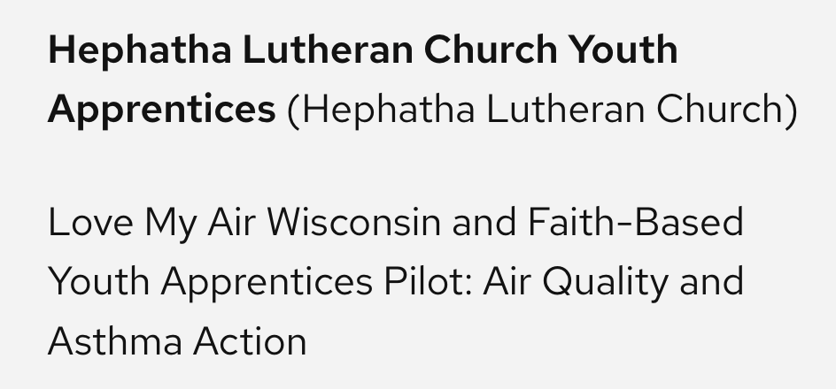
https://haqast.org/wp-content/uploads/sites/91/2026/06/Sara_Kroening_Slides.pdf
https://haqast.org/wp-content/uploads/sites/91/2026/05/Hephatha-Research-Poster-HAQAST.pdf

Slide 8

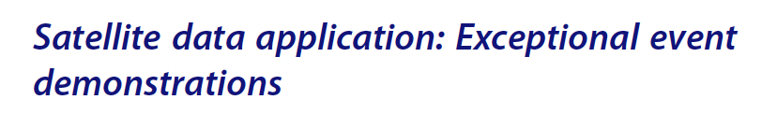
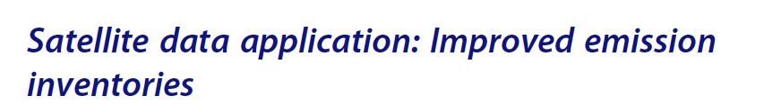
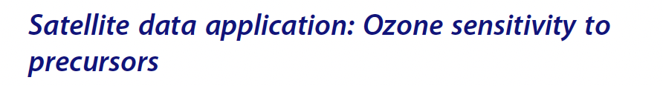

Slide 9

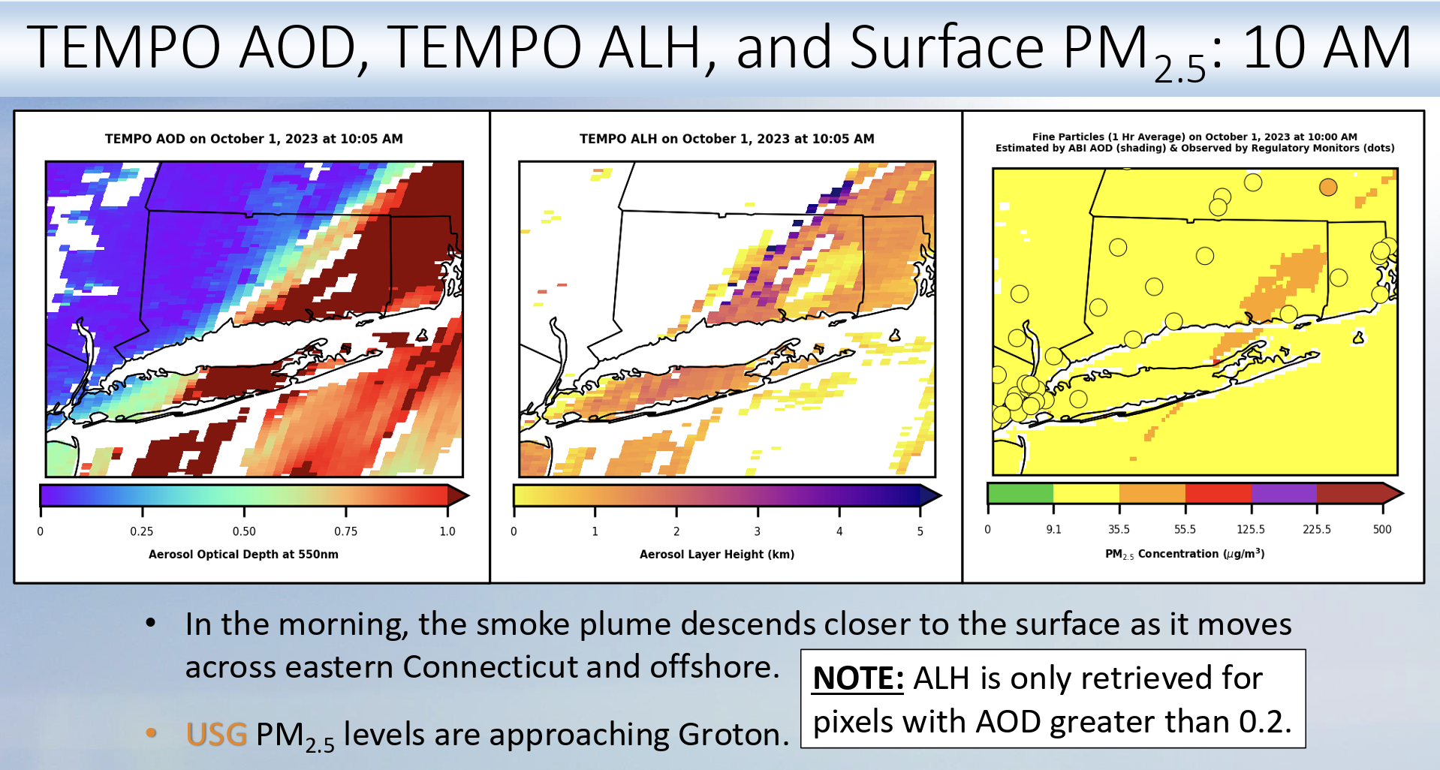
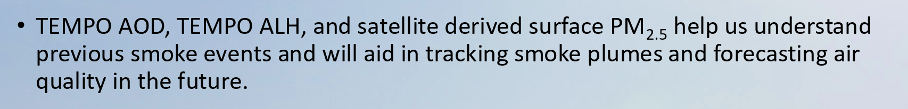
https://haqast.org/wp-content/uploads/sites/91/2026/06/Amanda_Fritz_Slides.pdf

Slide 10
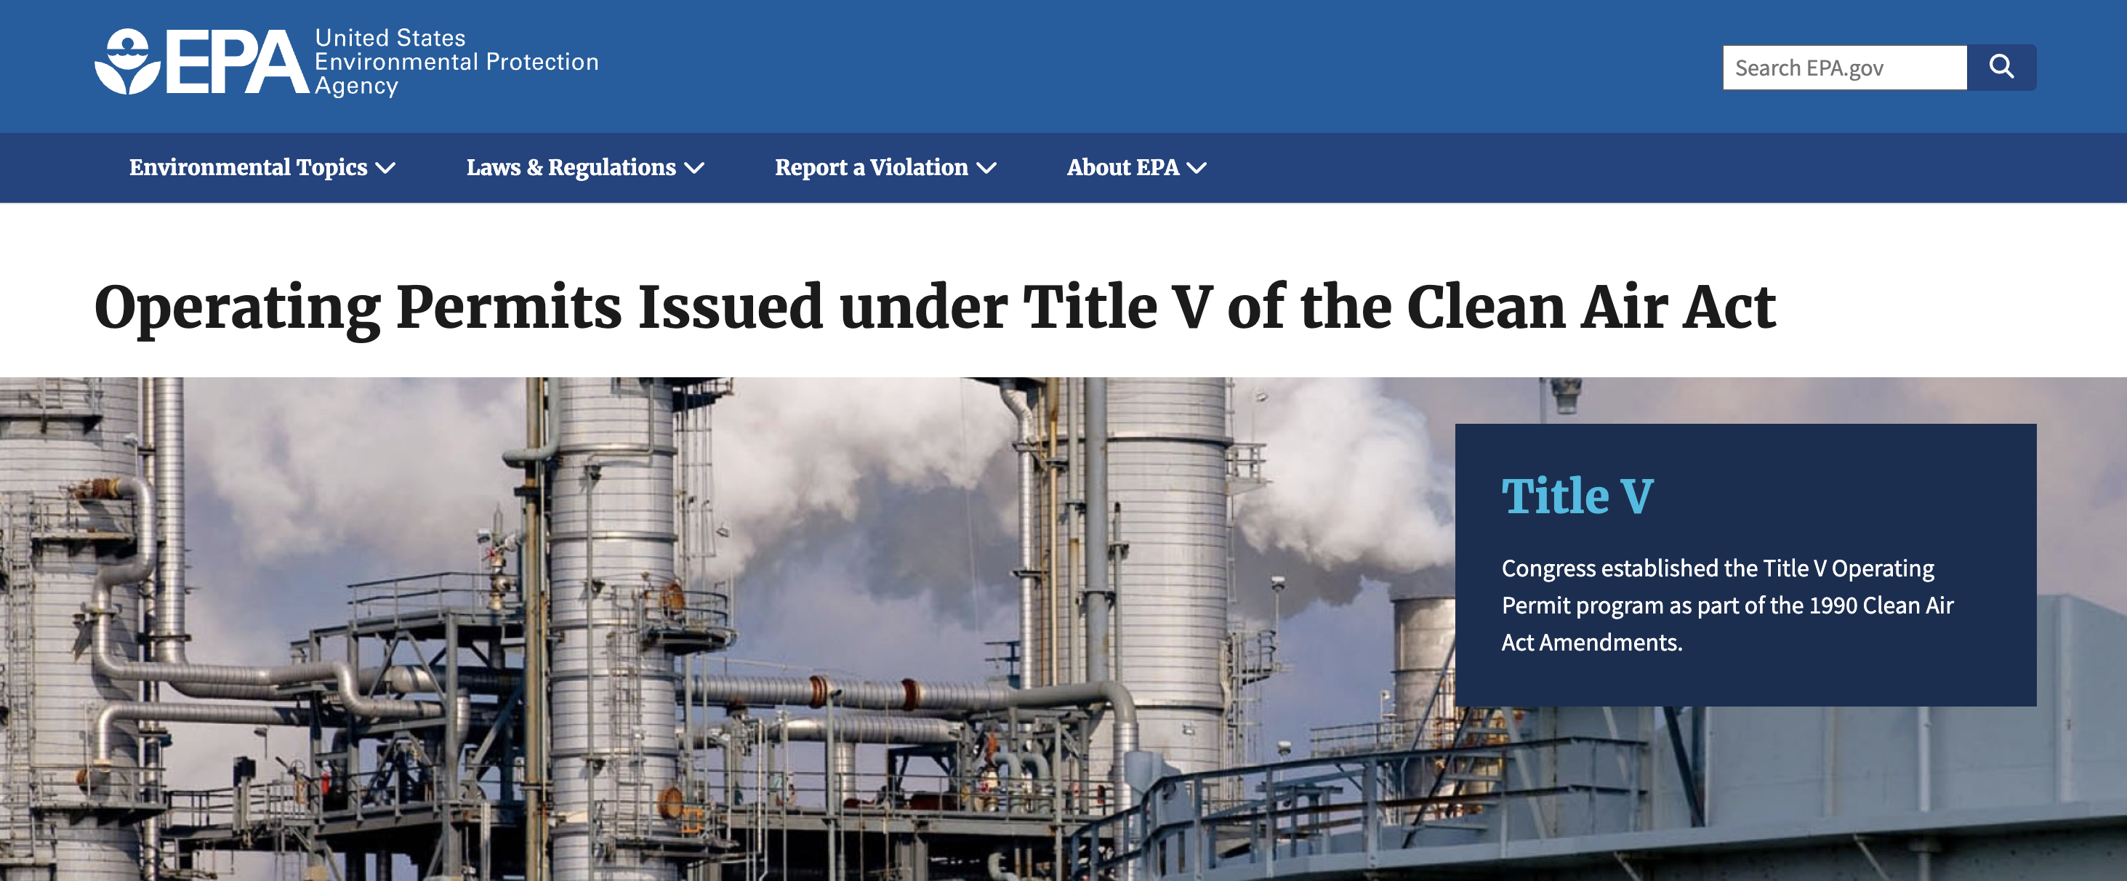
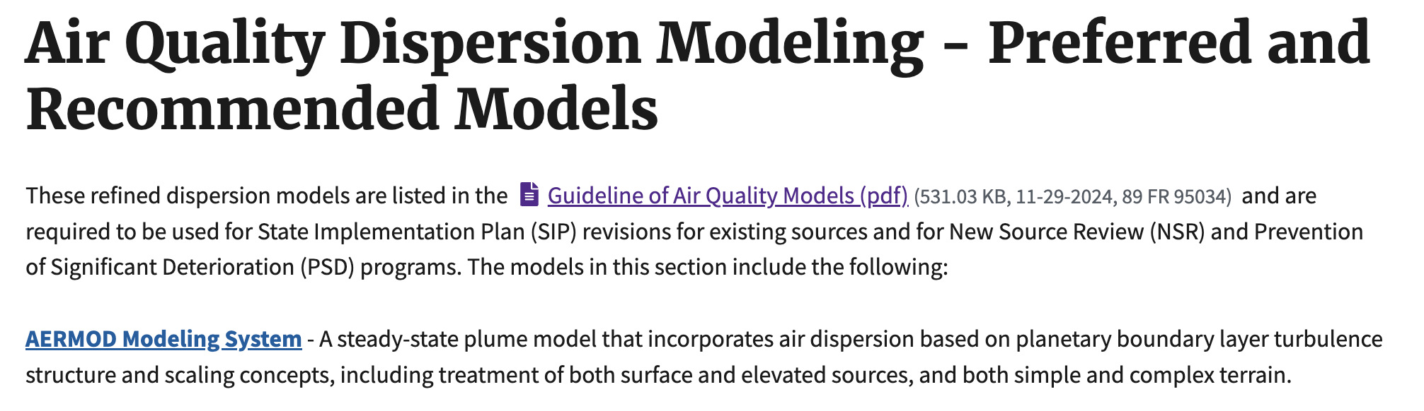
https://www.epa.gov/title-v-operating-permits;
https://www.epa.gov/scram/air-quality-dispersion-modeling-preferred-and-recommended-models

Slide 11
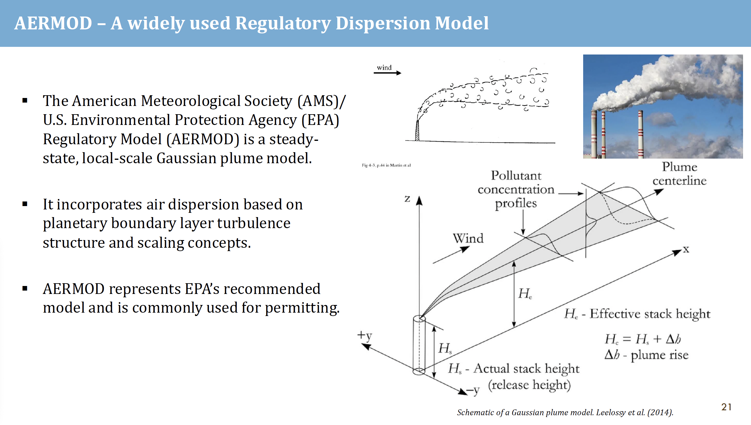
AERMOD Slides from
Xinran Wu Ph.D. defense;
work with Dr. Monica Harkey;
Paper in prep

Slide 12
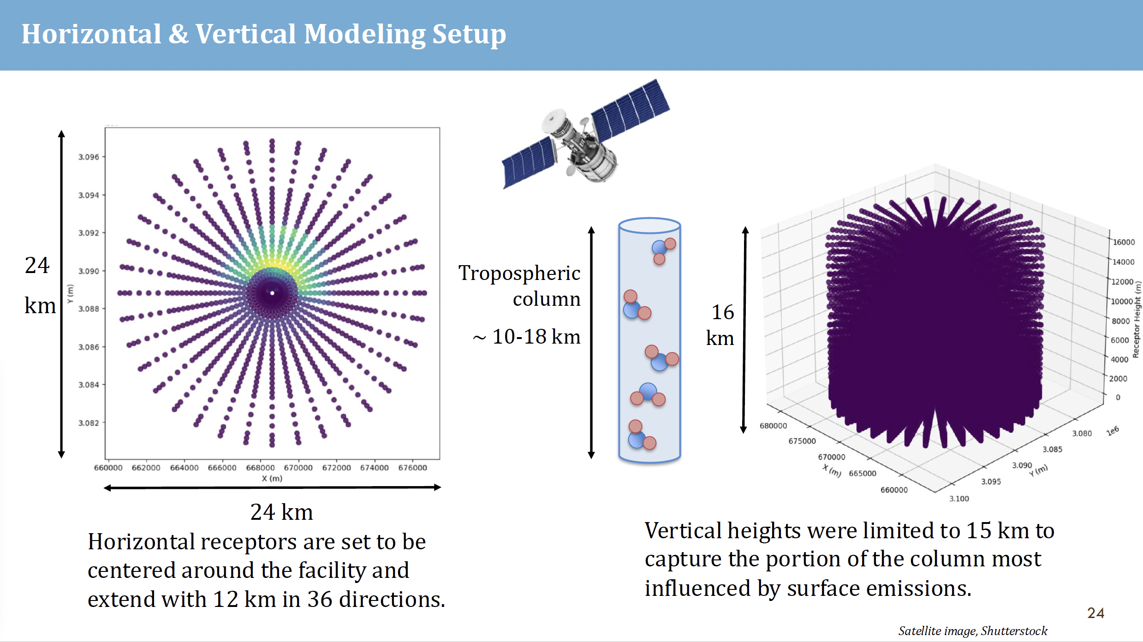

Slide 13
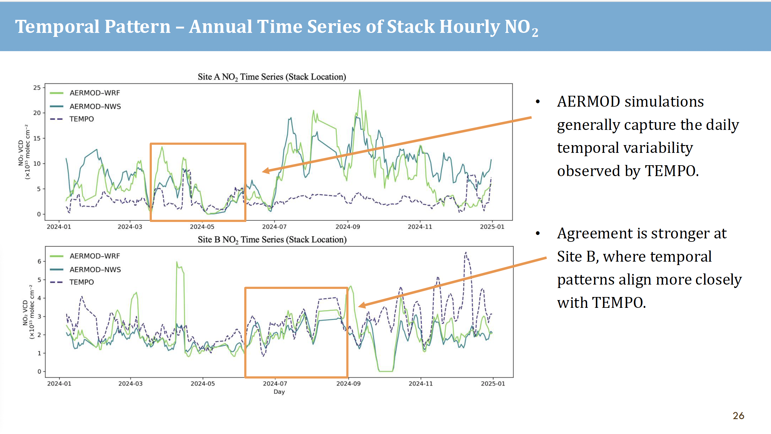

Slide 14
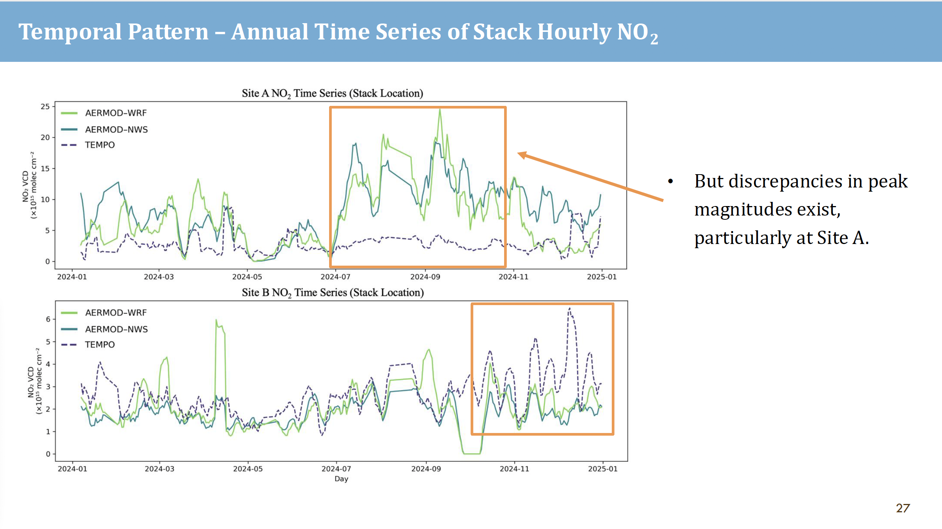

Slide 15
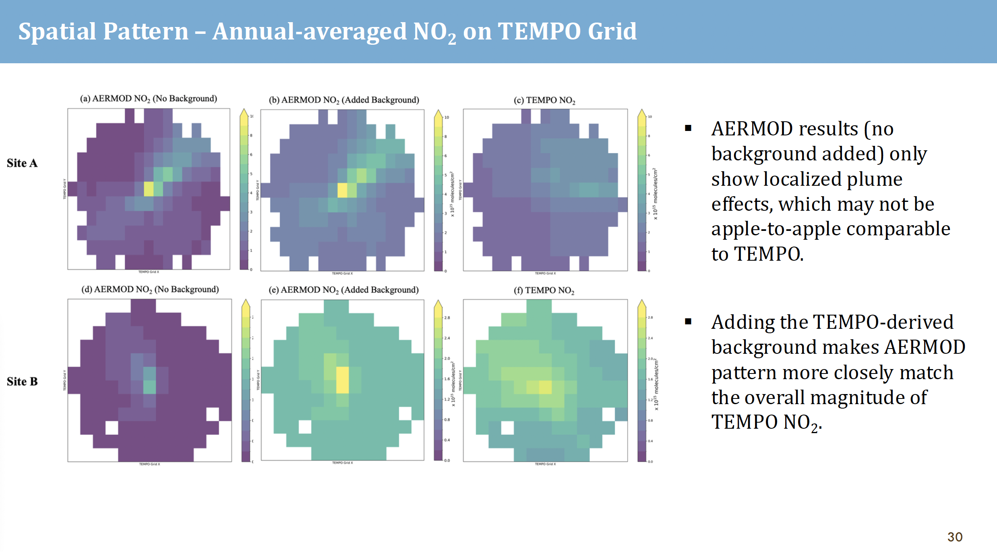
AERMOD VCD
No Background
AERMOD VCD
TEMPO Background
TEMPO VCD

Slide 16
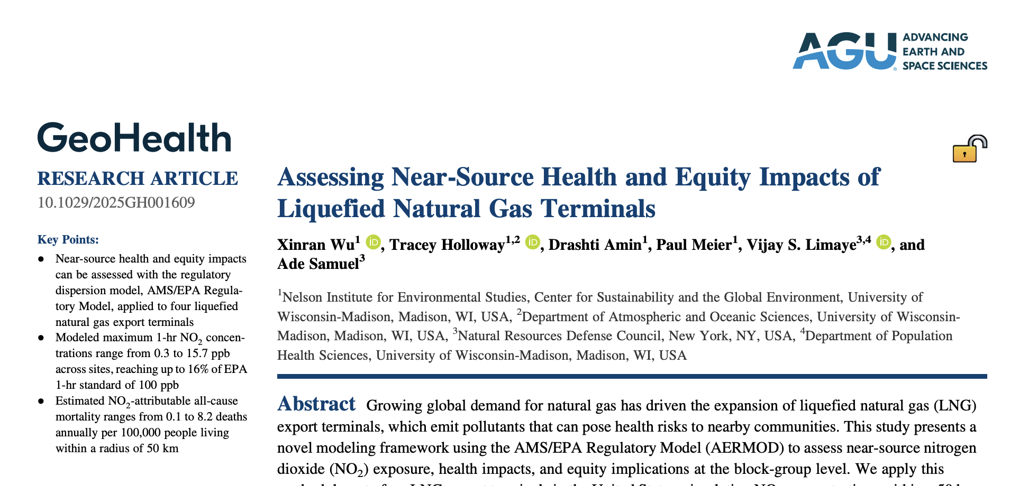
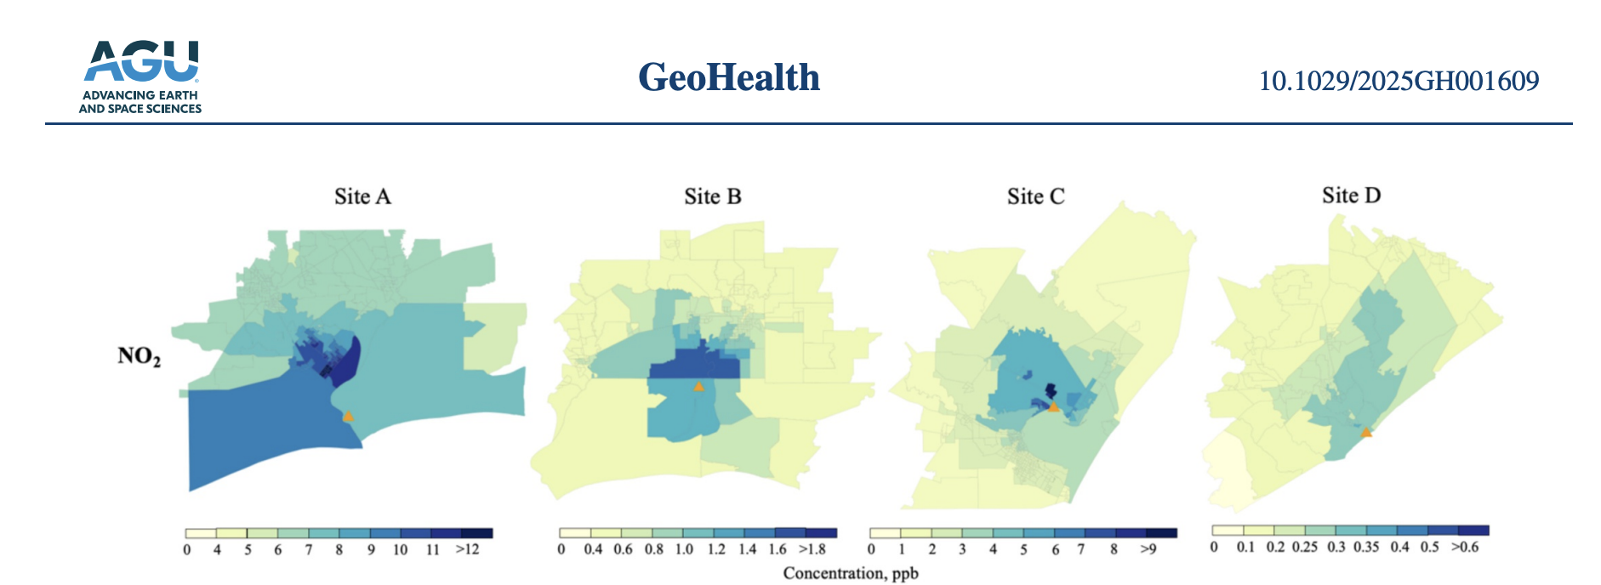

Slide 17



Slide 18
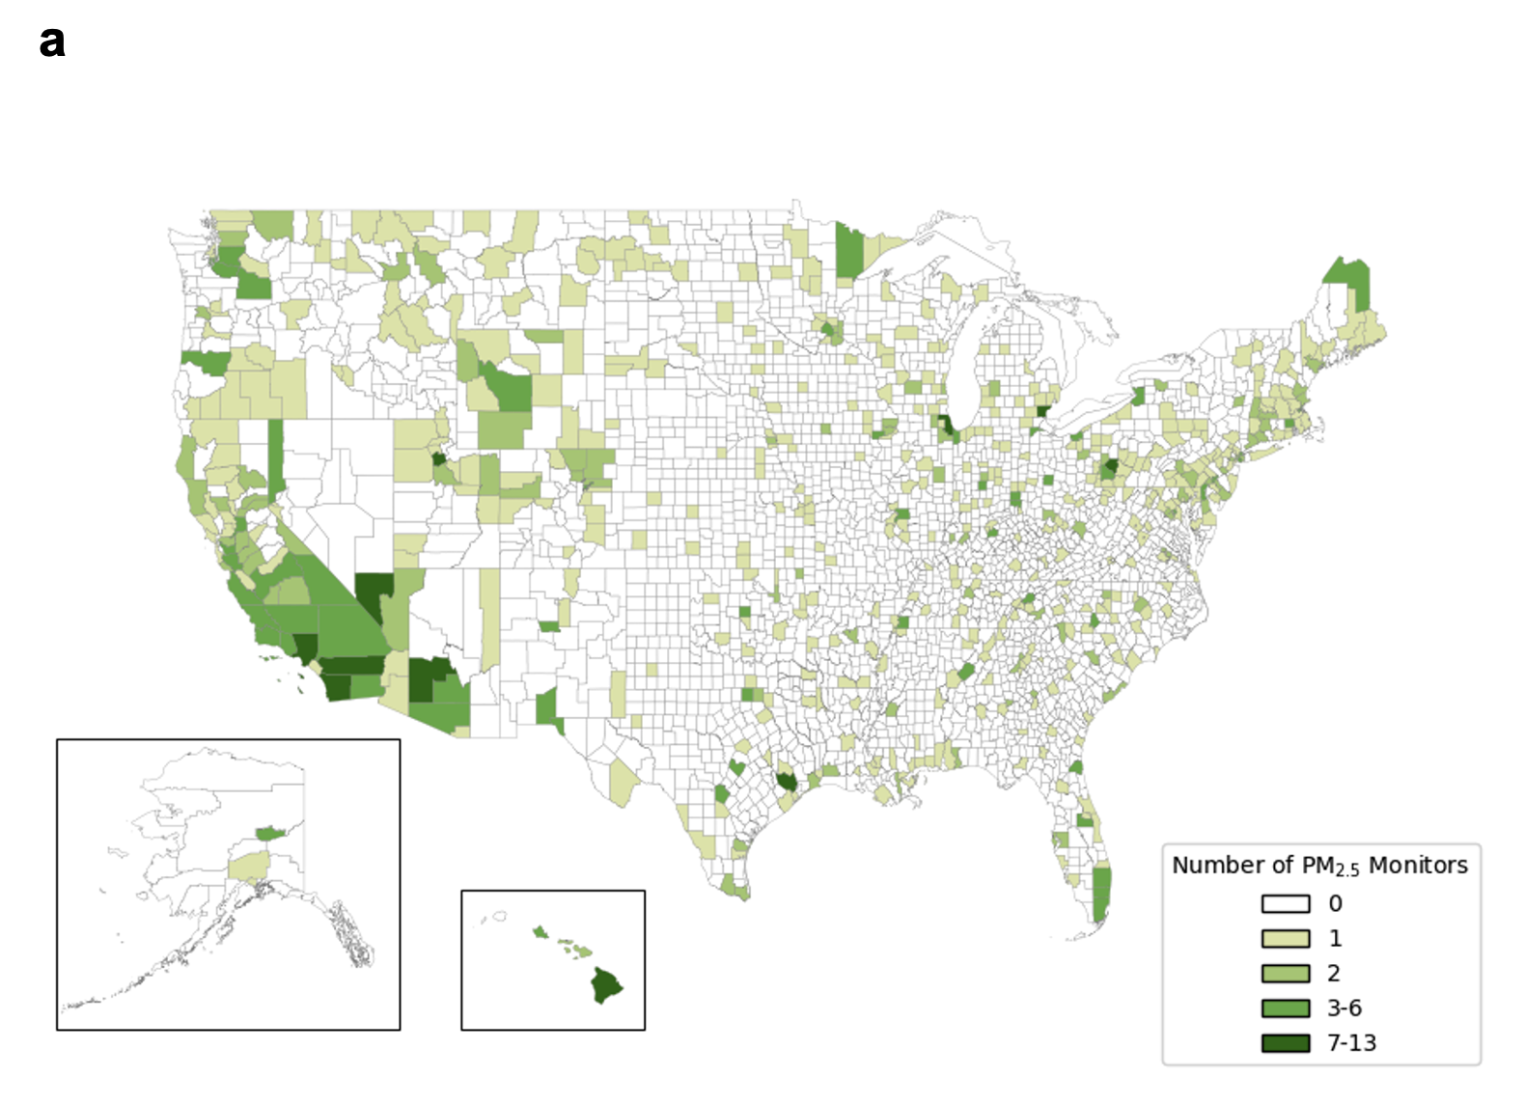
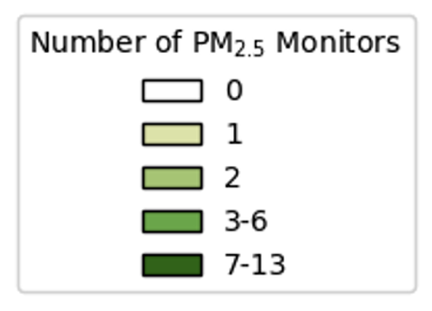
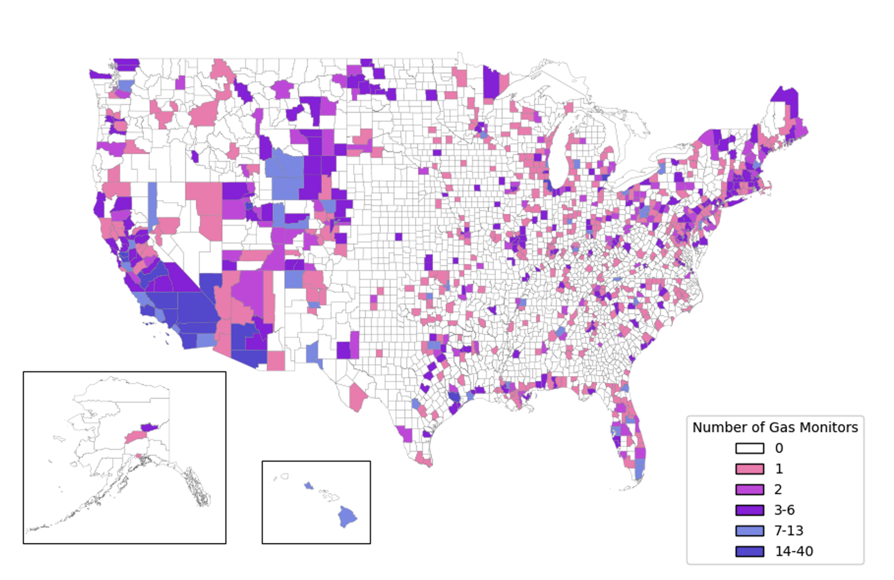
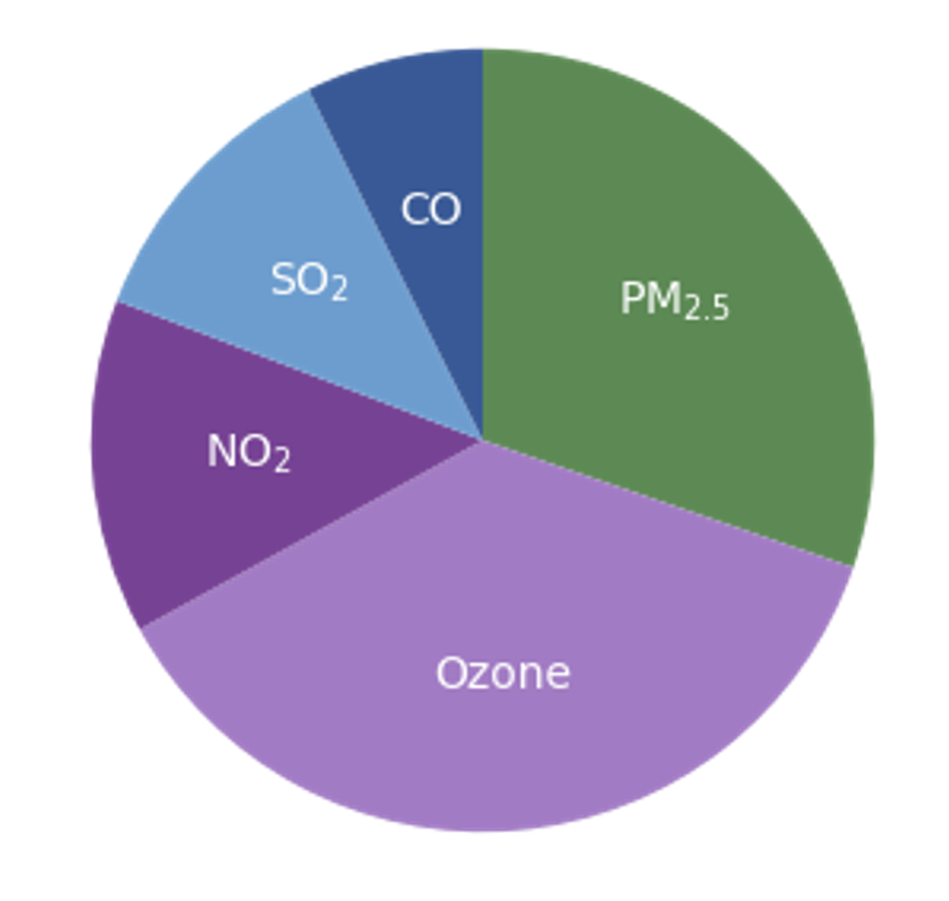
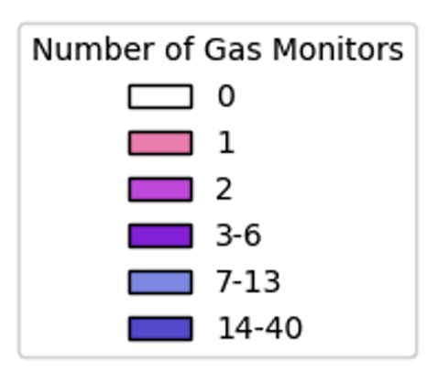
Holloway et al., 2025 AWMA Critical Review Supplementary Material (courtesy Summer Acker
Notes:
Supporting Figure 1: Overview of 2024 active EPA Air Quality System monitors for the continental U.S., Alaska, and Hawaii Panel (a) shows a map of the spatial distribution of PM_{2.5} monitors; Panel (b) shows a map of the spatial distribution of gas phase monitors for ozone, NO₂, SO₂, and CO; Panel (c) shows a pie chart of the total distribution of monitors PM_{2.5} (1022 monitors); ozone (1240 monitors); NO₂ (467 monitors); SO₂ (400 monitors); and CO (246 monitors). Among monitored pollutants shown here, 837 sites locations have more than one monitor: 414 sites have 2 monitors; 237 locations, 3 monitors; 110 locations, 4 monitors; 76 locations 5 monitors. Monitor totals include areas shown, as well as Puerto Rico and the U.S. Virgin Islands.

Slide 19

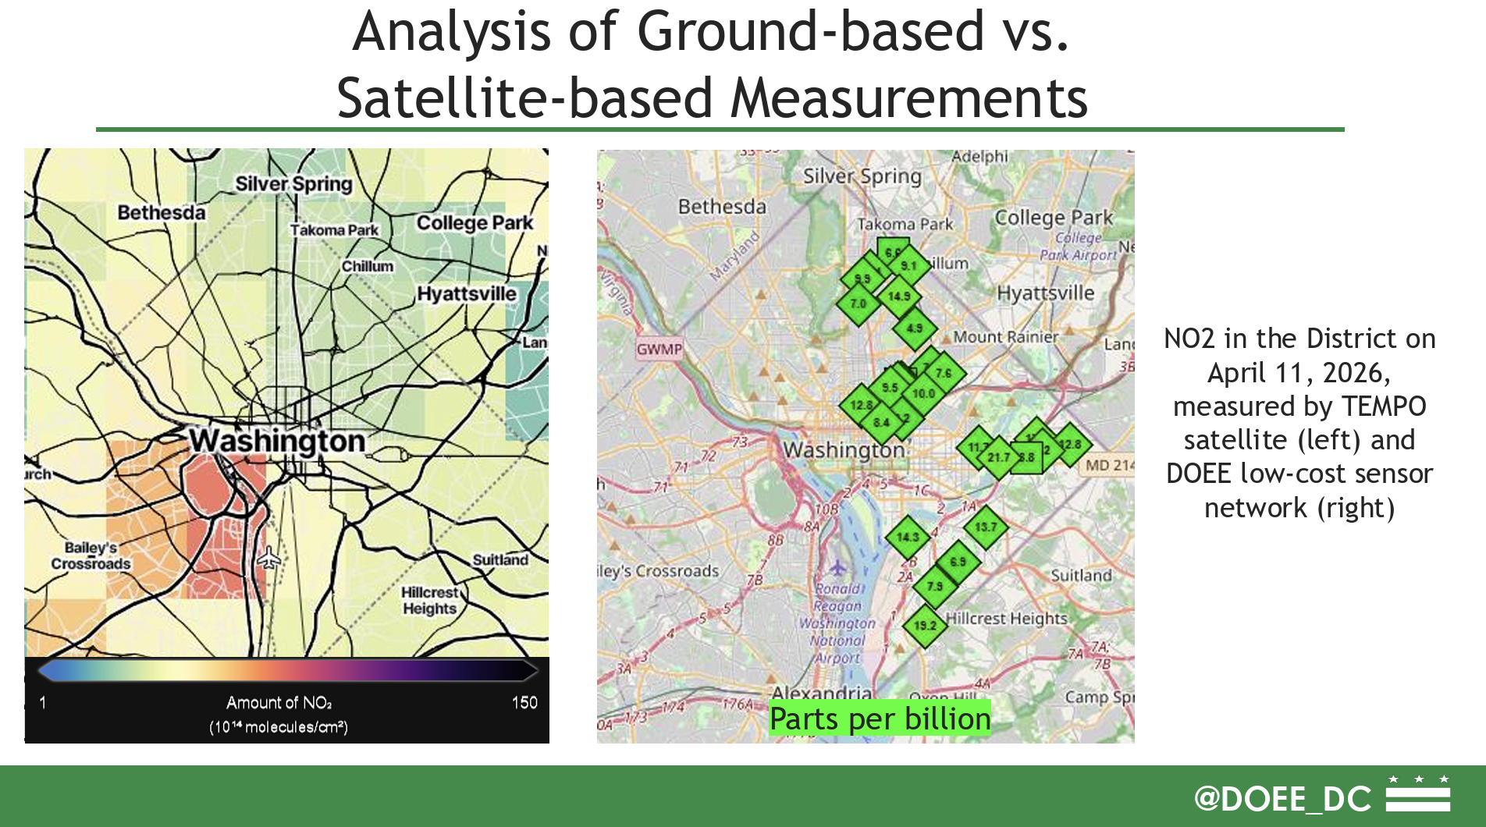
https://haqast.org/wp-content/uploads/sites/91/2026/06/Samuel_Kay_Slides.pdf

Slide 20

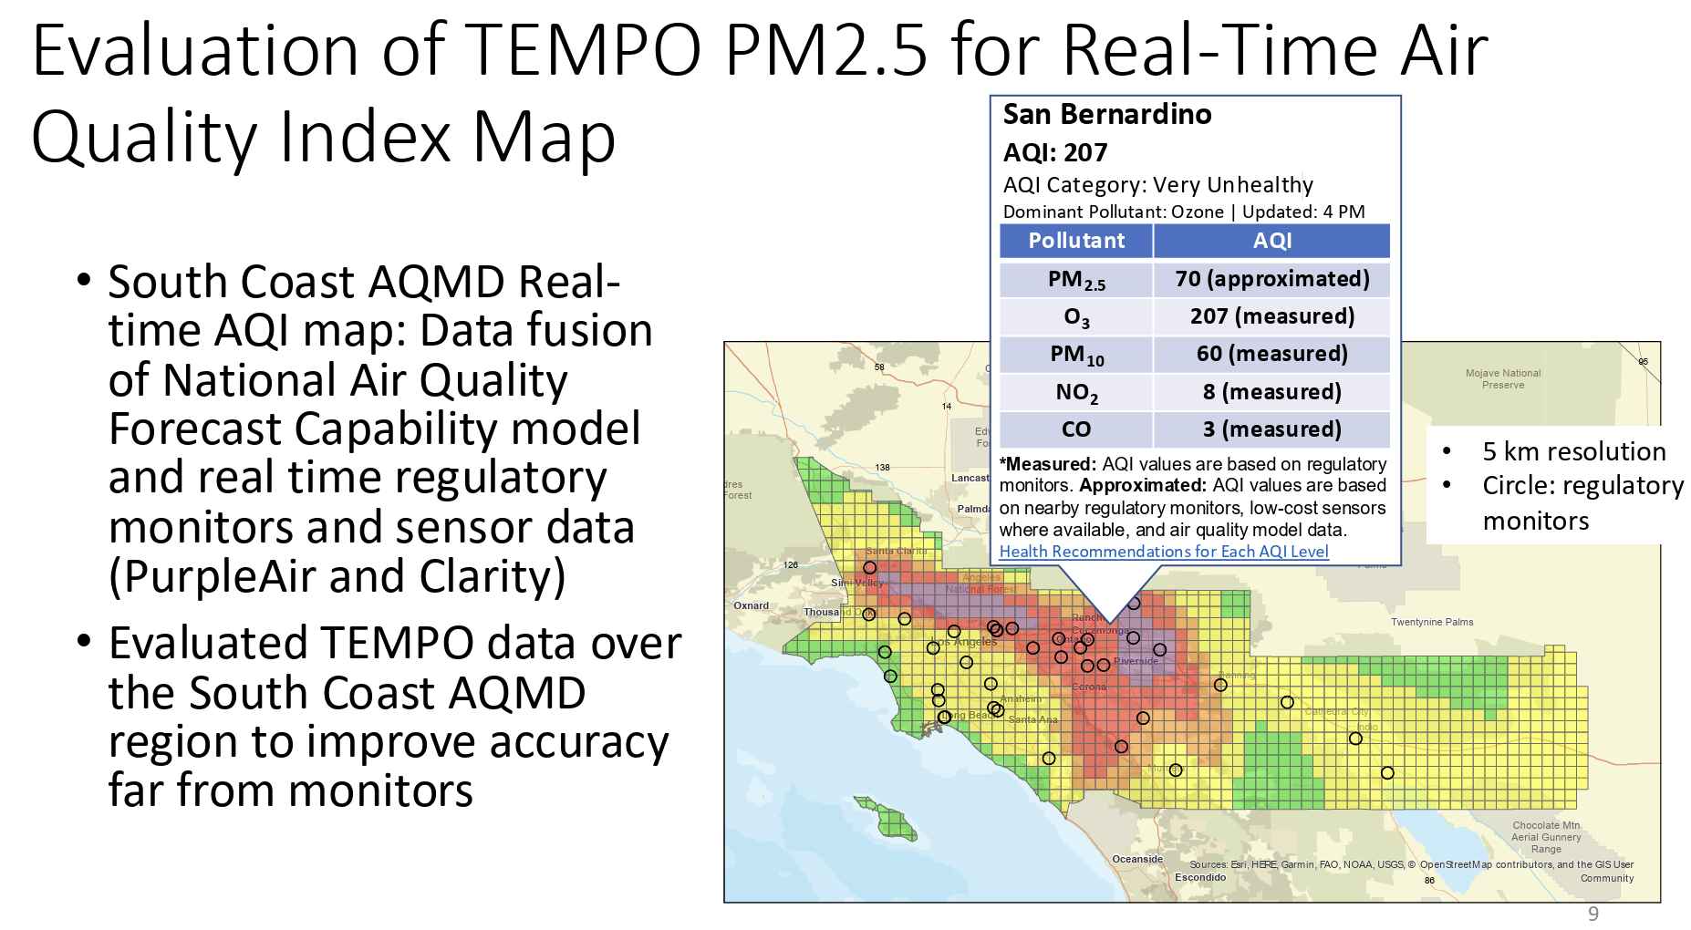
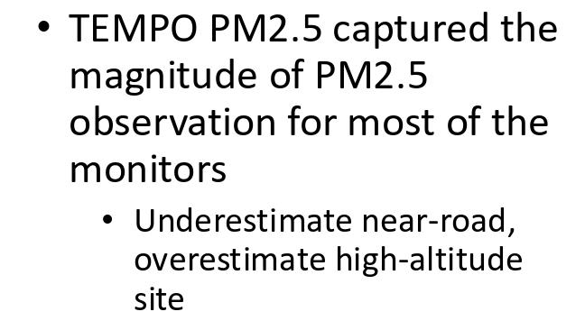
https://haqast.org/wp-content/uploads/sites/91/2026/06/Nico_Schulte_Slides.pdf

Slide 21

https://haqast.org/wp-content/uploads/sites/91/2026/06/Xiangyu_Jiang_Slides.pdf

Slide 22

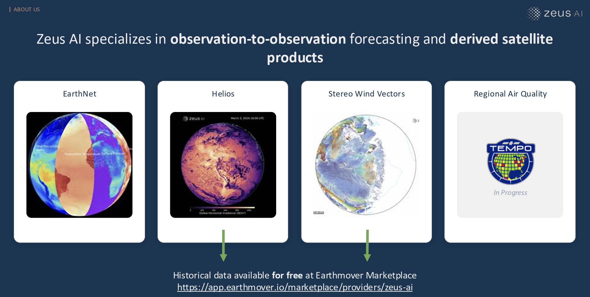

haqast.org/wp-content/uploads/sites/91/2026/06/Elise_Penn_Slides.pdf

Slide 23

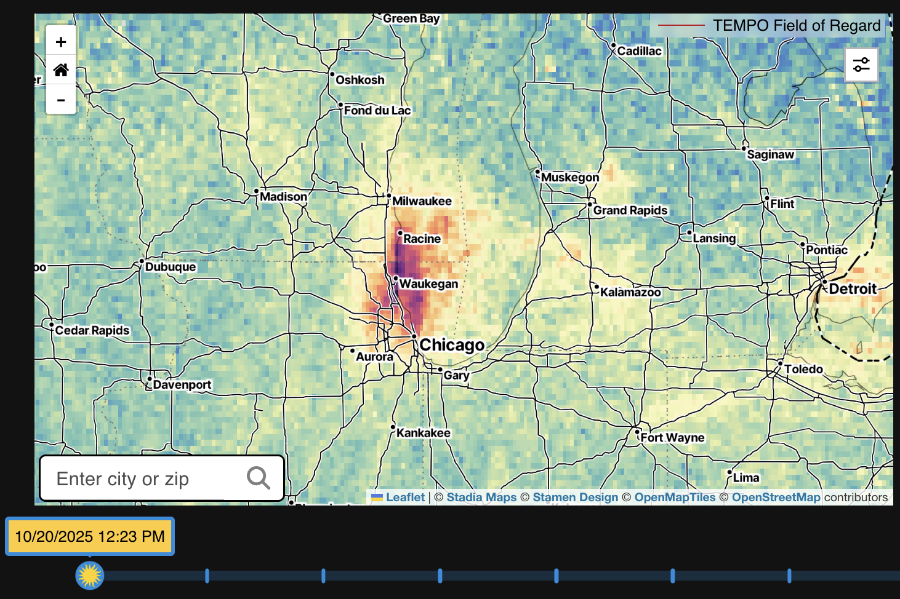
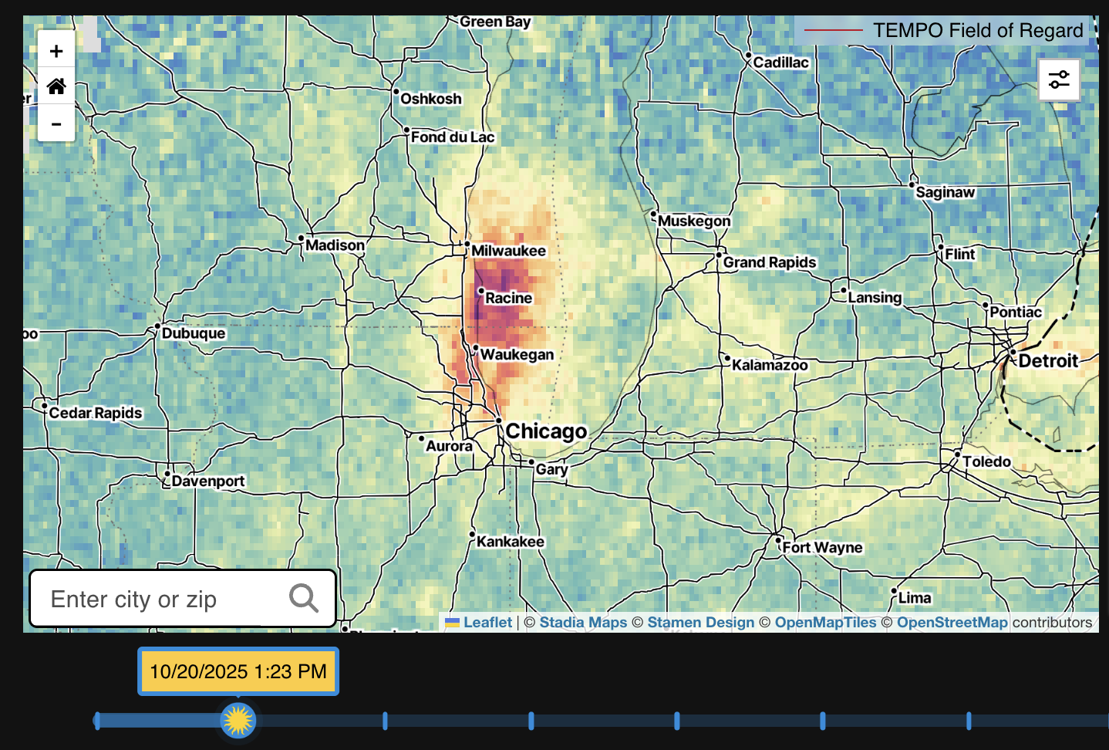
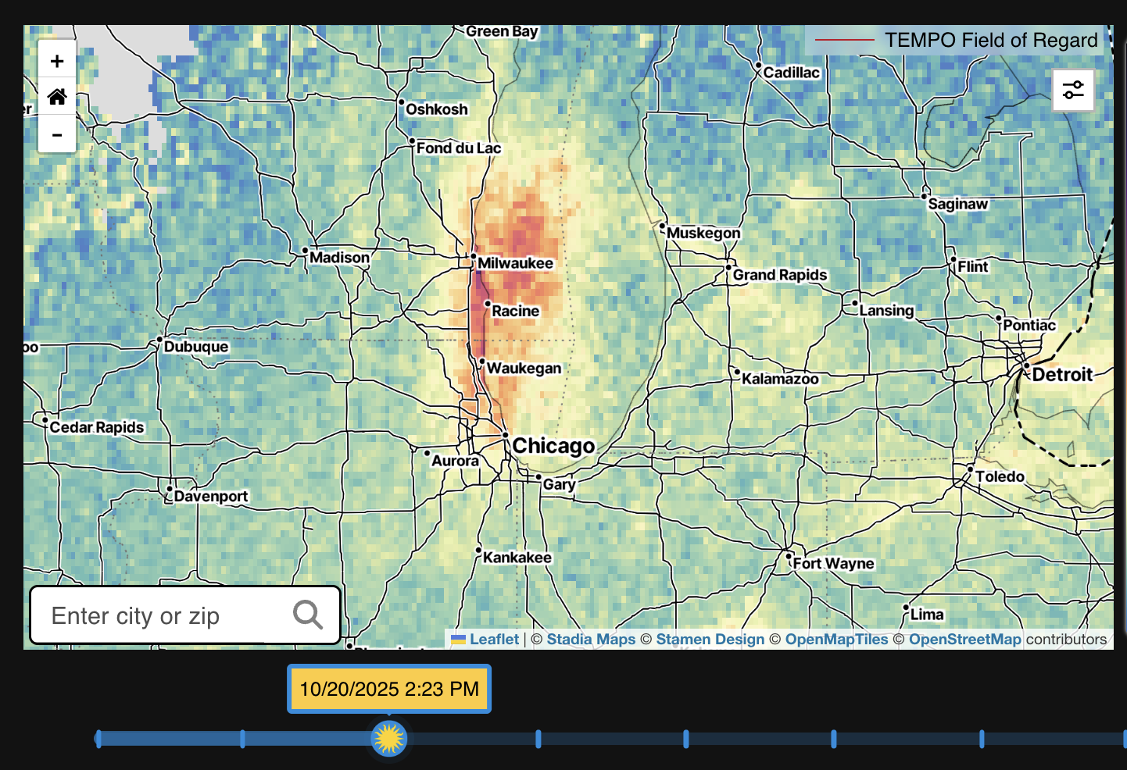
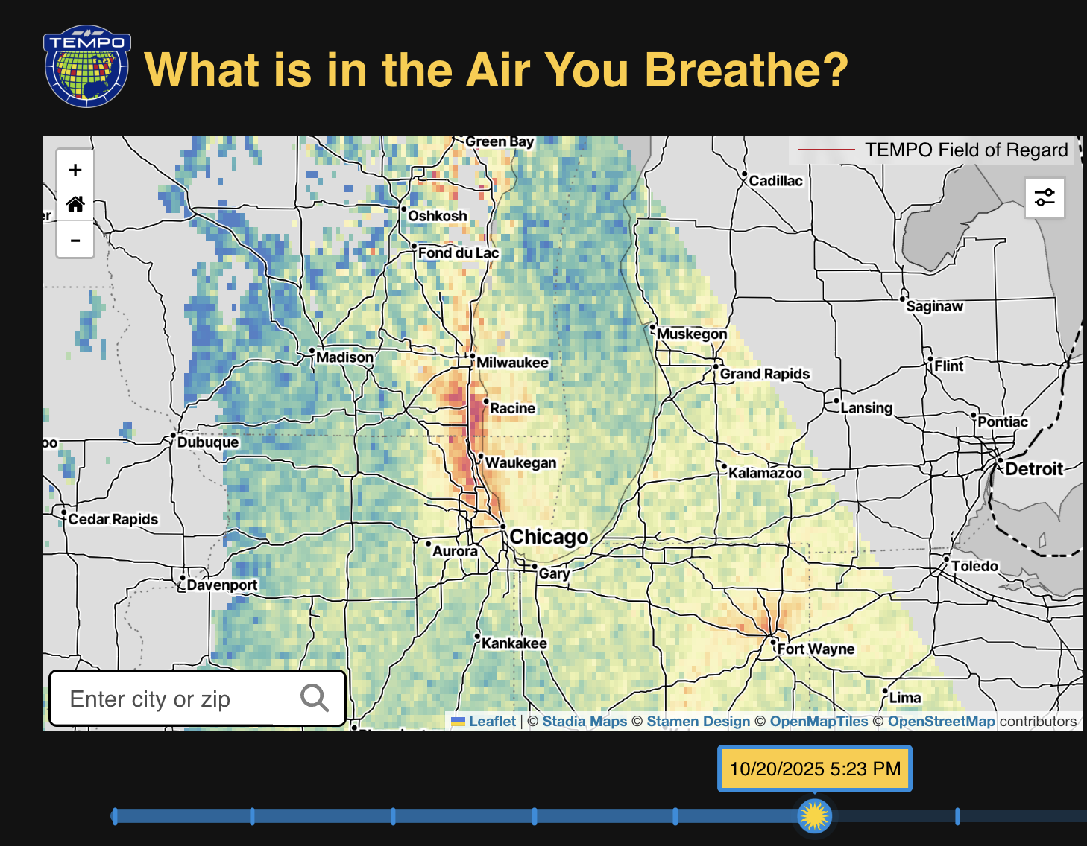
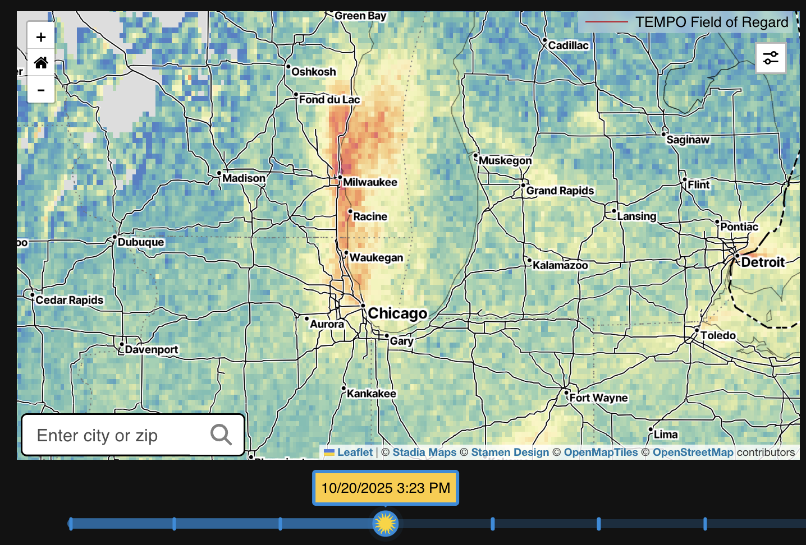
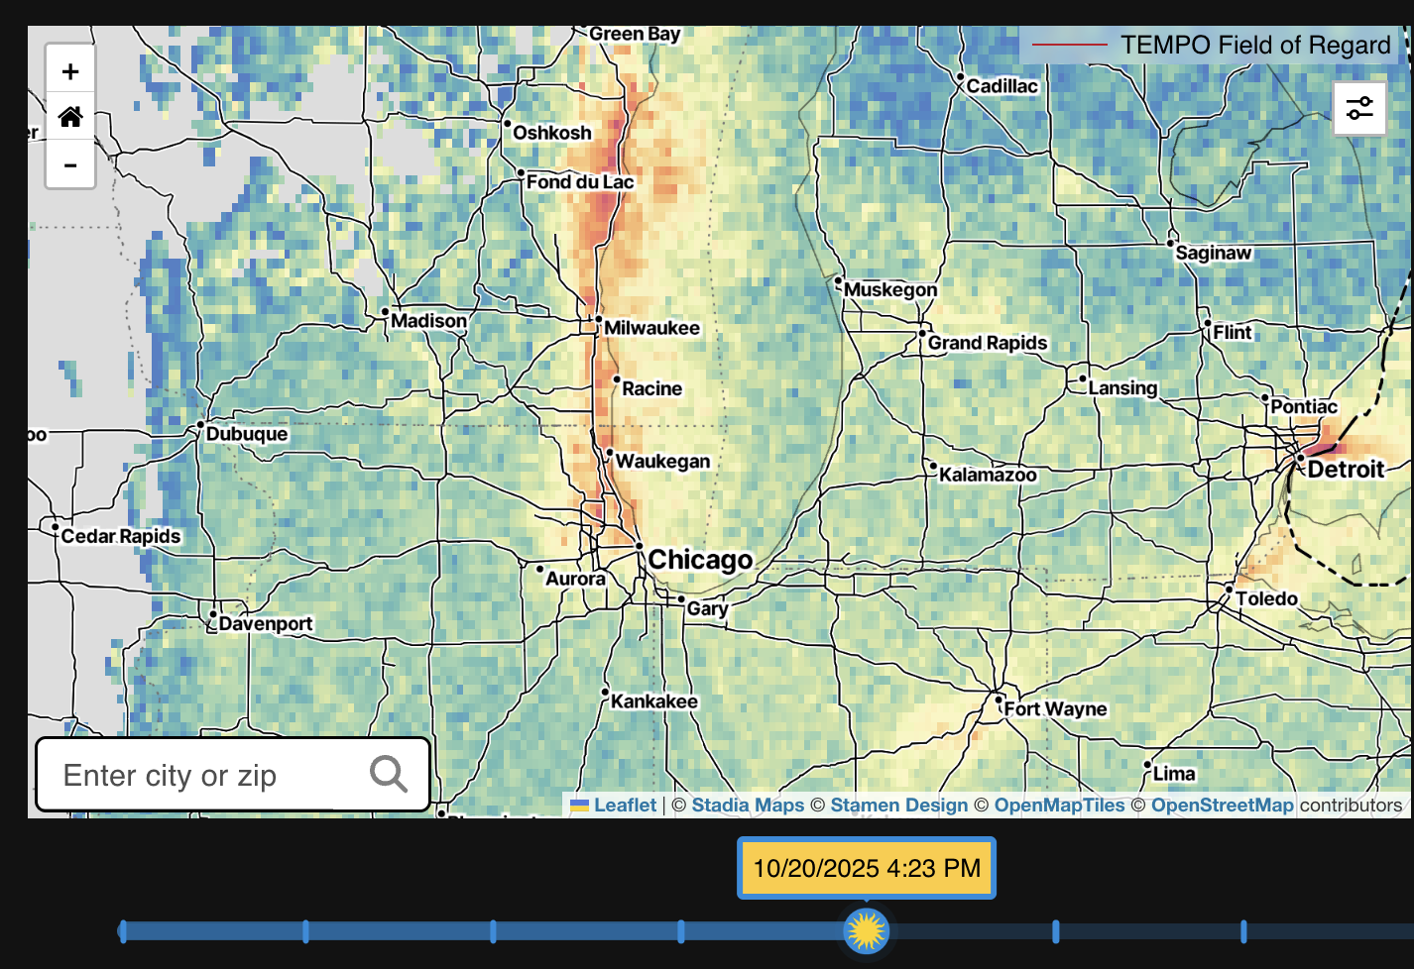
NO₂ 10/20/25: 11:30 am to 6:30 pm
https://tempo.si.edu/data_for_public.html

Slide 24

Opportunities to Engage!
HAQAST website
  haqast.org
HAQAST Tiger Teams
HAQAST Atlanta – January 7-8, 2027
Newsletter
  https://explore.wisc.edu/haqastlanding
LinkedIn
  https://www.linkedin.com/company/nasa-health-and-air-quality-applied-sciences-team

