Slide 1
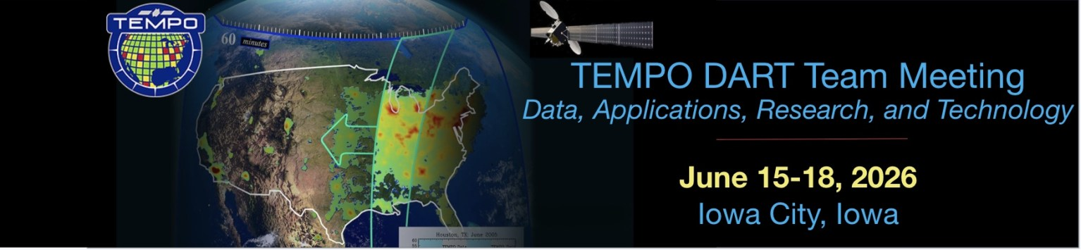
http://tempo.si.edu/
Building a Community of Practice for the TEMPO Mission
Aaron Naeger
SPoRT & TEMPO Teams
NASA Marshall Space Flight Center, Huntsville, AL

Slide 2
Overview TEMPO Early Adopters Program

Slide 3
TEMPO Early Adopters to Community of Practice
Objective 1
Engage a broad spectrum of stakeholders & end users to characterize needs and expand use of TEMPO data
Objective 2
Use current sensors & proxy data to demonstrate capabilities and prepare applications of TEMPO
Objective 3
Align the TEMPO observing time, products, & data interfaces to user needs and applications
Prepare users for operational TEMPO data
NGOs
TEMPO Launch
Other
Early successes from program:
Expanded level of knowledge of TEMPO data & breadth of TEMPO applications
Tailored TEMPO data files & tools to early adopter needs
Promoted needs of TEMPO near real-time products into data pipeline
Enhance and accelerate applications of TEMPO data
Academia
Maximize the value of TEMPO data for societal benefit
NASA/NOAA
Local/State/Regional Agencies
Extend TEMPO mission lifetime
3
3
Notes:
Animation showing one day in the life of TEMPO as it scans east to west across the TEMPO FoR, showing large tropospheric NO2 columns from urban areas like Chicago and Los Angeles, NO2 plumes related to wildfires in the western U.S. especially in California, and notable NO2 columns over the Permian Basin.

Slide 4
TEMPO Early Adopters & Core Applications
Early Adopters provided key input on core applications during the pre-launch mission phase
Multi-Pollutant Data Assimilation
Early Adopter Program has grown from ~40 members in 2018 to ~640 members in 2026
Growth across all core application areas especially in the air quality and health applications
~ 110 members from from local, state, and regional agencies
  Growing Community of Practice (~ 50 currently) among these agencies with air quality management focus
Growth of Community of Practice members in private sector (e.g., Google, Ramboll, Sonoma Tech)
Operational Water Vapor Assimilation
Forecast Support & Evaluation
Forecasting Weather Disasters
Weather Analysis & Forecasting
Air Quality Modeling & Forecasting
Estimate Anthropogenic Emissions
Harmful Algal Blooms
Vegetation & Ocean Monitoring
Monitoring Pollutant Plumes & Emissions
Monitoring Wildfire Plumes
O₃-Induced Crop Damages
Public Health
Air Quality Management
Short-Term Exposure Assessments
Exceptional Events
Daily UV Exposures
Assessing Long-Term Pollutant Trends
4
4
Notes:
Animation showing one day in the life of TEMPO as it scans east to west across the TEMPO FoR, showing large tropospheric NO2 columns from urban areas like Chicago and Los Angeles, NO2 plumes related to wildfires in the western U.S. especially in California, and notable NO2 columns over the Permian Basin.

Slide 5
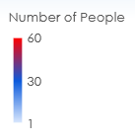
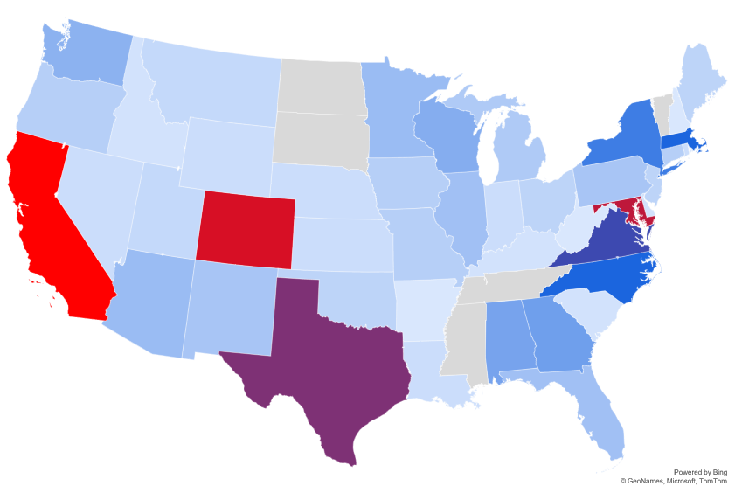
TEMPO Early Adopters from Coast to Coast
Indicates states where state/local air agencies are using TEMPO data and/or attended an in-person ARSET training event
Approximately 570 Early Adopter members across the U.S. with largest participation from CA (70) and CO (55)
Approximately 70 Early Adopters outside of U.S. including 18 from Canada and 13 from Mexico
Active engagement with state and local air agencies across U.S.
5
5
Notes:
Animation showing one day in the life of TEMPO as it scans east to west across the TEMPO FoR, showing large tropospheric NO2 columns from urban areas like Chicago and Los Angeles, NO2 plumes related to wildfires in the western U.S. especially in California, and notable NO2 columns over the Permian Basin.

Slide 6
Recent TEMPO Early Adopter Program Successes

Slide 7
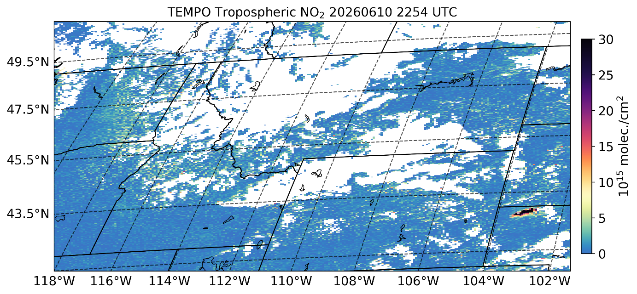
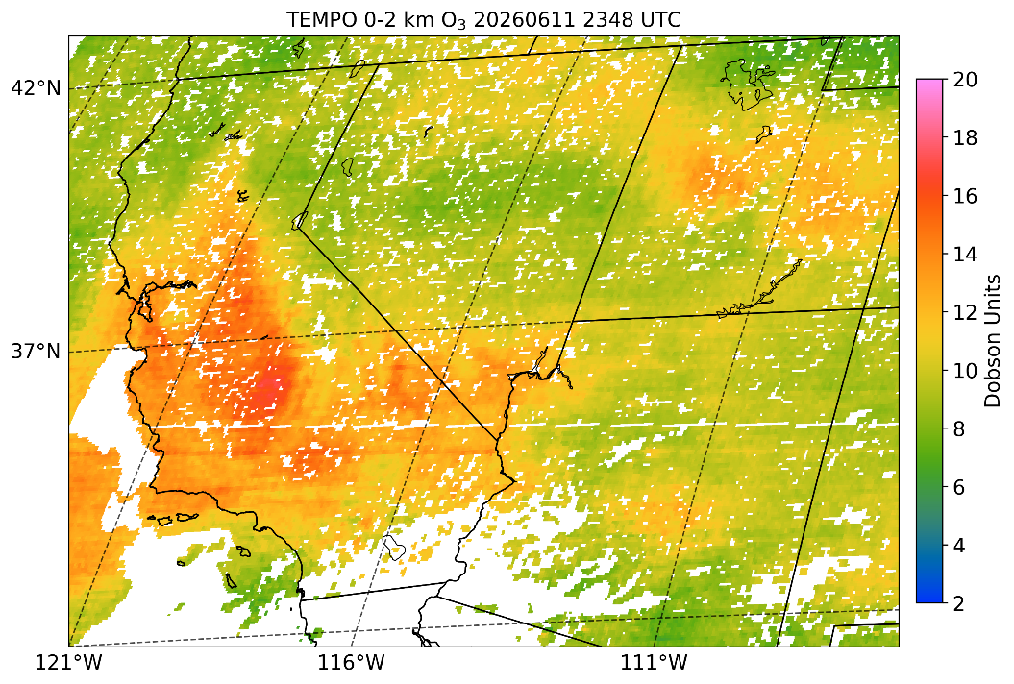
Enhancing SPoRT TEMPO Viewer for Early Adopters
Early Adopters have been analyzing TEMPO data on the SPoRT viewer
Additional domains added to SPoRT viewer per request of Early Adopters
Near real-time (NRT) NO₂ and HCHO along with Ozone Profile products added to SPoRT viewer
TEMPO True Color and composite Red-Green-Blue imagery are available for viewing
SPoRT viewer is being upgraded to an interactive pan-and-zoom viewer with data query capabilities (release date August)
Viewer will be used for providing imagery of developmental and value-added products
7
7
Notes:
Animation showing one day in the life of TEMPO as it scans east to west across the TEMPO FoR, showing large tropospheric NO2 columns from urban areas like Chicago and Los Angeles, NO2 plumes related to wildfires in the western U.S. especially in California, and notable NO2 columns over the Permian Basin.

Slide 8
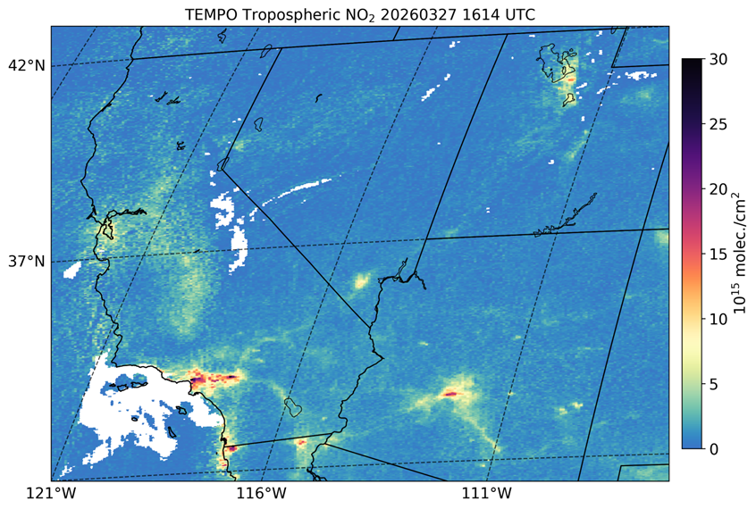
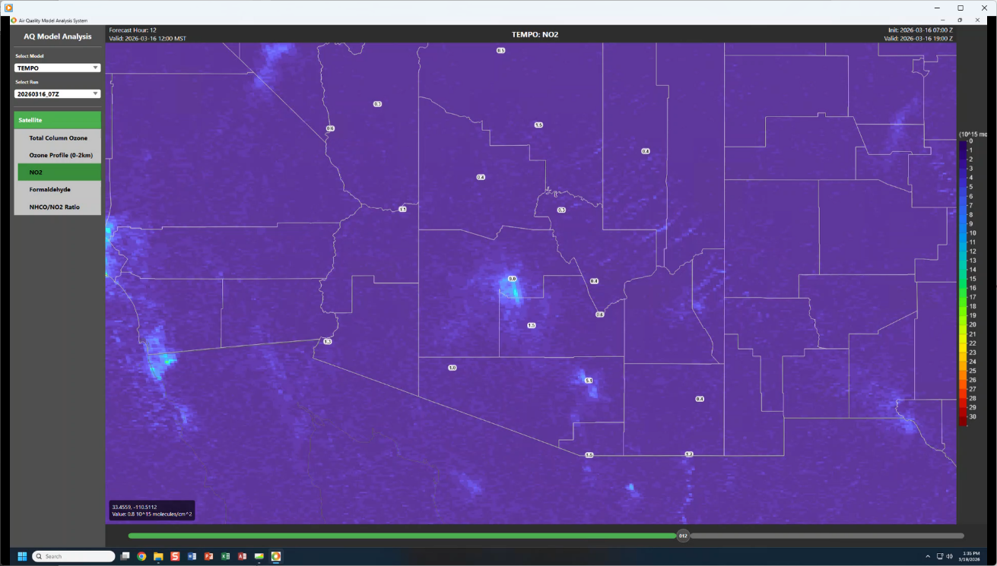
Inclusion of TEMPO NRT Data in Viewers
TEMPO NRT NO₂ in SPoRT Viewer
Arizona DEQ have been engaged with program since pre-launch era of mission
We further engaged with Arizona DEQ regarding the recent TEMPO NRT data
Operational forecasters were especially interested in NRT NO₂ data
Arizona DEQ moved forward with adding TEMPO NRT NO₂ data to their own visualization system
They are now routinely assessing TEMPO NRT data for air quality monitoring and forecasting operations
Expanding engagement to additional air agencies on inclusion of TEMPO data into their operations
“After looking at the TEMPO NO2 data, it was nice to see the higher concentrations move quickly off to the south that day.”
TEMPO NRT NO₂ in Arizona DEQ viewer
8
8
Notes:
Animation showing one day in the life of TEMPO as it scans east to west across the TEMPO FoR, showing large tropospheric NO2 columns from urban areas like Chicago and Los Angeles, NO2 plumes related to wildfires in the western U.S. especially in California, and notable NO2 columns over the Permian Basin.

Slide 9
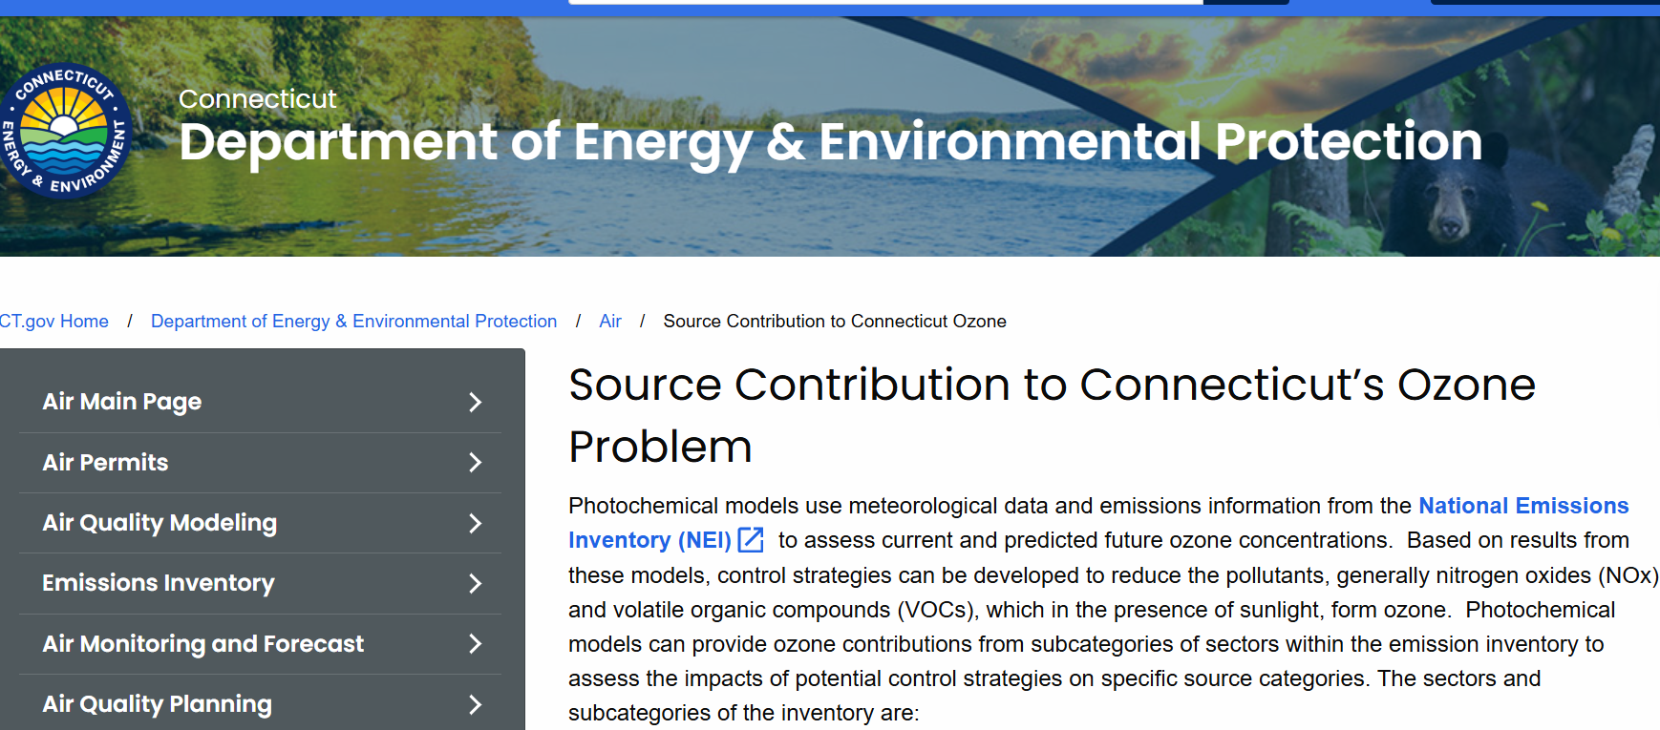
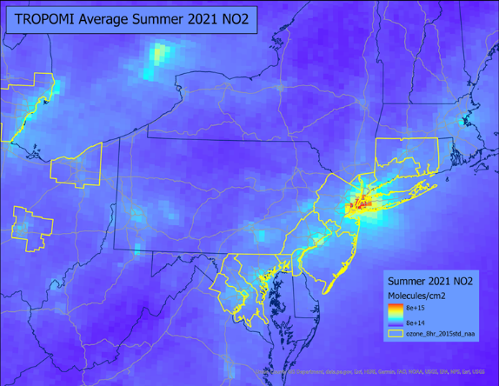
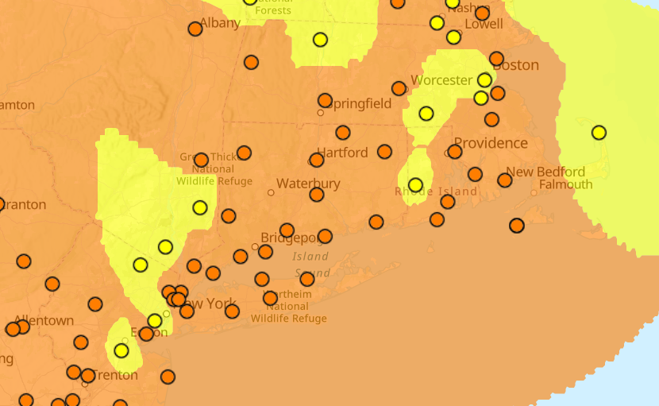
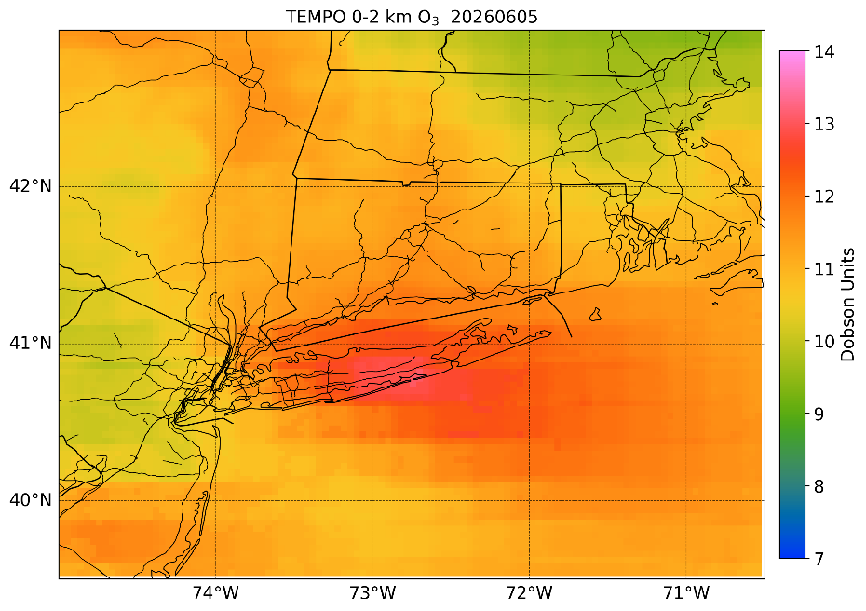
CTDEEP Preparing for Ozone Season
CTDEEP webpage focused on Connecticut’s ozone problem currently includes TROPOMI data
CTDEEP plans to update webpage to showcase the ability of TEMPO to monitor the diurnal evolution of NO₂
They also expressed interest in adding daily TEMPO FNR (HCHO / NO₂ ratio) maps to the webpage
Python scripts to download TEMPO NO₂ and HCHO data from RSIG were developed for generating maps and performing calculations
Continue coordination with CTDEEP on their website updates and TEMPO data including ozone profile product
Ozone monitors
0-2 km O₃ columns
9
June 5, 2026
9
Notes:
Animation showing one day in the life of TEMPO as it scans east to west across the TEMPO FoR, showing large tropospheric NO2 columns from urban areas like Chicago and Los Angeles, NO2 plumes related to wildfires in the western U.S. especially in California, and notable NO2 columns over the Permian Basin.

Slide 10
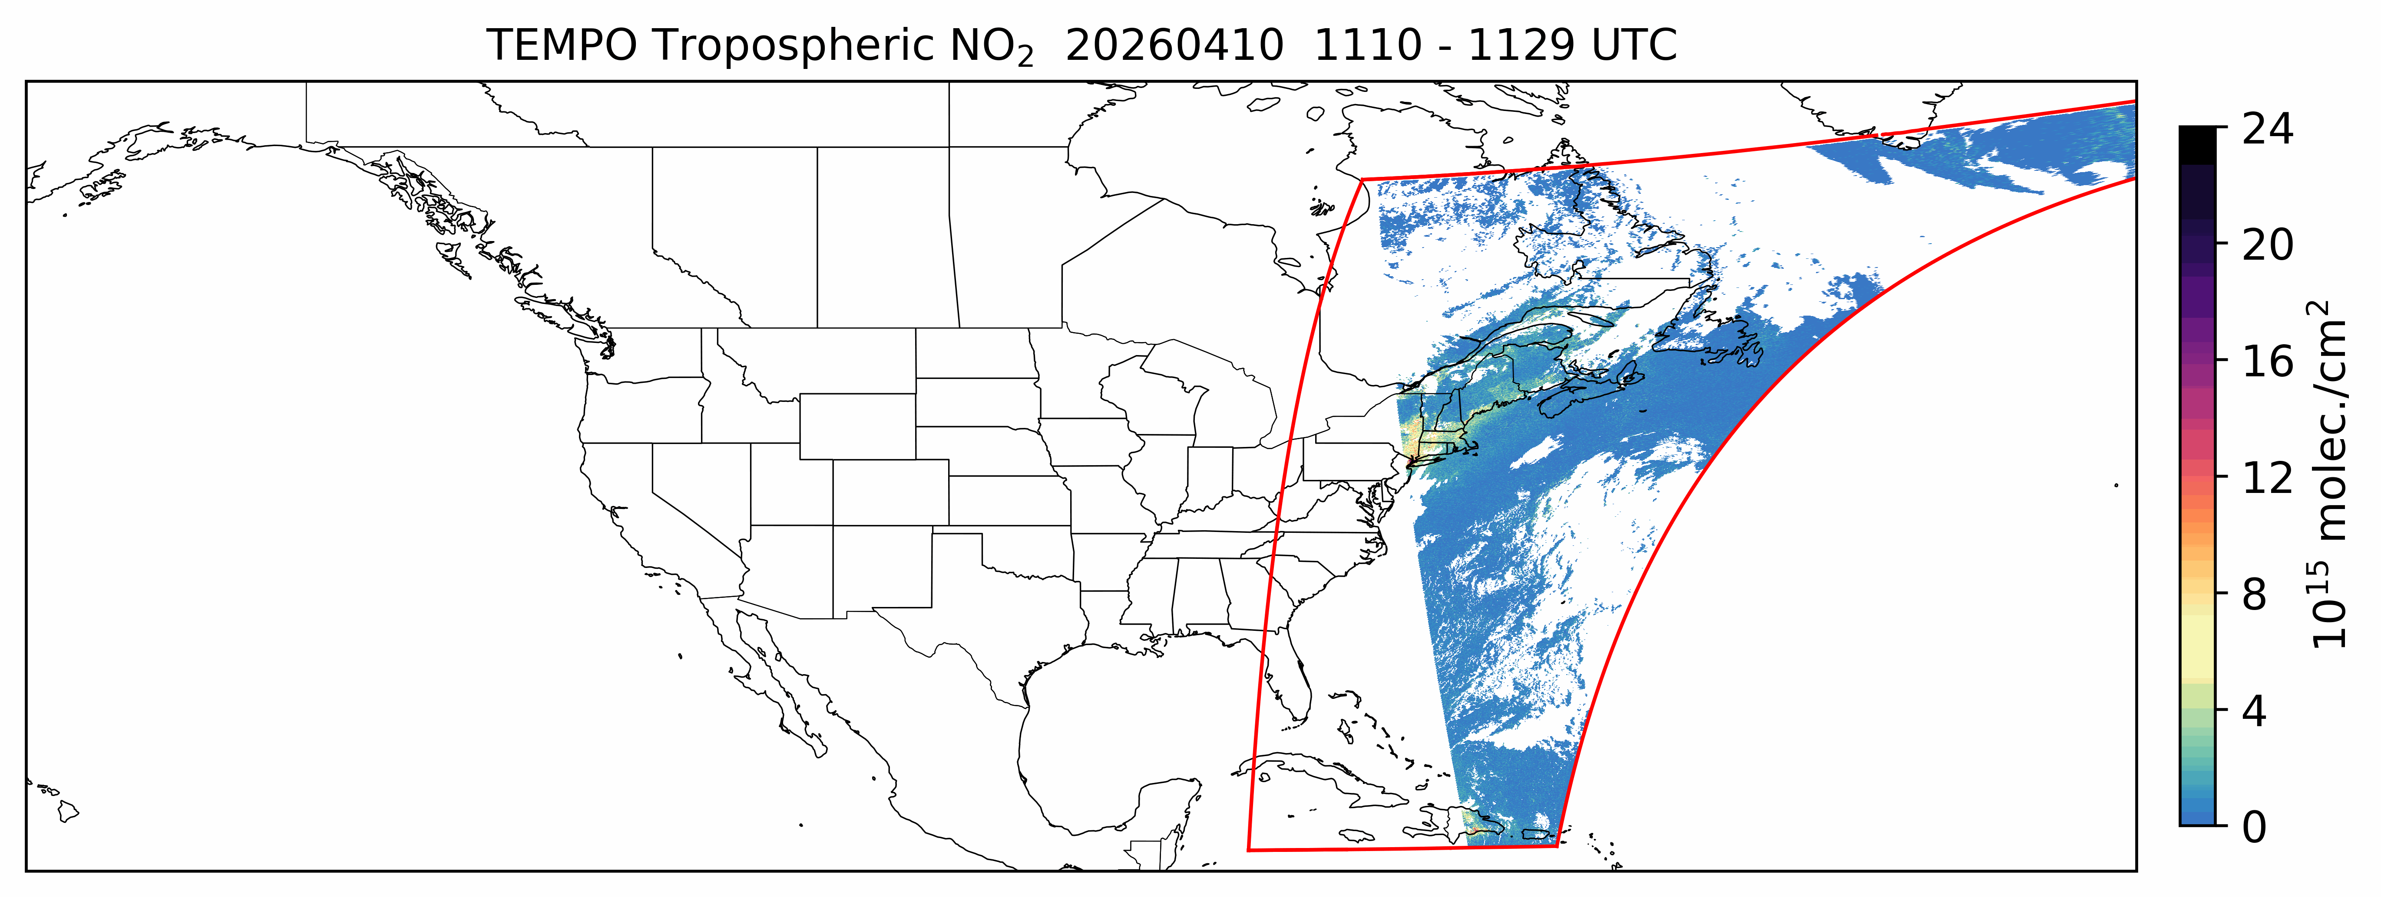
TEMPO Special Operations for Early Adopters
Cloud Fraction < 0.5
SZA < 80°
Special operations consisting of higher frequency scans over slices of the FoR can also be conducted on an infrequent, requested basis
5 minutes scans were conducted for 4-days on April 8, 10, 11, and 12 every other hour throughout the daytime, targeting prescribed burning across Georgia
10
10
Notes:
Animation showing one day in the life of TEMPO as it scans east to west across the TEMPO FoR, showing large tropospheric NO2 columns from urban areas like Chicago and Los Angeles, NO2 plumes related to wildfires in the western U.S. especially in California, and notable NO2 columns over the Permian Basin.

Slide 11
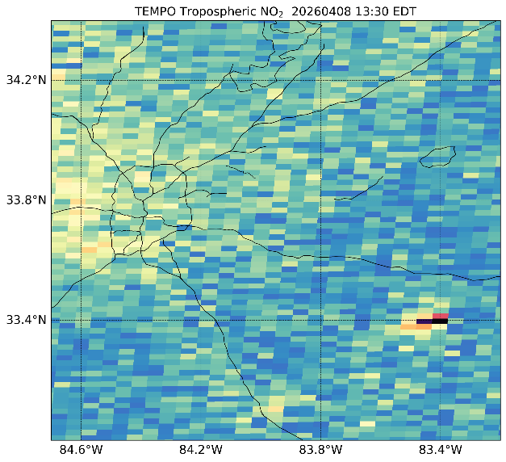
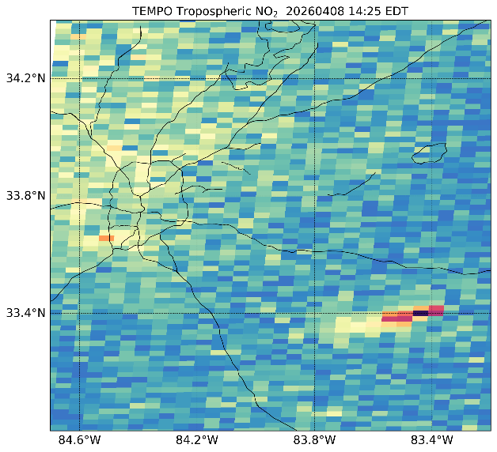
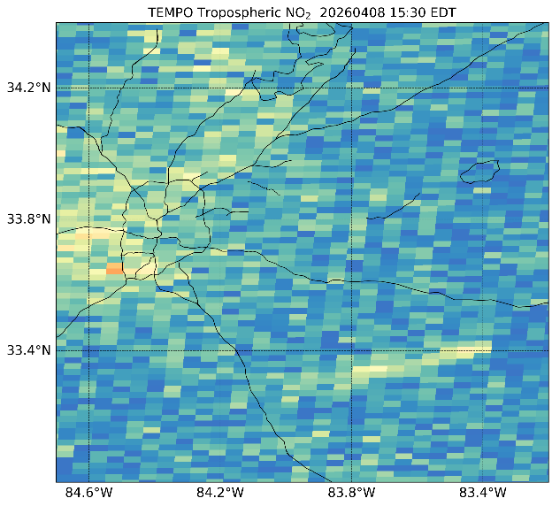
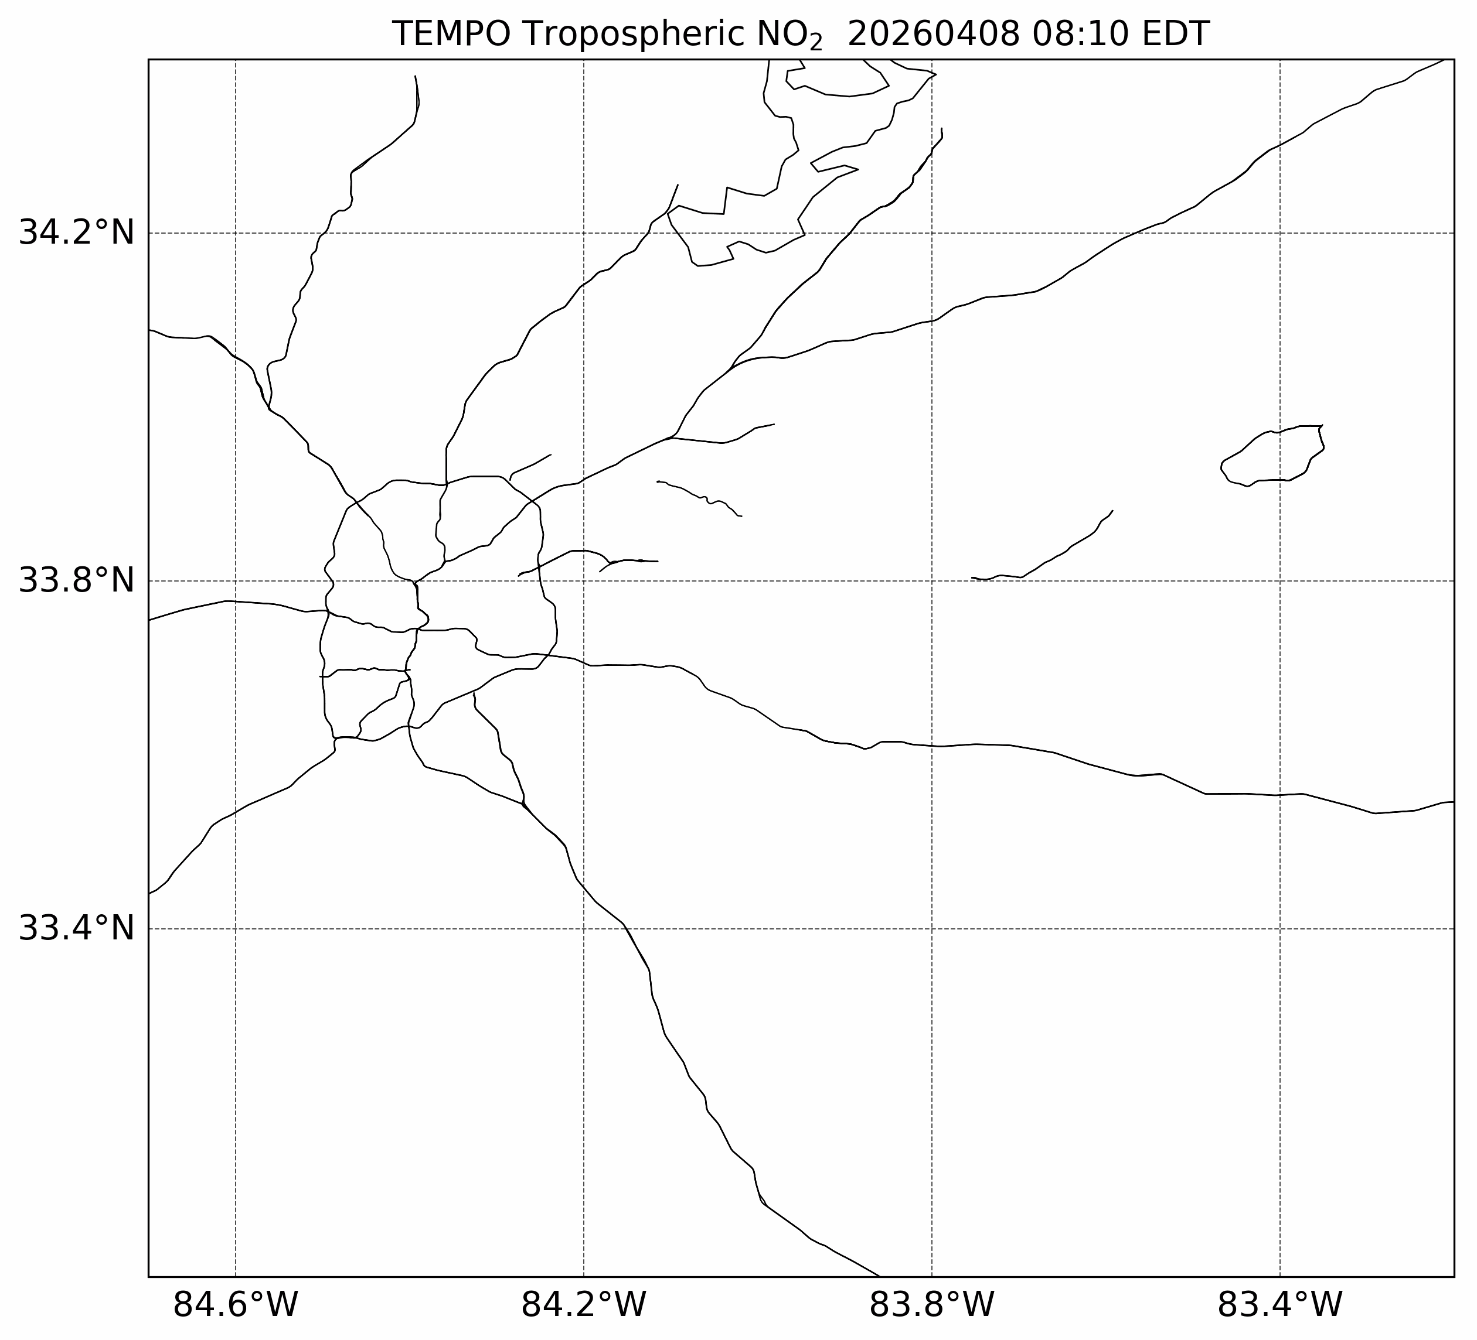
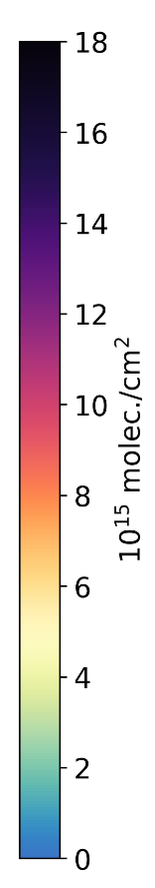
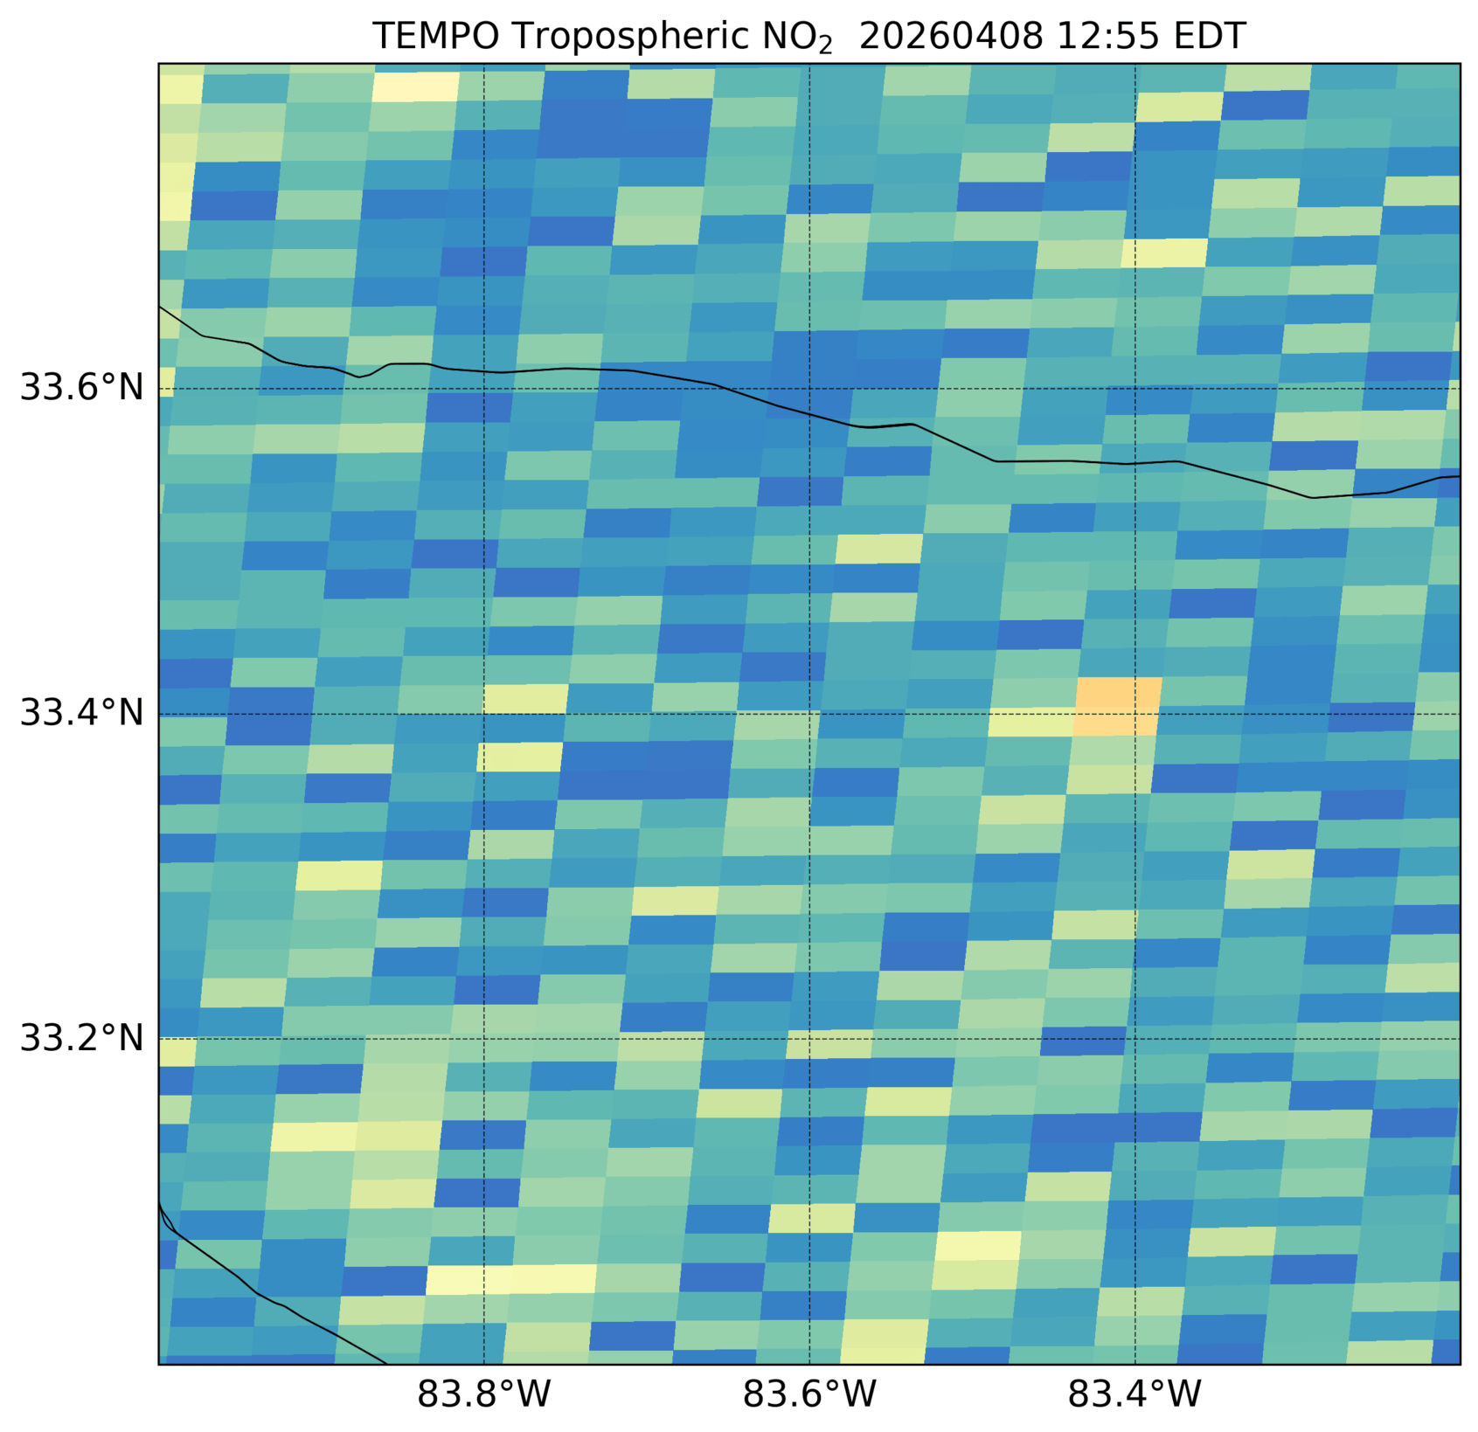

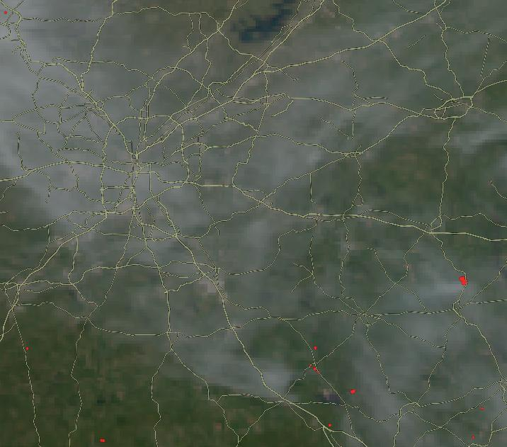
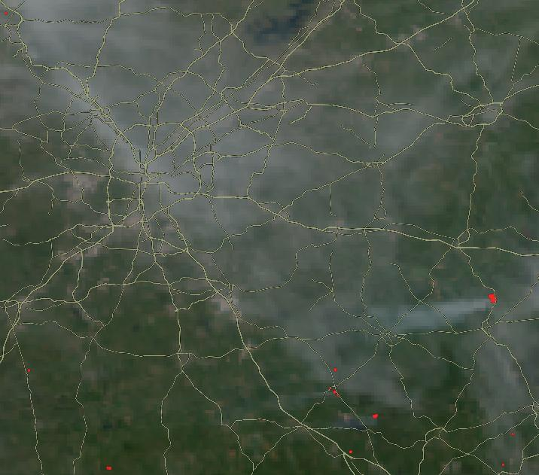
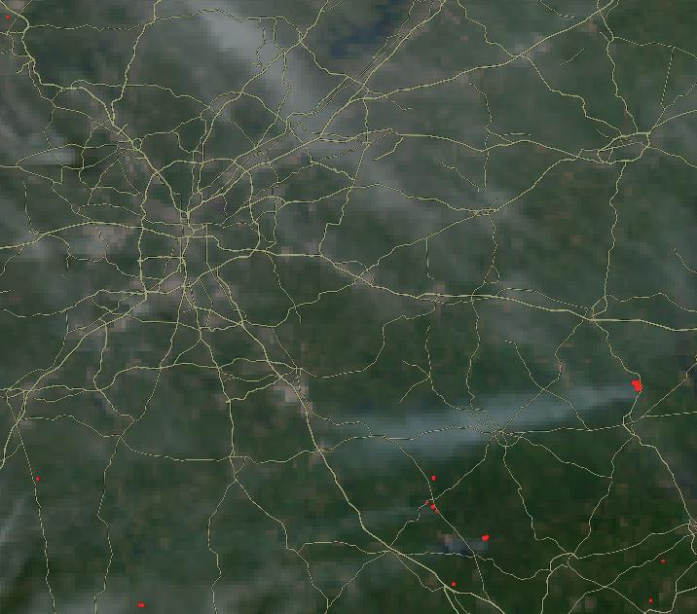
Special Operations – Prescribed Burn Zoom
13:30 EDT
14:25 EDT
15:30 EDT
Cloud Fraction < 0.2
SZA < 80°
Tropospheric NO₂
Tropospheric NO₂
GOES ABI True Color
A standard operation day would have provided 3 scans of the smoke plume from the burn
Special operation scans observed the full life cycle of the smoke plume from the initial NO₂ hot spot to the westward transport of the NO₂ plume over its ~ 2.5-hour lifetime
11
11
Notes:
Animation showing one day in the life of TEMPO as it scans east to west across the TEMPO FoR, showing large tropospheric NO2 columns from urban areas like Chicago and Los Angeles, NO2 plumes related to wildfires in the western U.S. especially in California, and notable NO2 columns over the Permian Basin.

Slide 12
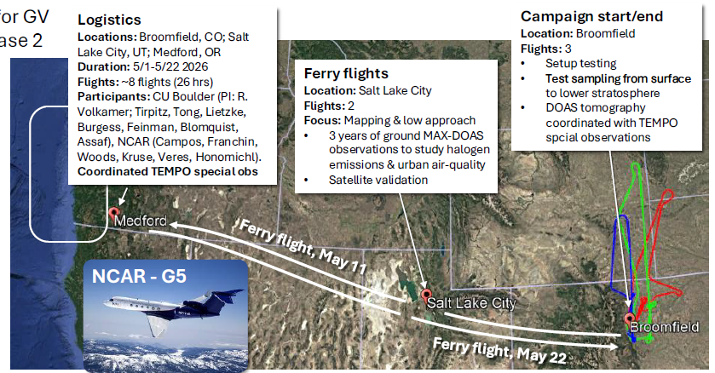
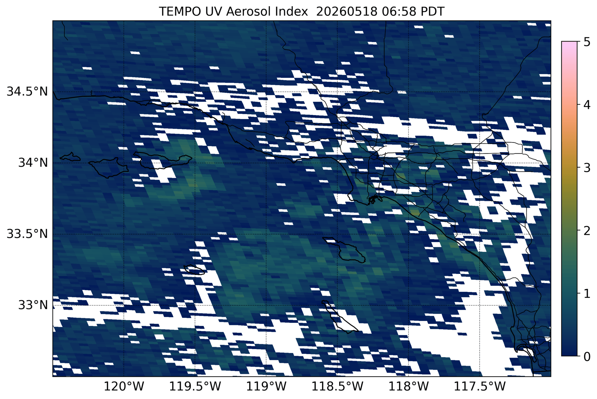
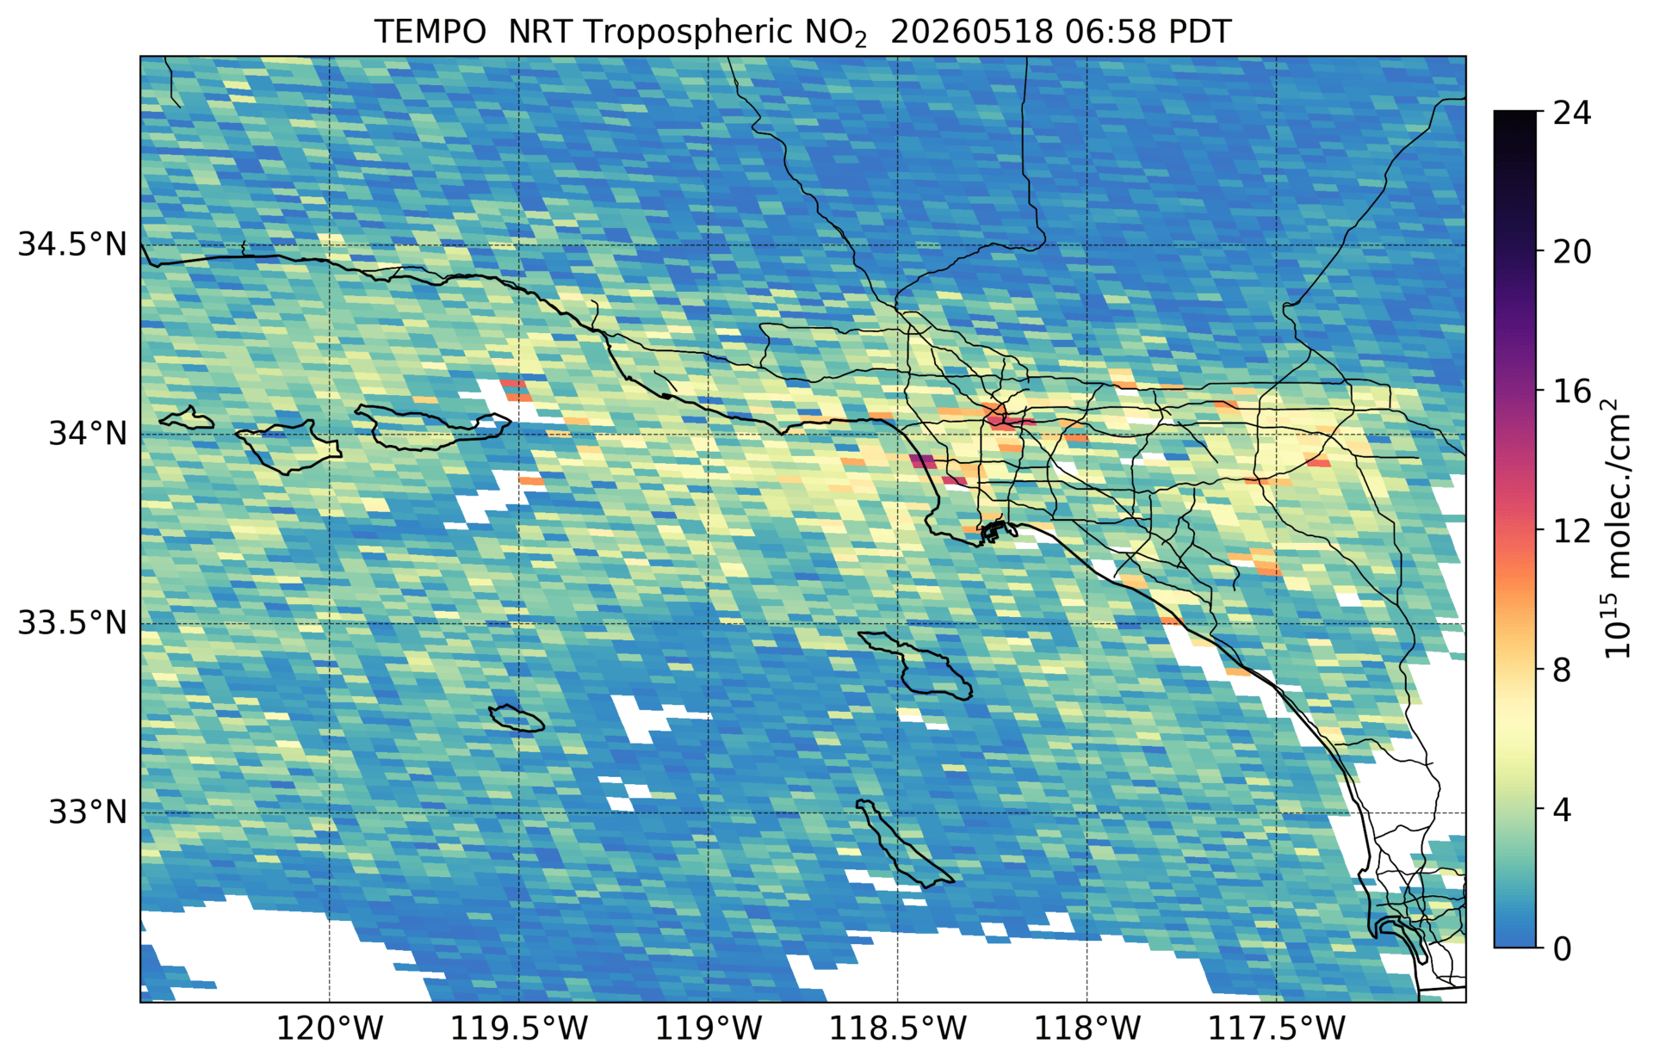
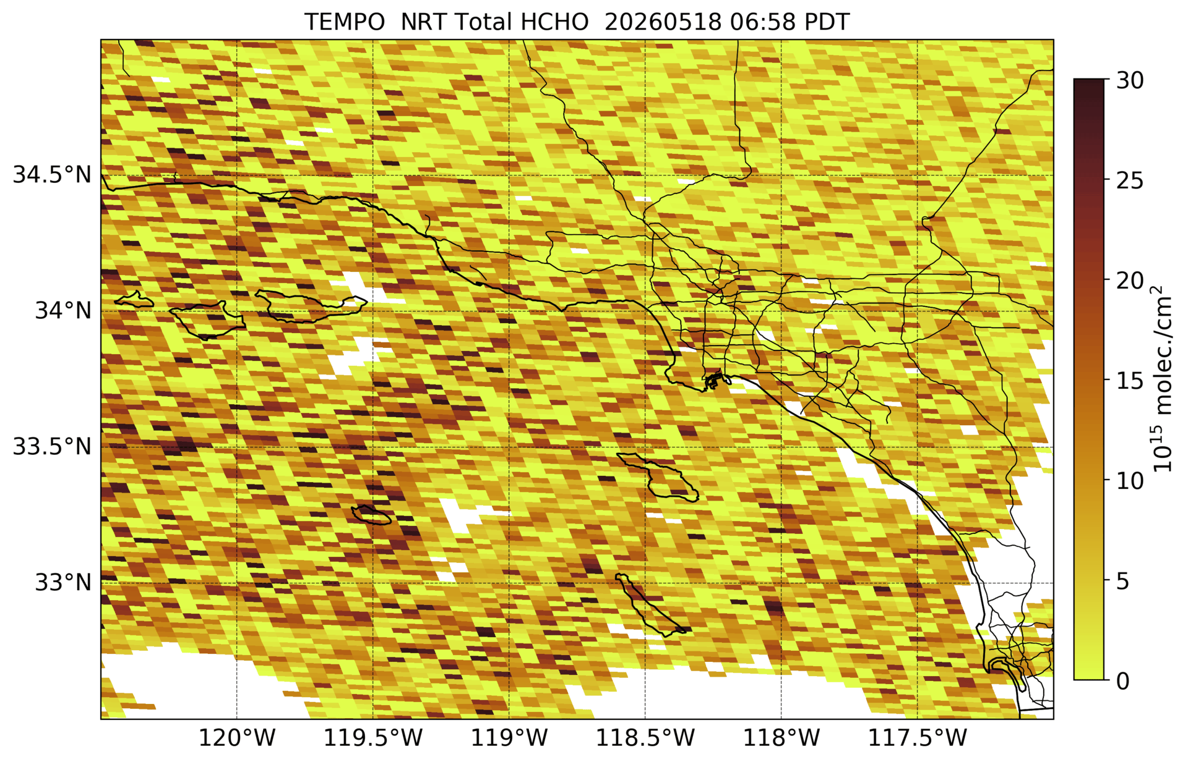
Special Operations To Support Field Campaign
UV Aerosol Index
NCAR-funded TI3GER-2 campaign
Will support validation of TEMPO NO₂ and HCHO
Cloud Fraction < 50%
SZA < 80°
Tropospheric NO₂
Total HCHO
TEMPO special operations conducted on 9 days from May 7-22
On May 18, 2 hours of continuous special observations of 10-min frequency over West U.S.
Santa Rosa and Sandy Fires observed by TEMPO
12
12
Notes:
Animation showing one day in the life of TEMPO as it scans east to west across the TEMPO FoR, showing large tropospheric NO2 columns from urban areas like Chicago and Los Angeles, NO2 plumes related to wildfires in the western U.S. especially in California, and notable NO2 columns over the Permian Basin.

Slide 13
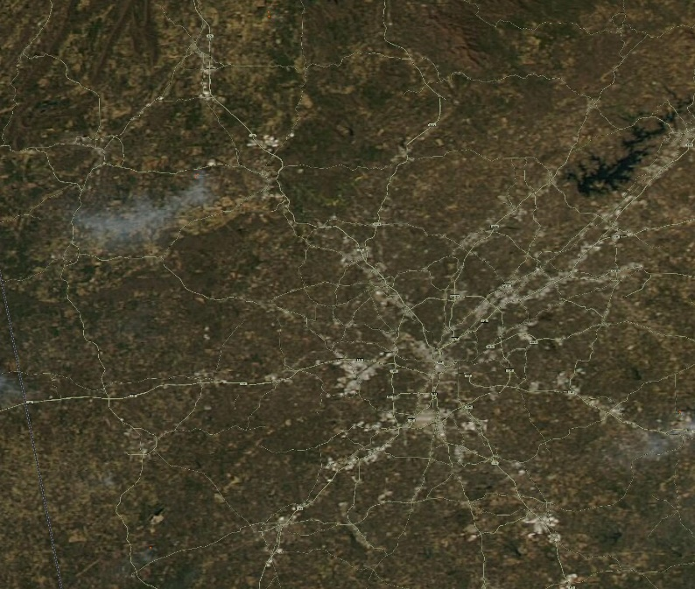
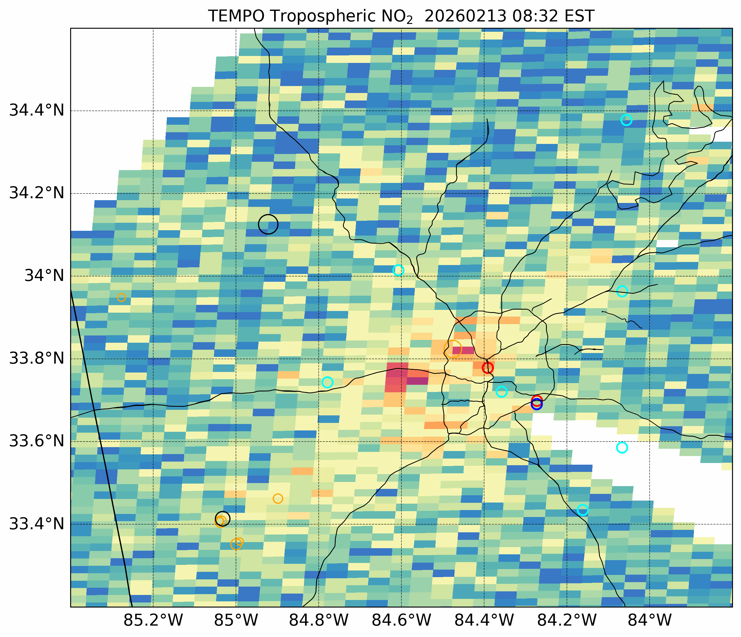
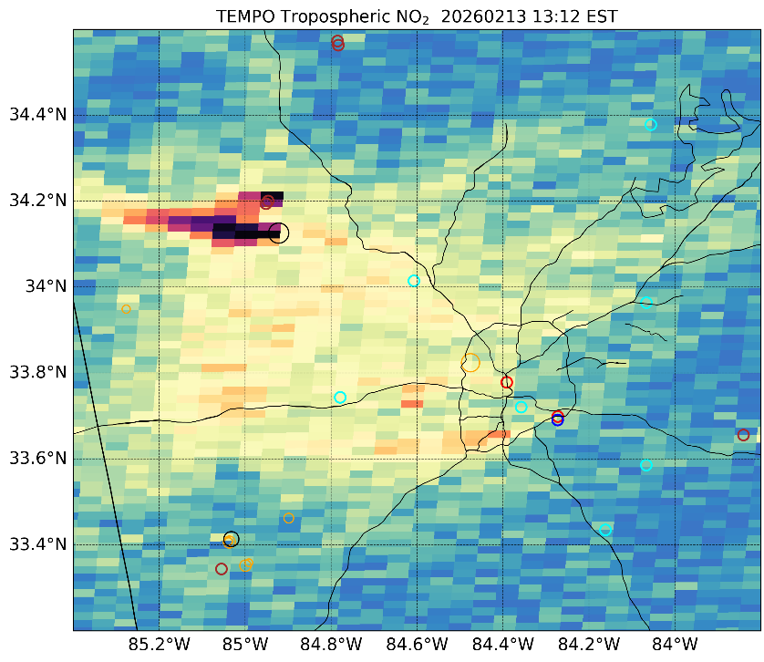

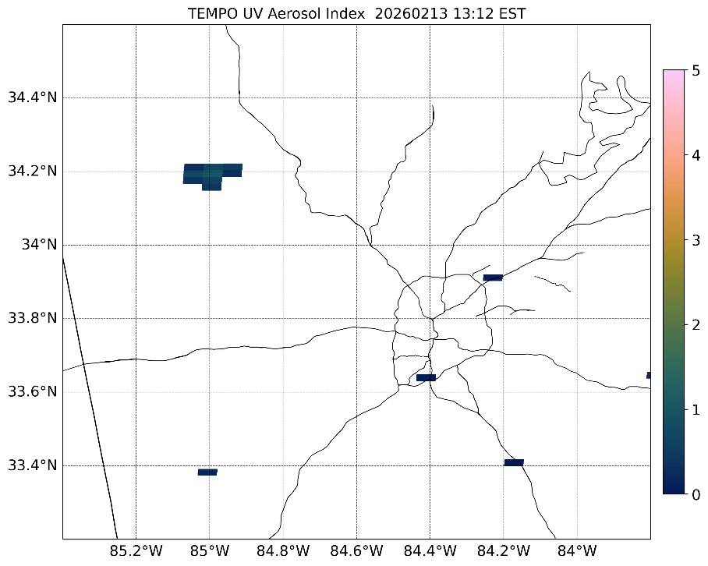
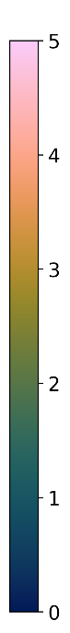
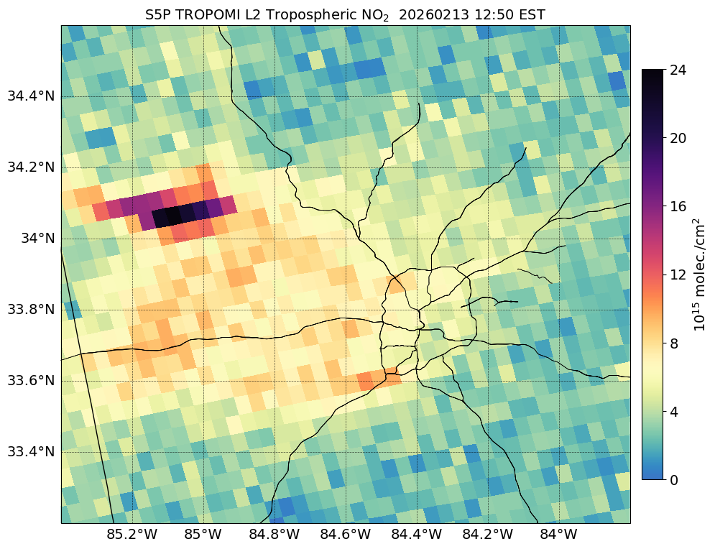
Sharing Use Cases with Early Adopters
NO₂
NO₂ ~1:10 p.m. EST
MODIS Aqua ~2040 UTC
Feb. 13, 2026
UVAI @ ~1:10 p.m. EST
TEMPO observed a NO₂ hot spot from a prescribed burn just north of an elongated NO₂ plume tied to a large power plant in Georgia
UVAI showed positive values associated with the absorbing smoke aerosols from the burn
TROPOMI ~12:50 p.m. EST
13
13

Slide 14
Summary & Upcoming Work
TEMPO Early Adopters Program continues to engage stakeholders with goal of transitioning community from Community of Potential to Community of Practice
  Leverage projects and stakeholder engagement in NASA HAQ and HAQAST programs to accelerate transition to Community of Practice
  Expand engagement with TEMPO twilight product
  Planning upcoming TEMPO Early Adopters meeting this fall 2026
Coordination with SNWG (Satellite Needs Working Group) to enhance stakeholder engagement with TEMPO near real-time and future enhanced products
Continue inclusion of dedicated TEMPO trainings in NASA ARSET Program
  In-person training at upcoming 2026 National Air Quality Conference
Continue coordination with stakeholders and researchers on unique opportunities for TEMPO special operations
  Planning upcoming special operations in June and July focused on World Cup cities in coordination with CDC stakeholders and lightning NOx with TEMPO science team
Note: Recommended effective cloud fraction filter for quantitative analysis is > 0.1
aaron.naeger@nasa.gov

Slide 15
Backup Slides

Slide 16
Recent Early Adopter Program Accomplishments
  Accelerated the assimilation of TEMPO data in the JEDI system with the GEOS-CF model
  Supported ingestion of TEMPO data in Google Earth Engine
  Successful coordination of TEMPO special operations for a myriad of events including field campaigns, prescribed burns, lightning NOx, and ozone exceedance days
  Facilitated and enhanced ARSET trainings on TEMPO data
  Early development of TEMPO processing codes which accelerated use of TEMPO data at state and local air agencies
  Involvement of researchers and stakeholders from Early Adopters Program in current NASA Earth Action Programs (NASA Health and Air Quality and HAQAST Programs)
  Built a portfolio of use cases for demonstrating TEMPO data capabilities and applications
16
16

