Slide 1
Update from the NASA Health and Air Quality Program and MIO
June 17, 2026
John Haynes, MS
jhaynes@nasa.gov
Program Manager, Health and Air Quality Applications
Program Manager, Multisource Integrated Observatory
Earth Action/Earth Science Division
NASA Headquarters
Washington, DC

Slide 2
Earth Action Strategy
  Drive U.S. economic growth: Help U.S. businesses, from farms to the space economy, use Earth data to compete and innovate
  Equip leaders to act: Deliver trusted data and tools to local, state, and federal partners to increase resilience, security, and prosperity
  Accelerate AI for Earth: Apply AI to widen access to Earth data and speed insight
  Strengthen American resilience to hazards: Target fire, flood, drought, heat, and health threats
  Scale what works: Support efficient solutions that work across regions and missions
  Stay adaptive: Build programs that adjust as budgets, risks, and national priorities evolve
Earth Action

Slide 3
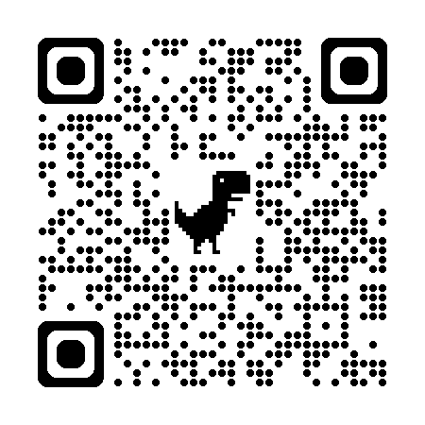













Agriculture
Disasters
Earth Information Center
EarthRISE
Ecological
Conservation
Interagency Satellite Observation Needs
ACTION
Energy & Infrastructure
Health & Air Quality
Private Sector Engagement
Water Resources
Wildland Fires
Commercial Satellite Data Acquisition

Slide 4

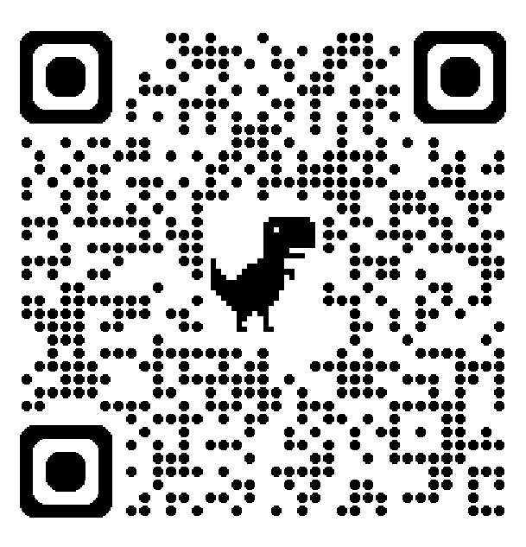
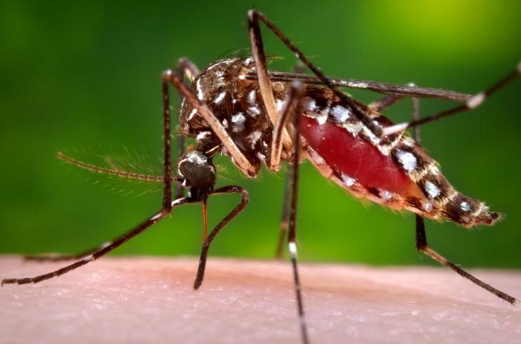
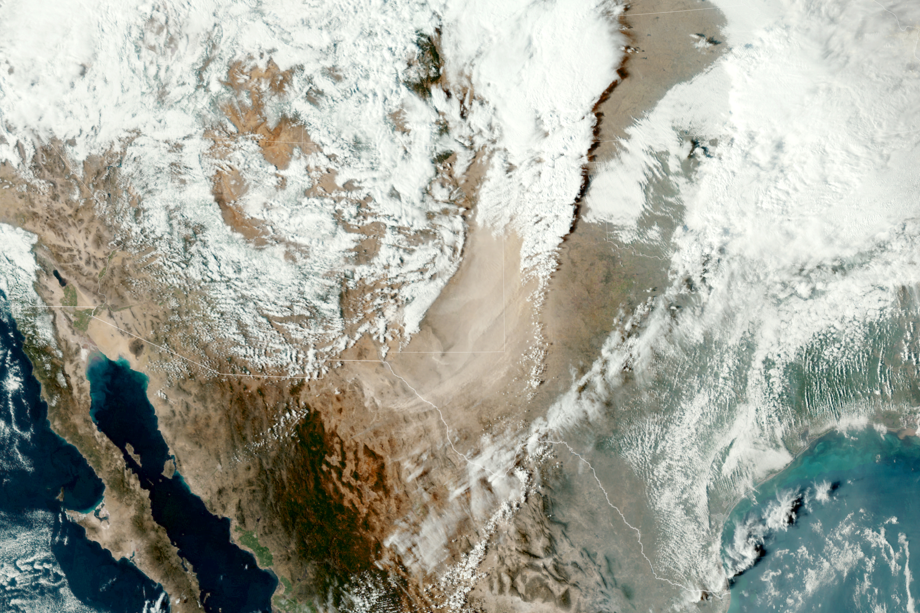
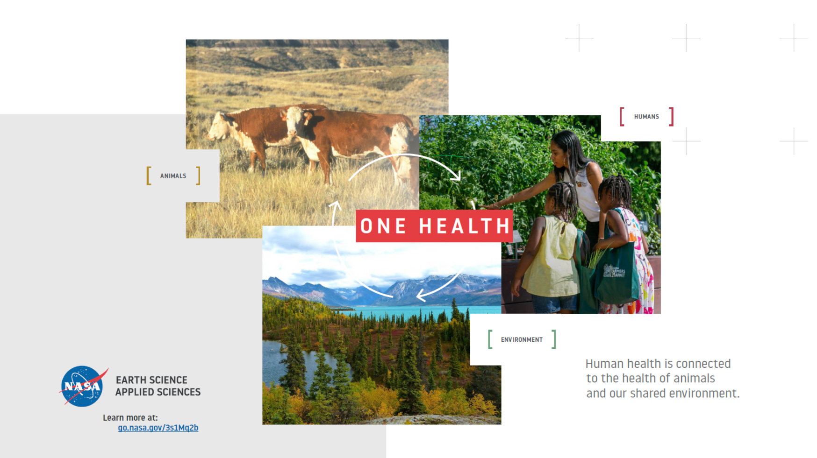
NASA Health and Air Quality Applications
We support the use of Earth observation data in air quality management and public health applications to protect and enhance health, security, and the economy in the areas of:
  Infectious diseases and environmental health
  Toxic and pathogenic exposures and health-related hazards
  Implementation of air quality standards, policies, and regulations
  Effects of climate change on public health and air quality
Aedes aegypti
Dust plume over TX/NM
Major Partners include International (e.g., GEO, UNICEF), Federal (e.g., CDC, EPA, NIH, NOAA), State (e.g., South Dakota, California, Texas), and Private sectors (e.g., Google, Moore Foundation).

Slide 5


NASA Health and Air Quality Applied Sciences Team (HAQAST)
4th Generation (2025-2029).
14 Members/PIs selected in June 2025 in response to ROSES 2024 HAQAST.
Team Lead -- Tracey Holloway (U. of Wisconsin).
Public meetings held semi-annually. Last meeting was in May 2026 in Madison, WI.
Core projects to be executed by each PI.
A unique feature of HAQAST is Tiger Teams (TTs). TTs are short-term, high-impact collaborative efforts between HAQAST members and public stakeholders to identify and solve critical problems using NASA data and products. Details of current and past TTs can be found here: https://haqast.org/tiger-teams/. Eight new TTs were announced in May 2026 (the most ever)!
Next meeting is November 7-8, 2027, in Atlanta, GA (hybrid).
https://haqast.org/

Slide 6
New HAQAST TT Projects Significantly Leveraging TEMPO
Lead, Jennifer Kaiser (GA Tech): Establishing Best Practices for TEMPO Formaldehyde Observations in Regulatory Applications: Demonstrations in Chicago, St. Louis, and New York
Lead, Carl Malings (Morgan State U.): HAQAST Support for AIR4US Implementation (A multi-agency effort to support air quality information data management and services by advancing the value, completeness, transparency, and accessibility of air quality information needed for decision-making at the local, state, and regional scale).
Lead, Aaron Naeger (NASA MSFC): Analysis of TEMPO Ozone Profile Data for Monitoring Ozone Exceedances
Lead, Talat Odman (GA Tech): Distinguishing Prescribed Fire versus Wildfire in the Contiguous US for Fire Management and Health and Air Quality Organizations

Slide 7

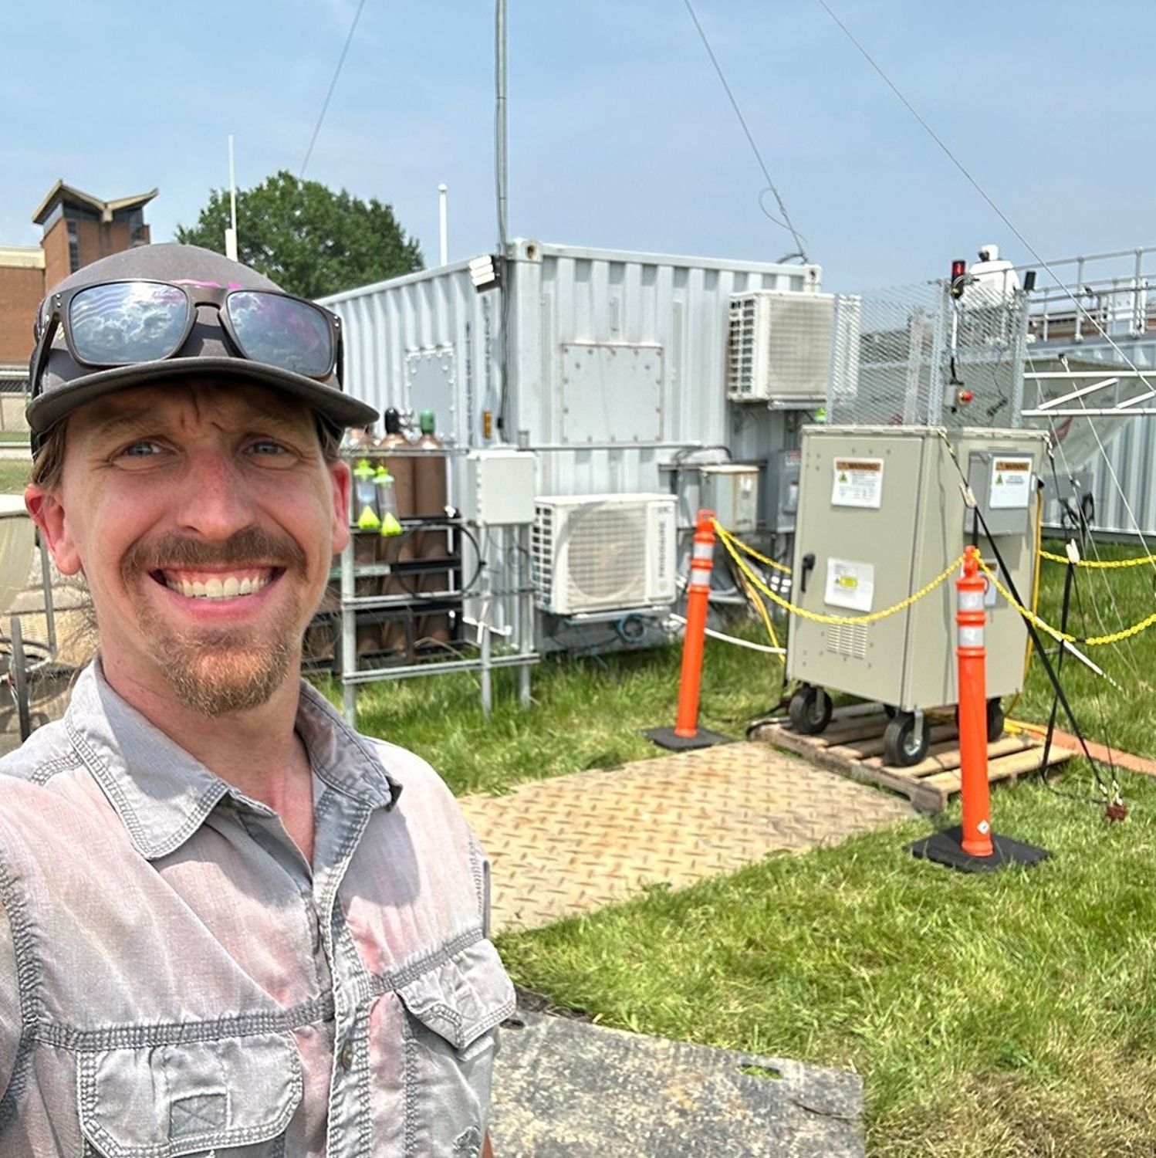
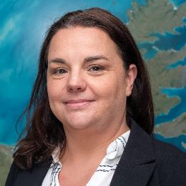
PROJECT STATUS: PRE-FORMULATION
John Haynes
Program Manager
About MIO
John Sullivan
Deputy Program Manager
Integration for Innovation:
Accelerating Earth Understanding, Maximizing Impact
HEADQUARTERS
Leadership and oversight of all MIO activities, including DARTs and Project Office. Programmatic alignment across ESD.
GOAL
NASA’s Multisource Integrated Observatory (MIO) maximizes science by combining trusted multisource data, innovative technology, and world-leading science expertise to accelerate the pace of discovery and advance applications for real-world use. ​
OBJECTIVES
Integrate the broad spectrum of data and tools required to accelerate the pace of scientific discovery and innovation ​
Deliver high-impact, actionable information based on multisource data, technology, and science​
Advance science-to-application pipelines across public and private sectors​
Cecile Rousseaux
Project Scientist
PROJECT OFFICE (GSFC)
Facilitation of Multisource DARTs, integration support for Mission DARTs, and delivery of enabling infrastructure and capabilities.

Slide 8



Transformative Structure
Combining multisource data to advance Earth science and inform critical decisions on national security, resource management, and disaster response
COMPONENTS
Multisource
Integrated
Observatory
Multisource DARTs
Extracting maximum value and impact by combining observations from multiple sources
Including ground-based, airborne, partner, and commercial observations, plus stakeholder insights
Breaking through collaboration barriers to enable cross-cutting teams
Coordinating observations, cross-validation, and measurements across platforms
Unifying the program of record into an enterprise for Earth system science questions
Addressing the most important societal challenges
Multisource Integrated Observatory
Mission DARTs
Project Office

Slide 9
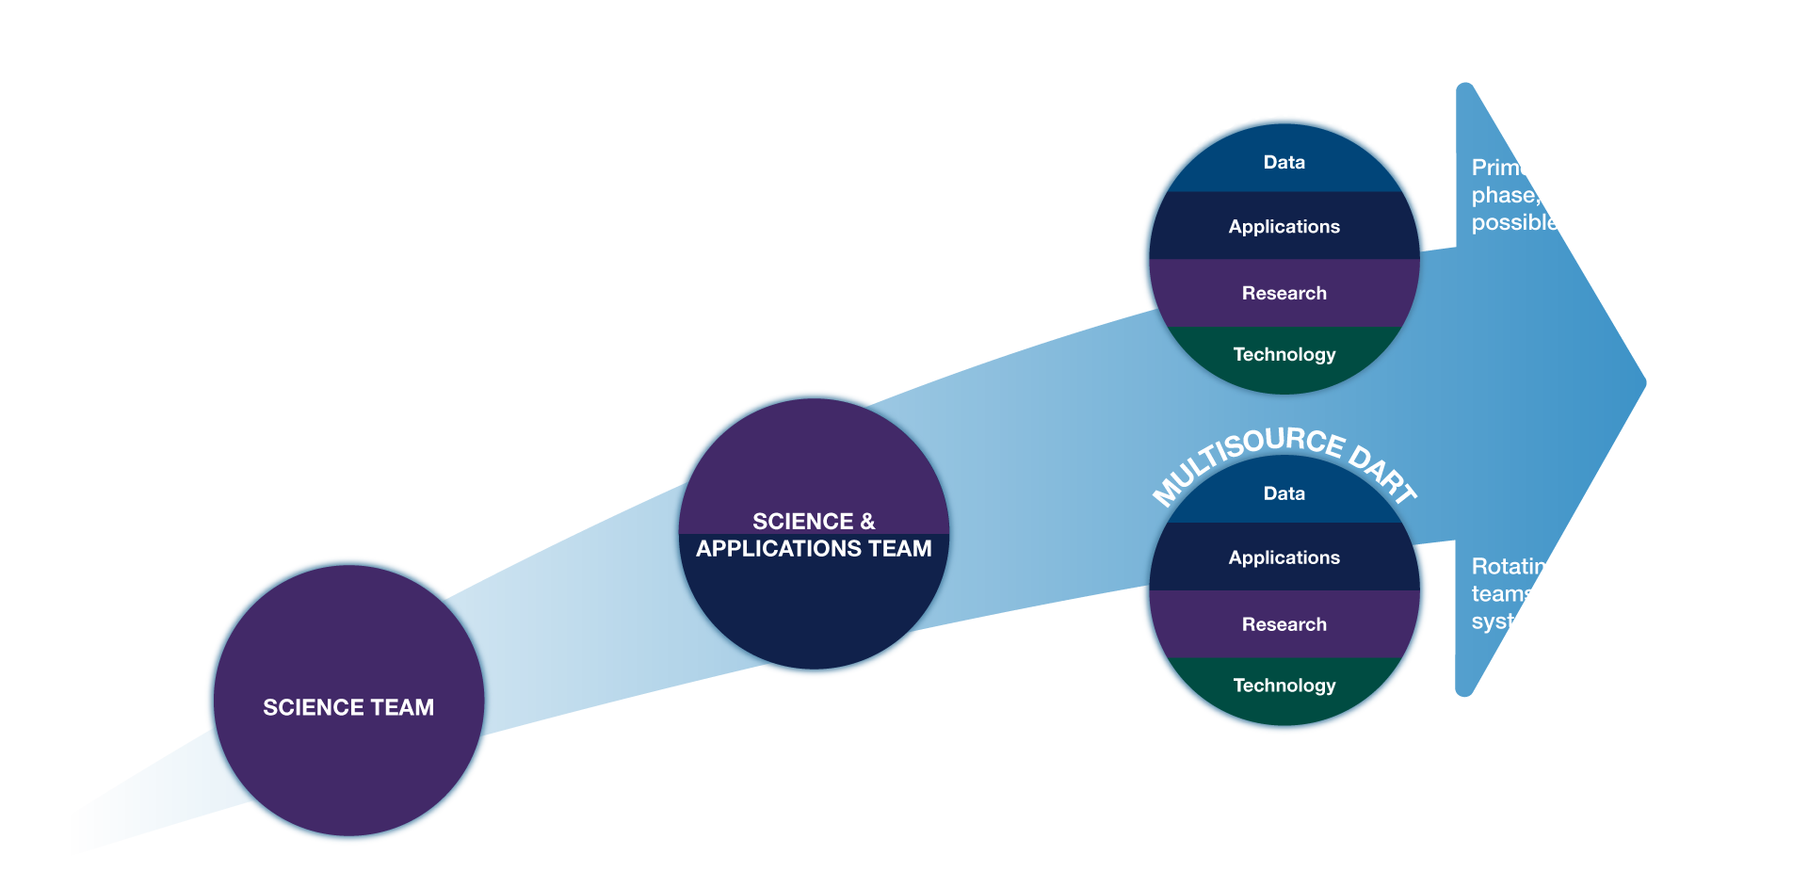
Evolution of NASA Earth Science Mission Teams
Multisource Integrated Observatory

Slide 10
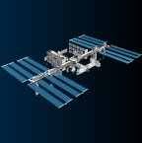
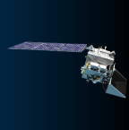
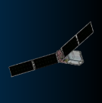
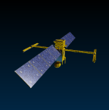
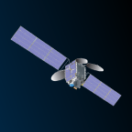
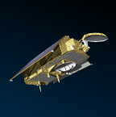
DART Integrators
The DART Integrator serves as the formal coordination conduit between the operational mission's DART Team and other DARTs, creating a two-way bridge for information and collaboration.
Multisource Integrated Observatory
EMIT
PACE
SWOT
Dana Chadwick
Jeremy Werdell
Augusto Getirana
JPL
GSFC
GSFC
PREFIRE
TEMPO
SENTINEL-6B
Brian Kahn
Laura Judd
Joshua Willis
JPL
LaRC
JPL
*NISAR DART Integrator TBD

Slide 11



Multisource DART Teams (ROSES-26)
Multisource Integrated Observatory
MULTISOURCE DART
MULTISOURCE DART
RFI
Water
Life
Challenges
Characterizing the movement, distribution, and availability of water
Droughts and flood impacts
Precipitation, snow melt, evapotranspiration rates, sea level rise
Ground water storage and land subsidence
Energy cycles
Intersections with applications (i.e., water management, agriculture, health, disaster preparedness)
Integrating measurements to understand the interactions between Earth systems and life
Hazards
Air quality and pollution
Land and ocean management practices
Ecosystem characterization
Environmental determinants of disease
Identifying large scale interconnected challenges that can be addressed with multisource data
RFI to incubate new multisource solicitation themes for ROSES-27 and beyond.

Slide 12


Tackling the most pressing questions
Focus on NASA’s unique position
Infusing technology and data science
Multisource Integrated Observatory
Ensure full integration across efforts
Main Takeaways
Expanding investigator opportunities
Create productive pathways for mid-career scientists
Driving continuous innovation
Empower DARTs to push boundaries over time
Navigating the transition together
Work together with the community to ensure success

