Slide 1



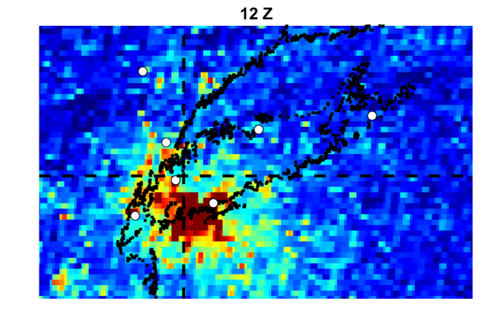
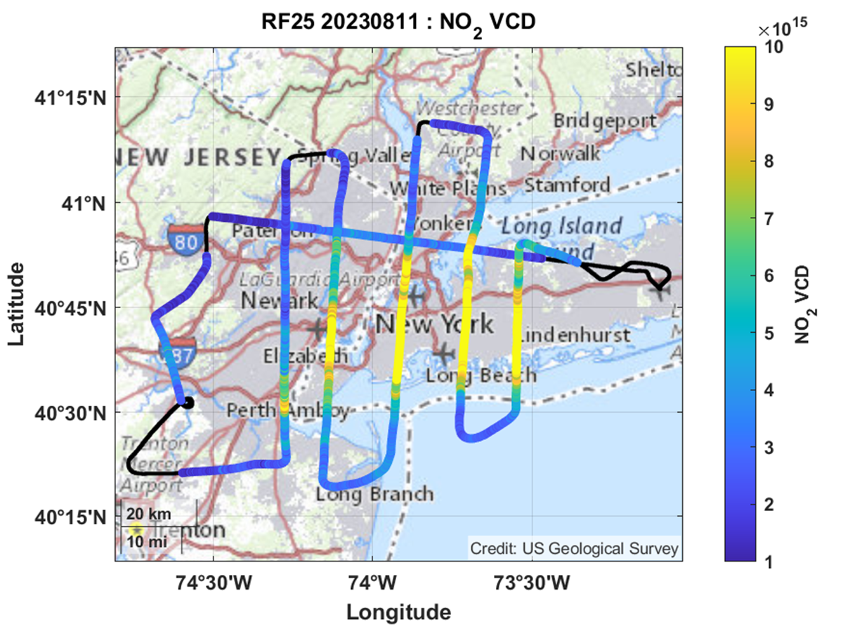
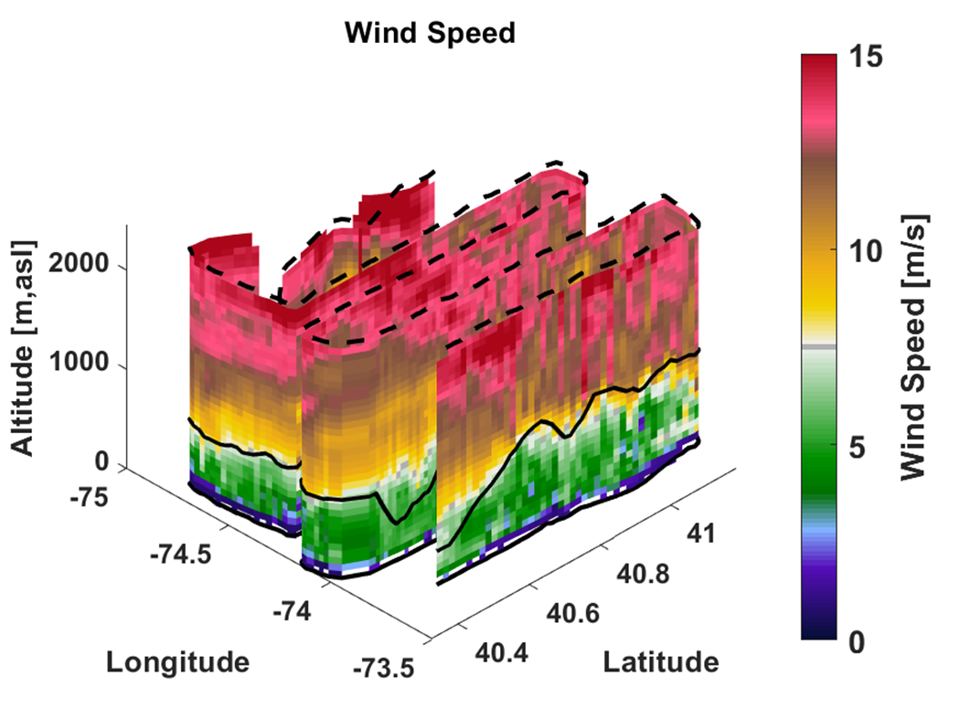
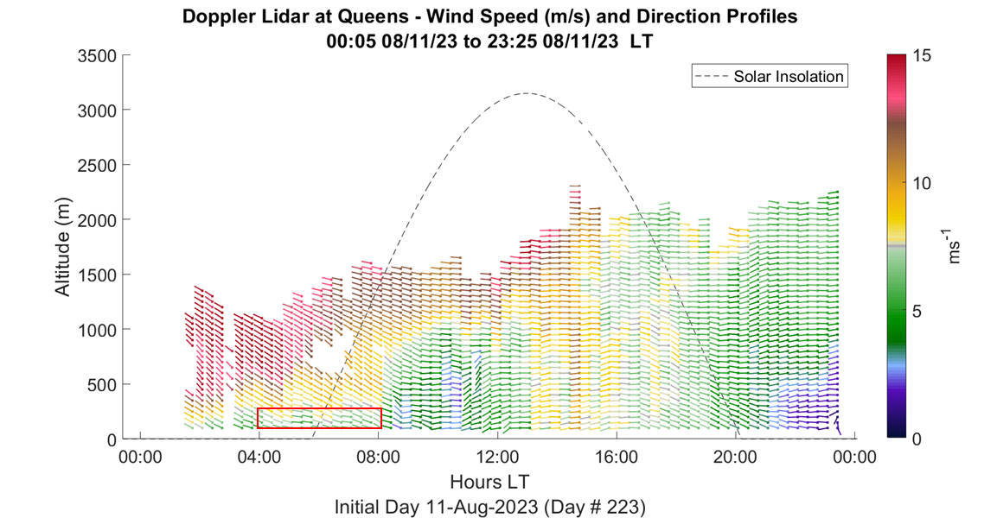
Baidar–Quantification of NO_{x} Emissions from New York
Sunil Baidar
CIRES, University of Colorado Boulder and NOAA Chemical Sciences Laboratory
Demonstrate potential to derive spatially and temporally resolved NO_{x} emission rates for New York using airborne and TEMPO measurements respectively.
Temporally resolved NO_{x} emissions:
TEMPO + Doppler Lidar
Spatially resolved NO_{x} emissions:
Airborne MAX-DOAS + Scanning Doppler Lidar

Slide 2

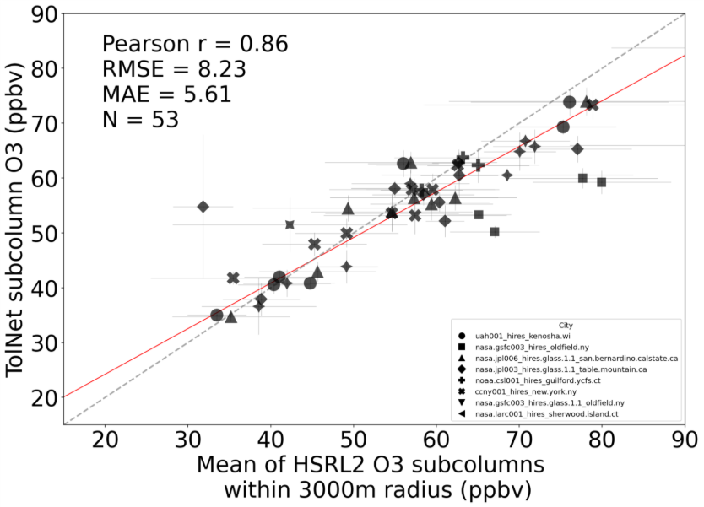
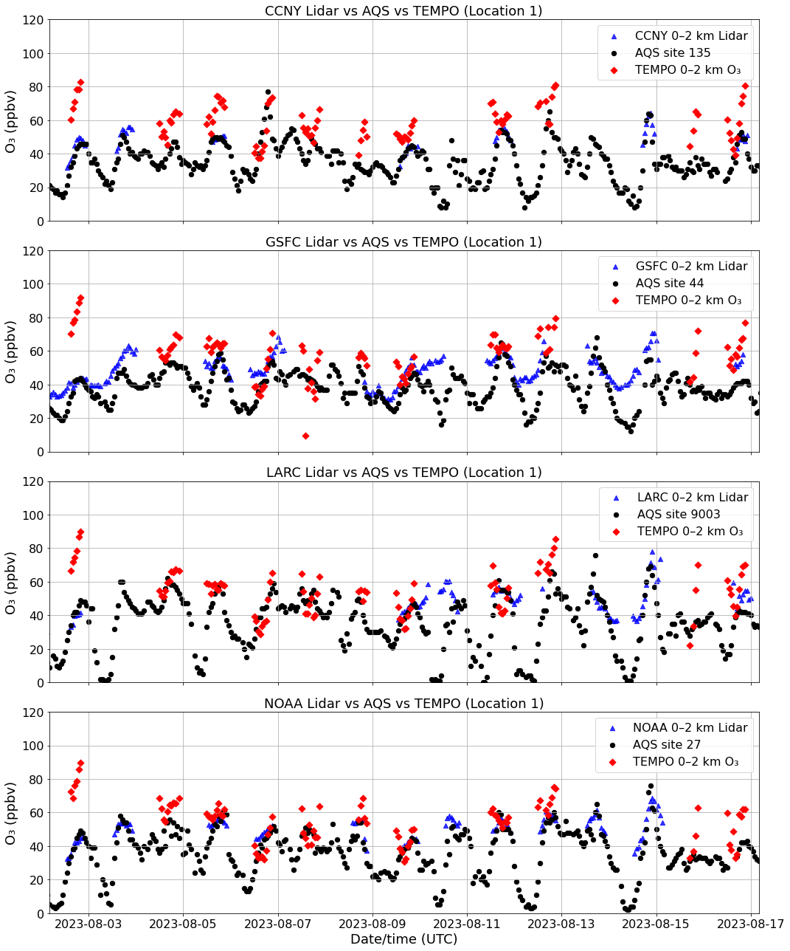
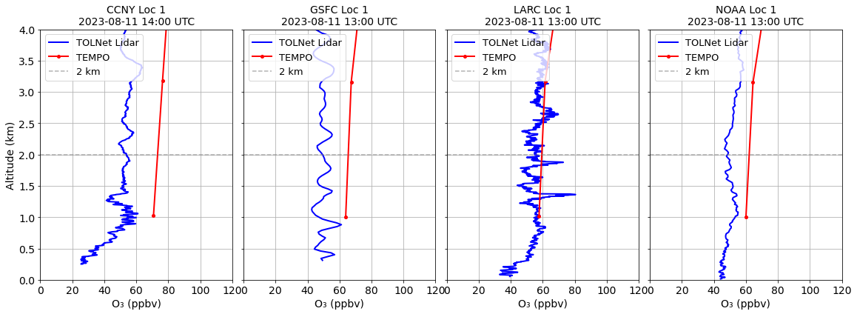
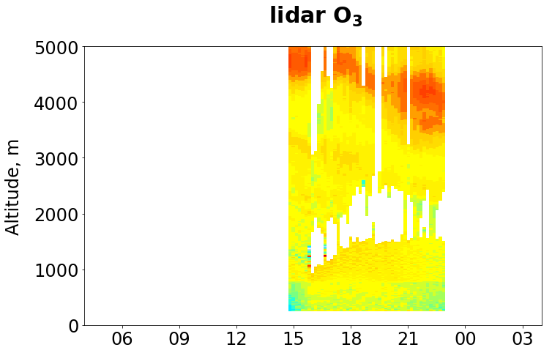
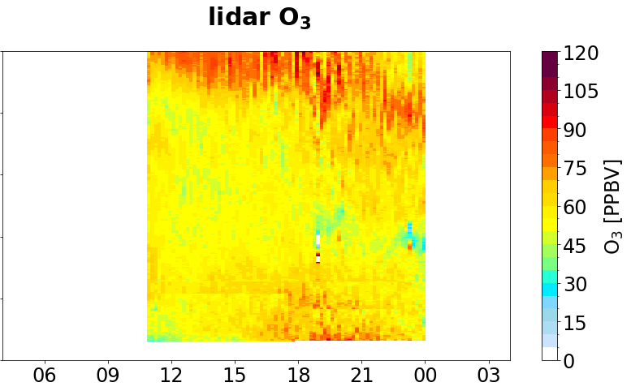
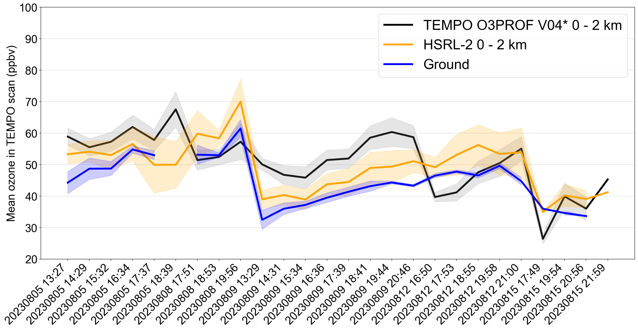
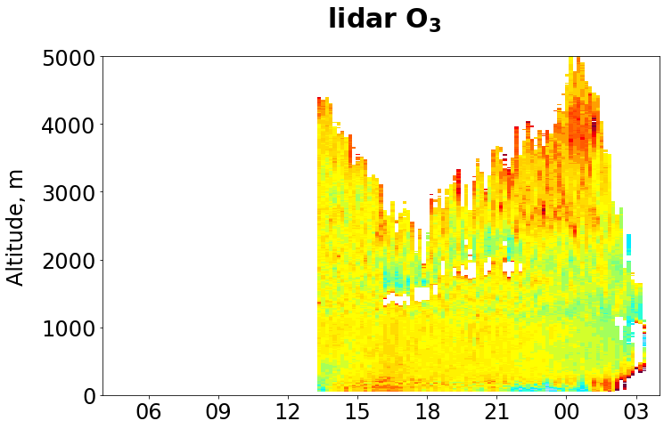
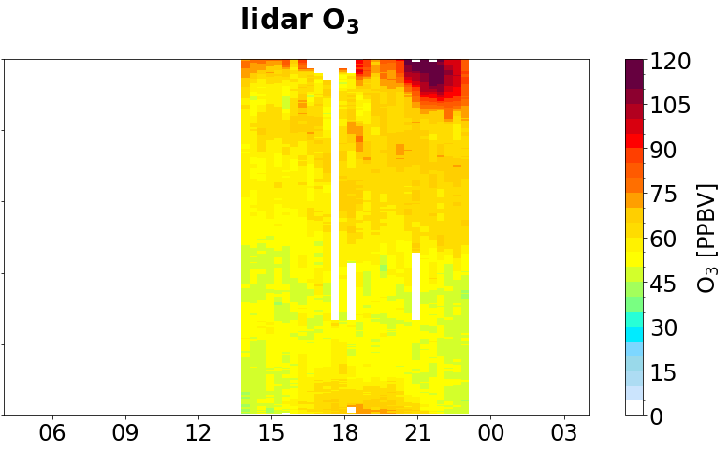
Bernier-Assessing TEMPO O₃ profile products for informing surface AQ
Mary Angelique G. Demetillo¹, Claudia M. Bernier² (claudia.m.bernier@nasa.gov), Laura M. Judd¹, Matthew Johnson²; ¹NASA Langley, Hampton, VA, ²NASA Ames Research Center, Moffett Field, CA
Ground & aircraft-based lidars capture similar 0–2 km O₃ during STAQS lending confidence to their use as independent validation references for TEMPO.
How well does the TEMPO 0–2 km subcolumn O₃ capture surface O₃ variability during STAQS?
On days with poor comparisons, what does the ground based O₃ lidar reveal?
CCNY
GSFC
HSRL-2 does not sample larger gradient viewed by TEMPO.
Potentially impacts of a shallow marine layer?
Mean O3 in TEMPO scan (ppbv)
LMOL
NOAA
NYC
CHI
NYC
CHI
CHI
TEMPO scan hour (UTC)

Slide 3

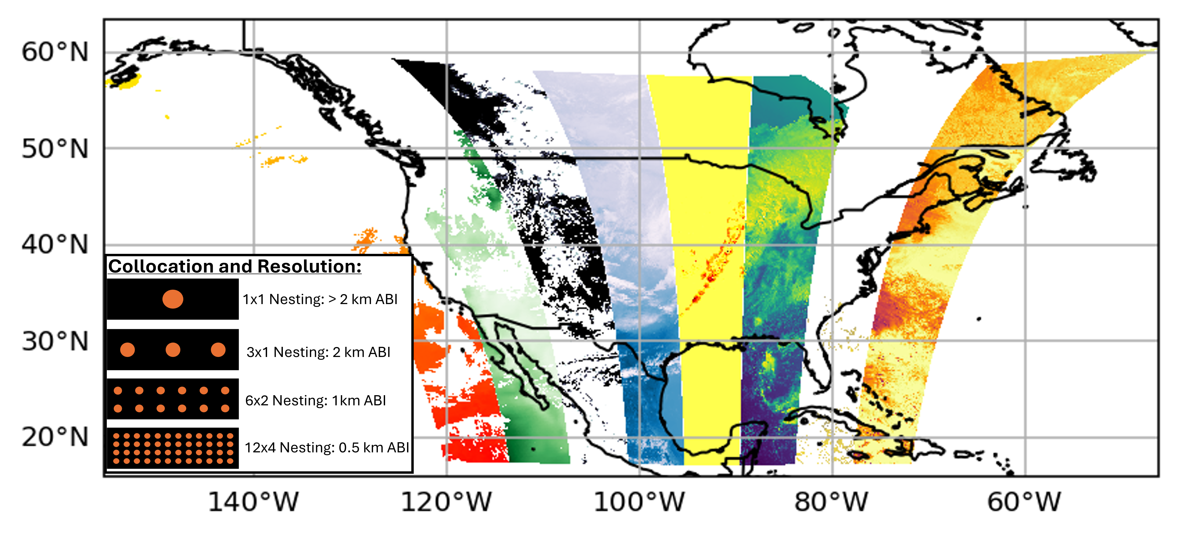
Carr–Enabling TEMPO-ABI Synergies
James L. Carr | jcarr@carrastro.com | Carr Astronautics
Oaklin Keefe | oaklin.keefe@carrastro.com | Carr Astronautics
Xi Chen | xi-chen-4@uiowa.edu | University of Iowa
Jun Wang | jun-wang-1@uiowa.edu | University of Iowa
Lorena Castro García | lcastrogarcia@uiowa.edu | University of Iowa
Collocate over 30 ABI L1 and L2 Products with TEMPO Pixels
Easy to Use Python w/ HTML UI on GitHub
All TEMPO L1 and L2 Granules
NetCDF Output
Seamless Access to NOAA Datasets on AWS
Finds most Simultaneous ABI
Preserves Native ABI Resolution
Now Beta Testing
Funded under NASA ROSES 80NSSC25K0221, University of Iowa

Slide 4
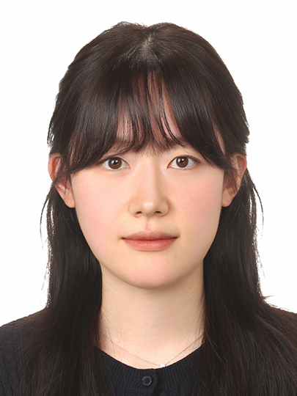
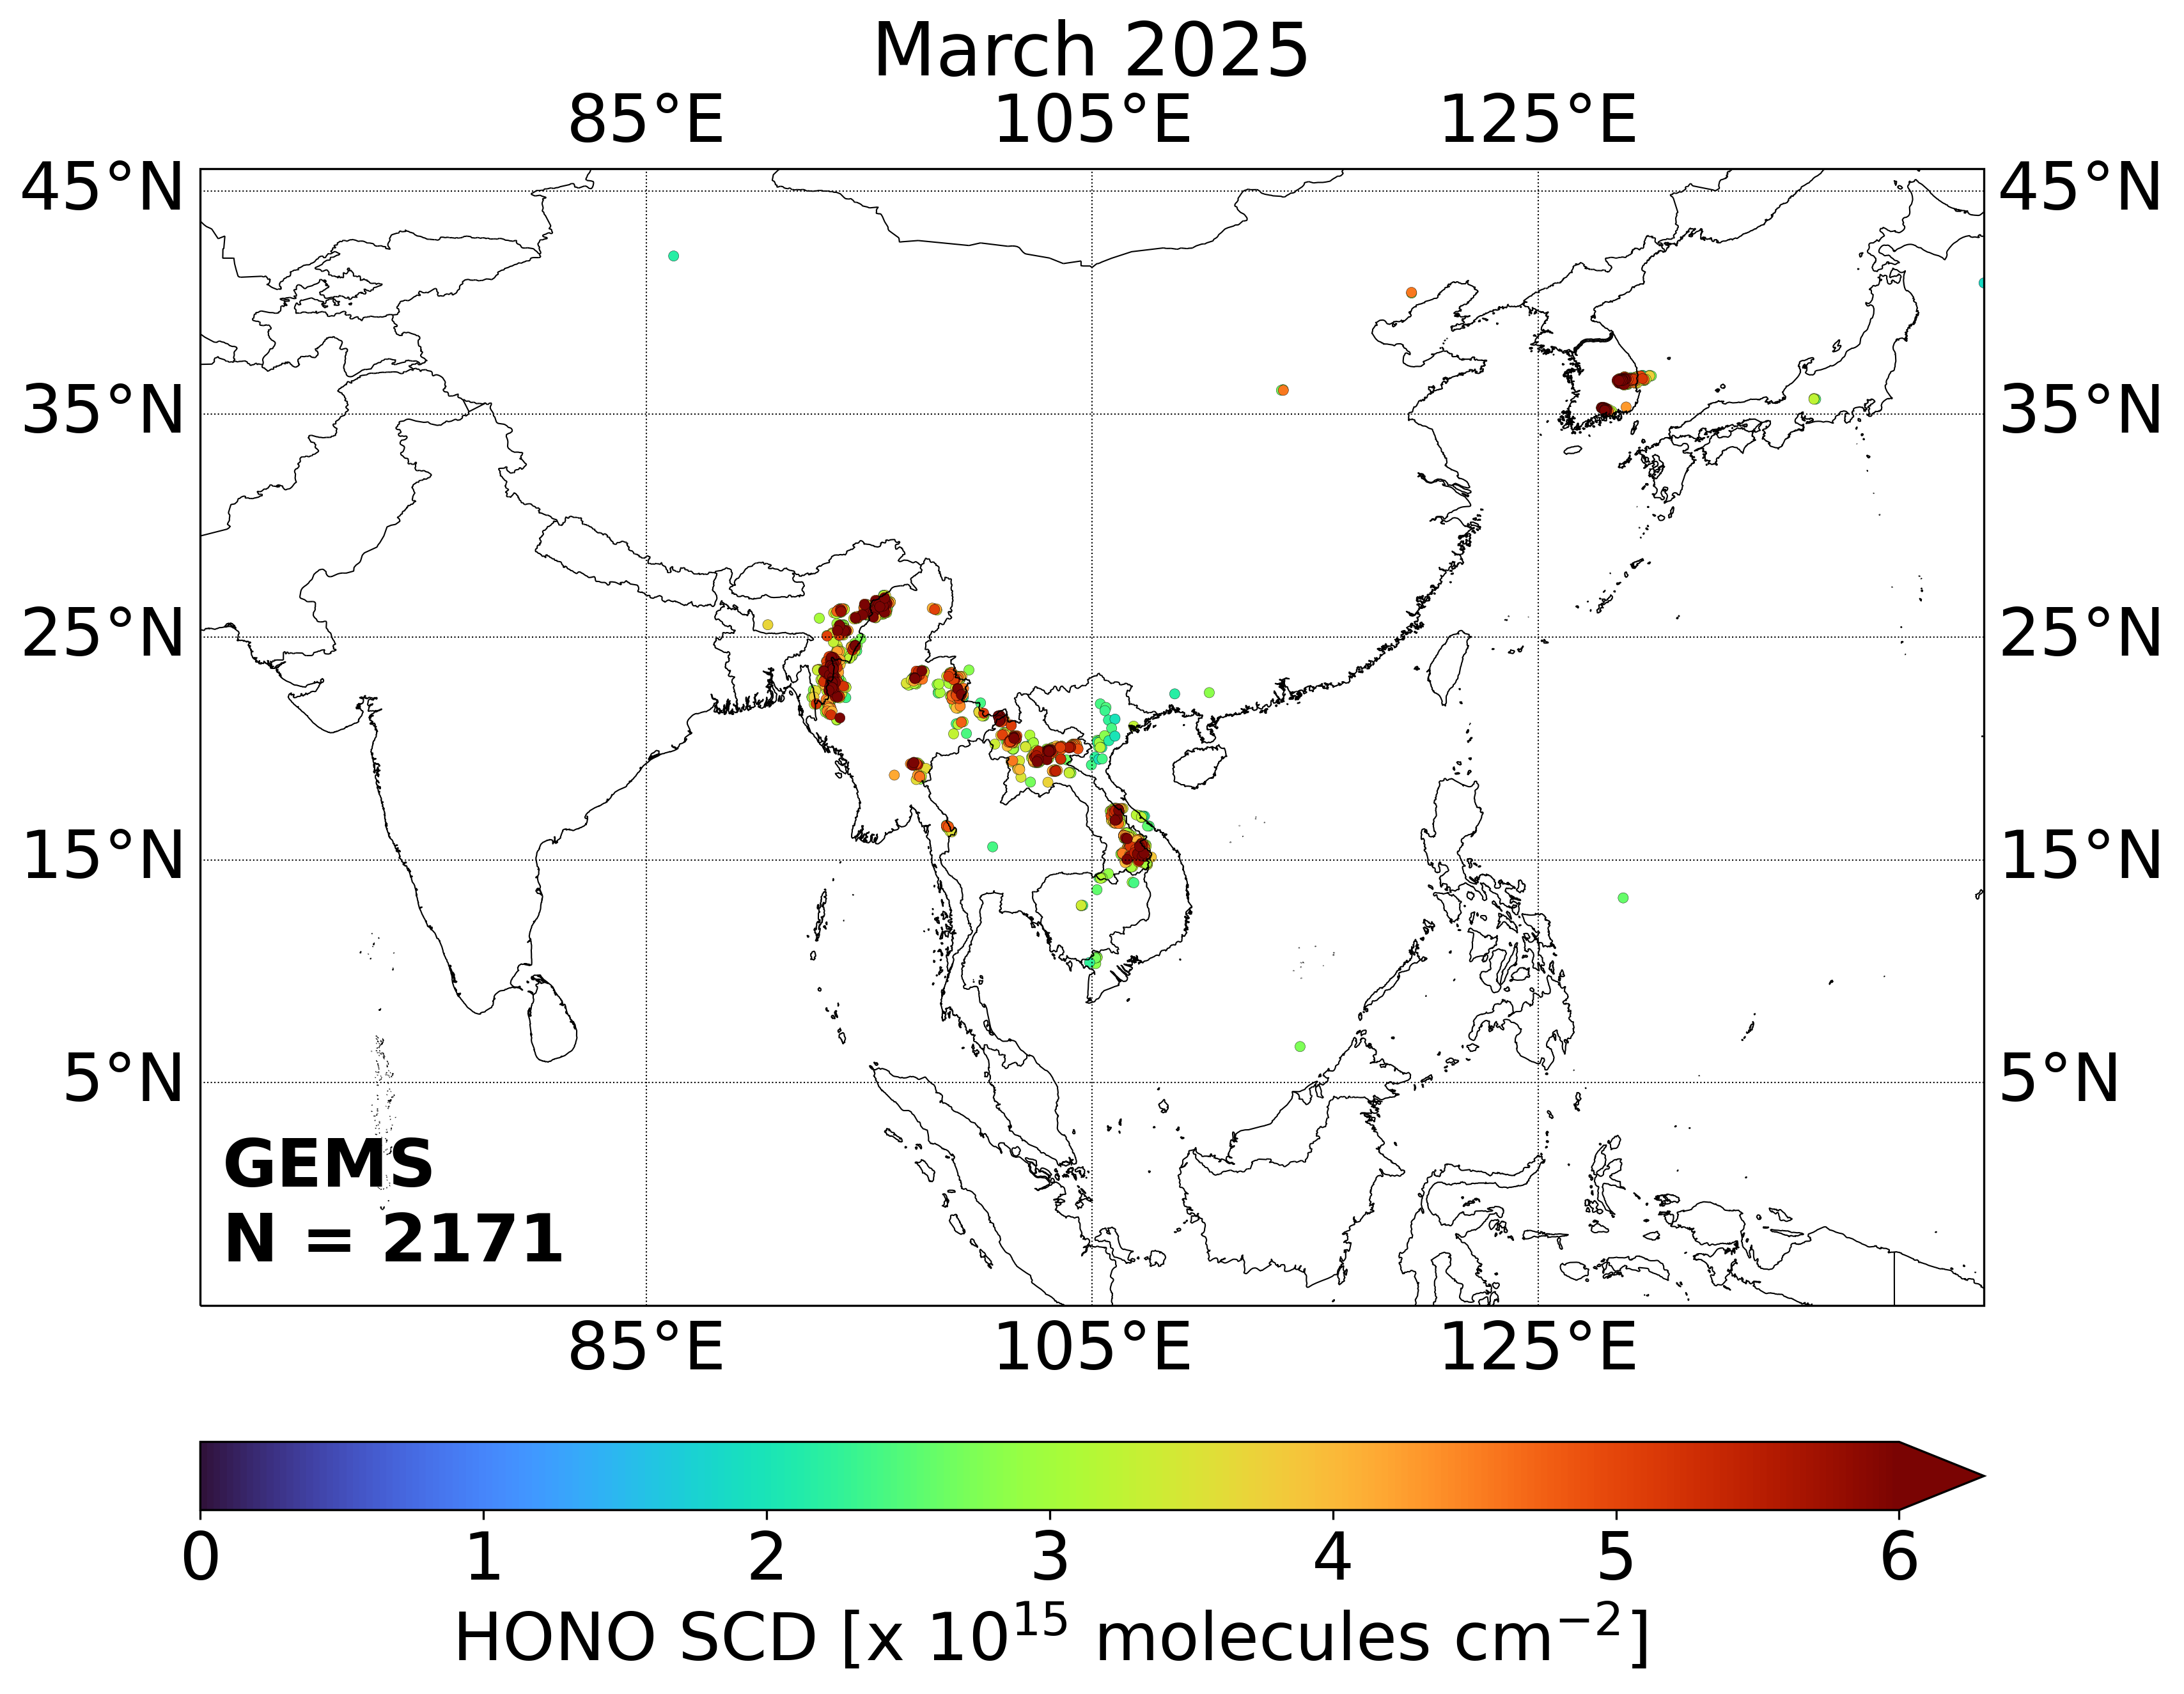
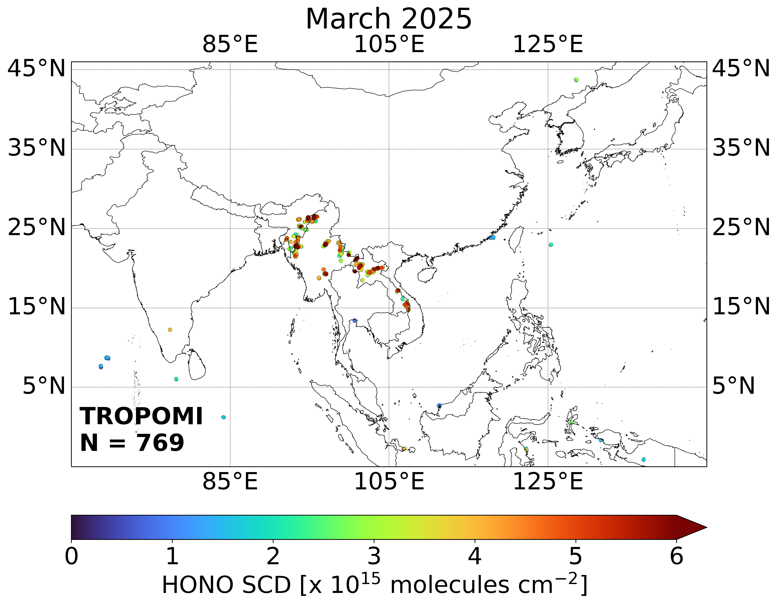
Cha–GEMS HONO Retrieval and Application to Asian Fire Plumes
Hyeji Cha¹, Jhoon Kim¹, Nicolas Theys², Heesung Chong³, DhaHyun Ahn¹, Sang Seo Park⁴, Won-Jin Lee⁵, Suna Shin⁵, Hyejoung Shin⁵
¹Department of Atmospheric Sciences, Yonsei University, Seoul, Republic of Korea; ²Royal Belgian Institute for Space Aeronomy (BIRA-IASB), Brussels, Belgium, ³Atomic and Molecular Physics Division, Center for Astrophysics, Harvard & Smithsonian, Cambridge, MA, USA; ⁴Department of Civil, Urban, Earth, and Environmental Engineering, Ulsan National Institute of Science and Technology, Ulsan, Republic of Korea; ⁵Environment Satellite Center, National Institute of Environmental Research, Incheon, Republic of Korea
HONO Enhancements in Fire Plumes (Mar 2025)
Topic: HONO Retrieval Algorithm using GEMS UV Spectra
Target species: Nitrous Acid (HONO)
Major source of hydroxyl radicals (OH) in the troposphere → influences atmospheric oxidation capacity, pollutants, and greenhouse gases.
Weak absorber—Satellite observations of HONO remain limited (e.g., TROPOMI, IASI, and GEMS)
Highlights
Development of GEMS HONO slant column retrievals based on COBRA (Theys et al., 2021; 2025): “COBRA Yonsei Implementation”
  → Potential implementation as a GEMS Level 2 research product
Applications to recent wildfire events in South Korea and Southeast Asia
  Time-series analysis with co-emitted trace gases and aerosols using GEMS Level 2 products
  Comparison with TROPOMI observations
GEMS
TROPOMI

Slide 5
Place a headshot of yourself here
Chai–Development and Evaluation of GEMS AOD Version 3.0
Yujin Chai, Yonsei University,
Jhoon Kim, Minseok Kim, Yeseul Cho, Sujung Go, Mijin Kim, Hyunkee hong
Describes the GEMS AOD V3.0 updates and validation results
Main updates:
  Reconstructed LUTs for 4 aerosol models (expanded from 3 in the operational version)
  DNN-based post-processing of AOD
  Two AOD output variables provided: AOD from the physical algorithm and AOD after post-processing
Validation results:
  Reduced underestimation at high AOD (contribution of the new LUT)
  Decreased diurnal bias (contribution of post-processing)
  Reasonable SSA accuracy (contribution of the new LUT)

Slide 6
Deng– Fires Reverse US Policy-Relevant Ozone Trends
Weizhi Deng, University of Iowa
with Jun Wang, Meng Zhou
We developed a gapless, long-term (2003-2024), high-resolution (1 km) MDA8 ozone dataset in the US,
and found worsened surface ozone pollution since 2015 driven by wildfire emissions.
Hourly surface ozone estimates can be further enabled by TEMPO using AI/ML and data fusion techniques.

Slide 7
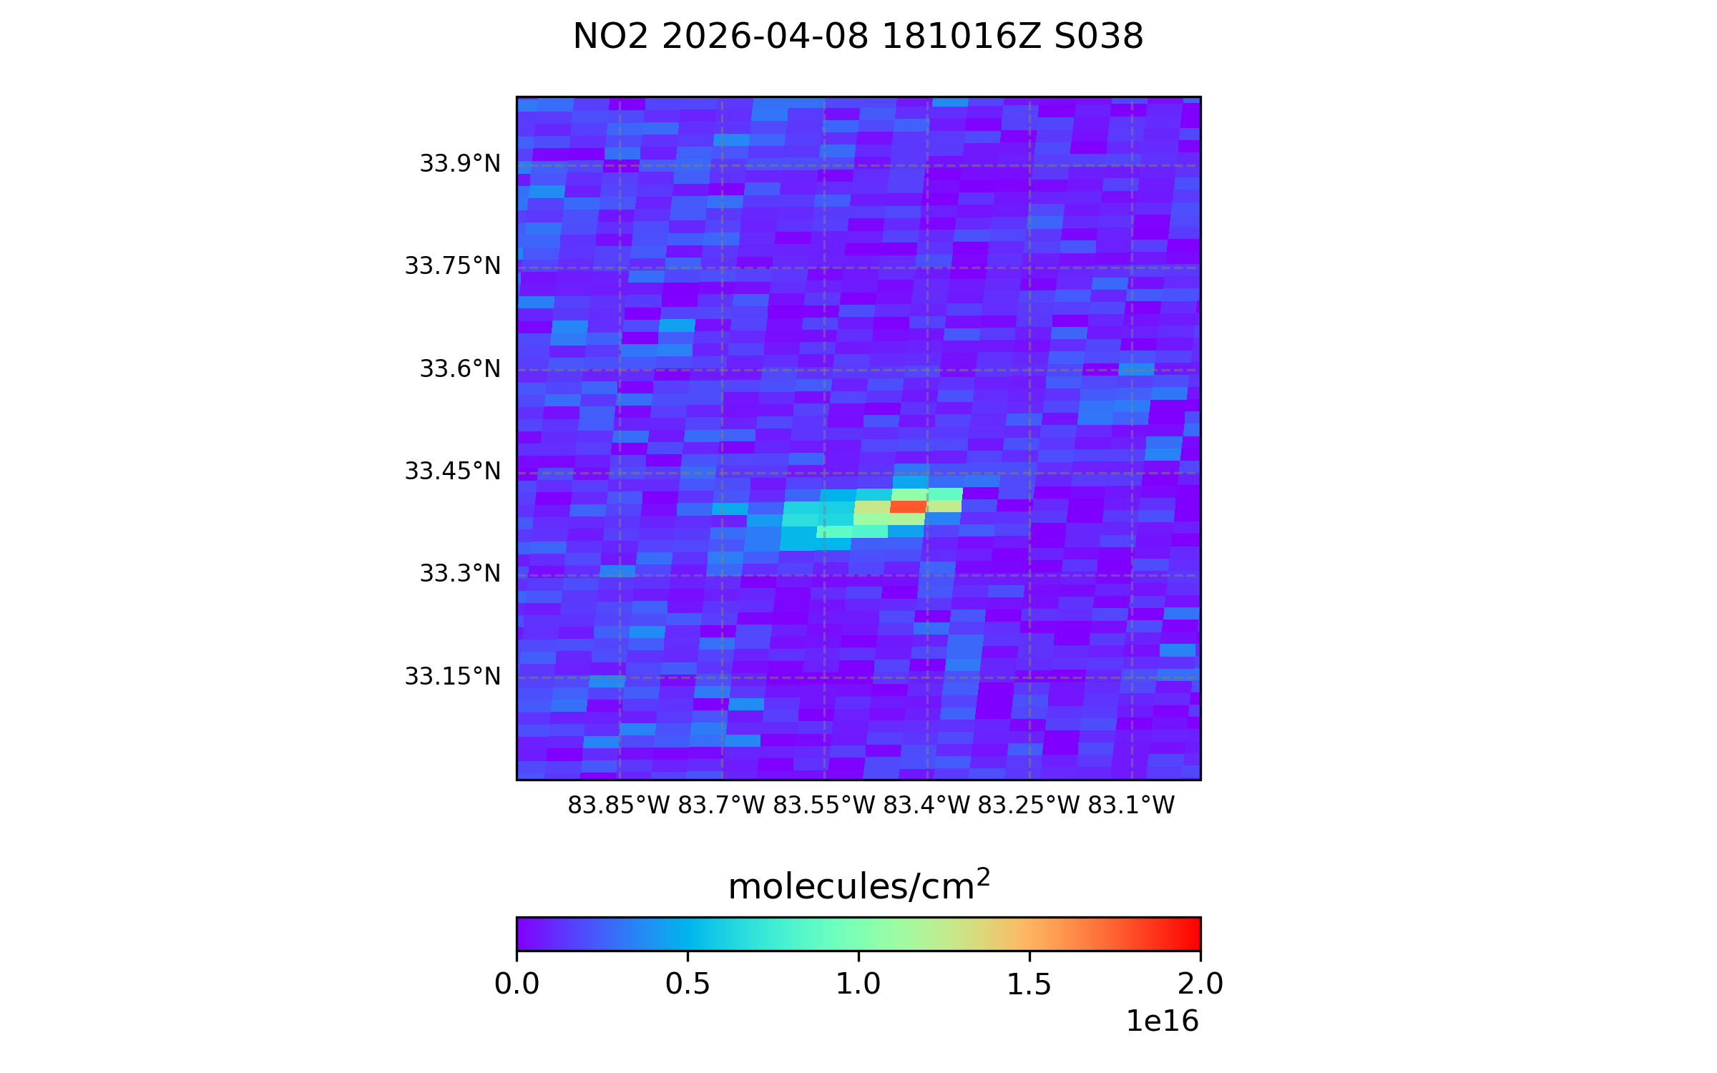
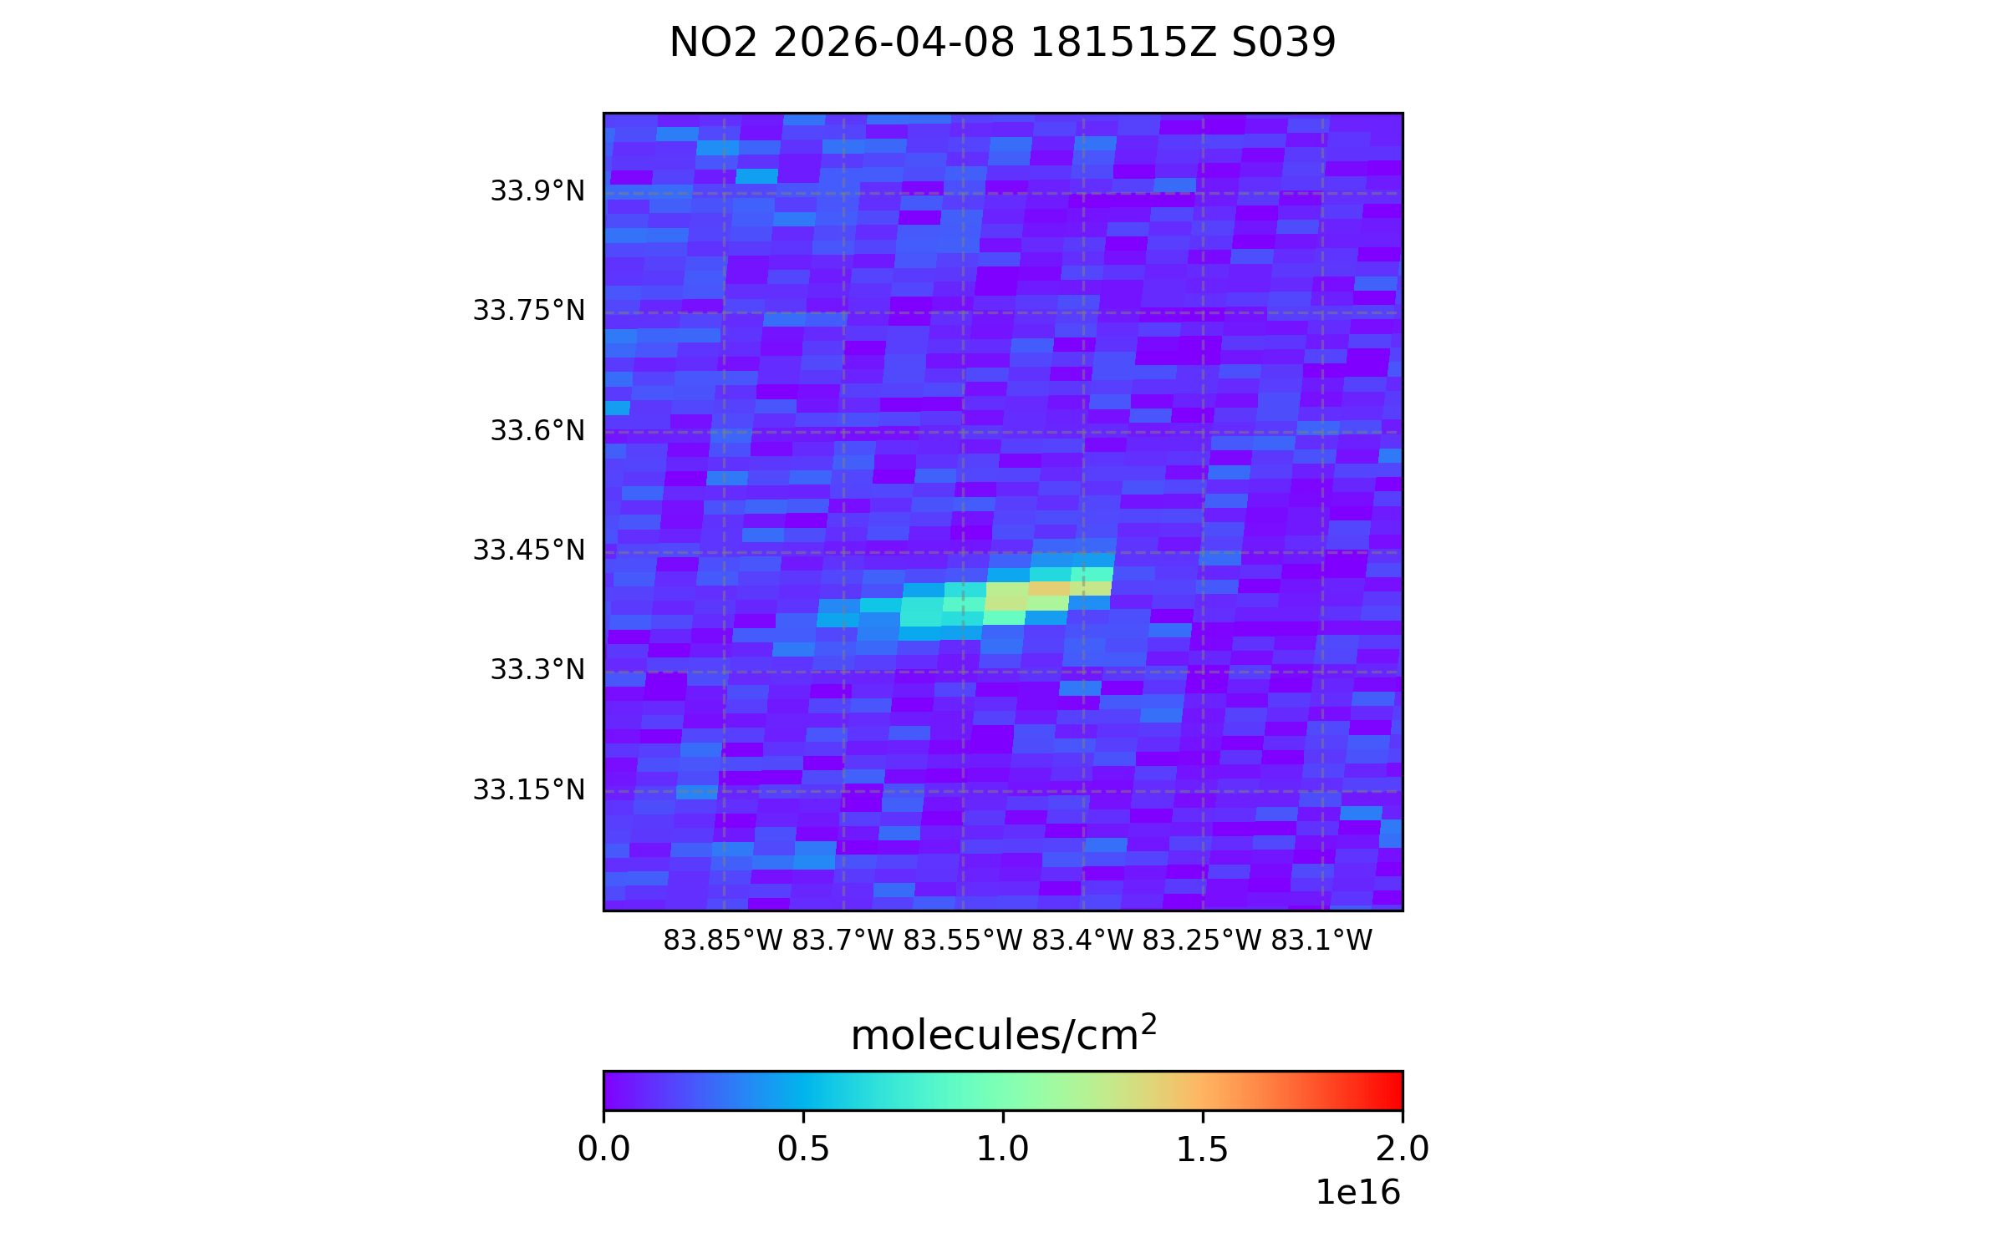
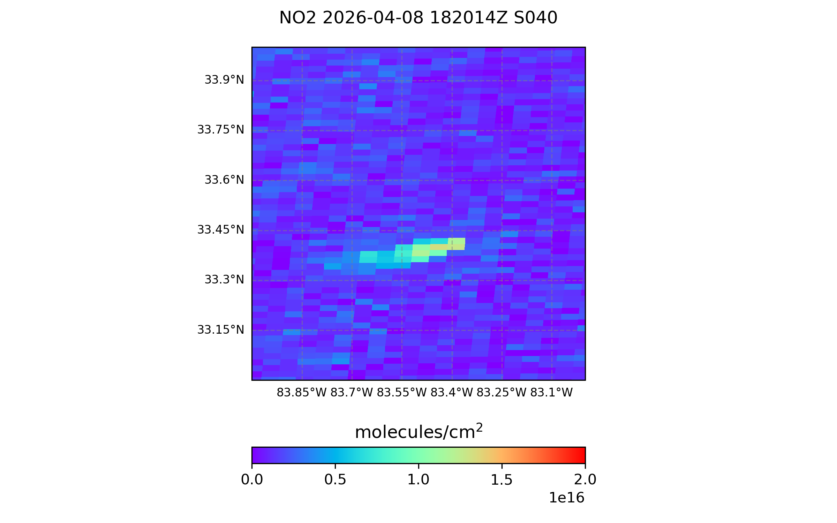
Fitzmaurice–From wildfires to the moon: TEMPO Special Observations
Jean A. Fitzmaurice, Lindsay P. Yatsuhashi, Raid M. Suleiman, John E. Davis, John C. Houck
TEMPO Operations Team | SAO | Cambridge, MA
5 minute special observation scans over Georgia

Slide 8

Place a headshot of yourself here
Mahan Hajiabbasi–Irrigation Optimization in a POMDP Environment Using AquaCrop Model
Mahan Hajiabbasi Somehsaraie, Iowa Technology Institute, College of Engineering, University of Iowa
Agriculture accounts for nearly 70% of global freshwater use, making efficient irrigation critical for sustainable crop production. This research explores irrigation scheduling using reinforcement learning (RL) under realistic conditions where farmers do not have access to complete soil and crop information.
Irrigation management was formulated as a Partially Observable Markov Decision Process (POMDP), and Proximal Policy Optimization (PPO) agents were trained within the AquaCrop simulation environment. Two approaches are evaluated: a history-based POMDP using past weather observations and a forecast-augmented POMDP that incorporates short-term precipitation forecasts.
Results show that integrating rainfall forecasts improves decision-making, producing the highest reward (518.4) and crop yield (13.87 t/ha), outperforming both a fully observable MDP benchmark and a history-based POMDP. These findings demonstrate that weather-informed RL can achieve effective irrigation control without requiring direct access to hidden soil states.

Slide 9

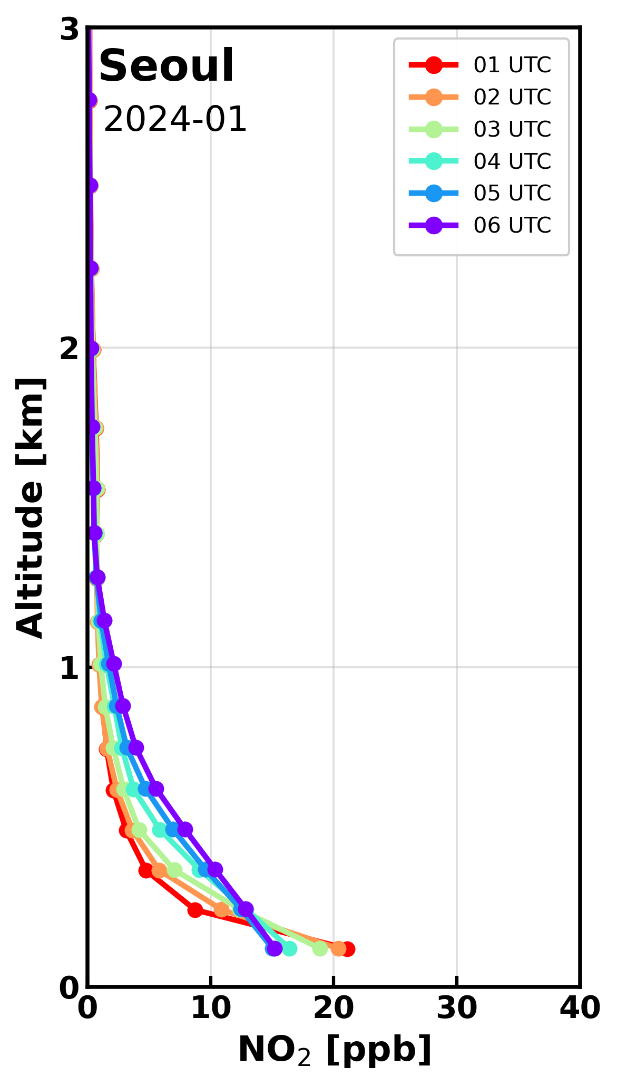
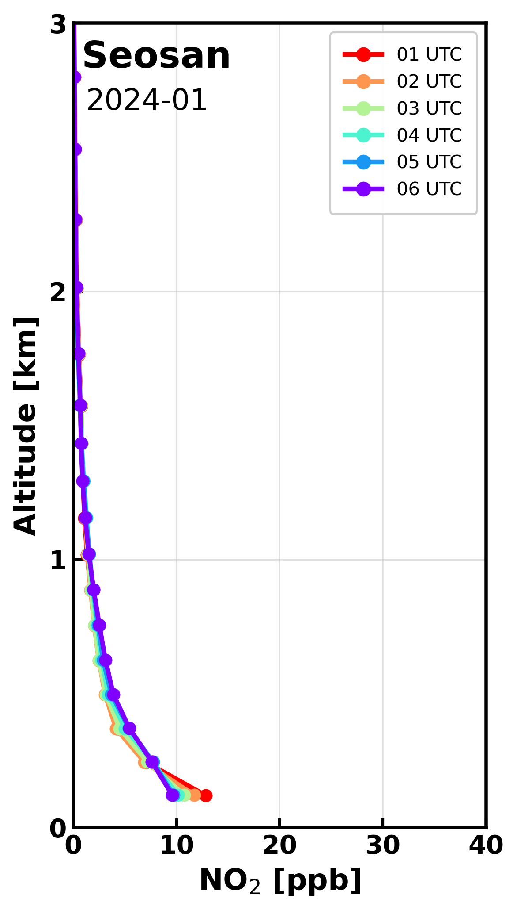
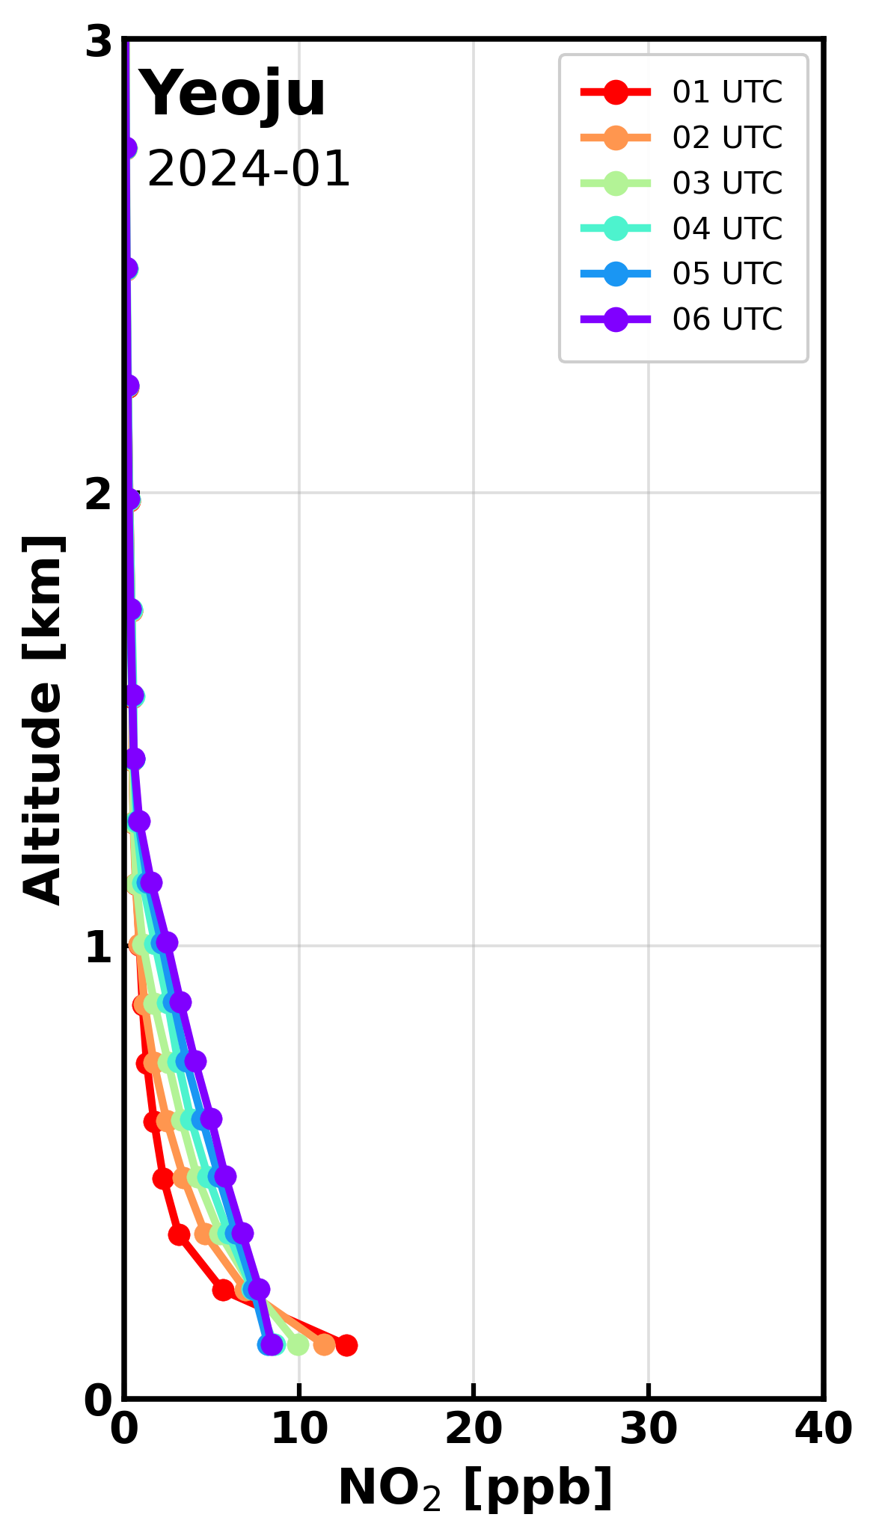
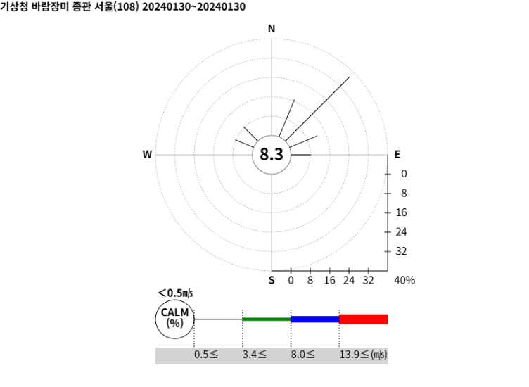
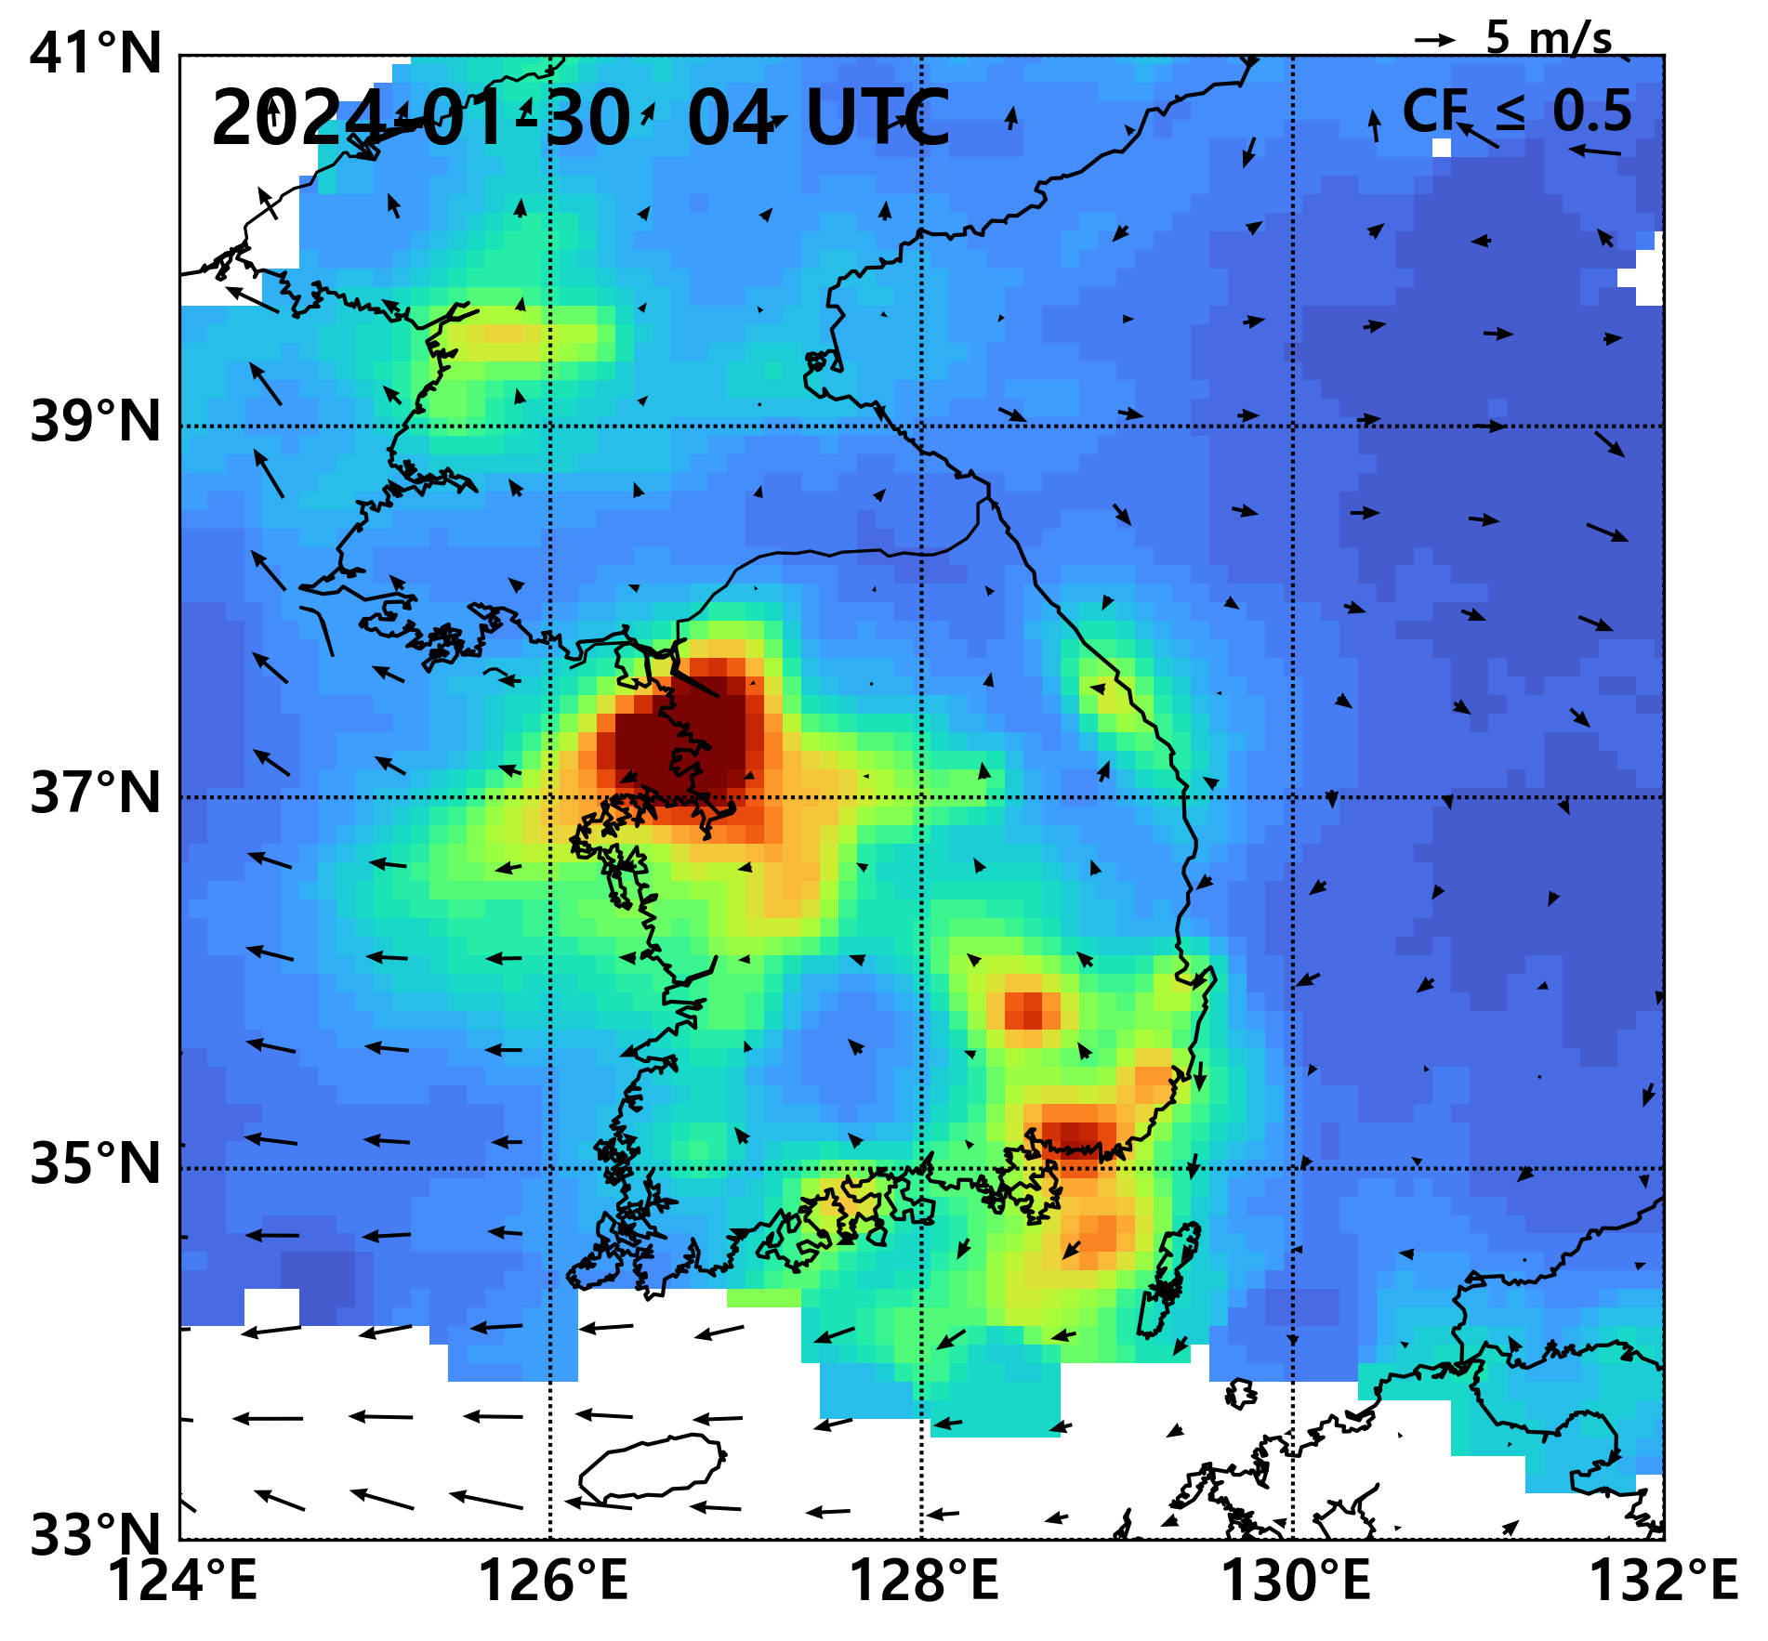
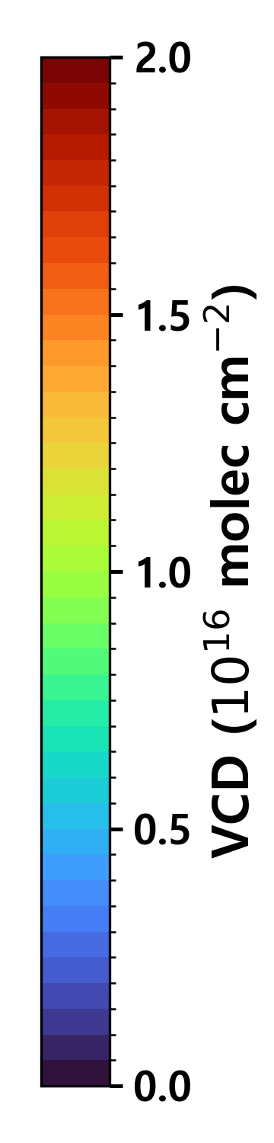
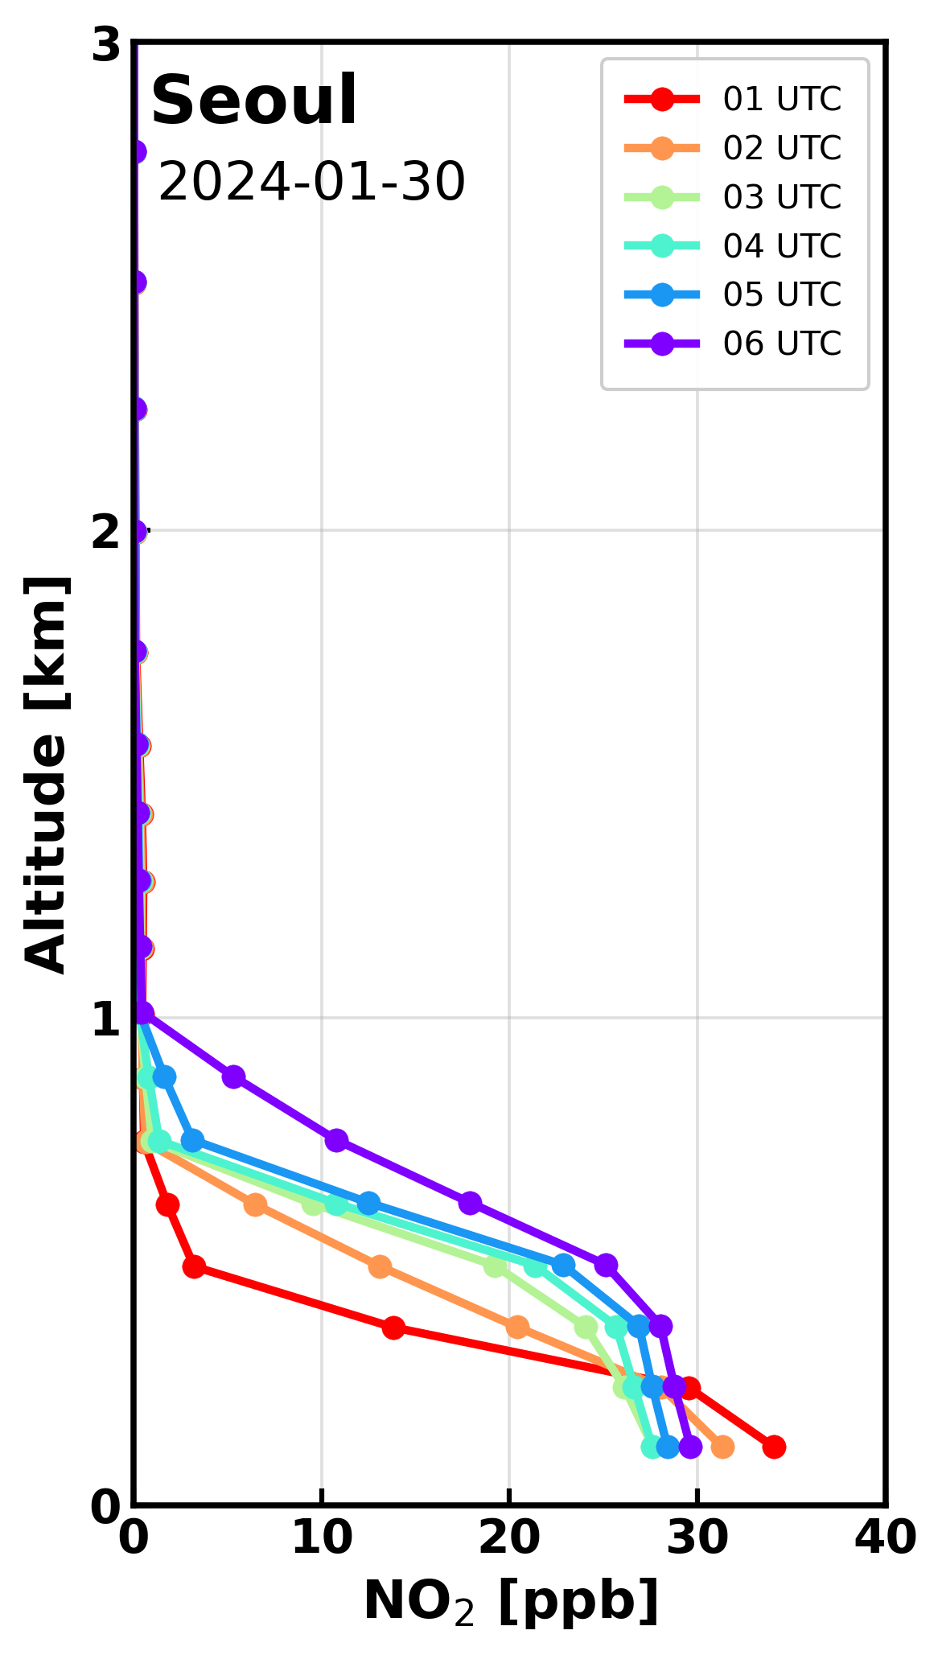
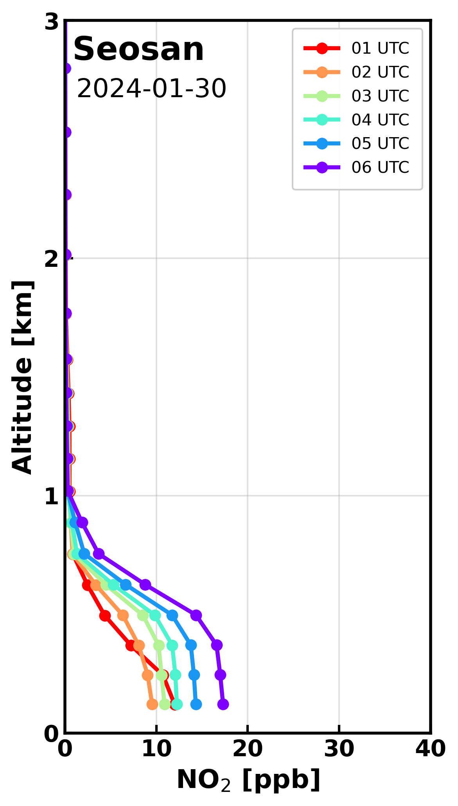
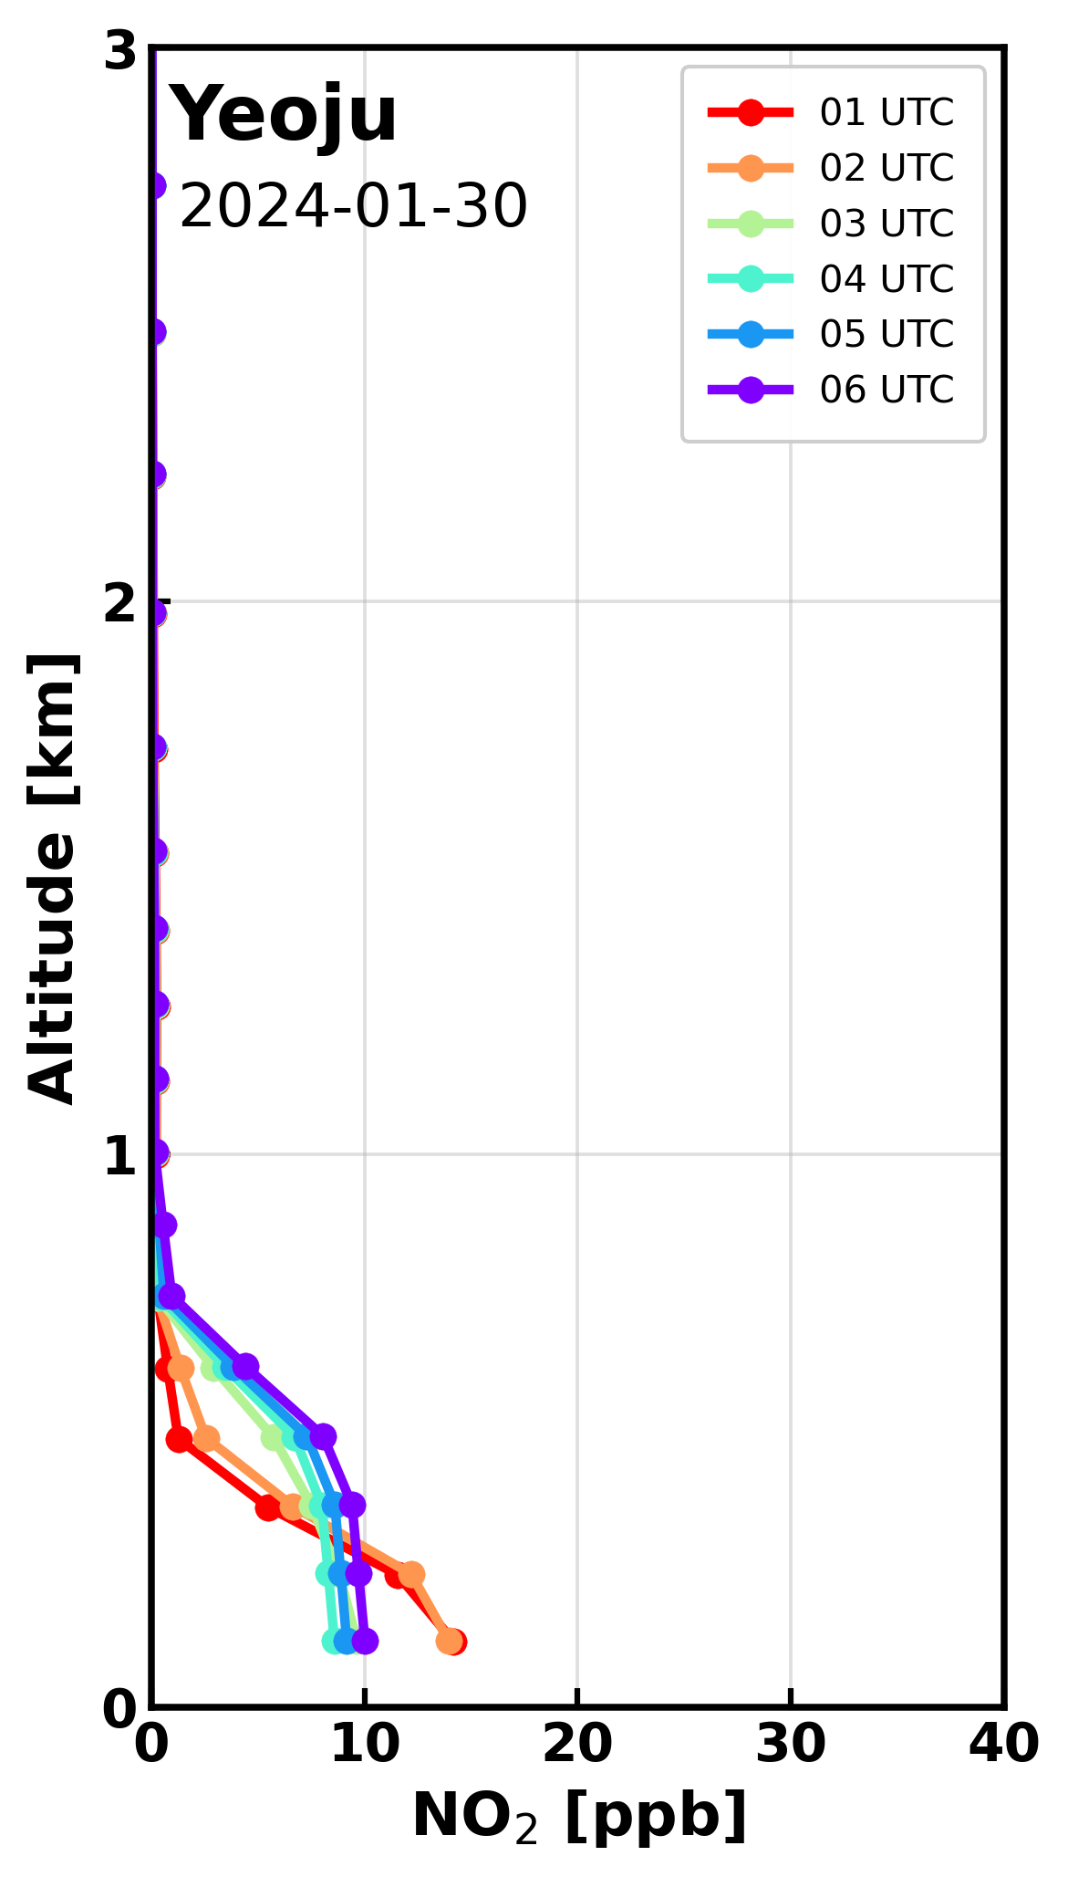
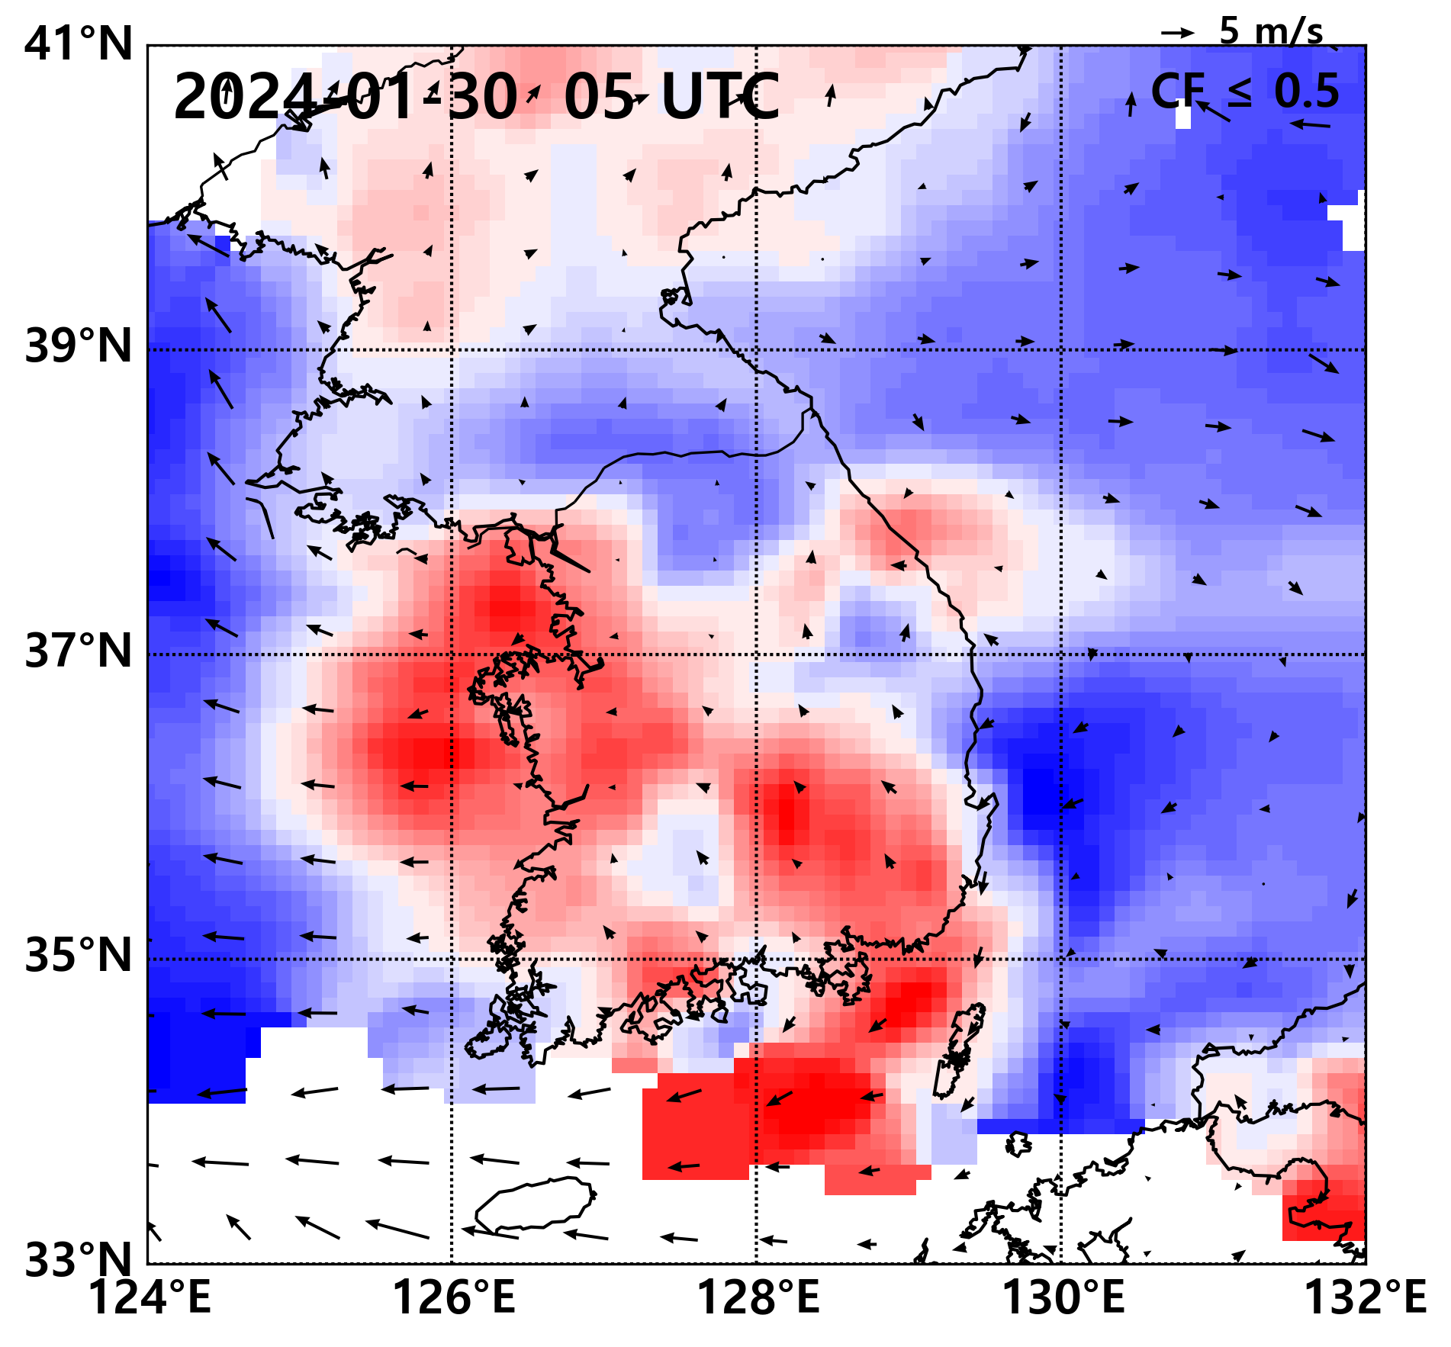
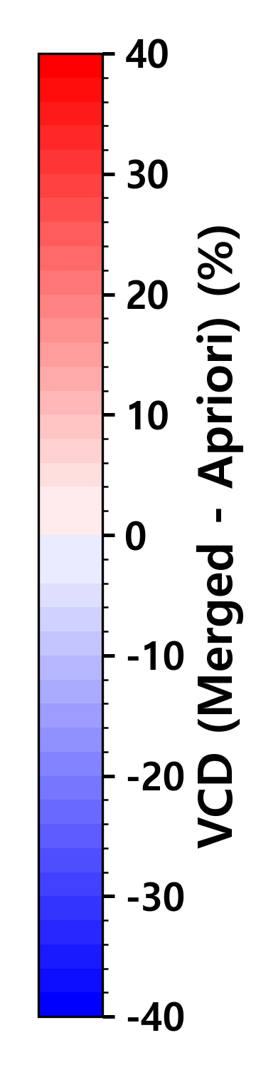
Place a headshot of yourself here
Hong–Impact of Climatological versus Near-Real-Time CTM
Fields on GEMS NO₂ Retrievals
Hyunkee Hong(NIER), Hyo-jung Lee and Min-jun Park(PNU)
GEMS a priori
On January 30, easterly winds were dominant, unlike the typical wintertime westerly flow.
The easterly flow affected the NO₂ profile over Seosan.
Near real time

Slide 10

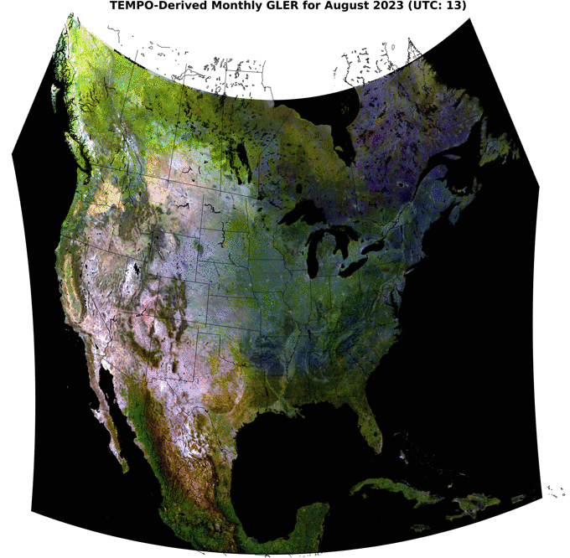
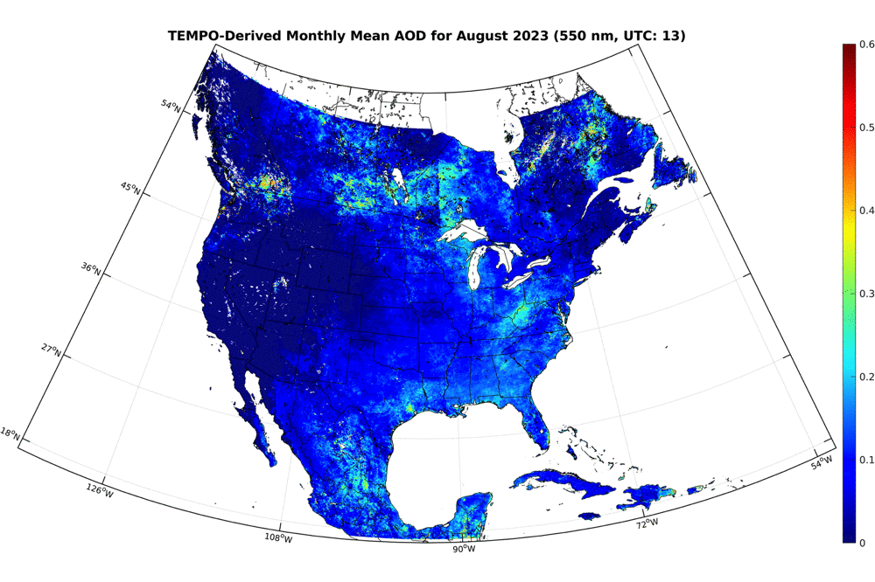
Place a headshot of yourself here
Hou–Simultaneous Retrieval of AOD and GLER from TEMPO
Weizhen Hou, Center for Astrophysics | Harvard & Smithsonian
Xiong Liu, Jun Wang, Kelly Chance, et al.

Slide 11

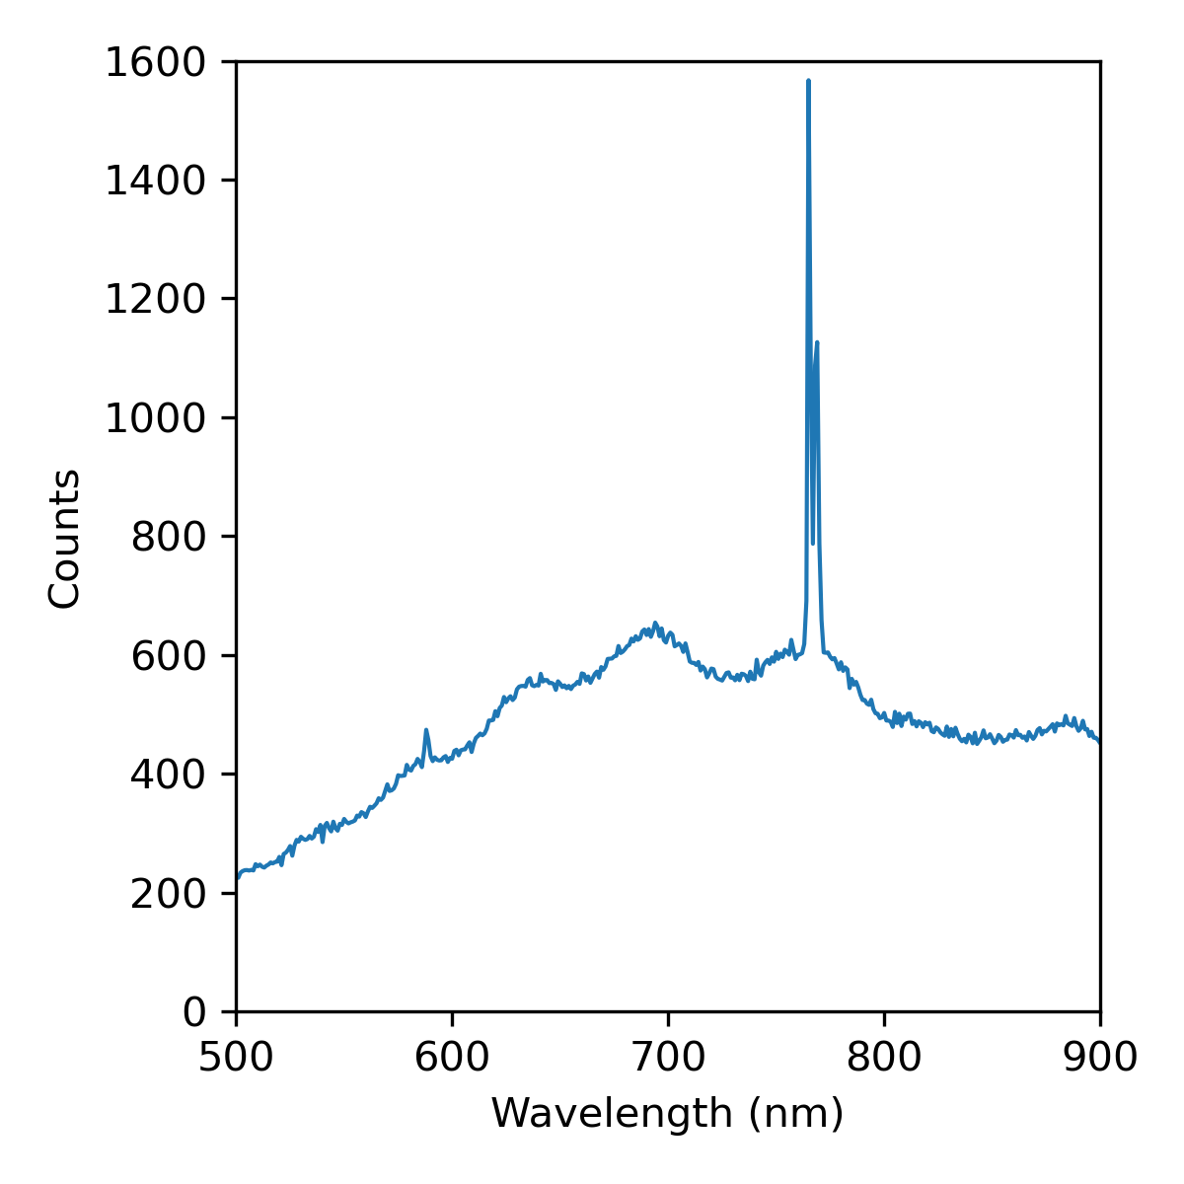

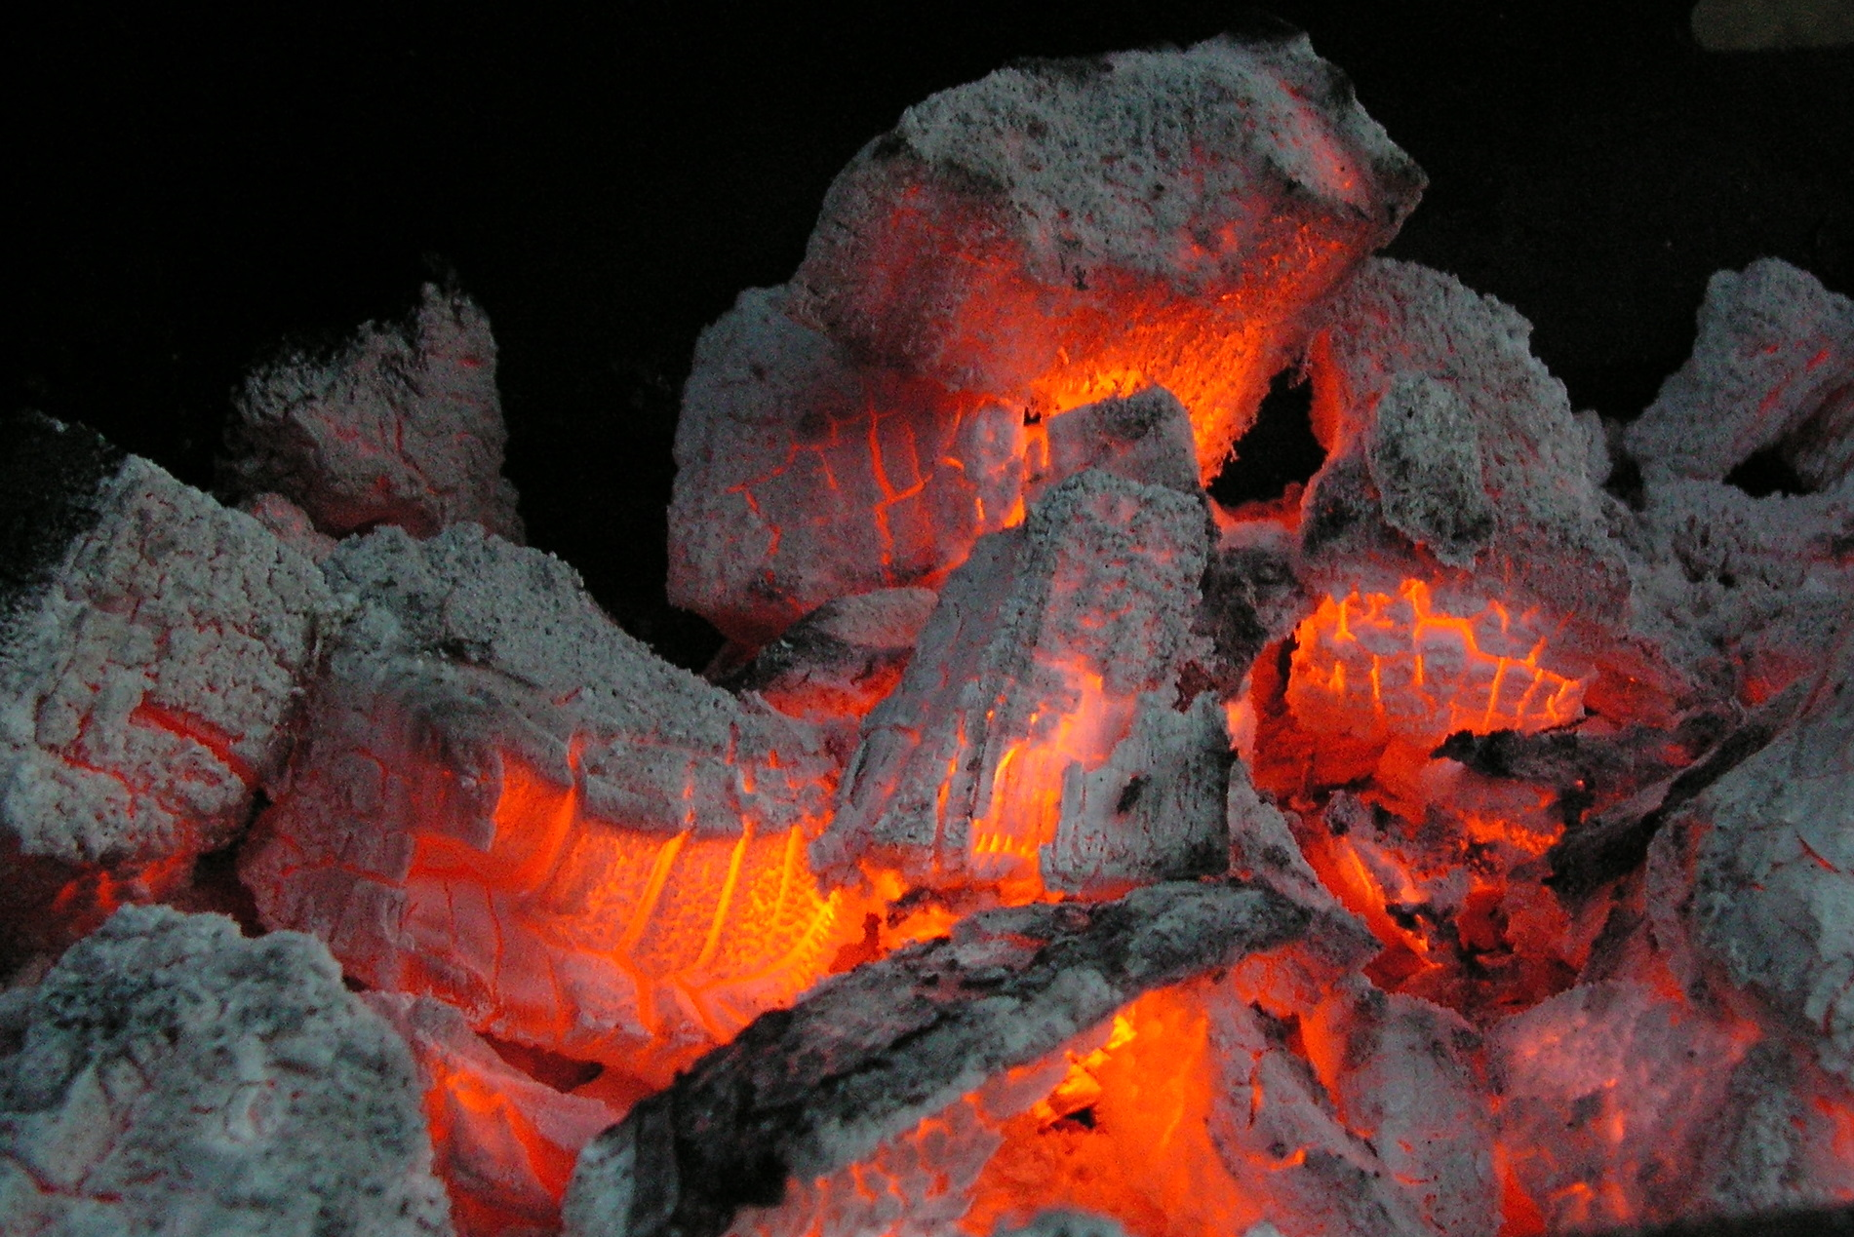
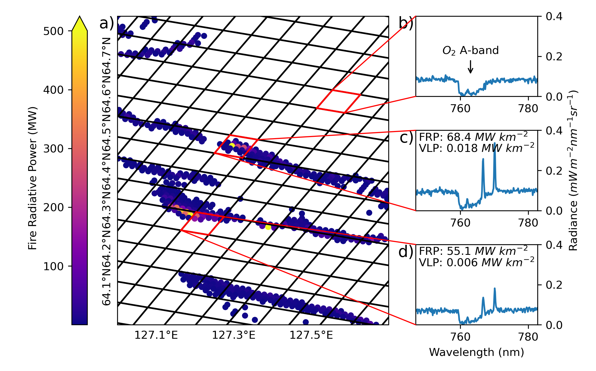
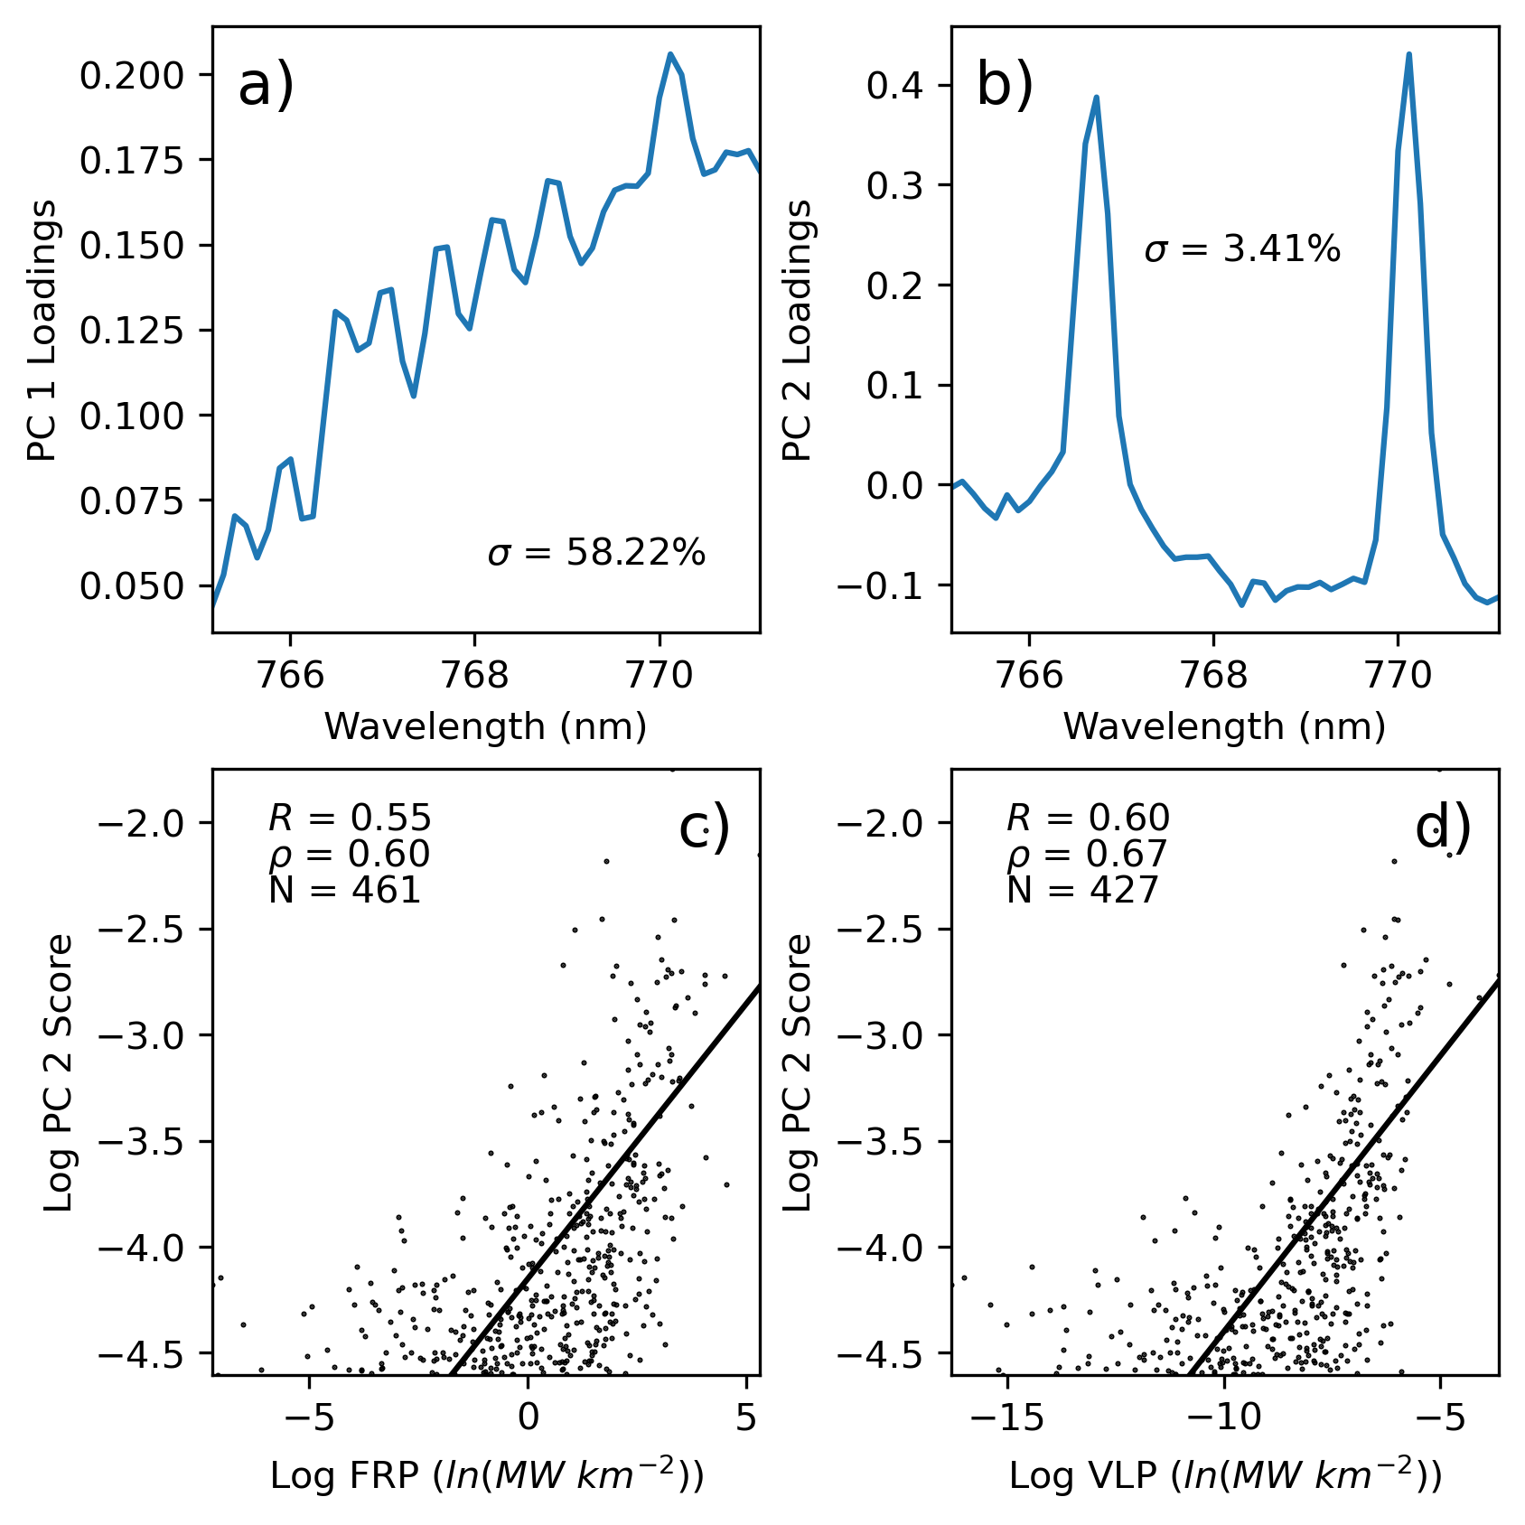
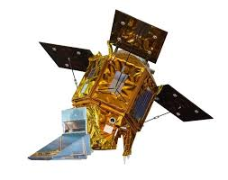
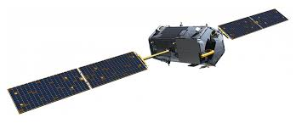
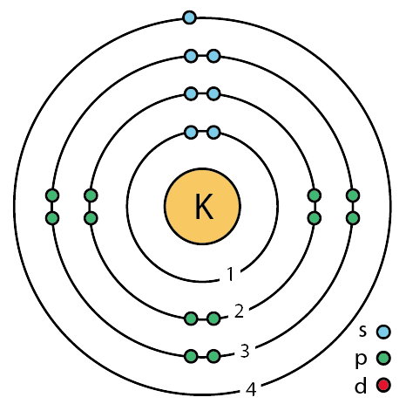
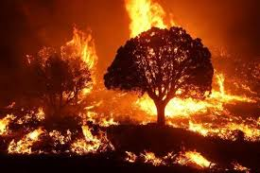
Place a headshot of yourself here
Julstrom–Satellite Detection of K-Lines in Wildfire Spectra
William Julstrom¹, Jun Wang¹, Meng Zhou¹
1. University of Iowa, Dept. of Chem. And Biochem. Engineering
The spectrum of biomass burning contains strong potassium emission lines
✅
❌
These K-lines are specific to flaming combustion
Hyperspectral Instruments
Detection of K-lines in Fire Pixels
Retrieval and characterization with PCA
TROPOMI
OCO-2

Slide 12

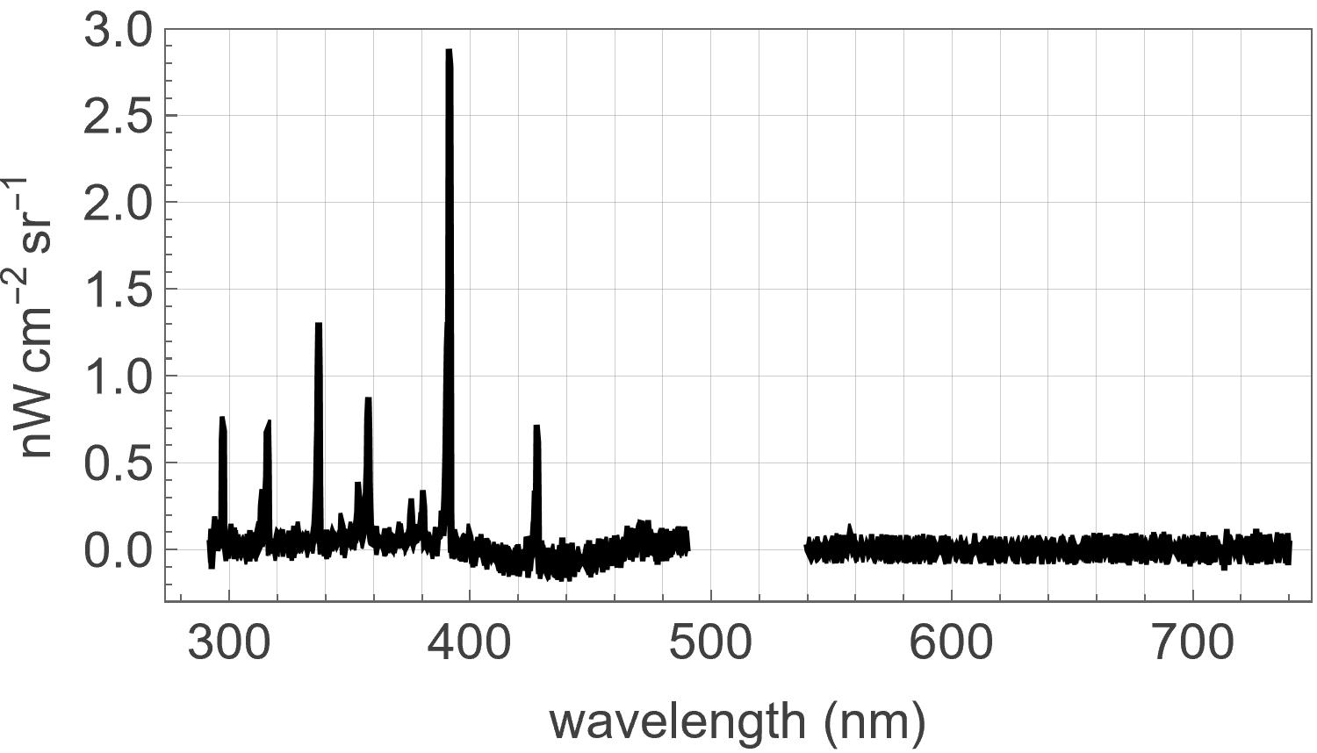
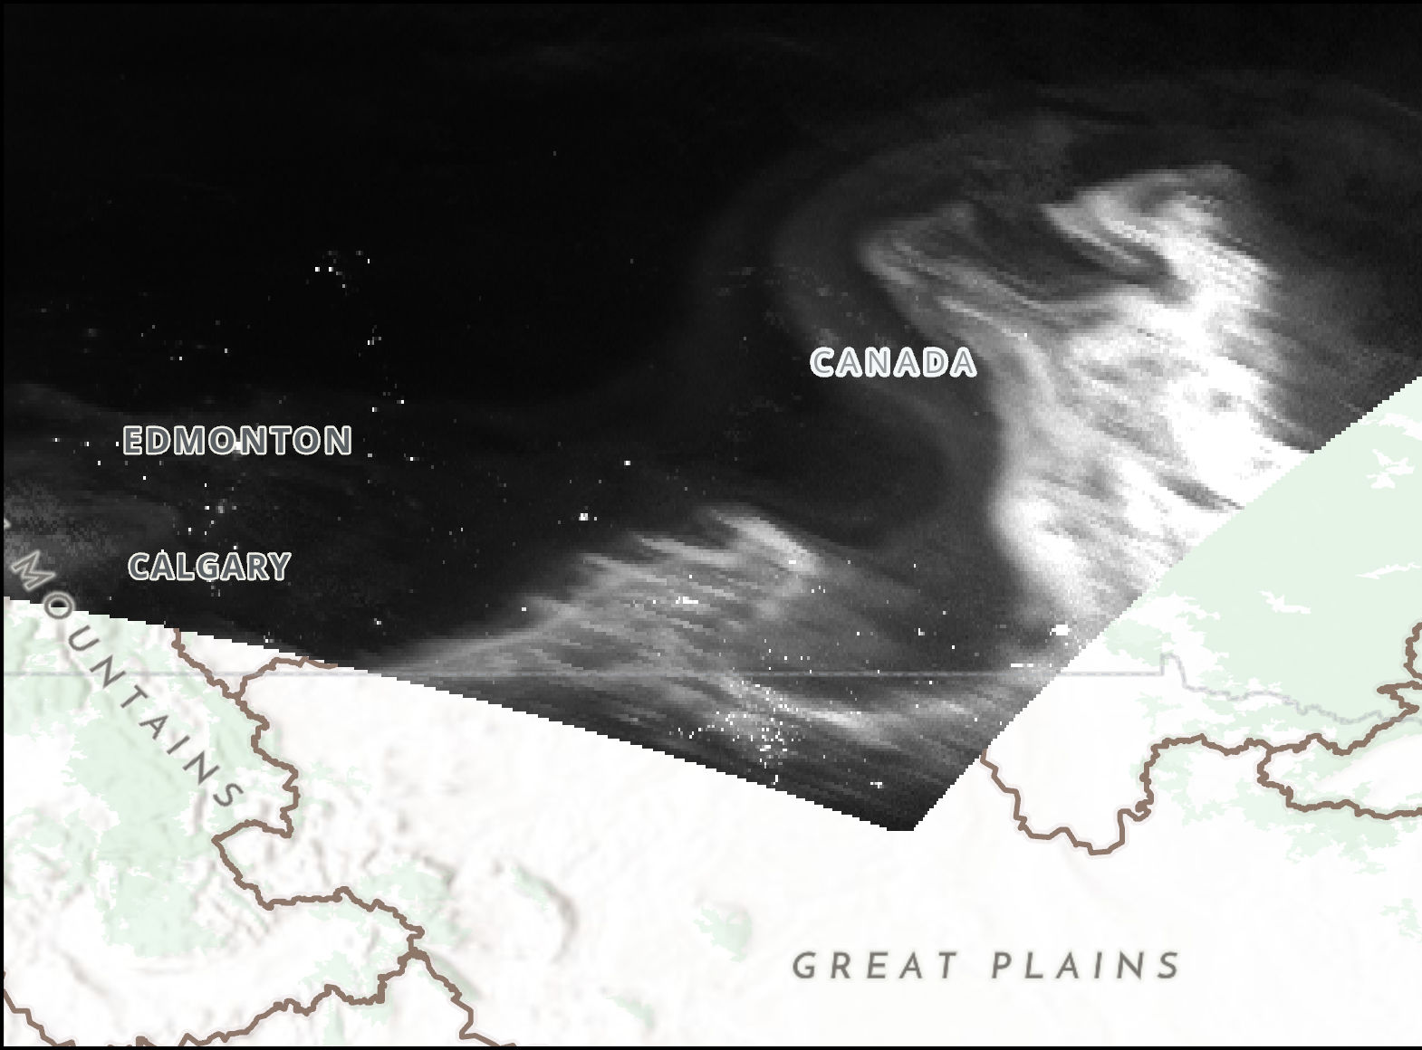
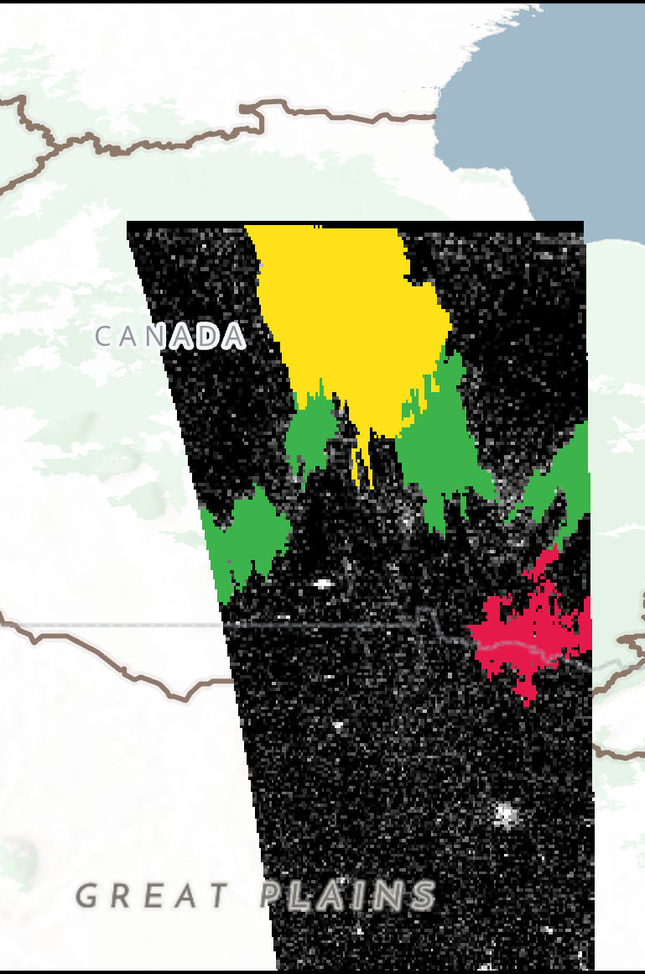
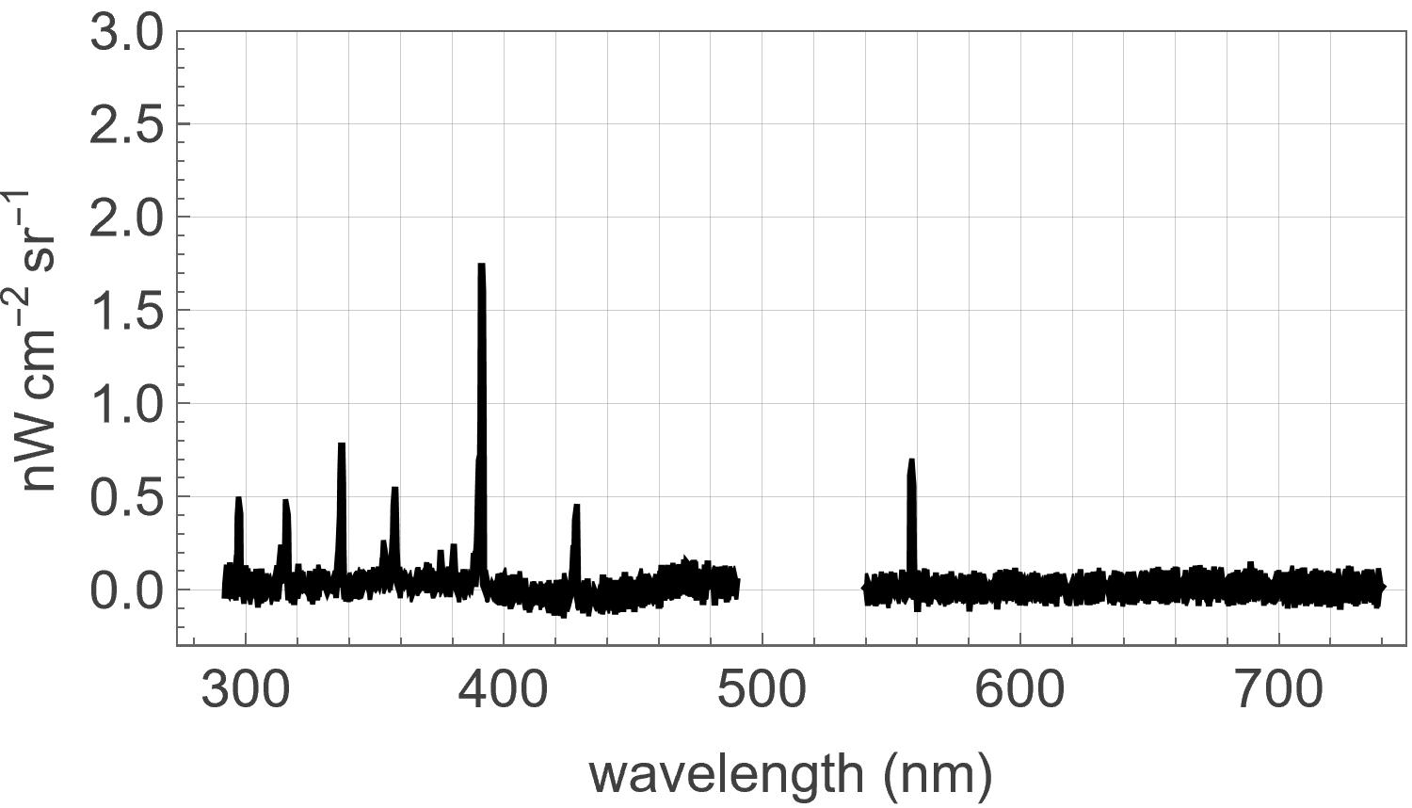
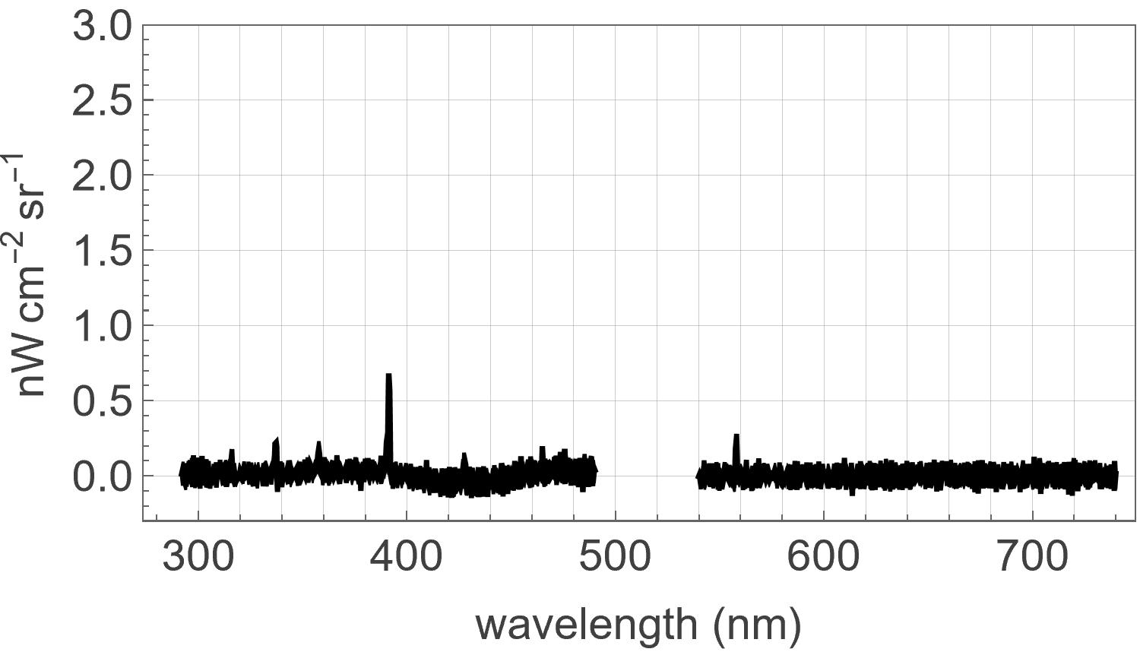
Kalb -- TEMPO Nighttime Lights Applications
Virginia Kalb^{1,2}, James Carr^{3,}, Houria Madani³, Zhuosen Wang^{1,4},
Ranjay Shrestha^{1,5}, Srija Chakraborty^{1,6} , Miguel Román¹
¹NASA/Goddard Space Flight Center, ²Science & Technology Corp., ³Carr Astronautics, Greenbelt,MD⁴, University of MD, ⁵SSAI, ⁶USRA
Geomagnetic Storm on October 11, 2024:
JPSS2 DNB 10:00Z
TEMPO RADT 09:55:08Z

Slide 13

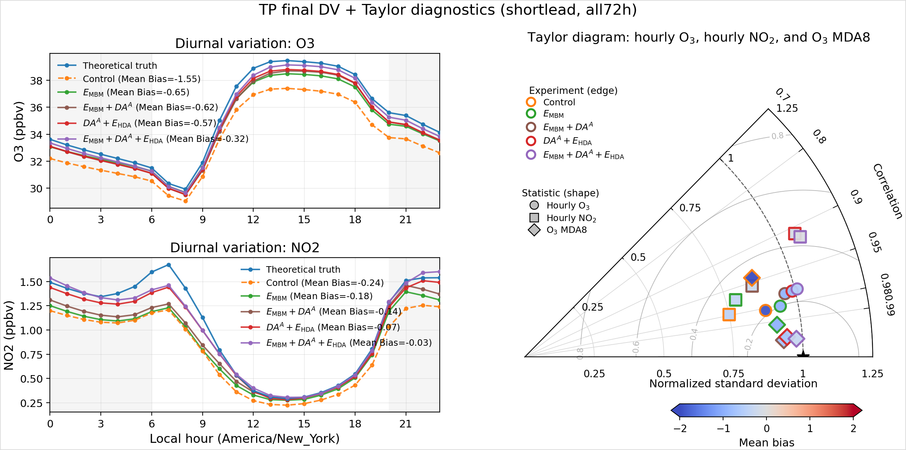
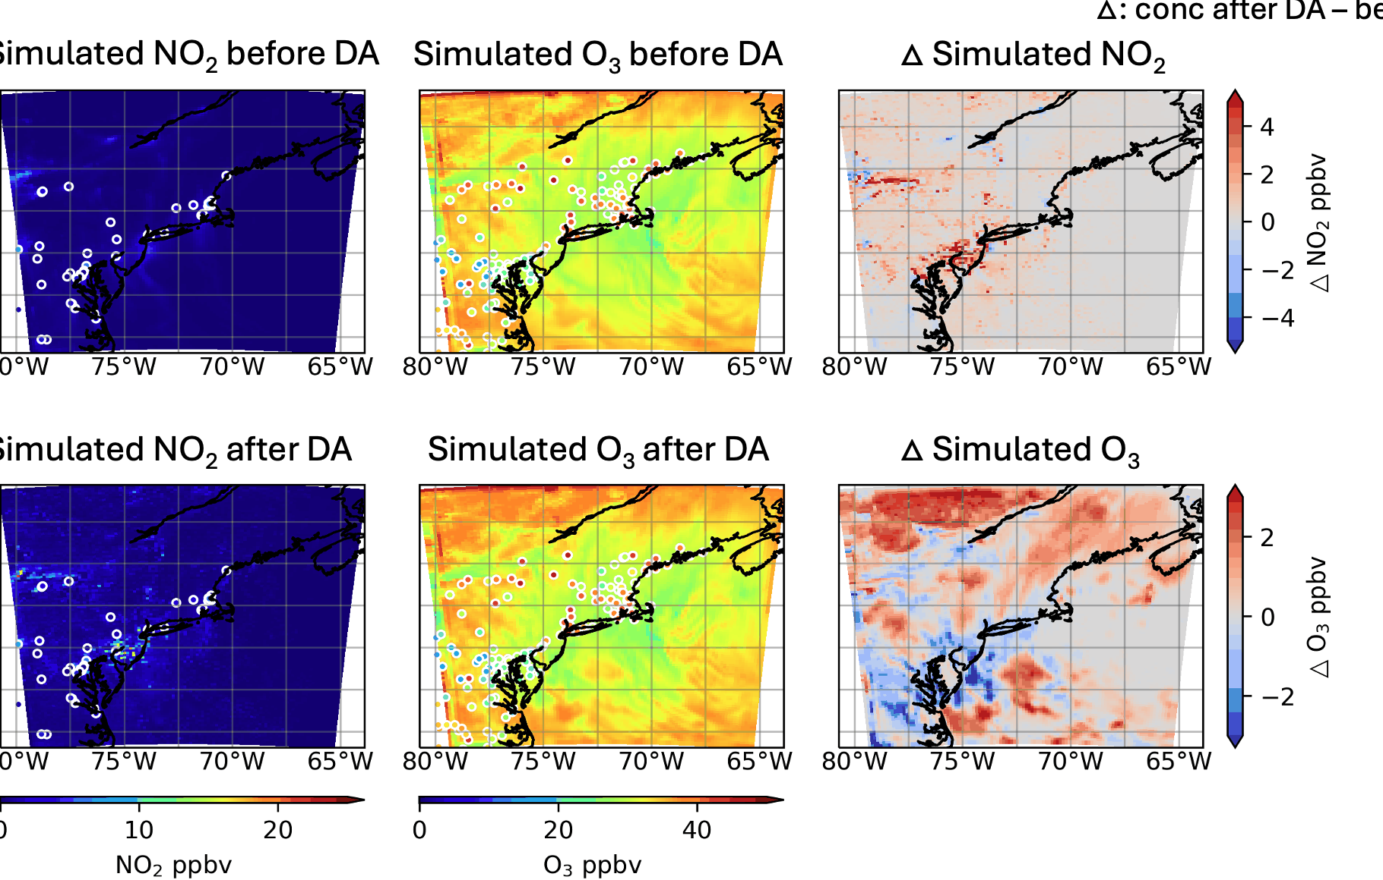
Li – TEMPO NO₂ DA for O₃ Forecast in UI-WRF-Chem
Chengzhe Li, Jun Wang, Huanxin (Jessie) Zhang
Department of Chemical and Biochemical Engineering, The University of Iowa
Key result: combined DA-informed emission update improves O₃ 72-h forecast skill
What I will share
How hourly TEMPO-like NO₂ VCDs are assimilated with ETKF.
How short-lived NO₂ information is converted into emission updates.
How the pseudo-TEMPO framework transitions to real TEMPO NRT DA.
Real TEMPO application underway
Visit the poster for the full ETKF–MBM workflow, experiment matrix, and real-case demo.
The full DA-MBM framework gives the lowest O₃/NO₂ mean bias and improved statistics across 72-h forecasts.
Contact: Chengzhe Li · chengzli@uiowa.edu
WRF-Chem · ETKF · TEMPO NO₂ · O₃ forecasting

Slide 14

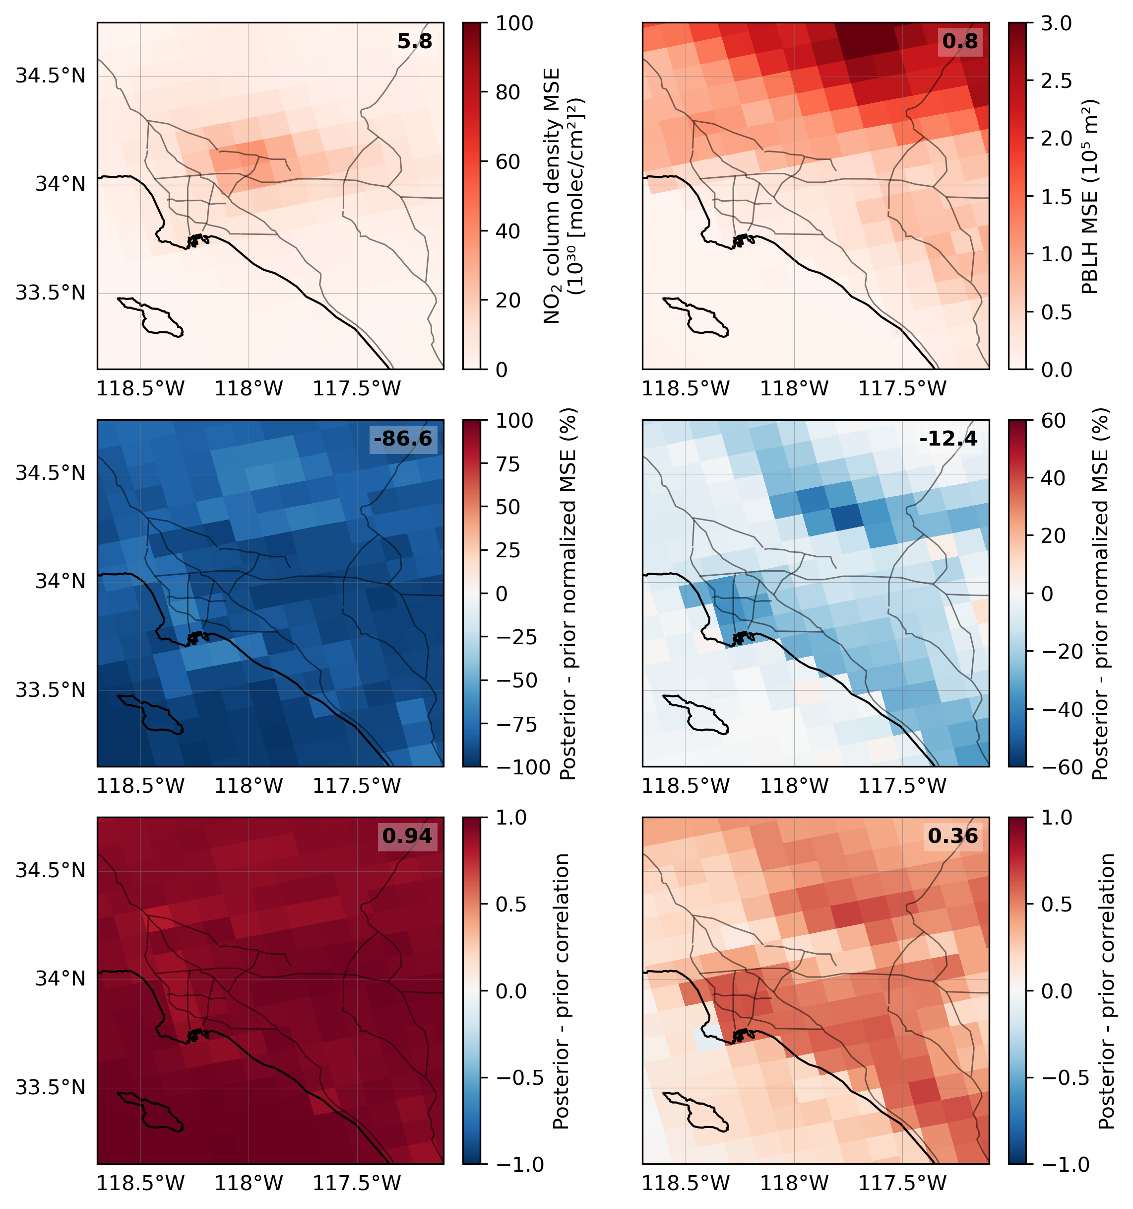
Mei - Constraining boundary layer height with NO₂ columns Eric J. Mei, U. of Washington; Center for Astrophysics, Harvard & Smithsonian
Alexander J. Turner, Gregory J. Hakim, and Qindan Zhu
Data assimilation of NO₂ column density improves estimates of PBLH.
PBLH MSE decreases
PBLH corr. increases
ΔMSE
ΔCorrelation
Los Angeles, CA

Slide 15
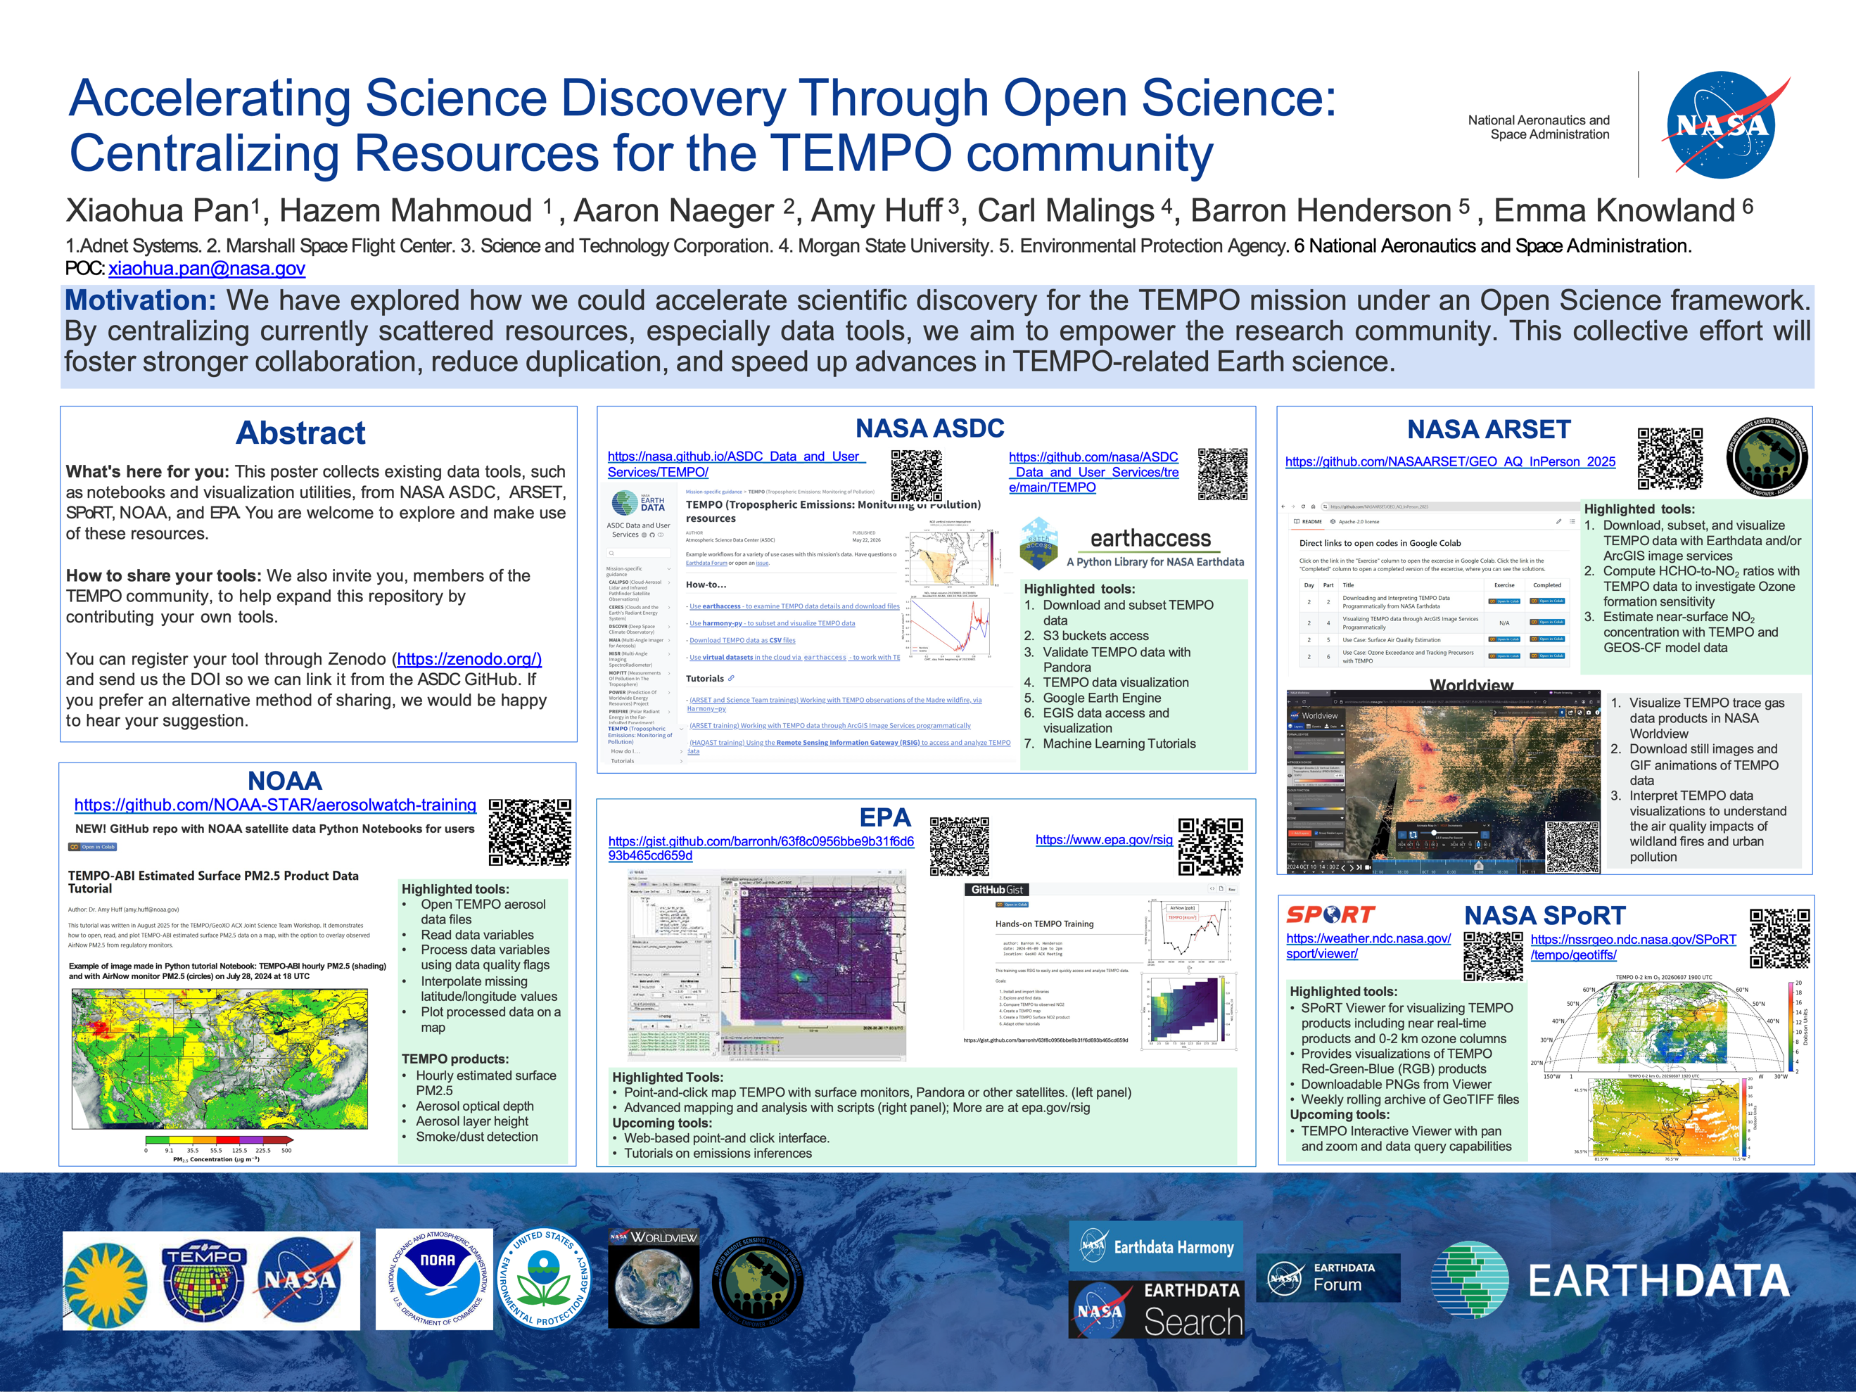

Slide 16
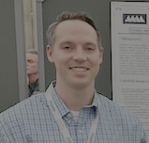










Place a headshot of yourself here
Phoenix–GEOS-CF Forecast Evaluation using TOLNet Ozone Profiles
Daniel B. Phoenix^{1,2}, Guillaume P. Gronoff², K. Emma Knowland³, Matthew Johnson⁴, Claudia Bernier⁴, and Maurice Roots⁵
¹Analytical Mechanics Associates, Hampton, VA, USA, ²NASA Langley Research Center, Hampton, VA, USA, ³NASA Headquarters, Washington, D.C., USA,
⁴NASA Ames Research Center, Moffett Field, CA, USA, ⁵NASA Goddard Space Flight Center, Greenbelt, MD, USA
TOLNet ozone profiles from 2020-2025 are used to evaluate the GEOS-CF ozone forecast
2. A subset of lidar acquisitions were categorized by the atmospheric condition: calm days, stratospheric intrusion, smoke plume, frontal passages.
CCNY
TOPAZ
TROPOZ
TMTOL
SMOL-4,5
LMOL
SMOL-3
UAH
Model Bias:
All LMOL Profiles
3. Lastly, versions 1 & 2 of the GEOS-CF analysis are evaluated and compared
Version 1 Bias
Version 2 Bias
1. The forecasts are evaluated for diurnal and seasonal variations, as well as forecast lead time.
V2 Ozone is ~10% higher

Slide 17




Place – Evaluation of Pandora surface NO₂ and HCHO
Bryan Place, Sciglob LLC/NASA Goddard
Apoorva Pandey, Jonguk Park, Lukas Valin, Eric Baumann, Dirk Felton, Amanda Teora, Mitchell Rodgers, Drew Gentner, Andrew Whitehill, Thomas Hanisco, Nader Abuhassan, Alexander Cede and Elena Lind
OldField NY HCHO
Bronx NY NO₂
R = 0.81
In situ
In situ
R = 0.73
Pandora
Pandora
Pandoras and surface monitors were co-located on the east coast,
Strong comparison correlations meant the Pandoras could boast,
Overall HCHO was biased high,
While NO₂ concentrations fell a bit shy,
Drop by to learn about what impacted the agreement the most

Slide 18
Place a headshot of yourself here
Radkevich – Python Notebooks for Comparison of … TEMPO V04 and Pandora
Alexander Radkevich, ASDC, NASA LaRC; ADNET Systems, Inc.
Daniel Kaufman, ASDC, NASA LaRC; Booz-Allen and Hamilton, Inc.
Present update of existing notebooks comparing NO₂ tropospheric, HCHO total, and O₃ total columns;
Details on accounting temporal features of Pandora retrieval for co-locating in time;
Details on co-locating in space;
Once Pandora location and timeframe of interest are selected, further processing is fully automated;
Key new feature – the use of L2 subsetter, reducing size of downloaded files by a factor of ~1800;
Selected results will also be presented.

Slide 19



Rangel de la Tejera – I-Canopy: A Scalable IoT Sensor Platform for High-Resolution Microclimate Monitoring
Rafael Rangel de la Tejera¹, Jun Wang¹, Lorena Castro García¹, Meng Zhou¹ and Spencer Kuhl²
¹Department of Chemical and Biochemical Engineering, University of Iowa, Iowa City, IA, USA
²Iowa Prototype and Research LLC, Iowa City, IA, USA
This poster presents the development and validation of I-Canopy, a low-cost IoT sensor platform designed for high-resolution microclimate monitoring in agricultural environments.
The system consists of self-sustained atmospheric and soil sensing units that measure air temperature, relative humidity, pressure, soil moisture and soil temperature.
The poster highlights the sensor design, deployment, data transmission workflow and validation of I-Canopy measurements against NOAA weather station observations.

Slide 20






Characterizing the Role of Planetary Boundary Layer Dynamics in Linking TEMPO HCHO Columns to Surface Air Quality
Prajjwal Rawat^{1,2}, James H. Crawford², Katherine R. Travis², Laura M. Judd², James J. Szykman³, Ruben Delgado¹, Lukas C. Valin³, Barron Henderson³,
Thomas F. Hanisco⁴, Gonzalo Gonzalez Abad⁵
¹Hampton University, VA, ²NASA LaRC, VA, ³EPA, NC, ⁴NASA GSFC, MD, ⁵SAO, Cambridge, USA
Validated TEMPO HCHO columns serve as a highly responsive proxy for effectively tracking surface O₃​ and PM​_{2.5} variability
PBL Dynamics as a Physical Regulator and Isolating Vertical Mixing Drivers:
Water Vapor Modulation of O₃​–HCHO & HCHO can Enhance Traditional AOD PM_{2.5}​ Tracking
PM_{2.5}
Aeronet AOD
Pandora HCHO (DU)

Slide 21








Place a headshot of yourself here
Rinaman–HCHO & NO₂ in situ observations over Baltimore
Johanna Rinaman Canet, University of Maryland Baltimore County & NASA GSFC
Erin Delaria, Jason St. Clair, Tom Hanisco, Lee Thornhill, Reem Hannun, Apoorva Pandey, Bryan Place, Andrew Swanson, Jay Tomlin, Jin Liao, Steven Rosesmith, Jonguk Park, Addison Colwell, Glenn M. Wolfe
HCHO
NO₂
TEMPO HCHO and NO₂ column validation
Investigating TEMPO spatial, diurnal, and day-to-day variability
TEMPO column
In situ mixing ratio
5.8 kts
5.8 kts

Slide 22









Place a headshot of yourself here
Roots – Multi-Source Observations for Understanding
Pollution Distribution
Maurice Roots, NASA GSFC – NPP
Catalog
Characterize
Generalize
I study nocturnal wind patterns that form a few hundred meters above the ground. These winds are strong enough to move air hundreds of miles, carrying with it water vapor, aerosols, and trace gases. My current work focuses on how these winds – known as low-level jets— are affecting atmospheric composition and, in turn, the people, environment, and economy of the I-95 corridor between Washington, DC and New York City.

Slide 23



Retrieval of Aerosol Optical Centroid Height (AOCH) using TEMPO
Oxygen B band: Algorithm development and preliminary results
Inderjeet Singh*, Xi Chen*, Zhendong Lu, Jun Wang*
Iowa Technology Institute, University of Iowa
We present an algorithm to retrieve Aerosol Optical Centroid Height
(AOCH) along with AOD at high spatiotemporal resolution for the TEMPO instrument.
Research is still ongoing, but some preliminary results are presented.
The following are few details about algorithmic implementation
  Programming Language: python
  Products: AOD at 443 nm, 550 nm, 680 nm; 354-388 nm UVAI; AOCH (km);
  Surface reflectance at 443 nm and 680 nm; Cloud flag; Quality flags
  Output Format: netCDF

Slide 24







Wu – Comparisons of the TEMPO Ozone Profile Product with Ground-Based Ozone Lidar and Applications to Air Quality Studies over New York City
Yonghua Wu, Thomas Ely, Fred Moshary
the City College of New York
20260518 21:00UTC O₃-AQI
Initial comparisons of O₃ profile between TEMPO and CCNY O₃-lidar product indicate good consistency below 10-km AGL, statistical average of their relative difference is generally ≤ 20% except the 0-2km product.
For the 0–2 km O₃, the TEMPO product overestimates O₃ values relative to the lidar retrievals in 2025, better agreement in 2026.
Spatial distributions of TEMPO 0-2 km O₃ product generally show consistent O₃ hot-spot with ground-level O₃ monitoring in the NJ-NY-CT tri-state area, indicating the downwind transport and regional impact of urban plumes.
CT
NJ
NY
airnow.gov
Temporal comparison of 0-2km O₃
TEMPO vs. lidar O₃ profile
NOAA-EPA NAQFC forecast O₃
CT
NY
NJ

Slide 25






Using TEMPO to identify agricultural NO₂ hotspots for FarmFlux
Jessie Zhang, Jun Wang, Lakhima Chutia, Lorena Castro, Meng Zhou (U of Iowa)
Emily Fischer (CSU), Jeffrey Geddes (BU), Glenn Wolfe ( NASA GSFC)
TEMPO NO₂ (March-June, 2024-2025)
with FarmFlux target regions
TEMPO data helps guide FarmFlux sampling:
NE Corn/Soy region example
What month/ week of the month should FarmFlux sample?
March
April
May
June
2024
2025
2026
What time of the day should FarmFlux sample?
Morning
Noon
Afternoon-Evening
March
May
June
TEMPO NO₂ shows persistent enhancements from March- June, with broader hotspots in May.
TEMPO hourly NO₂ shows sustained daytime enhancements during May-June.

