Slide 1

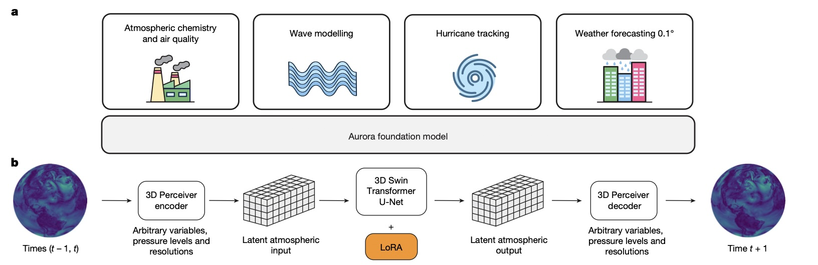
TEMPO DART 2026
Fine-Tuning Earth System Foundation Models to Predict Fire-Related Near-Ground NO₂
Reference: Bodnar et al., Nature (2025)
Hugo Lee¹ (huikyo.lee@jpl.nasa.gov)
¹: Jet Propulsion Laboratory, California Institute of Technology
01
Notes:
Opening slide. Emphasize that the talk connects Earth system foundation models, TEMPO observations, and near-ground NO₂ prediction for fire-related air quality.

Slide 2
Geospatial Foundation Models (GeoFMs)
Why pretrain + fine-tune changes atmospheric ML workflows
From task-specific models to reusable atmospheric intelligence
01 Task-specific ML
XGBoost, CNNs, GANs, diffusion models, ViTs, and related models are often trained from scratch for one science task.
02 Foundation models
Prithvi WxC, Aurora, and ORBIT are pretrained on massive archives to learn broad atmospheric dynamics, physics, and chemistry.
03 Fine-tuning
A frozen or partially adapted FM can be specialized for forecasting, downscaling, hurricane tracking, gravity waves, and air-quality bias correction.
Key idea for this talk: use a pretrained global air quality FM, then fine-tune it regionally for fire-related NO₂.
Pretraining provides broad context; fine-tuning focuses it on a regional decision-support target.
TEMPO DART 2026 • Aurora / TEMPO / AirNow
02
Notes:
Original detailed points retained in condensed form: most atmospheric ML/DL models are task-specific; FMs such as NASA Prithvi WxC, Microsoft Aurora, and DOE ORBIT are pretrained in a task-agnostic manner on massive data and can be fine-tuned for tasks including forecasting, downscaling, hurricane tracking, and gravity wave parameterization.

Slide 3
Air Pollution Predictions Using Aurora FM
Open-source 1.3B+ dynamics-and-chemistry model for 3-D forecasts
Aurora Air Pollution connects global reanalysis/forecast context to AQ predictions that can be fine-tuned for regional decisions.
Aurora Air Pollution
>1.3 Billion
parameters
0.4° global
Pretrained on
ERA5 • CMIP6 • MERRA-2 • CAMS
Meteorology + chemistry
CAMS reanalysis / forecasts
Static terrain, land, emissions-like fields
Global AQ outputs
2-D: column O₃, NO₂, CO, SO₂; PM and surface pollutants
3-D: chemical species + meteorology across pressure levels
Fast inference for scenario experiments
→
→
Fine-tuning and digital-twin workflow
Observations + simulations
TEMPO • AirNow • GCHP
Fine-tuned
Aurora recipes
Scenario engine + AQ alerts
rapid what-if simulations
→
→
TEMPO DART 2026 • Aurora / TEMPO / AirNow
03
Notes:
Aurora Air Pollution has more than 1.3 billion parameters and produces global chemistry and meteorology forecasts. Fine-tuning is framed as a path to a TEMPO/AirNow/GCHP-enabled digital twin workflow.

Slide 4
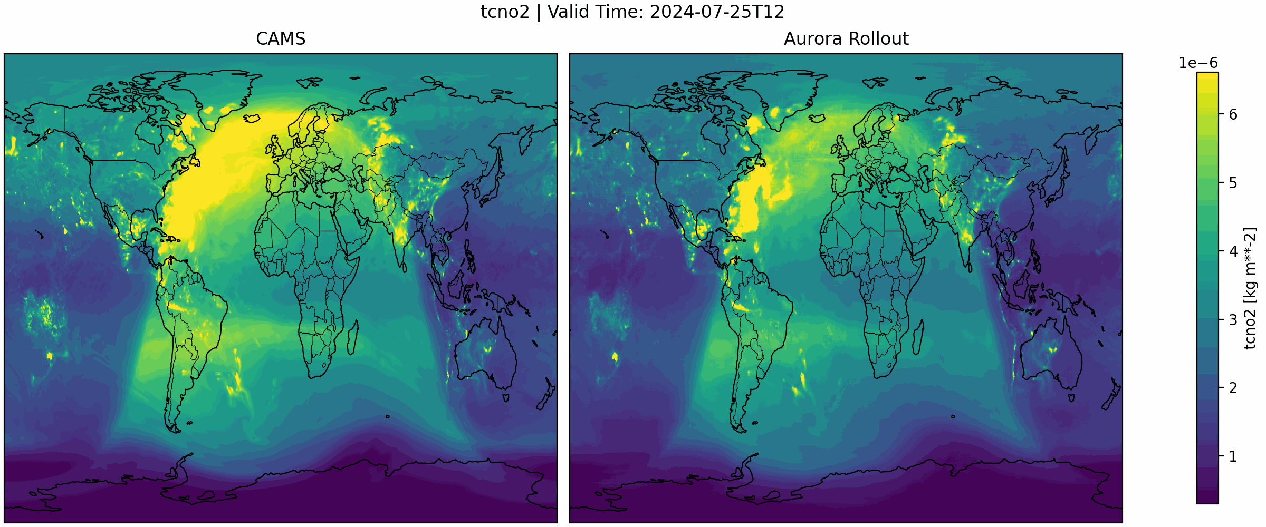
Aurora zero-shot: 3-Day Global Forecast without Fine-Tuning
Example initialization: CAMS 2024-07-25 00Z; six 12-hour steps
Initialization
CAMS 2024-07-25 00Z
U10, V10, T2M, SLP; chemistry columns; 13 pressure levels
Rollout
6 × 12 hours = 3 days
pretrained Aurora Air Pollution (0.4°)
Outputs
CO, O₃, NO, NO₂, PM, SO₂
+ winds, temperature, geopotential height
Zero-shot forecast comparison
Zero-shot rollout workflow
01
Download CAMS data
(initial input)
02
Aurora checkpoint
03
6-step rollout
04
NetCDF output
→
→
→
TEMPO DART 2026 • Aurora / TEMPO / AirNow
04
Notes:
Original details condensed: initial CAMS data include near-surface meteorology, chemistry columns, and 13 pressure-level variables from 1000 to 50 hPa. The zero-shot run uses pretrained Aurora Air Pollution at 0.4 degrees, six 12-hour steps, and outputs chemistry plus meteorology.

Slide 5
Static Variable Inputs
Static grid shape: 451 × 900
Aurora uses fixed gridded surface and emissions-like variables alongside dynamic atmospheric fields.
Geophysical variables
lsm — land–sea mask (0 or 1)
z — surface height
slt — soil type stored as float values 0–7
Emissions-like fields
static_ammonia / static_ammonia_log
static_co / static_co_log
static_nox / static_nox_log
static_so2 / static_so2_log
Soil type codes: 0 ocean · 1 coarse · 2 medium · 3 medium fine · 4 fine · 5 very fine · 6 organic · 7 tropical organic
Reference: Bodnar et al. (2025)
TEMPO DART 2026 • Aurora / TEMPO / AirNow
05
Notes:
This slide enlarges the original variable list while retaining all static variables: lsm, z, slt, and static emissions-like fields for ammonia, CO, NOx, and SO2, including log variants.

Slide 6
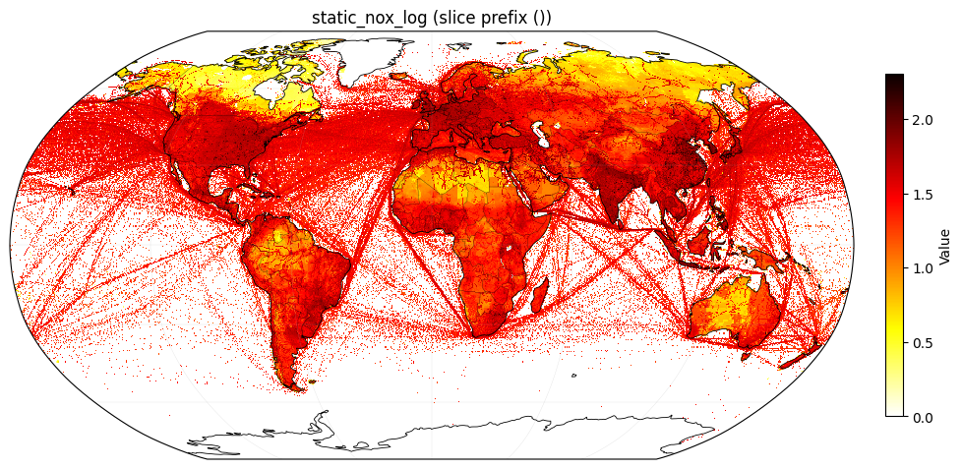
Aurora Static Variables Editor
Notebook: github.com/midatm1234/aurora/blob/chem/examples/static_variables_editor.ipynb
01
Inspect & edit
Load the static variables, inspect them, and compare original vs. edited maps before saving.
02
Editable targets
Ammonia, CO, NOx, and SO₂ can be edited; log fields update consistently.
03
Regional masks
Apply edits globally or within a latitude/longitude region using a mask.
Example: static_nox_log
04
Important limitation
Adding a new variable requires extending the model configuration.

Slide 7
Fine-Tuning the Aurora Rollout Model
Frozen Aurora backbone + trainable flow-matching residual head
Input
(t−Δt, t)
Aurora Air Pollution
1.3B parameters
frozen
Flow Matching
trainable
Bias-corrected NO₂
1000, 925, 850 hPa + column
(t+Δt)
→
→
→
Regional domain
U.S. West
Lat: 31–52°N
Lon: 128–100°W
Predictors
Surface: t2m, u10, v10, msl, tcno2
Profiles: z, u, v, t, q, no2 at 13 levels
Static emissions fields
Training setup
Batch size: 8
Learning rate: < 3e−4
Loss: residual flow matching + spatial, correlation, extremes, distribution, and column/profile terms
The Aurora FM stays frozen;
the residual head learns the regional bias-correction.
TEMPO DART 2026 • Aurora / TEMPO / AirNow
07
Notes:
Original details retained: predictors include t2m, u10, v10, msl, tcno2; z, u, v, t, q, no2 at 13 pressure levels plus static emissions fields. Loss includes base flow-matching residual loss and structural terms for spatial gradients, anomaly correlation, extremes, peaks, distribution matching, and column NO2/profile NO2 coherence.

Slide 8
Flow Matching
Residual denoising head for bias correction
Target residual: ε = y_true − ŷ
Aurora prediction
ŷ
Noisy residual
εₜ
Flow Matching
denoise + predict residual
Residual
r̂
Output
ŷ + r̂
→
→
→
→
Training
The head sees noise-corrupted versions of the true residual at random noise levels and learns to recover the clean residual.
Inference
Starting from random noise, the head iteratively denoises a residual estimate r̂ and adds it back to Aurora.
Flow matching is used as a bias-correction layer on top of Aurora rollout output.
TEMPO DART 2026 • Aurora / TEMPO / AirNow
08
Notes:
Flow matching: the model learns a residual correction r_hat and adds it back to Aurora prediction y_hat. Training uses noisy residuals; inference uses iterative denoising.

Slide 9
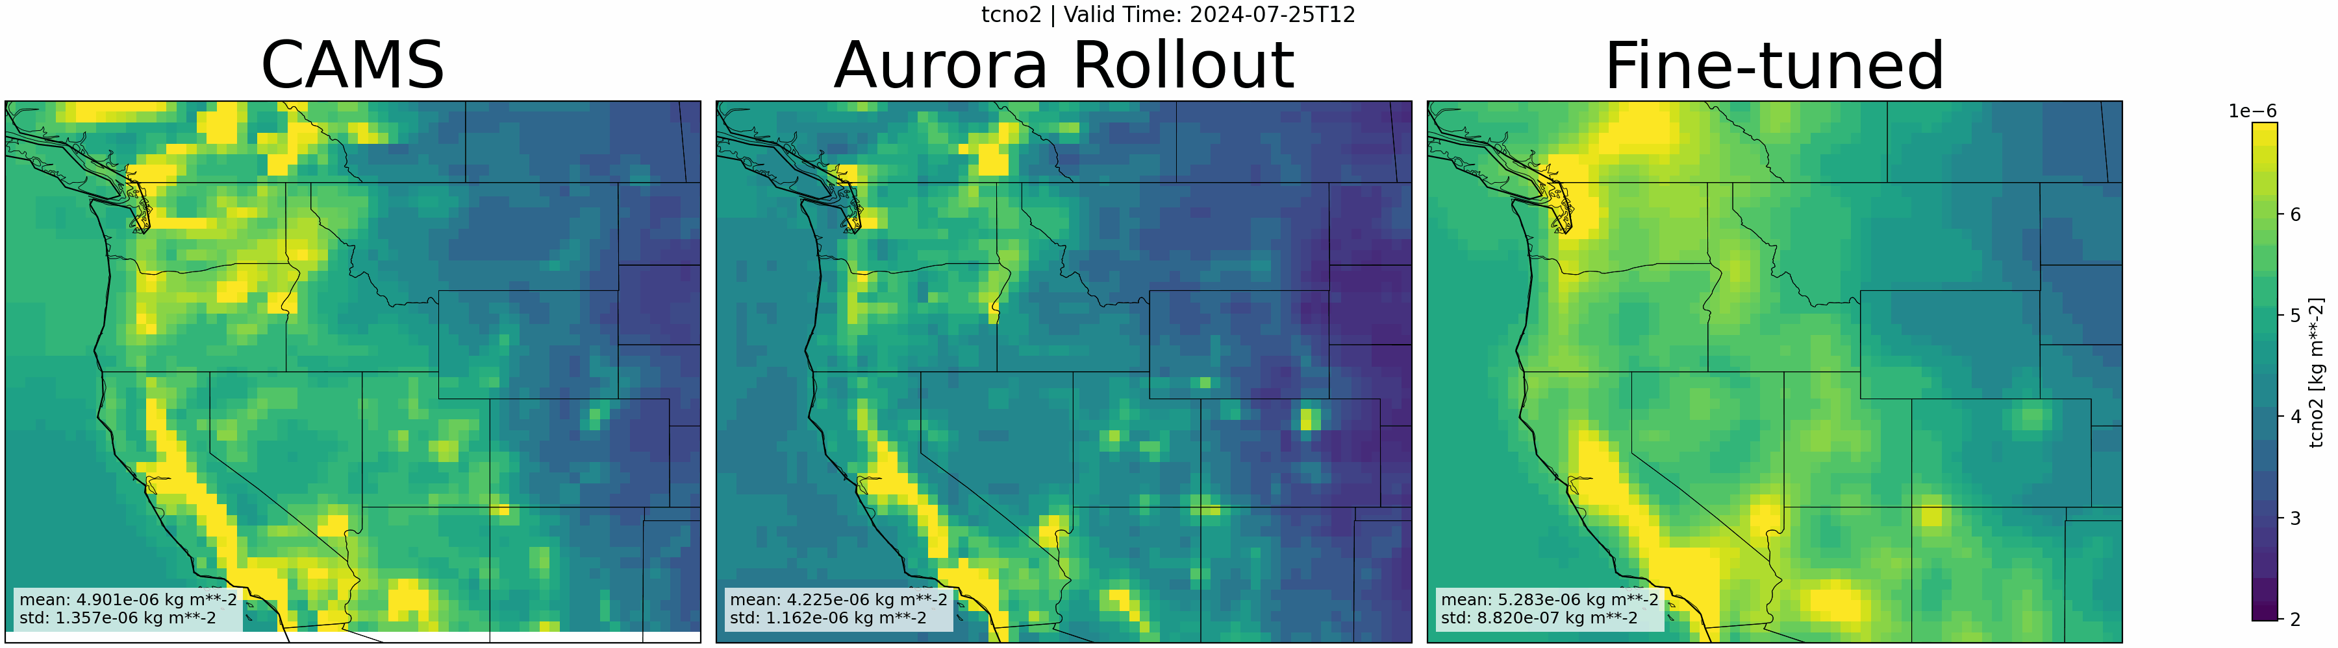
Fine-Tuning Results: Improvement with Longer Training Data
Training data: one year of CAMS forecasts, July 2023–June 2024
Total-column NO₂ comparison over the U.S. West
Main improvement
The fine-tuned Aurora output shows better agreement with the CAMS forecast than the zero-shot Aurora rollout.
Remaining challenge
Joint bias correction for total-column NO₂ and 13-level vertical NO₂ profiles remains difficult.
TEMPO DART 2026 • Aurora / TEMPO / AirNow
09
Notes:
After training the Flow Matching model using one year of CAMS data from July 2023 to June 2024, the fine-tuned Aurora output shows better agreement with CAMS forecast than Aurora rollout. Bias correction for both total column NO2 and vertical NO2 profiles at 13 levels remains a significant challenge.

Slide 10


Microsoft/Aurora Collaboration
Cloud acceleration for Aurora fine-tuning and NASA air-quality applications
Why JPL is a strong partner
Expertise in air quality, physics-based modeling, data assimilation, and satellite retrievals.
Collaboration support
Azure credits; Microsoft senior data scientist support; access to NVIDIA A100/H100 processors.
Community pathway
Microsoft is open-sourcing Aurora and collaborating with the University of Cambridge and Hadley Centre.
TEMPO DART 2026 • Aurora / TEMPO / AirNow
10
Notes:
Original collaboration points retained: Microsoft AI for Good Lab is excited to work with JPL; provided Azure credits; assigned a senior data scientist; enabled access to A100/H100; open-sourcing Aurora; collaborations with University of Cambridge and Hadley Centre.

Slide 11
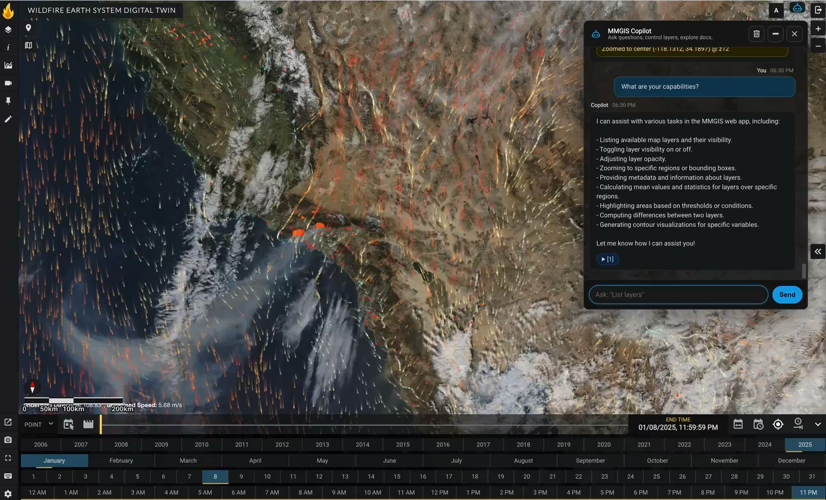
Interpretive AI Layer: Multi-Mission GIS Copilot
Connecting TEMPO-informed GeoFM forecasts to actionable decision support
Decision-support goal
Translate observational and model fields into plain-language wildfire and air-quality guidance.
Data fusion
Combine TEMPO, AirNow, Aurora, and GIS layers in one analysis workspace.
Agentic workflow
Automate queries, map interpretation, and scenario summaries for end users.
Vision: wildfire and air-quality decision support through open-source GIS + Agentic AI.
TEMPO DART 2026 • Aurora / TEMPO / AirNow
11
Notes:
Interpretive AI layer: connect TEMPO-informed, fine-tuned GeoFM forecasts to open-source GIS and Agentic AI tools for wildfire and air-quality decision support.

Slide 12
Summary and Next Steps
Aurora + flow matching + TEMPO/AirNow path toward near-ground NO₂ prediction
1
Aurora enables rapid global 3D air-quality prediction, but zero-shot rollout still needs regional bias correction.
2
Flow-matching fine-tuning improves total-column NO₂ agreement with CAMS over the U.S. West.
3
Next: fine-tune Aurora using TEMPO tropospheric column NO₂ as a predictor and EPA AirNow near-ground NO₂ as the target.
4
Decision support: connect TEMPO-informed GeoFM forecasts to open-source GIS and Agentic AI tools.
Xiaohua Pan, Wednesday 11 AM, “Advancing Wildfire Monitoring with TEMPO and ML Tools: Hourly Smoke and Fire-Front Mapping and Near-Surface NO₂ Predictions.”
TEMPO DART 2026 • Aurora / TEMPO / AirNow
12
Notes:
Summary points from original slide: Aurora enables fast global 3D air-quality prediction but zero-shot rollout requires regional bias correction; flow-matching fine-tuning improves total-column NO2 agreement with CAMS over the U.S. West; next step is to fine-tune Aurora with TEMPO tropospheric column NO2 as predictor and ground-based AirNow NO2 observations as target; connect GeoFM forecasts to open-source GIS and Agentic AI decision support; remind audience to attend Xiaohua Pan talk.

