Slide 1

Towards Assimilation of TEMPO Aerosol Layer Height into the Unified Forecast System
Brian McDonald, Ph.D.
Program Lead, Atmospheric Composition Modeling
NOAA Chemical Sciences Laboratory
TEMPO DART Team Meeting
(June 16, 2026)

Slide 2

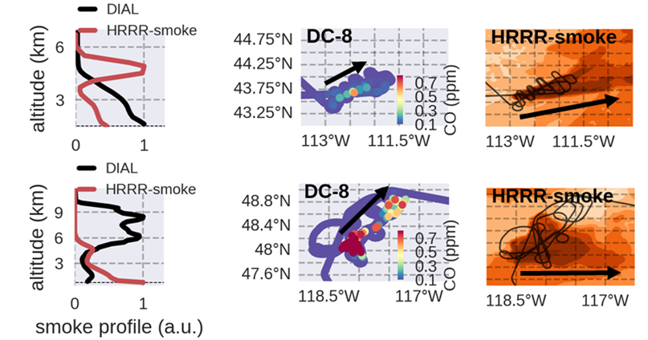


Plume Injection Height Critical for Predicting Smoke Transport
Airborne lidar
Too
far
Sheep
(Jul 24, 2019)
Trammell
Lyu
Wrong
direction
Williams Flats
(Aug 8, 2019)
Siyuan
Wang
Support from
NOAA Climate Program Office
  NASA DIAL: Johnathan Hair, Taylor Shingler, Marta Fenn

Slide 3
Research Objectives
Evaluate TEMPO aerosols (AOD and ALH) with NASA DC-8 airborne in-situ observations
Evaluate UFS-Chem aerosols with NASA DC-8 airborne in-situ observations
Assess aerosol layer height with NASA GV airborne lidar

Slide 4
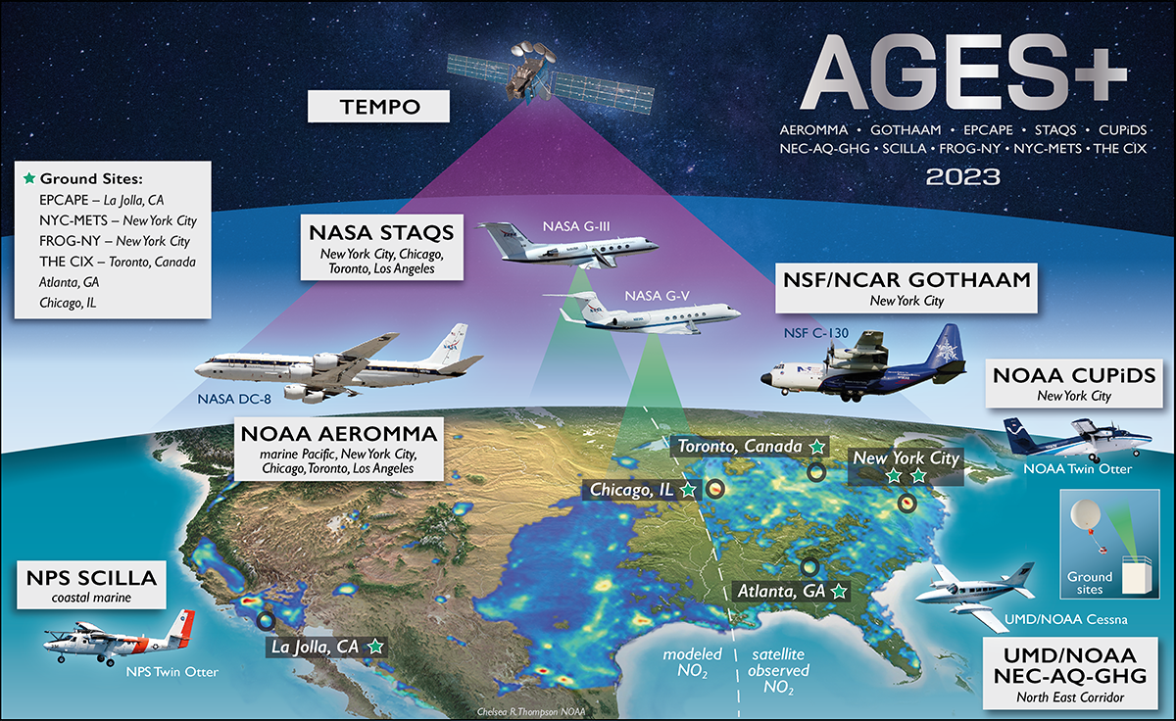







AGES+ Airborne Field Campaigns in Summer 2023
https://csl.noaa.gov/projects/ages/

Slide 5
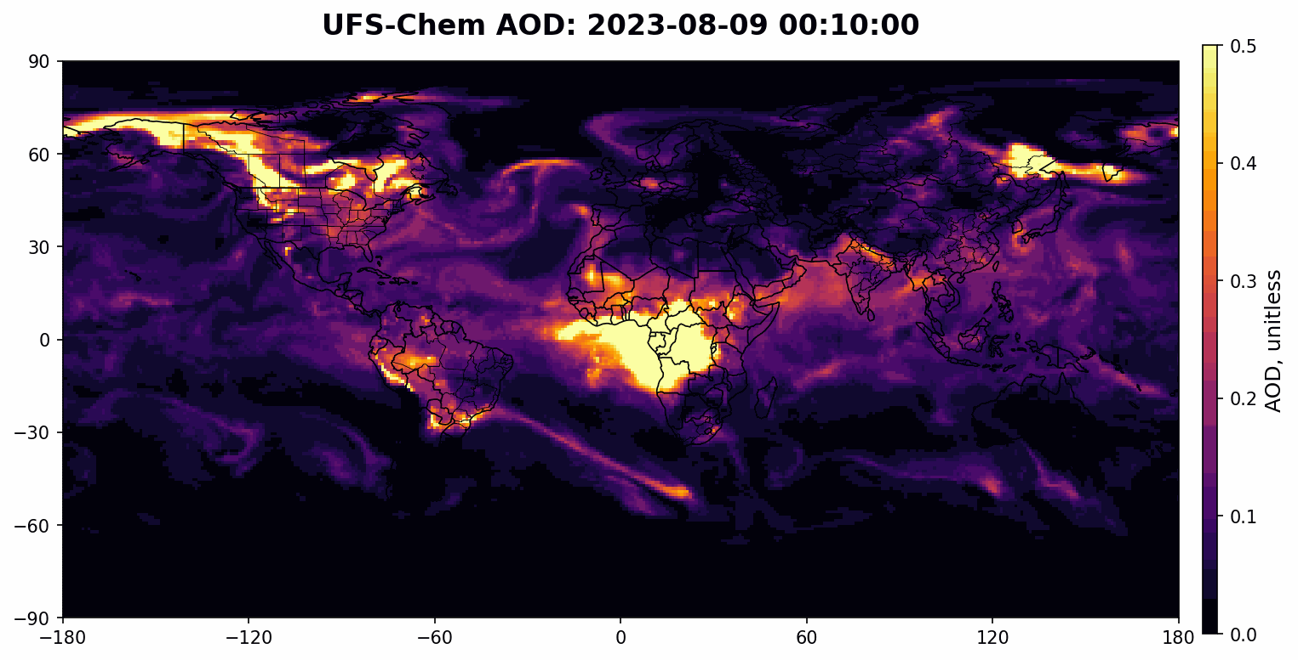



Eastern US Flights were Impacted by Canadian Wildfires
Maggie
Bruckner
Becky
Schwantes
UFS-Chem model described in He et al. (JAMES, 2026)
Supported by Bipartisan Infrastructure Law

Slide 6
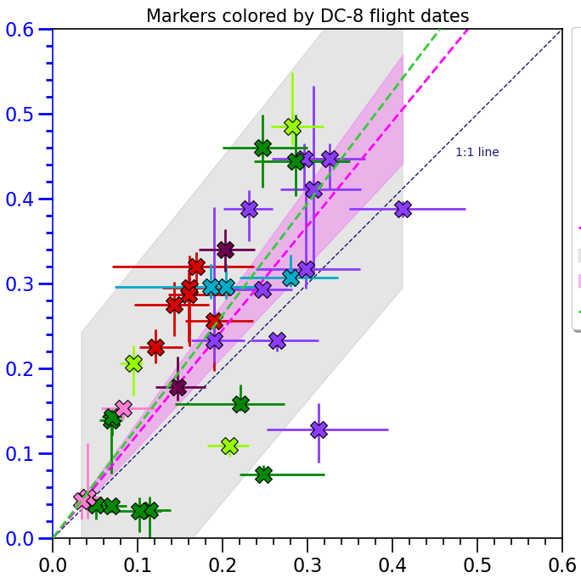
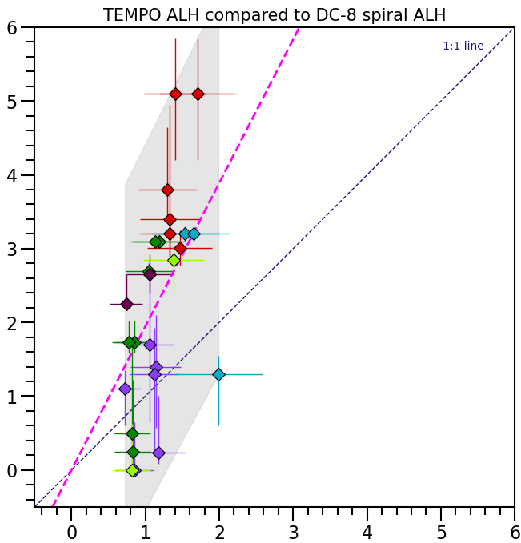


TEMPO Aerosols versus NASA DC-8 Spirals
TEMPO AOD
TEMPO ALH
Han
Hyun
Slope = 1.23
R² = 0.88
Slope = 1.94
R² = 0.80
Adam
Ahern
DC-8 AOD (unitless)
DC-8 ALH (km)

Slide 7
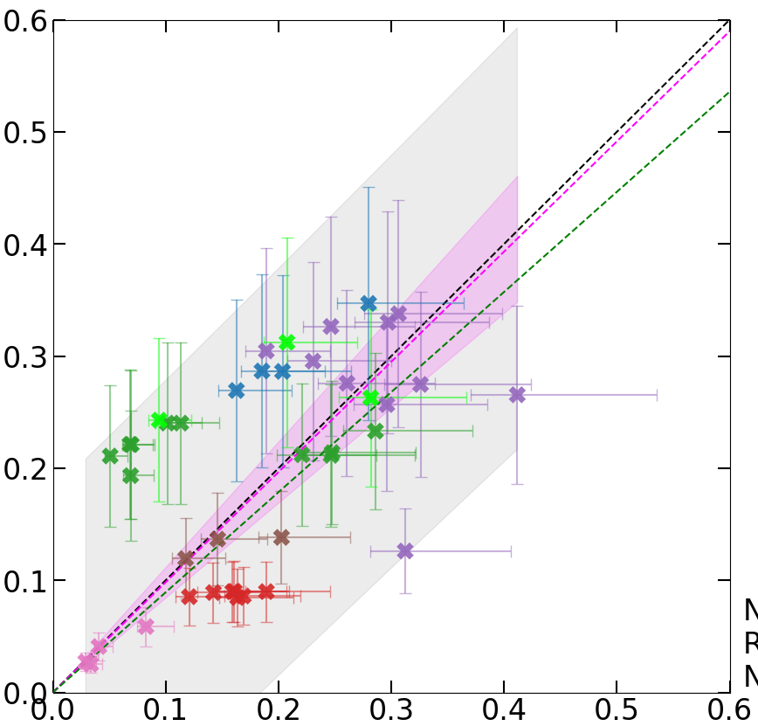
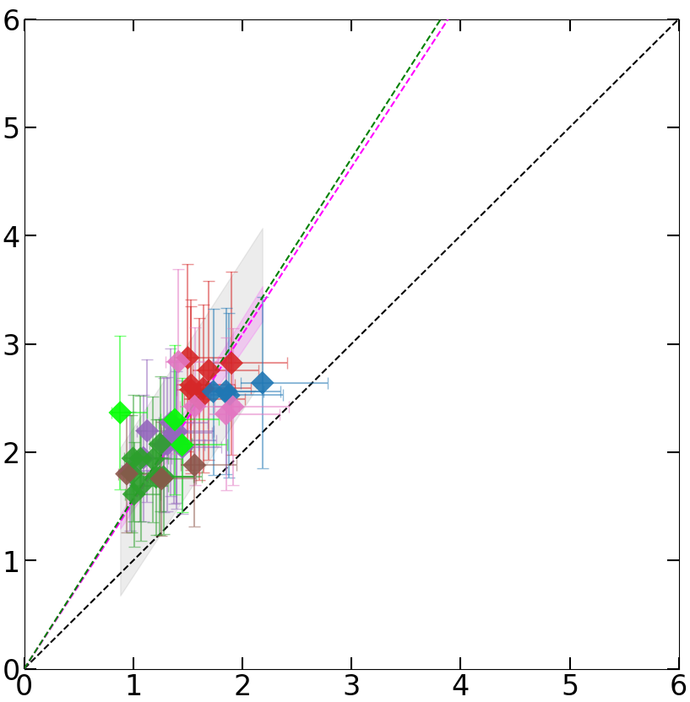

UFS-Chem Aerosols versus NASA DC-8 Spirals
UFS-Chem AOD
UFS-Chem ALH
Trammell
Lyu (CIRES)
Slope = 0.98
R² = 0.32
Slope = 1.54
R² = 0.51
Owen
Cooper
DC-8 AOD (unitless)
DC-8 ALH (km)

Slide 8
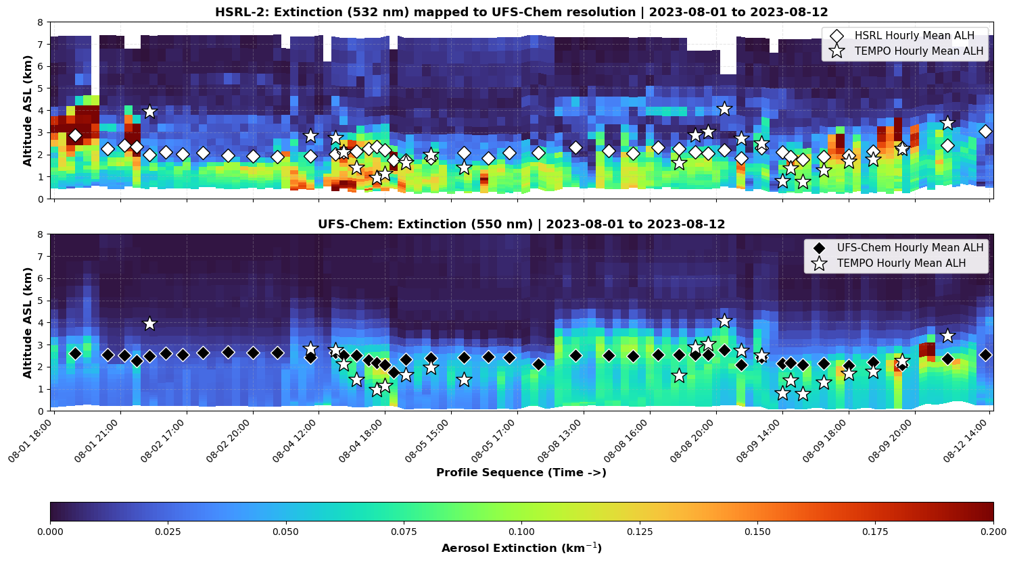
TEMPO and UFS-Chem versus NASA GV5 Airborne Lidar
HSRL-2 (532 nm)
TEMPO (550 nm)
ALH ~ 2.2 km
UFS-Chem
(550 nm)
ALH ~ 2.4 km

Slide 9

Summary
TEMPO and UFS-Chem AOD agree with NASA DC-8 in-situ obs
TEMPO and UFS-Chem ALH ~2x higher than NASA DC-8 in-situ obs
TEMPO and UFS-Chem ALH agrees with NASA GV5 airborne lidar
Han
Hyun
Adam
Ahern
Owen
Cooper
Trammell
Lyu
Siyuan
Wang
Becky
Schwantes
Maggie
Bruckner
Shobha
Kondragunta
Acknowledgment: Hai Zhang (NESDIS) for TEMPO aerosol products, Dan Cziczo and Chuck Brock for aerosol measurements, John Hair for HSRL-2, AEROMMA-STAQS teams,
Bipartisan Infrastructure Law, NOAA Climate Program Office

Slide 10
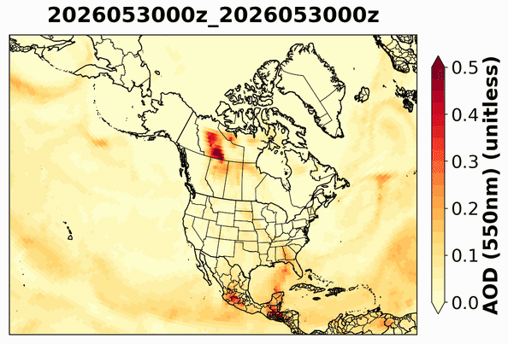
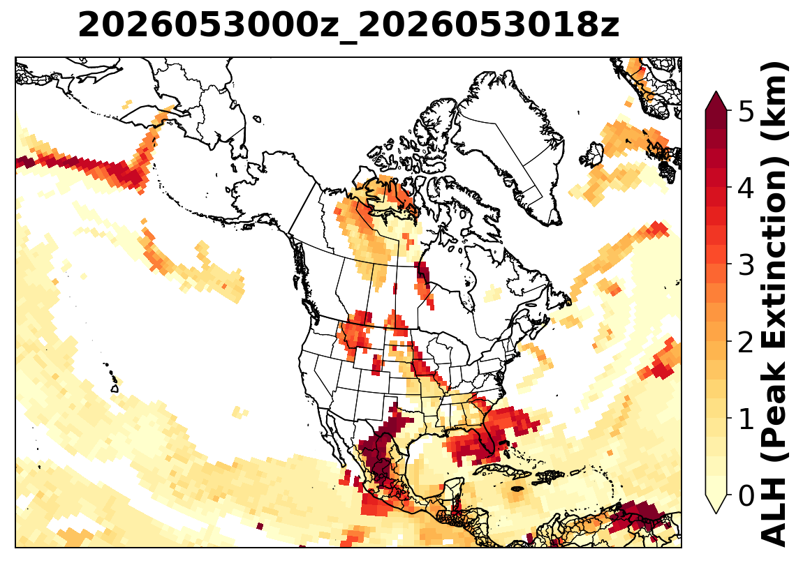

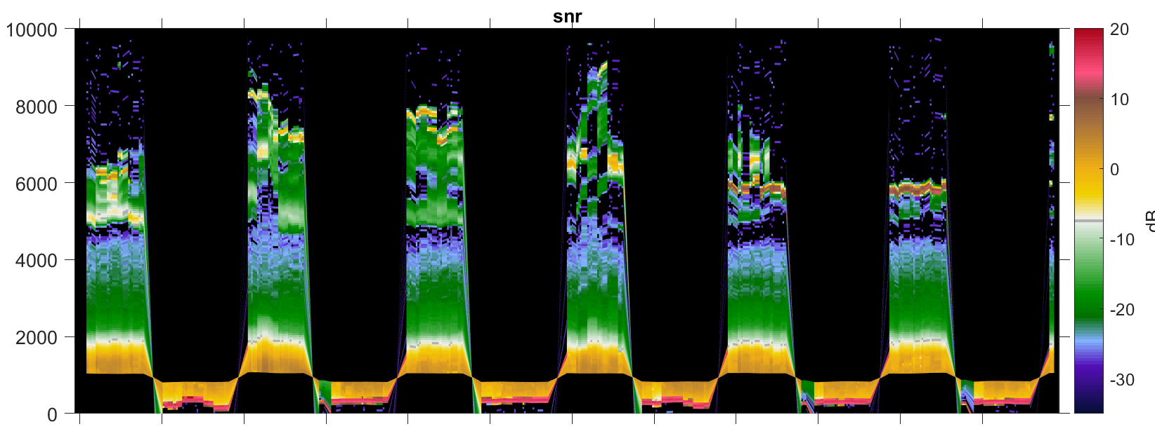
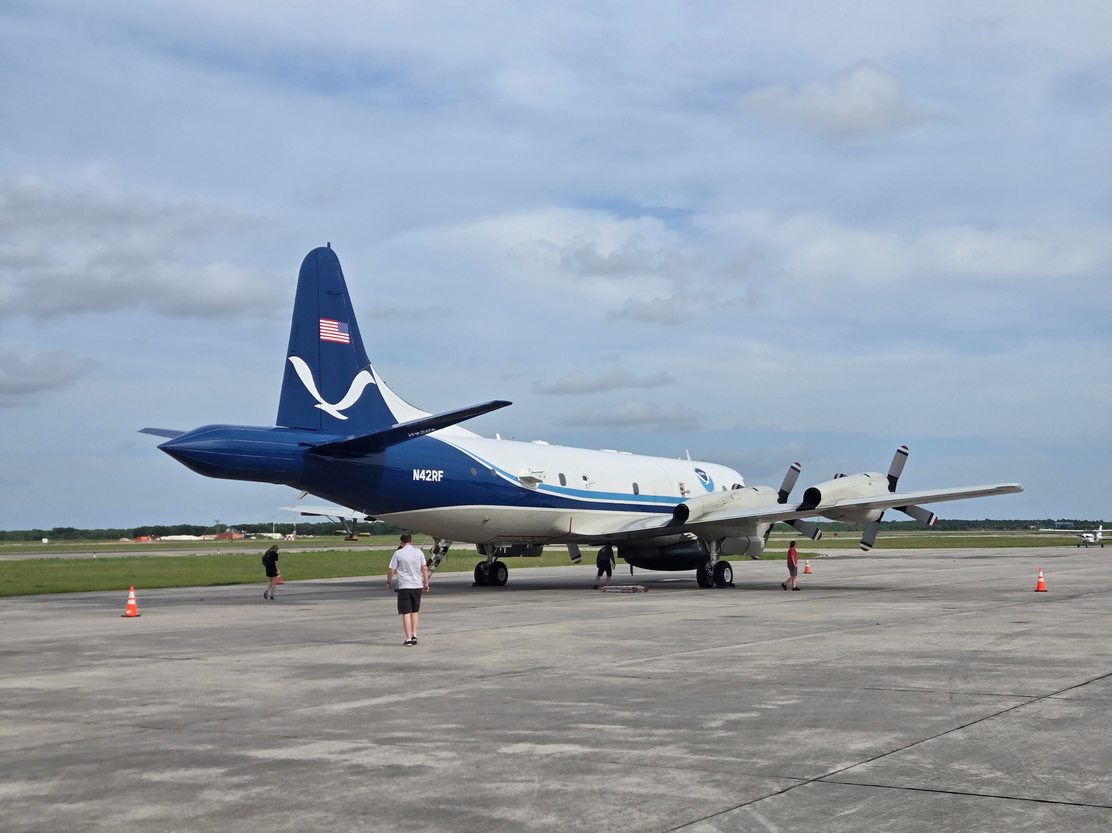
Texas Air Quality Study (TexAQS) and NASA SARP
Lofted smoke
over Dallas, TX
(5/30/2026)
Aerosol backscatter
(uncorrected)
19:40
19:41
19:42
19:43
19:44

