Slide 1

Advancing TEMPO NO₂ Utilization: 4DEnVar Data Assimilation, Emission Inversion, and Near Real-Time Forecast Monitoring with GEOS-CF/JEDI
Maryam Abdi-Oskouei, Jérôme Barré, Viral Shah, Pam Wales, Fei Liu, Michael Anstett, Doruk Ardag, Furkan Goktas, Ricardo Todling, Emma Knowland, Steven Pawson
TEMPO DART Team Meeting, Iowa City, IA
June 16, 2026

Slide 2
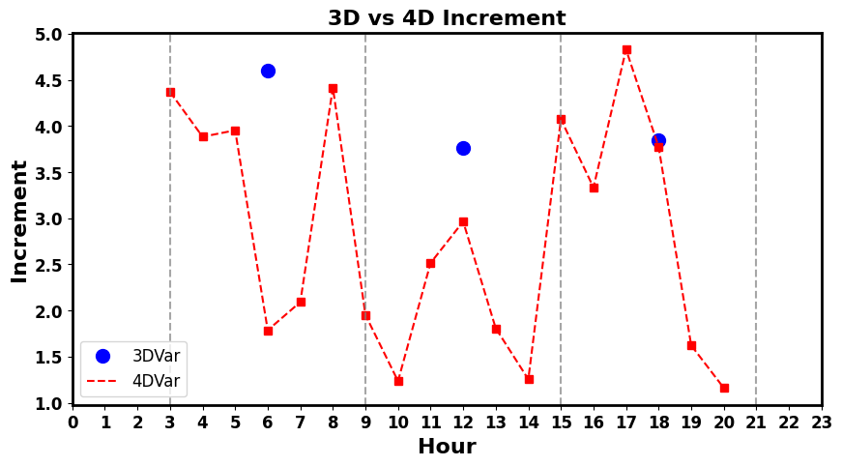
JEDI-based 4DEnvar system for TEMPO NO₂ assimilation
JEDI (Joint Effort for Data assimilation Integration) is a generic and modular data assimilation framework that supports various DA methodology such as 4D methodology for atmospheric composition
TEMPO
Abdi-Oskouei et al. (2026), 10.1029/2025MS005482

Slide 3
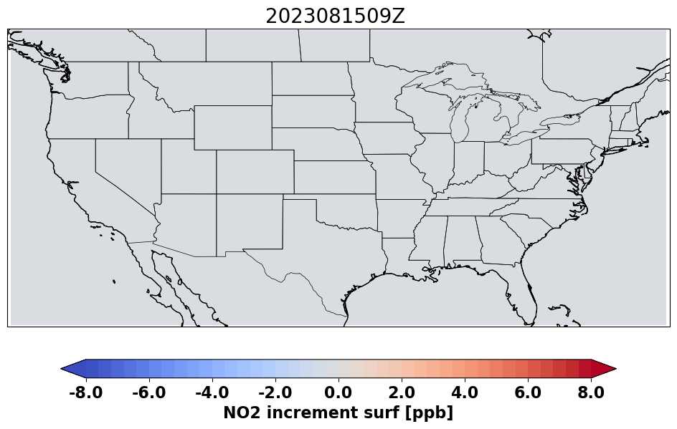
JEDI-based 4DEnvar system for TEMPO NO₂ assimilation
JEDI (Joint Effort for Data assimilation Integration) is a generic and modular data assimilation framework that supports various DA methodology such as 4D methodology for atmospheric composition
Experiment design:
GEOS-CF interfaced with JEDI
EDA 4DEnVar with 32 members for Aug 2023.
  Deterministic C360 (0.25º) resolution
  Ensemble C90 (1º) resolution
Assimilation observations:
  TEMPO tropospheric NO₂ (SZA < 70º, CF < 0.15)
  TROPOMI tropospheric NO₂ (qa > 0.75, -65º < lat < 65º)
Independent observations:
  Pandora total column NO₂
  AirNow surface NO₂ and O₃
  AEROMMA and STAQS field campaigns
Hourly NO₂ increment at surface
TEMPO
Abdi-Oskouei et al. (2026), 10.1029/2025MS005482
Notes:
CEDS emissions, replay of meteorology to FP

Slide 4
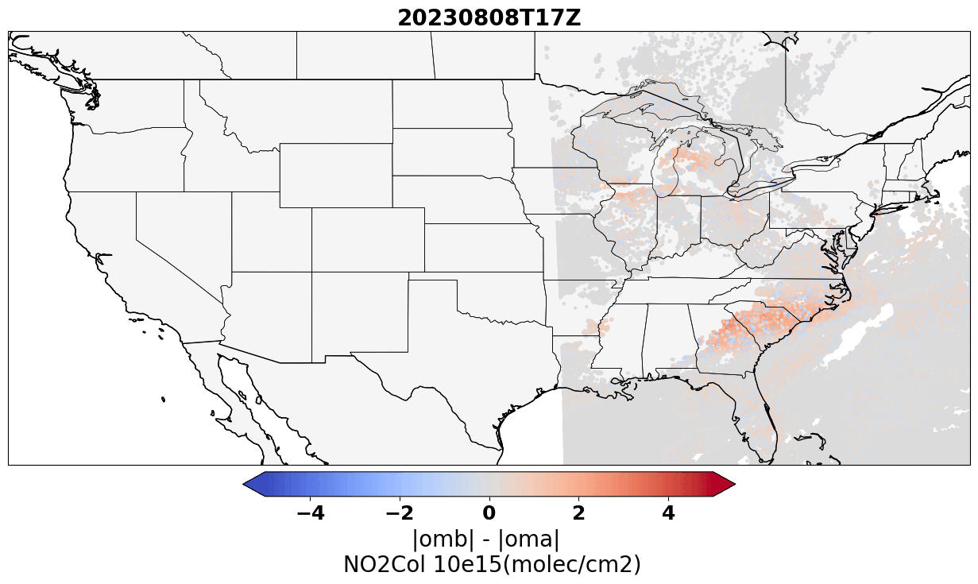
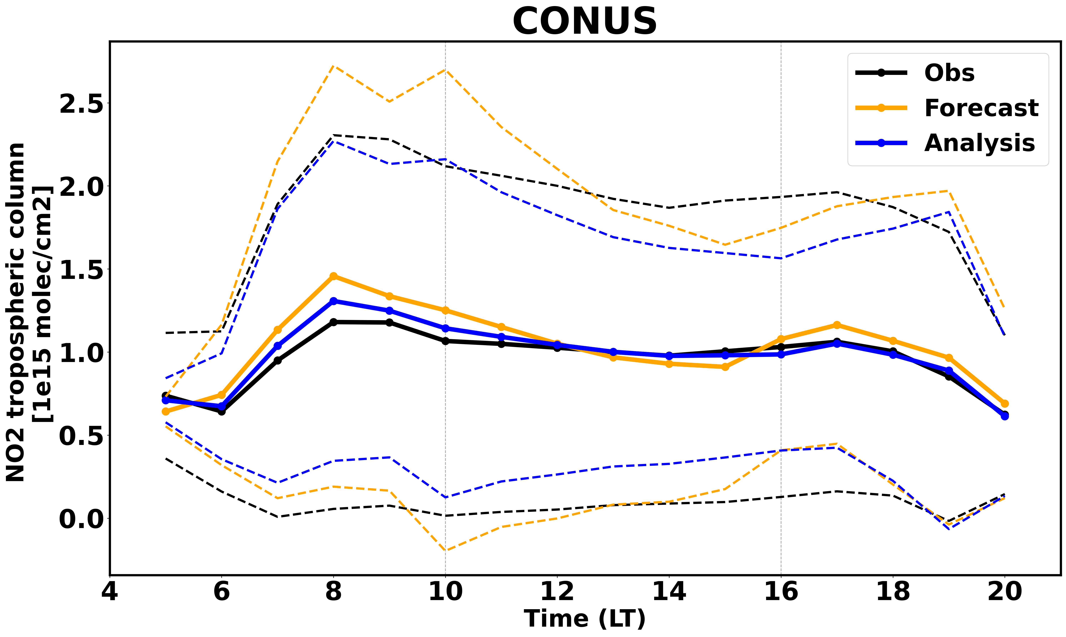
Obs-space: fit to TEMPO obs
OmA < OmB shows DA functioning correctly
Strongest fit improvement in early morning
4DEnVar propagates obs influence across full 6-hr window
Abdi-Oskouei et al. (2026), 10.1029/2025MS005482

Slide 5
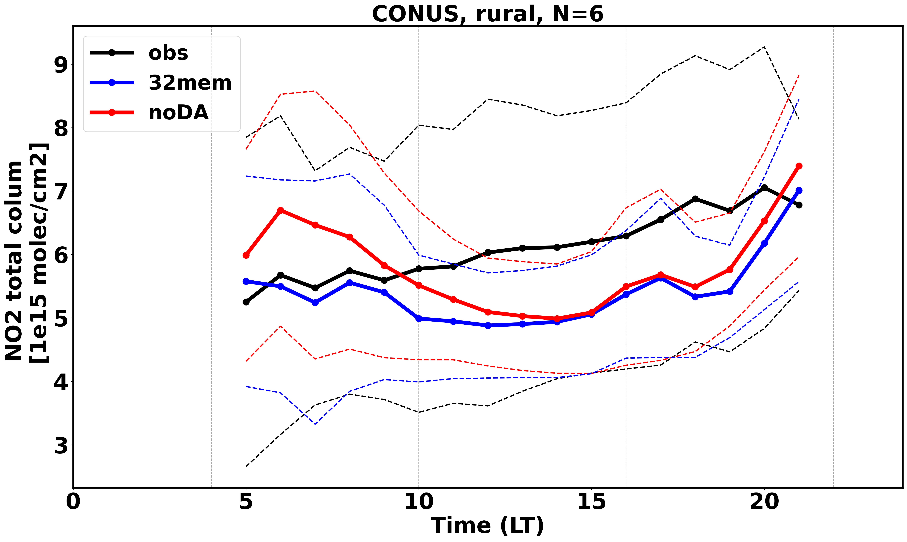
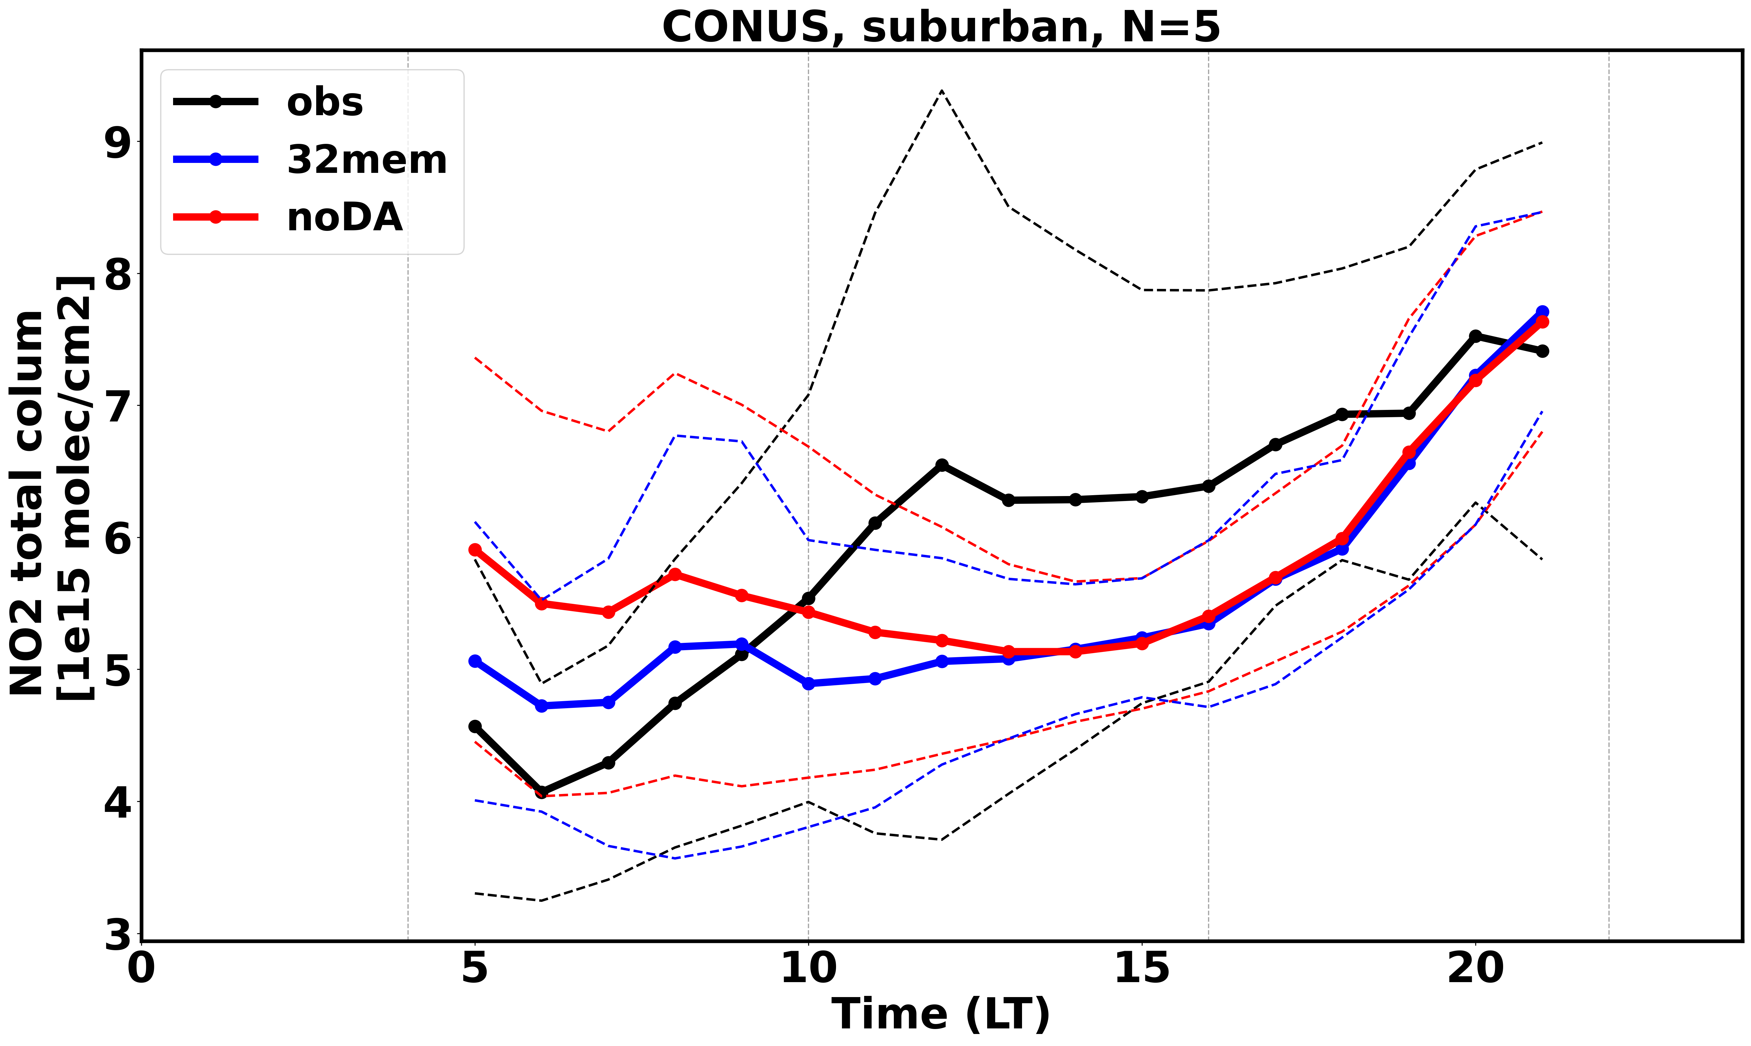
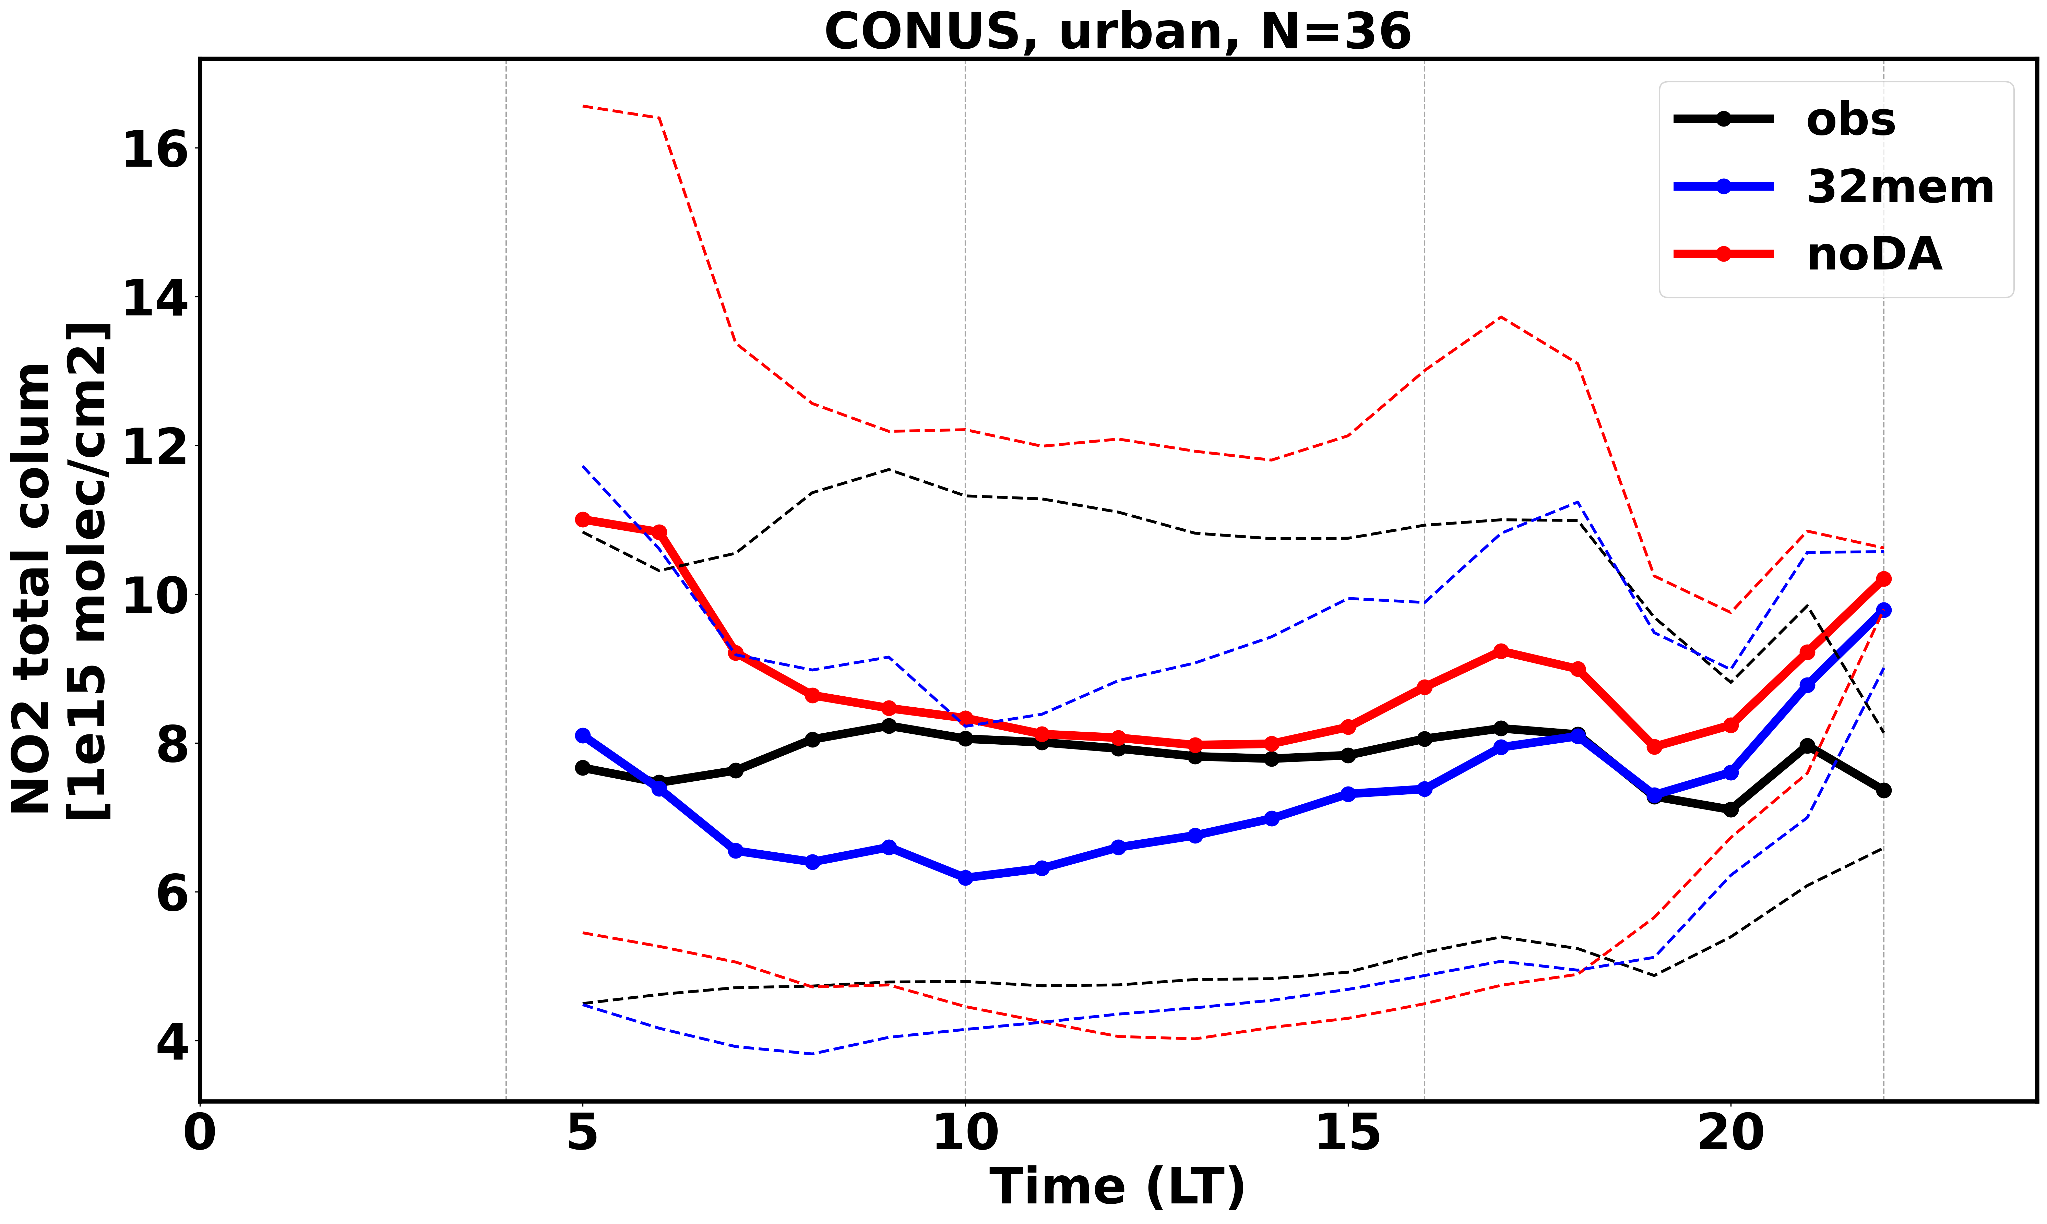
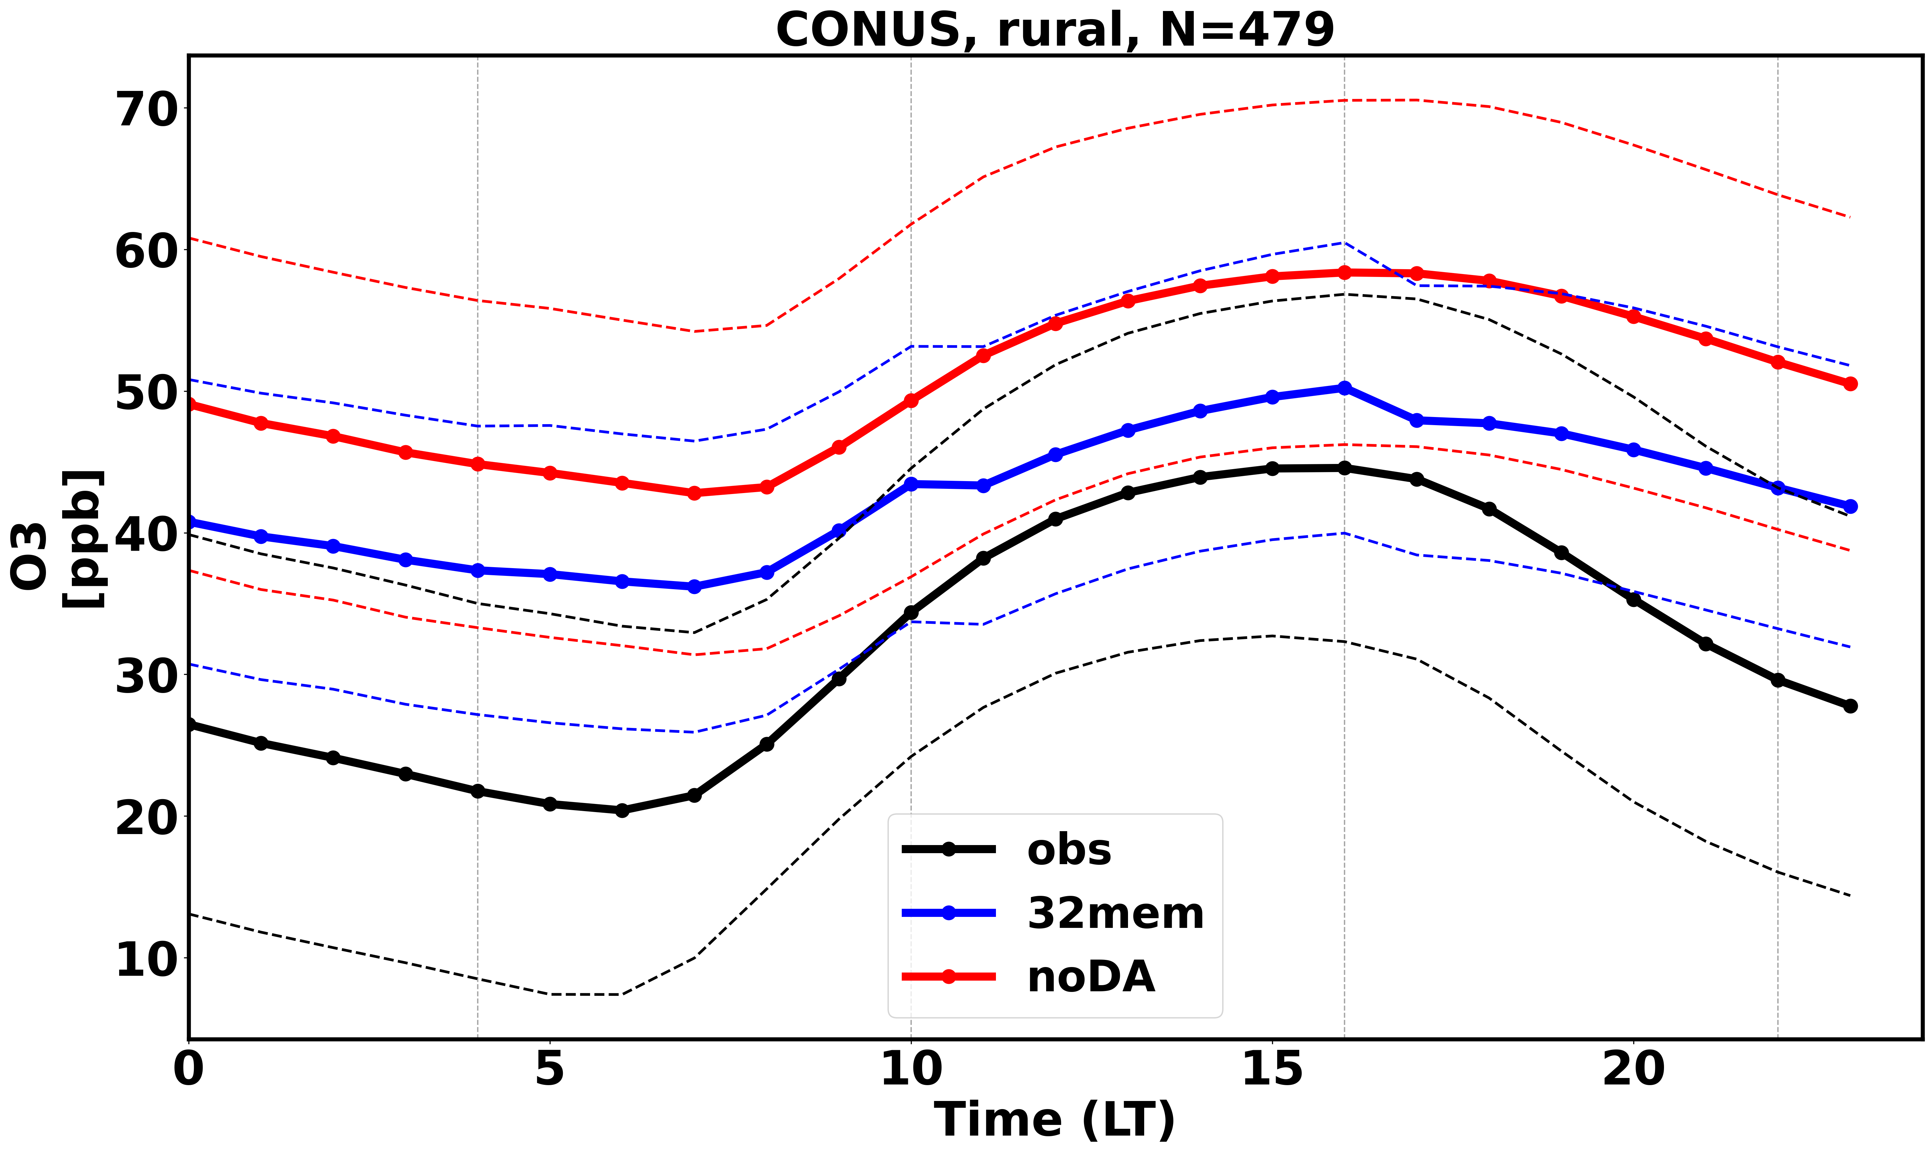
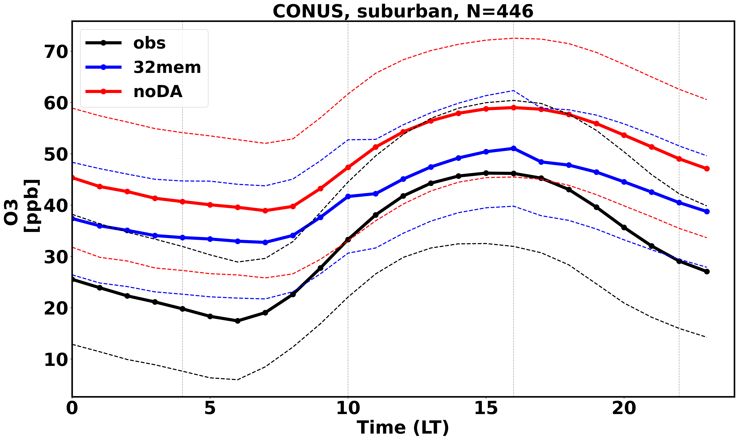
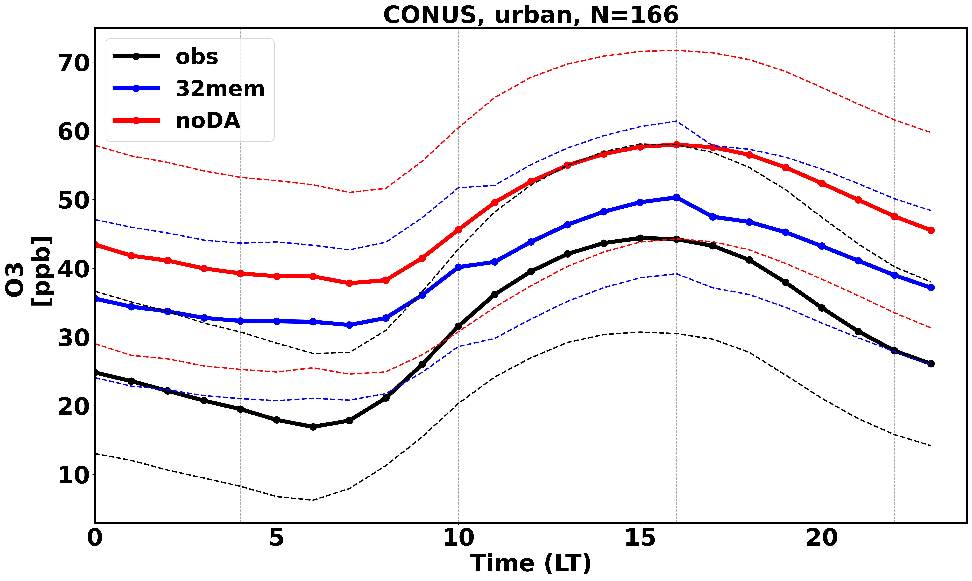
Validation against independent observation
Rural and Suburban: improved total column NO₂ in morning. Urban: mixed
Indirect ozone improvement

Slide 6
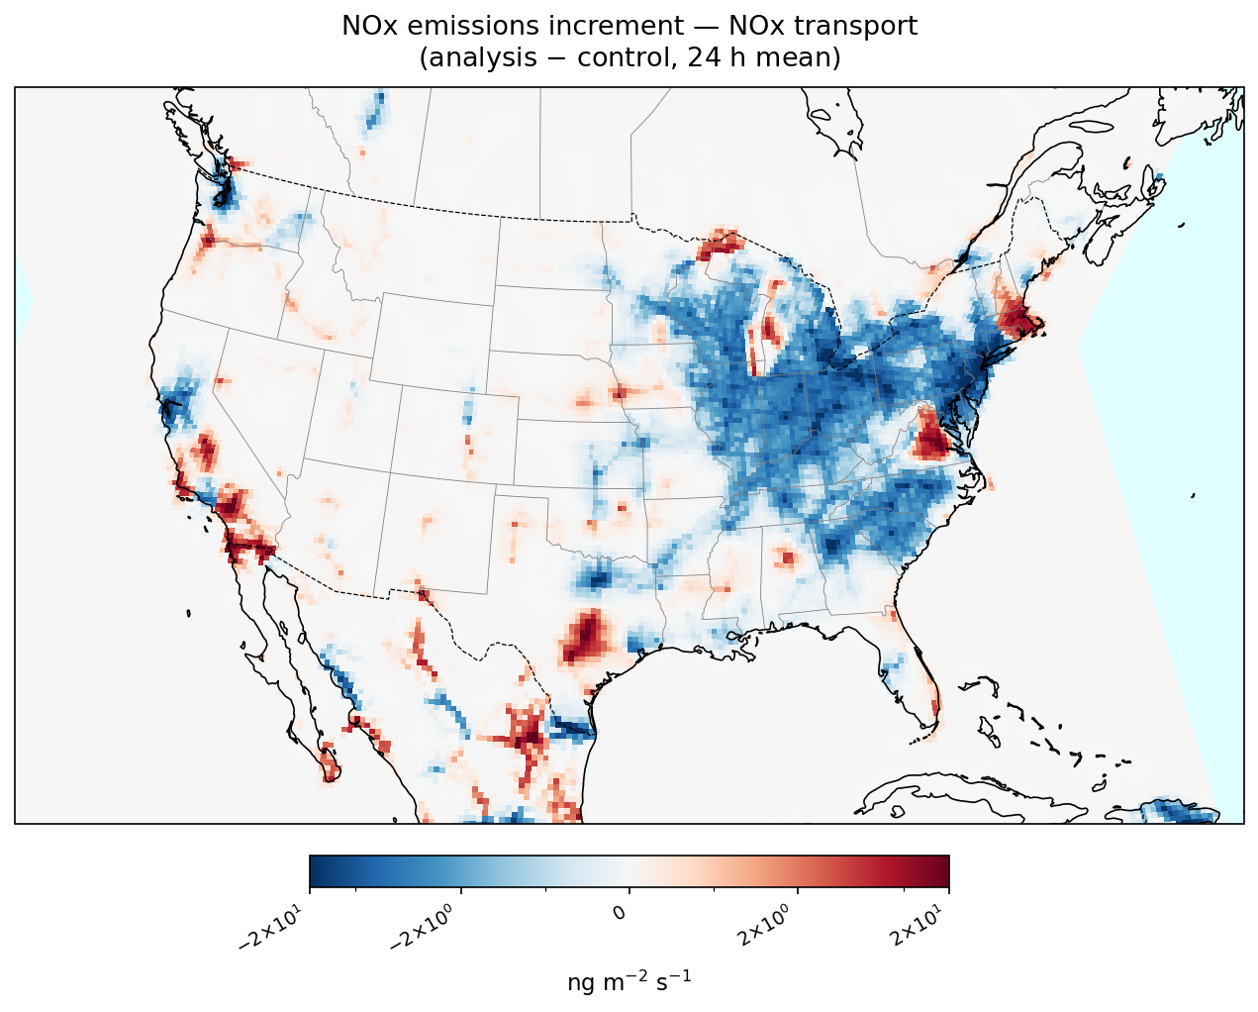
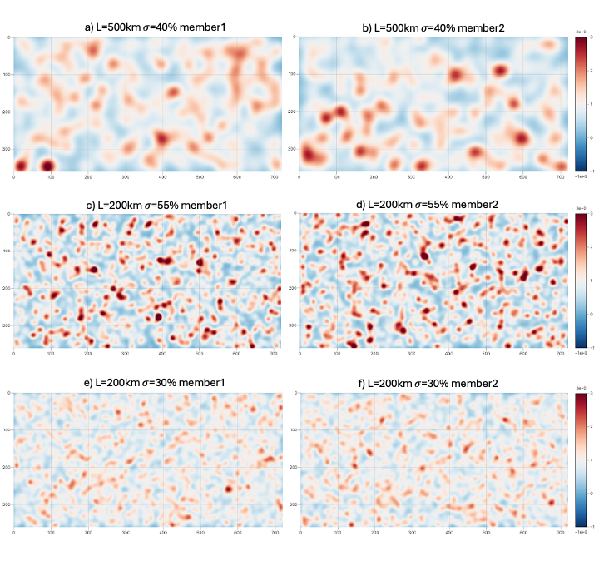
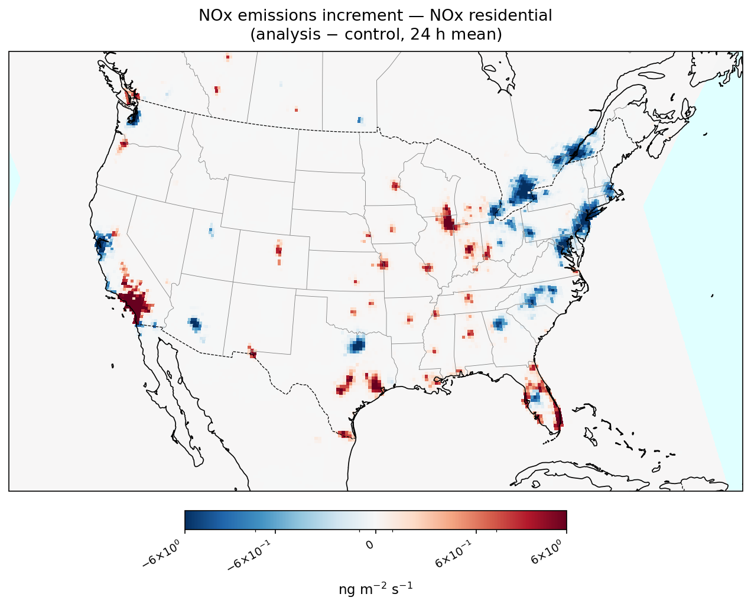
Emission perturbations and adjustment
GEOS-CF concentration to emission
Jacobians/sensitivities - increments
Gamma random Perturbation generator per sector
https://github.com/jeromebarre/perturbator
HEMCO perturbation scaling factors
on emissions
JEDI DA perturbation scaling factors adjustment
+
temporal harmonization smoothing

Slide 7
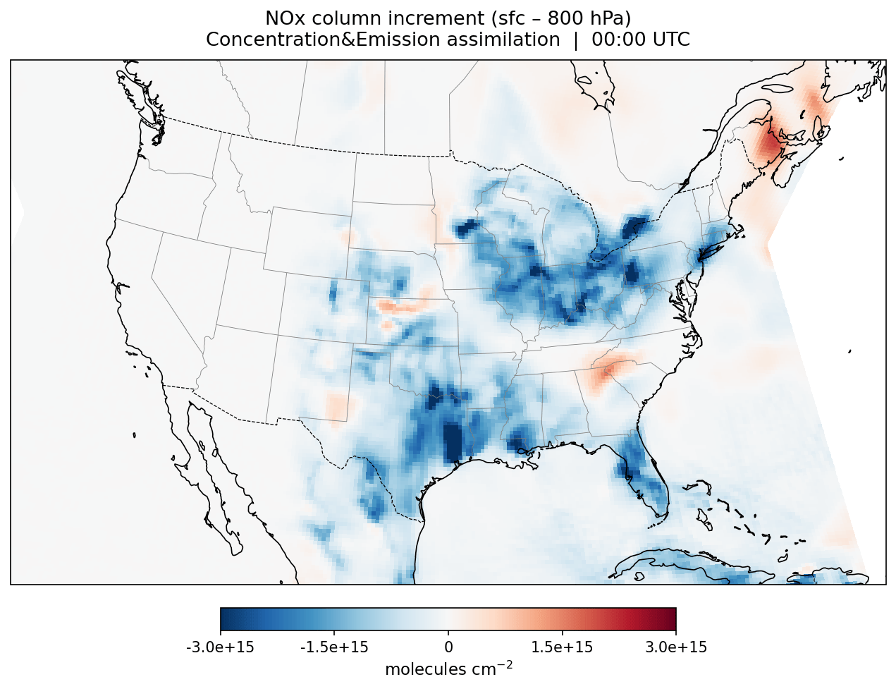
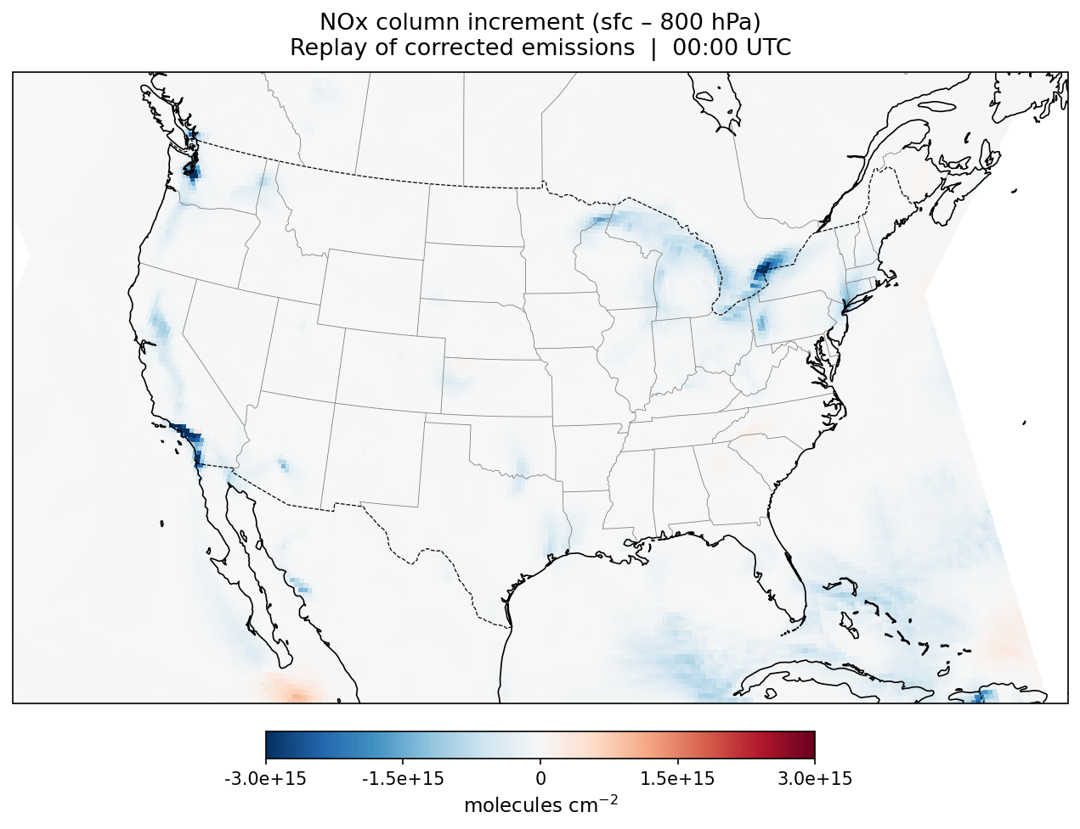
Concentration vs emission constraints
[Surface, 800hPa] NOx partial column: August 4, 2023
Concentration analyses vs control (noDA)
Replay of emission analyses vs control (noDA)

Slide 8
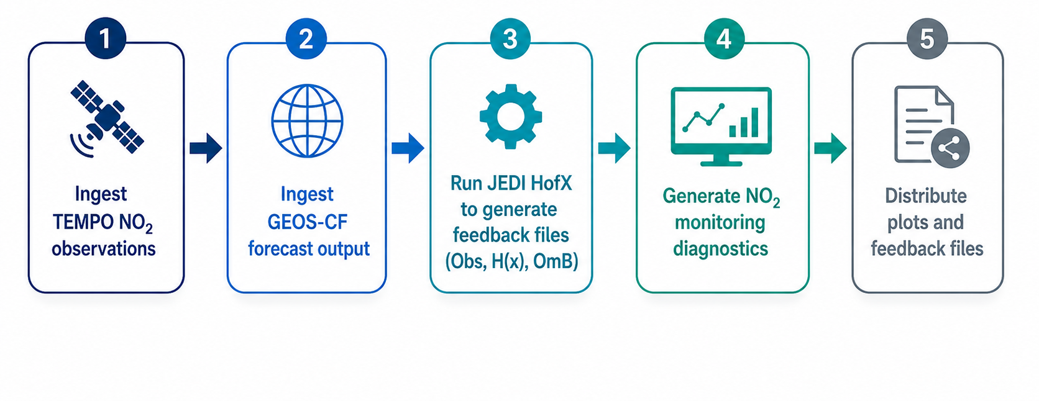
End-to-end GEOS-CF monitoring system using TEMPO NO₂ observation powered by JEDI and SWELL workflow
GEOS-CF v3 data assimilation component will be JEDI-based
The end-to-end monitoring system provides an opportunity to test JEDI and SWELL workflow in NRT before the release of GEOS-CF v3
Continuous comparison between GEOS-CF and TEMPO can provide information about the performance of the system

Slide 9
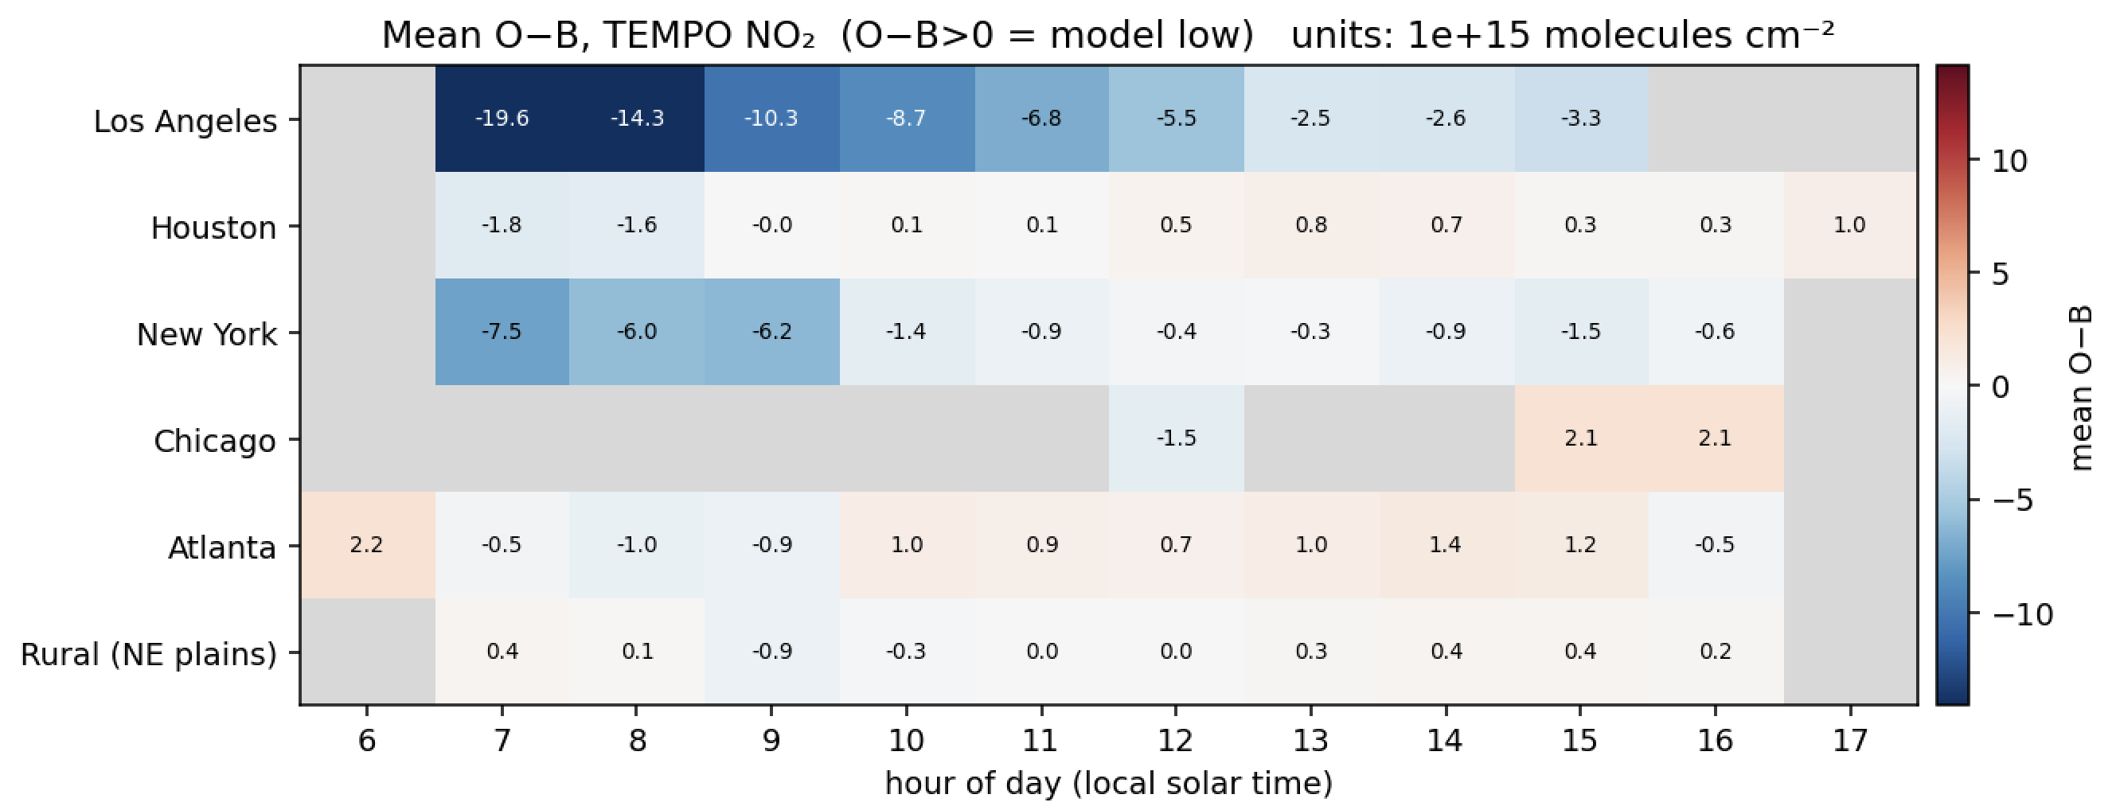
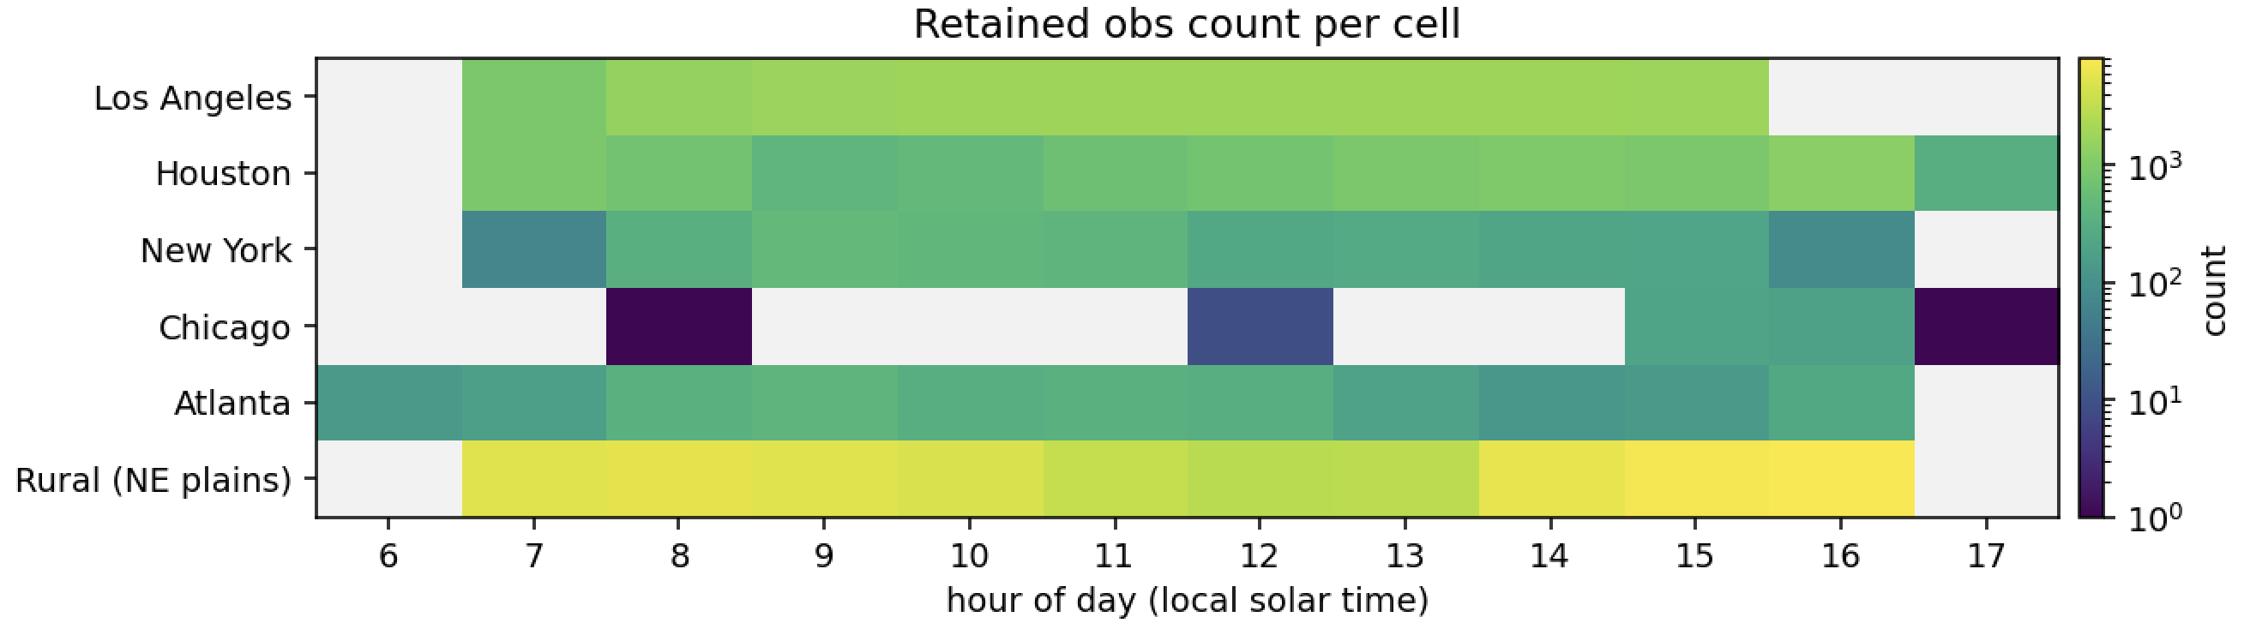
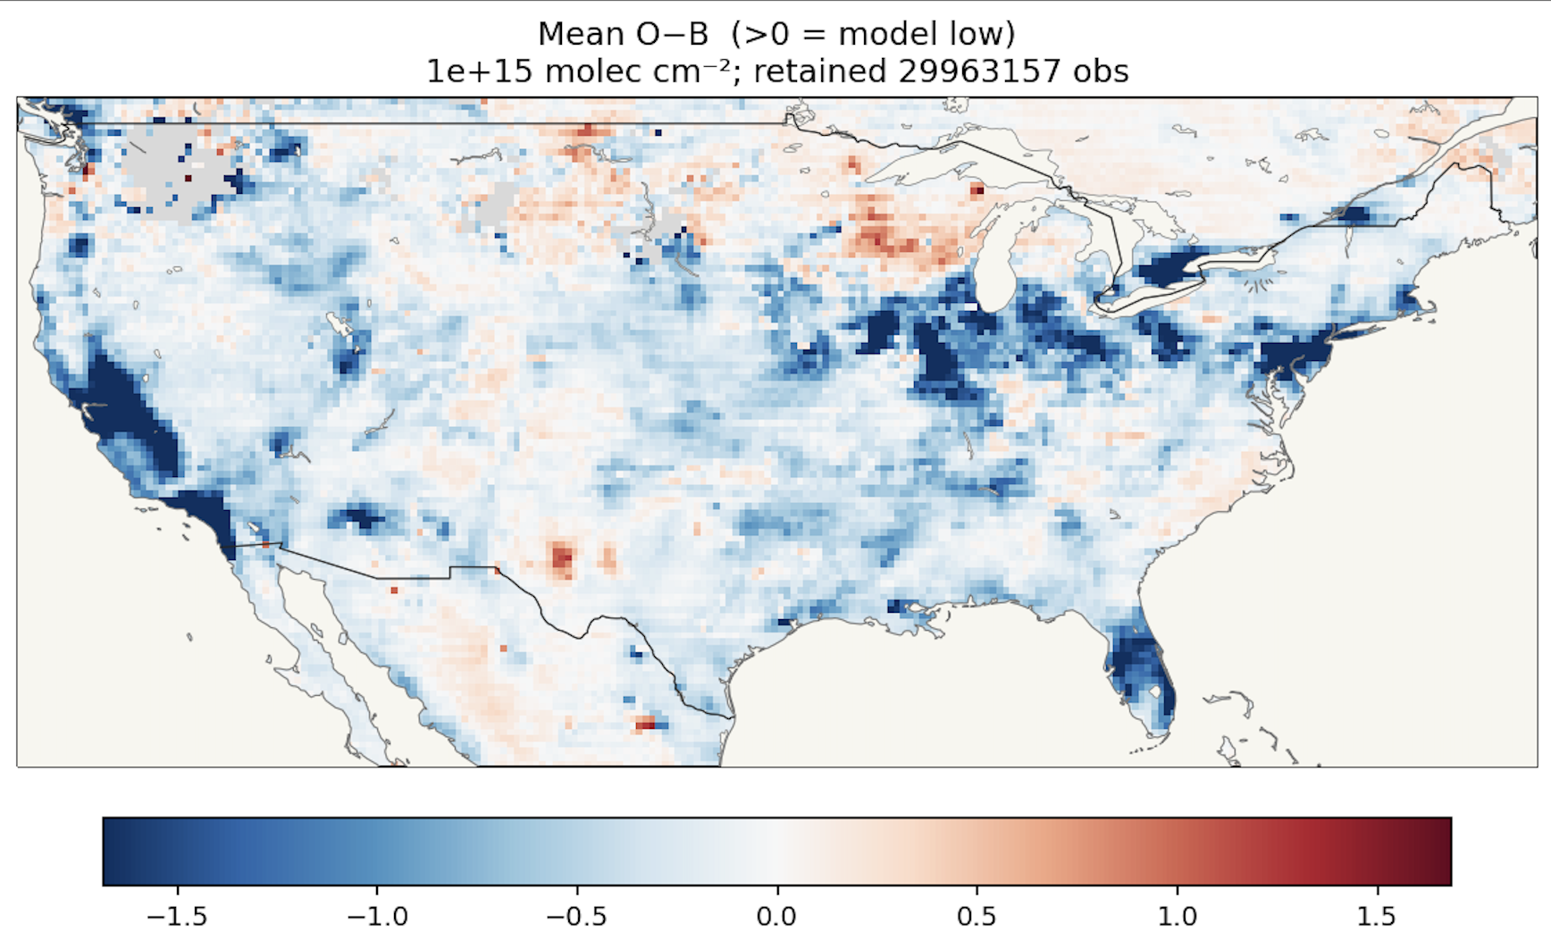
Summary
We assimilated TEMPO NO₂ using a 4DEnVar approach with EDA methodology in a JEDI/GEOS-CF system.
Results show a better fit to the observations, with strong increments during the morning.
Constraining NO₂ concentrations in the system improved the representation of surface O₃.
We are currently working to expand the system to constrain anthropogenic NOₓ emissions.
We are also setting up an end-to-end GEOS-CF monitoring system using TEMPO NO₂ observations with JEDI and the SWELL workflow in preparation for GEOS-CF v3.

Slide 10
backup

Slide 11
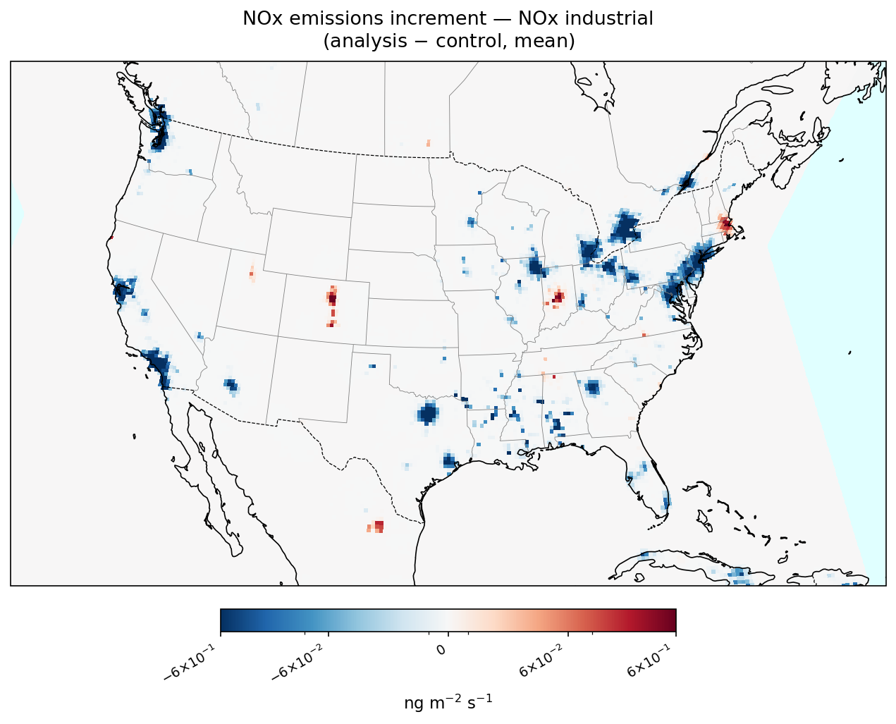
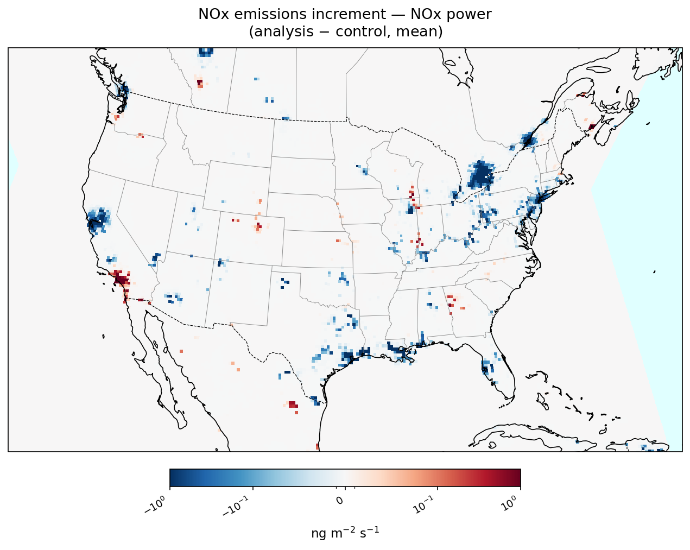
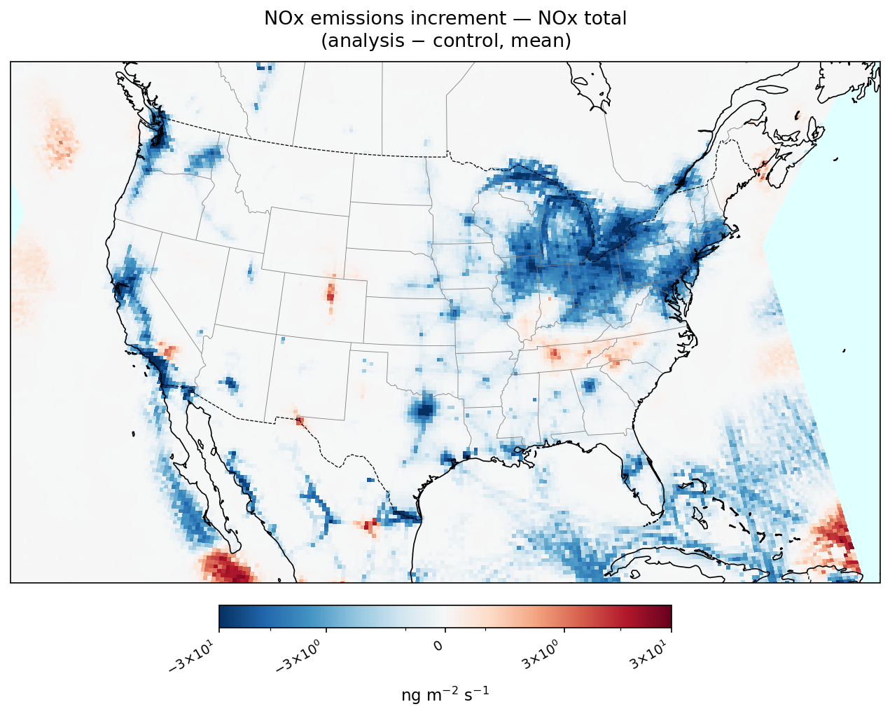
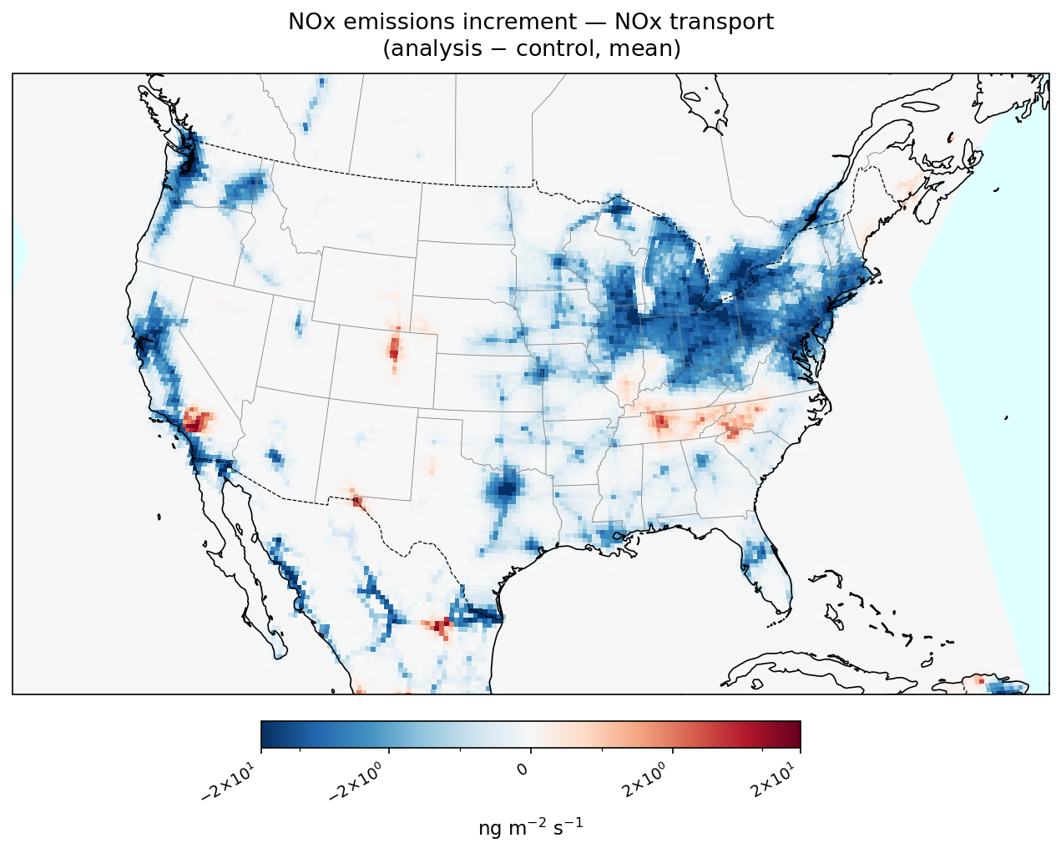
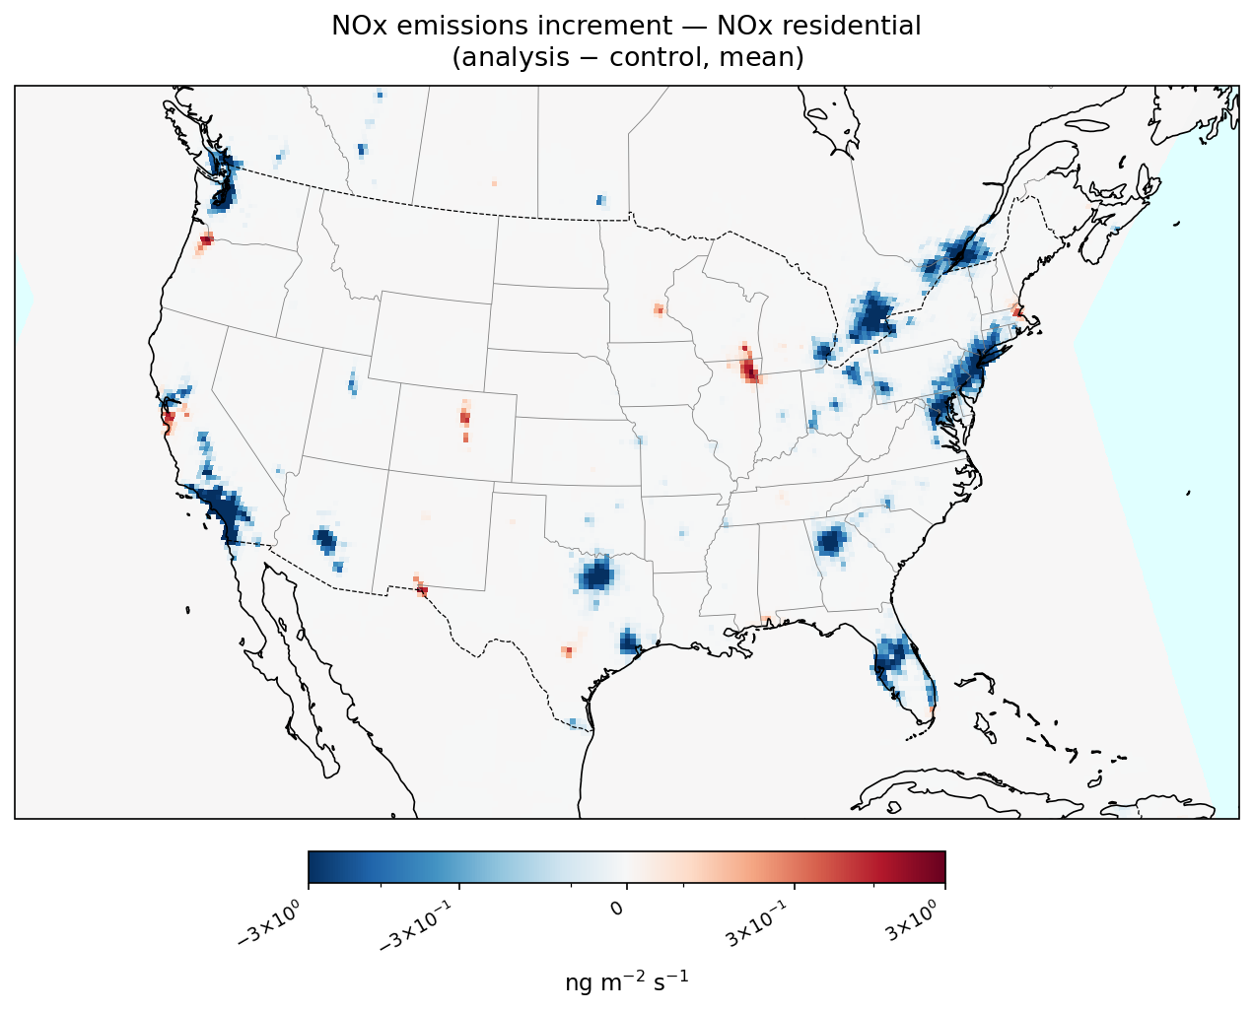
Emission increments

