Slide 1






Assimilation of TEMPO NO₂ and HCHO to Constrain Emissions and Air Quality Forecasts using an Ensemble Kalman Filter
Chia-Hua Hsu (CUB, NIES), Daven K. Henze (CUB)
Arthur P. Mizzi (NASA)
Owen Cooper, Brian McDonald (NOAA CSL)
Kelley Wells, Dylan Millet (UM)
Jennifer Kaiser (GIT)

Slide 2

Top-Down Estimates of US NO_{x} Emissions using TEMPO NO₂
(Hsu et al., JGR 2026)
Launched
First Light
V03 Data Release
May 2024
April 2023
August 2023
TEMPO v3 midday obs provide better constraints on NO_{x} emissions than TROPOMI, while morning/late afternoon TEMPO data subject to uncertainties.
Top-down NO_{x} emissions generally agree with 2023 GRA²PES, improve O₃ and NO_{x} simulations (particularly in LA), but may over-correct in urban cores

Slide 3
Joint NO_{x} and NMVOC Emissions Inversion using TEMPO
(Hsu et al., in prep.)
Launched
First Light
V03 Data Release
V04 Data
May 2024
April 2023
August 2023
Objectives:
Evaluate observations against Pandora, compare v03 and v04 retrievals
Jointly optimize NO_{x} and NMVOC emissions and investigate the benefits and challenges of multispecies emissions inversion
Method: Joint assimilation of NO₂ and formaldehyde (HCHO). The latter produced largely in the atmosphere by oxidation of other VOCs

Slide 4
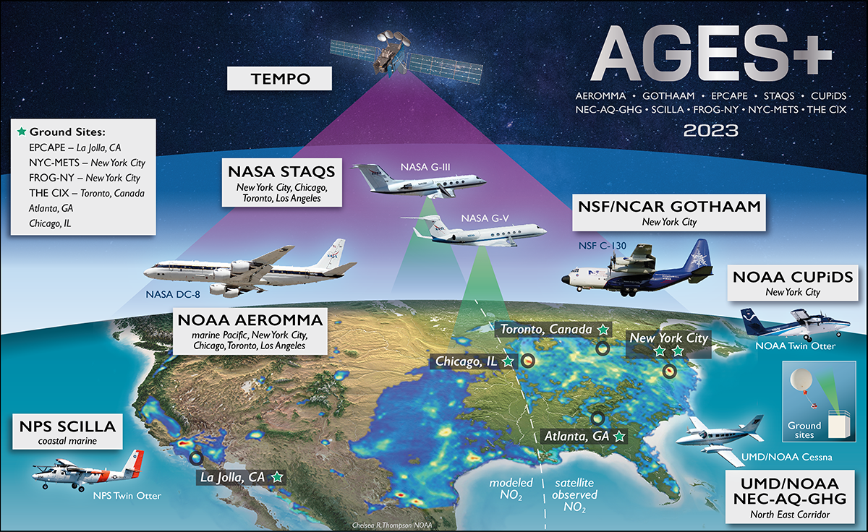







AGES+ Airborne Field Campaigns in Summer 2023
https://csl.noaa.gov/projects/ages/

Slide 5
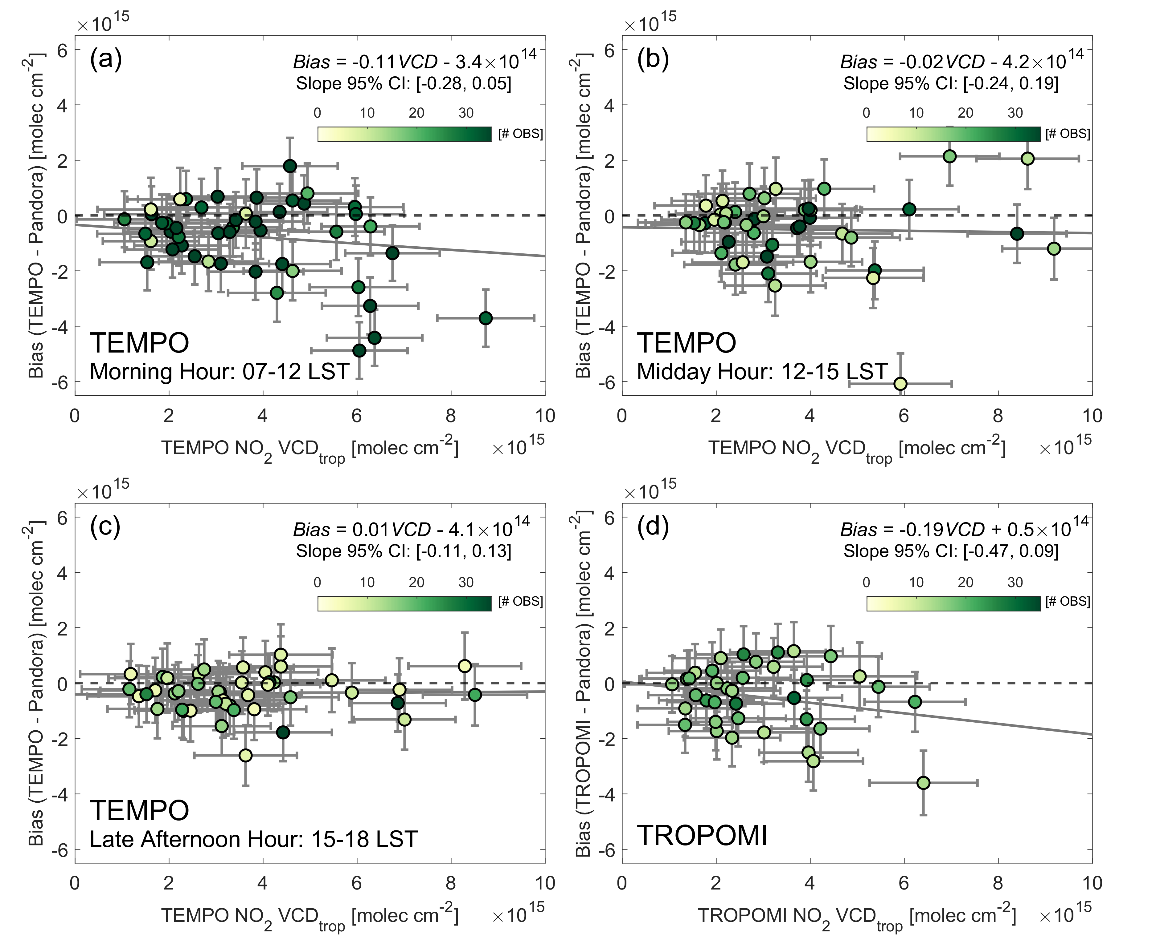
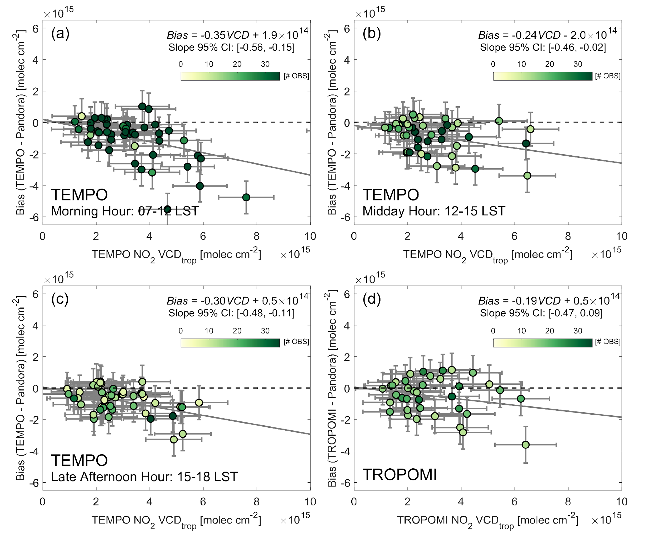
Evaluation of TEMPO NO₂ with Pandora Network
TEMPO NO₂ V3
TEMPO NO₂ V4

Slide 6
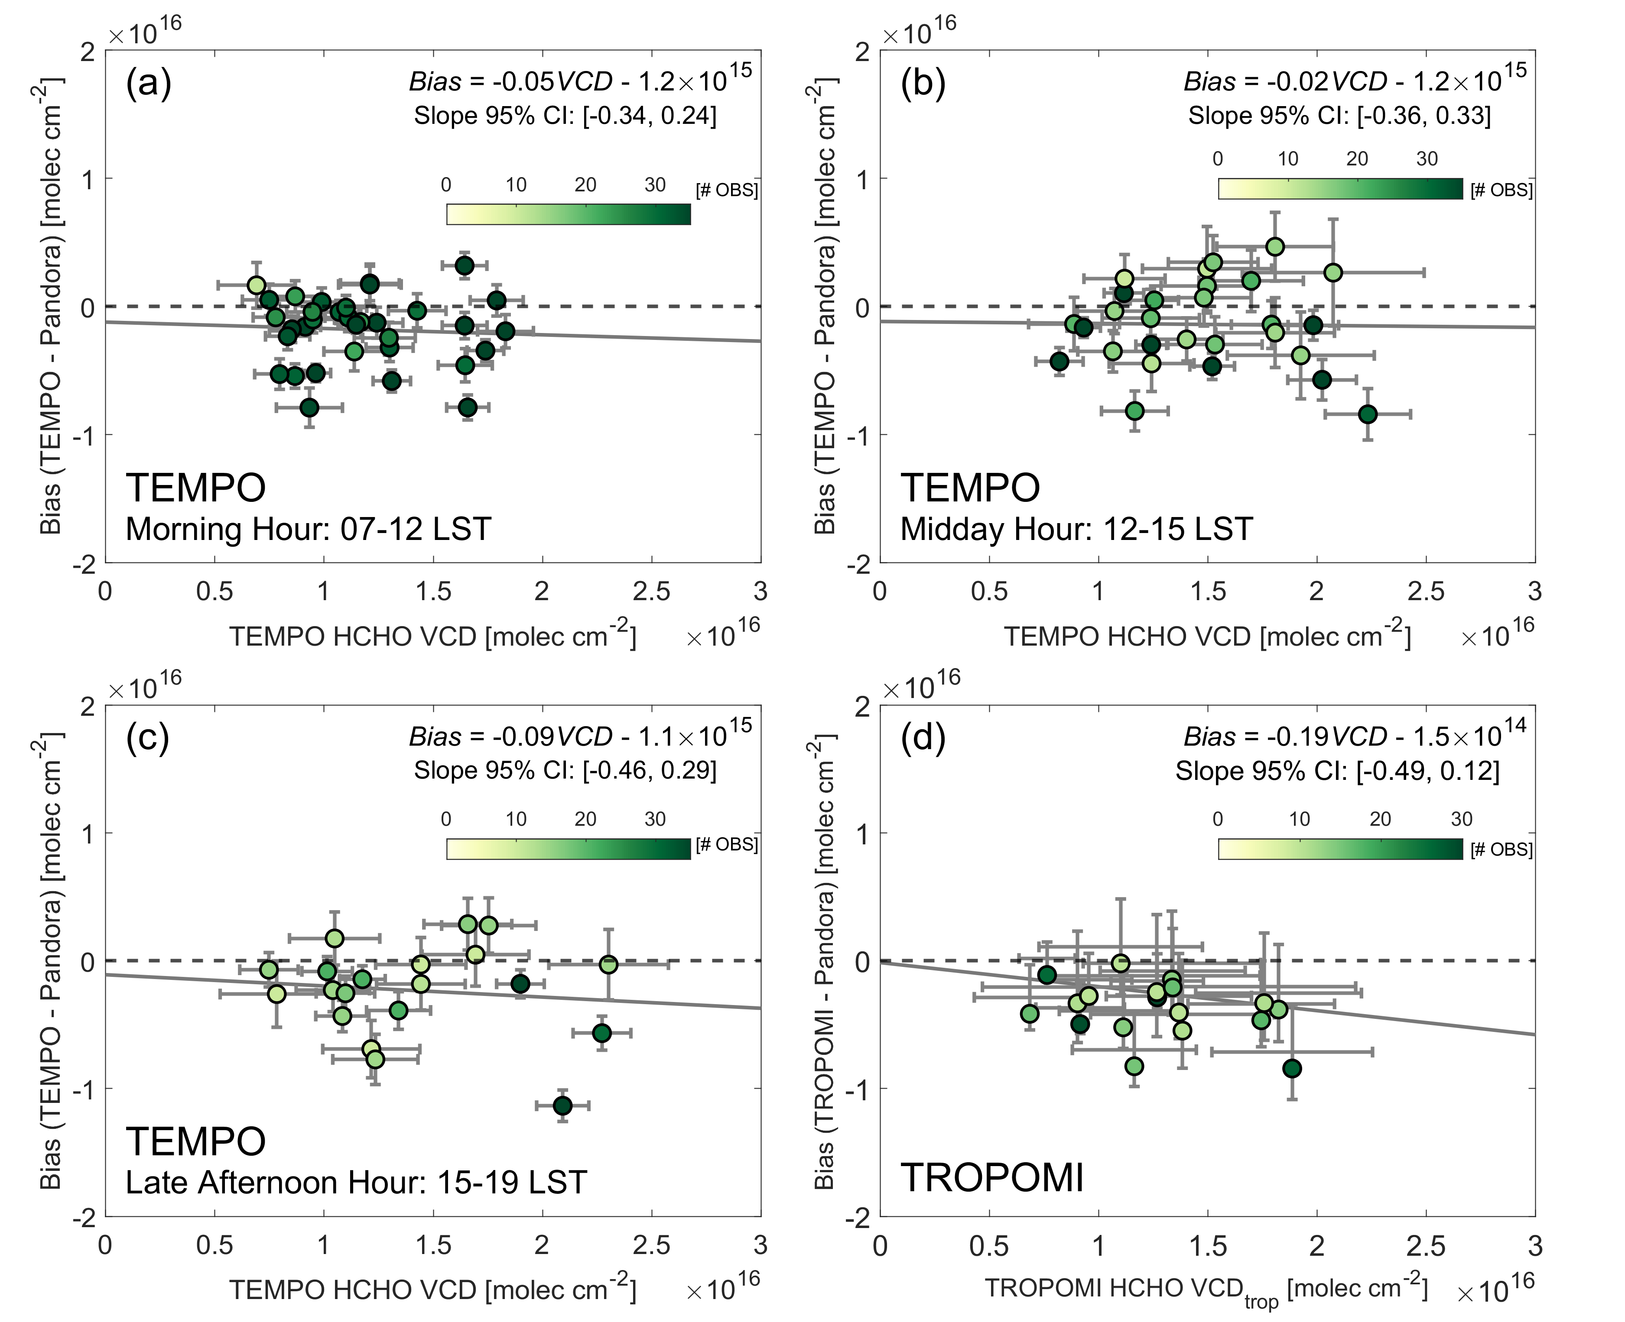
Evaluation of TEMPO HCHO with Pandora Network
TEMPO HCHO V3
TEMPO HCHO V4

Slide 7

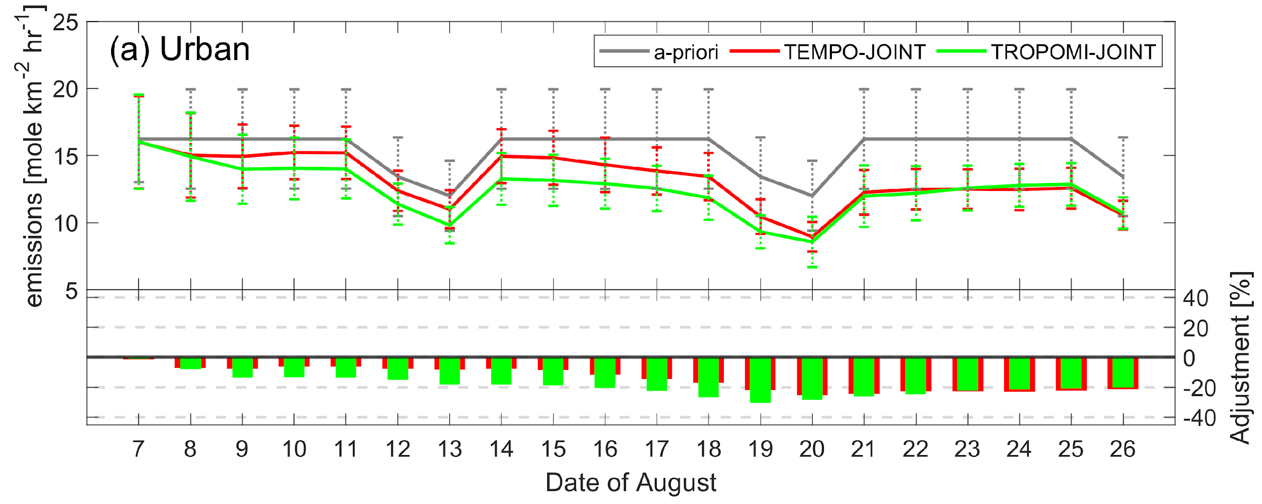
Assimilating TEMPO V4 Lowers GRA²PES 2023 NO_{x} Emissions
2023
Top-down NO_{x} emissions ~20% lower than 2023 GRA²PES when utilizing TEMPO V4 (whereas in agreement with TEMPO V3)

Slide 8
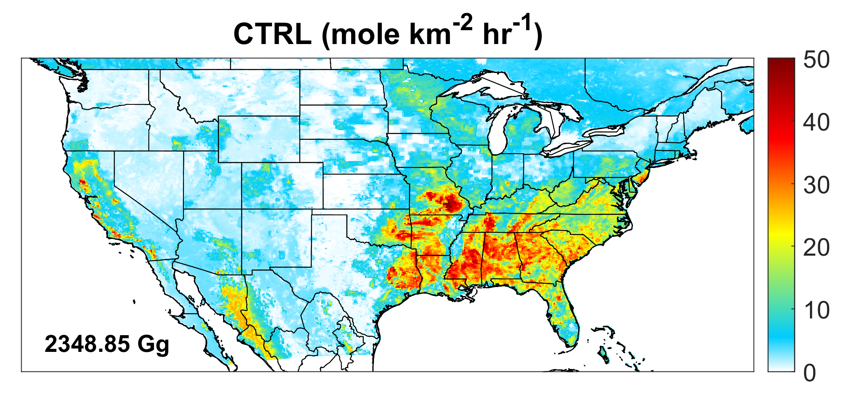
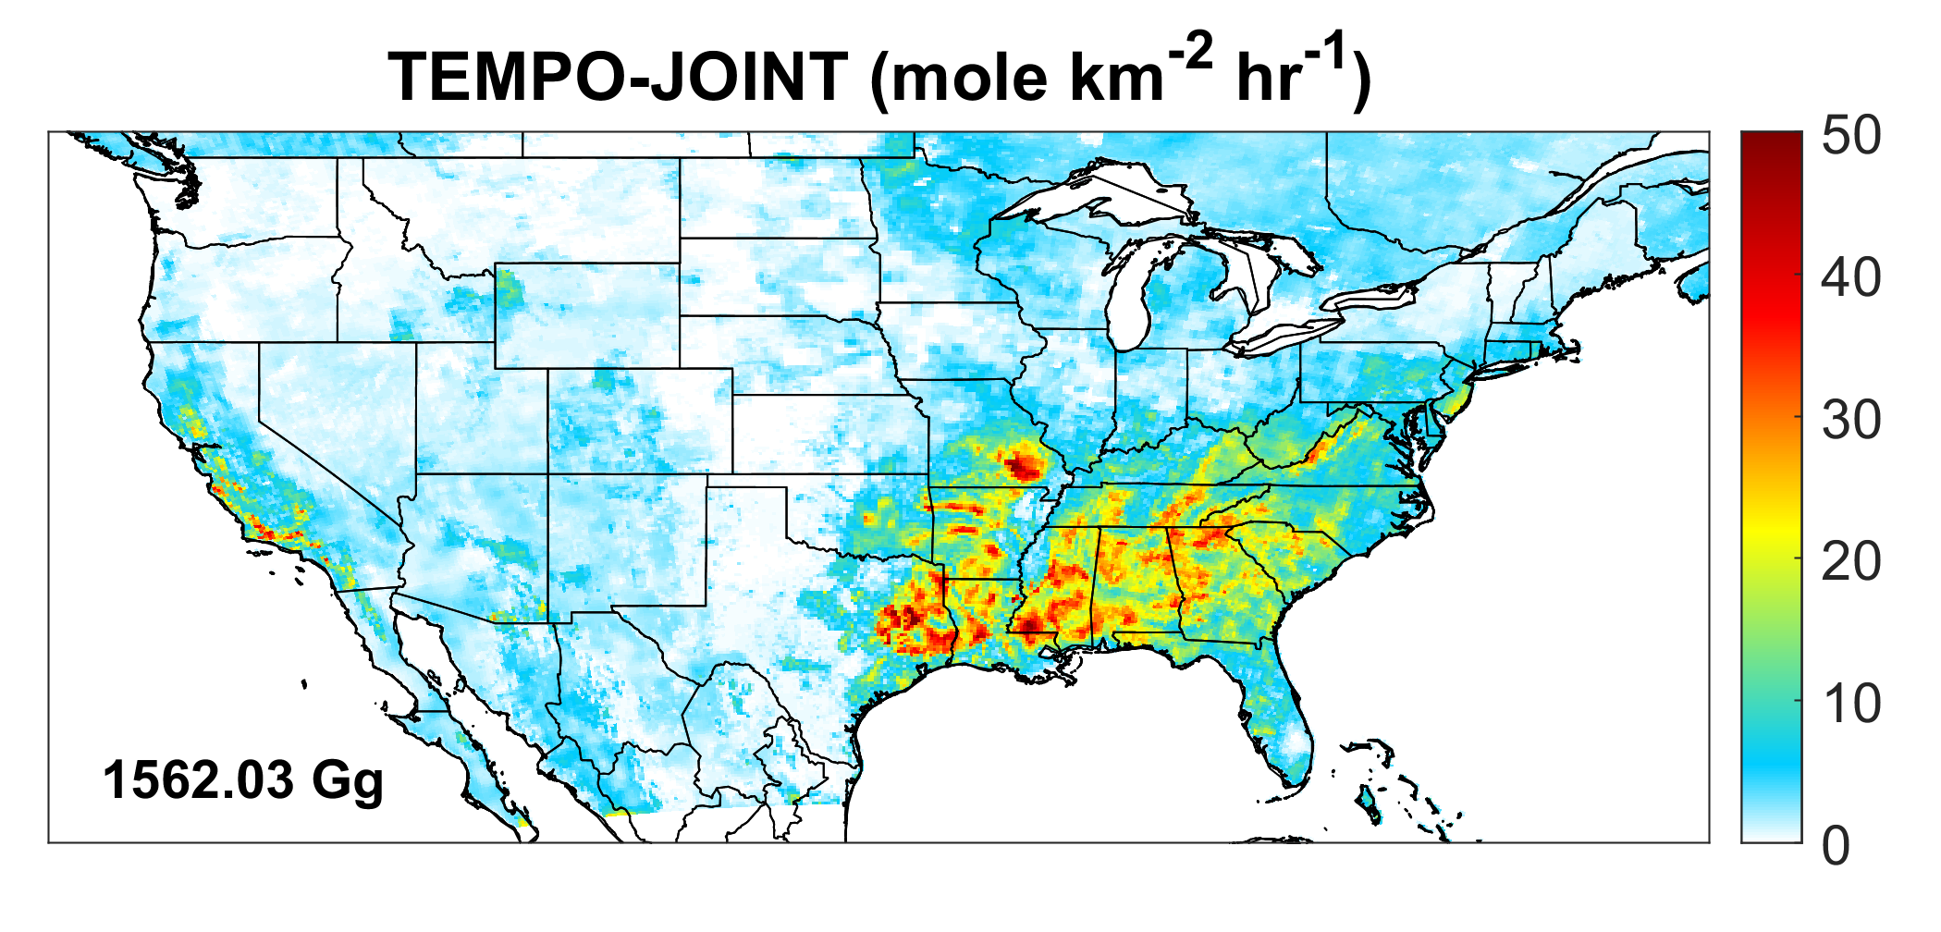
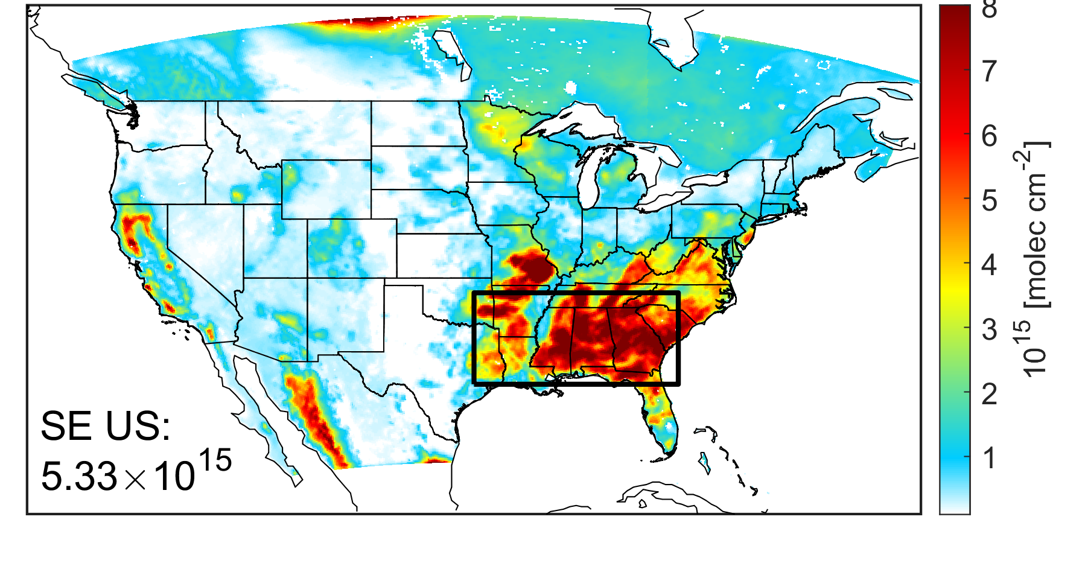
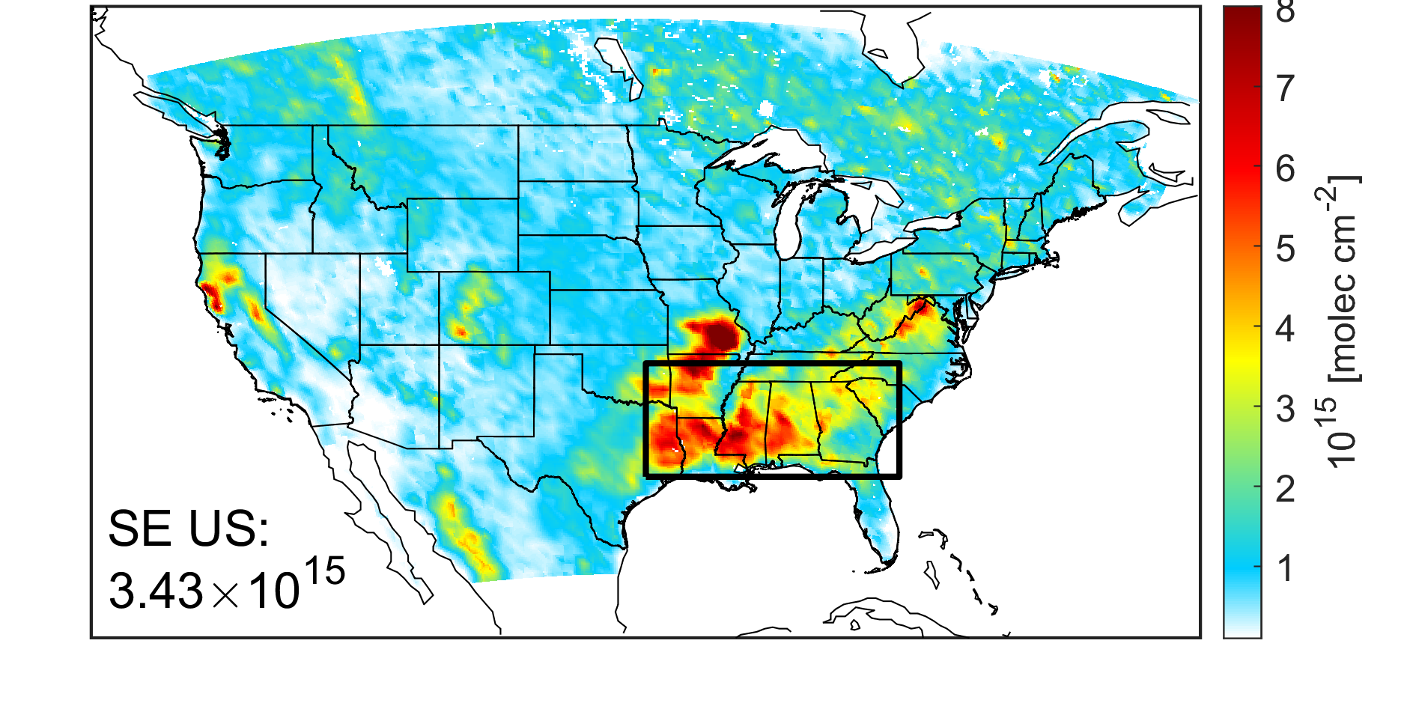

BEIS Isoprene Emissions High in WRF-Chem
-34%
2350 Gg
1562 Gg
CTRL (10¹⁵ molec cm⁻²)
CrIS Isoprene (10¹⁵ molec cm⁻²)
+55%
Wells et al. (JGR-Atmos., 2022)

Slide 9
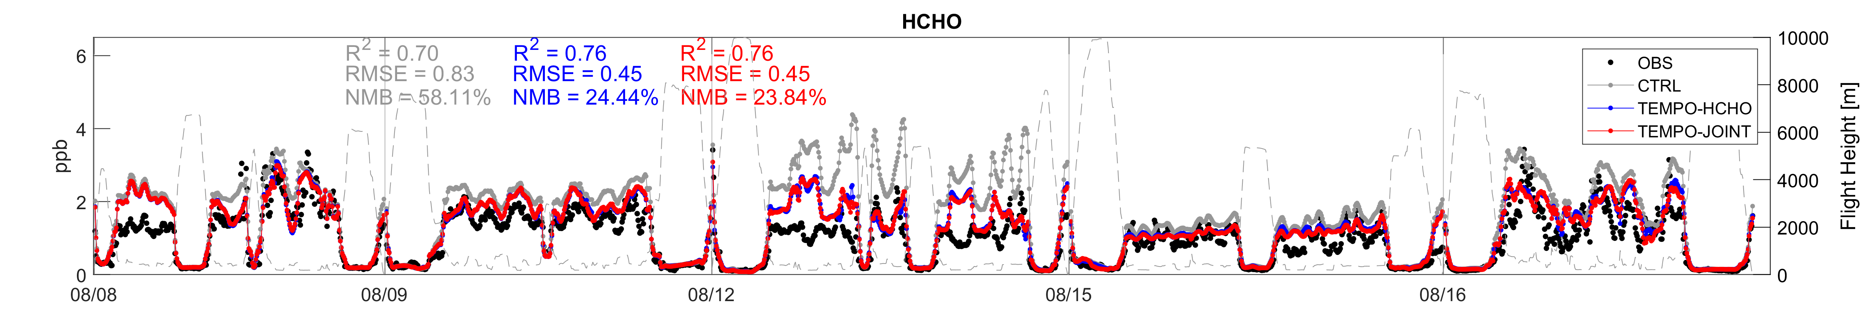
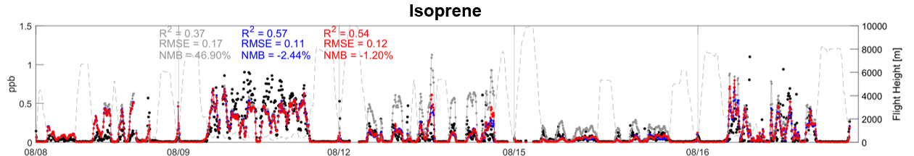

Evaluation of WRF-Chem/Chem-DART with AEROMMA DC-8
TEMPO
HCHO
TEMPO
Joint
A-priori
HCHO
Chicago
NYC
Chicago
Chicago
NYC
TEMPO DA improves HCHO, isoprene, benzene, methanol, ethene;
Mixed performance for other VOCs

Slide 10
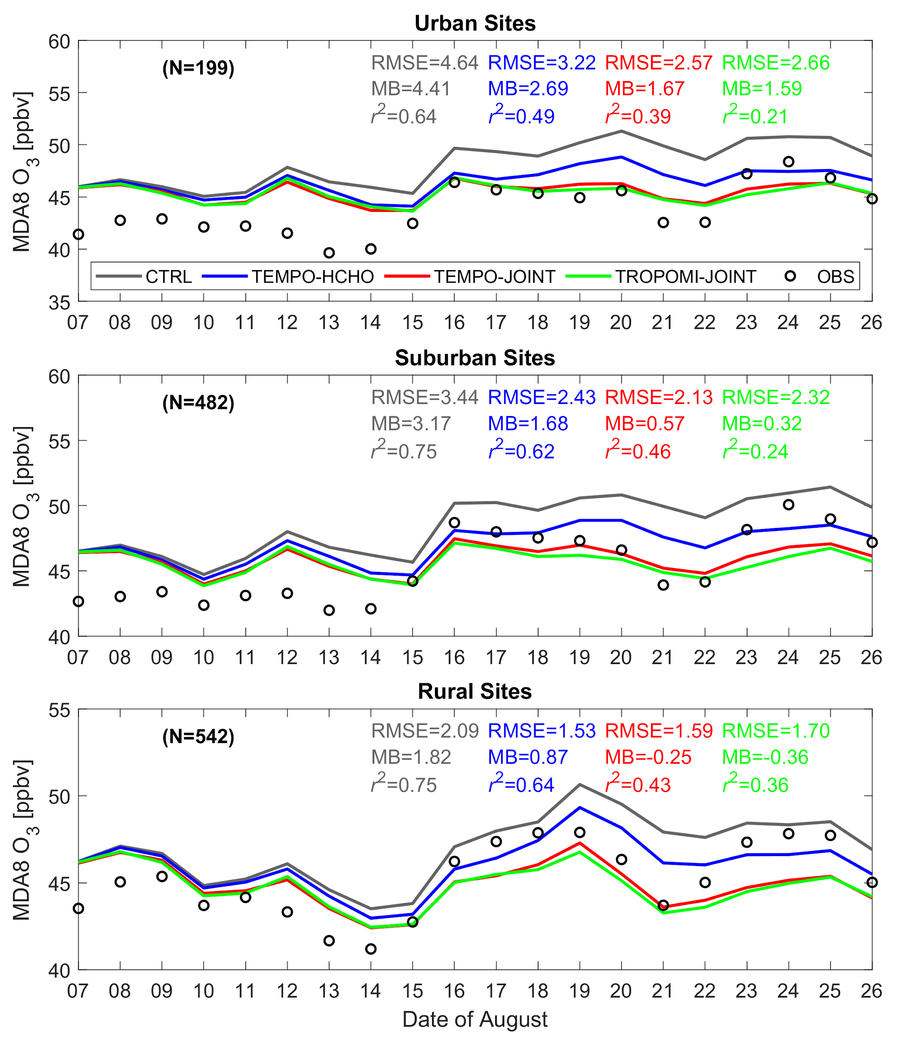
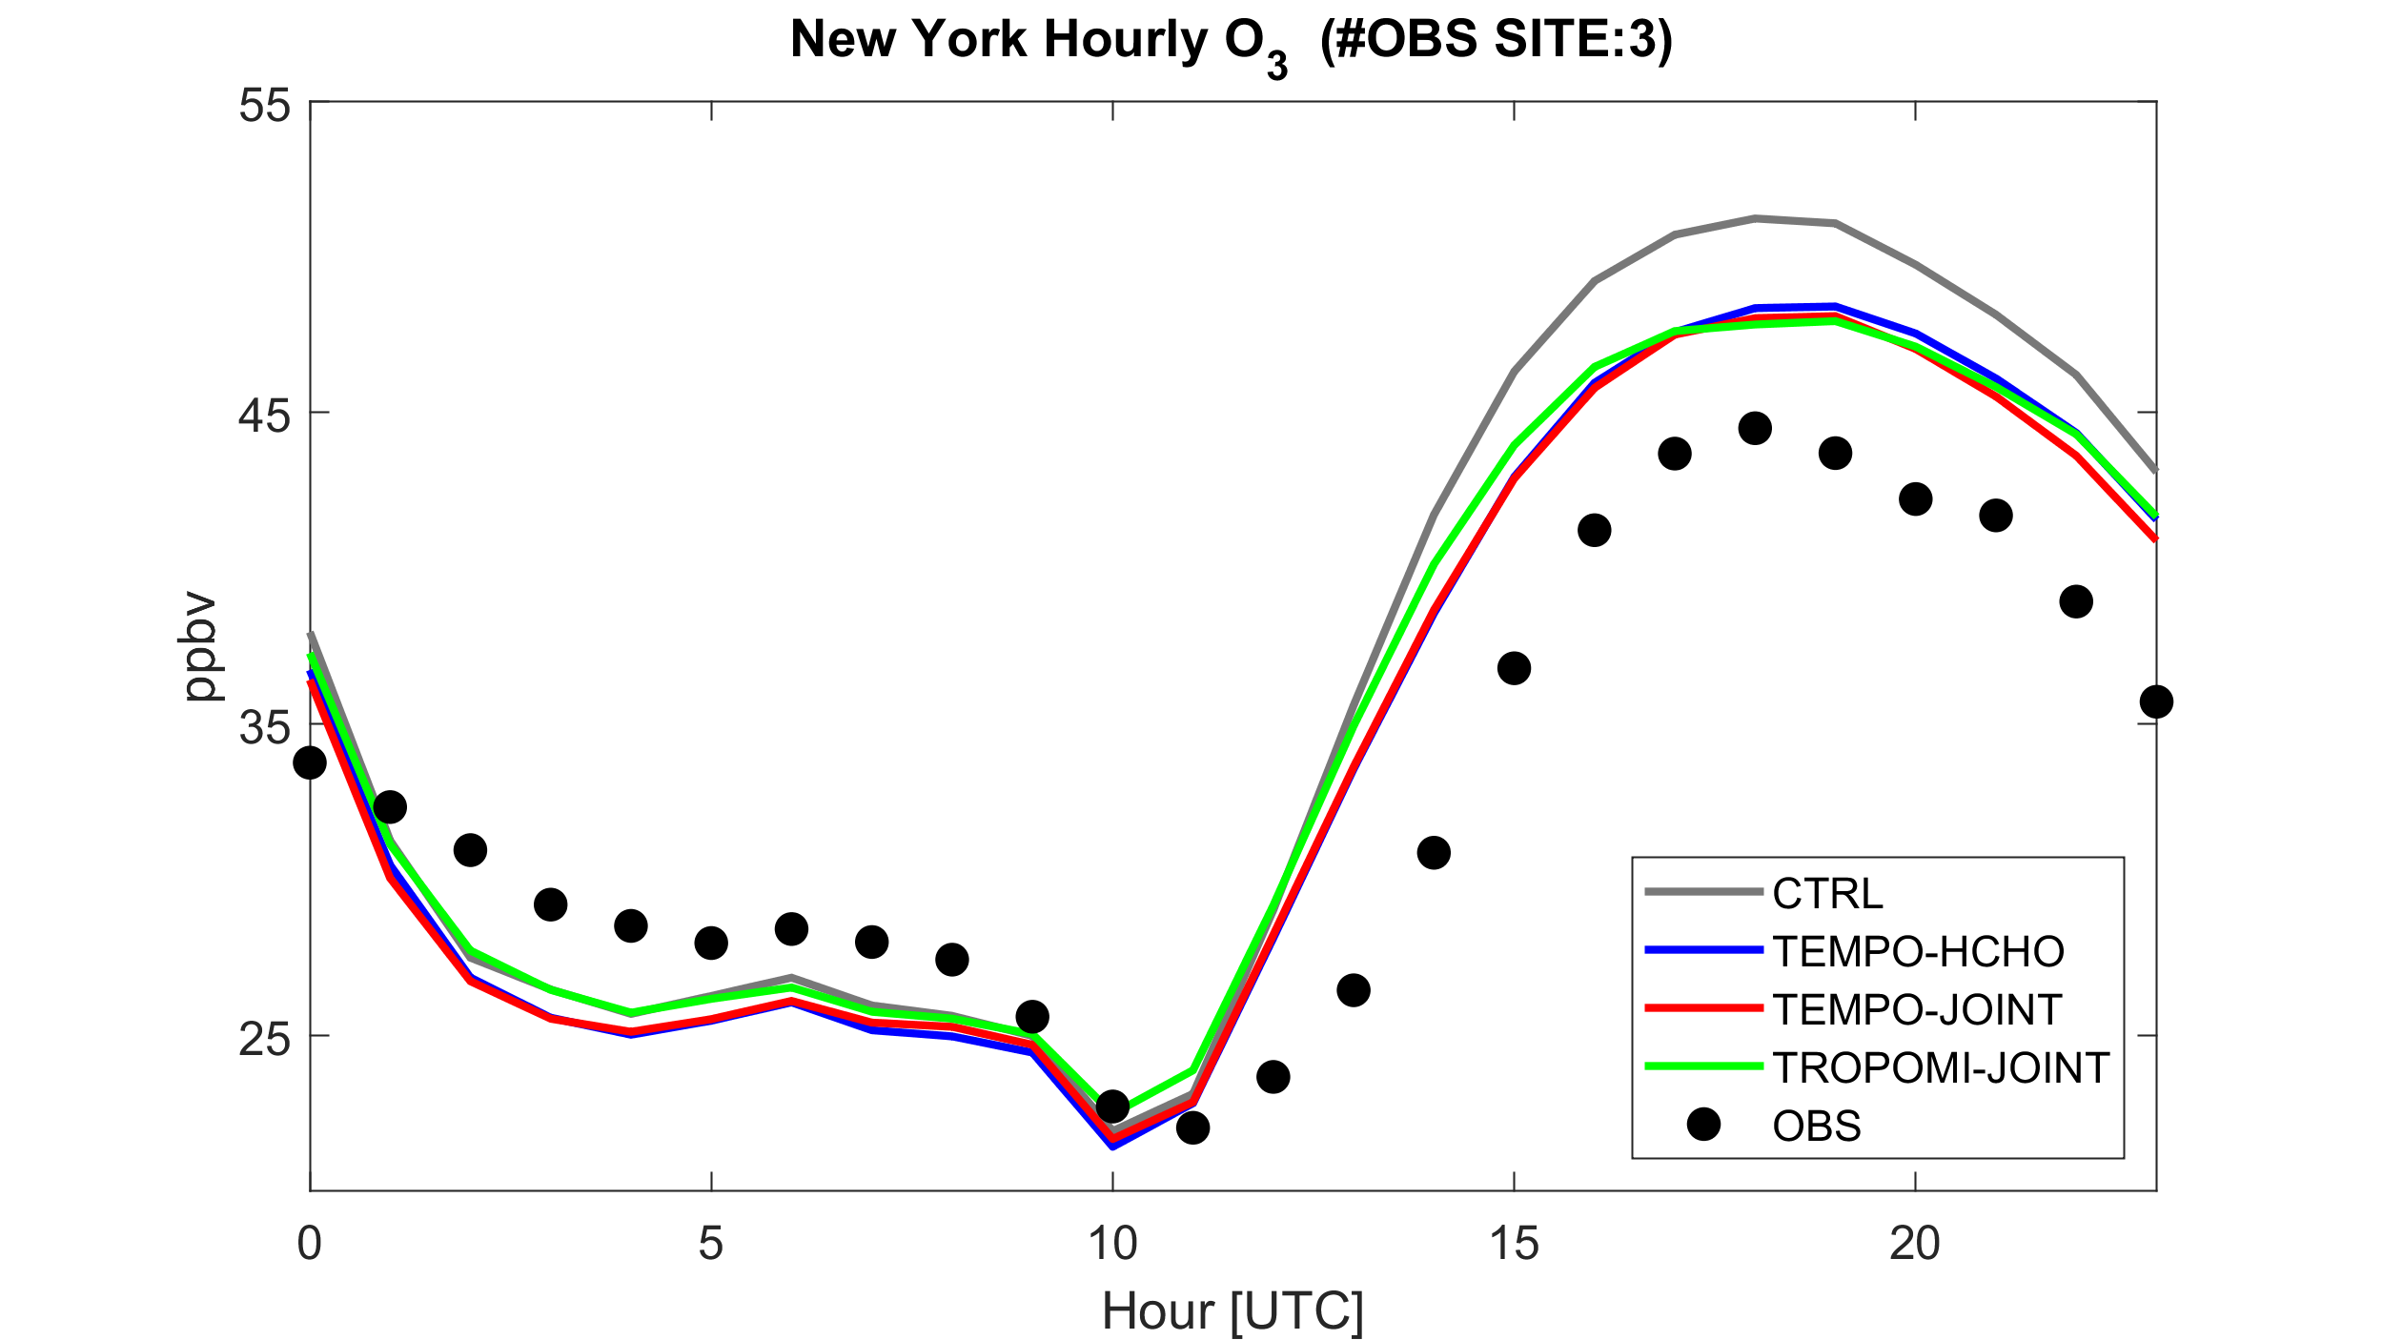
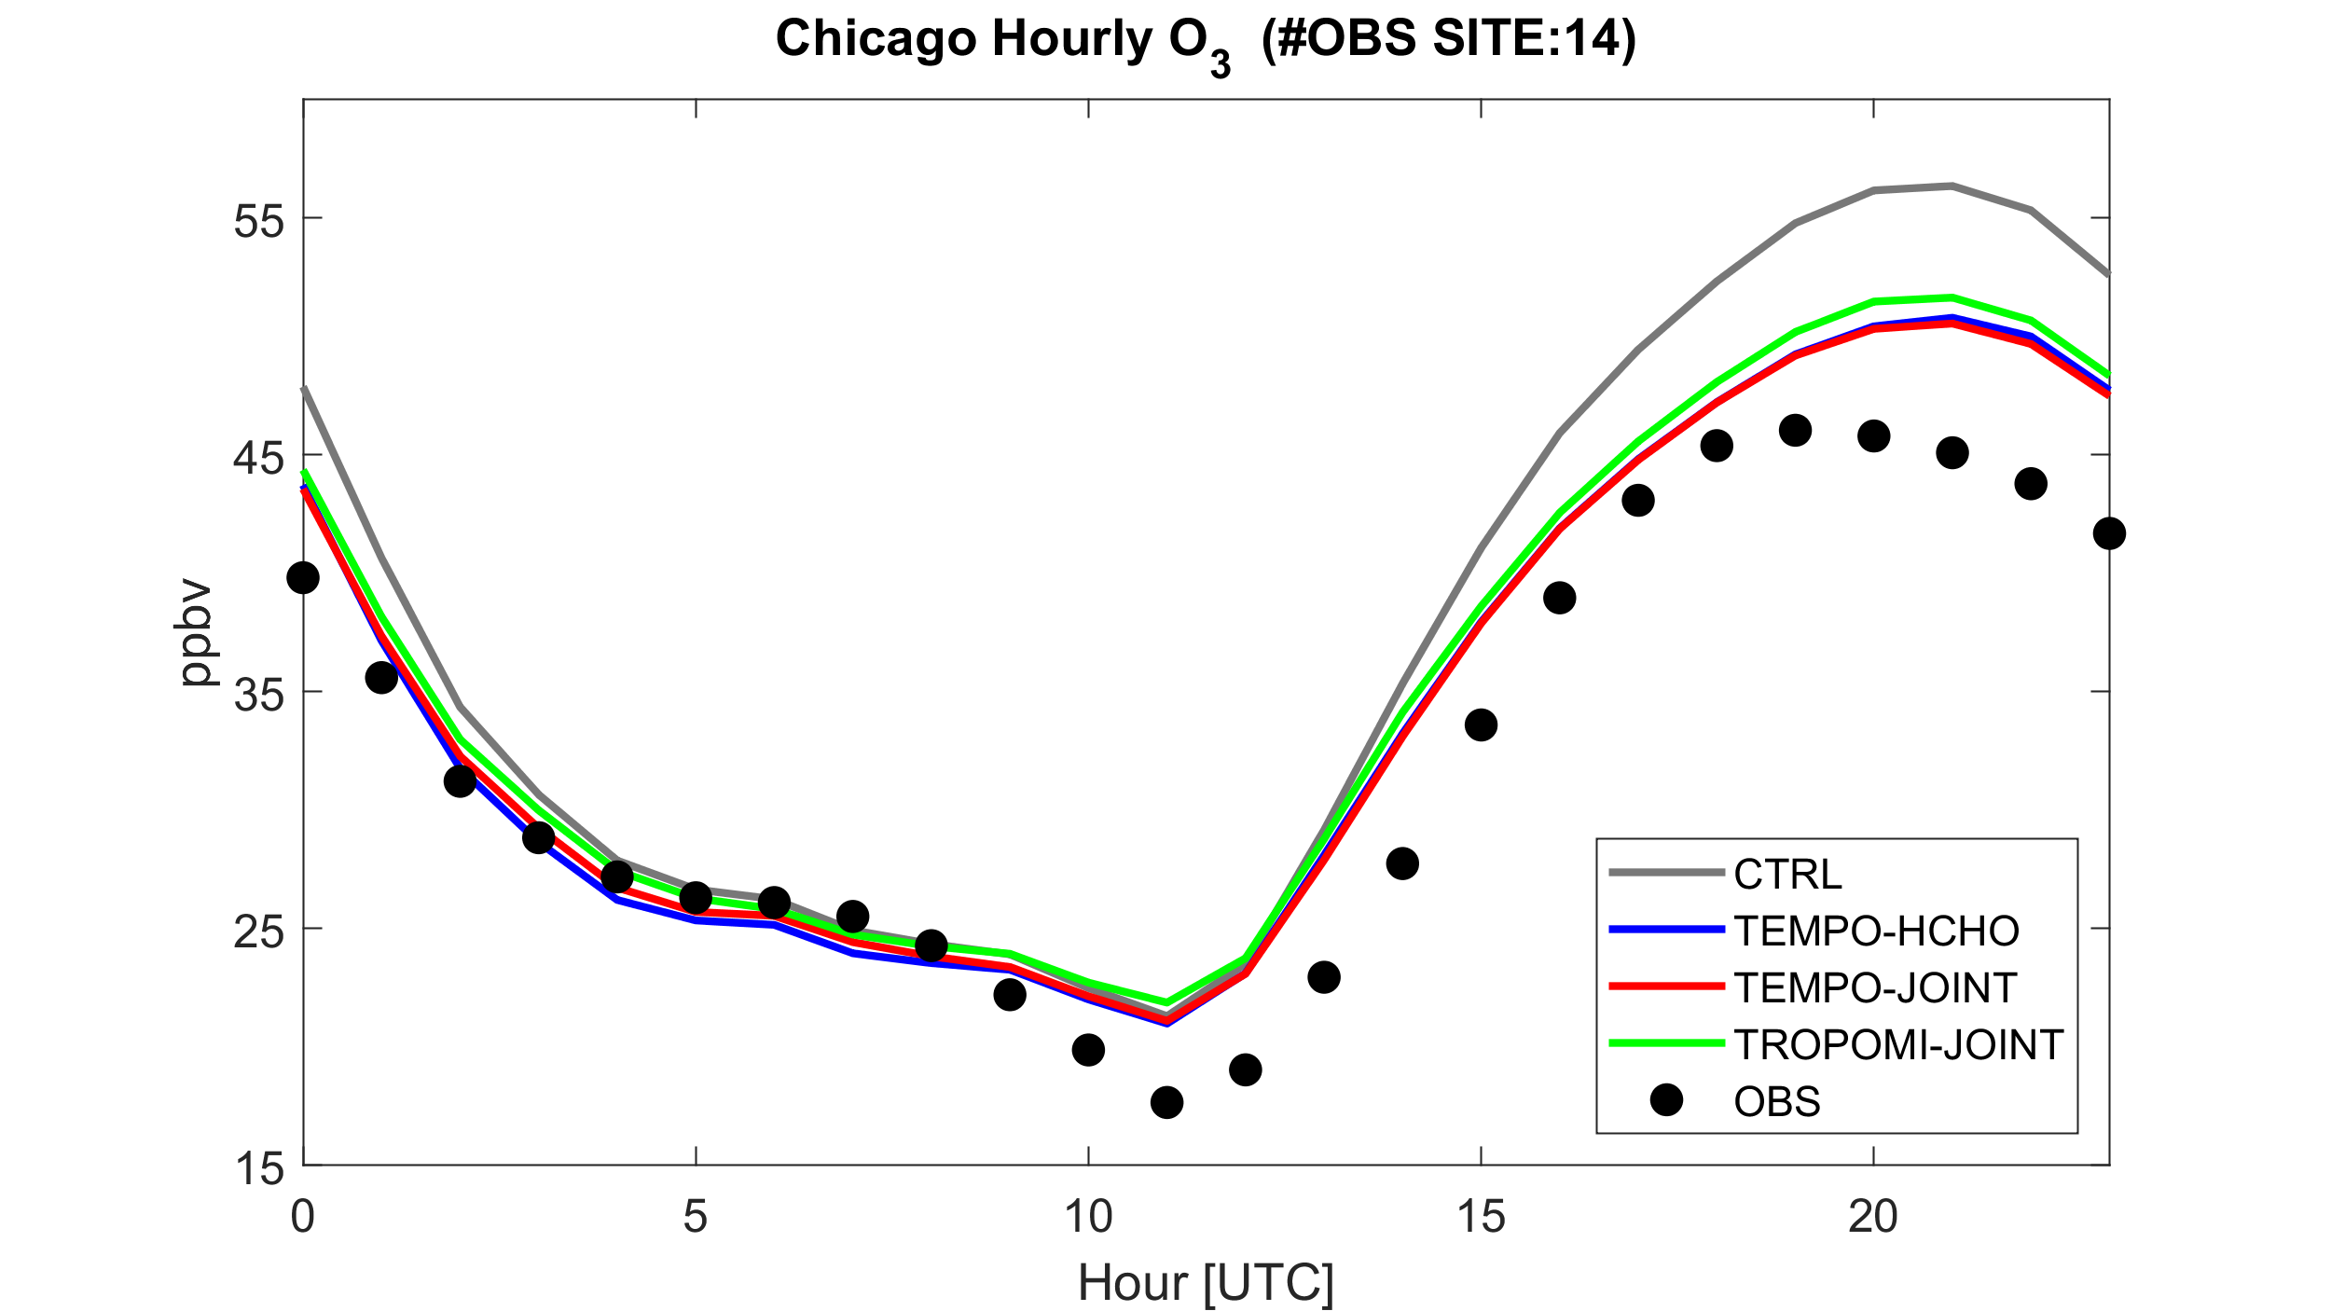
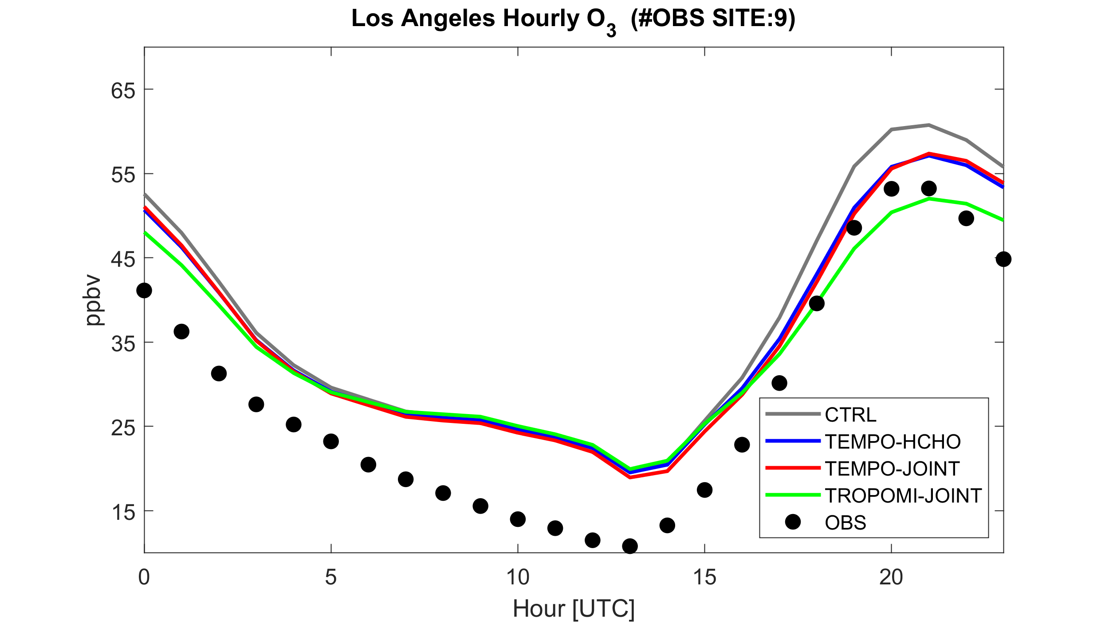
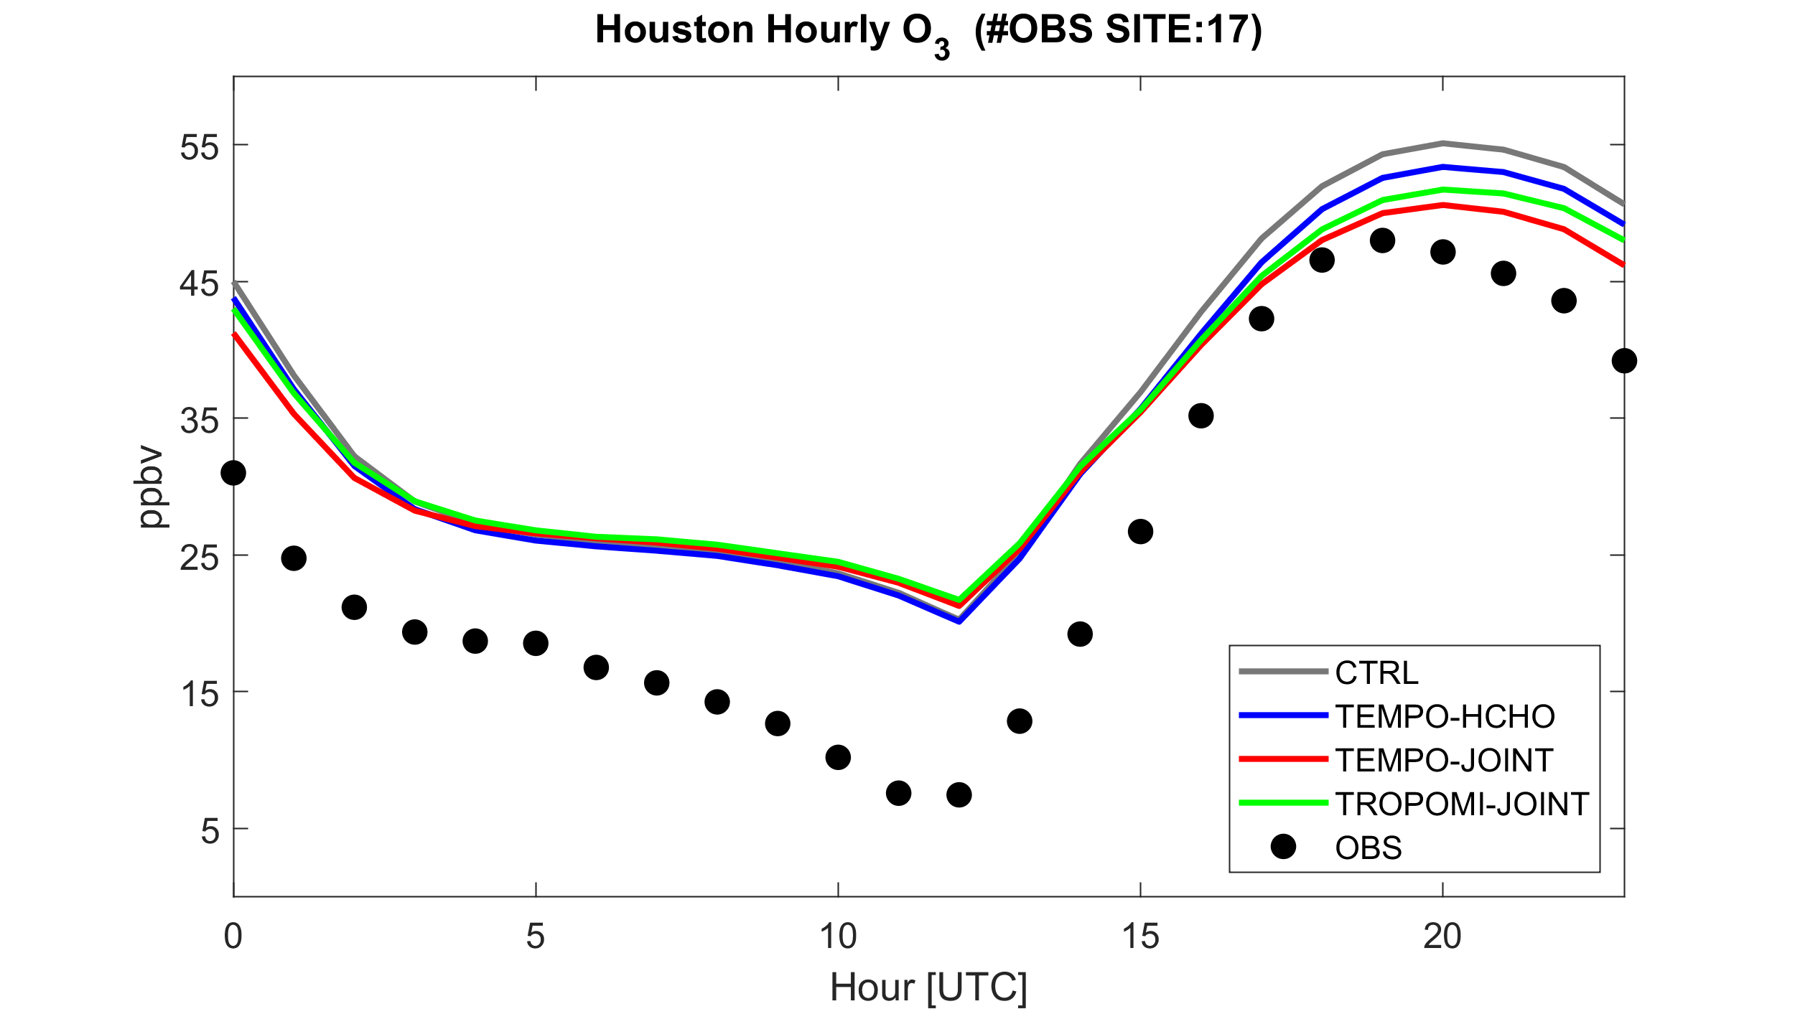
Top-Down Emissions Adjustment Improves Ozone Prediction
CNTRL TEMPO HCHO TEMPO HCHO+NO2 TROPOMI HCHO + NO2
VOC-limited
VOC-limited
NYC
Chicago
VOC-limited
NO_{x}-limited
LA
Houston

Slide 11
Summary
TEMPO HCHO assimilation improves model estimates of HCHO, isoprene, and other VOCs
Joint assimilation of HCHO & NO₂ improves O₃ predictions over NO₂ or HCHO alone
Despite other improvements, low NO₂ bias in urban cores exacerbated in TEMPO v04 compared to v03
  Top-down urban NOx emissions may be biased low
  NO₂ bias correction needed prior to assimilation
  Evaluation in additional months ongoing

