Slide 1



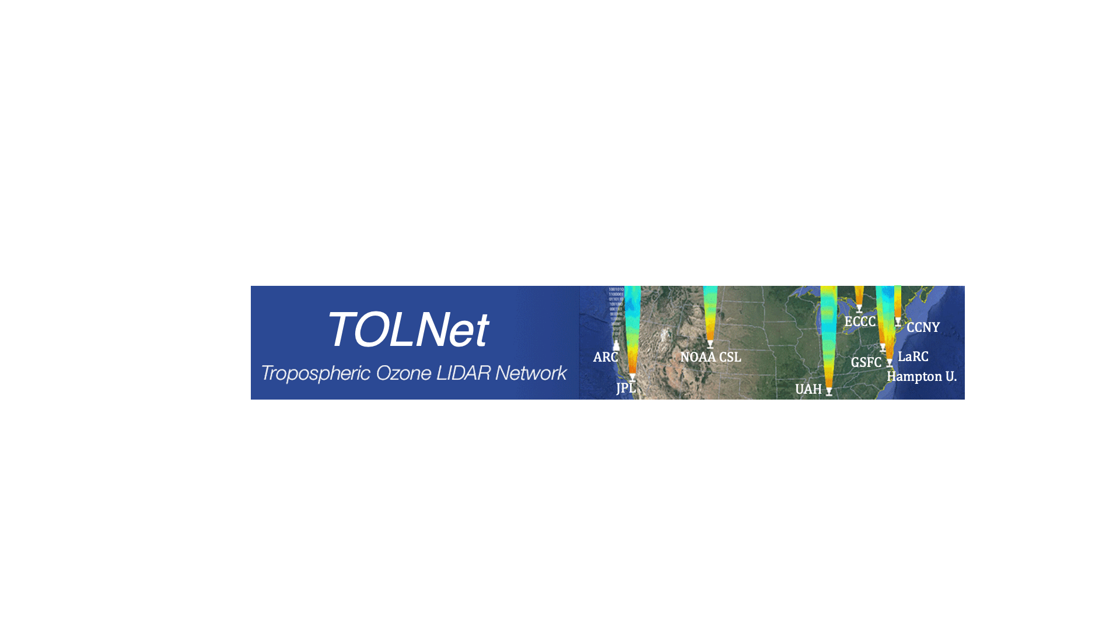


TEMPO/TOLNet
Science Team Workshop
U. Iowa, Iowa City, Iowa
15 June 2026
Validation of TEMPO O₃ profiles and NO₂ column with
TOLNet/RO₃QET and SeaRey measurements
Mike Newchurch and John Burden
U Alabama in Huntsville
TOLNet.larc.nasa.gov

Slide 2
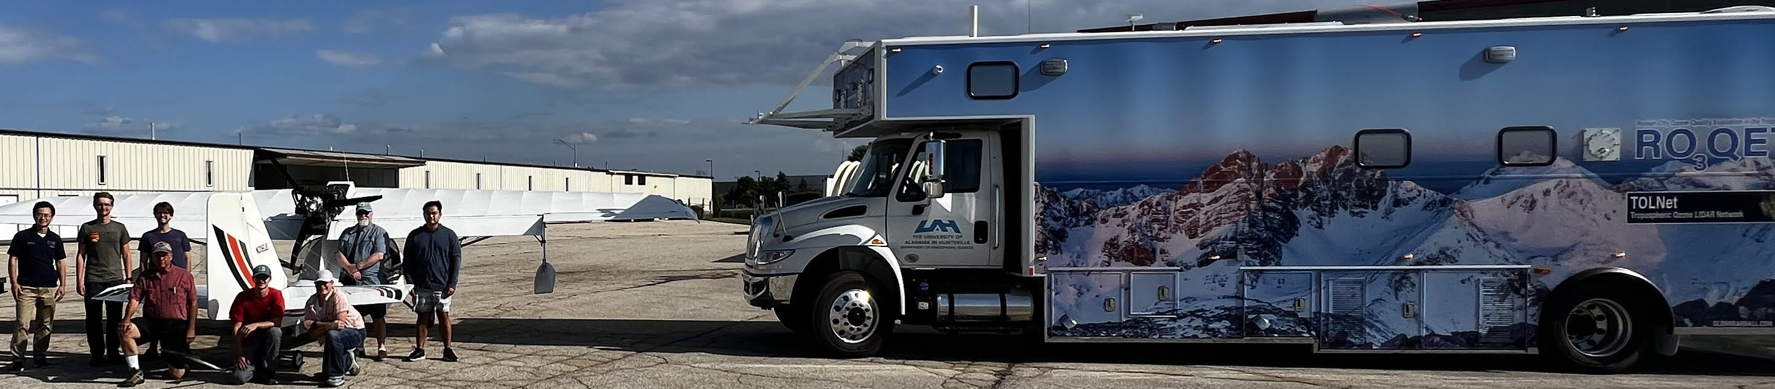
Acknowledgements
Funding: NASA Earth Science Atmospheres/TOLNet and Electric Power Research Institute (EPRI)
Collaborators: TOLNet (8 talks this STM) and TEMPO Science Teams (especially Brad Pierce/U Wisc.)
Hangar Host: Jeff Sickel and Steve Jones, Hangar9, Kenosha, WI

Slide 3
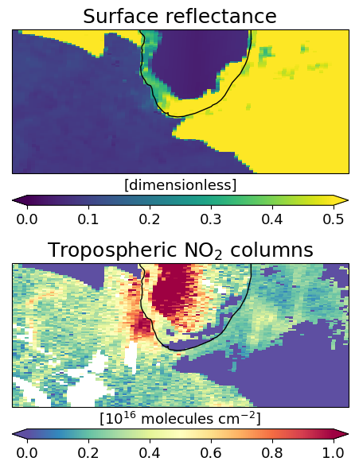
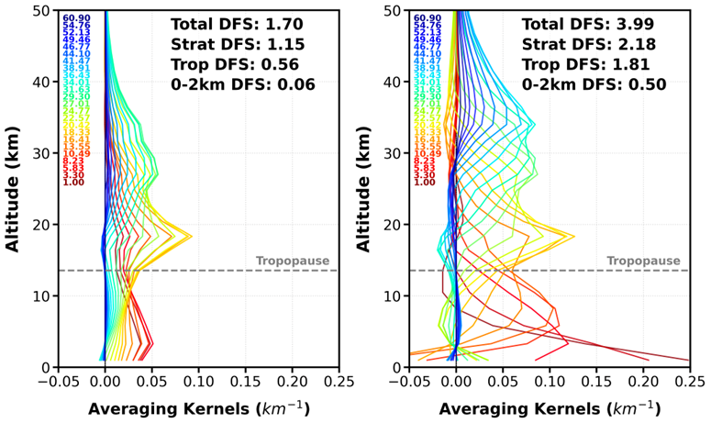
Over-Guide: Baseline Needs
UV-Visible O₃ profile Enhancement (backup slide)
Computational Resources (backup slide)
Objective: Optimize O₃ profile retrieval by adding visible spectral range, improving visible detector calibration and advancing characterization of surface reflectance
Objective: Expand computational capacity of the Science Data Processing Center
Benefits: Expedite reprocessing of five years of data after the release of version 5 expected September 2028.
Benefits: Enhance near-surface O₃ sensitivity, improve aerosol layer height and trace gas products, enable Solar-Induced Fluoresce retrieval, and increase computational efficiency
Degrees of freedom in the O₃ profile retrieval increase by a factor of eight for the 0-2 km altitude range when the visible O₃ Chappuis band is added (right panel). Version 4 (left panel) is only using UV wavelengths.
Errors in the characterization of the surface reflectance lead to artifacts in Level 2 products. This scene shows areas covered by snow, clear land and water, resulting in NO₂ distribution artifacts near the coast of Lake Michigan (black circle).
Chicago
V4, UV-only (308-340 nm)
UV-Visible (293-340 nm, 540-650 nm)
Enhanced sensitivity to tropospheric O₃

Slide 4

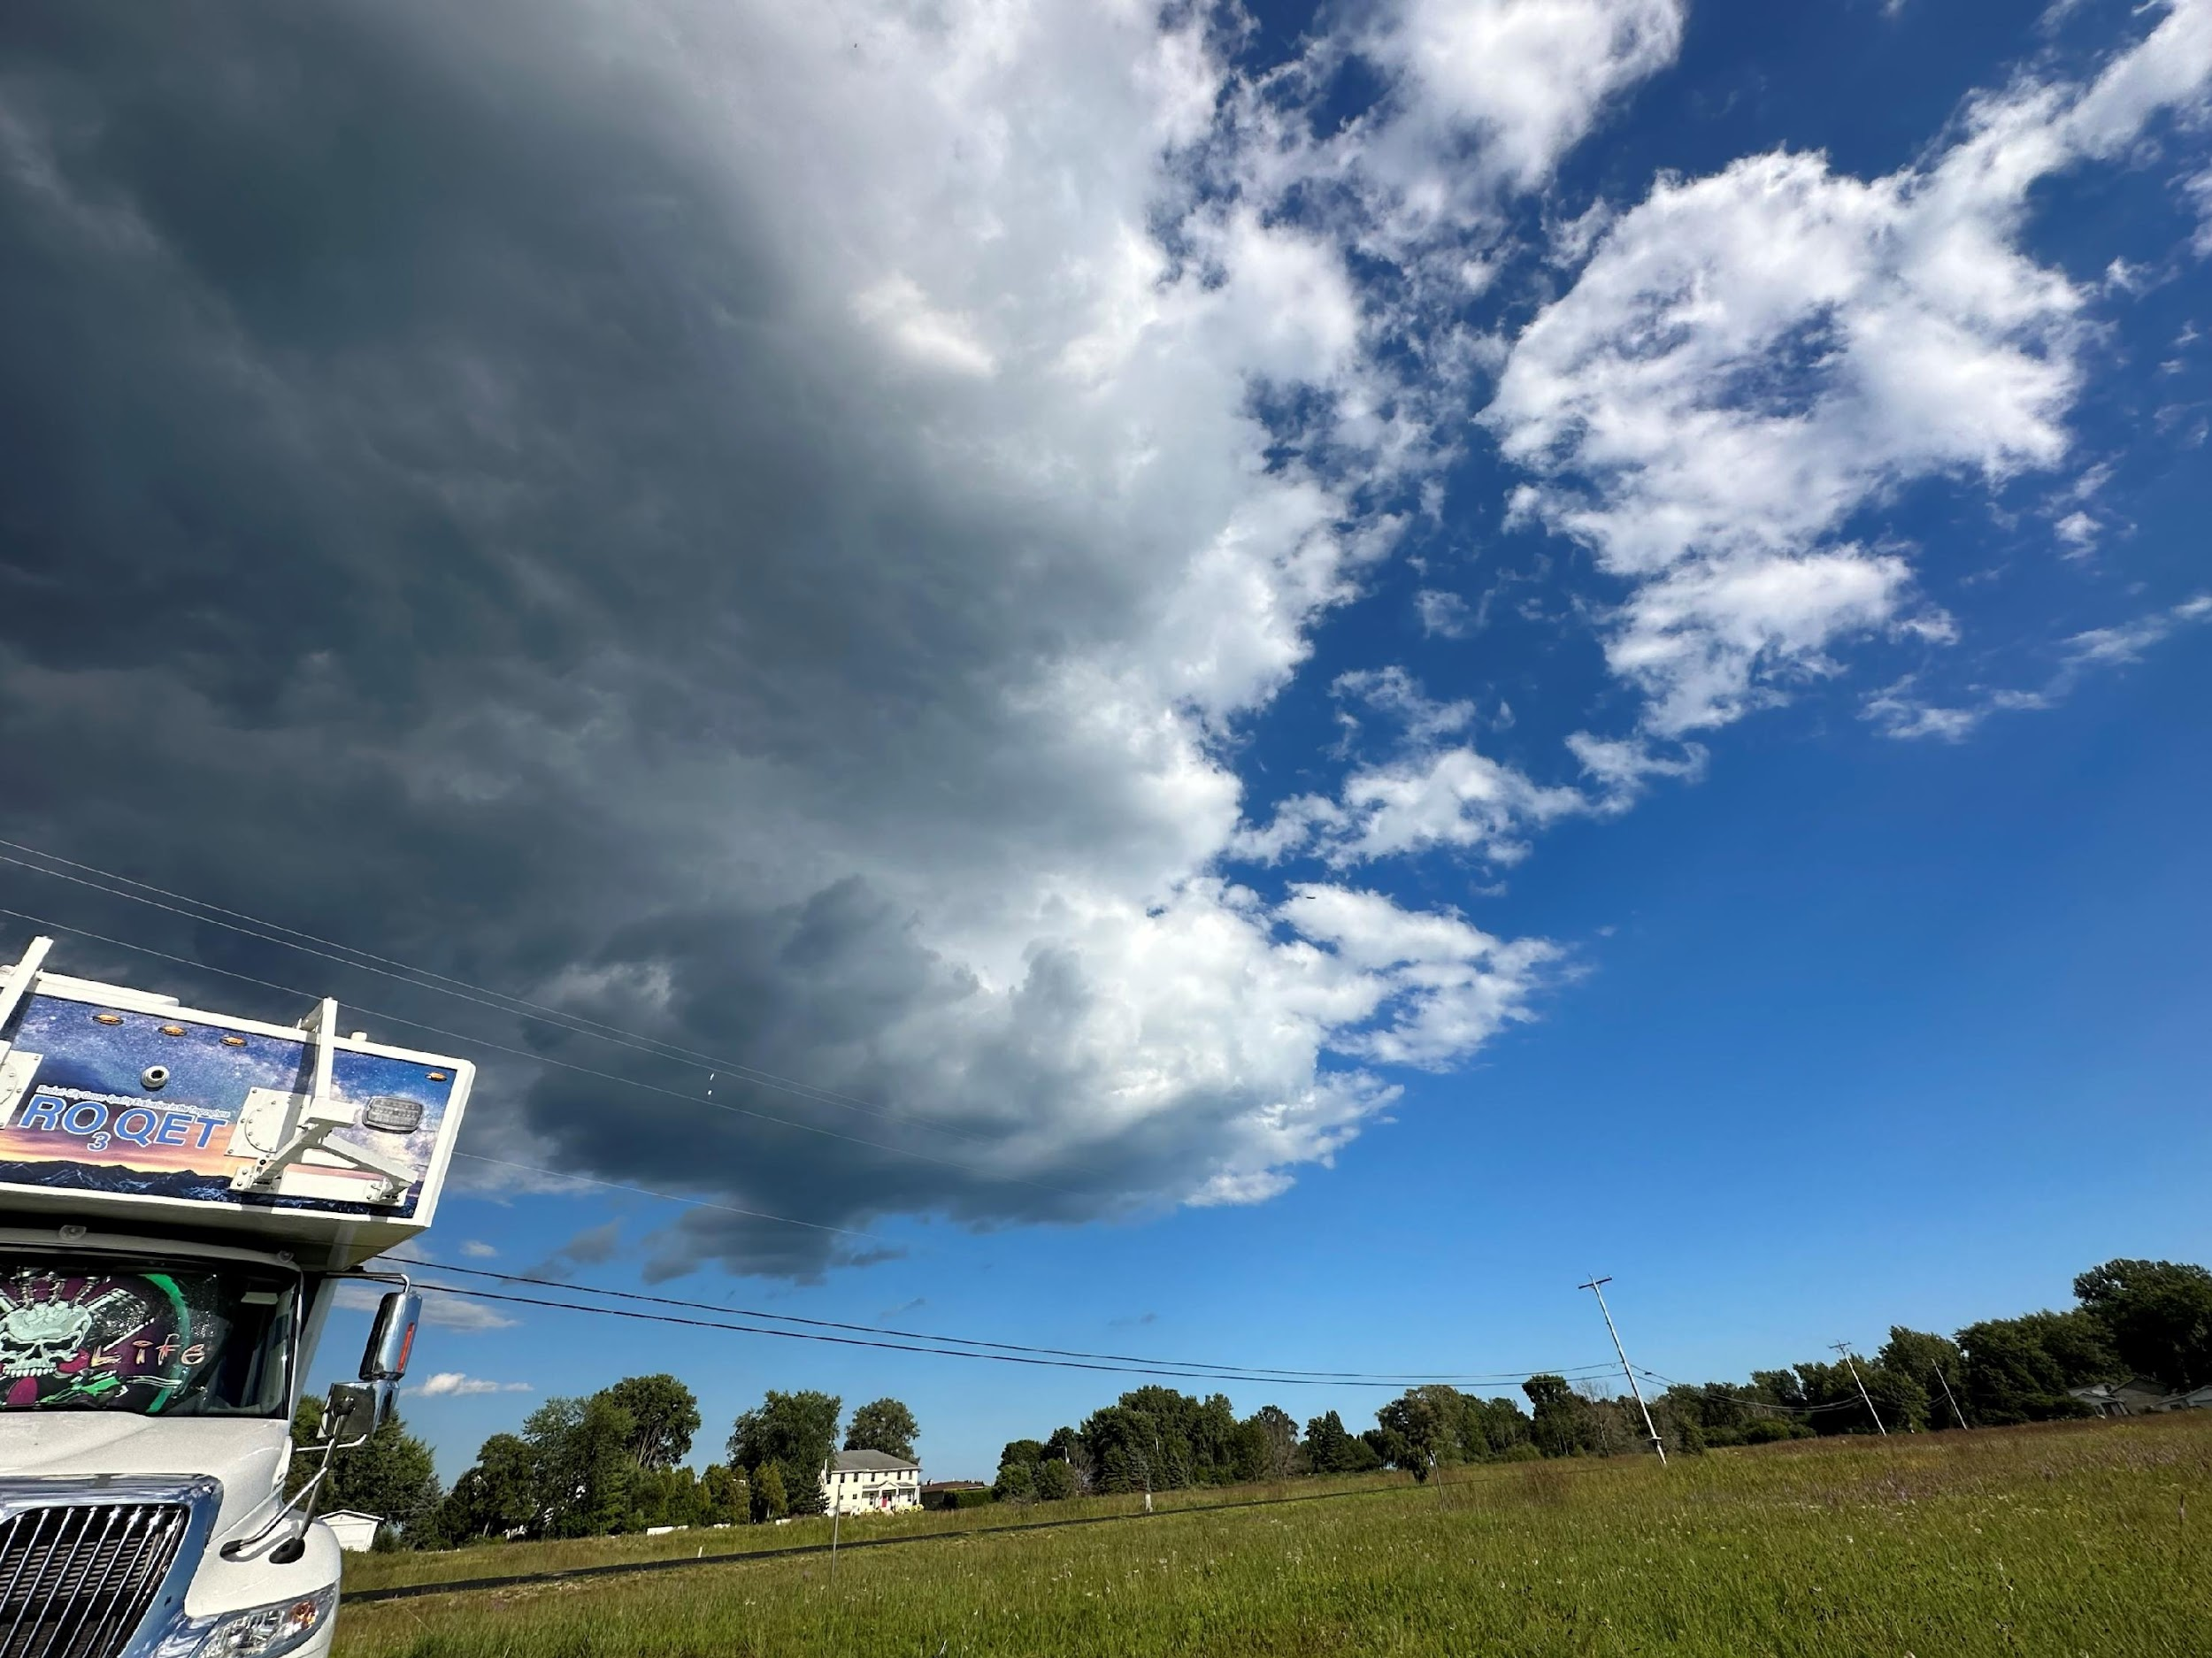
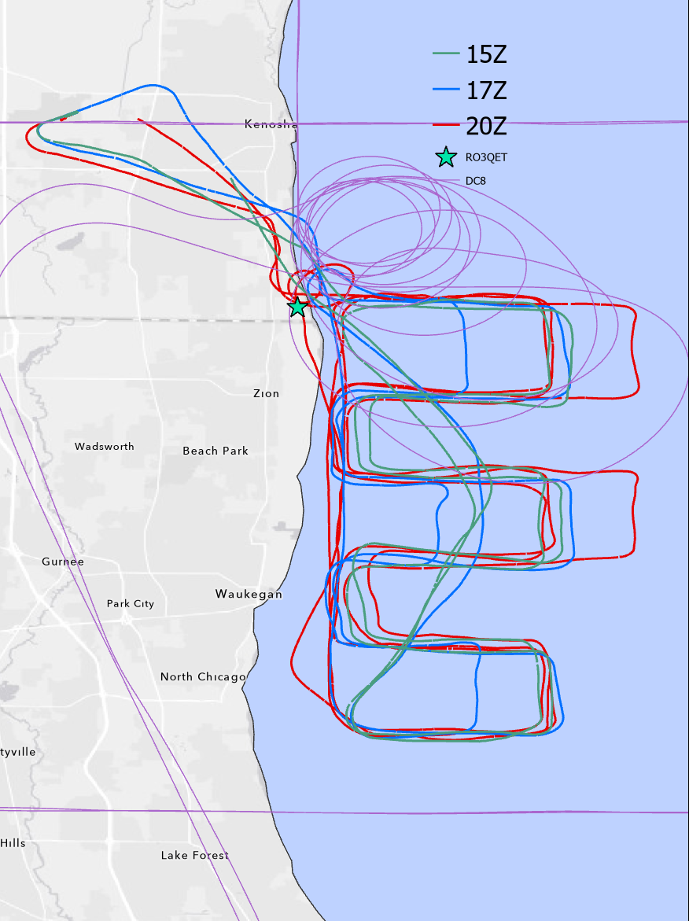
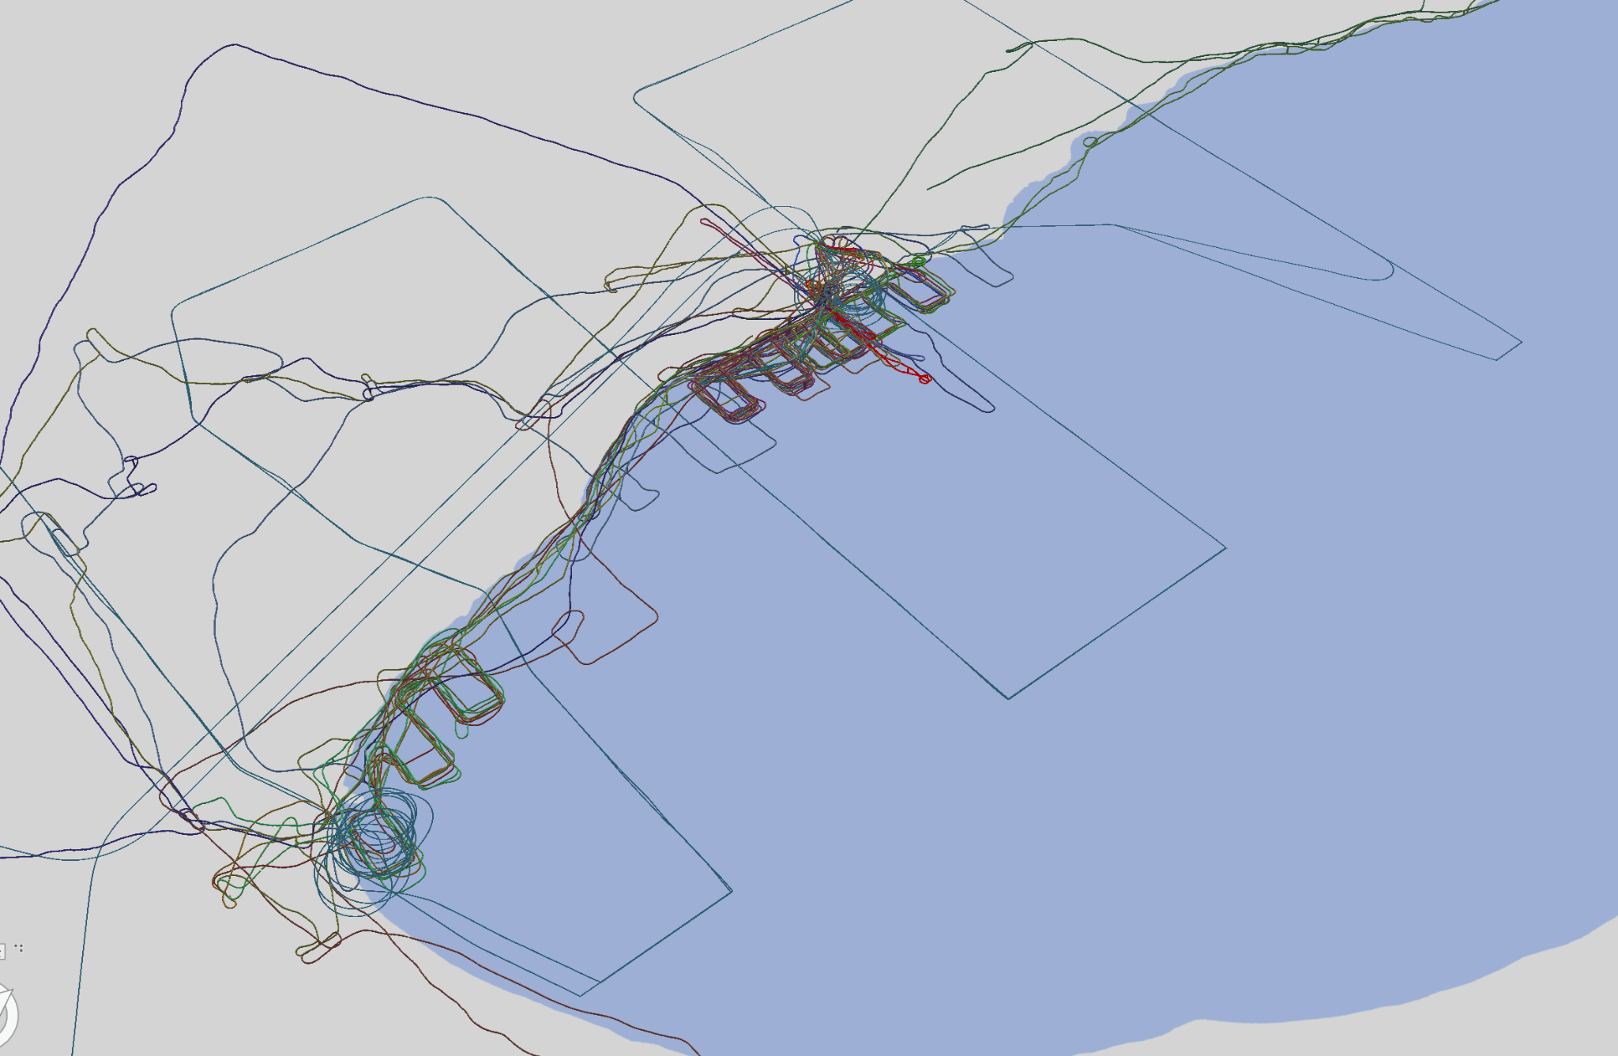


Study Extent on 8/2/23 RO3QET and Searey
Kenosha
RO₃QET
Chicago
Lake Michigan
Newchurch and Burden TEMPO/TOLNet STM 2026 U Iowa

Slide 5
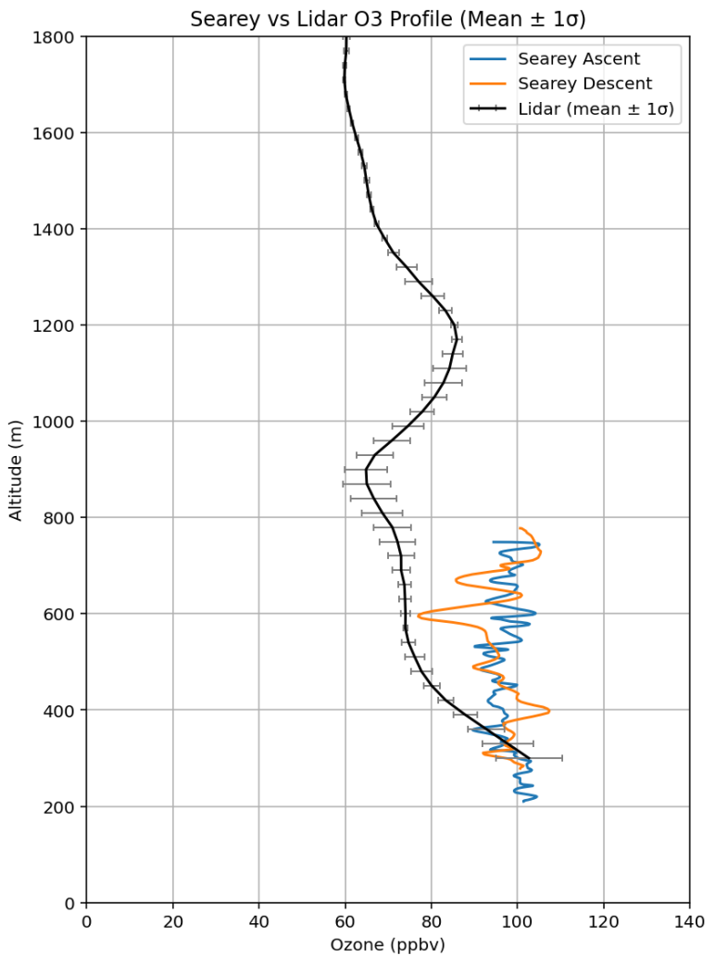
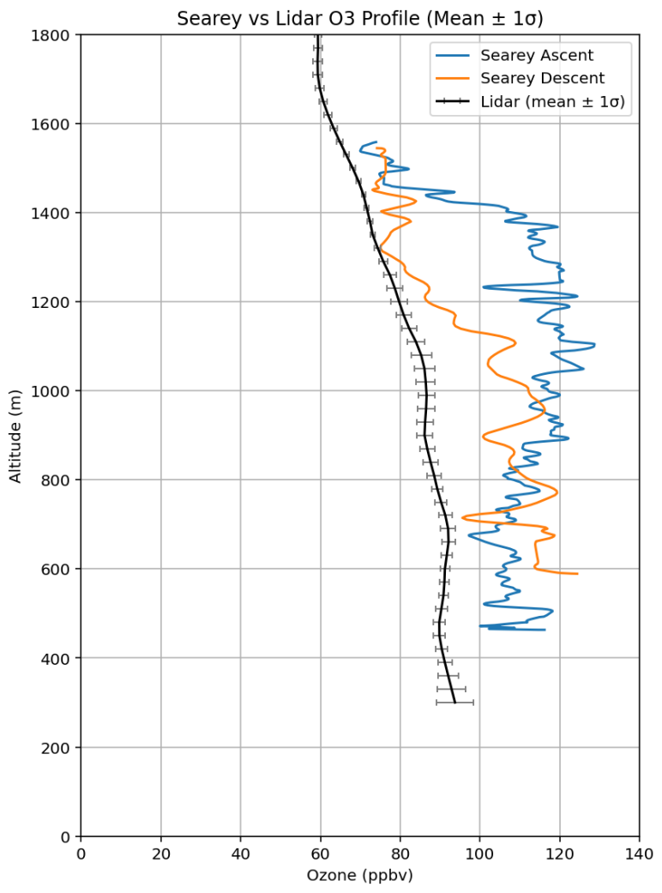
RO3QET-Searey Ozone Comparison at the Lakeshore
These example profiles illustrate how quickly the ozone profiles can change in time due to the Lake breeze effect and also higher concentrations over the lake (measured by the SeaRey) compared to concentrations over the land (measured by RO₃QET).
Newchurch and Burden TEMPO/TOLNet STM 2026 U Iowa

Slide 6
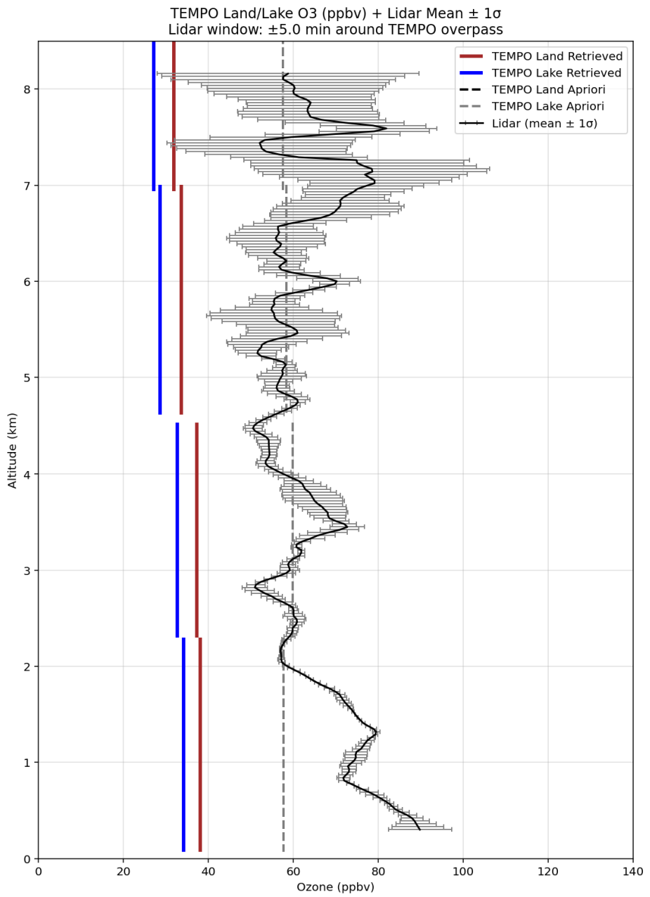
RO₃QET and SeaRey ozone compared to TEMPO: Land/Lake Differneces
The left plot shows a RO₃QET averaged ozone profile with std dev bars ±5 minutes of the time of the TEMPO time. TEMPO is represented as isotonic layers where the midpoint value represents the entire thickness of a layer. It includes the retrieval: Red over land (42.5, -87.81), Blue over lake (42.58, -87.75), and Black dash a priori from TEMPO.
The plot on the right shows a comparison of the longest ascent (Blue) and descent (Orange) of the last flight from Searey on 8/2/23 to the lidar averaged over that same period of time with std dev bars.
The bottom plot represents the lidar curtain shown as a averaged profile to further illustrate variability behind the std dev bars magnitude.
The lake measurements were significantly higher than those over land.
TEMPO shows that the priors between over Lake Michigan and over land in Kenosha do not change much at low altitudes and, at 1.5 km, are 20 ppbv lower than the lidar. The a priori above 2 km seems to be a good estimation of the layer average but the retrievals are 20-30 ppbv lower.
Newchurch and Burden TEMPO/TOLNet STM 2026 U Iowa

Slide 7
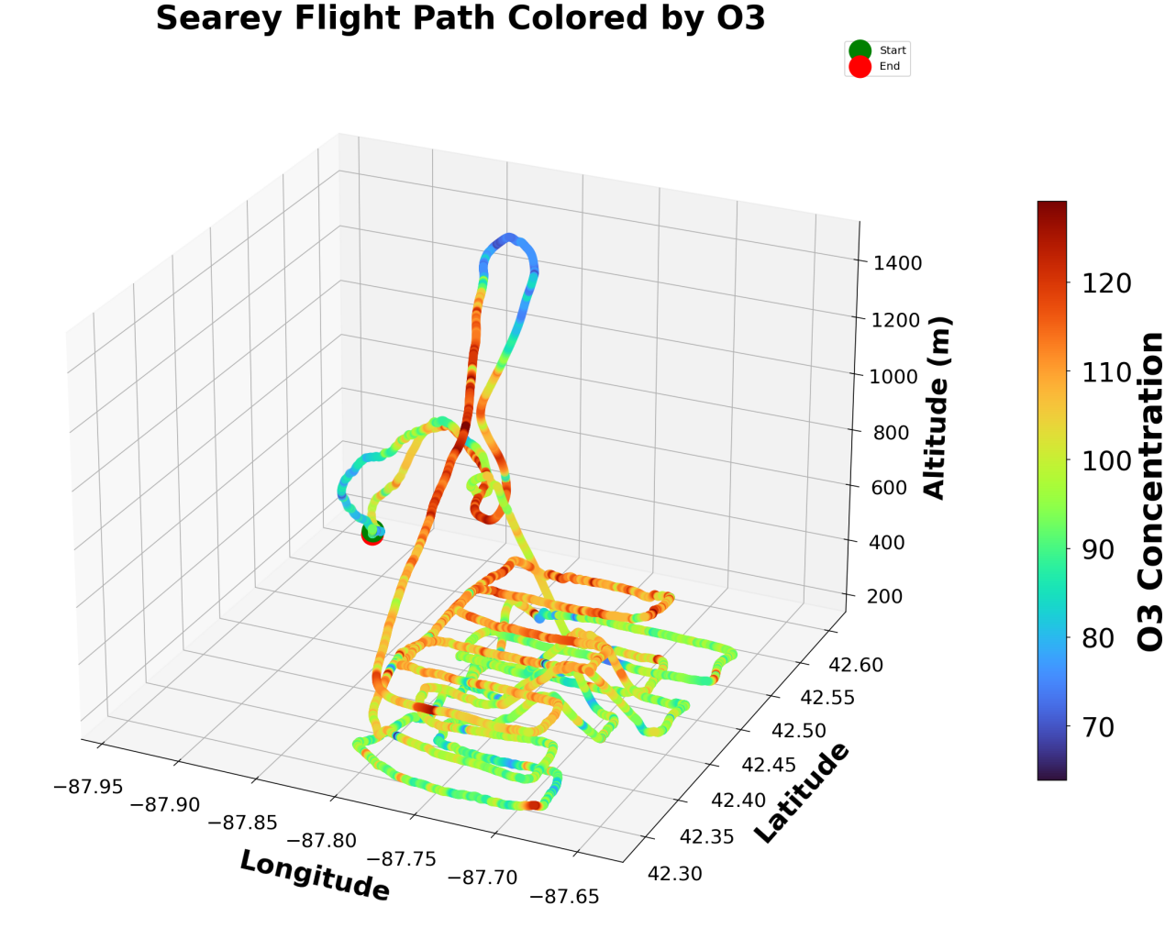
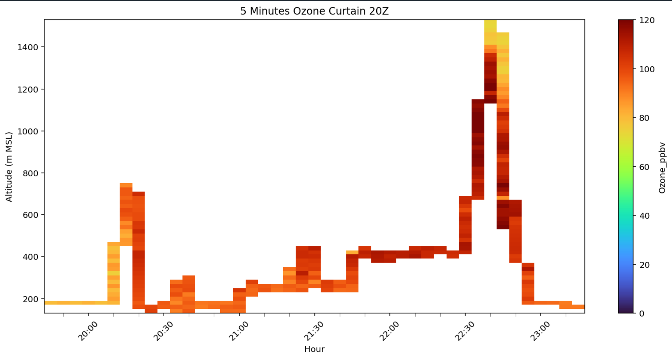
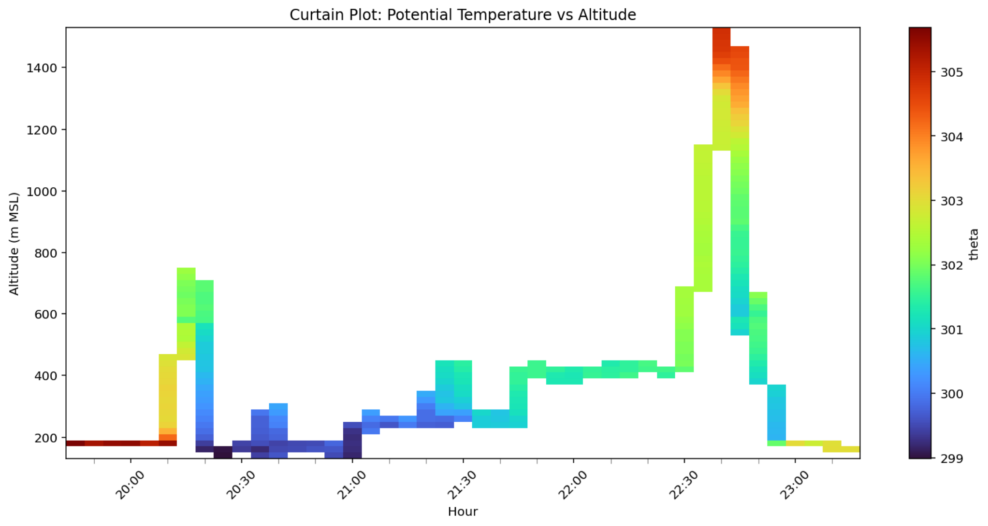
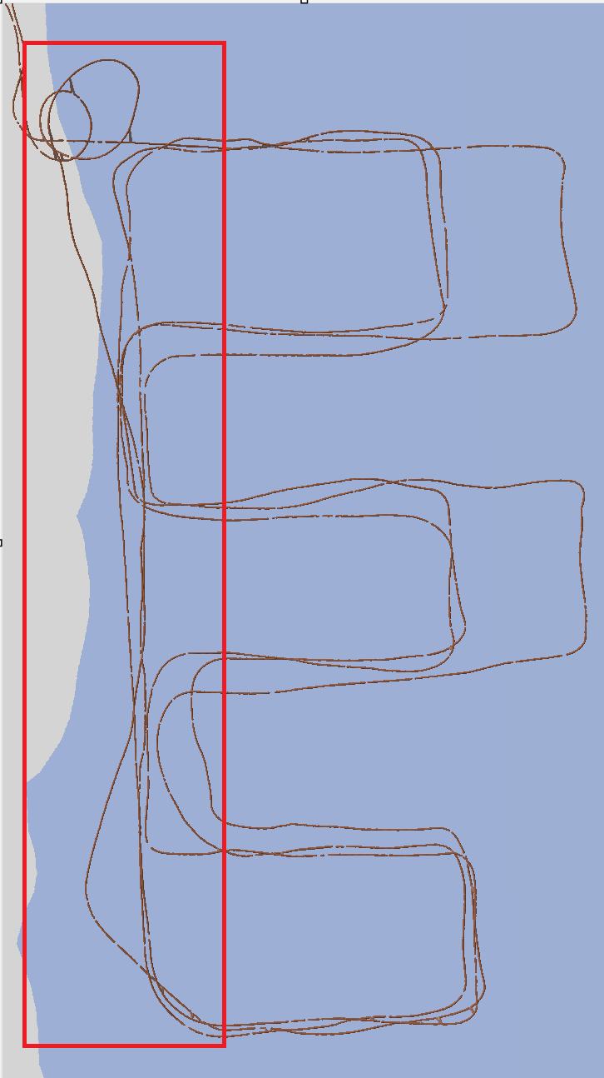
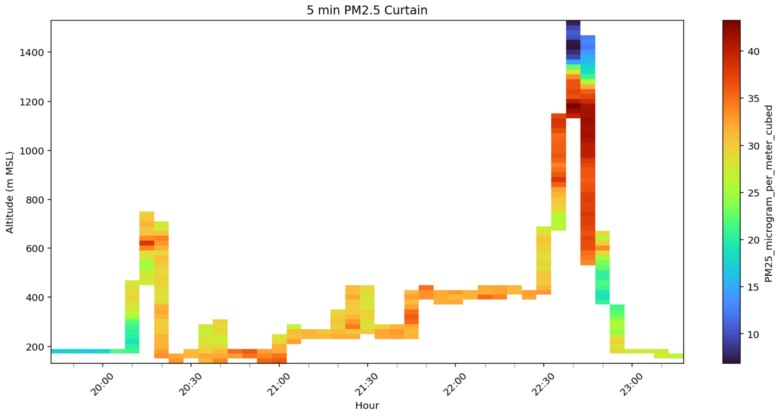
Investigating Differences 1.2-1.4 km between Land and Lake
Near 22:45 Z, SeaRey observed a sharp change in the atmosphere around 1.4 km, where ozone and PM 2.5 both dropped quickly. At the same height, potential temperature jumped by about 3°C, showing the air above was more stable and came from a different source. This means the aircraft crossed a real boundary between two air masses. Windsondes show increasing ascent rates below 2000m that indicate updraft near the shoreline.
These observations show how lake‑breeze flows and nearby clean air can stack and mix in complex ways, creating sharp layers that satellites observations with low tropospheric sensitivity will miss. Also, based on the lack of variation between land and lake pixels a priori used by TEMPO in this case, the spatial resolution of models used for priors may not be sensitive to to the sharp changes at land-lake boundaries.
Very sharp ozone spatial gradients
Newchurch and Burden TEMPO/TOLNet STM 2026 U Iowa
Notes:
Make red line thicker, lighter background lake

Slide 8
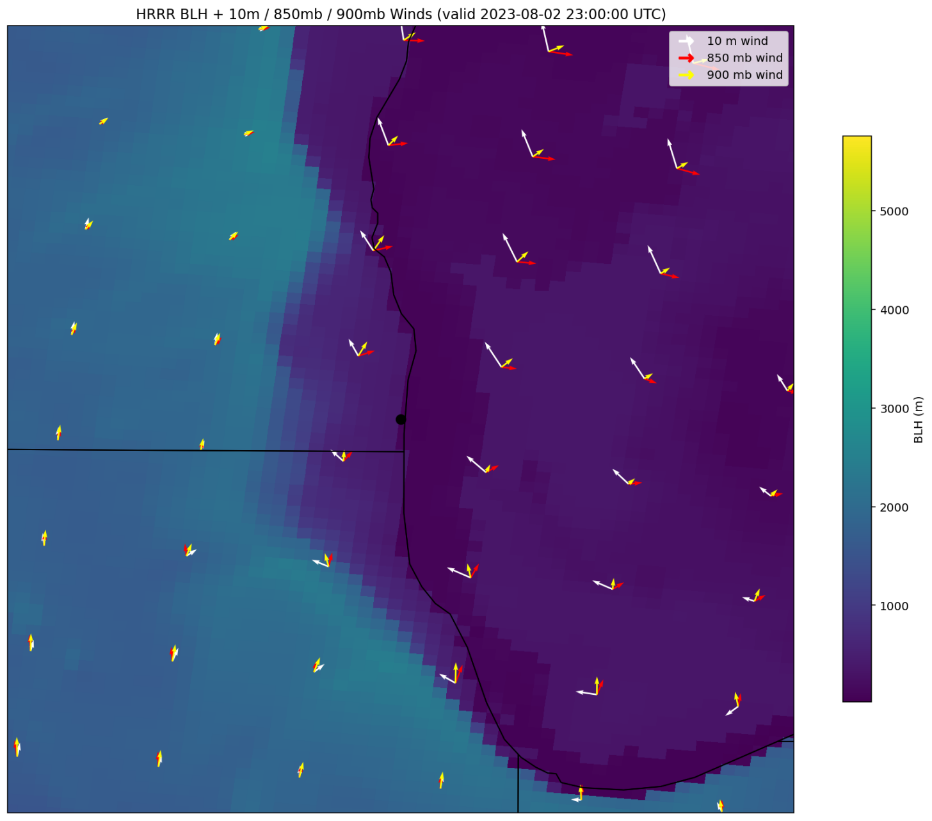
HRRR Winds: sfc, above PBL (850 mb) and below PBL top (900 mb)
At 2300 utc, HRRR shows the Lake Breeze effect that SeaRey sampled. The arrows indicate direction at multiple pressure levels to show the circulation and the base map is colored by boundary layer height. The boundary layer over the lake that was still circulating polluted air from the week prior was advecting onto the land. The SeaRey measurements pass through that PBL ceiling.
These measurements show that cleaner air was aloft.
On the next slide the Lidar data from the campaign ozone curtain shows the improving air quality through continuous observation at the Chiwaukee Prairie site. This curtain shows high ozone concentrations start aloft and move downward near the surface where ozone remains for roughly a week until lower concentrations appear and remain low near surface until the end of the campaign.
Newchurch and Burden TEMPO/TOLNet STM 2026 U Iowa

Slide 9
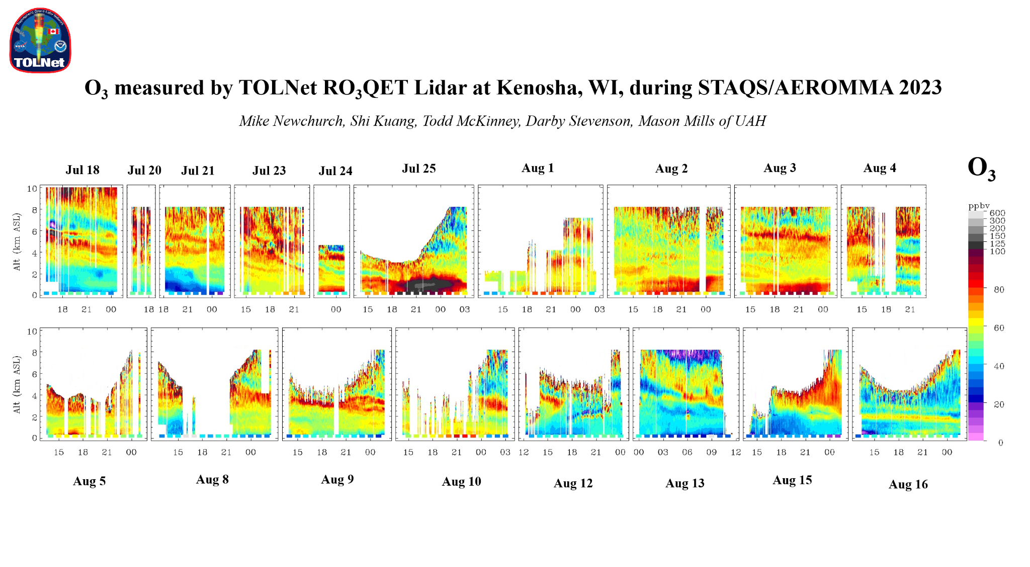

Slide 10
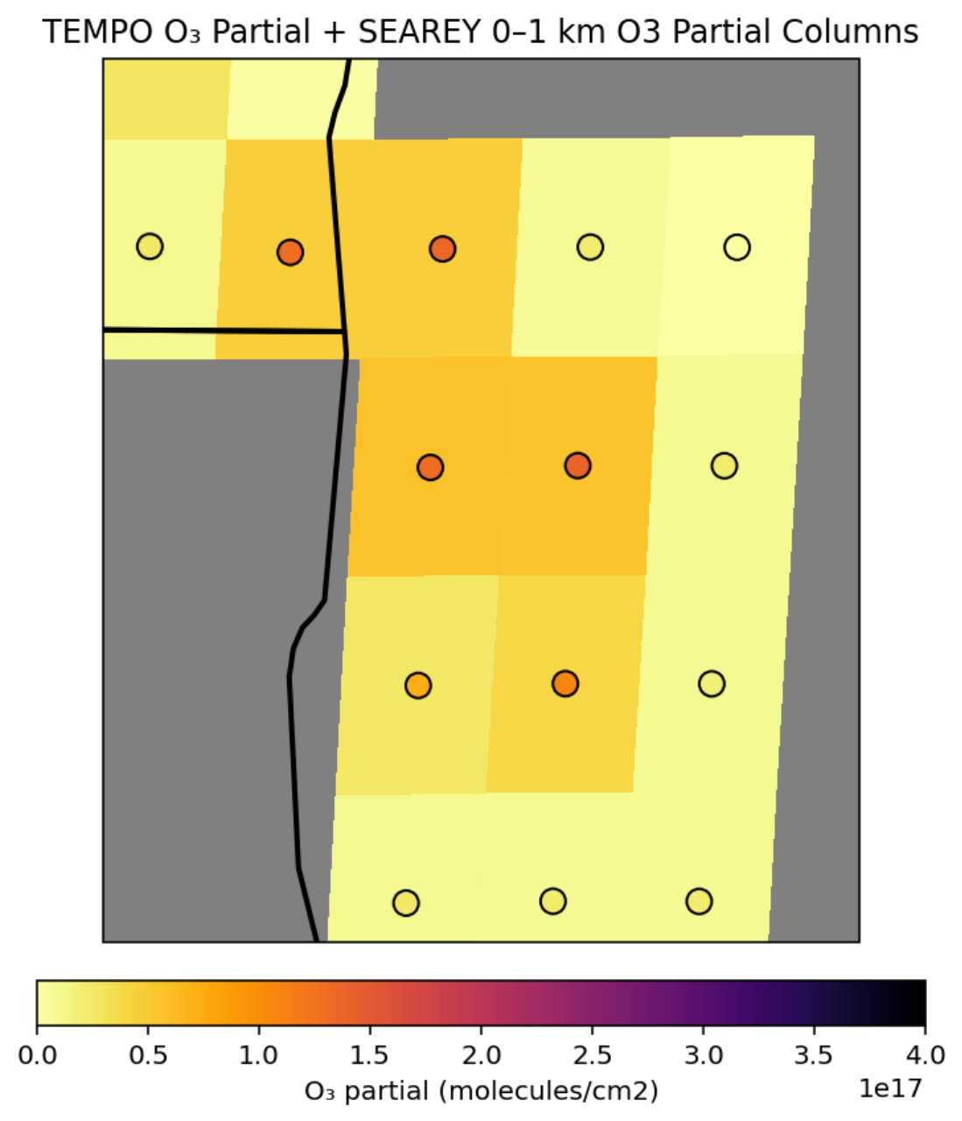
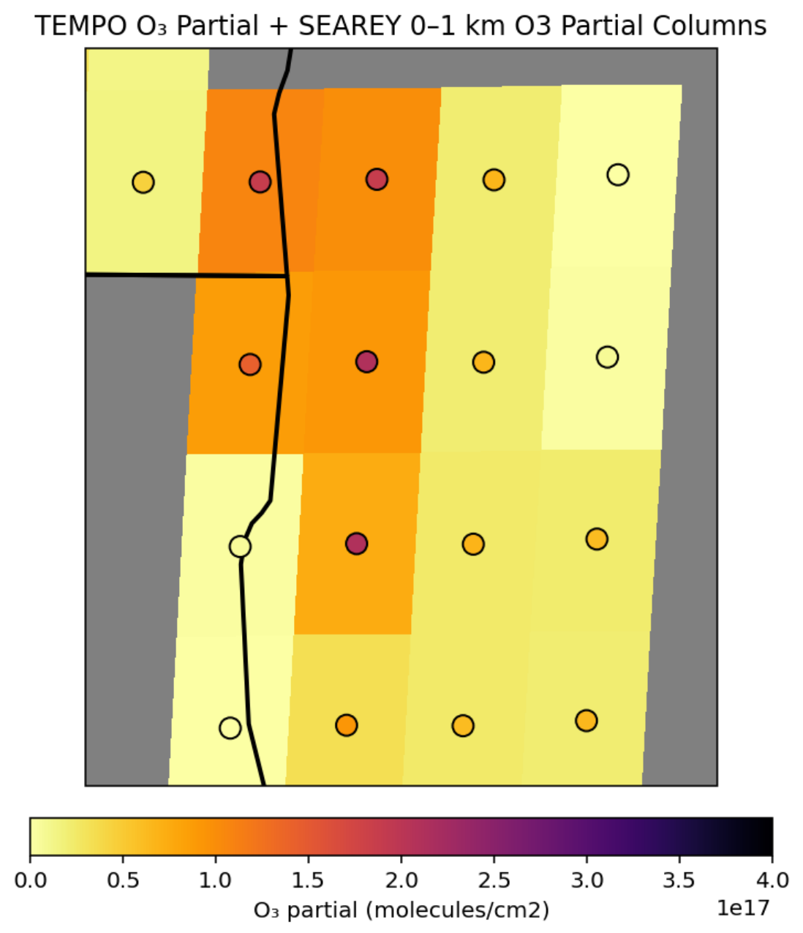
Ozone Partial Columns: Searey and TEMPO
15Z
20Z
Mean Bias (T - S): -36 ×10¹⁵
Median Bias: -15 ×10¹⁵
Std Dev: 31
RMSE: 48
Min Difference: -91
Max Difference: -1
Mean Pixel % Bias: -61.6%(Higher Searey)
Mean Bias (T - S): -46×10¹⁵
Median Bias: -43 ×10¹⁵
Std Dev: 36
RMSE: 59
Min Difference: -136
Max Difference: -0.7
Mean Pixel % Bias: -59.9% (Higher Searey)
The TEMPO O₃ partial column results from extracting the SeaRey vertical extent from the 2-km partial column altlitude extent.
Newchurch and Burden TEMPO/TOLNet STM 2026 U Iowa
Notes:
Scale tempo to searey ceiling

Slide 11
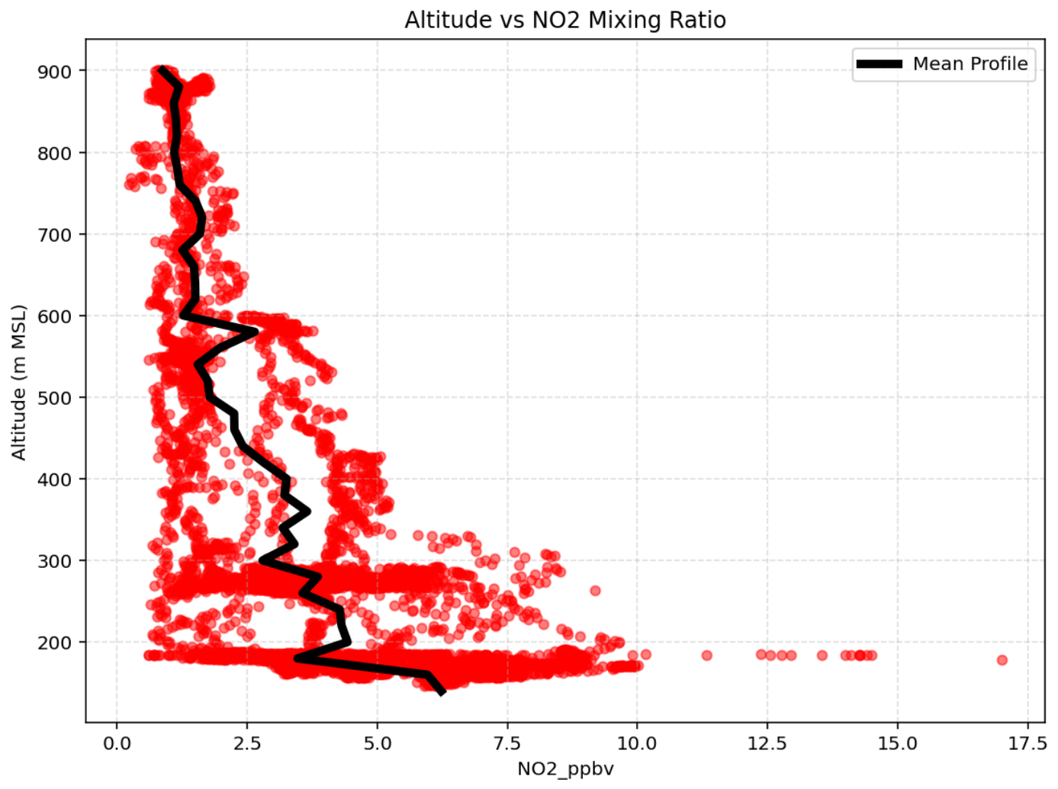
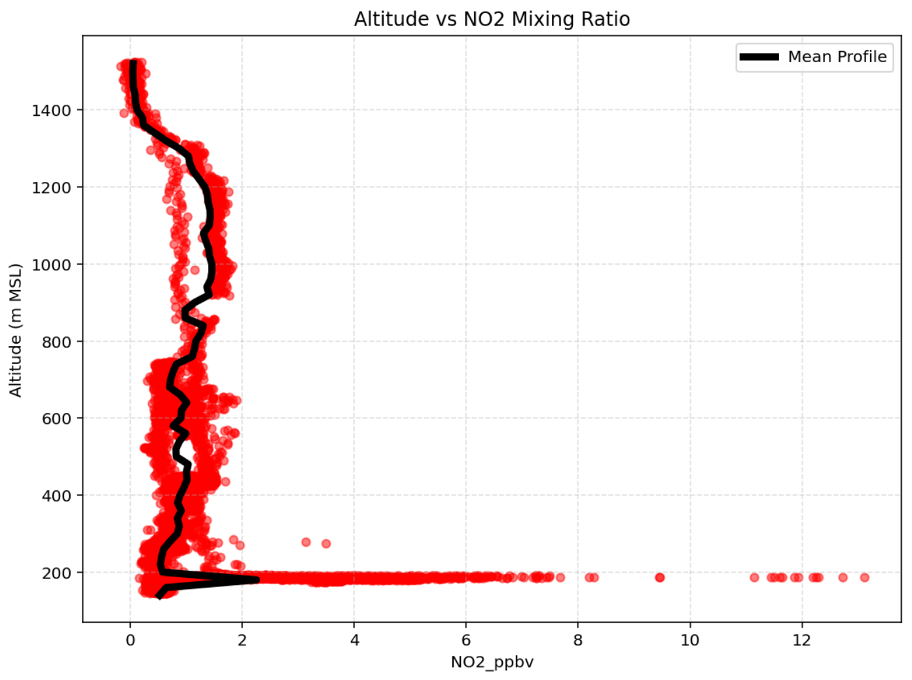
NO₂ Flight Profiles
The TEMPO NO₂ partial column results from scaling the TEMPO tropospheric column by the normalized SeaRey flight-average vertical profile extracting the SeaRey vertical extent from the tropospheric column.
Morning flight
Afternoon flight
Newchurch and Burden TEMPO/TOLNet STM 2026 U Iowa
Notes:
Clearly some pixels have less vertical information than others as illustrated by the top two plots which can make direct comparison of Searey to TEMPO difficult because it is not clear whether disagreement is due to lack of vertical information.
The Searey data points that fall within a pixel contribute to a profile and nothing above or below the min and max are assumed. Then that profile is integrated to get the partial column value significantly smaller than TEMPOs tropospheric column.
For this analysis the mean profile of that Searey flight is assumed to be an acceptable profile shape for the extent we are comparing. Under this assumption the NO2 is considered negligible beyond the ceiling of that profile and the provided TEMPO tropospheric column is distributed according to the shape of that profile and the min and max altitude of the Searey interpolated profile for a pixel is used to extract a comparable fraction of the tropospheric column.

Slide 12
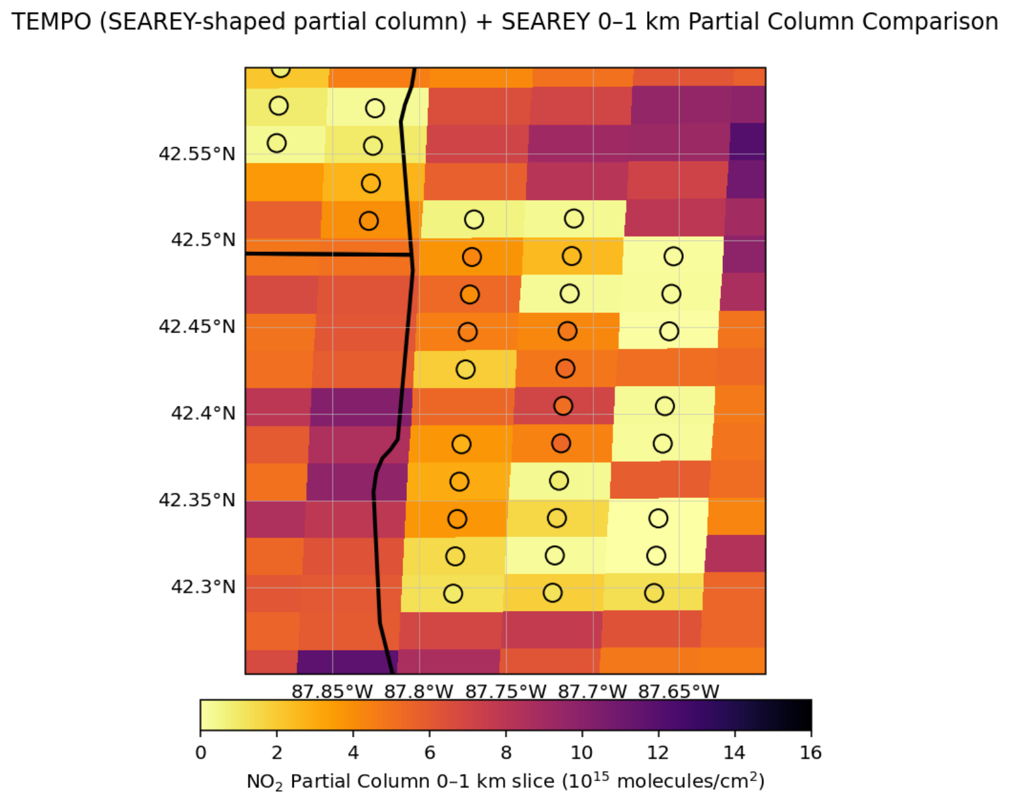
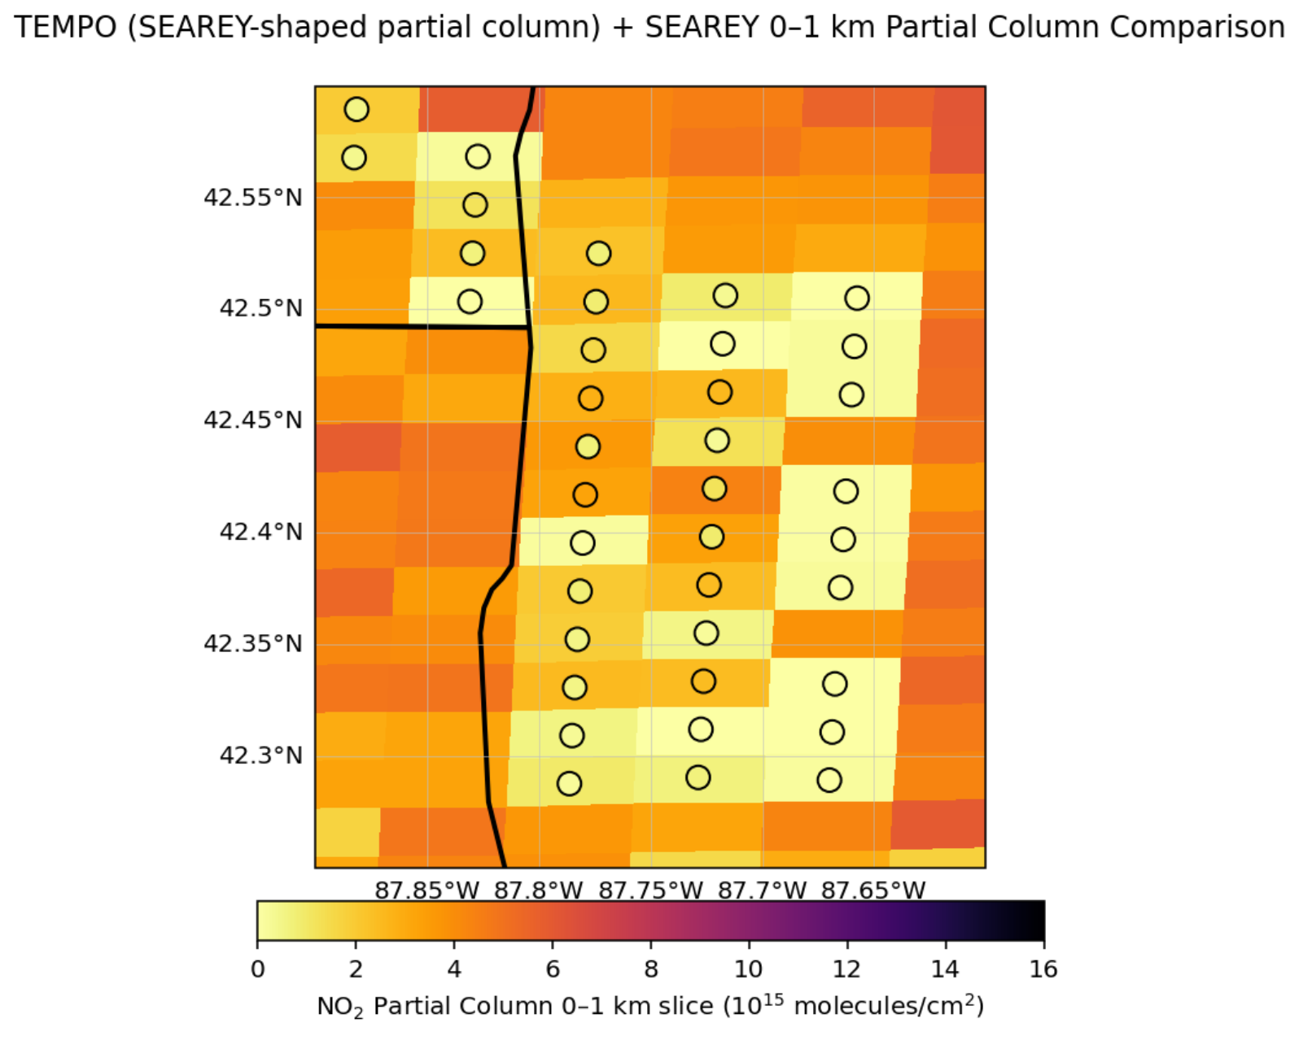
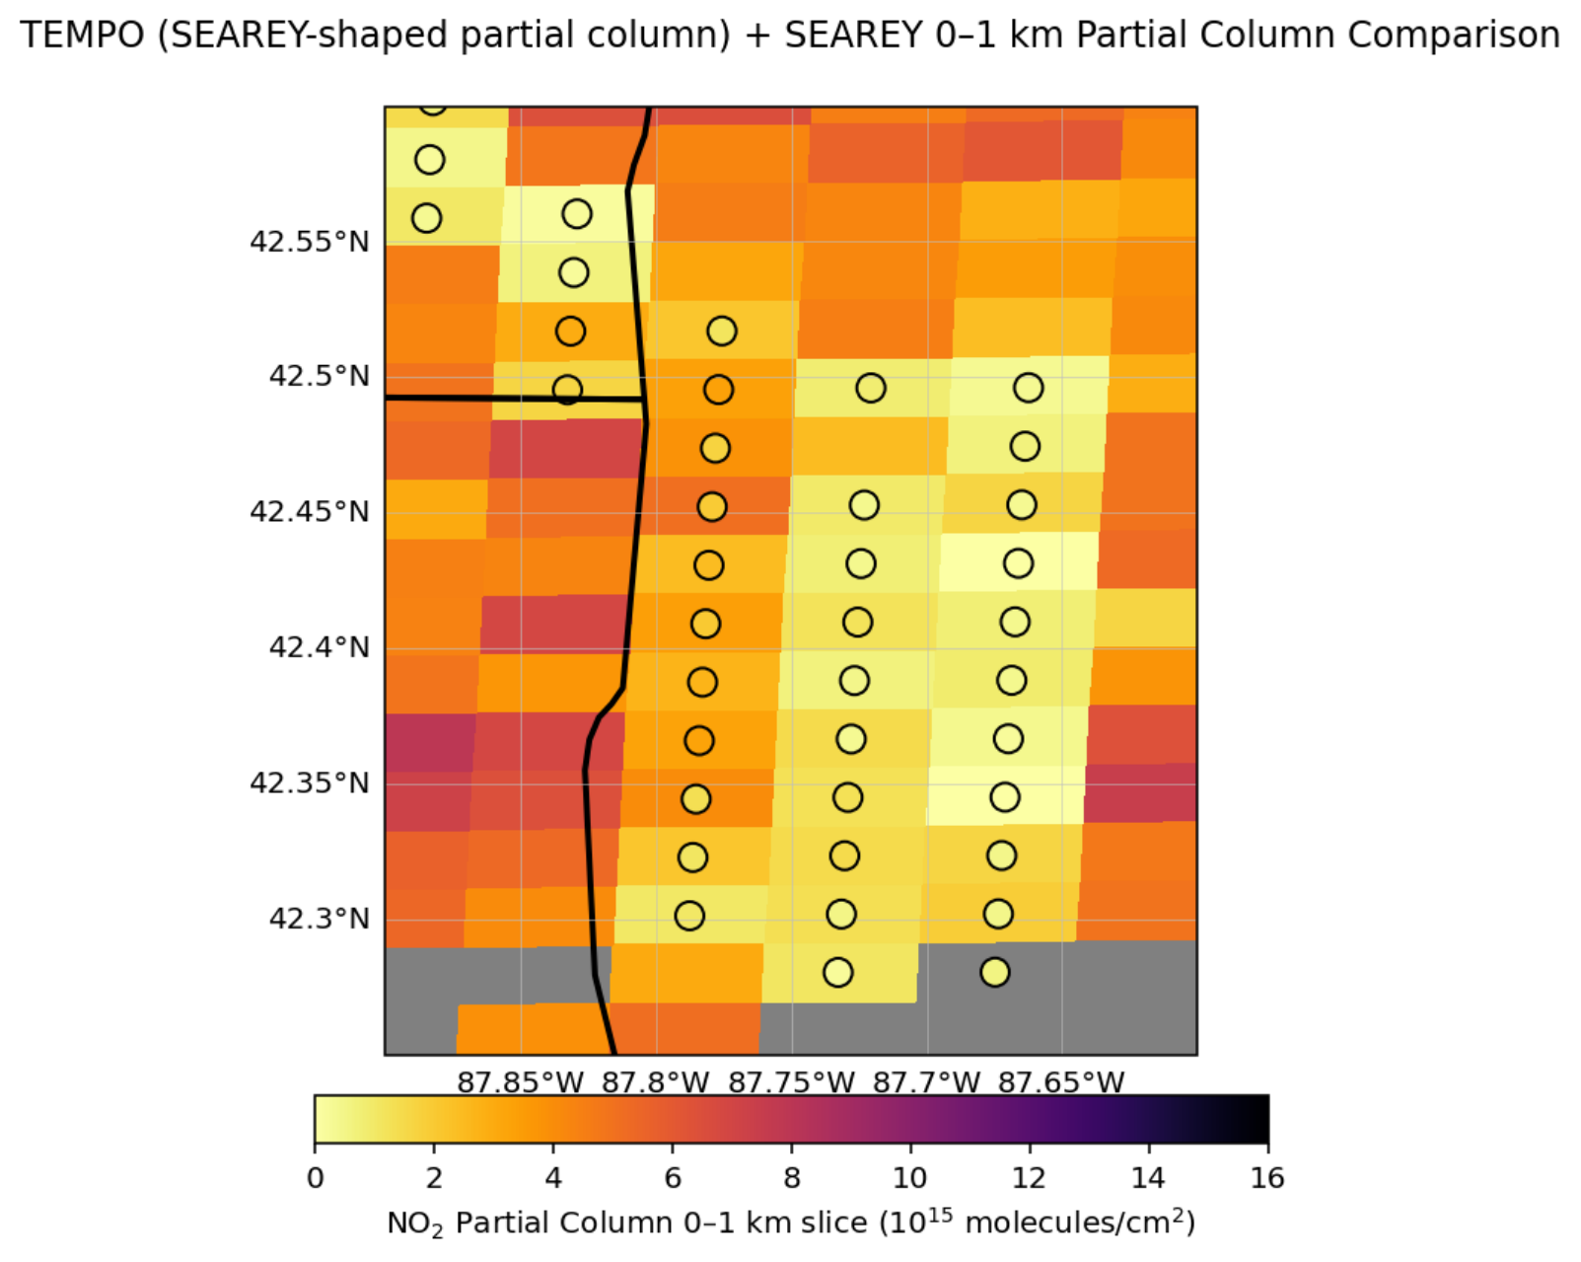
NO₂ TEMPO partial tropospheric column comparison with SeaRey
15Z
17Z
20Z
In pixels where SeaRey measurements exist, the TEMPO NO₂ partial column results from scaling the TEMPO tropospheric column by the normalized SeaRey average vertical profile extracting the SeaRey vertical extent from the tropospheric column. In other pixels (with no SeaRey circles, the (taller) entire TEMPO tropospheric NO₂ column is plotted.
Newchurch and Burden TEMPO/TOLNet STM 2026 U Iowa

Slide 13
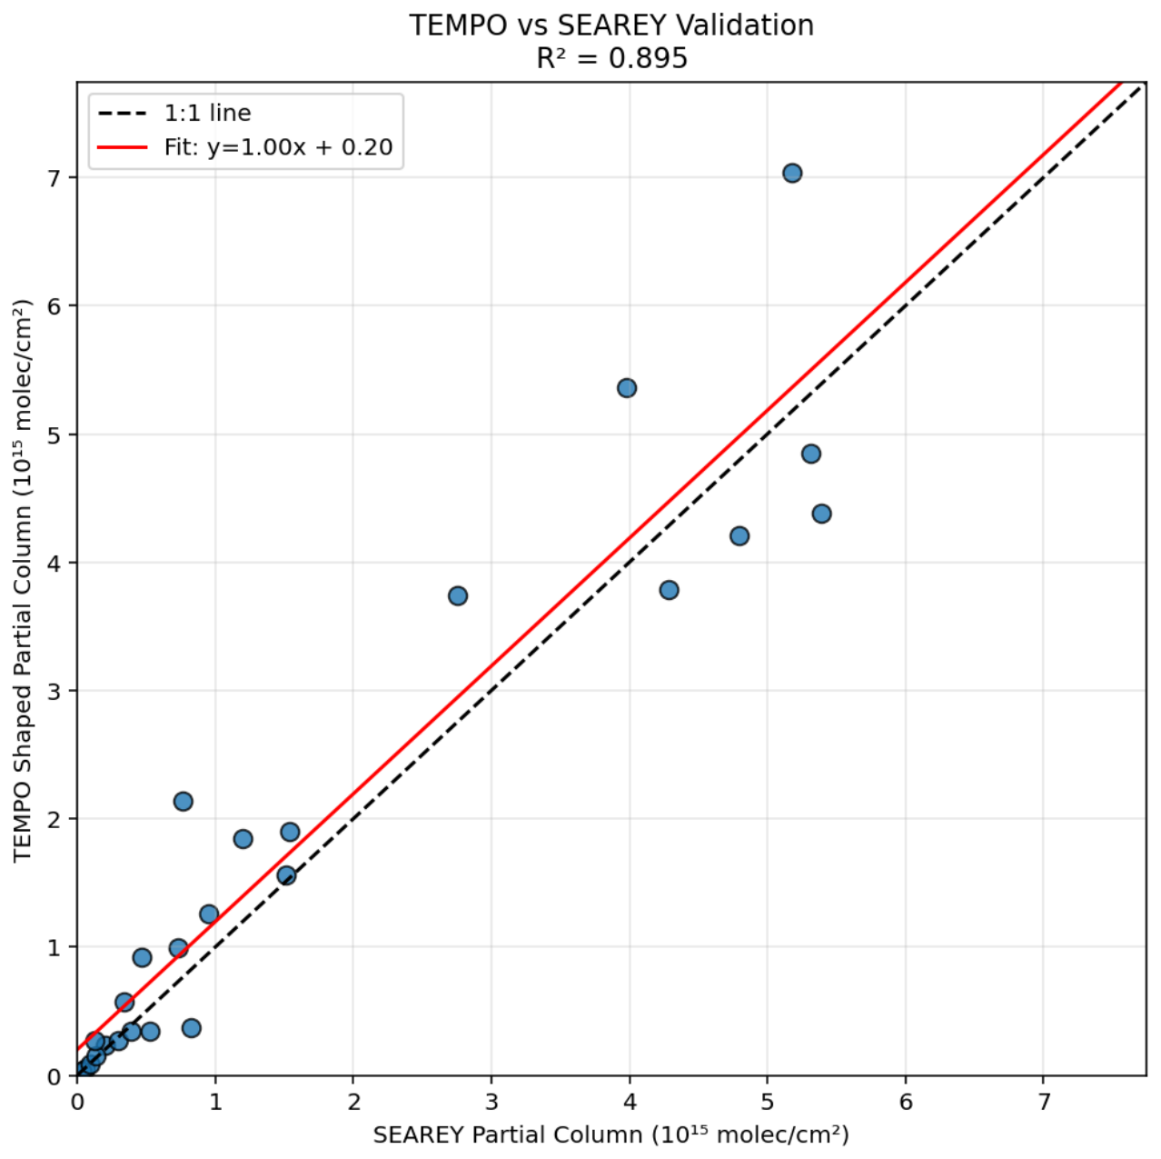
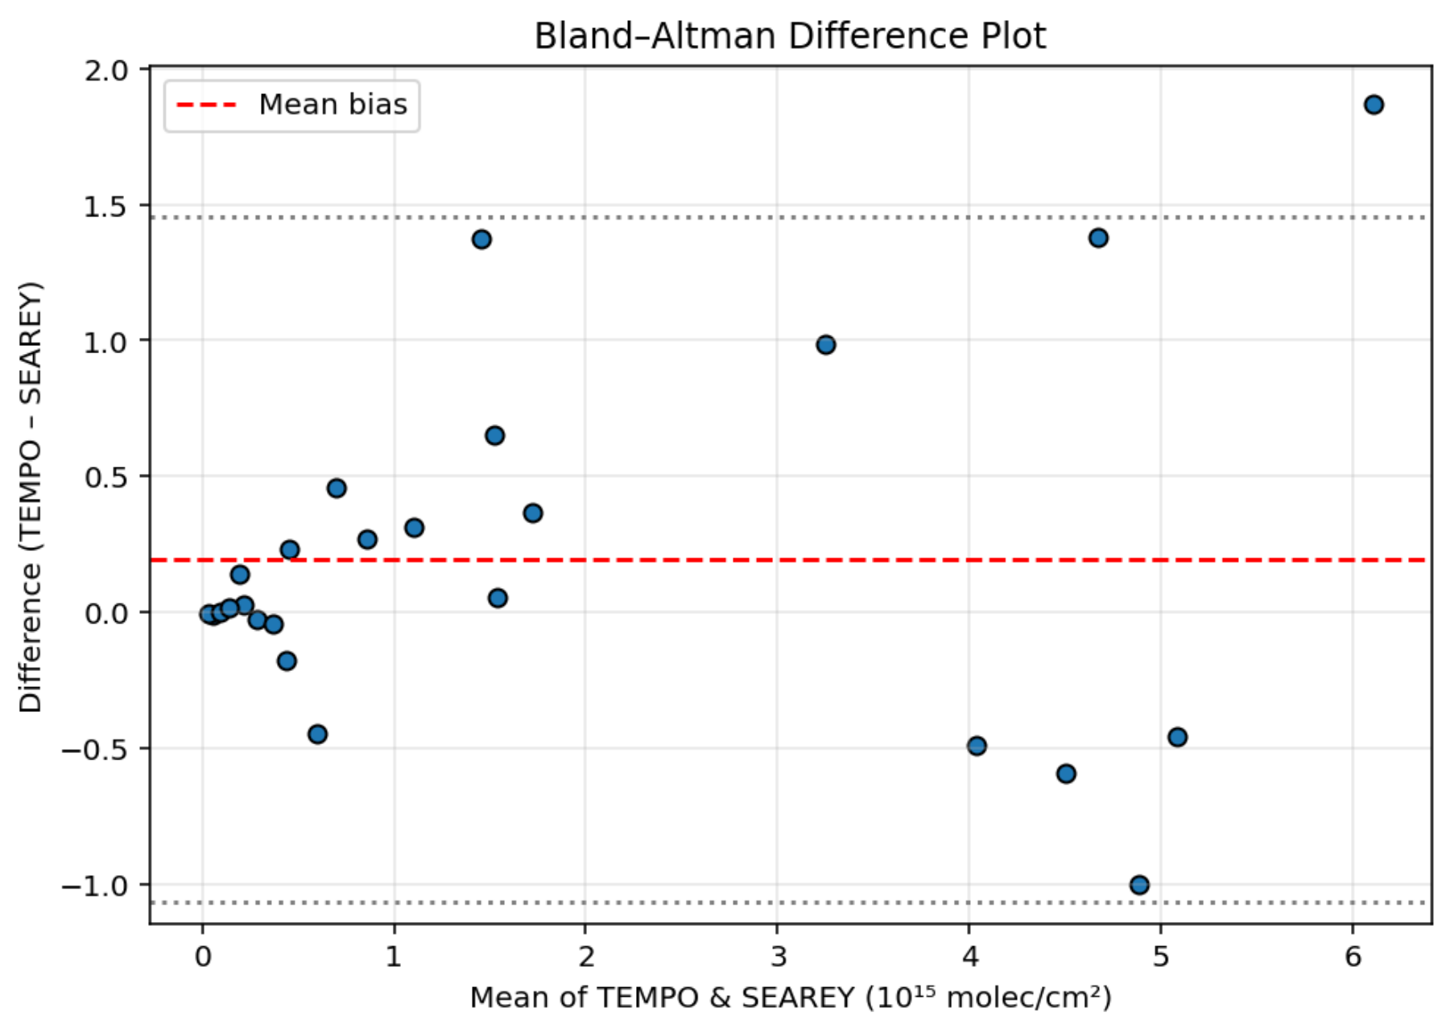
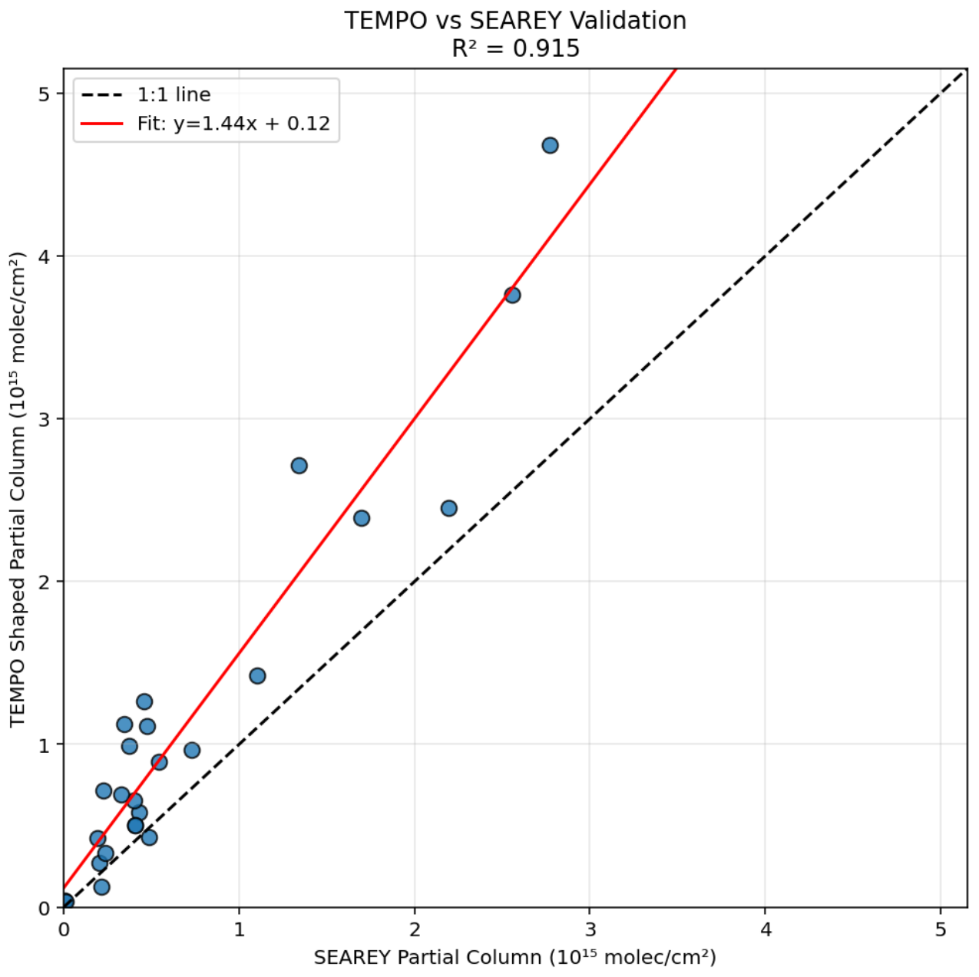
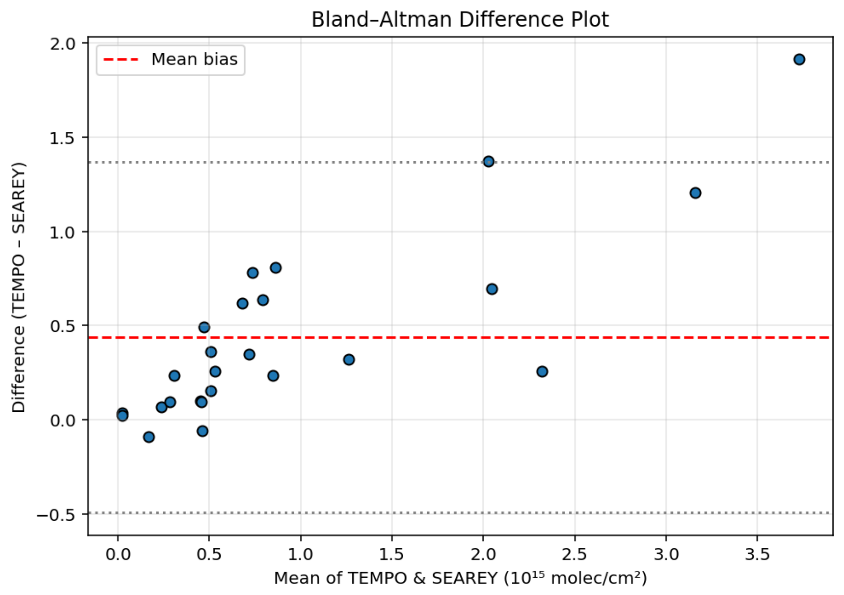
TEMPO NO₂ Validation
The 15Z morning flight with a
shallower BL agree very closely.
Mean Bias (T-S): 0.2 ×10¹⁵
Median Bias: 0.02 ×10¹⁵
Std Dev: 0.6
RMSE: 0.7
Min Difference: -1
Max Difference: 2
The 20Z afternoon flight has a much deeper BL but also has a higher ceiling on the mean profile which shows the limitations of the assumption of negligible NO2 above the SeaRey mean profile but also that more vertical information leads to better agreement.
Mean Bias (T-S): 0.4 ×10¹⁵
Median Bias: 0.3 ×10¹⁵
Std Dev: 0.5
RMSE: 0.6
Min Difference: -0.09
Max Difference: 2
15Z
20Z
Newchurch and Burden TEMPO/TOLNet STM 2026 U Iowa

Slide 14
Conclusions
Ozone and NO₂ often vary significantly with respect to space and time. These gradients result from the Lake Breeze effect, plume transport, and the interaction of diurnal chemistry and kinematics. These sharp gradients are difficult for models and satellite measurements to reproduce. In-situ airborne and ground-based lidar measurements provide needed context to understand the distributions.
NO₂ partial tropospheric column product compare very well to in-situ measurements near surface when the NO₂ vertical distribution is primarily at the surface, especially in the morning.
Currently, tropospheric ozone retrieval is a challenge (especially near surface) for TEMPO due to the strong attenuation of the UV spectrum in the stratosphere that leaves very little surface information after the two-way photon trip. Also, ozone often has sharp vertical gradients near the surface that can not be captured accurately at TEMPO’s vertical resolving resolution. Nevertheless, comparisons to in-situ measurements of comporable column extents show promising agreement, especially over more homogeneous conditions.
Newchurch and Burden TEMPO/TOLNet STM 2026 U Iowa

Slide 15
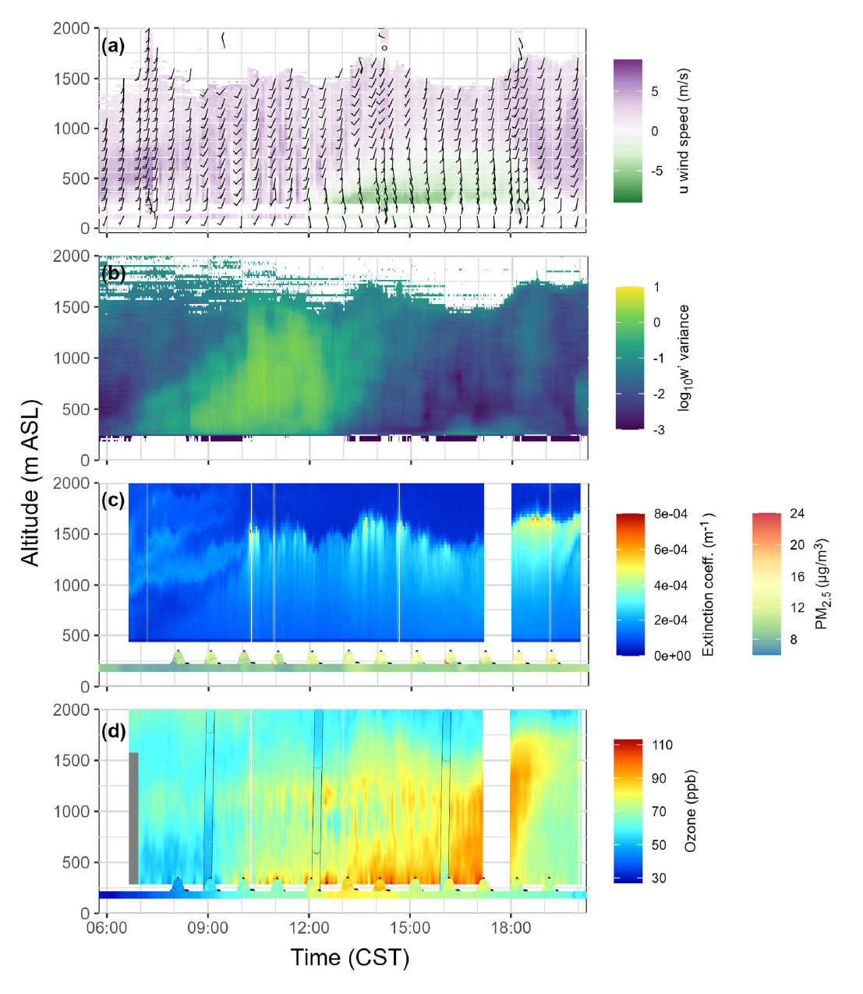
Dickens et al, submitted to JGR Atmospheres, 2026
Figure 9. Vertical profiles of winds, aerosols, and O3 from LiDAR measurements at Chiwaukee
851 Prairie over time on 2 August 2023. (a) Wind barbs from the wind LiDAR, with surface winds
852 shown in the bottom row and wind sonde data in the vertical columns at 07:15, 14:15, and
853 18:15 CST. Colors show the U component of the winds, and wind barbs are depicted in knots
(1 kt ≈ 0.51 m/s) using the standard convention to enhance detail. (b) Variance 854 in vertical
855 winds (m2/s-2). (c) Aerosol extinction coefficients at 299 nm from the aerosol LiDAR with
856 regulatory surface monitored PM2.5 data and UAS PM2.5 data shown at the bottom. (d) O3
857 concentrations from the O3 LiDAR, with O3 sonde data overlaid and regulatory surface
858 monitoring data and UAS data shown at the bottom. The figure uses the traditional color
859 scale for O3 LiDARs; see Figure S15 for a color blind friendly version.

Slide 16
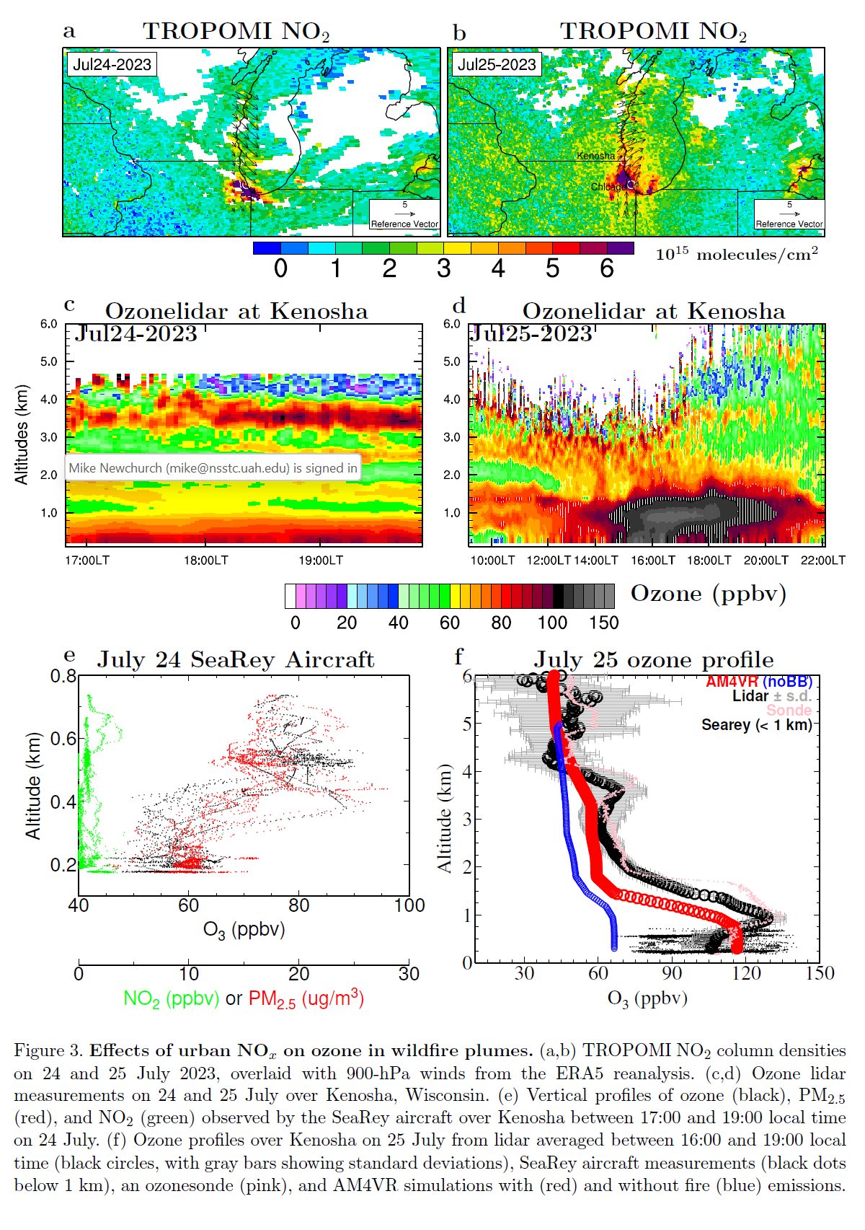
Lin et al., submitted to Science Advances, 2026

Slide 17
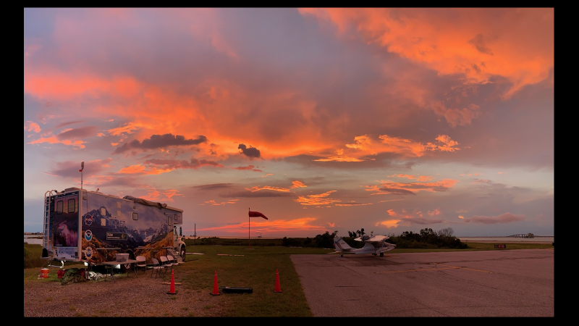

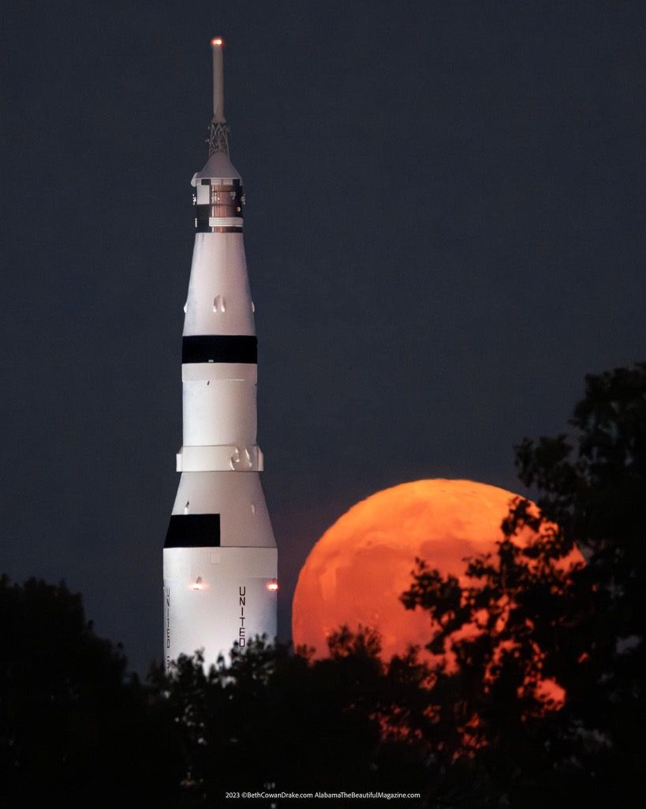
TOLNet.larc.nasa.gov

