Slide 1
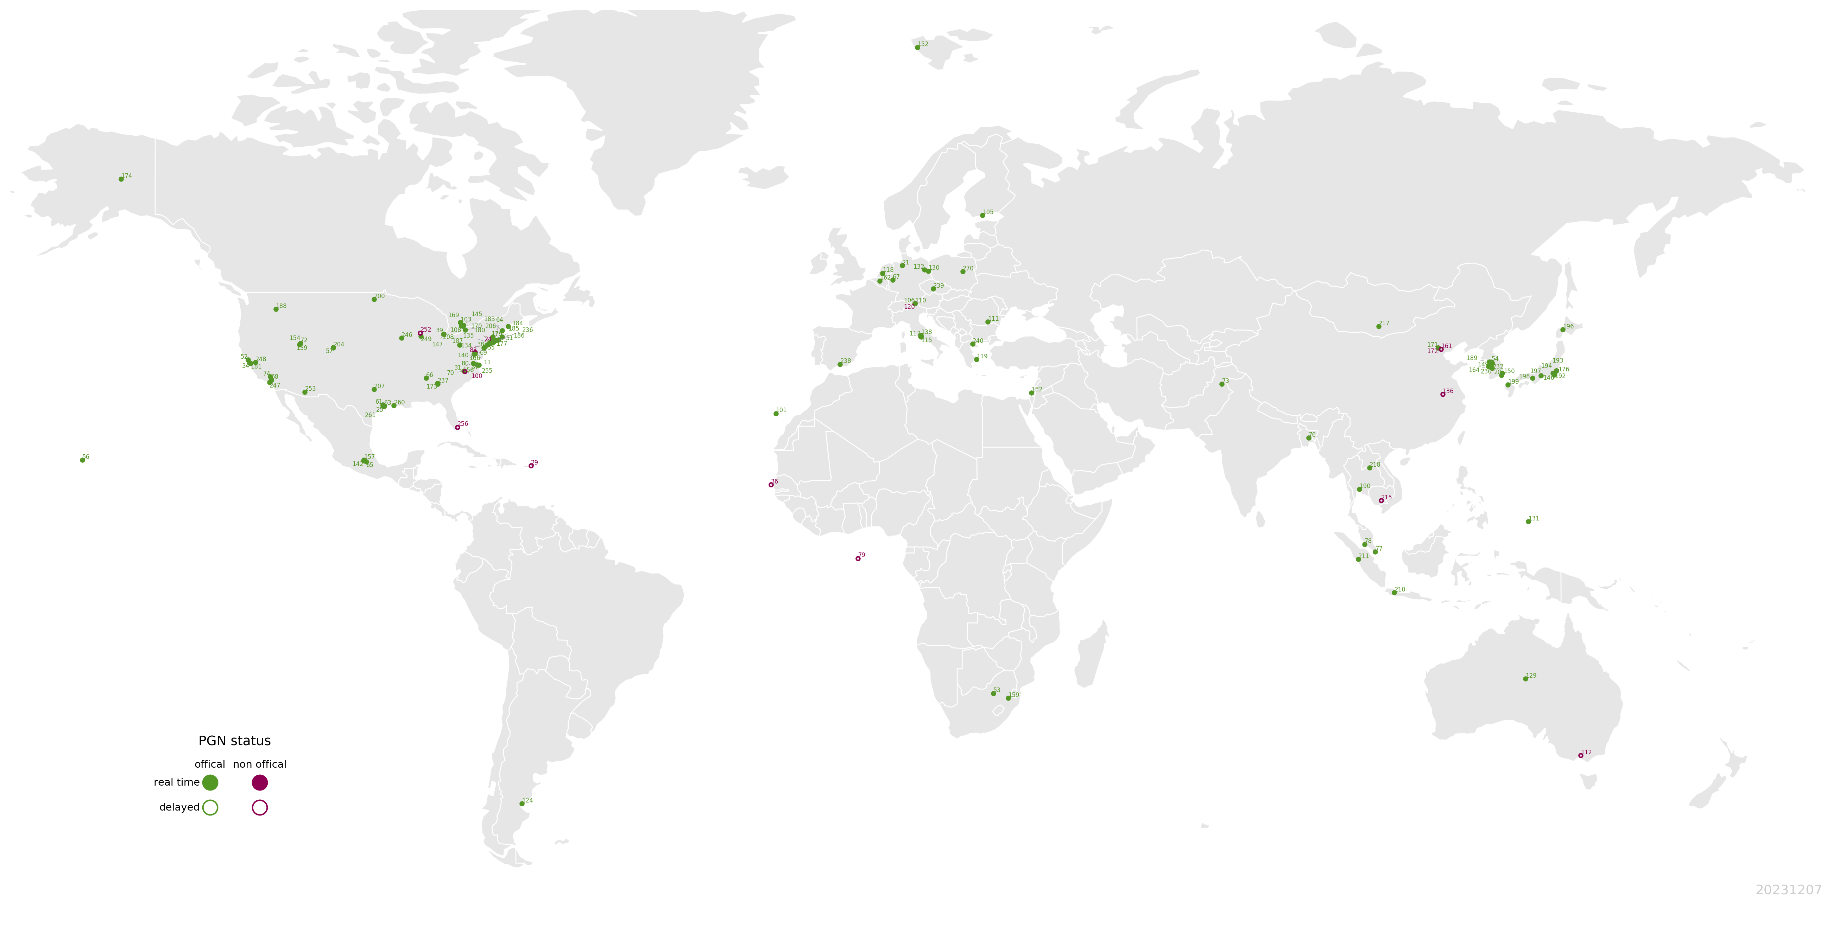







Optimal-Estimation Pandonia Global Network (PGN) Formaldehyde (HCHO) Profile Retrievals across North America
Tianlang Zhao¹, Jingqiu Mao^{1*}, Xiaoyi Zhao^{2*}, Martina M Friedrich³, Debora Griffin², Ramina Alwarda⁴, Kimberly Strong⁴, William R Simpson¹, Martin Tiefengraber⁵, Manuel Gebetsberger⁵, Alexander Cede⁵, Elena Spinei⁶, Apoorva Pandey^{6,7}, Viral Shah^{6,8}, Pamela A. Wales^{6,8} , K. Emma Knowland^{6,8,9}, Thomas F Hanisco⁶
¹ University of Alaska Fairbanks ² Environment Canada, ³ BIRA-IASB, ⁴ University of Toronto, ⁵ LuftBlick, ⁶ NASA GSFC, ⁷ University of Maryland Baltimore County , ⁸ Morgan State University, ⁹ NASA Headquarter
* Corresponding authors
This work is supported by UAF Troth Yeddha’ fellowship and NASA HAQAST grant

Slide 2

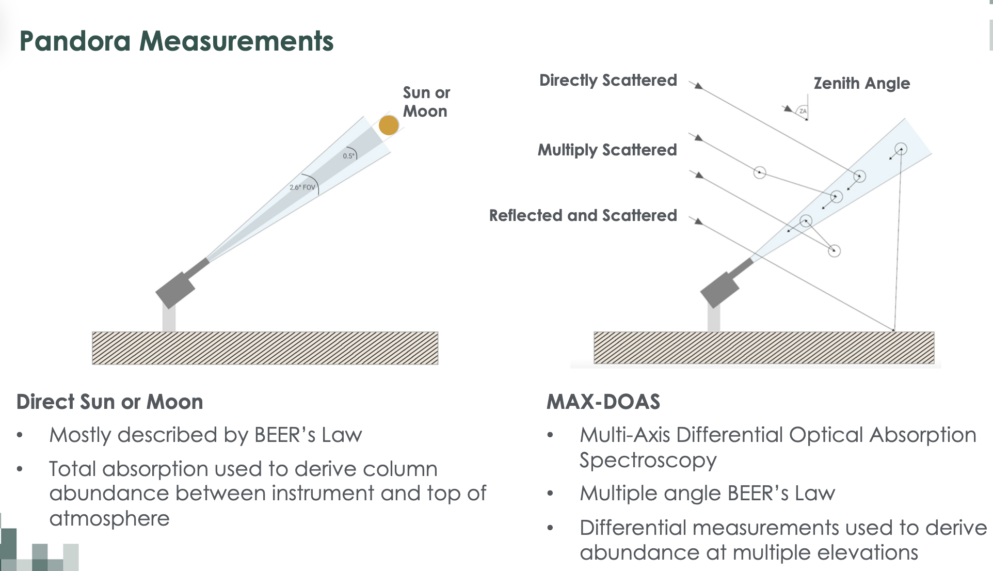
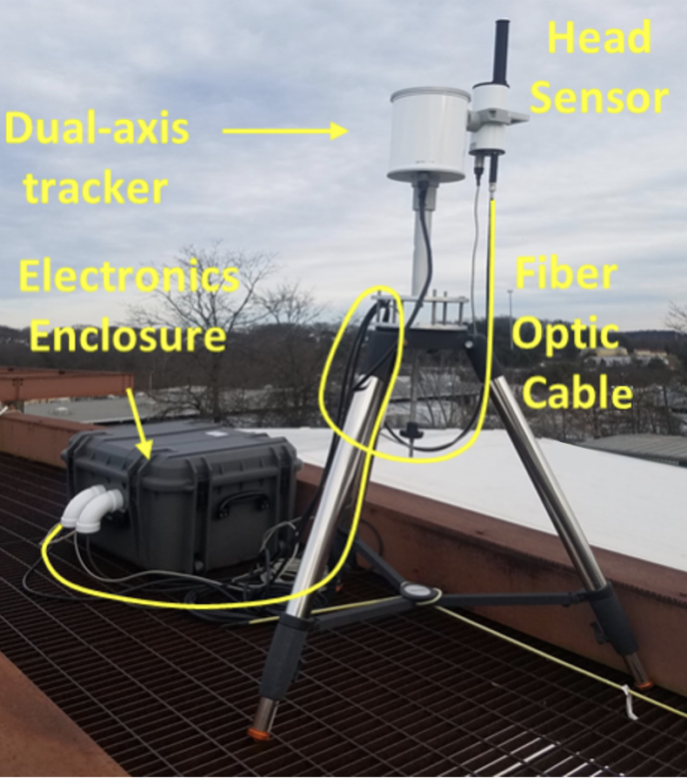
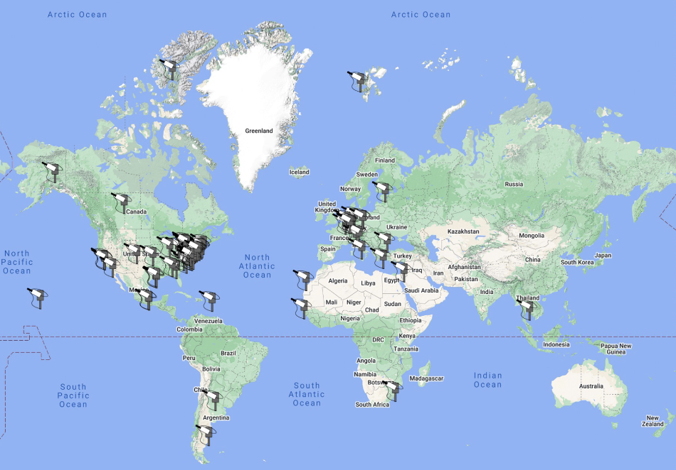
Quick introduction: what are Pandora and PGN?
Pandora is a ground-based sun/sky/moon viewing UV-Vis spectrometer system
Pandora has two operation mode: direct-sun and sky-scan (MAX-DOAS)
Direct-sun: derive total column (widely used for satellite validation)
Sky-scan: derive vertical profile
PGN: Pandonia Global Network, the global network of Pandora instrument
Notes:
There are currently over 180 quasi-autonomous Pandora instruments deployed and operationally live as part of the Pandonia Global Network (PGN).

Slide 3
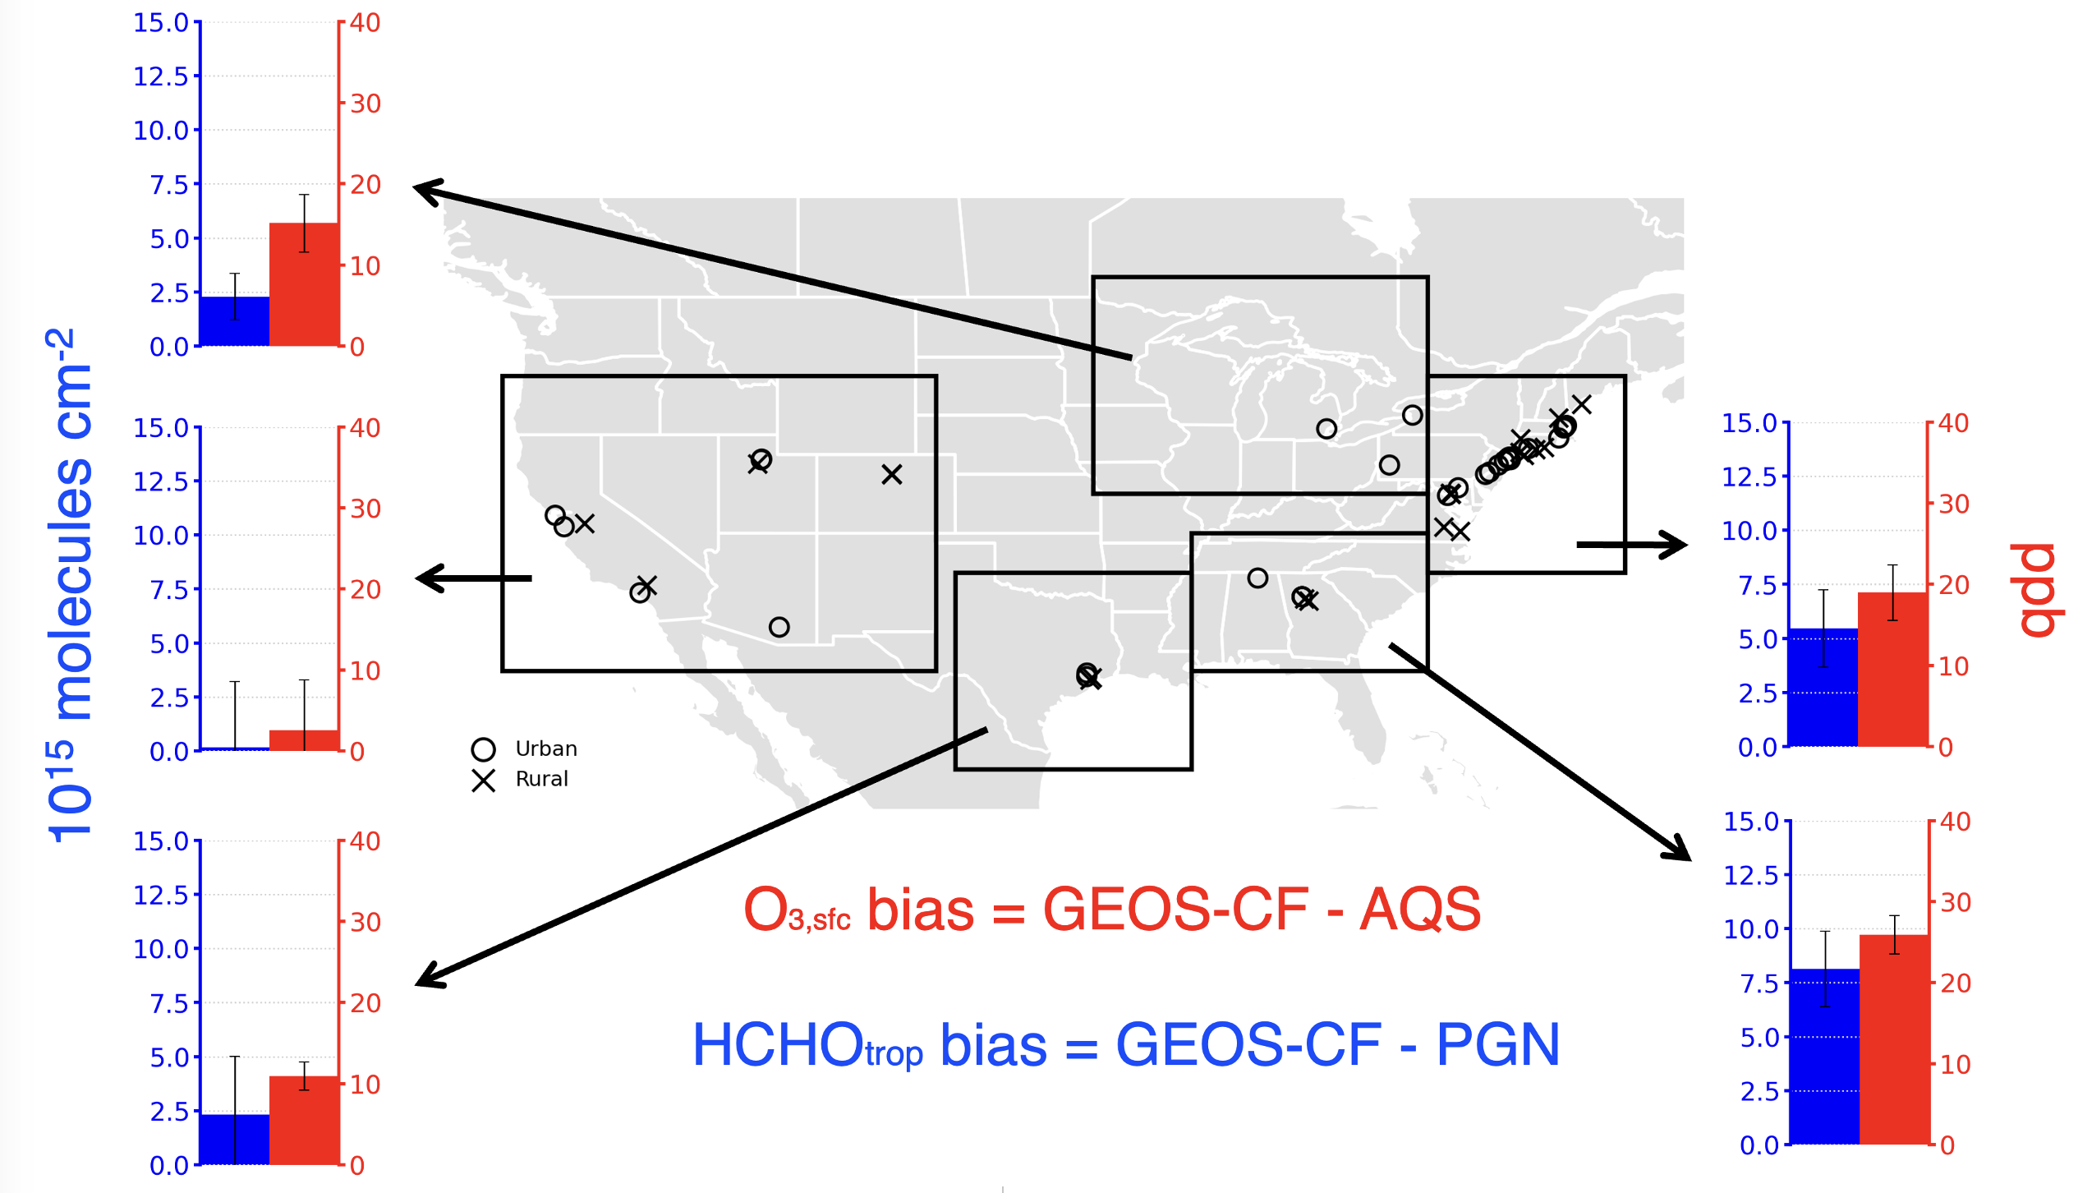
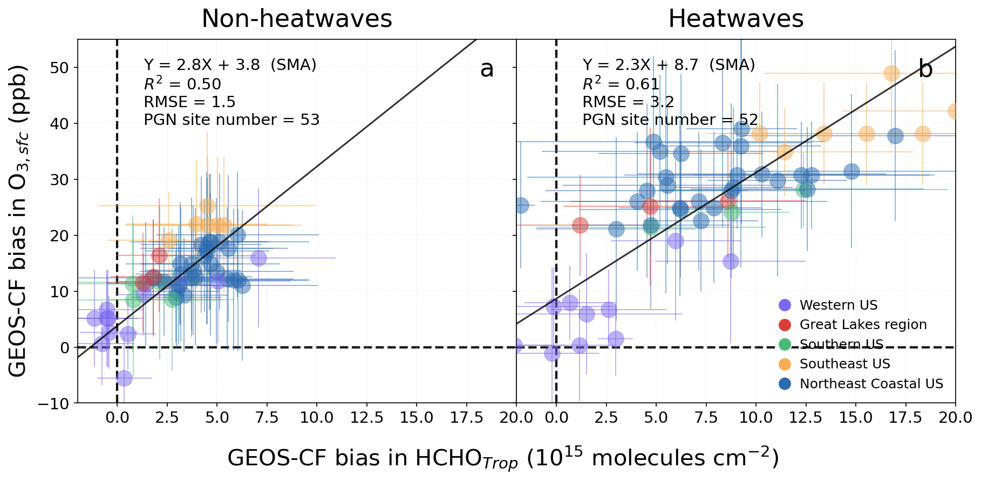
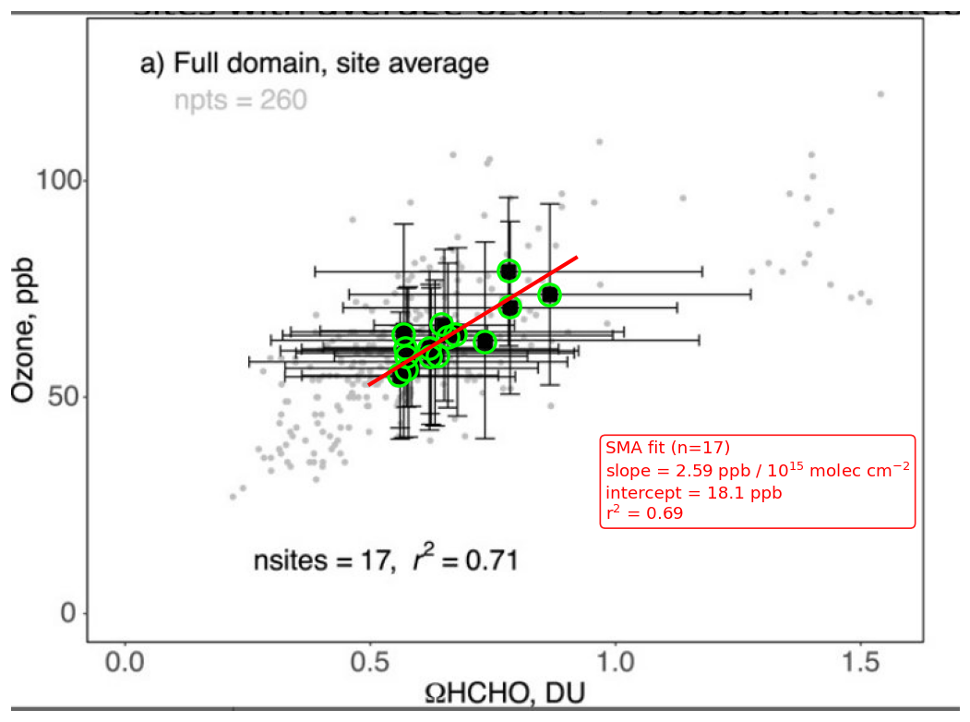
Model has correlated biases in surface ozone and HCHO column
(Submitted to ES&T)
Slope = 2.8, intercept = 3.8
Black dots: 17 SLAMS ozone monitor locations during LISTOS campaign
(ppb O_{3,sfc} / 10¹⁵ molec cm⁻² HCHO)
(ppb O₃)
Slope = 2.6
These biases are likely related to chemical production, especially during heatwaves
(Travis et al, 2022)
Notes:
Positive bias in surface ozone in eastern US is a common issue in atmos chemistry models.
In GEOSCF , we find that HCHO trop column bias has a similar spatial distribution with surface ozone bias.
They are showing a correlation across the five regions of contiguous US, and both increase with temperature.
The regression slope of biases is very similar to the slope of O3 and HCHO during LISTOS campaign.

Slide 4
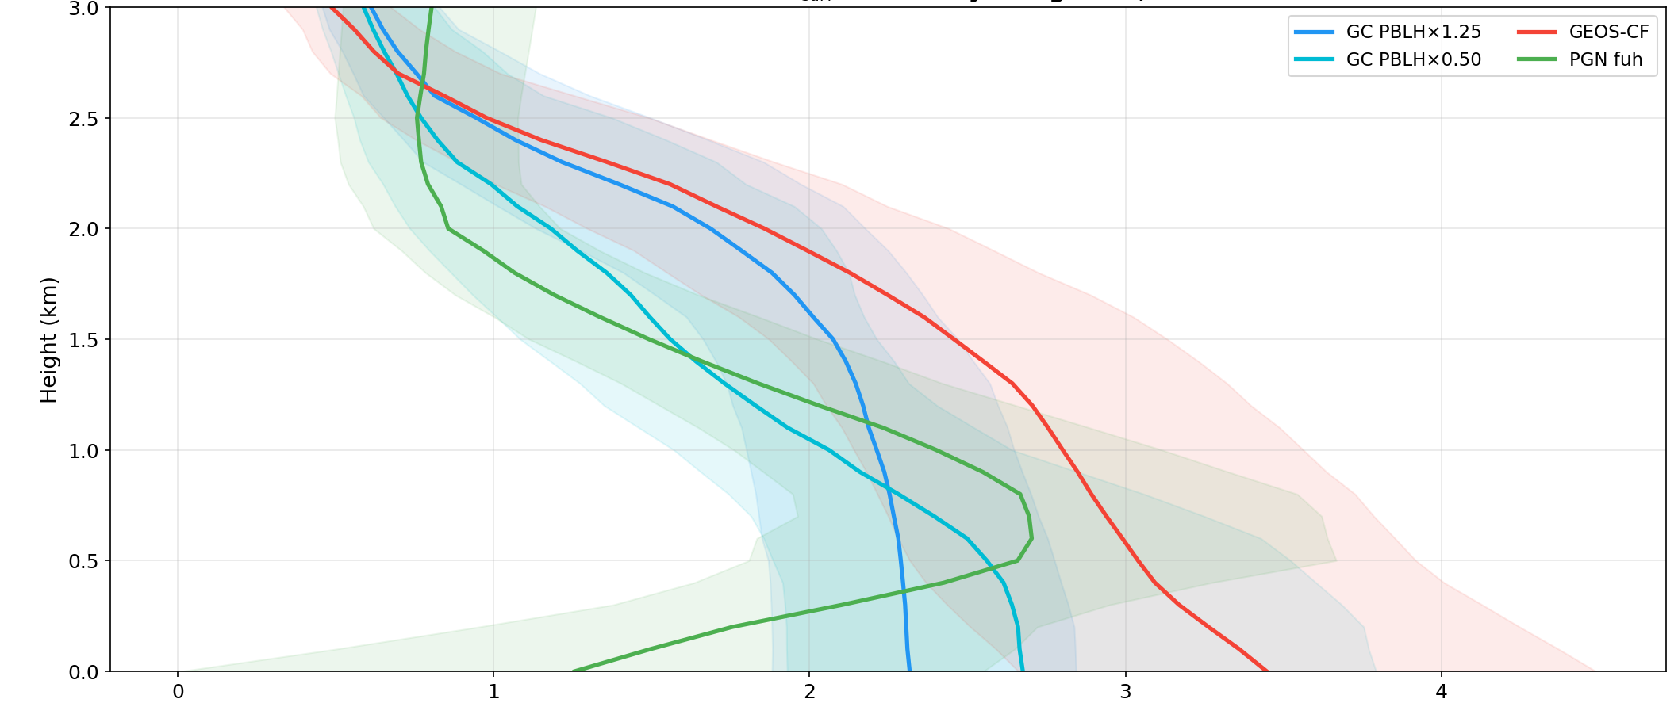
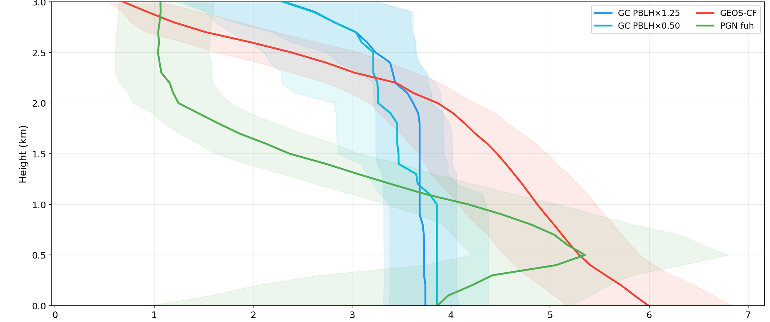
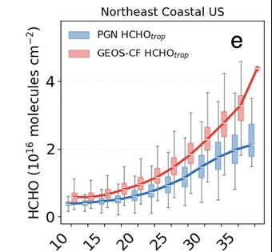
Model shows a stronger PBL mixing than PGN
Northeast Coastal US, HCHO profile, July-August 2022, 12-15LT average
Surface T in 25-30°C
Surface T in 35-40°C
GEOS-Chem
^{(PBLH x 1.25)}
Altitude (km)
GEOS-CF
GEOS-Chem
^{(PBLH x 1.25)}
GEOS-CF
GEOS-Chem
^{(PBLH x 0.5)}
GEOS-Chem
^{(PBLH x 0.5)}
PGN sky-scan L2
PGN sky-scan L2
HCHO (ppb)
HCHO (ppb)
PGN shows a different HCHO profile shape than GEOS-CF, including a stronger vertical gradient, and an aloft layer within PBL*
Excessive PBL mixing could potentially lead to overestimation in HCHO and O₃
GEOS-CF HCHO trop column
PGN HCHO trop column
(~0-3km)
*Zhao et al,. 2025 GRL
Surface T

Slide 5
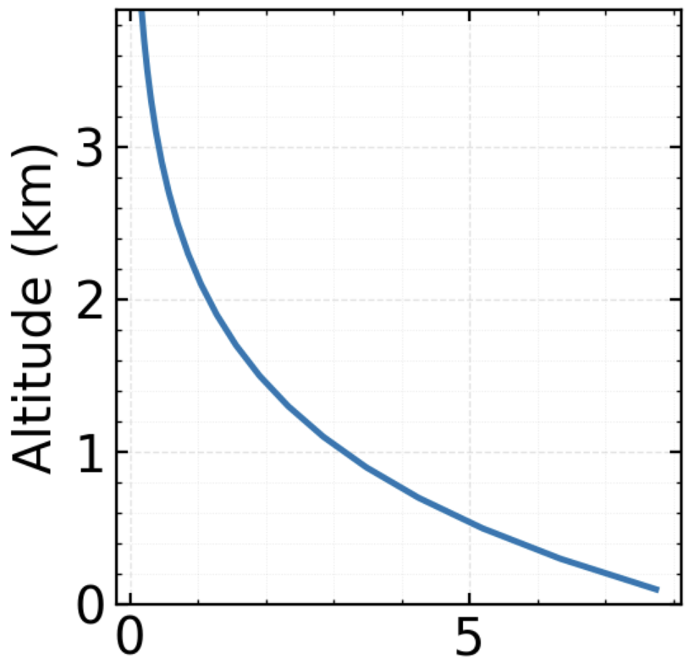
We present a new retrieval of PGN HCHO profiles using MMF* optimal estimation (OE) algorithm
QDOAS fitting
PGN L1 data
HCHO, O₄ dSCDs
HCHO 324.5-359nm
O₄ 425-490nm
Elevation angle sequence: 1,2,3,4,5,6,7,8,9,10,15,20,30,90
Quality-controlled PGN MMF HCHO profiles, aerosol extinction profiles,
averaging kernel, DOF…
Remove blocked elevation angles;
Apply HCHO and O₄ fitting RMS filter (RMS < 1e-3)
A priori profile
(constant, exponential decay, scale height=1km)
QA flag
HCHO concentration (molec cm⁻³)
Filtered HCHO, O₄ dSCDs
PGN MMF HCHO profiles
MMF profiling
*MMF: Mexican MAX-DOAS Fit (Friedrich et al., 2019)

Slide 6
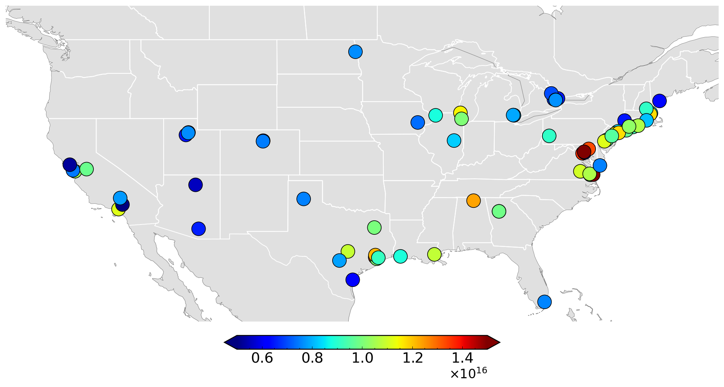
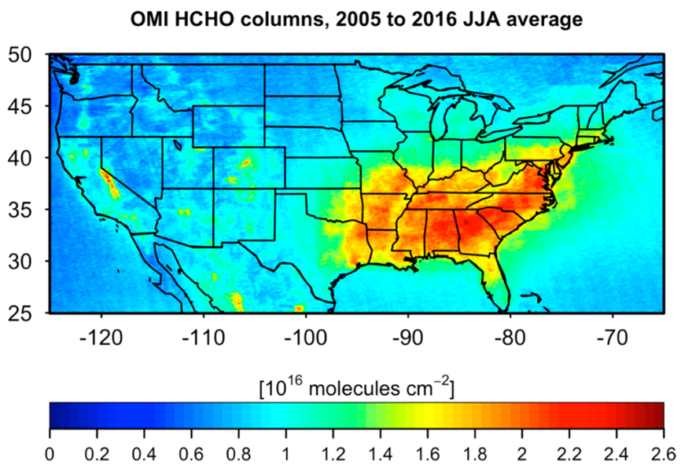
PGN MMF HCHO profile retrieval is performed at 76 sites, during 2023-2025 summers
(Zhu et al 2017, ES&T)
HCHO tropospheric column (HCHO_{trop}) from PGN MMF retrieval, across the contiguous US
MMF HCHO_{trop} show a similar spatial pattern as previous satellite retrieval reported

Slide 7
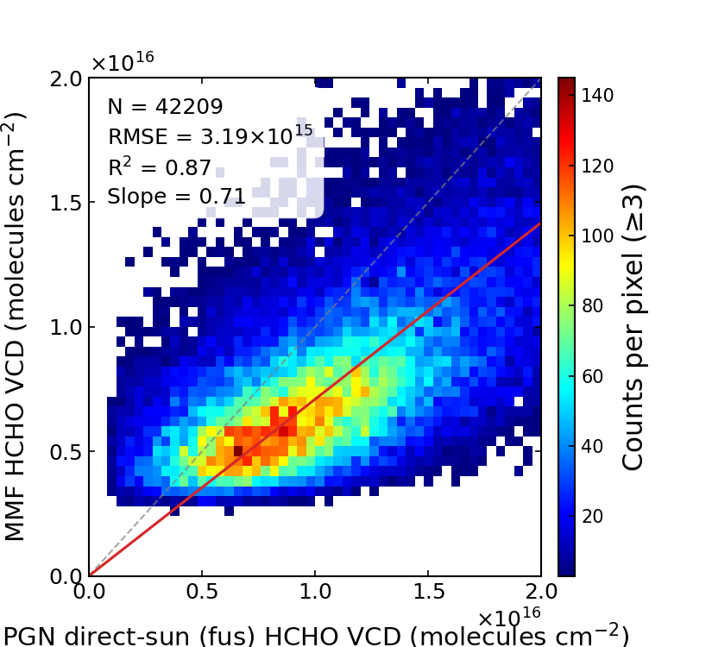
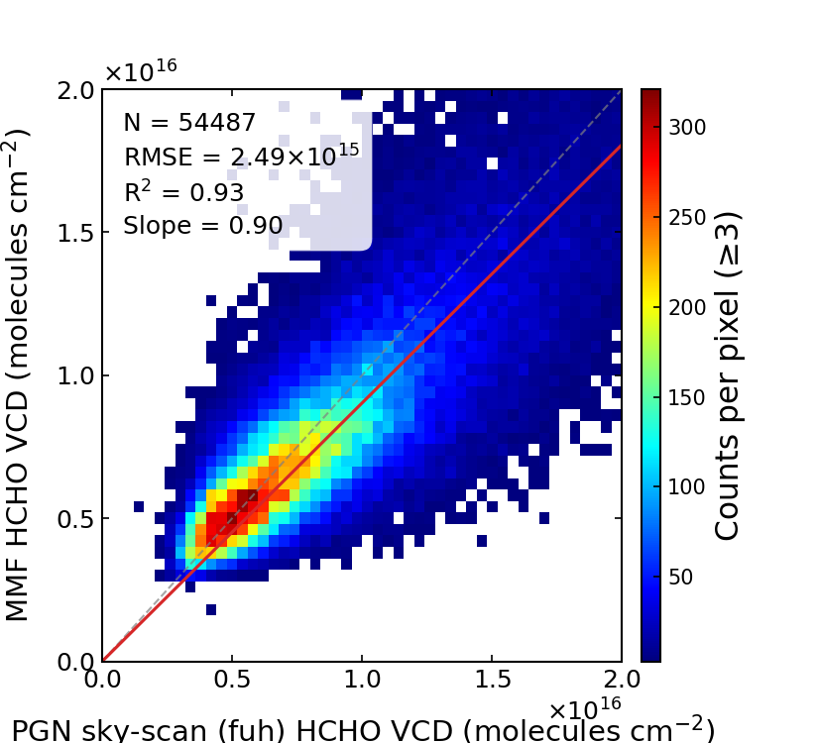
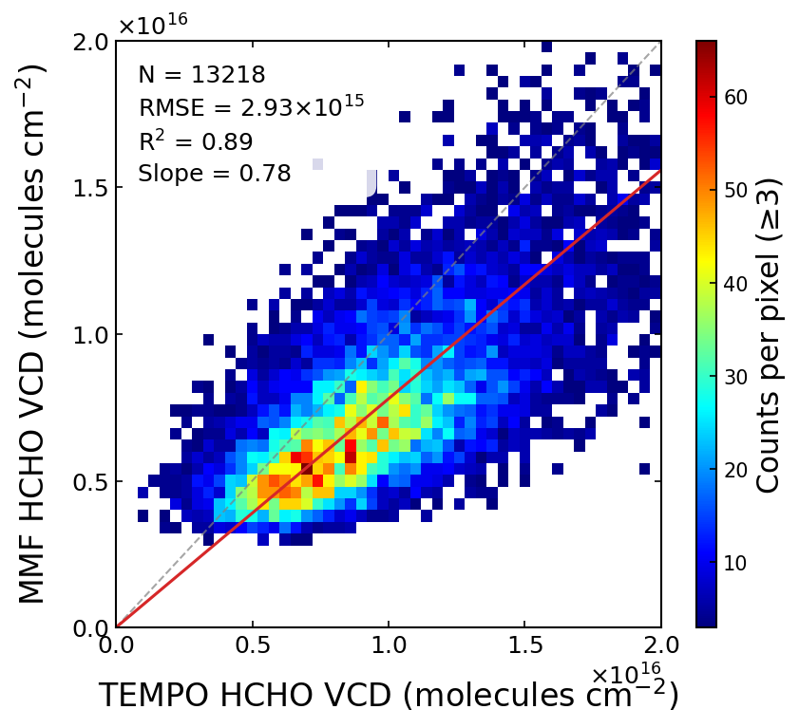
MMF HCHO_{trop} vs TEMPO and PGN L2 data
MMF HCHO
trop column
(molec cm⁻²)
TEMPO HCHO trop column
(10¹⁶ molecules cm⁻²)
PGN direct-sun
total column
(10¹⁶ molecules cm⁻²)
PGN sky-scan
trop column
(10¹⁶ molecules cm⁻²)
MMF HCHO_{trop} agrees well with PGN sky-scan L2 trop column;
MMF HCHO_{trop} shows a negative bias relative to PGN direct-sun and TEMPO HCHO columns, likely because the profile retrieval has a limited sensitivity to HCHO above ~3 km.

Slide 8
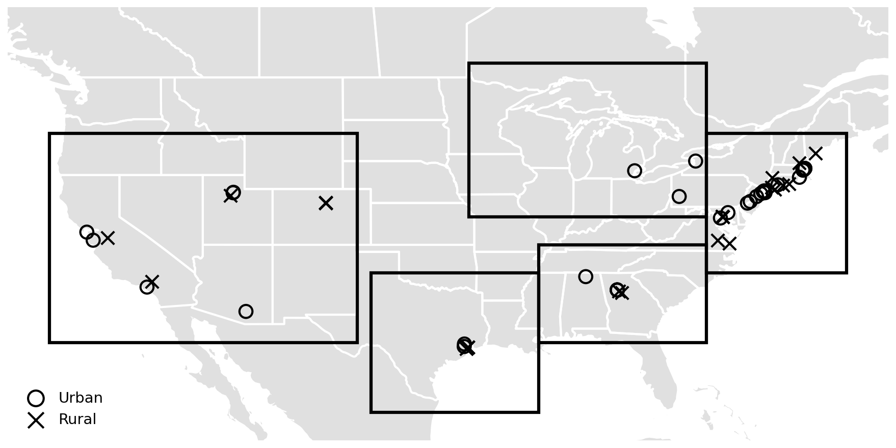
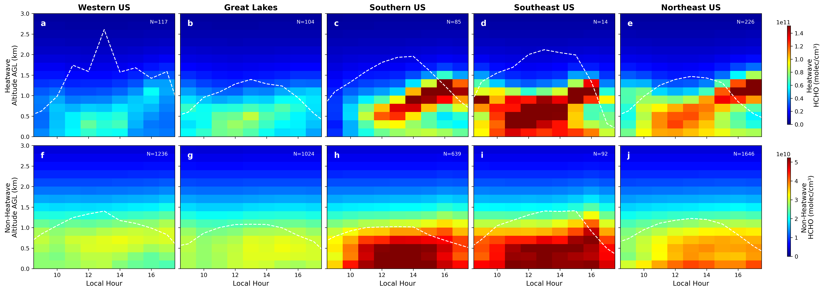
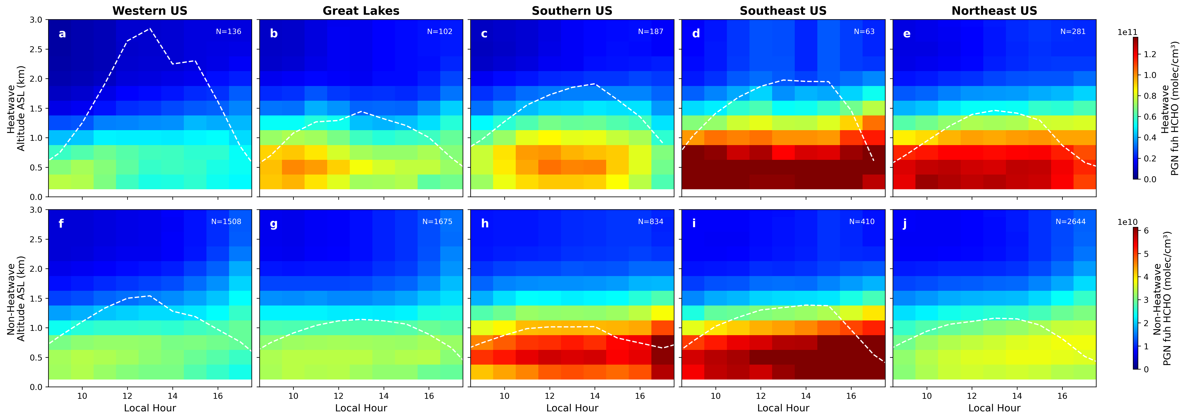
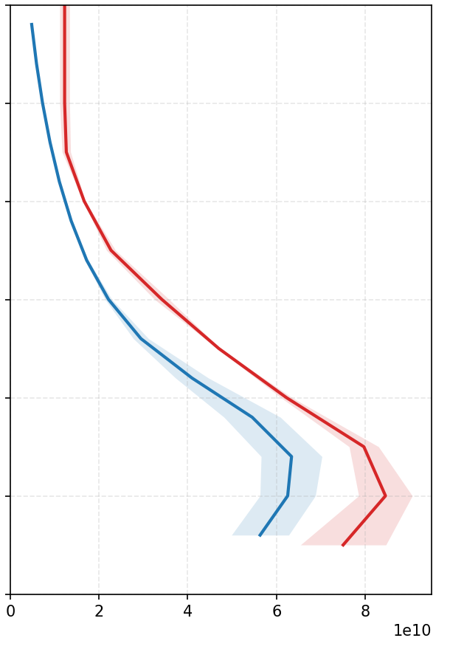
MMF median HCHO profile in five regions of US, during 2023-2025 summers
Great Lakes
Western US
Northeast Coastal
Southeast US
Southern US
MMF HCHO
PGN sky-scan L2 at Southeast US
Heatwaves
Heatwaves
Local noon (12-15 LT)
Altitude (km)
Non-heatwaves
Non-heatwaves
PGN L2
MMF
Local time (hour)
Local time (hour)
MMF HCHO profiles indicate that HCHO may be not well-mixed in PBL, especially during heatwaves.
During heatwaves, MMF show a more clear HCHO aloft layer than PGN L2 data. They are similar in other cases.
Notes:
Add PBLH from GEOSCF and ERA5 and Ceilometer
Potentially more Ceilometers

Slide 9
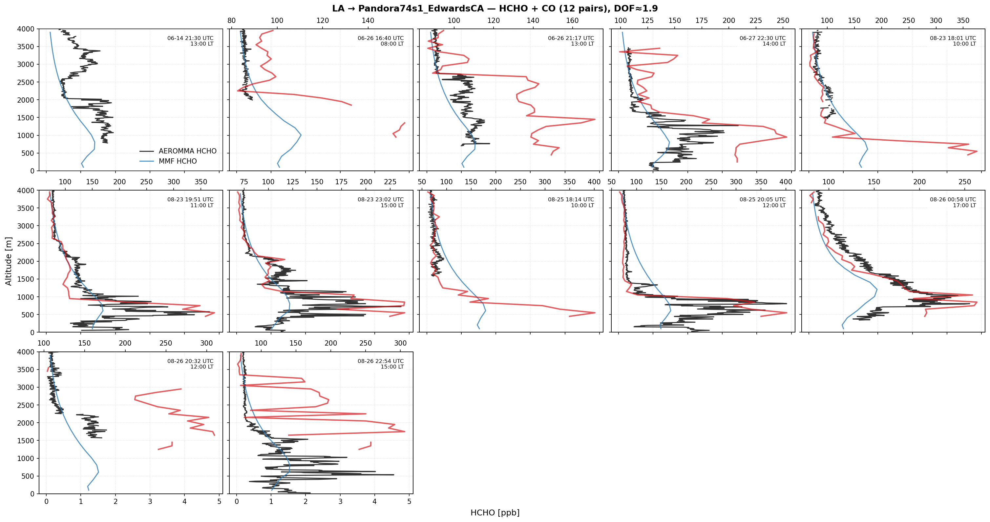
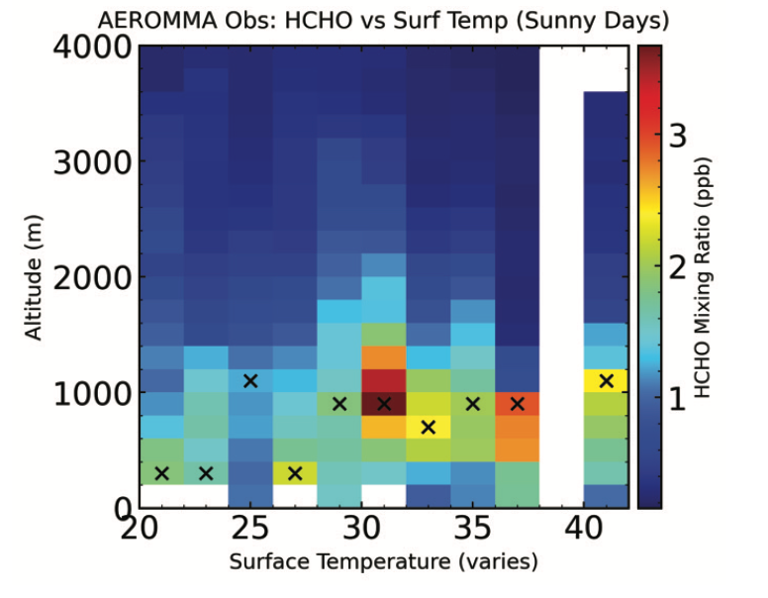
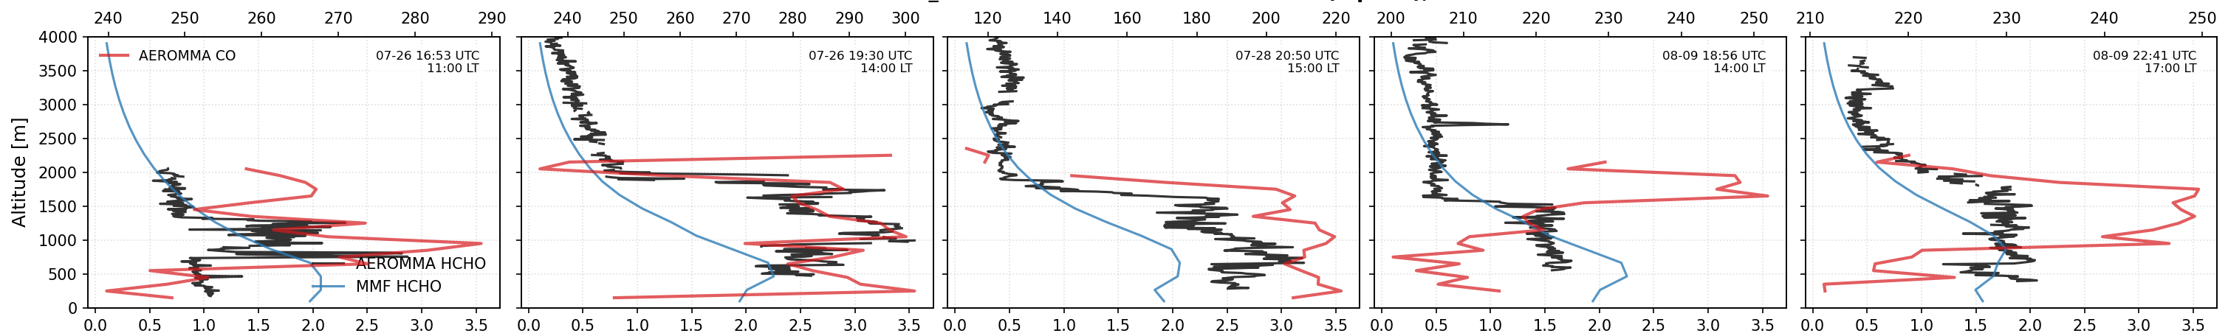
Elevated HCHO aloft during heatwaves: real signal or artifact?
Los Angeles
CO mixing ratio (ppb)
AEROMMA aircraft campaign,2023
AEROMMA HCHO profiles also show a non-well-mixed PBL under high surface temperature,
NYC
HCHO mixing ratio (ppb)
But AEROMMA-PGN collocated observations are likely influenced by fire smokes, so we need more evidences

Slide 10
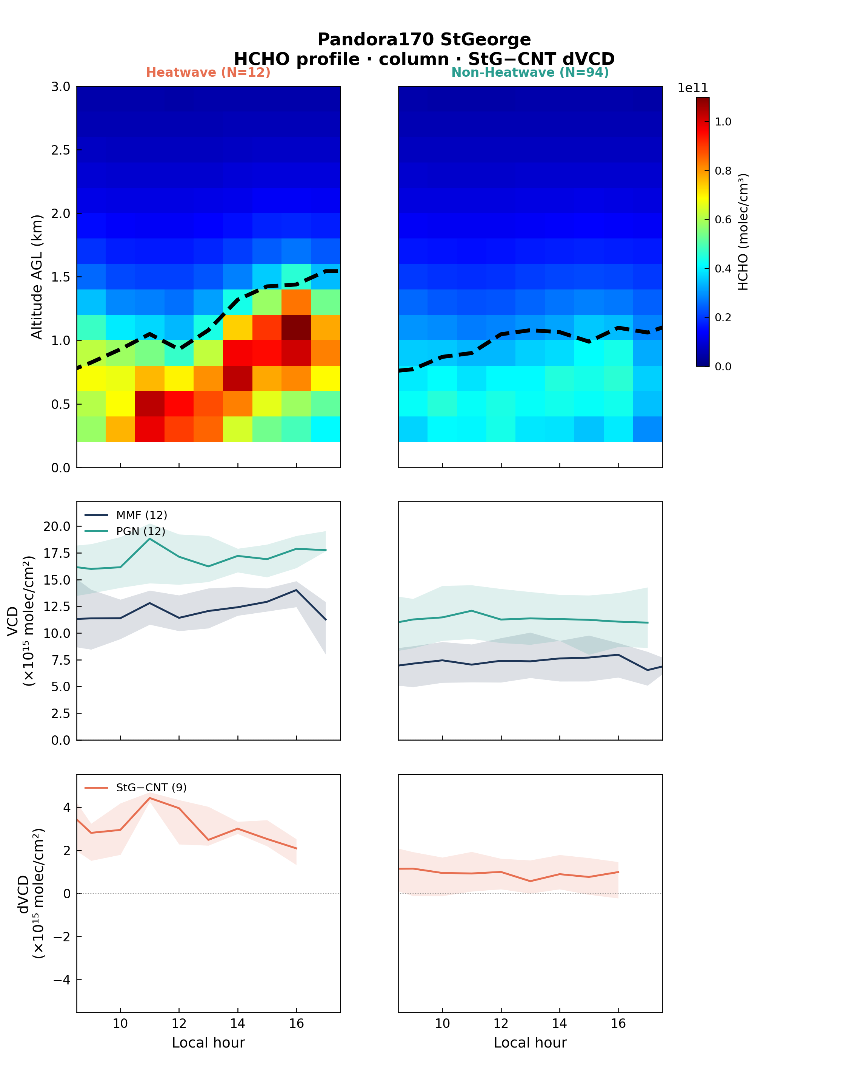
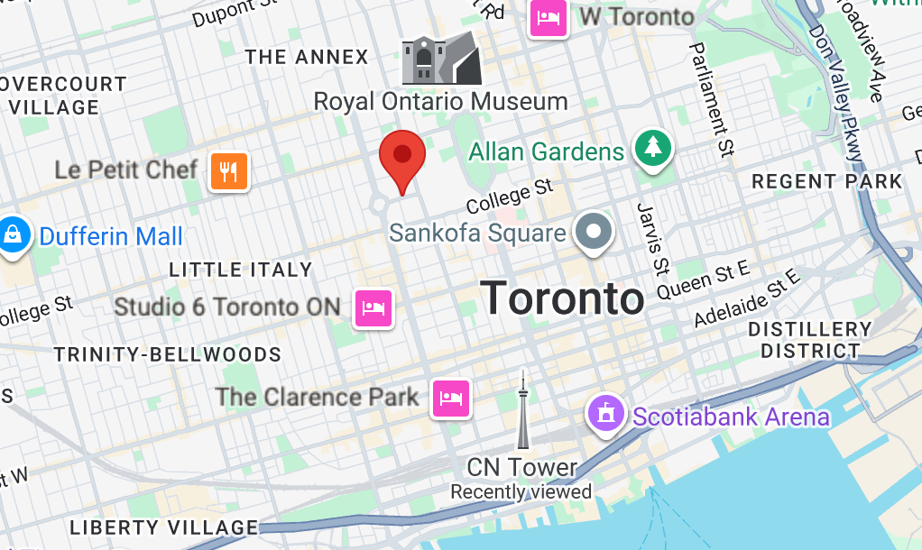
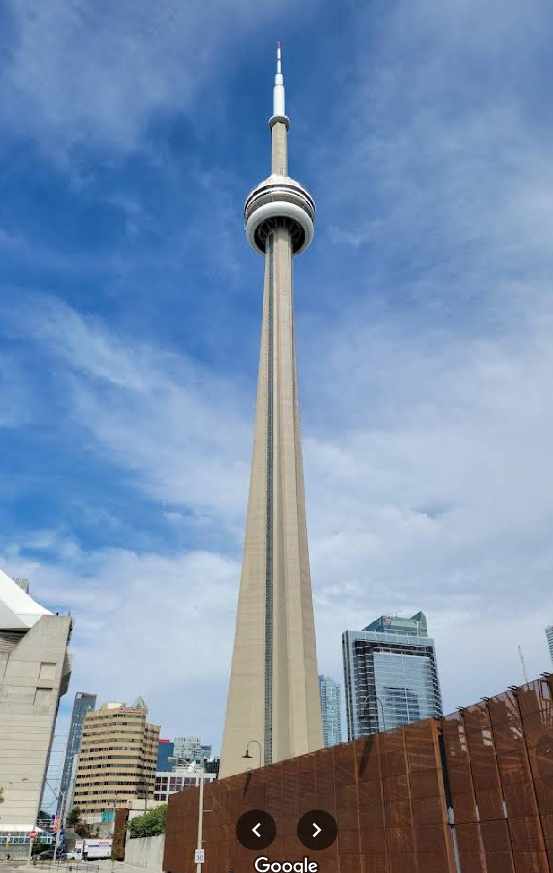
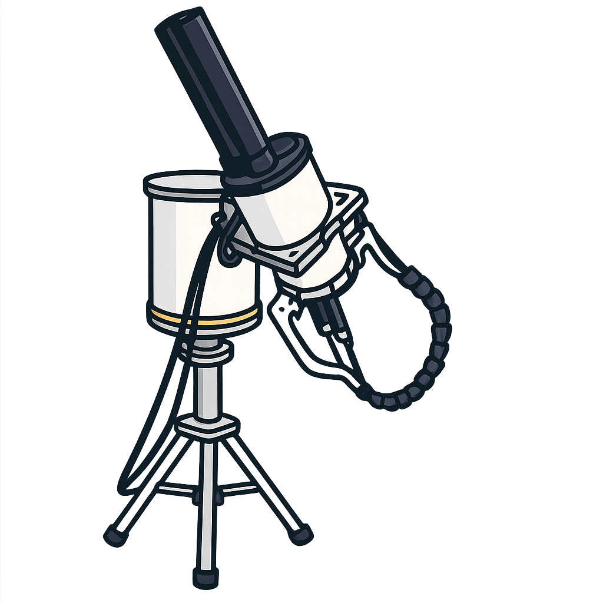
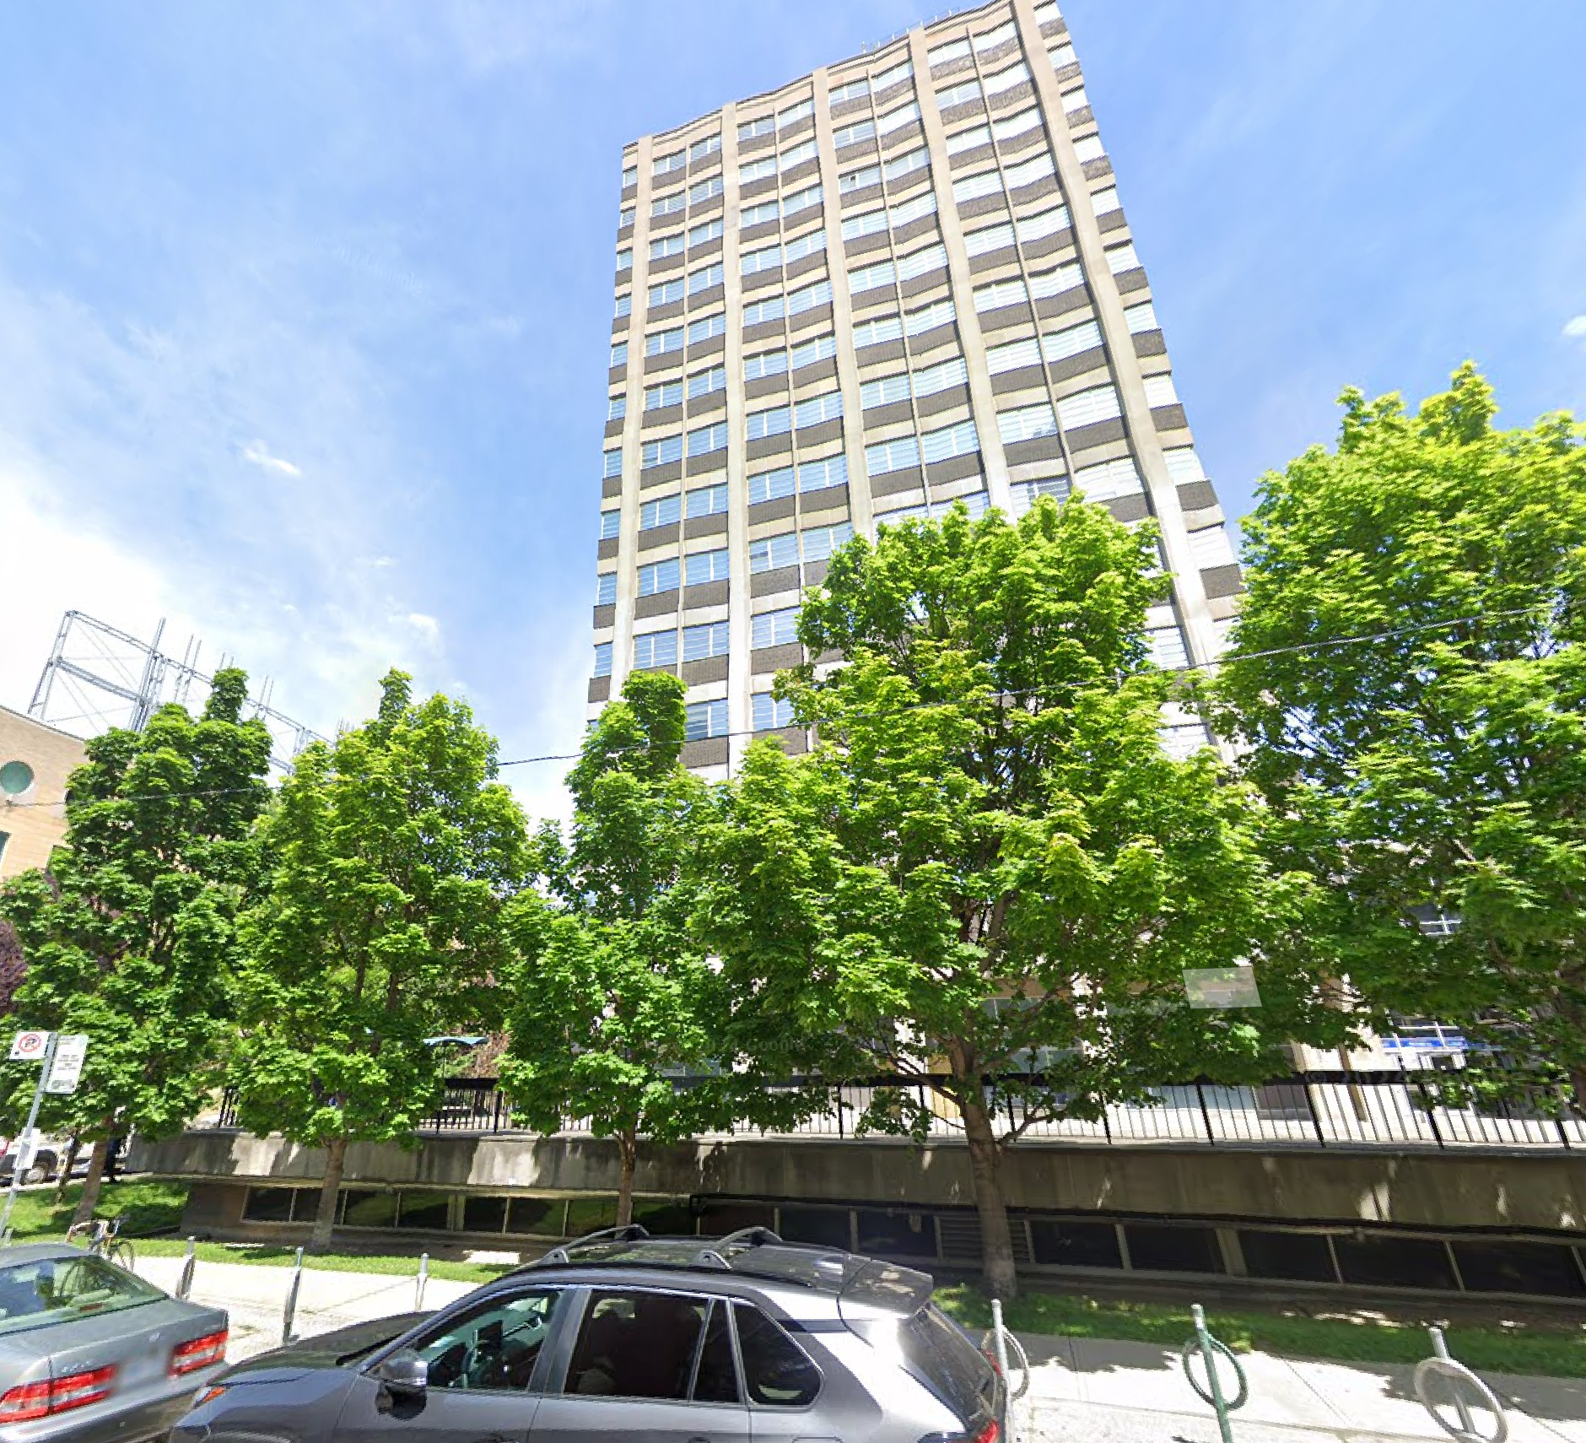
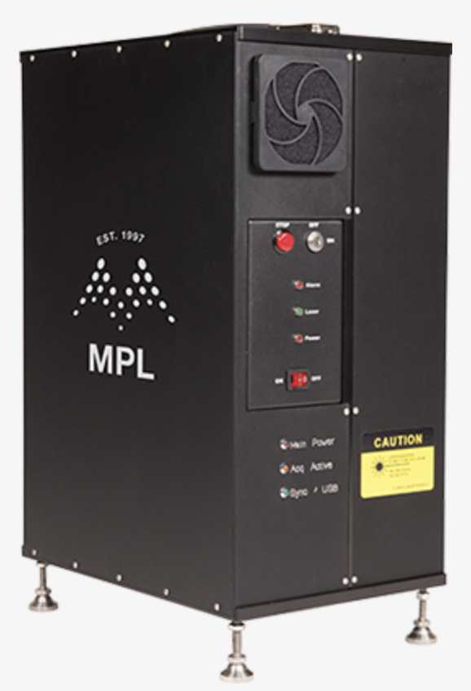
A case study at Toronto St George site,
during 2024-2025 summers
Azimuth Viewing Angle
1.3 miles
Altitude (km)
CNTower
StGeorge
There are two Pandoras, nearly collocated horizontally, but has ~150m vertical gap.
The difference in direct-sun total column, and MMF profiling, can be independent constraint on HCHO abundance within the layer.
Also, there is a mini Micro Pulse LiDAR (MPL) at the StGeorge site, run by Dr. Debra Wunch.
Pandora 243
Toronto-CNTower
Pandora 170
StGeorge
miniMPL
Local hour
Notes:
We use a case study to validate the aloft layer in the afternoon. There are two Pandora at downtown Toronto, the StGeorge P170, CNTower P243, they are horizontally collocated, but has a vertical gap of 150m. Also there is a mini micro Pulse lidar at the StGeorge site to provide boundary layer height measurements. Direct-sun, sky-scan , miniMPL there are three independent measurements.

Slide 11
Heatwaves
Non-Heatwaves
Pandora direct-sun HCHO VCD at StGeorge P170 is increasing from 12 to 16 LT.
This is consistent with the MMF HCHO trop column diurnal cycle.
MMF HCHO
Vertical profile
(StGeorge)
HCHO total column
And
MMF trop column
(StGeorge)
Difference of Pandora direct-sun HCHO VCD at StGeorge P170 and CNTower P243 is decreasing from 12 to 16 LT.
This is consistent with the MMF HCHO profile diurnal cycle near the surface.
StG - CNTower
PGN direct-sun
HCHO total column difference
Local hour

Slide 12
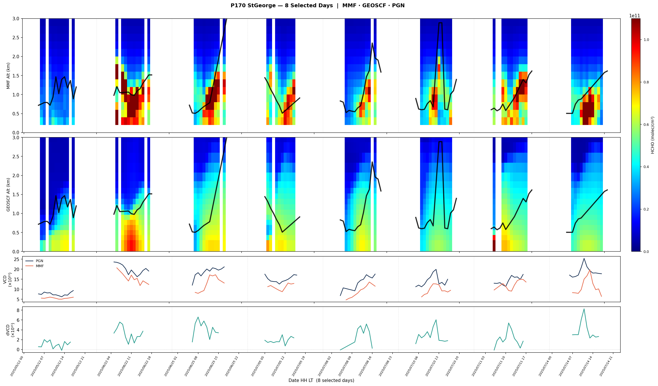
8 selected days at StGeorge P170 in 2025 summer
miniMPL PBLH is consistent with the upper bound of HCHO aloft layers from MMF, providing independent evidence of the accuracy of MMF retrieval
MMF
miniMPL
GEOSCF
HCHO VCD
PGN direct-sun
MMF
When there is aloft layer in the afternoon, HCHO column increases, but surface HCHO reduces.
HCHO VCD
difference

Slide 13
Takeaways
We successfully retrieved HCHO profiles at 76 PGN sites across North America using MMF OE profiling algorithm, which are consistent with satellite and PGN level-2 column products.
MMF HCHO profiles show elevated HCHO aloft during heatwaves, which GEOS-Chem and GEOS-CF does not capture.
A case study using dual Pandora with an altitude gap, and collocated miniMPL provides independent evidence that support the existence of aloft layers. However, more measurements are needed to verify the MMF profiles.
Thank you for your attention!

Slide 15
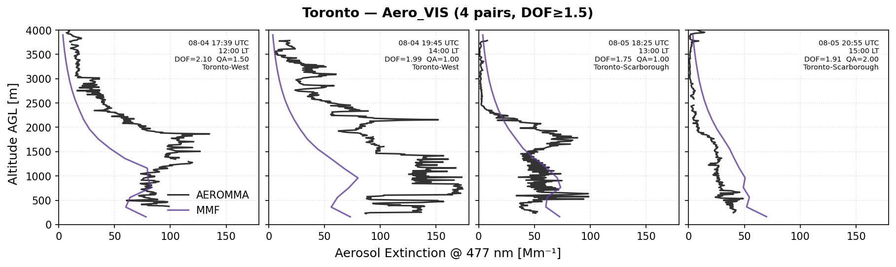
AEROMMA vs MMF aerosol extinction coefficient profile (477nm)
The Pandora instruments are selected because they are located within 50km distance from AEROMMA profiles. Only profiles with DOFS>1.5 are selected. Then the profiles are grouped by cities.
QA flag and DOFS are listed on each panel.
At Toronto, the MMF and AEROMMA have the best agreement in aerosol profiles.

Slide 16
